Slide 1
Abiding in His Word
Notes:
Intro / setup:
Upcoming home Bible studies
Upcoming new segment of classes
Recent conversations w/ people who don’t know Word…
We need to love the word of God!
*References from Psalm 119

Slide 2
So Jesus said to the Jews who had believed him, “If you abide in my word, you are truly my disciples, and you will know the truth, and the truth will set you free.”
John 8:31-32
Notes:
General Lesson Outline:
How do I know what is the word of Jesus?
How will the word of Jesus effect my life?
How do I practically “abide in [His] word”?

Slide 3
So Jesus said to the Jews who had believed him, “If you abide in my word, you are truly my disciples, and you will know the truth, and the truth will set you free.”
John 8:31-32

Slide 4
So Jesus said to the Jews who had believed him, “If you abide in my word, you are truly my disciples, and you will know the truth, and the truth will set you free.”
John 8:31-32
Notes:
Reasons we desperately need the Word of God:
Lots of ideologies / sources of information in the world.
Difficult ideas (some even apparently conflicting) within Scripture.
Cannot know God without Him revealing Himself.

Slide 5
So Jesus said to the Jews who had believed him, “If you abide in my word, you are truly my disciples, and you will know the truth, and the truth will set you free.”
John 8:31-32, NASB
Spoken by the Lord
Proclaimed by Witnesses
Recorded in Written Form
Notes:
John 17:13-21
Matthew 28:18-20
Hebrews 2:1-4
Ephesians 2:19-22; 3:1-5

Slide 6
So Jesus said to the Jews who had believed him, “If you abide in my word, you are truly my disciples, and you will know the truth, and the truth will set you free.”
John 8:31-32, NASB

Slide 7
Soap
  So that He might sanctify her, having cleansed her by the washing of water with the word (Ephesians 5:26)
Food & Medicine
  In pointing out these things to the brethren, you will be a good servant of Christ Jesus, constantly nourished on the words of the faith and of the sound doctrine which you have been following. (1 Timothy 4:6, NASB)
Toolbox & Training
  All Scripture is inspired by God and is profitable for teaching, for reproof, for correction, for training in righteousness; so that the man of God may be adequate, equipped for every good work. (2 Timothy 3:16-17, NASB)
Sword—Scalpel
  Therefore, take up the full armor of God … the sword of the Spirit, the word of God (Ephesians 6:13, 17)
  For the word of God is living and active and sharper than any two-edged sword, and piercing as far as the division of soul and spirit, of both joints and marrow, and able to judge the thoughts and intentions of the heart. (Hebrews 4:12, NASB)
Seed
  for you have been born again not of seed which is perishable but imperishable, that is, through the living and enduring word of God
Lamp
  So we have the prophetic word made more sure, to which you do well to pay attention as to a lamp shining in a dark place, until the day dawns and the morning star arises in your hearts.

Slide 8
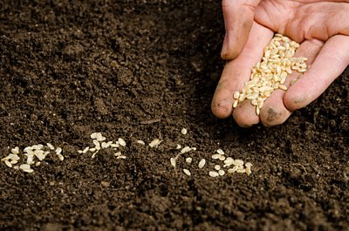
for you have been born again not of seed which is perishable but imperishable, that is, through the living and enduring word of God
1 Peter 1:23, NASB
Notes:
The Word is like Seed.
It takes time to grow, but it will produce if we give it time.
A baby cannot be produced without seed. Neither can a child of God be produced without the Word.

Slide 9

to make her holy, cleansing her with the washing of water by the word
Ephesians 5:26, HCSB
Notes:
The Word is like soap.
You can’t know and use the Word rightly unless you’re willing to accept that you aren’t clean and you want that to change.

Slide 10
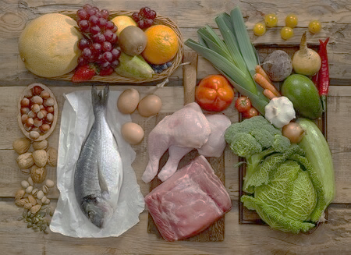
you will be a good servant of Christ Jesus, having nourished yourself on the words of the faith and of the good teaching that you have followed.
1 Timothy 4:6, NET
Notes:
The Word is food and medicine for our souls.
In order to gain the benefit of the Word you need to…
Ingest healthy ideas (instead of the ‘junk food’ of the world’s thoughts).
Have regular intake (can’t eat one time for a week and be fine).
Enjoy a ‘balanced diet’ for optimum effect. [different parts of Bible = different food groups]

Slide 11

All Scripture is breathed out by God and profitable … that the man of God may be complete, equipped for every good work.
2 Timothy 3:16-17, ESV
Notes:
The Word is a toolbox that enable us to get through life from day to day.
We all use equipment for our jobs. The Bible gives us all the equipment we need to know how to navigate life.
Tools are to be used in a right way for specific purposes. The Bible is that way too.
Tools require training and practice in order to rightly utilize them. The Bible is that way too.

Slide 12
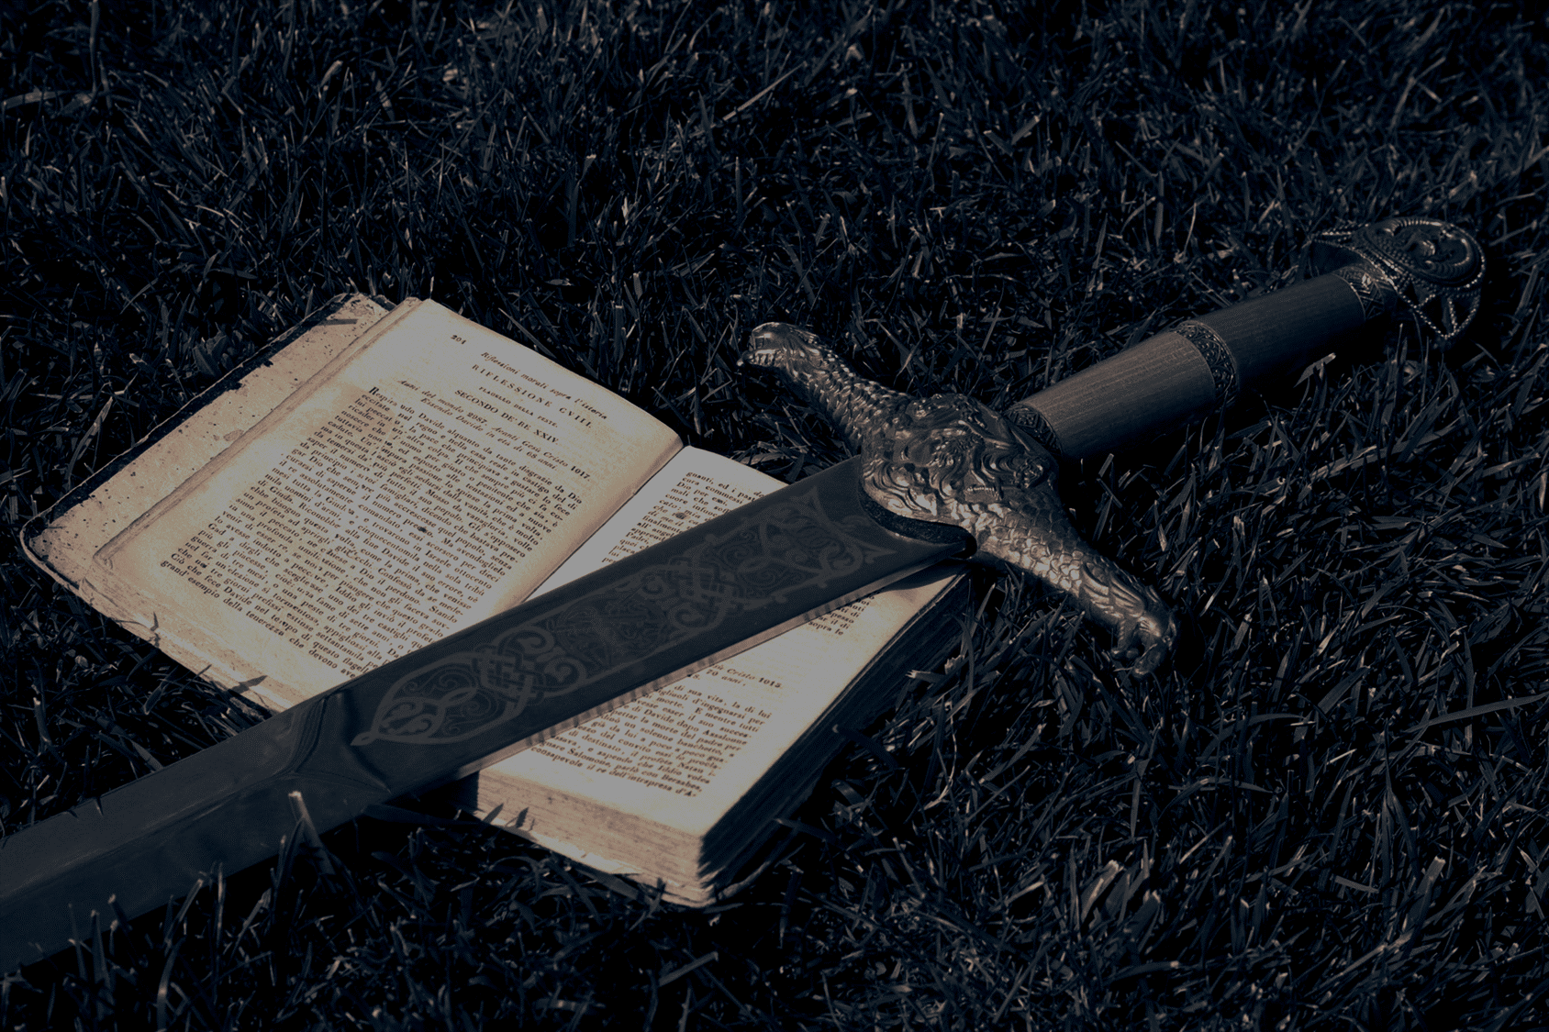
Therefore, take up the full armor of God … the sword of the Spirit, the word of God
Ephesians 6:13, 17, NASB
Notes:
The Word is like a Sword … “that makes the wounded whole”
We need to realize that we are in a fight every day (temptation, lost-ness, discouragement, etc.). God’s Word is what enables us to be successful.
But this Sword is not only a weapon against enemies from without. It also serves as a scalpel that pierces our own hearts. (Hebrews 4:12)

Slide 13
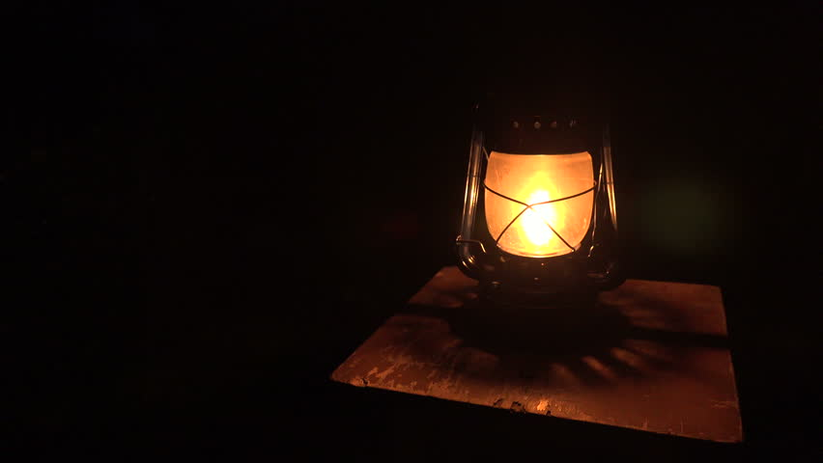
So we have the prophetic word made more sure, to which you do well to pay attention as to a lamp shining in a dark place, until the day dawns and the morning star arises in your hearts.
2 Peter 1:19, NASB
Notes:
The Word is a Lamp.
When we are directionless, hopeless, frustrated, etc. we have the Word that shines to point us on our way.

Slide 14
So Jesus said to the Jews who had believed him, “If you abide in my word, you are truly my disciples, and you will know the truth, and the truth will set you free.”
John 8:31-32
Notes:
John 1:1-18; 18:36-38
Highlight that Christ as the central message of Scripture

Slide 15
Abiding in the Word Today
Devote time in your schedule.
Partner with someone else.
Read it aloud, write it out, memorize it.
Participate in church learning activities.
Practice what you read.

