Slide 1

The book of
Genesis
Lesson 3-4: Adam & Eve

Slide 2
Class Schedule, (Segment 1)
Session | Topic | Reading | Date
Lesson 1 – Grant | Introduction |  | Sun, April 16
Lesson 2 – Grant | Creation | Gen 1:1-2:3 | Wed, April 19
Lesson 3 - Sam | Adam & Eve | Gen 2:4-4:26 | Sun, April 23
Lesson 4 - Sam | Adam & Eve – Descendants | Gen 2:4-4:26 | Wed, April 26
Lesson 5 - Danny | Science, History & Genesis |  | Sun, April 30
Lesson 6 – Grant | Key Figure: Adam |  | Wed, May 3
Lesson 7 – Grant | Noah | Gen 5:1–9:29 | Sun, May 7
Lesson 8 – Grant | Noah | Gen 5:1–9:29 | Wed, May 10
Lesson 9 - Sam | After the Flood | Gen 10:1-11:26 | Sun, May 14
Lesson 10 - Sam | Review |  | Wed, May 17
Lesson 11 – Grant, Danny | Aspects of Patriarchal Life |  | Sun, May 21
Lesson 12 – Sam | Abraham | Gen 11:27-25:12 | Wed, May 24
Lesson 13 - Sam | Abraham | Gen 11:27-25:12 | Sun, May28
Notes:
Note that we’re approaching this as a textual study, meaning that our focus will mainly stay on the features of the book which God inspired. For that reason it will be important that you read the book. There is lesson material, but that should only help focus your reading. I think you should have plenty of time for reading. Since we won’t have a lot of time to read the text aloud in class, having the text read means that you’ll be able to follow any discussion we have and be able to easily understand anything we talk about from up here.
Note that we’ve broken this down by section/topic rather than by date. We didn’t’ want to commit to strict sections of the text which are large and deal with the same basic characters. So for instance we’ve allowed 2 classes to cover Noah and the Flood, or 5 classes to cover Abraham. Lesson material should reflect that setup. It won’t be lesson 1,2,3, etc. The material you get will cover the entire section and can be done at your own pace.
We have interjected here a number of ‘topical’ classes. Danny Haynes will be presenting a single class at the beginning covering the issues of how Genesis relates to science and history. The point of the class is more of a textual study of Genesis, but we recognize that those are important issues and worth addressing so Danny has agreed to give us an overview of some of those evidences. We also have a class once we start the section on the patriarchs that I hope will be a historical look at the life of the patriarchs, and explain the world in which they lived. That should be really interesting and help our study through the last ¾ of the book. There are two classes that will focus on the characters of Adam and Abraham, and I think specifically will look at what the New Testament writers have to say about them. That should broaden our understanding of the significance of them for understanding who we are as Christians today. And then we have a couple of review periods in there as well.

Slide 3
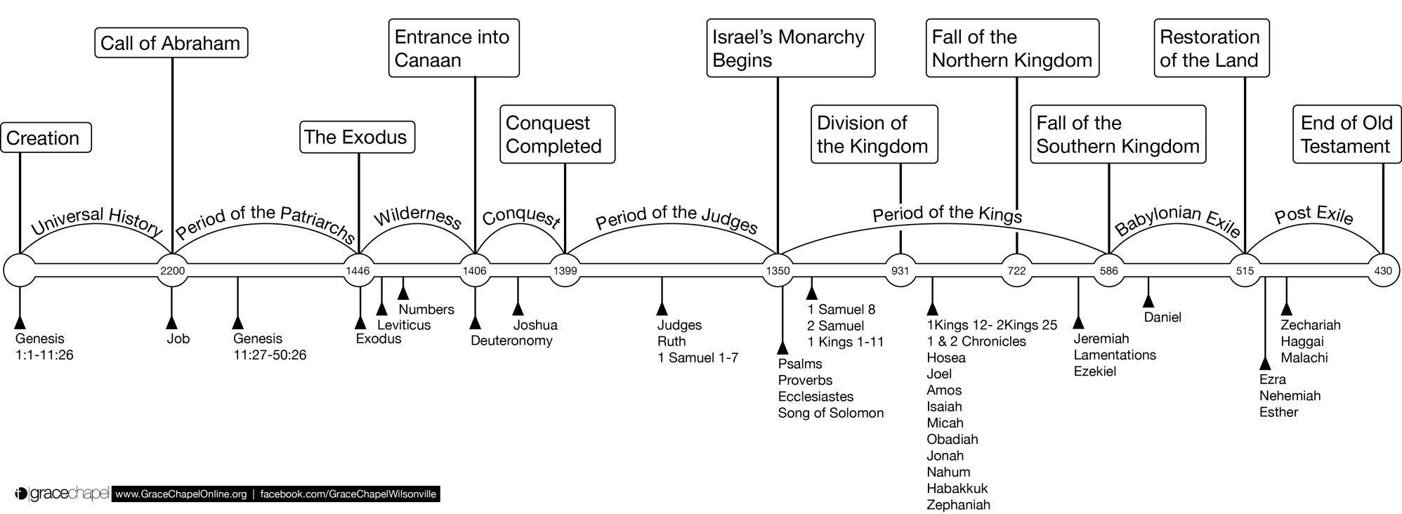

Old Testament Timeline

Slide 4
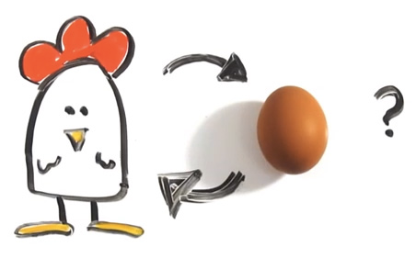
Genesis Answers…
The Important questions of life…

Slide 5
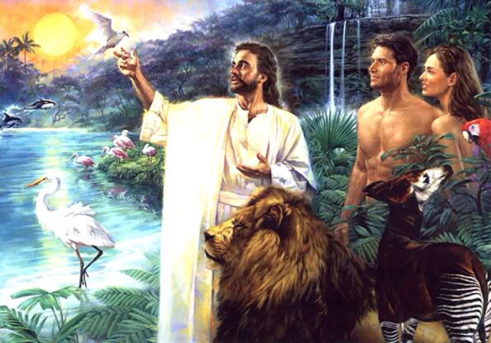
Creating Man
Man was formed…
  From the dust of the earth
  In God’s image, according to His likeness
  With the breath of life in his nostrils
  Male and female
With purpose…
  Be fruitful and multiply
  Fill the earth and subdue it
  Have dominion over fish, birds, and all creatures that move
  Tend the garden and care for it
  Allowed to eat all plants – (applied to both man and animal)

Slide 6

Life in the Garden
The Lord God planted a garden…
  Eastward in Eden
  Near lands that were known to Moses
  Every tree that is pleasant to the sight and good for food
  The tree of the knowledge of good and evil
  The tree of life
  A river flowed out of it
  Watered by a mist
  Created on the 6th day
  He put the man in it

Slide 7
But Something was NOT Good
Then God saw everything that He had made, and indeed it was very good… (Gen 1:31)
Man was alone
  God would make a comparable helper
  Formed every bird and beast – Adam named them
Then he was not
  Formed women from a rib taken from Adam, Brought her to the man
    Bone of my bone
    Flesh of my flesh
    Called Woman
    Taken out of Man
  One flesh
  Naked and unashamed

Slide 8
Questions
Man was created in God’s image. In what ways are we like God? Were both Man and Woman similar to God in these ways?
What similarities did Man and Woman have with animals? What differences?
Why was Woman created? Was there a need that existed?
Did hunger or other physical desires exist in the garden?
Were Adam and Eve married? Did they have sexual relations?
Were their roles different at all?

Slide 9
The First Sin
Therefore, to him who knows to do good and does not do it, to him it is sin. (Jas 4:17)
The Actors
  The serpent – more cunning than any beast of the field
  The woman –knew the command and the consequences
  The man – who did not lead
The Terms
  Do not eat, lest you die
  But… you will become like God, knowing good and evil
The Act
  The women saw that it was
    Good for food
    Pleasant to the eyes
    Desirable to make one wise
  She took the fruit and ate
  She gave to her husband with her, and he ate
For all that is in the world—the lust of the flesh, the lust of the eyes, and the pride of life—is not of the Father but is of the world. (1Jn 2:16)

Slide 10
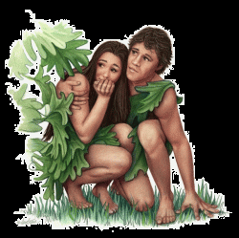
Discovery
Therefore, to him who knows to do good and does not do it, to him it is sin. (Jas 4:17)
Their eyes were opened
  They DID know good and evil
  Realized they were naked, and clothed themselves
  Heard the sound of God and hid themselves
Questions
  “Where are you?”
  “Who told you that you were naked?”
  “Have you eaten of the tree… that you should not eat?”
  “What is this you have done?”
Response
  Adam: The woman you gave me, she gave, and I ate
  Eve: The serpent deceived me, and I ate
  God did not question the serpent

Slide 11
Consequences, The Curse
The Serpent – Because you have done this [deceived the woman]
  Cursed more than all cattle and beasts
  Go on your belly, eat dust
  Enmity between you and the woman
  Enmity between your seed and her Seed
The Man – Because you heeded the voice of your wife and ate
  Cursed is the ground for your sake
    In toil you shall eat all your life
    Thorns and thistles will grow for you
    In the sweat of your face you shall eat bread
The Woman
  Greatly multiply your sorrow and conception
  In pain you shall bring forth children
  Desire shall be for your husband, he shall rule over you

Slide 12
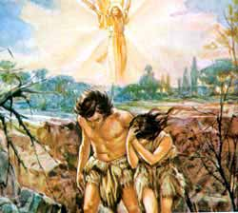
Consequences, Separation
Sent out from the Garden
  Separated from the tree of life
  Prevented from returning
Other changes
  Clothed with animal skins
  Adam named his wife Eve
  They began to have children

Slide 13
Questions
What was the first sin? What caused each to sin? (Gen 3:1-6,12,13, 2 Cor 11:3)
Was there a role reversal in the way the sin occurred?
Why did Adam knowingly sin?
What additional differences between men and women are implied after the fall (Gen 3:16-19)?
How would the curses affect the relationship between men and women? How might romance change?
How would the curses affect other natural desires, such as hunger?

Slide 14
Family Relationships
In the Garden, Before the Fall
“One Flesh”
Children
Woman
Man
Earth
(Garden)
“be fruitful”
Helper
Subdue

Slide 15
Family Relationships
After the Fall
Pain
Rule Over
Toil
“One Flesh”
Children
Woman
Man
Earth
(Multiplied)
“be fruitful”
Helper
Subdue
(Thorns, etc)
People
Affection
Security
Cooperation
Feeling
Intuition
Things
Self/Ego
Achievement
Competition
Facts
Logic
Desire
Differences in Emphasis and Abilities

Slide 16
God’s Design of the Family
And Adam said: "This is now bone of my bones And flesh of my flesh; She shall be called Woman, Because she was taken out of Man."
Therefore a man shall leave his father and mother and be joined to his wife, and they shall become one flesh.
(Gen 2:23-24)
Key Point of Eph 5:28-33: Love and Sacrifice
This passage is quoted 3 times in the New Testament, to teach us about marriage
  Eph 5:28-33, Paul to the Ephesians
  Matt 19:4-6, Jesus to the Jews
  1 Cor 6:15-17, Paul to the Corinthians
So husbands ought to love their own wives as their own bodies; he who loves his wife loves himself. For no one ever hated his own flesh, but nourishes and cherishes it, just as the Lord does the church…
"FOR THIS REASON A MAN SHALL LEAVE HIS FATHER AND MOTHER AND BE JOINED TO HIS WIFE, AND THE TWO SHALL BECOME ONE FLESH."
This is a great mystery, but I speak concerning Christ and the church. Nevertheless let each one of you in particular so love his own wife as himself, and let the wife see that she respects her husband.
(Eph 5:28-33)

Slide 17
God’s Design of the Family
And Adam said: "This is now bone of my bones And flesh of my flesh; She shall be called Woman, Because she was taken out of Man."
Therefore a man shall leave his father and mother and be joined to his wife, and they shall become one flesh.
(Gen 2:23-24)
Key Point of Eph 5:28-33: Love and Sacrifice
Key Point of Matt 19:4-6: Permanent, Not to be Broken
And He answered and said to them, "Have you not read that He who made them at the beginning 'MADE THEM MALE AND FEMALE,'
and said, 'FOR THIS REASON A MAN SHALL LEAVE HIS FATHER AND MOTHER AND BE JOINED TO HIS WIFE, AND THE TWO SHALL BECOME ONE FLESH' ?
So then, they are no longer two but one flesh. Therefore what God has joined together, let not man separate." (Mat 19:4-6)

Slide 18
God’s Design of the Family
And Adam said: "This is now bone of my bones And flesh of my flesh; She shall be called Woman, Because she was taken out of Man."
Therefore a man shall leave his father and mother and be joined to his wife, and they shall become one flesh.
(Gen 2:23-24)
Key Point of Eph 5:28-33: Love and Sacrifice
Key Point of Matt 19:4-6: Permanent, Not to be Broken
Key Point of 1 Cor 6:15-17: Agreement in Purpose & Action
(Improper Union Defiles)
Do you not know that your bodies are members of Christ? Shall I then take the members of Christ and make them members of a harlot? Certainly not!
Or do you not know that he who is joined to a harlot is one body with her? For "THE TWO," He says, "SHALL BECOME ONE FLESH."
But he who is joined to the Lord is one spirit with Him.
(1Co 6:15-17)

Slide 19
Family Relationships
In Christ, The Ideal Marriage
Honor
Submit
Hope
Nurture
Admonish
Rule Manage
Chasten
Love
Love
Woman
Man
Spiritual
  Provided Spiritual Leadership (Eph 5:24, 1 Tim 2:12-13)
Emotional
  Loved, Desired, Sense of belonging (Eph 5:25-29, Sol 7:10)
  Respected, Honored (1 Pet 3:7, Sol 7:10)
  Protected from Fear (Sol 4:7-8, 1 Pet 3:6)
  Given an Object of Affection (Sol 8:1-2)
Physical
  Sexual Desires Satisfied (1 Cor 7:3-5)
  Protected, Provided for (1 Tim 5:8)
Spiritual
  Provided Spiritual Companionship (1 Pet 3:7)
Emotional
  Ego, Sense of Worth Bolstered (1 Pet 3:6, Prov 20:29)
  Respect of Others Fostered (Prov 12:4, 31:23)
  Comforted in Insecurity (Gen 24:67)
  Companionship, Contentment (Sol 8:10)
Physical
  Sexual Desires Satisfied (1 Cor 7:3-5, Prov 5:15-19)
  Food, Clothing, Provision (Prov 31:13-15)
Needs Fulfilled

Slide 20
Family Relationships
Honor
Submit
Hope
The Consequences of Sin are addressed… In God’s way
Nurture
Admonish
Rule Manage
Chasten
Love
Love
Sin “does not reign in our mortal bodies” (Rom 5:21, 6:12)
  The guilt of sin before God is removed through the sacrifice of Jesus
  We reduce the consequences of sin in this fallen world by following God’s plans and adopting the character of His Son (Rom 8:20-23, 1 John 3:2-3)

Slide 21
Questions
How is each of these “Garden Conditions” partly restored in a godly romantic love?
  Perfectly suited companionship
  No shame or embarrassment
  No competition or jealousy
  No pain, failure, disappointment
  No fear of separation or loss
  Perfect sense of value and purpose
How does sin affect family relationships?
How does righteousness affect family relationships?
Has God’s view of family relationships changed? Has man’s?

Slide 22
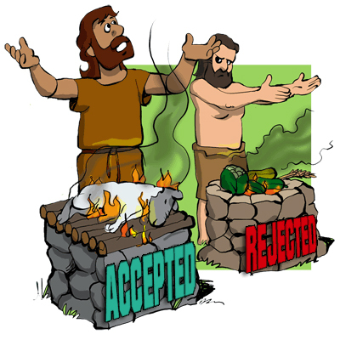
Cain and Abel
Cain - Adam’s first born
  “I have acquired a man from the Lord”
  A tiller of the ground, like his father
  Offered a sacrifice that was not accepted
  In the New Testament, “his works were evil” (1 John 3:12)
Abel
  A keeper of sheep
  Offered a sacrifice of firstborn and fat of the flock
  In the New Testament, “by faith offered a better sacrifice” (Heb 11:4)
  Jesus testified to his righteousness (Matt 23:35)

Slide 23
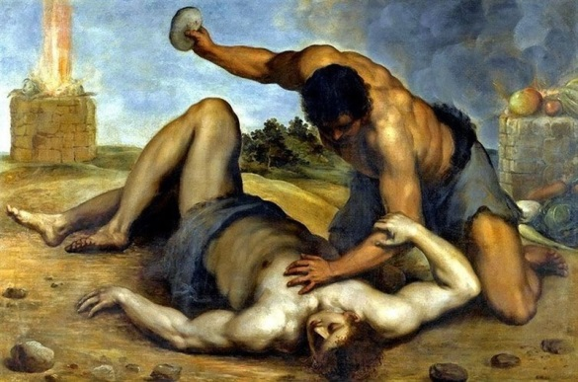
The Sin of Cain
God Speaks a Warning
  Notices his anger, and that his countenance has fallen
  If you do well, will you not be accepted?
  If you do not do well, Sin lies at the door
  It’s desire is for you, but you should rule over it
Cain Kills Abel
  Premeditated - he speaks to him first
  In secret – while in the field
  Lied to God about knowing where Abel was
  Denied responsibility – “Am I my brother’s keeper?”

Slide 24
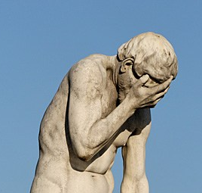
Consequences
Discovery
  Where is Abel your brother?”
  “What have you done?”
  The voice of Abel’s blood cries out from the ground
Consequences
  You are cursed from the earth
  The ground shall not yield its strength
  A fugitive and a vagabond
Evaluation of the curse
  Punishment greater than he can bear
  Driven out from the face of the ground
  Hidden from God’s face
  A fugitive and a vagabond
  Anyone who finds him will kill him

Slide 25
Questions
Are we responsible for our brothers?
What was the punishment for this murder? Is this consistent with later law (Gen 9:5-6)?
Why was Abel’s sacrifice accepted?
Should Cain have been able to avoid the sin he committed?

Slide 26
Generations after Adam
Seth
  Another seed in place of Abel, whom Cain killed
  Lineage of Noah, David, and Christ through Seth
8 Generations before Noah
  Average life span >900 years
  1656 years from Creation to the Flood
Noah
  “This one will comfort us concerning our work and the toil of our hands, because of the ground which the Lord has cursed”
  Noah was 600 years old when the Flood came

Slide 27
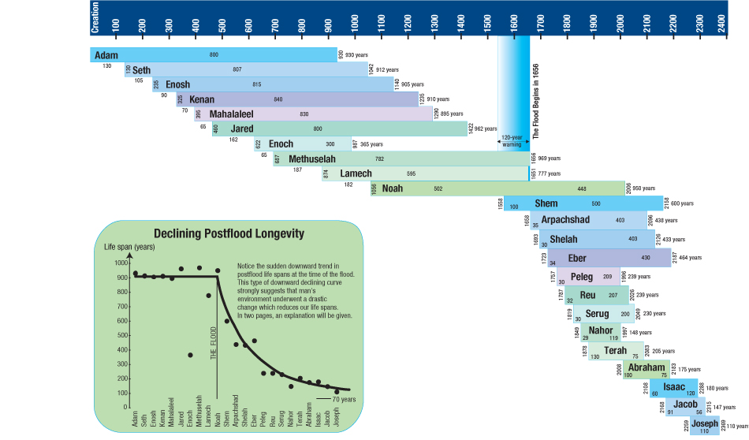
Genealogy of Adam

Slide 28
Genesis Answers…
Which came first: The chicken or the egg?
  Causality Dilemma
  Often represents the “unsolvable conundrum”
  May be an excuse to do nothing or to consider more analysis. Avoids decision or action.
For the Evolutionist
  The explanation cannot include an all-powerful God who created
  Generally concludes the egg came first
    The egg came first, as the first egg-laying animals evolved millions of years prior to birds.
    “Which came first: the chicken or the egg? The egg – laid by a bird that was not a chicken”
For the Christian
  So God created … every winged bird according to its kind. And God saw that it was good. And God blessed them, saying, "Be fruitful and multiply, and … let birds multiply on the earth." (Gen 1:21-22)
  So first the Chicken, which was commanded to be fruitful and multiply, producing the egg
AND FURTHERMORE:
  It’s the chicken, get on with it! (2 Tim 2:16)

