Slide 1
Where Do You Turn in a Time of Trouble?

Slide 2
Promises and Power of God
For He Himself has said, “I will never leave you nor forsake you.” – Hebrews 13:5b
God of all comfort, ⁴ who comforts us in all our tribulation – II Corinthians 1:3-4
²⁰ Now to Him who is able to do exceedingly abundantly above all that we ask or think, according to the power that works in us – Eph. 3:20

Slide 3
Ephesians 4:11-12
¹¹ And He Himself gave some to be apostles, some prophets, some evangelists, and some pastors and teachers, ¹² for the equipping of the saints for the work of ministry, for the edifying of the body of Christ

Slide 4
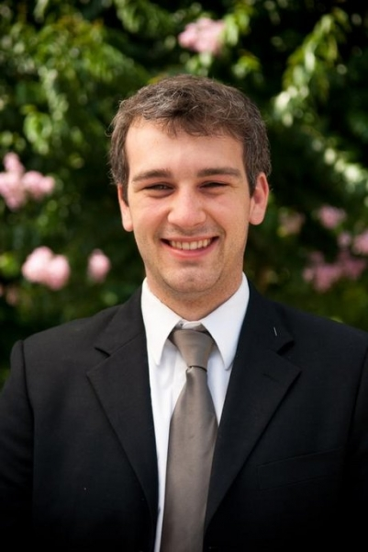
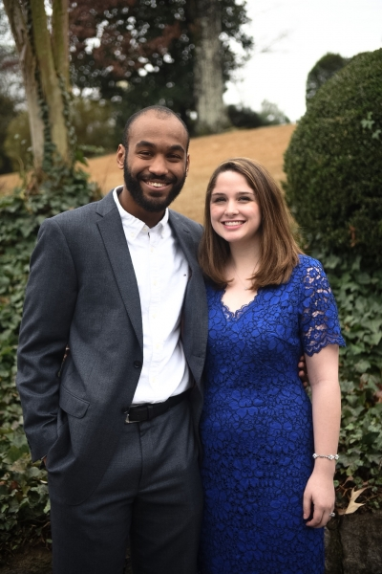
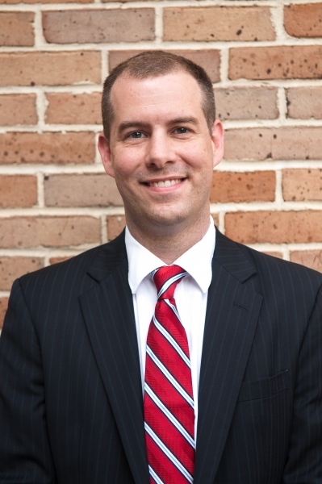
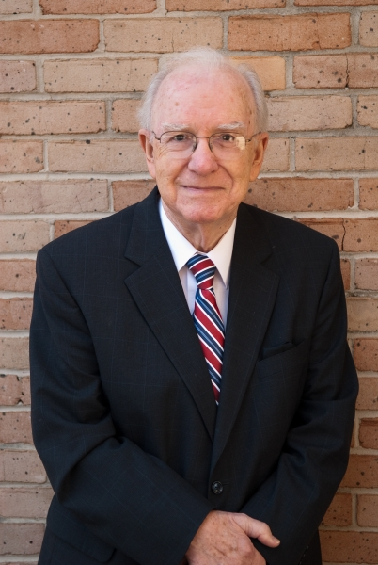
Ephesians 4:11-12
¹¹ And He Himself gave some to be apostles, some prophets, some evangelists, and some pastors and teachers, ¹² for the equipping of the saints for the work of ministry, for the edifying of the body of Christ

Slide 5
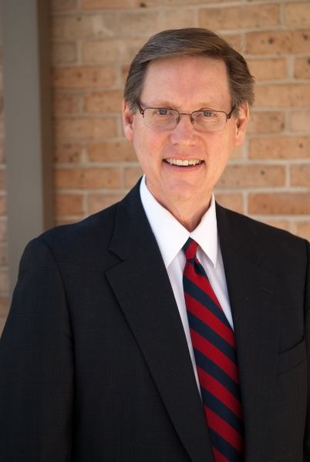
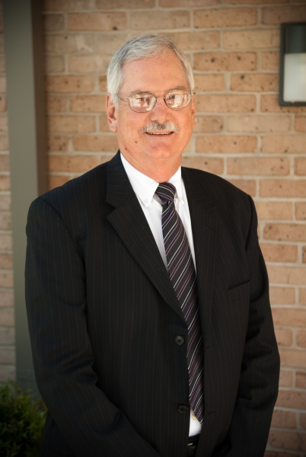
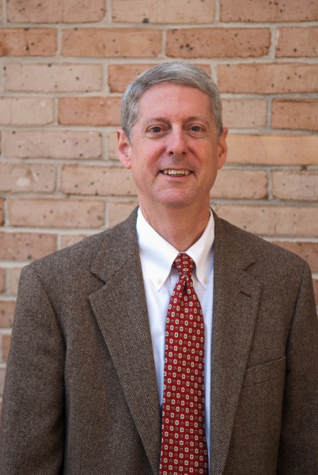
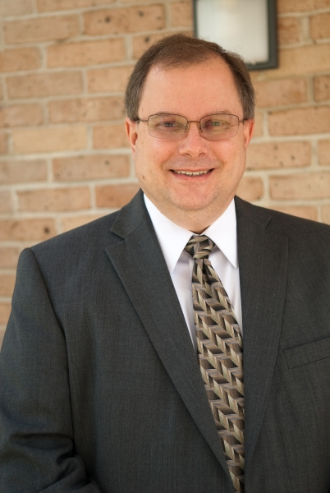
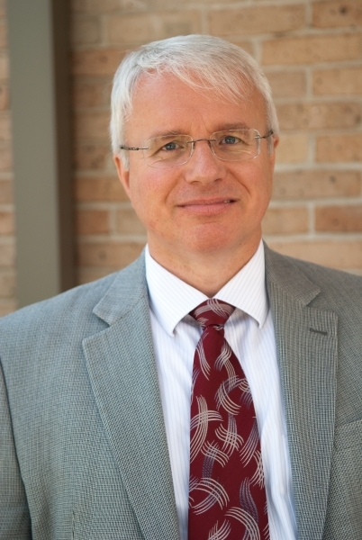
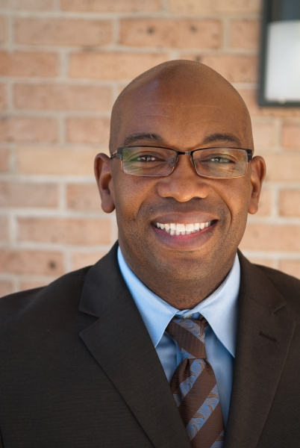
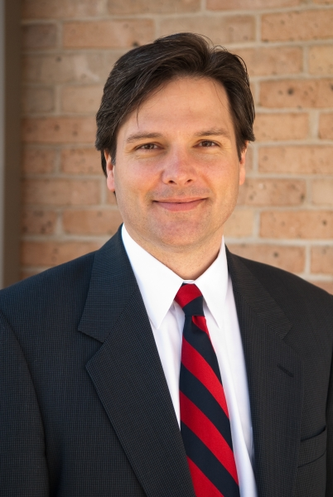
Ephesians 4:11-12
¹¹ And He Himself gave some to be apostles, some prophets, some evangelists, and some pastors and teachers, ¹² for the equipping of the saints for the work of ministry, for the edifying of the body of Christ

Slide 6
Focus on the Weak
³⁵ I have shown you in every way, by laboring like this, that you must support the weak. And remember the words of the Lord Jesus, that He said, ‘It is more blessed to give than to receive.’” – Acts 20:35

Slide 7
Focus on the Weak
⁴ The weak you have not strengthened, the sick you have not healed, the injured you have not bound up, the strayed you have not brought back, the lost you have not sought, and with force and harshness you have ruled them. ⁵ So they were scattered, because there was no shepherd, and they became food for all the wild beasts. My sheep were scattered; ⁶ they wandered over all the mountains and on every high hill. My sheep were scattered over all the face of the earth, with none to search or seek for them. – Ezekiel 34:4-6

Slide 8
God’s Care For the Hurting
¹⁶ I will seek the lost, and I will bring back the strayed, and I will bind up the injured, and I will strengthen the weak,
so will I seek out my sheep, and I will rescue them from all places where they have been scattered on a day of clouds and thick darkness. ¹³ And I will bring them out from the peoples and gather them from the countries, and will bring them into their own land. And I will feed them on the mountains of Israel, by the ravines, and in all the inhabited places of the country. ¹⁴ I will feed them with good pasture, and on the mountain heights of Israel shall be their grazing land. There they shall lie down in good grazing land, and on rich pasture they shall feed

Slide 9
Excuses for Avoiding Elders
I know what they will say
They won’t understand me – they are nothing like me
They are too busy or won’t have time or concern for me

Slide 10
Ephesians 4:13-16
¹³ till we all come to the unity of the faith and of the knowledge of the Son of God, to a perfect man, to the measure of the stature of the fullness of Christ; ¹⁴ that we should no longer be children, tossed to and fro and carried about with every wind of doctrine, by the trickery of men, in the cunning craftiness of deceitful plotting, ¹⁵ but, speaking the truth in love, may grow up in all things into Him who is the head—Christ— ¹⁶ from whom the whole body, joined and knit together by what every joint supplies, according to the effective working by which every part does its share, causes growth of the body for the edifying of itself in love.

