Slide 1
The book of Genesis
Lesson 9: After the Flood

Slide 2
Class Schedule, (Segment 1)
Session | Topic | Reading | Date
Lesson 1 – Grant | Introduction |  | Sun, April 16
Lesson 2 – Grant | Creation | Gen 1:1-2:3 | Wed, April 19
Lesson 3 - Sam | Adam & Eve | Gen 2:4-4:26 | Sun, April 23
Lesson 4 - Sam | Adam & Eve – Descendants | Gen 2:4-4:26 | Wed, April 26
Lesson 5 - Danny | Science, History & Genesis |  | Sun, April 30
Lesson 6 – Grant | Key Figure: Adam |  | Wed, May 3
Lesson 7 – Grant | Noah | Gen 5:1–9:29 | Sun, May 7
Lesson 8 – Grant | Noah | Gen 5:1–9:29 | Wed, May 10
Lesson 9 - Sam | After the Flood | Gen 10:1-11:26 | Sun, May 14
Lesson 10 - Sam | Review | Gen 1-11 | Wed, May 17
Lesson 11 – Grant, Danny | Aspects of Patriarchal Life |  | Sun, May 21
Lesson 12 – Sam | Abraham | Gen 11:27-25:12 | Wed, May 24
Lesson 13 - Sam | Abraham | Gen 11:27-25:12 | Sun, May28
Notes:
Note that we’re approaching this as a textual study, meaning that our focus will mainly stay on the features of the book which God inspired. For that reason it will be important that you read the book. There is lesson material, but that should only help focus your reading. I think you should have plenty of time for reading. Since we won’t have a lot of time to read the text aloud in class, having the text read means that you’ll be able to follow any discussion we have and be able to easily understand anything we talk about from up here.
Note that we’ve broken this down by section/topic rather than by date. We didn’t’ want to commit to strict sections of the text which are large and deal with the same basic characters. So for instance we’ve allowed 2 classes to cover Noah and the Flood, or 5 classes to cover Abraham. Lesson material should reflect that setup. It won’t be lesson 1,2,3, etc. The material you get will cover the entire section and can be done at your own pace.
We have interjected here a number of ‘topical’ classes. Danny Haynes will be presenting a single class at the beginning covering the issues of how Genesis relates to science and history. The point of the class is more of a textual study of Genesis, but we recognize that those are important issues and worth addressing so Danny has agreed to give us an overview of some of those evidences. We also have a class once we start the section on the patriarchs that I hope will be a historical look at the life of the patriarchs, and explain the world in which they lived. That should be really interesting and help our study through the last ¾ of the book. There are two classes that will focus on the characters of Adam and Abraham, and I think specifically will look at what the New Testament writers have to say about them. That should broaden our understanding of the significance of them for understanding who we are as Christians today. And then we have a couple of review periods in there as well.

Slide 3
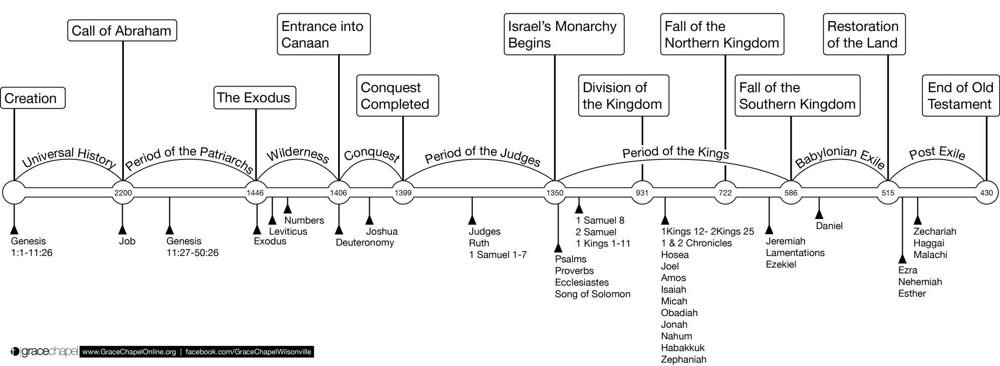
Old Testament Timeline

Slide 4
Content & Structure
“These are the generations of…”
2:4
Heavens & Earth
5:1
6:9
Noah
10:1
11:10
Noah’s Sons
Shem
Adam
11:27
Terah
25:12
25:19
Isaac
36:1
37:2
Jacob (Israel)
Ishamel
Esau(Edom)
Notes:
Structure is important as well because it tells something about the intentions of the author, and Genesis has one of the most clearly defined structures of any book of the Bible. The various stories and episodes within Genesis are organized around 10 different ‘accounts’ or ‘generations.’ In each of the verses listed you have the phrase ‘elleh toledot’ in Hebrew, which is usually translated as “These are the generations of…” This phrase introduces a genealogy and or a narrative in the name of person referenced which progresses the story along from one phase to another.
[[Do you see anything here that interests you or surprises you?]] [[What does this tell you about the author’s intentions?]]
These formulaic introductions are frequently followed by genealogies – [[what is the purpose of recording a genealogy in a book like Genesis?]]
Note that the first 5 of these occur in the Primordial History section of 1-11, while the last 5 occur in the larger section of the book which deals with the patriarchs of Israel. (11:27, which is right at the end of chapter 11, is the ACTUAL transition point from Primordial History to Patriarchal History)

Slide 5
Changes After the Flood
9:1 “Be fruitful and multiply, and fill the earth…” (not subdue it)
9:2 Fear and dread of man on every beast
9:3 “Every moving thing that lives shall be food for you…”
9:6 “Whoever sheds man’s blood, by man his blood shall be shed…”
9:11 Covenant to never again destroy the earth by flood
9:13 Rainbow in the cloud as a sign of the covenant
Reduction in lifespan
Confusion of languages

Slide 6
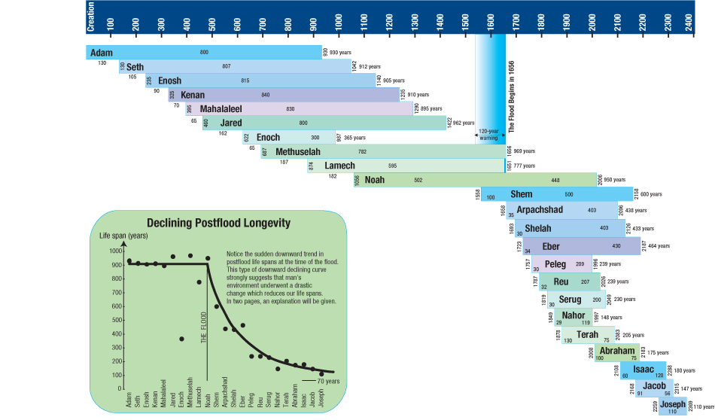
Adam
Gen 5:1
Noah
Gen 6:9
Noah’s Sons
Gen 10:1
Shem
Gen 11:10
Terah
Gen 11:27

Slide 7
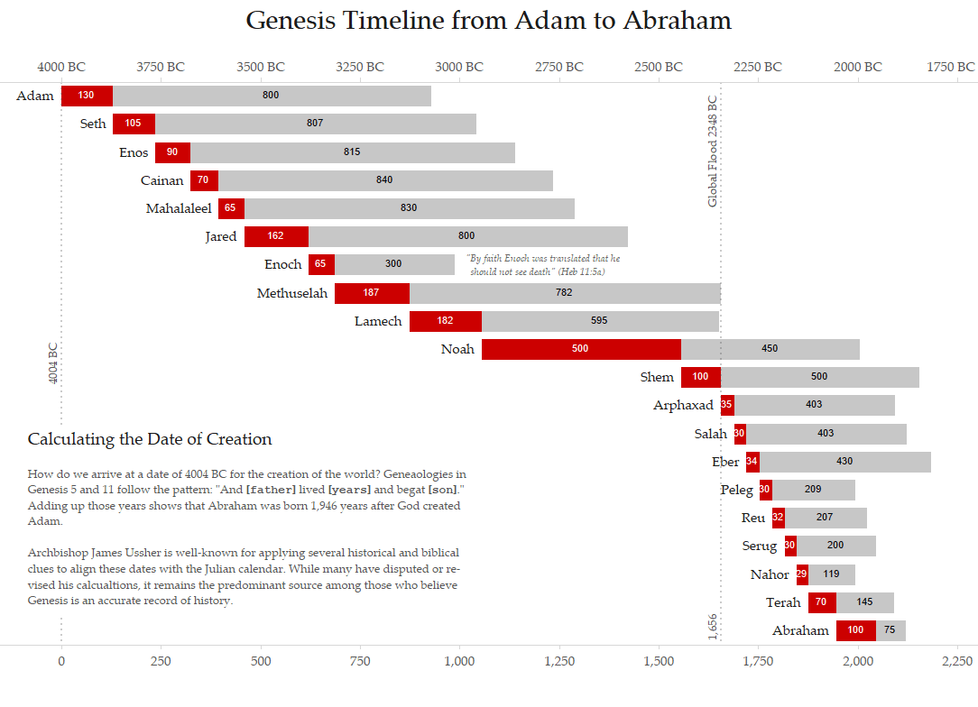

Slide 8
Questions
Did God limit man’s life to a specified Length?
Gen 6:3 “… his days shall be 120 years”
Ps 90:10 “The days of our lives are 70 years; And if by reason of strength they are 80 years, …”
Are the Genealogies of Genesis complete?
Can they be used to date the earth?
Is there a mistake in the age of Terah when Abraham was born?
Stephen’s testimony in Acts 7:4 vs. math in the genealogies
Does it Matter?
2 Tim 3:16, 2:15-16
Deut 29:29

Slide 9
The Nations of Earth
All families descended from Noah’s 3 sons (Gen 6:10, 10:1, 32)
The nations were divided in the days of Eber (Gen 10:25)
Nimrod “a mighty hunter before the Lord” (Gen 10:8, Descended from Ham)

Slide 10
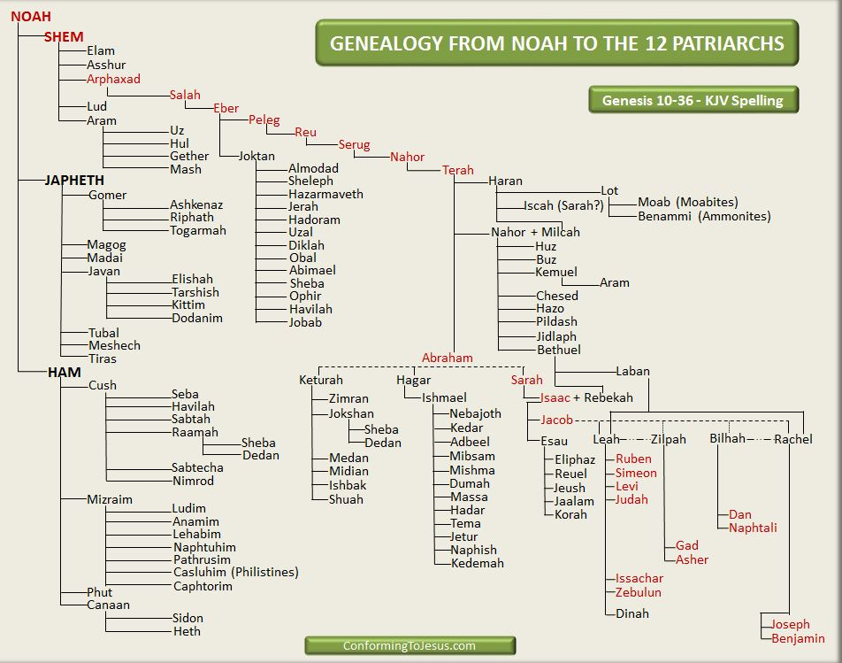
Nations Descended from Noah
Gen 10:1 Genealogy of the Sons of Noah
All Nations of earth
Divided in the time of Eber
Peleg’s descendants are not listed
Gen 11:10 Genealogy of Shem
Godly lineage of Abraham, David, and Jesus

Slide 11
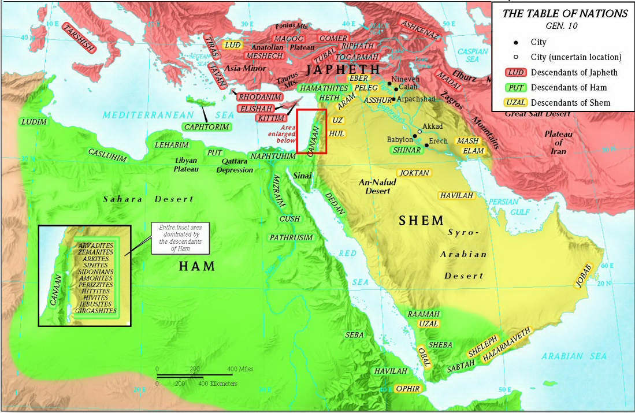
Lands of the Sons of Noah

Slide 12
Prophecy of Noah
So Noah awoke from his wine, and knew what his younger son had done to him. Then he said: "Cursed be Canaan; A servant of servants He shall be to his brethren." And he said: "Blessed be the LORD, The God of Shem, And may Canaan be his servant. May God enlarge Japheth, And may he dwell in the tents of Shem; And may Canaan be his servant." (Gen 9:24-27)
"When the LORD your God brings you into the land which you go to possess, and has cast out many nations before you, the Hittites and the Girgashites and the Amorites and the Canaanites and the Perizzites and the Hivites and the Jebusites, seven nations greater and mightier than you, and when the LORD your God delivers them over to you, you shall conquer them and utterly destroy them. You shall make no covenant with them nor show mercy to them … you shall destroy their altars, and break down their sacred pillars, and cut down their wooden images, and burn their carved images with fire. "For you are a holy people to the LORD your God; the LORD your God has chosen you to be a people for Himself, a special treasure above all the peoples on the face of the earth. (Deu 7:1-6)

Slide 13
The Nations of Earth
All families descended from Noah’s 3 sons (Gen 6:10, 10:1, 32)
The nations were divided in the days of Eber (Gen 10:25)
Nimrod “a mighty hunter before the Lord” (Gen 10:8, Descended from Ham)
Moses make s point to discuss Nimrod in the midst of the genealogy
H.C Leupold suggest Gen 10:8 might be translated as “the first tyrant upon the earth”
The verb form of the name Nimrod means “let us revolt”
“In the sight of Yaweh” suggests pride or that God was aware
The beginning of his kingdom was Babel (Babylon empire)
Then he went to Assyria and built Ninevah (Assyrian empire)

Slide 14
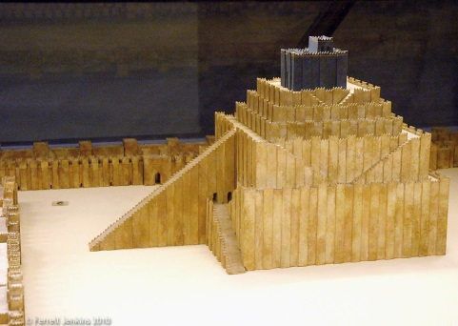
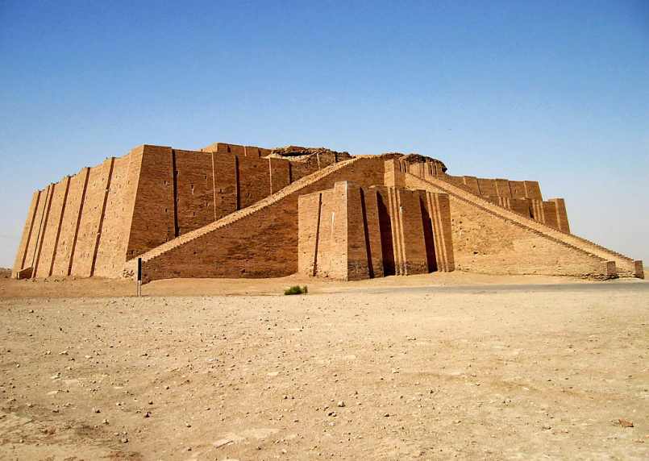
Confusing of Languages
The whole earth had 1 language and speech
Journeyed to Shinar and dwelt there
Started to build a tower
Baked brick and asphalt
To reach the heavens
To make a name
To avoid being scattered
The Lord came down
“…this is what they begin to do…”
Nothing would stop them
Confused their language
Scattered them across the whole earth
Called Babel because God confused the language
Reconstructed Ziggurat at Ur in Iraq.
Photo by Josh McFall.

