Slide 1
Writing Lab

Slide 2
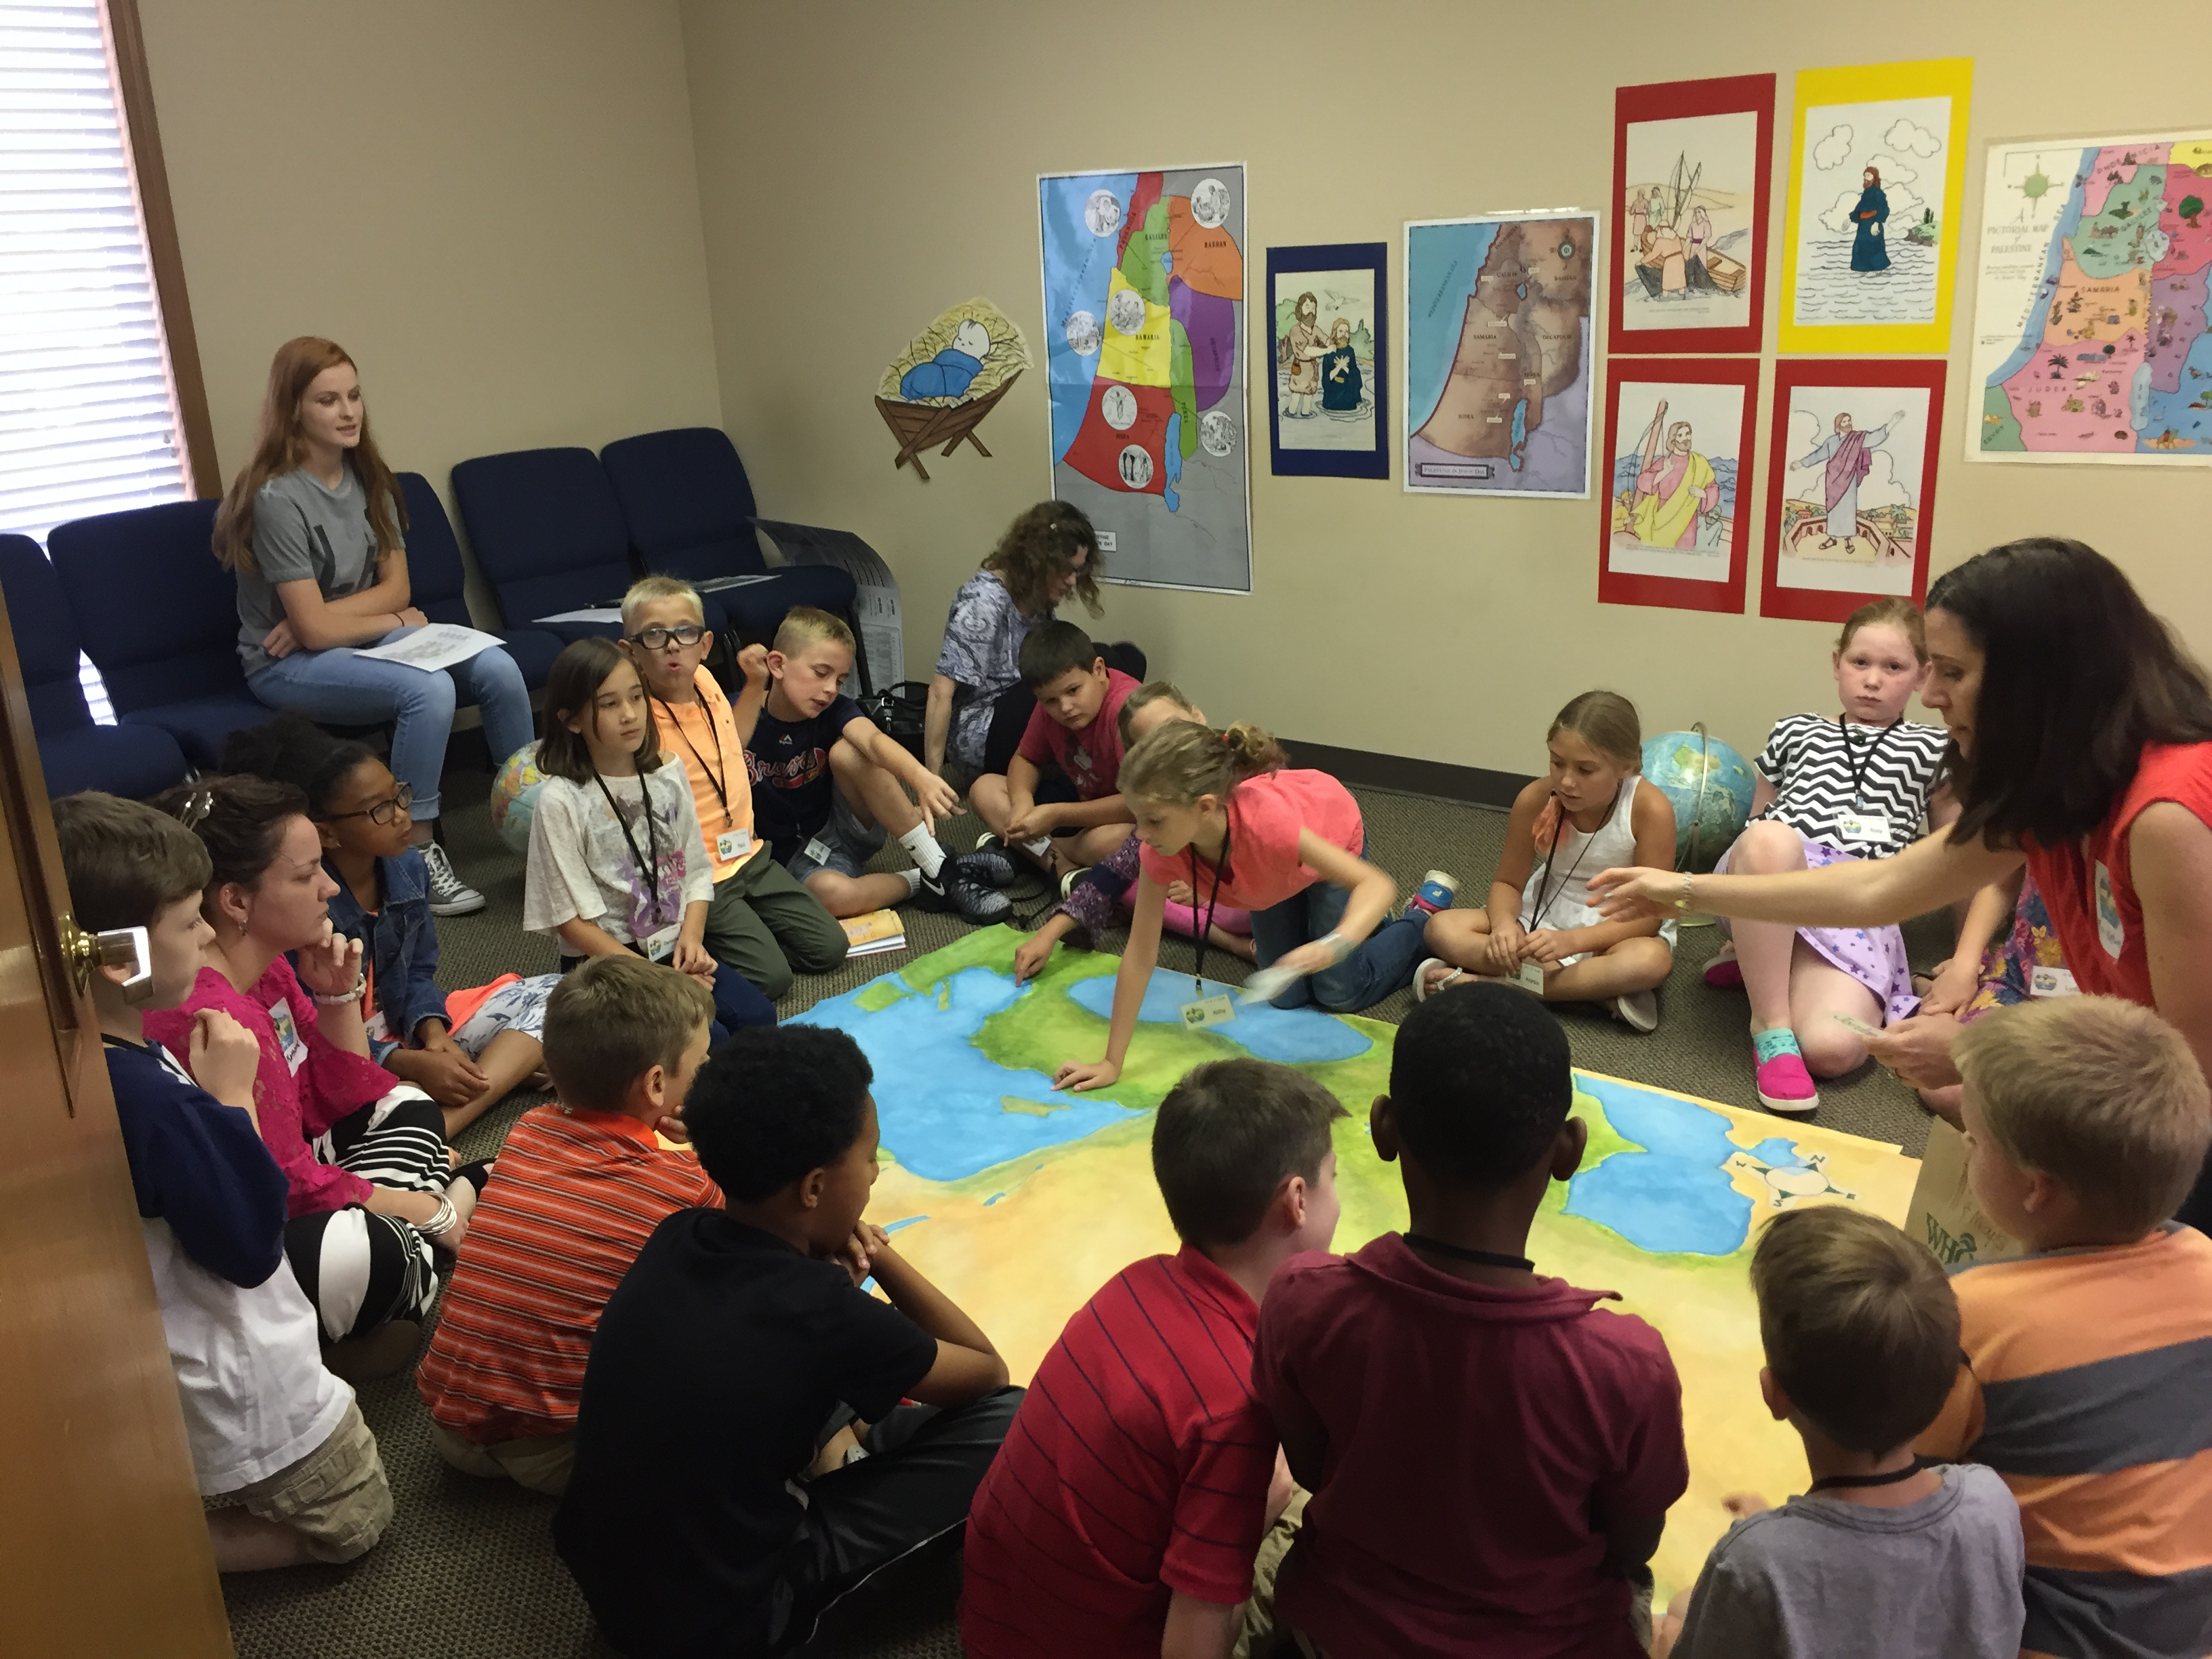
Geography & Timeline

Slide 3
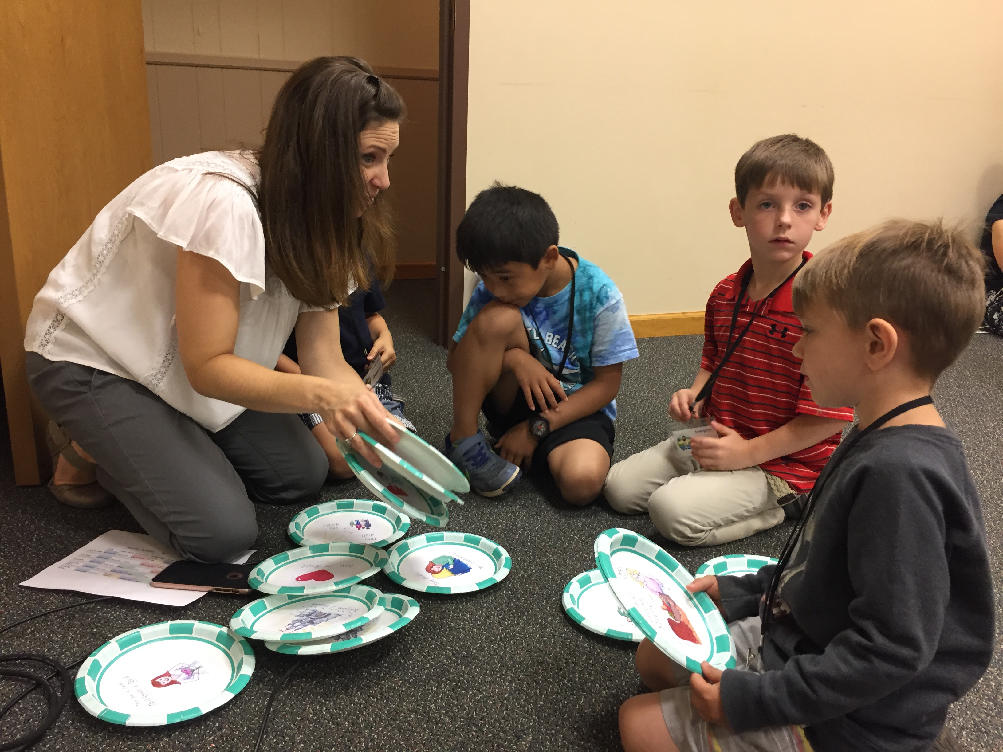
Memorization

Slide 4
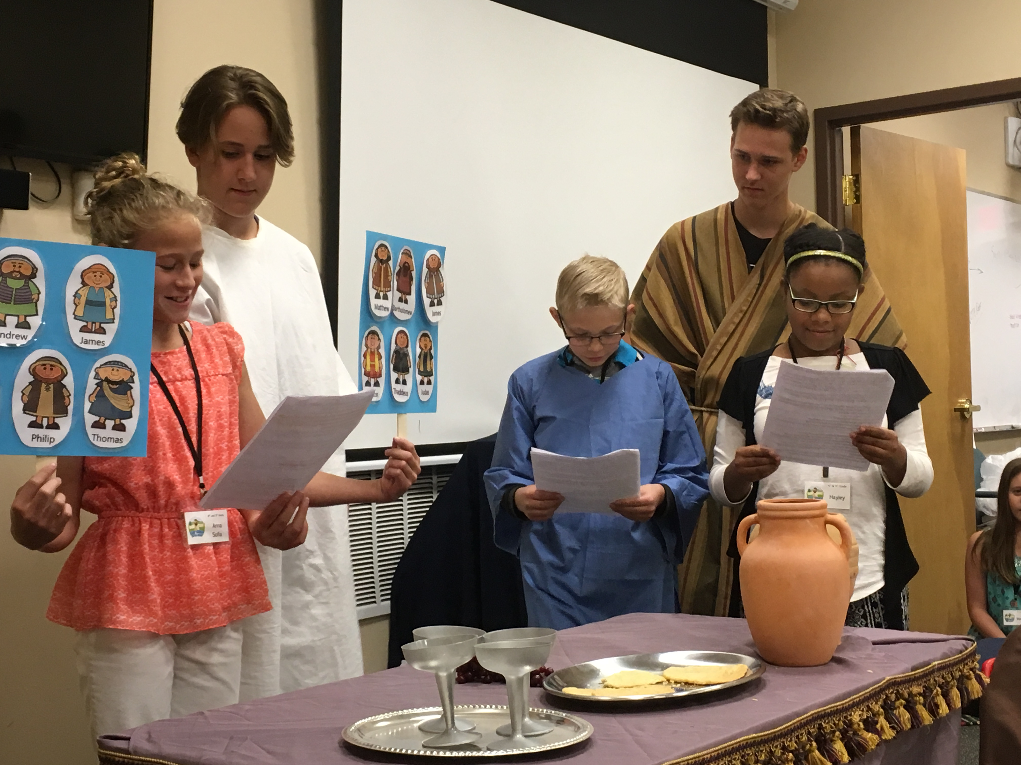
Skits For Application

Slide 5
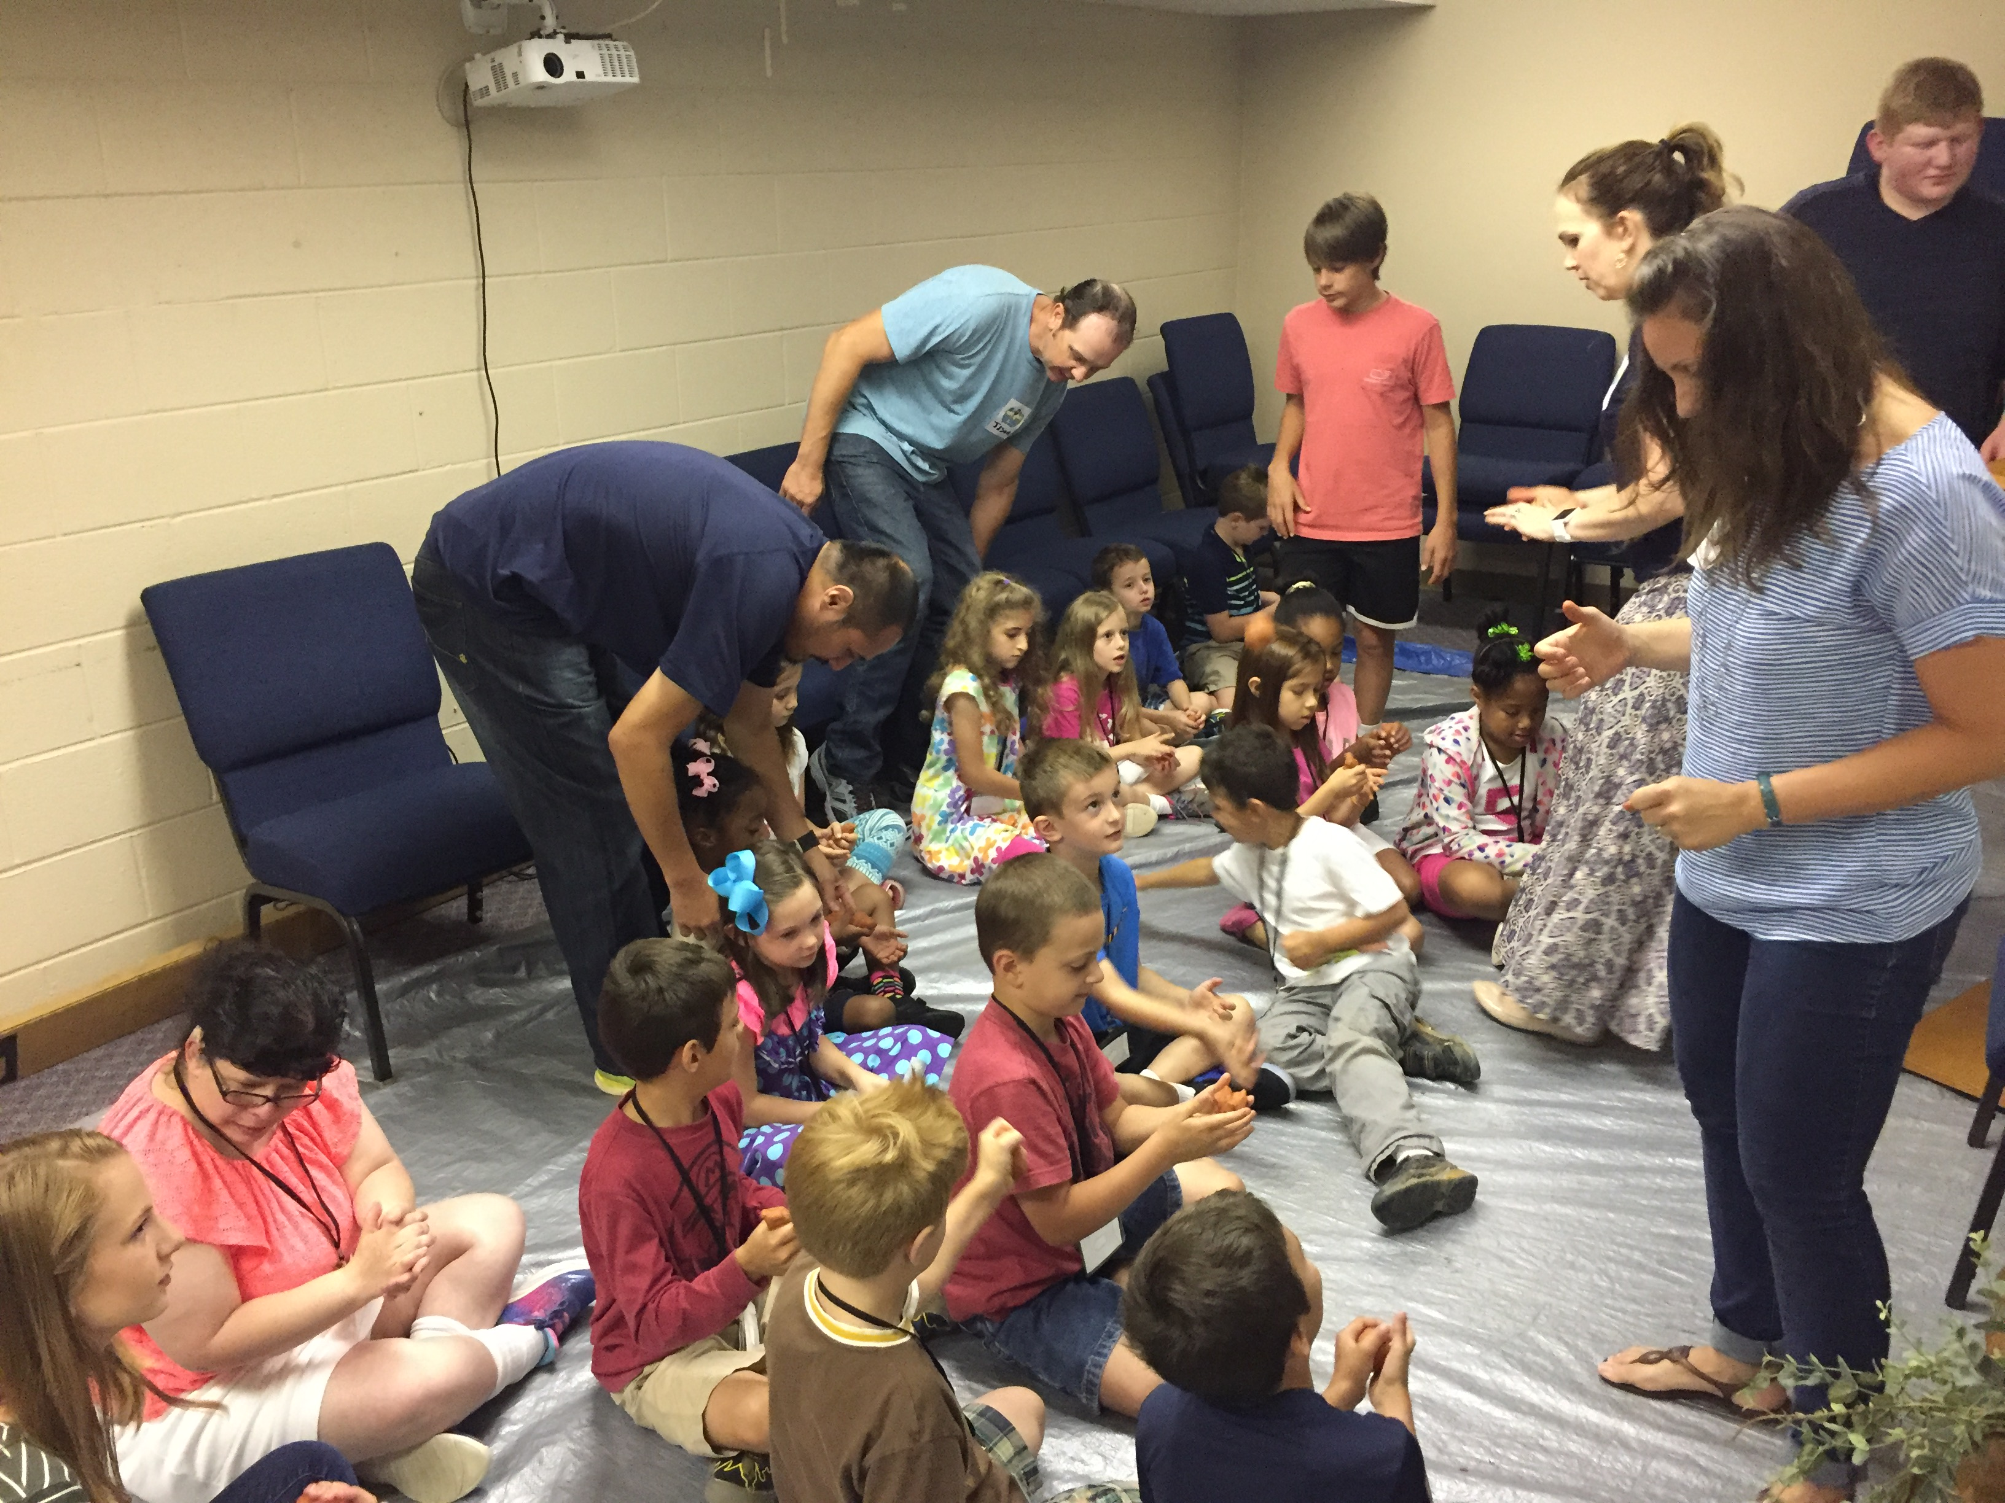
Life & Times: What’s It Like?

Slide 6
Thinking deeper

Slide 7
Jesus Directs Us Toward Deeper Thinking
How Are The Teachings of Jesus Promoting A Superior Righteousness?
Matthew 5:20
How Is This Command Setting Me Apart As Different From The Rest of The World?
Matthew 5:13-16
What Is This Command Molding Me Into?
Matthew 5:48
What Does This Command Require & What Will I Learn In The Process of Fulfilling The Command?
Matthew 6:3-4

Slide 8
Jesus Directs Us Toward Deeper Thinking
What Underlying Truth Is Jesus Helping Me Understand?
Matthew 6:28-30
What Warnings Are Being Issued & Why?
Matthew 7:1-2
What Excuses or Hesitations Tempt Me Not To Act On Jesus Words?
Matthew 7:24-27

Slide 9
Thinking Deeper About Mistreatment
Key Verses: Matthew 5:38-42
Rather Than Insist On Justice, I Will Endure More.
Thinking Deeper: The Long-Suffering I Learn In Small Insults, Is Helpful In Bigger Troubles.
Thinking Deeper: I Will Give More Than Is Required, Not For My Benefit, Or Even To Bless Others, But To Glorify God.
Notes:
I will bear what I can. God bears what He can!

Slide 10
Thinking Deeper About Correction
Key Verses: Matthew 7:3-5
Thinking Deeper: I Must Abandon Hypocritical Judgments. (Luke 18:11-12, Mt 23:4)
Thinking Deeper: I Must Acknowledge & Address The Beam In My Own Eye.
Thinking Deeper: I Must Welcome The Intervention of My Imperfect Brothers.

Slide 11
Thinking Deeper About The Golden Rule
Key Verses: Matthew 7:7-12
Thinking Deeper: An Incredible Summary, But Not The Epitome of Religious Teaching.
Thinking Deeper: Jesus Isn’t Simply Forbidding The Negative, He Is Charging Us To Be Proactive In Our Good Works.
Thinking Deeper: What I Really Want Is Someone To Act With Thoughtfulness & Compassion.
Notes:
Not The Epitome: I mean by this that – treating others with kindness is not all there is to being a Christian. As important as this is…Jesus says this embodies the second greatest commandment – but not the first. KNOWING GOD AND LOVING HIM WITH ALL OUR HEART is essential.

Slide 12
Thinking deeper

