Slide 1
The Book of Genesis
Jacob

Slide 2
Overview of Chapters 12-50
Establishes God’s plan to redeem his creation through a single entity: Abraham>Israel
Characterized by God’s gracious covenant with his chosen people and their response of faithfulness.
Consists of Three Parts
Abra(ha)m Cycle: 11:27-25:18
Jacob/Israel Cycle: 25:19-37:1
Joseph Cycle: 37:2-50:26
12-50 Patriarchal History
Promise/Covenant
Preservation of Heir (Issac)
Abraham
Takeover of Blessing
Travails in Laban’s House
Jacob
The Dreamer Estranged & Reconciled to his Brothers
Joseph

Slide 3
Themes & Theology
God as Creator
The unifying theme of the Patriarchal History is divine promise.
Sovereign
Faithfulness
Marked by Covenant

Slide 4
Themes & Theology
God’s people as keepers of creation
Abraham and descendants as ‘tricksters’
Reversals/The Younger over the Older
Name Meanings
Ancestry
Land

Slide 5
Geography

Slide 6
Jacob Cycle
God is faithful to His choice
God’s choice is not a guarantee of a ‘good life’
Abraham
Jacob
Father-Son Relationship
Sojourn within Canaan
Promise
Sacrifice
Brother Relationship
Sojourn away from / back to Canaan
Blessing
Trickery
Notes:
The things we have mentioned thus far are true either because of or in spite of the fact that Jacob is not a good guy in traditional sense in the story of the bible. Jacob is a schemer, a scoundrel, a rascal, a rogue, and a mama’s boy. He provides little, if any, example of exemplary behavior. One commentator puts it this way: “The narrative about Jacob portrays Israel in its earthiest and most scandalous appearance in Genesis. The narrative is not edifying in any conventional religious or moral sense. Indeed, if one comes to the narrative with such an agenda, the narrative is offensive.”
And so this batch of stories presents us with a problem…what do we take from Jacob as a whole? I would suggest two major lessons. 1) God is faithful to his sovereign choice. We’ve already said that the major theme of the Patriarchal history is that of divine promise – within that context God acts in ways which we may not understand, but which serve his eternal purpose. And no matter what, God will continue to act in accordance with those promises. That is precisely the point Paul makes about God’s choice of Jacob in Romans 9, saying that God’s choice is not because of works, but because of him who calls. For that reason, I think it is important to remind ourselves that God’s choice to bless Abraham through the covenant promises was not based on Abraham’s righteousness or faithfulness. Abraham only showed righteousness as a response to God’s choice, not as a prerequisite to it. God’s choice to bless Abraham is just as much about God’s grace as his choice of Jacob. 2) God’s sovereign election is not a guarantee of earthly blessing and what we might call a ‘good life’ (although sometimes it is, we’ll see that in a moment w/ Isaac), but in fact may bring with it conflict. Jacob’s life is marked by conflict – in his stolen blessing from Esau, his treachery both from and towards his uncle Laban, and even in his wrestling with God. Jacob is an example that God’s ‘plan’ often works through a lifetime of pain - and this is exactly why, I think, Jacob turns out to be perfect namesake for Israel. A people who indeed wrestled with God for their entire existence could have no better person to embody their history.
A few points that are interesting to contrast this unit with the Abraham unit we just came through: 1) Whereas the overarching issues in the Abraham narrative have to do with the father-son relationship, Jacob deals with other familial conflicts, not only between he and his uncle, but most notably with his brother Esau. 2) Whereas Abraham dwells and lives mostly with the promised land of Canaan, Jacob’s journey takes him back to Haran, out of the land, and back to it. 3) Inasmuch as promise and blessing can be distinguished, Abraham deals more with the notion of promise, whereas Jacob deals more with blessing. Promise is more vertical/religious, where blessing is more horizontal/earthly, 4) The character of Abraham deals mostly in sacrifice, whereas the character of Jacob deals mostly in trickery and deceitfulness.

Slide 7
Jacob Outline
Conflict w/ Esau 25:19-28:9
Conflict w/ Laban 29:1-30
Escape from Laban 30:25-31:55
Reconciliation w/ Esau 32-33:17
Meeting at Bethel
28:10-22
Birth of Children
29:31-30:24
Meeting at Penu’el
32:22-32
Concluding Material 33:18-36:43
Notes:
In terms of the outline of this section, the bulk of the account we have goes from chapters 25 through 33, and deal with Jacob’s conflicts with Esau and Laban, and you can see here that the story starts and ends with Esau and that the conflict and escape from Laban is in the middle.
Between these sections are very significant occurrences. On his way to Laban Jacob encounters YHWH at Bethel. That’s the story of the angels going up and down the ladder or stairway. Within Laban’s household we’re told about the children that Jacob has by his wives and servants – these of course become more significant near the end of Jacob’s life. Thirdly, just before he reconciles with Esau, Jacob encounters God again at Penu’el and wrestles with him there. These three narratives I think are the redemption of Jacob, because these are the times when we really see God actively working toward the eventual establishment of his people Israel.

Slide 8
The Blessing of Isaac
The only chapter in Genesis which focuses on the character of Isaac independent from Abraham/Jacob
Expansion on the conflict with Abimelech in Ch. 20
God repeats covenant promises to Isaac (v.3-5, 24-25)
God blesses Isaac with material wealth (v.13-16)
God’s blessing results in a treaty with Abimelech regarding the water rights in the area.
Notes:
Why is this story here?
The juxtaposition of Isaac as trickster here, and yet being tricked in the next chapter is emphasized.
The pattern of conflict-resolution fits nicely with the Jacob story
Shows the wealth of Isaac, which emphasizes the birthright Esau has just given up

Slide 9
The Birth of Esau & Jacob
Isaac prays to the LORD/YHWH to overcome Rebekah’s barrenness
The children ‘struggled’ in the womb
3 things revealed
Two children (boys)
These are designated as the ancestors of two future peoples/nations
The older son will serve the younger
Notes:
The story of Esau and Jacob begins with a familiar problem – barrenness, but it is more quickly overcome in this case, and in double measure!
Rebekah is disturbed by the activity proceeding in her womb, and so she goes to ‘consult with’ or ‘inquire of’ the LORD.
[[What are 3 things revealed to Rebekah?]]
She is having twin boys
These are designated as the ancestors of two future nations.
The older son will serve the younger. It should be noted that this ‘prophetic’ word from God here has double meaning. First, that Jacob, not Esau, will receive the rights and blessings of the firstborn son. Second, that Edom would serve Israel. Of course, Paul gives this verse a 3rd meaning in Romans 9, as a precedent for God’s choice to reveal the Gospel to Gentiles.
Thus, these births are within the womb destined by God. God is already disclosing to their mother, the course that these two lives will have. It is not insignificant that God’s choice here overrules the cultural law of ‘primogeniture’ – that is, the privileging of the first-born. That concept wasn’t just a convenient way of doing things, it was a fundamental conviction and procedure at that time. And yet God elects to overturn that concept here by blessing the younger over the older.

Slide 10
The Birth of Esau & Jacob
God’s choice overturns ‘primogeniture’
Esau
Red/ruddy
Hairy
Hunter
Jacob
Grabbing onto his brother’s heel
Mild-mannered
Notes:
Thus, these births are within the womb destined by God. God is already disclosing to their mother, the course that these two lives will have. It is not insignificant that God’s choice here overrules the cultural law of ‘primogeniture’ – that is, the privileging of the first-born. That concept wasn’t just a convenient way of doing things, it was a fundamental conviction and procedure at that time. And yet God elects to overturn that concept here by blessing the younger over the older.
Esau’s name appears to be given in consideration of the fact that he is hairy and red (not necessarily that he has red hair). The Hebrew terms separately for those two attributes are direct etymological referents of Esau’s ancestral nation Edom, and the location where he comes to live Seir. Esau is described as one who is skillful and experienced in hunting. Because Isaac, we are told, has an appetite for game/meat, he prefers/loves Esau.
Jacob comes from the womb second – but fighting all the way. The significant act of holding on to his brother’s heel is presented as an act of conflict, as if Jacob is still wrestling with Esau to be the first one born. The action leads to his name, a verbal form of the Hebrew noun ‘heel’ which means ‘to follow closely’ in the sense of attempting to restrain, hold back, overtake, or supplant.’ Jacob, we are told, is a man who stayed within the tent home, and thus was preferred by his mother. The word in v. 27 sometimes translated ‘quiet’ or ‘mild’ is a word that in other contexts in the Bible refers to moral integrity – e. g of Job as ‘blameless’ in Job 1:8. But that isn’t the sense here since a) that doesn’t contrast well with Esau as a hunter, and b) Jacob is anything but blameless. Here it means something like ‘naïve to ways of the outside world (as exemplified by Esau) – he is therefore settled, not adventurous.

Slide 11
Esau Sells the Birthright
Esau the Hunter is famished
‘The red stuff…the red stuff!’
Edom
Birthright
Reserved for the firstborn male
Double portion of inheritance
Jacob seals the transaction with Esau’s oath
Esau ‘disregarded’ his birthright.
Notes:
Genesis has already had two cases of fraternal rivalry – Cain v. Abel and Ishmael v. Isaac. In both cases, the elder brother emerges unfavorably. This case is no different.
Esau apparently wasn’t that skilled – he comes home one day with nothing. This is really expressed in the Hebrew. For one, the verb for eat connotes the action of gulping down, as if Esau is going to eat the whole bowl in one swallow. Second, the phrase ‘the red stuff’ – it is actually repeated in the Hebrew, indicating that Esau doesn’t care what it is, he just wants it now!
Here we have a second explanation for the origins of Esau’s name – again the connection of the notion of ‘red,’ this time with Edom, the name of the people whom Esau will bear.
Jacob immediately responds by asking him for his birthright. Birthright is exclusively associated with the firstborn male of any family. In Hebrew usage, this person is often expressed in relation to the father with the phrase ‘the first issue of his strength.’ or with the mother with the phrase ‘the first to open the womb.’ So there was a recognized significance to being the first born. And this came with special privileges. Deut. 21:15-17 demonstrates that a father is obligated to acknowledge his firstborn son as the principal heir, which resulted in an inheritance twice as large as that given to any other children.) This is what Jacob is bartering for here – the double-portion of his father’s inheritance (which is large because we know of Isaac’s wealth.
My understanding is that while they are often connected, the birthright is separate from the blessing of the father.
Esau agrees and Jacob confirms the action with Esau’s oath, swearing to give up his birthright. The deal is done. The actions of Esau are highlighted by the concluding statement. Esau quickly eats and goes away, seemingly without regret, and thus we are told he ‘despised/spurned/repudiated’ his birthright.

Slide 12
The Book of Genesis
Jacob

Slide 13
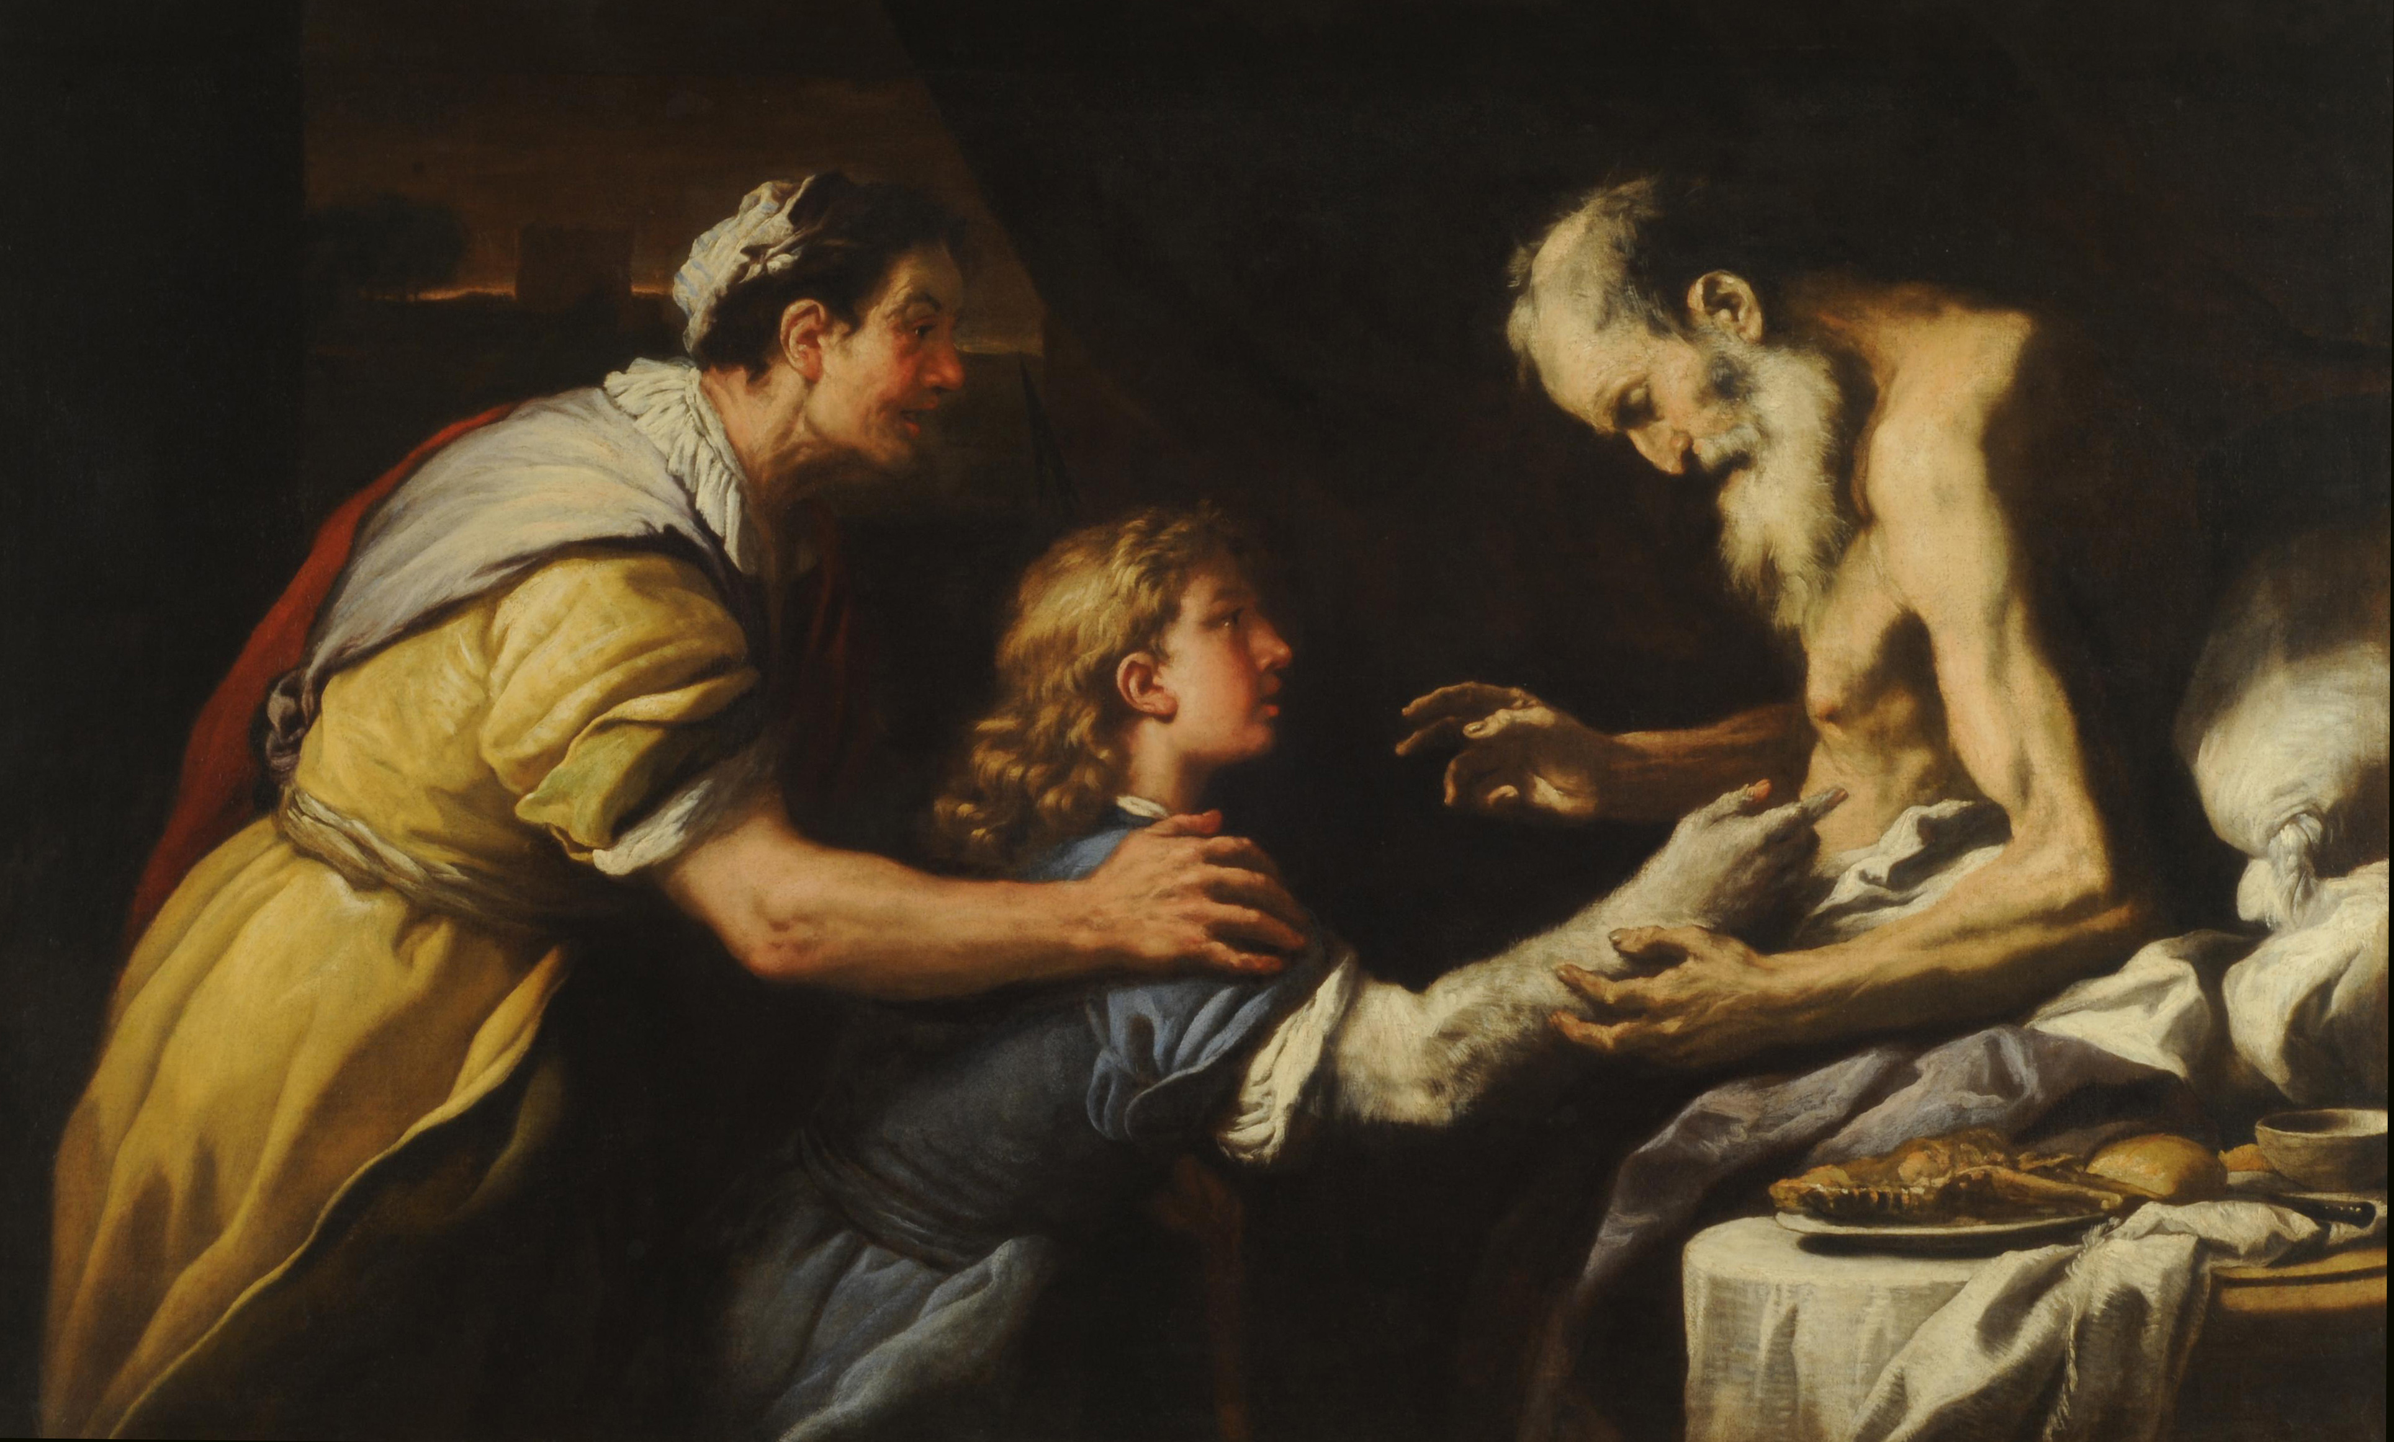
Jacob Steals the Blessing
Aged and blind Isaac prepares to bless Esau
Blessing
Sets identity/destiny of the child
Intergenerational
Holds genuine power
Rebekah initiates the trickery
Food / Skin / Clothing
Jacob is readily complicit
Notes:
…but at this point Jacob has only half of what he needs. He also needs to overcome his father’s love of Esau to receive the family blessing.
Isaac, old and blind, sends out Esau to hunt so that he may prepare what amounts to Isaac’s final meal with the intention that he will bless Esau upon eating it.
The notion of the blessing here is foreign to our rational individualistic culture. Our is one in which initiative to make one’s own way in the world is privileged. A person has a say in the outcome of their own life, and is a direct result of the choices that a person makes. But the blessing from a father to a son functions another way – to establish the identity of the child and set his destiny for him. What Jacob will be is established and set in motion by these words. Thus, parents have a direct say in the destinies of the lives of their children. And of course, the blessing of this family is all the more important, because the blessing carries with it the hope of fulfillment of God’s promises to Abraham.
This is something which we don’t have a good understanding today. I think we identify with Esau once the deed has been done and discovered when he says “Bless me also father!” and “Do you only have one blessing?” Why can’t Isaac renege on what has been done, considering that cheating was definitively involved? The answer is because that’s not how the act of blessing works. The words and actions of Isaac cannot be dismissed or undone because the words themselves have a genuine power and authority. Once they are spoken, the cannot be taken back. Isaac can no more take back his blessing than he can make himself see again.
[[Why does Rebekah initiate the deception?]]
She refers to Isaac/Esau as ‘your father/brother’
The deception is elaborate – she cooks a meal, and makes Jacob up in goat hair and Esau’s clothing.
[[How would you describe Jacob’s willingness to go along with this?]]
His concern is not about whether to go through with it, but rather how they’ll get away with it.
He is worried that the ruse will bring a curse upon him, rather than a blessing

Slide 14
Jacob Steals the Blessing
Jacob tells two lies:
Purposely identifies himself as Esau
Appeals to YHWH’s aid to explain himself
Issac remains suspicious
3 parts to the blessing
Basis for the blessing
What Jacob will receive
Jacob’s future descendants
Notes:
[[What two lies does Jacob tell?]]
Despite the elaborate rues, Isaac remains suspicious – Jacob has to answer for his supposed whereabouts, the speed with which the food was prepared, and his tone of voice…And in v. 23-4 when most bibles say that Isaac blesses Jacob (actually, this should probably be taken as ‘he was about to bless him’ or ‘was on the verge of blessing him’), he asks him a second time, just to make sure he really is Esau. J
The blessing has 3 parts
The basis for the blessing – this is maybe the high point of the irony in this story. Because Jacob smells like a fertile field which has been blessed by God, his blessing is of a type which will follow suit.
A statement of what Jacob will receive – phrases about dew of heaven, fatness of earth, grain and wine are predictions of wealth and fertility. For the most part, Jacob becomes a herdsman, not a farmer, but like his father, he too will be physically blessed
A statement of his position over others, which we be manifested in his future descendants – This is not just a statement about Jacob, but about the nation which will bear his later name of Israel – other nations are to serve them, and they will be lord over their brothers (particularly Esau/Edom). And the final statement strongly alludes to the original promise to Abraham, that those who curse him will be cursed and those who bless him will be blessed.

Slide 15
Isaac and Esau Mourn
Jacob leaves quickly and Esau returns ready to receive the blessing
Esau matches his father’s distress
Isaac maintains and repeats the blessing to Jacob
Esau connects Jacob’s actions with his birthright also
Esau is given a ‘blessing’ of his own
Esau will become a man of the sword (i.e. war/plunder)
His people will not serve Israel forever
Notes:
The action in the story is quite vivid here – picturing Esau returning just as Jacob leaves.
Esau’s reaction tells that he understands the importance of the deception which Isaac has discovered and revealed. In fact, the descriptions of the reactions are grammatically identical, indicating that they mourn not only equally but together over this fraud.
Again, Isaac makes no attempt to rescind the blessing. It is irrevocable. It is important here, to underscore the point earlier, that Isaac does not do this because he has an insight into the divine will. He does not appeal to God’s word to Rebekah (if he even knows it), or that it must be God’s will that this happened. No, the blessing is what the blessing is because that’s the way blessings go…
Jacob open admits that the blessing was taken deceit, though he does not implicate Rebekah (if he even knows to)
Esau ties this event with the taking of his birthright, suggesting that at least Esau sees Jacob acting deviously in both cases.
Esau sees that Jacob has earned his name – he is the ‘heel-grabber,’ the ‘supplanter’
Esau is given a loose kind of blessing in the end
He will be a predator, a man of the sword, living by violence
Like Jacob this concerns not only himself but his future people – there will come a time when they will break loose from their brother.
May refer to Edom’s independence from Israel during the reign of Jehoram King of Judah as told in 2 Kings/2 Chronicles

Slide 16
The Separation of Jacob & Esau
Two stories give independent reasons for Jacob leaving his home and running off to Padan-Aram
Esau plots to kill Jacob
Jacob should find a wife
Esau’s wives
Esau had 2 wives from among the Hittite women
In response to Jacob search for a wife, Esau marries an Ishmaelite woman
Notes:
The two stories at the end of 27 and beginning of 28 give different reasons for Jacob going off to Haran/Padan-Aram.
Ch. 27 states that Esau was plotting to kill Jacob after Isaac died. For a second time, Rebekah is able to learn the truth beforehand, and warns him to run to her brother Laban in Haran
She states that he should go for ‘a while…until she is able to bring him back.’ We should note that Jacob ends up being gone for 20 years – and we not told that he ever sees his mother again after this.
In addition, Isaac apparently doesn’t die during that time, or for some time long afterwards, in fact….when Isaac does finally die, the reconciled brothers will bury him together.
Ch. 28 tells us that Jacob should go to Laban in order to seek a wife
Here Isaac has no qualms over the deception used to procure the blessing, and Isaac again blesses Jacob, wishing upon him the blessing of Abraham, that he would return to take possession of the land.
The other subplot to this story that we have not touched on is that Esau is already married, and married to foreign women from among the Hittites. We are told that upon Jacob leaving to find a wife from among the family, that he makes an attempt at the same, marrying an Ishmaelite woman.
- It is important that though Esau leaves the story for a while, he will return later, and will be painted in a more sympathetic light. Not only does he forgive Jacob, but his full line of descendants and the kingly class among them is given in chapter 36 at the end of the Jacob cycle.

Slide 17
Encounter at Bethel
Jacob comes to Nowhere
‘A Certain Place’
Stone Pillow
The Dream
Ladder/Stairway
Angels ascending/descending
YHWH stands ‘above it’ / ‘beside him’
Promises Repeated
Jacob makes a vow at ‘Bethel’
Notes:
It should be noted that when Jacob leaves for Bethel he is already, pretty old – he is somewhere between 40-70 years old. And he has never encountered YHWH at this point in his life. That might seem strange considering that God has chosen Jacob from birth to the be the one to carry forward the covenant.
Jacob comes to ‘a certain place’ – we are not told the name of the place until the conclusion of the story. This suggests that Jacob is really nowhere – he is in an undefined, uncharted spot. This is reinforced by the detail that there is no place to stay, so that he uses a stone for a pillow. Jacob is on the run and he is alone.
One interesting note from the Hebrew text here that is probably not reflected in your English translations: The verb tenses in v. 10-11 (left/went/came/stayed/put/lay down/dreamed (v.12)) are all (essentially) indicative, past tense verbs – that is they state what happened. But w/ the description of the dream in v. 12, starting with the word ‘Look!’ or ‘Behold!,’ the verbs change to participles, thus describing the action as present, and encouraging us to see what he sees: (“And behold, a stairway setting upon the earth, and the top of it reaching to heaven. And behold, the angels of God ascending and descending on it. And Behold, the LORD standing above it, saying…)
Here we have another instance of God appearing in a dream. [[When did that happen before?]] With Abimelech in ch. 20.
The Dream itself is strange. We have God’s angels or messengers (we’ve already encountered these before as well!) going up and down on a ladder, or stairway. Traditionally, this has been read as a ladder, but as stairways are easier to imagine and to paint, that’s more to some. Some have suggested that ‘ladder’ doesn’t make sense because a ladder doesn’t really allow for two-way traffic, but then I would suggest that more important than that is why winged angels would need either one.
But the dream is important too…[[Does the description ‘there was a ladder set upon the earth, and the top of it reached to heaven’ remind you of anything?]] But here we have angels coming down to earth and go back up to heaven [[What does that mean?]] Whereas at Babel you had men attempting to reach up to heaven, I think this dream gives us a window into the realities of the spiritual realm. Heaven and earth are already connected, they already overlap, and here are God’s messengers coming down to do God’s will and returning back to God. God is not in the world, but he is not separate from the world either. And now, despite Jacob’s isolation, God is reaching down to interject himself into Jacob’s life – He is not alone!
This is suggested by the looseness of the preposition in v. 13 – most translations position God as ‘above it’ that is, at the top of the ladder. But the preposition there could also read ‘over him,’ suggesting that YHWH speaks at Jacob’s side a the bottom of the ladder.
YHWH then repeats the promises given to Jacob’s father and grandfather – the promise of the land for his descendants, the numerous descendants, as the dust of the earth, and again, that all the families of the earth will be blessed in him/them. Jacob is now the bearer of the promises and the covenant. It is interesting that YHWH does not make any mention of stolen blessing from Isaac. These promises are not just the next step in the line of Abraham – these are a fresh start for Jacob personally. Thus, God says in v. 15 “Behold, I am with you and will keep you wherever you go, and will bring you back to this land. For I will not leave you until I have done what I have promised you.’ Notice there that six times God is the subject of what he will do to/for Jacob. The emphasis is upon God as the protector of Jacob’s life.
And Jacob surely gets the significance of all this:
This place is a sacred place: Surely, the LORD is in this place! This place is the ‘house of God,’ the ‘gate of heaven!’ Bethel would become one of the leading Israelite cities under the divided kingdom, and one of its most important holy places (for better or worse!)
Thus the stone pillow is made a monument, a visual symbol of the encounter.
He names the place ‘Bethel’ (lit. ‘house of God’)
Jacob makes his own vow
Focuses on the more immediate aspects of God’s promise to him in v. 15-16.
Calls for God’s protection and provision, and return to his homeland
Promises devotion to God expressed in the tithe.
We shouldn’t read too much into the conditional form of the statement

Slide 18
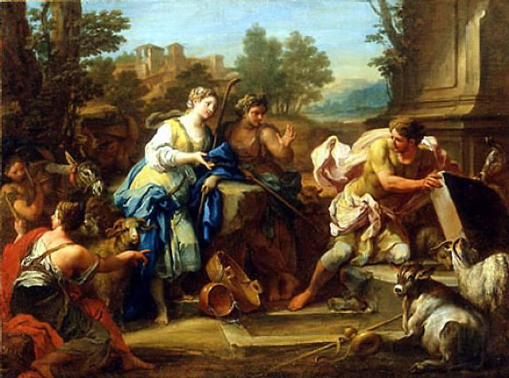
Jacob Meets Rachel & Laban
Jacob reaches ‘the East’
Inquires of Laban (lit. Is peace to him?)…
…but encounters Rachel at the well
Jacob moves the well stone by himself…
Then kisses Rachel, and cries.
Laban comes and invites Jacob into his house.
Notes:
Padan-Aram is ‘the East’ in Genesis geography
This story is intended to be funny…
He is looking for Laban and asks the shepherds about him
But he finds Rachel at the well. This is pretty typical – we’ve already seen Isaac’s wife found at the well, now Jacob will find his there too.
In a feat of herculean strength, he is able to move the stone from the well by himself when he sees Rachel.
This reminds me of John 21 – when the disciples encounter the resurrected Jesus after fishing. Having caught a net-load of fish, it says the disciples brought the boat up to the shoreline. But then when Jesus asked for some of the fish, Peter – the most enthusiastic – goes back onto the boat, grabs the entire net of 153 large fish, and drags them up to where Jesus is on the shore, and the net was not broken.
This is juxtaposed by the next action, in which he kisses Rachel and cries.
This kiss is probably not a romantic kiss, but a kiss of greeting (although it is strange for it to involve a woman), much like the kiss between Jacob and Laban to follow.
The crying is probably due to the successful end of his journey (remember it’s a long way from Beer-Sheeba in south Canaan to Padan-Aram)…either that or because he had thrown out his back rolling the stone away

Slide 19
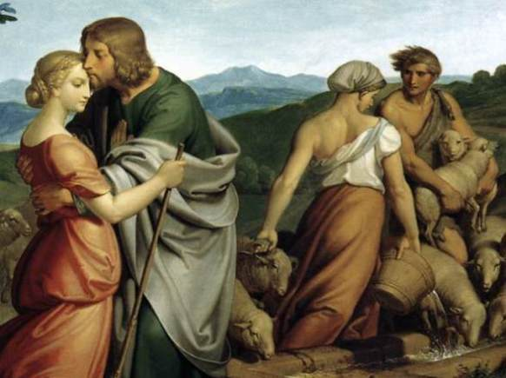
The Deceiver is Deceived
Jacob agrees to work for Laban for his daughter Rachel
He loves Rachel’s physical appearance
When Jacob calls for Rachel’s hand, Laban throws a party
Laban delivers Leah to Jacob
Notes:
Although we could have mentioned this before, the way women are treated in this story offends our modern sensibilities, with women used as wages and as sexual bait for trickery, we aren’t told about the perspectives of these women to these arrangements until later in which we find out about their rivalry over bearing children…these kinds of issues are difficult, unfortunately that can’t be our focus in a class of this scope. I would say, that there are several other places in the biblical story where other women are held up in a positive light. We shouldn’t use a text like this to promote the idea that women are wholly degraded by the Bible, because that just isn’t true.
Jacob agrees to work 7 years in Laban’s house, with his payment to be eventual marriage to Rachel. It is unclear the meaning/intention of Laban’s statement in v. 15, or why 7 years is the contract term for a wife.
It is clear why Jacob agrees to this – he finds Rachel physically attractive. We are told that Leah has ‘weak’ eyes – it’s not clear what this means, but it could mean that she had youthful eyes. Regardless, he loves Rachel because she is beautiful in form and appearance – another translation states she is ‘shapely and attractive.’
Laban’s deception of Jacob is set up in v. 19 when he implies that the terms of the agreement are acceptable to him
V. 20 is a rare example of a statement of romantic love in the OT.
Jacob calls on Laban to give Rachel to him
The language here is fairly demanding, indicating Jacob’s sense of right
He calls Rachel his wife, and makes a strong indication of his intentions.
The procedure here – the party, the giving of the woman – is a bit strange. It is not clear how the ceremony works.
Laban delivers Leah to Jacob and the two are intimate during the night.
Jacob does not realize the deception until the morning. (It was dark, perhaps he was drunk)…”Behold, it was Leah!!”
[[What are the parallels between this story and Jacob’s taking of the blessing?]]
Pretending to be another person
In the presence of the one tricked
Both involve not being able to see
Jacob pretends to be his older brother / Leah pretends to be her older sister

Slide 20
The Deceiver is Deceived
Jacob discovers the ruse and is angry!
Laban appeals to cultural custom as a defense
Jacob takes Rachel as his wife also, but works another 7 years
Jacob loved Rachel more than Leah
Notes:
[[How does Jacob’s offense at this action strike you? Is he justified in his anger?]]
Laban appeals to cultural custom as a defense for his action. Despite his earlier indication that he would give Rachel, he now suggests that he was not able to give Rachel before Leah. In doing so, he ironically calls Leah ‘the firstborn.’
However, the resulting offer in v. 27 to have Jacob work for another 7 years indicates his real motives – he gets to double up on Jacob’s contract!
Jacob is able to take Rachel as his wife prior to that time, and the story tells us in v. 30 that Jacob loved Rachel more than Leah – literally that he ‘hated’ Leah.
Here is one more parallel with the earlier story. Parental favoritism has turned into marital favoritism.

Slide 21
The Book of Genesis
Jacob

Slide 22
The 12 Sons of Jacob
Reuben
Simeon
Dan
Naphtali
Levi
Judah
Gad
Asher
Issachar
Zebulun
Joseph
Benjamin
Notes:
Chapters 29 and 30 of Genesis relate the births of Jacob’s children and the significance of their names.
Two significant themes in these chapters:
1. Despite the fact that Jacob loves Rachel, she is barren – a familiar theme in Genesis as we’ve seen. God looks favorably upon Leah, and grants here the privilege of children.
2. This leads to a sibling rivalry between the two sisters, resulting in 13 children born to Jacob – 12 sons and a daughter (who we’ll meet later). These 12 sons will be important at the end of Genesis when Jacob gives out the blessing before he dies.
6 children born to Leah
2 to Rachel’s maid Bilhah
2 to Leah’s maid Zilpah
Finally…2 to Rachel herself. These two Joseph and Benjamin will be the object of Jacob’s affection, a problem which will result in the downfall of Jacob’s life.
And of course Joseph will be the primary character in the final act in the narrative of Genesis.

Slide 23
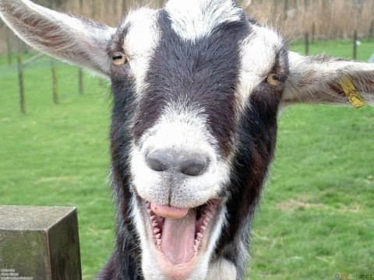
Tricks with Sheep & Goats
Jacob requests to go home
Laban will do anything to
make sure he stays
Appeals to YHWH’s blessing
Jacob asks for a portion of
Laban’s flock
The ‘irregular’ animals
He allows Laban to ‘audit’ his flocks
Notes:
- Jacob sees the birth of a son to Rachel as a reason to go back home…
- Jacob calls on Laban to allow him to take his family and leave
- Laban apparently refuses the request without explicitly saying so, instead asking Jacob to stay with him and name his pay.
Laban appeals to Jacob on the basis that Jacob’s God YHWH had blessed him.
V. 27 suggests that Laban has become rich himself, and many translations indicate that this is through some form of divination, or pagan magic. It’s not clear what that means or how that would have worked. It isn’t even clear that’s what the text actually means here. Regardless, Laban doesn’t attribute his wealth to his own doing, but to Jacob’s presence in his household.
Jacob agrees to stay with Laban, but looks to increase his own families assets by asking for a portion of Laban’s flock. He asks for the spotted, multicolored sheep and goats and the black sheep. In the Mediterranean world sheep are normally white and goats are normally black, so Jacob is asking for the irregular animals. These are more rare, and so they make up a smaller portion of the flock, and as a result are harder to breed.
He allows Laban to account for what Jacob keeps and ‘audit’ his flocks. Jacob claims that his ‘righteousness’ will be upheld – a statement ironic in two ways, because 1. Jacob has been unrighteous before, and 2. because Laban is perhaps more unrighteous even than Jacob

Slide 24
Tricks with Sheep & Goats
Laban undercuts the deal
Jacob’s portion is given to Laban’s sons
Jacob shows ingenuity/ trickery/ (magic?) of his own
Uses white tree branches to affect breeding patterns
Selectively breeds the best of the flock
Jacob uses Laban’s flock to make himself rich
Notes:
[[Does Laban Agree to Jacob’s requested wage? What does he do to his flock?]]
Laban undercuts the deal he makes with Jacob by designating those portions of the flock that would have been given to Jacob as belonging to his sons. And then they go 3-days journey away from Jacob so that he can’t chase them down. Thus, Jacob doesn’t get the portion of the flock that he would have intended – the wage he asked for is virtually nothing.
The account here of what Jacob does in response is interesting. This is certainly meant to the turn the tables back onto Laban’s for his dishonesty in the previous agreement. It is not clear whether this is also an act of trickery, or genetic ingenuity, or his own brand of magic, or all three… He takes shoots from nearby trees, and peels them in such a way as to put white stripes in them and fixes them inside the water troughs that the animals drink from. Then, the animals come to drink, and to mate, and the result is that these all white sheep and all black goats end up breeding multicolored sheep and goats. On top of that, Jacob starts to selectively breed the animals this way so that he reserves the best of the flock for himself.
And so Jacob makes himself rich at the expense of Laban’s own flock

Slide 25
Jacob’s Flight From Laban
Jacob perceives Laban’s change in favor for him
YHWH calls on Jacob to remember the promise and return home
“I will be with you”
Another dream from “The God of Bethel”
Leah & Rachel acknowledge the wrong of their father
Regarded as ‘foreigners’
‘Devoured’ the inheritance
Jacob leaves with HIS family on HIS property
Rachel steals Laban’s gods // Jacob ‘steals Laban’s heart’
Notes:
But with the increase of his herds and wealth comes the decrease of his reputation in the eyes of Laban. Laban’s sons are able to see what Jacob has and feel he has in some way cheated Laban – in reality this might involve more jealousy than retribution. But this comes to affect Laban’s view of Jacob as well, and even Jacob is able to perceive it.
[[What is your perception of Laban’s character?]]
The change in Laban’s mind here appears to be directly tied to what financial gain he gets out of their relationship. That seems to have been Laban’s major character trait all along – someone who is willing to take advantage of people when they bring him benefit, but apparently now ready to discard them once they don’t.
Despite Laban’s change, the disposition of God has not changed toward Jacob during his time in Haran. God calls to Jacob to leave and then when Jacob disucsses his plans w/ his wives he tells them of another dream he has from God which references the goat breeding and calls on him to “return to the land of your kindred.”
Jacob defends himself to L&R about Laban’s unfair practices, and somewhat surprisingly, I think – they agree! They are perhaps more harsh even than Jacob, saying that he has treated them as foreign women to has made money off of them and taken what should have been theirs in the first place. Thus, they tacitly acknowledge Jacob’s God, giving their consent to go along with his plan to follow God and leave.
v. 17-18 clearly make the point that what Jacob is doing is legitimate in terms of what he takes with him when he goes. Jacob came into Laban’s house empty-handed, but he will leave it with a good amount of wealth.
And although, unknowingly, he will leave with something else – foreign gods. With Laban away from the homestead, Rachel goes into his house and steals his gods.
What does this mean? So one thing that becomes very clear in this story and what follows is that Laban is a kind of polytheist, as most of the other peoples of his time and place. The various gods that Laban is devoted to may have been YHWH, on some level (that isn’t uncommon in the OT, to have foreigners acknowledge YHWH as God without becoming an Israelite or giving up their other Gods.), but would have included other gods, of various types, origins and abilities. It seems that what Rachel has taken here are the representations of ‘household’ Gods – personal deities which would have been thought to control and protect the welfare of the homestead, the family, and the family business.
What we are not told is why Rachel would do this. There are a number of possibilities. [[Why do you think she would do this?]]
A way of acknowledging YHWH as God?
A way of acknowledging the power of these gods to give protection to Jacob?
A way of preserving Jacob’s portion of the household property?
A calling card left out of spite or vindictiveness?
A bargaining chip?
An asset for monetary value?
From the perspective of the story, we might speculate on the reason for Rachel’s action, but from the standpoint of the telling of the story, the reason for this detail in v.19 is to set up the next comment in v.20. Your bible might say that Jacob deceived or tricked Laban by not telling him that he was leaving. That’s an accurate translation, the idea here is that Jacob is plotting his escape and resorts to lack of information to be able to make the getaway…but the phrase here is literally ‘ Jacob stole Laban’s heart.’ The idea is that this act is a punch to the gut of Laban, and deliberately so – Jacob leaves with no indication.

Slide 26
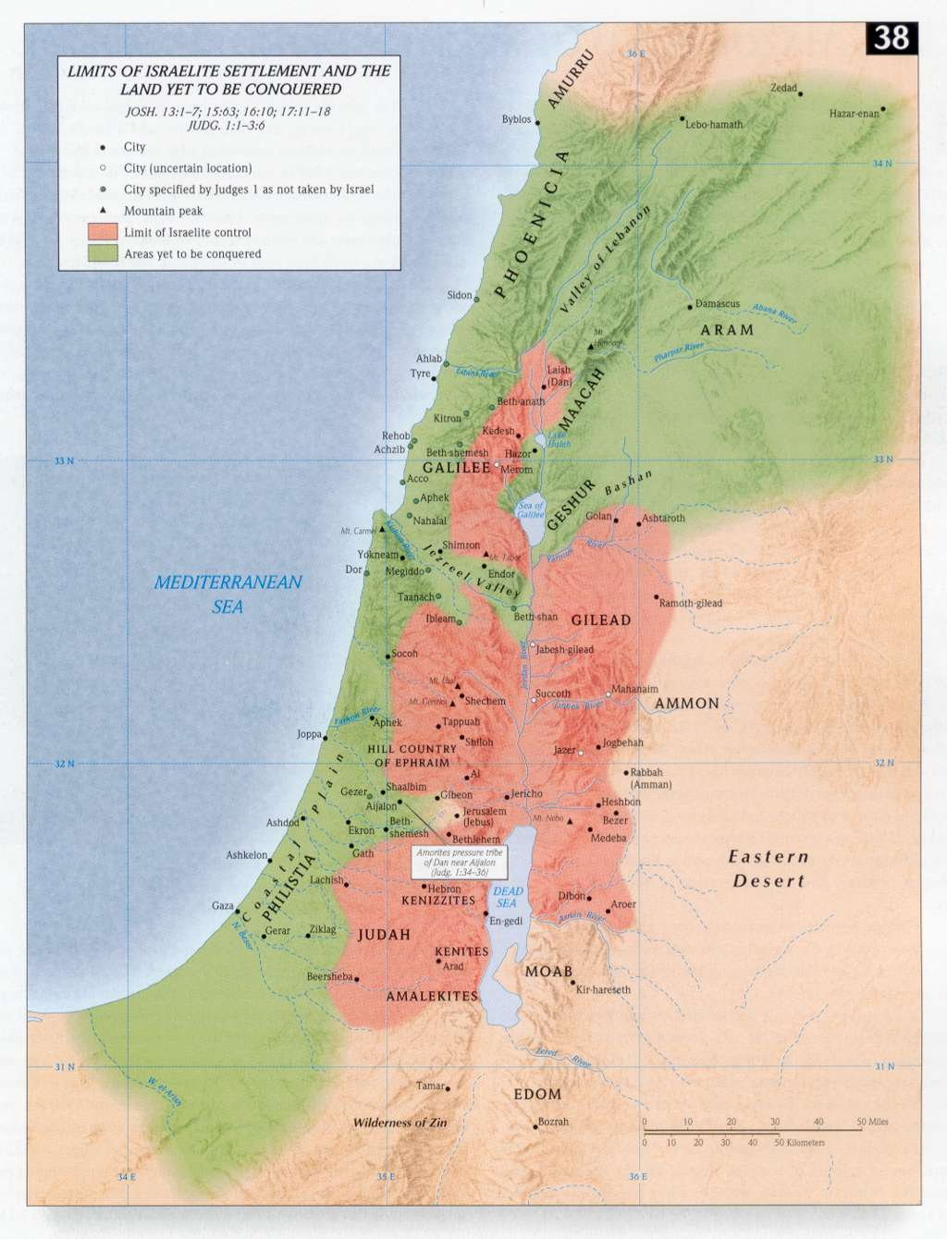
Laban & Jacob Reconcile
While chasing Jacob down, God appears to Laban in a dream to warn him about harming Jacob
Laban charges Jacob with deceit and foolishness
‘Deceived Me’
‘Carried away my daughters’
‘Flee secretly’
Notes:
- Jacob is 3 days out before Laban knows he has left, and Laban goes after him…
- Again we have God appearing in dreams – in this case to Laban to warn him not to harm Jacob. Here we continue to see God’s provision and watchfulness for Jacob
Laban overtakes Jacob in the hill country of Gilead, which is on the west side of the Jordan, so Jacob is at least 2/3 of the way home.
Laban upbraids Jacob for his behavior, expressing his anger at Jacob’s dishonest and expression of care for him and his family
It is highly unlikely, however, that this is a genuine response
Laban expresses his right as the head of household to punish them, but Laban respects Jacob’s God and heeds his warning

Slide 27
Laban & Jacob Reconcile
Laban is allowed to search for his missing gods
Rachel becomes the deceiver
Jacob gives a comprehensive defense to Laban
Appeals to his loyalty in hard conditions
Accuses him of deceptive wages
Attributes his success, and the dream, to God’s justice
‘The Fear of Isaac’
Notes:
Laban equally accuses Jacob of stealing his gods. Jacob allows Laban to search for them, unknowingly putting his wife in danger by calling for death upon the one who has them. As a result, Rachel becomes the deceiver in this story – of her own father – pretending to be weary and not able to rise from the place where she was sitting on them.
There is something in this episode that is subtly critical of false gods – you have Jacob’s God who appears in dreams and directs the actions of mean, and you have Laban’s gods which can’t be found to help, because a menstruating (that is, ritually unclean) woman is sitting on them.
Laban is not able to find them, which then angers Jacob more and gives him opportunity to launch into a defense against his uncle and father in law. In this speech, Jacob:
Appeals to his loyalty to Laban, his proficiency with Laban’s flock
Accuses Laban of deceptive payment/wages
And appeals to his God, the God of his fathers, as the one who guided Jacob and judged against Laban in the dream
Here there is an interesting reference to God as ‘the Fear or Dreaded One’ of Isaac. This suggests that the God of Isaac is one who creates fear and dread, as apparently evidenced by Laban’s dream. The connection to Isaac, may be way of recalling the connection Laban had with Isaac, since his sister Rebekah became Isaac’s wife.

Slide 28
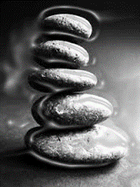
Laban & Jacob Reconcile
Laban reluctantly agrees to let Jacob go
A covenant is established between the two
Marked by a pillar and mound of stones
To watch over Jacob (as protection / threat)
As a border between their two peoples
To establish peace and justice between them
Invokes the gods of Jacob and Nahor
Commemorated with a meal
Notes:
Laban is clearly reluctant to let Jacob leave. He reasserts his rights in v. 43, but given that he is resigned to the outcome, suggests a covenant between himself and Jacob to settle the matter.
With this suggestion, Laban is tacitly acknowledging Jacob as independent from his household.
However, this is likely a way for him to still feel in control of the situation, as if this were his idea all along.
The covenant established between Laban and Jacob is marked by the pillar and mound of stones. We have already seen Jacob do this once before after seeing God at Bethel.
For Jacob, this pillar and mound serves a similar purpose, as a memorial of God’s goodness and protection over him. Laban appears to see it differently. For him, this is a physical marker of YHWH’s presence to watch over Jacob, not with the promise of provision, but as a threat – specifically that he not mistreat Laban’s daughters or grandchildren.
It also serves as a border between their two peoples, that they not pass the way of each other with malicious intent
Thus the covenant is meant for peace justice
Laban invokes not only the God of Jacob, YHWH, but also the ‘God of Nahor,’ which probably refers not to God, but to a separate diety recognized by Abraham’s distant family
It is commemorated with a meal

Slide 29
Jacob Prepares to Meet Esau
Jacob sends word to Esau of his successful return
Jacob has three strategies:
Divide up his people into two camps
PRAY!
Gifts
Jacob’s Prayer
Invokes YHWH as the God of his fathers Abraham/Isaac
Recalls God’s promises
Expresses humility and concern
Jacob gives gifts to Esau to appease him (lit. ‘cover his face’)
Notes:
Jacob is afraid of Esau’s intentions – the messengers don’t make them clear!
Jacob’s grandfather had once rescued lot with 318 men, now Esau brings 400 on what Jacob assumes is a mission of destruction
‘coming to meet you’ in v. 6 is a phrase that in other places in the OT refers to engagement in battle.
Jacob has three strategies to get out of his predicament.
He divides up his family into two camps. This is an effort to preserve something of his home and possessions. It appears that Jacob is willing to sacrifice half of what he has so that the other half may escape.
Pray!
Give Esau gifts
[[What do you see in Jacob’s prayer? Would you say he is changed?]]
Jacob’s prayer is certainly positive, but doesn’t indicate a changed man – Jacob doesn’t change until he has meets God. That comes during the night.
When Jacob gives Esau gifts, he gives a substantial amount of animals and does it in a way as to try to appease Esau, sending them in waves to try to overwhelm Esau, with the promise that Jacob is coming behind.
There is a heavy emphasis in v. 21-22 on the word ‘face.’ it actually appears in the Hebrew 5 times. It reads literally as “For Jacob reasoned: ‘I may be able to cover his face with gifts that go before my face. Then later when I see his face, perhaps he will raise my face, so the gifts went on ahead of his face…”
There are two reason’s for this: 1) it confirms that Jacob is not actually ready to ‘face’ his brother, that he wants to hide in the back and see how things play out. 2) Linguistically, it sets up the real encounter Jacob is about to have – not with Esau, but with the face of God Himself.

Slide 30
The Book of Genesis
Jacob

Slide 31
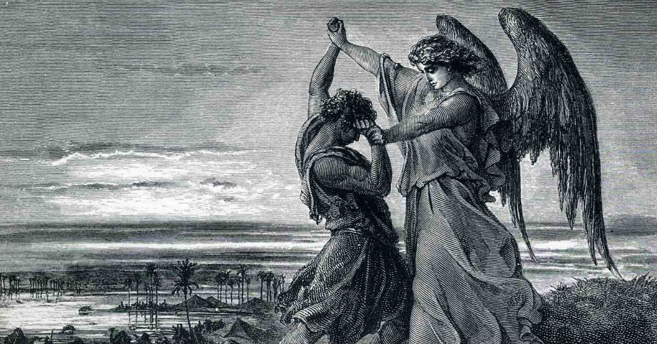
Jacob Cycle
God is faithful to His choice
God’s choice is not a guarantee of a ‘good life’
Notes:
Throughout this story, we’ve seen Jacob manipulate his way through relationships, whether that be capitalizing on the weakness of his brother for his birthright, deceiving his father for the blessing, gaining wealth at the expense of his uncle. Jacob is a man who, through whatever means necessary, always seems to come out on top – he is the ‘supplanter’ – even though it results in conflict and fear. Jacob’s reward for getting the best of his family is that he ends up on the run from them.
And yet at the background of this life of Jacob is Jacob’s God, who chose Jacob to bear the burden of this life of blessing. God loved Jacob from the beginning, set things in motion for these events to occur, announced himself to Jacob at Bethel and watched over Jacob during his time in Laban’s household.
These two ideas go back to the two lessons that we suggested at the beginning of this unit of stories. 1) God is faithful to his sovereign choice. 2) God’s choice is not a guarantee of a ‘good life.’ I hope you can see, as we have seen with Jacob, that these two ideas are likely to produce conflict and contention. I would suggest probably everyone here, in one way or another, has felt the tension of the conflict that these two ideas create. We trust in God to provide, and he does provide, but not in ways that are always easy to deal with. Faithfulness to God is not always the ability to stand in partnership with God against the evils of the world – sometimes faithfulness feels more like a wrestling match with God himself.
For that reason, Jacob’s encounter at Peniel with the man who seems to be God (the designation is intentionally ambiguous in the story), is I think the defining moment in the story of Jacob in Genesis. In this story, we have a microcosm of the way Jacob has lived his life – in contention with others –on this occasion he has the strength to outlast his opponent but cannot overcome him. In the end, he leaves with a blessing – a blessing consisting of a new name and new limp, a bodily injury. They are markers of a new identity for Jacob – not one which necessarily transforms his character or life (Jacob isn’t having a conversion moment here) – but which embraces his life of conflict as an indication of God’s faithfulness, memorializes the conflict which has now extended itself even upon God, and warns him that he cannot prevail upon God and come away unscathed. Thus, the outcome of this encounter is for Jacob both a Magnificent Defeat and Crippling Victory. Jacob’s faithfulness to God is evidenced by failure to overcome him, but his unwillingness to let God go…
And because this is certainly in view within the whole narrative of Genesis, the story sets that identity upon the nation of Israel. If ever a people wrestled with God it was his own people of Israel. Jacob is the namesake for that people who went back and forth with God in their faithfulness to him and infidelity against his law, in their devotion and violation against him. This story is formative for the identity of all God’s people, of whatever time and place.

Slide 32
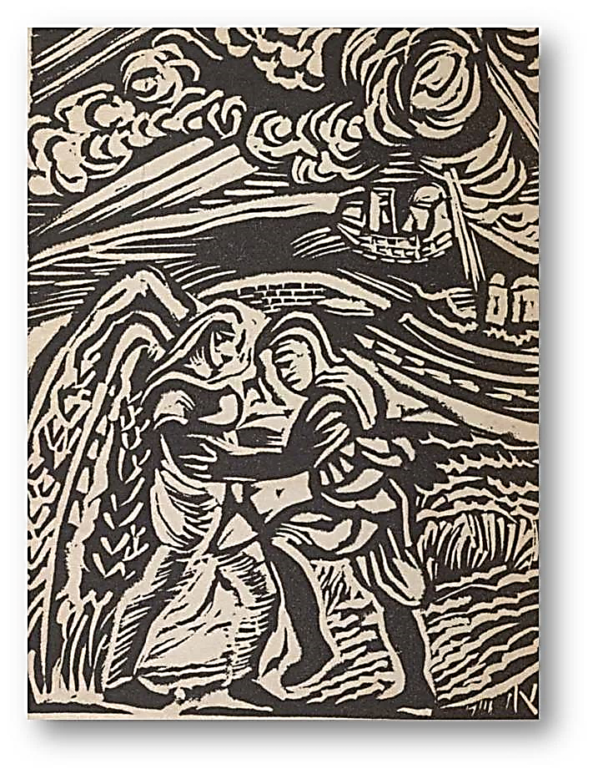
Encounter at Peniel
Jacob’s family are fleeing from Esau
Setting: In a river canyon at night
Jacob is alone
Who is the man Jacob wrestles with?
“In the womb [Jacob] took his brother by the heel, and in his manhood he stove with God.
He strove with the angel and prevailed; he wept and sought his favor”
Hosea 12:3-4
Notes:
As part of Jacob’s plan to divide up his camp as a measure of protection against the potential attack of Esau, Jacob takes his immediate family and has them cross over the river Jabbok.
You can probably hear the consonantal similarity between Jabbok and Jacob. The same is true for the work ‘wrestle’ [yeabeq]
The setting for the encounter is pretty impressive, this river is situated in deep cut canyons in the eastern part of Canaan, and this takes place at night. With his family safely across the river, Jacob is now alone. We’ve seen before God appear to Jacob in a dream while he is alone.
The text is pretty abrupt here in introducing the wrestling match. Apparently it comes upon us the reader as quickly as it did upon Jacob. No introductions are given, or reasons for this taking place…it just happens.
[[Who is the man Jacob wrestles with?]] The text calls him a ‘man’ on multiple occasions. There is actually a reference to this event in the prophet Hosea where he identifies the man as an angel of God. At the conclusion of this, Jacob is going to make a reference to having seen the face of God.
We’ve seen this before where men are messengers or angels, but then also God, or at least the idea of seeing God is hinted at. We haven’t really talked about this so far, but in the Pentateuch, and especially Genesis, these individuals – whether men or angels – appear as manifestations of God in the world. We often thing of angels as God’s representatives, but in Genesis they are more like representations of God.

Slide 33
Encounter at Peniel
The match lasts all night
Jacob wrestles the man to a draw
The man ‘touched the hollow of his
thigh,’ thus putting it ‘out of joint.’
Jacob demands a blessing
He receives a new name, ‘Israel’
‘God rules’
‘He who strives with God’
Notes:
This wrestling match lasts all night long…this is some battle!
In the end, this divine man cannot overcome Jacob…this is some show of strength and stamina!
The decisive blow is then made when the man ‘touched the hollow of Jacob’s thigh,’ thus putting it out of joint.
And yet Jacob seems to not the man go, he’s still got him in some kind of hold. The man demands to let him go – there may or may not be some significance to the fact that morning has come and the man/angel must leave…
Jacob demands that he receive a blessing…before he could take a blessing through deception, now he attempts to gain it through strength
in asking for a blessing, Jacob seems to be asking for a submission – he wants the man to tap out. Jacob wants to be declared the winner.
What he receives in response is a blessing of sorts…
The man asks Jacob his name…[[Does the man know his name? Why ask him?]] The man knows who Jacob is…the point of asking the name is not for introductions, but to draw out the meaning of the name. Jacob isn’t sharing information, he is declaring that the name Jacob fits him – he is the supplanter – or at least has been up to now.
But now, in biblical idiom, the man says ‘it shall be said no more of you Jacob,’ but ‘Israel’
The word Israel actually has a disputed meaning among scholars of ancient Hebrew. It’s original meaning is ‘El/Elohim rules or heals’
As most name meanings have in the OT, the name’s significant comes from its phonetic connection to another word, in this case the Hebrew word ‘sara’ for ‘struggle.’ Thus Israel is the one who stuggles, or strives with God.
As we suggested earlier, this new name is a memorialization of his conflict with God, at the same time embracing God’s provision for him in his life.
The man says the name is given because he has striven with God and men and has prevailed. [[How had Jacob prevailed against God?]] Not because he defeats God, but because he would not let God go…Jacob’s demand for blessing – his insistence to come out on top, despite being at disadvantage is the mark of his character.

Slide 34
Encounter at Peniel
Jacob asks for the man’s name in return
“Why do you ask my name?”
Jacob names the spot ‘Peniel’
‘I have seen God face to face’
‘My life has been preserved’
Jacob limps away to meet Esau
Notes:
Jacob asks for the man’s name, but is shut down. The man will not return Jacob’s concession. [[Why not?]]
The response from the man may be a way of asking “Don’t you already know who I am?”
I take ‘And there he blessed him’ as at least encompassing their conversation and the designation of Jacob’s new name.
Jacob names the place Peniel, meaning literally the ‘face of God,’ stating that his encounter is essentially seeing God face to face
This expression is probably not to be taken literally, but indicative of a direct, unmediated encounter with God
Jacob recognizes God’s preservation of his life, not just in this moment, but up to this moment as well.
Thus Jacob leaves that place, and he will return to family to go meet his brother in the confidence of God’s protection, and with the limp to prove it.

Slide 35
Reconciliation with Esau
Jacob leads his family out to meet Esau
Esau’s reaction is overwhelmingly positive
Embrace / Wept
Refuses Jacob’s gift
Invitation to hospitality
Jacob’s reaction remains defensive
Attributes all success / family to God
Imposes upon Esau to accept the gift
Rejects Esau’s offer for hospitality and assistance
Notes:
This story is told really well, there is a fair amount of tension. We don’t know what Esau’s attitude toward Jacob is until Jacob does.
Jacob leads his family out…before remember he was afraid to see his brother’s face, and was on the run…now he is at the front of the party
Esau’s reaction is totally positive. Jacob needed God’s intervention to stop retailiation from Laban – not so for Esau. Esau has seemingly forgiven and forgotten any wrong that Jacob perpetrated against him.
The embrace and weep together
Esau refuses Jacob’s gift and invites him to his home.
Jacob’s response is less enthusiastic
He speaks of God’s bring Jacob success, but skims over much of the details
He demands that Esau accept his gift – this is probably a way of recompensing him for the stolen birthright/blessing
He refuses Esau’s hospitality and assistance.
Esau comes off as a good guy in this story.
Meanwhile Jacob fids his way down to Shechem and for the first time in 20 years is back in the land of his father and grandfather. He buys land in the area and his family sets up their own homestead in the land. God had promised to protect Jacob until he returned. God has kept his promise.

Slide 36
Two Other Events
Jacob’s only daughter Dinah is violated
Jacob’s sons act deceptively in vengeance
The men of Shechem are circumcised
Simeon & Levi, lead a massacre of the men of the city
Jacob’s family become a pariah among the people of the land
Jacob Returns to Bethel
Rids the family of foreign gods
Jacob to Israel is confirmed
God repeats the covenant promises to Jacob
Notes:
Two other events:
1) Dinah is violated and her brothers, Jacob’s sons, enact revenge on the inhabitants of Shechem
2) Jacob returns to Bethel to have God confirm the covenant promises to him
After the Esau genealogy in ch. 36, the Jacob narrative concludes in 37:1 – “Jacob lived in the land of his father’s sojournings, in the land of Canaan.”

