Slide 1
The book of Genesis
Lesson 23: Joseph
The Ruler

Slide 2
Class Schedule, (Segment 1)
Session | Topic | Reading | Date
Lesson 14 – Grant | Key Figure: Abraham |  | Sun, June 4
Lesson 15 – Grant | Abraham | Gen 11:27-25:11 | Sun, June 11
Lesson 16 – Sam | Abraham | Gen 11:27-25:11 | Wed, June 14
Lesson 17 – Sam | Abraham | Gen 11:27-25:11 | Sun, June 18
Lesson 18 – Grant | Jacob | Gen 25:12-36:43 | Wed, June 21
Lesson 19 – Grant | Jacob | Gen 25:12-36:43 | Sun, June 25
Lesson 20 – Grant | Jacob | Gen 25:12-36:43 | Wed, June 28
Lesson 21 – Grant | Jacob | Gen 25:12-36:43 | Sun, July 2
Lesson 22 – Sam | Joseph – The Dreamer | Gen 37, 39-41 | Wed, July 5
Lesson 23 – Sam | Joseph – The Ruler | Gen 42-45 | Sun, July 9
Lesson 24 – Sam | Joseph and his Brothers | Gen 38, 46-48 | Wed, July 12
Lesson 25 – Sam | The Twelve Sons of Israel | Gen 49-50 | Sun, July 16
Lesson 26 - Grant | Review |  | Wed, July 19
Notes:
Note that we’re approaching this as a textual study, meaning that our focus will mainly stay on the features of the book which God inspired. For that reason it will be important that you read the book. There is lesson material, but that should only help focus your reading. I think you should have plenty of time for reading. Since we won’t have a lot of time to read the text aloud in class, having the text read means that you’ll be able to follow any discussion we have and be able to easily understand anything we talk about from up here.
Note that we’ve broken this down by section/topic rather than by date. We didn’t’ want to commit to strict sections of the text which are large and deal with the same basic characters. So for instance we’ve allowed 2 classes to cover Noah and the Flood, or 5 classes to cover Abraham. Lesson material should reflect that setup. It won’t be lesson 1,2,3, etc. The material you get will cover the entire section and can be done at your own pace.
We have interjected here a number of ‘topical’ classes. Danny Haynes will be presenting a single class at the beginning covering the issues of how Genesis relates to science and history. The point of the class is more of a textual study of Genesis, but we recognize that those are important issues and worth addressing so Danny has agreed to give us an overview of some of those evidences. We also have a class once we start the section on the patriarchs that I hope will be a historical look at the life of the patriarchs, and explain the world in which they lived. That should be really interesting and help our study through the last ¾ of the book. There are two classes that will focus on the characters of Adam and Abraham, and I think specifically will look at what the New Testament writers have to say about them. That should broaden our understanding of the significance of them for understanding who we are as Christians today. And then we have a couple of review periods in there as well.

Slide 3
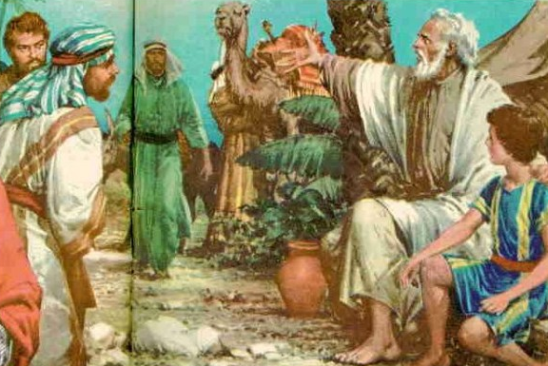
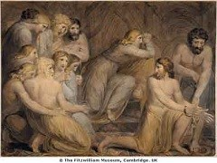
The Brothers Come to Buy Grain
Jacob sends the ten brothers to Egypt for grain
Heard a report of grain for sale
Kept Benjamin at home “lest some calamity befall him”
“Why do you look at one another?”
The first meeting with Joseph
Joseph knows them, and speaks harshly
They do not know him, and fear
Joseph charges them with being spies
Imprisons them for three days “bring your brother!”
The brothers begin to question themselves
Recognize guilt for their treatment of Joseph
Joseph understood their words, but they did not know
Releases them, but binds Simeon before them

Slide 4
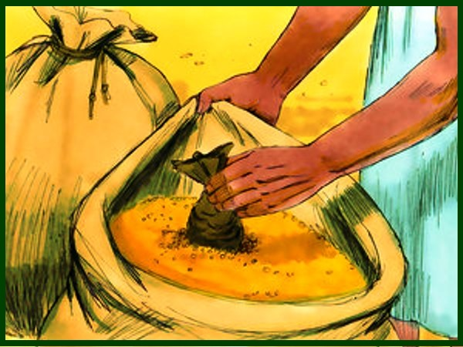
The Return to Canaan
The Nine brothers return
Given grain and provisions for the journey
Find their money in the mouth of one of their sacks
“What is this that God has done to us?”
Told Jacob all that happened to them
Told him of the requirement to bring Benjamin
The rest of the money is also found, and they are afraid
Jacob now grieves for Simeon as “lost” as well
The need to return for more food is recognized
Rueben’s offer is rejected
Jacob sends the brothers back for more food
Judah insists that Benjamin come, offers himself as surety

Slide 5
Questions
How would you describe “brotherly affection” in the family of Israel? Were they on a path to become a great people?
What concerns might Joseph have had for Benjamin?
What benefit might Joseph have expected in speaking harshly, putting the brothers in prison, and binding Simeon before them?
The brothers have begun to feel guilt over Joseph. Have they repented? Are guilt and repentance the same?

Slide 6
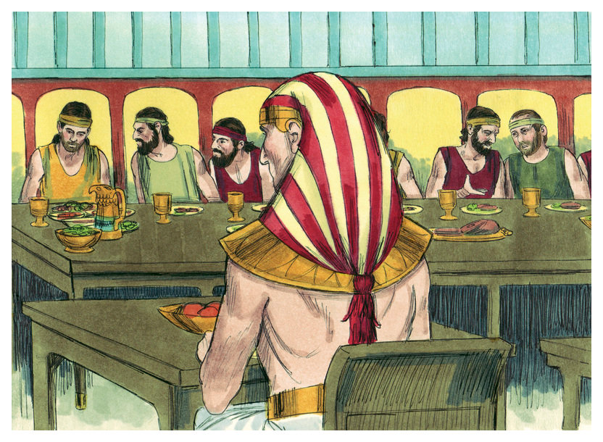
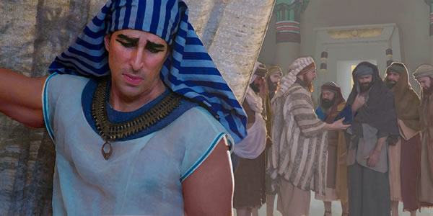
The Second Journey to Egypt
Jacob sends them again
Sent a gift from Canaan and double money
Sent Benjamin
Blessed them on the journey
Joseph commanded a meal for the brothers
At his own house
Restored Simeon to them
Received the gift
Seated them in order of age
Five portions to Benjamin from his own table
The brothers are afraid
Approached the Steward about the money in the sacks
Drank wine and were merry with him

Slide 7
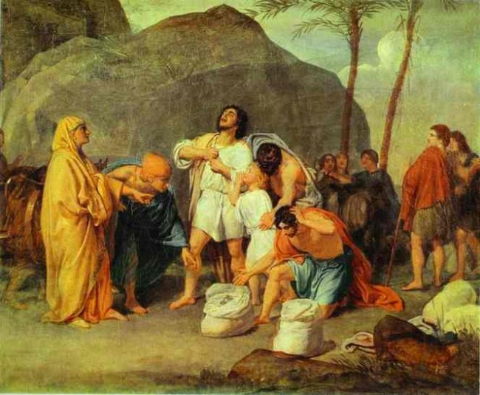
The Brothers Tested
The accusation against them
Money put in their sacks again
Joseph’s cup in Benjamin’s sack
“Why have you repaid evil for good?”
The brothers protest
The cup is found with Benjamin
No Defense is possible
The brothers rend their garments, all return to Egypt
All brothers consent to a common fate
Judah intercedes for Benjamin himself
None will return home without all returning

Slide 8
Questions
Why did Jacob send the brothers to Egypt again?
What was Jacob’s fear? How did he attempt to mitigate it?
What things did Joseph do to confuse his brothers? Why?
With what did Joseph test his brothers? Did they pass the test?
Is repentance evident in their actions now?

Slide 9
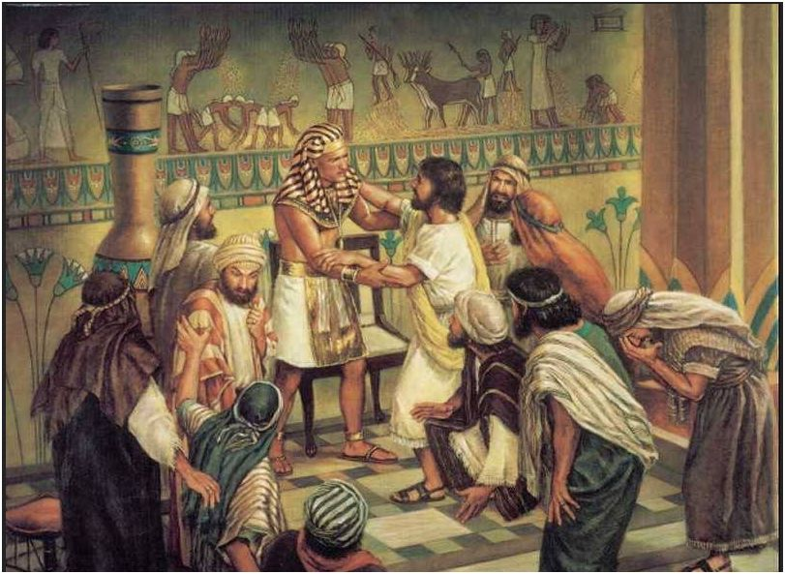
Joseph Revealed
A family reunited
Sent the Egyptians from the room
Revealed his identity
Called them to come near him
Credits God’s purpose and providence for Israel
Sent to preserve a posterity
Weeps loudly – heard by Egyptians and Pharoah
Joseph Promises a home and care in Egypt
Go and tell Jacob
God had given him the ability to provide this
Come at once. Do not delay
Provides gifts to his brothers and father
Commanded them not to be troubled on the way

Slide 10
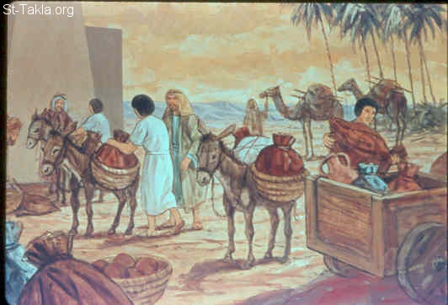
“Come to Egypt”
Pharoah Commanded Joseph
This pleased Pharoah and his servants
Bring them to Egypt in carts
Settle in Goshen
Provide the best of the land for them
When Jacob was told, his heart stood still
He did not believe them
He saw the carts and heard their words
“It is enough”

Slide 11
Questions
Why do you think Joseph sent the Egyptians out when he revealed himself to his brothers?
How did the brothers feel about this revelation? Why?
What steps did Joseph take to relieve their concerns?
What changes in the brothers are now evident?

Slide 12
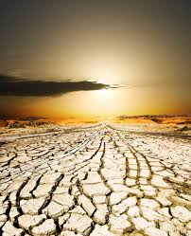
Surviving the Famine in Egypt
As the famine raged on
All the money in Egypt was spent and gathered up
All the livestock was collected
All the land was bought by Pharoah
Joseph moved the people to the cities
Gave them seed to sow
Implemented the 1/5th Tax for Pharoah

