Slide 1

WORSHIP
Embry Hills
Fall 2016

Slide 2
Course goals
Understand better why we worship and who benefits from our worship
Comprehend more fully what God has revealed about Him-self, and explore how that knowledge impacts our worship
Evaluate worship and our parts in it using reason, not emotion
Improve the external and internal processes of worship in our lives

Slide 3
Class schedule
Lesson | Class Date
1. History and Definition of Worship | 23-Jul
1. History and Definition of Worship | 26-Jul
Lesson 1 or 2 Spillover | 30-Jul
2. Worshiping in Spirit and in Truth | 2-Aug
2. Worshiping in Spirit and in Truth | 6-Aug
3. Covenant Service and Worship | 9-Aug
NO CLASS – CARL BALLARD SPEAKING | 13-Aug
4. Decorum in Worship | 16-Aug
5. Worship in Song | 20-Aug
6. Worship in the Lord's Supper | 23-Aug
7. Worship in Prayer | 27-Aug
8. Worship in the Collection | 30-Aug
9. Worship in Scripture Reading & Preaching | 3-Sep
10. Review | 6-Sep

Slide 4
Definition and History of Worship
Lesson 1

Slide 5
Brainstorm: what words or ideas do you associate, or hear others associate, with worship?

Slide 6
Two Views of worship
Checklist Worship
  “Worship is a specific set of commanded acts.”
  Do all the right things in the right order
  More corporate focus
  Emotion viewed as disorderly or out of place
  Key passage: 1 Cor. 14:40
  DANGER: Legalism
Willy-Nilly Worship
  “Worship is about feeling close to God.”
  What you do doesn’t really matter
  More individual focus
  Emotion embraced (and perhaps pursued)
  Key Passage: 2 Sam. 6:21-22
  DANGER: Emotionalism

Slide 7
Finding a definition of worship
The human experience of worship
  Two views of worship
  Worship words
  Markers of worship across time and culture
  The corruption of God-given worship
The object of our worship
  Worship and God’s self-revelation
  God’s self-revelation in the New Covenant
Why we worship
  Response to God’s nature
  Communion with God
  Remembrance and celebration of covenant

Slide 8
Worship words
Proskuneo: to “[prostrate] oneself before a person and [kiss] his feet, the hem of his garment, the ground, etc.” (Ardnt, Gingrich, & Danker; qtd in Jividen)
  Metaphorical description of the attitude of humility and recognition of worth required for worship, 1 Cor. 14:25
  Best description: the attitude and pattern of behavior of reverence
  Best synonym: venerate
Latreuo: to engage in the specific rituals of worship, especially sacrifice (Kittel, qtd. in Jividen)
  Luke 2:37: [Anna] did not depart from the temple, worshiping with fasting and prayer night and day.
  Best synonym: liturgize
Both words are used in Matt. 4:10: You shall venerate the Lord your God and him only shall you liturgize.

Slide 9
Communion with the supernatural
Man was created for communion with God
  Compare Gen. 3:8 and Lev. 26:12
That communion was lost in the Fall
  Gen. 3:22-24; 4:26

Slide 10
“Calling on the Name of Jehovah”
Used to describe worship in OT
  Gen 4:26, 12:8, 21:33, etc.
Three possible meanings:
  “To invoke Jehovah’s help and blessing”
  “To declare Jehovah’s name to others”
  “To know the name of Jehovah”
All three acts are essential to communion with someone
Our worship should:
  Invoke God’s help and blessing
  Declare who God is to others
  Increase our awareness and understanding of who God is (what He has done)

Slide 11
Communion with the supernatural
Man was created for communion with God
  Compare Gen. 3:8 and Lev. 26:12
That communion was lost in the Fall
  Gen. 3:22-24; 4:26
Communion with God is the heart of every covenant God has made
  Gen. 17:7; Exo. 19:5-6; Jer. 31:33-34; Rev. 21:3
In worship, we recall the communion of Creation and look forward to the communion of the New Creation

Slide 12
Boundaries: Sacred vs. Profane
First established by God, Gen. 3:24
Inherent to construction of tabernacle and temple
  Tabernacle, Leviticus 16
  Solomon’s temple: 2 Chron. 3-4

Slide 13
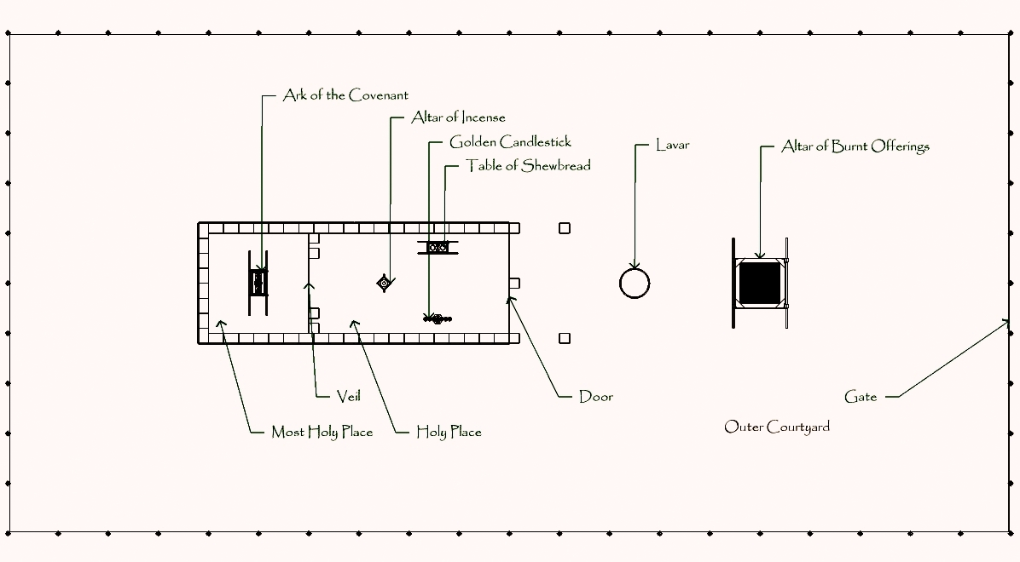
The Tabernacle

Slide 14
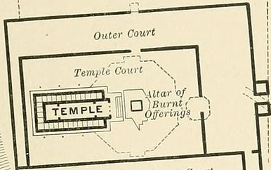
Solomon’s temple

Slide 15
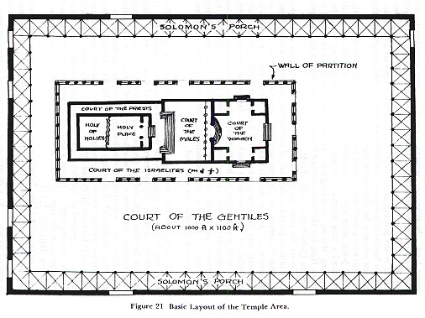
Herod’s temple

Slide 16
Boundaries: Sacred vs. Profane
First established by God, Gen. 3:24
Inherent to construction of tabernacle and temple
Expressed in nearly every religious or ceremonial structure

Slide 17
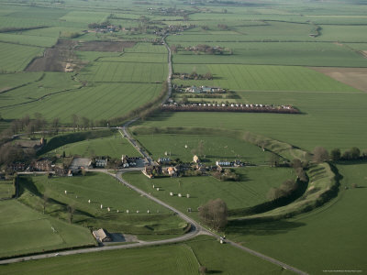
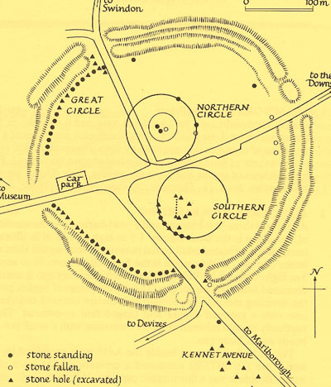
Avebury, england

Slide 18
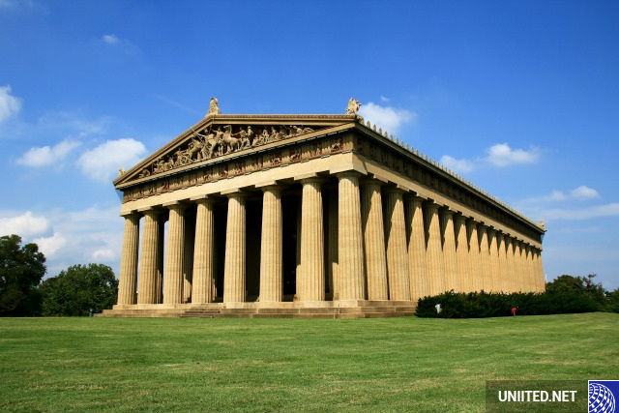
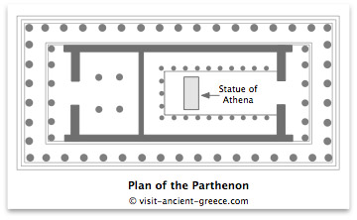
Parthenon, Greece

Slide 19
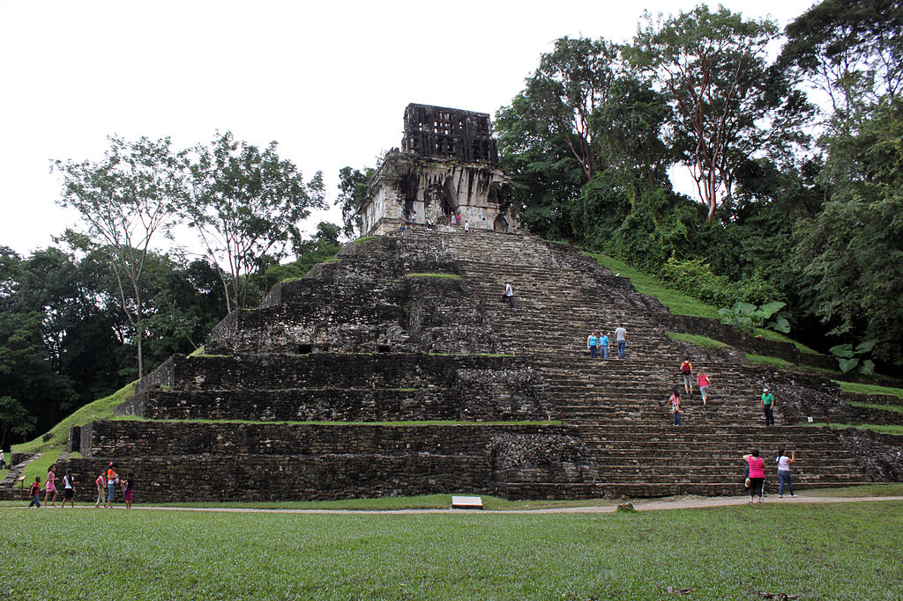
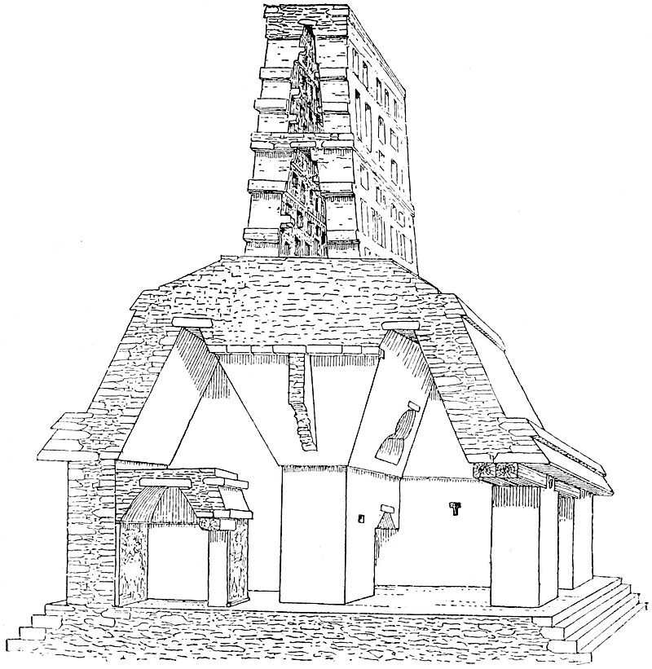
Temple of the cross, Chiapas, Mexico

Slide 20
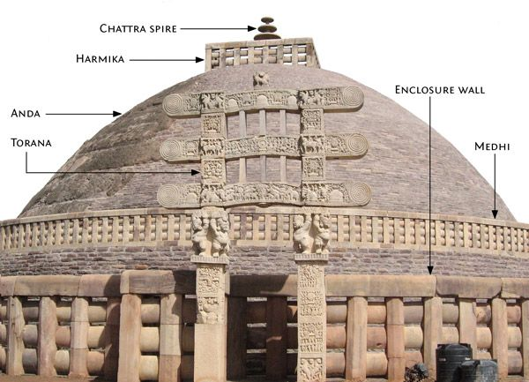
The Great stupa, sanchi, india

Slide 21
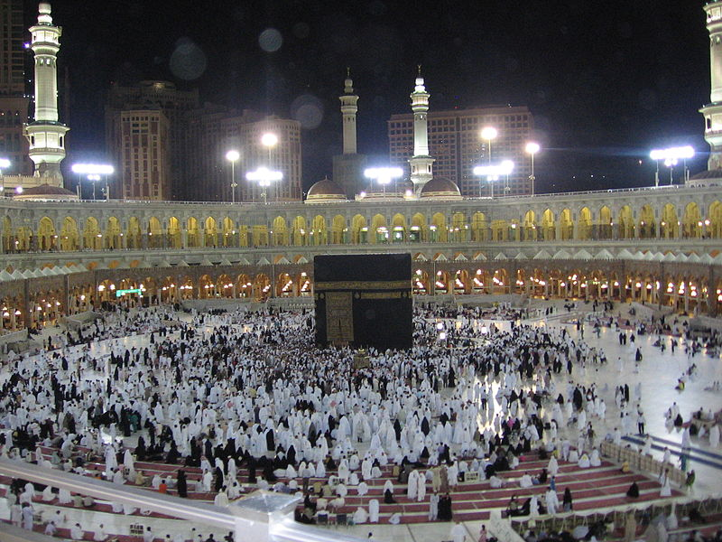
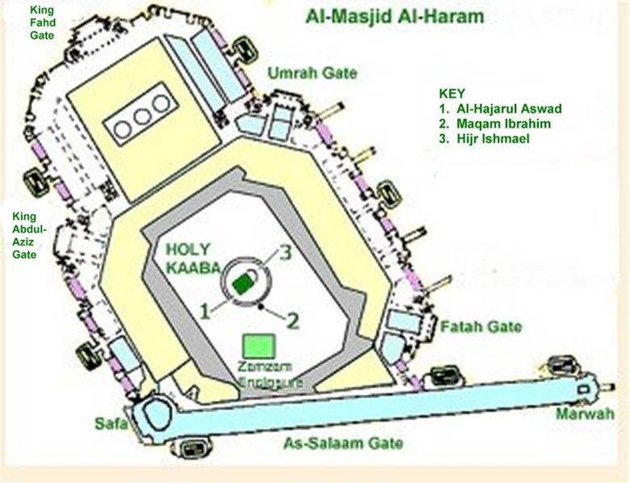
The KAABA, mecca

Slide 22
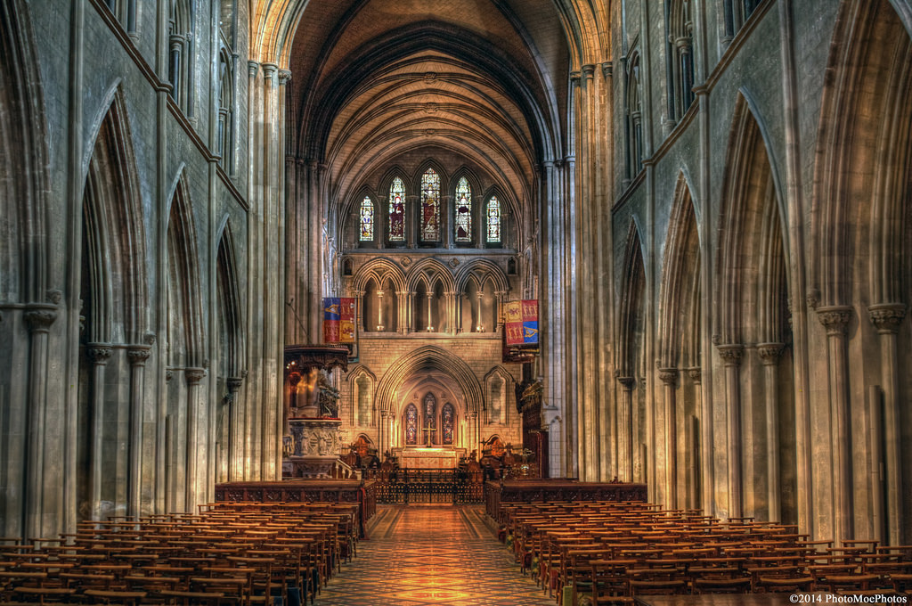
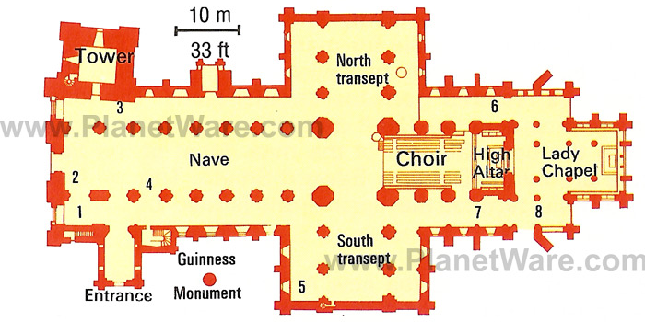
St. Patrick’s cathedral, dublin

Slide 23
Boundaries: Sacred vs. Profane
First established by God, Gen. 3:24
Inherent to construction of tabernacle and temple
Expressed in nearly every religious or ceremonial structure
  Purpose: to limit access to the sacred
    To those who are worthy/initiated
    For protection against the deity
Christ broke down walls of separation
  Between man and man, Eph. 2:11-22
  Between man and God, Heb. 10:19-22
Are there still boundaries we should observe in our worship?

Slide 24
Definition and History of Worship
Lesson 1

Slide 25
Class schedule
Lesson | Class Date
1. History and Definition of Worship | 23-Jul
1. History and Definition of Worship | 26-Jul
Lesson 1 or 2 Spillover | 30-Jul
2. Worshiping in Spirit and in Truth | 2-Aug
2. Worshiping in Spirit and in Truth | 6-Aug
3. Covenant Service and Worship | 9-Aug
NO CLASS – CARL BALLARD SPEAKING | 13-Aug
4. Decorum in Worship | 16-Aug
5. Worship in Song | 20-Aug
6. Worship in the Lord's Supper | 23-Aug
7. Worship in Prayer | 27-Aug
8. Worship in the Collection | 30-Aug
9. Worship in Scripture Reading & Preaching | 3-Sep
10. Review | 6-Sep

Slide 26
Finding a definition of worship
The human experience of worship
  Two views of worship
  Worship words
  Markers of worship across time and culture
  The corruption of God-given worship
The object of our worship
  Worship and God’s self-revelation
  God’s self-revelation in the New Covenant
Why we worship
  Response to God’s nature
  Communion with God
  Remembrance and celebration of covenant

Slide 27
Communion with the supernatural
Man was created for communion with God
  Compare Gen. 3:8 and Lev. 26:12
That communion was lost in the Fall
  Gen. 3:22-24; 4:26
Communion with God is the heart of every covenant God has made
  Gen. 17:7; Exo. 19:5-6; Jer. 31:33-34; Rev. 21:3
In worship, we recall the communion of Creation and look forward to the communion of the New Creation

Slide 28
Boundaries: Sacred vs. Profane
First established by God, Gen. 3:24
Inherent to construction of tabernacle and temple
Expressed in nearly every religious or ceremonial structure
  Purpose: to limit access to the sacred
    To those who are worthy/initiated
    For protection against the deity
Christ broke down walls of separation
  Between man and man, Eph. 2:11-22
  Between man and God, Heb. 10:19-22
Are there still boundaries we should observe in our worship?

Slide 29

Sacrificial offerings
The first recorded act of worship, Gen. 4:3-7
Purpose: to offer something of value to the deity to demonstrate the value of the deity to the worshiper

Slide 30
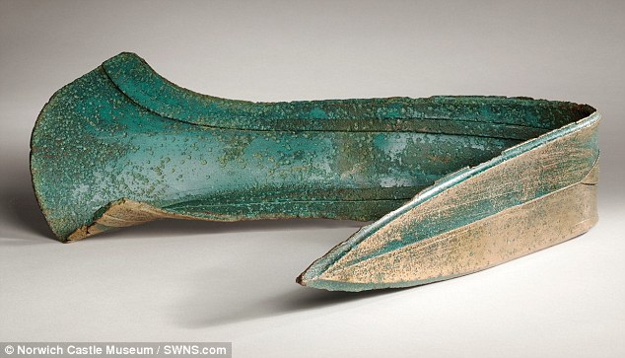
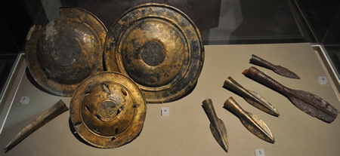


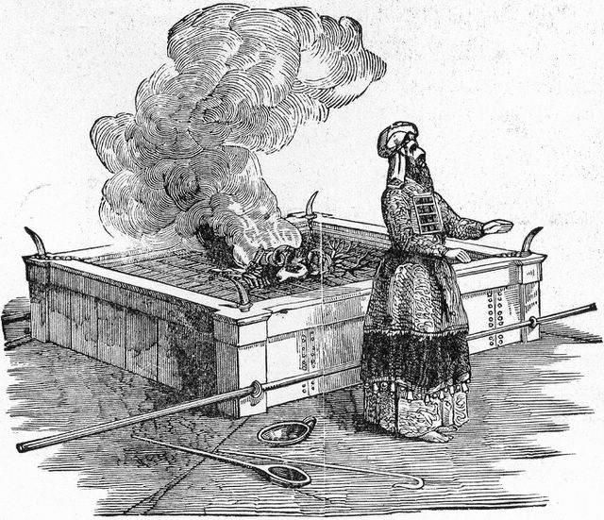
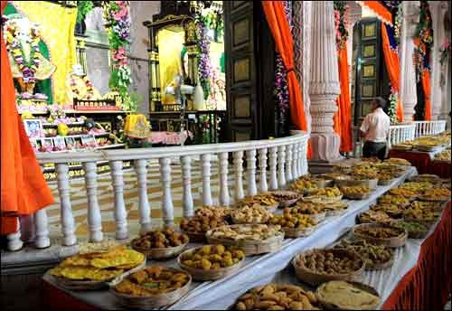
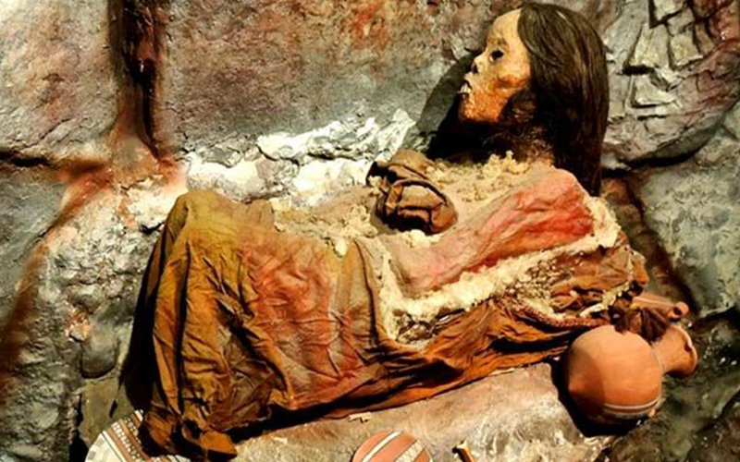
Sacrifices

Slide 31
Sacrificial offerings
The first recorded act of worship, Gen. 4:3-7
Purpose: to offer something of value to the deity to demonstrate the value of the deity to the worshiper
Sacrifices for sin not mentioned until the Law (cf. Gen. 8:20; 12:7; 35:7, etc.)
  Exception: Job 1:5 & 42:8?
God introduced substitutionary sacrifice (Lev. 17:11), which Jesus perfected (Heb. 10:10)
Do we still have sacrifices in our worship today?

Slide 32
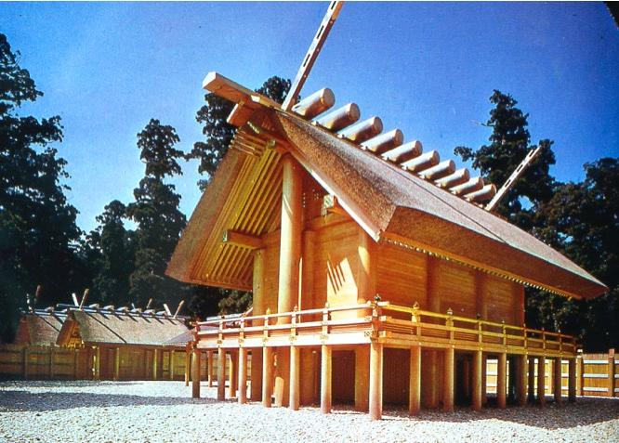
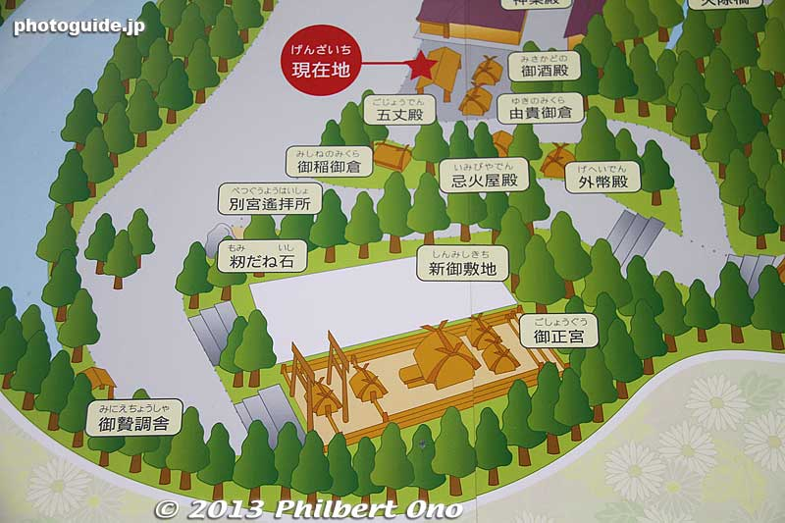
Ise Jingu Grand Shrine, Naiku, Japan

Slide 33
Ritual (correct procedure)
The first worship was marred by incorrect procedure, Gen. 4:3-7
Correct procedure was essential to Jewish worship, Exo. 25:40; Lev.16-17
In world religions, “a sequence of activities involving gestures, words, and objects…designed to influence preternatural entities or forces on behalf of the actors' goals and interests.” (Turner)
Is ritual still important in our worship?
Notes:
Colossians 2:16-17; 20-23 have been read to say that ritual is no longer of any value because “the substance is Christ,” therefore we can do whatever we want.

Slide 34
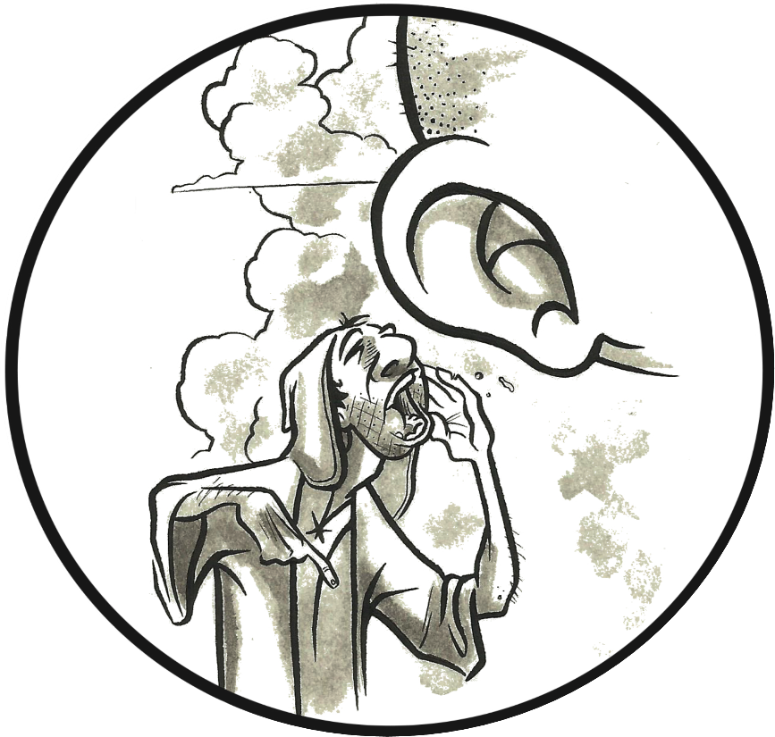
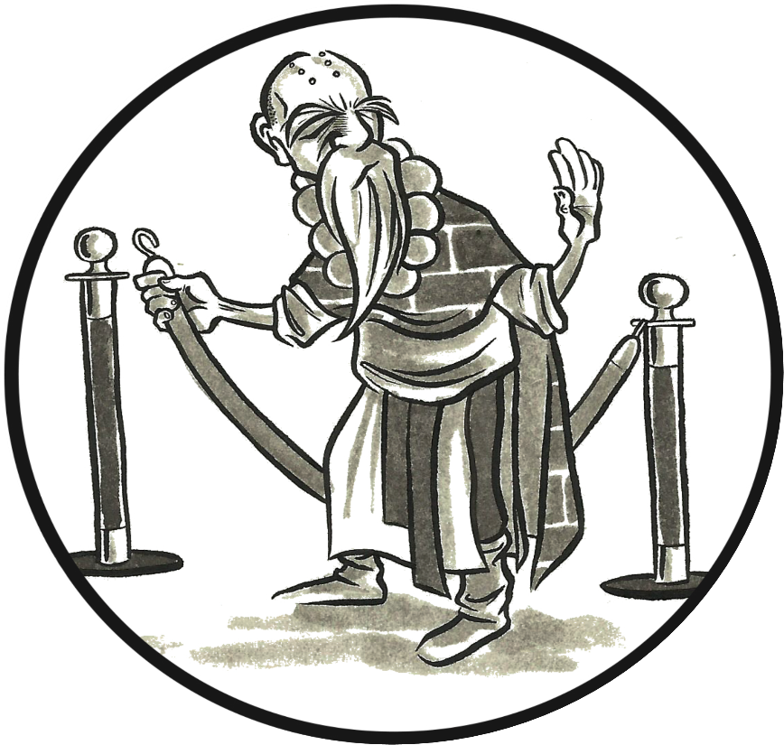
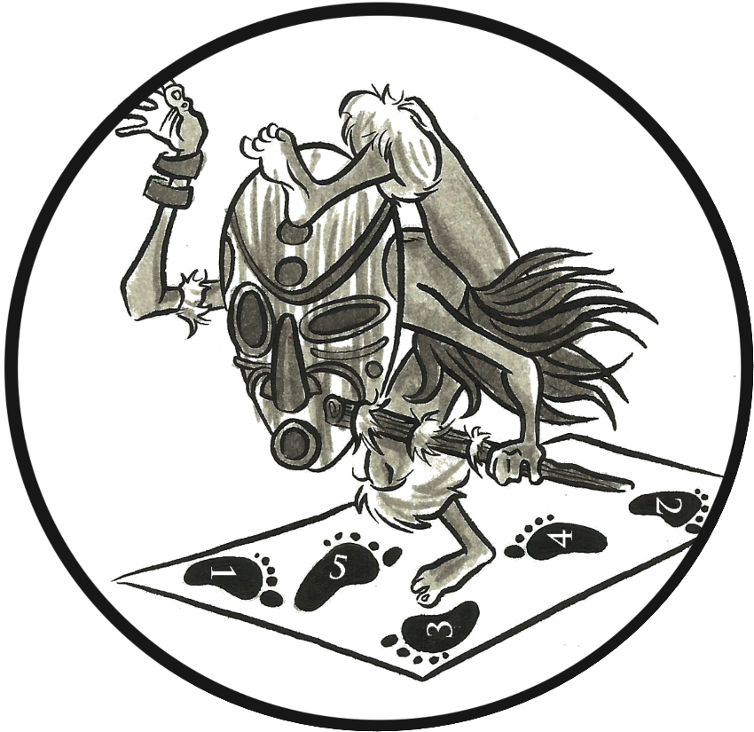

Markers of worship
Communion with
the Supernatural
Boundaries between
Sacred & Profane
Ritual
(Correct Procedure)
Sacrificial Offerings

Slide 35
LOOK AT JUDE 11-12.
What do Cain’s way, Baalam’s error, and Korah’s rebellion have in common? Why would Jude choose these examples? In the context of the book, what point is he making?

Slide 36
Corruption of worship - jude 11-12
The way of Cain - an unacceptable sacrifice
  By faith Abel offered to God a more acceptable sacrifice than Cain, through which he was commended as righteous, God commending him by accepting his gifts. (Heb. 11:4)
The error of Balaam - corrupted procedure
  While Israel lived in Shittim, the people began to whore with the daughters of Moab. These invited the people to the sacrifices of their gods, and the people ate and bowed down to their gods. So Israel yoked himself to Baal of Peor. And the anger of the LORD was kindled against Israel. (Num. 25:1-3)
The rebellion of Korah - broken boundaries between sacred and profane
  They assembled themselves together against Moses and against Aaron and said to them, “You have gone too far! For all in the congregation are holy, every one of them, and the LORD is among them. Why then do you exalt yourselves above the assembly of the LORD?” (Num. 16:3)
Jude claims that these false teachers have corrupted their own worship, which could corrupt the readers’ worship, and their salvation (communion with God), v.12

Slide 37
In romans 1:18-32, How are moral corruption and corruption of worship connected to one another? Which influences the other? Which comes first? Consider also Genesis 4:3-8.

Slide 38
Corruption in RomANS 1
DID NOT GLORIFY GOD/
GIVE THANKS
v.21
HEARTS DARKENED/
BECAME FOOLS
vv.21-22
GOD GAVE THEM UP
CORRUPTED THEIR WORSHIP (IDOLS)
vv.23; 25
UNCLEAN ACTS/
VILE PASSIONS
vv.24; 26-27
GOD GAVE THEM UP
REFUSED KNOWLEDGE OF GOD
vv.28
REPROBATE MIND
(UNABLE TO PLEASE GOD)
vv.28-32
PERSONAL EVIL
vv.29-31
SOCIETAL EVIL
v.32

Slide 39
Finding a definition of worship
The human experience of worship
  Two views of worship
  Worship words
  Markers of worship across time and culture
  The corruption of God-given worship
The object of our worship
  Worship and God’s self-revelation
  God’s self-revelation in the New Covenant
Why we worship
  Response to God’s nature
  Communion with God
  Remembrance and celebration of covenant

Slide 40
The object of our worship
God’s covenants with His people, and the worship He expects, are founded on revelations of Himself
  God spoke His names to Abraham, Isaac, and Jacob
    El Shaddai, the God who makes promises, Genesis 17:1
    Yahweh, the God who keeps promises, Genesis 15:7
  God revealed Himself in smoke and fire to Moses and Israel at Sinai
    As Yahweh, keeping His promises to their fathers, Exodus 6:2-8
    This more detailed revelation signaled a new covenant between God and man, Exodus19-20
  God amplified His self-revelation to the prophets during the Exile, Isaiah 6; Ezekiel 1
    To confirm that Yahweh would keep the promises to the fathers and to David, Isaiah 11; Jeremiah 33
    To look forward to the coming new covenant, Jeremiah 31:31-37
  God revealed Himself fully through Jesus Christ, the express image of the Father, Hebrews 1:3
    The worship associated with this covenant would be “in spirit and in truth,” John 4:23
Our worship should be based on and enhanced by our more perfect knowledge of God, Philippians 3:3

Slide 41
What do you think causes the living creatures and the elders to worship as they do in Revelation 4?
How do they worship so continuously and devotedly?
Why is God described in these terms?

Slide 42
What are some reasons and occasions that we might worship god?

Slide 43
Occasions/reasons for worship
When we realize (more/again) who God is, Revelation 4:2-11
When it’s the right time to worship, Genesis 4:3
When God seems to have abandoned us, Job 1:20
When God keeps His promises, Genesis 12:7
When God makes a promise to us, Genesis 28:16-22
When God demonstrates His power, Exodus 15:1-21
When we prosper, Deuteronomy 26:10
When we want to remember God’s promises/covenant, 1 Sam. 7:5-12
When we want to commune with God, 1 Samuel 15:24-31

Slide 44
Why do we worship?
Not because God needs it or is enhanced by it, Psalm 50:9-13; Acts 17:24-25
Because we need to be reminded of:
  God’s nature as revealed in Christ
  God’s work in history and our lives
  Our covenant with Him
  God’s promises
  What He requires of us (moral behavior)
Because we need each other’s help in this work, Hebrews 10:19-25
We are the primary beneficiaries of our worship.

Slide 45
What is worship?
True worship is the celebration of being in covenant fellowship with the sovereign and holy triune God,
by means of
the reverent adoration and spontaneous praise of God’s nature and works,
the expressed commitment of trust and obedience to the covenant responsibilities, and
the memorial reenactment of entering into covenant through ritual acts,
all with the confident anticipation of the fulfillment of the covenant promises in glory.
Allen P. Ross
Recalling the Hope of Glory

Slide 46
Markers of worship
Communion with
the Supernatural
Boundaries between
Sacred & Profane
Ritual
(Correct Procedure)
Sacrificial Offerings

Slide 47
Class schedule
Lesson | Teacher | Class Day/Date
1. Definition and History of Worship | Mason | Sun 11-Sep
1. Definition and History of Worship | Mason | Wed 14-Sep
2. Worshiping in Spirit and in Truth | Mason | Sun 18-Sep
2. Worshiping in Spirit and in Truth | Mason | Wed 21-Sep
3. Covenant Service and Worship | Mason | Sun 25-Sep
4. Decorum in Worship | Mason | Wed 28-Sep
5. Worship in Song | Mason | Sun 2-Oct
6. Worship in the Lord's Supper | Mason | Wed 5-Oct
7. Worship in Prayer | Jack | Sun 9-Oct
8. Worship in the Collection | Jack | Wed 12-Oct
9. Worship in Scripture Reading & Preaching | Mason | Sun 16-Oct
Buffer Class Period | TBD | Wed 19-Oct
No Class - Gospel Meeting |  | Sun 23-Oct
10. Review | Mason | Wed 26-Oct

Slide 48
Definition and History of Worship
Lesson 1

Slide 49
Worshiping in spirit and in truth
Lesson 2

Slide 50
“in spirit and in truth”
The context of the passage, John 4:7-29
  What is Jesus telling the woman at the well?
  What contrasts is he drawing?
Spirit and Truth
  Enthusiasm and Correct Procedure?
  Fleshly ordinances vs spiritual
  Mediated worship in the Old and New Testaments
  The fuller revelation of God in Christ
The Markers of Worship in New Testament worship
  What has been superseded
  What remains

Slide 51
The context of john 4:23-24
Jesus offers the woman living water, but asks her to call her husband
  She asks a theological question to distract Him, v.20
  In the discussion that follows, Jesus is guiding her back to the main subject: He is from God
    v.10: “If you knew the gift of God, and who it is who is saying to you, ‘Give me a drink,’ you would have asked him, and he would have given you living water.”
    v.25-26: “The woman said to him, ‘I know that Messiah is coming (he who is called Christ). When he comes, he will tell us all things.’ Jesus said to her, ‘I who speak to you am he.’”
The woman’s question: Where is the right place to worship?
  Jesus is unequivocal in his answer:
    You worship what you do not know, v.22 (in other words, “you’re wrong”)
    But soon the location of worship won’t matter at all, vv.21, 23-24
  Note the contrasts Jesus draws:
    “worship what you do not know” vs. “worship in truth” (ignorance vs. knowledge)
    “worship in this mountain/Jerusalem” vs. “worship in spirit” (physical vs. spiritual)
  Jesus’ conclusion: “You can know that I am from God because of what I reveal.”

Slide 52
Find passages in the Old Testament where God asked for whole-hearted worship.
Find passages where God emphasizes the need for worship that is according to the pattern He ordained.

Slide 53
Worshiping in spirit and in truth
Lesson 2

Slide 54
Class schedule
Lesson | Teacher | Class Day/Date
1. Definition and History of Worship | Mason | Sun 11-Sep
1. Definition and History of Worship | Mason | Wed 14-Sep
2. Worshiping in Spirit and in Truth | Mason | Sun 18-Sep
2. Worshiping in Spirit and in Truth | Mason | Wed 21-Sep
3. Covenant Service and Worship | Mason | Sun 25-Sep
4. Decorum in Worship | Mason | Wed 28-Sep
5. Worship in Song | Mason | Sun 2-Oct
6. Worship in the Lord's Supper | Mason | Wed 5-Oct
7. Worship in Prayer | Jack | Sun 9-Oct
8. Worship in the Collection | Jack | Wed 12-Oct
9. Worship in Scripture Reading & Preaching | Mason | Sun 16-Oct
Buffer Class Period | TBD | Wed 19-Oct
No Class - Gospel Meeting |  | Sun 23-Oct
10. Review | Mason | Wed 26-Oct

Slide 55
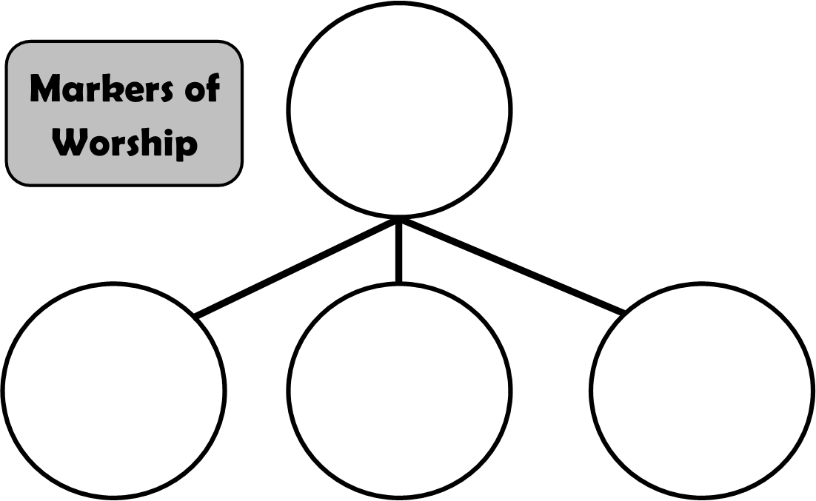
Communion with
the Supernatural
Boundaries between
Sacred & Profane
Ritual
(Correct Procedure)
Sacrificial Offerings

Slide 56
“in spirit and in truth”
The context of the passage, John 4:7-29
  What is Jesus telling the woman at the well?
  What contrasts is he drawing?
Spirit and Truth
  Enthusiasm and Correct Procedure?
  Fleshly ordinances vs spiritual
  Mediated worship in the Old and New Testaments
  The fuller revelation of God in Christ
The Markers of Worship in New Testament worship
  What has been superseded
  What remains

Slide 57
enthusiasm and procedure
Enthusiastic worship (not just going through the motions)
  Genesis 4:4-5? – And the LORD had regard for Abel and his offering, but for Cain and his offering he had no regard. So Cain was very angry, and his face fell.
  1 Samuel 15:22 – Has the LORD as great delight in burnt offerings and sacrifices, as in obeying the voice of the LORD? Behold, to obey is better than sacrifice, and to listen than the fat of rams.
  Malachi 1:6-8 - But you say, ‘How have we despised your name?’ By offering polluted food upon my altar. But you say, ‘How have we polluted you?’ By saying that the LORD's table may be despised. When you offer blind animals in sacrifice, is that not evil? And when you offer those that are lame or sick, is that not evil? Present that to your governor; will he accept you or show you favor? says the LORD of hosts.
  See also Psalm 51:16-19; Isaiah 1:10-17
Correct Procedure (what God has commanded)
  Genesis 4:4-5?
  Leviticus 10:1-2 (Nadab and Abihu)
  Numbers 16:35 – And fire came out from the Lord and consumed the 250 men offering the incense.
  Deuteronomy 4:2 – You shall not add to the word that I command you, nor take from it, that you may keep the commandments of the LORD your God that I command you.

Slide 58
side 1: What does 2 Corinthians 3:7-18 say Christ came to remove from the Jews’ hearts? What do you think this represents? side 2: What does John 1:1-18 say Christ came to earth to make known to us?

Slide 59
fleshly ordinances vs spiritual
God gave the Israelites the ordinances (worship and covenant) that they needed to guide them to a fuller knowledge
  Called “bondage of the rudiments of the world,” Galatians 4:1-3
  Imposed until a time of reformation, Hebrews 9:10
  A shadow of things to come, Colossians 2:16-23
  They (and the whole world) needed this kind of worship, Exodus 32
  The world needed a “school bus driver” to bring us to Christ, Galatians 3:24
Christ has given us new and better ordinances
  We were slaves; now we are children of God, Galatians 4:4-7
  Our confidence is not in the [fleshly ordinances], Philippians 3:2-3
  Hebrews 9:1-13; 10:19-25
  Our ordinances make us more like Christ, Ephesians 4:11-16
    They make our primary communion spiritual again, vv.17-32

Slide 60
Mediated worship
All relationships with God require an access point
  Usually for God’s communication with man, Galatians 3:19
    Also for sacrifices and gifts to God, Hebrews 8:3-4
  Communication with God (prayer, vows, etc.) have always been unmediated
All worship and covenants since the garden have been mediated
  Head of family, Job 1:5; Genesis 12:1-7
  More righteous people, Job 42:8; 1 Samuel 15:22ff
  Priesthood, Genesis 14:18; Numbers 3:1-10
The problem with these mediators
  They are subject to all the weaknesses of those they mediate for
    They would die, and need replacements, Hebrews 7:23
    They had to offer sacrifices for their own sins, Hebrews 7:27
  They constitute another boundary or separation between God and man, Heb. 8:7-12

Slide 61
Mediator of a better covenant
Christ was not subject to the weaknesses of other priests
  Does not die, Hebrews 7:23-24
  Was tempted, but without sin, Hebrews 4:15
  Can sympathize with our weaknesses while maintaining His holiness, ibid.
Christ is with the Father, and is therefore a more perfect mediator, Hebrews 8:1-2
  Declared the Father to us as one “who is in the bosom of the Father,” John 1:18
  Speaks as a son, rather than a servant, Hebrews 7:28
  “Lives to make intercession,” Hebrews 7:25 – i.e.- this is His job
When we worship, we approach God through our mediator
  Why the Lord’s Supper is the center of our worship
    Commemorates the sacrifice that inaugurated the covenant, 1 Corinthians 11:25
    Celebrates the blood that atones for our sins (and makes us clean to approach God), Hebrews 9:12
  Yet, our “mediator” gives us direct access to God

Slide 62
List some similarities and differences in the appearances of God in Exo. 18-19/Deut. 5; Ezekiel 1/Isaiah 6; and the Transfiguration (Matthew 17/Mark 9/Luke 9)

Slide 63
Worshiping in spirit and in truth
Lesson 2

Slide 64
Class schedule
Lesson | Teacher | Class Day/Date
1. Definition and History of Worship | Mason | Sun 11-Sep
1. Definition and History of Worship | Mason | Wed 14-Sep
2. Worshiping in Spirit and in Truth | Mason | Sun 18-Sep
2. Worshiping in Spirit and in Truth | Mason | Wed 21-Sep
3. Covenant Service and Worship | Mason | Sun 25-Sep
3. Covenant Service and Worship | Mason | Wed 28-Sep
4. Decorum in Worship | Mason | Sun 2-Oct
5. Worship in Song | Mason | Wed 5-Oct
6. Worship in the Lord's Supper | Mason | Sun 9-Oct
7. Worship in Prayer | Jack | Wed 12-Oct
8. Worship in the Collection | Jack | Sun 16-Oct
9. Worship in Scripture Reading & Preaching | Mason | Wed 19-Oct
No Class - Gospel Meeting |  | Sun 23-Oct
10. Review | Mason | Wed 26-Oct

Slide 65
Communion with
the Supernatural
Boundaries between
Sacred & Profane
Ritual
(Correct Procedure)
Sacrificial Offerings

Slide 66
worship in spirit and in truth worship according to spiritual ordinances, informed by an accurate knowledge of god as declared by Jesus Christ

Slide 67
“in spirit and in truth”
The context of the passage, John 4:7-29
  What is Jesus telling the woman at the well?
  What contrasts is he drawing?
Spirit and Truth
  Enthusiasm and Correct Procedure?
  Fleshly ordinances vs spiritual
  Mediated worship in the Old and New Testaments
  The fuller revelation of God in Christ
The Markers of Worship in New Testament worship
  What has been superseded
  What remains

Slide 68
List some similarities and differences in the appearances of God in Exo. 18-19/Deut. 5; Ezekiel 1/Isaiah 6; and the Transfiguration (Matthew 17/Mark 9/Luke 9)

Slide 69
Revelation of God in christ
Source of Light
  He that follows me will not walk in the darkness, but will have the light of life, John 8:12
  The light of the gospel of the glory of Christ, who is the image of God, 2 Corinthians 4:4
Surrounded by Cloud
  And even if our gospel is veiled, it is veiled to those who are perishing. In their case the god of this world has blinded the minds of the unbelievers, to keep them from seeing the light of the gospel of the glory of Christ, who is the image of God, 2 Corinthians 4:3-4
Speaks the Truth (and is the source of it)
  A voice from the cloud said, “This is my beloved Son, with whom I am well pleased; listen to him,” Matthew 17:5
Christ is the most real depiction of God
  The LORD spoke with you face to face at the mountain, out of the midst of the fire, Deuteronomy 5:4
  Such was the appearance of the likeness of the glory of the LORD, Ezekiel 1:28
  No one has ever seen God; the only [begotten] God, who is at the Father's side, he has made him known, John 1:18
  In him the whole fullness of deity dwells bodily, Colossians 2:9
Fearful worship is the natural and obvious response, Ezekiel 1:28; Matthew 17:6; Deuteronomy 5:5
Yet, “we are very bold. […] We all, with unveiled face, beholding the glory of the Lord, are being transformed into the same image from one degree of glory to another.”

Slide 70
Markers of worship in the nT
Boundaries between Sacred and Profane
  Nothing sacred about the place of worship, so no need to protect it, John 4:21-23
  What boundaries should we think about regarding worship?
    Behavior in the building (children, eating, playing)
EXAMPLE

Slide 71
Markers of worship in the nT
Boundaries between Sacred and Profane
  Nothing sacred about the place of worship, so no need to protect it, John 4:21-23
  What boundaries should we think about regarding worship?
    Behavior in the building (children, eating, playing)
    What activities the group (or the elders) permit in the building (weddings, funerals, etc.)
    Sin in the church, 1 Corinthians 6
  Criteria: to demonstrate in our choices the new boundaries between our sacred lives and the profane world, Ephesians 4:17-32
Sacrificial Offerings
  Our sacrifice has been offered once for all, so no need for continual offerings, Hebrews 9:12
  What sacrifices should we think about in worship?
    Offering (contribution), Philippians 4:18
    Lord’s Supper (remembrance and proclamation of the sacrifice), 1 Corinthians 11:26-27
    Prayers, Revelation 5:8
    Singing/Praising, Hebrews 13:15
  Criteria: to demonstrate in every action that we “fill up…what is lacking in Christ’s sufferings,” Col.1:24

Slide 72
Markers of worship in the nT
Ritual (Correct Procedure)
  We are not bound by food, or drink, or festivals, new moons, or Sabbath, since the substance belongs to Christ, Colossians 2:16-18
  What ritual or procedural matters should we think about in worship?
    Not confusing or discouraging anyone, especially visitors, 1 Corinthians 14:24
    Convicting anyone who worships with us that God is among us (that we are communing with God), v.25
    Preventing and limiting the indulgence of the flesh, Colossians 2:20-23
  Criteria: to demonstrate by our actions that God (who is a God of peace, not confusion) is the originator and object of our worship, not ourselves, so that everyone may learn who God is and what He requires of them, 1 Corinthians 14:40

Slide 73
Spirit & truth: conclusions
Not a description of how we worship, but of the worship itself
We worship according to spiritual ordinances informed by the fuller revelation of God in Christ Jesus
  Christ is our perfect high priest, offering the perfect sacrifice of His blood
  We approach the throne of God inside the Most Holy Place with boldness
Our worship is spiritually focused, not physically focused
  We have been shown the Father through Jesus, a more intimate and spiritual revelation
  We should not try to gratify our fleshly desires in worship
    To be entertained, 1 Corinthians 11:21
    To be intellectually stimulated, Acts 17:21
Our goals in worship:
  To honor God
  To learn about God
  To learn and encourage moral behavior individually
  To “stir one another up to love and good works”

Slide 74
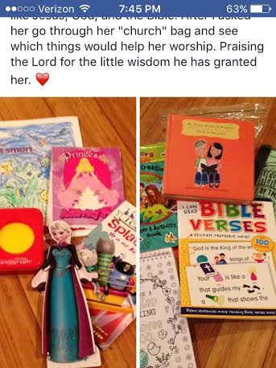

Slide 75
New covenant and worship
I. Christ’s Ministry for Access to God is Superior to the Old Covenant Ministry (7:1–10:18)
1. Christ’s Superiority as High Priest Necessary for a Better Covenant (7:11-8:6)
2. A More Real Covenant (8:7-13)
a. The Inadequacy of the Old Covenant (8:7-9)
b. The Adequacy of the New Covenant (8:10-13)
3. A More Real Sanctuary (9:1-12)
a. The Imperfection of the Earthly Sanctuary (9:1-10)
b. The Perfection of the Heavenly Sanctuary (9:11-12)
4. A Perfect Sacrifice (9:13–10:18)
a. The Necessity of Shed Blood (9:13-22)
b. The Purification of the Heavenly Sanctuary (9:23-28)
c. The Permanence of the Sacrifice (10:1-18)
1) The Inadequacy of the Levitical Sacrifices (10:1-9)
2) The Adequacy of Christ’s Sacrifice (10:10-18)
II. How We Respond to the Better Covenant and Christ’s Superior Ministry (10:19–13:17)
1. Exhortation to Enter the New Sanctuary, i.e.- Worship (10:19-31)
a. Draw Near to the Most Holy Place (where God is) in Faith (10:19-22)
b. Hold Fast to the Confession of our Hope (in God’s nature) (10:23)
c. Stir Up One Another to Moral Action and Love (10:24-25)

Slide 76
Why do you think the New Testament writers use the language of worship to describe our relationship to God and our behavior in the new covenant?

Slide 77
Covenant service and worship
Lesson 3

Slide 78
Class schedule
Lesson | Teacher | Class Day/Date
1. Definition and History of Worship | Mason | Sun 11-Sep
1. Definition and History of Worship | Mason | Wed 14-Sep
2. Worshiping in Spirit and in Truth | Mason | Sun 18-Sep
2. Worshiping in Spirit and in Truth | Mason | Wed 21-Sep
3. Covenant Service and Worship | Mason | Sun 25-Sep
3. Covenant Service and Worship | Mason | Wed 28-Sep
4. Decorum in Worship | Mason | Sun 2-Oct
5. Worship in Song | Mason | Wed 5-Oct
6. Worship in the Lord's Supper | Mason | Sun 9-Oct
7. Worship in Prayer | Jack | Wed 12-Oct
8. Worship in the Collection | Jack | Sun 16-Oct
9. Worship in Scripture Reading & Preaching | Mason | Wed 19-Oct
No Class - Gospel Meeting |  | Sun 23-Oct
10. Review | Mason | Wed 26-Oct

Slide 79
Communion with
the Supernatural
Boundaries between
Sacred & Profane
Ritual
(Correct Procedure)
Sacrificial Offerings

Slide 80
Definition of worship
True worship is the celebration of being in covenant fellowship with the sovereign and holy triune God,
by means of
the reverent adoration and spontaneous praise of God’s nature and works,
the expressed commitment of trust and obedience to the covenant responsibilities, and
the memorial reenactment of entering into covenant through ritual acts,
all with the confident anticipation of the fulfillment of the covenant promises in glory.
Allen P. Ross
Recalling the Hope of Glory

Slide 81
Covenant service and worship
Use of worship words to describe the covenant
  Worship as the expression of our covenant relationship
  Two wrong views about the relationship between covenant behavior and public worship
Worship vs. Covenant (Moral) Behavior
  Biblical examples of separating of the two
  Definition of terms in Romans 12:1-2
  Covenant behavior is the foundation of our worship
  Worship produces covenant behavior
Wrong views of the connection between corporate worship and covenant relationship
  Ignore clear connection between worship and moral behavior
  Conflate corporate and individual worship

Slide 82
Worship words
Worship words are often used to describe the New Covenant
  Heb. 9:11-15 – High Priest/sacrifice language to describe Christ mediating the New Covenant
  1 Cor. 10:14-22 – Sacrifice/Lord’s Supper language to describe fellowship with idols or Christ
  Ephesians 2:14-15 – Temple structure and worship regulations to describe Christ’s uniting Jew and Gentile in the New Covenant
  Does Romans 12:1 fit this pattern? I appeal to you therefore, brothers, by the mercies of God, to present your bodies as a living sacrifice, holy and acceptable to God, which is your spiritual worship.
Why are worship words used to describe our covenant?
  Acts of worship are clear visual representations of our communion with God
  Worship is the fullest expression of our covenant relationship with God, Heb. 10:19-25
  Worship recalls the establishment of the covenant and previews its fulfillment, 1 Cor. 11:23-26

Slide 83
Definition of worship
True worship is the celebration of being in covenant fellowship with the sovereign and holy triune God,
by means of
the reverent adoration and spontaneous praise of God’s nature and works,
the expressed commitment of trust and obedience to the covenant responsibilities, and
the memorial reenactment of entering into covenant through ritual acts,
all with the confident anticipation of the fulfillment of the covenant promises in glory.
Allen P. Ross
Recalling the Hope of Glory

Slide 84
Worship words
Worship words are often used to describe the New Covenant
  Heb. 9:11-15 – High Priest/sacrifice language to describe Christ mediating the New Covenant
  1 Cor. 10:14-22 – Sacrifice/Lord’s Supper language to describe fellowship with idols or Christ
  Ephesians 2:14-15 – Temple structure and worship regulations to describe Christ’s uniting Jew and Gentile in the New Covenant
  Does Romans 12:1 fit this pattern? I appeal to you therefore, brothers, by the mercies of God, to present your bodies as a living sacrifice, holy and acceptable to God, which is your spiritual worship.
Why are worship words used to describe our covenant?
  Acts of worship are clear visual representations of our communion with God
  Worship is the fullest expression of our covenant relationship with God, Heb. 10:19-25
  Worship recalls the establishment of the covenant and previews its fulfillment, 1 Cor. 11:23-26
Wrong views of the relationship between covenant service and worship
  Worship is the entirety of our covenant service – “Sunday/Wednesday Christianity”
  Everything we do glorifies God, so discrete worship is unimportant – “Life as worship”

Slide 85
Worship vs. Covenant behavior
Biblical examples of a distinction:
  Abraham: Genesis 22:5
  Ethiopian Eunuch: Acts 8:27
  Conclusion: worship is a distinct act separate from our covenant behavior
What about Romans 12:1?
  Words translated “spiritual worship” in ESV are logikos latreia
  Other translations:
    true and proper worship – NIV
    reasonable service – KJV
    truly the way to worship him – NLT
    spiritual service – ASV
    spiritual service of worship – NASB
    intelligent service - YLT

Slide 86
Worship words
Proskuneo: to “[prostrate] oneself before a person and [kiss] his feet, the hem of his garment, the ground, etc.” (Ardnt, Gingrich, & Danker; qtd in Jividen)
  Metaphorical description of the attitude of humility and recognition of worth required for worship, 1 Cor. 14:25
  Best description: the attitude and pattern of behavior of reverence
  Best synonym: venerate
Latreuo: to engage in the specific rituals of worship, especially sacrifice (Kittel, qtd. in Jividen)
  Luke 2:37: [Anna] did not depart from the temple, worshiping with fasting and prayer night and day.
  Best synonym: liturgize
Both words are used in Matt. 4:10: You shall venerate the Lord your God and him only shall you liturgize.

Slide 87
Worship vs. Covenant behavior
Biblical examples of a distinction:
  Abraham: Genesis 22:5
  Ethiopian Eunuch: Acts 8:27
  Conclusion: worship is a distinct act separate from our covenant behavior
What about Romans 12:1?
  Words translated “spiritual worship” in ESV are logikos latreia
  “the sacrifice that makes the most sense”
  Paul’s point in Romans 12 is that the only logical response to the great salvation God offers (chs.2-8) and the promise of punishment for disobedience (chs.9-11) is sacrificial submission to God
  The worship language in Romans 12 is a metaphor for our service to God

Slide 88
Worship vs. Covenant behavior
The validity and effectiveness of our worship depends on our covenant behavior
  Observing the Passover, Exodus 12:48
  Prayer, Mark 11:25
  Sacrifices, Matthew 5:23-24; Psalm 51:16-19
  All worship, and perhaps especially the Lord’s Supper, 1 Corinthians 10:21-22
Worship should produce and encourage covenant (moral) behavior
  Worshipping should help us evaluate our lives for sin and resolve to fix it (immediately if necessary), Matthew 5:23-24
  We gather together for corporate worship so we can encourage one another to behave consistently with the covenant, Hebrews 10:19-25
  Incorrect worship has the opposite effect, 1 Corinthians 11:30

Slide 89
Problems with limited views
“Life as Worship”
“Sunday-Wednesday”
They ignore the clear scriptural separation of covenant service (moral behavior, lifestyle) and worship
  Worship is not the whole of our covenant service toward God
  Covenant service is clearly distinguished from organized, ordered worship
Confuse corporate worship and individual worship
  Both types of worship are commanded for Christians
  Each has a specific use in building us up in our covenant service
They produce (and even encourage) moral laxness
  We feel our service is done if we attend worship, and may be prone to sin because “I did my job this week.”
  We may feel like we don’t need other Christians, and become morally inbred.

Slide 90
Decorum in worship
Lesson 4

Slide 91
Class schedule
Lesson | Teacher | Class Day/Date
1. Definition and History of Worship | Mason | Sun 11-Sep
1. Definition and History of Worship | Mason | Wed 14-Sep
2. Worshiping in Spirit and in Truth | Mason | Sun 18-Sep
2. Worshiping in Spirit and in Truth | Mason | Wed 21-Sep
3. Covenant Service and Worship | Mason | Sun 25-Sep
3. Covenant Service and Worship | Mason | Wed 28-Sep
4. Decorum in Worship | Mason | Sun 2-Oct
5. Worship in Song | Mason | Wed 5-Oct
6. Worship in the Lord's Supper | Mason | Sun 9-Oct
7. Worship in Prayer | Jack | Wed 12-Oct
8. Worship in the Collection | Jack | Sun 16-Oct
9. Worship in Scripture Reading & Preaching | Mason | Wed 19-Oct
No Class - Gospel Meeting |  | Sun 23-Oct
10. Review | Mason | Wed 26-Oct

Slide 92
Communion with
the Supernatural
Boundaries between
Sacred & Profane
Ritual
(Correct Procedure)
Sacrificial Offerings

Slide 93
Decorum in worship
Review: Purposes of Worship
  Why we worship
  Who benefits from our worship
Worship on the Vertical and Horizontal Planes
Clothing and the Human Condition
  Why we wear clothes
  How to dress for success in worship
Reverent Behavior
Markers of Worship in Dress and Behavior

Slide 94
Why do we wear clothes at all?

Slide 95
Why do we worship?
Not because God needs it or benefits from it, Psalm 50:9-13; Acts 17:24-25
Because we need to be reminded of:
  God’s nature as revealed in Christ
  God’s work in history and our lives
  Our covenant with Him
  God’s promises
  What He requires of us (moral behavior)
Because we need each other’s help in this work, Hebrews 10:19-25
We are the primary beneficiaries of our worship.

Slide 96
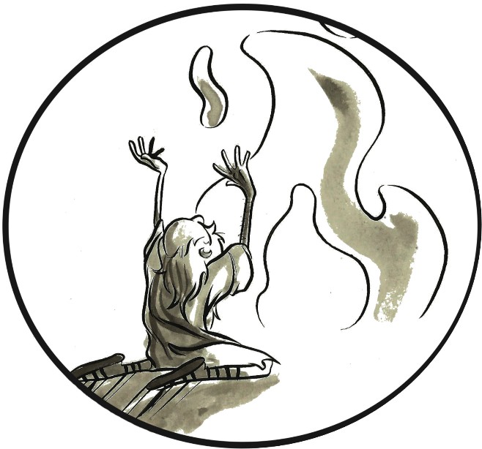
Vertical & horizontal Worship
GOD
Bible
TRUTH
TRUTH
Act of Worship
PRAISE

Slide 97
Vertical & horizontal Worship
GOD
TRUTH
PRAISE
TRUTH
TRUTH
PRAISE
PRAISE
Teach & Encourage
Teach & Encourage

Slide 98
Clothing and the human condition
Why we wear clothes
  To protect us from the weather
  To cover our nakedness, Genesis 3:7, 21
  To send a message about:
    Our bodies (pride, shame)
    Our sexual availability (positive or negative)
    Our wealth (jewelry, name brands, quality materials)
    Our loyalties (to brands, teams, causes, people, religions)
  In the end, mostly for others’ sakes

Slide 99
What is the obvious application of James 2:2-4?
Why do you think James has to warn the brethren about judging people based on how they are dressed?

Slide 100
Clothing and the human condition
Why we wear clothes
  To protect us from the weather
  To cover our nakedness, Genesis 3:7, 21
  To send a message about:
    Our bodies (pride, shame)
    Our sexual availability (positive or negative)
    Our wealth (jewelry, name brands, quality materials)
    Our loyalties (to brands, teams, causes, people, religions)
  In the end, mostly for others’ sakes
We determine people’s “worth” based on their clothing, James 2:2-4
  James has to tell Christians not to do it because it’s instinctive to read the messages people send and determine their worth according to our valuation of those messages
  We should consider this behavior in choosing our own dress

Slide 101
Clothing and the human condition
Dressing for success in worship
  “Bring your best to the Lord”?
    How do we determine “best”? Most expensive? Fanciest? Most comfortable?
    God doesn’t care what we wear
  Cultural norms are different from place to place, and always changing
    Don’t hold one location to another location’s standards
    Consider the past to not offend older folks
    Don’t focus too much on current fashion (save money and time)
    Don’t criticize new trends as inherently wrong
  Demonstrate purpose in your dress
    Dress to show your submission to God, not to fashion, 1 Corinthians 11:7-12
    Control the message you send – that you have come to worship
    Make your dress look intentional, not accidental
    Dress for what you might be called on to do at church
DON’T judge anyone based on their clothing, James 2:2-4

Slide 102
In 2 Samuel 6:16-22,
What is Michal’s objection to David’s dancing before the Lord? Is it a valid objection?
Why or why not?

Slide 103
Decorous behavior
    Decorous behavior is the mark of an “imitator of God,” Ephesians 5:1-21
      Our behavior indicates whether we are wise or foolish, v.17; Proverbs 14:16
We worship in spirit and in truth, John 4:23
  Application: anything that takes our minds off of the spiritual and onto the physical must be eliminated
    Specific application: Don’t distract anyone if you can help it.
    Specific application: Don’t be so easily distracted. (2 Samuel 6:22)
  Considerations about our behavior:
    People will (unfairly, sinfully) judge us based on how we (and our kids) behave at church
    What will demonstrate most clearly my intent to worship God? (2 Samuel 6:21)
    What will edify and encourage the most people?

Slide 104
Decorous behavior choices
    Getting up to leave during services (instead of meeting needs beforehand)
    Eating in the building
    Letting kids make noise/play during services
    Setting limits for kids in the building (running, making noise, etc.)
    Women wearing head coverings, 1 Corinthians 14
    Women speaking in Bible class, 1 Corinthians 14
    Selling or promoting a business in the building
    Deciding where in the auditorium to sit for worship/Bible study
    Looking like you’re alert and interested
    Choosing topics of conversation before/after services

Slide 105
Planes of worship
    Speaking to God (vertical upward)
      In thanksgiving, praise, petition, and expressions of trust through prayer and song
      In proclaiming our belief in Christ’s salvatory acts through the Lord’s Supper
      In thanksgiving and expressions of trust in making a contribution
    Listening to God (vertical downward)
      In learning His Word through song, reading of scripture, sermons/Bible classes
      In recalling and understanding Christ’s sacrifice for us in the Lord’s Supper
    Teaching and Admonishing One Another (horizontal)
      In singing (and indirectly through prayer and scripture reading)
      In proclaiming our belief in Christ’s salvatory acts through the Lord’s Supper
      In hearing fresh perspectives on God’s Word in sermons/Bible classes
      In setting/receiving examples of generosity in making a contribution

Slide 106
Markers of worship in decorum
Boundaries between Sacred and Profane
  Criteria: to demonstrate in our choices the new boundaries between our sacred lives and the profane world, Ephesians 4:17-32
  Think about creating a distinction between everyday life and worship in what you wear/how you act
    For the sake of your own relationship with God
    To show others your intention to honor God
Sacrificial Offerings
  Criteria: to demonstrate in every action that we “fill up…what is lacking in Christ’s sufferings,” Col.1:24
  Consider giving up your rights to wear/do whatever you want for others’ sakes, 1 Corinthians 8:8-9
Ritual (Correct Procedure)
  Criteria: to demonstrate by our actions that God (who is a God of peace, not confusion) is the originator and object of our worship, not ourselves, so that everyone may learn who God is and what He requires of them, 1 Corinthians 14:40
  Consider the patterns of dress and behavior where you worship
    Don’t buck the trend just to stir things up
    By your dress and behavior, set an example of coming to church to worship, learn, and edify

Slide 107
Worship in song
Lesson 5

Slide 108
Class schedule
Lesson | Teacher | Class Day/Date
1. Definition and History of Worship | Mason | Sun 11-Sep
1. Definition and History of Worship | Mason | Wed 14-Sep
2. Worshiping in Spirit and in Truth | Mason | Sun 18-Sep
2. Worshiping in Spirit and in Truth | Mason | Wed 21-Sep
3. Covenant Service and Worship | Mason | Sun 25-Sep
3. Covenant Service and Worship | Mason | Wed 28-Sep
4. Decorum in Worship | Mason | Sun 2-Oct
5. Worship in Song | Mason | Wed 5-Oct
6. Worship in the Lord's Supper | Mason | Sun 9-Oct
7. Worship in Prayer | Jack | Wed 12-Oct
8. Worship in the Collection | Jack | Sun 16-Oct
9. Worship in Scripture Reading & Preaching | Mason | Wed 19-Oct
No Class - Gospel Meeting |  | Sun 23-Oct
10. Review | Mason | Wed 26-Oct

Slide 109
Communion with
the Supernatural
Boundaries between
Sacred & Profane
Ritual
(Correct Procedure)
Sacrificial Offerings

Slide 110
Worship in song
Introduction to study of “5 Acts of Worship”
  Public Worship vs. Private Worship
  Other ways to describe worship actions
Purposes of Singing
  Singing in “Planes of Worship”
  Being filled with the Spirit
Requirements/Regulations for Singing
  What we sing: Psalms, hymns, & spiritual songs
  How we sing: 1 Corinthians 14
Markers of Worship and Singing
“Good” hymns and song services

Slide 111
“5 acts of worship”
    Based on examples and teaching in the New Testament, we identify 5 acts of worship:
      Singing
      Praying
      Observing the Lord’s Supper
      Contributing to the Work of the Church
      Reading Scripture
    These are only the corporate acts of worship
There are individual acts of worship as well:
  Fasting, Matthew 6:16-18, Acts 14:23, etc.
  Meditating (thinking about how to apply the Word), Philippians 4:8; 1 Thes. 5:21
  Baptism, 1 Peter 3:21

Slide 112
“5 acts of worship”
    Based on examples and teaching in the New Testament, we identify 5 acts of corporate worship
There are individual acts of worship as well
There are also other ways to organize the actions we perform in public worship:
  Anderson, qtd. in Jividen:
    Talking to God in prayer and praise
    Listening to God in Bible reading and proclamation
    Communing with God in the Lord’s Supper
    Submitting to God in response to this fellowship of worship; adjusting our sense of relationship by giving and doing
  Planes of Worship
    Speaking to God (vertical upward)
    Listening to God (vertical downward)
    Teaching and Encouraging One Another (horizontal)

Slide 113
Planes of Worship
GOD
TRUTH
SPEAKING
TRUTH
TRUTH
SPEKAING
SPEAKING
Teach & Encourage
Teach & Encourage

Slide 114
What are the purposes given in scripture for our worship in song? What do we accomplish? Consider Eph. 5:15-19, Col.3:16, and Psalm 33:1-3.

Slide 115
Purposes of singing
To praise and thank God in song, Psalm 33:1-3
To learn the Word
  “Let the word of Christ dwell in you richly,” Colossians 3:16
  “Understand what the will of the Lord is,” Ephesians 5:17
To teach one another the Word
  “Teaching… one another,” Colossians 3:16
  “Addressing [speaking to] one another in psalms and hymns and spiritual songs,” Ephesians 5:19
To encourage one another to obey or apply the Word
  “…admonishing one another,” Colossians 3:16
  “Be filled with the Spirit, addressing [speaking to] one another in psalms and hymns and spiritual songs,” Ephesians 5:18-19

Slide 116
Being “filled with the spirit”
Contrasted to being drunk, Ephesians 5:18
  In context, part of mission to cast off the “unfruitful works of darkness,” v.11
  Part of a two-fold contrast in vv.15-18
    Source of wisdom: self (foolish) vs. will of the Lord (wise), vv.15-17
    Source of joy: wine vs. the Spirit, v.18
A statement of character, Acts 6:3
[2] And the Spirit of the LORD shall rest upon him, the Spirit of wisdom and understanding, the Spirit of counsel and might, the Spirit of knowledge and the fear of the LORD. [3] And his delight shall be in the fear of the LORD. He shall not judge by what his eyes see, or decide disputes by what his ears hear, (Isaiah 11:2-3)
Singing should improve our character by increasing our knowledge of what God requires of us and encouraging us to do it

Slide 117
Regulations for singing
What we sing: Psalms, Hymns, Spiritual Songs
  Psalms: OT psalms set to music, arranged or unarranged
    In the NT: 1 Corinthians 14:26, Matthew 26:30
    “The Lord’s My Shepherd” – Psalm 23
    “Before Jehovah’s Awful Throne” – Psalm 100
  Hymns: songs of praise to God
    In the NT: Romans 11:33-36, 1 Timothy 3:16, 1 Peter 2:21-24, etc.
    “In Christ Alone”
    “I Sing the Mighty Power of God”
  Spiritual Songs: songs that focus on spiritual things (application-focused)
    In the NT: Ephesians 5:14, 2 Timothy 2:11-14
    “Day by Day”
    “Send the Light”
Notes:
God Bless America (i.e.-patriotic songs)
Songs about mothers
Songs that dictate behavior without establishing a Biblical moral foundation

Slide 118
Regulations for singing
How we sing: 1 Corinthians 14
  1 Corinthians 14 does apply to singing, v.15
    “You know that being able to understand applies to prayer and singing; it applies to speaking in tongues, too.”
    “Being able to understand is clearly necessary for speaking in tongues, but it also applies to praying and singing.”
  Criteria and applications from this chapter:
    Seek to edify the whole group, vv.1-5 → Don’t sing hymns others may be uncomfortable with.
    Focus on content, not emotion/experience, vv.6-8 → Hymns should provoke thought, not emotion.
    Do not speak things no one understands, vv.9-19 → Don’t sing words you don’t understand.
    Convict the outsider, vv.20-25 → Hymns should contain clear, comprehensible messages.
    Interpret what is said, vv.26-29 → Study/explain difficult or archaic language.
    Don’t all speak at once: take turns, vv.30-31 → Don’t all sing different words at once.

Slide 119
Markers of worship & singing
Boundaries between Sacred and Profane
  Criteria: to demonstrate in our worship the boundaries between our sacred lives and the profane world, Ephesians 4:17-32
  Example: Be careful about singing hymns to “secular” tunes
    “To Be Like Jesus” – “This Land Is Your Land”
    “There Is A Green Hill” in Hymns for Worship – “House of the Rising Sun”
Sacrificial Offerings
  Criteria: to demonstrate in our worshipthat we “fill up…what is lacking in Christ’s sufferings,” Col.1:24
  Example: Be willing to learn new songs (see Psalm 33:3)
Ritual (Correct Procedure)
  Criteria: to demonstrate by our actions that God (who is a God of peace, not confusion) is the originator and object of our worship, not ourselves, so that everyone may learn who God is and what He requires of them, 1 Corinthians 14:40
  Example: Don’t sing songs where every part sings different words (e.g.- “The Greatest Commands”)

Slide 120
What, in your opinion, makes a particular hymn or a song service edifying or not edifying?

Slide 121
The ideal song service
Every hymn teaches God’s Word in a scriptural way
  The words are easy to understand
  The music highlights the thoughts, rather than distracting from them
  The hymns are lead so as not to distract from the lyrics
    Not too fast or slow; without histrionics
The worshipers sing with resistance to distractions
The hymns are familiar enough to sing, but still provoke thought/learning
The hymns accentuate the other acts of worship
  Hymns theme: “Christ’s Love for All”; Sermon: “Jesus as the Righteous Judge”
The invitation song invites people to obey the Gospel
The worshipers think about the songs lead during the week to understand them (and the scriptures they’re based on) better
  They prepare to worship more perfectly when those songs are lead again

Slide 122
Worship in the lord’s supper
Lesson 6

Slide 123
Class schedule
Lesson | Teacher | Class Day/Date
1. Definition and History of Worship | Mason | Sun 11-Sep
1. Definition and History of Worship | Mason | Wed 14-Sep
2. Worshiping in Spirit and in Truth | Mason | Sun 18-Sep
2. Worshiping in Spirit and in Truth | Mason | Wed 21-Sep
3. Covenant Service and Worship | Mason | Sun 25-Sep
3. Covenant Service and Worship | Mason | Wed 28-Sep
4. Decorum in Worship | Mason | Sun 2-Oct
5. Worship in Song | Mason | Wed 5-Oct
6. Worship in the Lord's Supper | Mason | Sun 9-Oct
7. Worship in Prayer | Jack | Wed 12-Oct
8. Worship in the Collection | Jack | Sun 16-Oct
9. Worship in Scripture Reading & Preaching | Mason | Wed 19-Oct
No Class - Gospel Meeting |  | Sun 23-Oct
10. Review | Mason | Wed 26-Oct

Slide 124
Communion with
the Supernatural
Boundaries between
Sacred & Profane
Ritual
(Correct Procedure)
Sacrificial Offerings

Slide 125
Worship in the Lord’s Supper
Purposes of the Lord’s Supper
  To commemorate our covenant
  To declare God’s mercy to others
  To look forward to the fulfillment of the covenant
Deriving authority from examples
  Binding/non-binding examples
  Generic/specific authority
  Our authority for components of the Lord’s Supper
Partaking of the Lord’s Supper
  “Discerning the body”
  “Partaking in a worthy manner”
  Markers of Worship in the Lord’s Supper

Slide 126
What are the purposes of the Lord’s Supper as stated in
1 Corinthians 10 & 11 and the gospel accounts?

Slide 127
Purposes of the Lord’s Supper
To remember Christ’s death, 1 Corinthians 11:24-25; 26
  We commemorate the establishment of our covenant, Luke 22:19-20
  Other views: a celebration of our salvation; a re-enactment of Christ’s sacrifice
To “proclaim the Lord’s death…”, I Corinthians 11:26
  Proclaiming our faith in the effectiveness of Christ’s sacrifice in our lives
  Proclaiming our loyalty to the covenant we are in, 1 Corinthians 10:17
  Proclaiming the power of God’s salvation to others
To unite ourselves with the blood of Christ, 1 Corinthians 10:16
To look forward to the fulfillment of the covenant, 11:26
  Anticipating “drinking it new… in My Father’s kingdom,” Matthew 26:29

Slide 128
Planes of Worship
GOD
TRUTH
SPEAKING
TRUTH
TRUTH
SPEKAING
SPEAKING
Teach & Encourage
Teach & Encourage

Slide 129
Authority for the Lord’s Supper
Direct Commands
As a memorial, 1 Corinthians 11:24
Includes self-examination, 1 Cor.11:28
Not a common meal, 1 Cor. 11:34
Examples
Elements (fruit of the vine, unleavened bread), Luke 22:17-20
When (first day of the week), Acts 20:6ff
When (Thursday evening), Mark 14:12
When (evening/night), Matt. 26:20; Acts 20:11
Order of elements, 1 Corinthians 11:24-25
For Christians only, Acts 2:42
Blessing/giving thanks, Matt. 26:26-27
One cup and one loaf, Mark 14:22-23
Central focus of our assembly on Sunday, Acts 20:11
With a meal, Matthew 26:26; Acts 20:11
Only with established congregations, Acts 20:6ff

Slide 130
Deriving authority from examples
Examples do not make the law: they simply indicate its existence
  If an action in scripture is approved, then it is in accordance with the law
  If the law is not revealed expressly, we must discover it through the investigation of examples
  All approved examples will form a consistent pattern
Two kinds of authority: specific and generic
  Generic authority: human choice or option is permitted
    Example: “go and make disciples,” Matthew 28:18 (on a boat? on foot? by airplane?)
  Specific authority: no element of human choice is permitted
    Example: “sing and make melody in your hearts, Ephesians 5:19 (only singing authorized)
  We must determine if an example is illustrative of generic authority or specific authority
For the Lord’s Supper, 1 Corinthians 11 serves as a touchstone in determining authority for specific actions
  Paul is writing to correct their abuses: to set them straight in their observance rituals
  To do this, he distills the gospel accounts to the essentials and applies them

Slide 131
examples for the Lord’s Supper
Specifically authoritative (must do this)
  Central focus of our assembly on Sunday, Acts 20:11
  Elements (fruit of the vine, unleavened bread), Luke 22:17-20
  When (first day of the week), Acts 20:6ff
  For Christians only, Acts 2:42
  Blessing/giving thanks, Matt. 26:26-27
  Order of elements, 1 Corinthians 11:24-25
Incidental details (indicative of generic authority)
  When (evening/night), Matthew 26:20; Acts 20:11 (command: 1st day of week)
  One cup and one loaf, Mark 14:22-23 (command: bread & fruit of the vine)
  With a meal, Matthew 26:26; Acts 20:11 (command: partake; see also 1 Corinthians 11:20)
Undecided:
  Only with established congregations, Acts 20:6ff

Slide 132
What does Paul say in 1 Corinthians 10 and 11 are some consequences of observing the Lord’s Supper incorrectly?

Slide 133
partaking of the Lord’s Supper
“Discerning the body,” 1 Corinthians 11:29
  In the context, contrast between partaking of a common meal and partaking of the Lord’s Supper
    vv.20-21: “When you come together, you cannot eat the Lord’s Supper because you’re too busy eating a meal.”
    vv.22-25: “When you partake of the Lord’s Supper, you are partaking of the body and blood of the Lord, not a common meal.”
  Discerning the body is telling the difference between common food and the Lord’s Supper
    Different purposes (physical vs. spiritual nurturance)
    Different appetites (physical vs. spiritual)
    Knowing these differences makes the physical act of eating the Lord’s Supper that much more effective as a reminder of the communion that we celebrate in it
“Partaking in a worthy manner”
  Comes from “whosoever shall eat the bread or drink the cup of the Lord in an unworthy manner,” 1 Corinthians 11:27
  In the context, “an unworthy manner” is eating the Lord’s Supper as a common meal, vv.28-29

Slide 134
partaking of the Lord’s Supper
“Partaking in a worthy manner” (cont’d)
  By extension, “an unworthy manner” would be using the Lord’s Supper for anything not specified as its scriptural purpose
    Meal
    Social divider, v.22
    Celebration
  We should determine this for ourselves, 1 Corinthians 11:28-29
    We must examine ourselves for:
      Wrong motives for partaking
      True faith in Jesus (full understanding of his work and role as High Priest and sacrifice)
      Sincere desire to live like Jesus
      Sins that have disqualified us from covenantal communion with God
    We should perform this examination before we partake, not during, v.28
    If we examine ourselves, we will not be judged for partaking incorrectly, v.31
Reenactment of the sacrifice on the cross (Sacrifice of the Mass)
Distinguisher between congregations

Slide 135
Markers of worship & Lord’s supper
Boundaries between Sacred and Profane
  Criteria: to demonstrate in our worship the boundaries between our sacred lives and the profane world, Ephesians 4:17-32
  Example: Don’t get caught up in the “quality” of the emblems
Sacrificial Offerings
  Criteria: to demonstrate in our worship that we “fill up…what is lacking in Christ’s sufferings,” Col.1:24
  Example: Consider the actions we engage in that are not sacrificial; resolve to change
Ritual (Correct Procedure)
  Criteria: to demonstrate by our actions that God (who is a God of peace, not confusion) is the originator and object of our worship, not ourselves, so that everyone may learn who God is and what He requires of them, 1 Corinthians 14:40
  Example: Don’t change the order in which we partake of the emblems

Slide 136
What, in your opinion, makes a lord’ supper service edifying or not edifying?

Slide 137
The ideal Lord’s Supper
Hymn about the death of Christ or the establishment of the Lord’s Supper
The comments are well-thought out and concise
Comments that focus our minds on what the Lord’s Supper is about:
  Christ’s work of sacrificial redemption
  God’s mercy in providing a sacrifice
  How we proclaim the Lord’s death
  The ultimate fulfillment of the new covenant
  How we participate in the blood and body of Christ (1 Corinthians 10:16)
The prayers simply (but actually) offer thanks for the appropriate emblem
I don’t get distracted by any of the above not happening

Slide 138
Class schedule
Lesson | Teacher | Class Date
1. Definition and History of Worship | Mason | 11-Sep
1. Definition and History of Worship | Mason | 14-Sep
2. Worshiping in Spirit and in Truth | Mason | 18-Sep
2. Worshiping in Spirit and in Truth | Mason | 21-Sep
3. Covenant Service and Worship | Mason | 25-Sep
4. Decorum in Worship | Mason | 28-Sep
5. Worship in Song | Mason | 5-Oct
6. Worship in the Lord's Supper | Mason | 9-Oct
7. Worship in Prayer | Jack | 12-Oct
8. Worship in the Collection | Jack | 16-Oct
9. Worship in Scripture Reading & Preaching | Mason | 19-Oct
No Class - Gospel Meeting |  | 23-Oct
10. Review | Mason | 26-Oct

Slide 139
WORSHIP IN PRAYER
Lesson 7

Slide 140
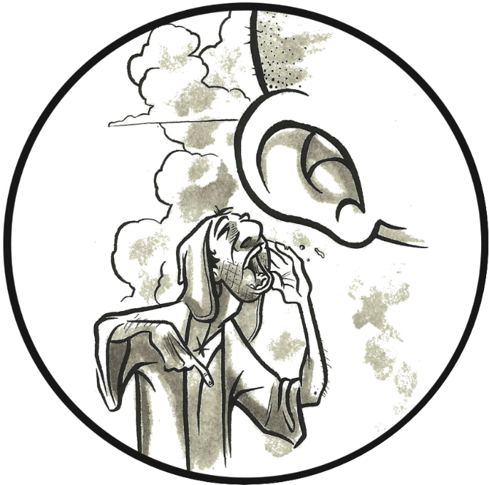
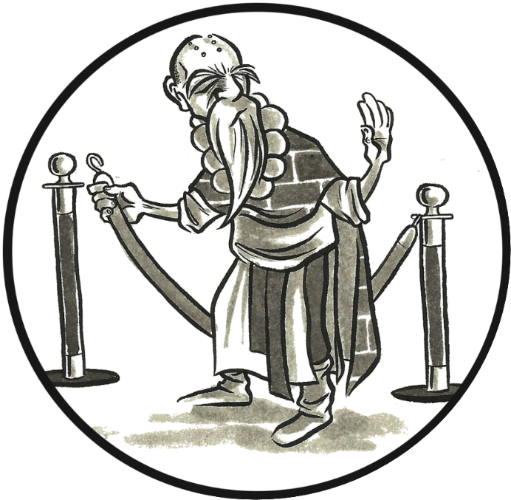
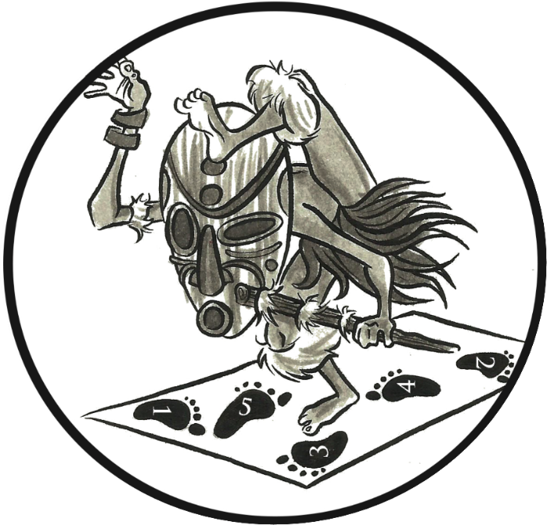

Communion with
the Supernatural
Boundaries between
Sacred & Profane
Ritual
(Correct Procedure)
Sacrificial Offerings

Slide 141
Worship in prayer
What is Prayer?
How is prayer unique compared to other acts of worship (singing, Lord’s supper, collection, scripture reading, sermons)?
What if we engage this act of worship (prayer) and do not receive an answer?

Slide 142
Worship words
Proskuneo: to “[prostrate] oneself before a person and [kiss] his feet, the hem of his garment, the ground, etc.” (Ardnt, Gingrich, & Danker; qtd in Jividen)
  Metaphorical description of the attitude of humility and recognition of worth required for worship, 1 Cor. 14:25
  Best description: the attitude and pattern of behavior of reverence
  Best synonym: venerate
Latreuo: to engage in the specific rituals of worship, especially sacrifice (Kittel, qtd. in Jividen)
  Luke 2:37: [Anna] did not depart from the temple, worshiping with fasting and prayer night and day.
  Best synonym: liturgize
Both words are used in Matt. 4:10: You shall venerate the Lord your God and him only shall you liturgize.

Slide 143
What did n.t. Christians pray for publicly?
Appointment of new leaders (Acts 1:24; 6:6)
Elders (Acts 14:23; 20:36-38)
Evangelist/Mission (Acts 13: 2-3)
Saints (Eph 6:18)
All people, kings, high positions (1 Tim 2:1-8)
Boldness (Acts 4:23-31)
Safety of other saints (Acts 12:5, 12-17)
Sickness (James 5:13-15)
Sins (James 5:15-18)
Thanksgiving (1 Cor 14:15-17)

Slide 144
Worship in prayer
What common goal should prayer be aimed at (I Tim 2)?
What is the purpose of prayer (public or private)?
What is the relationship between prayer and faith?
How can we more effectively follow public prayers led by others to better “worship” God?
What should prayer accomplish in the minds of the hearers?

Slide 145
Worship in scripture reading & preaching
Lesson 9

Slide 146
Class schedule
Lesson | Teacher | Class Day/Date
1. Definition and History of Worship | Mason | Sun 11-Sep
1. Definition and History of Worship | Mason | Wed 14-Sep
2. Worshiping in Spirit and in Truth | Mason | Sun 18-Sep
2. Worshiping in Spirit and in Truth | Mason | Wed 21-Sep
3. Covenant Service and Worship | Mason | Sun 25-Sep
3. Covenant Service and Worship | Mason | Wed 28-Sep
4. Decorum in Worship | Mason | Sun 2-Oct
5. Worship in Song | Mason | Wed 5-Oct
6. Worship in the Lord's Supper | Mason | Sun 9-Oct
7. Worship in Prayer | Jack | Wed 12-Oct
8. Worship in the Collection | Jack | Sun 16-Oct
9. Worship in Scripture Reading & Preaching | Mason | Wed 19-Oct
No Class - Gospel Meeting |  | Sun 23-Oct
10. Review | Mason | Wed 26-Oct

Slide 147
Communion with
the Supernatural
Boundaries between
Sacred & Profane
Ritual
(Correct Procedure)
Sacrificial Offerings

Slide 148
Worship in scripture reading & preaching
Worship and the Knowledge of God
Building Knowledge and Understanding
  Purpose of Public Reading of Scripture
  Purpose of Preaching
“Focusing our Thoughts” or “Excluding Thoughts of the World”
Markers of Worship in Scripture Reading and Preaching

Slide 149
Definition of worship
True worship is the celebration of being in covenant fellowship with the sovereign and holy triune God,
by means of
the reverent adoration and spontaneous praise of God’s nature and works,
the expressed commitment of trust and obedience to the covenant responsibilities, and
the memorial reenactment of entering into covenant through ritual acts,
all with the confident anticipation of the fulfillment of the covenant promises in glory.
Allen P. Ross
Recalling the Hope of Glory

Slide 150
Worship and the Knowledge of God
We must know who God is and what He wants to worship appropriately, Acts 17:23, 29-30
  At Sinai, Israel defaulted to their knowledge of pagan Gods
  Their sin was not abandoning God, but confusing His nature and desires for them with those of the gods they knew in Egypt, Exodus 32:5
A key outcome of worship should be moral behavior
  To change our behavior, we must know what to do and why
  Therefore, every new covenant brings:
    An enhanced revelation of God
    A change in the requirements of worship
In worship, God has provided for us to learn more about Him, and more about what He expects of us

Slide 151
Why does Moses say in Exodus 20:20 that God speaking to Israel was to test them?
How is this a test?

Slide 152
Knowledge & Understanding
Knowledge of God and from God is a test, Exodus 20:20
  Test of our willingness to listen to God at all (to focus on something other than self)
  Test of our willingness to believe what God says (to accept it as true)
  Test of our willingness to do what He says (to make application or change)
  Jesus describes this process in Matthew 7:24-29

Slide 153
Find 5 verses in psalm 119 that do not contain the word “law” or a synonym.

Slide 154
Knowledge & Understanding
Knowledge of God and from God is a test, Exodus 20:20
  Test of our willingness to listen to God at all (to focus on something other than self)
  Test of our willingness to believe what God says (to accept it as true)
  Test of our willingness to do what He says (to make application or change)
  Jesus describes this process in Matthew 7:24-29
Psalm 119 highlights how God’s revelation necessitates action
  vv.84, 90, 121, 122, 132 do not use a synonym for “law”
  Instead, “execute judgment,” “faithfulness,” “surety” or “guarantee”—covenant words
  God’s act of revealing Himself demonstrates covenant faithfulness
  His nature is a guarantee that He will keep the covenant He makes with us, Hebrews 6:13
Our worship in public reading and preaching should:
  Increase our knowledge and understanding of God’s Word (His covenant faithfulness)
  Increase our desire and motivation to do what we’re commanded (our covenant faithfulness)

Slide 155
Public Scripture readings
Always associated with an expected change in belief or behavior
  Hezekiah’s Re-establishment of Temple Worship, 2 Chronicles 29:25
  Josiah’s Reforms, 2 Kings 22:11-13
  Return from Exile, Nehemiah 8:14-16
Often accompanied by some explanation of the passage, Nehemiah 8:7-8
The Ideal Scripture Reading:
  Selected to increase knowledge and/or produce action
  Succinctly but helpfully introduced (context, summary, application)
  Read from a version that is accurate but easy to listen to
  Read in a way that does not distract from the text
    Not too dull or monotone
    Not too dramatic

Slide 156
preaching
Always associated with an expected change in belief or behavior
  Sermon on the Mount, Matthew 7:24-26
  Sermon at Pentecost, Acts 2:40
  Sermon in Antioch of Pisidia, Acts 13:40-41
Always includes quotation and explication of Scripture
The Ideal Sermon:
  Scripturally-focused, not opinion-focused
    Helps us understand and apply God’s word more accurately
  Applications are challenging but achievable
  Of a length appropriate to the content
    Complex topics and passages require more explanation
    Simple topics and passages should not be harped on needlessly

Slide 157
Markers of worship & scripture
Boundaries between Sacred and Profane
  Criteria: to demonstrate in our worship the boundaries between our sacred lives and the profane world, Ephesians 4:17-32
  Example: Don’t be distracted by “thoughts of this world”
Sacrificial Offerings
  Criteria: to demonstrate in our worship that we “fill up…what is lacking in Christ’s sufferings,” Col.1:24
  Example: Find things in our lives to give up or change based on improved knowledge
Ritual (Correct Procedure)
  Criteria: to demonstrate by our actions that God (who is a God of peace, not confusion) is the originator and object of our worship, not ourselves, so that everyone may learn who God is and what He requires of them, 1 Corinthians 14:40
  Example: Determine to fully engage with the reading/preaching

Slide 158
How do we “focus our thoughts” or “Remove distractions of the world” for our worship?

Slide 159
What to think about during scripture reading and preaching
What is revealed about God’s nature in this passage of scripture?
  What is revealed about my nature?
What actions are commanded or implied by this passage or concept?
  What other applications can I make that are related, but not stated explicitly?
What is the context of this passage? How does this passage fit into that context?
  How does it further the argument or revelation?
What other passages say something similar to this one? What do they add?
Can I summarize this passage or concept in one to two sentences?
  Can I explain it clearly to someone else?

Slide 160
Review & case studies
Lesson 10

Slide 161
Class schedule
Lesson | Teacher | Class Day/Date
1. Definition and History of Worship | Mason | Sun 11-Sep
1. Definition and History of Worship | Mason | Wed 14-Sep
2. Worshiping in Spirit and in Truth | Mason | Sun 18-Sep
2. Worshiping in Spirit and in Truth | Mason | Wed 21-Sep
3. Covenant Service and Worship | Mason | Sun 25-Sep
3. Covenant Service and Worship | Mason | Wed 28-Sep
4. Decorum in Worship | Mason | Sun 2-Oct
5. Worship in Song | Mason | Wed 5-Oct
6. Worship in the Lord's Supper | Mason | Sun 9-Oct
7. Worship in Prayer | Jack | Wed 12-Oct
8. Worship in the Collection | Jack | Sun 16-Oct
9. Worship in Scripture Reading & Preaching | Mason | Wed 19-Oct
No Class - Gospel Meeting |  | Sun 23-Oct
10. Review | Mason | Wed 26-Oct

Slide 162
Review and Case studies
Speed-of-Light Overview of Course
Course Goals Review
Case Study: Archippus’s Views on Worship

Slide 163
Worship words
Proskuneo: to “[prostrate] oneself before a person and [kiss] his feet, the hem of his garment, the ground, etc.” (Ardnt, Gingrich, & Danker; qtd in Jividen)
  Metaphorical description of the attitude of humility and recognition of worth required for worship, 1 Cor. 14:25
  Best description: the attitude and pattern of behavior of reverence
  Best synonym: venerate
Latreuo: to engage in the specific rituals of worship, especially sacrifice (Kittel, qtd. in Jividen)
  Luke 2:37: [Anna] did not depart from the temple, worshiping with fasting and prayer night and day.
  Best synonym: liturgize
Both words are used in Matt. 4:10: You shall venerate the Lord your God and him only shall you liturgize.

Slide 164
Two Views of worship
Checklist Worship
  “Worship is a specific set of commanded acts.”
  Do all the right things in the right order
  More corporate focus
  Emotion viewed as disorderly or out of place
  Key passage: 1 Cor. 14:40
  DANGER: Legalism
Willy-Nilly Worship
  “Worship is about feeling close to God.”
  What you do doesn’t really matter
  More individual focus
  Emotion embraced (and perhaps pursued)
  Key Passage: 2 Sam. 6:21-22
  DANGER: Emotionalism

Slide 165
Communion with
the Supernatural
Boundaries between
Sacred & Profane
Ritual
(Correct Procedure)
Sacrificial Offerings

Slide 166
Herod’s temple

Slide 167
Avebury, england

Slide 168
The KAABA, mecca

Slide 169
St. Patrick’s cathedral, dublin

Slide 170
Sacrifices

Slide 171
Ise Jingu Grand Shrine, Naiku, Japan

Slide 172
What is worship?
True worship is the celebration of being in covenant fellowship with the sovereign and holy triune God,
by means of
the reverent adoration and spontaneous praise of God’s nature and works,
the expressed commitment of trust and obedience to the covenant responsibilities, and
the memorial reenactment of entering into covenant through ritual acts,
all with the confident anticipation of the fulfillment of the covenant promises in glory.
Allen P. Ross
Recalling the Hope of Glory

Slide 173
Worship in Spirit & truth
Not a description of how we worship, but of the worship itself
We worship according to spiritual ordinances informed by the fuller revelation of God in Christ Jesus
  Christ is our perfect high priest, offering the perfect sacrifice of His blood
  We approach the throne of God inside the Most Holy Place with boldness
Our worship is spiritually focused, not physically focused
  We have been shown the Father through Jesus, a more intimate and spiritual revelation
  We should not try to gratify our fleshly desires in worship
    To be entertained, 1 Corinthians 11:21
    To be intellectually stimulated, Acts 17:21
Our goals in worship:
  To honor God
  To learn about God
  To learn and encourage moral behavior individually
  To “stir one another up to love and good works”

Slide 174
Covenant service and worship
“Life as Worship”
“Sunday-Wednesday”
They ignore the clear scriptural separation of covenant service (moral behavior, lifestyle) and worship
  Worship is not the whole of our covenant service toward God
  Covenant service is clearly distinguished from organized, ordered worship
Confuse corporate worship and individual worship
  Both types of worship are commanded for Christians
  Each has a specific use in building us up in our covenant service
They produce (and even encourage) moral laxness
  We feel our service is done if we attend worship, and may be prone to sin because “I did my job this week.”
  We may feel like we don’t need other Christians, and become morally inbred.

Slide 175
Cycles of worship
Moral
Behavior
Improved
Worship

Slide 176
The Acts of worship
Traditionally we identify 5: singing, prayer, Lord’s Supper, scripture reading, collection
Each act of worship is designed by God to benefit us by:
  Increasing our knowledge of His word
  Renewing our commitment to live as He has commanded
  Building unity as God’s people through mutual encouragement
  Giving us a stronger sense of God’s authority, justice, and mercy
Planes of Worship
  Speaking to God (vertical upward)
  Listening to God (vertical downward)
  Teaching and Encouraging One Another (horizontal)

Slide 177
Vertical & horizontal Worship
GOD
TRUTH
PRAISE
TRUTH
TRUTH
PRAISE
PRAISE
Teach & Encourage
Teach & Encourage

Slide 178
Goals of the study
Comprehend more fully who God is, and explore how that knowledge impacts our worship
Evaluate worship and our parts in it using reason, not emotion
Improve the external and internal processes of worship in our lives
Understand better who are the beneficiaries of our worship, and why we worship

Slide 179
Case study: Archippus decide which topic your group wants to consider.

Slide 180
Case study: archippus
Use Archippus’s opinions above and in the discussion topic you choose to help you formulate a response. Consider the following questions:
To what passages would you direct him in his study of worship generally, or of your act in particular?
How do Archippus’s views of worship generally, or your act specifically, compare to the Biblical model?
  Where is he correct?
  Where is he in error?
  Where is he correct in theory, but slightly missing it in application?
In what ways could you modify our “traditional” worship based on Archippus’s views?

