Slide 1
Decisions, Decisions, Decisions!

Slide 2
“We all make numerous decisions everyday; unconsciously or consciously, sometimes doing it automatically with little effort or thinking and yet, at other times, we agonize for hours over another. Why do we make these choices -- be it from deciding what to have for lunch or whether to say yes to that job offer halfway round the world?”

Slide 3
Marriage?
“The sons of God saw the daughters of men, that they were beautiful; and they took wives for themselves of all whom they chose.” (Genesis 6:2)
“Then the Lord saw that the wickedness of man was great in the earth, and that every intent of the thoughts of his heart was only evil continually.” (Genesis 6:2)

Slide 4
Business?
“So Lot went out and spoke to his sons-in-law, who had married his daughters, and said, “Get up, get out of this place; for the Lord will destroy this city!” But to his sons-in-law he seemed to be joking..” (Genesis 19:14)
“And Lot lifted his eyes and saw all the plain of Jordan, that it was well watered everywhere (before the Lord destroyed Sodom and Gomorrah) like the garden of the Lord, like the land of Egypt as you go toward Zoar.” (Gen. 13:10)
“But his wife looked back behind him, and she became a pillar of salt” (Gen. 19:26)
, Verse 13)

Slide 5
Religion?
“Sarai said to Abram, “See now, the Lord has restrained me from bearing children. Please, go in to my maid; perhaps I shall obtain children by her.” And Abram heeded the voice of Sarai. ” (Genesis 16:2)
“He shall be a wild man; His hand shall be against every man, And every man’s hand against him. And he shall dwell in the presence of all his brethren.” (Genesis 16:12)
The Arabs

Slide 6
The most serious consequences resulted from a decision that seemed very insignificant!

Slide 7
A Very Little Decision: To eat or not to eat
“⁶ So when the woman saw that the tree was good for food, that it was pleasant to the eyes, and a tree desirable to make one wise, she took of its fruit and ate. She also gave to her husband with her, and he ate. ” (Genesis 3:6)
“…through one man sin entered the world, and death through sin, and thus death spread to all men, because all sinned.” (Romans 5:12)

Slide 8
One thing common to all these bad decisions:
They did not seek God’s counsel.

Slide 9
End Results were always good when God was obeyed.
Seth “Then men began to call on the name of the Lord.” Genesis 4:6)
“Noah did according to all that the Lord commanded”
“By faith Abraham offered up his only begotten son” (Hebrews 11:17)
Joseph: “How then can I do this great wickedness, and sin against God?” (Gen. 39:9)
A righteous “seed” was preserved for the fulfillment of God’s promise.
“for the saving of his household” (Hebrews 11:7)
“In your seed all the nations of the earth shall be blessed, because you have obeyed My voice.” (Genesis 22:18)
Preserved Jacob’s posterity and saved many lives (Gen. 45:7)

Slide 10
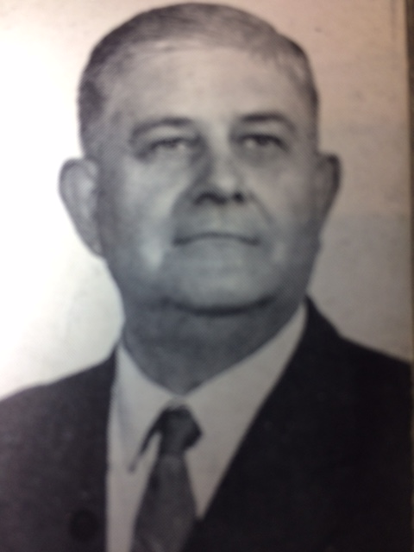
Scholars,
“It’s always right to do right,
And it’s always wrong to do wrong.”

Slide 11
1 Peter 3:10-12
“He who would love life And see good days, Let him refrain his tongue from evil, And his lips from speaking deceit. ¹¹ Let him turn away from evil and do good; Let him seek peace and pursue it. ¹² For the eyes of the Lord are on the righteous, And His ears are open to their prayers; But the face of the Lord is against those who do evil.”

