Slide 1
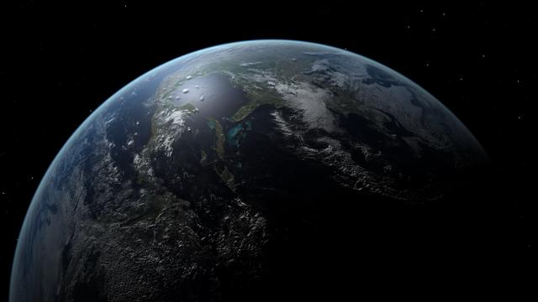

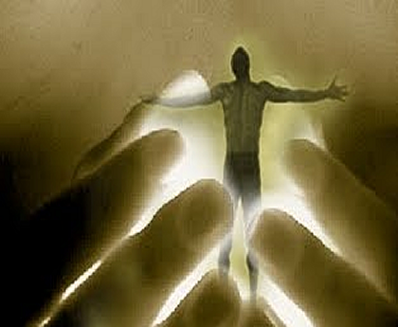
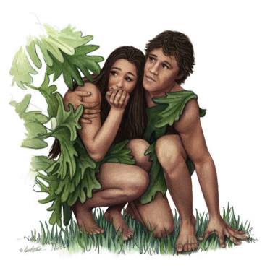
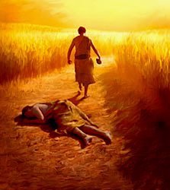
Studies in the book of Genesis:
Evangelism based on
the Nature of God and His World
Genesis 1:
The Nature of
God
Genesis 2:
The Nature of
Man
Genesis 3:
The Nature of
Sin
Genesis 4:
The Nature of
A Fallen World

Slide 2
“¹⁸For the wrath of God is revealed from heaven against all ungodliness and unrighteousness of men, who suppress the truth in unrighteousness,
¹⁹because what may be known of God is manifest in them, for God has shown it to them.
²⁰For since the creation of the world His invisible atributes are clearly seen, being understood by the things that are made, even His eternal power and Godhead, so that they are without excuse...”
Romans 1:18-20

Slide 3
“²¹because, although they knew God, they did not glorify Him as God, nor were thankful, but became futile in their thoughts, and their foolish hearts were darkened.
²²Professing to be wise, they became fools,
²³and changed the glory of the incorruptible God into an image made like corruptible man – and birds and four-footed animals and creeping things.
²⁴Therefore, God also gave them up to uncleanness, in the lusts of their hearts, to dishonor their bodies among themselves,
²⁵who exchanged the truth of God for the lie, and worshiped and served the creature rather than the Creator...”
Romans 1:21-25

Slide 4

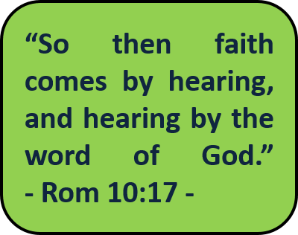
What we believe about the Nature of God affects the
way that we worship; and the wrath of God is revealed
against every form of false and misdirected worship!
The wrath of God is revealed from heaven against all ungodliness and unrighteousness of men, ...who exchanged the truth of God for the lie, and worshiped and served the creature rather than the Creator...
- Romans 1:18-25 -
What must we do to escape the wrath of
God?
As we examine the word that God Himself revealed about His creation, we are able to analyze the nature of the Creator by means of His masterwork of creation...
“Now faith is the substance of things hoped for, the evidence of things not seen. For by it the elders obtained a good testimony. By Faith we understand that the worlds were framed by the word of God, so that the things which are seen were not made of things which are visible.” - Hebrews 11:1-3 -
“But without faith it is impossible to please God”
- Hebrews 11:6 -

Slide 5
Genesis 1:1-5
1:1 If God created “In the beginning”, then what existed
before that?
Only God!!
The Creator, of necessity must have existed BEFORE His creation; in stating that God created “In the beginning”, Genesis 1:1 emphasizes His ETERNAL NATURE
[cp Rm 1:20]
Genesis 1:
“The Nature of God”

Slide 6
ETERNITY
ETERNAL BEING
IMMORTAL beings
(angels, demons
and human souls)
MORTAL beings
(animals, plants, human bodies, etc.)
TIMELINE
“In the beginning”
[Genesis 1:1]
“Then comes the end”
[1 Corinthians 15:24]
“the last day”
[John 12:48]
Genesis 1:
“The Nature of God”

Slide 7
ETERNITY
ETERNAL BEING
ETERNAL BEING: is not born and cannot die, nor is limited by TIME; eternity is a quality that is unique to the DIVINE NATURE of God
IMMORTAL beings: are born into TIME, but cannot die; in some form they continue to exist beyond the line we call TIME
TIMELINE
MORTAL beings: are born, die, and cease to exist during the line we call TIME
Genesis 1:
“The Nature of God”

Slide 8
Genesis 1:1-5
or, “carnal”
1:1 “the heavens and the earth” describes the whole
universe, whether visible (earthly, with physical
beings) or invisible (heavenly, with celestial
beings) [cp 2:1]
or, “spiritual”
Genesis 1:
“The Nature of God”

Slide 9
Genesis 1:1-5
1:2 “the earth was
without form,
and void;
and darkness was on the face of the deep.”
These are three conditions/situations that God will address and “fix” during the week of creation…
Genesis 1:
“The Nature of God”

Slide 10
Genesis 1:1-5
1:2 “...the Spirit of God was hovering
over the face of the waters.”
The first time God presents Himself in the Bible, it is as SPIRIT!
compare this same truth in other passages:
- Exodus 3:2: appeared before Moses in a “burning” bush (flame)
- Exodus 13:21-22: led the people of Israel out of Egypt as a column
of fire and cloud (flame, smoke)
- Exodus 19:9, 16: appeared before Israel as a dark storm cloud over
Mount Sinai, with thunder and lightning (cloud, electrical storm)
Genesis 1:
“The Nature of God”

Slide 11
Genesis 1:1-5
1:2 “...the Spirit of God was hovering
over the face of the waters.”
According to both Moses and Jesus, understanding God’s spiritual nature is absolutely necessary if we wish to worship Him in truth!
The first time God presents Himself in the Bible, it is as SPIRIT!
compare this same truth in other passages:
- Exodus 3:2: appeared before Moses in a “burning” bush (flame)
Moses, in Deuteronomy 4:15-20
“Take careful heed to yourselves, for you saw no form when the Lord spoke to you …lest you act corruptly and make for yourselves any carved image in the form of any figure… lest you…feel driven to worship them…”
Jesus, in John 4:23-24
“…the true worshipers will worship the Father in spirit and truth; for the Father is seeking such to worship Him. God is Spirit, and those who worship Him must worship in spirit and truth.”
- Exodus 13:21-22: led the people of Israel out of Egypt as a column
of fire and cloud (flame, smoke)
- Exodus 19:9, 16: appeared before Israel as a dark storm cloud over
Mount Sinai, with thunder and lightning (cloud, electrical storm)
Genesis 1:
“The Nature of God”

Slide 12
Genesis 1:1-5
1:2 “...the Spirit of God was hovering
over the face of the waters.”
The first time God presents Himself in the Bible, it is as SPIRIT!
One of the biggest religious errors is changing “the glory of the incorruptible (Eternal, Spiritual) God into an image made like corruptible man – and birds and four-footed animals and creeping things (temporal, physical creatures)...” worshiping and serving “the creature rather than the Creator” [Rm 1:23-25]. We must learn by His word to think and act (worship!) according to the truth of God!!
Genesis 1:
“The Nature of God”

Slide 13
Genesis 1:1-5
God’s creative power resides in His word!
1:3 “...God said, ‘Let there be light’; and there was light.”
compare this same truth in other passages:
- Genesis 1:6, 9, 11, 14, 20, 24, 26, 29: “Then God said...”
- Psalm 33:6, 9: “By the word of the Lord the heavens were made,
And all the host of them by the breath of His mouth... For He
spoke and it was done; He commanded and it stood fast.”
- Hebrews 1:3 (of Jesus): “upholding all things by the word of His
power” [Hb 11:3, “the worlds were framed by the word of God”]
- Romans 1:16: The gospel “is the power of God to salvation...”
- John 17:17: “Sanctify them by Your truth; Your word is truth.”
Genesis 1:
“The Nature of God”

Slide 14
Genesis 1:1-5
1:3 “...God said, ‘Let there be light’; and there was light.”
God’s first act in the creation was to remove the darkness!
(this was one of the three “situations” to be “addressed”)
Physical light was necessary for the creation to have life and vision. In Christ, the new creation has spiritual life and sight by His “light”:
- John 1:4, 9: “In Him was life, and the life was the light of men.
...That was the true Light which gives light to every man...”
- John 9:5: “I am the light of the world.”
[cp 1 John 1:5: “God is light”]
Genesis 1:
“The Nature of God”

Slide 15
Genesis 1:1-5
By God’s nature, He works only that which is good!
1:4 “And God saw the light, that it was good...”
examine God’s observation concerning all of His creation:
- Genesis 1:4, 10, 12, 18, 21, 25, 31: “...and indeed it was very good.”
As we consider God’s work and His commands, we should always trust that He works all for good, even if we do not understand it: “...God is light and in Him is no darkness at all.” [1 John 1:5; cp James 1:17; etc.]
after all, His desire is to transform us to be like He is:
- Romans 8:29: “...to be conformed to the image of His Son...”
- 2 Peter 1:4: “...you may be partakers of the divine nature...”
- 1 Peter 1:16: “Be holy, for I am holy.”
Genesis 1:
“The Nature of God”

Slide 16
Genesis 1:1-5
1:4 “...and God divided the light from the darkness...”
“Divide” (literally, “separated” [ESV, NIV, NASB, RSV]) is part of “holiness”; God “separated” many things by His creation:
- Genesis 1:4: separated light from darkness
- Genesis 1:6-7: separated the waters below from the waters above
- Genesis 1:9-10: separated the dry land from out of the water
- Genesis 1:12: separated plants according to their kind by seed
- Genesis 1:14: separated the Day from the Night
- Genesis 1:21, 24: separated the animals according to their kind
- Genesis 2:3: separated one day from the seven for His rest
Genesis 1:
“The Nature of God”

Slide 17
Genesis 1:1-5
1:5 “God called the light Day, and the darkness...Night.
So the evening and the morning were the first day.”
The eternal God, who lives outside of time, with the creation of day and night, evening and morning, established time for all physical creation: from THIS moment, TIME began!
- Despite what is called “science”, the universe is not a result of random
mysterious forces operating during many billions of years, but is the
result of an intelligent creative force working during six 24-hour days
- According to God’s teaching, everything that began from this ‘first
day’ is moving toward judgment day, ‘the last day’. Jesus Himself
said: “He who rejects me...has that which judges him – the word...
will judge him in the last day” [Jn 12:48]
Genesis 1:
“The Nature of God”

Slide 18
THE NATURE OF GOD
He is ETERNAL (quality unique to the Divine Nature) [1:1]
He is SPIRIT (He is not physical; in no way like man) [1:2]
His creative power resides in His WORD [1:3]
He is GOOD (it’s impossible for Him to think or do evil) [1:4]
He is HOLY (‘separated’; His nature is to ‘sanctify’) [1:4]

Slide 19


Genesis 1:6-13
“Then God said, ‘Let there be a firmament in the midst of the waters, and
let it divide the waters from the waters.’ Thus God made the firmament, and
divided the waters which were under the firmament from the waters which were
above the firmament; and it was so. And God called the firmament Heaven. So
the evening and the morning were the second day. [1:6-8]
“waters” above the firmament
The blue “sky”:
waters under the firmament
Genesis 1:
“The Nature of God”

Slide 20
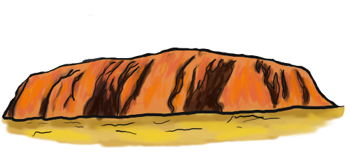
Genesis 1:6-13
Then God said, ‘Let the waters under the heavens be gathered together into
one place, and let the dry land appear’; and it was so. And God called the dry
land Earth, and the gathering together of the waters He called Seas. And
God saw that it was good. [1:9-10]
Genesis 1:
“The Nature of God”

Slide 21
Genesis 1:6-13
When God separated light (day) and darkness (night) [1:4-5],
the waters above from those below the firmament [1:6-7],
He showed that
He is the God of order; the word of God decrees order
and places form where once there was chaos...
and the seas from the dry land [1:9-10],
Darkness
Light
Genesis 1:
“The Nature of God”

Slide 22
God is a God of ORDER
The word of God, as Creator, ordains (organizes) His creation:
“So they put it aside until morning, as Moses had ordered, and it did not become foul nor was there any worm in it.”
Exodus 16:24 [NASB]
“Moses commanded the Israelites: ‘Assign this land by lot as an inheritance. The Lord has ordered that it be given to the nine-and-a-half tribes...” Numbers 34:13 [NIV]
“The people were all so amazed that they asked each other, ‘What is this? A new teaching – and with authority! He even gives orders to impure spirits and they obey him.’”
Mark 1:27 [NIV]
“Now concerning the collection for the saints, as I have given orders to the churches of Galatia, so you must do also.” 1 Corinthians 16:1 [NKJV]

Slide 23
God is a God of ORDER
If God maintains
ORDER by the power of His word, then why does the world seem to be so full of DISORDER???
The word of God, as Creator, ordains (organizes) His creation:

Slide 24
God is a God of ORDER
The word of God, as Creator, ordains (organizes) His creation:
Disorder is the result of disobedience to God’s word:
“Because you have heeded the voice of your wife, and have eaten from the tree of which I commanded you, saying, ‘You shall not eat of it’: cursed is the ground for your sake... Both thorns and thistles it shall bring forth... Till you return to the ground...” Genesis 3:17-19
“Then Nadab and Abihu, the sons of Aaron, each took his censer and put fire in it, put incense on it, and offered profane fire before the Lord, which He had not commanded them. So fire went out from the Lord and devoured them, and they died...” Leviticus 10:1-2
“But we command you, brethren... that you withdraw from every brother who walks disorderly...” 2 Thessalonians 3:6

Slide 25
Genesis 1:6-13
“Then God said, ‘Let the earth bring forth grass, the herb that yields seed,
and the fruit tree that yields fruit according to its kind, whose seed is in
itself, on the earth’; and it was so. And the earth brought forth grass, the
herb that yields seed according to its kind, and the tree that yields fruit,
whose seed is in itself, according to its kind. And God saw that it was good.
So the evening and the morning were the third day.” [1:11-13]
After creating light to put away the darkness and giving form and order to what once was chaos, God then began to fill in the “void” with plants to cover the face of the earth
And the God of order established a law to govern the reproduction of plant life: each plant would have within itself the seed for the next generation of its own species!
Genesis 1:
“The Nature of God”

Slide 26
THE NATURE OF GOD
He is ETERNAL (quality unique to the Divine Nature) [1:1]
He is SPIRIT (He is not physical; in no way like man) [1:2]
His creative power resides in His WORD [1:3]
He is GOOD (it’s impossible for Him to think or do evil) [1:4]
He is HOLY (‘separated’; His nature is to ‘sanctify’) [1:4]
He is ORDERLY and establishes order by His word [1:6-13]

Slide 27
Genesis 1:14-19
Yes!! [1:4-5]
Why, then, would God do this again
here??
“Then God said, ‘Let there be lights in the firmament of the heavens to
divide the day from the night; and let them be for signs and seasons,
and for days and years; and let them be for lights in the firmament of
the heavens to give light on the earth’; and it was so.” [1:14-15]
❶
❷
Didn’t God already separate day and night?
❶
So, why again?
❷
What does the word “sign” mean?
Dictionary.com: “1. a token; indication. 2. any object, action, event, pattern, etc., that conveys a meaning.”
Genesis 1:
“The Nature of God”

Slide 28
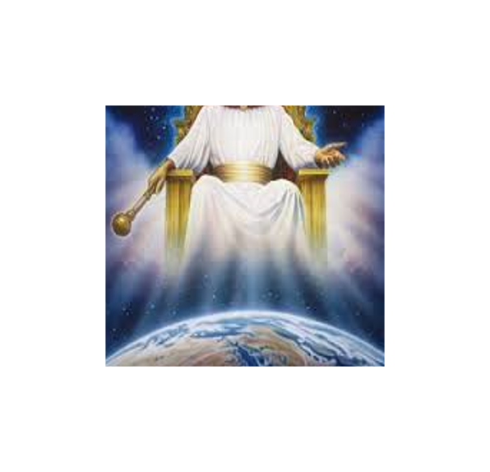

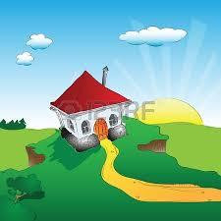
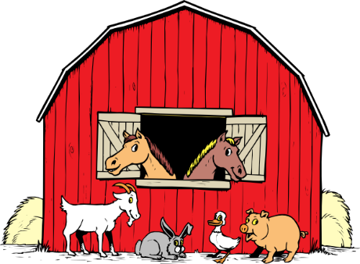
Genesis 1:14-19
“Then God said, ‘Let there be lights in the firmament of the heavens to
divide the day from the night; and let them be for signs and seasons,
and for days and years; and let them be for lights in the firmament of
the heavens to give light on the earth’; and it was so.” [1:14-15]
❶
❷
Didn’t God already separate day and night?
❶
So, why again?
What does the word “sign” mean?
❷
Indication
Signs would be useful for what part of the creation?
Plants?
God?
Animals?
Genesis 1:
“The Nature of God”

Slide 29
Genesis 1:14-19
“Then God said, ‘Let there be lights in the firmament of the heavens to
divide the day from the night; and let them be for signs and seasons,
and for days and years; and let them be for lights in the firmament of
the heavens to give light on the earth’; and it was so.” [1:14-15]
❶
❷
❸
❹
Didn’t God already separate day and night?
❶
So, why again?
No!! In eternity, before the universe began, He was just fine without physical light; John tells us HE is light!
[1 John 1:5]
What does the word “sign” mean?
❷
Indication – for whom?
Does God (Spirit, Eternal) need to count time?
❸
So, why this?
❹
Does God need the light?
Genesis 1:
“The Nature of God”

Slide 30
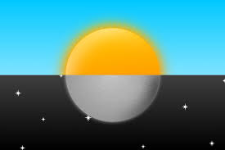

Genesis 1:14-19
“Then God said, ‘Let there be lights in the firmament of the heavens to
divide the day from the night; and let them be for signs and seasons,
and for days and years; and let them be for lights in the firmament of
the heavens to give light on the earth’; and it was so.” [1:14-15]
❶
❷
❸
❹
God made all these things (and all things!) for man’s benefit – even when not one person had yet been made on the earth! God planned all things for us!
Didn’t God already separate day and night?
❶
So, why again?
What does the word “sign” mean?
❷
Indication – for whom?
Does God (Spirit, Eternal) need to count time?
❸
So, why this?
Does God need the light?
❹
So then, why this light on earth?
Day
Signs
Time
Night
Light
Genesis 1:
“The Nature of God”

Slide 31



Genesis 1:14-19
“Then God made two great lights: the greater light to rule the day, and the lesser light to rule the night. He made the stars also. God set them in the firmament of the heavens to give light on the earth, and to rule over the day and over the night, and to divide the light from the darkness. And God saw that it was good. So the evening and the morning were the fourth day.”
[1:16-19]
Greater
The great lights “govern” in two ways:
- illuminate the earth, making it so
that man can live and do his work
[cp John 9:4: “I must work while it is
day... the night is coming when no
one can work.”]
Lesser
Genesis 1:
“The Nature of God”

Slide 32
Genesis 1:14-19
“Then God made two great lights: the greater light to rule the day, and the lesser light to rule the night. He made the stars also. God set them in the firmament of the heavens to give light on the earth, and to rule over the day and over the night, and to divide the light from the darkness. And God saw that it was good. So the evening and the morning were the fourth day.”
[1:16-19]
Greater
The great lights “govern” in two ways:
“rule”
- illuminate the earth
- separate light and darkness, making
manifest the kingdom of God. [“He has
delivered us from...darkness and conveyed
us into the kingdom...” (Col 1:13); and called
us “out of darkness into His marvelous
light.” (1 Peter 2:9)]
Lesser
Genesis 1:
“The Nature of God”

Slide 33
THE NATURE OF GOD
He is ETERNAL (quality unique to the Divine Nature) [1:1]
He is SPIRIT (He is not physical; in no way like man) [1:2]
His creative power resides in His WORD [1:3]
He is GOOD (it’s impossible for Him to think or do evil) [1:4]
He is HOLY (‘separated’; His nature is to ‘sanctify’) [1:4]
He is ORDERLY and establishes order by His word [1:6-13]
He is a God who PLANS and who prepared all the physical universe for man’s needs before ever creating him [1:14-18]

Slide 34
God emphasizes SEVEN times that the same fixed law which governs the plants and their seeds is established to govern the “seed” of all living beings: each will reproduce only “according to its own kind”! [v21 (2x), v24 (2x), v25 (3x)]
Genesis 1:20-25
1:20 “...Let the waters abound with an abundance of
living creatures...”
1:21 “So God created great sea creatures...with which the
waters abounded...”
1:22 “...And God blessed them, saying: ‘Be fruitful and
multiply, and fill the waters...let birds multiply’”
God addresses the issue of the “void”, filling the land with plants, the heavens with lights, the waters with fish, the sky with birds, and the whole earth with land animals. He then establishes the blessing of fixed laws to govern procreation so that all living beings can continue to fill the emptiness!
Genesis 1:
“The Nature of God”

Slide 35
THE NATURE OF GOD
He is ETERNAL (quality unique to the Divine Nature) [1:1]
He is SPIRIT (He is not physical; in no way like man) [1:2]
His creative power resides in His WORD [1:3]
He is GOOD (it’s impossible for Him to think or do evil) [1:4]
He is HOLY (‘separated’; His nature is to ‘sanctify’) [1:4]
He is ORDERLY and establishes order by His word [1:6-13]
He is a God who PLANS and who prepared all the physical universe for man’s needs before ever creating him [1:14-18]
He is LORD and prepared fixed laws to govern His creation; He is the only one with the power to interrupt these laws, and when He does, the result is called a “miracle” [1:20-25]

Slide 36
Some erroneously teach that God may have been speaking with the angels or even with Satan here, but the New Testament gives us a very clear answer
Genesis 1:26-31
1:26 “...Let Us make man in Our image, according to Our
likeness...”
“Let Us”?
“...in Our image”?
With whom was God speaking?
God, the Father, was speaking to Jesus, the Son!!
“All things were made through Him, and without Him nothing was made that was made.” [Jn 1:3; cp Hb 1:2]
“For by Him all things were created that are in heaven and that are on earth... All things were created through Him and for Him.” [Col 1:16]
Genesis 1:
“The Nature of God”

Slide 37

Genesis 1:26-31
1:26 “...Let Us make man in Our image, according to Our
likeness...”
Head?
What would be the “image” or “likeness” of God?
Arms?
Remember: “God is Spirit”; He has no physical body as man has! By the context of Genesis 1, the idea that man was made in the image and likeness of God could not be speaking of some physical aspect.
Legs?
Feet?
Genesis 1:
“The Nature of God”

Slide 38
Genesis 1:26-31
In this way,
both man and woman are made in the “image” and “likeness” of God! [Genesis 1:27]
1:26 “...Let Us make man in Our image, according to Our
likeness;
let them have dominion over the fish...
over the birds...over the cattle, over all the earth...”
1:28 “...God blessed them, and said to them, ‘Be fruitful
and multiply; fill the earth and subdue it...’”
Head?
What would be the “image” or “likeness” of God?
The context emphasizes in what ways man carries the “image” and “likeness” of God:
“let them have dominion over” all animals [1:26];
“Be fruitful”, mulitiply, fill the earth, subdue it [1:28]; (govern, procreate)
Arms?
Legs?
Feet?
Genesis 1:
“The Nature of God”

Slide 39

Genesis 1:26-31
1:29 “...I have given you every herb...and every tree whose
fruit yields seed; to you it shall be for food...”
Genesis 1:
“The Nature of God”

Slide 40


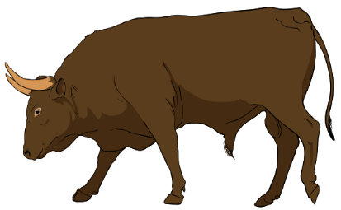

Genesis 1:26-31
1:29 “...I have given you every herb...and every tree whose
fruit yields seed; to you it shall be for food...”
1:30 “Also, to every beast...to every bird of the air, and to
everything that creeps...every green herb for food”
Genesis 1:
“The Nature of God”

Slide 41

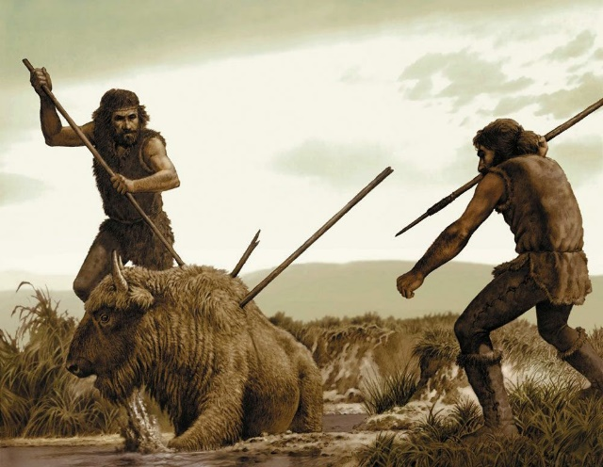





Genesis 1:26-31
1:31 “Then God saw everything that He had made,
and indeed it was very good.”
Before Sin
After Sin
Genesis 1:
“The Nature of God”

Slide 42
Genesis 1:26-31
1:31 “Then God saw everything that He had made,
and indeed it was very good.”
Restoration from Sin in Old Testament Prophetic Vision
“The wolf also shall dwell with the lamb, The leopard shall lie down with the
young goat, The calf and the young lion and the fatling together... The cow
and the bear shall graze; Their young ones shall lie
down together; And the lion shall eat straw like the
ox.” [Isaiah 11:6-7; cp Isaiah 65:25; etc.] This is not
literal; it is an image of Eden’s original paradise.
Genesis 1:
“The Nature of God”

Slide 43
THE NATURE OF GOD
He is ETERNAL (quality unique to the Divine Nature) [1:1]
He is SPIRIT (He is not physical; in no way like man) [1:2]
His creative power resides in His WORD [1:3]
He is GOOD (it’s impossible for Him to think or do evil) [1:4]
He is HOLY (‘separated’; His nature is to ‘sanctify’) [1:4]
He is ORDERLY and establishes order by His word [1:6-13]
He is a God who PLANS and who prepared all the physical universe for man’s needs before ever creating him [1:14-18]
He is LORD and prepared fixed laws to govern His creation; He is the only one with the power to interrupt these laws, and when He does, the result is called a “miracle” [1:20-25]
He made man in His own image and likeness so that, in a world where everything was very good, the man could take part in His Divine good nature and plan [1:26-31]

Slide 44
For further study on this subject, or if you have any comments, questions or suggestions about these slides, please contact me, Carl D. Ballard, via e-mail: carldballard@hotmail.com

