Slide 1
Gospel of Matthew
Chapters 1-2 (continuation)

Slide 2
The Gospel of Matthew – Chapter 1
The book of the genealogy of Jesus Christ, the son of David, the son of Abraham.
“Jesus” (Iesous (Gr.), Jeshua (Hebrew)
"Jehovah is salvation" or "Savior.
Christ/Messiah/Anointed
John 4:25 -The woman said to Him, "I know that Messiah is coming (He who is called Christ); when that One comes, He will declare all things to us.
John 4:26 - Jesus said to her, "I who speak to you am he."
“Son of David”
II Samuel 7:12-16 - When your days are complete and you lie down with your fathers, I will raise up your descendant after you, who will come forth from you, and I will establish his kingdom. ¹³ He shall build a house for My name, and I will establish the throne of his kingdom forever.
By tracing His descent from David, Matthew demonstrates Christ's legal claim to be the "King of the Jews"
Son of Abraham
Recalls the promise made in Genesis 12.3, 18.18, 22.18, et.al. wherein God promised blessing for "all families of the earth”

Slide 3
Matthew’s Genealogy
Abraham
Isaac
Jacob
Judah
Perez and Zerah by Tamar
Perez begot Hezron
Ram
Amminadab
Nahshon
Salmon
Boaz by Rahab
Obed by Ruth
Jesse
David
Solomon (by Bathsheba)
Rehoboam
Abijah
Asa
Jehoshaphat
Joram
Uzziah
Jotham
Ahaz
Hezekiah
Manasseh
Amon
Josiah
Jeconiah and brethren at time of carrying away
Jeconiah begot
Shealtiel
Zerubbabel
Abiud
Eliakim
Azor
Zadok
Achim
Eliud
Eleazar
Matthan
Jacob
Joseph the husband of Mary, of whom was born
Jesus who is called Christ.
This genealogy sends a clear message of the grace that is extended by Jesus the Christ, the King to all sinners regardless of gender or nationality. It was not intended to be a simple ancestral record, but a resume of redemptive history.

Slide 4
Fulfilled Prophecy
Having demonstrated that Jesus possessed the pedigree to be Messiah and King, Matthew builds his case (that Jesus is the Christ) by showing how His birth and early life fulfilled prophecy. Five events in Chapters 1 & 2:
Jesus' name,
birth,
place of birth,
exile and
childhood
are cited to illustrate how His life fit the Mes­sianic profile foretold in the OT.

Slide 5
“Formula Quotations” of Old Testament in Matthew
Matthew 1:22 - what was spoken by the Lord through the prophet might be fulfilled . ..
Matthew 2:5-6- for so it has been written by the prophet, . . .
Matthew 2:15- that what was spoken by the Lord through the prophet might be fulfilled . . .
Matthew 2:17- that which was spoken through Jeremiah the prophet was fulfilled.
Matthew 4:14- to fulfill what was spoken through Isaiah the prophet . . .
Matthew 8:17- in order that what was spoken through Isaiah the prophet might be fulfilled . . .
Matthew 12:17- in order that what was spoken through Isaiah the prophet, might be fulfilled, saying . . .
Matthew 13:35- what was spoken through the prophet might be fulfilled . . .
Matthew 21:4- that what was spoken through the prophet might be fulfilled, saying . . .
Matthew 27:9- Then that which was spoken through Jeremiah the prophet was fulfilled, saying…
*Matthew 2:23; 26:56

Slide 6
His hold upon the country was shaky at best. Should a bona fide Jewish king appear on the horizon, his own hegemony could be quickly overthrown" (Mounce, 14). Joining Herod in his un­rest was "all Jerusalem." The citizenry likely feared the conse­quences that would ensue as a result of the king's pathological suspicions. "When Herod the Great trembled the whole city shook" (Morris, 37).
Matthew 2:1-6
Now after Jesus was born in Bethlehem of Judea in the days of Herod the king, behold, wise men from the east came to Jerusalem, ² saying, “Where is he who has been born king of the Jews? For we saw his star when it rose and have come to worship him.” ³ When Herod the king heard this, he was troubled, and all Jerusalem with him; ⁴ and assembling all the chief priests and scribes of the people, he inquired of them where the Christ was to be born. ⁵ They told him, “In Bethlehem of Judea, for so it is written by the prophet:
⁶ “‘And you, O Bethlehem, in the land of Judah, are by no means least among the rulers of Judah; for from you shall come a ruler who will shepherd my people Israel.’”
2nd fulfillment passage
Micah 5:2
II Samuel 5:2

Slide 7
Matthew 2:19-23
¹⁹ But when Herod died, behold, an angel of the Lord appeared in a dream to Joseph in Egypt, ²⁰ saying, “Rise, take the child and his mother and go to the land of Israel, for those who sought the child's life are dead.” ²¹ And he rose and took the child and his mother and went to the land of Israel. ²² But when he heard that Archelaus was reigning over Judea in place of his father Herod, he was afraid to go there, and being warned in a dream he withdrew to the district of Galilee. ²³ And he went and lived in a city called Nazareth, so that what was spoken by the prophets might be fulfilled, that he would be called a Nazarene.
After Herod's death his kingdom was divided among three sons. Archelaus’ brutal character was much like that of his father.

Slide 8
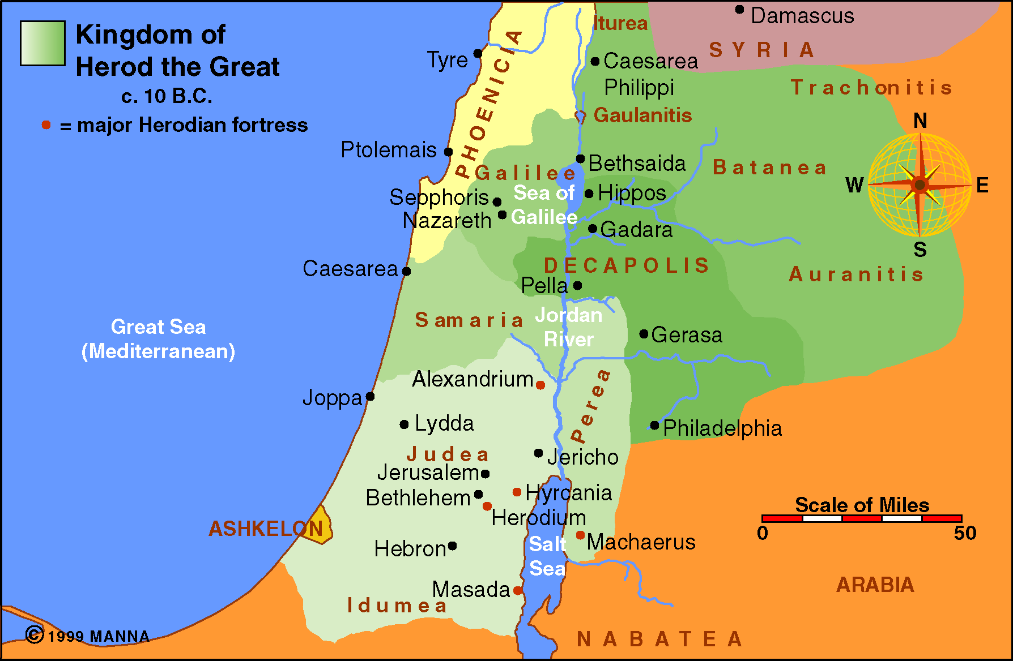
Antipas - tetrarch of Ga­lilee and Perea
Philip - tetrarch of Trachonitis and Ituraea
Archelaus was given Judea, Samaria and Idumea

Slide 9
Matthew 2:19-23
¹⁹ But when Herod died, behold, an angel of the Lord appeared in a dream to Joseph in Egypt, ²⁰ saying, “Rise, take the child and his mother and go to the land of Israel, for those who sought the child's life are dead.” ²¹ And he rose and took the child and his mother and went to the land of Israel. ²² But when he heard that Archelaus was reigning over Judea in place of his father Herod, he was afraid to go there, and being warned in a dream he withdrew to the district of Galilee. ²³ And he went and lived in a city called Nazareth, so that what was spoken by the prophets might be fulfilled, that he would be called a Nazarene.
5th fulfillment passage?
If he was intending to show a ﬁxed Scripture, he would not have said, “that which was spoken through the prophets,” but simply, “that which was spoken through the prophet.” However, as it is, speaking of “prophets” plural, he shows that he is not choosing the words of Scripture, but the sense. In the obscurity of Nazareth, the OT predictions of a humble, despised background for the Messiah found their fulfillment. (Ps 22:6-8; Isa 49:7, 53:2-3; Zech 11:4-14)

Slide 10
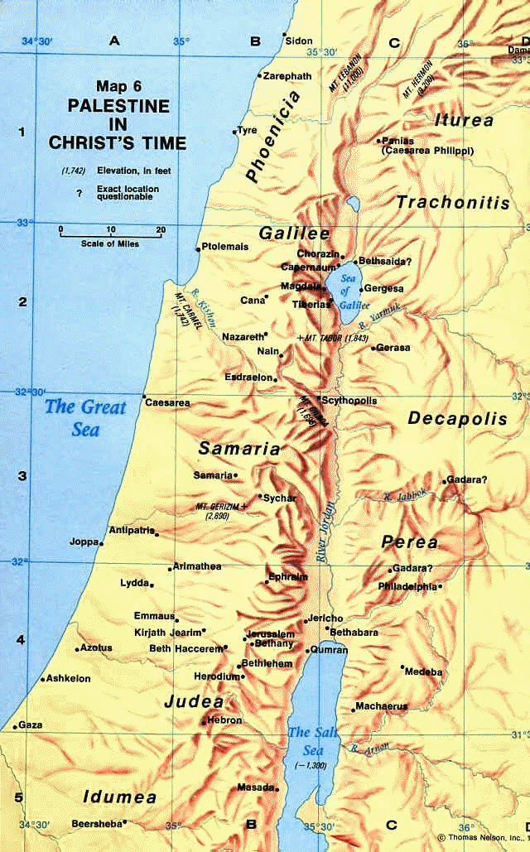
Nazareth
To be called a "Nazarene" in first century Palestine meant you were "from the wrong side of the tracks." "During Jesus' lifetime Nazareth was a small, unfortified rocky village, nestling between two valleys, inhabited by peasants and artisans, eking a meager livelihood out of their olive groves, vine­yards and cattle. It possessed no strategic or religious impor­tance and stood far from the busy thoroughfares and Galilean cities"

Slide 11
Chapters 3-4

Slide 12
OT Prophecy (John)
For four centuries the prophetic voice had been silent. But with the coming of John the Baptist there arrived the promised “Elijah” who would usher in the great and dreadful day of the Lord.
Mal 3:1 "Behold, I send My messenger, And he will prepare the way before Me.
Mal 4:5 Behold, I will send you Elijah the prophet before the coming of the great and dreadful day of the LORD.
There was controversy among the Jews as to the identity of the “Elijah” who is to come.

Slide 13
OT Prophecy (John)
Jesus identifies the Elijah to come as John.
Mt 17:10-13 - And His disciples asked Him, saying, "Why then do the scribes say that Elijah must come first?" 11 Jesus answered and said to them, "Indeed, Elijah is coming first and will restore all things. 12 "But I say to you that Elijah has come already, and they did not know him but did to him whatever they wished. Likewise the Son of Man is also about to suffer at their hands." ¹³ Then the disciples understood that He had spoken to them about John the Baptist

Slide 14
John the Baptist
Only Luke explains the background of John. We learn that
John was Jesus’ relative (Luke 1:36),
born to Elizabeth, the formerly barren wife of a priest named Zacharias (Luke 1:5-7).
His birth, and conception, while not of the nature of Jesus’ virgin conception, was brought about by the will of God to parents past the ordinary age of childbearing (Luke 1:18).
His father was told before his birth:
Luke 1:15-17: For he will be great in the sight of the Lord; and he will drink no wine or liquor, and he will be filled with the Holy Spirit while yet in his mother’s womb. ¹⁶ And he will turn many of the sons of Israel back to the Lord their God. ¹⁷ It is he who will go as a forerunner before Him in the spirit and power of Elijah, to turn the hearts of the fathers back to the children, and the disobedient to the attitude of the righteous, so as to make ready a people prepared for the Lord.”

Slide 15
Matthew 3:1-12: John’s Preaching
Now in those days John the Baptist came, preaching in the wilderness of Judea, saying, ² “Repent, for the kingdom of heaven is at hand.”
Acts 19:4- Paul said, “John baptized with the baptism of repentance, telling the people to believe in Him who was coming after him, that is, in Jesus.”
Luke 3:1 - Now in the fifteenth year of the reign of Tiberius Caesar (took
the throne in A.D. 14) , when Pontius Pilate was governor of Judea, and Herod was tetrarch of Galilee, and his brother Philip was tetrarch of the region of Ituraea and Trachonitis, and Lysanias was tetrarch of Abilene, ² in the high priesthood of Annas and Caiaphas, the word of God came to John, the son of Zacharias, in the wilderness.
Therefore “In those days” would be approximately 29-30 AD. Jesus was a resident of Nazareth. Gap of ≈30 years between chapters 2 & 3.

Slide 16
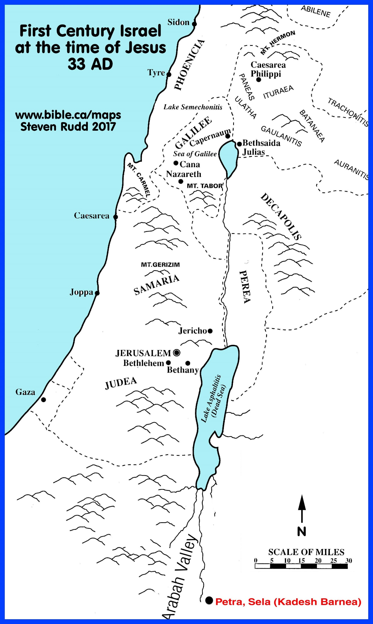
“in the wilderness of Judea”

Slide 17
Matthew 3:1-12: John’s Preaching
Now in those days John the Baptist came, preaching in the wilderness of Judea, saying, ² “Repent, for the kingdom of heaven is at hand.”
Thayer: “to change one’s mind for the better, heartily to amend with abhorrence of one’s past sins” (405).
W. E. Vine says “this change of mind involves both a turning from sin and a turning to God” (III: 281).

Slide 18
Repentance in the Bible
Sorrow for Sin
Repentance is the change of mind produced by godly sorrow and resulting in a change of conduct!
Reformation
“For godly sorrow produces repentance leading to salvation, not to be regretted; but the sorrow of the world produces death.”
(2 Cor. 7:10)
“Gentiles…should repent and turn to God, and do works befitting repentance. (Acts 26:20)
“Therefore bear fruits worthy of repentance
(Matthew 7:8)
Change of Mind & Will
Change of Life
& Salvation
Godly Sorrow

Slide 19
Repentance is:
Change of mind resulting in a change of behavior
You look at sin differently than before
You think differently – about what you’ve done.
A Decision to turn from evil and turn to the good!

Slide 20
“The Kingdom of Heaven”
Only Matthew uses the phrase “the kingdom of heaven”
This concept was likely born out of the promise given to Daniel that the time would come when “the God of heaven will set up a kingdom which shall never be destroyed; and the kingdom shall not be left to other people; it shall break in pieces and consume all these kingdoms, and it shall stand forever” (Dan. 2:44)
“Kingdom” refers to a king’s rule, authority, or sovereignty.
“Heaven” might signify that the kingdom’s origin, king, laws, privileges, etc, are all heavenly
“At hand” is in the perfect tense and indicates a past action with continuing results. God was not getting ready to establish His rule for it is eternal. He was, however, getting ready to manifest it, as He had in the past, by reestablishing a Son of David on the throne.
It was not intended to refer to a physical kingdom but, rather, to spiritual submission to Christ as king

Slide 21
Matthew 3:1-12: John’s Preaching
Now in those days John the Baptist came, preaching in the wilderness of Judea, saying, ² “Repent, for the kingdom of heaven is at hand.” ³ For this is the one referred to by Isaiah the prophet when he said,
“The voice of one crying in the wilderness, ‘Make ready the way of the Lord, Make His paths straight!’”
Isaiah 40:3
Messenger (herald) to go before
Prepare the way (road/highway)
Crying (shouting) the message
Mission = Make ready the way of the Lord; make his paths straight (by repentance and truth)
“Lord” refers to an owner; a master who has complete control. This underscores Jesus’ deity.
When kings went on trips they sent advance men to prepare a way, where there were no roads. Sometimes this meant leveling mountains, raising valleys, filling swamps, bridging rivers or removing other obstacles. Isaiah’s prophecy didn’t mean John would literally pave roads, but that he would prepare men for the Messiah by preaching repentance and urging them to straighten out the crooked things in their life.

Slide 22
Johns Message
John's preaching was centered around repentance. (cf Lk. 3:10-14)
rich he urged the proper attitude toward the poor.
publicans he demanded honesty.
soldiers he urged no violence to any man and to be content with their wages.
Pharisees he demanded they bring forth the proper fruits of repentance.
Why was this message so important to the coming of Jesus?
Jews needed a radical spiritual change to be ready for the Kingdom of Heaven.
Luke 7:30 --- But the Pharisees and the lawyers rejected God’s will for themselves, not having been baptized by John
Do we have barriers that are obstructing us, things to which we cling that keep us from Christ? we must move those out of our lives and make our lives straight if we want to be filled up with Christ.

Slide 23
Matthew 3:1-12: John’s Preaching
Now in those days John the Baptist came, preaching in the wilderness of Judea, saying, ² “Repent, for the kingdom of heaven is at hand.” ³ For this is the one referred to by Isaiah the prophet when he said,
“The voice of one crying in the wilderness, ‘Make ready the way of the Lord, Make His paths straight!’”
⁴ Now John himself had a garment of camel’s hair and a leather belt around his waist; and his food was locusts and wild honey. ⁵ Then Jerusalem was going out to him, and all Judea and all the district around the Jordan; ⁶ and they were being baptized by him in the Jordan River, as they confessed their sins.
Dress and diet are similar to that of Elijah. (2 Kings 1:8)
Jewish Expectation?
John 3:23: John also was baptizing in Aenon near Salim, because there was much water there; and people were coming and were being baptized

Slide 24
Matthew 3:1-12: John’s Preaching
⁷ But when he saw many of the Pharisees and Sadducees coming for baptism, he said to them, “You brood of vipers, who warned you to flee from the wrath to come? ⁸ Therefore bear fruit in keeping with repentance; ⁹ and do not suppose that you can say to yourselves, ‘We have Abraham for our father’; for I say to you that from these stones God is able to raise up children to Abraham. ¹⁰ The axe is already laid at the root of the trees; therefore every tree that does not bear good fruit is cut down and thrown into the fire.
Jeremiah 31:32 - The days are coming,” declares the Lord, “when I will make a new covenant with the people of Israel and with the people of Judah.
Under Moses, birth into the community of Israel placed one under a covenant relationship to God, but not necessarily in a relationship in which they “knew” the Lord. Under Christ, the very deﬁnition of a covenant relationship with Christ means that one “knows” the Lord. John rebukes the incongruity of thinking that a familial relationship with Abraham was enough to hide the sinfulness of one’s life. God raised up children for Abraham from the barren womb of Sarah—he could just as easily produce children from the stones. The true test of belonging to God is not ancestry of the ﬂesh but obedience of the ﬂesh and the spirit. K. Pope – Matthew (Truth Commentaries)
Matthew introduces two of the major antagonists of Jesus’ earthly ministry.
The Pharisees were a political party fiercely devoted to defending Judaism from the corrupting influence of Greek culture. “In their zeal for the Law they almost deified it and their attitude became merely external, formal, and mechanical. They laid stress, not upon the righteousness of an action, but upon its formal correctness. Consequently their opposition to Christ was inevitable; His manner of life and teaching was essentially a condemnation of theirs …” (W.E. Vine, Complete Expository Dictionary of Old and New Testament Words, p. 470).
There is still room for them in the kingdom if they will repent. But their repentance must be more than just lip service; it must issue in fruit (actions & attitudes) consistent with a true change of heart.

Slide 25
Matthew 3:1-12: John’s Preaching
⁷ But when he saw many of the Pharisees and Sadducees coming for baptism, he said to them, “You brood of vipers, who warned you to flee from the wrath to come? ⁸ Therefore bear fruit in keeping with repentance; ⁹ and do not suppose that you can say to yourselves, ‘We have Abraham for our father’; for I say to you that from these stones God is able to raise up children to Abraham. ¹⁰ The axe is already laid at the root of the trees; therefore every tree that does not bear good fruit is cut down and thrown into the fire.
This is the ﬁrst of three references to ﬁre in three verses. It clearly refers to the ﬁres of eternal punishment. This must be taken into consideration in any interpretation of the meaning of the “ﬁre” referenced in the two verses that follow.
God was ready to cut down unfruitful Jews and cast them into unquenchable fire (vs 12). The axe was “laid” to the branches to prune them, but at the root to destroy them. This is a sober picture of impending judgement.

Slide 26
Matthew 3:1-12: John’s Preaching
11 "As for me, I baptize you with water for repentance, but He who is coming after me is mightier than I, and I am not fit to remove His sandals; He will baptize you with the Holy Spirit and fire. 12 "And His winnowing fork is in His hand, and He will thoroughly clear His threshing floor; and He will gather His wheat into the barn, but He will burn up the chaff with unquenchable fire."
The inference from Matthew and John (Jn 1:15) is that Christ, as a member of the Godhead, was John’s commander and chief long before John’s life and work began. John understood his position and role.

Slide 27
“He will Baptize with Holy Spirit & Fire”
Often fire is used to symbolize God's fiery wrath and judgment upon the wicked (Ezek. 21:31-32; Isa. 29:6)
HS Baptism ( Joel 2:28; Acts 2 & 10)
Joel 2:28 - “It will come about after this That I will pour out My Spirit on all mankind; And your sons and daughters will prophesy, Your old men will dream dreams, Your young men will see visions.
Acts 1:4-5 – Gathering them together, He commanded them not to leave Jerusalem, but to wait for what the Father had promised, “Which,” He said, “you heard of from Me; ⁵ for John baptized with water, but you will be baptized with the Holy Spirit not many days from now.”
Acts 2:4 - And they were all filled with the Holy Spirit and began to speak with other tongues, as the Spirit was giving them utterance.
Acts 10:44 - While Peter was still speaking these words, the Holy Spirit fell upon all those who were listening to the message. ⁴⁵ All the circumcised believers who came with Peter were amazed, because the gift of the Holy Spirit had been poured out on the Gentiles also. ⁴⁶ For they were hearing them speaking with tongues and exalting God. Then Peter answered, ⁴⁷ “Surely no one can refuse the water for these to be baptized who have received the Holy Spirit just as we did, can he?” ⁴⁸ And he ordered them to be baptized in the name of Jesus Christ.

Slide 28
BAPTISM | NATURE | PURPOSE | BY | SUBJECTS | ELEMENT | ACT | DURATION
JOHN’S | Commandment (Lk 7:29-30) | To prepare for Messiah (Jn 1:31; Lk 3:3-6; Acts19:4) | John (Mk 1:5) | Penitent Jews (Mk 1:4-5) | Water (Jn 1:26) | Immersion (Mk 1:10; Jn 3:23) | Ceased before the Cross (Acts 19:3-5)
HOLY SPIRIT | Promise (Acts 1:4-5) | To empower for special work (Acts 1:8; Jn 16:13; Jn 14:26; II Cor 12:12) To prove Gods acceptance of Gentiles (Acts 11:15-18) | Christ Matt. 3:11 | Apostles (Acts 2:1-4) Cornelius’ household (Acts 11:15-16) | Holy Spirit (Matt. 3:11) | Over-powering (Matt 10:19-20; Acts 2:4) | Occurred but twice (Acts 2 & 10) Each a special case
FIRE | Warning (Matt 3:11-12) | Punishment (Matt. 25:45-46) | Christ (Matt. 3:11) | Wicked (Matt 3:10; II Thess 1:7-8) | Fire (Matt. 3:11) | Overwhelming (Rev. 20:15) | Everlasting (Matt. 25:41)
Great Com-mission | Commandment (Matt 28:19; Acts 2:38) | Forgiveness (Acts 2:38; I Peter 3:21) | Disciples (Matt 28:19) | Penitent believers (Mk 16:18; Acts 2:38) | Water (Acts 8:36-39) | Immersion (Rom. 6:3-5) | Till end (Matt. 28:19-20)
Notes:
(This HS baptism has caused a lot of confusion and many different ideas in the religious world. But if we want to see the meaning of the statement we should look for the fulfillment. Look to see where it is fulfilled to determine the nature of the prophecy.
John looks to a time when the one to come, as foreseen by Joel (2:28) will pour out the Spirit upon all flesh. Beyond baptism in water, as commissioned by Jesus (Jn 3:3-5; Mt. 28:19; Acts 8:36-40) the coming Messiah was to pour forth the Spirit, as the fulfillment reveals, on the apostles and the household of Cornelius.
Holy Spirit baptism was not administered by any mere mortal, but it was performed by the Lord Jesus Christ. This was not a baptism that could possibly be administered by a human, for the element into which the subject was immersed, or overwhelmed was the Holy Spirit.
Please notice that the purpose of the baptism was to empower the subject to work miracles and prophesy by the power of the Holy Spirit. Just before Jesus ascended into heaven, He directed and promised His apostles:
"And being assembled together with them, He commanded them not to depart from Jerusalem, but to wait for the Promise of the Father, "which," He said, "you have heard from Me; for John truly baptized with water, but you shall be baptized with the Holy Spirit not many days from now.""Therefore, when they had come together, they asked Him, saying, "Lord, will You at this time restore the kingdom to Israel?" And He said to them, "It is not for you to know times or seasons which the Father has put in His own authority. But you shall receive power when the Holy Spirit has come upon you; and you shall be witnesses to Me in Jerusalem, and in all Judea and Samaria, and to the end of the earth." Acts 1:4-8
How were the apostles to accomplish this incredible mission? How would uneducated Galileans be able to preach the gospel in all of Judea, much less to the ends of the earth? How would they remember what Jesus said? How would they prove that their testimony was truly from God? Jesus informed the apostles that they would "receive power when the Holy Spirit has come upon you". This special assistance was previously promised to the apostles, Jesus special ambassadors. They were to be guided into all truth and enabled to confirm their message through miraculous signs (John 16:13; Mark 16:17-20). Ten days after Jesus' ascension, on the day of the feast of Pentecost, the promise was fulfilled when the apostles were "baptized with the Holy Spirit" and "received power".
"When the Day of Pentecost had fully come, they were all with one accord in one place."And suddenly there came a sound from heaven, as of a rushing mighty wind, and it filled the whole house where they were sitting."Then there appeared to them divided tongues, as of fire, and one sat upon each of them. And they were all filled with the Holy Spirit and began to speak with other tongues, as the Spirit gave them utterance." Acts 2:1-4
The only other record of Holy Spirit Baptism occurs in Acts 10 at the conversion of Cornelius and his family. The conversion was unique because it was the first conversion of Gentiles. Until this point, the gospel had only been preached to Jews around Judea and Samaria. By the time of the events in Acts 10, the time had come for the gospel to be preached to "every creature" (Mark 16:15-16), and a powerful sign was required to convince the Jews that non-Jews were also to be granted the opportunity to repent unto life.
Lukes account adds fire to the Holy Spirit:
Lu 3:16 John answered, saying to all, "I indeed baptize you with water; but One mightier than I is coming, whose sandal strap I am not worthy to loose. He will baptize you with the Holy Spirit and fire.
Baptism of Fire
Fire is often used to symbolize God's treatment of the righteous and the wicked. Some passages use fire to symbolize God's fiery wrath and judgment upon the wicked (Ezekiel 21:31-32; Isaiah 29:6). Other passages refer to a difficult, but merciful trial by a refining fire that purges God's people of their wickedness (Zechariah 13:8-9; Malachi 3:1-4). In each case of fire's symbolic use, the context determines whether the intent is punishment or refinement. With these two possible uses in mind, let us examine the context of the references to "baptism of fire".
"Now as the people were in expectation, and all reasoned in their hearts about John, whether he was the Christ or not,"John answered, saying to all, "I indeed baptize you with water; but One mightier than I is coming, whose sandal strap I am not worthy to loose. He will baptize you with the Holy Spirit and fire."His winnowing fan is in His hand, and He will thoroughly clean out His threshing floor, and gather the wheat into His barn; but the chaff He will burn with unquenchable fire." Luke 3:15-17
John's answer was given in response to the question of him being the Messiah, or Christ. He contrasts himself with the Messiah by contrasting his baptism with the those baptisms administered by the Messiah. He continues to expound on the Messiah's authority through His power to separate the righteous from the wicked and render judgment.
Please notice that the only other reference to the "fire" of verse 16 is that of "unquenchable fire" in verse 17. Verse 17 illustrates the Messiah's judgment through an old figure of separating the useless chaff from the desired wheat kernels. The winnower separates the wheat to be saved, while the chaff is separated for destruction by fire, which illustrates the ultimate redemption of the righteous and the destruction of the wicked. This would cause one to reasonably conclude that baptism by fire is nothing other than a symbol of the eternal destruction of the wicked in hell's fire. Fire- suggests the eternal fire.
Mt 3:10-12 "And even now the ax is laid to the root of the trees. Therefore every tree which does not bear good fruit is cut down and thrown into the fire. 11 "I indeed baptize you with water unto repentance, but He who is coming after me is mightier than I, whose sandals I am not worthy to carry. He will baptize you with the Holy Spirit and fire. 12 "His winnowing fan is in His hand, and He will thoroughly clean out His threshing floor, and gather His wheat into the barn; but He will burn up the chaff with unquenchable fire."
Matt 3:10 refers to the fire of destruction 3:12 is the fire of destruction so the fire in 3:11 must be the fire of destruction

Slide 29
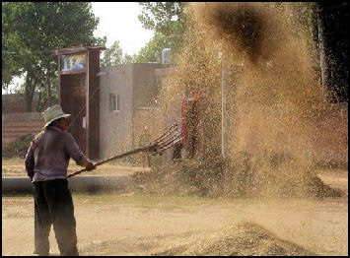
Matthew 3:1-12: John’s Preaching
The farmer uses a winnowing fork to toss harvested grain into the air. This was done so the wind could blow away the chaff (the husks, straw, rubbish). When the Messiah appears the wheat (the righteous) will be separated from the chaff (ungodly). The good grain will be gathered into the granary (the kingdom), but the chaff will be burned with unquenchable fire – a graphic depiction of hell (25:41, Mk 9:43ff)
11 "As for me, I baptize you with water for repentance, but He who is coming after me is mightier than I, and I am not fit to remove His sandals; He will baptize you with the Holy Spirit and fire. 12 "And His winnowing fork is in His hand, and He will thoroughly clear His threshing floor; and He will gather His wheat into the barn, but He will burn up the chaff with unquenchable fire."

Slide 30
Matthew 3:13-17 – Baptism of Jesus
¹³ Then Jesus arrived from Galilee at the Jordan coming to John, to be baptized by him. ¹⁴ But John tried to prevent Him, saying, “I have need to be baptized by You, and do You come to me?” ¹⁵ But Jesus answering said to him, “Permit it at this time; for in this way it is fitting for us to fulfill all righteousness.” Then he permitted Him.
The only inspired record of Jesus’ life during the period after it said he lived in Nazareth (2:23) relates that Jesus was in Galilee through his twelfth year (Luke 2:39-42)

Slide 31
Why was Jesus Baptized?
Jesus was not baptized as an act of personal repentance because he had no sin from which to repent (Heb. 4:15)
He did it to “fulfill all righteousness”. John was God's prophet, and Jesus would be obedient unto the Father by being baptized by the Father's prophet (precept of God given by prophet)
While in the flesh, Jesus kept the Law and he did all those things which God required of man which set a pattern for us
In all likelihood it was required to emphasize His identity with sinners (see Lev. 16:21-22). He would save people from their sins (1:21) by being “numbered with the transgressors” (Isa. 53:12) (Chumbley – Matthew Commentary, 62).

Slide 32
Matthew 3:13-17 – Baptism of Jesus
¹³ Then Jesus arrived from Galilee at the Jordan coming to John, to be baptized by him. ¹⁴ But John tried to prevent Him, saying, “I have need to be baptized by You, and do You come to me?” ¹⁵ But Jesus answering said to him, “Permit it at this time; for in this way it is fitting for us to fulfill all righteousness.” Then he permitted Him. ¹⁶ After being baptized, Jesus came up immediately from the water; and behold, the heavens were opened, and he saw the Spirit of God descending as a dove and lighting on Him, ¹⁷ and behold, a voice out of the heavens said, “This is My beloved Son, in whom I am well-pleased.”
Luke 3:21 - while He was praying, heaven was opened.
Based on Jewish expectation the descent of the Spirit upon Jesus identifies him as the coming Messiah (Isa. 61:1) Jesus identifies himself as the anointed one from Isa.61:1 (Lk. 4:16-21)
.
This is the first of three times in the Gospels that God audibly spoke form heaven (17:3, Jn 12:27-30). That he did so here is significant for what He said implies that all Christ had done up to this point was in perfect accordance with His will. At the start of Christ’s public ministry the Father and the Holy Spirit launched Him on the work by dramatically testifying to His Divine nature and by giving Him the acceptance of heaven.

Slide 33
Matthew 4:1-11 The Temptation of God in the Flesh
Then Jesus was led up by the Spirit into the wilderness to be tempted by the devil. ² And after He had fasted forty days and forty nights, He then became hungry. ³ And the tempter came and said to Him,

Slide 34
The Temptations of Jesus
Jesus was led into the wilderness (probably the wilderness of Judah near where John was baptizing)
Fasted 40 days and 40 nights
40 day fast by Moses on Mt Sinai (Ex 34:28; Duet 9:18)
When Elijah fled from Jezebel he fasted 40 days and nights on the way to Mt. Sinai (I Kings 19:8)
Both men engaged in this period of fasting and solitude in preparation for signiﬁcant events in their life and work. In a similar way, near the beginning of his public ministry, Jesus initiates this phase of work with a forty day period of fasting.

Slide 35
First Temptation – Question God’s Care (Show His Independence)
“If You are the Son of God, command that these stones become bread.” Jesus and Satan knew he was the Son of God and had the power.
What good is there in having supernatural power if you don’t use it? Prove his power and satisfy his hunger. Seems reasonable. Would the Father let His “Beloved Son” be hungry?
Would Jesus be self willed like Eve (Gen 3:6); impatient like Esau (Gen 25:29-34) or dissatisfied like the Israelites in the wilderness.
It is written, (total trust in God’s word) 'MAN SHALL NOT LIVE ON BREAD ALONE, BUT ON EVERY WORD THAT PROCEEDS OUT OF THE MOUTH OF GOD. (Deut. 8:3) -1500 years old but still reliable and relevant
“He humbled you, allowed you to hunger, and fed you with manna which you did not know nor did your fathers know, that he might make you know that man shall not live by bread alone; but man lives by every word that proceeds from the mouth of the LORD” (Deut. 8:3).
God led Israel into the wilderness and used hunger to teach them that complete obedience to His word was their highest priority. In the wilderness, they panicked and acted in unbelief (Ex 16:1-3)
Jesus humbly appeals to the principle that should govern man—dependence upon God’s word.
Jesus will live according to Gods word trusting the Father. His belly would not be His god-Phil 3:19
Would not act on the level of His physical desire though it was strong. (James 1:14)
Our lives are based on principles taught in God’s word. We must not only know them but practice them. Matthew 6:33 seek first the king…
This is the perfect example of how God’s people are to face temptation. The Psalmist said, “Your word I have hidden in my heart, that I might not sin against you!” (Ps. 119:11)
When we are suffering we often look for fast relief and Satan is the master of the quick fix. Satan will offer Jesus a shortcut in each temptation.
II Timothy 3:13-16 - But evil men and impostors will proceed from bad to worse, deceiving and being deceived. ¹⁴ You, however, continue in the things you have learned and become convinced of, knowing from whom you have learned them, ¹⁵ and that from childhood you have known the sacred writings which are able to give you the wisdom that leads to salvation through faith which is in Christ Jesus..

Slide 36
Second Temptation -Question His Faith (Dependence on God)
“So you intend to live by what is written?” “I will give you scripture”
Satan quotes scripture, (Psalm 91:11-12 - For He will give His angels charge concerning you, To guard you in all your ways.(Satan leaves this part out) ¹² They will bear you up in their hands, That you do not strike your foot against a stone.)
Test God’s care – Jump from the temple, Prove He loves you and that you trust Him
Satan was trying to make Jesus show a lack of conﬁdence in God. Insists that God prove Himself, after He has already proven Himself. It is putting God in a position to be forced to respond in one’s favor. This is to put God to the test. Satan is misapplying scripture by disregarding its context and is meaning.
Psalm 95:8-11 refers to incident at Massah in Exodus 17. Instead of trusting God for water they wondered, “Is the Lord among us or not? (Prove yourself…again)
Reply - 'YOU SHALL NOT PUT THE LORD YOUR GOD TO THE TEST.'" (Deut 6:16)
Those in the ﬂesh are often tempted to doubt God’s care for his people. Satan hopes to provoke the same faithless sentiment in order to move Jesus to test God’s care.

Slide 37
Third Temptation – Questioned His Hope
Obtain kingdoms of the world by worshipping Satan, just once.
Temptation appealed to power and pride
Avoid the hardships and sufferings that were ahead
Glory Without Service – No Need To Die
“Go Satan! FOR IT IS WRITTEN, YOU SHALL WORSHIP THE LORD YOUR GOD, AND SERVE HIM ONLY.” (Deut. 6:13)
He will not bow to him even though it means He must die on the cross.
Jesus obtained all earthly and heavenly authority by serving God (Matt. 28:18)
We have the same weapons that Jesus had: Scripture, Faith in God.
“just this once” is all that is necessary to wreck a life, or destroy God’s purpose in your life and for your future.
“Worship” involves more than public worship, it is a daily activity that glorifies God in every relationship and situation

Slide 38
The Temptations of Jesus
Luke 4:13 Now when the devil had ended every temptation, he departed from Him until an opportune time.
Does Heb 2:17-18; 4:14-16 have any bearing upon this period of Jesus’ life?
Heb 4:14-16 -Therefore, since we have a great high priest who has passed through the heavens, Jesus the Son of God, let us hold fast our confession. For we do not have a high priest who cannot sympathize with our weaknesses, but One who has been tempted in all things as we are, yet without sin. 16Therefore let us draw near with confidence to the throne of grace, so that we may receive mercy and find grace to help in time of need.
Jesus participates in the human experience. In Jesus we do not have one who sat from afar and separate from mankind but one who comes and lives in flesh and being in the flesh he is subjected to things in his divine state he would not be subjected to.
This section is intended not only to show us a sinless Savior but an exemplary one. These trials are illustrative of the kinds of temptations we all face. We are tempted:
To place physical needs above spiritual pursuits
By the “glitter” of the world which blinds us to true glory
To doubt God’s providential care or tempted to test God
Worship someone other than God or something rather than God
Notes:
”

Slide 39
Harmony Notes
Between Matthew 4:11 and 4:12 comes:
John 1:35-51 when Jesus first meets several future apostles.
John 2-4, often known as “The Early Judean Ministry.”
At this time Jesus:
“Cleanses” the temple for the first time (Jn 2:13-22).
Works signs during Passover (Jn 2:23-25).
Discusses the kingdom with Nicodemus (Jn 3:1-21).
Baptizes many in Judea (Jn 3:22ff).
Converses with the woman at Jacob’s well and tarries in Sychar (Jn 4:1-42).
All of this occurs before the disciples are called to follow Jesus on a “full-time” basis.
This is important when we see the calling of Peter Andrew James and John to follow Jesus on a full time basis.

Slide 40
Matthew 4:12-17 - Galilean Ministry
Now when Jesus heard that John had been taken into custody, He withdrew into Galilee; ¹³ and leaving Nazareth, He came and settled in Capernaum, which is by the sea, in the region of Zebulun and Naphtali.
Jesus’ hometown of Nazareth rejects him (Luke 4:16-30)
John 14:3-4 - For when Herod had John arrested, he bound him and put him in prison because of Herodias, the wife of his brother Philip. ⁴ For John had been saying to him, “It is not lawful for you to have her.”

Slide 41
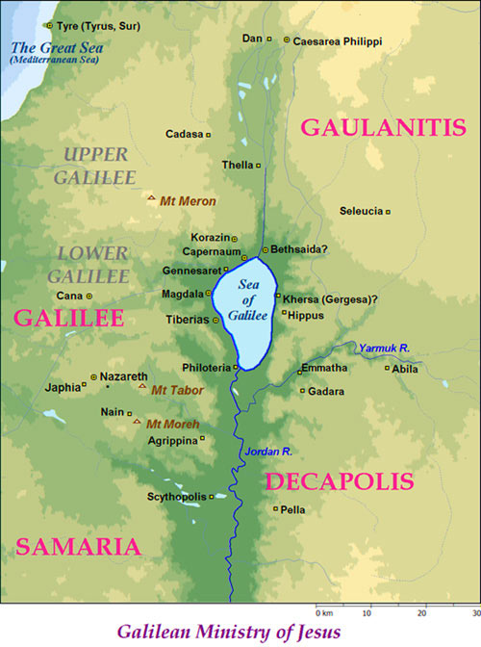
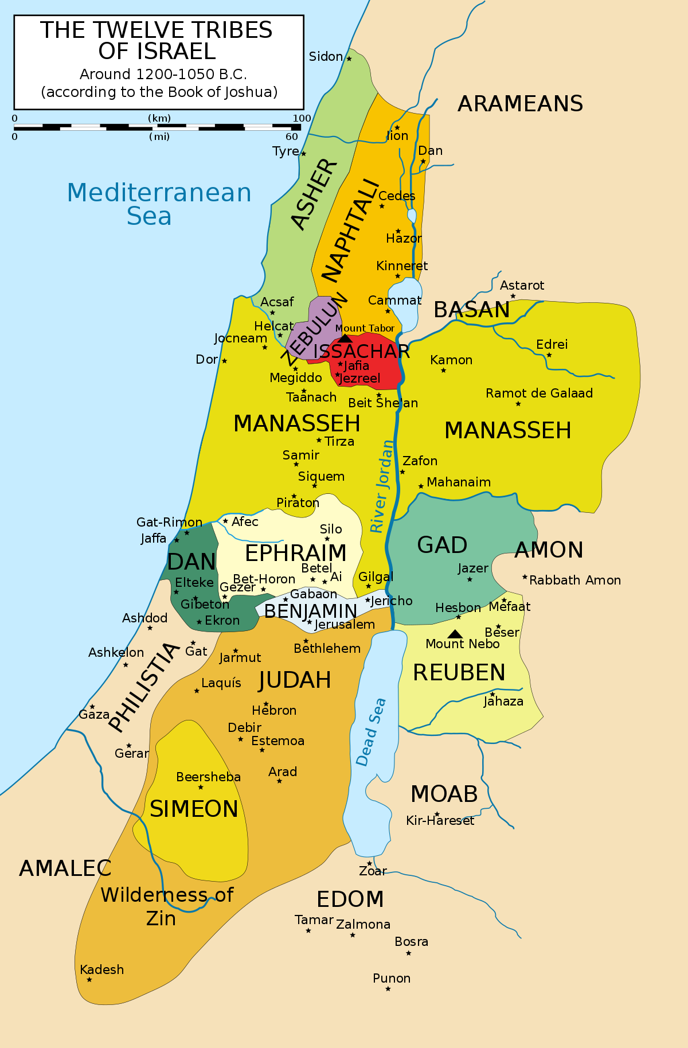

Slide 42
Matthew 4:12-17 - First Galilean Ministry
Now when Jesus heard that John had been taken into custody, He withdrew into Galilee; ¹³ and leaving Nazareth, He came and settled in Capernaum, which is by the sea, in the region of Zebulun and Naphtali.¹⁴ This was to fulfill what was spoken through Isaiah the prophet:
¹⁵ “The land of Zebulun and the land of Naphtali, By the way of the sea, beyond the Jordan, Galilee of theGentiles— ¹⁶ “The people who were sitting in darkness saw a great Light, And those who were sitting in the land and shadow of death, Upon them a Light dawned.”
¹⁷ From that time Jesus began to preach and say, “Repent, for the kingdom of heaven is at hand.”
“Fulfillment” passage?
This was the area on the northern boundary that had often borne the brunt of foreign aggression and was first to fall into Gentile hands when Assyria invaded. “Galilee of the Gentiles” described the area ethnically. Because of its proximity to Gentile territory, the area had a large Gentile population. Many Judean Jews were embarrassed by their country cousins and used the expression ‘Galilee of the Gentiles” as a pejorative (Jn 7:40-42,52). Politically, spiritually and culturally the area and its people were stigmatized as being “in the dark.” This is fulﬁlled in the life of Jesus, who was from the tribe of Judah, but grew up and lived in Galilee
Isaiah 9:1-2: But there will be no more gloom for her who was in anguish; in earlier times He treated the land of Zebulun and the land of Naphtali with contempt, but later on He shall make it glorious, by the way of the sea, on the other side of Jordan, Galilee of the Gentiles. The people who walk in darkness will see a great light; Those who live in a dark land, The light will shine on them

Slide 43
Matthew 4:18-22: Call of First Disciples
Luke records that all four men were “partners” in the ﬁshing business (Luke 5:7, 10)
Now as Jesus was walking by the Sea of Galilee, He saw two brothers, Simon who was called Peter, and Andrew his brother, casting a net into the sea; for they were fishermen. ¹⁹ And He said to them, “Follow Me, and I will make you fishers of men.” ²⁰ Immediately they left their nets and followed Him. ²¹ Going on from there He saw two other brothers, James the son of Zebedee, and John his brother, in the boat with Zebedee their father, mending their nets; and He called them.²² Immediately they left the boat and their father, and followed Him
This was not their first encounter with Jesus.
Early Judean Ministry found in John 2-4.
John 1:35 - John the Baptist pointing to Jesus had identiﬁed him to two of his disciples (likely Andrew and John) as the “Lamb of God” (John 1:35)
John 1:40-41- Andrew brought Simon to Jesus saying “we have found the Messiah”
when it was clear that it was God’s Son who stood before them and beckoned them to follow him, there could be no delay.

Slide 44
Matthew 4:23-25 Teaching & Healing in Galilee
Jesus was going throughout all Galilee, teaching in their synagogues and proclaiming the gospel of the kingdom, and healing every kind of disease and every kind of sickness among the people.
²⁴ The news about Him spread throughout all Syria; and they brought to Him all who were ill, those suffering with various diseases and pains, demoniacs, epileptics, paralytics; and He healed them. ²⁵ Large crowds followed Him from Galilee and the Decapolis and Jerusalem and Judea and from beyond the Jordan.
Healing authenticated His message (11:26)
This is the ﬁrst NT reference to synagogues. It is assumed that synagogue worship developed during the Babylonian exile to enable displaced Jews an opportunity for worship and study of the law. By NT times the synagogue was an established feature of Judaism inside and outside of Jerusalem (cf. Acts 6:9).
The light dawned in Galilee (4:16), but it was seen far beyond Galilee. They came from the four corners of the ancient holy land – Galilee (NW), Decapolis (NE), Judea (SW) Perea –beyond Jordan (SE). Decapolis and “beyond Jordan” describe predominately Gentile areas.

Slide 45
Matthew 4: Conclusions
The trials of Jesus show the nature of God’s kingdom: live by God’s word, trust in God, worship and service to God.
The message of Jesus from the outset has the promise of proclamation to the Gentiles
Jesus’ disciples seek to gather men to God as fishers of men

Slide 46
Themes in Matthew
“Continues to build case for Jesus’ Messiahship by showing how His life fulfilled OT prophecy
“Galilee of the Gentiles”, magi, genealogy
Matthew 28:18-20
Authority of Jesus
He is God’s saving power and presence for humans, Jew and Gentile
Responsibilities as Citizens – Go and make disciples, baptizing, teaching…

