Slide 1
The Antiochan Model
Proactive Openness to Outsiders (Acts 11:19-21)
Sacrificial Love for the Needy (Acts 11:27-30)
Devotion to Fasting and Prayer (Acts 13:2-3)
Commitment to Truth (Acts 13:1; 15:1-5)
Mission: Kingdom Expansion (11:19-26; 13:1-3; 15:35-41)

Slide 2
“On-The-Go”
Disciple Making

Slide 3
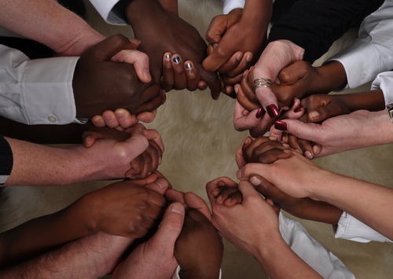
Pray with other believers

Slide 4
Contact a friend 1x / week for prayer requests
Gather some friends together 1x / month for prayer

Slide 5
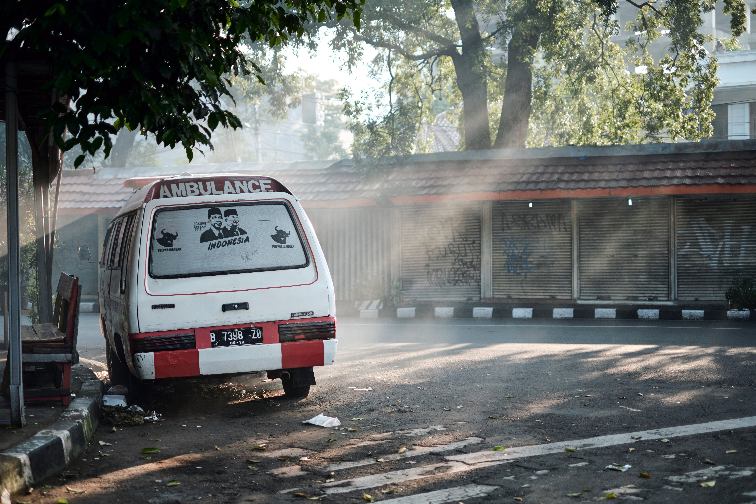
Do Good, Credit God

Slide 6
Speak, work, and dress differently than the world
Abstain from ungodly social and entertainment media
Engage in church and / or community service
Be open about the reason(s) for your moral choices
Handle rejection with grace
Prepare a personal ‘line’ that you use to deflect attention toward God when someone addresses your conduct.

Slide 7

Answer every question of life with Scripture.

Slide 8

Question everyone about everything

Slide 9
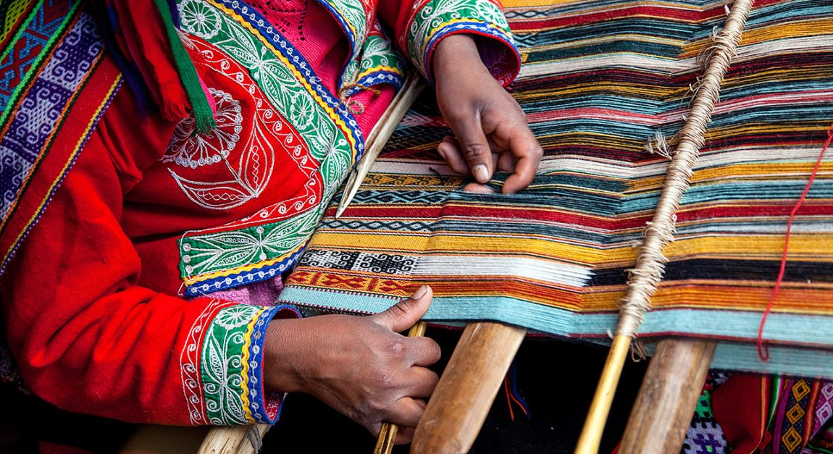
Weave Gospel threads into daily conversation

Slide 10
“Every time I see a rainbow it makes me appreciate God’s commitment to His promises.”
“Yeah the political climate worries me sometimes, but I try to remember that God is actually controlling these things.”
“The other night at our Bible study…”

Slide 11

Give (and accept) invitations for spiritual engagement

Slide 12
Invite someone to the Gospel Meeting (NEXT WEEK!)
Invite someone to a group Bible study
Invite someone to read the Bible with you
Set yourself a monthly / weekly invite goal

Slide 13

Open up your circle for “hospitality”

Slide 14
Stop going alone.

