Slide 1
“Charles Darwin had a big idea, arguably the most powerful idea ever….
Darwin's big idea explains all of life and its consequences…”
Richard Dawkins
The Guardian, Feb. 8, 2008
Then God said, “Let us make man in our image, after our likeness. And let them have dominion…
So God created man in his own image, in the image of God he created him; male and female he created them.
Genesis 1:26-27

Slide 2
Have I Been Told the Truth?
Messages which challenge today’s conventional thinking about…
Darwinian Evolution
The great
force

Slide 3
The great
force
Darwinian Macroevolution
Descent with modification
Modification by natural selection
“Survival of the fittest”
“…it follows that as each selected and favored form increases in number, so will the less favored forms decrease and become rare….
But we may go further than this; for as new forms are continually and slowly being produced, unless we believe that the number of specific forms goes on perpetually and almost indefinitely increasing, numbers inevitably must become extinct.” ― Charles Darwin, The Origin of Species(1859)

Slide 4
The great
force
Scientific Problems with Darwinian Macroevolution
Cannot be proven by the scientific method
Absence of transitionary forms
Complexity of life begs for the existence of a designer
Irreducible complexity – organisms could not have existed in simpler states

Slide 5
The great
force
Social Darwinism
Human societies will undergo the natural selection process
There will emerge stronger, more fit, more adaptable human individuals and groups
Those who are not and do not must give way to those who are and do

Slide 6
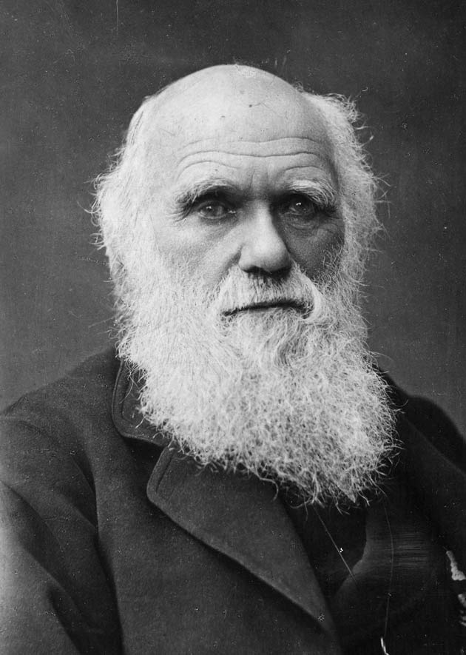
The great
force
“With savages, the weak in body or mind are soon eliminated; and those that survive commonly exhibit a vigorous state of health. We civilised men, on the other hand, do our utmost to check the process of elimination; we build asylums for the imbecile, the maimed, and the sick; we institute poor-laws; and our medical men exert their utmost skill to save the life of every one to the last moment. There is reason to believe that vaccination has preserved thousands, who from a weak constitution would formerly have succumbed to small-pox. Thus the weak members of civilised societies propagate their kind. No one who has attended to the breeding of domestic animals will doubt that this must be highly injurious to the race of man. It is surprising how soon a want of care, or care wrongly directed, leads to the degeneration of a domestic race; but excepting in the case of man himself, hardly any one is so ignorant as to allow his worst animals to breed.
- Charles Darwin, The Descent of Man (1871)

Slide 7
The great
force
“At some future period, not very distant as measured by centuries, the civilised races of man will almost certainly exterminate and replace throughout the world the savage races.
― Charles Darwin, The Descent of Man (1871)

Slide 8
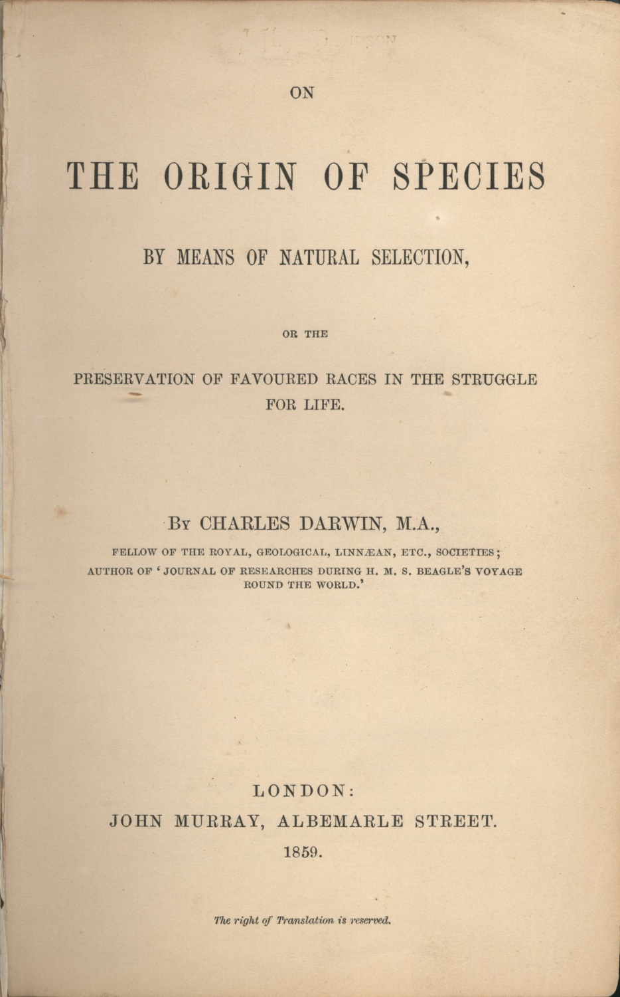
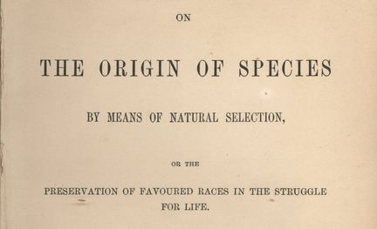

Slide 9
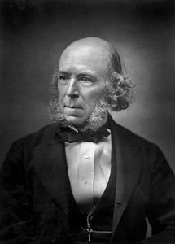
The great
force
Social Darwinism
“The forces which are working out the great scheme of perfect happiness, taking no account of incidental suffering, exterminate such sections of mankind as stand in their way, with the same sternness that they exterminate beasts of prey and herds of useless ruminants.” ― Herbert Spencer, Social Statics or The Conditions Essential to Human Happiness Specified and the First of Them Developed (1868)

Slide 10
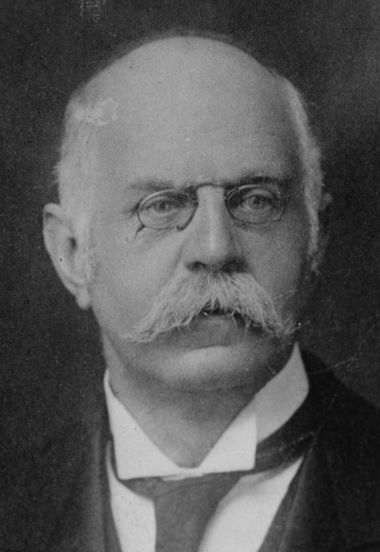
The great
force
Social Darwinism
Eugenics
the science of improving a human population by controlled breeding to increase the occurrence of desirable heritable characteristics. …a method of improving the human race…
- Oxford Dictionaries
the science of improving a human population by controlled breeding to increase the occurrence of desirable heritable characteristics. Developed largely by Francis Galton as a method of improving the human race, it fell into disfavor only after the perversion of its doctrines by the Nazis.
Powered by Oxford Dictionaries · © Oxford University Press
the science of improving a human population by controlled breeding to increase the occurrence of desirable heritable characteristics. Developed largely by Francis Galton as a method of improving the human race, it fell into disfavor only after the perversion of its doctrines by the Nazis.
Powered by Oxford Dictionaries · © Oxford University Press
the science of improving a human population by controlled breeding to increase the occurrence of desirable heritable characteristics. Developed largely by Francis Galton as a method of improving the human race, it fell into disfavor only after the perversion of its doctrines by the Nazis.
Powered by Oxford Dictionaries · © Oxford University Press
Leonard Darwin (son of Charles Darwin)

Slide 11
The great
force
Social Darwinism
““My firm conviction is that if wide-spread Eugenic reforms are not adopted during the next hundred years or so, our Western Civilization is inevitably destined to such a slow and gradual decay as that which has been experienced in the past by every great ancient civilization. The size and the importance of the United States throws on you a special responsibility in your endeavours to safeguard the future of our race. Those who are attending your Congress will be aiding in this endeavour, and though you will gain no thanks from your own generation, posterity will, I believe, learn to realize the great dept it owes to all the workers in this field.” ― Leonard Darwin (1850-1943),

Slide 12
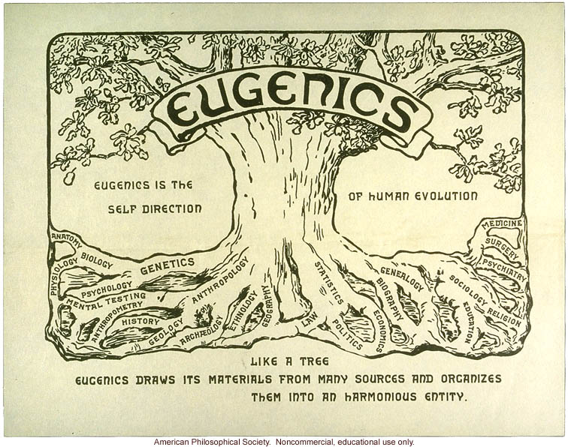
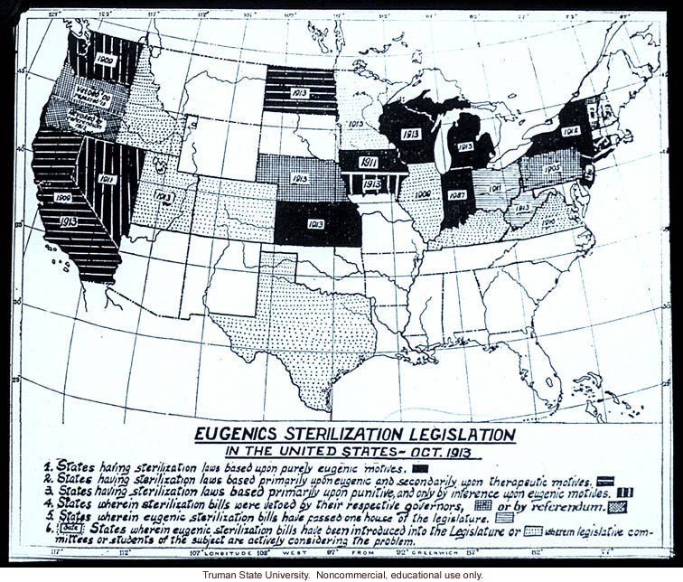

Slide 13
The great
force
Social Darwinism
“Truly, this earth is a trophy cup for the industrious man. And this rightly so, in the service of natural selection. He who does not possess the force to secure his Lebensraum (living space) in this world, and, if necessary, to enlarge it, does not deserve to possess the necessities of life. He must step aside and allow stronger peoples to pass him by.”
– Adolph Hitler
The annual rally of young officer cadets, Berlin
December 18, 1940

Slide 14
The great
force
Should not Darwinian macroevolution’s impact on human relationships and societies be part of the discussion today?

Slide 15
The great
force
God the Mighty Creator and Loving Father
In the beginning, God created the heavens and the earth. Genesis 1:1
"For God so loved the world, that he gave his only Son, that whoever believes in him should not perish but have eternal life...” John 3:16
Darwinian Survival
vs.
Biblical Love

Slide 16
The great
force
God the Mighty Creator and Loving Father
The great life force is not the Darwinian adapting and surviving drive
It is the act of self-sacrifice out of love seen in Jesus Christ
Darwinian Survival
vs.
Biblical Love

Slide 17
The great
force
God the Mighty Creator and Loving Father
For the love of Christ controls us, because we have concluded this: that one has died for all, therefore all have died; and he died for all, that those who live might no longer live for themselves but for him who for their sake died and was raised.
From now on, therefore, we regard no one according to the flesh. Even though we once regarded Christ according to the flesh, we regard him thus no longer.
2 Corinthians 5:14-16
Darwinian Survival
vs.
Biblical Love

Slide 18
The great
force
God the Mighty Creator and Loving Father
For in Christ Jesus you are all sons of God, through faith. For as many of you as were baptized into Christ have put on Christ. There is neither Jew nor Greek, there is neither slave nor free, there is neither male nor female, for you are all one in Christ Jesus. And if you are Christ's, then you are Abraham's offspring, heirs according to promise.
Galatians 3:26-29
Darwinian Survival
vs.
Biblical Love

Slide 19
The great
force
God the Mighty Creator and Loving Father
Why has the social dimension of Darwinism been buried underneath all the scientific jargon?
No one really wants to live in Darwin’s world!
Darwinian Survival
vs.
Biblical Love

Slide 20
The great
force
God the Mighty Creator and Loving Father
And he made from one man every nation of mankind to live on all the face of the earth, having determined allotted periods and the boundaries of their dwelling place, that they should seek God, in the hope that they might feel their way toward him and find him. Yet he is actually not far from each one of us, for
"'In him we live and move and have our being';
as even some of your own poets have said,
"'For we are indeed his offspring.'
- Acts 17:26-28
Darwinian Survival
vs.
Biblical Love

Slide 21
The great
force

