Slide 1
IMPORTANCE OF HOLINESS
“Pursue…holiness, without which no one will see the Lord.” Hebrews 12:14

Slide 2
What is Holiness?
a) Separation to God
b) The conduct befitting those separated.
Of all the activities in which holiness should be expected it would be in worship!

Slide 3
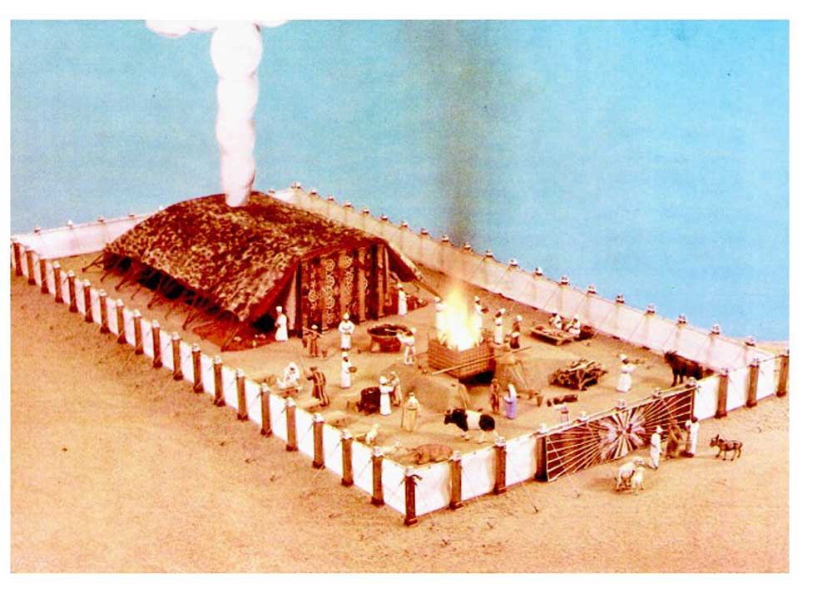
Leviticus 10: 3, 10
³ Then Moses said to Aaron, “It is what the Lord spoke, saying,
‘By those who come near Me I will be treated as holy, And before all the people I will be honored.’”
¹⁰ You are to distinguish between the holy and the common and between the unclean and the clean.”

Slide 4
The beauty of holiness
King James, New King James
“Oh, worship the Lord in The beauty of holiness.”
1 Chronicles 16:29
Psalm 29:2
Psalm 96:9

Slide 5
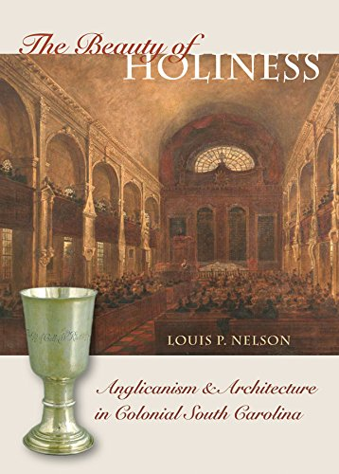
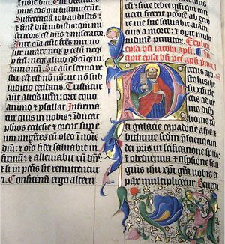
The BEAUTY OF HOLINESS does not involve aesthetics!

Slide 6
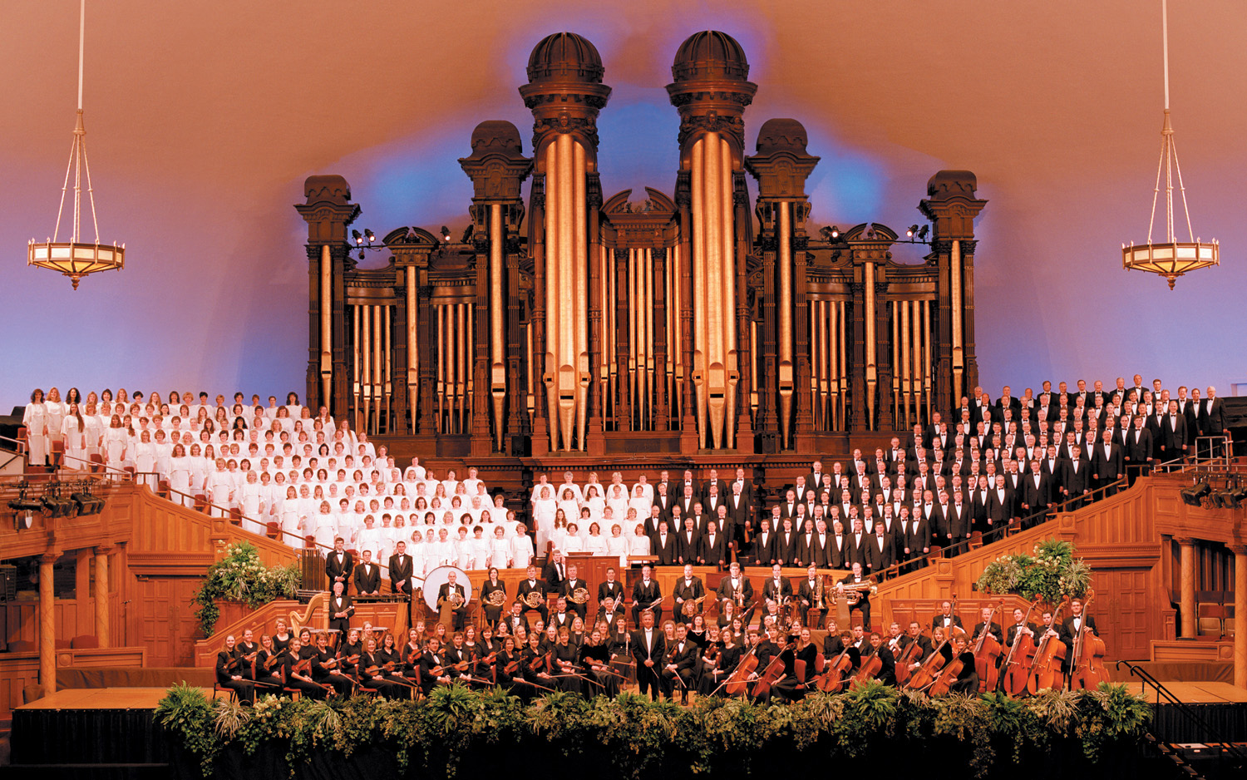

Slide 7
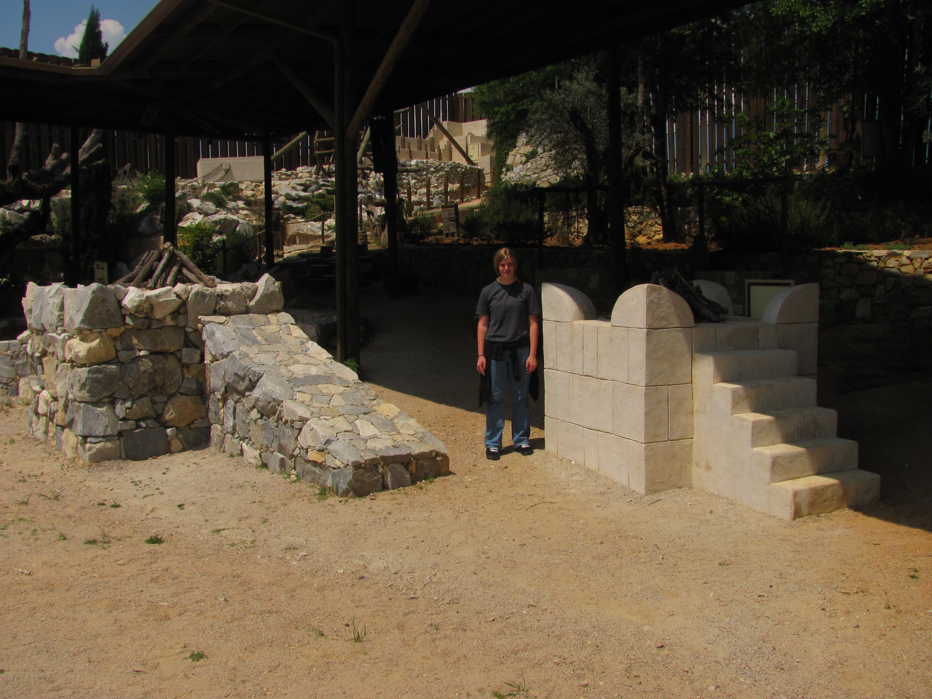
Which of these altars would please God?
“And if you make Me an altar of stone, you shall not build it of hewn stone; for if you use your tool on it, you have profaned it.” (Exodus 20:25)

Slide 8
Worship “in the beauty of holiness” cannot include anything of human invention.
Whatever is done must be divine in its origin.

Slide 9
In the Jewish Age God accommodated the immaturity of His people.
The Temple Appealed to Physical and Aesthetic
Sight of Gold
Smell of Incense
Sound of Instruments
Touch of Sacrifice
Taste of Peace Offerings

Slide 10
Jesus predicted a change.
“Woman, believe Me, the hour is coming when you will neither on this mountain, nor in Jerusalem, worship the Father. ²² You worship what you do not know; we know what we worship, for salvation is of the Jews. ²³ But the hour is coming, and now is, when the true worshipers will worship the Father in spirit and truth; for the Father is seeking such to worship Him. ²⁴ God is Spirit, and those who worship Him must worship in spirit and truth.”

Slide 11
Hebrews Compares the Two
“We have such a High Priest, who is seated at the right hand of the throne of the Majesty in the heavens, ² a Minister of the sanctuary and of the true tabernacle which the Lord erected, and not man.” (Hebrews 8:2)
“For Christ has not entered the holy places made with hands, which are copies of the true, but into heaven itself, now to appear in the presence of God for us.” (Hebrews 9:24)

Slide 12
In the Jewish Age God accommodated the immaturity of His people.
The Temple Appealed to Physical and Aesthetic
The New Covenant involves None of This
“we walk by faith, not by sight.” (2 Cor. 5:7)
“incense…the prayers of the saints.” (Rev. 5:8)
“making melody in your heart” (Eph. 5:19)
“baptized into His death” (Rom. 6:3)
L.S. only material element
Sight of Gold
Smell of Incense
Sound of Instruments
Touch of Sacrifice
Taste of Peace Offerings

Slide 13
Today, we can worship “in the beauty of holiness” only as we do what is authorized by the Lord
Otherwise, it is “in the beauty (?) of humanity”
“You are those who justify yourselves before men, but God knows your hearts.
For what is highly esteemed among men is an abomination in the sight of God. (Luke 16:15)

Slide 14
New American Standard
“Ascribe to the Lord the glory due His name; Bring an offering, and come before Him;
Worship the Lord In holy array.”
This emphasizes the character of the worshiper.

Slide 15
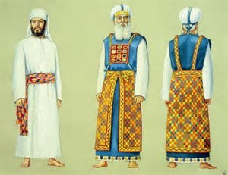
In the Old Testament this might Refer to clothing of Priests
This Photo by Unknown Author is licensed under CC BY-SA

Slide 16
In the New Testament there is no material “holy array.”
My brethren, do not hold the faith of our Lord Jesus Christ, the Lord of glory, with partiality. ² For if there should come into your assembly a man with gold rings, in fine apparel, and there should also come in a poor man in filthy clothes, ³ and you pay attention to the one wearing the fine clothes and say to him, “You sit here in a good place,” and say to the poor man, “You stand there,” or, “Sit here at my footstool,” ⁴ have you not shown partiality among yourselves, and become judges with evil thoughts? (James 2:1-4)

Slide 17
In the New Testament, “fine linen is the righteous acts of the saints.” (Revelation 19:8)
“I desire therefore that the men pray everywhere, lifting up holy hands, without wrath and doubting” (1 Timothy 2:8).
“In like manner also, that the women adorn themselves in modest apparel, with propriety and moderation, not with braided hair or gold or pearls or costly clothing, ¹⁰ but, which is proper for women professing godliness, with good works.” (1 Timothy 2:9-10)
“But why do you call Me ‘Lord, Lord,’ and not do the things which I say?” (Luke 6:46)

Slide 18
Colossians 3:12-16
¹² Therefore, as the elect of God, holy and beloved, put on tender mercies, kindness, humility, meekness, longsuffering; ¹³ bearing with one another, and forgiving one another, if anyone has a complaint against another; even as Christ forgave you, so you also must do. ¹⁴ But above all these things put on love, which is the bond of perfection. ¹⁵ And let the peace of God rule in your hearts, to which also you were called in one body; and be thankful. ¹⁶ Let the word of Christ dwell in you richly in all wisdom, teaching and admonishing one another in psalms and hymns and spiritual songs, singing with grace in your hearts to the Lord. ¹⁷ And whatever you do in word or deed, do all in the name of the Lord Jesus, giving thanks to God the Father through Him.”

Slide 19
Parable of the Wedding Feast
¹¹ “But when the king came in to see the guests, he saw a man there who did not have on a wedding garment. ¹² So he said to him, ‘Friend, how did you come in here without a wedding garment?’ And he was speechless.
¹³ Then the king said to the servants, ‘Bind him hand and foot, take him away, and cast him into outer darkness; there will be weeping and gnashing of teeth.’ (Matthew 22:11-13)

Slide 20
English Standard Version 1 Chronicles 16:29
“Ascribe to the Lord the glory due his name; bring an offering and come before him!
Worship the Lord in the splendor of holiness.”
This emphasizes the Glory of the One who is worshiped
“Tremble before him, all the earth”

Slide 21
Psalm 96:9
Worship the Lord in the splendor of holiness; tremble before him, all the earth!
Worship = “to depress, i.e. prostrate (in homage to royalty or God): bow (self) down, crouch, fall down (flat), humbly beseech, do (make) obeisance, do reverence, make to stoop.”

Slide 22
A Common Reaction to Encounters with the Splendor of God’s Holiness
Genesis 17:1-3 “Then Abram fell on his face”
Exodus 34:8 “So Moses made haste and bowed his head toward the earth, and worshiped.”
Ezekiel 1:29 “So when I saw it, I fell on my face.”
Daniel 8:17 “I was afraid and fell on my face.”
Luke 24:5 “they were afraid and bowed their faces to the earth”
Acts 22:7 “I fell to the ground..”
Revelation 1:17 “And when I saw Him, I fell at His feet as dead.”

Slide 23
The New Testament Word: PROSKUNEO
To make obeisance, do reverence to (from pros, towards, and kuneo, to kiss).
These actions are not necessarily physical—
They are primarily mental
Such worship requires faith to recognize the Splendor of the Holiness that surrounds the God we worship.
Revelation 4:2-11

Slide 24
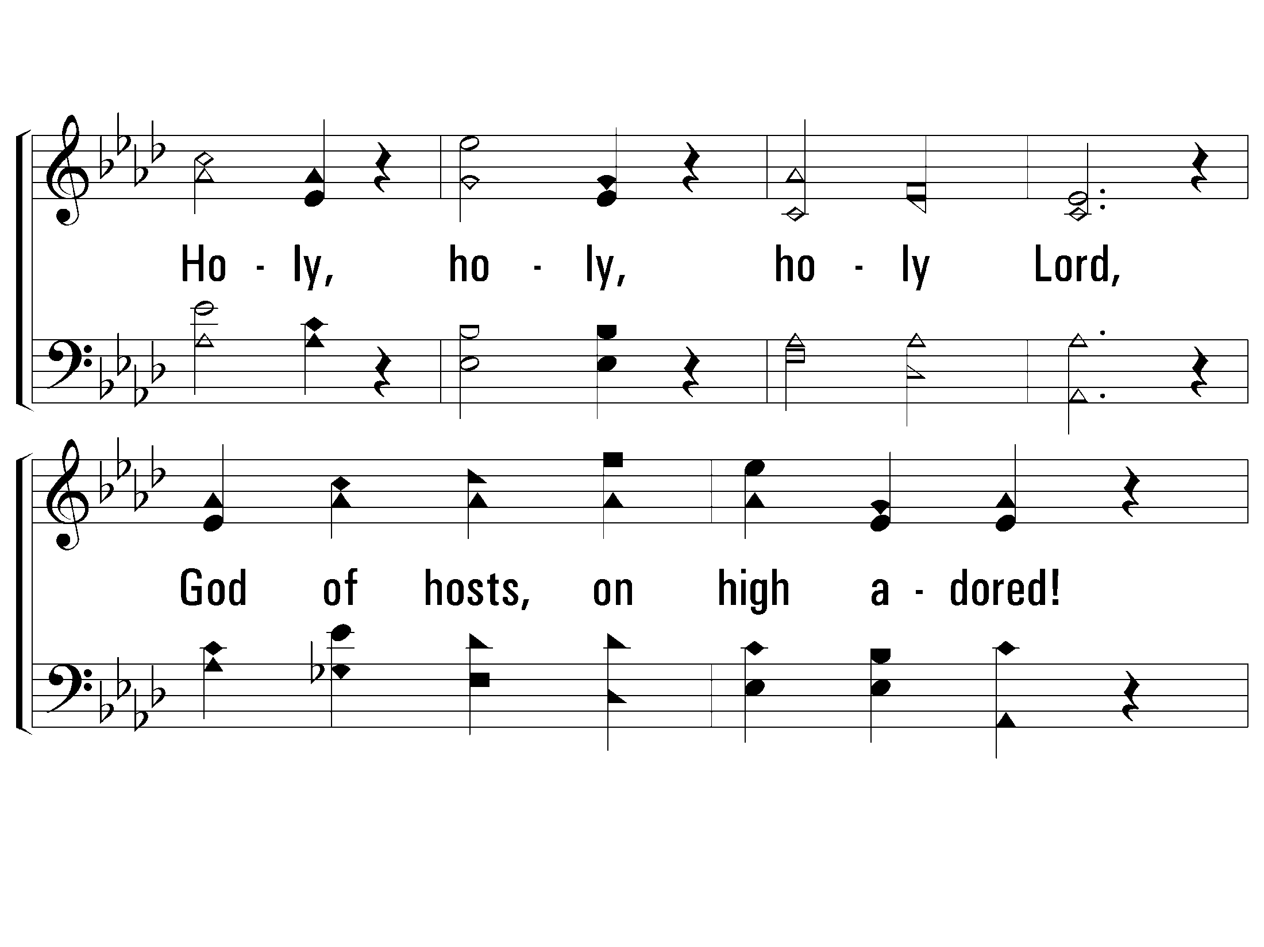
S – On Zion’s Glorious Summit
515
© 2002 The Paperless Hymnal™

Slide 25
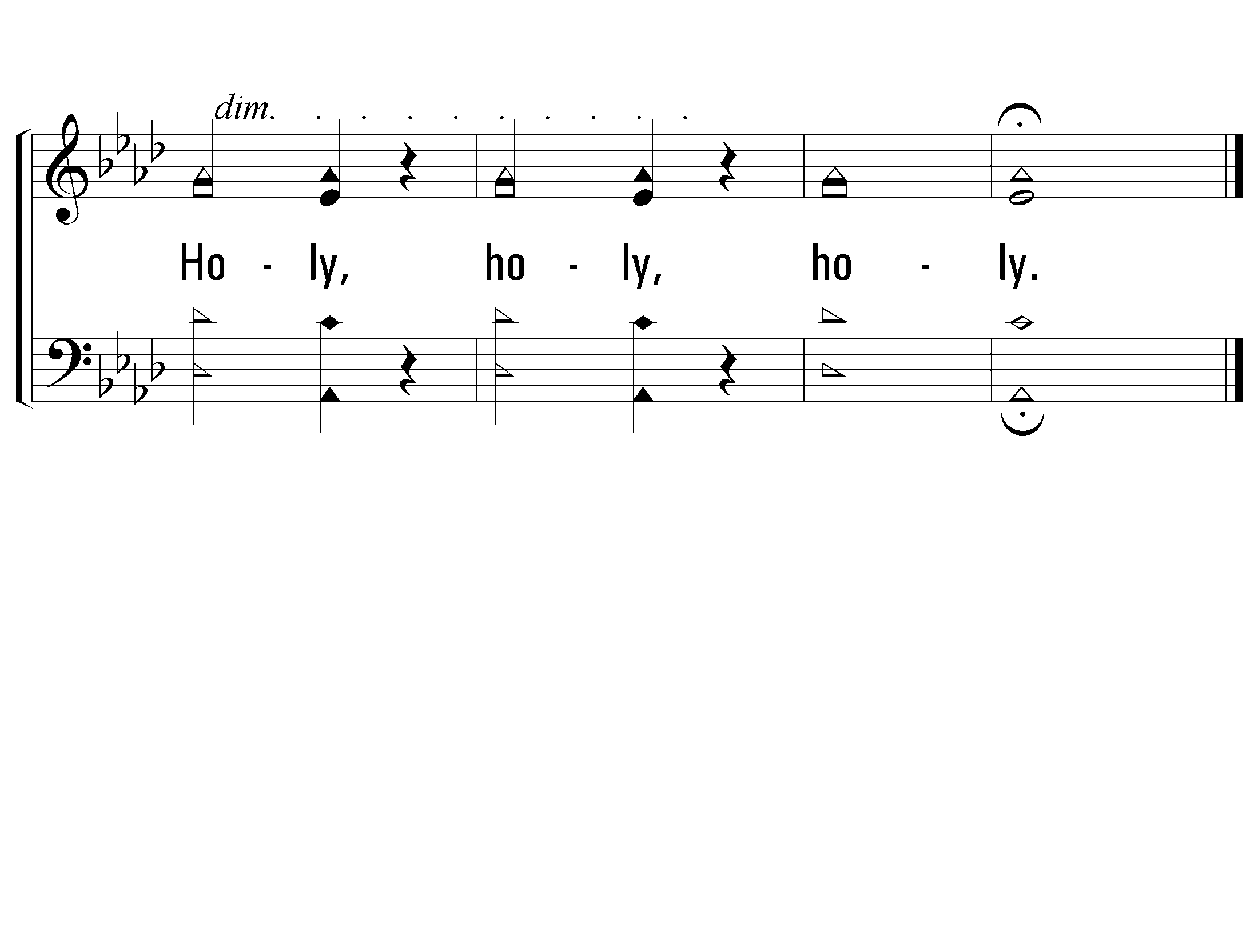
S – On Zion’s Glorious Summit
515
© 2002 The Paperless Hymnal™

Slide 26
Three Translations
(KJV) “Oh, worship the Lord in the beauty of holiness!”
(NASB) “Worship the Lord in holy array.”
(ESV) “Worship the Lord in the splendor of holiness.”
When holy actions, sanctified by the Lord,
are performed by Saints, living holy lives,
inwardly bowing and prostrate in reverence before their holy God…
There can be no question that this is…
Worship in the Beauty of Holiness.

