Slide 1
Secularism
Sands of our Time

Slide 2
Secularism:
Living without concern for or submission to spiritual and / or religious considerations.

Slide 3
Quotes about Secularism
One manifestation of secularism is asserting the right to be free from religious rule and teachings, or, in a state declared to be neutral on matters of belief, from the imposition by government of religion or religious practices upon its people
Another manifestation of secularism is the view that public activities and decisions, especially political ones, should be uninfluenced by religious beliefs or practices.
indifference to or rejection or exclusion of religion and religious considerations

Slide 4
Hedonism - Pleasure is the highest good
Secularism - God is excluded from perspective
Naturalism - Everything comes from natural properties and causes

Slide 5
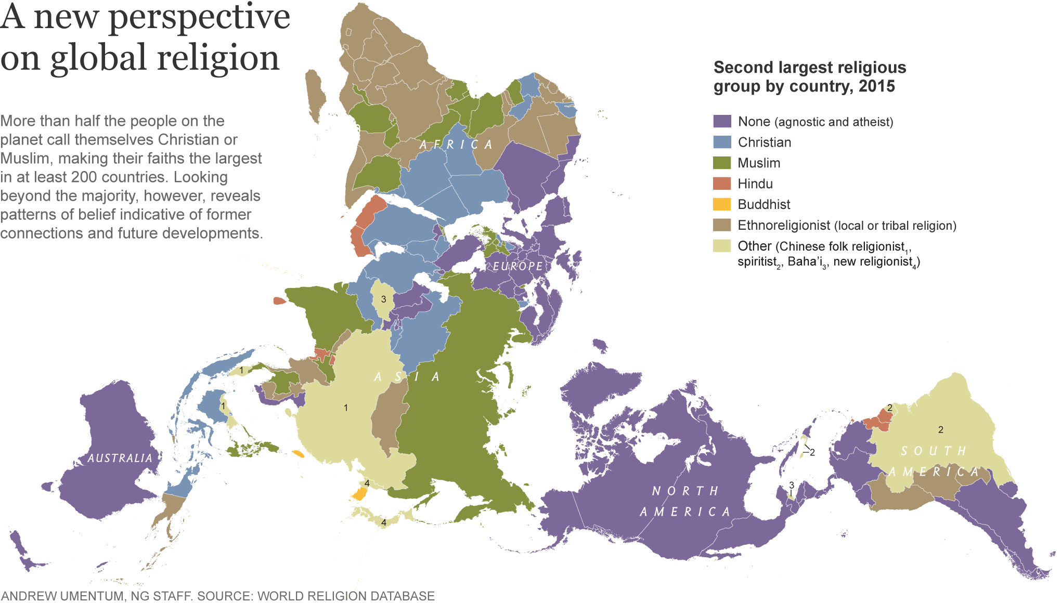
Notes:
https://news.nationalgeographic.com/2016/04/160422-atheism-agnostic-secular-nones-rising-religion/
http://www.pewforum.org/2015/04/23/live-event-the-future-of-world-religions/

Slide 6
Subjectivism // Consumerism // Humanism
Secularism
God and supernatural excluded from life
Naturalism
No supernatural origins of life
Notes:
Secularism - God is excluded from perspective
Hedonism - Pleasure is the highest good
Naturalism - Everything comes from natural properties and causes

Slide 7
Utilitarianism
Live for greatest good for greatest number
Secularism
God and supernatural excluded from life
Naturalism
No supernatural origins of life
Notes:
Secularism - God is excluded from perspective
Hedonism - Pleasure is the highest good
Naturalism - Everything comes from natural properties and causes

Slide 8
Hedonism
Pleasure is the rule for life
Secularism
God and supernatural excluded from life
No Basis for Ethics
No Reason for Hope
Naturalism
No supernatural origins of life
Notes:
Secularism - God is excluded from perspective
Hedonism - Pleasure is the highest good
Naturalism - Everything comes from natural properties and causes

Slide 9
“Do not be amazed at this, because a time is coming when all who are in the tombs will hear his voice ²⁹ and will come out—the ones who have done what is good to the resurrection resulting in life, and the ones who have done what is evil to the resurrection resulting in condemnation.
John 5:28-29
Notes:
for you will be repaid at the resurrection of the righteous. Luke 14:14
“Do not be amazed at this, because a time is coming when all who are in the tombs will hear his voice ²⁹ and will come out—the ones who have done what is good to the resurrection resulting in life, and the ones who have done what is evil to the resurrection resulting in condemnation. John 5:29
So since we are God’s offspring, we should not think the deity is like gold or silver or stone, an image made by human skill and imagination. ³⁰ Therefore, although God has overlooked such times of ignorance, he now commands all people everywhere to repent, ³¹ because he has set a day on which he is going to judge the world in righteousness, by a man whom he designated, having provided proof to everyone by raising him from the dead.” Acts 17:30-31
But I confess this to you, that I worship the God of our ancestors according to the Way (which they call a sect), believing everything that is according to the law and that is written in the prophets. ¹⁵ I have a hope in God (a hope that these men themselves accept too) that there is going to be a resurrection of both the righteous and the unrighteous. ¹⁶ This is the reason I do my best to always have a clear conscience toward God and toward people. Acts 24:14-16
We know that since Christ has been raised from the dead, he is never going to die again; death no longer has mastery over him. ¹⁰ For the death he died, he died to sin once for all, but the life he lives, he lives to God. ¹¹ So you too consider yourselves dead to sin, but alive to God in Christ Jesus. ¹² Therefore do not let sin reign in your mortal body so that you obey its desires , ¹³ and do not present your members to sin as instruments to be used for unrighteousness, but present yourselves to God as those who are alive from the dead and your members to God as instruments to be used for righteousness. Romans 6:1-13

Slide 10
Jesus said to her, “I am the resurrection and the life. The one who believes in me will live even if he dies, ²⁶ and the one who lives and believes in me will never die. Do you believe this?”
John 11:25-26
Notes:
For I consider that the sufferings of this present time are not worthy to be compared with the glory that is to be revealed to us. ¹⁹ For the anxious longing of the creation waits eagerly for the revealing of the sons of God. ²⁰ For the creation was subjected to futility, not willingly, but because of Him who subjected it, in hope ²¹ that the creation itself also will be set free from its slavery to corruption into the freedom of the glory of the children of God. Romans 8:18-25
For our citizenship is in heaven, from which also we eagerly wait for a Savior, the Lord Jesus Christ; ²¹ who will transform the body of our humble state into conformity with the body of His glory, by the exertion of the power that He has even to subject all things to Himself. Philippians 3:20-21
For the Lord Himself will descend from heaven with a shout, with the voice of the archangel and with the trumpet of God, and the dead in Christ will rise first. ¹⁷ Then we who are alive and remain will be caught up together with them in the clouds to meet the Lord in the air, and so we shall always be with the Lord. ¹⁸ Therefore comfort one another with these words. … For God has not destined us for wrath, but for obtaining salvation through our Lord Jesus Christ, ¹⁰ who died for us, so that whether we are awake or asleep, we will live together with Him. 1 Thessalonians 4:13-5:11
Blessed be the God and Father of our Lord Jesus Christ, who according to His great mercy has caused us to be born again to a living hope through the resurrection of Jesus Christ from the dead, ⁴ to obtain an inheritance which is imperishable and undefiled and will not fade away, reserved in heaven for you 1 Peter 1:3-4
But the day of the Lord will come like a thief, in which the heavens will pass away with a roar and the elements will be destroyed with intense heat, and the earth and its works will be burned up.¹¹ Since all these things are to be destroyed in this way, what sort of people ought you to be in holy conduct and godliness, ¹² looking for and hastening the coming of the day of God, because of which the heavens will be destroyed by burning, and the elements will melt with intense heat! ¹³ But according to His promise we are looking for new heavens and a new earth, in which righteousness dwells. 2 Peter 3:10-13
Beloved, now we are children of God, and it has not appeared as yet what we will be. We know that when He appears, we will be like Him, because we will see Him just as He is. 1 John 3:1-3
Revelation 21:1-8, 22:1-5

