Slide 1
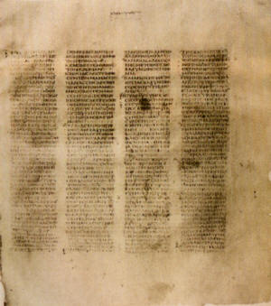
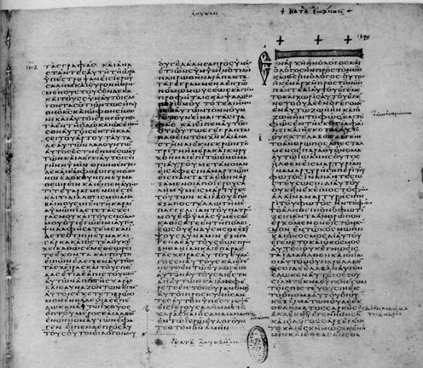
HOW WE GOT the Bible
A class on Bible origin, transmission and reliability
January 2018
Lesson 3
Evidence of Inspiration, Internal

Slide 2
Class Objectives
Show the importance of the Bible to our faith & that it is reliable.
Demonstrate that we can be confident that we have God’s inspired word today.
Understand the difference in modern versions of English Bible
Be able to answer questions about the origin of the Bible

Slide 3
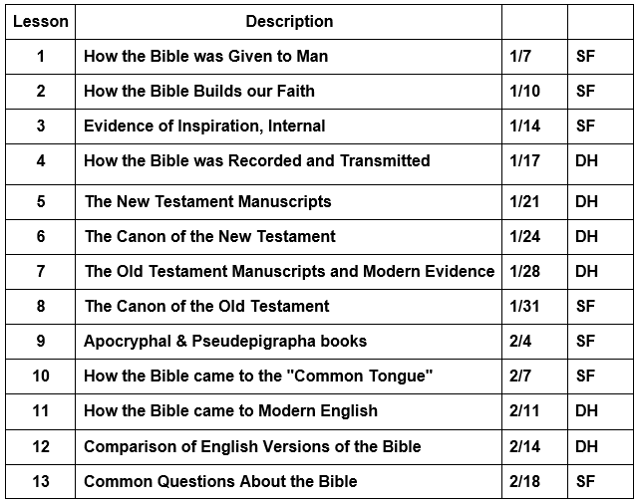
Course Content

Slide 4
The Bible is Uniquely Consistent
Across Time, Space, Language, Culture, and Socio-Economic Status

Slide 5
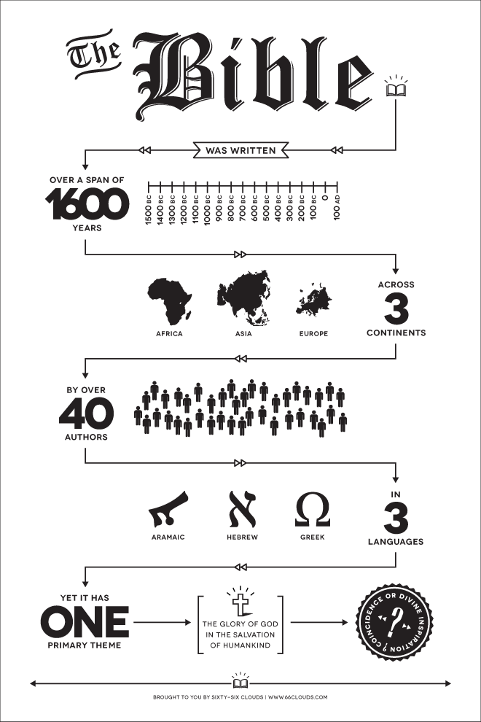
Uniqueness of God’s Word
Unique
being the only one
being without a like or equal
unusual
Consistent
marked by harmony, regularity, or steady continuity : free from variation or contradiction
marked by agreement : compatible
showing steady conformity to character, profession, belief, or custom

Slide 6
Authors
Socio-Economic differences
Moses, trained in the courts of Egypt
Daniel, a prime minister in Babylon
Amos, a herdsman
Joshua, a military leader
Luke, a physician
Matthews, a tax collector
Peter and John, fishermen
Solomon, a King of Israel
Paul, a rabbi
Places of writing
Moses, in the wilderness
Jeremiah, in a dungeon
Daniel, on a hillside and in a palace
Paul, inside prison walls
Luke, while traveling

Slide 7
One Common Message

Slide 8
Permanence of Marriage
Gen 2:23-24, The Command
Mark 10:2-9, The Question
Deu 24:1, The Law cited
Mal 2:16, The Principle
Jer 3:6-8, Used as an example
And Adam said: "This is now bone of my bones And flesh of my flesh; She shall be called Woman, Because she was taken out of Man." Therefore a man shall leave his father and mother and be joined to his wife, and they shall become one flesh. (Gen 2:23-24)
Moses, in a book of history
Mark, recording Jesus in his gospel
Moses, in a book of Law
Malachi, a prophet after the exile
Jeremiah, before and during the exile
The Pharisees came and asked Him, "Is it lawful for a man to divorce his wife?" testing Him. And He answered and said to them, "What did Moses command you?" They said, "Moses permitted a man to write a certificate of divorce, and to dismiss her." And Jesus answered and said to them, "Because of the hardness of your heart he wrote you this precept. But from the beginning of the creation, God 'MADE THEM MALE AND FEMALE.' 'FOR THIS REASON A MAN SHALL LEAVE HIS FATHER AND MOTHER AND BE JOINED TO HIS WIFE, AND THE TWO SHALL BECOME ONE FLESH'; so then they are no longer two, but one flesh. Therefore what God has joined together, let not man separate." (Mar 10:2-9)
"When a man takes a wife and marries her, and it happens that she finds no favor in his eyes because he has found some uncleanness in her, and he writes her a certificate of divorce, puts it in her hand, and sends her out of his house, (Deu 24:1)
"For the LORD God of Israel says That He hates divorce, For it covers one's garment with violence," Says the LORD of hosts. Therefore take heed to your spirit, That you do not deal treacherously." (Mal 2:16)
The LORD said also to me in the days of Josiah the king: "Have you seen what backsliding Israel has done? She has gone up on every high mountain and under every green tree, and there played the harlot. And I said, after she had done all these things, 'Return to Me.' But she did not return. And her treacherous sister Judah saw it. Then I saw that for all the causes for which backsliding Israel had committed adultery, I had put her away and given her a certificate of divorce; yet her treacherous sister Judah did not fear, but went and played the harlot also. (Jer 3:6-8)

Slide 9
Jesus Death for Atonement
Luke 24:25-27
Luke 24:44-47
Matt 5:18
Psalms 22
Isaiah 53
Then He said to them, "O foolish ones, and slow of heart to believe in all that the prophets have spoken! Ought not the Christ to have suffered these things and to enter into His glory?" And beginning at Moses and all the Prophets, He expounded to them in all the Scriptures the things concerning Himself. (Luk 24:25-27)
2 disciples, walking to Emmaus
Jesus with the apostles and disciples
Jesus, preaching on a mountain
Psalm of David, during the United Kingdom
Isaiah the Prophet, in the Kingdom of Judah
Then He said to them, "These are the words which I spoke to you while I was still with you, that all things must be fulfilled which were written in the Law of Moses and the Prophets and the Psalms concerning Me." And He opened their understanding, that they might comprehend the Scriptures. Then He said to them, "Thus it is written, and thus it was necessary for the Christ to suffer and to rise from the dead the third day, and that repentance and remission of sins should be preached in His name to all nations, beginning at Jerusalem. (Luk 24:44-47)
For assuredly, I say to you, till heaven and earth pass away, one jot or one tittle will by no means pass from the law till all is fulfilled.
(Mat 5:18)
… My God, My God, why have You forsaken Me? Why are You so far from helping Me, And from the words of My groaning? (Psa 22:1)
All those who see Me ridicule Me; They shoot out the lip, they shake the head, saying, "He trusted in the LORD, let Him rescue Him; Let Him deliver Him, since He delights in Him!" (Psa 22:7-8)
I can count all My bones. They look and stare at Me. They divide My garments among them, And for My clothing they cast lots. (Psa 22:17-18)
He is despised and rejected by men, A Man of sorrows and acquainted with grief. And we hid, as it were, our faces from Him; He was despised, and we did not esteem Him. Surely He has borne our griefs And carried our sorrows; Yet we esteemed Him stricken, Smitten by God, and afflicted. But He was wounded for our transgressions, He was bruised for our iniquities; The chastisement for our peace was upon Him, And by His stripes we are healed. All we like sheep have gone astray; We have turned, every one, to his own way; And the LORD has laid on Him the iniquity of us all. (Isa 53:3-6)

Slide 10
A Contrast

Slide 11
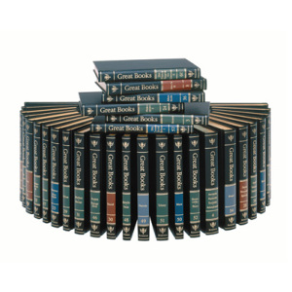
Works of Man
“Great Books of the Western World”
Completed in 1952 (54 Vol), updated in 1990 (60 Vol)
Criteria for selection
Contemporary Significance: Relevant to problems and issues of today
Infinite re-readability
Relevance to a large number of the “Great Ideas” (from 25-75 of 102)
Selections from 450 works, of nearly 100 authors, over 2500 years
Would this be similar to the Bible?
Would it be as consistent?

Slide 12
Josh McDowell’s Challenge
Contrast the books of the Bible with the compilation of Western classics called the “Great Books of the Western World”. The Great Books contain selections from more than 450 works by close to 100 authors spanning a period of about 25 centuries: Homer, Plato, Aristotle, Plotinus, Augustine, Aquinas, Dante, Hobbes, Spinoza, Calvin, Rousseau, Shakespeare, Hume, Kant, Darwin, Tolstoy, Whitehead, and Joyce, to name but a handful. While these individuals are all part of the Western tradition of ideas, they often display an incredible diversity of views on just about every subject. And while their views share some commonalities, they also display numerous conflicting and contradictory positions and perspectives. In fact, they frequently go out of their way to critique and refute ideas proposed by their predecessors.
A representative of the Great Books of the Western World came to my house one day, attempting to recruit salesmen for the series. He spread out a chart describing the series, and spent five minutes talking to my wife and me about it. We then spent an hour and a half talking to him about the Bible, which we presented as the greatest book of all time.
I challenged this representative to take just 10 of the authors from the Great Books series, all from one walk of life, one generation, one place, one time, one mood, one continent, one language, and all addressing one controversial subject. I then asked him, “Would the authors agree with one another?”
He paused and then replied, “No.”
“What would you have, then” I retorted. Immediately he answered, “a conglomeration.”
Two days later he committed his life to Christ.
Josh McDowell, “The New Evidence that Demands a Verdict”, Thomas Nelson, 1999
Choose any 10 Authors from
One walk of life
One generation
One place
One mood
One time
One Continent
One language
Addressing 1 controversial subject
Would they agree?

Slide 13
Fulfillment of Prophecy

Slide 14
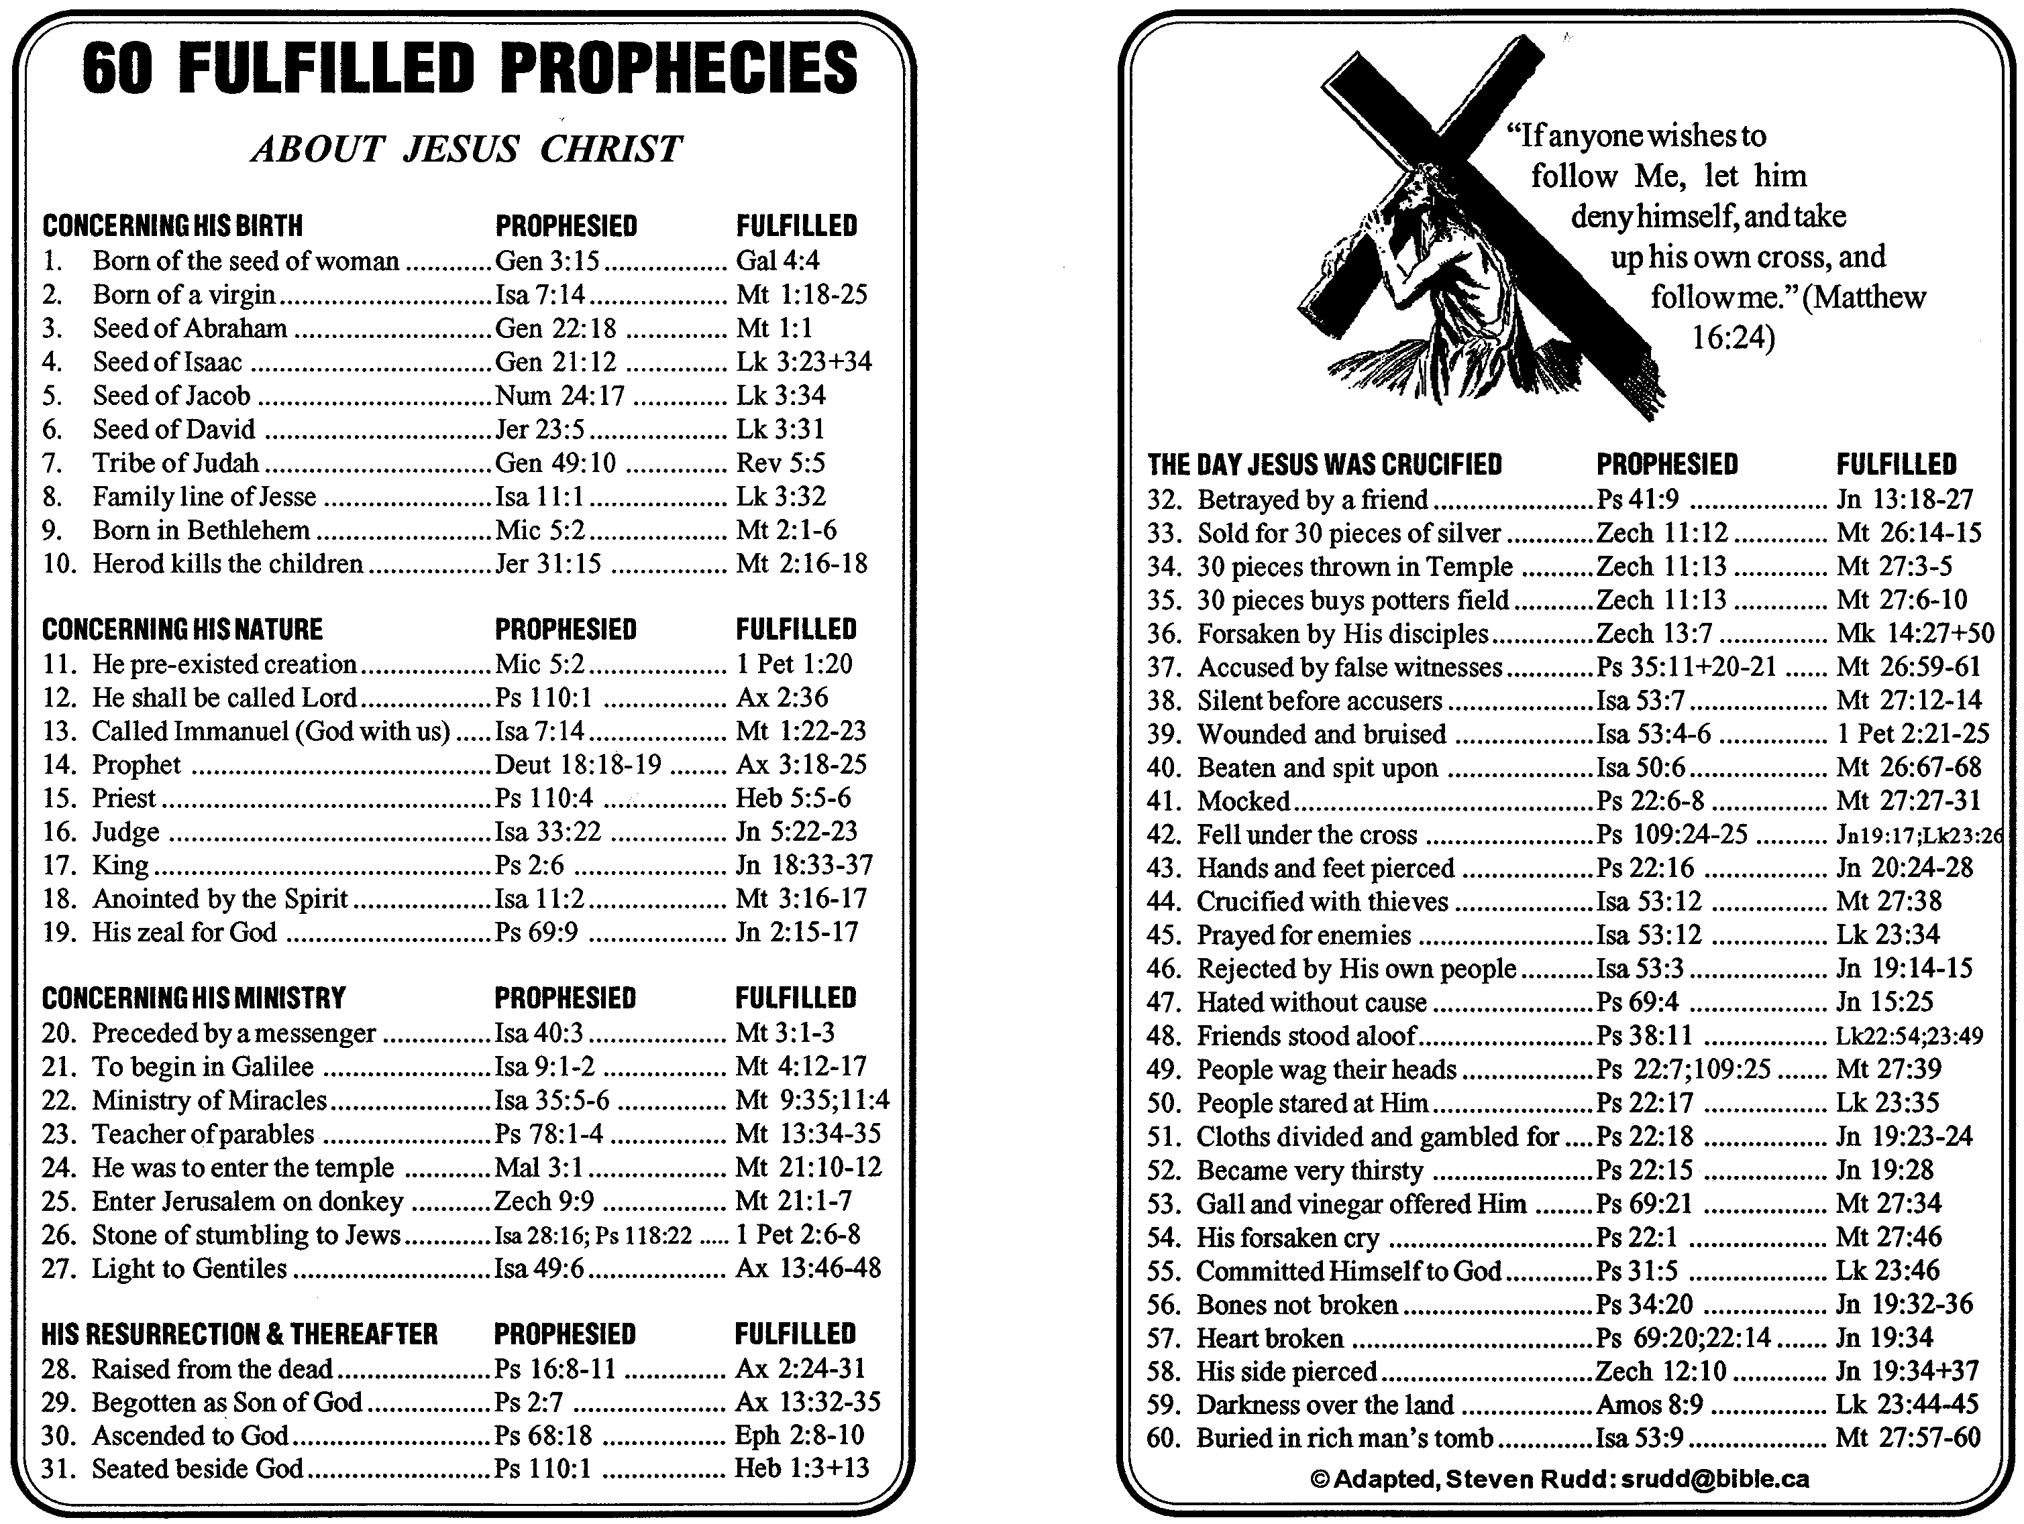

Slide 15
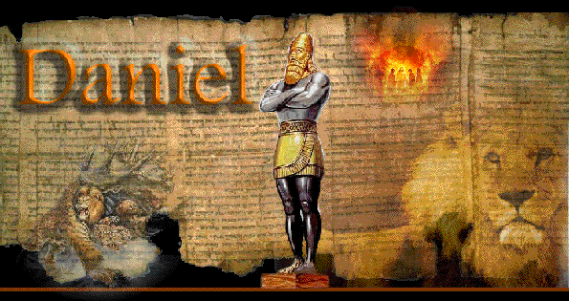
Working in the Nations

Slide 16
Summary
The Bible is uniquely consistent in theme, despite the tremendous differences in human authors that wrote it
Topics that are presented in the Bible are consistent throughout
All prophecies in scripture about Jesus were fulfilled
Internal evidence supports that the message is from God

