Slide 1
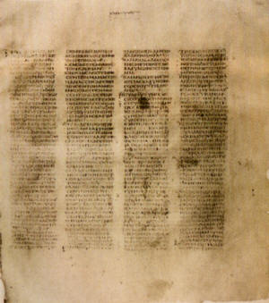
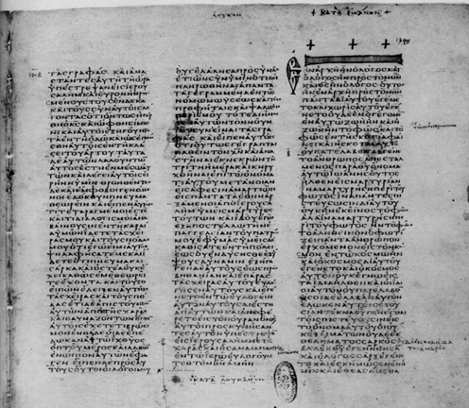
HOW WE GOT the Bible
A class on Bible origin, transmission and reliability
January 2018
Lesson 4
How the Bible was Recorded and Transmitted

Slide 2
Class Objectives
Show the importance of the Bible to our faith & that it is reliable.
Demonstrate that we can be confident that we have God’s inspired word today.
Understand the difference in modern versions of English Bible
Be able to answer questions about the origin of the Bible

Slide 3
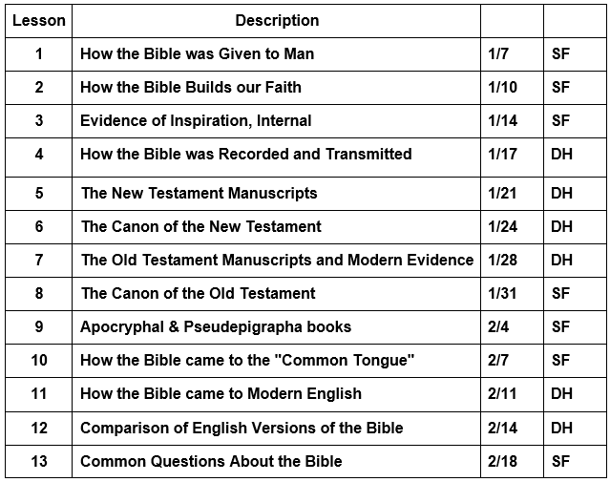
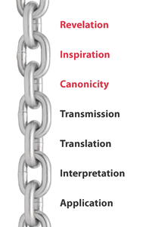
Course Content

Slide 4
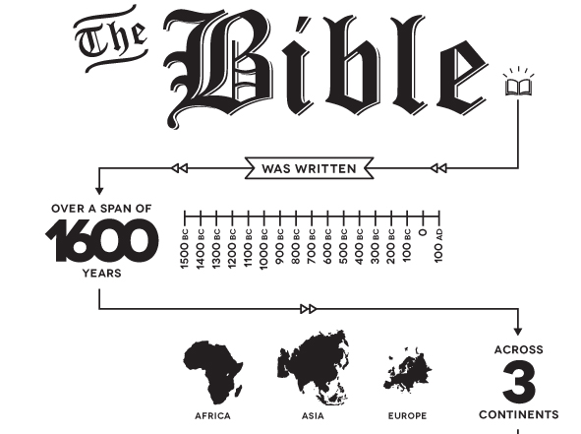

Slide 5
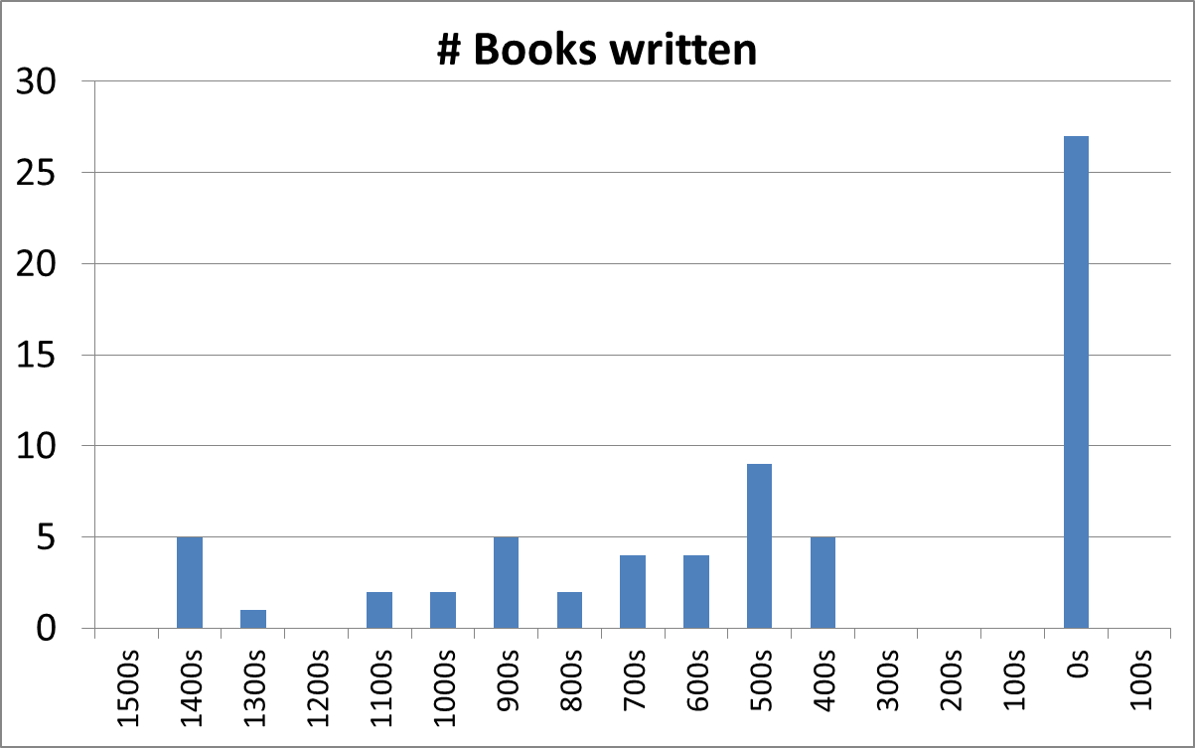
Distribution of Time of Writing of Bible Books
New Testament
Moses
History & Prophets
Poetry & Wisdom

Slide 6
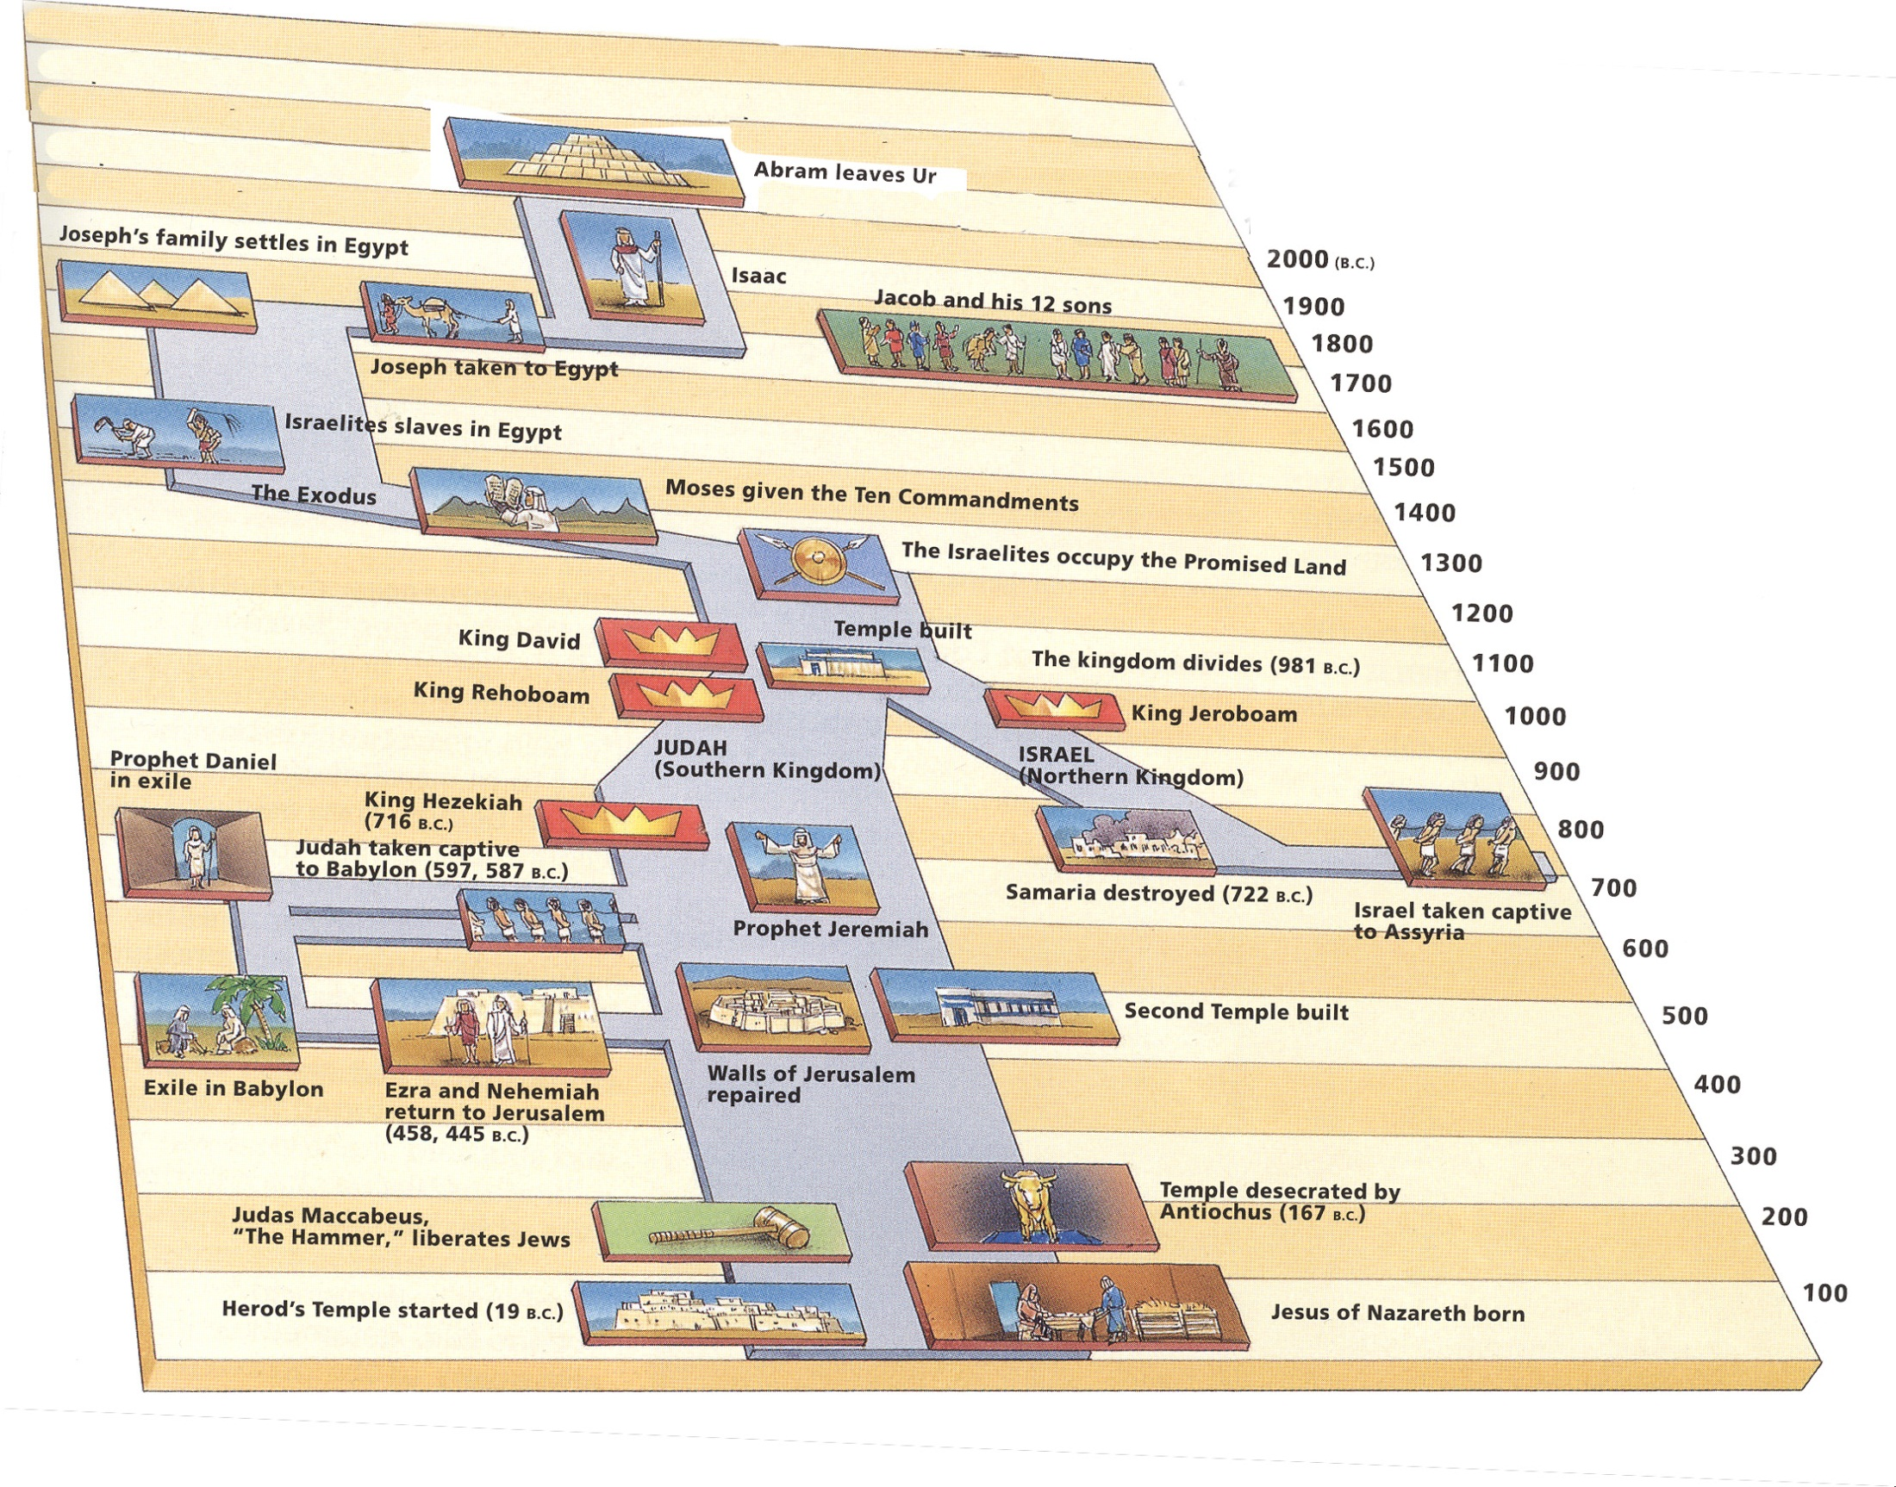

Moses
Poetry & Wisdom
History & Prophets
Daniel Roars

Slide 7

Prophetic Waves
Assyrian Threat
Syrian Threat
Babylonian Threat
Romans
Moses
Exodus
Persian
Written
Israel Falls
Abraham
Judah Falls
Judges
Kingdom Divides
Captivity
& Return
United Kingdom
Oral
Daniel
roars
Greeks
2100
1400
1100
1000
900
800
700
600
500
400
100
0
~30
100
605
597
586
538
458
444
722
Christ
Exile
Return

Slide 8
New Testament Chronology*
Inception
Expansion
Destruction of Jerusalem
Paul’s 2nd Imprisonment
Council in Jerusalem
Paul’s 1st Imprisonment
Saul’s Conversion
Paul’s 2nd Journey
Birth of Jesus
Baptism of Jesus
Paul’s 1st Journey
Paul’s 3rd Journey
Crucifixion
Consolidation
- 4
26
29
36
45
49
52
55
60
68
70
85
95
Matthew, Luke
Acts
General Epistles
Rev
Mark
Paul’s Epistles
John
Jas
Eph
I Pet
I-III Jno
Gal
Phil
II Pet
Rev
Col
Heb
I & II Thes
Phle
Jude
I & II Cor
I Tim
Rom
Titus
II Tim
Matthew
Luke
John
*Merrill C. Tenney, New Testament Survey, Eerdmans, 1954, p128.
Mark
Acts

Slide 9
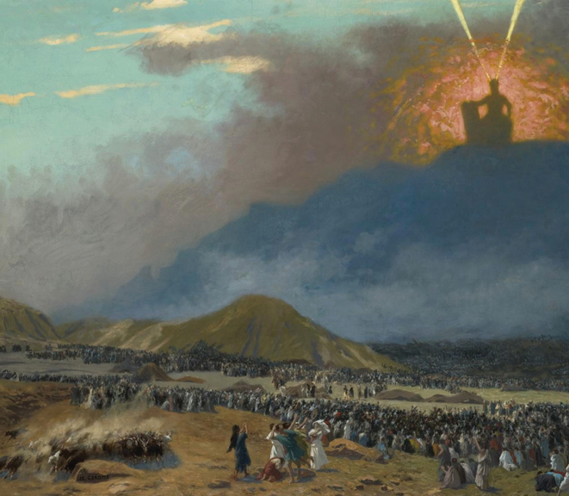
Covenant Established
Exodus 19:5-8 (ESV)
⁵ Now therefore, if you will indeed obey my voice and keep my covenant, you shall be my treasured possession among all peoples, for all the earth is mine; ⁶ and you shall be to me a kingdom of priests and a holy nation.
These are the words that you shall speak to the people of Israel.”
⁷ So Moses came and called the elders of the people and set before them all these words that the LORD had commanded him.
⁸ All the people answered together and said, “All that the LORD has spoken we will do.” And Moses reported the words of the people to the LORD.

Slide 10
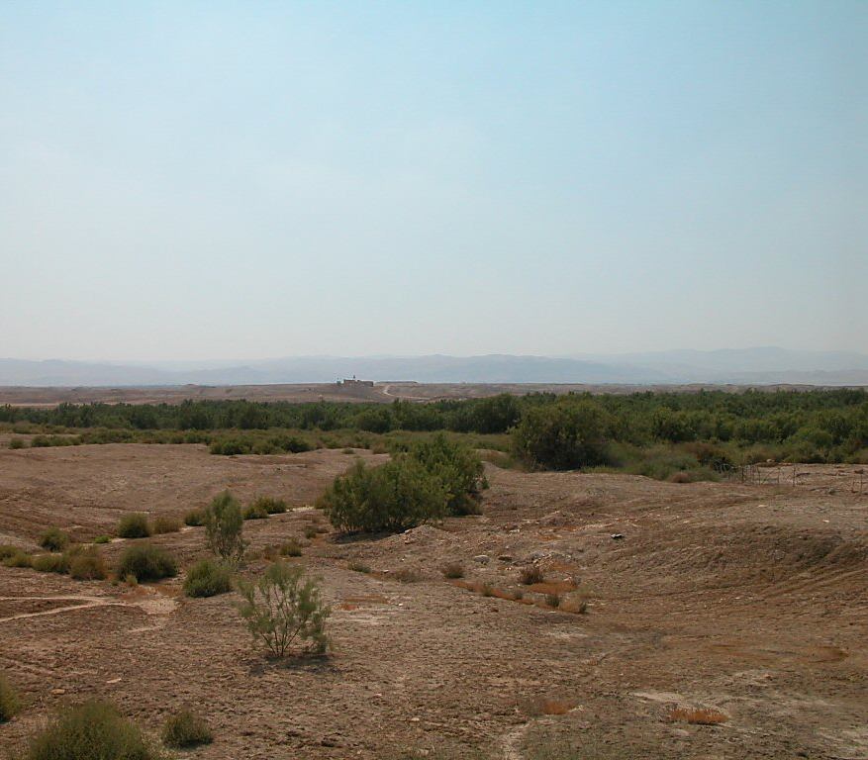
Covenant Established
Deuteronomy 29:9-15 (ESV)
⁹ Therefore keep the words of this covenant and do them, that you may prosper in all that you do.
¹⁰ “You are standing today all of you before the LORD your God: the heads of your tribes, your elders, and your officers, all the men of Israel, ¹¹ your little ones, your wives, and the sojourner who is in your camp, from the one who chops your wood to the one who draws your water, ¹² so that you may enter into the sworn covenant of the LORD your God, which the LORD your God is making with you today,
¹³ that he may establish you today as his people, and that he may be your God, as he promised you, and as he swore to your fathers, to Abraham, to Isaac, and to Jacob.
¹⁴ It is not with you alone that I am making this sworn covenant,
¹⁵ but with whoever is standing here with us today before the LORD our God, and with whoever is not here with us today.
Bethany beyond Jordan, view toward Jordan River
Notes:
Deuteronomy 31:24-26 (ESV) ²⁴ When Moses had finished writing the words of this law in a book to the very end,
²⁵ Moses commanded the Levites who carried the ark of the covenant of the LORD,
²⁶ “Take this Book of the Law and put it by the side of the ark of the covenant of the LORD your God, that it may be there for a witness against you.

Slide 11
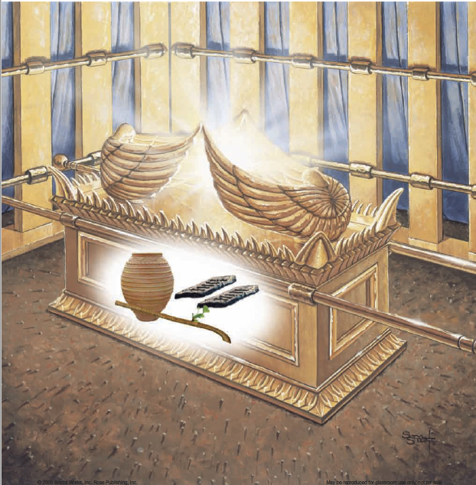
Book of the Law
Deuteronomy 31:24-26 (ESV) ²⁴ When Moses had finished writing the words of this law in a book to the very end,
²⁵ Moses commanded the Levites who carried the ark of the covenant of the LORD,
²⁶ “Take this Book of the Law and put it by the side of the ark of the covenant of the LORD your God, that it may be there for a witness against you.
Ark of the Covenant
Notes:
Deuteronomy 31:24-26 (ESV) ²⁴ When Moses had finished writing the words of this law in a book to the very end,
²⁵ Moses commanded the Levites who carried the ark of the covenant of the LORD,
²⁶ “Take this Book of the Law and put it by the side of the ark of the covenant of the LORD your God, that it may be there for a witness against you.

Slide 12
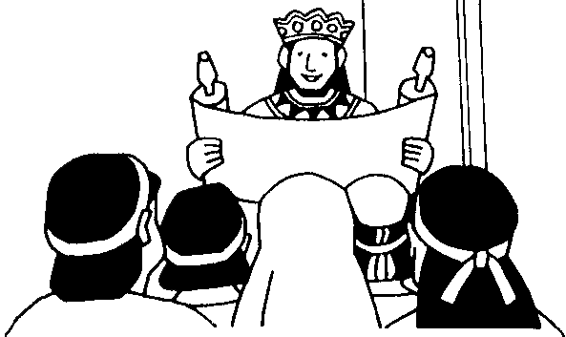

Covenant to Follow the Law
2 Chronicles 15:12-14(ESV)
¹²And they entered into a covenant to seek the Lord, the God of their fathers,
with all their heart and with all their soul,
¹³but that whoever would not seek the Lord, the God of Israel, should be put to death, whether young or old, man or woman.
¹⁴They swore an oath to the Lord with a loud voice and with shouting and with trumpets and with horns.
Asa
911-870
Joash
835-796
2 Kings 11:17(ESV)
¹⁷And Jehoiada made a covenant between the Lord and the king and people, that they should be the Lord’s people, and also between the king and the people.
2 Kings 23:3(ESV)
³And the king stood by the pillar and made a covenant before the Lord, to walk after the Lord and to keep his commandments and his testimonies and his statutes with all his heart and all his soul, to perform the words of this covenant that were written in this book. And all the people joined in the covenant.
Josiah
640-609

Slide 13
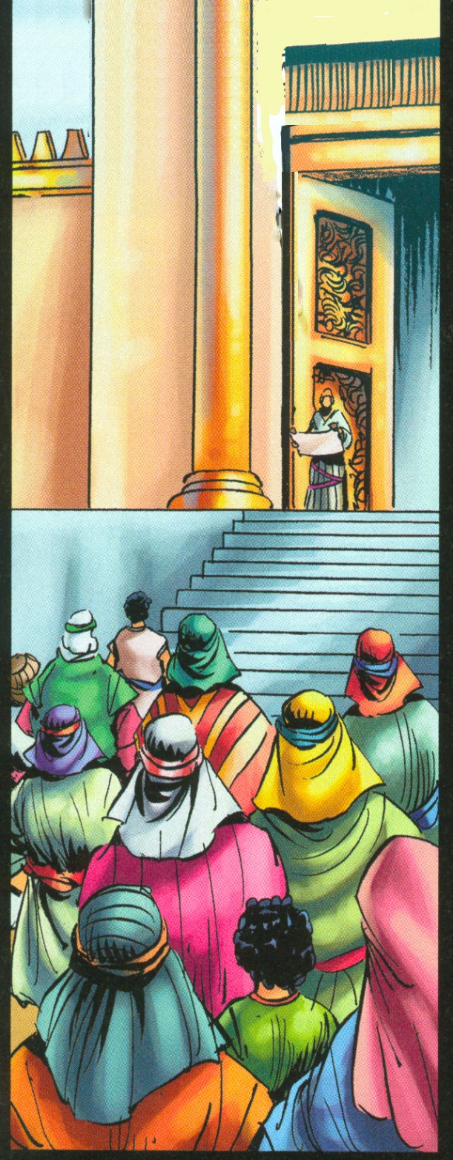
Joash & the Covenant
Chr 23:11
2 Chronicles 23:11(NKJV)
¹¹And they brought out the king’s son, put the crown on him, gave him the Testimony, and made him king. Then Jehoiada and his sons anointed him, and said, “Long live the king!” the priest posted watchmen over the house of the Lord.
2 Chronicles 23:11(NIV)
¹¹Jehoiada and his sons brought out the king’s son and put the crown on him; they presented him with a copy of the covenant and proclaimed him king. They anointed him and shouted, “Long live the king!”
2 Chronicles 23:11(ESV)
¹¹Then they brought out the king’s son and put the crown on him and gave him the testimony. And they proclaimed him king, and Jehoiada and his sons anointed him, and they said, “Long live the king.”
2 Chronicles 23:11(YLT)
¹¹And they bring out the son of the king, and put upon him the crown, and the testimony, and cause him to reign; and Jehoiada and his sons anoint him, and say, ‘Let the king live!’

Slide 14
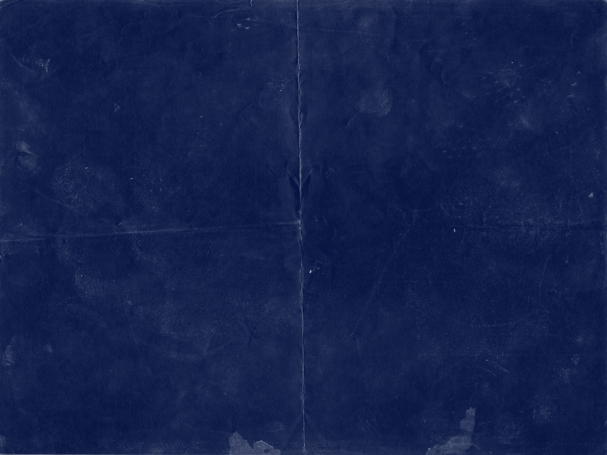
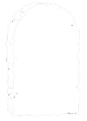


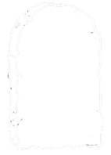


Law of Moses + Joshua
History
Ge–26
Nu-5
1Kg-13
1Ch-14
2Ch-19
Ex–13
Le-10
1Sa-9
Dt-27
Jo-22
2Sa-6
2Kg-12
Ne-5
Prophets & Poetry
New Testament
Da-7
Ho-5
Mal-7
Ps-23
Je-25
Heb-19
Eze-17
Is-13
ESV- appearance of “Covenant” >5

Slide 15

Law of Moses + Joshua
History
Ge–26
1Kg-13
Nu-5
1Kgs-16
1Ch-14
2Ch-19
Le-10
1Sa-9
Dt-27
Jo-22
Dt-22
Ex–13
Ex-13
2Sa-6
2Ch-26
2Kg-12
Jo-12
Es-19
2Kgs-30
Ezra-11
Ne-5
Ne-9
1 Co-20
Prophets & Poetry
Mt-12
New Testament
Ga-7
Da-7
Mal-7
1 Co-20
Da-14
Ho-5
Mk-10
Ro-26
Lk-12
Ps-23
Je-25
Heb-19
Je-18
2 Co-12
Eze-17
Ac-12
Is-13
Re-27
Is-7
Jn-13
1 Jn-13
ESV- appearance of “Write, Wrote, Written” >5

Slide 16



Law of Moses + Joshua
History
Ge–26
Nu-5
1Kg-13
1Ch-14
2Ch-19
Le-10
1Sa-9
Dt-27
Jo-22
Ex–13
Jo-7
2Sa-6
2Kg-33
2Kg-12
Eza-5
2Ch-26
Dt-9
Ne-8
Ne-5
Prophets & Poetry
New Testament
Mt-5
Da-7
Da-5
Mal-7
Re-31
Ho-5
Mk-5
Ps-23
Je-25
Lk-8
Je-27
Jn-14
Heb-19
Ps-5
Eze-17
Is-13
Acts-9
Is-7
Ro-7
ESV- Scroll, Book & Scripture >5

Slide 17



Law of Moses + Joshua
History
Ge–26
Nu-5
1Kg-13
1Ch-14
2Ch-19
Ex–13
Le-10
1Sa-9
Dt-27
Jo-22
2Sa-6
2Kg-12
Ne-6
2Kg-7
Ne-5
Prophets & Poetry
New Testament
Da-7
Da-5
Ho-5
Mal-7
Mt-7
Acts-9
Ps-23
Je-25
Heb-19
Eze-17
Is-13
Je-13
Is-7
ESV- appearance of “Covenant” & “Read” >5

Slide 18
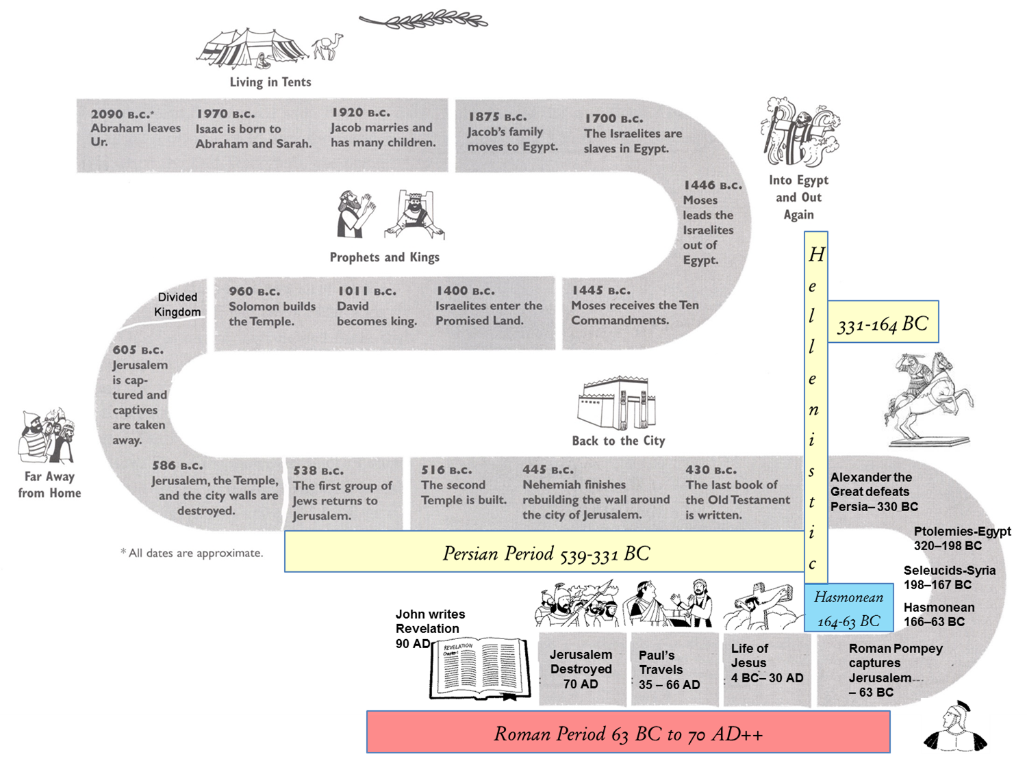
Sojourners in the land
Conquest of the land
Living in the land
Taken from the land
Remnant returns
Christ comes

Slide 19
Law of Hammurabi
Ur of Chaldees
Sojourners in the land
Conquest of the land
Living in the land
Taken from the land
Remnant returns
Christ comes

Slide 20
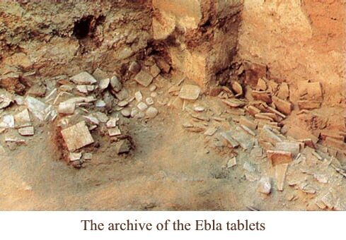
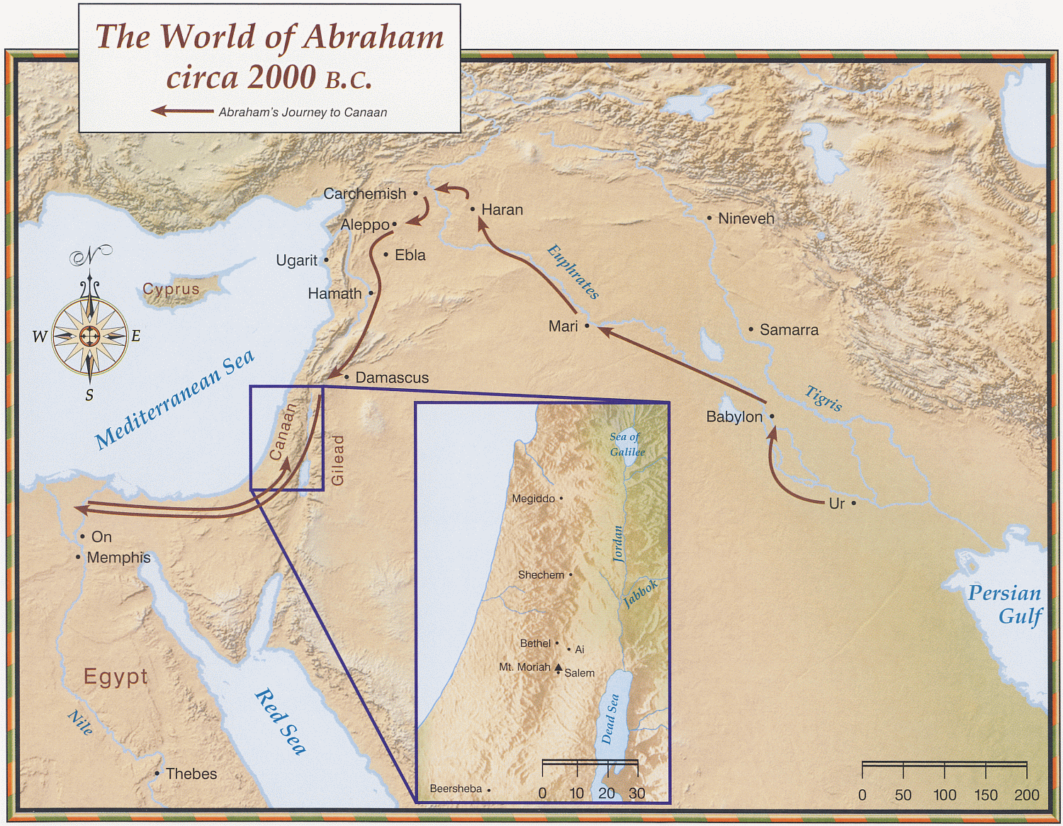

Slide 21
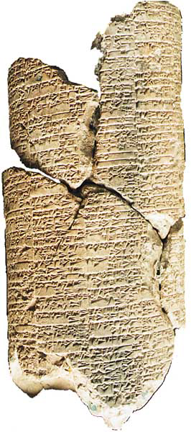
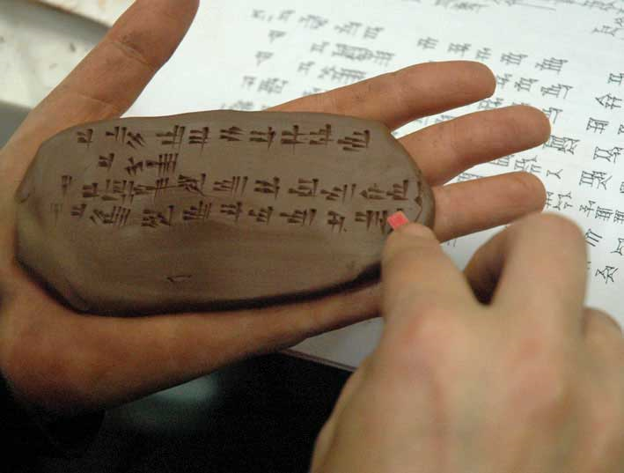
Earliest known code of laws is the Ur-Nammu code
From the reign of King Shulgi (2095–2047 B.C.) of Sumer.
Notes:
Courtesy of the Schøyen Collection
Laying down the law. The earliest known code of laws is the Ur-Nammu code from the reign of King Shulgi (2095–2047 B.C.) of Sumer. It predates Hammurabi’s law code by about 300 years. Schøyen’s copy, the clay cylinder at left, originally held all 57 laws of the code—covering criminal law, family law, inheritance law, labor law (including slave rights) and agricultural and commercial tariffs. Whereas other Near Eastern law codes like Hammurabi’s or that of the Bible (in Exodus) are retaliatory—prescribing “an eye for an eye, tooth for a tooth,” and so on—the Ur-Nammu code is less crude, despite being older. Instead of vengeance, it prescribes monetary compensation for wrongs: For instance, “If a man knocks out the eye of another man, he shall weigh out one-half a mina of silver.”
Editor, Hershel Shanks: BAR 28:05 (Sep/Oct 2002). Biblical Archaeology Society, 2004; 2004

Slide 22
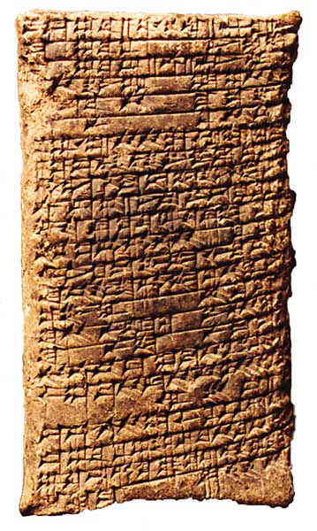
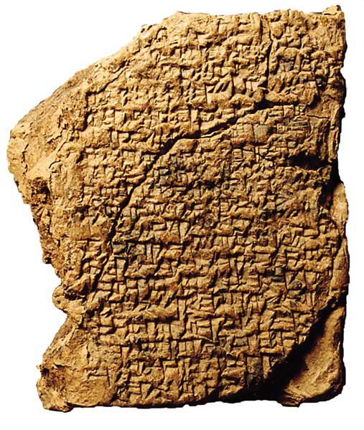
Cuneiform Examples
Babylonia cuneiform tablet
Student Scribe Practice
Babylonia Gilgamesh epic
1800’s to 1700’s B.C
1800’s B.C
Notes:
Courtesy of the Schøyen Collection
An ‘A’ for effort. This 19th-century B.C. cuneiform tablet from Babylonia looks as if it could be a record of a conquest, a royal decree or a mythological epic—but it is actually a lesson tablet inscribed by a pupil in a scribal training center. It reads: “Graduate of the Scribal Academy, where did you go in olden days? I went to school. What did you do in school? I read my tablet, and copied my tablet. They prepared for me my prepared lines. Let me tell you what my teacher told me. Even a fool could easily follow his instructions. Tablets of Sumerian and Akkadian, tablets of the scribal art. I am a scribe and know how to inscribe a stela.” The colophon credits the goddess of writing, Nisaba, and notes that “Suen-Uselli received it on the 22nd day of Month 11.” (There is no indication what grade the ancient scribe-to-be received for this assignment.)
Editor, Hershel Shanks: BAR 28:05 (Sep/Oct 2002). Biblical Archaeology Society, 2004; 2004
Courtesy of the Schøyen Collection
The Gilgamesh epic also incorporates the oldest account of a world-destroying deluge—the flood later retold in Genesis. The Bible describes the cause of the flood as God’s anger with mankind’s wickedness, but the ancient Mesopotamian version attributes it to human noisiness, which prevented the chief Babylonian god, Enlil, from sleeping. This tablet, from 19th–18th century B.C. Babylonia, records a version of the flood story in which Ziusudra (the counterpart of Noah) is described as being a priest of the god Enki.
Editor, Hershel Shanks: BAR 28:05 (Sep/Oct 2002). Biblical Archaeology Society, 2004; 2004

Slide 23
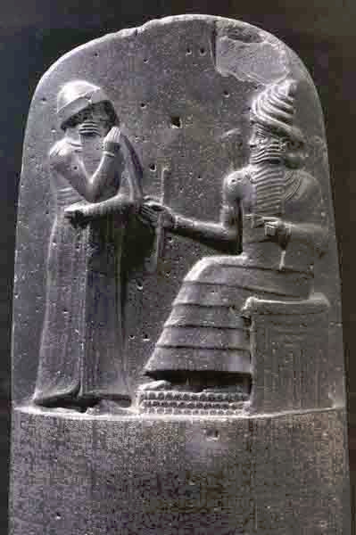
Stele of Hammurabi
Abraham ~2090 BC leaves Ur
Stele set of laws called Hammurabi's Code perhaps was the most influential law of the Near East.
Hammurabi (1729-1686 BCE) ordered the text of this law copied several times, and placed in public places of his empire, as to make it known in the entire land basis for every trial. A completely preserved diorite column (2.25 m high) with 282 paragraphs
Notes:
Stele of Hammurabi
The set of laws called Hammurabi's Code perhaps was the most influential law of the Near East. Hammurabi (1729-1686 BCE) ordered the text of this law copied several times, and placed in public places of his empire, as to make it known in the entire land basis for every trial. A completely preserved diorite column (2.25 m high) with 282 paragraphs was discovered during excavations of Susa. The stele was plundered around 1160 BCE by the Elamites after the conquest of Babylon, and was removed to their capital Susa. In the upper area on the left, the stele shows king Hammurabi in front of the son god Shamash. The biblical law has many parallels to the Code of Hammurabi, but the similarities may rather go back to the idea of the law common in entire the Near East
1000 Bible Images. Bellingham, WA : Logos Research Systems, 2009
Louvre Museum, Paris
Hammurabi, king of Babylon (1792–1750 B.C.), the figure at left, raises his hand to his lips in supplication to the enthroned god Shamash. This seven-foot-high basalt stela from Susa, southeastern Mesopotamia, also displays a cuneiform text known as the Laws of Hammurabi, containing a prologue, 282 laws and an epilogue.

Slide 24
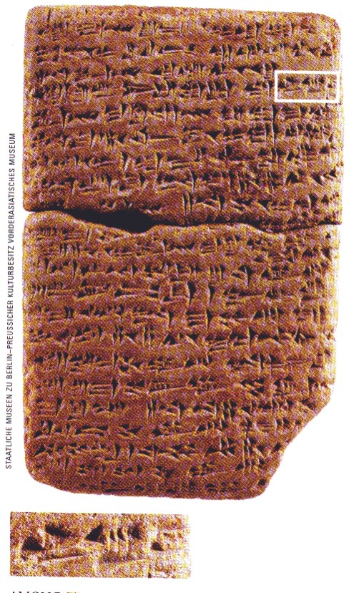
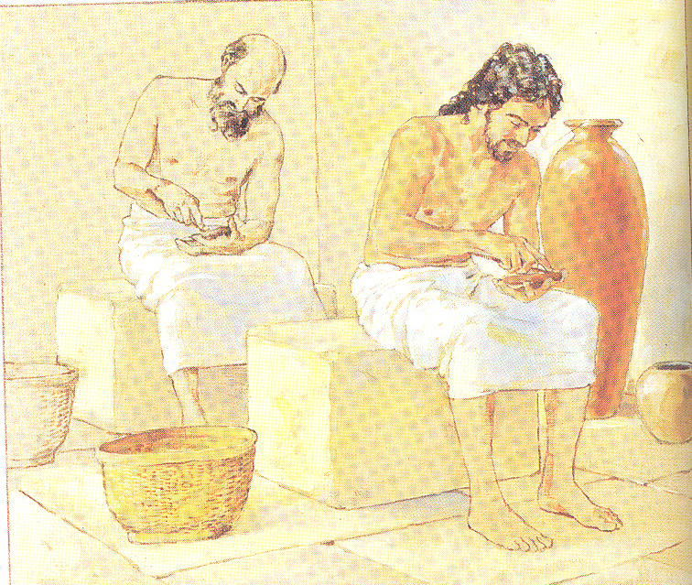
Armarna letter – 14th Century BC
Correspondence from royal archives
Amenophis III & his son Akhenaten
Letter sent by Abdi-Heba, ruler of Jerusalem or Urusalim
BAR May/Jun 2003 pg 55

Slide 25
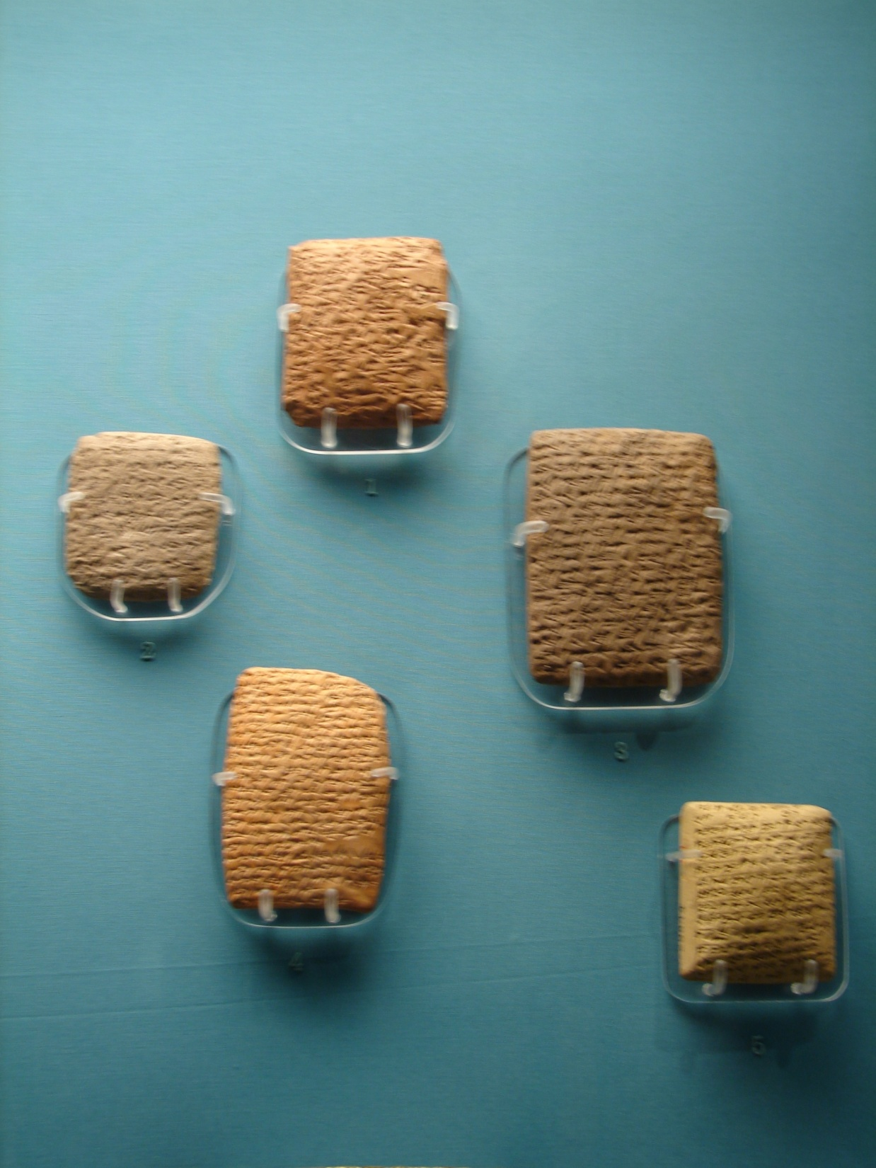
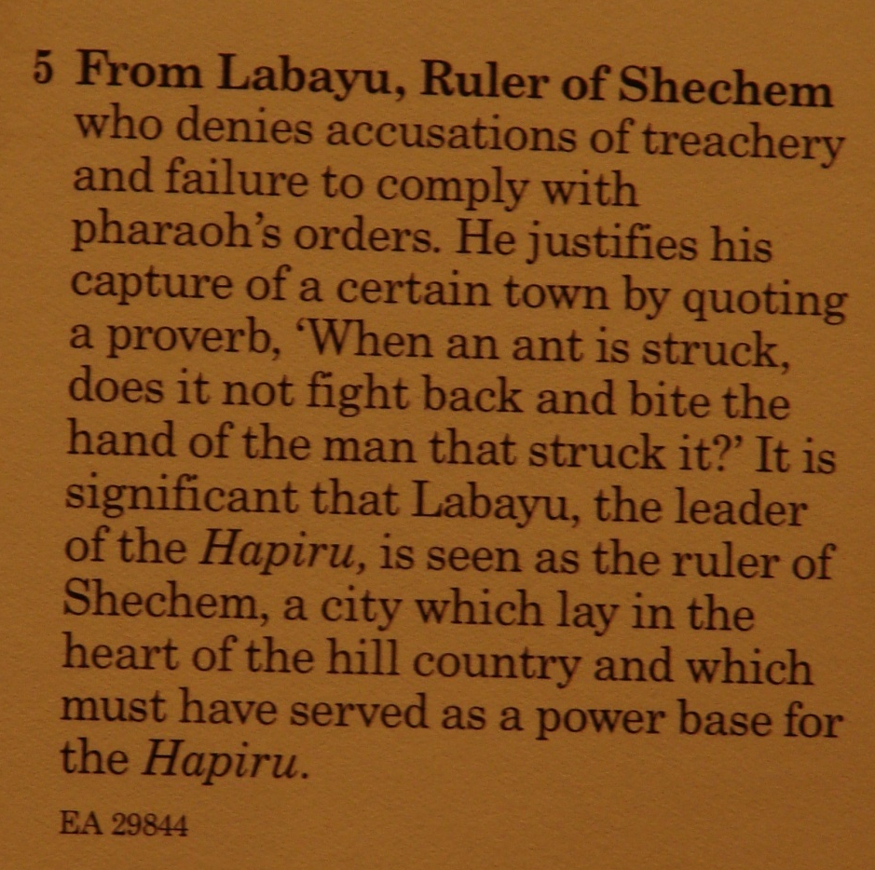
Armana Tablets

Slide 26
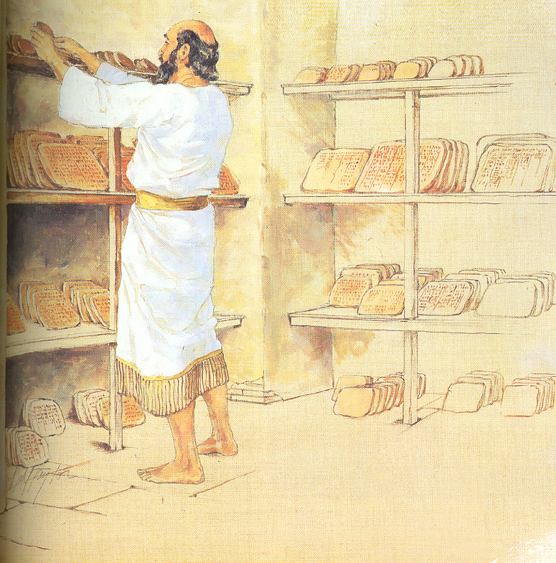
WRITING MATERIALS
Clay -- Huge libraries of clay tablets have been unearthed in Asia, Assyria and Babylonia. These tablets were written on when they were soft and then oven-baked or allowed to dry in the sun. See Ezekiel 4:1..
Ezekiel 4:1 (ESV) “And you, son of man, take a brick and lay it before you, and engrave on it a city, even Jerusalem. (~586 BC)

Slide 27
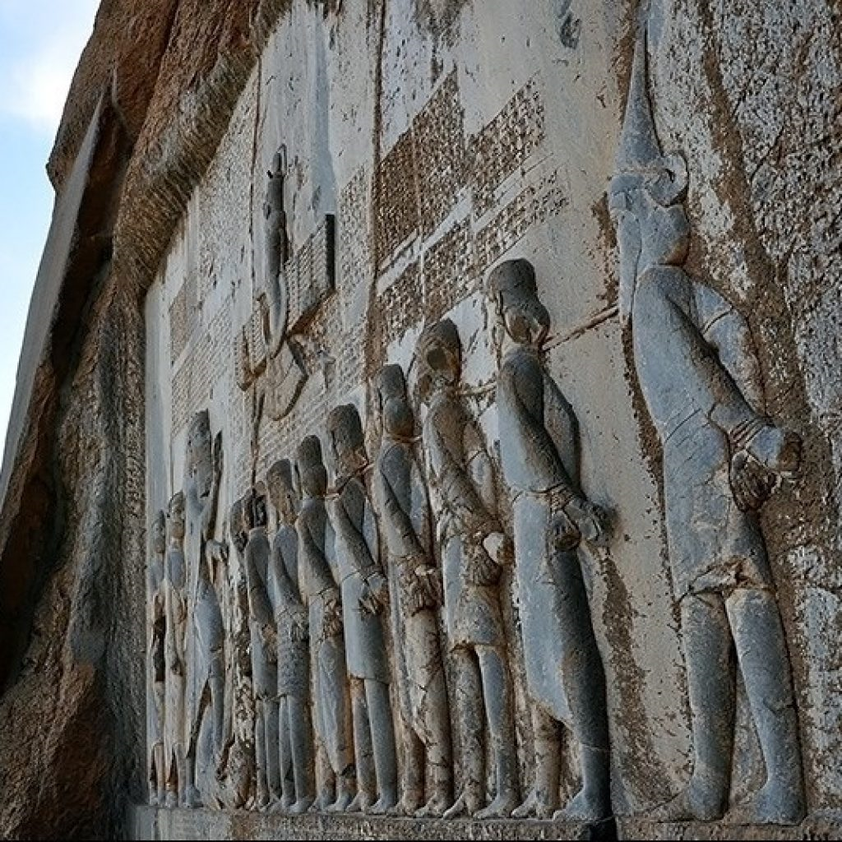
Behistun Inscription
This monumental trilingual cuneiform inscription records the deeds of Darius I (Darius the Great), the Persian king who supported the reconstruction of the Jerusalem Temple, according to the Book of Ezra. The several-hundred-square-foot relief and inscription, carved on a cliff near Behistun
The cuneiform inscription, recorded in Old Persian, Elamite and Babylonian, provided a key to deciphering all three scripts.
Notes:
A LINGUISTIC KEY UNLOCKS THREE. This monumental trilingual cuneiform inscription records the deeds of Darius I (Darius the Great), the Persian king who supported the reconstruction of the Jerusalem Temple, according to the Book of Ezra. The several-hundred-square-foot relief and inscription, carved on a cliff near Behistun (modern Bisitun, Iran), depicts an oversized Darius, a winged sun disk, attendants and prisoners hailing the god Ahuramazda. The cuneiform inscription, recorded in Old Persian, Elamite and Babylonian, provided a key to deciphering all three scripts.
As Ahura Mazda-the supreme winged deity of the ancient Persians-hovers overhead, king Darius the Great (522–486 B.C.) places his foot on the neck of a rival king and judges nine others in this relief celebrating Darius’s triumphs. The extensive trilingual inscription surrounding this image, carved high up on a cliff in Behistun (modern Bisitun, Iran), enabled the 19th-century British army officer and linguist Henry Creswicke Rawlinson to decipher cuneiform.

Slide 28
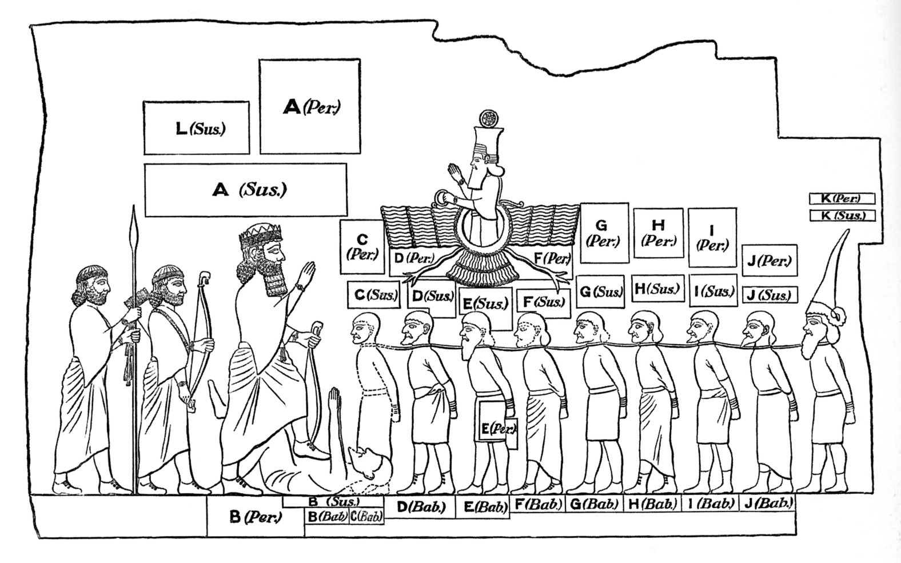
Behistun Inscription
As Ahura Mazda-the supreme winged deity of the ancient Persians-hovers overhead, king Darius the Great (522–486 B.C.) places his foot on the neck of a rival king and judges nine others in this relief celebrating Darius’s triumphs. The extensive trilingual inscription surrounding this image, carved high up on a cliff in Behistun (modern Bisitun, Iran), enabled the 19th-century British army officer and linguist Henry Creswicke Rawlinson to decipher cuneiform
Notes:
A LINGUISTIC KEY UNLOCKS THREE. This monumental trilingual cuneiform inscription records the deeds of Darius I (Darius the Great), the Persian king who supported the reconstruction of the Jerusalem Temple, according to the Book of Ezra. The several-hundred-square-foot relief and inscription, carved on a cliff near Behistun (modern Bisitun, Iran), depicts an oversized Darius, a winged sun disk, attendants and prisoners hailing the god Ahuramazda. The cuneiform inscription, recorded in Old Persian, Elamite and Babylonian, provided a key to deciphering all three scripts.
As Ahura Mazda-the supreme winged deity of the ancient Persians-hovers overhead, king Darius the Great (522–486 B.C.) places his foot on the neck of a rival king and judges nine others in this relief celebrating Darius’s triumphs. The extensive trilingual inscription surrounding this image, carved high up on a cliff in Behistun (modern Bisitun, Iran), enabled the 19th-century British army officer and linguist Henry Creswicke Rawlinson to decipher cuneiform.

Slide 29
Sojourners in the land
Moses
Conquest of the land
Living in the land
Taken from the land
Remnant returns
Christ comes

Slide 30
Old Testament Books of the LAW --
Exodus 17:14 -- “Write this in a book as a memorial, and recite it ...”
Exodus 24:3-4 -- “... wrote down all the words of the Lord ...”
Exodus 24:7 -- “then he took the book of the covenant and read it in the hearing of the people; and they said, ‘All that the Lord has spoken we will do ...’”
Exodus 24:12 -- “... and I will give you stone tablets with the law and the commandment which I have written for their instruction.”
Exodus 32:15-16 -- “... tablets which were written on both sides ...”
Exodus 34:27 -- “... write down these words, for in accordance with these words I have made a covenant with you and with Israel.”
Numbers 33:1-2 -- “... Moses recorded their starting places ...”
Deuteronomy 27:2-4 -- “... and write on them all the words of this law ... and you shall coat them with lime.”
Deuteronomy 31:24-26 -- “... when Moses finished writing the words of this law in a book until they were complete, ... it may remain there as a witness against you.”

Slide 31
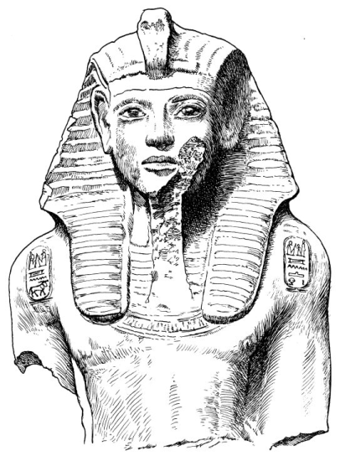
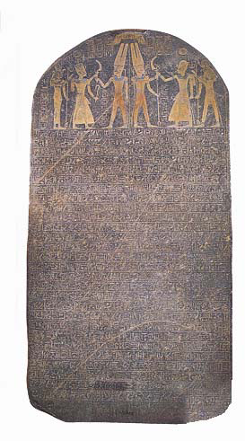

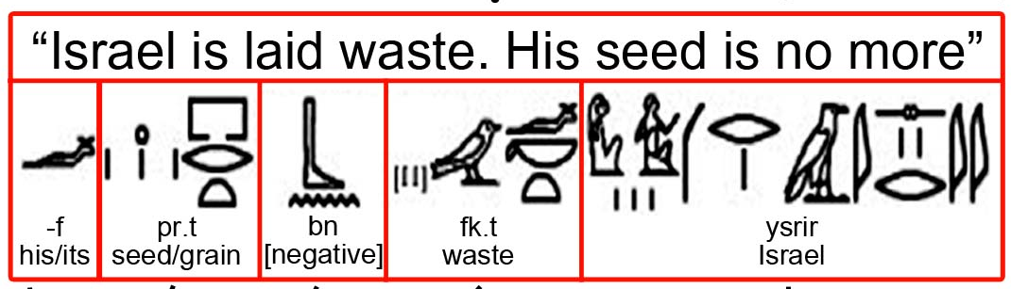
Merneptah stela
“Israel is laid waste and his seed is not” reads the hieroglyphic text in the second line from the bottom of the
Discovered at the funery temple of Pharaoh Merneptah (ruled c. 1213–1203 B.C.) in Thebes, this 7.5-foot-high granite monolith recounts Merneptah’s campaigns in Canaan, where he defeated a people called Israel in Canaan’s central highlands.
Dating to about 1209 B.C., the monolith contains the earliest reference to Israel, and is indispensable for dating Biblical events for which there is scant, or even nonexistent, extra-Biblical evidence.
The determinative for Israel on
the Merneptah stele.

Slide 32
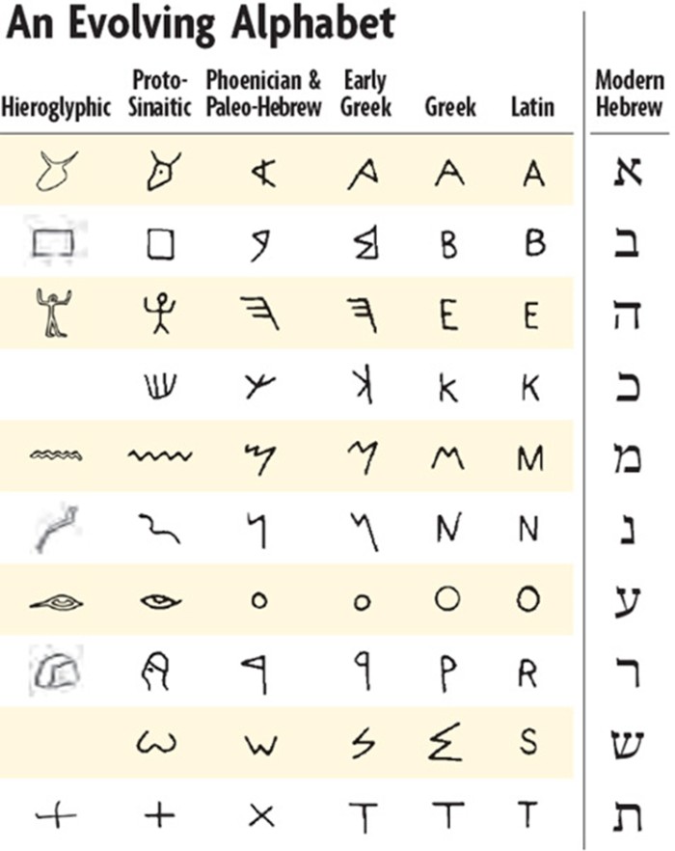
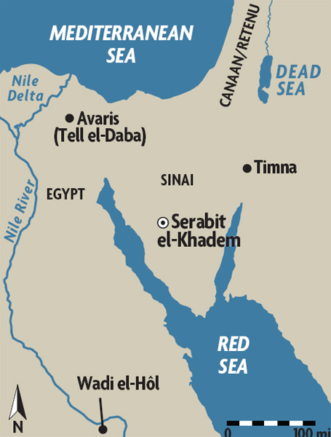
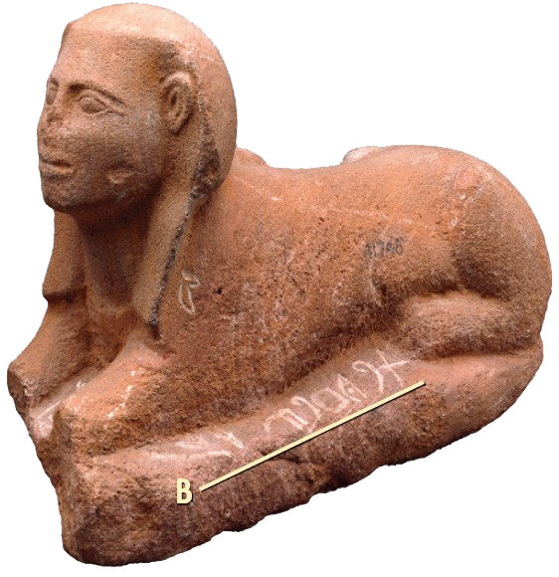

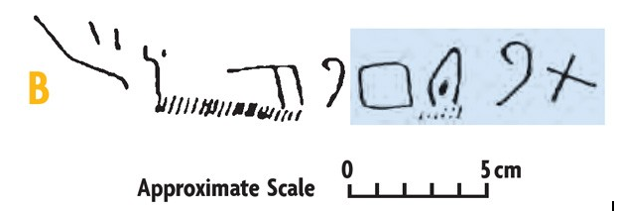
Development of the Alphabet
The hieroglyphic text identifies the name of the goddess to whom the sphinx is dedicated as Hathor, “the mistress of turquoise.” The famous Egyptologist Alan Gardiner observed that each of the signs in the Proto-Sinaitic texts represented not an entire word, as in hieroglyphic, but only its initial sound. Four of these strange signs (written left-to-right) spelled the name Baalat, a Canaanite word also meaning “the Mistress.”
rich turquoise mines during Egyptian Middle Kingdom (c.1950–1800 B.C.)
Jacob’s family moves to Egypt about 1875 BC
B
Baalat,

Slide 33
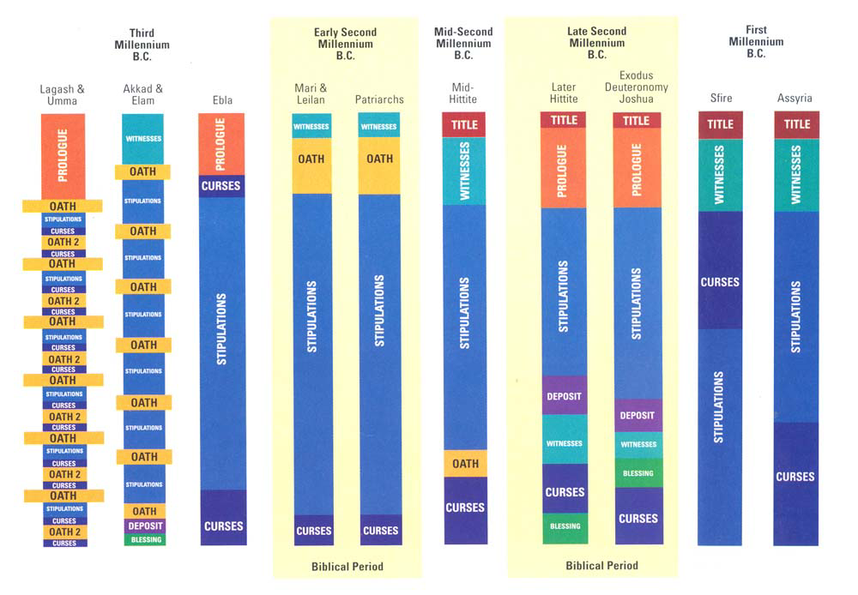
Deuteronomy & Treaties

Slide 34
Deuteronomy & Treaties

Slide 35
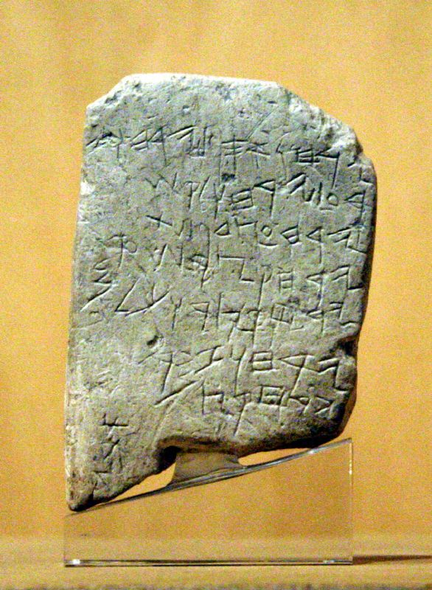
Gezer Calendar
This soft limestone tablet is just over 4 in. [10 cm.] high and is inscribed with seven lines of ancient Hebrew. It was written in the 10th century B.C. (days of Solomon or Rehoboam).
Translation:
His double-month is ingathering
His double-month is sowing
His double-month is late-planting.
His month is chopping flax.
His month is barley harvest.
His month is harvest and measuring (?).
His double-month is pruning. His month is summer fruit.
Lower left vertical margin – a personal name “Abiya.”
Zondervan Atlas 21–79: Gezer Calender

Slide 36
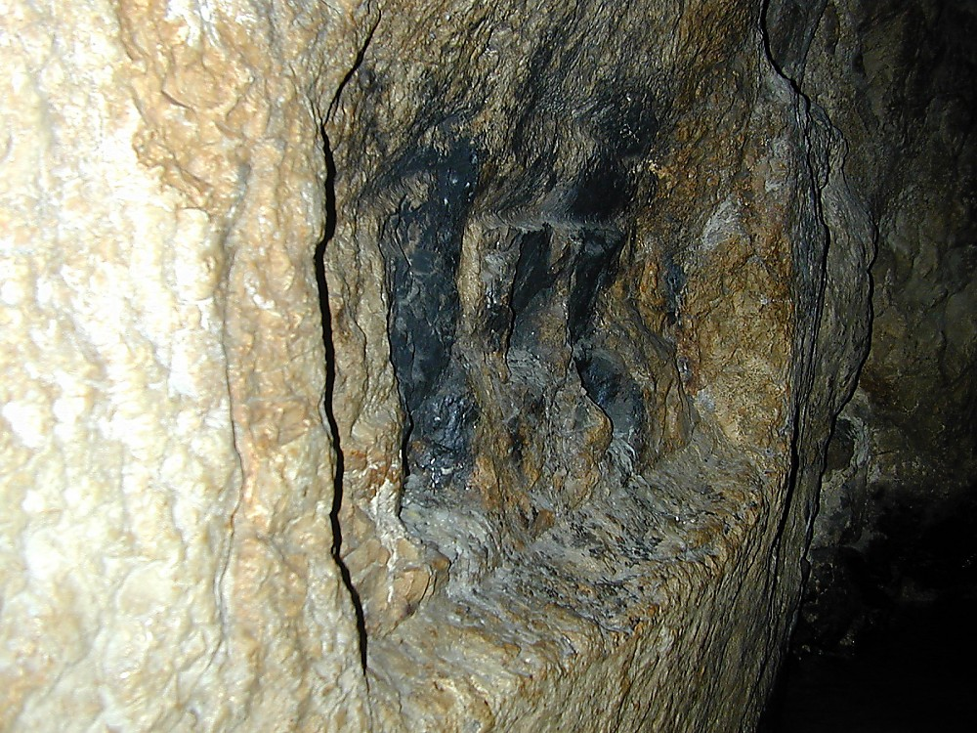
Location of Siloam Inscription in Hezekiah’s Tunnel

Slide 37
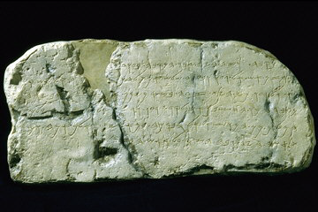
Siloam Inscription

Slide 38

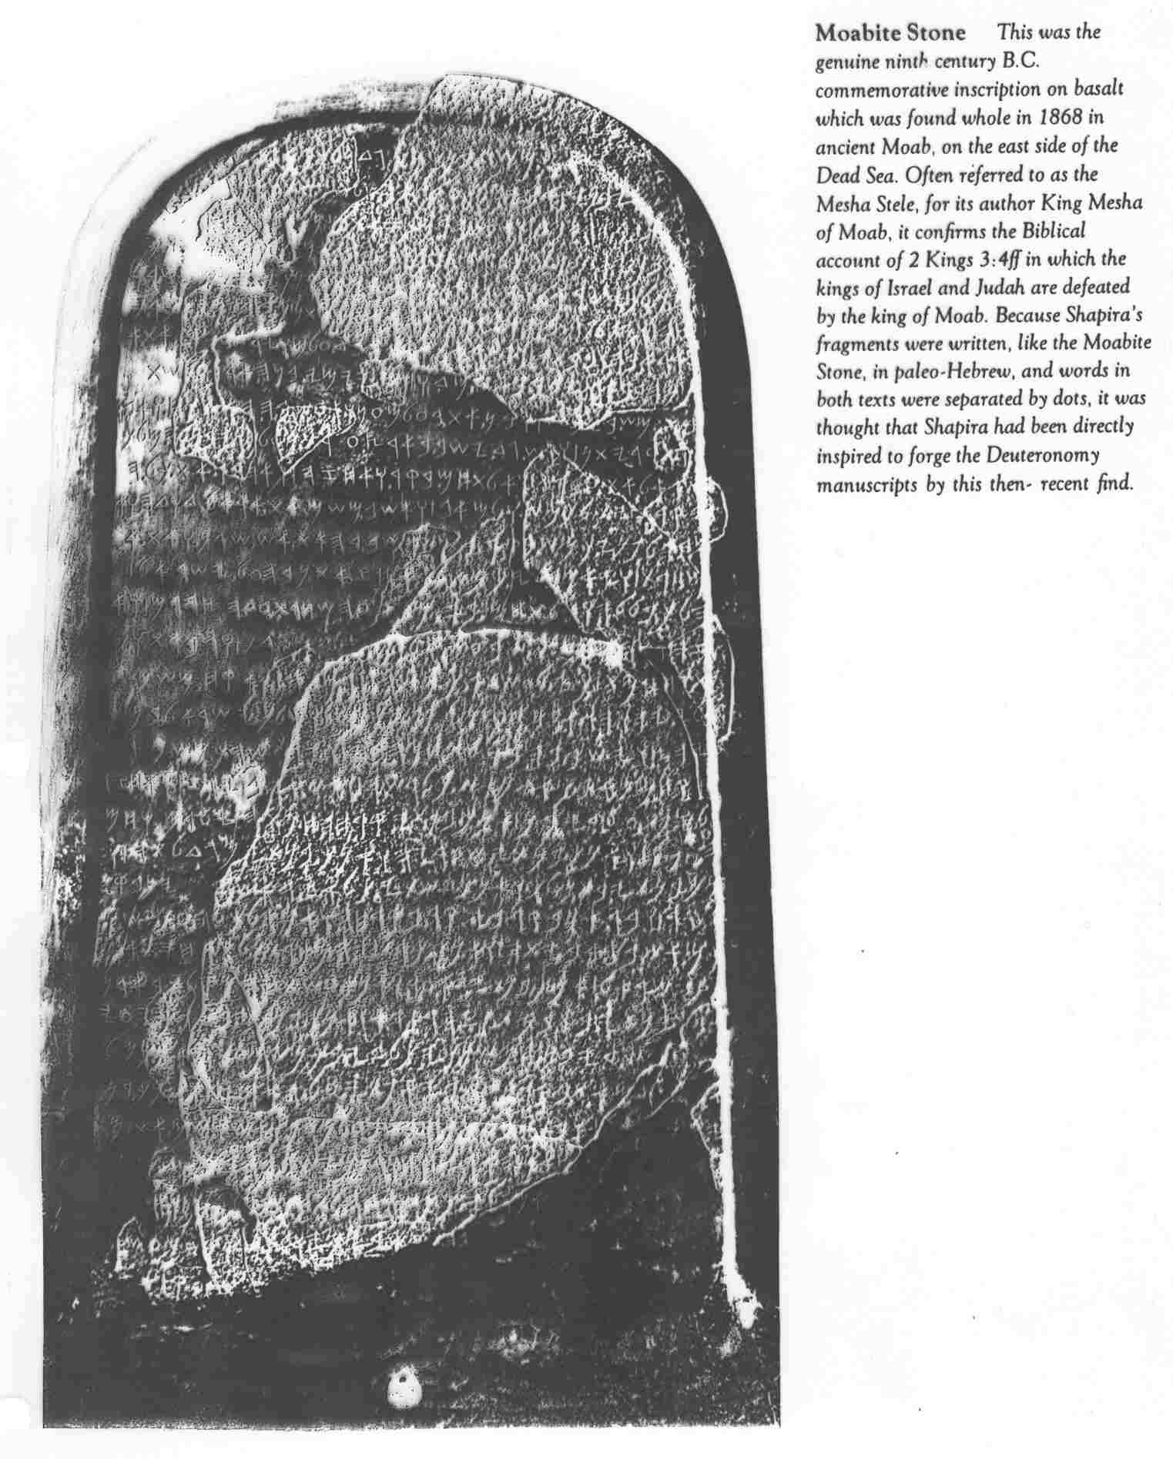
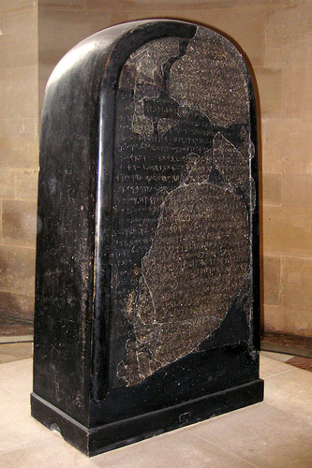
Moabite Stone
Found 1868

Slide 39
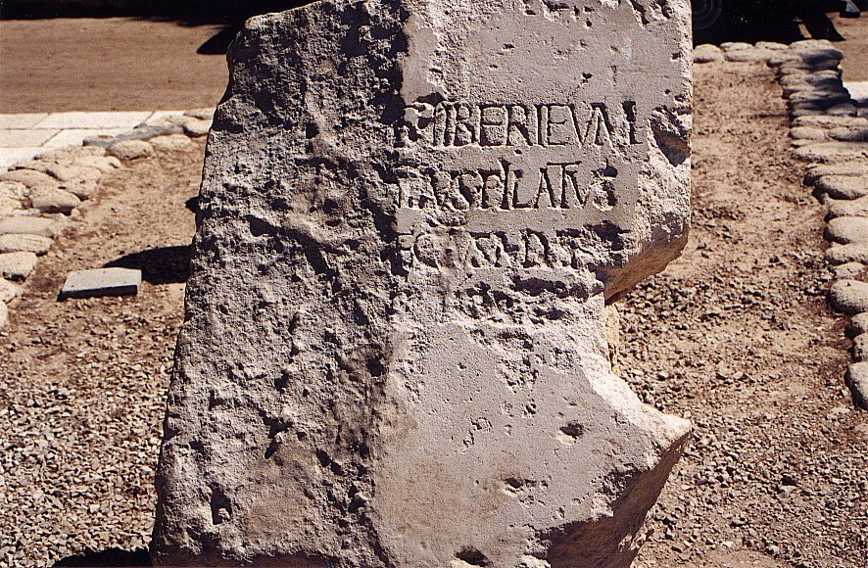
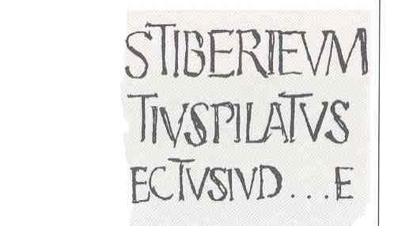
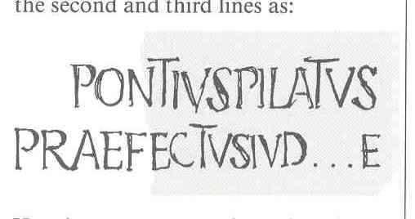
Pilate Inscription
Discovered at Caesarea in secondary use in a later wall, this inscription bears witness to a major New Testament figure and settles the debate over Pilot’s title of Prefect rather than the inferior Procurator.
Notes:
Pilate Inscription:
Discovered at Caesarea in secondary use in a later wall, this inscription bears witness to a major New Testament figure and settles the debate over Pilot’s title of Prefect rather than the inferior Procurator.
7) Pontius Pilate inscription - 1961
Italian excavators working at the Roman theater in Caesarea Maritima uncovered a monumental inscription naming another central figure in Christ's crucifixion drama. Though only partly legible, it clearly says: "Pontius Pilatus, Prefect of Judea." Visitors to Caesarea's theater today see a replica, the original is in the Israel Museum in Jerusalem.

Slide 40
Sojourners in the land
Joshua
Conquest of the land
Living in the land
Taken from the land
Remnant returns
Christ comes

Slide 41
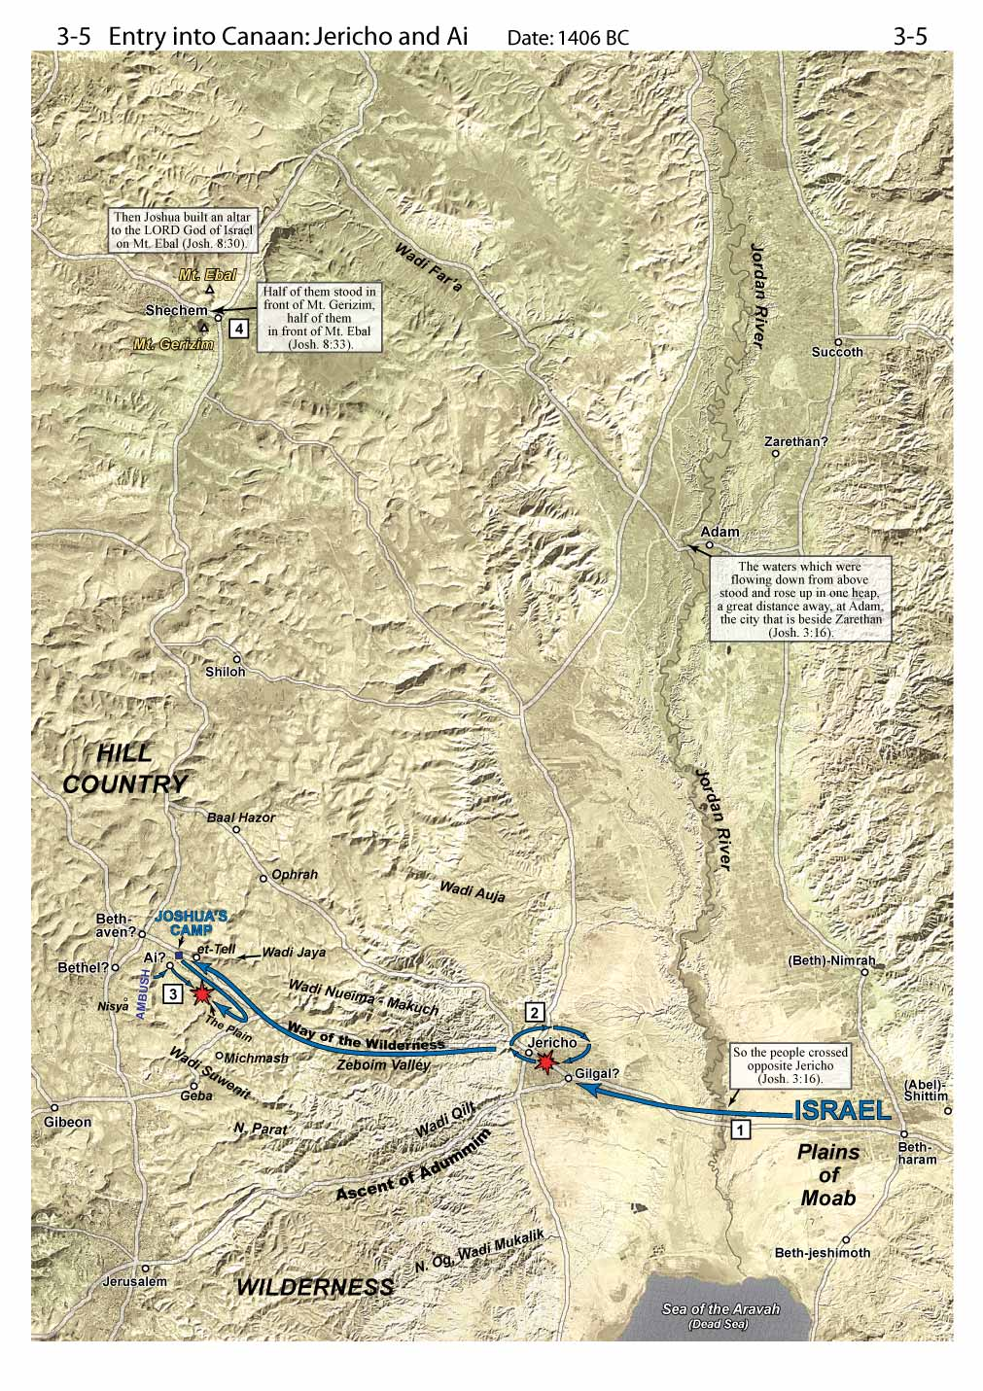
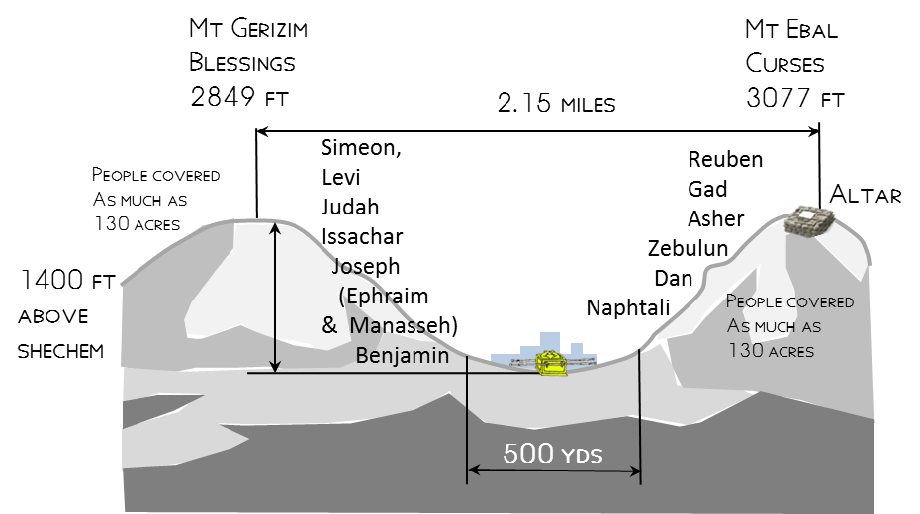
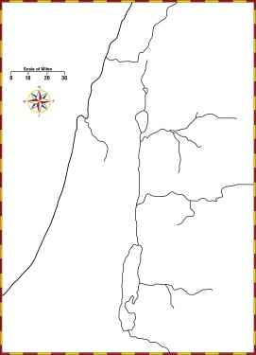
1. Cross Jordan
2. Jericho
3. Ai
4. Shechem

Slide 42
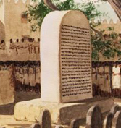

Deuteronomy 27:2-3(ESV)
2And on the day you cross over the Jordan to the land that the Lord your God is giving you, you shall set up large stones and plaster them with plaster.
3And you shall write on them all the words of this law, when you cross over to enter the land that the Lord your God is giving you, a land flowing with milk and honey, as the Lord, the God of your fathers, has promised you.
stone pillar (massebah) found at Shechem may be similar to the one that Joshua set up as a witness to the renewal of the covenant.
Notes:
Deuteronomy 27:2-3(ESV)
2And on the day you cross over the Jordan to the land that the Lord your God is giving you, you shall set up large stones and plaster them with plaster.
3And you shall write on them all the words of this law, when you cross over to enter the land that the Lord your God is giving you, a land flowing with milk and honey, as the Lord, the God of your fathers, has promised you.

Slide 43

Joshua 24
²⁵So Joshua made a covenant with the people that day, and put in place statutes and rules for them at Shechem.
²⁶And Joshua wrote these words in the Book of the Law of God. And he took a large stone and set it up there under the terebinth that was by the sanctuary of the Lord.

Slide 44

Shechem standing stone
Standing stone
A witness to covenant between Joshua and People
“You are witnesses against yourselves that you have chosen the Lord, to serve him.
Then put away the foreign gods that are among you
incline your heart to the Lord, the God of Israel.”
“The Lord our God we will serve, and his voice we will obey.”
This stone shall be a witness against us, for it has heard all the words of the Lord that he spoke to us. Therefore it shall be a witness against you, lest you deal falsely with your God.”
Joshua 24
¹⁴“Now therefore fear the Lord and serve him in sincerity and in faithfulness. Put away the gods that your fathers served beyond the River and in Egypt, and serve the Lord.
¹⁵And if it is evil in your eyes to serve the Lord, choose this day whom you will serve, whether the gods your fathers served in the region beyond the River, or the gods of the Amorites in whose land you dwell. But as for me and my house, we will serve the Lord.”
Notes:
This stone pillar (massebah) found at Shechem might be similar to the one that Joshua set up as a witness to the renewal of the covenant.

Slide 45

The sayings of Balaam, son of Beor, the man who was a seer of the gods.” It is written with ink on plaster and refers to the non-Israelite prophet known from Numbers 22–24
What would be gained from copying the law on stone & from reading the law to the people (Deut 27:2-4)?
Deuteronomy 27:2-3(ESV)
2And on the day you cross over the Jordan to the land that the Lord your God is giving you, you shall set up large stones and plaster them with plaster.
3And you shall write on them all the words of this law, when you cross over to enter the land that the Lord your God is giving you, a land flowing with milk and honey, as the Lord, the God of your fathers, has promised you.
stone pillar (massebah) found at Shechem may be similar to the one that Joshua set up as a witness to the renewal of the covenant.
Notes:
Deuteronomy 27:2-3(ESV)
2And on the day you cross over the Jordan to the land that the Lord your God is giving you, you shall set up large stones and plaster them with plaster.
3And you shall write on them all the words of this law, when you cross over to enter the land that the Lord your God is giving you, a land flowing with milk and honey, as the Lord, the God of your fathers, has promised you.

Slide 46


Artist’s reconstruction of the Deir Alla building. Telescoping into one drawing details of the building both before and after the earthquake, the artist shows us the two areas where most of the inscribed fragments probably fell
Bright red and black letters painted on plaster wall fragments relate a 2,600-year old religious text.

Slide 47


Notes:
Garo Nalbandian/Amman Archaeological Museum
“Balaam, son of Beor,” the name of a Biblical prophet, appears, incompletely, in the plaster wall fragment enclosed in blue, left. The four groupings of fragments called Combination I are seen here as they were published in 1976, forming 18 lines of text. At that time the excavators did not connect these four groups. Over the last decade, however, various scholars have realigned the groups and have painstakingly filled in gaps with a few of the hundreds of original fragments.
Now André Lemaire has proposed a restoration of Combination I based on these scholars’ work. Tiny fragments, sometimes a single letter here and another letter there, have been placed in the puzzle, which has been tightened to 16 lines.
Above the first line of Combination I, the scribe painted a thick straight red line, part of a red frame that originally enclosed the column of text on its top and left sides. A few words of line one were also written in red because they form the tide of this portion of text: “[Ba]laam [son of Beo]r, the man who was a seer of the gods.” This is undoubtedly the famous Balaam, son of Beor, who figures so prominendy in Numbers 22–24.
Below, top, shows the four groupings as pictured left. Below, bottom, shows the four groupings as compressed, forming 16 instead of 18 lines. Other fragments, not shown, have also been added in Lemaire’s reconstruction (see sidebar below).
Editor, H. S. (2004; 2004). BAR 11:05 (Sep/Oct 1985). Biblical Archaeology Society.

Slide 48
Sojourners in the land
Conquest of the land
David
Living in the land
Taken from the land
Remnant returns
Christ comes

Slide 49


Oldest Hebrew Inscription Discovered in Israelite Fort on Philistine Border

Slide 50


Find Location
It is a five-line, 6-by-6-inch ostracon, an inscription on a broken piece of pottery used as a kind of ancient notepaper.

Slide 51
Inscription –
Dates around 1000 BC
0
1. Do not oppress, and serve God … despoiled him/her
2. The judge and the widow wept; he had the power
3. over the resident alien and the child, he eliminated them together
4. The men and the chiefs/officers have established a king
5. He marked 60 [?] servants among the communities/habitations/generations
The text directs the recipient faithfully to accept those decisions, in his comportment and in regulating local situations, and, in particular, in matters dealing with the needy, the widow, the resident alien and children, in contrast to that which was done previously.
The text is thus a message to a local leader about decisions taken by someone in a higher position of authority, which the recipient must accept.

Slide 52



Tel Dan Inscription
“House of David”
Fragment of a monumental inscription from the First Temple Period
Discovered in an excavation of the ancient city of Dan.
First extra-biblical reference to the "House of David" ever discovered.
A monument erected by a king of Aram indicating victory over his enemies. Written in Aramaic the inscription dates to the 9th century BCE.
Notes:
This fragment of a monumental inscription from the First Temple Period was discovered in an excavation of the ancient city of Dan. It is the first extra-biblical reference to the "House of David" ever discovered. It appears to have been part of a monument erected by a king of Aram indicating victory over his enemies. Written in Aramaic with the words separated by dots, the inscription dates to the 9th century BCE.
2) House of David Inscription - 1993
After the end of a 25-year excavation at Tel Dan in northern Israel, while work crews were readying the site for visitors, someone noticed lines of writing on a rock in the late afternoon sun. Upon closer examination, it turned out to be a stele fragment mentioning King David's dynasty, and dating to approximately 100-200 years after the traditional 10th century B.C. date of King David's reign. It is the first mention of King David, and the earliest mention of a Biblical figure outside of the Bible. The inscription is now in the Israel Museum in Jerusalem.

Slide 53
Sojourners in the land
Conquest of the land
Kings & Prophets
Living in the land
Taken from the land
Remnant returns
Christ comes

Slide 54
Old Testament WRITINGS --
Psalm 102:18 -- “This will be written for the generation to come; That a people yet to be created may praise the Lord.”
Proverb 22:20-21 -- “Have I not written to you excellent things ... to make you know the certainty of the words of truth ...”
Ecclesiastes 12:10 -- “The Preacher sought to find delightful words and to write words of truth correctly.”

Slide 55
Old Testament “Former” PROPHETS
Psalm 102:18 -- “This will be written for the generation to come; That a people yet to be created may praise the Lord.”
Joshua 24:25-26 -- “... and Joshua wrote these words in the book of the law of God ...”
1 Samuel 10:25 -- “Then Samuel told the people the ordinances of the kingdom, and wrote them in the book and placed it before the Lord ...”
2 Chronicles 26:22 -- “Now the rest of the acts of Uzziah, first to last, the prophet Isaiah, the son of Amos, has written.”
Nehemiah 8:1-3,5 -- “... and he read from it [the law of Moses] before the square ... in the presence of men and women ... and all the people were attentive to the book of the law ... and when he opened it, all the people stood up.”

Slide 56


WRITING MATERIALS
Wood – For many centuries wooden tablets were used as writing surfaces in Greece. Wooden writing tablets have also been found in both Egypt and Palestine. See Isaiah 30:8 and Habakkuk 2:2.
?

Slide 57
Isaiah & Habakkuk
Isaiah 30:8-10 (ESV)
⁸ And now, go, write it before them on a tablet and inscribe it in a book, that it may be for the time to come as a witness forever.
⁹ For they are a rebellious people, lying children, children unwilling to hear the instruction of the LORD;
¹⁰ who say to the seers, “Do not see,” and to the prophets, “Do not prophesy to us what is right; speak to us smooth things, prophesy illusions,
Habakkuk 2:2 (ESV) ² And the LORD answered me: “Write the vision; make it plain on tablets, so he may run who reads it.

Slide 58


Slide 59

Josiah Hears the Law
2 Kings 22:10-11 (NKJV)
¹⁰Then Shaphan the scribe showed the king, saying, “Hilkiah the priest has given me a book.” And Shaphan read it before the king.
¹¹Now it happened, when the king heard the words of the Book of the Law, that he tore his clothes.

Slide 60
Josiah Hears the Law
2 Kings 22:18-20(NKJV)
¹⁸ …‘Thus says the Lord God of Israel: “Concerning the words which you have heard—
¹⁹ because your heart was tender, and you humbled yourself before the Lord when you heard what I spoke against this place and against its inhabitants, that they would become a desolation and a curse, and you tore your clothes and wept before Me,
I also have heard you,” says the Lord.
²⁰Surely, therefore, I will gather you to your fathers, and you shall be gathered to your grave in peace; and your eyes shall not see all the calamity which I will bring on this place”…

Slide 61

Response of Jehoakim
Jeremiah 36
²¹So the king sent Jehudi to bring the scroll, and he took it from Elishama the scribe’s chamber. And Jehudi read it in the hearing of the king and in the hearing of all the princes who stood beside the king.
²²Now the king was sitting in the winter house in the ninth month, with a fire burning on the hearth before him.
²³And it happened, when Jehudi had read three or four columns, that the king cut it with the scribe’s knife and cast it into the fire that was on the hearth, until all the scroll was consumed in the fire that was on the hearth.
²⁴Yet they were not afraid, nor did they tear their garments, the king nor any of his servants who heard all these words

Slide 62




Baruch Bulla
Clay bulla with an Individual’s seal used to secure documents, many have been found from this time
“Belonging to Berekhyahu, son of Neriyahu, the Scribe” declares this bulla or lump of clay - this bulla bears a human detail: a fingerprint—presumably of Jeremiah’s scribe—appears on the upper left edge.
When God told Jeremiah of the disasters that would strike Judah if it did not mend its wicked ways, “Jeremiah called Baruch son of Neriah; and Baruch wrote down in the scroll, at Jeremiah’s dictation, all the words which the Lord had spoken to him” ( Jeremiah 36:3–4 ).
Editor, H. S. 2002;2002. BAR 22:02 (March/April 1996). Biblical Archaeology Society
Notes:
5) Baruch Bulla - 1978.
A bulla (hardened clay seal impression) containing the stamp and name of the scribe of Jeremiah appeared on the antiquties market in the 1970's and was published by archaeologist Nahman Avigad in 1978. The seal, with the inscription "belonging to Berekhyahu, son of Neriyahu, the scribe" in old Hebrew script, can now be seen in the Israel museum in Jerusalem. A number of other seals connected to personalities mentioned in the Bible have also been found.

Slide 63



Michal Roche-Ben Ami
City gate of ancient Lachish. Most of the Lachish letters, 21 ostraca inscribed with messages from one Judean military commander to another, were found on the floor of a guardroom in this gate. They were buried by destruction debris when the Babylonians attacked this fortified gate and took the city in about 588 B.C.
BAR 10:02 (March/April 1984).
Notes:
The letters clearly constituted some kind of correspondence and name lists. According to another scholar, J. W. Jack, who studied them, they were written in “iron-carbon ink with a reed or wood pen, the nib part of which must have been broad but not split.”† Since the ostraca were inscribed in different handwritings, it is safe to assume that several scribes were involved. Some of the ostraca are inscribed on both sides, starting on the outer side of the jar. According to Jack, the handwriting is “fluent cursive, resembling in some signs the Samaria Ostraca.”† The ink is still so clear on most of the Lachish ostraca that they can be read without difficulty. It is almost as if they had been written the day before their discovery. However, only seven of the 21 are long enough to produce a coherent translation.
A reading of the ostraca suggests that they belong to an exchange of letters between two military commanders. Unfortunately, only one side of this exchange has survived. The sender of the letters, Hosha‘yahu, is mentioned in Ostracon III but not in the others—a strange fact. The addressee, Ya’ush, is mentioned in three of the ostraca (II, III, VI), but not in the others. Together, the ostraca seem to describe certain events the sender wishes to bring to the attention of the addressee.
Over the years most scholars have accepted the interpretation that Hosha‘yahu, the sender, was commander of an outpost and reported to Ya’ush, the commander of Lachish and its region. We can conclude that the addressee, Ya’ush, is Hosha‘yahu’s superior by the way Hosha‘yahu addresses Ya’ush: “Who is thy servant (but) a dog”† (Ostraca II, V, VI). This expression was also used by vassals addressing their overlord, Pharaoh, in the Amarna Letters.*
† J. W. Jack, “The Lachish Letters; Their Date and Import; An Examination of Professor Torczyner’s View,” Palestine Exploration Quarterly 70 (1938), p. 167.
† Ibid.
† Translated by William R Albright, in Ancient Near Eastern Texts Relating to the Old Testament, Third Edition with Supplement, ed. James B. Pritchard (Princeton University Press: Princeton, N.J., 1969).
* The Amarna letters are 14th-century B.C. missives written in Akkadian cuneiform by feudal princes of Canaan to their Egyptian overlords. The clay tablets were discovered in the diplomatic archive of two 18th-dynasty Pharaohs at Tell el-Amarna near Cairo.
Editor, H. S. (2004; 2004). BAR 10:02 (March/April 1984). Biblical Archaeology Society.
Some of the reports sent by Hosha‘yahu to Ya’ush describe events taking place just before the letters were written. In Ostracon II, Hosha‘yahu the sender seems to be trying to quell a rumor about himself. As he tells the story, the rumor is untrue. Hosha‘yahu invokes Yahweh to “afflict those who re[port] an (evil) rumor about which thou art not informed!” In Ostracon V a humble Hosha‘yahu asks Ya’ush: “How can thy servant benefit or injure the king.” In Letter VII: “Truly I lie not—let my lord send thither!” Has Hosha‘yahu been charged with plotting rebellion or treason against Jerusalem?
In Ostracon III Hosha‘yahu refers to a letter from Ya’ush received by him on the previous day in which he, Hosha‘yahu, had been accused of some misdeed. In the same letter, Hosha‘yahu makes a reference to a delegation going to Egypt: “The commander of the host, Coniah son of Elnathan, hath come down in order to go into Egypt.” Hosha‘yahu ends the letter by mentioning another letter he has received; this passage contains an intriguing reference to “the prophet”: “And as for the letter of Tobiah, servant of the king, which came to Shallum son of Jaddu‘a through the prophet, saying ‘Beware!’, thy servant hath sent it to my lord.” Apparently, Hosha‘yahu has been accused of reading a letter sent to someone else. Some scholars also saw here a reference to an event described in Jeremiah 26:20–23, in which the prophet Uriah flees to Egypt. In this Biblical text, Elnathan son of Achbor is sent to Egypt to capture Uriah. In the Lachish ostracon, Coniah son of Elnathan goes down to Egypt.
Although it’s not easy to project the full contents of the Lachish Letters, most scholars concluded that they were describing the final days of Judah, when she was defending herself against the Babylonian onslaught in the early sixth century B.C.* The mention of a prophet and a delegation to Egypt perhaps referred to the prophet and delegation mentioned in the Book of Jeremiah.
* This should be distinguished from the attack of the Assyrian king Sennacherib a little more than 100 years earlier, in 701 B.C., described in “Destruction of Judean Fortress Portrayed in Dramatic Eighth-Century B.C. Pictures” and “News from the Field: Defensive Judean Counter-Ramp Found at Lachish in 1983 Season.”
Editor, H. S. (2004; 2004). BAR 10:02 (March/April 1984). Biblical Archaeology Society.
The case for a connection with the Biblical text became even stronger in Ostracon IV. Hosha‘yahu reports: “And let (my lord) know that we are watching for the signals of Lachish, according to all the indications which my lord hath given, for we cannot see Azekah.” To many scholars this sentence seemed to refer to the war situation in Judah just before the fall of Jerusalem. At the time Ostracon IV was written, Azekah had fallen to the Babylonians, and Lachish alone (except for Jerusalem) remained unconquered. A report in the Bible written, as it were, almost the day before this Lachish letter, refers to the fact that at one point in the battle only Lachish and Azekah were left (again, except for Jerusalem). By the time Ostracon IV was written, Azekah too had fallen. As we read in the book of Jeremiah: “The prophet Jeremiah spoke all these words to King Zedekiah of Judah in Jerusalem, when the army of the king of Babylon was waging war against Jerusalem and against the remaining towns of Judah, against Lachish and Azekah, for they were the only fortified towns of Judah that were left” (Jeremiah 34:6, 7). Editor, H. S. (2004; 2004). BAR 10:02 (March/April 1984). Biblical Archaeology Society.
Several of the Lachish Letters make references to similar events and occurrences. They also contain a number of repetitions. Some scholars explain these similarities and repetitions by suggesting that these messages were urgent. The military commander who sent them was unsure that any particular letter would reach its destination, so he sent several letters with the same information. The urgency of the situation was emphasized by the fact that the style of the letters was that of dictation. In addition, five of the letters were written on sherds from the same jar.† The sender apparently needed to repeat the message because delivery was so uncertain.
Since some letters seem to allude to accusations against Hosha‘yahu, some scholars suggested that the letters were collected at the gatehouse as part of a court martial dossier against Hosha‘yahu. Perhaps Hosha‘yahu was accused of conspiracy or at least of not following the policy of the administration. In Ostracon V, he tries to defend himself, “How can thy servant benefit or injure the king?”
† J. W. Jack, op. cit.
Editor, H. S. (2004; 2004). BAR 10:02 (March/April 1984). Biblical Archaeology Society.

Slide 64

Letters from Military Governor of Lachish
One letter reports that the
garrison is watching for the smoke signal from Lachish & that the signal from Azekah could not be seen.
Jeremiah 34:7 indicates these two places as being the only fortified towns
remaining in Judah.

Slide 65
Letters from Military Governor of Lachish
Jeremiah 34:6 - 7 (ESV) ⁶Then Jeremiah the prophet spoke all these words to Zedekiah king of Judah, in Jerusalem, ⁷when the army of the king of Babylon was fighting against Jerusalem and against all the cities of Judah that were left, Lachish and Azekah, for these were the only fortified cities of Judah that remained.

Slide 66

Ketef Hinnom
Amulets
1 in width
0.4 in width
Two tiny silver amulets scrolls discovered at a burial cave at Ketef Hinnom overlooking Mt. Zion.
Written in ancient Hebrew script date to 7th century BC.
Scrolls comprise the earliest-known fragments of a biblical text and pre-date the earliest scrolls from Qumran by more than 300 years.
Form of Priestly blessing Num 6:24,25
3.8 in
Length
1.5 in
Length
Notes:
3) Amulet scroll - 1979
The oldest passage of scripture currently known was found written on a tiny scrap of silver. It was rolled up and apparently worn around someone's neck, and buried with them, then found in an excavation of burial caves directed by archaeologist Gabriel Barkai in the shoulder of Hinnom area, overlooking Mt. Zion. The scripture passage is from the Aharonic or priestly blessing, found in Numbers 6:24,25. The amulet scroll can now be seen in the Israel Museum in Jerusalem.
. Amulet 1 measures
only 1 inch in height
and 0.4 inches in diameter.
Even smaller is the size
of Amulet 2, which measures only 0.5 inches high
with a diameter of 0.2 inches. After Amulet 1 was
unrolled, its length was measured at 3.8 inches and
its width 1 inch. By comparison, Amulet 2 measures
1.5 by 0.4 inches. This places the size of Amulet 2
just shorter than the length of a standard matchstick.
We should note that Amulet 2 contains 12 lines of
text. This means that a scribe found a way to incise
12 lines of Hebrew text on a metal scroll the length
of a matchstick!

Slide 67



Silver Amulets
500’s BC Century
both of which resemble the priestly blessing of Numbers 6:24–26:
“The LORD bless you and keep you; the LORD make his face to shine upon you, and
be gracious to you; the LORD lift up his countenance upon you, and give you peace.”

Slide 68
Sojourners in the land
Conquest of the land
Living in the land
Taken from the land
Remnant returns
Christ comes
Essene

Slide 69



Dead Sea Scrolls
Library of an ancient Jewish sect (Essenes)
Collection includes the oldest extant copies of the Hebrew Scriptures known
Scrolls were stored in clay jars and sealed in caves along the Dead Sea
Manuscripts pre-date the earliest previously-known Biblical manuscripts by more than 1,000 years.
Notes:
Dead Sea Scrolls:
Thought by many to be the library of an ancient Jewish sect (Essenes), this collection includes the oldest extant copies of the Hebrew Scriptures known, as well as many previously unknown books. The scrolls were stored in clay jars and sealed in caves along the shores of the Dead Sea. These manuscripts pre-date the earliest previously-known Biblical manuscripts by more than 1,000 years.
1) Dead Sea Scrolls - 1947
This chance discovery by bedouin shepherds in a cave overlooking the Dead Sea occurred just before the half way mark of the century, as the brand new state of Israel was being birthed. It appears on most lists of top archaeological discoveries and top religious events of the 20th century. The Dead Sea Scrolls are 2,000 year old documents, found in 11 caves in all, including the oldest versions of Hebrew scriptures.
...These documents provide a critical window into events in the cradle of monotheistic religions at a time when rabbinic judaism was forming, Christianity was about to begin, and the canonization of holy scripture was underway. The significance and meaning of the hundreds of Dead Sea Scrolls documents is still being debated by scholars.
...Portions of the Dead Sea Scrolls are on display in the Shrine of the Book, at the Israel Museum in Jerusalem. Others, including the Copper Scroll, can be seen at the Archaeological Museum in Amman. Many of the smallest scroll fragments are kept at the Rockefeller Museum in East Jerusalem.

Slide 70

Qumran Copying Scrolls

Slide 71

Qumran Copying Scrolls

Slide 72


Notes:
That Qumran was not home to the Essenes has been suggested before, with theories that identify the site as everything from a Roman villa, military fortress, fortified farm, and now a pottery factory. To be sure, Magen and Peled are respected scholars who have excavated at Qumran. But their view is clearly in the minority. When you read a statement like this, "There is not an iota of evidence that it was a monastery," red flags should be flying. That the majority of scholars would hold to a certain interpretation without one iota of evidence tel ls us more about the speaker than the theory. That the only outside scholar that the NYT quotes is Norman Golb should cause all the bells to be sounding. Anyone who has spent time in the area has to just bust out laughing when reading Magen's idea that these caves are “the last spot they could hide the scrolls before descending to the shore” of the Dead Sea. I can just picture these guys running away from the Romans and just stopping by Cave 1 to drop off some scrolls! Oh wait, we need some jars for these - quick, run to the pottery factory and bring some back here! Those who have been to Cave 1 will understand the humor more; it's not exactly "on the way" (Cave 2 even less so). The proximity of Caves 4, 5, 7, 8, 9, and 10 to the site is telling as well. They are all less than 50 meters from the inhabitation. The attempts to separate the scrolls from the site are an utter failure.
I certainly wouldn't discourage anyone from reading the articles or the book about this theory. But here's the problem: too often these minority theories get the sensational coverage and people read about them and, lacking any other knowledge, are taken in. Instead, they should be first directed to the theories which have long been held and tested. After reviewing the mountain of evidence that Qumran was an Essene settlement, then go and weigh it against the latest view.

Slide 73


Slide 74


Slide 75


Slide 76



Slide 77
The Isaiah Scroll
The individual strips and the pages on them:
Strip 1.---- 3 pages: 1 - 3
Strip 2 ---- 4 pages: 4 - 7
Strip 3 ---- 4 pages: 8 -11
Strip 4 ---- 4 pages: 12 - 15
Strip 5 ---- 4 pages: 16 - 19
Strip 6 ---- 3 pages: 20 - 22
Strip 7 ---- 3 pages: 23 - 25
Strip 8 ---- 2 pages: 26 - 27
Strip 9 ---- 3 pages: 28 - 30
Strip 10 --- 3 pages: 31 - 33
Strip 11 --- 3 pages: 34 - 36
Strip 12 --- 4 pages: 37 - 40
Strip 13 --- 3 pages: 41 - 43
Strip 14 --- 3 pages: 44 - 46
Strip 15 --- 3 pages: 47 - 49
Strip 16 --- 3 pages: 50 - 52
Strip 17 --- 2 pages: 53 - 54
The Isaiah Scroll is made up of 17 strips of leather that were sewn together to make the scroll.
Some of the seams that join the 17 sections are in very good condition and some have been repaired and some have places where the sewing has unraveled and has not been repaired.
Some have almost completely lost the sewing material. The material between the 16 and 17th strip (the last joint) is completely gone

Slide 78

A very clear fingerprint of the scribe can be seen on scroll page 44 between lines 10 and 13 at Isaiah 53:5-7
5 But He was wounded for our transgressions, He was bruised for our iniquities; The chastisement for our peace was upon Him, And by His stripes we are healed.
6 All we like sheep have gone astray; We have turned, every one, to his own way; And the LORD has laid on Him the iniquity of us all.
7 He was oppressed and He was afflicted, Yet He opened not His mouth; He was led as a lamb to the slaughter, And as a sheep before its shearers is silent, So He opened not His mouth.

Slide 79

Column V The Great Isaiah Scroll 5:14 to 6:7
The first word in line 19 is obliterated. It is unreadable. The editor has put dots under and over this word to indicate a mistake of some kind
6:1
For example in Isaiah 6 there are 37 variants readings and almost all are differences in spellings. Only 3 are significant enough to be reflected in an English translation;
6:5
Notes:
Physical characteristics: This is the second page on this the second strip of leather sewn in the scroll. There will be four pages on this strip rather than the average one usually containing three pages. Some of the leather has disintegrated and there are portions of the last line missing but at least a trace of each letter is still visible. Except for a small fragment missing in mid first line which has obliterated one or two letters there are no other missing letters on this page. The two splits or tears separate words slightly but they are still readable. Spatiums: There are 7 spatiums indicating breaks in thought in lines 1, 6, 7, 8, 14, 15, and 25. These correspond to the beginnings of verses and the versification is the same as in the received text.. In line 1 the beginning of verse 5:15. The space in line 6 begins verse 20. Space in line 7 begins vs 21. In line 8 it is vs 22. The space in line 14 begins vs 26. The spatium before the last word on line 25 begins vs 6:5.
Paragraphs: The paragraph in line 3 ends verse 17 and verse 18 begins with the first word of the next line The paragraph in line 20 ends chapter 5 and the next line is the beginning of chapter 6.
Line 19: Correction: The first word in line 19 is obliterated. It is unreadable. The editor has put dots under and over this word to indicate a mistake of some kind and there is a word missing but there is no attempt to edit the mistake. The missing word should be "tereph" (prey).
Inserted letters between the lines: In line 4 the article He is written between the lines on the second word. Directly below that is a yod that was elided and a waw as a conjunction is above line 6 where it is meant to be ve-la-tov. In line 7 , the last word the ayin was left out of the word be-e'yneyhem and it is written above the word. In line 18 an aleph is written above the last word in the line which is necessary to correct the spelling.
Different readings: In verse 24 on line 10 the 5th word in Q has "ve-ae'sh" (flame) and the masoretic has "ha-shesh" (chaff). And the next word in Q adds a waw after the initial letter lamed as "lohabath" which may be fem pl ending while the Masoretic has "lehabah" (another word for flame.) But rather than the added waw being an "o" sound it is more likely that it simply represents that a vowel sound is present after the lamed. Please see the introductory page where the addition of waw for any vowel sound in Q is discussed. It is possible that Q adds only a redundant "ae'sh" and the other words ("lohabath" and "lehabah") are the same or related. In line 13 and word 3 the verb hayah is written "ve-tehayah" but in the Masoretic it is "va-tehiy". The sixth word in verse 27 "lo'" (not) in the masoretic is not found in Q. In verse 29 on line 19 just after the correction of tereph, the 3rd word is "aeyn" (not) But in Q there is a superfluous nun which begins the word.
Other Variations in Q from the Masoretic Text:
Line 1: 6th word: Q = cj waw missing which is in M.
Line 4: 5th word: Q = "ha-shav" with out final aleph (the vanity) and M = "ha-shav' " with final aleph. The pronunciation is the same.
Line 5: 1st word: Q = "yachish" imp 3ms (make haste) and M = "yachishah" imp 3ms + cohortive (Let him make haste). 5th word in line 5: Q = "ve-tiqrovah" with the addition of a final "he' not in M. The addition of "he" to the end of many words in Q nat having the "he" in M is very frequent. many times there is not apparent grammatical reason for the addition of the "he" and it is simply the Aramaic "accent" of the scribe. There are other cases where there is a real grammatical reason for the addition of the "he." This is discussed at length in the Introductory page.
Line 6: 1st word: Q = a "he" missing from the word "we know."
Line 14: 5th word: Q = "yadayv" Q adds a yod before the 3ms suf. This can be mistaken for a plural noun construct + suf. The addition of this yod before the suffix is frequent in Q and is to be considered a sign of construct rather than indicating a plural noun. See further under section VI. and subdivision D. on the Introductory Page.
Line 15: 1st and last words: Q adds aleph. "bo" is missing and would have aleph appended ordinarily (The last word is "ve-lo' ") Both words are preps. + suf 3ms and in M are simply "lo" (to him) and "bo" (in him). Aleph is added to many cjs and preps that end ordinarily with a waw or yod. See section VI. E. on the Introductory page.
Line 24: 1st word: M= "ve-qar'a " cj + verb qal per 3ms (and he called) [cried] and Q = "ve-qariym" cj + masc pl part. which may be translated "and crying" or "and they cried." 5th word: M has 3 occurrences of "qadosh" (holy!) while there are only 2 occurrences of this word in Q.

Slide 80
Daniel & Dead Sea Scrolls
125 BC-50 AD
125 BC-50 AD
75-25 BC
30 BC-50 AD
Observe: no Aprocrypha later than Antiochus IV Epiphanes (~168 BC) in Dead Sea Scrolls
150-75 BC
30-68 AD
150 BC-75 AD
50 AD
A manuscript of Daniel dating about 120 B.C. brings into question the alleged Maccabean date of its composition. - Leon Mauldin

Slide 81


Oldest Daniel Manuscript at Qumran
Linda Manies, based on p. 18, Bulletin of the American Schools of Oriental Research 274 (1989)
A reconstruction of 4QDanc. the oldest manuscript of the book of Daniel (second half of the second century BC). Shown are the positions of the fragments of 4QDanc across four columns of the original scroll (reading was from right to left).
Inasmuch as Daniel was already canonical at Qumran at about 100 BC, (~120 BC) how could it have become so quickly canonical if it had just been produced a mere half century before?
Fragment 3 of 4QDanc with Daniel 11:13–17, 25–29.
Hasel, G. (2011). New Light on the Book of Daniel from the Dead Sea Scrolls. Bible and Spade, 24(1–4).

Slide 82



Willful King vs 36
Roman Empire Augustus –4 BC/14 AD 11:45
Daniel 11:45(ESV)
⁴⁵And he shall pitch his palatial tents between the sea and the glorious holy mountain. Yet he shall come to his end, with none to help him.

Slide 83


WRITING MATERIALS
Papyrus -- In New Testament times papyrus was the most important writing material that could be found in the ancient world. The papyrus plant grew in abundance along the Nile river.

Slide 84







Slide 85




Slide 86

Manufacture
Groups of 4 parchment sheets layered with hair sides facing each other
1
9
10
2
Four sheets then folded to create a gathering of 16 pages
3
11
12
4
5
13
14
6
7
8
15
16

Slide 87
WRITING MATERIALS
Ink -- Inks were of different mixtures, but the inks used on vellum manuscripts were of a permanent nature. Usually, ink was made from gum, charcoal or lamp black and water..

Slide 88

Ink Analysis of Gospel of Judas
The ancient ink and found that they are consistent with ingredients in known inks from the third and fourth centuries A.D. The ink includes a carbon black constituent, in the form of soot, bound with a gum adhesive.
Notes:
Physical evidence of the Gospel of Judas' age was found not only within the papyruses but also in the ink that was used to pen the ancient Coptic script. Analysis suggests that the ink may itself constitute a unique and important discovery.
McCrone Associates, a firm specializing in forensic ink analysis, conducted a transmission electron microscopy (TEM) test on samples of the document's ink.
The procedure uncovered the components used to create the ancient ink and found that they are consistent with ingredients in known inks from the third and fourth centuries A.D. The ink includes a carbon black constituent, in the form of soot, bound with a gum adhesive.
An additional procedure, Raman spectroscopy analysis, established that the ink also included a metal-gallic component like those used in third-century iron-gall inks.
McCrone Associates reports that the Gospel of Judas may have been penned with an early form of iron-gall ink that included a small amount of carbon black (soot). If so, it could be a previously unknown "missing link" between the ancient world's carbon-based inks and the iron-gall alternatives that became popular in medieval times.

Slide 89

Quill and ink well
Quill and ink well
Notes:
Jeremiah 36:18 (NIV) “‘Yes,’ Baruch replied, ‘he dictated all these words to me, and I wrote them in ink on the scroll.’”

Slide 90


Dead Sea Scroll Ink Wells
Notes:
The Essene’s choice of ink was also fortunate. Most of the scrolls are written in a carbon ink made from soot or lampblack. Gum arable, a liquid adhesive, was added to stabilize the carbon ink. Lampblack is an inert and very durable substance. Unlike most modern inks which fade and even disappear after a few decades, the ink on the Dead Sea Scrolls has remained dark and legible for more than twenty centuries. Editor, H. S. (2004; 2004). BAR 07:04 (July/Aug 1981). Biblical Archaeology Society.
Not all of the Dead Sea Scrolls were written with this ink, however. For example, the scroll known as the Genesis Apocryphon was written in an iron gall ink which includes gallotannic acid. Over the ages the acidity of this ink ate away the parchment. As a result, this scroll came to us in a much more deteriorated condition than the scrolls written in carbon ink, and the task of deciphering the Genesis Apocryphon was correspondingly more formidable.Aside from the parchment and the ink, the single most important factor accounting for the extraordinary preservation of the scrolls is the climatic condition of the caves in which they were stored. The air there is extremely dry, the temperature is stable within very narrow limits, and there is almost no air flow within the caves. When the scrolls were placed in the caves, they dehydrated gradually and soon reached a state of almost perfect equilibrium with the environment which surrounded and protected them. Moreover, the same climatic conditions which favored the preservation of the scrolls prevented the growth of harmful bacteria which might otherwise have caused them to decompose.Editor, H. S. (2004; 2004). BAR 07:04 (July/Aug 1981). Biblical Archaeology Society.
Reuven and Edith Hecht MuseumDried ink discovered inside this Qumran inkwell may prove important for future research, especially if the ink matches that on any Dead Sea Scrolls. Solomon H. Steckoll, working on behalf of the Antiquities Department of Jordan, discovered this unbroken inkwell at Qumran in the 1960s. The inkwell measures about 2 inches (5.5 cm) tall and 1.5 inches (3.9 cm) in diameter.Editor, H. S. (2004; 2004). BAR 20:05 (Sep/Oct 1994). Biblical Archaeology Society.

Slide 91

Priceless rubbish
The rubbish mounds of Oxyrhynchus
Notes:
The town dumps of ancient Oxyrhynchus remained intact right up to the late nineteenth century. They didn’t look exciting, just a series of mounds covered with drifting sand. But they offered ideal conditions for preservation. In this part of Egypt it never rains; perishables which are above the reach of ground water will survive. In the dumps was something which the famous sites of classical Greece and Italy could not preserve: papyrus, the ancient equivalent of paper.

Slide 92

Scribes Practicing Various Styles: Late second or third century AD
Notes:
One of the ancient scribes of Oxyrhynchus in the process of demonstrating his talents. The same line is written in various styles. A fictitious pseudo-epic line is used for copying practice because it contains every letter of the alphabet. (Similar lines are discussed by Clement of Alexandria, Strom. v 8.46-9; see also D. Hagedorn, ZPE 2 (1968) 65-9, to whose examples may be added P.Köln IV no. 175). The first line is written in cramped, tall upright letters of the ‘chancery’ type. The second line is in a similar style, but larger. The third attempt is the same pseudo-epic line in large, round uncial letters, decorated with serifs, of a much more archaic type.
The Oxyrhynchus Papyri vol. XXXI no. 2604
© E.E.S. In preparation for publication

Slide 93
Scribes Practicing Various Styles: Late second or third century AD
The first line is written in cramped, tall upright letters of the ‘chancery’ type.
Notes:
One of the ancient scribes of Oxyrhynchus in the process of demonstrating his talents. The same line is written in various styles. A fictitious pseudo-epic line is used for copying practice because it contains every letter of the alphabet. (Similar lines are discussed by Clement of Alexandria, Strom. v 8.46-9; see also D. Hagedorn, ZPE 2 (1968) 65-9, to whose examples may be added P.Köln IV no. 175). The first line is written in cramped, tall upright letters of the ‘chancery’ type. The second line is in a similar style, but larger. The third attempt is the same pseudo-epic line in large, round uncial letters, decorated with serifs, of a much more archaic type.
The Oxyrhynchus Papyri vol. XXXI no. 2604
© E.E.S. In preparation for publication

Slide 94
Scribes Practicing Various Styles: Late second or third century AD
The second line is in a similar style, but larger.
Notes:
One of the ancient scribes of Oxyrhynchus in the process of demonstrating his talents. The same line is written in various styles. A fictitious pseudo-epic line is used for copying practice because it contains every letter of the alphabet. (Similar lines are discussed by Clement of Alexandria, Strom. v 8.46-9; see also D. Hagedorn, ZPE 2 (1968) 65-9, to whose examples may be added P.Köln IV no. 175). The first line is written in cramped, tall upright letters of the ‘chancery’ type. The second line is in a similar style, but larger. The third attempt is the same pseudo-epic line in large, round uncial letters, decorated with serifs, of a much more archaic type.
The Oxyrhynchus Papyri vol. XXXI no. 2604
© E.E.S. In preparation for publication

Slide 95
Scribes Practicing Various Styles: Late second or third century AD
The third attempt is the same pseudo-epic line in large, round uncial letters, decorated with serifs, of a much more archaic type.
Notes:
One of the ancient scribes of Oxyrhynchus in the process of demonstrating his talents. The same line is written in various styles. A fictitious pseudo-epic line is used for copying practice because it contains every letter of the alphabet. (Similar lines are discussed by Clement of Alexandria, Strom. v 8.46-9; see also D. Hagedorn, ZPE 2 (1968) 65-9, to whose examples may be added P.Köln IV no. 175). The first line is written in cramped, tall upright letters of the ‘chancery’ type. The second line is in a similar style, but larger. The third attempt is the same pseudo-epic line in large, round uncial letters, decorated with serifs, of a much more archaic type.
The Oxyrhynchus Papyri vol. XXXI no. 2604
© E.E.S. In preparation for publication

Slide 96


WRITING MATERIALS
Vellum or parchment – Vellum and parchment were the result of an improved process of perfecting the treatment of skins for the purposes of writing. Originally, vellum denoted skins of calves and antelopes while parchment referred to materials obtained from sheep and goats..

Slide 97



From Scroll to Printed Bible

Slide 98
Behistun Inscription
This monumental trilingual cuneiform inscription records the deeds of Darius I (Darius the Great), the Persian king who supported the reconstruction of the Jerusalem Temple, according to the Book of Ezra. The several-hundred-square-foot relief and inscription, carved on a cliff near Behistun
The cuneiform inscription, recorded in Old Persian, Elamite and Babylonian, provided a key to deciphering all three scripts.
Notes:
A LINGUISTIC KEY UNLOCKS THREE. This monumental trilingual cuneiform inscription records the deeds of Darius I (Darius the Great), the Persian king who supported the reconstruction of the Jerusalem Temple, according to the Book of Ezra. The several-hundred-square-foot relief and inscription, carved on a cliff near Behistun (modern Bisitun, Iran), depicts an oversized Darius, a winged sun disk, attendants and prisoners hailing the god Ahuramazda. The cuneiform inscription, recorded in Old Persian, Elamite and Babylonian, provided a key to deciphering all three scripts.
As Ahura Mazda-the supreme winged deity of the ancient Persians-hovers overhead, king Darius the Great (522–486 B.C.) places his foot on the neck of a rival king and judges nine others in this relief celebrating Darius’s triumphs. The extensive trilingual inscription surrounding this image, carved high up on a cliff in Behistun (modern Bisitun, Iran), enabled the 19th-century British army officer and linguist Henry Creswicke Rawlinson to decipher cuneiform.

Slide 99
Behistun Inscription
As Ahura Mazda-the supreme winged deity of the ancient Persians-hovers overhead, king Darius the Great (522–486 B.C.) places his foot on the neck of a rival king and judges nine others in this relief celebrating Darius’s triumphs. The extensive trilingual inscription surrounding this image, carved high up on a cliff in Behistun (modern Bisitun, Iran), enabled the 19th-century British army officer and linguist Henry Creswicke Rawlinson to decipher cuneiform
Notes:
A LINGUISTIC KEY UNLOCKS THREE. This monumental trilingual cuneiform inscription records the deeds of Darius I (Darius the Great), the Persian king who supported the reconstruction of the Jerusalem Temple, according to the Book of Ezra. The several-hundred-square-foot relief and inscription, carved on a cliff near Behistun (modern Bisitun, Iran), depicts an oversized Darius, a winged sun disk, attendants and prisoners hailing the god Ahuramazda. The cuneiform inscription, recorded in Old Persian, Elamite and Babylonian, provided a key to deciphering all three scripts.
As Ahura Mazda-the supreme winged deity of the ancient Persians-hovers overhead, king Darius the Great (522–486 B.C.) places his foot on the neck of a rival king and judges nine others in this relief celebrating Darius’s triumphs. The extensive trilingual inscription surrounding this image, carved high up on a cliff in Behistun (modern Bisitun, Iran), enabled the 19th-century British army officer and linguist Henry Creswicke Rawlinson to decipher cuneiform.

Slide 100
WRITING MATERIALS
Papyrus -- In New Testament times papyrus was the most important writing material that could be found in the ancient world. The papyrus plant grew in abundance along the Nile river.

Slide 103
Manufacture
Groups of 4 parchment sheets layered with hair sides facing each other
1
9
10
2
Four sheets then folded to create a gathering of 16 pages
3
11
12
4
5
13
14
6
7
8
15
16

Slide 104
Dead Sea Scroll Ink Wells
Notes:
The Essene’s choice of ink was also fortunate. Most of the scrolls are written in a carbon ink made from soot or lampblack. Gum arable, a liquid adhesive, was added to stabilize the carbon ink. Lampblack is an inert and very durable substance. Unlike most modern inks which fade and even disappear after a few decades, the ink on the Dead Sea Scrolls has remained dark and legible for more than twenty centuries. Editor, H. S. (2004; 2004). BAR 07:04 (July/Aug 1981). Biblical Archaeology Society.
Not all of the Dead Sea Scrolls were written with this ink, however. For example, the scroll known as the Genesis Apocryphon was written in an iron gall ink which includes gallotannic acid. Over the ages the acidity of this ink ate away the parchment. As a result, this scroll came to us in a much more deteriorated condition than the scrolls written in carbon ink, and the task of deciphering the Genesis Apocryphon was correspondingly more formidable.Aside from the parchment and the ink, the single most important factor accounting for the extraordinary preservation of the scrolls is the climatic condition of the caves in which they were stored. The air there is extremely dry, the temperature is stable within very narrow limits, and there is almost no air flow within the caves. When the scrolls were placed in the caves, they dehydrated gradually and soon reached a state of almost perfect equilibrium with the environment which surrounded and protected them. Moreover, the same climatic conditions which favored the preservation of the scrolls prevented the growth of harmful bacteria which might otherwise have caused them to decompose.Editor, H. S. (2004; 2004). BAR 07:04 (July/Aug 1981). Biblical Archaeology Society.
Reuven and Edith Hecht MuseumDried ink discovered inside this Qumran inkwell may prove important for future research, especially if the ink matches that on any Dead Sea Scrolls. Solomon H. Steckoll, working on behalf of the Antiquities Department of Jordan, discovered this unbroken inkwell at Qumran in the 1960s. The inkwell measures about 2 inches (5.5 cm) tall and 1.5 inches (3.9 cm) in diameter.Editor, H. S. (2004; 2004). BAR 20:05 (Sep/Oct 1994). Biblical Archaeology Society.

Slide 105
WRITING MATERIALS
Vellum or parchment – Vellum and parchment were the result of an improved process of perfecting the treatment of skins for the purposes of writing. Originally, vellum denoted skins of calves and antelopes while parchment referred to materials obtained from sheep and goats..

Slide 108
Daniel & Dead Sea Scrolls
125 BC-50 AD
125 BC-50 AD
75-25 BC
30 BC-50 AD
Observe: no Aprocrypha later than Antiochus IV Epiphanes (~168 BC) in Dead Sea Scrolls
150-75 BC
30-68 AD
150 BC-75 AD
50 AD
A manuscript of Daniel dating about 120 B.C. brings into question the alleged Maccabean date of its composition. - Leon Mauldin

Slide 109
Oldest Daniel Manuscript at Qumran
Linda Manies, based on p. 18, Bulletin of the American Schools of Oriental Research 274 (1989)
A reconstruction of 4QDanc. the oldest manuscript of the book of Daniel (second half of the second century BC). Shown are the positions of the fragments of 4QDanc across four columns of the original scroll (reading was from right to left).
Inasmuch as Daniel was already canonical at Qumran at about 100 BC, (~120 BC) how could it have become so quickly canonical if it had just been produced a mere half century before?
Fragment 3 of 4QDanc with Daniel 11:13–17, 25–29.
Hasel, G. (2011). New Light on the Book of Daniel from the Dead Sea Scrolls. Bible and Spade, 24(1–4).

Slide 110
Willful King vs 36
Roman Empire Augustus –4 BC/14 AD 11:45
Daniel 11:45(ESV)
⁴⁵And he shall pitch his palatial tents between the sea and the glorious holy mountain. Yet he shall come to his end, with none to help him.

