Slide 1
The Importance of Bible Study
How to Create Better Reading Habits

Slide 2
The Importance of Bible Study
How to Create Better Reading Habits

Slide 3
Why Do We Have Poor Bible Reading Habits?
I don’t have the time/I forget to.
It’s too confusing/ hard to understand/
I never get anything out of it.
We think the Bible is Optional.
I don’t know where to start/I get distracted.
I’m already reading this spiritual/religious book.
Free PowerPoint Templates
Notes:
Let’s be honest: if you don’t read your Bible it is because you don’t want to read your Bible. And to bottom line this further, this is indicative or your relationship with God. We cannot separate a love for the Word of God and the God of the Word.

Slide 4
Why Should I Study the Scriptures…
Jesus and His Early Disciples Did.
Luke 2:46-49;4:16-20
Acts:17:10-13; 2nd Timothy 3:15
Helps Fight Temptations and Discouragement
Luke 4:3-12; James 1:17-22
Joshua 1:7-8; 2nd Peter 3; Hebrews
Ezekiel 3:1-4;16-19
2nd Timothy 1:13; 2:8-9,14-15;3:14
Helps You Evangelize to Others
Helps You Like a Transformed Life
2nd Peter 1:3-4; 1st John 1:1-4; 4:6
Romans 12:2; Colossians 3:9; 16
Free PowerPoint Templates
Notes:
Ephesians 3:4
Colossians 4:16
1 Thessalonians 5:27

Slide 5
How Do I Create Better Study Habits
Community
Study
Individual
Study
Free PowerPoint Templates

Slide 6
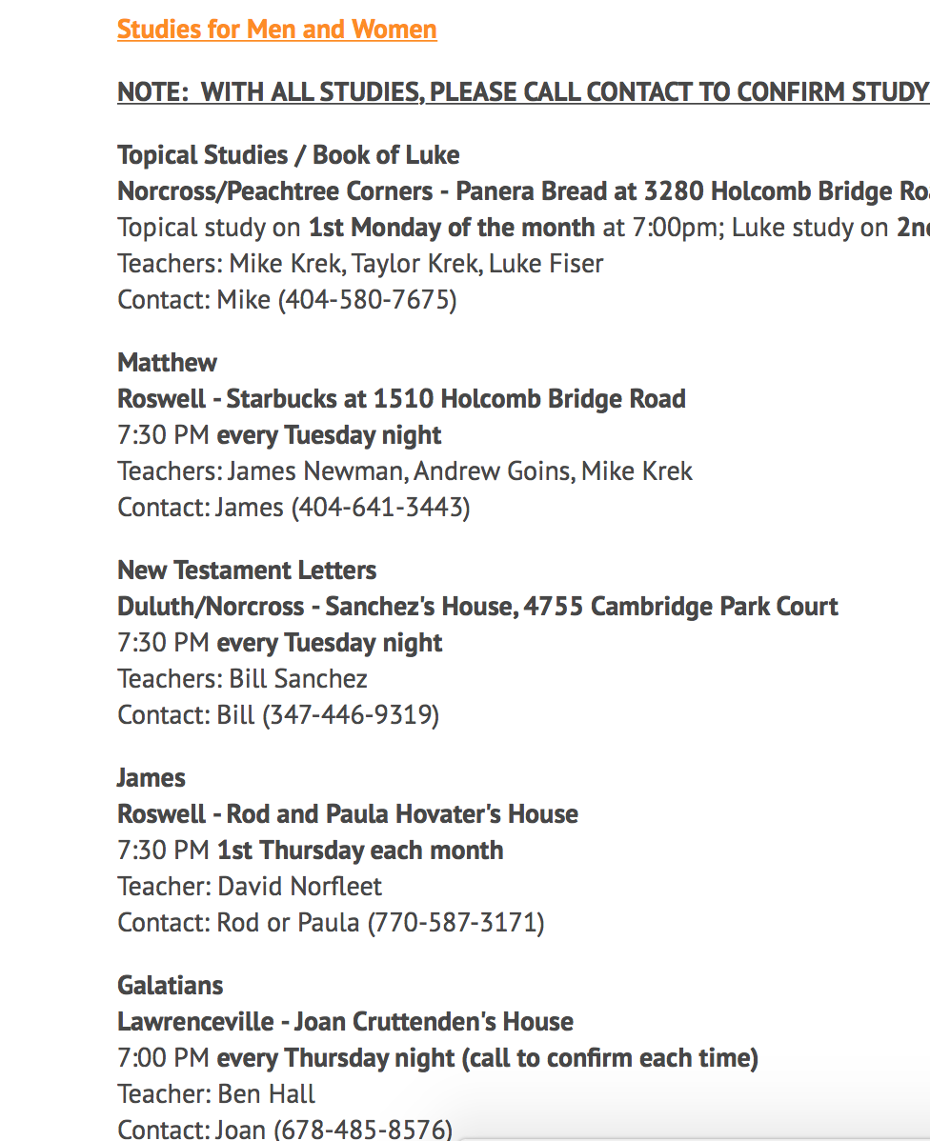
How Do I Create Better Study Habits
Community Study
Come to Church Services! (And Bible Class)
Join an Extra Bible Class Throughout the Week.
Free PowerPoint Templates

Slide 7
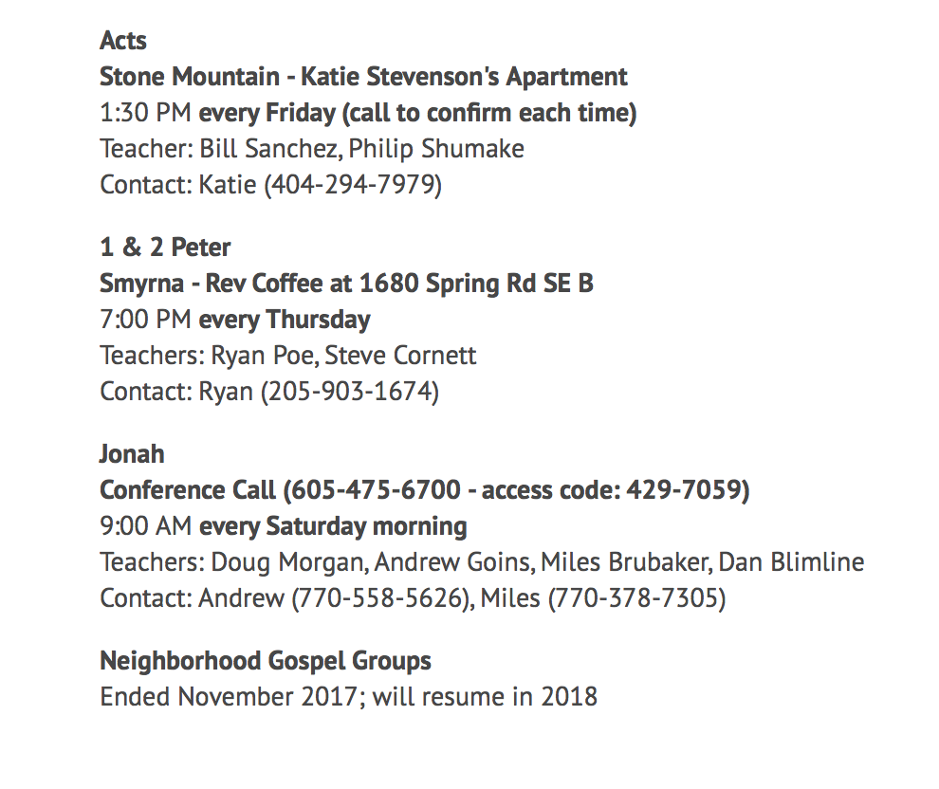
How Do I Create Better Study Habits
Community Study
Come to Church Services! (And Bible Class)
Join an Extra Bible Class Throughout the Week.
Free PowerPoint Templates

Slide 8
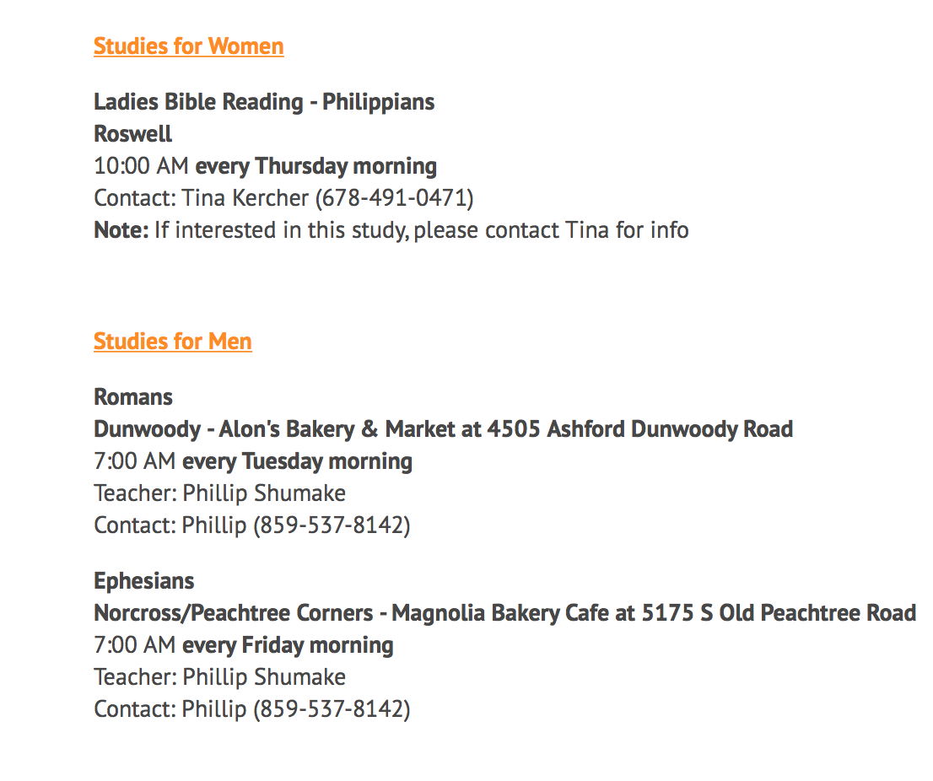
How Do I Create Better Study Habits
Community Study
Come to Church Services! (And Bible Class)
Join an Extra Bible Class Throughout the Week.
Free PowerPoint Templates

Slide 9
How Do I Create Better Study Habits
Community Study
Individual Study
Come to Church Services! (And Bible Class)
Join an Extra Bible Class Throughout the Week.
Ask Someone to Study/Read with You One on One.
Dedicate Yourself to Reading on Your Own.
Write Down Scripture.
Meditate on the Word.
Listen to the Word.
Free PowerPoint Templates

Slide 10
Principles for a Better Bible Study
Commit to Both Community and Individual Studies
Have a Realistic Plan that Pushes You.
Be a Purposeful Bible Student
Notes:
Have a Realistic Plan that Pushes You. (Pick a place/time/book)(Say You’re going to join a meet up and go twice a month)
(Netflix)
Commit to Both Individual and Community Studying
Read Purposefully Write down questions, thoughts, concerns, doubts
Translation Matters – Nehemiah 8:1-8

Slide 11
My delight is in the law of the Lord,
And in His law I meditate day and night.
I will be like a tree firmly planted by streams of water,
Which yields its fruit in its season
And its leaf does not wither;
And in whatever I do, I prosper.
Notes:
his delight is in the law of the Lord,
And in His law he meditates day and night.
He will be like a tree firmly planted by [b]streams of water,
Which yields its fruit in its season
And its leaf does not wither;
And in whatever he does, he prospers.

