Slide 1
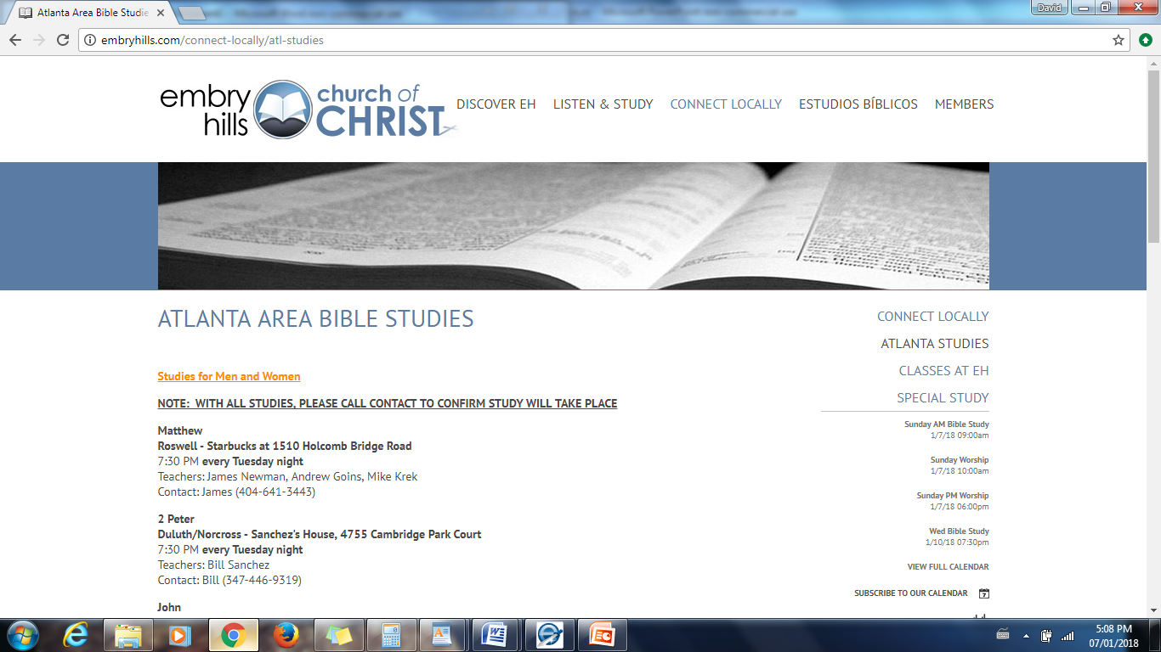

Slide 2
Neighborhood Gospel Groups
Approximately February 18 – March 30

Slide 4
Three Passages on the Priority of Prayer
(Acts 6:4, 1 Corinthians 7:5, Luke 22:46)

Slide 5
Acts 6:4 “But we will give ourselves continually to prayer and to the ministry of the word of God.”
Acts shows us that the apostles stayed very busy preaching and teaching the gospel (2:42, 2:46, 4:12-16, 4:21, 5:42)
Acts also shows us their great prayerfulness (2:42, 3:1, 4:23-31, 8:15, 9:11, 10:9, etc.)
If the apostles were to now take charge of this good work of distribution, something else would have to give (6:2,4).
We can always do everything that God expects us to do, but we simply can’t do everything we might like to do. Something has to give, but one thing that cannot give is prayer (1 Th. 5:17).

Slide 6
1 Corinthians 7:5 “Do not deprive one another except with consent for a time, that you may give yourselves to fasting and prayer.”
In marriage there is a complete giving of oneself – each belongs to the other, and no spouse is to “defraud” their mate.
There is one exception given, with three elements:
Mutual agreement
Limited time
The proper motive: prayer
The verse seems to assume that there are times that we will want to separate ourselves from the cares of this world (Matt. 13:22) and devote ourselves more fervently, uninterrupted, to prayer.

Slide 7
Luke 22:46 “Then He said to them, ‘Why do you sleep? Rise and pray, lest you enter into temptation.”
We may want to sympathize with the apostles, but to Jesus, sleep was not justifiable under the circumstances! Prayer is presented as key to Jesus’ success and key to the apostles’ failure.
It was typical for Jesus to pray at times of bodily weakness when He might otherwise have been resting and recovering
Matthew 14:23
Mark 1:35
Luke 5:16
Luke 6:12

Slide 8
Building On The Rock

