Slide 1
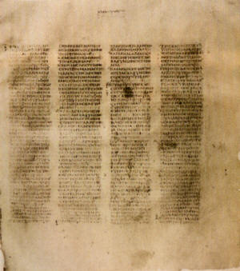
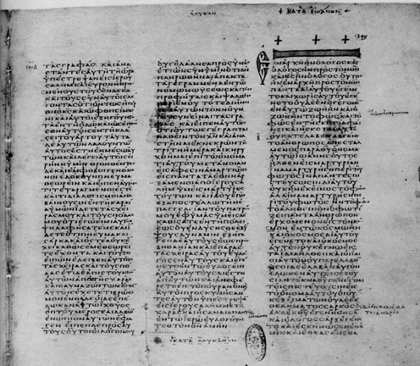
HOW WE GOT the Bible
A class on Bible origin, transmission and reliability
January 2018
Lesson 11
How the Bible came to Modern English

Slide 2
Class Objectives
Show the importance of the Bible to our faith & that it is reliable.
Demonstrate that we can be confident that we have God’s inspired word today.
Understand the difference in modern versions of English Bible
Be able to answer questions about the origin of the Bible

Slide 3
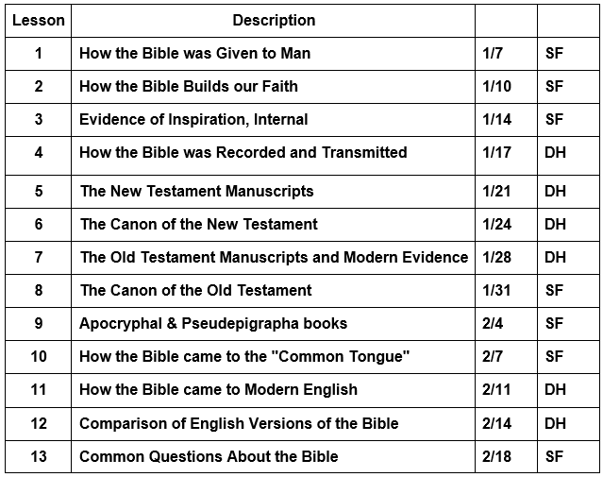
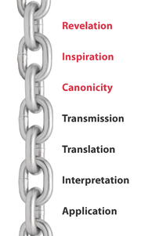
Course Content

Slide 4
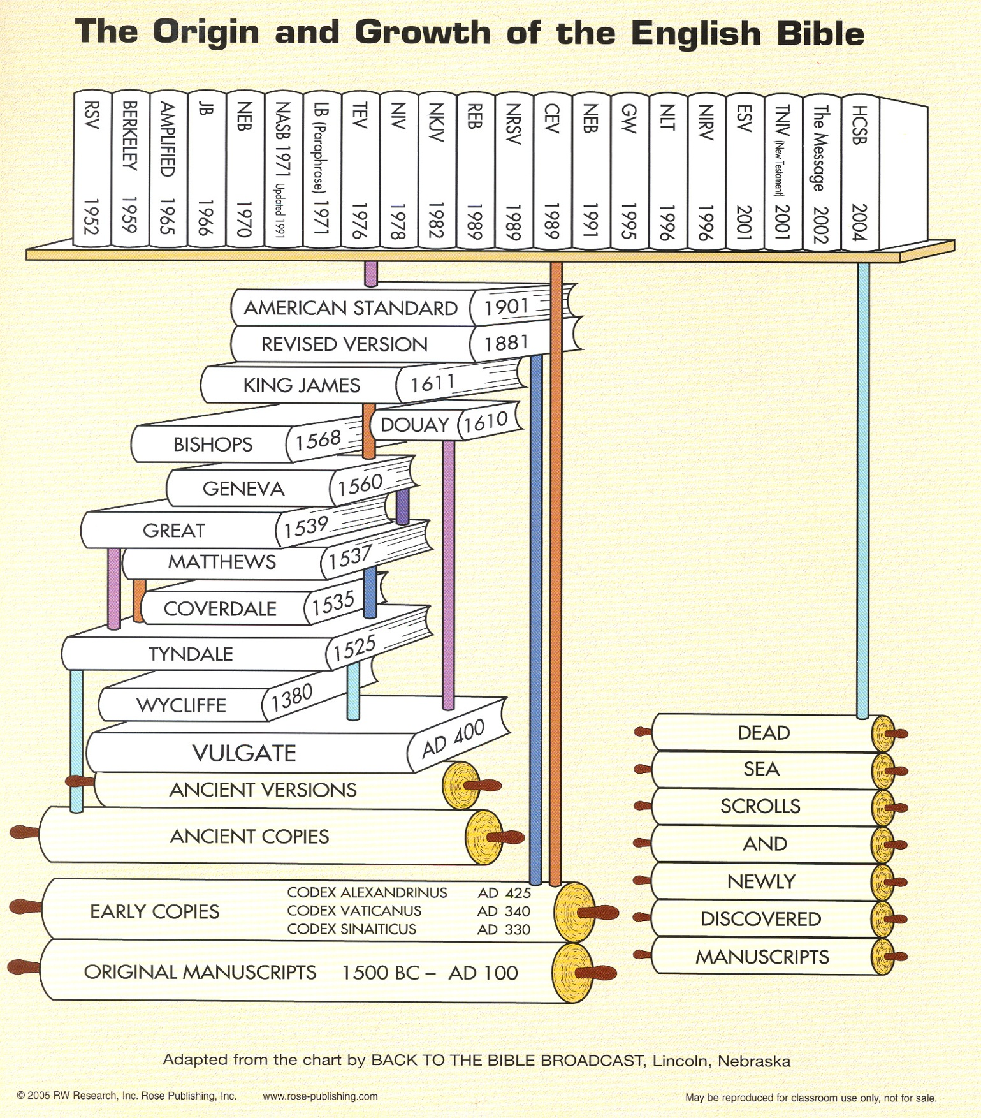
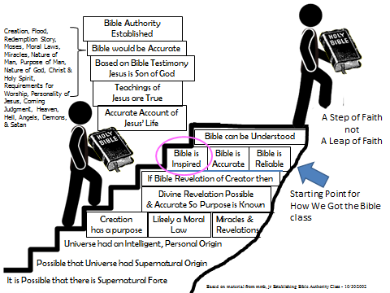
Origin & Growth of English Bible
Lessons 12
Lessons 11
Lessons 10
Lessons 4 to 9
Lessons 1 to 3

Slide 5

3 major periods of church history
patristic period (100-604)
  explosion of vernacular versions
  post-NT until Council of Chalcedon (451)
  transitional phase: 451-604 (Gregory the Great)
    Jerome’s Vulgate; Augustine’s theology
    Frozen – no commentaries etc
medieval period (604-1517)
  from Gregory the Great to the Reformation
  Latin foreign tongue (even in Italy)
modern period (1517-present)
  from the Reformation to today
Translations and Commentaries in Church History

Slide 6
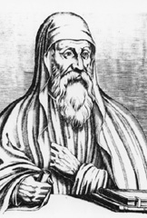
Patristic period (100-451)
explosion of biblical commentaries
Alexandrian School: Pantaenus, Clement, Origen, Dionysius, Didymus the Blind, Cyril, Pierius, Ambrose
Antiochene School: Lucian, Eusebius, Maris, Eudoxius, Theognis, Asterius, Arius, Diodorus, Theodore, Polychronius, John Chrysostom, Ephraem
Eclectic: Isidore, Theodoret, Gregory of Nazianzus, Gregory of Nyssa, Hilary, Ambrosiaster, Pelagius, Jerome, Augustine
Translations and Commentaries in Church History

Slide 7
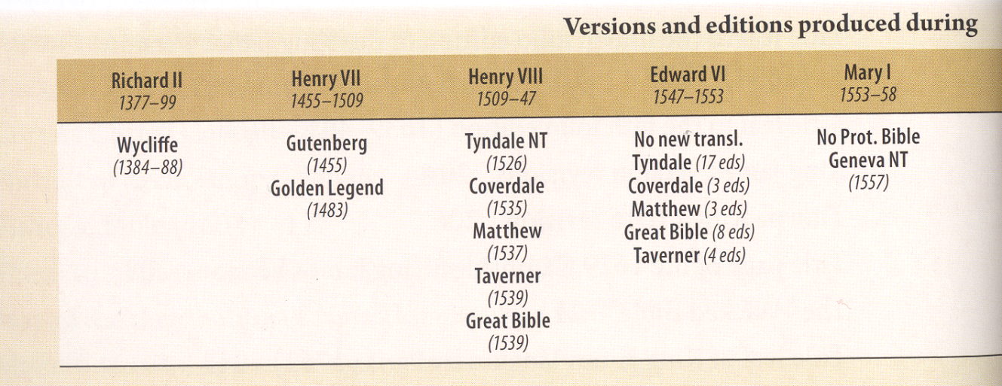
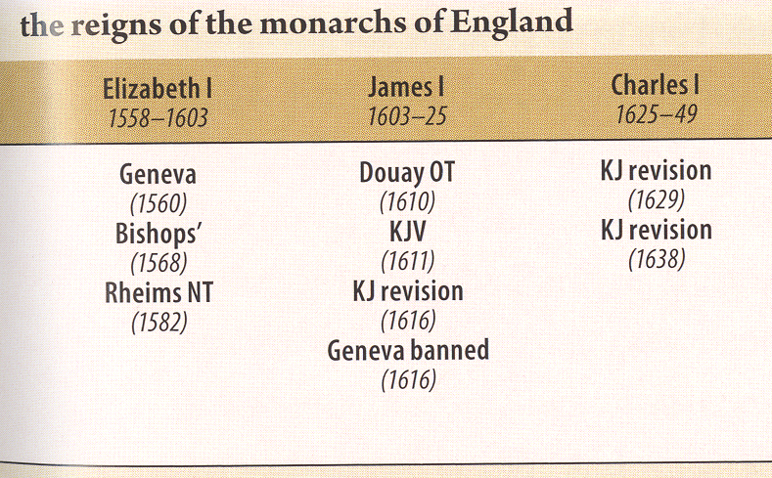
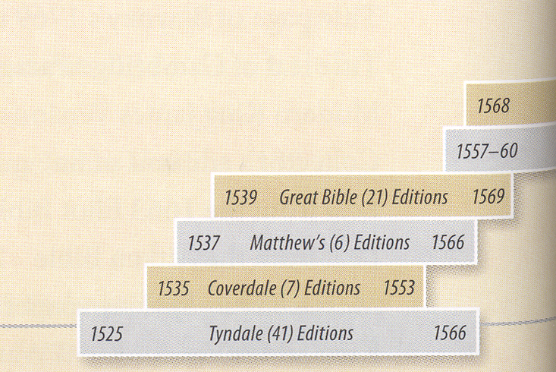
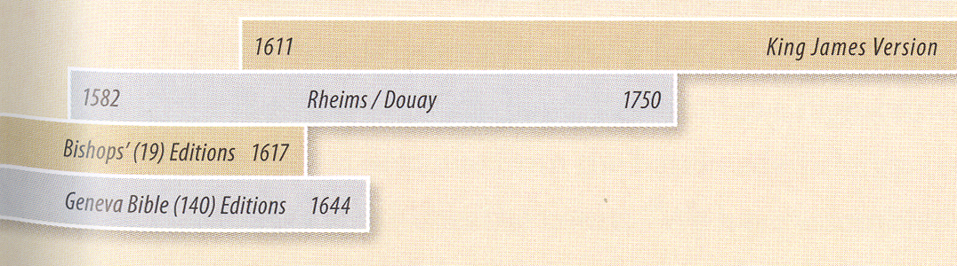
English Versions & Editions
Today
Visual History of King James Bible
Donald Brake & Shelly Bleach 2011

Slide 8
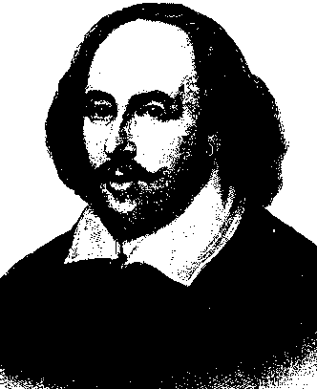
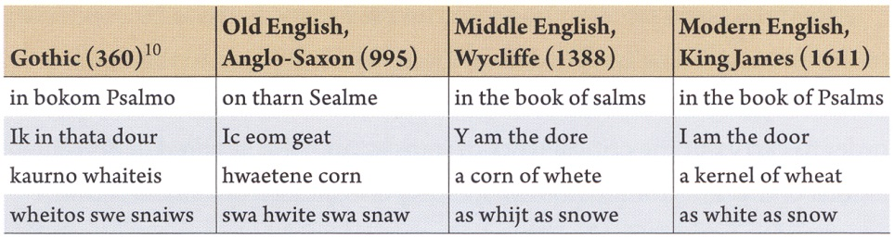
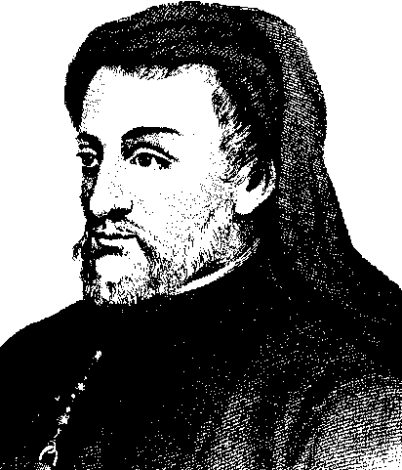
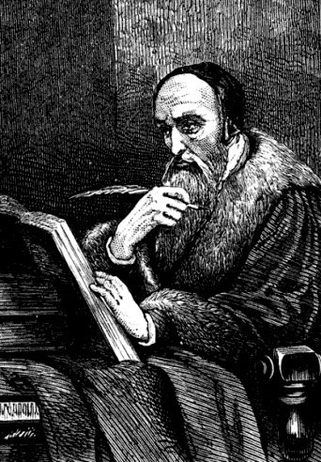
Development of English
William Shakespeare
Geoffrey Chaucer
John Wycliffe

Slide 9
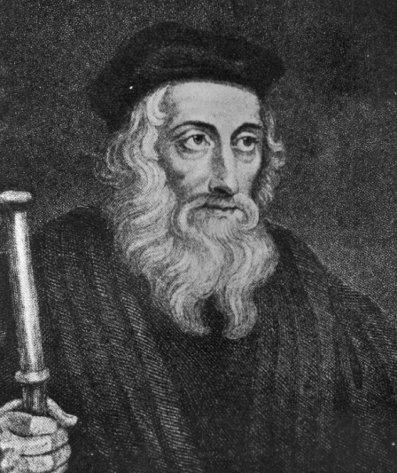
John Wycliffe (1324?-1384)
“No man was so rude a scholar but that he might learn the words of the Gospel according to his simplicity.”
“Those Heretics who pretend that the laity need not know God’s law but that the knowledge which priests have had imparted to them by word of mouth is sufficient, do not deserve to be listened to. For Holy Scriptures is the faith of the Church, and the more widely its true meaning becomes known the better it will be. Therefore since the laity should know the faith, it should be taught in whatever language is most easily comprehended…. Christ and His apostles taught the people in the language best known to them.”
Translations and Commentaries in Church History

Slide 10
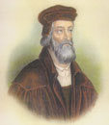
Wycliffe on Scripture
For him the Bible was the fundamental source of Christianity which is binding on all men.
From this one can easily see how the next step came about: the furnishing of the Bible to the people in their mother tongue.
Wycliffe put most emphasis on Scripture: "Even though there were a hundred popes and though every mendicant monk were a cardinal, they would be entitled to confidence only in so far as they accorded with the Bible."
Therefore in this early period it was Wycliffe who recognized and formulated the formal principle of the Reformation-- the unique authority of the Bible for the belief and life of the Christian.

Slide 11

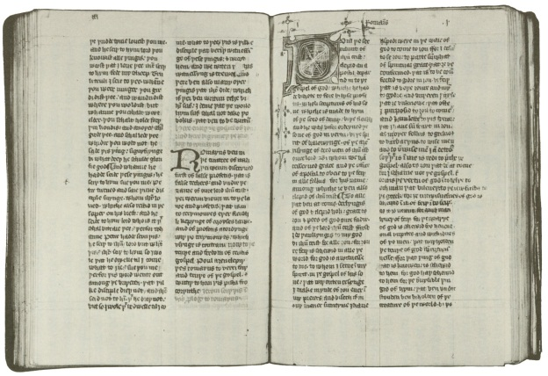
AD 1408
The Wycliffe Bible
In 1408 the English church, forbid "anyone to translate or even read a vernacular (English) version of the Bible in whole or in part without the approval of his diocesan bishop or of a provincial council."
1500 BC 500 BC AD 1 AD 500 AD 1000 AD 1500 AD 1900 AD 2000

Slide 12
AD 1428
The Wycliffe Bible
Wycliffe had the peculiar idea that the common man was worth something. “No man,” he said, “was so rude a scholar but that he might learn the words of the Gospel according to his simplicity.”
In this belief, during the last years of his life and with the assistance of some of his students, Wycliffe undertook a translation of the Scriptures from the Latin into the English tongue.
Lightfoot, Neil R. (2003-07-01). How We Got the Bible (pp. 175-176). Baker Publishing Group. Kindle Edition.
1500 BC 500 BC AD 1 AD 500 AD 1000 AD 1500 AD 1900 AD 2000

Slide 13

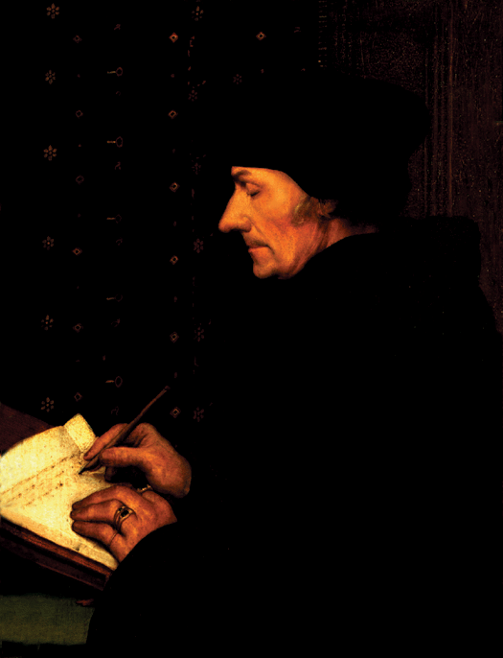
AD 1516
Erasmus
Erasmus, a priest and Greek scholar, publishes a new Greek edition and a more accurate Latin translation of the New Testament in AD 1516.
This milestone was the first non-Latin Vulgate text of the scripture to be produced in a millennium… and the first ever to come off a printing press.
Erasmus
1500 BC 500 BC AD 1 AD 500 AD 1000 AD 1500 AD 1900 AD 2000

Slide 14
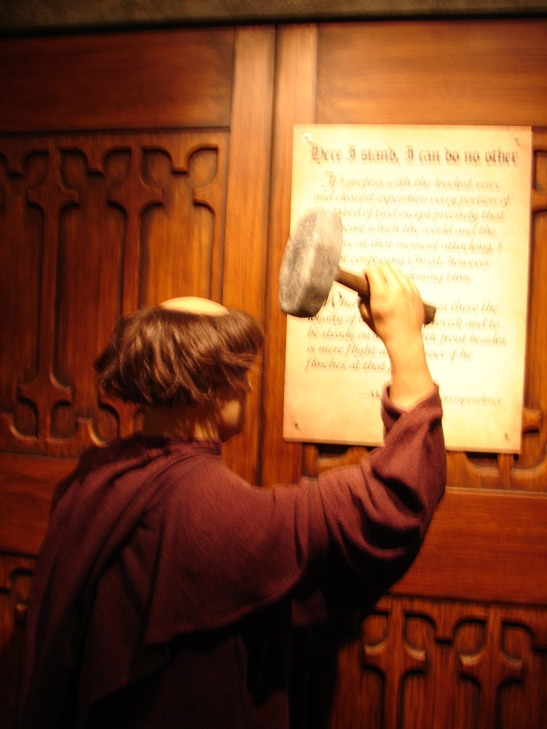
AD 1517
Martin Luther
Luther declared his intolerance for the Roman Church’s corruption on Halloween in 1517, by nailing his 95 Theses of Contention to the Wittenberg Church door. Luther, who would be exiled in the months following the Diet of Worms Council in 1521
Martin Luther
1500 BC 500 BC AD 1 AD 500 AD 1000 AD 1500 AD 1900 AD 2000

Slide 15
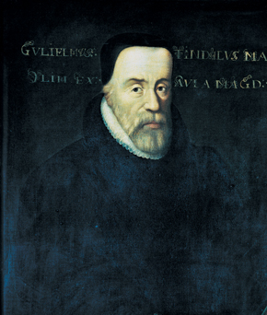
AD 1525
William Tyndale
William Tyndale, priest and Oxford scholar, translates the New Testament from Greek into English (AD 1525), but cannot get approval to publish it in England.
He was so fluent in eight languages that it was said one would think any one of them to be his native tongue.
1500 BC 500 BC AD 1 AD 500 AD 1000 AD 1500 AD 1900 AD 2000

Slide 16

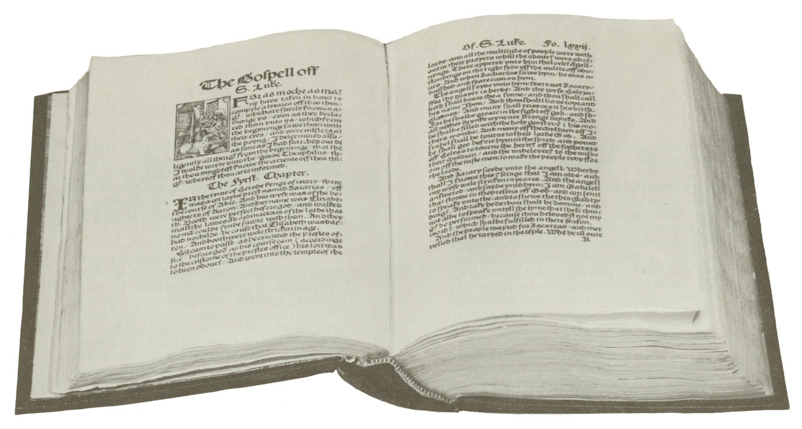
The First Printed English New Testament AD 1525
(Tyndale’s Bible)

Slide 17
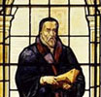
William Tyndale
(1494-1536 )
A clergyman hopelessly entrenched in Roman Catholic dogma once taunted Tyndale with the statement, “We are better to be without God’s laws than the Pope’s”.
Tyndale was infuriated by such Roman Catholic heresies, and he replied, “I defy the Pope and all his laws. If God spare my life ere many years, I will cause the boy that drives the plow to know more of the scriptures than you!”

Slide 18
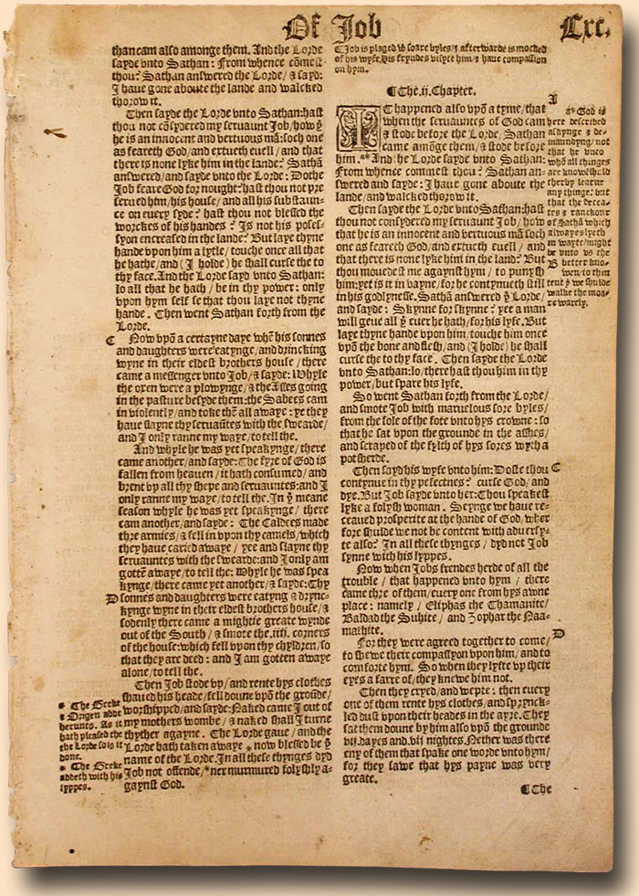
1537 Matthew-Tyndale Leaf

Slide 19
AD 1536
William Tyndale
Tyndale used the word
“congregation” instead of “church,”
“love” instead of “charity,”
“repentance” instead of “penance,”
He coined such words as “Passover,” “scapegoat,” “mercy seat,” and “long-suffering.”
Expressions of Tyndale
“the kingdom of heaven is at hand” (Matt. 3: 2);
“the pinnacle of the temple” (Matt. 4: 5);
“the salt of the earth” (Matt. 5: 13);
“daily bread” (Matt. 6: 11);
“Consider the lilies of the field, how they grow” (Matt. 6: 28);
“meek and lowly in heart” (Matt. 11: 29); “shepherds abiding in the field” (Luke 2: 8);
“eat, drink, and be merry” (Luke 12: 19);
“fatted calf” (Luke 15: 23);
“only begotten son” (John 1: 14, 18);
“in my Father’s house are many mansions”
(John 14: 2);
“in whom we live and move and have our being”
(Acts 17: 28);
“God forbid” (Rom. 3: 4);
“sounding brass” and “tinkling cymbal”
(1 Cor. 13: 1);
“in the twinkling of an eye” (1 Cor. 15: 52); “singing and making melody” (Eph. 5: 19);
“office of a bishop” (1 Tim. 3: 1);
“the pleasures of sin for a season” (Heb. 11: 25); “an advocate with the Father” (1 John 2: 1); “Behold, I stand at the door and knock”
(Rev. 3: 20).
80% of KJV from Tynade’s Translation
1500 BC 500 BC AD 1 AD 500 AD 1000 AD 1500 AD 1900 AD 2000

Slide 20
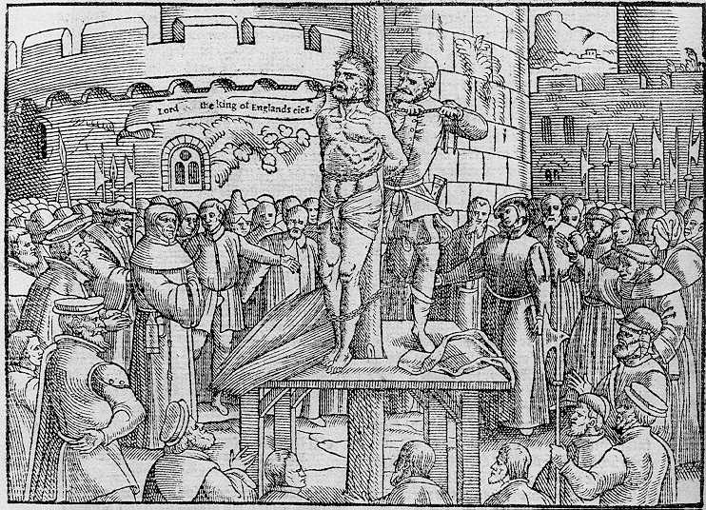
Tyndale
“After being arrested, imprisoned for over 500 days of horrible conditions, tried for heresy and treason in a ridiculously unfair trial, and convicted Tyndale was then strangled and burnt at the stake in the prison yard, Oct. 6, 1536. His last words were,
"Lord, open the king of England's eyes."

Slide 21
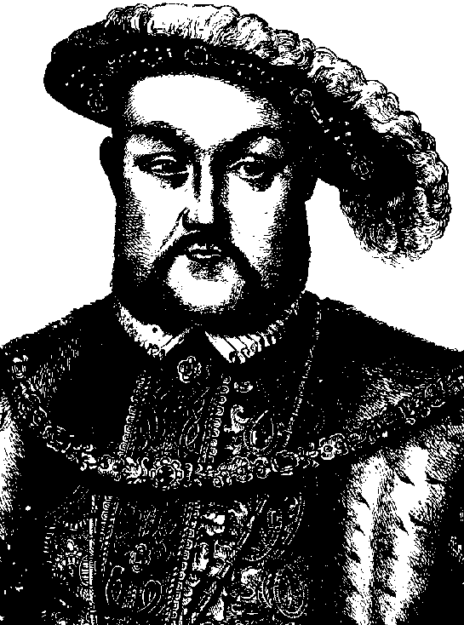
AD 1537
The Great Bible
Later, Thomas Cromwell, advisor to King Henry VIII, entrusts Coverdale to revise Matthew’s Bible to make the Great Bible.
Henry VIII
(1491-1547)
1500 BC 500 BC AD 1 AD 500 AD 1000 AD 1500 AD 1900 AD 2000

Slide 22
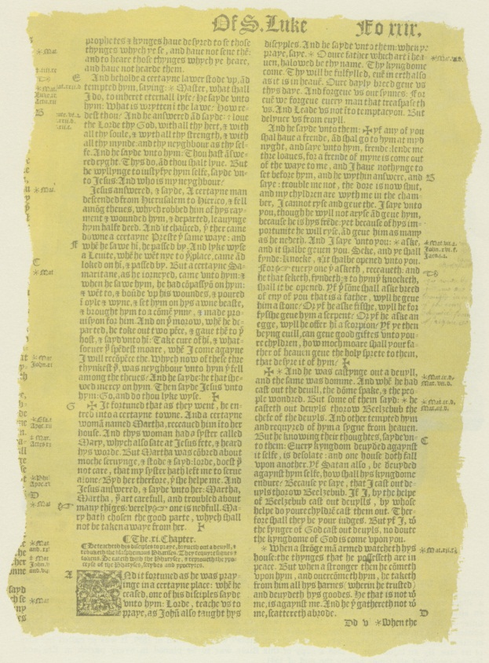
AD 1539
The Great Bible
In AD 1539, the Great Bible is placed in every church by order of Thomas Cranmer, archbishop under
King Henry VIII.
It is read aloud except during services and sermons.
Page from the Great Bible
1500 BC 500 BC AD 1 AD 500 AD 1000 AD 1500 AD 1900 AD 2000

Slide 23
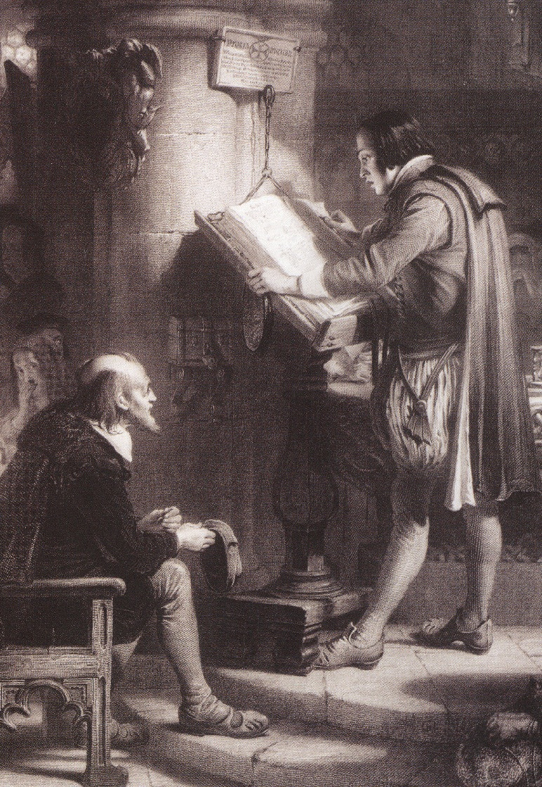
AD 1539
The Great Bible
This Bible is chained to the church pillars to discourage theft.
At times preachers complained that the people would rather read the Bible than listen to their sermons.
1500 BC 500 BC AD 1 AD 500 AD 1000 AD 1500 AD 1900 AD 2000

Slide 24
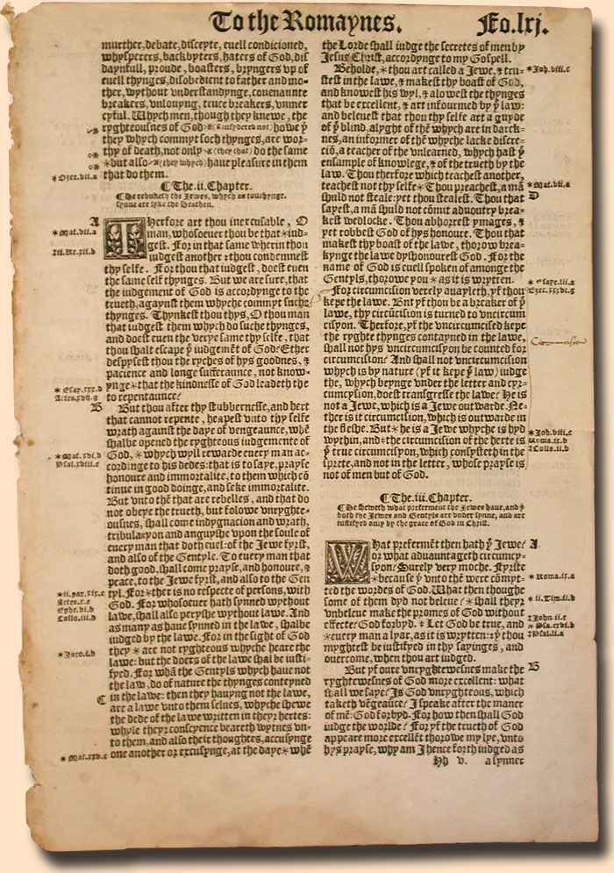
1539-40 Great Bible Leaf
.

Slide 25
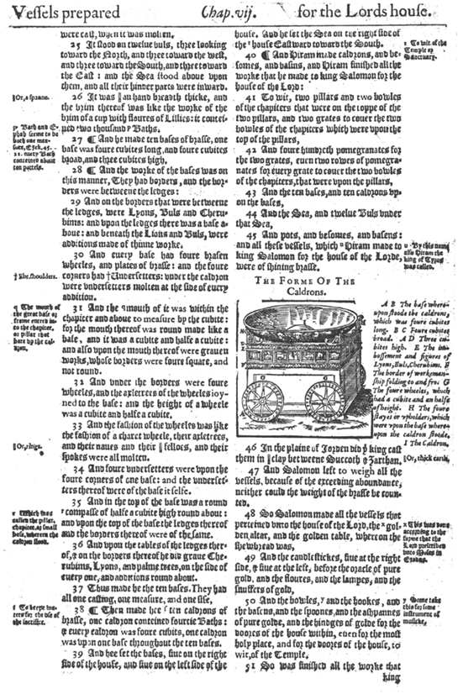
AD 1560
The Geneva Bible
Exiles from England flee to
Geneva, Switzerland. In AD 1560, they print the Geneva Bible, which is a complete revision of the Great Bible with the Old Testament translated from Hebrew.
Page from Geneva Bible
1500 BC 500 BC AD 1 AD 500 AD 1000 AD 1500 AD 1900 AD 2000

Slide 26
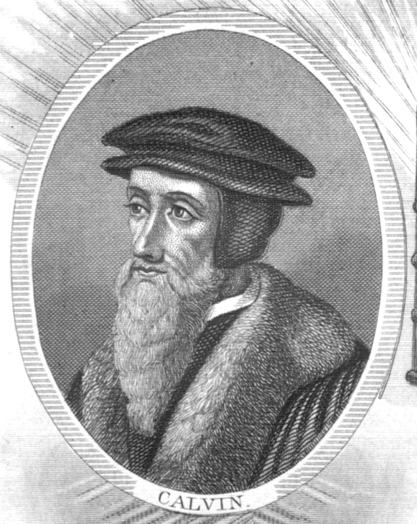
AD 1560
The Geneva Bible
The Geneva Bible contains theological notes from Protestant scholars
John Calvin, Beza, Knox,
and Whittingham. It is the first Bible to use Roman type.
John Calvin
1500 BC 500 BC AD 1 AD 500 AD 1000 AD 1500 AD 1900 AD 2000

Slide 27
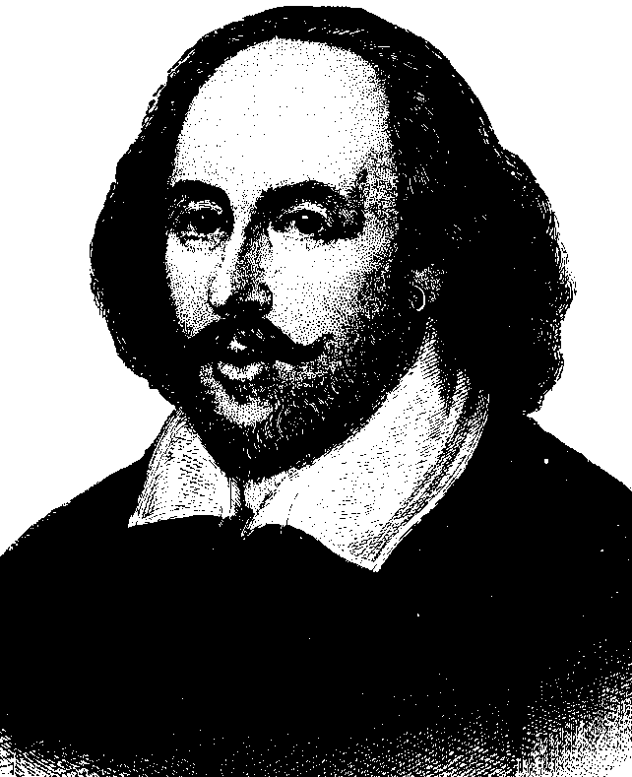
AD 1560
The Geneva Bible
This is the Bible of Shakespeare and the one carried to America by the Pilgrims in AD 1620.
The AD 1640 edition is the
first English Bible to omit
the Apocrypha.
William Shakespeare
1500 BC 500 BC AD 1 AD 500 AD 1000 AD 1500 AD 1900 AD 2000

Slide 28
AD 1560
The Geneva Bible
It was so accurate and popular, that a half-century later, when the King James Bible came out… it retained more than 90% of the exact wording of the Geneva Bible.
Page from Geneva Bible
1500 BC 500 BC AD 1 AD 500 AD 1000 AD 1500 AD 1900 AD 2000

Slide 29
AD 1560
The Geneva Bible
Due to a passage in Genesis describing the clothing that God fashioned for Adam and Eve upon expulsion from the Garden of Eden as "Breeches" (an antiquated form of "Britches"), some people referred to the Geneva Bible as the Breeches Bible.
Page from Geneva Bible
1500 BC 500 BC AD 1 AD 500 AD 1000 AD 1500 AD 1900 AD 2000

Slide 30
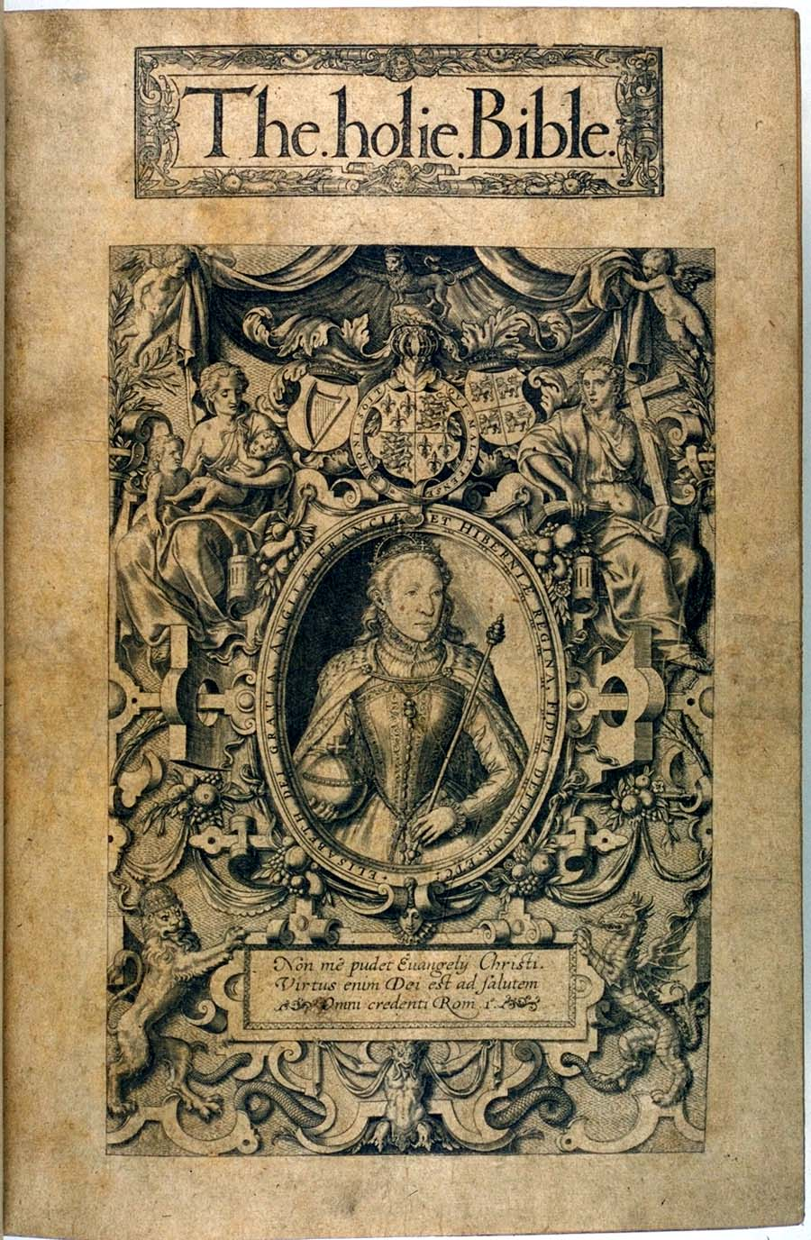
AD 1568
The Bishop’s Bible
Deficiencies in the Great Bible became evident when compared to Geneva Bible, but it was unacceptable to church leaders since it had sectarian marginal notes and some questionable passages. Matthew Parker, Arch-Bishop of Canterbury, and 8 bishops revised the Great Bible. The front page showed Queen Elizabeth and Bishops presiding over a bishop dominated church.
1500 BC 500 BC AD 1 AD 500 AD 1000 AD 1500 AD 1900 AD 2000
1500 BC 500 BC AD 1 AD 500 AD 1000 AD 1500 AD 1900 AD 2000

Slide 31
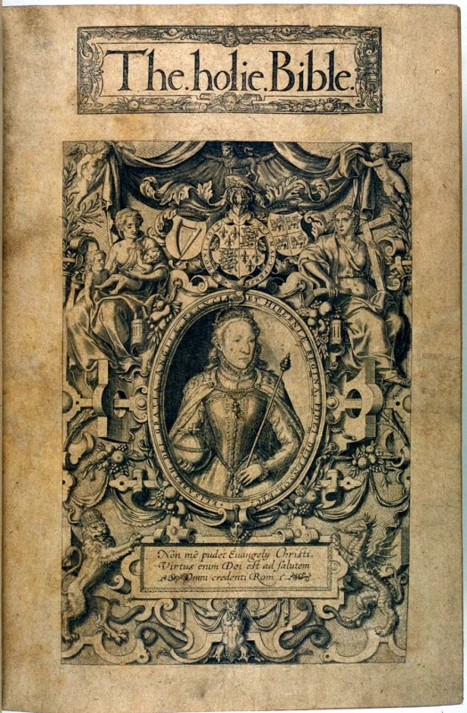
AD 1568
The Bishop’s Bible
  Ecclesiastes 11:1
  Geneva Bible used
  “Cast thy bread upon the waters”
  Bishop’s Bible translation used
  “Lay thy bread upon wet faces”
1500 BC 500 BC AD 1 AD 500 AD 1000 AD 1500 AD 1900 AD 2000
1500 BC 500 BC AD 1 AD 500 AD 1000 AD 1500 AD 1900 AD 2000

Slide 32
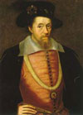
King James Bible
With the death of Queen Elizabeth I, Prince James VI of Scotland became King James I of England in 1603.
The Protestant clergy approached the new King in 1604 and announced their desire for a new translation to replace the Bishop's Bible first printed in 1568.
They knew that the Geneva Version had won the hearts of the people because of its excellent scholarship, accuracy, and exhaustive commentary.
Did not want the controversial marginal notes (proclaiming the Pope an Anti-Christ, etc.) Essentially, the leaders of the church desired a Bible for the people, with scriptural references only for word clarification or cross-references.
1500 BC 500 BC AD 1 AD 500 AD 1000 AD 1500 AD 1900 AD 2000
1500 BC 500 BC AD 1 AD 500 AD 1000 AD 1500 AD 1900 AD 2000

Slide 33
King James – Two View Points
Church of England | Puritans
Bishops/Priests needed for a church to interpret God’s word for them | Christians could have access to God’s word without help
Private interpretation of scripture a sin of arrogance | Each souls can converse with God’s word directly unmediated by any worldly church
 | God’s thoughts and actions can be interpreted by the words of scripture
Bible can only be understood from inherited wisdom from tradition, past councils, etc | Against Bishop Bible, Baptizing infants, fasting, kneeling at communion, wedding rings, bishops, priests and priest robes
The church used rituals, crosses, God as a mystery which required ceremony and respect for the inherited pass to be approached and worshipped | Use of crosses and symbolism the remnants of Catholic worship

Slide 34
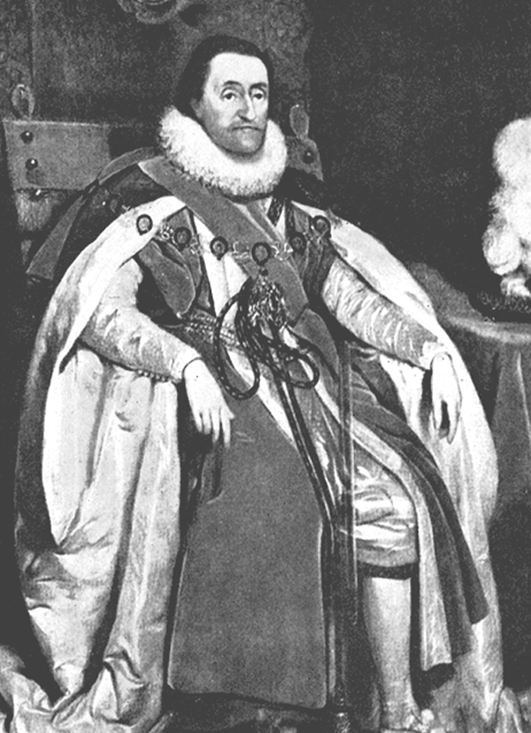
AD 1611
King James Version
King James I commissions 54 scholars to undertake a new Bible translation.
For six years, six teams of scholars using the Textus Receptus, Bishops Bible, and Tyndale’s Bible, complete the new version in AD 1611.
King James I of England
1500 BC 500 BC AD 1 AD 500 AD 1000 AD 1500 AD 1900 AD 2000

Slide 35
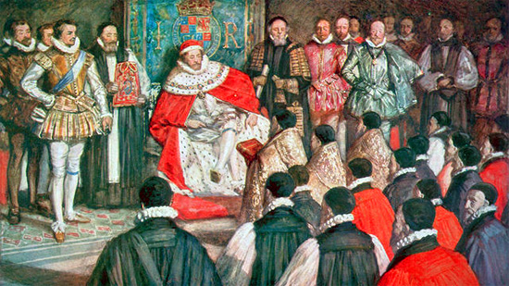
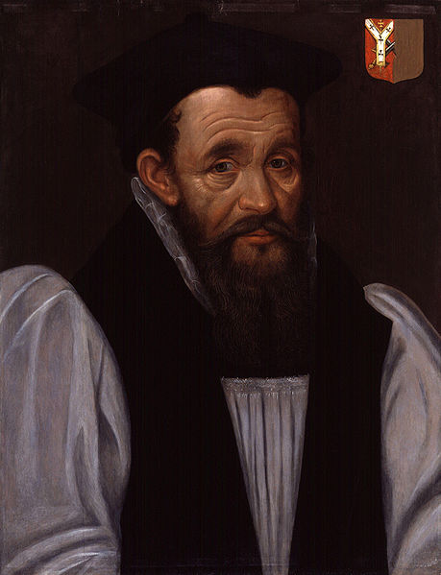
Rules for Translating
Use Bishops Bible with as little alteration as possible (8%).
Names of the prophets and holy writers retained as used by people.
Keep the old ecclesiastical words
When questioning translation of a word use what is in most agreement with ancient church fathers.
Keep Division of chapters
No marginal notes except for explanation of words.
Make reference of one Scripture to another.
Each company is to confer on translation on each member and agree
When a company has completed translation then reviewed by rest of the translators
If the other companies have issues with parts of the translation sent to them, make a note of the questioned passage and send back to the translators. If agreement cannot be reached it will be reviewed at the end of the work
If any given passage has an obscure or doubted meaning direct questions to any learned man who would have knowledge on the matter
Richard Bancroft
Archbishop of Canterbury
Principle Organizer of Companies & Rules of Translation
1544-1610

Slide 36
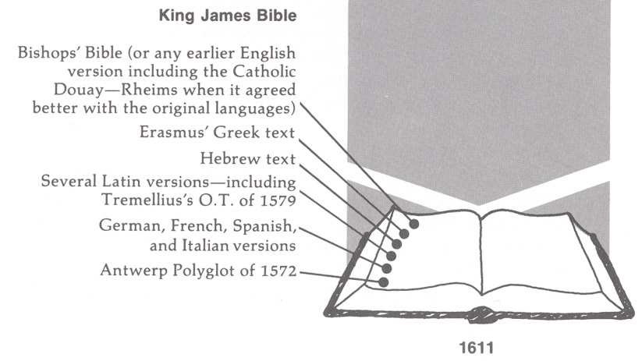
King James Bible
This "translation to end all translations" (for a while at least) was the result of the combined effort of about fifty scholars. They took into consideration:
  Bishop Bible, Tyndale New Testament,
  The Coverdale Bible,
  The Matthews Bible,
  The Great Bible,
  The Geneva Bible,
  even the Rheims New Testament (Catholic)
Revision of the Bishop's Bible had begun.
  1603 King James becomes King of England
  1604 Hampton Court Conference (Othello, Merry Wives of Winsdor, Measure for Measure)
  From 1605 to 1606 the scholars engaged in private research.
    1605 Gunpowder plot – Merchant of Venice, King Lear
  From 1607 to 1609 the work was assembled.
  In 1610 the work went to press
  In 1611 the first of the huge (16 inch tall) pulpit folios known today as "The 1611 King James Bible" came off the printing press.

Slide 37
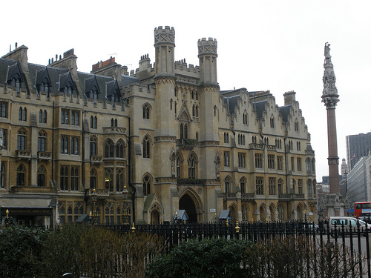
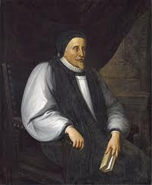
Westminster Company
1st Westminster Company
Lancelot Andrews (Director)
1555-1626
Genesis
Exodus
Leviticus
Numbers
Deuteronomy
Joshua
Judges
Ruth
1,2 Samuel
1,2 Kings
2nd Westminster Company
William Barlow (Director)
??-1613
Romans Hebrews
1,2 Corinthians James
Galatians 1,2 Peter
Ephesians 1,2,3 John
Philippians Jude
Colossians
1,2 Thessalonians
1,2 Timothy
Titus
Philemon

Slide 38
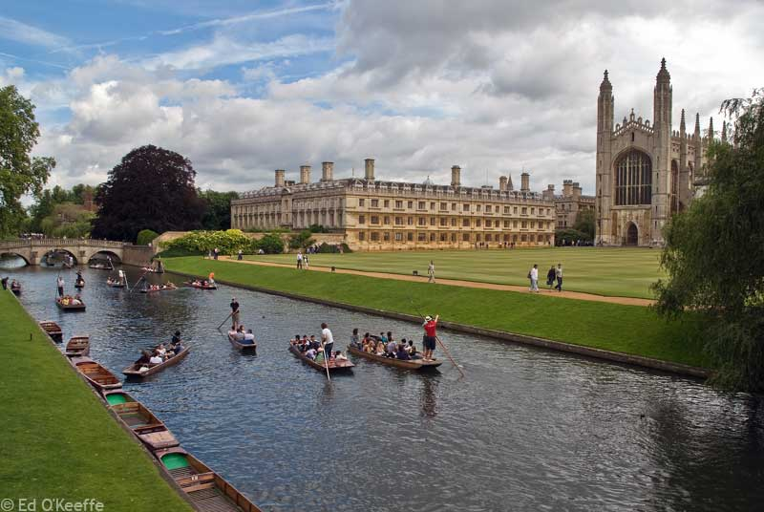
Cambridge Company
Puritan Element
1st Cambridge Company
Edward Lively (Director)
1545-1605
1,2 Chronicles
Ezra
Nehemiah
Esther
Job
Psalms
Proverbs
Ecclesiastes
Song of Songs
2nd Cambridge Company
John Duport (Director)
??-1617
The Apocrypha

Slide 39
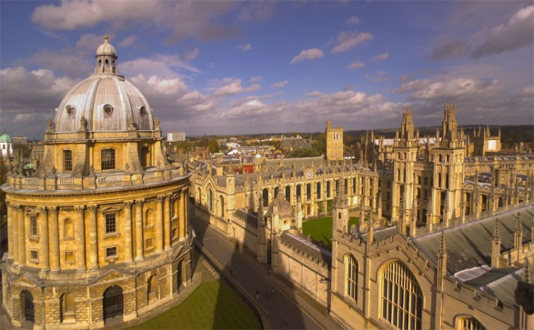
Oxford Company
1st Oxford Company
John Harding (Director)
Isaiah
Jeremiah
Lamentations
Ezekiel
Daniel
Hosea
Joel
Amos
Obadiah
Jonah Micah
Nahum Habakkuk
Zephaniah Haggai
Malachi
2nd Oxford Company
Thomas Ravis (Director)
1560-1609
Matthew
Marl
Luke
John
Acts
Revelation

Slide 40
Luke 1:57
13 words
15 words
15 words
NRSV & ESV -14 words
Now the time came for Elizabeth to give birth, and she bore a son.
NASB – 17 words
Now the time had come for Elizabeth to give birth, and she gave birth to a son.
New Century Bible – 13 words
When it was time for Elizabeth to give birth, she had a boy

Slide 41
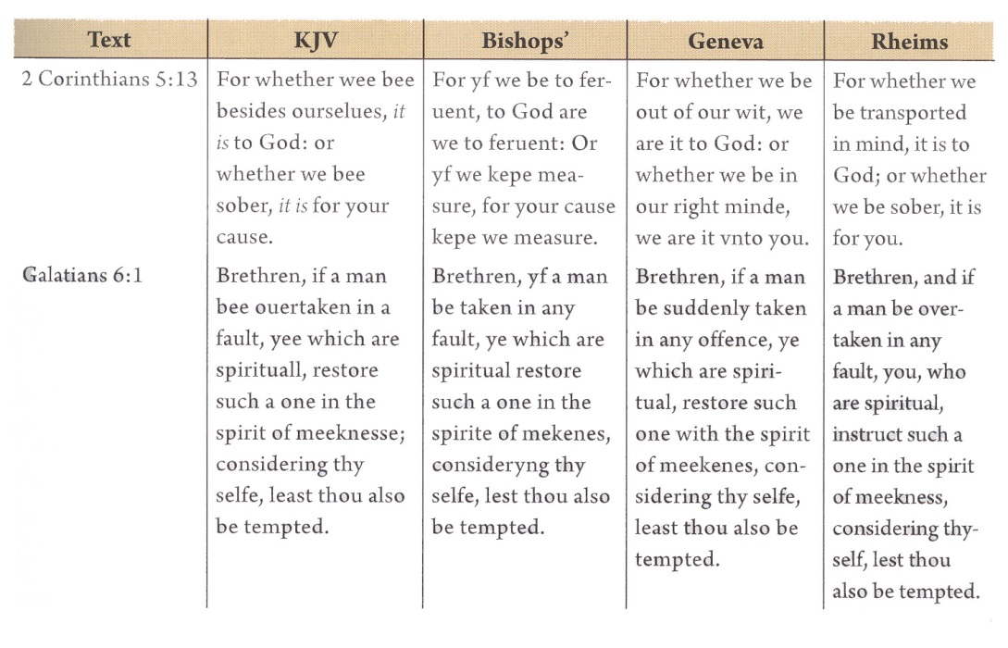
Comparison of KJV to Parallel Bible of the Time
2 Corinthians 5:13 (ESV)
For if we are beside ourselves, it is for God; if we are in our right mind, it is for you.

Slide 42
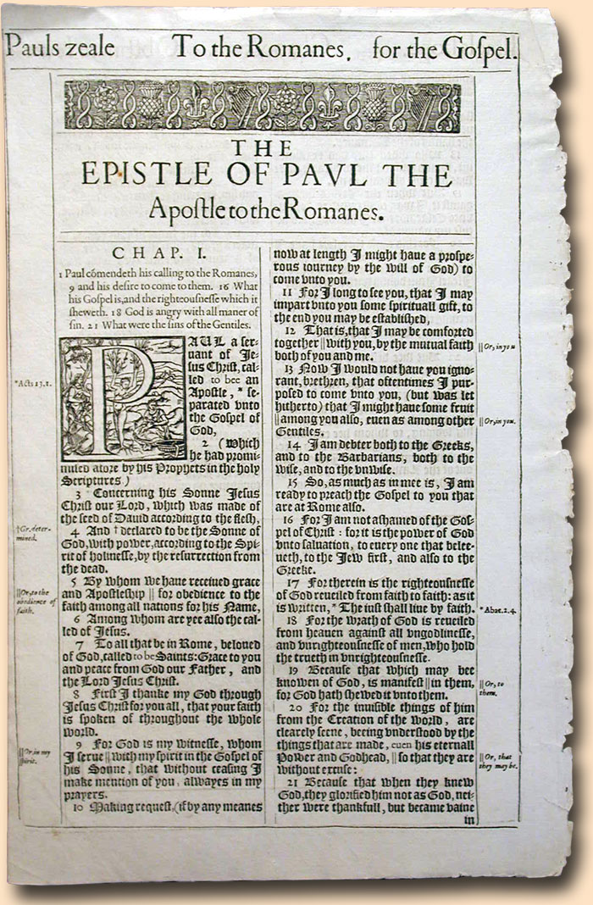
1611 King James

Slide 43
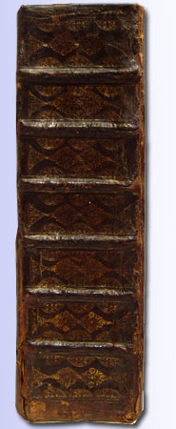
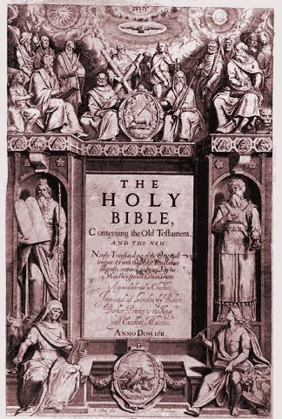
King James
1611

Slide 44
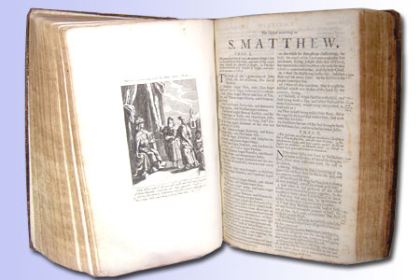
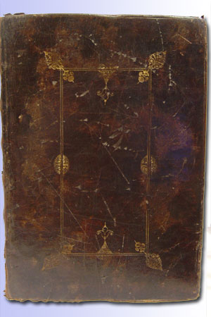
King James
1611

Slide 45
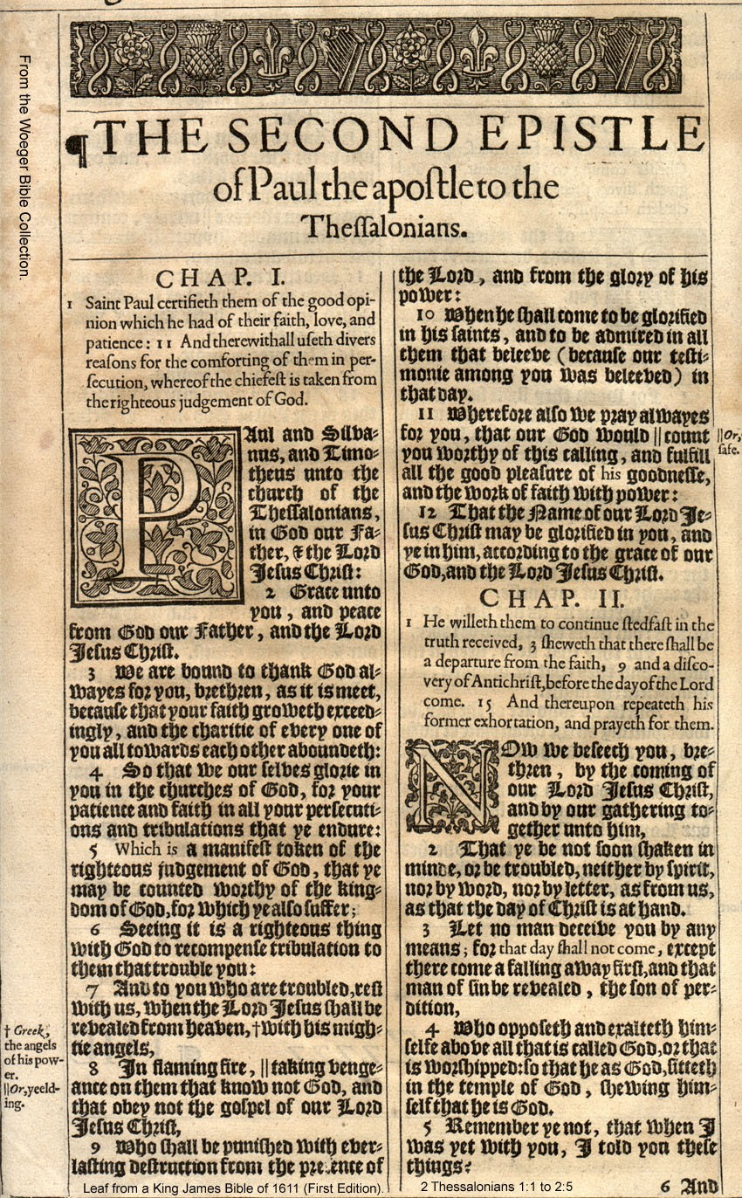
King James - 1611

Slide 46

King James - 1611

