Slide 1
Lisbon, Portugal Beira & Maputo, Mozambique Victoria, Mahe, Seychelles
May 2017
Preaching & Teaching Trip

Slide 2
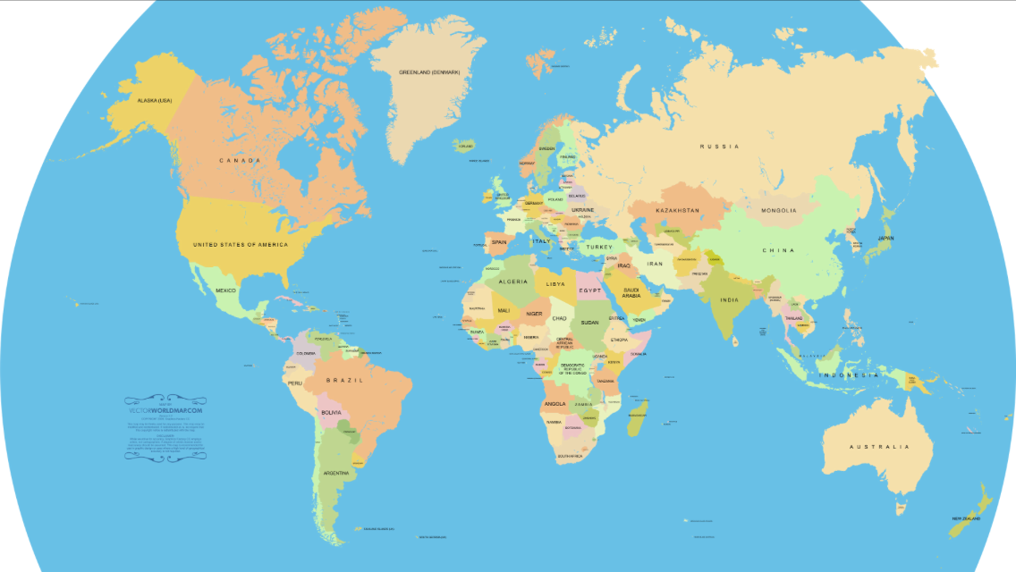
Where In The World Did We Go?
Portugal
Seychelles
Mozambique

Slide 3
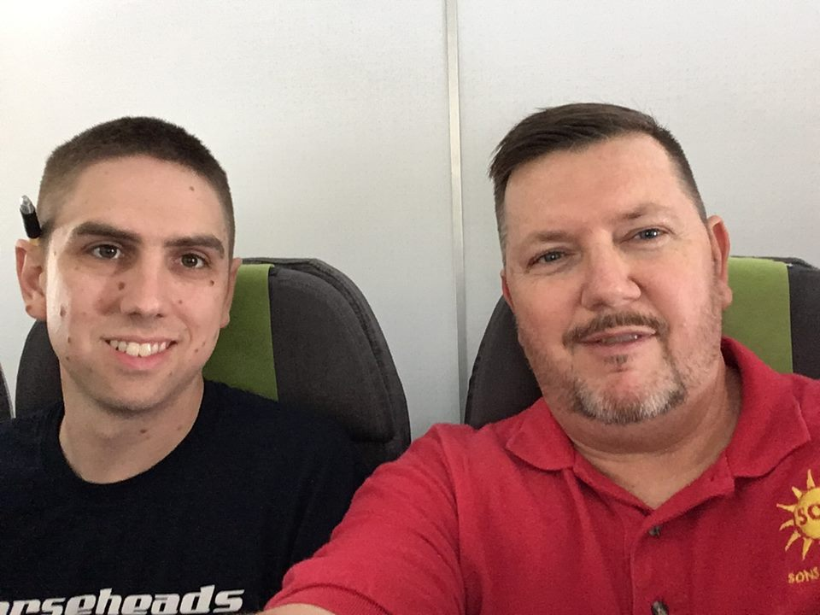
First 2 Nights Spent On Planes

Slide 4
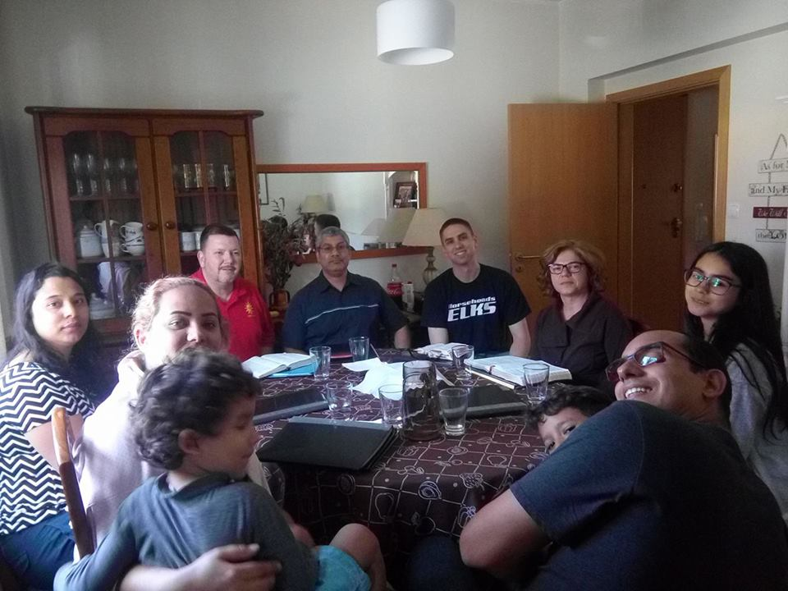
The Church In Lisbon
Elen
Joe
Luis
Tim
Isabel
Lauana
Thays
Caio
Luíz Felipe
Peterson

Slide 5
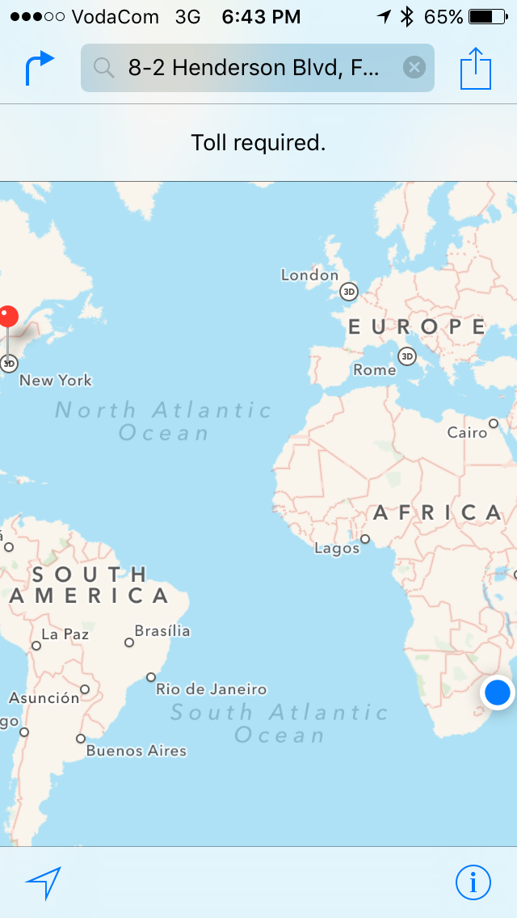
Toll Required
Lots of support
Financial
Emotional
spiritual
A willing family

Slide 6
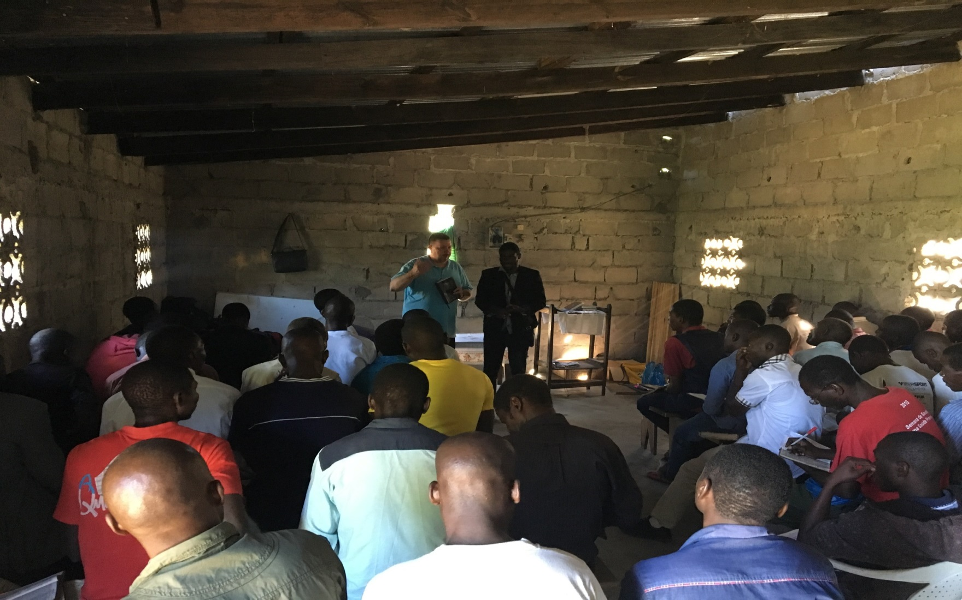
Studies In Beira

Slide 7
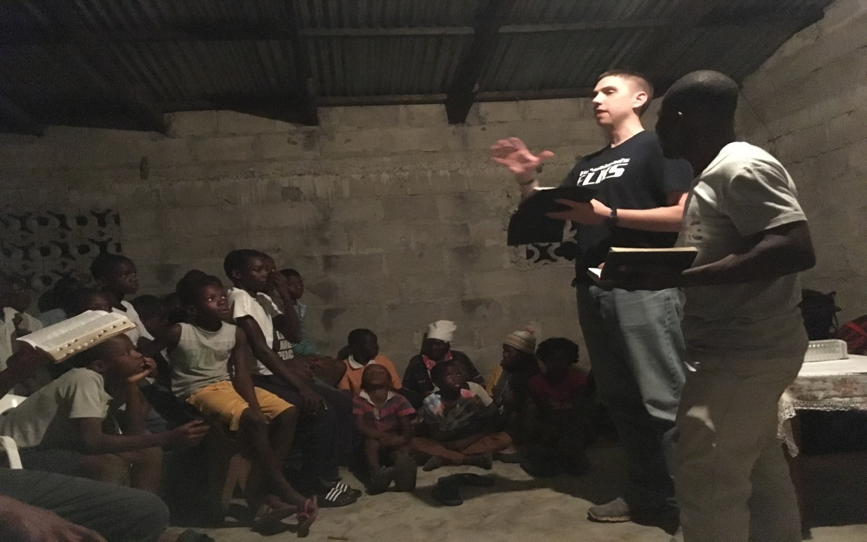
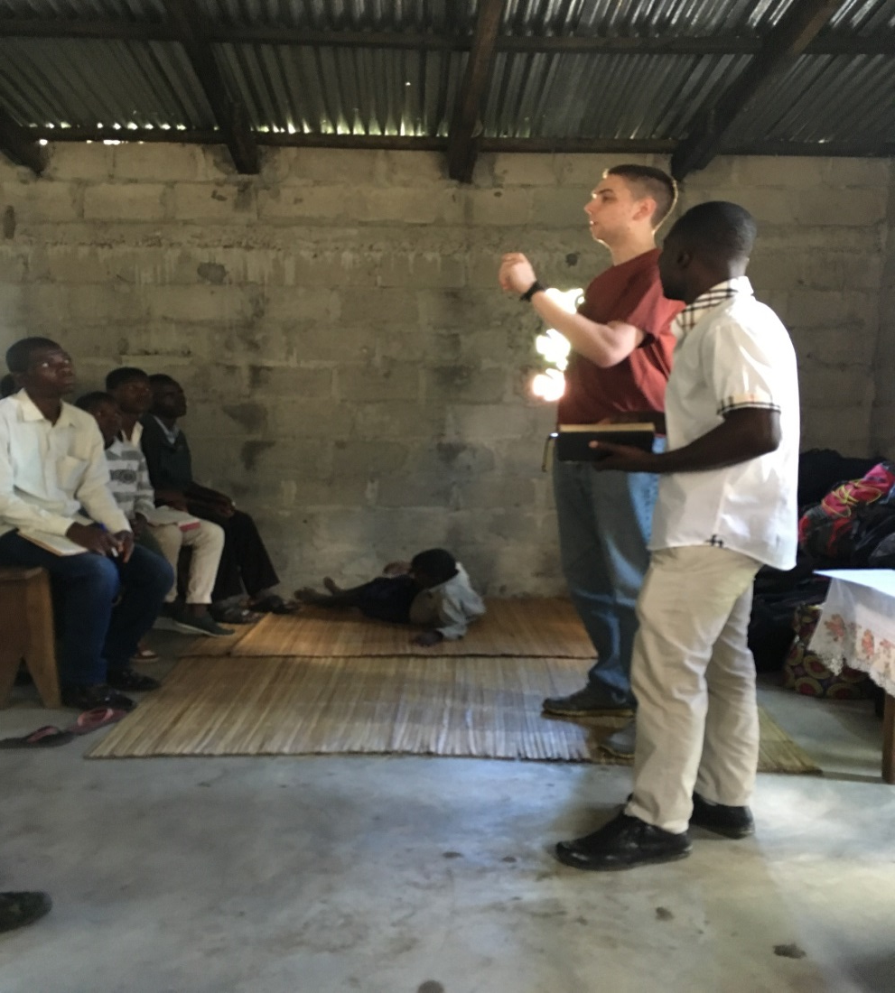
Preaching all day

Slide 8
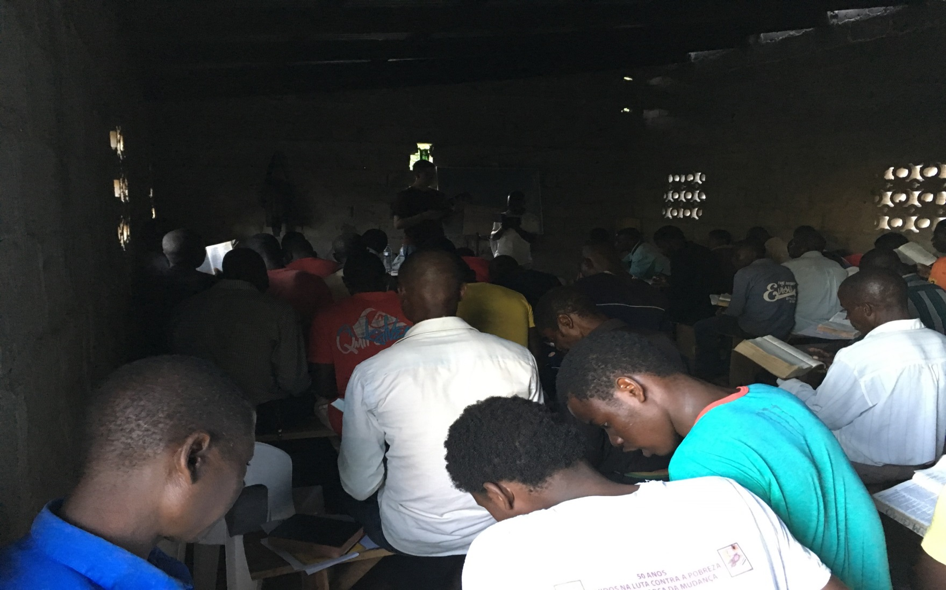
Acts 17:11
THIS!
This is why I go to Mozambique

Slide 9
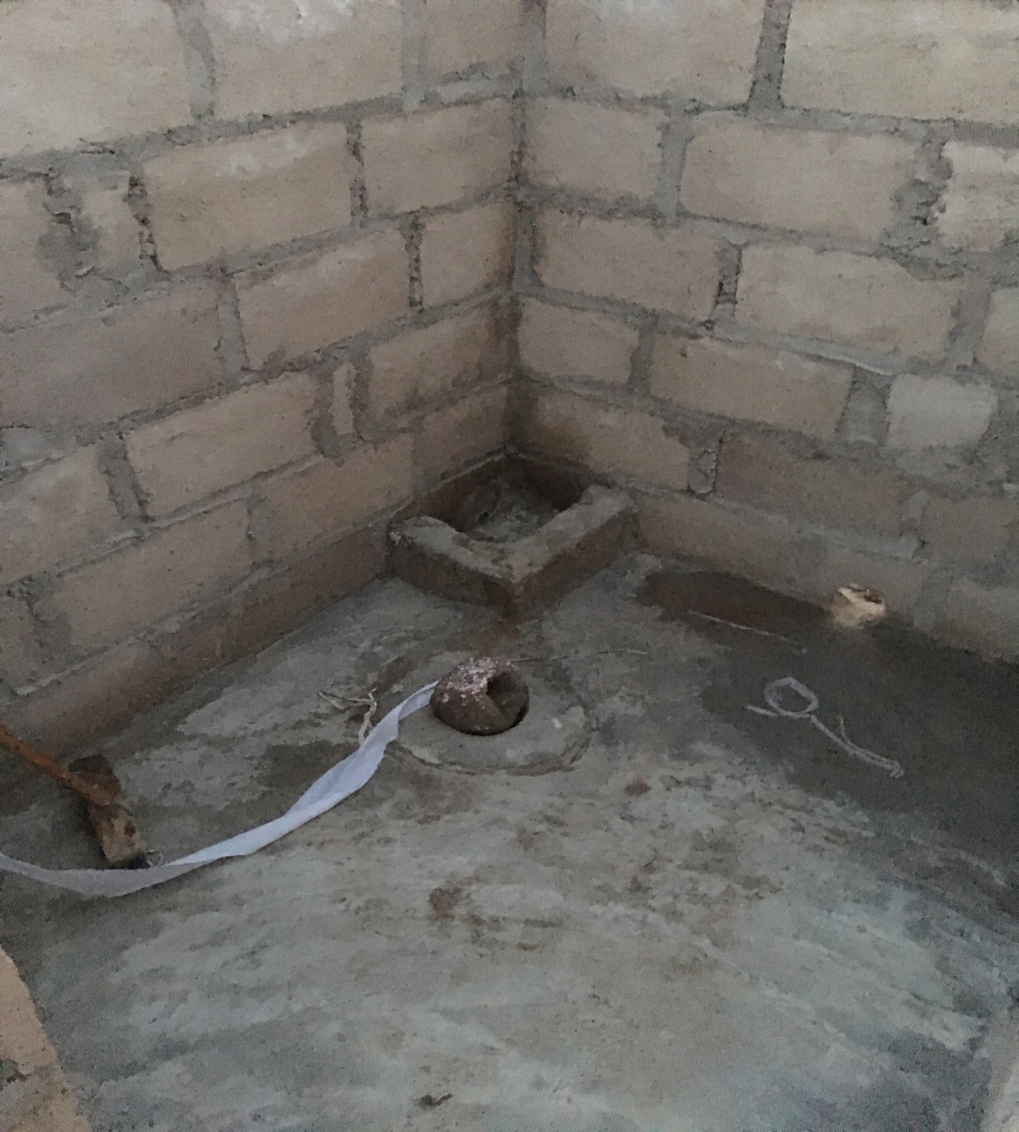
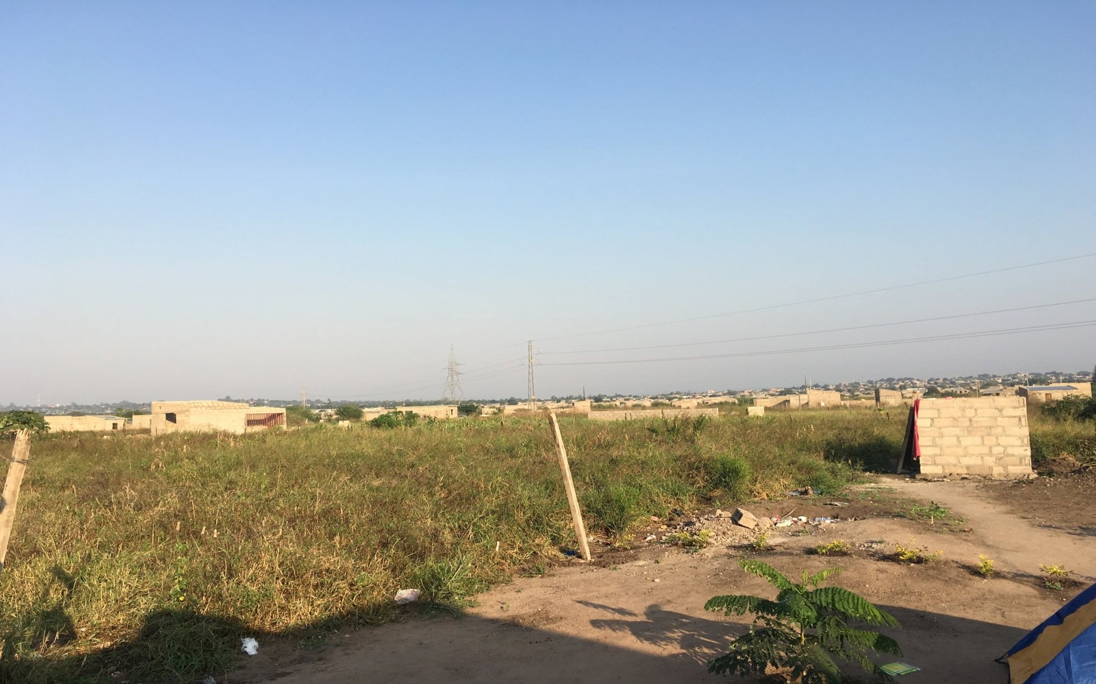
Bathroom In Boane?

Slide 10
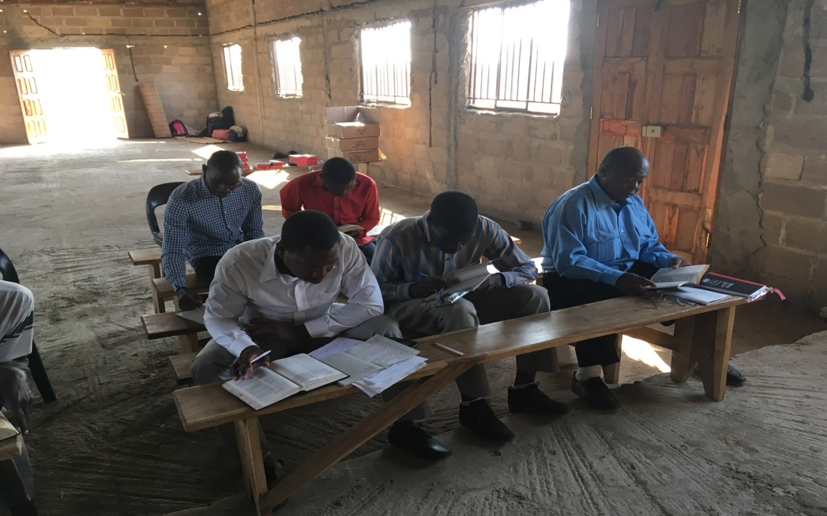
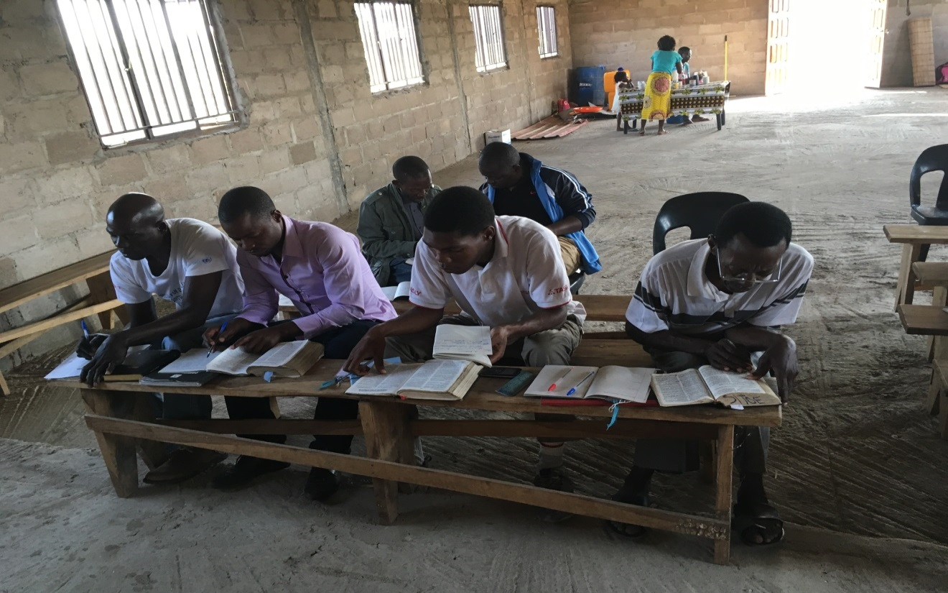
Studies In Boane

Slide 11
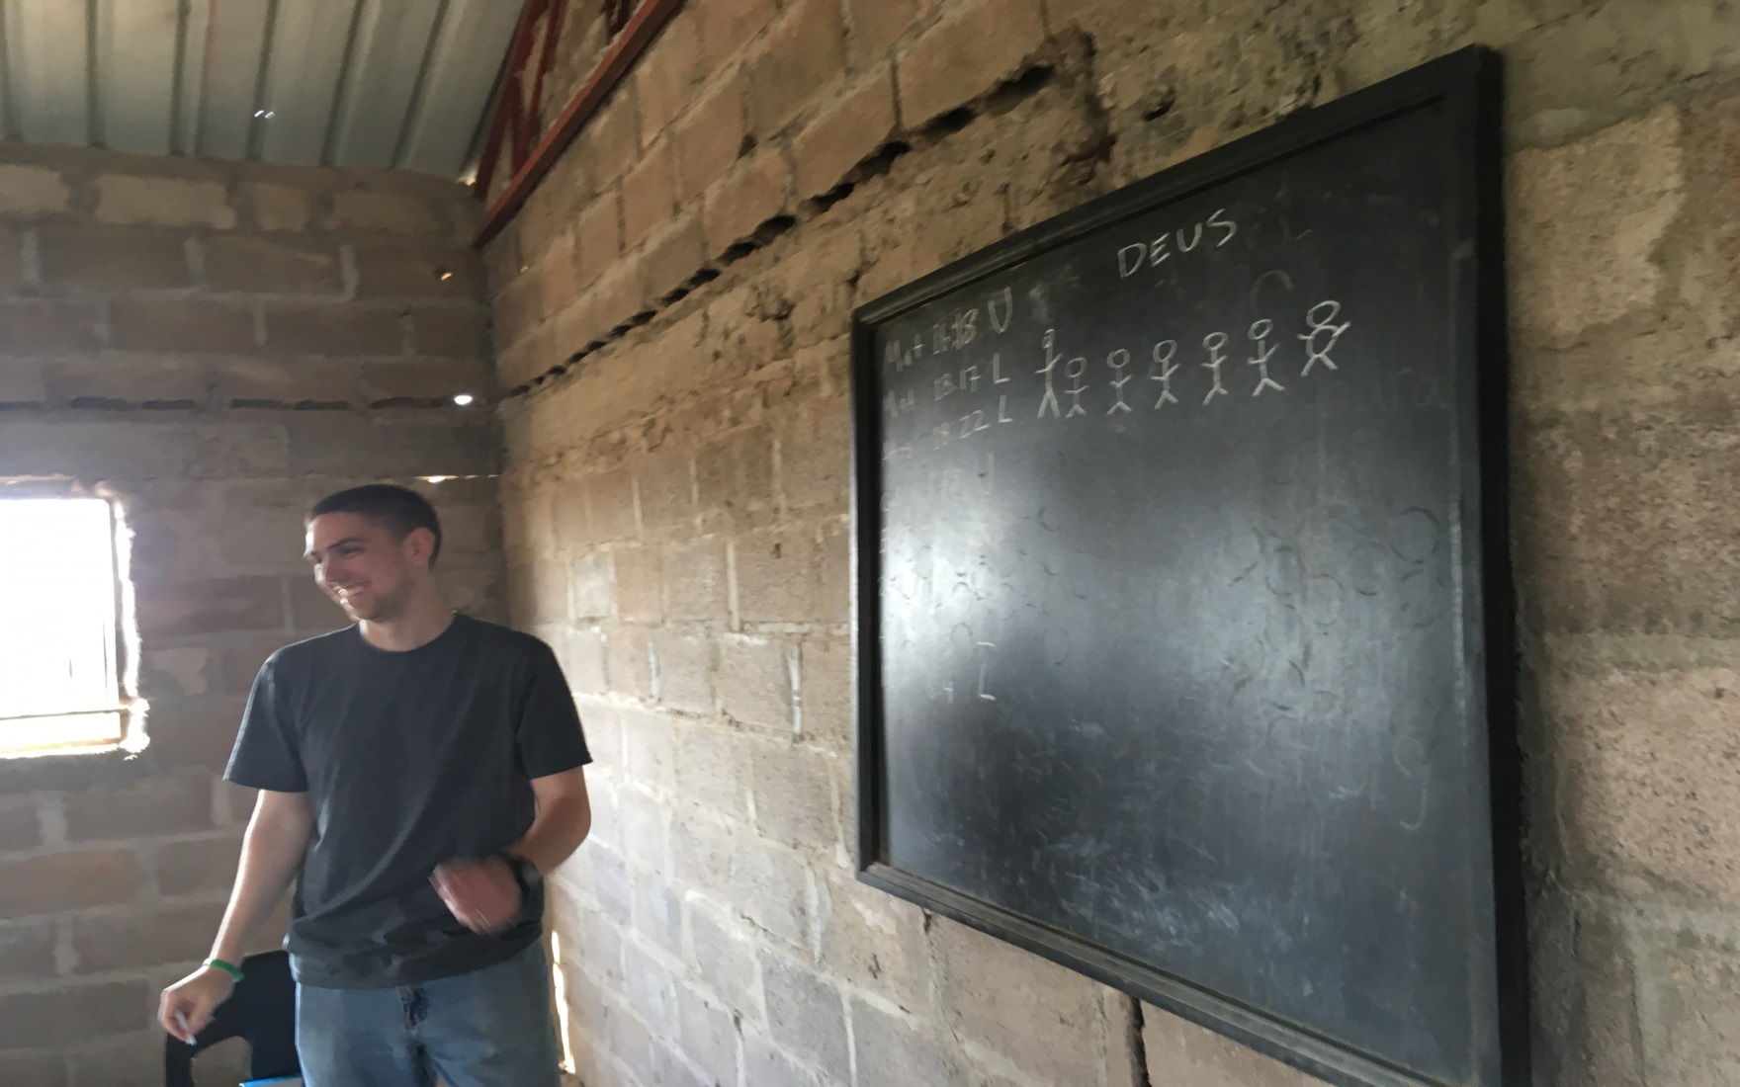
The Joy Of Teaching

Slide 12
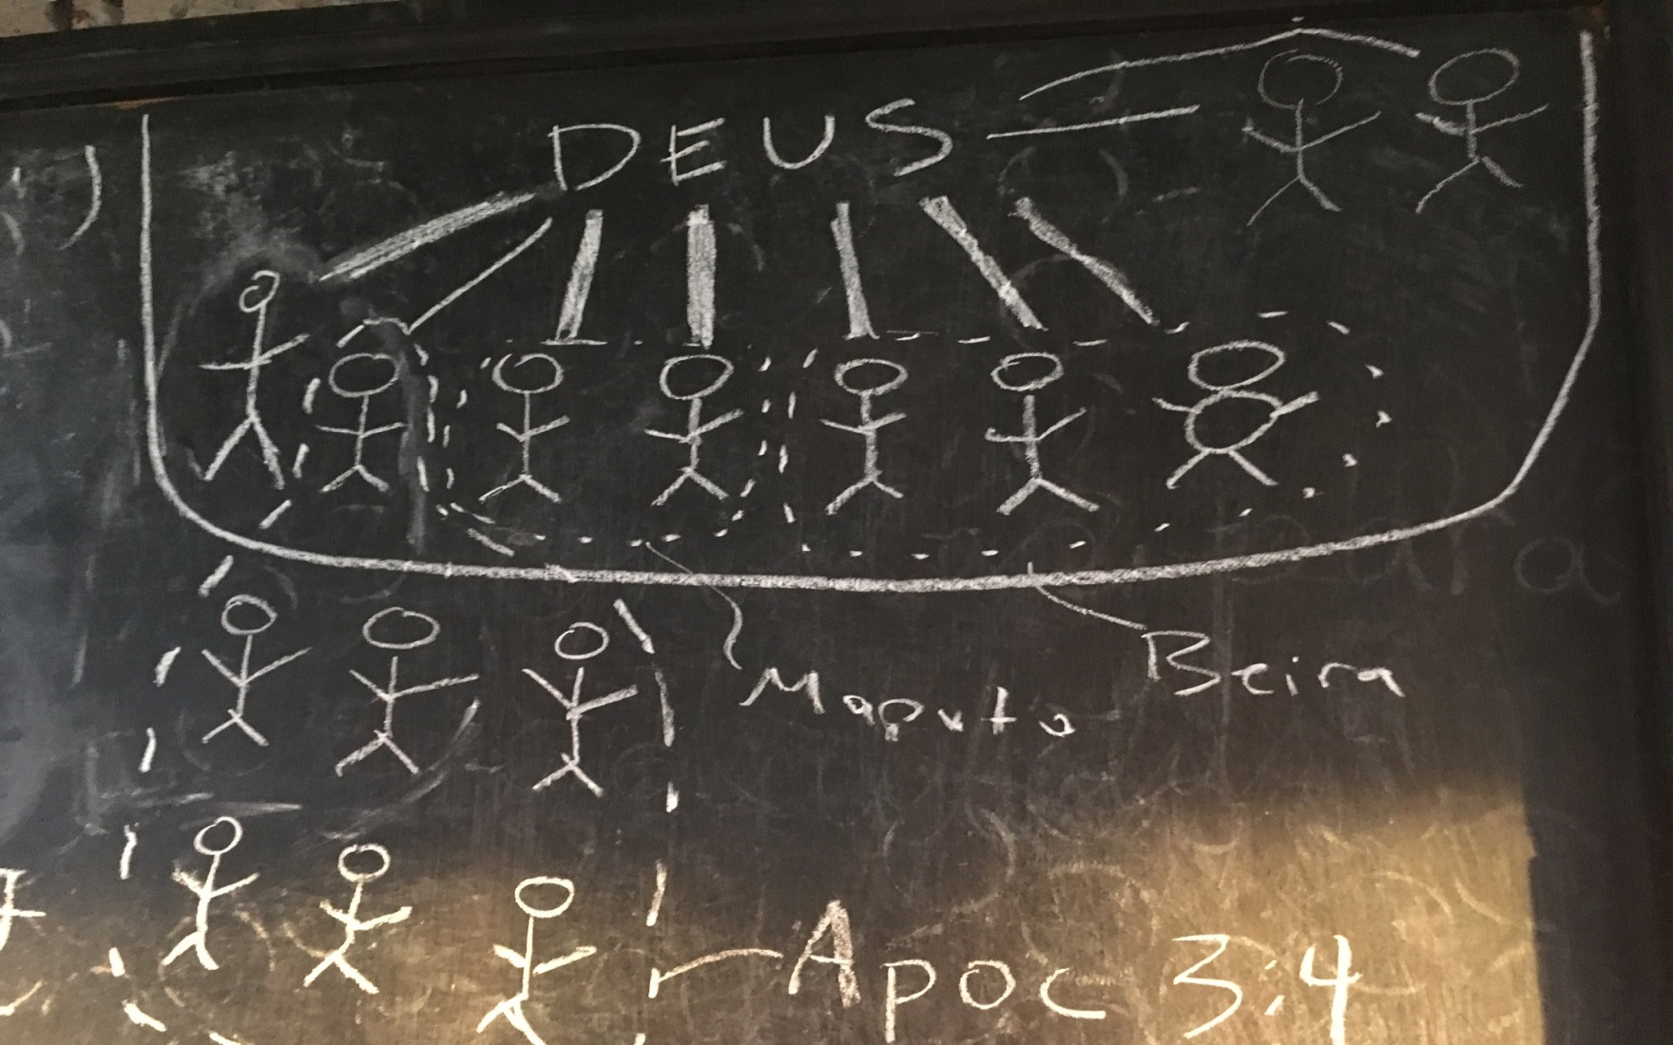
And Of Teasing Your FIL

Slide 13
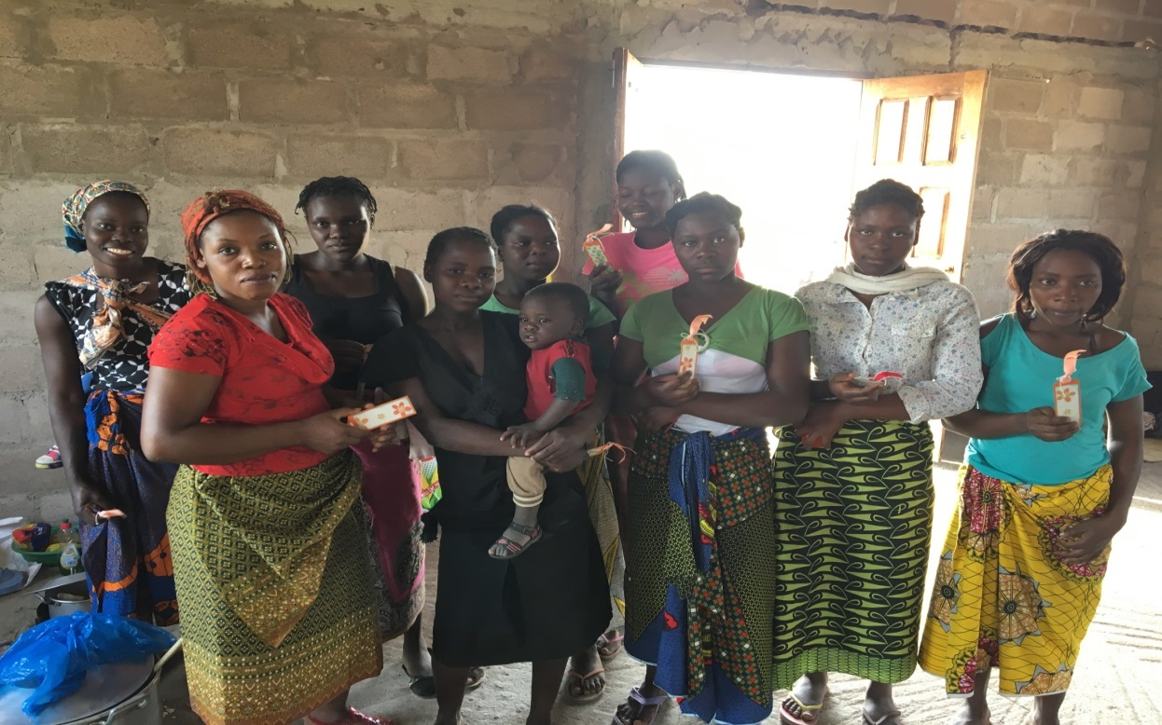
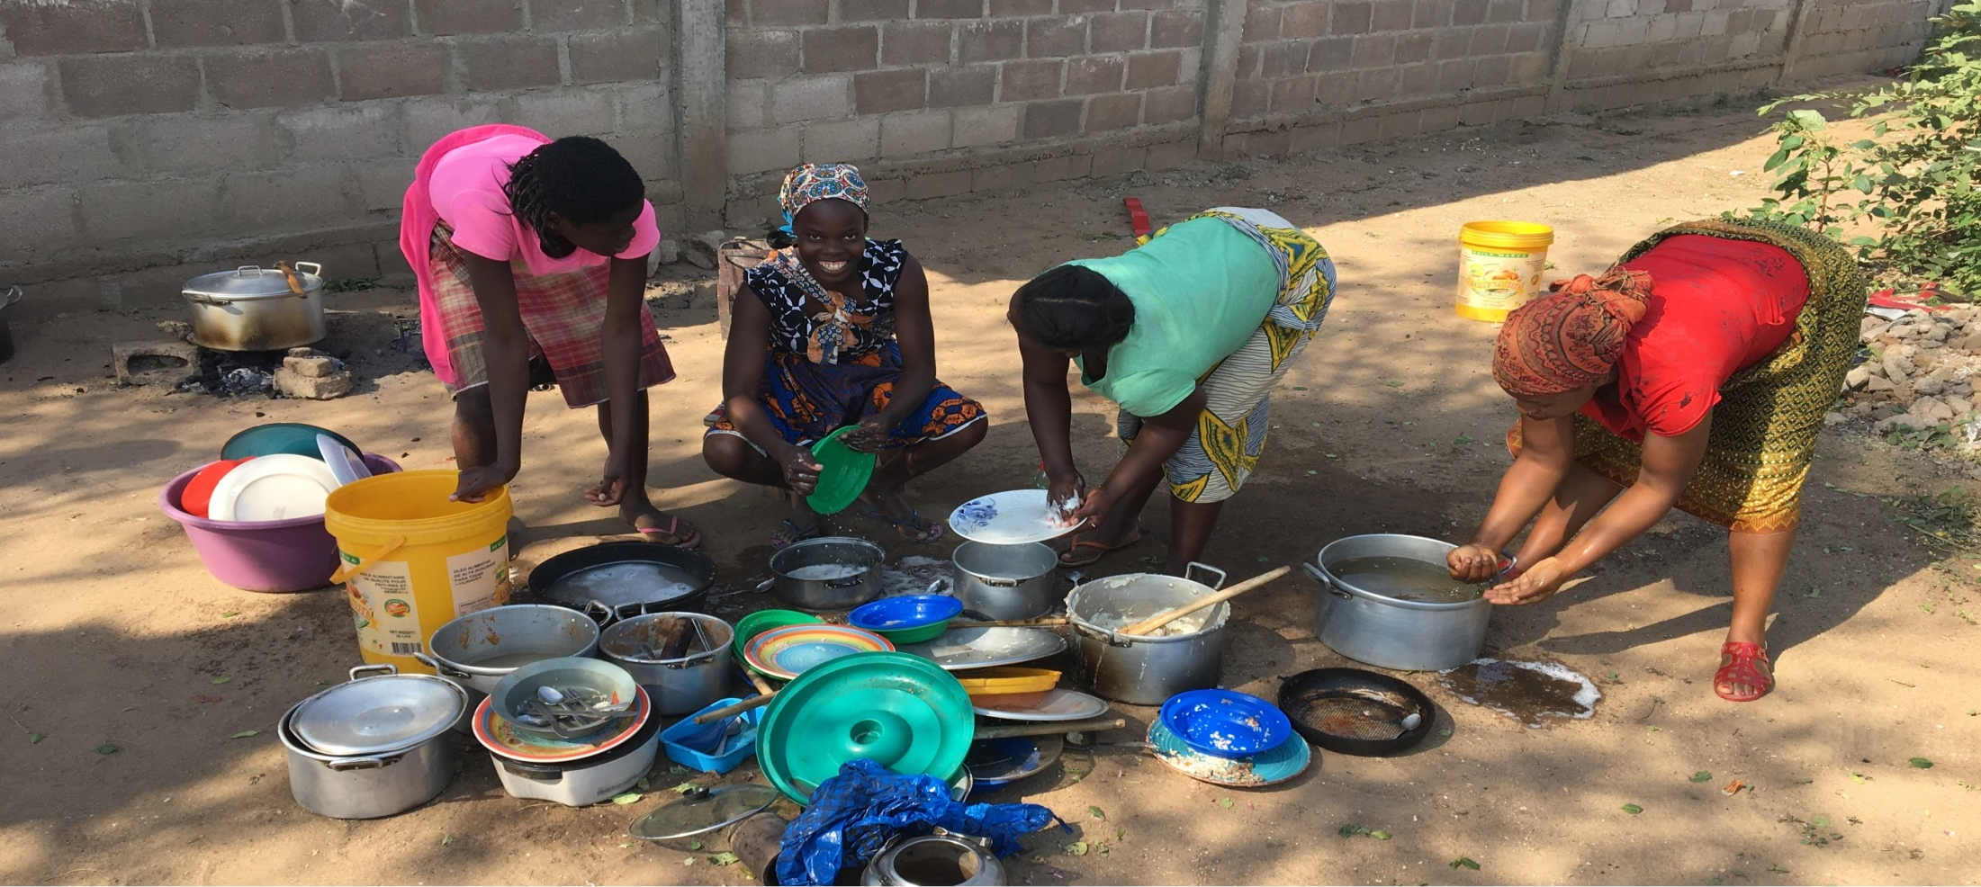
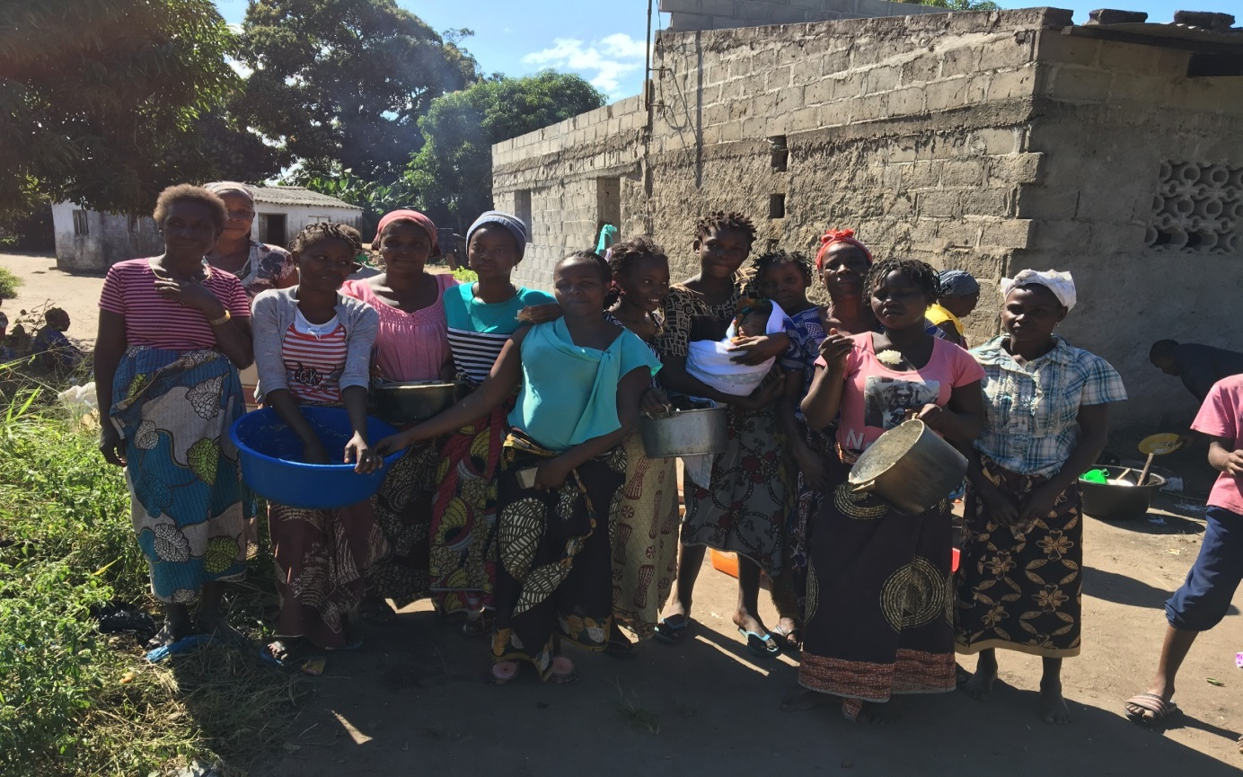
Luke 8:1-3 Kind Of Women

Slide 14
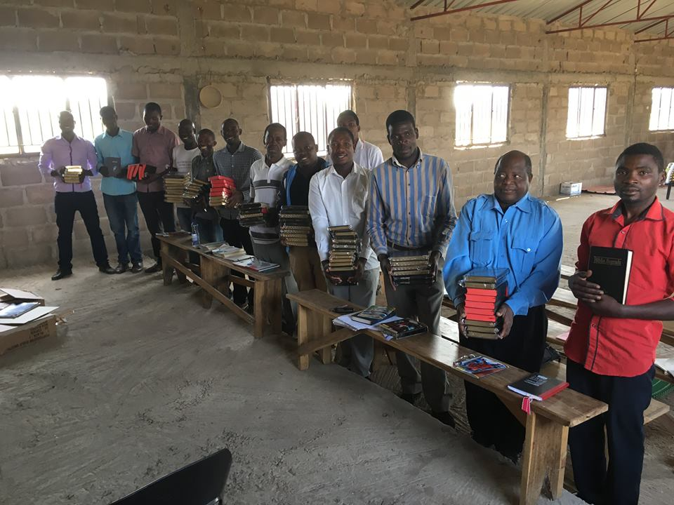
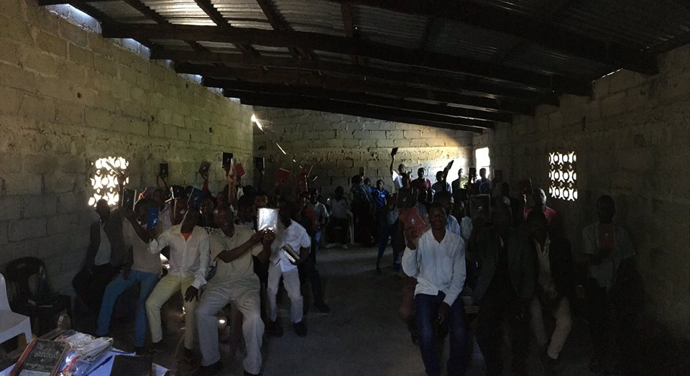
Sharing The Scriptures

Slide 16
Lisbon, Portugal Beira & Maputo, Mozambique Victoria, Mahe, Seychelles
May 2017
Preaching & Teaching Trip

Slide 17
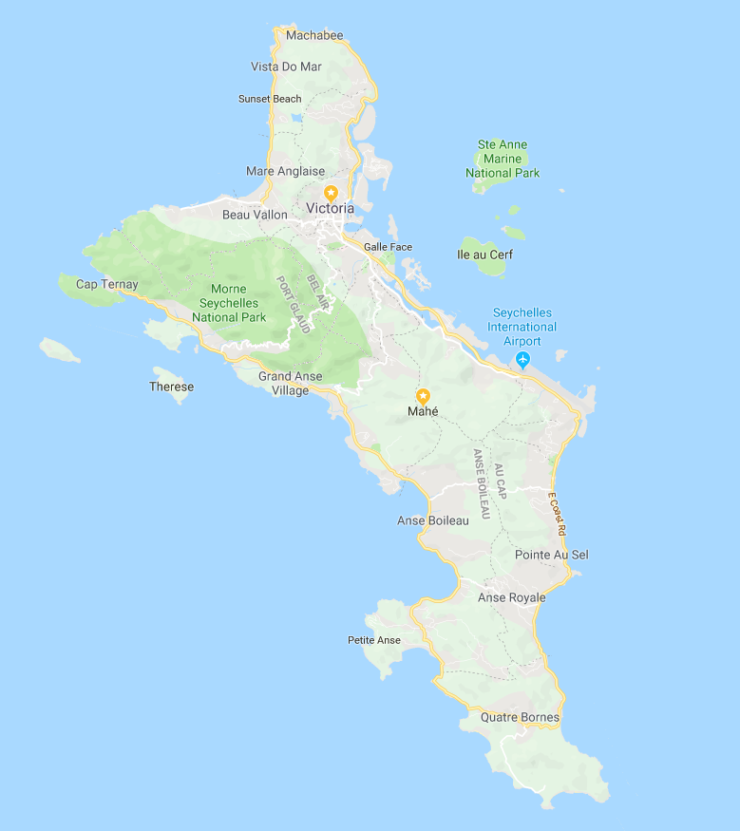
Where In The World Did We Go?
Seychelles

Slide 18
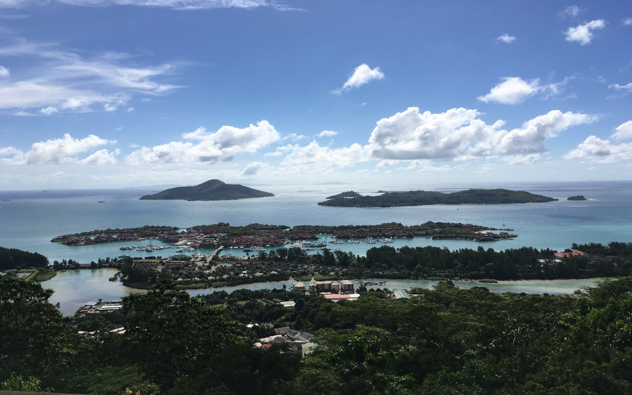
The Seychelle Islands

Slide 19
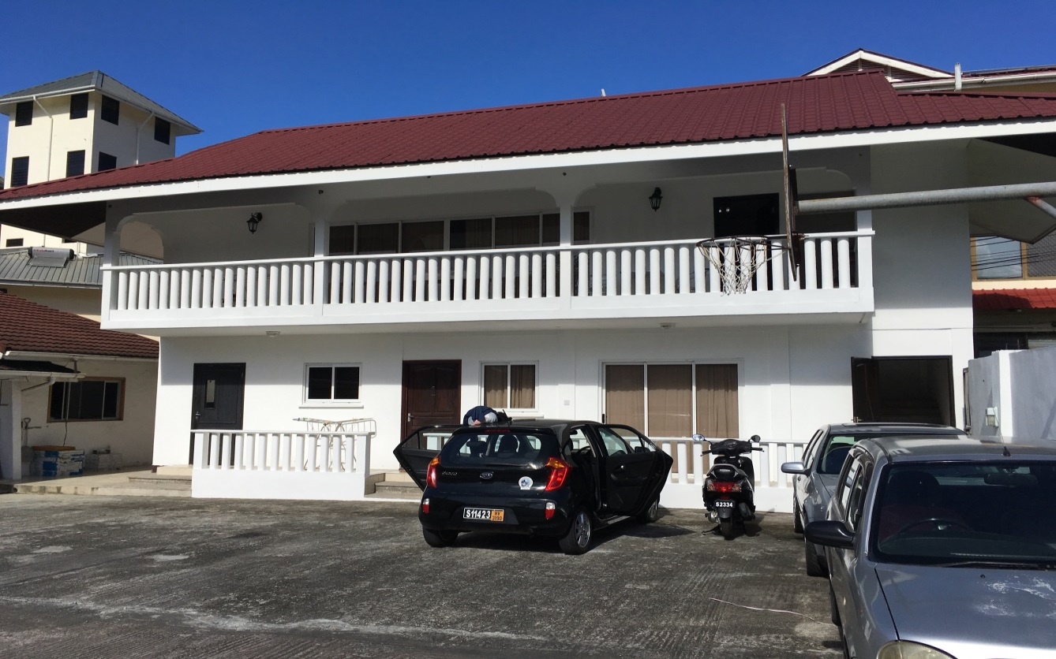
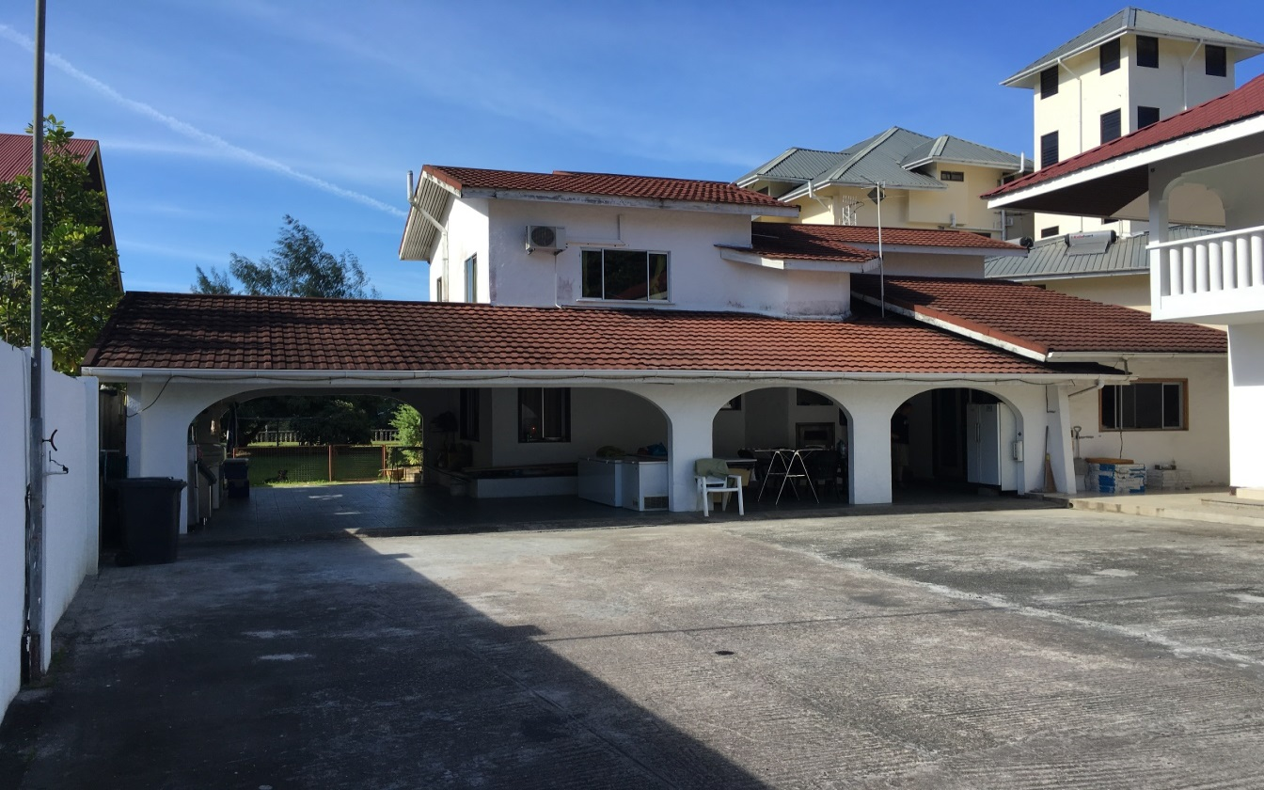
Thomas’ Hospitality

Slide 20
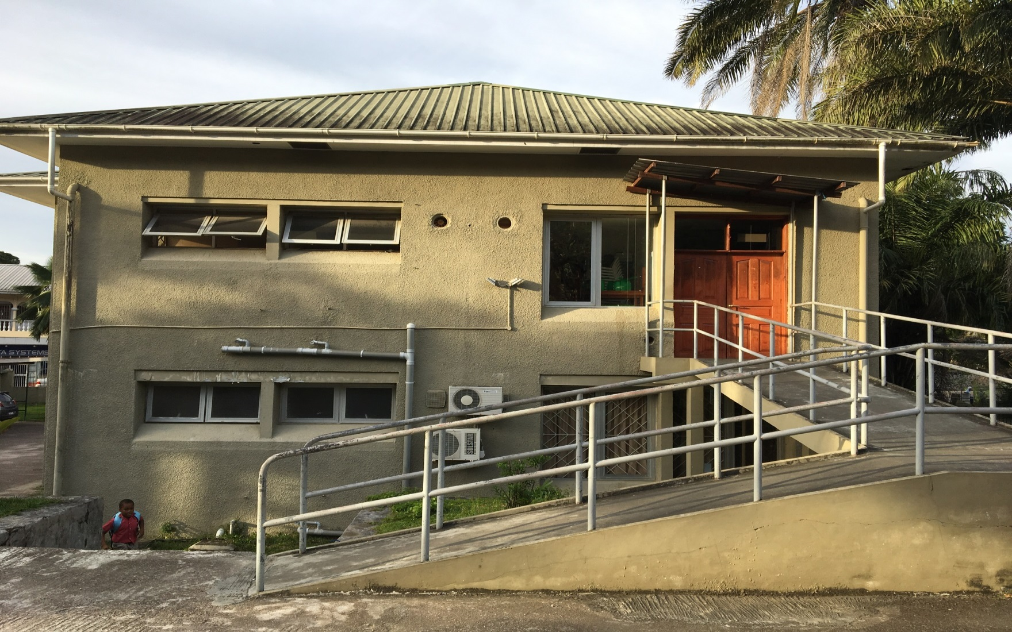
Outside of building where the church meets

Slide 21
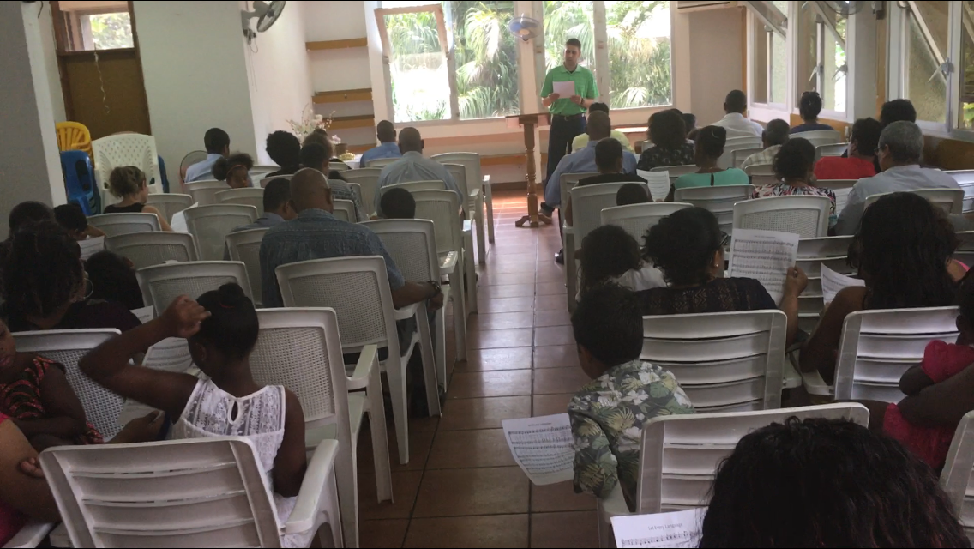
The Church In Victoria

Slide 22
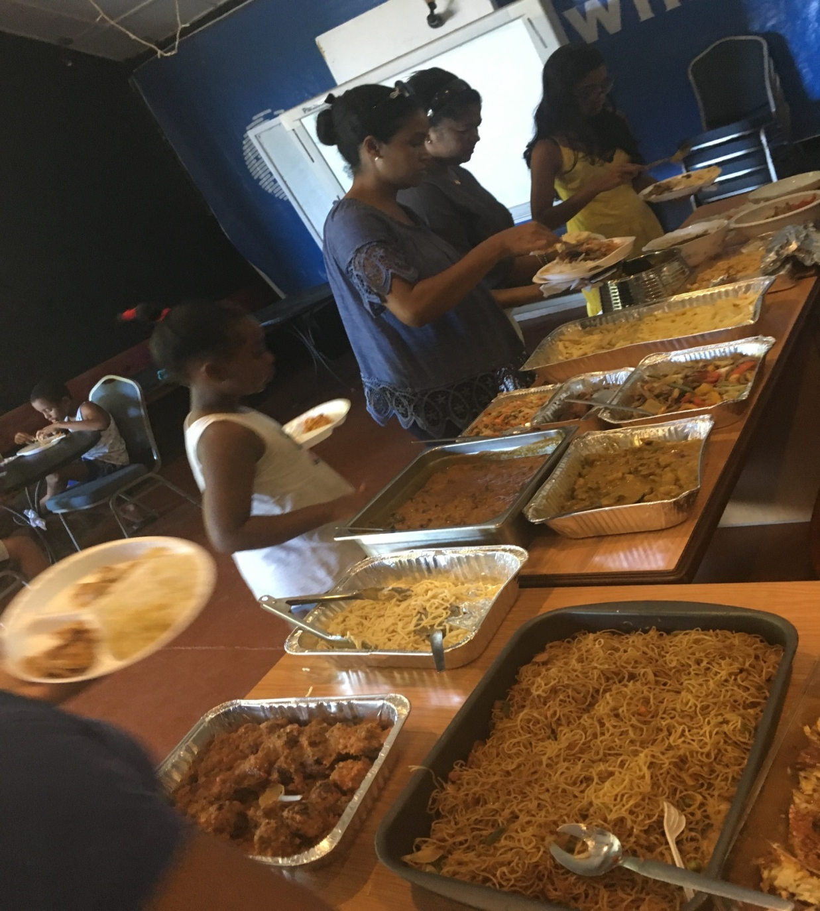
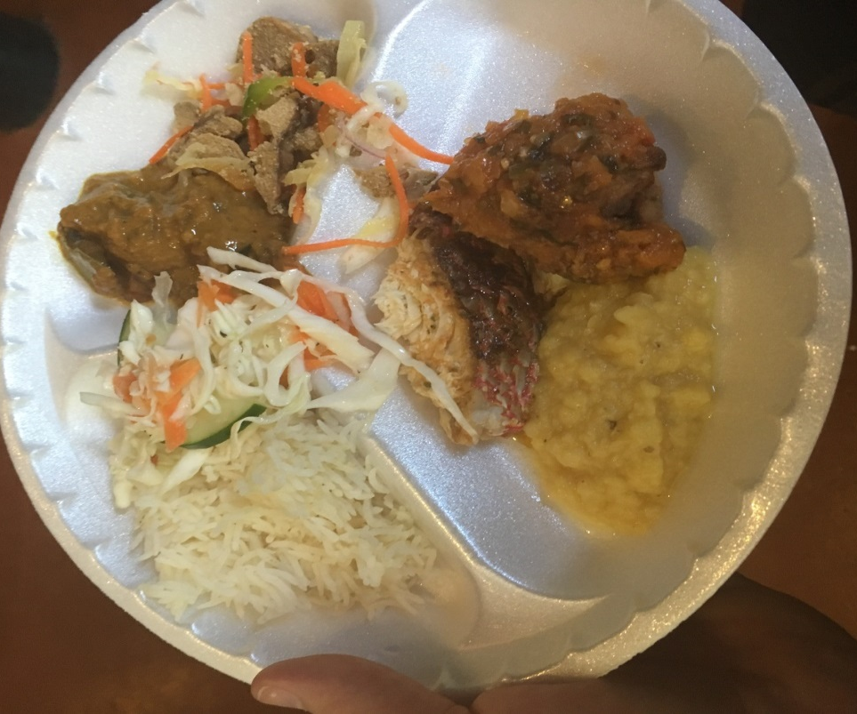
All things to all men

Slide 23
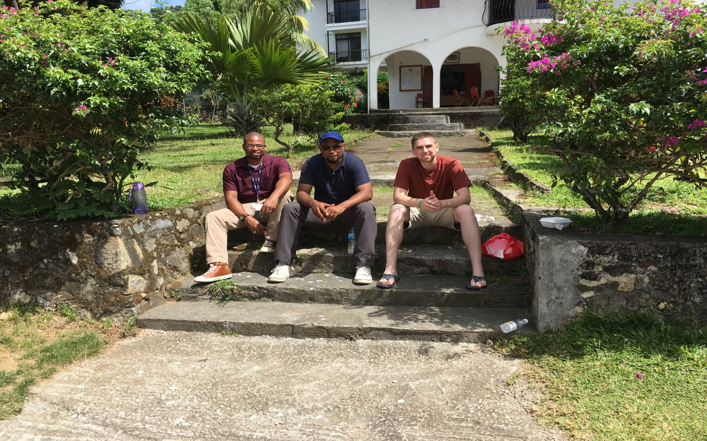
Monday lunch: Jimmy, Peter, Tim, and I

Slide 24
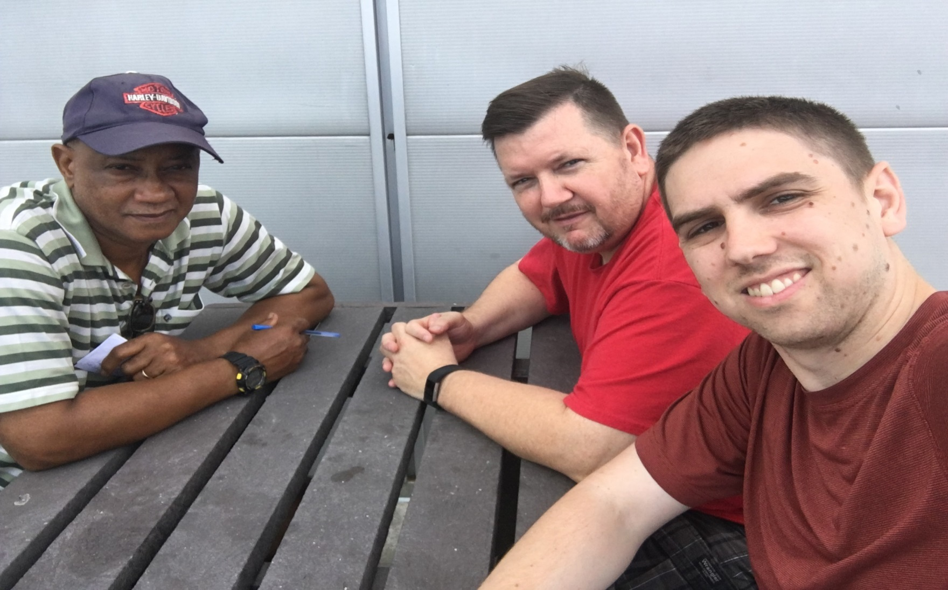
Meeting Simon outside a supermarket

Slide 25
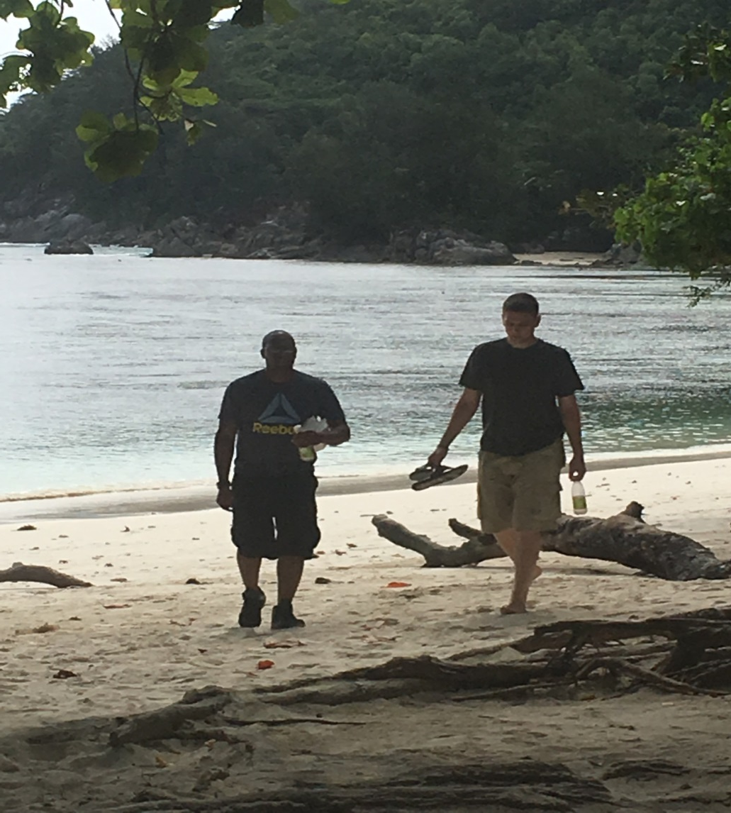
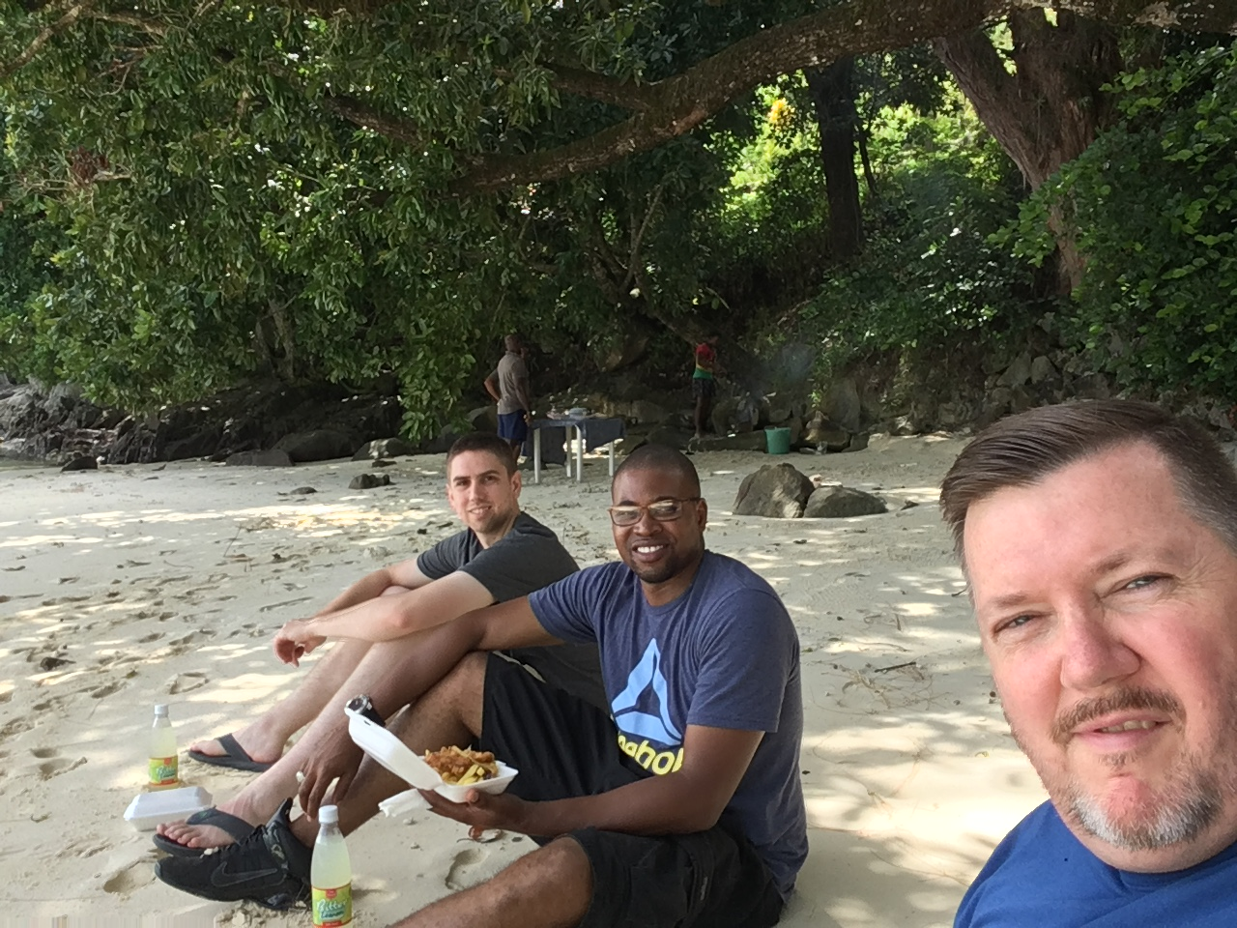
Fishers of men

Slide 26
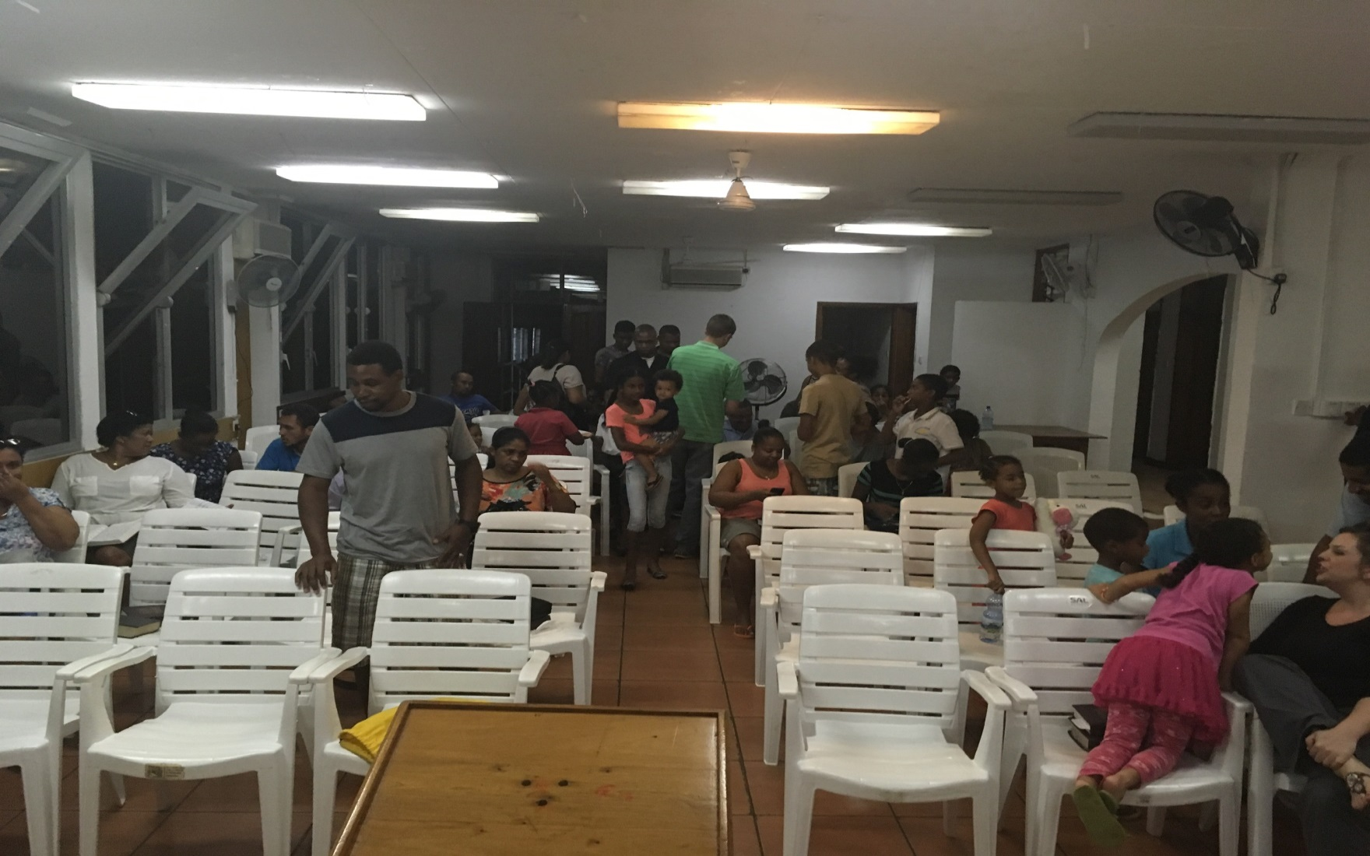
Tuesday night class on Evangelism

Slide 27
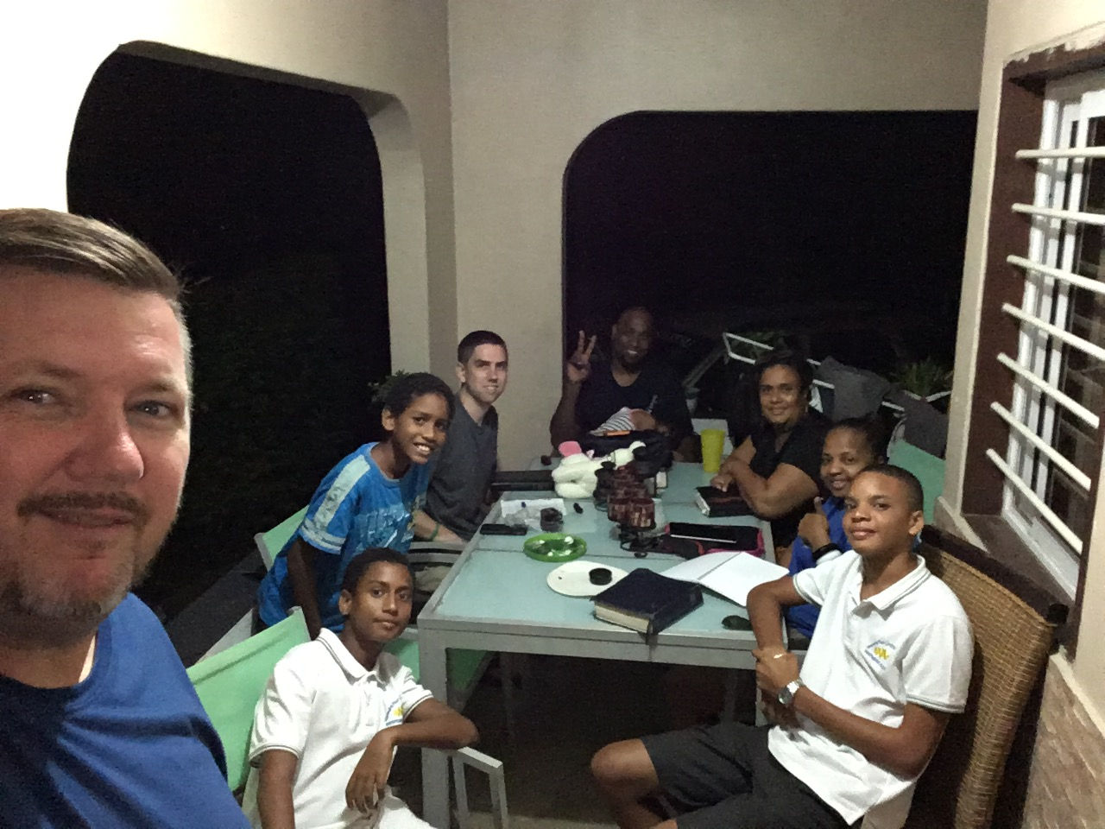
Wednesday night study at Peter’s

Slide 28
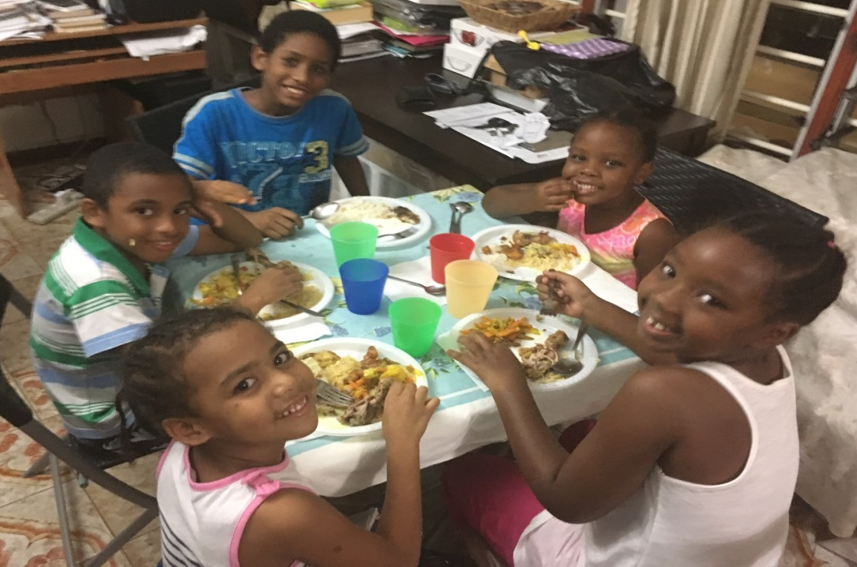
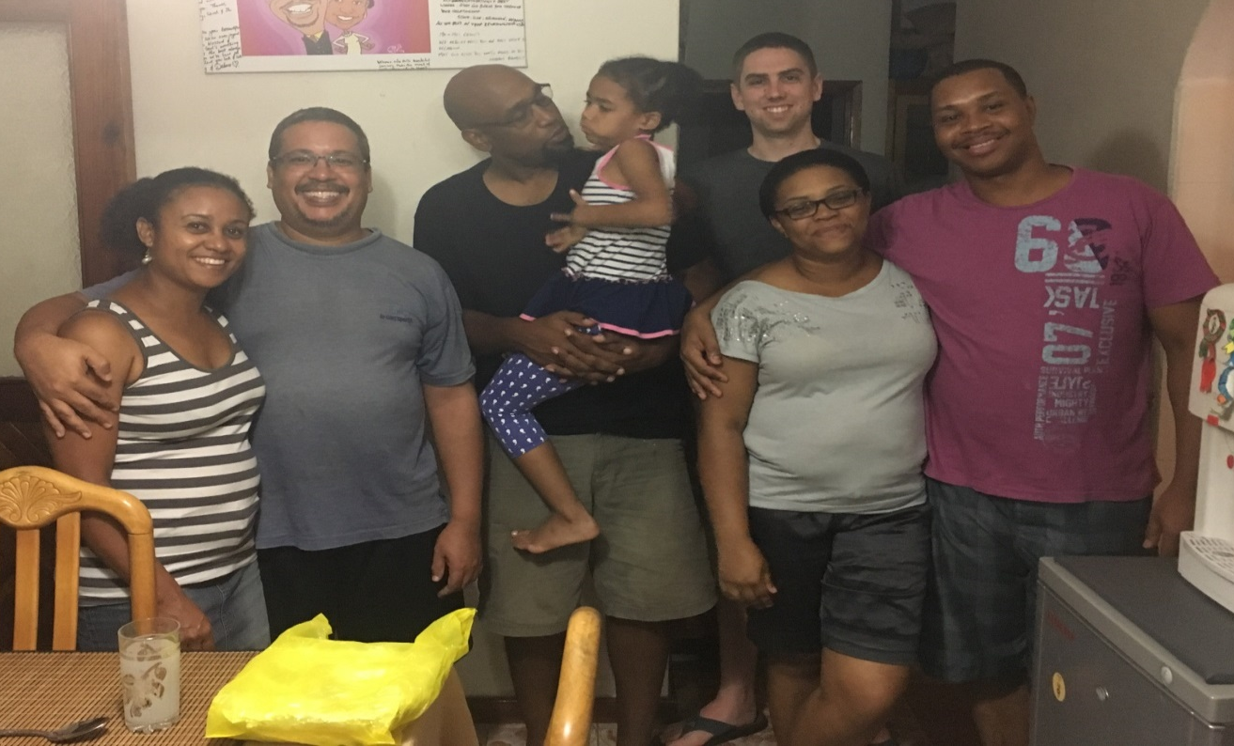
Wednesday night, late dinner after study

Slide 29
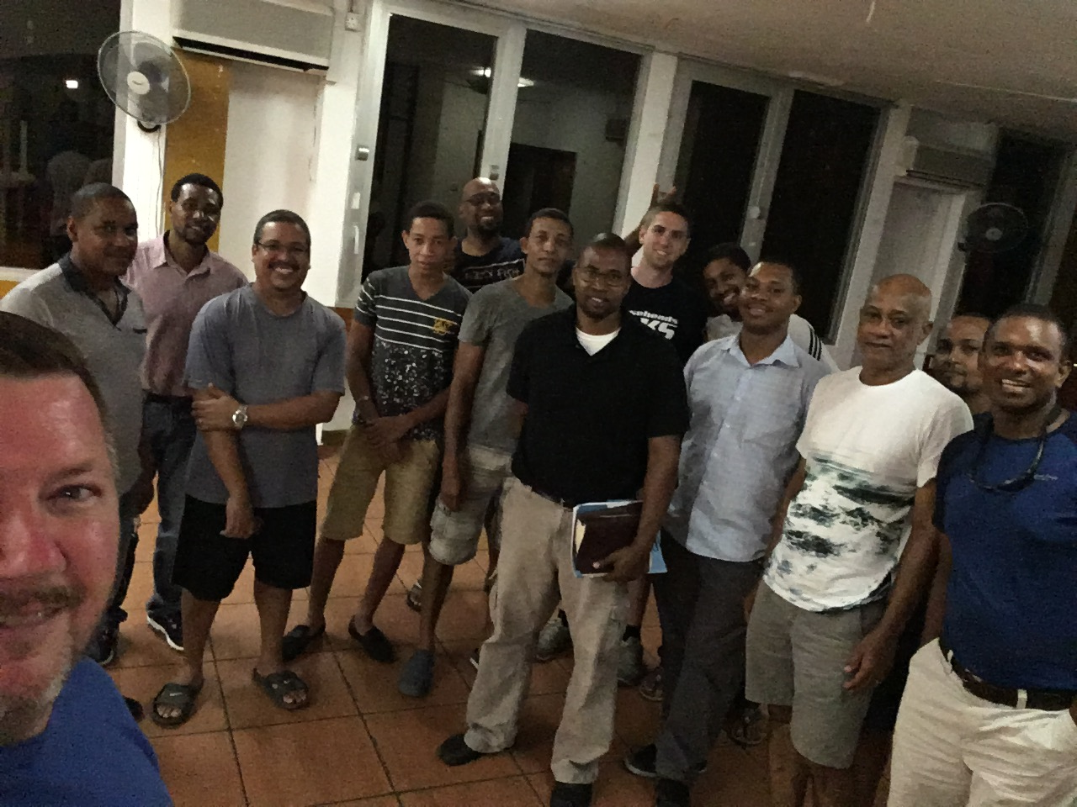
Thursday Night Men’s Class

Slide 30
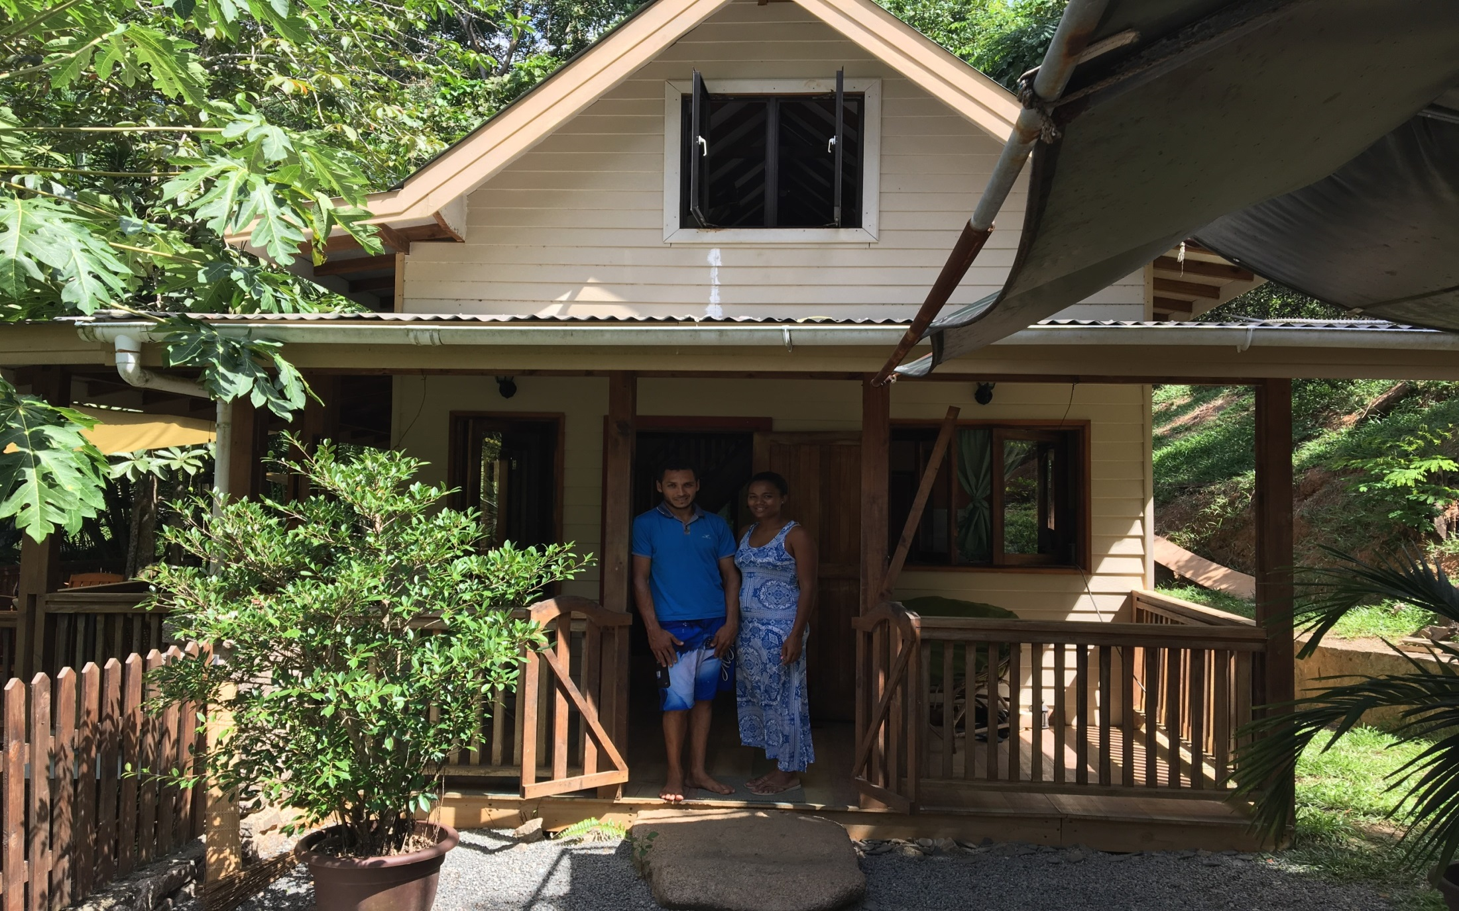
Thursday Night Men’s Class

Slide 31
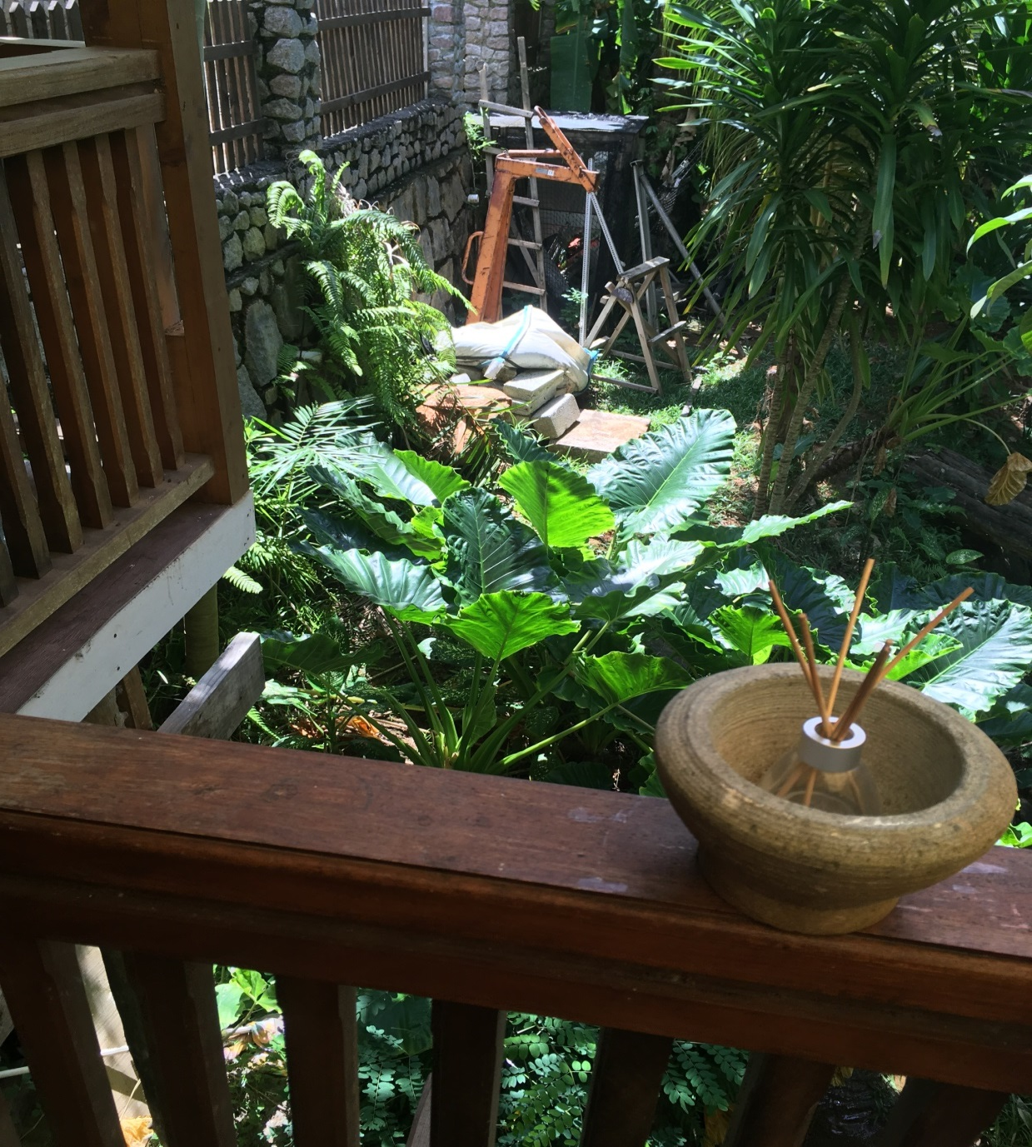
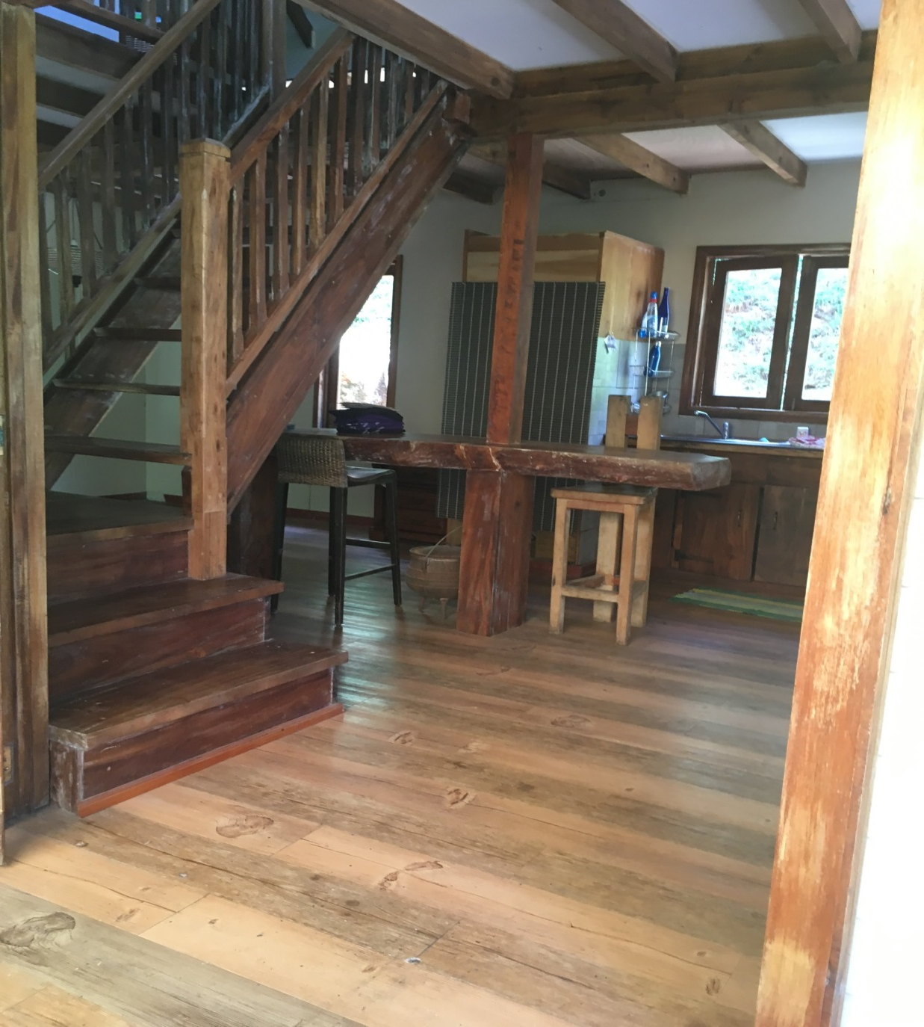
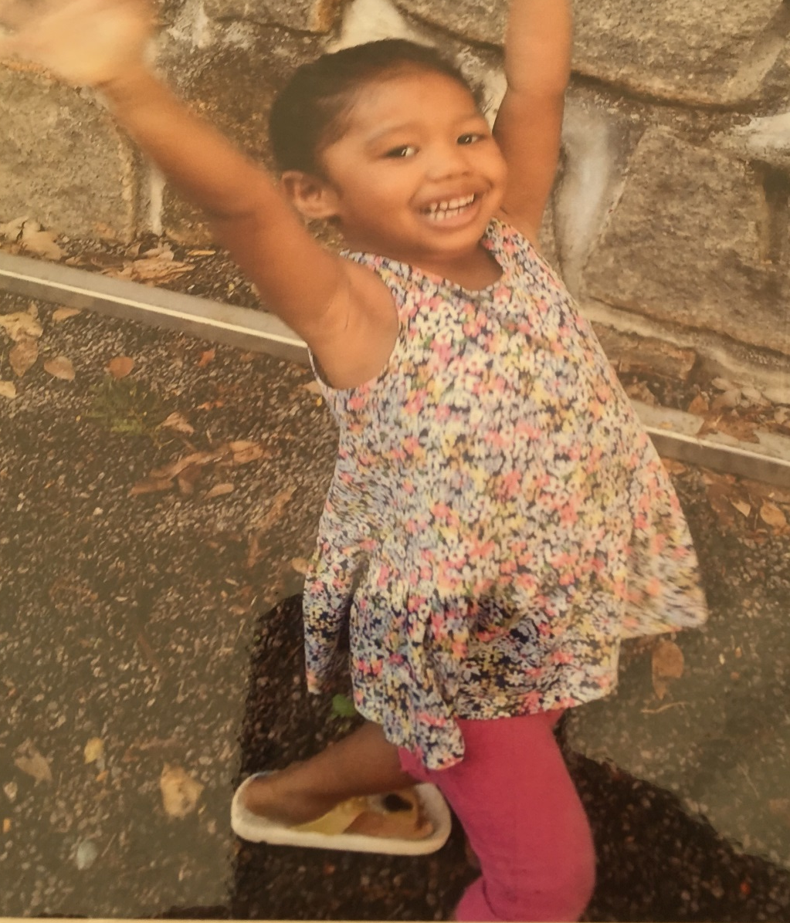
Tuesday lunch with the Jean Marc & Tracy
LiLia

Slide 32
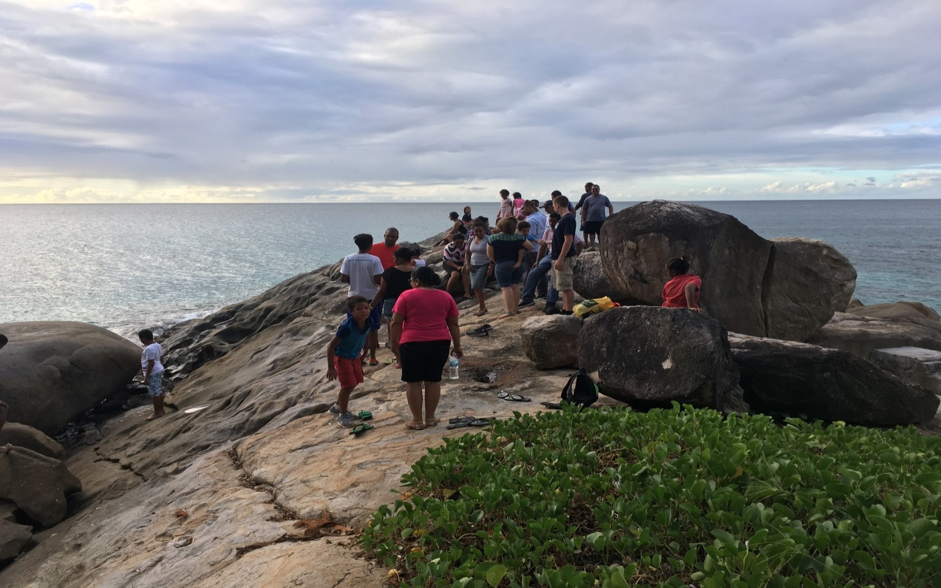
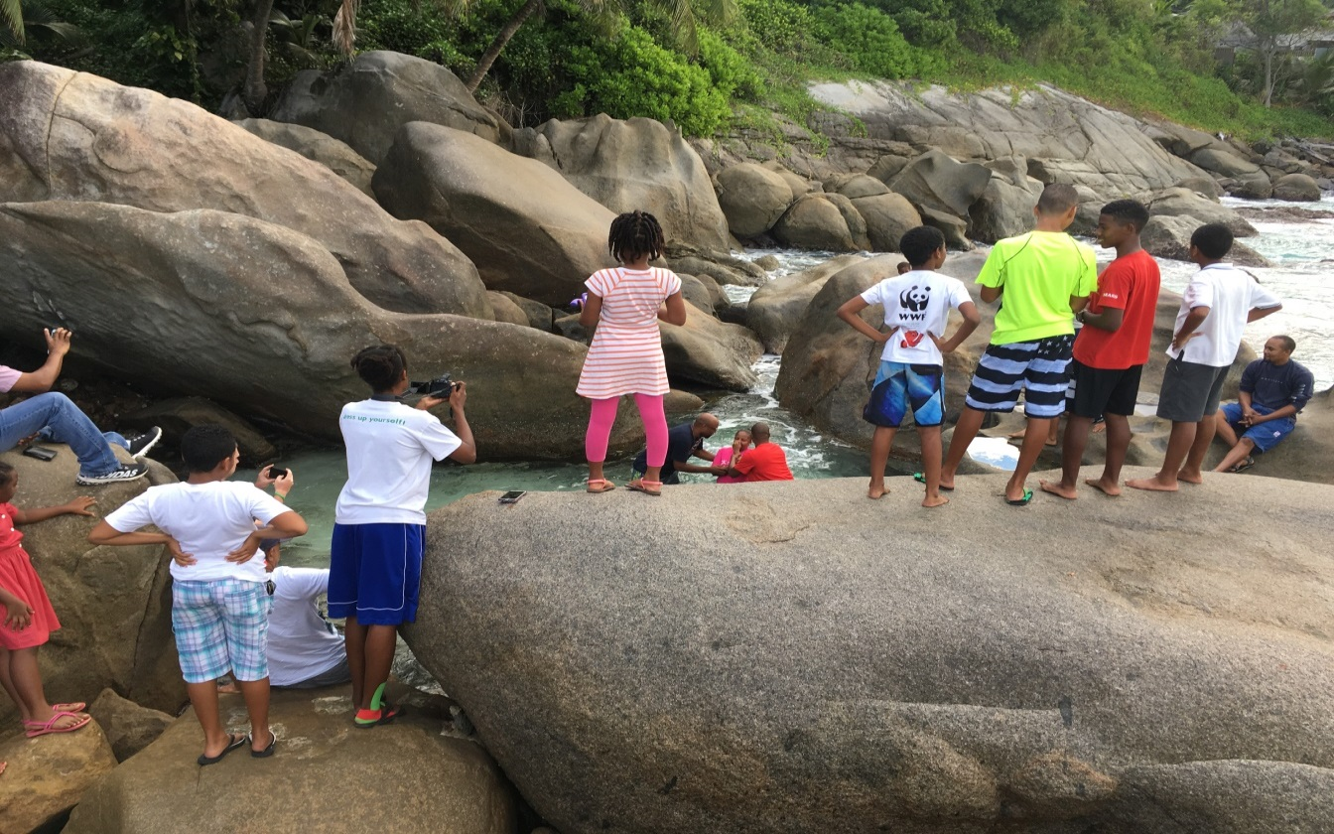
Baptism of Deborah

Slide 33
