Slide 1
Tools for Examination of the Evidence
Lesson 2

Slide 2
Class Outline
Lesson | Description
1 | Jesus of the Bible vs Reinvented Jesus of Modern Man
2 | Tools for Examination of the Evidence
3 | Does the Eyewitness Evidence of the Biographies of Jesus the Christ Stand Up to Scrutiny?
4 | Was the Documentary Evidence (Jesus’ Biographies) Reliably Preserved for Us?
5 | Is There Credible Non-Biblical Evidence for Jesus outside His Biographies?
6 | Does Archaeology/the Scientific Evidence Confirm or Contradict Biographies of Jesus?
7 | Was Jesus Really Convinced That He Was the Son of God and did Jesus the Christ fulfill the Attributes of God?
8 | The Psychological Evidence; Was Jesus Crazy When He Claimed to Be the Son of God?
9 | The Fingerprint Evidence – Prophecy Did Jesus—and Jesus Alone—Match the Identity of the Messiah?
10 | The Resurrection – was Jesus Raised from the Dead?
11 | What is the Evidence of that Jesus was seen Alive after His Death on the Cross?
12 | Tactics for Discussing the Case for Jesus the Christ
13 | What Does the Evidence Establish—And What Does It Mean Today?

Slide 3
Class Objectives
Discuss who Jesus was provides opportunities to have deeper discussions with people.
Much of the modern world does not believe that God exists or that Jesus exists. How do we talk to people who question the existence of God and Jesus? How do we talk to people who are seeking to understand what the Bible says? This class will look at approaches to talking to non-believers.
Establish the Reliability, Accuracy and Transmission of the Bible with respect to the New Testament.

Slide 4
Class Questions
A friend of mine said Jesus never existed. How do you answer something like this?
Do you remember what evidence of Jesus you needed before being baptized?

Slide 5
Written by Paul - Undisputed
First Epistle to the Thessalonians (51 AD)
Epistle to the Galatians (47 (51-53)AD?)
First Epistle to the Corinthians (52-56 AD)
Second Epistle to the Corinthians (52-56 AD)
Epistle to the Philippians (60-62 AD)
Epistle to Philemon (60-62 AD)
Epistle to the Romans (52-57 AD)

Slide 6
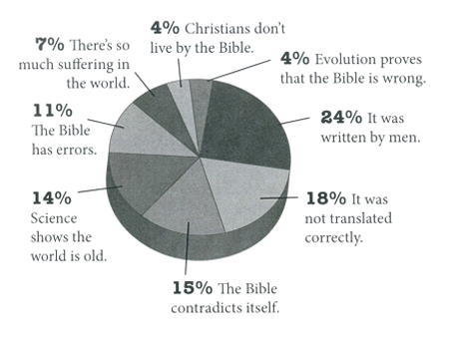
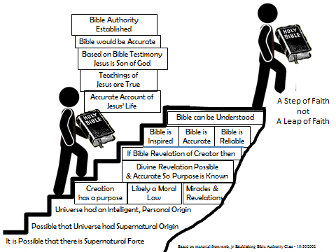
Rating the Bible
vs Bible that says
it is young
Responses of those who left church

Slide 7
Who do Men Say
Jesus of Nazareth, or Jesus Christ (as Christians call him), is undoubtedly the best known and most influential human person in world history.
If we say Jesus is purely a construct, without any historical roots, then Christianity itself would be in danger of collapsing
For if the dead do not rise, then Christ is not risen.
And if Christ is not risen, your faith is futile; you are still in your sins!
Then also those who have fallen asleep in Christ have perished.
If in this life only we have hope in Christ, we are of all men the most pitiable.
1 Cor 15:16-19 (NKJV)

Slide 8
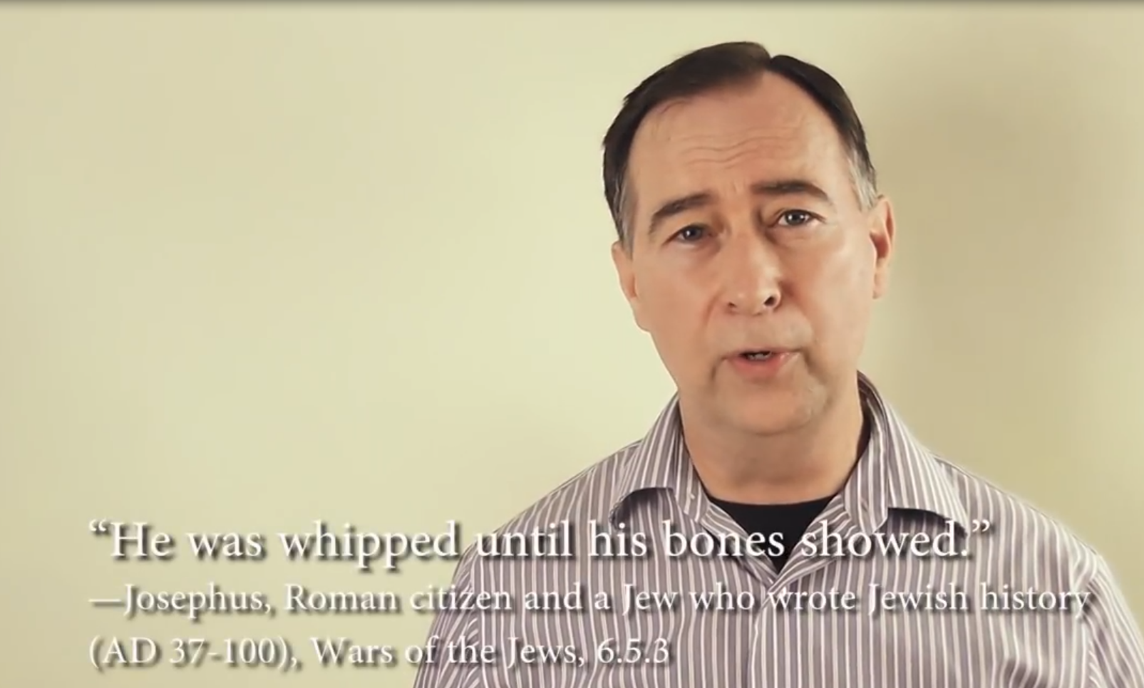
“What Romans said about crucifixion”
Matthew 27:26 (NKJV) ²⁶ Then he released Barabbas to them; and when he had scourged Jesus, he delivered Him to be crucified.

Slide 9

“What Romans said about crucifixion”
Matthew 27:26 (NKJV) ²⁶ Then he released Barabbas to them; and when he had scourged Jesus, he delivered Him to be crucified.

Slide 10
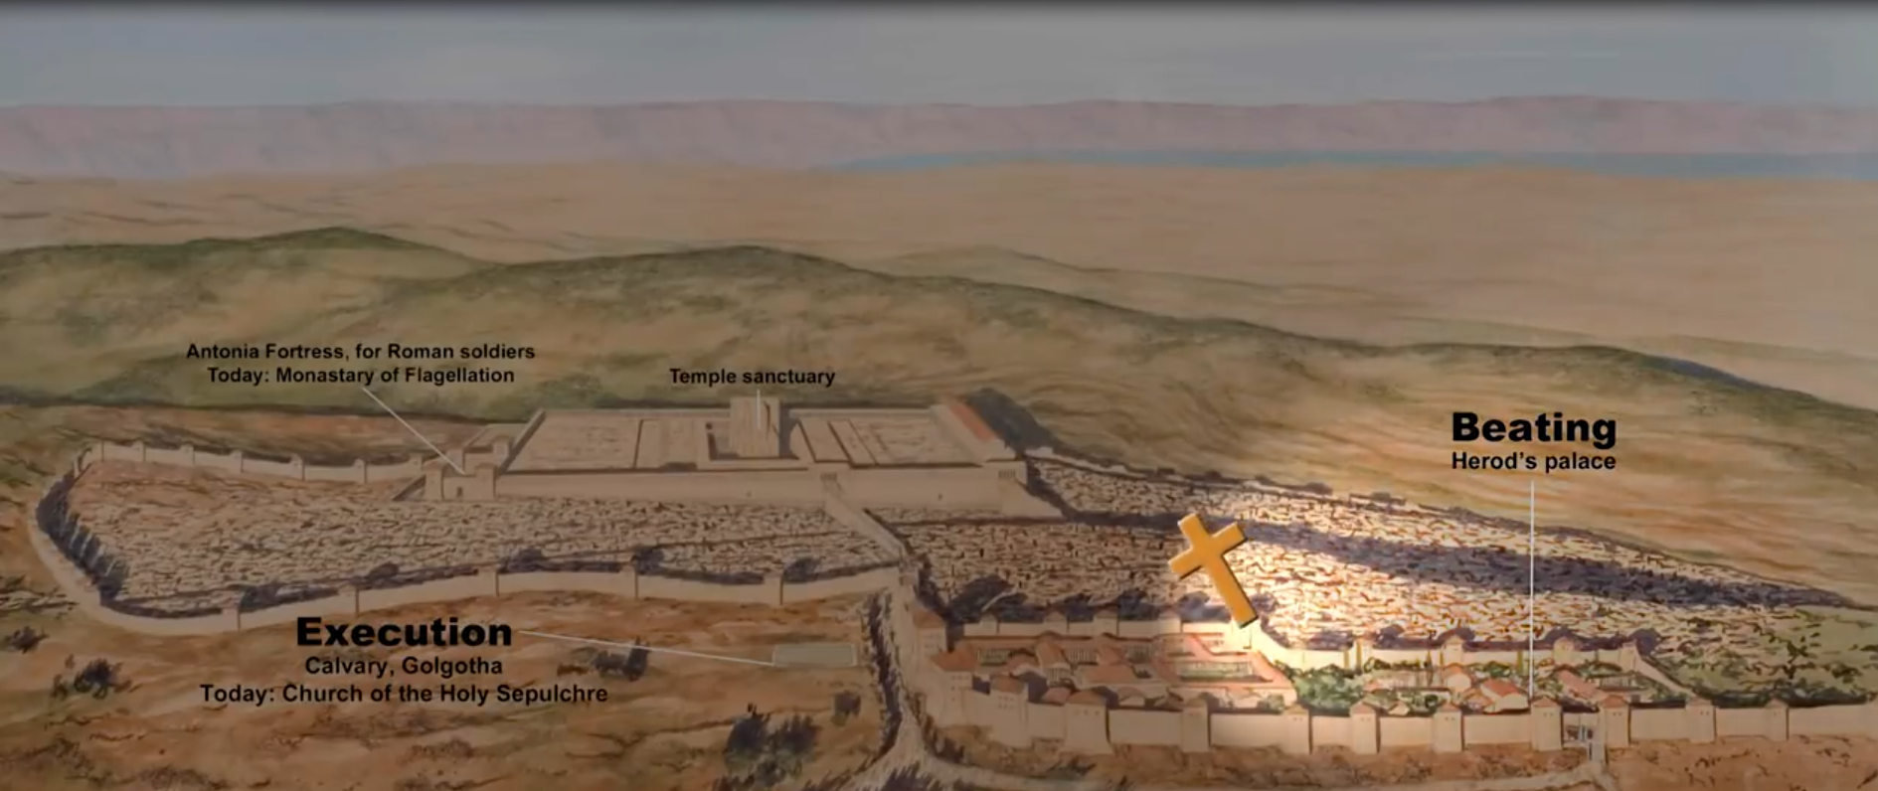
“What Romans said about crucifixion”
Matthew 27:33 (NKJV) ³³ And when they had come to a place called Golgotha, that is to say, Place of a Skull,

Slide 11
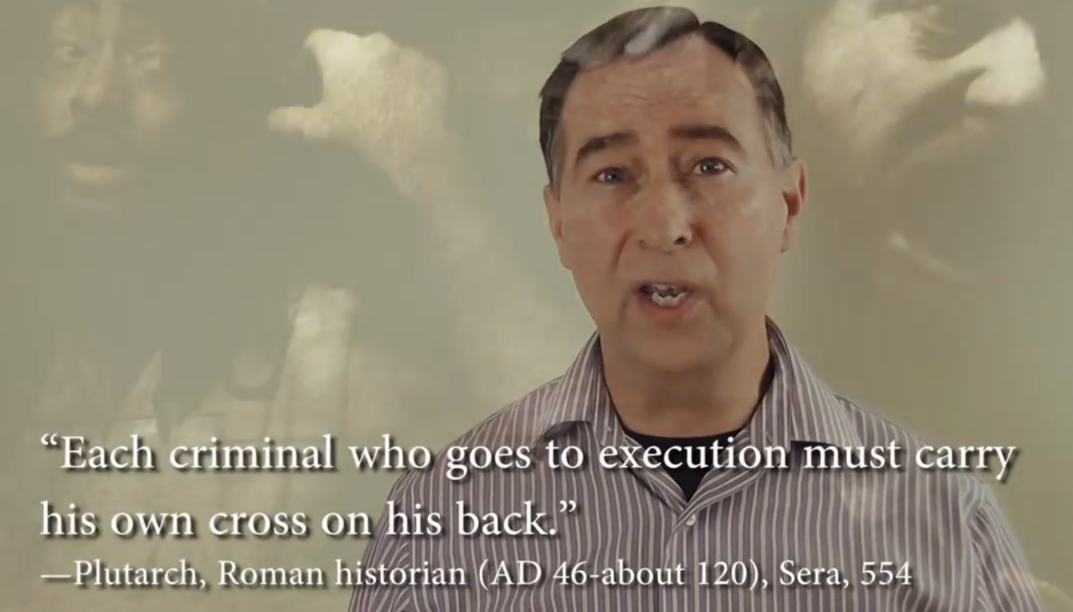
“What Romans said about crucifixion”
Matthew 27:32 (NKJV) ³² Now as they came out, they found a man of Cyrene, Simon by name. Him they compelled to bear His cross.

Slide 12
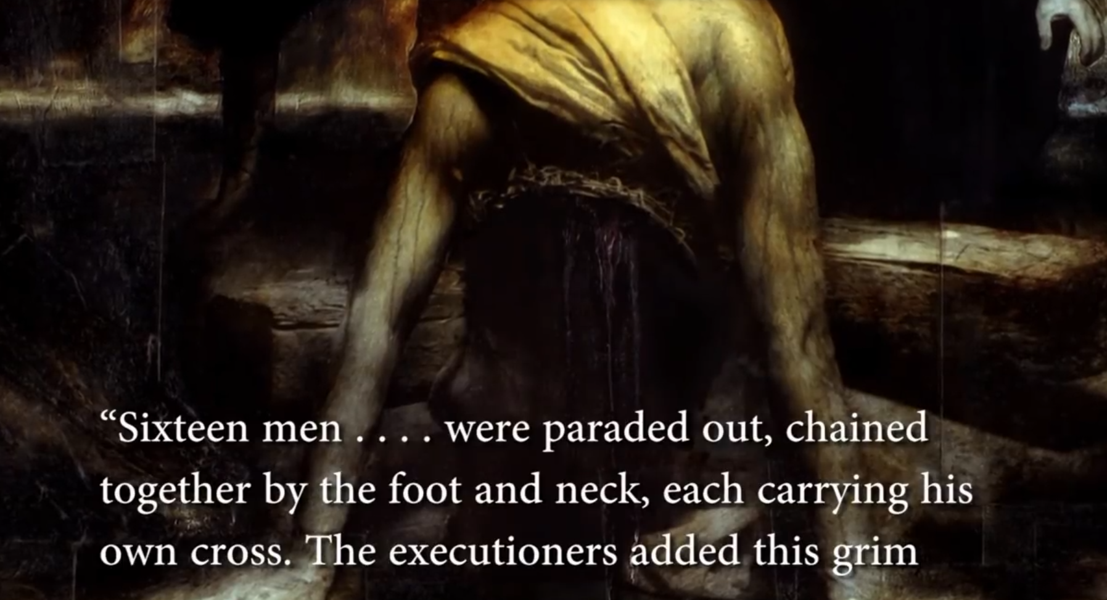
“What Romans said about crucifixion”

Slide 13
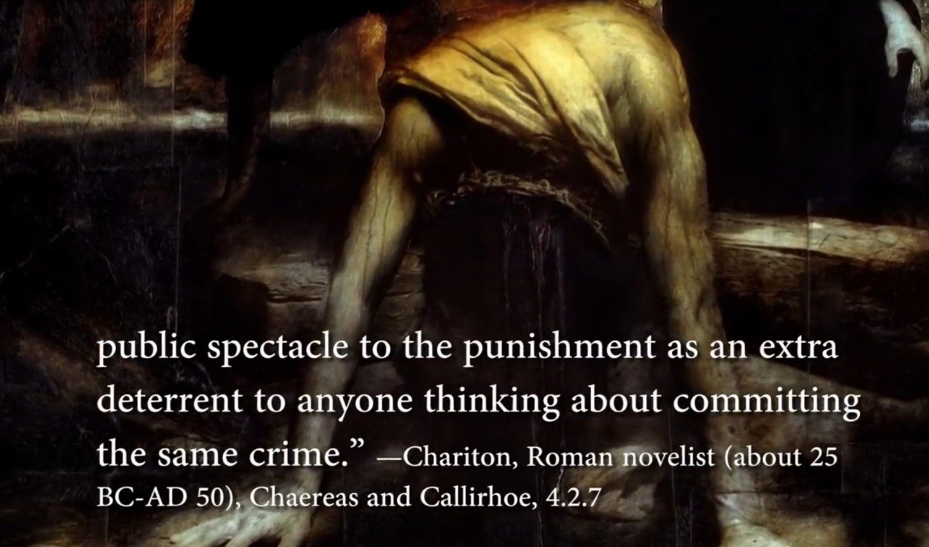
“What Romans said about crucifixion”
Matthew 27:28-31 (NKJV) ²⁸ And they stripped Him and put a scarlet robe on Him.
²⁹ When they had twisted a crown of thorns, they put it on His head, and a reed in His right hand. And they bowed the knee before Him and mocked Him, saying, "Hail, King of the Jews!"
³⁰ Then they spat on Him, and took the reed and struck Him on the head.
³¹ And when they had mocked Him, they took the robe off Him, put His own clothes on Him, and led Him away to be crucified.

Slide 14
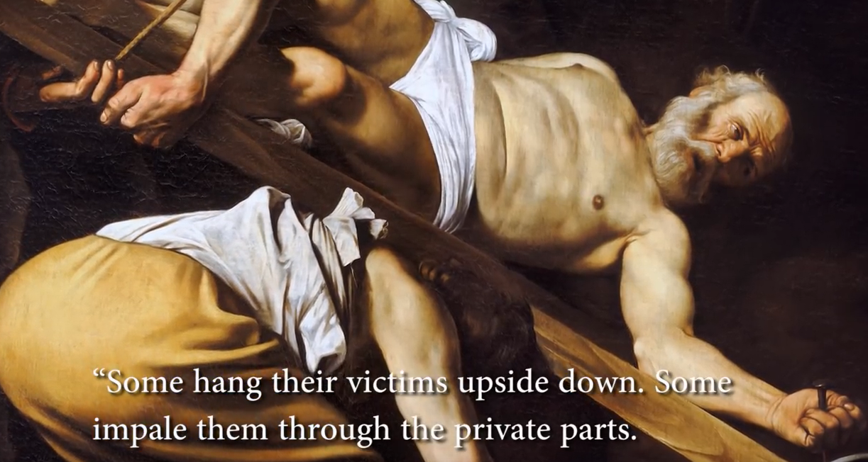

Slide 15
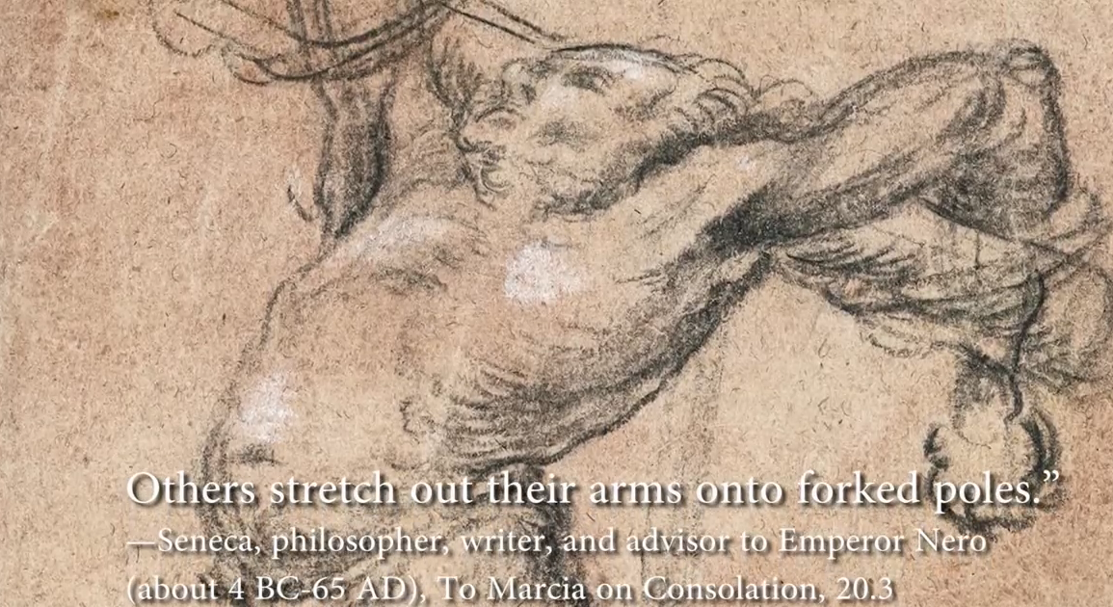

Slide 16
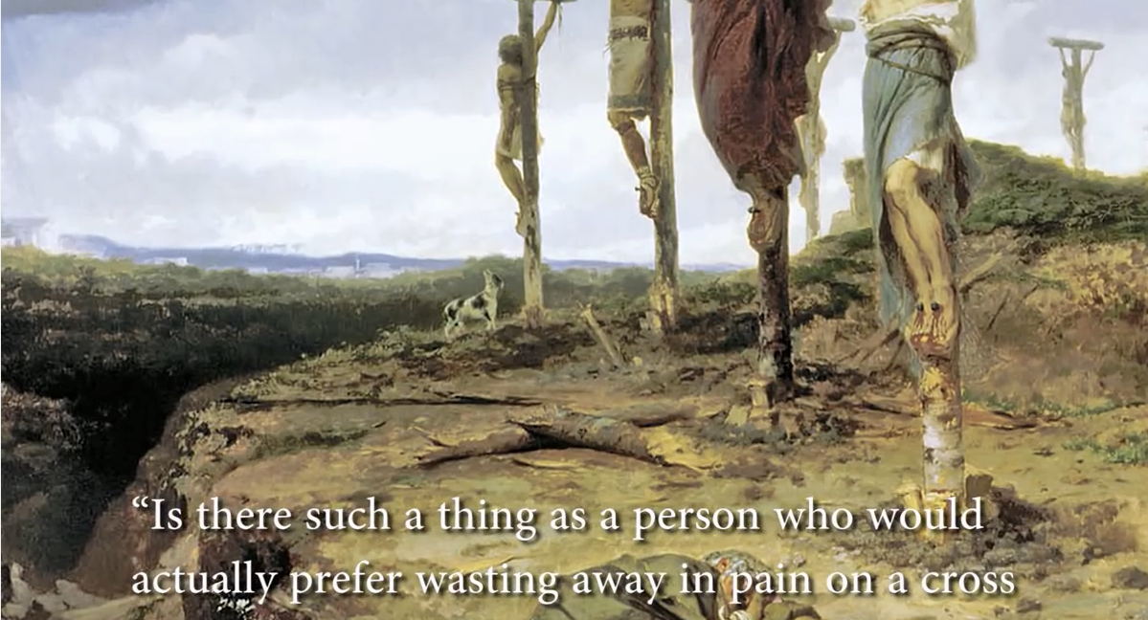

Slide 17
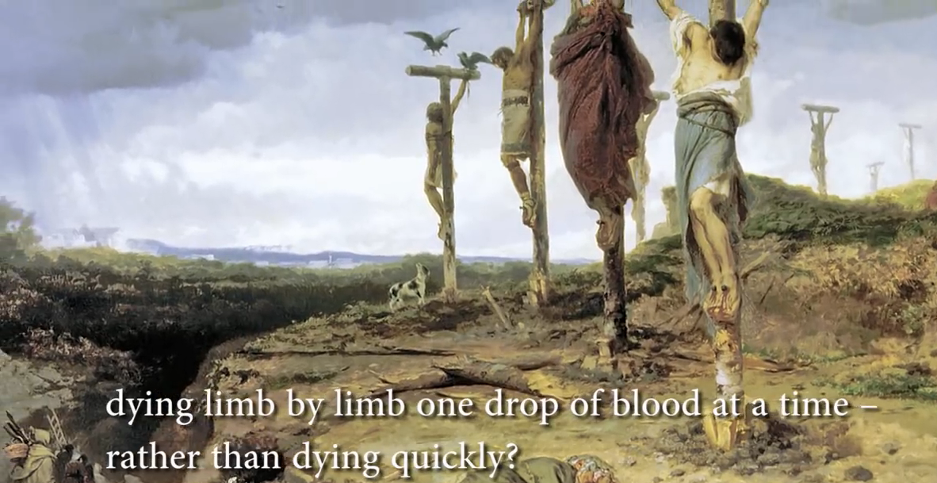

Slide 18
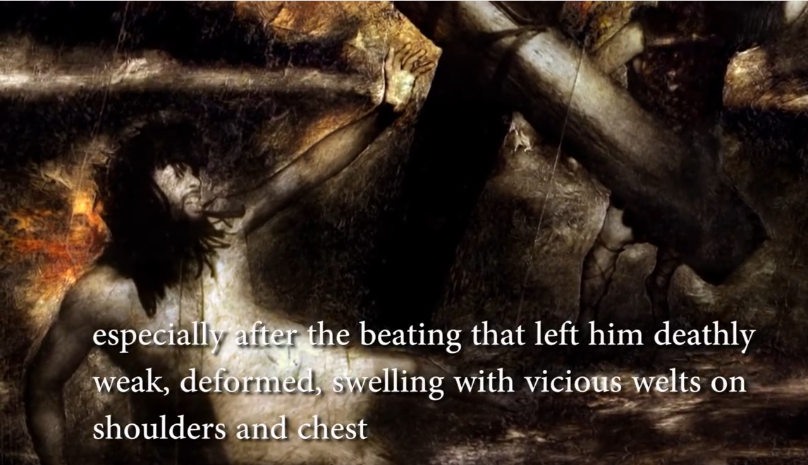

Slide 19
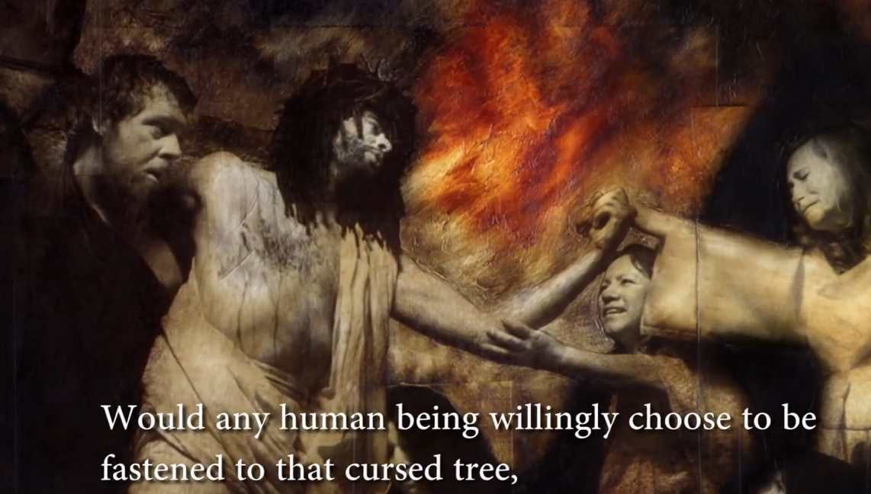

Slide 20
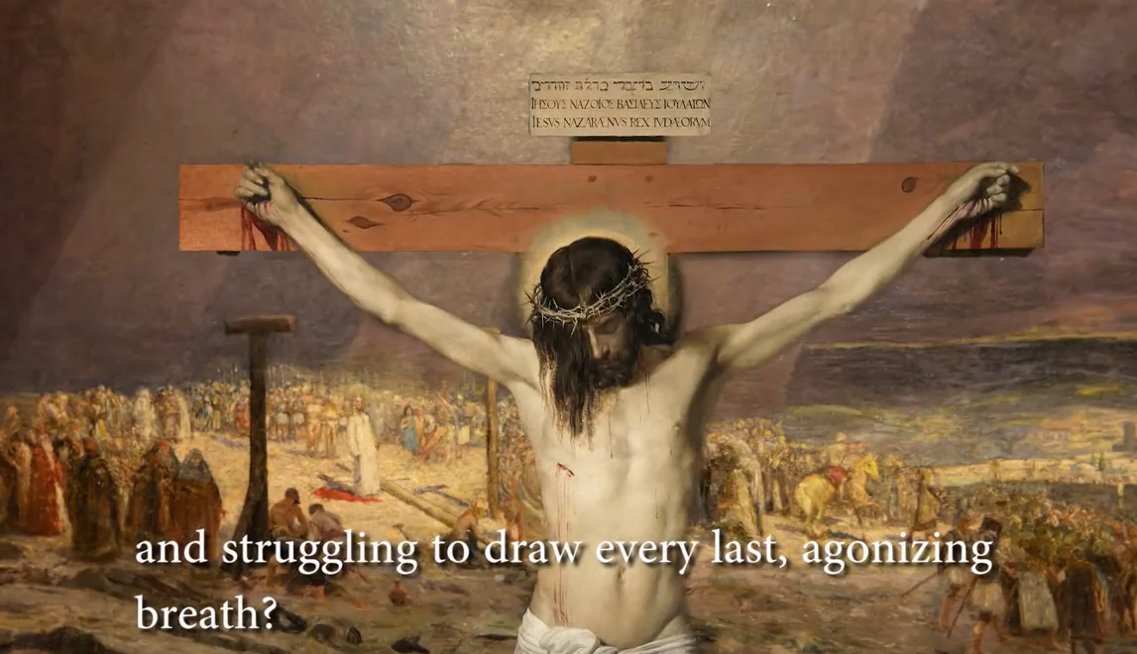

Slide 21
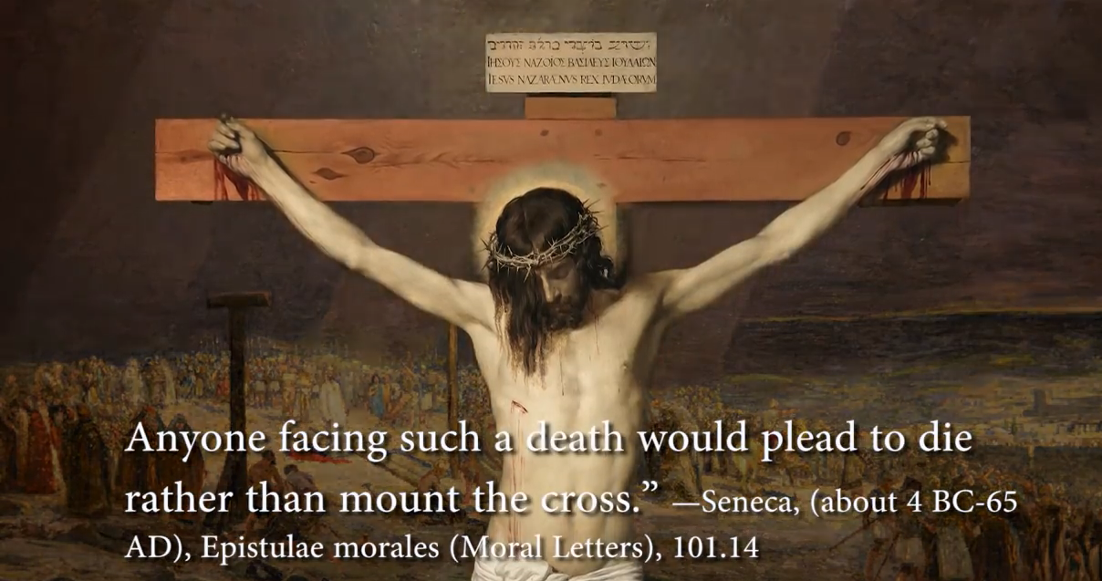

Slide 22
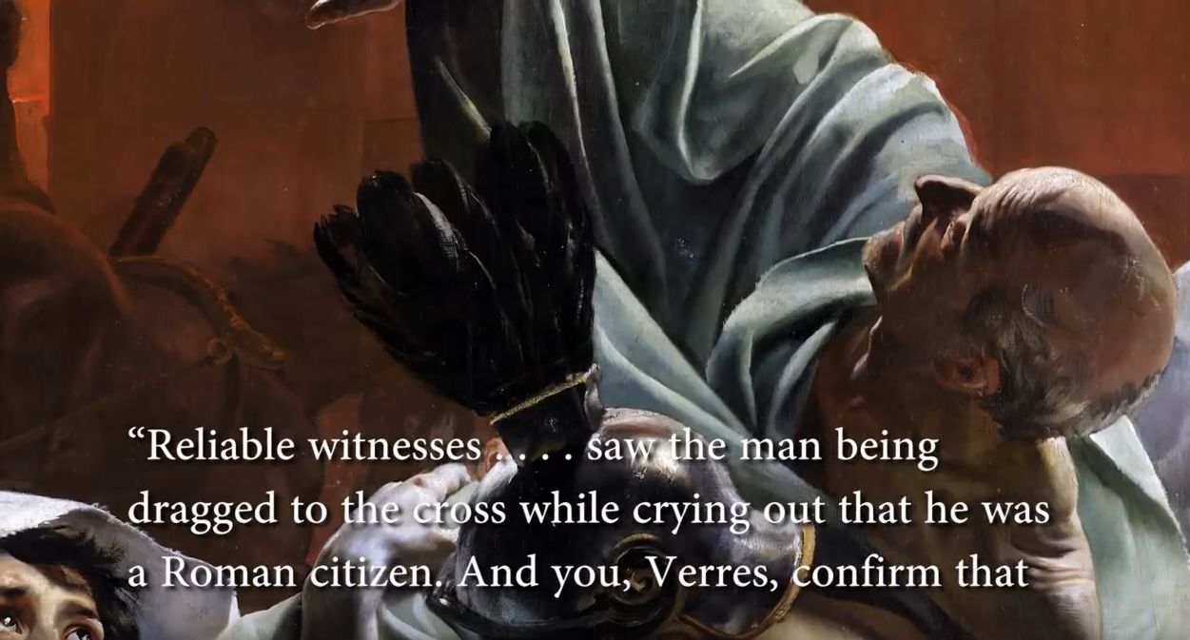

Slide 23
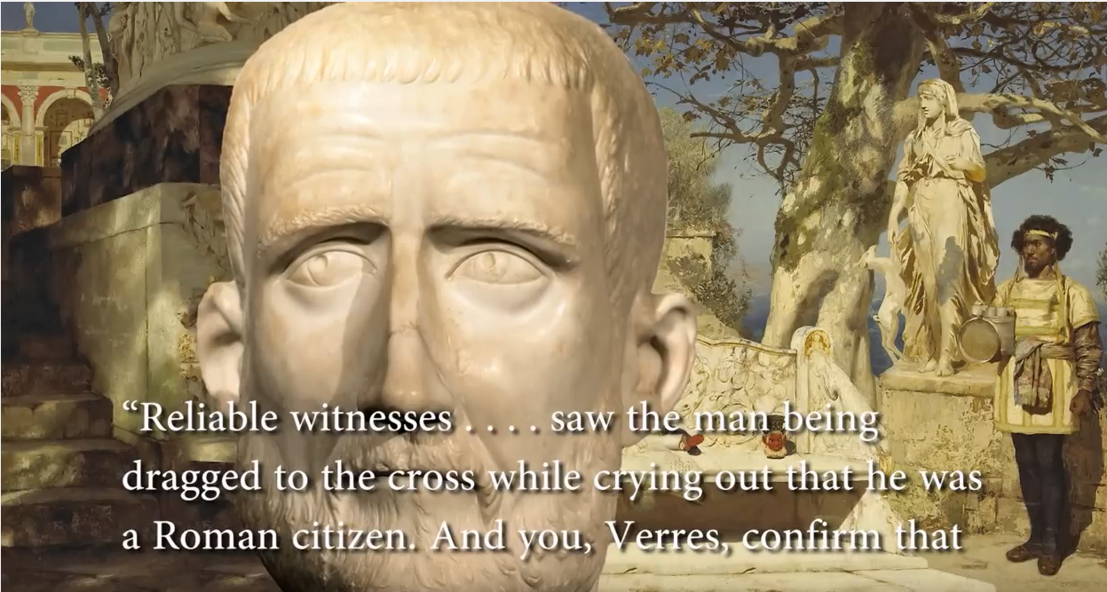

Slide 24
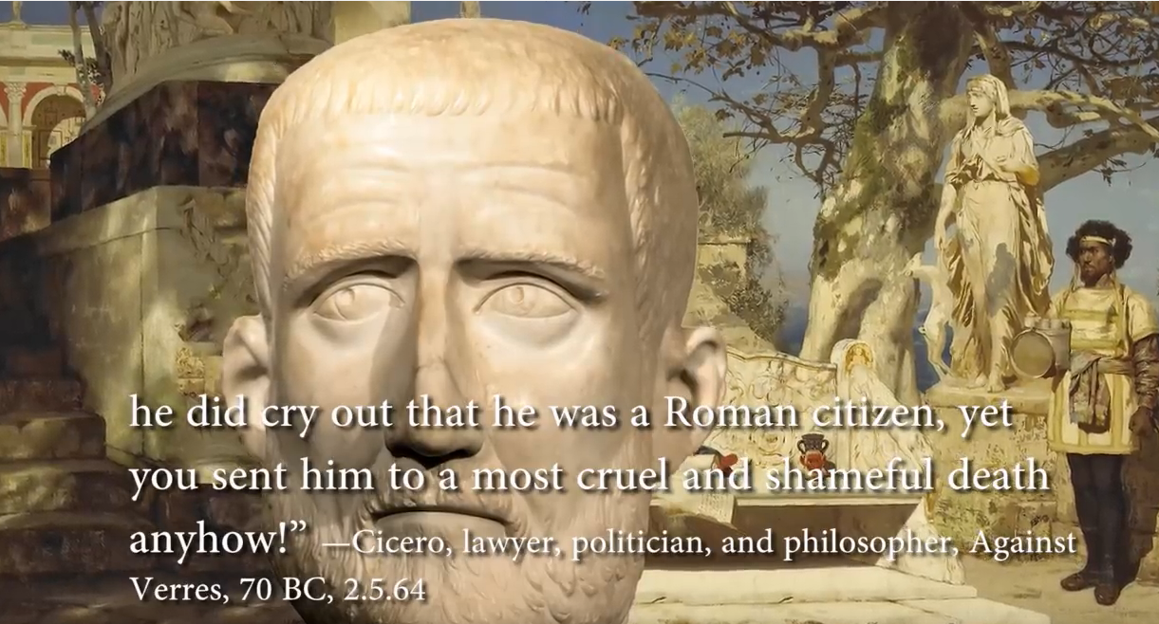

Slide 25
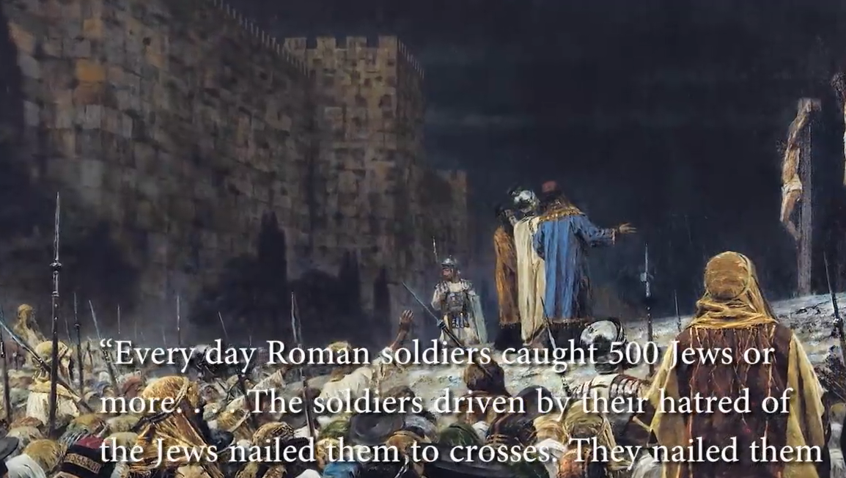

Slide 26
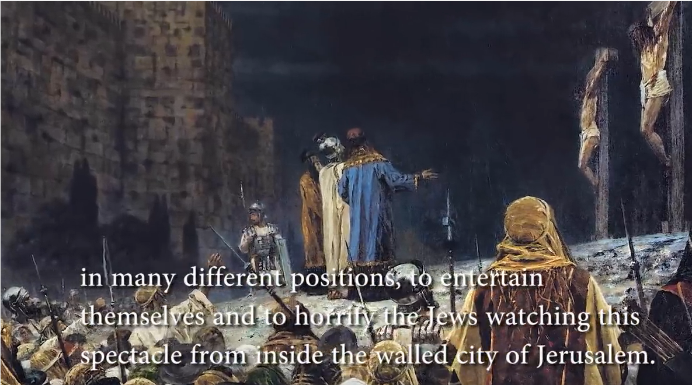

Slide 27
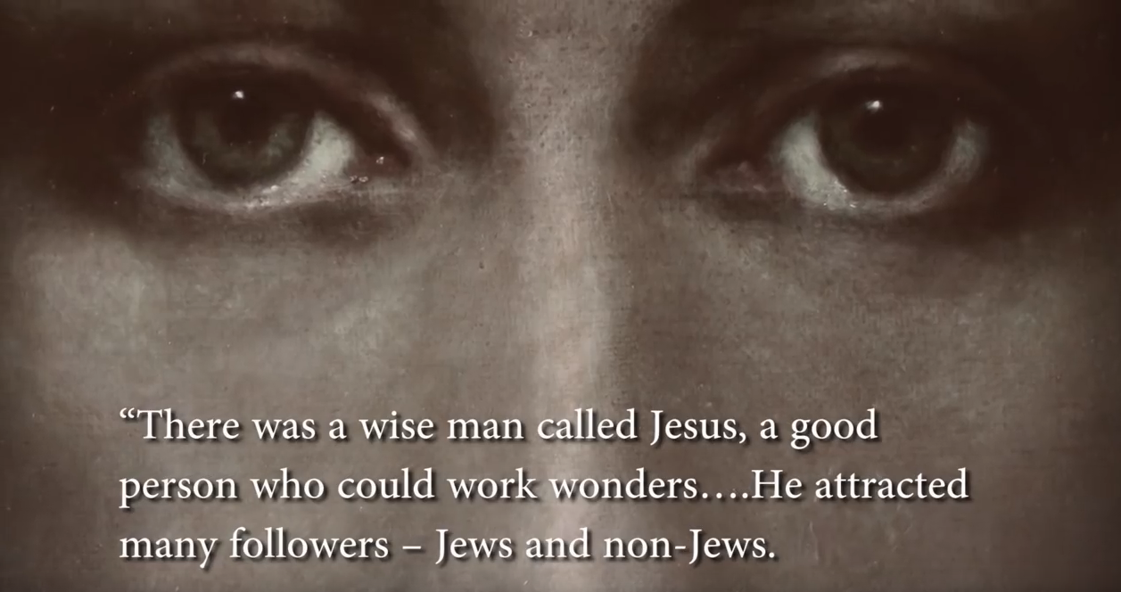

Slide 28
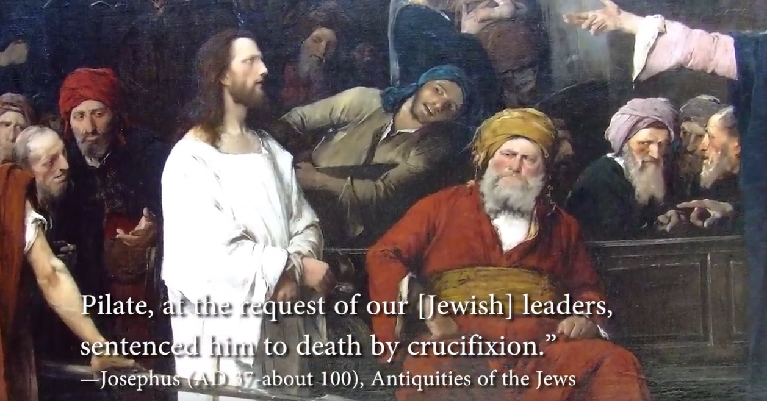
Matthew 27:22 (NKJV) ²² Pilate said to them, "What then shall I do with Jesus who is called Christ?" They all said to him, "Let Him be crucified!"

Slide 29
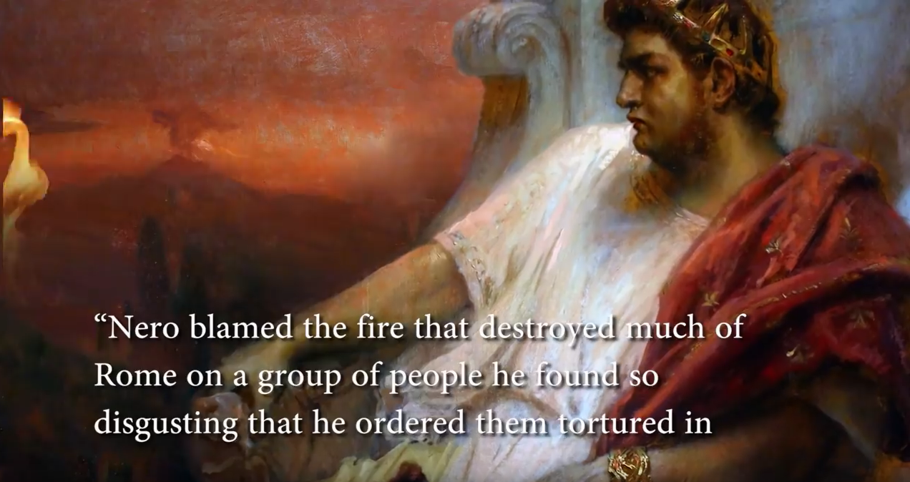

Slide 30
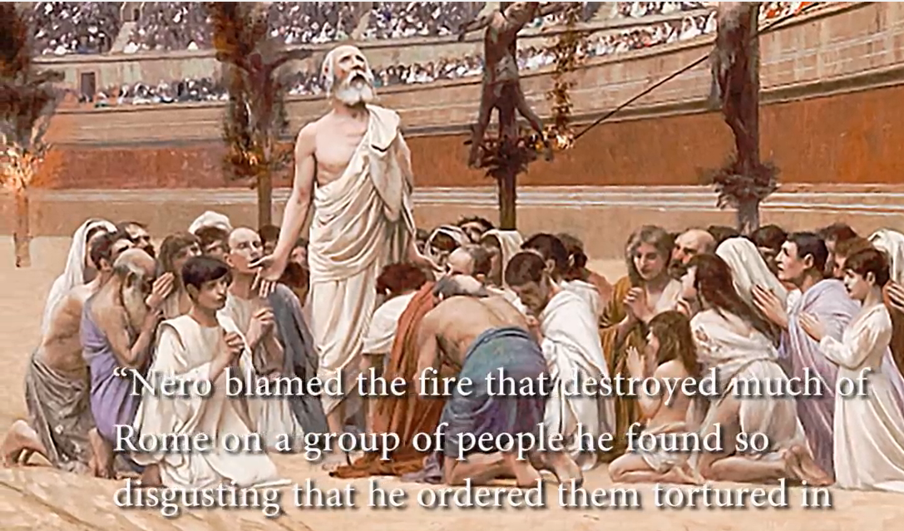

Slide 31
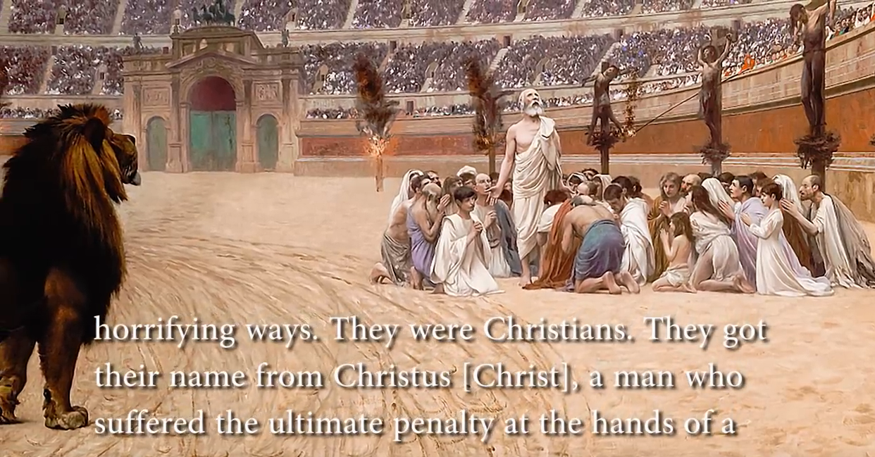

Slide 32
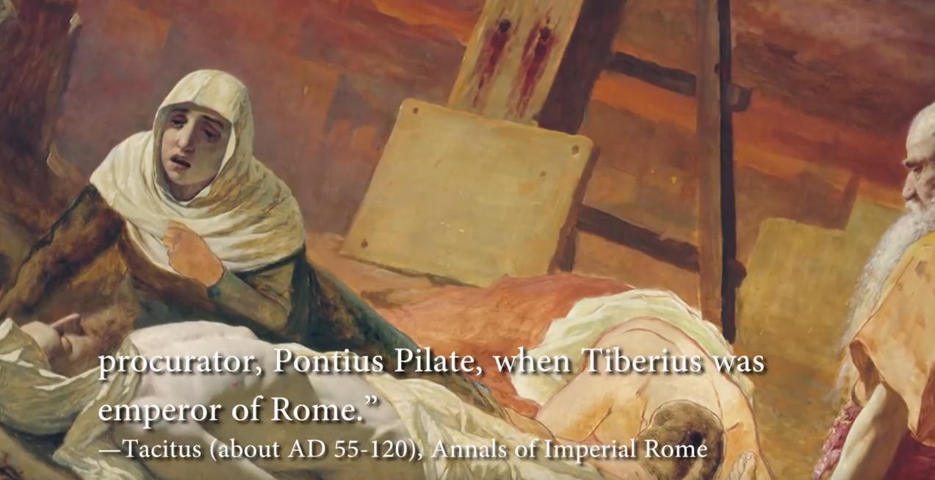
Matthew 27:1-2 (NKJV) ¹ When morning came, all the chief priests and elders of the people plotted against Jesus to put Him to death.
² And when they had bound Him, they led Him away and delivered Him to Pontius Pilate the governor.

Slide 33
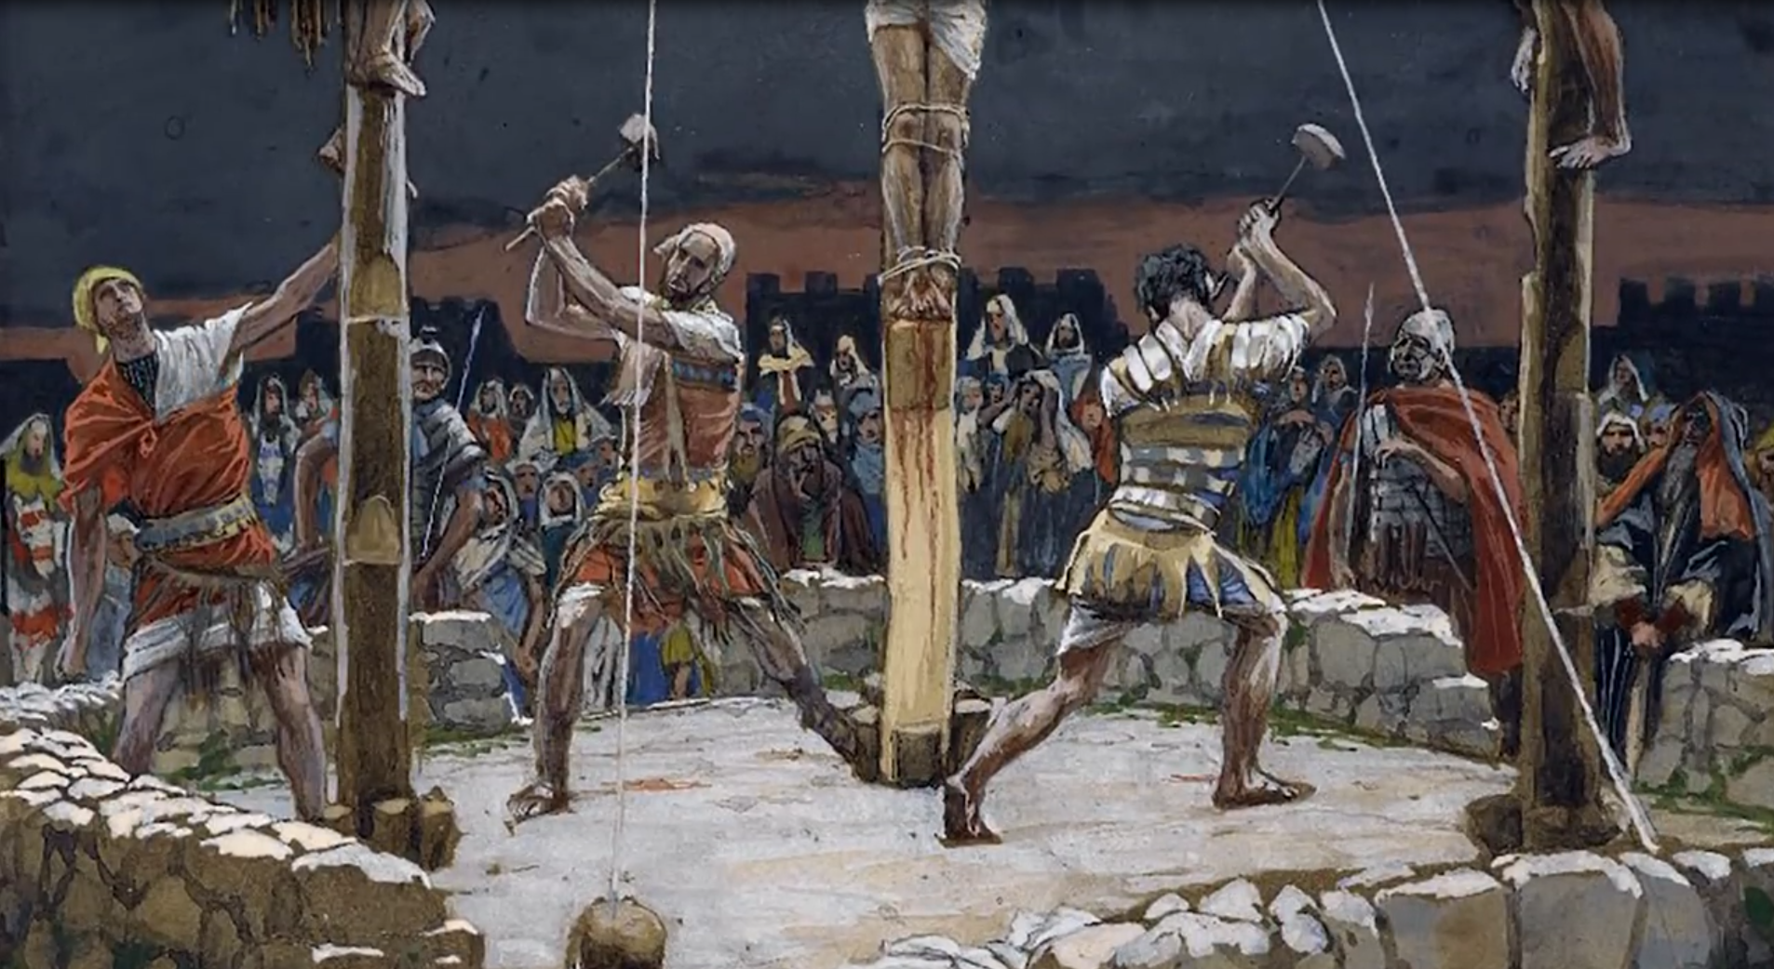
“What Romans said about crucifixion”

Slide 34


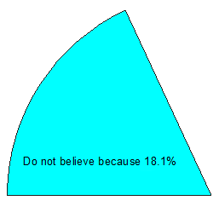



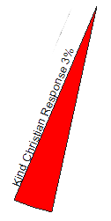
“What Romans said about crucifixion”
TYPE OF RESPONSES

Slide 35

“What Romans said about crucifixion”

Slide 36
Who is Jesus
He is the Christ (Messiah), the Anointed One foreseen by the Old Testament prophets.
(Isaiah 9:6; Matthew 16:16; John 4:25–26; John 6:69)
He is the Savior of the world, the one who delivers from sin.
  (John 3:16–18; John 4:42; Acts 5:31; 1 John 4:14)
He is the Lamb of God, the one who sacrificed His life for sins.
  (Isaiah 53:7; John 1:29)
He is the Son of God, having a unique and intimate relationship with God the Father.
  (John 20:31)
He is the Creator of all things. (John 1:3; Colossians 1:16–17, Hebrews 1:2, 3)
He is equal to God. (John 5:23; Philippians 2:6)
He is eternal, existing with God from the very beginning. (John 1:1–2)
He is God in the flesh, revealing to us what God is like. (John 1:18, Hebrews 1:3)
He is the Lord of all. (Acts 10:36, Philippians 2:9–11)
He was born of a virgin. (Isaiah 7:14, Matthew 1:22–23; Luke 1:27–35)
He has the authority to forgive sins. (Mark 2:10)
He is worshiped. (John 9:38; Luke 24:52; Hebrews 1:6)
He is the living Savior, raised from the dead and sitting today at the right hand of God;
By His resurrection we have new life. (1 Peter 3:21–22; Romans 8:34)

Slide 37
Jesus of Modern Scholar
The followers of Jesus invented his deity after his death
Jesus was a Magician
Jesus is a non-apocalyptic, teasing teacher
Jesus was an apocalyptic prophet
Jesus was a Cynic
Jesus just man
Jesus never claimed to be God
Jesus was a revolutionary, a sage, an iconoclastic Jew

Slide 38










Does the Timeline Fit?
Can we answer these questions?
Was the witness truly PRESENT to see what he or she claims to have seen?
Can the statements and claims of the witness be VERFIED in some way?
Has the witness been HONEST and ACCURATE over time, or did his or her account change over time?
Does the witness possess a BIAS that would motivate him or her to lie?
Is there enough time to
Add miracles, resurrection story
And multiple layers to NT
Ministry of Jesus
Miracles
Resurrection
70 AD
Temple
Destroyed
95 AD
Clément's Letter
10 NT Books
140 AD
Marcion
Canon
200 AD
Muratorian Canon
4 Gospels
Acts, Paul, 1-2 John
Jude, Revelation
367 AD
Athanasius
Lists all
27 NT books
Outer Limits
Of Resources
For Class
30 AD
100 AD
200 AD
300 AD
400 AD
Can the following be shown?
The gospels were written early enough to contain the actual observations of real eyewitnesses who lived and served with Jesus.
They can be corroborated by internal literary evidence and external evidence from ancient, non-Christian sources and archaeology.
The contents of the gospels haven’t changed over time, and the writers of the Gospels lacked any bias or motivation to lie about what they observed.

Slide 39

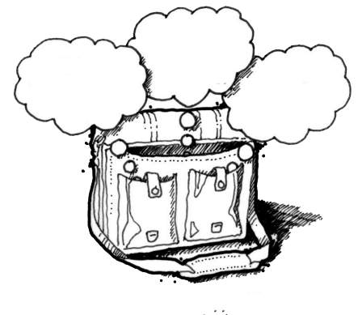
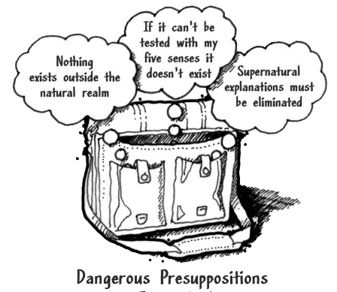
God
Supreme Being
We are created
Bible is
Accurate
Bible is Inspired
Bible is
Reliable
Super Naturalism it is possible that there is
a supreme being/someone beyond natural order
Intelligent Design – a programmer
nothing exists beyond the natural realm
Philosophical Naturalism The presuppositional belief
that only natural laws and forces occur
No God
No Supreme Being
We come from nothing
Using God
To fill in the Gaps

Slide 40
God
Supreme Being
We are created
X
Cannot explain
Cannot understand
Can not fill gap with God
Do we have proof that Bible is from Supreme Being
Bible is
Accurate
Bible is Inspired
Bible is
Reliable
A Programmer has means
to control/go outside
the normal laws
Super Naturalism it is possible that there is
a supreme being/someone beyond natural order
Intelligent Design – a programmer
Attempt
Explanations
For Bible (it is lies, etc)
nothing exists beyond the natural realm
Philosophical Naturalism The presuppositional belief
that only natural laws and forces occur
Only acceptable evidence is what we can observe
Natural order only
If we can not explain the answer it is not God/superstition in the gaps
No God
No Supreme Being
We come from nothing
Random Design/Evolution
Observe micro evolution
= macro evolution

Slide 41



Bible Authority Established
Creation, Flood, Redemption Story, Moses, Moral Laws, Miracles, Nature of Man, Purpose of Man, Nature of God, Christ & Holy Spirit, Requirements for Worship, Personality of Jesus, Coming Judgment, Heaven, Hell, Angels, Demons, & Satan
Bible would be Accurate
Based on Bible Testimony Jesus is Son of God
Teachings of
Jesus are True
Accurate Account of Jesus’ Life
A Step of Faith not
A Leap of Faith
Bible can be Understood
Bible is Inspired
Bible is Accurate
Bible is Reliable
If Bible Revelation of Creator then
Divine Revelation Possible
& Accurate So Purpose is Known
Starting Point for
How We Got the Bible
class
Creation
has a purpose
Likely a Moral Law
Miracles &
Revelations
Universe had an Intelligent, Personal Origin
Possible that Universe had Supernatural Origin
It is Possible that there is Supernatural Force
Based on material from mmb, jr Establishing Bible Authority Class - 10/30/2002

