Slide 1
Jeremiah – 40 years of prophecy
Lesson 10: Destruction of Judah

Slide 2
Class Objectives
Give examples of how God moves in the Nations and in Time to accomplish His will
See Jeremiah as a real person in history, and how God developed his faith
See how idolatry betrays our relationship with God
See God’s mercy displayed, even in judgement

Slide 3
Outline of Jeremiah
Part I: Chapter 1
Part II: Chapter 2-20
Part III: Chapters 21-39
Part IV: Chapters 40-45
Part V: Chapters 46-51
Historical Appendix: Chapter 52
Jeremiah’s call
Speeches and Prophecies during rule of Josiah
Prophecies of Specific Events during rule of Jehoiakim & Zedekiah
Judah After the Fall of Jerusalem
The Lord’s Word Against Foreign Nations
The Fall of Jerusalem
Notes:
Part I: Chapter 1 Jeremiah’s call
Part II: Chapter 2-20 Speeches and Prophecies Concerning Judah & Jerusalem Primarily During the Time of Josiah, (641-610 B.C.)
Part III: Chapters 21-39 Prophecies of Specific Events during the Time of
Jehoiakim (608-597) and Zedekiah, (597-586),
1: Woe to Zedekiah, Chs. 21-24
2: In the Fourth Year of Jehoiakim, Chs. 25-26
3: In the Fourth Year of Zedekiah, Chs. 27-29
4: The Book of God’s Consolation, Chs. 30-33
5: Under the Reign of Zedekiah, Ch. 34
6: Under the Reign of Jehoiakim, Chs. 35-36
7: Under Zedekiah, Chs. 37-39
Part IV: Chapters 40-45 Jeremiah’s Ministry to Judah After the Fall of
Jerusalem,
Part V: Chapters 46-51 The Lord’s Word Against Foreign Nations,
Historical Appendix: Chapter 52 The Fall of Jerusalem

Slide 4
Dating of Jeremiah’s Prophecies
645
KINGS
Of
JUDAH
640
EVENTS
635
Josiah begins reforms
630
1-6
Josiah purges idolatry
625
Jeremiah Called
JOSIAH
11-13
Book of Law found
620
18-20
615
7-10
22:1-23
Nineveh falls
JEHOAHAZ
610
25
26
35
36:1-8
45:1-49:33
605
36:9-32
First Deportation, Daniel & Ezekiel taken
JEHOIAKIM
JEHOIACHIN
600
14-17
23-24
29-31
49:34-39
595
Second Deportation
ZEDEKIAH
22:24-30
50-51
590
21
27-28
GEDALIAH
585
32-34
37
38-44
Destruction of Jerusalem, Final Deportation
580
575
570
565
52
560
Jehoiachin released & fed at kings table

Slide 5
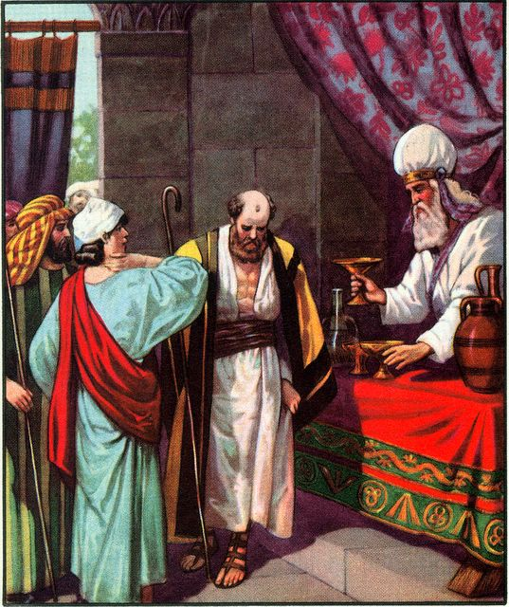
Contrasts in Obedience
Princes of Judah and their slaves (34:8-22)
During the siege of Nebuchadnezzar, near the end of Zedekiah’s reign
King Zedikiah proclaimed that Hebrew slaves should be freed
A formal covenant was made in the temple, before God
The princes turned and brought them back into subjection again (v21)
Therefore, God proclaims liberty to them: to sword, pestilence, and famine
Rechabites and the command of their father (35:1-19)
Jeremiah brings them into the temple, and offers them wine
They refuse: because of obedience to their father, Jonadab (~250 years ago)
They will not drink wine, or build houses, or plant gardens
They have only come into Jerusalem for protection from the Chaldeans
Therefore, because they obeyed: They would not lack a man to stand before Him
God contrasts the obedience of the Rechabites to the disobedience of the men of Judah in a stinging rebuke (35:12-17)

Slide 6
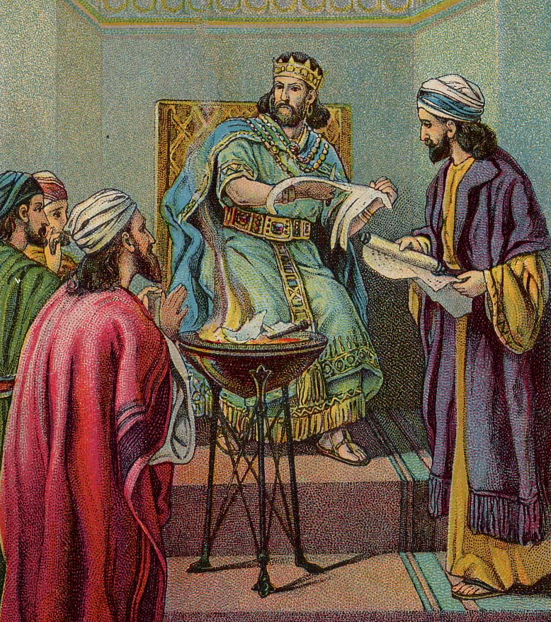
King Jehoiakim and the book of prophecy
Baruch Recorded Jeremiah’s Prophecies (36:1-26)
In the 4th year of Jehoiakim, Jeremiah dictated a book to Baruch
All the words of prophecy to date, “maybe they will hear and turn”
Read all the words in the Temple, on the day of fasting
The Princes heard of it, asked for him to read to them, were afraid
Baruch and Jeremiah were told to hide
The Princes told king Jehoiakim, who asked for the scroll to be brought
Jehudi read the scroll to the King, who destroyed it in fire
The King and his servants “were not afraid…did not rend their garments”
Commanded to seize Jeremiah and Baruch, but the Lord hid them
Baruch rewrote the book (36:27-32)
All the words were rewritten, plus “many similar words”
Jehoiakim’s end was prophesied

Slide 7
Questions
Were the leaders of the people required to release Hebrew slaves? Under what circumstances?
Why do you think the leaders agreed to release them? What caused them to change their minds?
Why were the Rechabites commended by God? What pattern can we learn from their example?
What do you see in Jehoiakim’s attitude toward God’s Word? Do we see this today?
What attitude do you see in the princes of Judah when they heard the words of the scroll? Was this a sufficient response?

Slide 8
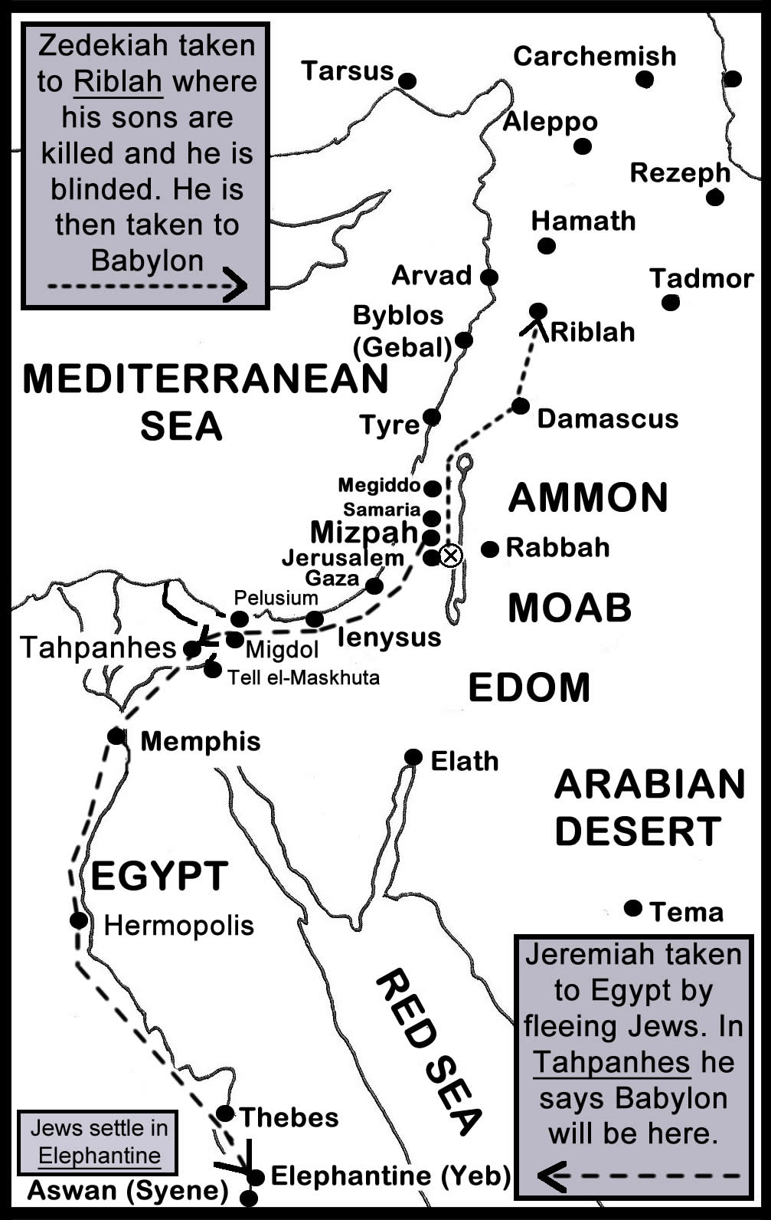
The Fall of Jerusalem
In the 11th year of Zedekiah, 4th month, 9th day (587 BC) (39:1-10)
After a long siege, the walls were breached
Burned the Temple, the kings house, and the houses of the people
Broke down the walls
Carried away the remnant and those who surrendered to Babylon
Left only the very poorest in the land
Nebuchadnezzar commanded release and care for Jeremiah (39:11-18)
Removed from prison, given to care of Gediliah
Ebed-Melech is spared, he trusted in God (rescued Jeremiah 38:7-13)
God’s judgement on the city is “for adversity and not for good”

Slide 9
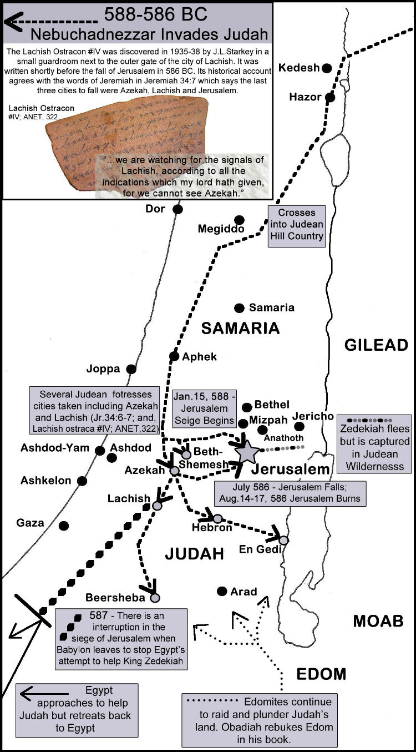
Warnings to Zedikiah
At the beginning of the siege of Jerusalem by Nebuchadnezzar (34:1-3)
The city is given to Babylon, will be burned
You shall be captured, shall see and speak to the King of Babylon, go to Babylon
When the Babylonians leave to fight Egypt (34:17-22)
The leaders who broke the covenant will die and not be buried
The city is given to Babylon, will be burned, become a desolation without inhabitant
Zedekiah and the princes will be given to their enemies (Babylon)
When Zedekiah sends for word, after Babylonians depart (37:6-10, 17)
Pharoah’s army will not help. The Chaldeans will return and take the city
Zedekiah will be delivered into the hand of the king of Babylon
After being but into the dungeon, near the end of the siege (38:14-24)
If you surrender to the King of Babylon, you and your family shall live and the city will not be burned
If not, the city will be burned, you shall be taken away as captive

Slide 10
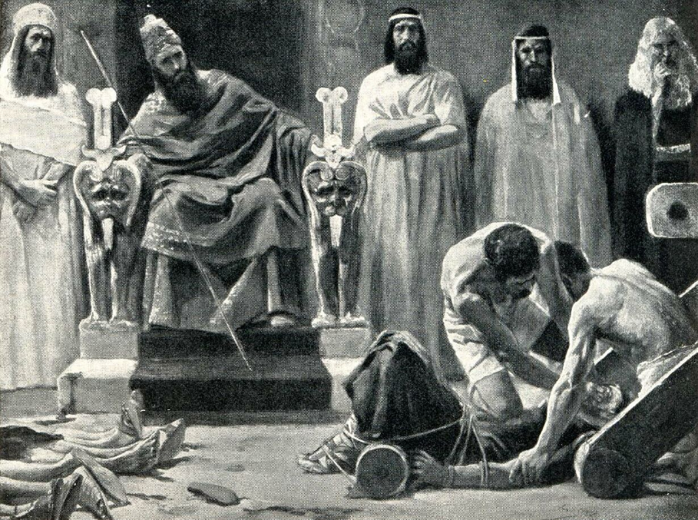
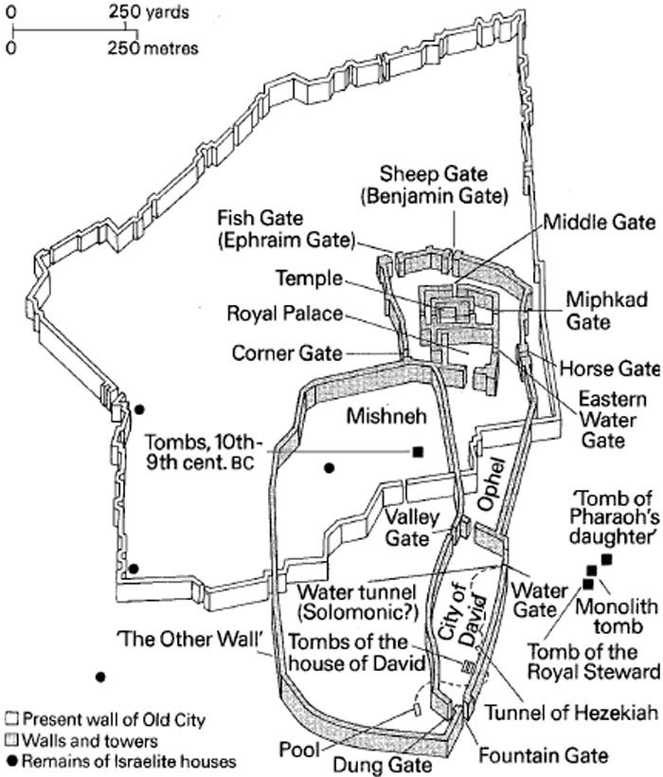
The End of Zedikiah
When Nebuchadnezzar took the city
The princes of Babylon entered and sat in the Middle Gate
King Hezekiah and the army fled through the back
Hezekiah was captured on the plains of Jericho, taken to Riblah
The King of Babylon saw and spoke to him: pronouncing judgement
Family and nobles were killed before him
Blinded and bound in bronze fetters
Carried away to Babylon

Slide 11
And the LORD God of their fathers sent warnings to them by His messengers, rising up early and sending them, because He had compassion on His people and on His dwelling place. But they mocked the messengers of God, despised His words, and scoffed at His prophets, until the wrath of the LORD arose against His people, till there was no remedy.
Therefore He brought against them the king of the Chaldeans, who killed their young men with the sword in the house of their sanctuary, and had no compassion on young man or virgin, on the aged or the weak; He gave them all into his hand. And all the articles from the house of God, great and small, the treasures of the house of the LORD, and the treasures of the king and of his leaders, all these he took to Babylon.
Then they burned the house of God, broke down the wall of Jerusalem, burned all its palaces with fire, and destroyed all its precious possessions. And those who escaped from the sword he carried away to Babylon, where they became servants to him and his sons until the rule of the kingdom of Persia, to fulfill the word of the LORD by the mouth of Jeremiah, until the land had enjoyed her Sabbaths.
As long as she lay desolate she kept Sabbath, to fulfill seventy years.
(2Ch 36:15-21)

Slide 12
Questions
What do you see in the character and attitudes of Zedekiah with respect to God’s Word? Had he heard the message?
Did Zedekiah combine hearing with action?
Would God have relented and spared the city if Zedekiah had repented?
Did God fulfill His prophecies to Zedekiah?
Why was God’s word to Judah “for adversity and not for good” in 39:16? What does this mean?

Slide 13
Thank you

