Slide 1
Jeremiah – 40 years of prophecy
Lesson 12: Judgement on the nations

Slide 2
Class Objectives
Give examples of how God moves in the Nations and in Time to accomplish His will
See Jeremiah as a real person in history, and how God developed his faith
See how idolatry betrays our relationship with God
See God’s mercy displayed, even in judgement

Slide 3
Outline of Jeremiah
Part I: Chapter 1
Part II: Chapter 2-20
Part III: Chapters 21-39
Part IV: Chapters 40-45
Part V: Chapters 46-51
Historical Appendix: Chapter 52
Jeremiah’s call
Speeches and Prophecies during rule of Josiah
Prophecies of Specific Events during rule of Jehoiakim & Zedekiah
Judah After the Fall of Jerusalem
The Lord’s Word Against Foreign Nations
The Fall of Jerusalem
Notes:
Part I: Chapter 1 Jeremiah’s call
Part II: Chapter 2-20 Speeches and Prophecies Concerning Judah & Jerusalem Primarily During the Time of Josiah, (641-610 B.C.)
Part III: Chapters 21-39 Prophecies of Specific Events during the Time of
Jehoiakim (608-597) and Zedekiah, (597-586),
1: Woe to Zedekiah, Chs. 21-24
2: In the Fourth Year of Jehoiakim, Chs. 25-26
3: In the Fourth Year of Zedekiah, Chs. 27-29
4: The Book of God’s Consolation, Chs. 30-33
5: Under the Reign of Zedekiah, Ch. 34
6: Under the Reign of Jehoiakim, Chs. 35-36
7: Under Zedekiah, Chs. 37-39
Part IV: Chapters 40-45 Jeremiah’s Ministry to Judah After the Fall of
Jerusalem,
Part V: Chapters 46-51 The Lord’s Word Against Foreign Nations,
Historical Appendix: Chapter 52 The Fall of Jerusalem

Slide 4
Dating of Jeremiah’s Prophecies
645
KINGS
Of
JUDAH
640
EVENTS
635
Josiah begins reforms
630
1-6
Josiah purges idolatry
625
Jeremiah Called
JOSIAH
11-13
Book of Law found
620
18-20
615
7-10
22:1-23
Nineveh falls
JEHOAHAZ
610
25
26
35
36:1-8
45:1-49:33
605
36:9-32
First Deportation, Daniel & Ezekiel taken
JEHOIAKIM
JEHOIACHIN
600
14-17
23-24
29-31
49:34-39
595
Second Deportation
ZEDEKIAH
22:24-30
50-51
590
21
27-28
GEDALIAH
585
32-34
37
38-44
Destruction of Jerusalem, Final Deportation
580
575
570
565
52
560
Jehoiachin released & fed at kings table

Slide 5
Prophets in Judah
Prophets
Daniel
606 to 536 BC
Habakkuk
Ezekiel
Jeremiah
Captives
Captives
592 to 570 BC
627
-
586
Zephaniah
Nahum
st
nd
1
2
Judah Falls
630
620
610
600
590
580
Josiah
Jehoiakim
Zedekiah
After the Fall of Israel
Jehoahaz
Jehoiachin
Kings

Slide 6
A Prophet to the Nations
Purpose was beyond Judah (1:5-10)
  A prophet to the nations
  Set over Nations and Kingdoms to root out and pull down…
Messages behind the messages
  Immediate satisfaction: Enemies of Judah will be punished
  God punishes evil wherever it is found
  God is in control of the nations and times
  God’s moral laws are universal, they apply to all people

Slide 7
Prophecies Against Egypt
Judgement 1 (46:1-12)
  Nation Named: Egypt in the time of Jehoiakim
  Their Sin:
    Pride in covering the earth (46:7-8), in the strength of their arms (46:3-4)
  Their Punishment:
    Defeat and Humiliation at Carchemish (46:5-6, 9-10)
Judgement 2 (46:13-26)
  Nation Named: Egypt after the fall of Jerusalem
  Their Sin:
    Trusting their false gods, and in their own might (46:25)
  Their Punishment:
    God’s servant Nebuchadnezzar would invade
    Valiant men and mercenaries would fail
    Egypt shall be ashamed
  Unexpected Hope:
    Afterward it shall be inhabited as before (46:26)

Slide 8
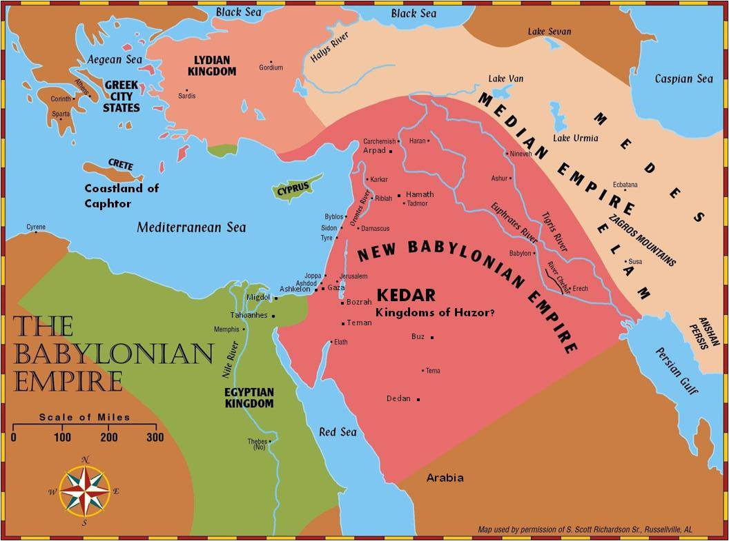
Prophecies to the Nations
46:1-12, Egypt at Carchemish
46:13-26, Egypt invaded

Slide 9
Prophecies Against Philistines
Judgement (47:1-7)
  Nation Named:
    Philistines: Remnant of Caphtor, Gaza and Ashkelon
  Their Sin:
    Not specified
  Their Punishment:
    Waters rise from the north in a flood (Egypt coming from Carchemish? Or Babylon?)
    Great fear in their defeat

Slide 10
Prophecies to the Nations
47:1-7 Philistines

Slide 11
Prophecies Against Moab
Judgement (48:1-47)
  Nation Named:
    Moab and its Cities (descended from Lot)
  Their Sin:
    Trusted in their works and treasures (48:7)
    Has been at ease, working deceitfully (48:10-11)
    Pride and Haughtiness (48:26, 29)
    Idolatry (48:35)
  Their Punishment:
    Plunder and great destruction (48:3,8,15
    Chemosh shall go into captivity (48:7,13)
    Cause idolatry to stop (48:35)
  Unexpected Hope:
    I will bring back the captives in the latter days (46:47)

Slide 12
Prophecies to the Nations
48:1-47, Moab
49:1-6, Ammon

Slide 13
Prophecies Against Ammon
Judgement (49:1-6)
  Nation Named:
    Ammonites
  Their Sin:
    Idolatry – Milcom/Molech inherits Gad (48:1)
  Their Punishment:
    Alarm of war heard
    Villages burned with fire
    Ai is plundered
    Milcom shall go into captivity
  Unexpected Hope:
    Afterwards, I will bring back the captives

Slide 14
Prophecies to the Nations
48:1-47, Moab
49:1-6, Ammon

Slide 15
Prophecies Against Edom
Judgement (49:7-22)
  Nation Named:
    Edom (from Esau)
  Their Sin:
    Fierceness and Pride in their defenses (49:16, Oba 1-6)
  Their Punishment:
    Complete destruction (49:9-10, 17-22)
    Bozrah a waste (49:13)

Slide 16
Prophecies to the Nations
Edom (49:7-22

Slide 17
Prophecies Against Other Nations
Syria (Damascus) (49:23-27)
  Sin not specified
  Punishment will be shame and terror
Kedar and Hazor
  Sin not specified
  Punishment – devastation, fear, calamity
  Nebuchadnezzar has taken counsel against them
  A dwelling place for jackels
Elam
  Sin not specified
  Punishment: destroyed and scattered, dismayed before their enemies, consumed by the sword
  But in the latter days, He will bring back the captives
Damascus, 49:23-27
Kedar and Hazor, 49:28-33
Elam, 49:34-39

Slide 18
Prophecies to the Nations
Damascus, Elam, Kedar and Hazor

Slide 19
Promised Restoration
Some nations would be restored
Some Nations would not
Israel
Egypt
Moab
Ammon
Elam
Philistines
Edom
Damascus
Kedar and Hazor

Slide 20
Thank you

