Slide 1
Revelation

Slide 3
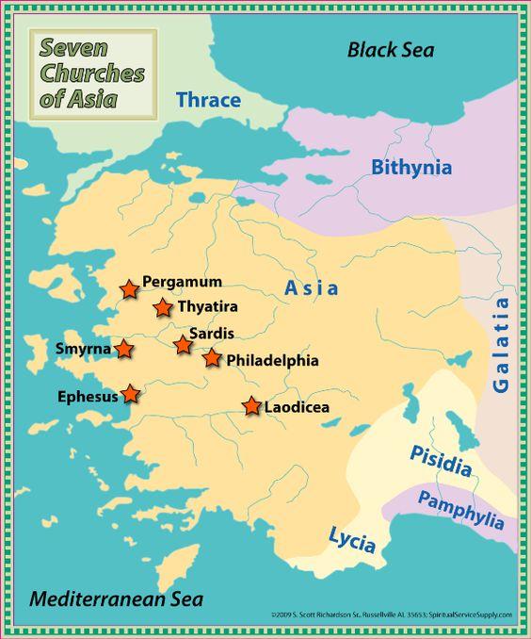

Slide 4
Overview of The Revelation
Introduction (Ch. 1)
The 7 Churches (Ch. 2-3)
Heavenly Scene: The Throne & The Lamb (Ch. 4-5)
The 7 Seals (Ch. 6-8)
Heavenly Scene: Silence in Heaven (Ch. 8)
The 7 Trumpets (Ch. 8-11)
Heavenly Scene: The Spiritual Conflict (Ch. 12-14)
The 7 Bowls (Ch. 15-18)
Heavenly Scene: The Spiritual Victory (Ch. 19)
Conclusion: The Rule of Christ (Ch. 20-22)

Slide 5
Class Goals
To Better Understand The Language & Structure of Revelation.
To Understand The Purpose & Dramatic Style of Apocalyptic Literature.
To Identify Key Verses In Each Chapter As Stepping Stones of Understanding.
To Explain The Shortcomings of Premillennial Interpretations.
To Tackle A Challenging Book With The Support & Wisdom of Friends.
To More Clearly See The Events, Instructions, & Message of Revelation.
To See The Glory, Authority, Power, & Triumph of Jesus More Clearly.
To See The Limitations & Weaknesses of Earthly Kingdoms More Clearly.
To Fully Respond To The Insights Given In Revelation.
To Grow In Praise To God & Loyalty to His Kingdom.
To Increase Our Alertness & Preparation For The Judgment of God.
To Instill Courage & Hope In The Face of Persecutions.
To Stir Up Our Joy & Hope For Heaven.
Notes:
If we understand it – we can see it clearly. If we can see it clearly – we can respond to it.
To Emphasize Key Verses In Each Chapter That Provide Stepping Stones for Understanding the Full Book of Revelation.
To Examine & Understand The Use of Old Testament Language.

Slide 6
Revelation 1:1-3
Apocalypse
“The Revelation of Jesus Christ, which God gave Him to show to His bond-servants, the things which must soon take place; and He sent and communicated it by His angel to His bond-servant John, ² who testified to the word of God and to the testimony of Jesus Christ, even to all that he saw. ³ Blessed is he who reads and those who hear the words of the prophecy, and heed the things which are written in it; for the time is near.”
Visual
Timing
Messenger
Source
Purpose
Action

Slide 7
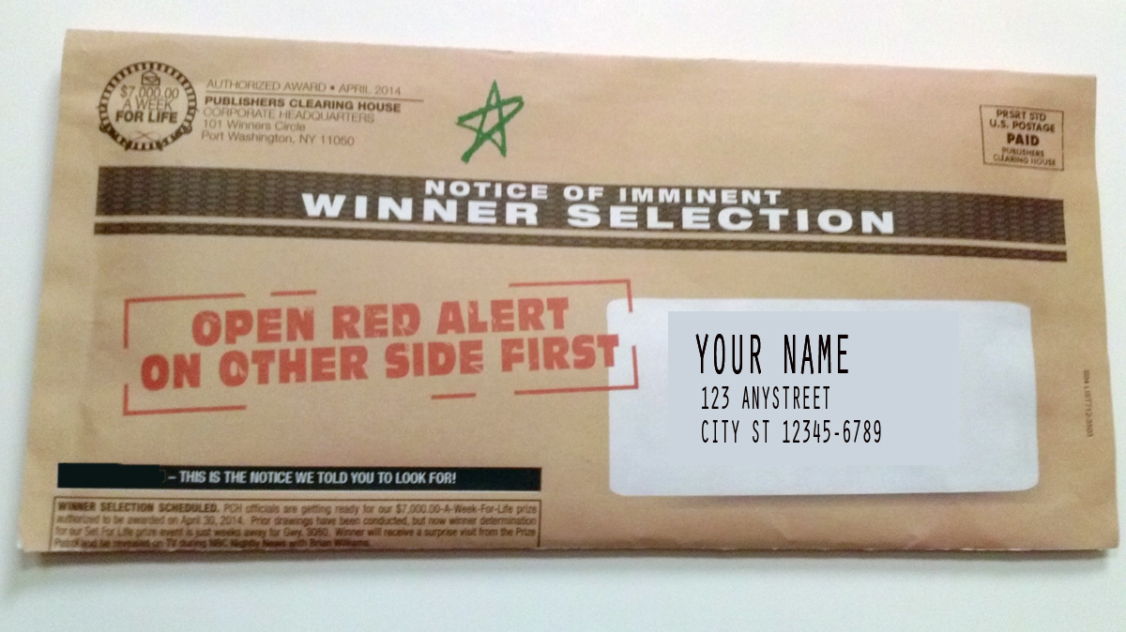
Understanding Begins With Learning About The Genre…
Notes:
When we get a mailing – telling us we may have won $25 million – we toss it in the trash.

Slide 8
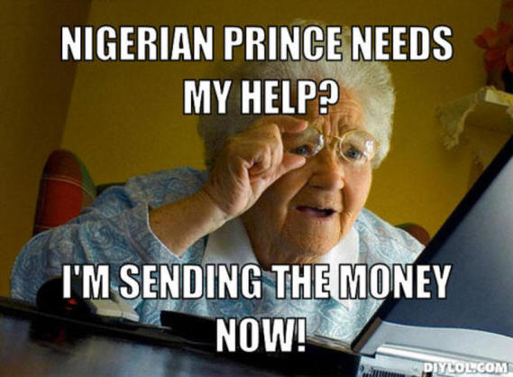
Understanding Begins With Learning About The Genre…
Notes:
When we get a mailing – telling us we may have won $25 million – we toss it in the trash.

Slide 9
Understanding Begins With Learning About The Genre
This is Apocalyptic Literature
“The Revelation (apokalypsis) of Jesus Christ, which God gave Him to show His bond-servants, the things which must soon take place; and He sent and communicated it by His angel to His bond-servant John” (Revelation 1:1)
Notes:
Understanding does not begin with – picking apart every little detail.
The key
The chain
The dragon.
We will not make the correct associations and interpretations without knowing how this letter is to be approached!
** We all know how important this is when reading the poetry in Psalms or the sayings in Proverbs… It is just as important in this genre.

Slide 10
1st Century Audiences Knew & Recognized This Style of Writing.
Apocalyptic Literature Flourished During The Intertestamental Period.
“the original readers lived in a time when the genre of apocalyptic was common and they had access to all kinds of material that reads much like Revelation. …scholars have identified at least 14 works that are considered to be Jewish apocalyptic that were written BEFORE the first century AD.” (Mark Roberts, pg 38)
Notes:
To us, Revelation is like nothing we’ve ever read before.
To them, Revelation reads just like one – of many – apocalyptic works… they had grown familiar with!

Slide 11
1st Century Audiences Knew & Recognized This Style of Writing.
Jewish Apocalyptic Works:
2 Baruch, 2 Enoch, Apocalypse of Abraham, War Scroll, 4 Ezra
“George Nickelsburg, an internationally known specialist in the field of early Judaism and the origins of Christianity, notes that works like 1 Enoch and Jubilees were considered authoritative in some circles, meaning they were certainly not obscure unknown works.”
Notes:
To us, Revelation is like nothing we’ve ever read before.
To them, Revelation was one – of many – apocalyptic works…

Slide 12
1st Century Audiences Knew & Recognized This Style of Writing.
Even In America, We Have Some Exposure To An Apocalyptic Writing Style…
“Mine eyes have seen the glory of the coming of the Lord; He is trampling out the vintage where the grapes of wrath are stored He hath loosed the fateful lightning of His terrible swift sword; His truth is marching on.”
Notes:
To us, Revelation is like nothing we’ve ever read before.
To them, Revelation was one – of many – apocalyptic works…
These are the words of the Battle Hymn of the Republic. Their author, abolitionist Julia Ward Howe, describes the Civil War in terms of a spiritual battle with dramatic and memorable language that is not meant to be picked apart but taken as a whole expression of her feelings and as a call to action for her cause.

Slide 13
The Society for Biblical Literature
“A genre of revelatory literature with a narrative framework, in which a revelation is mediated by an otherworldly being to a human recipient, disclosing a transcendent reality which is both temporal, insofar as it envisages eschatological salvation and spatial insofar as it involves another supernatural world.”
“intended to interpret present earthly circumstances in light of the supernatural world of the future, and to influence both the understanding and behavior of the audience by means of divine authority.”
Notes:
I’m going to share a BIG definition – and we are going to break it down for the rest of the class….
It’s a mouth full – but the key points are EXCELLENT!!!!

Slide 14
Key Points of Apocalyptic Lit.
Revelatory Literature:
Claims It Is A Divine Message Coming From Heaven.
Narrative Framework: It Tells A Story.
Otherworldly Beings: Usually An Angel.
Temporal & Spatial:
“What is happening in the heavenly realm is reflected in the earthly events seen around us.”
Eschatological Salvation:
In The End, God Will Save.
Influence Audience: Trust & Endure
Notes:
Divine Message: Don’t throw our hands up and say – I’ll never understand this. The whole point is to understand it. And to know that understanding it as a whole is not lazy or inaccurate, but actually the first and primary point!
Page 24 – Temporal & Spatial
*** Reflected – not a one-for-one correlation. Simply pulling back the curtains and telling us – what you are experiecing on earth is connected to a larger drama unfolding between God and Satan.

Slide 15
Simplified Definition
A story, written in a time of crisis and distress, that is given by otherworldly beings explaining how God will reverse everything so the righteous will triumph.

Slide 16
5 Principles For Studying Apocalyptic Literature
Do Look For Interpretations of Crucial Symbols Given In The Text.
Do Visualize What We Are Reading.
Do Focus On Major Themes Being Developed.
Do Not Forcing Symbols From Different Passages To Always Have The Same Meaning.
Do Not Ignoring The Stated Time & Audience.

Slide 17
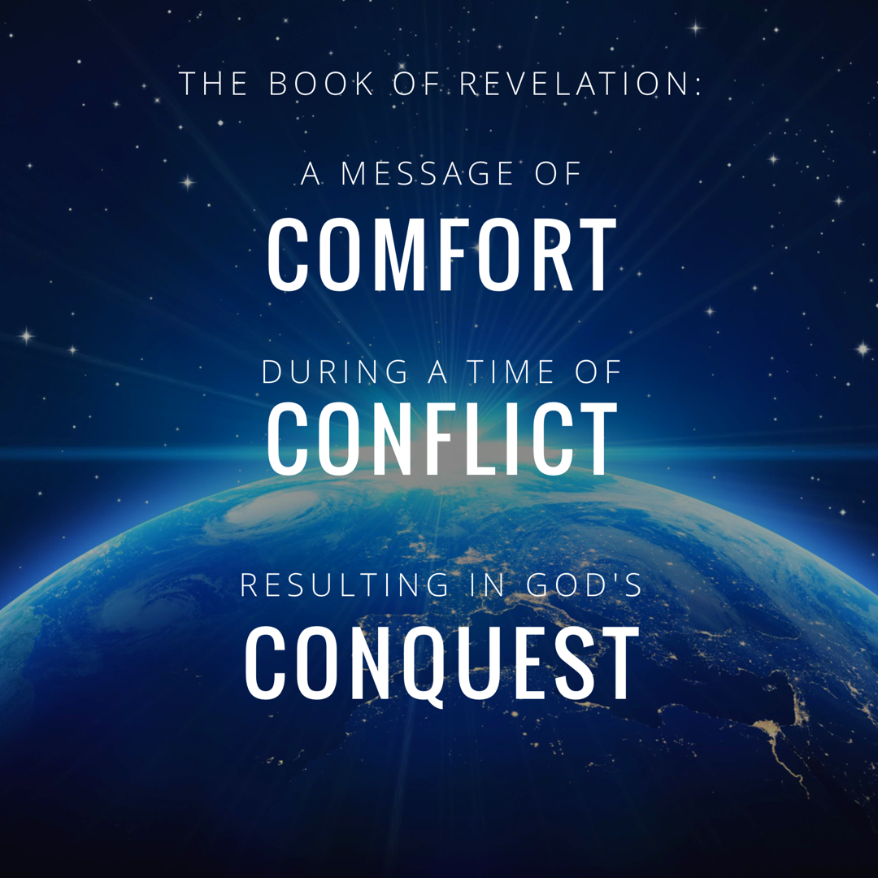

Slide 18
1. Jewish Apocalyptic Examples
“The eagle which you saw coming up from the sea is the fourth kingdom which appeared in a vision to your brother Daniel…this is the interpretation: it is these whom the most high has kept for the eagle’s end; this was the reign which was brief and full of tumult as you have seen.
Notes:
4 Ezra – you’ll notice in this quote that the interpretation is going to be given.
Same in Daniel 7:15-17 the Interpretation is GIVEN.

Slide 19
Jewish Apocalyptic Examples
“…And as for the lion whom you saw rousing up out of the forest and roaring and speaking to the eagle and reproving him for his unrighteousness, and as for all his words that you have heard, this is the Messiah whom the Most High has kept until the end of days, who will arise from the posterity of David, and will come and speak to them; He will denounce them for their ungodliness and for their wickedness and will cast up before them their contemptuous dealings.”
4 Ezra 12:11,30-31

Slide 20
Jewish Apocalyptic Examples
2 Baruch 42:1 “I will explain these things to you as well.”
2 Baruch 56:1 “you have asked the Most High to reveal to you the interpretation of the vision you have seen and I have been sent to tell you.”
Notes:
Daniel 8:15-17….remember we said “otherworldly beings” would explain the visions

Slide 21
Jewish Apocalyptic Examples
“This high mountain you saw, whose summit is like the throne of the Lord, is the throne where the Holy and Great One, the Lord of Glory, the Eternal King will sit…and this beautiful fragrant tree will be given to the righteous and humble.”
1 Enoch 25:2-6
Notes:
1 Enoch goes on to describe this tree and planted in the north with a river flowing from it to the south. AND those directions (N and S) have no specific meaning. They are just part of the overall picture and narrative.

Slide 22
Revelation Also Explains Important Details.
Revelation 5:6
Revelation 7:13-14
And Leaves Some Details As Purely Dramatic Narrative (9:1-12)
Revelation 17:1, 7, 15
Revelation 20:2
Notes:
9:1-12 - Our job is not to match these locust to current events – helicopters, missles, bullets etc… Our job is to understand – this was really terrible because a Spiritual Battle is taking place.

Slide 24
2. Apocalyptic Lit Is Meant To Be Mentally Visualized
Revelation 1:1
Revelation 1:11
Revelation 4:1
Revelation 17:1
Revelation 21:9
Notes:
Daniel 8:1-3 notice how often this is written in terms of what is SEEN or LOOKED upon.

Slide 25
3. Apocalyptic Literature Carries The Theme of Faithfulness In Crisis
Revelation 2:10
Revelation 6:9
Revelation 7:14
Revelation 12:17
Revelation 16:15
Revelation 17:14
Revelation 21:3-8

Slide 26
Apocalyptic Lit Emphasizes That God Does Not Fail To Accomplish His Will.
Revelation 11:17-18 + Revelation 16:7
Revelation 18:5, 20 + Revelation 19:2, 6
“Those first century saints being pounded on the anvil of persecution needed a message reassuring them that the world was not off its tracks and that they could still count on God. That is one of the primary purposes of apocalyptic literature.” (M. Roberts, pg 88)

Slide 27
4. Like A Large Mural, Each Scene Uses Independent Imagery.
Examine The Use of A Temple In…
Revelation 7:15-17
Revelation 21:22-23
The Point: Just because an element is mentioned in one work, doesn’t mean it will have the exact same purpose or meaning in another portion.
Notes:
There are commonalities that are helpful. I don’t want to take away from that. The idea of scary beast as bad guy is obvious. But sometimes the beast is a nation, sometimes a ruler, sometimes the Devil. We have to be careful we don’t “pick and choose” details and FORCE them unfairly from one work onto another.
Examine Temple…in ch 7 – the imagery emphasizes the worship and service of the redeemed.
In ch 21, the absence emphasizes the holiness of GOD.
Pg 79-80

Slide 28
5. Accept The Given Time & Audience
God’s Great Action Is To Be Viewed As Very Soon.
“For the age has lost its youth, and the times begin to grow old. For the age is divided into twelve parts, and nine of its parts have already past, as well as half of the tenth.” 4 Ezra 14:10-12
Revelation 1:1, 22:6-7, 20
Notes:
Soon & Quickly are the key words of apocaplypic literature.
Those who want to make the book of Revelation all about the United Nations, and the things from the evening news that worry us – have missed the point for the original readers.

Slide 29
Can We Understand It? Yes.
Luke: This book was written to show that Jesus came to seek and to save the lost.
(Luke 19:10)
Revelation: This book was written to teach me God is in control and I must be faithful to Him.
“…this person has framework to fit in other truths that amplify and support the main message.”
Notes:
Similar Imagery
Pressing Timeline

Slide 30
Revelation 1:1-3
Apocalypse
“The Revelation of Jesus Christ, which God gave Him to show to His bond-servants, the things which must soon take place; and He sent and communicated it by His angel to His bond-servant John, ² who testified to the word of God and to the testimony of Jesus Christ, even to all that he saw. ³ Blessed is he who reads and those who hear the words of the prophecy, and heed the things which are written in it; for the time is near.”
Visual
Timing
Messenger
Source
Purpose
Action

Slide 31
Revelation

Slide 32
Revelation 1:4-8
Message to the Seven Churches
⁴ John to the seven churches that are in Asia: Grace to you and peace, from Him who is and who was and who ^{[c]}is to come, and from the seven Spirits who are before His throne, ⁵ and from Jesus Christ, the faithful witness, the firstborn of the dead, and the ruler of the kings of the earth. To Him who loves us and released us from our sins ^{[d]}by His blood— ⁶ and He has made us to be a kingdom, priests to ^{[e]}His God and Father—to Him be the glory and the dominion forever and ever. Amen. ⁷ Behold, He is coming with the clouds, and every eye will see Him, even those who pierced Him; and all the tribes of the earth will mourn over Him. So it is to be. Amen.
⁸ “I am the Alpha and the Omega,” says the Lord God, “who is and who was and who ^{[f]}is to come, the Almighty.”

