Slide 1
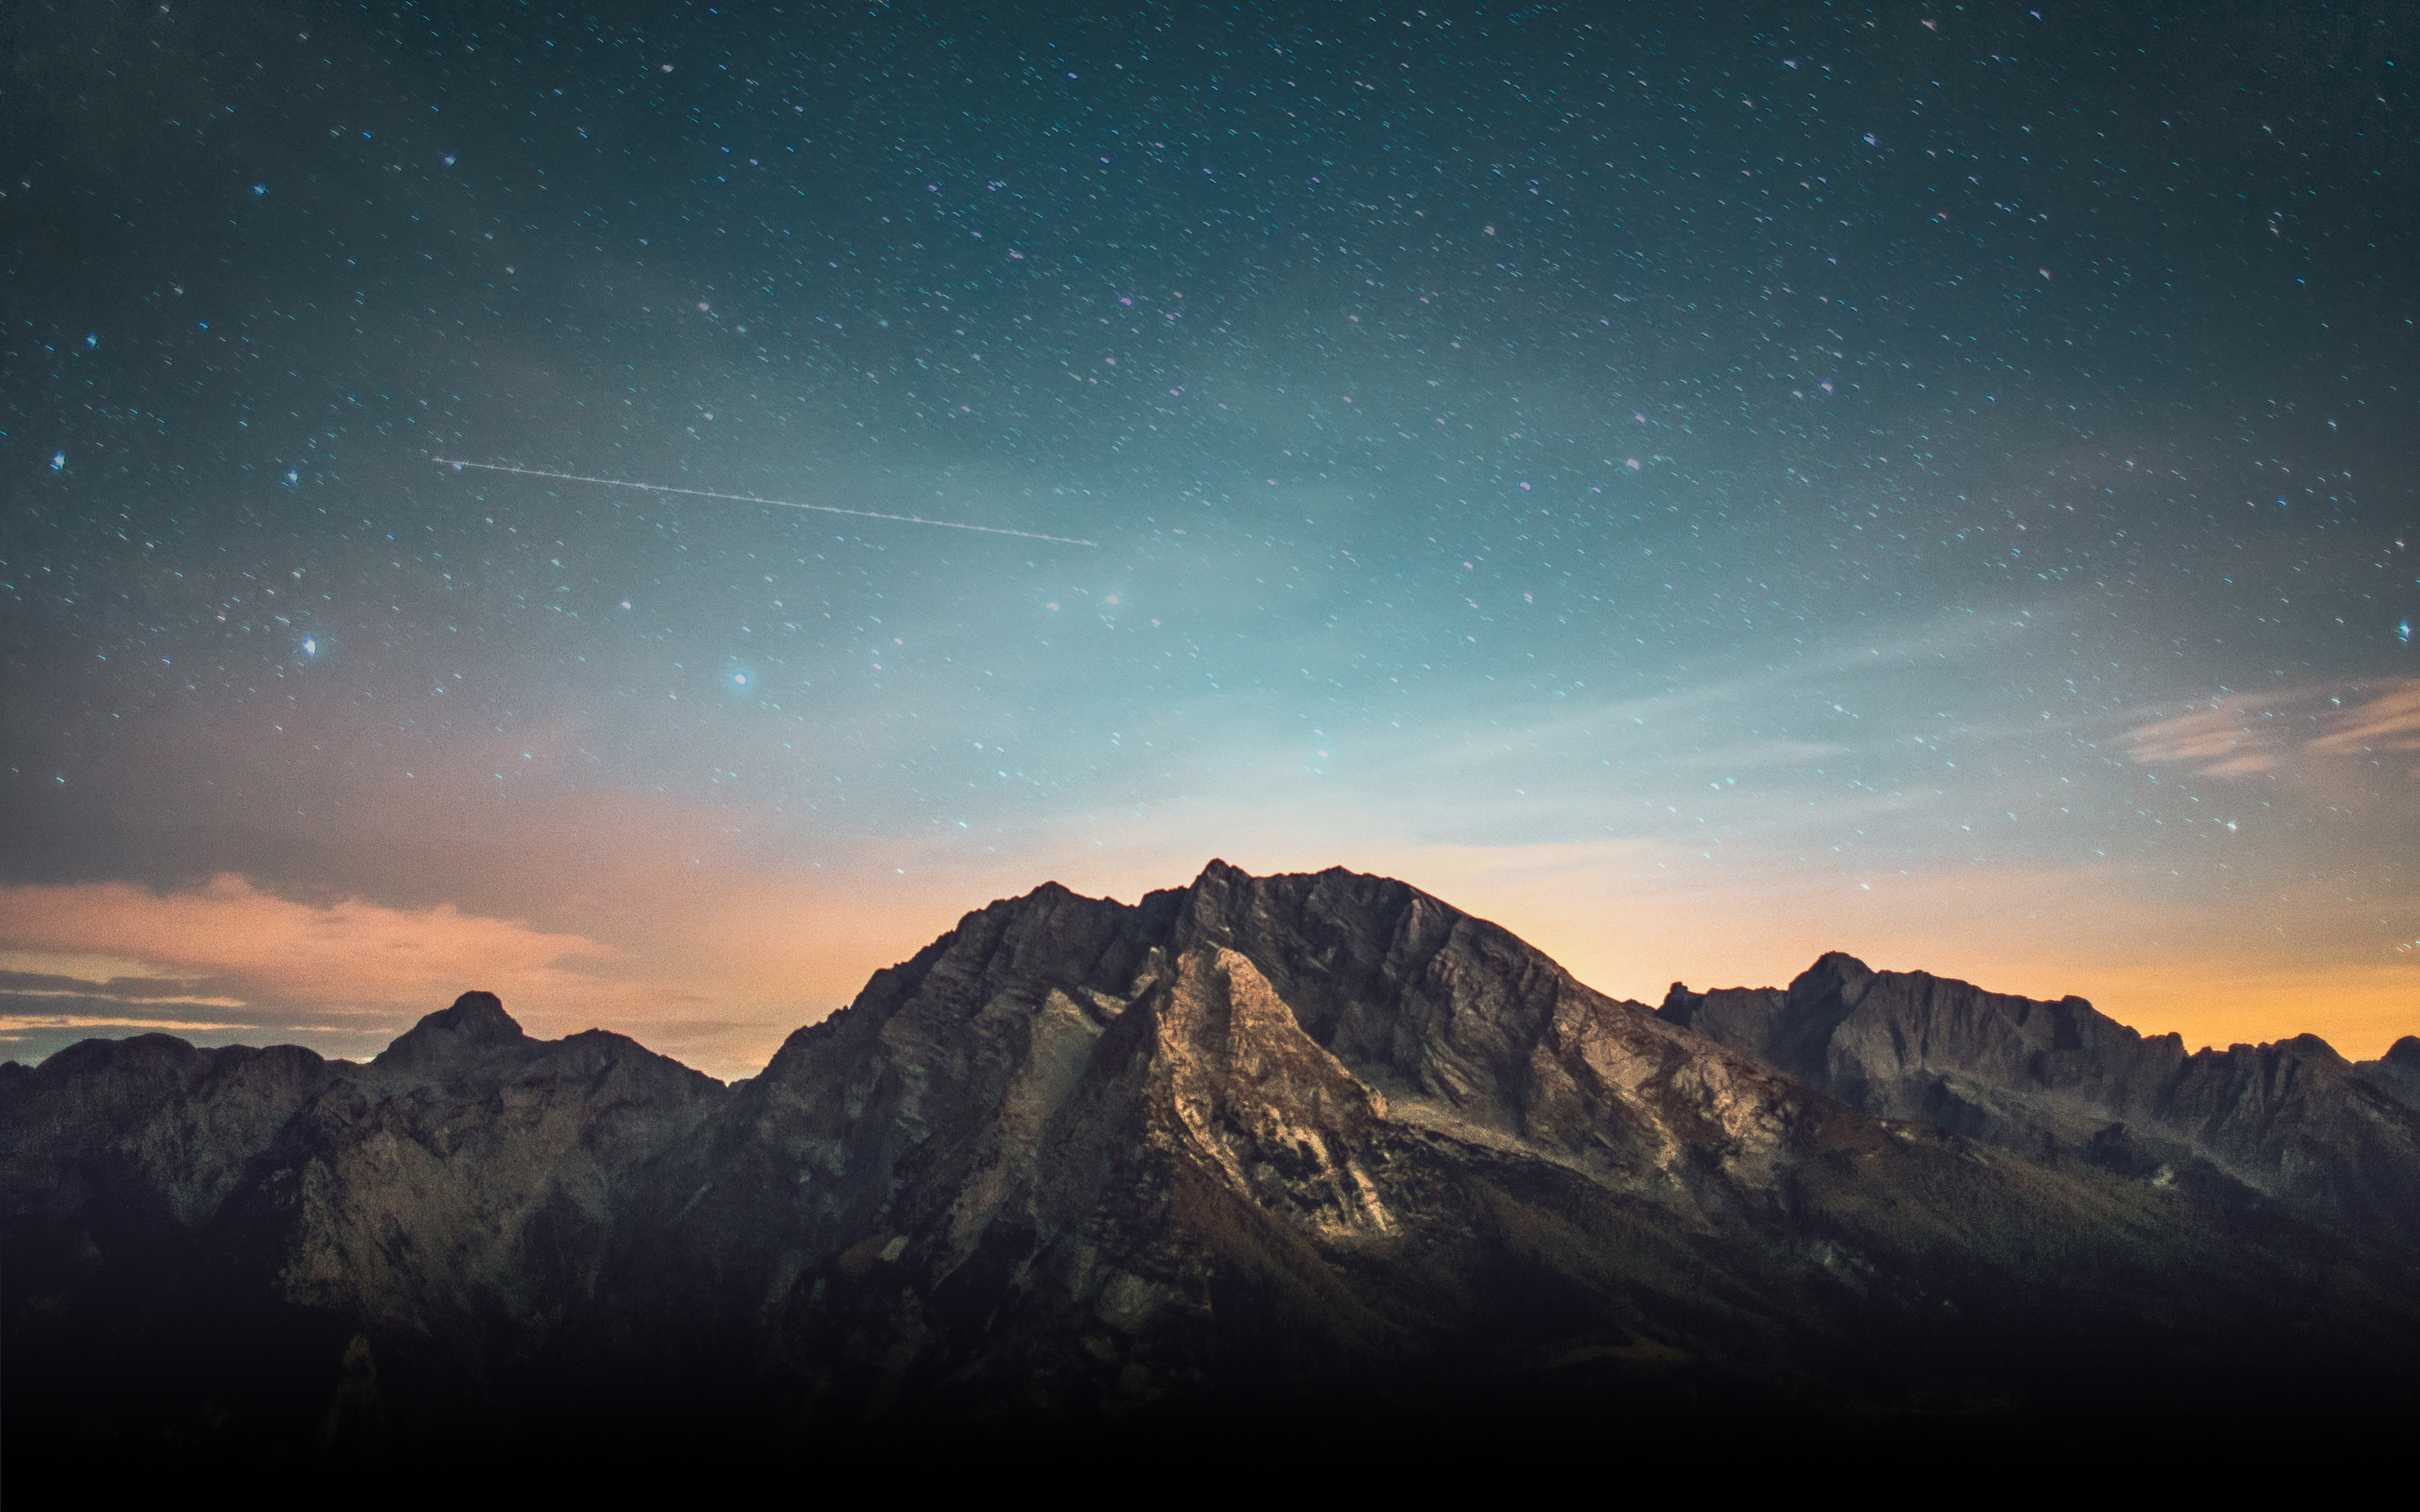
Building On The Rock
Notes:
What a year of building on the Rock. Tonight is the last lesson in this series,so I think it’s appropriate for me to share some observations.
I’ve heard the theme come up in private studies and in groups of friends. I’ve heard people talking about the lessons and thinking about how to apply the instructions.
But what I’m most thankful for is what I’ve seen. I’ve seen members here move off of the sand. I’ve seen members tackle sinful habits and make real progress in real change. I’ve seen members rededicate themselves to personal Bible study. I’ve seen both teens and adults examine the evidence for Christ and the Scriptures, and walk away with more conviction.
And if that doesn’t in some way describe you: If you haven’t considered more carefully where you can make changes to be sure your life is ON THE ROCK – then it is not too late. Building on the Rock is something I hope you’ll commit to take seriously even in the lesson this evening.
Tonight we are discussing a phrase Jesus used at the end of Matthew 7 to describe a life built on the sand. . . “Great Was The Fall”.

Slide 3
“Great Was The Fall”
“Everyone then who hears these words of mine and does them will be like a wise man who built his house on the rock. And the rain fell, and the floods came, and the winds blew and beat on that house, but it did not fall, because it had been founded on the rock. And everyone who hears these words of mine and does not do them will be like a foolish man who built his house on the sand. And the rain fell, and the floods came, and the winds blew and beat against that house, and it fell, and great was the fall of it.”
Matthew 7:24-27
Notes:
We need to focus on this phrase because Jesus wants us to consider the END RESULT of a life not built with HIM as the ROCK.
If we dismiss, minimize, or reject His teachings in the sermon on the mount and in any of his preaching, then this is the end we can expect.
A Great Fall.
In Matthew 7, both men are capable builders, both men construct fine homes, and from the outside they both look the same. BUT THERE IS A DIFFERENCE IN THE FOUNDATION THAT OVER TIME WILL PROVE TO BE CRITICAL.
Tonight we aren’t just talking about getting back up again.
We are talking about the tragic – and devasting loss that comes from falling.
There are days you never get back.
Relationships you miss.
We can vividly see this in the old testament city of Jericho. From the outside it looked to be the best, strongest, most secure city. But of course: When God led Joshua and the people to Jericho: Great Was It’s Fall.

Slide 4
Great Was The Fall at Jericho
“So the people shouted, and priests blew the trumpets; and when the peoples heard the sound of the trumpet, the people shouted with a great shout and the wall fell down flat, so that the people went up into the city, every man straight ahead, and they took the city.”
“They burned the city with fire, and all that was in it. Only the silver and gold, and articles of bronze and iron, they put into the treasury of the house of the LORD.” (Joshua 6:20, 24)
Notes:
The Fall of Jericho is one of the most famous “Great Falls” in all the Bible because it is a miraculous example of God’s ability to OVERPOWER anyone and everyone.
Tonight, I want you to please re-visit Jericho with me to think about three things.
1.) The Fall of the City.
2.) The Fall of Achan.
3.) The Fall I Must Avoid.

Slide 5
Great Was The Fall at Jericho
We Place Our Faith In God’s Power.
We Willingly Follow God’s Unusual Plans.
We Believe In God’s Promises.
The Real Battle Was For The Hearts of His People: Will we do what seems absurd, to see God do what seems impossible?
Notes:
At Jericho We Learn Some OBVIOUS lessons about WHERE we place our FAITH.
God Overpowers All of His Enemies:
The Fall of Jericho is one of the most famous “Great Falls” in all the Bible because it is a miraculous example of God’s ability to OVERPOWER anyone and everyone.
The Fall Was Not Because of A Construction Error:
The Walls Were Built Correctly.
The Fall Was Not Because of A Superior Army:
They Were Inexperienced & In Unfamiliar Territory
If I had to guess, I’d say the majority of the audience has heard sermons before – maybe you’ve even taught classes before with the foundational lessons of faith to be learned from this chapter… But it’s not just the city that fell this day. It is Achan. And it is his fall that I think brings striking lessons that motivate us to BUILD ON THE ROCK.

Slide 6
Great Was The Fall in Achan’s Heart
“Rise up! Consecrate the people and say, “Consecrate yourselves for tomorrow, for thus the LORD, the God of Israel, has said, “There are things under the ban in your midst, O Israel. You cannot stand before your enemies until you have removed the things under the ban from your midst.” (Joshua 7:13)
Notes:
Joshua 7:1, 13-15, 19-26

Slide 7
Great Was The Fall in Achan’s Heart
Because of Achan’s Disregard for Others
Joshua 6:16-21
Because of Achan’s Disobedience
Joshua 7:13
Because of Achan’s Greed
Joshua 7:21
Because of Achan’s Deception
Joshua 7:22
Notes:
DISREGARD: When we build on the sand, we are setting up others around us to suffer. Joshua warned Achan – and we need to take this warning to heart.
DISOBEDIENCE: In the moment, He took it.
GREED: We don’t know if Achan was rich or poor – but Greed doesn’t care. The poorest people can be content and the riches can be greedy – or the poorest can be fooled into the idolatry of greed and the richest can be the most generous. But Greed is a danger to anyone.
DECEPTION: He hid it all. And it wasn’t on accident. In the middle of a battle, when he should have been side-by-side with others from Judah – we was sneaking off alone. When we are like Achan and are sneaking off alone to indulge in sin – that deception is never going to Last. What is going to happen: Is A Great Fall.
The Fall of Achan should teach us a really important lesson: ANY of US can fall like Achan.
Satan wants us to think “No, that will never happen to me.” “Not my house, Not my life”
But the truth is: I’m not the exception.

Slide 8
I Am Not The Exception. Every Life Built On The Sand Will Fall. And Great Is The Fall.
Notes:
Beware the “Bias” that says: It won’t happen to me. I’m as frustrated by “bias” in news reporting as anyone – but I’m far more concerned about the BIAS we carry within our thinking. When we think that we can build on the sand and get away with it (even short term) we are greatly deceived!!!
Nimrod: Weakness of Self as god.
Bable: Disobedience – Trusting In Wrong Strength.
Esau: Impatience, Hunger, Foolishness, Short Sighted, Poor Value
Lot: Lost His Family, His Influence, His Sobriety,
Balaam: Knew God, But Loved The Wealth & Popularity of the World
Pharaoh: Unrelenting Hard Heart. Wouldn’t Listen
Absalom: Pursued The Throne, Instead of The King of Kings On The Throne.
Gehazi: Thought He Could Hide His Greed
Herod: Heard About Christ, But Sought To Destroy Him
Herod: Given The World, But Consumed By Pride & Ingratitude
The Mocking Thief: Spoke From Pain
Judas: Walked with Christ, But Was Controlled by Greed & Dishonor

Slide 9
Retelling Achan’s Story, So We Can Rewrite Our Stories.
I Need To Focus on God’s Leadership.
I Need To Reflect on God’s Worthiness.
I Need To View God’s Promises With Gratitude.
I Need To Seek The Help of My Friends.
I Need To Acknowledge That God Sees Everything I’ve Tried To Bury.
I Need To Seek Grace When in Guilt.
Notes:
We love and care about every single person here. Every one connected to the family. And especially every member of this church: we are a body. When you are fighting sin – we want to be fighting with you. Imagine you were Achan’s friend and could have spent the day before with him. There are a bunch of things we could say to him…that we need to be saying to ourselves.
Think about What Achan Could Have Done Differently? … Maybe You’ll Come up with some I don’t have on my list. But let me at least share a few options.
LEADERSHIP: Achan could have re-focused on the Ark of the Covenant. (Ch. 6:6 – this was the first part of the plan.) Sometimes we get in a rut doing the same thing – day after day. And we lose focus of what all of this is really pointing towards: God!
I’m tempted to think all this marching is just a waste of time.
I’m going to remind myself to look toward the ark to see God’s plan.
WORTHINESS: (6:17). Tempting to say, “God doesn’t need all of this.” When we should be thinking that He is worthy of all this and more! God gets the first fruits! Which leads into the next point: There were MORE FRUITS in other cities that God had already promised they would receive very soon!
PROMISES: (1:1-9) Achan may have been poor and in need. I wish he could have seen that the ENTIRE LAND was right before Him. WE need to remember all that God has given us already and all He has sat before us for the future!
SEEK FRIENDS: Hey, I struggle with this.
I know myself…the spoils of Jericho are going to be hard for me to resist.
I know myself…I don’t always make great choices in the moment, let’s fight side by side so that I stay focused on the battle.
BURIED: (7:22) He sees all. I’m sure there are people here tonight and you think you’ve done a good job of burying your struggle. God sees it. Clear as day. And, there are people here who would HELP YOU, if you let them see it too.
GRACE. Guilt of that long night had to be so hard. In Joshua 7:13 – They were told to Consecrate Themselves that evening. This is a “Why Not Tonight” moment! Achan had the chance that very night to march up to Joshua’s tent and confess. But he kept it all hidden.
I can imagine how much guilt lay upon him that night. The fear. The sleeplessness. Knowing: I’ve got to stand before the Lord.
I’m telling you tonight – don’t go back to your tent full of sin, when the Grace of God is calling at the Cross.

Slide 10
I Am Not My Own. Jesus Paid The Ransom For Me. I Choose To Build On The _______.
Notes:
Look at that blank on the screen. Let it hang there a minute. If I put a keyboard in front of you…would you quickly type “R, O, C, K”
Or would you shrink away, lower your head, and let satan peck out – s, a, n, d.
Like Achan – we have to make a choice. A choice to build on the ROCK!
I don’t want to fall. I don’t want you to FALL. So, tonight – Make JESUS your ROCK. The one who comes first. The one who you listen to, obey, and walk with every day.
1 Corinthians 6:20
²⁰ For you have been bought with a price: therefore glorify God in your body.
1 Peter 1:17-21
¹⁷ If you address as Father the One who impartially judges according to each one’s work, conduct yourselves in fear during the time of your stay on earth; ¹⁸ knowing that you were not ^{[r]}redeemed with perishable things like silver or gold from your futile way of life inherited from your forefathers, ¹⁹ but with precious blood, as of a lamb unblemished and spotless, the blood of Christ. ²⁰ For He was foreknown before the foundation of the world, but has appeared ^{[s]}in these last times for the sake of you ²¹ who through Him are believers in God, who raised Him from the dead and gave Him glory, so that your faith and hope are in God.

Slide 11
Building On The Rock

