Slide 1
Was the Documentary Evidence (Jesus’ Biographies) Reliably Preserved for Us?
Lesson 4

Slide 2
Class Outline
Lesson | Description
1 | Jesus of the Bible vs Reinvented Jesus of Modern Man
2 | Tools for Examination of the Evidence
3 | Does the Eyewitness Evidence of the Biographies of Jesus the Christ Stand Up to Scrutiny?
4 | Was the Documentary Evidence (Jesus’ Biographies) Reliably Preserved for Us?
5 | Is There Credible Non-Biblical Evidence for Jesus outside His Biographies?
6 | Does Archaeology/the Scientific Evidence Confirm or Contradict Biographies of Jesus?
7 | Was Jesus Really Convinced That He Was the Son of God and did Jesus the Christ fulfill the Attributes of God?
8 | The Psychological Evidence; Was Jesus Crazy When He Claimed to Be the Son of God?
9 | The Fingerprint Evidence – Prophecy Did Jesus—and Jesus Alone—Match the Identity of the Messiah?
10 | The Resurrection – was Jesus Raised from the Dead?
11 | What is the Evidence of that Jesus was seen Alive after His Death on the Cross?
12 | Tactics for Discussing the Case for Jesus the Christ
13 | What Does the Evidence Establish—And What Does It Mean Today?

Slide 3

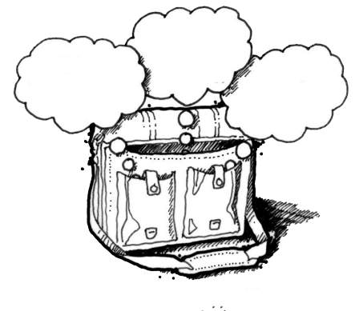
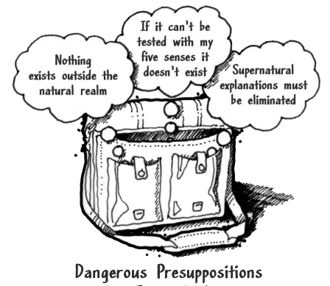
God
Supreme Being
We are created
Bible is
Accurate
Bible is Inspired
Bible is
Reliable
Super Naturalism it is possible that there is
a supreme being/someone beyond natural order
Intelligent Design – a programmer
nothing exists beyond the natural realm
Philosophical Naturalism The presuppositional belief
that only natural laws and forces occur
No God
No Supreme Being
We come from nothing
Using God
To fill in the Gaps

Slide 4



Bible Authority Established
Creation, Flood, Redemption Story, Moses, Moral Laws, Miracles, Nature of Man, Purpose of Man, Nature of God, Christ & Holy Spirit, Requirements for Worship, Personality of Jesus, Coming Judgment, Heaven, Hell, Angels, Demons, & Satan
Bible would be Accurate
Based on Bible Testimony Jesus is Son of God
Teachings of
Jesus are True
Accurate Account of Jesus’ Life
A Step of Faith not
A Leap of Faith
Bible can be Understood
Bible is Inspired
Bible is Accurate
Bible is Reliable
If Bible Revelation of Creator then
Divine Revelation Possible
& Accurate So Purpose is Known
Starting Point for
How We Got the Bible
class
Creation
has a purpose
Likely a Moral Law
Miracles &
Revelations
Universe had an Intelligent, Personal Origin
Possible that Universe had Supernatural Origin
It is Possible that there is Supernatural Force
Based on material from mmb, jr Establishing Bible Authority Class - 10/30/2002

Slide 5
Class Objectives
Show that the Bible text has been preserved and has been transmitted in a reliable fashion.

Slide 6
J Wallace
4 questions to evaluate witnesses
1. Can I be sure that these modern-day versions of the Bible— the end product of countless copying throughout the ages— bear any resemblance to what the authors originally wrote?
2. How can anyone believe the New Testament account of the life of Jesus, seeing that it was written long after His death?
3. Aren’t the genealogies of Jesus given in Matthew and Luke contradictory?
The class tonight
The class this segment

Slide 7
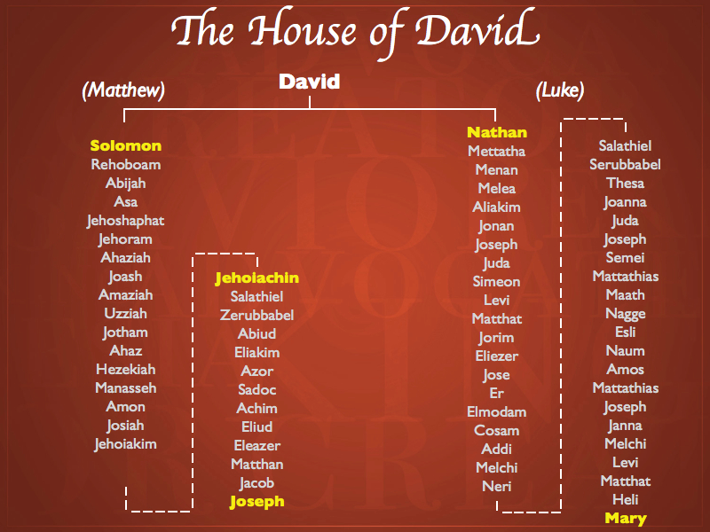
genealogies of Jesus given in Matthew and Luke contradictory

Slide 8
Strobel’s 8 Questions
THE INTENTION TEST This test seeks to determine whether it was the stated or implied intention of the writers to accurately preserve history.
THE ABILITY TEST Even if the writers intended to reliably record history, were they able to do so?
THE CHARACTER TEST This test looks at whether it was in the character of these writers to be truthful.
THE CONSISTENCY TEST Here’s a test that skeptics often charge the gospels with failing. After all, aren’t they hopelessly contradictory with each other?

Slide 9
THE BIAS TEST This test analyzes whether the gospel writers had any biases that would have colored their work.
THE COVER-UP TEST When people testify about events they saw, they will often try to protect themselves or others by conveniently forgetting to mention details that are embarrassing or hard to explain.
THE CORROBORATION TEST When the gospels mention people, places, and events, do they check out to be correct in cases in which they can be independently verified?
THE ADVERSE WITNESS TEST This test asks the question, where others present who would have contradicted or corrected the gospels if they had been distorted or false?

Slide 10
Written by Paul - Undisputed
Resurrection, Miracles, Deity
L07 First Epistle to the Thessalonians (51 AD) Danny H
L07 Epistle to the Galatians (47 (51-53)AD?) Joel Y
L11 First Epistle to the Corinthians (52-56 AD) DeAnna B
L11Second Epistle to the Corinthians (52-56 AD) Corey W
L08 Epistle to the Philippians (60-62 AD) Jana S, Chester T, Corey W
L08 Epistle to Philemon (60-62 AD) Sara H
L13 Epistle to the Romans (52-57 AD) Marty B

Slide 11

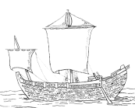








Paul’s Epistles
1 Thess ~50 AD
Gal ~53
1 Cor ~53-54
Phil ~55
Phmn~55
2 Cor ~55-56
Ro ~57
70 AD
Temple
Destroyed
27-30 AD
Ministry of Jesus
75 AD
100 AD
150 AD
200 AD
250 AD
25 AD
50 AD

Slide 12

Paul’s Epistles
1 Thess ~50 AD
Gal ~53
1 Cor ~53-54
Phil ~55
Phmn~55
2 Cor ~55-56
Ro ~57
70 AD
Temple
Destroyed
Polycarp
120 AD
Letter Quotes
16 NT Books
Clement
95 AD
Letter Quotes
10 NT Books
27-30 AD
Ministry of Jesus
75 AD
100 AD
150 AD
200 AD
250 AD
25 AD
50 AD
Tertullian (c. 150-c. 229) quotes from 23 of the 27 NT canon
AD 115,
Ignatius, bishop of Antioch,
Refers to “The Gospel” as
authoritative writing

Slide 13



100-200 AD
P104/ P. Oxy. 4404
Matthew 21
150-200 AD
P90 /P. Oxy. 3523
John 18-19
Paul’s Epistles
1 Thess ~50 AD
Gal ~53
1 Cor ~53-54
Phil ~55
Phmn~55
2 Cor ~55-56
Ro ~57
175-200 AD
Magdalen" papyrus
Matthew 3,5,26
70 AD
Temple
Destroyed
Polycarp
120 AD
Letter Quotes
16 NT Books
Clement
95 AD
Letter Quotes
10 NT Books
125-175 AD
J Ryland
John 18
27-30 AD
Ministry of Jesus
75 AD
100 AD
150 AD
200 AD
250 AD
25 AD
50 AD
Tertullian (c. 150-c. 229) quotes from 23 of the 27 NT canon
AD 105- 115
Ignatius, bishop of Antioch,
Refers to “The Gospel” as
authoritative writing

Slide 14
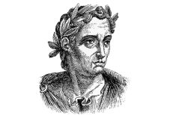
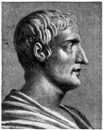

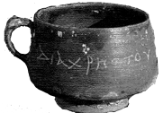
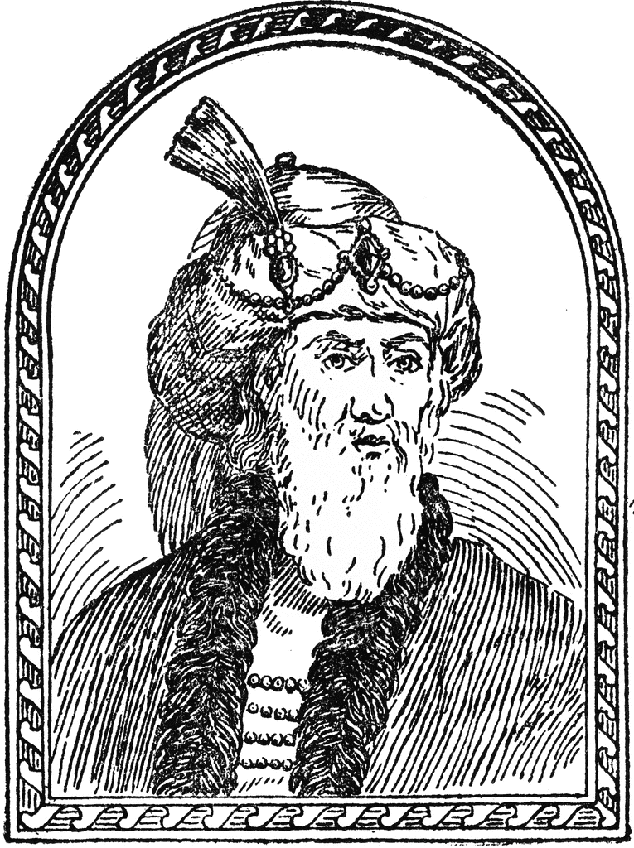
111 AD
Pliny the Younger
Letter to Trajan
115 AD
Tacitus
Nero & Christians
121 AD
Suetonius
Claudius, Nero & Christians
50 AD
Christ cup
Egypt
93 AD
Josephus
The Antiquities
100-200 AD
P104/ P. Oxy. 4404
Matthew 21
150-200 AD
P90 /P. Oxy. 3523
John 18-19
Paul’s Epistles
1 Thess ~50 AD
Gal ~53
1 Cor ~53-54
Phil ~55
Phmn~55
2 Cor ~55-56
Ro ~57
175-200 AD
Magdalen" papyrus
Matthew 3,5,26
70 AD
Temple
Destroyed
Polycarp
120 AD
Letter Quotes
16 NT Books
Clement
95 AD
Letter Quotes
10 NT Books
125-175 AD
J Ryland
John 18
27-30 AD
Ministry of Jesus
75 AD
100 AD
150 AD
200 AD
250 AD
25 AD
50 AD
Tertullian (c. 150-c. 229) quotes from 23 of the 27 NT canon
AD 115,
Ignatius, bishop of Antioch,
Refers to “The Gospel” as
authoritative writing
Notes:
Suetonius Tranquillas (AD 69-160) wrote under the Roman emperor Hadrian, and he was a friend of Pliny the Younger. mentions early Christians and may refer to Jesus Christ in his work Lives of the Twelve Caesars, written in AD 121

Slide 15


Mark in the 70s, Matthew and Luke in the 80s, John in the 90s.
100-200 AD
P104/ P. Oxy. 4404
Matthew 21
P. Oxy. 3523
Paul’s Epistles
1 Thess ~50 AD
Gal ~53
1 Cor ~53-54
Phil ~55
Phmn~55
2 Cor ~55-56
Ro ~57
Mark
175-200 AD
Magdalen" papyrus
Matthew 3,5,26
70 AD
Temple
Destroyed
Matthew
Luke
Polycarp
120 AD
Letter Quotes
16 NT Books
Clement
95 AD
Letter Quotes
10 NT Books
125-175 AD
J Ryland
John 18
27-30 AD
Ministry of Jesus
John
Luke
John
25 AD
50 AD
75 AD
100 AD
150 AD
200 AD
250 AD
Mark
Matthew
Tertullian (c. 150-c. 229) quotes from 23 of the 27 NT canon
AD 115,
Ignatius, bishop of Antioch,
Refers to “The Gospel” as
authoritative writing

Slide 16
Mark in the 70s, Matthew and Luke in the 80s, John in the 90s.
• 2 – Titus 3:1, Acts 20:35
• 7 – 1 Pet 3:20, 2 Pet 2:5
• 9 – Heb 11:5
• 34 – Quotes 1 Cor 2:9 and calls it scripture
• 35 – Rom 1:32
• 36 – Heb 1:3-4
• 37 and 38 – Church as a body metaphor, as in 1 Corinthians
• 46 – James 4:1
• 46 – Jesus' “millstone” quote (which is
present in Matthew, Mark and Luke)
• 49 – James 5:20
100-200 AD
P104/ P. Oxy. 4404
Matthew 21
Mark
P. Oxy. 3523
Paul’s Epistles
1 Thess ~50 AD
Gal ~53
1 Cor ~53-54
Phil ~55
Phmn~55
2 Cor ~55-56
Ro ~57
175-200 AD
Magdalen" papyrus
Matthew 3,5,26
70 AD
Temple
Destroyed
Polycarp
120 AD
Letter Quotes
16 NT Books
Clement
95 AD
Letter Quotes
10 NT Books
125-175 AD
J Ryland
John 18
27-30 AD
Ministry of Jesus
Luke
John
25 AD
50 AD
75 AD
100 AD
150 AD
200 AD
250 AD
Mark
Matthew
Tertullian (c. 150-c. 229) quotes from 23 of the 27 NT canon
AD 115,
Ignatius, bishop of Antioch,
Refers to “The Gospel” as
authoritative writing

Slide 17
Matthew 16:13 (NKJV) When Jesus came into the region of Caesarea Philippi, He asked His disciples, saying, "Who do men say that I, the Son of Man, am?"
Matthew 16:14 (NKJV) So they said, "Some say John the Baptist, some Elijah, and others Jeremiah or one of the prophets."
Matthew 16:15 (NKJV) He said to them, "But who do you say that I am?"
Matthew 16:16 (NKJV) ¹⁶ Simon Peter answered and said,
"You are the Christ, the Son of the living God."

Slide 18
Who is Jesus
He is the Christ (Messiah), the Anointed One foreseen by the Old Testament prophets.
(Isaiah 9:6; Matthew 16:16; John 4:25–26; John 6:69)
He is the Savior of the world, the one who delivers from sin.
  (John 3:16–18; John 4:42; Acts 5:31; 1 John 4:14)
He is the Lamb of God, the one who sacrificed His life for sins.
  (Isaiah 53:7; John 1:29)
He is the Son of God, having a unique and intimate relationship with God the Father.
  (John 20:31)
He is the Creator of all things. (John 1:3; Colossians 1:16–17, Hebrews 1:2, 3)
He is equal to God. (John 5:23; Philippians 2:6)
He is eternal, existing with God from the very beginning. (John 1:1–2)
He is God in the flesh, revealing to us what God is like. (John 1:18, Hebrews 1:3)
He is the Lord of all. (Acts 10:36, Philippians 2:9–11)
He was born of a virgin. (Isaiah 7:14, Matthew 1:22–23; Luke 1:27–35)
He has the authority to forgive sins. (Mark 2:10)
He is worshiped. (John 9:38; Luke 24:52; Hebrews 1:6)
He is the living Savior, raised from the dead and sitting today at the right hand of God;
By His resurrection we have new life. (1 Peter 3:21–22; Romans 8:34)

Slide 19
Jesus of Modern Scholar
The followers of Jesus invented his deity after his death
Jesus was a Magician
Jesus is a non-apocalyptic, teasing teacher
Jesus was an apocalyptic prophet
Jesus was a Cynic
Jesus just man
Jesus never claimed to be God
Jesus was a revolutionary, a sage, an iconoclastic Jew

Slide 20
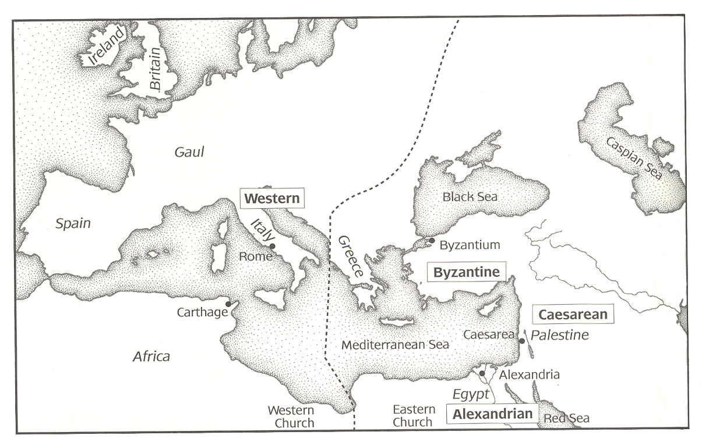
New Testament Manuscripts
The importance of early Christian ‘centers’ to Biblical manuscripts
Notes:
There was no instant New Testament Bible. Each New Testament book was written separately (except perhaps Luke and Acts) and sent to different people and places. These places had no faxes, computers or telephones. Paper was not yet popularized or available. Reading the scriptures was popular in churches. Copies were not easily made or preserved. The originals would be passed around from church to church.
As time went on, the 27 different documents (Bible books) would travel about and end up in different Christian churches or Christian centers. Each main Christian center would begin their own collection of these NT scriptures (ie. manuscripts) and make their own copies for those in their jurisdiction. Those who made these copies were scribes. Remember, writing was a special skill back in those days.
These centers then unconsciously would develop their own family of manuscripts through their copying efforts. There would be slight variations in these manuscripts, nothing significant., as we’ll discuss. Alexandria in Egypt had the driest climate and most well-preserved scriptures. The Western texts were centered in Rome. Later on Byzantine became the empire's capital and a major center for Christianity. The picture above shows the four main Christian centers in 600 A.D.

Slide 21
New Testament Manuscripts
Notes:
The original gospels and letters of the New Testament were written in Greek on papyrus and were penned in the latter half of the first century. While papyrus was widely used it had the disadvantage of being fragile. The original autographs of the New Testament perished within a few years of being written and due to their apostolic authority were copied and distributed.
This chart from the lesson material gives a good (if simplistic) view of how this process worked, with copies of an original being made, with little variation. Those which survived had copies made of those as well, and the process continued over generations. You can see how this process would lead to ‘families’ of copies. When we talk about Manuscripts, were referring to those copies of a text which we possess and can use as the basis for our knowledge of the original.

Slide 22
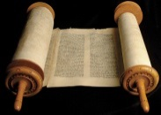
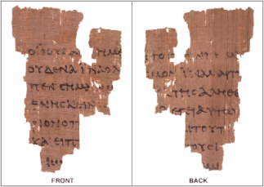



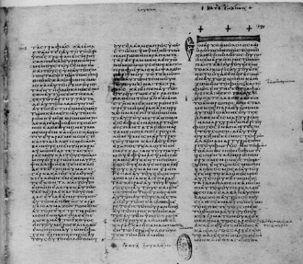
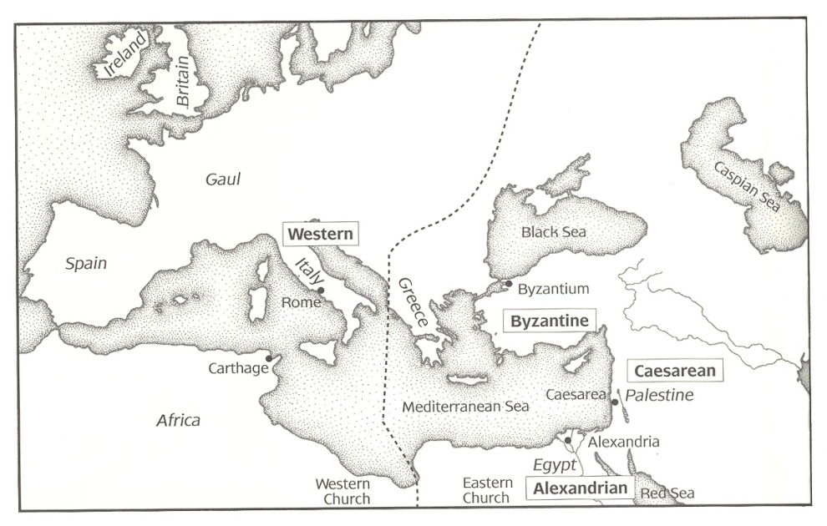
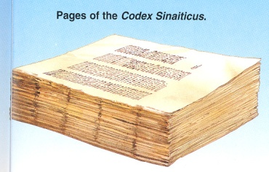
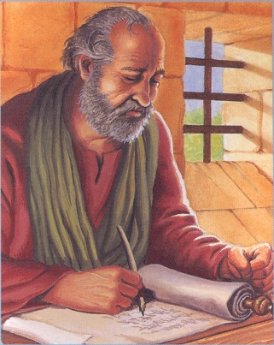
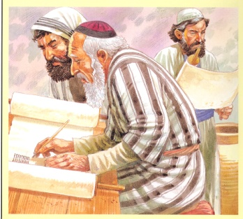
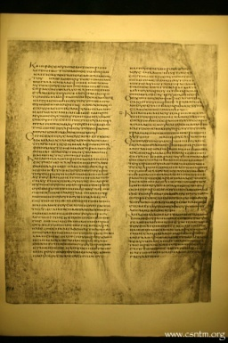
From Autograph to Manuscripts
Original Gospel, Epistles and Revelation written on Papyrus & Lost
Fragments of
Papyri
Codex Vaticanus
Copies collected at Bible Centers and Copied
Copies made & circulated
Codex Alexandrinus

Slide 23
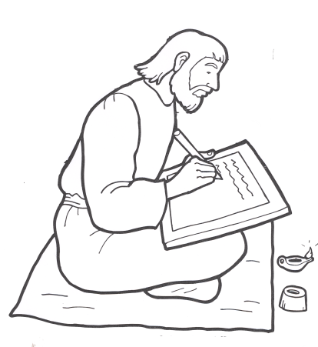
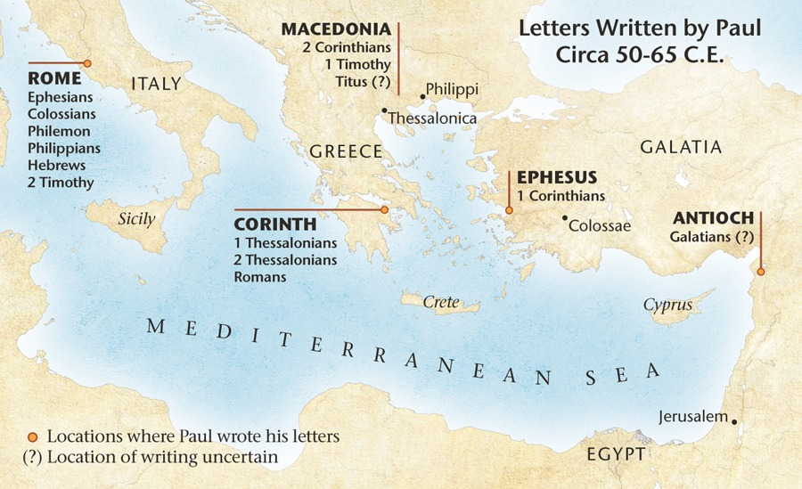
Books & Circulation Christians

Slide 24
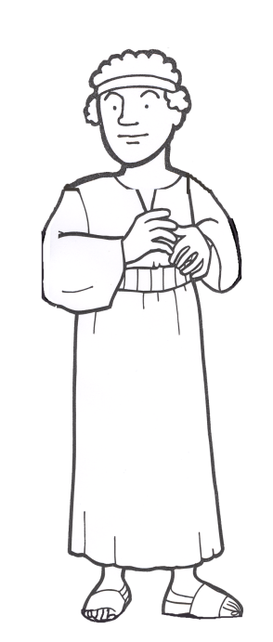
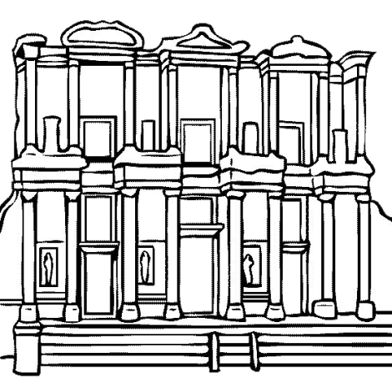
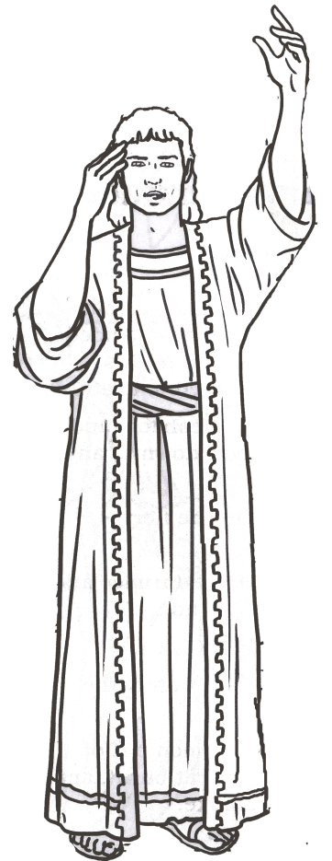
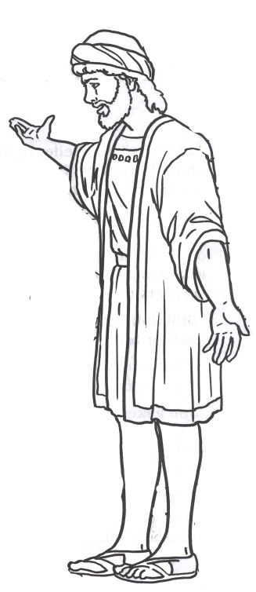
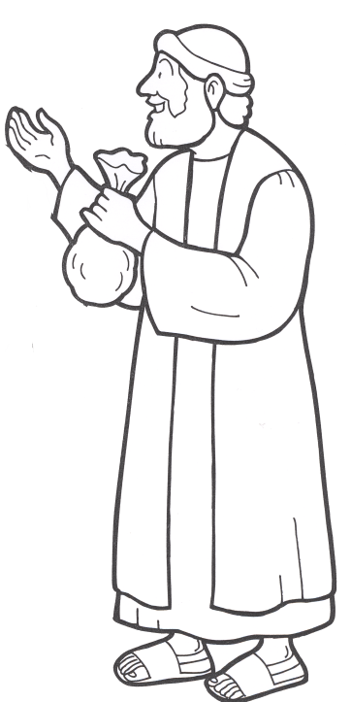
Books & Circulation Roman Culture
Reading Aids – few
Meant to Showcase Reader
Library
Grow with Empire
Library in Ephesus
Built 114-117 AD
Could Store
12000 scrolls
Book Seller
Buy copy
May agree to fee
per book
Makes a copy
when ordered
Bad copies
Author
Little/No Financial Benefit
Reputation
Sponsor
Copies to Friends
Notes:
between circa 114–117 A.D.[4][5] by Celsus' son, Gaius Julius Aquila (consul, 110 AD). The library was "one of the most impressive buildings in the Roman Empire" and built to store 12,000 scrolls

Slide 25
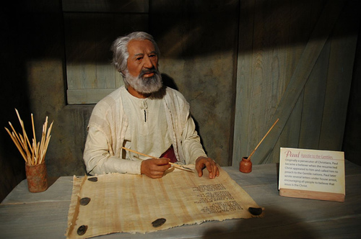
Apostles write or dictate
Autograph Text

Slide 26
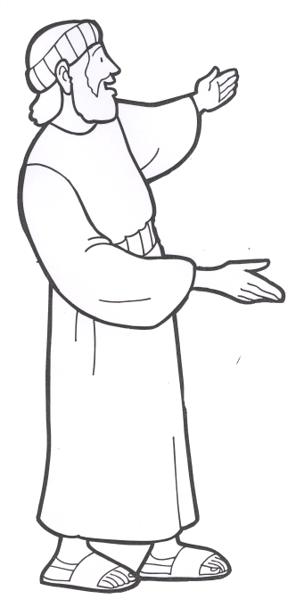
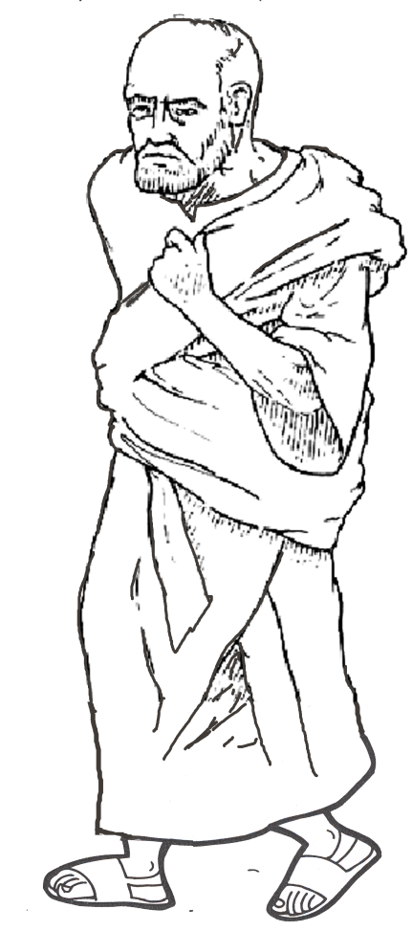
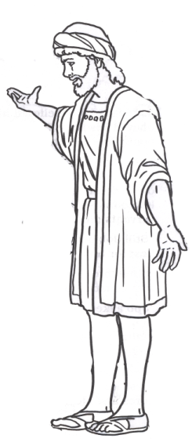
Books & Circulation Christians
Reading Aids – many
meant to Showcase Writing
Read to church
1 Thess 5:27 (ESV) I put you under oath before the Lord to have this letter read to all the brothers.
Copies for individuals & other churches
Colossians 4:16 (ESV) And when this letter has been read among you, have it also read in the church of the Laodiceans; and see that you also read the letter from Laodicea.
Author
Apostles
Companions of Apostles
Paul – answer, etc a Church
Others – General/Region/People
Notes:
The New Testament came into being gradually also, although the books themselves were written in a comparatively short period of time (A.D. 50– 100). The books were mostly letters penned by inspired men and addressed to different churches and individuals. From the first, however, they were looked upon as distinctively authoritative writings; thus they were received with respect and read in the public assemblies (1 Thess. 5: 27). Soon afterward came the interchange of extant letters among the churches (cf. Col. 4: 16), the individual churches in this way profiting from an exchange of apostolic instructions. The next step was the embodiment in writing of the central events of the life of Jesus. At first oral accounts of his work by eyewitnesses filled the needs of the infant church, but as years passed eyewitness accounts became few and insufficient. Now the demand was for authoritative written narratives, and in fulfillment of this demand Matthew, Mark, Luke, and John sent out their witness to Jesus (cf. Luke 1: 1– 4; John 20: 30– 31). The logical outgrowth of the Four Gospels was the Book of Acts,
Lightfoot, Neil R.. How We Got the Bible (p. 24). Baker Publishing Group. Kindle Edition.

Slide 27
Matthew via Egyptian Papyrus
~30 AD
55-65 AD
100
P77-104
200
P1
P64+67
300
80-90
Matthew
About 50 yrs
Gospel of Matthew 100 to 300 AD
ID | Text Quality | Transmission | Date
P77 | strict | free | 150-200
P104 | normal | strict | 150-200
P64+67 | strict | strict | 200
P1 | strict | strict | 250
P45 | normal | free | 250
P37 | normal | free | 260
P110 | normal | very free | 250-300
P103 | normal | very free | 275-300
P35 | strict | strict | 3rd
P53 | strict | normal | 3rd
P70 | strict | free | 3rd
P101 | normal | free | 3rd
P102 | strict | strict | 3rd
P35-102
Text Quality - how well corresponds to reconstructed initial text
Transmission - free is a freer readiness to adapt the text to harmonize, accidental changes etc

Slide 28
New Testament Manuscripts
Notes:
This means that there is more historical basis for the NT text than any other ancient writing…and it isn’t even close. So for a person to dispute the reliability of the NT based on the manuscript evidence is to undercut the entire basis for almost all historical investigation of ancient writing and culture.

Slide 29
New Testament Manuscripts
5,300+ Greek manuscripts
Nearly 20,000 manuscripts in non-original languages (Latin, Ethiopic, etc.)
Also, 36,000+ citations of NT texts among the Early Church Fathers

Slide 30
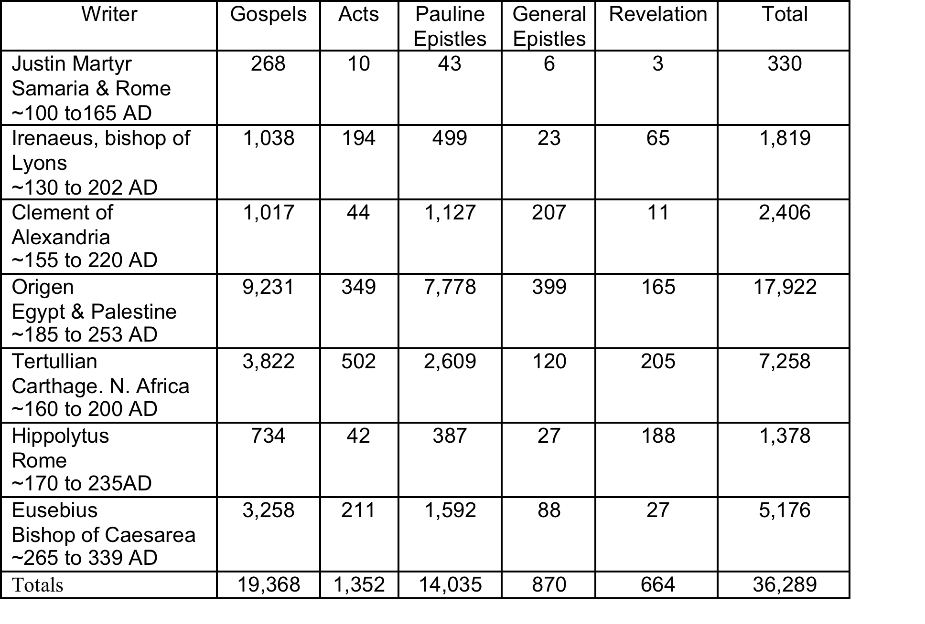
New Testament Citations

Slide 31
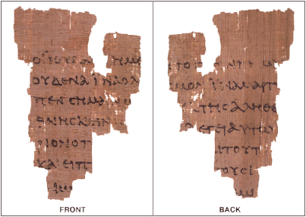
New Testament Manuscripts
The Rylands Papyrus, also known as the St John's fragment, is a papyrus fragment measuring only 3.5 by 2.5 inches at its widest
Dated to the first half of the 2nd century, making it the earliest NT fragment in existance
The front (recto) contains lines from the Gospel of John 18:31-33, in Greek, and the back (verso) contains lines from verses 37-38.

Slide 32
New Testament Manuscripts
The form of writing is used to date ancient documents - for example, the following MSS are all uncials:
  Codex (A) Alexandrinus – 5th C
  Codex (B) Vaticanus – 4th C
  Codex (C) Ephraem – 5th C
  Codex (D) Bezae – 5th/6th C
  Codex (a) Sinaiticus – 4th C

Slide 33
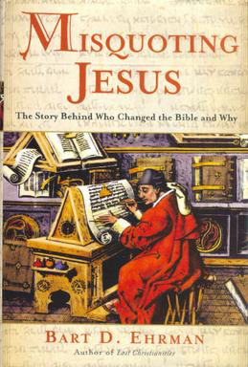
MSS Textual Variation
Over the vast amount of NT MSS, there are number of ‘textual variations’
Up to 200,000 ‘errors’
  However, this figures is based on a misrepresentative counting of the variants.
  Only 40 lines (400 words) of the 20,000 lines are in question. We can be sure that the New Testament is 99.5% pure.

Slide 34
MSS Textual Variation
Trivial Variations
MSS. 1 | Jesus Christ is the Savior of the whole worl.
MSS. 2 | Christ Jesus is the Savior of the whole world.
MSS. 3 | Jesus Christ s the Savior of the whold world.
MSS. 4 | Jesus Christ is th Savior of the whle world.
MSS. 5 | Jesus Christ is the Savor of the whole wrld.

Slide 35
Bible Evidence
V. Evidence from early Christian writers
Sir David Dalyrimple. All but eleven verses of the New Testament are found in the works of second and third century writers. In addition to the many thousands of NT manuscripts, there are over 86,000 quotations of the NT in the early church fathers, and quotations in thousands of early lectionaries (worship books).

Slide 36
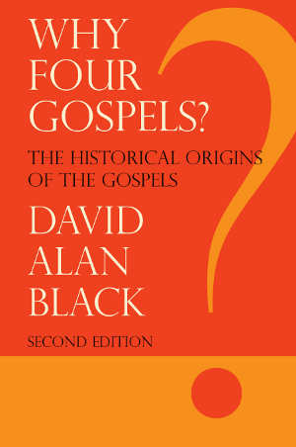
Bibliographic test
  How early are the texts written
Matthew: Written to Jewish believers; dated A.D 42
Luke: Written to Gentiles; dated A.D. 58-60
Mark: Written to Roman/Gentile believers; dated A.D. 66-67 (probably earlier)
John: Written to Christian believers; dated before A.D. 90*
- Dr. David Alan Black, New Testament Scholar, Why Four Gospels?

Slide 37
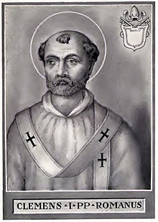
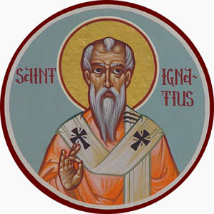
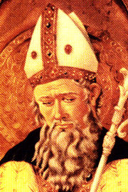
Evidence for Early Dating of the New Testament
1. Citations from Early Church Fathers Help Prove Early Dating
Clement
(c. A.D. 95)
Ignatius
(c. A.D. 107)
Polycarp
(c. A.D. 110)
11
24
17
Matthew
Mark
Luke
Romans
1 Corinthians
Ephesians
1 Timothy
Titus
Hebrews
James
1 Peter
All 4 Gospels
Acts
Romans
1 & 2 Corinthians
Galatians
Ephesians
Philippians
Colossians
1 Thessalonians
1 & 2 Timothy
All 4 Gospels
Acts
Romans
1 & 2 Corinthians
Galatians
Ephesians
Philippians
Colossians
2 Thessalonians
1 & 2 Timothy
1 Peter & 1 John
Titus
Philemon
Hebrews
James
1 & 2 Peter
1 & 3 John
Revelation

Slide 38
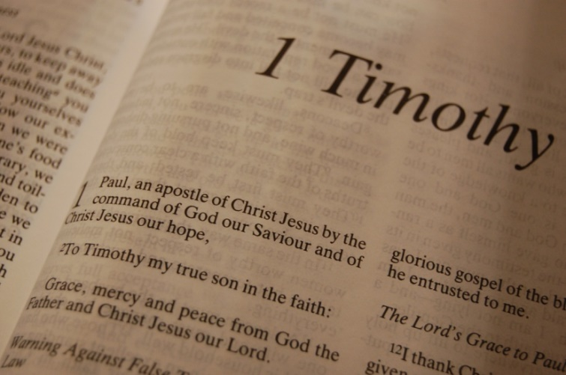
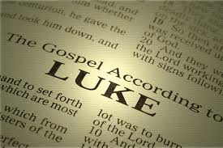
Evidence for Early Dating of the New Testament
5. Paul quotes Luke’s Gospel and refers to it as Scripture in 1 Timothy 5:18.
5:18 For the Scripture says, “You shall not muzzle an ox while it treads out the grain,” and, “The laborer is worthy of his wages.” NKJV
When Paul quotes the scripture that says, “The laborer is worthy of his wages” we know Paul was quoting the gospel of Luke.
Why?
Because this passage is something that only Luke (10:7) records for us. This statement is found nowhere else in the Bible, Old Testament or New.

Slide 39
MSS Distribution by Century & Type
Century | 2 100’s | 3 200’s | 4 | 5 | 6 | 7 | 8 | 9 | 10 | 11 | 12
Papyri Uncial Minuscule Lectionary | 1 | 31 3 | 20 16 1 | 8 44 1 | 9 60 3 | 13 29 4 | 3 27 22 | 47 13 116 | 18 125 143 | 1 436 241 | 586 490
Century | 13 | 14 | 15 | 16 | 17 | 18 | 19 | Totals
Papyri Uncial Minuscule Lectionary | 569 398 | 535 313 | 248 168 | 138 194 | 44 73 | 16 11 | 4 | 85 245 2,745 2,147
A General Introduction to the Bible – Norman L. Geisler, William E. Nix

Slide 40
Catalog of NT Books

Slide 41
MSS Textual Variation
Variations of No Consequence
Codex (D) Bezae Luke 6:5:
“On the same day seeing one working on the sabbath day, he said to him, Man, if you know what you are doing; you are blessed; but if you do not know, you are accursed and a transgressor of the law.”
Words, phrases, sentences which differ but are not supported by most authoritative textual witnesses.
Notes:
Such differences or additions are not supported by most other manuscripts. These are of little to no consequence because they don’t fundamentally change the substance of Jesus’ teaching

Slide 42
MSS Textual Variation
Variations of No Consequence
I John 5:7:
“For there are three that bear witness in heaven: the Father, the Word, and the Holy Spirit: and these three agree as one.”
[Found in later Latin MSS, but not in the earliest Ancient MSS]
Words, phrases, sentences which differ but are not supported by most authoritative textual witnesses.
Notes:
Such differences or additions are not supported by most other manuscripts. These are of little to no consequence because they don’t fundamentally change the substance of Jesus’ teaching

Slide 43
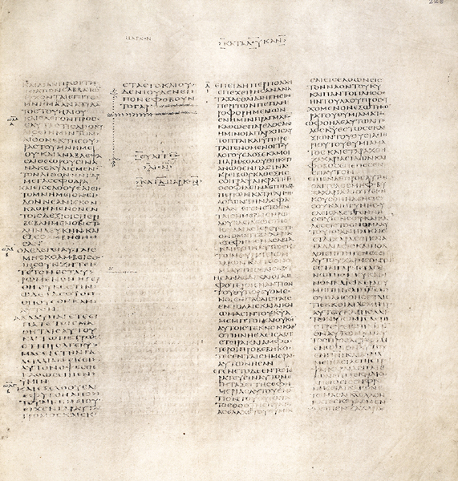
MSS Textual Variation
Variations of Cosequence
Mark 16:9-20 NOT included in the earliest MSS (4th C) –
(B) Vaticanus & (a) Sinaiticus
The only other Greek witness with exactly this form of chapter 16 is a 12th-century copy of Matthew and Mark
Long ending does occur in other 5th C MSS and is known among the Early Church Fathers.
Mark 16:8
Notes:
Such differences or additions are not supported by most other manuscripts. These are of little to no consequence because they don’t fundamentally change the substance of Jesus’ teaching

Slide 44
MSS Textual Variation
Variations of Consequence
Mark 16:9-20 NOT included in the earliest MSS (4th C) –
(B) Vaticanus & (a) Sinaiticus
NT Textual Variations is of consequence due to differences among reliable manuscripts
Mark 16:8
Notes:
Such differences or additions are not supported by most other manuscripts. These are of little to no consequence because they don’t fundamentally change the substance of Jesus’ teaching

Slide 45
Substantial Variations of No Consequence
“For there are three that bear witness in heaven: the Father, the Word, and the Holy Spirit: and these three agree as one.”
I John 5:7 (NKJV)
FOUND IN Late Latin Copies
NOT FOUND IN ANY Ancient Manuscripts

Slide 46
1 John 5:6-9 (NASB)
6 This is the one who came by water and blood, Jesus Christ; not with water only, but with the water and with the blood.
7 And it is the Spirit who bears witness, because the Spirit is the truth.
8 For there are three that bear witness, the Spirit and the water and the blood; and the three are in agreement.
9 If we receive the witness of men, the witness of God is greater; for the witness of God is this, that He has born witness concerning His Son.

Slide 47
Eight Reasons Given for Omission of
1 John 5:6-9 (by Adam Clarke)
1. Not present in any uncial Greek manuscript
2. Appears first in 15th or 16th century cursives
3. Omitted in all ancient versions, including Jerome’s Vulgate
4. Not used by the Greek “fathers” in support of the Trinity
5. Originally included in an exegesis by Cyprian (d. 258)
6. Found its way into the Textus Receptus because Erasmus found it in the Codex Britannicus (discovered in 1514)
7. Apparently the apostate church retained it to support their doctrine of the Trinity
8. First appears in Latin writers at end of 5th century

Slide 48
Substantial Variations of No Consequence
John 7:53 The words And everyone through sin no more (8:11) are bracketed by NU-Text as not original. They are present in over 900 manuscripts.
John 7:53-8:11 (KJV, NKJV)
NKJV
John 8
But Jesus went to the Mount of Olives.
Now early in the morning He came again into the temple, and all the people came to Him; and He sat down and taught them.
Then the scribes and Pharisees brought to Him a woman caught in adultery. And when they had set her in the midst,
they said to Him, “Teacher, this woman was caught in adultery, in the very act.
Now Moses, in the law, commanded us that such should be stoned. But what do You say?”
This they said, testing Him, that they might have something of which to accuse Him. But Jesus stooped down and wrote on the ground with His finger, as though He did not hear.
So when they continued asking Him, He raised Himself up and said to them, “He who is without sin among you, let him throw a stone at her first.”
And again He stooped down and wrote on the ground.
Then those who heard it, being convicted by their conscience, went out one by one, beginning with the oldest even to the last. And Jesus was left alone, and the woman standing in the midst.
When Jesus had raised Himself up and saw no one but the woman, He said to her, “Woman, where are those accusers of yours? Has no one condemned you?”
She said, “No one, Lord.” And Jesus said to her, “Neither do I condemn you; go and sin no more.”
the earliest manuscripts of the Gospel of John do not contain this beloved passage. Indeed, the first manuscript to contain the story is from around 400 C.E.

Slide 49
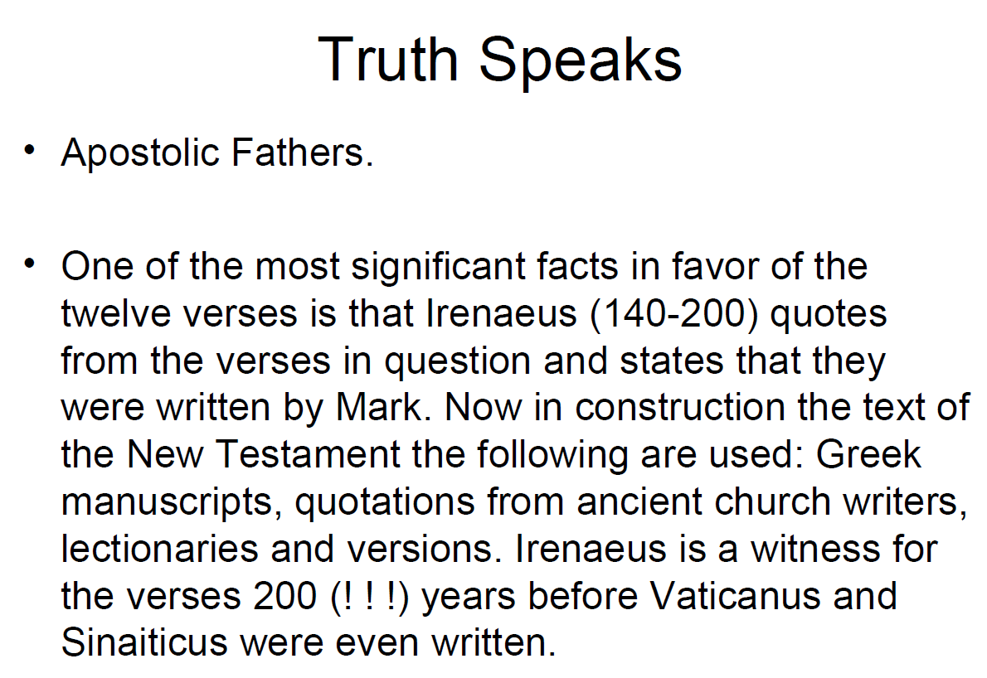


Slide 50
MSS Textual Variation
Solutions:
Almost all of any variations that exist across the MSS are trivial or of no consequence to the original meaning of a text or teaching of the early church
Those which are are known and incorporated into our modern texts based upon the best textual evidence and with notation to make the critical reader aware of the variation.

