Slide 1
Was Jesus Really Convinced That He Was the Son of God and did Jesus the Christ fulfill the Attributes of God
Lesson 7

Slide 2
Class Outline
Lesson | Description
1 | Jesus of the Bible vs Reinvented Jesus of Modern Man
2 | Tools for Examination of the Evidence
3 | Does the Eyewitness Evidence of the Biographies of Jesus the Christ Stand Up to Scrutiny?
4 | Was the Documentary Evidence (Jesus’ Biographies) Reliably Preserved for Us?
5 | Is There Credible Non-Biblical Evidence for Jesus outside His Biographies?
6 | Does Archaeology/the Scientific Evidence Confirm or Contradict Biographies of Jesus?
7 | Was Jesus Really Convinced That He Was the Son of God and did Jesus the Christ fulfill the Attributes of God?
8 | The Psychological Evidence; Was Jesus Crazy When He Claimed to Be the Son of God?
9 | The Fingerprint Evidence – Prophecy Did Jesus—and Jesus Alone—Match the Identity of the Messiah?
10 | The Resurrection – was Jesus Raised from the Dead?
11 | What is the Evidence of that Jesus was seen Alive after His Death on the Cross?
12 | Tactics for Discussing the Case for Jesus the Christ
13 | What Does the Evidence Establish—And What Does It Mean Today?

Slide 3
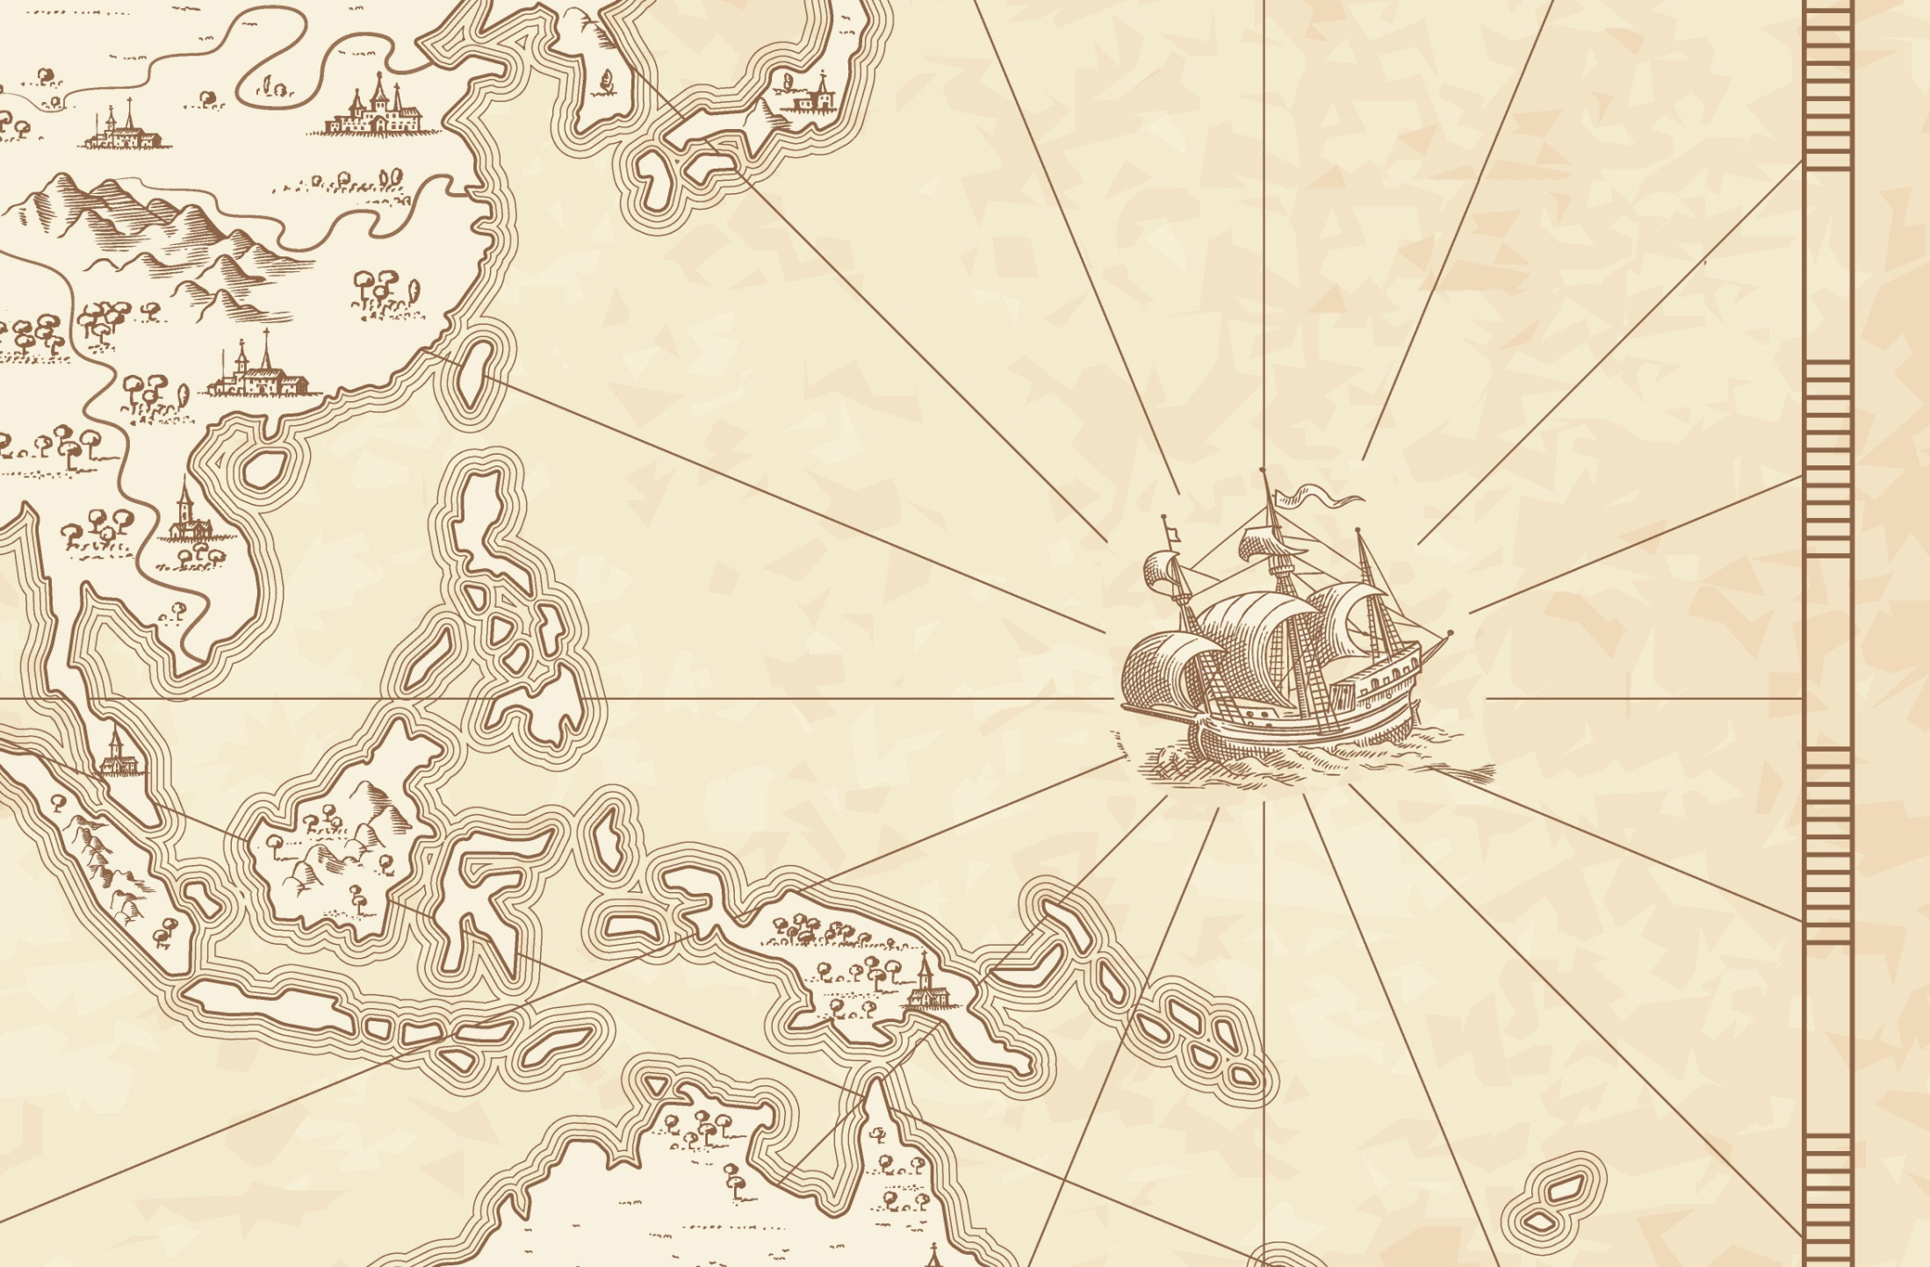
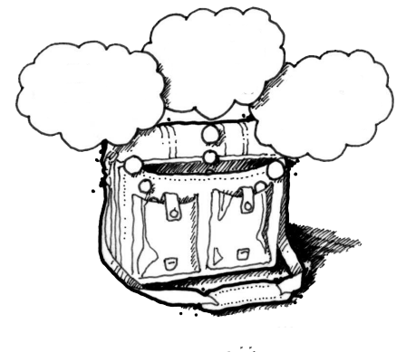
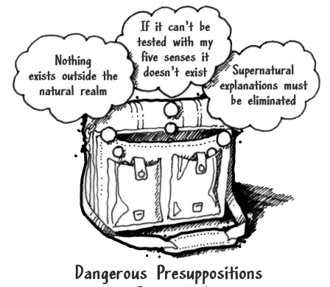
God
Supreme Being
We are created
Bible is
Accurate
Bible is Inspired
Bible is
Reliable
Super Naturalism it is possible that there is
a supreme being/someone beyond natural order
Intelligent Design – a programmer
nothing exists beyond the natural realm
Philosophical Naturalism The presuppositional belief
that only natural laws and forces occur
No God
No Supreme Being
We come from nothing
Using God
To fill in the Gaps

Slide 4
God
Supreme Being
We are created
Super Naturalism
Bible is
Accurate
Bible is Inspired
Bible is
Reliable
Resurrection
Prophecy/Messiah
Jesus Son of God
Was
Jesus
Crazy
Archaeology/the Scientific
Credible
Non-Biblical
Evidence
nothing exists beyond the natural realm
Reliably Preserved
Gospel Eyewitness Evidence
No God
No Supreme Being
We come from nothing

Slide 5
Bible Authority Established
Creation, Flood, Redemption Story, Moses, Moral Laws, Miracles, Nature of Man, Purpose of Man, Nature of God, Christ & Holy Spirit, Requirements for Worship, Personality of Jesus, Coming Judgment, Heaven, Hell, Angels, Demons, & Satan
Bible would be Accurate
Based on Bible Testimony Jesus is Son of God
Teachings of
Jesus are True
Accurate Account of Jesus’ Life
A Step of Faith not
A Leap of Faith
Bible can be Understood
Bible is Inspired
Bible is Accurate
Bible is Reliable
If Bible Revelation of Creator then
Divine Revelation Possible
& Accurate So Purpose is Known
Starting Point for
How We Got the Bible
class
Creation
has a purpose
Likely a Moral Law
Miracles &
Revelations
Universe had an Intelligent, Personal Origin
Possible that Universe had Supernatural Origin
It is Possible that there is Supernatural Force
Based on material from mmb, jr Establishing Bible Authority Class - 10/30/2002

Slide 6
Class Objectives
Profile Evidence that Jesus did claim to be God and Fulfill the Attributes of God

Slide 7
Questions
1. Did Jesus claim to be God? Even if He did make the claim, why should I believe it?
2. How can miracles be possible or were the biblical miracles magic tricks which fooled the simple, primitive people?
Confirms/gives context
The class tonight
Mt 2: 5-6 Born in Bethlehem – Micah 5:2
Mt 2:13-15 Flees to Egypt - Hosea 11:1
Mt 2:16-18 Death of male children in Bethlehem – Jeremiah 31:15
Mt 2:22-23 He shall be called a Nazarene ?
Notes:
Matthew 2:5-6 (NKJV) ⁵ So they said to him, "In Bethlehem of Judea, for thus it is written by the prophet: ⁶ 'But you, Bethlehem, in the land of Judah, Are not the least among the rulers of Judah; For out of you shall come a Ruler Who will shepherd My people Israel.' " Micah 5:2
Matthew 2:13-15 (NKJV) ¹³ Now when they had departed, behold, an angel of the Lord appeared to Joseph in a dream, saying, "Arise, take the young Child and His mother, flee to Egypt, and stay there until I bring you word; for Herod will seek the young Child to destroy Him." ¹⁴ When he arose, he took the young Child and His mother by night and departed for Egypt, ¹⁵ and was there until the death of Herod, that it might be fulfilled which was spoken by the Lord through the prophet, saying, "Out of Egypt I called My Son." (Hosea 11:1)
Matthew 2:16-18 (NKJV) ¹⁶ Then Herod, when he saw that he was deceived by the wise men, was exceedingly angry; and he sent forth and put to death all the male children who were in Bethlehem and in all its districts, from two years old and under, according to the time which he had determined from the wise men. ¹⁷ Then was fulfilled what was spoken by Jeremiah the prophet, saying: ¹⁸ "A voice was heard in Ramah, Lamentation, weeping, and great mourning, Rachel weeping for her children, Refusing to be comforted, Because they are no more." Jeremiah 31:15
Matthew 2:22-23 (NKJV) 22 But when he heard that Archelaus was reigning over Judea instead of his father Herod, he was afraid to go there. And being warned by God in a dream, he turned aside into the region of Galilee.
And he came and dwelt in a city called Nazareth, that it might be fulfilled which was spoken by the prophets, "He shall be called a Nazarene.“
Three major options exist for interpreting this verse. First, it may be that Matthew is associating the word Nazarene with the Hebrew word netser (“branch or sprout”). The “Branch” was a common term for the Messiah, such as in Isaiah 11:1: “A shoot will come up from the stump of Jesse; from his roots a Branch will bear fruit.” Hebrew was written with only consonants, and netser would have appeared as NZR—the same main consonants as Nazareth. In fact, in Aramaic, the common language of Jesus’ day, the word for “Nazareth” and the Hebrew word for “branch” sounded very much alike. Matthew’s point could be that Jesus was “sprouting up” from an obscure village in Galilee; Jesus was the Branch predicted by the prophets, and the name of the town He grew up in happens to sound just like the prophets’ word for “branch.” A second option is that Matthew is citing a prophecy not found in the Old Testament but in another source. If so, Matthew referred to a prophecy known to his original audience yet unknown to us today. However, this is unlikely and an argument from silence. A third option is that Matthew uses the word Nazarene in reference to a person who is “despised and rejected.” In the first century, Nazareth was a small town about 55 miles north of Jerusalem, and it had a negative reputation among the Jews. Galilee was generally looked down upon by Judeans, and Nazareth of Galilee was especially despised (see John 1:46). If this was Matthew’s emphasis, the prophecies Matthew had in mind could include these two passages concerning the Messiah: “But I am a worm and not a man, scorned by everyone, despised by the people. All who see me mock me; they hurl insults, shaking their heads” (Psalm 22:6–7). It’s true that Nazarenes were “scorned by everyone,” and so one could see this messianic prophecy as an allusion to Jesus’ hometown of Nazareth. “He was despised and rejected by mankind, a man of suffering, and familiar with pain. Like one from whom people hide their faces he was despised, and we held him in low esteem” (Isaiah 53:3). Again, in Jesus’ day, Nazarenes were “despised and rejected,” and so Isaiah’s prophecy could be viewed as an indirect reference to Jesus’ background as the supposed son of a carpenter from Nazareth. If Psalm 22:6–7 and Isaiah 53:3 are the prophecies that Matthew had in mind, then the meaning of “He shall be called a Nazarene” is something akin to “He shall be despised and mocked by His own people.”

Slide 8
Miracles = Magic Trick?
The reason I believe the miracles that Jesus did in the bible were mere magic tricks is because they are honestly not impressive from a magician’s standpoint.
Any magician alive today could recreate his effects. Some have already.
Criss Angel makes it appear as though he walks on water.
Practitioners of “voodoo” have ‘resurrected’ the dead before.
There’s even effects out there that could make it appear as though you heal the blind.
How do you know the person isn’t just misremembering what they heard in the story before they wrote it down in the New Testament? Human memory is far from reliable.
David Masters - Yes, even water to wine. I did that one as part of an economics project in high school.

Slide 9
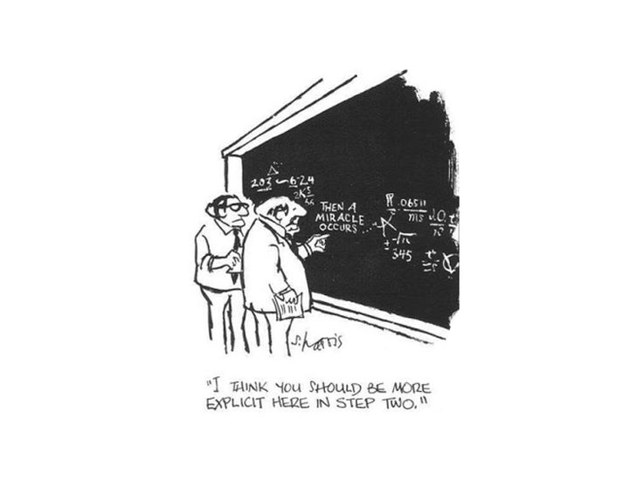
Miracles = God
Richard L Purtill notes five characteristics of a miracle.
“A miracle is an event
brought about by the power of God that is
a temporary
exception
to the ordinary course of nature
for the purpose of showing that God has acted in history.”
CS Lewis
“But if we admit God, must we admit Miracle?
Indeed, indeed, you have no security against it. Science has shown that under normal conditions dead people stay dead. But the Christian claim is that Jesus rose supernaturally, that is, that God has acted in history by raising Jesus from the dead. If there

Slide 10
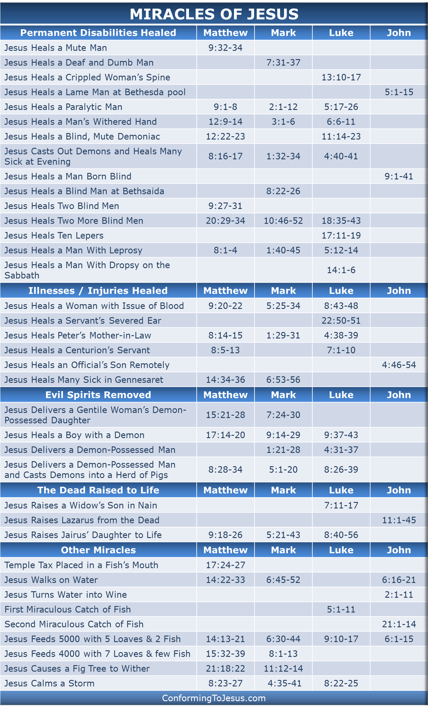
Miracles of Jesus
David Master’s claims can be matched by Magic
Any magic trick requires preparation & illusion
Could all of these be a trick, even the man born blind?
What about the resurrection of Jesus?

Slide 11
Did Jesus the Christ fulfill the Attributes of God?
Omniscience - In John 16:30 the apostle John affirms of Jesus, “ Now we can see that you know all things . ”
Omnipresence - Jesus said in Matthew 28:20, “ Surely I am with you always, to the very end of the age” and in Matthew 18:20, “ Where two or three come together in my name , there am I with them. ”
Omnipotence - “All authority in heaven and on earth has been given to me” Jesus said in Matthew 28:18.
Eternality - John 1:1 declares of Jesus, “In the beginning was the Word, and the Word was with God, and the Word was God.”
Immutability - Hebrews 13:8 says “Jesus Christ is the same yesterday and today and forever.”
Jesus said it all in John 14:7: “If you really knew me, you would know my Father as well.” Loose translation: “When you look at the sketch of God, you will see a likeness of me.”

Slide 12
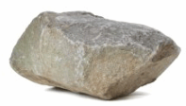
"Could God create a rock so heavy He could not lift it?"
This illogical question is representative of the type of proposed paradoxes atheists use in attempts to prove that God cannot exist.
Therefore God is not omnipotent. Therefore God does not exist.
The "paradox" lacks is vital information concerning God's nature
God can only do those things that are consistent with His nature. He cannot lie because it is against His nature to do so. Not being able to lie does not mean He is not God or that He is not all powerful.
Omnipotence is not the ability to do anything conceivable, but the ability to do anything consistent with His nature and consistent with His desire within the realm of His unlimited and universal power which we do not possess.
By the way God created the Universe, pretty Omnipotent.
God is supposed to be omnipotent.
If He is omnipotent, then He can create a rock so big that He can't pick it up.
If He cannot make a rock like this, then He is not omnipotent.
If He can make a rock so big that He can't pick it up, then He isn't omnipotent either.
Either way demonstrates that God cannot do something.

Slide 13
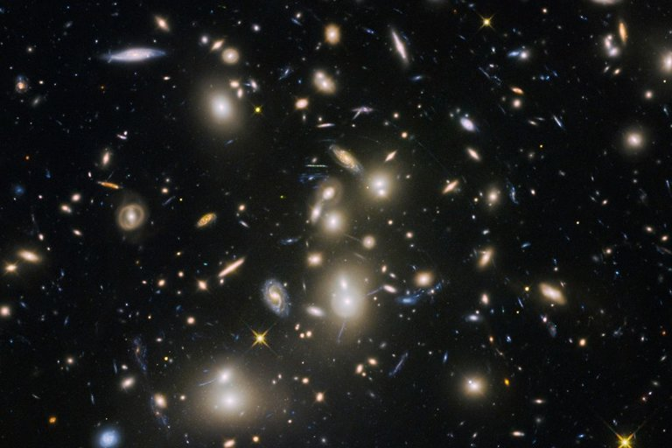
"Could God create a rock so heavy He could not lift it?"
This illogical question is representative of the type of proposed paradoxes atheists use in attempts to prove that God cannot exist.
Therefore God is not omnipotent. Therefore God does not exist.
The "paradox" lacks is vital information concerning God's nature
God can only do those things that are consistent with His nature. He cannot lie because it is against His nature to do so. Not being able to lie does not mean He is not God or that He is not all powerful.
Omnipotence is not the ability to do anything conceivable, but the ability to do anything consistent with His nature and consistent with His desire within the realm of His unlimited and universal power which we do not possess.
By the way God created the Universe, pretty Omnipotent.
God is supposed to be omnipotent.
If He is omnipotent, then He can create a rock so big that He can't pick it up.
If He cannot make a rock like this, then He is not omnipotent.
If He can make a rock so big that He can't pick it up, then He isn't omnipotent either.
Either way demonstrates that God cannot do something.

Slide 14
Matthew 16:13 (NKJV) When Jesus came into the region of Caesarea Philippi, He asked His disciples, saying, "Who do men say that I, the Son of Man, am?"
Matthew 16:14 (NKJV) So they said, "Some say John the Baptist, some Elijah, and others Jeremiah or one of the prophets."
Matthew 16:15 (NKJV) He said to them, "But who do you say that I am?"
Matthew 16:16 (NKJV) ¹⁶ Simon Peter answered and said,
"You are the Christ, the Son of the living God."

Slide 15
Son of Man
Matthew 12
³⁸Then some of the scribes and Pharisees answered, saying, “Teacher, we want to see a sign from You.”
³⁹But He answered and said to them,
“An evil and adulterous generation seeks after a sign, and no sign will be given to it except the sign of the prophet Jonah.
⁴⁰For as Jonah was three days and three nights in the belly of the great fish, so will the Son of Man be three days and three nights in the heart of the earth.
Daniel 7 (NKJV)
¹³ "I was watching in the night visions,
And behold, One like the Son of Man,
Coming with the clouds of heaven!
He came to the Ancient of Days,
And they brought Him near before Him. ¹⁴ Then to Him was given dominion and glory and a kingdom,
That all peoples, nations, and languages should serve Him.
His dominion is an everlasting dominion,
Which shall not pass away,
And His kingdom the one
Which shall not be destroyed

Slide 16
Son of Man
Matthew 9
¹So He got into a boat, crossed over, and came to His own city.
²Then behold, they brought to Him a paralytic lying on a bed.
When Jesus saw their faith, He said to the paralytic,
“Son, be of good cheer; your sins are forgiven you.”
³And at once some of the scribes said within themselves,
“This Man blasphemes!”
⁴But Jesus, knowing their thoughts, said,
“Why do you think evil in your hearts?
⁵For which is easier, to say,
‘Your sins are forgiven you,’ or to say, ‘Arise and walk’?
⁶But that you may know that the Son of Man has power on earth to forgive sins”—
then He said to the paralytic,
“Arise, take up your bed, and go to your house.”

Slide 17
Who is Jesus
He is the Christ (Messiah), the Anointed One foreseen by the Old Testament prophets.
(Isaiah 9:6; Matthew 16:16; John 4:25–26; John 6:69)
He is the Savior of the world, the one who delivers from sin.
(John 3:16–18; John 4:42; Acts 5:31; 1 John 4:14)
He is the Lamb of God, the one who sacrificed His life for sins.
(Isaiah 53:7; John 1:29)
He is the Son of God, having a unique and intimate relationship with God the Father.
(John 20:31)
He is the Creator of all things. (John 1:3; Colossians 1:16–17, Hebrews 1:2, 3)
He is equal to God. (John 5:23; Philippians 2:6)
He is eternal, existing with God from the very beginning. (John 1:1–2)
He is God in the flesh, revealing to us what God is like. (John 1:18, Hebrews 1:3)
He is the Lord of all. (Acts 10:36, Philippians 2:9–11)
He was born of a virgin. (Isaiah 7:14, Matthew 1:22–23; Luke 1:27–35)
He has the authority to forgive sins. (Mark 2:10)
He is worshiped. (John 9:38; Luke 24:52; Hebrews 1:6)
He is the living Savior, raised from the dead and sitting today at the right hand of God;
By His resurrection we have new life. (1 Peter 3:21–22; Romans 8:34)

Slide 18
Jesus of Modern Scholar
The followers of Jesus invented his deity after his death
Jesus was a Magician
Jesus is a non-apocalyptic, teasing teacher
Jesus was an apocalyptic prophet
Jesus was a Cynic
Jesus just man
Jesus never claimed to be God
Jesus was a revolutionary, a sage, an iconoclastic Jew

Slide 19
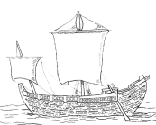
Paul’s Epistles
1 Thess ~50 AD
Gal ~53
1 Cor ~53-54
Phil ~55
Phmn~55
2 Cor ~55-56
Ro ~57
70 AD
Temple
Destroyed
27-30 AD
Ministry of Jesus
75 AD
100 AD
150 AD
200 AD
250 AD
25 AD
50 AD

Slide 20
Paul’s Epistles
1 Thess ~50 AD
Gal ~53
1 Cor ~53-54
Phil ~55
Phmn~55
2 Cor ~55-56
Ro ~57
70 AD
Temple
Destroyed
Polycarp
120 AD
Letter Quotes
16 NT Books
Clement
95 AD
Letter Quotes
10 NT Books
27-30 AD
Ministry of Jesus
75 AD
100 AD
150 AD
200 AD
250 AD
25 AD
50 AD
Tertullian (c. 150-c. 229) quotes from 23 of the 27 NT canon
AD 115,
Ignatius, bishop of Antioch,
Refers to “The Gospel” as
authoritative writing

Slide 21
100-200 AD
P104/ P. Oxy. 4404
Matthew 21
150-200 AD
P90 /P. Oxy. 3523
John 18-19
Paul’s Epistles
1 Thess ~50 AD
Gal ~53
1 Cor ~53-54
Phil ~55
Phmn~55
2 Cor ~55-56
Ro ~57
175-200 AD
Magdalen" papyrus
Matthew 3,5,26
70 AD
Temple
Destroyed
Polycarp
120 AD
Letter Quotes
16 NT Books
Clement
95 AD
Letter Quotes
10 NT Books
125-175 AD
J Ryland
John 18
27-30 AD
Ministry of Jesus
75 AD
100 AD
150 AD
200 AD
250 AD
25 AD
50 AD
Tertullian (c. 150-c. 229) quotes from 23 of the 27 NT canon
AD 105- 115
Ignatius, bishop of Antioch,
Refers to “The Gospel” as
authoritative writing

Slide 22
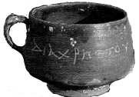
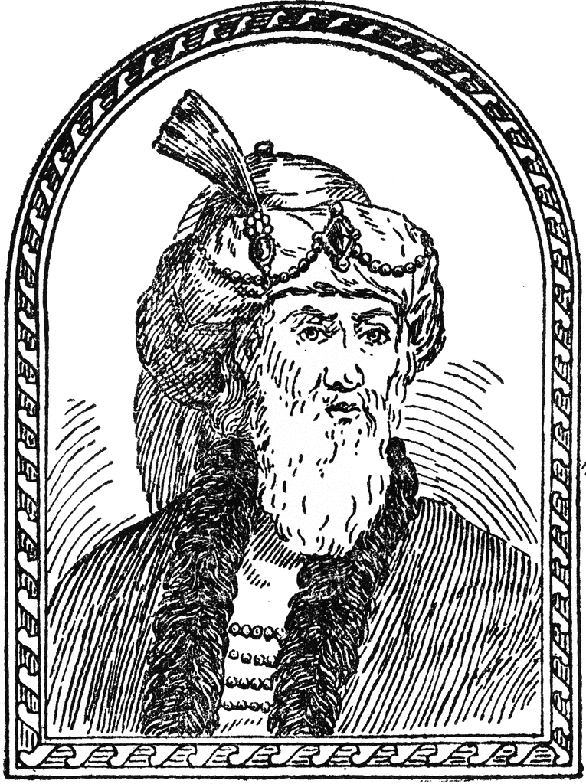
50 AD
Christ cup
Egypt
93 AD
Josephus
The Antiquities
100-200 AD
P104/ P. Oxy. 4404
Matthew 21
150-200 AD
P90 /P. Oxy. 3523
John 18-19
Paul’s Epistles
1 Thess ~50 AD
Gal ~53
1 Cor ~53-54
Phil ~55
Phmn~55
2 Cor ~55-56
Ro ~57
175-200 AD
Magdalen" papyrus
Matthew 3,5,26
70 AD
Temple
Destroyed
Polycarp
120 AD
Letter Quotes
16 NT Books
Clement
95 AD
Letter Quotes
10 NT Books
125-175 AD
J Ryland
John 18
27-30 AD
Ministry of Jesus
75 AD
100 AD
150 AD
200 AD
250 AD
25 AD
50 AD
28-29 AD
Death of
John The Baptist
Jesus ~30 AD
62 AD
Death of
James
Brother of Jesus
Tertullian (c. 150-c. 229) quotes from 23 of the 27 NT canon
AD 115,
Ignatius, bishop of Antioch,
Refers to “The Gospel” as
authoritative writing
Notes:
Suetonius Tranquillas (AD 69-160) wrote under the Roman emperor Hadrian, and he was a friend of Pliny the Younger. mentions early Christians and may refer to Jesus Christ in his work Lives of the Twelve Caesars, written in AD 121

Slide 23
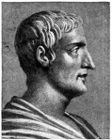
115 AD
Tacitus
Nero & Christians
50 AD
Christ cup
Egypt
93 AD
Josephus
The Antiquities
100-200 AD
P104/ P. Oxy. 4404
Matthew 21
150-200 AD
P90 /P. Oxy. 3523
John 18-19
Paul’s Epistles
1 Thess ~50 AD
Gal ~53
1 Cor ~53-54
Phil ~55
Phmn~55
2 Cor ~55-56
Ro ~57
175-200 AD
Magdalen" papyrus
Matthew 3,5,26
70 AD
Temple
Destroyed
Polycarp
120 AD
Letter Quotes
16 NT Books
Clement
95 AD
Letter Quotes
10 NT Books
125-175 AD
J Ryland
John 18
27-30 AD
Ministry of Jesus
75 AD
100 AD
150 AD
200 AD
250 AD
25 AD
50 AD
64 AD
28-29 AD
Death of
John The Baptist
Jesus ~30 AD
62 AD
Death of
James
Brother of Jesus
Tertullian (c. 150-c. 229) quotes from 23 of the 27 NT canon
AD 115,
Ignatius, bishop of Antioch,
Refers to “The Gospel” as
authoritative writing
Notes:
Suetonius Tranquillas (AD 69-160) wrote under the Roman emperor Hadrian, and he was a friend of Pliny the Younger. mentions early Christians and may refer to Jesus Christ in his work Lives of the Twelve Caesars, written in AD 121

Slide 24
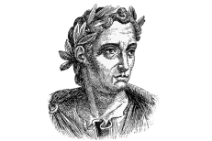
Mark 9:38-39 (NKJV) ³⁸ Now John answered Him, saying, "Teacher, we saw someone who does not follow us casting out demons in Your name, and we forbade him because he does not follow us." ³⁹ But Jesus said, "Do not forbid him, for no one who works a miracle in My name can soon afterward speak evil of Me.
111 AD
Pliny the Younger
Letter to Trajan
115 AD
Tacitus
Nero & Christians
121 AD
Suetonius
Claudius, Nero & Christians
50 AD
Christ cup
Egypt
93 AD
Josephus
The Antiquities
100-200 AD
P104/ P. Oxy. 4404
Matthew 21
150-200 AD
P90 /P. Oxy. 3523
John 18-19
Paul’s Epistles
1 Thess ~50 AD
Gal ~53
1 Cor ~53-54
Phil ~55
Phmn~55
2 Cor ~55-56
Ro ~57
175-200 AD
Magdalen" papyrus
Matthew 3,5,26
70 AD
Temple
Destroyed
Polycarp
120 AD
Letter Quotes
16 NT Books
Clement
95 AD
Letter Quotes
10 NT Books
125-175 AD
J Ryland
John 18
27-30 AD
Ministry of Jesus
75 AD
100 AD
150 AD
200 AD
250 AD
25 AD
50 AD
28-29 AD
Death of
John The Baptist
Jesus ~30 AD
~53 AD
Jews out Rome
62 AD
Death of
James
Brother of Jesus
Tertullian (c. 150-c. 229) quotes from 23 of the 27 NT canon
AD 115,
Ignatius, bishop of Antioch,
Refers to “The Gospel” as
authoritative writing
Notes:
Suetonius Tranquillas (AD 69-160) wrote under the Roman emperor Hadrian, and he was a friend of Pliny the Younger. mentions early Christians and may refer to Jesus Christ in his work Lives of the Twelve Caesars, written in AD 121

Slide 25
Written by Paul - Undisputed
Resurrection, Miracles, Deity
L07 First Epistle to the Thessalonians (51 AD) Danny H
L07 Epistle to the Galatians (47 (51-53)AD?) Joel Y
L11 First Epistle to the Corinthians (52-56 AD) Jackson Jacobs
L11Second Epistle to the Corinthians (52-56 AD) Corey W
L08 Epistle to the Philippians (60-62 AD) Jana S, Chester T, Corey W, DeAnna B
L08 Epistle to Philemon (60-62 AD) Sara H
L13 Epistle to the Romans (52-57 AD) Marty B

Slide 26
~55 AD
Mark
~60 AD
Matthew
~62 AD
Luke
~90 AD
John
Paul’s Missionary
Journeys
1 st
45-46
AD
2 nd
48-51
AD
3 rd
52-57
AD
Paul’s Epistles
70 AD
Temple
Destroyed
27-30 AD
Gal ~53
Ro ~57
Ministry of Jesus
1 Thess ~50 AD
Phil ~55
Phmn~55
1 Cor ~53-54
2 Cor ~55-56
20AD
30AD
40 AD
50AD
60 AD
70 AD
80 AD
90 AD
100 AD
75-90AD
Matthew
90 AD
John
65-75 AD
Mark
80-95 AD
Luke

Slide 27
Galatians
Notes:
Deity
Miracles
Resurrection

Slide 28
I Thessalonians
1 Thessalonians 1:5 (ESV) because our gospel came to you not only in word, but also in power and in the Holy Spirit and with full conviction. You know what kind of men we proved to be among you for your sake.
1 Thessalonians 1:9-10 (ESV) ⁹ For they themselves report concerning us the kind of reception we had among you, and how you turned to God from idols to serve the living and true God, ¹⁰ and to wait for his Son from heaven, whom he raised from the dead, Jesus who delivers us from the wrath to come.
1 Thessalonians 2:4 (ESV) ⁴ but just as we have been approved by God to be entrusted with the gospel, so we speak, not to please man, but to please God who tests our hearts.
1 Thessalonians 2:6 (ESV) ⁶ Nor did we seek glory from people, whether from you or from others, though we could have made demands as apostles of Christ.
1 Thessalonians 2:8 (ESV) ⁸ So, being affectionately desirous of you, we were ready to share with you not only the gospel of God but also our own selves, because you had become very dear to us.

Slide 29
I Thessalonians
1 Thessalonians 2:14-16 (ESV) ¹⁴ For you, brothers, became imitators of the churches of God in Christ Jesus that are in Judea. For you suffered the same things from your own countrymen as they did from the Jews, ¹⁵ who killed both the Lord Jesus and the prophets, and drove us out, and displease God and oppose all mankind ¹⁶ by hindering us from speaking to the Gentiles that they might be saved—so as always to fill up the measure of their sins. But wrath has come upon them at last!
1 Thessalonians 3:2 (ESV) ² and we sent Timothy, our brother and God’s coworker in the gospel of Christ, to establish and exhort you in your faith,
1 Thessalonians 3:11-13 (ESV) ¹¹ Now may our God and Father himself, and our Lord Jesus, direct our way to you, ¹² and may the Lord make you increase and abound in love for one another and for all, as we do for you, ¹³ so that he may establish your hearts blameless in holiness before our God and Father, at the coming of our Lord Jesus with all his saints.
1 Thessalonians 4:1-3 (ESV) ² For you know what instructions we gave you through the Lord Jesus. ³ For this is the will of God, your sanctification: that you abstain from sexual immorality;
Notes:
Deity
Miracles
Resurrection

Slide 30
I Thessalonians
1 Thessalonians 4:14-16 (ESV) ¹⁴ For since we believe that Jesus died and rose again, even so, through Jesus, God will bring with him those who have fallen asleep. ¹⁵ For this we declare to you by a word from the Lord, that we who are alive, who are left until the coming of the Lord, will not precede those who have fallen asleep. ¹⁶ For the Lord himself will descend from heaven with a cry of command, with the voice of an archangel, and with the sound of the trumpet of God. And the dead in Christ will rise first.
1 Thessalonians 5:9-10 (ESV) ⁹ For God has not destined us for wrath, but to obtain salvation through our Lord Jesus Christ, ¹⁰ who died for us so that whether we are awake or asleep we might live with him.
1 Thessalonians 5:23 (ESV) ²³ Now may the God of peace himself sanctify you completely, and may your whole spirit and soul and body be kept blameless at the coming of our Lord Jesus Christ.
Notes:
Deity
Miracles
Resurrection

Slide 31
II Thessalonians
Notes:
Deity
Miracles
Resurrection

Slide 32
II Thessalonians
2 Thessalonians 1:1-2 (ESV) ¹ Paul, Silvanus, and Timothy, To the church of the Thessalonians in God our Father and the Lord Jesus Christ: ² Grace to you and peace from God our Father and the Lord Jesus Christ.
2 Thessalonians 1:7-8 (ESV) ⁷ and to grant relief to you who are afflicted as well as to us, when the Lord Jesus is revealed from heaven with his mighty angels ⁸ in flaming fire, inflicting vengeance on those who do not know God and on those who do not obey the gospel of our Lord Jesus.
2 Thessalonians 1:12 (ESV) ¹² so that the name of our Lord Jesus may be glorified in you, and you in him, according to the grace of our God and the Lord Jesus Christ.
2 Thessalonians 2:13-14 (ESV) ¹³ But we ought always to give thanks to God for you, brothers beloved by the Lord, because God chose you as the first fruits to be saved, through sanctification by the Spirit and belief in the truth. ¹⁴ To this he called you through our gospel, so that you may obtain the glory of our Lord Jesus Christ.
2 Thessalonians 2:16-17 (ESV) ¹⁶ Now may our Lord Jesus Christ himself, and God our Father, who loved us and gave us eternal comfort and good hope through grace, ¹⁷ comfort your hearts and establish them in every good work and word.
Notes:
Deity
Miracles
Resurrection

Slide 33
II Thessalonians
2 Thessalonians 3:5 (ESV) ⁵ May the Lord direct your hearts to the love of God and to the steadfastness of Christ.
2 Thessalonians 3:6 (ESV) ⁶ Now we command you, brothers, in the name of our Lord Jesus Christ, that you keep away from any brother who is walking in idleness and not in accord with the tradition that you received from us.
2 Thessalonians 3:12 (ESV) ¹² Now such persons we command and encourage in the Lord Jesus Christ to do their work quietly and to earn their own living.
2 Thessalonians 3:17-18 (ESV) ¹⁷ I, Paul, write this greeting with my own hand. This is the sign of genuineness in every letter of mine; it is the way I write. ¹⁸ The grace of our Lord Jesus Christ be with you all.
Notes:
Deity
Miracles
Resurrection

Slide 34
Gospel Preached by Paul
1 Corinthians 15:1-8 (ESV)
¹ Now I would remind you, brothers, of the gospel I preached to you, which you received, in which you stand, ² and by which you are being saved, if you hold fast to the word I preached to you—unless you believed in vain. ³ For I delivered to you as of first importance what I also received:
that Christ died for our sins in accordance with the Scriptures, ⁴ that he was buried, that he was raised on the third day in accordance with the Scriptures, ⁵ and that he appeared to Cephas, then to the twelve. ⁶ Then he appeared to more than five hundred brothers at one time, most of whom are still alive, though some have fallen asleep. ⁷ Then he appeared to James, then to all the apostles. ⁸ Last of all, as to one untimely born, he appeared also to me.
Notes:
Deity
Miracles
Resurrection

