Slide 1
Revelation

Slide 2
Overview of The Revelation
Introduction (Ch. 1)
The 7 Churches (Ch. 2-3)
Heavenly Scene: The Throne & The Lamb (Ch. 4-5)
The 7 Seals (Ch. 6-8)
Heavenly Scene: Silence in Heaven (Ch. 8)
The 7 Trumpets (Ch. 8-11)
Heavenly Scene: The Spiritual Conflict (Ch. 12-14)
The 7 Bowls (Ch. 15-18)
Heavenly Scene: The Spiritual Victory (Ch. 19)
Conclusion: The Rule of Christ (Ch. 20-22)

Slide 3
Class Goals
To Better Understand The Language & Structure of Revelation.
To Understand The Purpose & Dramatic Style of Apocalyptic Literature.
To Identify Key Verses In Each Chapter As Stepping Stones of Understanding.
To Explain The Shortcomings of Premillennial Interpretations.
To Tackle A Challenging Book With The Support & Wisdom of Friends.
To More Clearly See The Events, Instructions, & Message of Revelation.
To See The Glory, Authority, Power, & Triumph of Jesus More Clearly.
To See The Limitations & Weaknesses of Earthly Kingdoms More Clearly.
To Fully Respond To The Insights Given In Revelation.
To Grow In Praise To God & Loyalty to His Kingdom.
To Increase Our Alertness & Preparation For The Judgment of God.
To Instill Courage & Hope In The Face of Persecutions.
To Stir Up Our Joy & Hope For Heaven.
Notes:
If we understand it – we can see it clearly. If we can see it clearly – we can respond to it.
To Emphasize Key Verses In Each Chapter That Provide Stepping Stones for Understanding the Full Book of Revelation.
To Examine & Understand The Use of Old Testament Language.

Slide 4
Revelation 1:1-3
Apocalypse
“The Revelation of Jesus Christ, which God gave Him to show to His bond-servants, the things which must soon take place; and He sent and communicated it by His angel to His bond-servant John, ² who testified to the word of God and to the testimony of Jesus Christ, even to all that he saw. ³ Blessed is he who reads and those who hear the words of the prophecy, and heed the things which are written in it; for the time is near.”
Visual
Timing
Messenger
Source
Purpose
Action

Slide 5
Apocalyptic Literature, A Simplified Definition
A story, written in a time of crisis and distress, that is given by otherworldly beings explaining how God will reverse everything so the righteous will triumph.

Slide 6
5 Principles For Studying Apocalyptic Literature
Do Look For Interpretations of Crucial Symbols Given In The Text.
Do Visualize What We Are Reading.
Do Focus On Major Themes Being Developed.
Do Not Force Symbols From Different Passages To Always Have The Same Meaning.
Do Not Ignore The Stated Time & Audience.

Slide 7
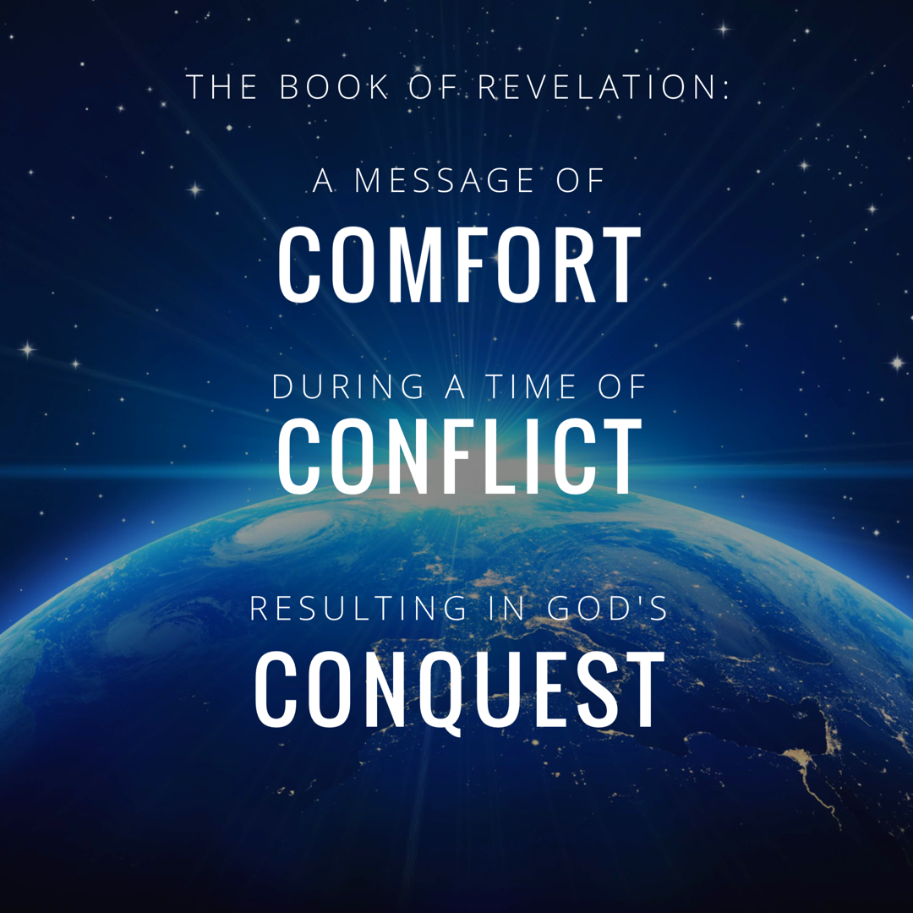

Slide 8
Lesson 2: Chapter 1 and 2
Chapter 1 – Key Verse 1:5 “…ruler of the kings of the earth…”
Introduction to Apocalyptic Message (vs. 1-3)
Divine Salutation of Grace & Peace To You… (vs. 4-6)
Coming with the Clouds (vs. 7)
Message To The Seven Churches of Asia Minor (vs. 8-11)
John’s Vision of Jesus As The Messenger to The Churches (vs. 12-16)
Jesus Explains The Meaning of The Vision. (vs. 17-20)
Chapter 2
The Church at Ephesus: Remember, Repent, Remove (vs. 1-7)
The Church at Smyrna: A Crown of Life for the Faithful (vs. 8-11)
The Church at Pergamum: Overcome False Teaching (vs. 12-17)
Notes:
Seven Spirits (possibly or even likely a reference to the Holy Spirit as complete in knowledge of the church.) – See Zechariah 4:1-10

Slide 9
Divine Grace & Peace In Suffering (1 Thessalonians 1:1-6)
Paul, Silas^{[a]} and Timothy, To the church of the Thessalonians in God the Father and the Lord Jesus Christ: Grace and peace to you. ² We always thank God for all of you and continually mention you in our prayers. ³ We remember before our God and Father your work produced by faith, your labor prompted by love, and your endurance inspired by hope in our Lord Jesus Christ. ⁴ For we know, brothers and sisters loved by God, that he has chosen you, ⁵ because our gospel came to you not simply with words but also with power, with the Holy Spirit and deep conviction. You know how we lived among you for your sake. ⁶ You became imitators of us and of the Lord, for you welcomed the message in the midst of severe suffering with the joy given by the Holy Spirit.
Notes:
Grace and Peace are the most common salutation. Two times when suffering and persecution are involved, the Grace and Peace is said to extend not only from the Father and Son, but also from the Holy Spirit. My observation is that these are the times it is especially important to lean on the Inspired Word given by the Spirit.

Slide 10
Divine Grace & Peace In Suffering (1 Peter 1:1-2)
Peter, an apostle of Jesus Christ, To God’s elect, exiles scattered throughout the provinces of Pontus, Galatia, Cappadocia, Asia and Bithynia, ² who have been chosen according to the foreknowledge of God the Father, through the sanctifying work of the Spirit, to be obedient to Jesus Christ and sprinkled with his blood: Grace and peace be yours in abundance.

Slide 11
Figurative Description of The Holy Spirit (Zechariah 4:1-6)
¹ Then the angel who talked with me returned and woke me up, like someone awakened from sleep. ² He asked me, “What do you see?” I answered, “I see a solid gold lampstand with a bowl at the top and seven lamps on it, with seven channels to the lamps. ³ Also there are two olive trees by it, one on the right of the bowl and the other on its left.” ⁴ I asked the angel who talked with me, “What are these, my lord?”
⁵ He answered, “Do you not know what these are?” “No, my lord,” I replied. ⁶ So he said to me, “This is the word of the Lord to Zerubbabel: ‘Not by might nor by power, but by my Spirit,’ says the Lord Almighty.

Slide 12
Jesus Christ, The Ruler of the Kings of the Earth
We Place Our Confidence In Jesus As Our Forerunner & Leader of Faith. (Hebrews 12:2)
Our Forerunner (vs 4-8)
Our Model When On Trial: He did not deny God under trials.
Our Model When Sentenced To Death: He placed His hope in being raised from the dead.
Our Model When Exalted In Heaven. He is exalted as ruler over earthly kingdoms.
Our Leader (vs. 7-8)
Our Eternal King Who Is Coming & Will Be Acknowledged.

Slide 13
Messianic Characteristic: Coming In The Clouds (Daniel 7:13-14)
¹³ “In my vision at night I looked, and there before me was one like a son of man, coming with the clouds of heaven. He approached the Ancient of Days and was led into his presence.¹⁴ He was given authority, glory and sovereign power; all nations and peoples of every language worshiped him. His dominion is an everlasting dominion that will not pass away, and his kingdom is one that will never be destroyed.
Notes:
This reference describes His royalty, His endurance, the confidence we can have in Him and in God’s faithfulness to preserve His kingdom forever.

Slide 14
Divine Judgement: Coming In The Clouds
For the day is near, the day of the LORD is near; it will be a day of clouds, a time of doom for the nations. Ezekiel 30:3
Then will appear in heaven the sign of the Son of Man, and then all the tribes of the earth will mourn, and they will see the Son of Man coming on the clouds of heaven with power and great glory. Matthew 24:30
Notes:
This reference describes His royalty, His endurance, the confidence we can have in Him and in God’s faithfulness to preserve His kingdom forever.

Slide 15
Divine Judgement: “Those Who Pierced Him”
I will pour out on the house of David and on the inhabitants of Jerusalem, the Spirit of grace and of supplication, so that they will look on Me whom they have pierced; and they will mourn for Him, as one mourns for an only son, and they will weep bitterly over Him like the bitter weeping over a firstborn. (Zechariah 12:10)
Notes:
Notice that the book of Revelation is going to deal with Israel, the outcome of their crucifixion of the Messiah.

Slide 16
Jesus Christ, The Ruler of the Kings of the Earth
In The Appearance of Jesus WE SEE…
Royal Clothing: Robe & Golden Sash
Indications of Wisdom/Insight: White Head & Fire In His Eyes
Power To Judge: Feet & Voice
In The Words of Jesus WE LEARN…
Christians Do Not Fear His Strength. We Know He Is Our Protector. (17)
Christians Trust His Divine, Everlasting Authority. (18)
Christians Listen To His Prophetic Message. (19)
Christians Acknowledge His Close Relationship With The Church. (20)
This book is an inspirational and informative message from our Greatest Hero.
Notes:
Wisdom and Insight go hand in hand. He can see what remains after it has been tested with fire.
Likely messengers from each church that would carry this letter to the congregations mentioned. Jesus would be with them and protect them in this task.
“We need to see Jesus in this chapter. He is in the midst of His churches, holding the people of God in His hand, bringing judgment on those who harm His people. It is a visual reminder that if God is for us, who can be against us: Rom. 8:31.”

Slide 17
Key Verses In The Book of Revelation
Rev. 1:1 “The Revelation of Jesus Christ…to show…soon take place.”
Rev. 1:5 “Jesus Christ…ruler of the kings of the earth…”
Rev. 1:20 “the seven lampstands are the seven churches…”
Notes:
Picture of Jesus in glory and in control over His churches.

Slide 19
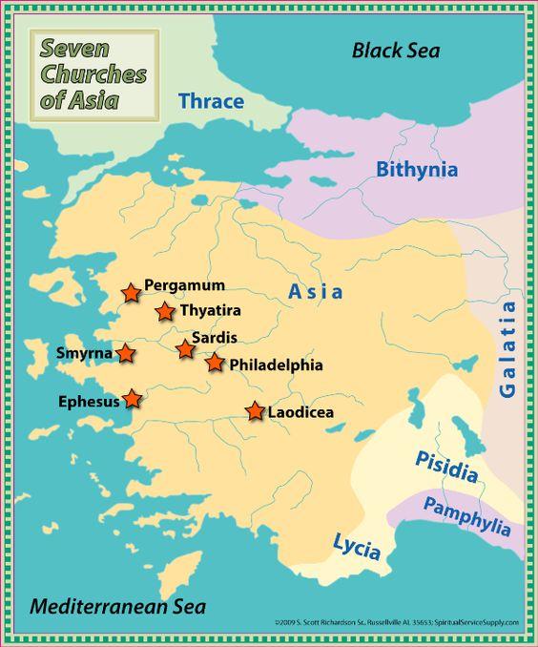

Slide 20
Chapter 2: Ephesus, Smyrna, Pergamum & Thyatira
If Jesus Wrote Me A Letter, What Would It Say?
A.) His Relevant Qualities
B.) His Insights, “I Know…”
C.) His Praise for the Church
D.) His Rebuke for the Church
E.) His Commands for the Church
F.) His Warnings for the Church
E.) His Promise to Those Who “Overcome”
Notes:
I you could ask Jesus anything, what would you ask: one of the kids said, “I guess to tell me more about Himself.”
Not Premillenial:
* I reject the idea that this is a description of 7 ages or periods of the church from apostolic to the end of time.
* I reject this because the lampstands are figurative and Jesus tells us that the churches are the correct interpretation of the figure. When the text interprets a figure there is we don’t then add another interpretation on top of that!
7 Churches, 7 Parts
RELEVANT QUALITIES…. Imagine being on a plane with a woman in labor and the flight attendant asks: Is there a Dr on board? You don’t raise you hand and say: I played high school soccer, love to fly fish, and happen to be an OB. You say: Yes, I’ve been an OB for 12 years, I’ll be right there!

Slide 21
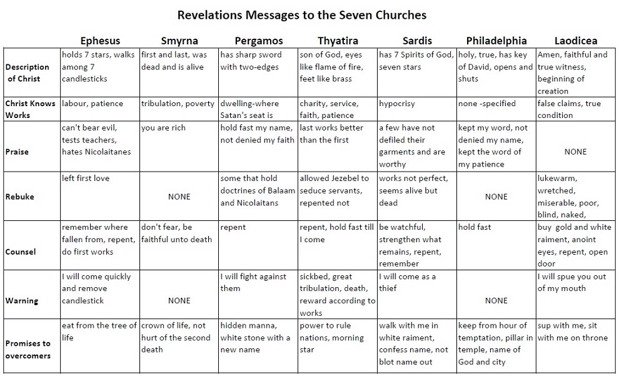

Slide 22
Ephesus
A.) His Relevant Qualities
The One who holds the 7 stars, walks among the 7 lampstands
B.) His Insights, “I Know…”
Your deeds, toil, perseverance, you put to test false apostles
C.) His Praise for the Church
You endure for My names sake and have not grown weary.
Hate the deeds of the Nicolaitans.
D.) His Rebuke for the Church
You have left your first love.
E.) His Commands for the Church
Remember from where you have fallen…
F.) His Warnings for the Church
He will remove their lampstand out of its place.
G.) His Promise to Those Who “Hear” and “Overcome”
Eat of the tree of life in the Paradise of God

Slide 23
The Church at Ephesus
God Desires & Deserves our Whole Heart.
We Remember How Wonderful He Is To Us.
We Remember How Powerful & Patient He Is.
We Remember The Freedom & Hope He Provides.
Notes:
I you could ask Jesus anything, what would you ask: one of the kids said, “I guess to tell me more about Himself.”
Not Premillenial:
* I reject the idea that this is a description of 7 ages or periods of the church from apostolic to the end of time.
* I reject this because the lampstands are figurative and Jesus tells us that the churches are the correct interpretation of the figure. When the text interprets a figure there is we don’t then add another interpretation on top of that!
7 Churches, 7 Parts
RELEVANT QUALITIES…. Imagine being on a plane with a woman in labor and the flight attendant asks: Is there a Dr on board? You don’t raise you hand and say: I played high school soccer, love to fly fish, and happen to be an OB. You say: Yes, I’ve been an OB for 12 years, I’ll be right there!

Slide 24
Symrna
A.) His Relevant Qualities
The first and last, who was dead and has come to life
B.) His Insights, “I Know…”
Your tribulation and your poverty
C.) His Praise for the Church
You are rich, even when facing the synagogue of Satan
D.) His Rebuke for the Church
----- NONE -----
E.) His Commands for the Church
Do not fear what you are about to suffer.
F.) His Warnings for the Church
The devil is about to…tribulation for 10 days.
G.) His Promise to Those Who “Hear” and “Overcome”
Be faithful until death and I will give you the crown of life.
You will not be hurt by the second death.
Notes:
Second Death. Spiritual defeat and separation from God for eternity.

Slide 25
The Church at Symrna
I Can Prepare For Economic Persecution.
I Must Determine Today, Who My True Master Will Be.
Matthew 6:24, Hebrews 10:34-35
I Can Prepare For People To Make False Claims About Following & Serving God.
“who say they are Jews”
I Can Make The Crown Of Life My Most Prized Reward.
Notes:
I you could ask Jesus anything, what would you ask: one of the kids said, “I guess to tell me more about Himself.”
Not Premillenial:
* I reject the idea that this is a description of 7 ages or periods of the church from apostolic to the end of time.
* I reject this because the lampstands are figurative and Jesus tells us that the churches are the correct interpretation of the figure. When the text interprets a figure there is we don’t then add another interpretation on top of that!
7 Churches, 7 Parts
RELEVANT QUALITIES…. Imagine being on a plane with a woman in labor and the flight attendant asks: Is there a Dr on board? You don’t raise you hand and say: I played high school soccer, love to fly fish, and happen to be an OB. You say: Yes, I’ve been an OB for 12 years, I’ll be right there!

Slide 26
Pergamum
A.) His Relevant Qualities
The one who has the sharp two-edged sword
B.) His Insights, “I Know…”
Where you dwell, where Satan’s throne is
C.) His Praise for the Church
You hold fast My name and did not deny My faith
D.) His Rebuke for the Church
Some who hold the teaching of Balaam & Nicolaitans (stumbling blokcs, idolatry, sexual immorality.)
E.) His Commands for the Church
Repent
F.) His Warnings for the Church
I will make war against them with sword of My mouth.
G.) His Promise to Those Who “Hear” and “Overcome”
Hidden manna & a white stone with a new name.
Notes:
I think it is pretty cool that Jesus acknowledges so much about knowing exactly what they are up against.
It is true that we should Do the Right Thing all the time, regardless of circumstances. But it is awesome when the Lord expresses: He knows the pressure we are under from our culture and the people around us.
Second Death. Spiritual defeat and separation from God for eternity.

Slide 27
The Church at Pergamum
I Can Resist The Temptation To Compromise & Tolerate False Doctrines.
I Must “Hold Fast” Jesus’ Name.
I Can Be Thoughtful of The Lives Lost for Christ.
“My faithful one who was killed…”
I Will Not Live By Bread Alone, But By Every Word That Proceeds Out Of The Mouth of God.
Matthew 4:4
Notes:
I you could ask Jesus anything, what would you ask: one of the kids said, “I guess to tell me more about Himself.”
Not Premillenial:
* I reject the idea that this is a description of 7 ages or periods of the church from apostolic to the end of time.
* I reject this because the lampstands are figurative and Jesus tells us that the churches are the correct interpretation of the figure. When the text interprets a figure there is we don’t then add another interpretation on top of that!
7 Churches, 7 Parts
RELEVANT QUALITIES…. Imagine being on a plane with a woman in labor and the flight attendant asks: Is there a Dr on board? You don’t raise you hand and say: I played high school soccer, love to fly fish, and happen to be an OB. You say: Yes, I’ve been an OB for 12 years, I’ll be right there!

Slide 28
Lord Help Us…
To Overflow With Genuine Love For You, So That Our Teachings & Good Deeds Are Not Empty.
To Be Rich In What Really Matters & Willing To Lose Everything That Doesn’t Matter…Even Including Our Life.
To Find Nourishment & Strength In His Name & The Name That He Will Give Us, Rather Than Become Starving In Sin.
To Resist Accepting or Compromising With False Teachings.

Slide 29
Key Verses In The Book of Revelation
Rev. 1:1 “The Revelation of Jesus Christ…to show…soon take place.”
Rev. 1:5 “Jesus Christ…ruler of the kings of the earth…”
Rev. 1:20 “the seven lampstands are the seven churches…”
Rev. 2:4 “you have left your first love…”
Rev 2:10 “be faithful until death, and I will give you the crown of life.”
Rev 2:14 “I have a few things against you…who hold the teaching of Balaam”
Notes:
Picture of Jesus in glory and in control over His churches.

Slide 30
Revelation

