Slide 1
Revelation

Slide 2
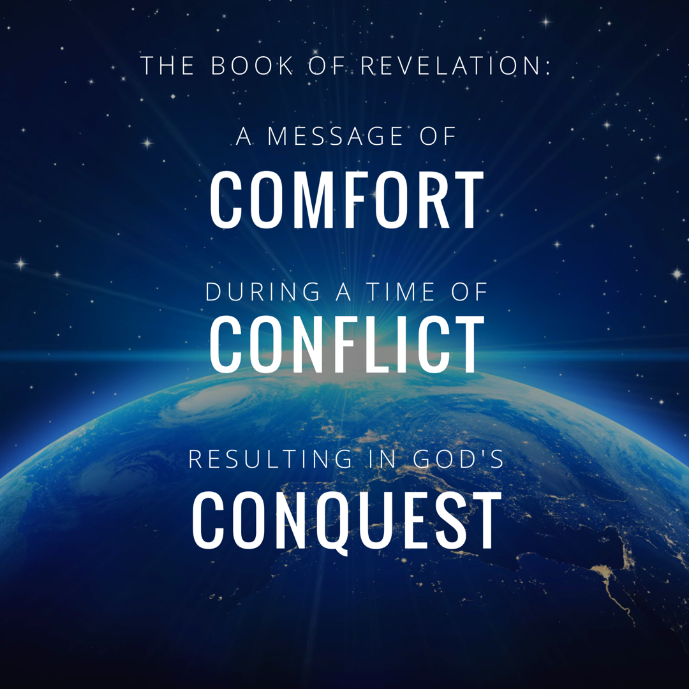

Slide 3
Before We Begin Ch. 4 & 5, Let’s Consider The Book As A Whole.
Notes:
Everyone Jokes “God Wins”. This is true. Have you thought about WHO God wins against? Who is He in competition with?
I want to show you some key verses in the book of Revelation to establish that this book is God’s battle against two familiar foes.
1.) The Jewish Officials who rejected Christ and opposed the preaching of the Gospel.
2.) The Roman Emperors who required Christians to worship them as a god.

Slide 4
God’s Judgment Upon The Jewish Officials & God’s Victory Over Roman Persecution
Jesus Rules His Church & Rewards Those Who Overcome.
Revelation 1-3
Judgment Begins On Earth Against Those Who Reject Christ (Likely The Jewish Officials.)
Revelation 4-7
Judgment Is Accomplished & Jesus Is Verified As The Ultimate King.
Revelation 8-11 (Emphasis on 11:15-17)
Satan Attacks The Church with Roman Political Pressure.
Revelation 12-13 (Emphasis on 13:4, 13:17)
Satan & His Allies Are Defeated.
Revelation 14-19 (Emphasis 17:16, 18:11, 19:2, 19:10)
Jesus Reigns Forever.
Revelation 20-22
Notes:
How should we approach the rest of the book? On Sunday we wrapped up the 7 churches and now before we get into chapter 4 and 5 seems like the best time to discuss how we study this book as a a whole.
We’ve established that it is apocalyptic literature – with visions and symbolic language.
** This book deals with the two biggest problems facing Christians. **. We know what these 2 problems are simply from reading the book of Acts. We see time and time again that Paul’s effort to spread the gospel is interrupted by Jews who violently oppose the gospel.
They had to face Jewish Officials who rallied the community against them, seeking imprisonment and execution.
And, They had to face Roman Officials who required them to worship the Emperor as a god to demonstrate national loyalty.
JUDGEMENT BEGINS ON EARTH….against who? Well in ch 2 and 3 we saw that it was a combo of false teachers and Jewish people in the synagogues what were rejecting Christ. So possibly against Jewish nation – in which some see the fall of Jerusalem.
But Christians didn’t just face opposition from Jews. Christians also faced opposition from Roman Emperors who demanded to be worshipped as a god.
Rome Itself is going to oppose Christians. This could be scary. It’s one thing to take on a local synoguge leader. It’s another thing completely to feel like you are up against the ENTIRE ROMAN EMPIRE.

Slide 5
Revelation Should Be Studied In Harmony With Other Clear Passages.
I Can’t Take A Premillennial Approach Because It Conflicts With Too Many Other Passages…
The Promises To Abraham Have Already Been Fulfilled.
Joshua 21:43-45, Romans 4:13-17, 11:26
The Kingdom & Reign of Christ Have Already Begun.
Hebrews 12:25-29, John 18:36, Acts 2:34, Hebrews 12:2
1 Timothy 6:15, Rev. 17:14, Rev. 19:16
The Tribulation Described In Matthew 24 Pertains To The Destruction of Jerusalem, Not The End Times.
Matthew 24:34, Luke 21:20
Notes:
How should we approach the rest of the book?

Slide 6
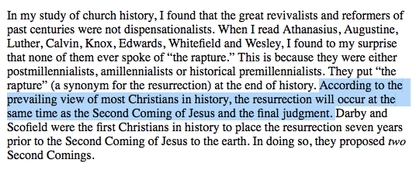
Although Premillennialism Is A Popular Teaching Today, This Has Not Always Been The Case.
Notes:
A Premillenial Interpretation demands that we take clear passages and FORCE them to match figurative passages. This is totally backwards.

Slide 7
Now, Let’s Look At The Glorious Throne of God
Notes:
Everyone Jokes “God Wins”. This is true. Have you thought about WHO God wins against? Who is He in competition with?
I want to show you some key verses in the book of Revelation to establish that this book is God’s battle against two familiar foes.
1.) The Jewish Officials who rejected Christ and opposed the preaching of the Gospel.
2.) The Roman Emperors who required Christians to worship them as a god.

Slide 8
Revelation Chapter 4
The Throne of Our Holy God
“Immediately I was in the Spirit; and behold, a throne was standing in heaven, and One sitting on the throne.” (Rev 4:2)
And the four living creatures, each one of them having six wings, are full of eyes around and within; and day and night they do not cease to say, “Holy, holy, holy is the Lord God, the Almighty, who was and who is and who is to come.” (Rev. 4:8)

Slide 9
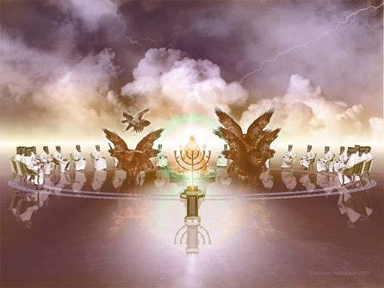
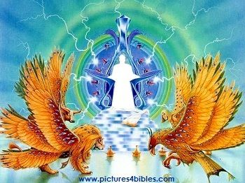
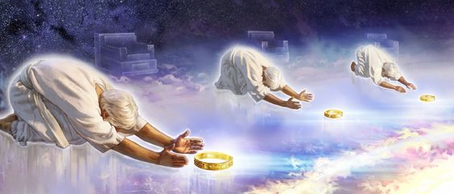
The Throne of our Holy God
Notes:
No one picture can fully capture this incredible scene.
As we read this – you’ll notice that John uses lots of images to describe the glory of the throne. But remember to think of this like a broadway play – We want to know WHERE IS THE SPOTLIGHT? The amazing backdrop is there to accentuate the main object of our focus – GOD.

Slide 10
Revelation Chapter 5
The Worthy Lamb
“And I saw a strong angel proclaiming with a loud voice, “Who is worthy to open the book and to break its seals?”(Rev 5:2)
“Worthy are You to take the book and to break its seals; for You were slain, and purchased for God with Your blood men from every tribe and tongue and people and nation.” (Rev. 5:9)
“saying with a loud voice, “Worthy is the Lamb that was slain to receive power and riches and wisdom and might and honor and glory and blessing.” (Rev. 5:12)

Slide 11
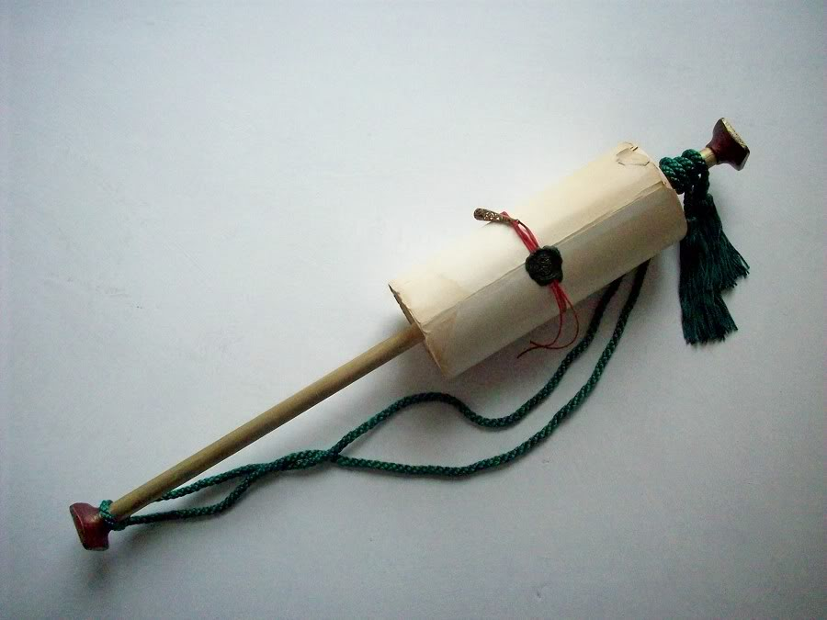
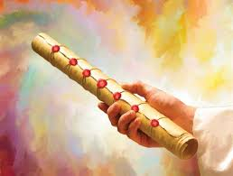
The Scroll with Seven Seals
Notes:
Jesus, the Lamb, is not described as worthy just to praise Him. He is described as worthy to open the seals of the scroll (or book).
This heavenly scene is the transition to the next section of the book – because as we’ve said all along – What happens in the spiritual realm is going to impact the physical realm.

Slide 12
Revelation Chapter 4 & Chapter 5
Chapter 4: The Throne of our Holy God.
Colorful, Vibrant, & Faithful (vs.1-3)
Active & Impressive (vs. 4-7)
HOLY, HOLY, HOLY (vs. 8)
“who lives forever and ever…” (vs. 10)
“glory and honor and thanks...” (vs. 11)

Slide 13
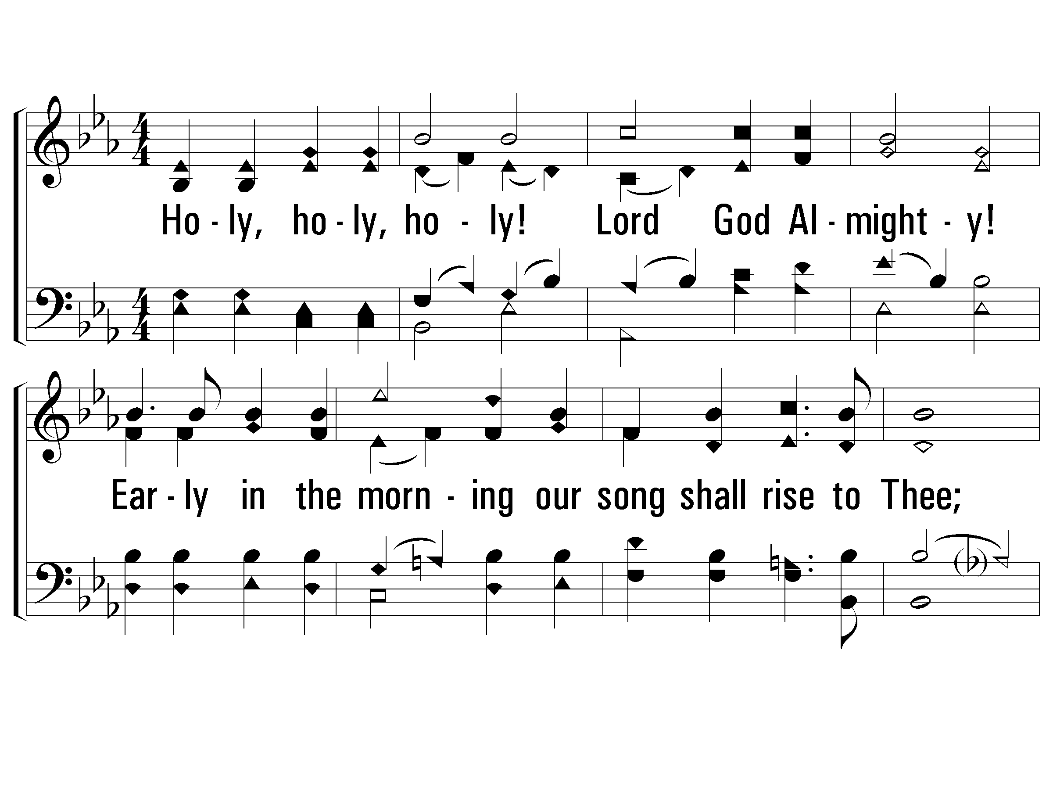
1 - Holy, Holy Holy!
238
1.
Holy, holy, holy! Lord God Almighty!
Early in the morning our song shall rise to Thee;
Holy, holy, holy! merciful and mighty!
God over all, and blest eternally.
Words by: Reginald Heber
Music by: John B. Dykes
© 2001 The Paperless Hymnal™

Slide 14
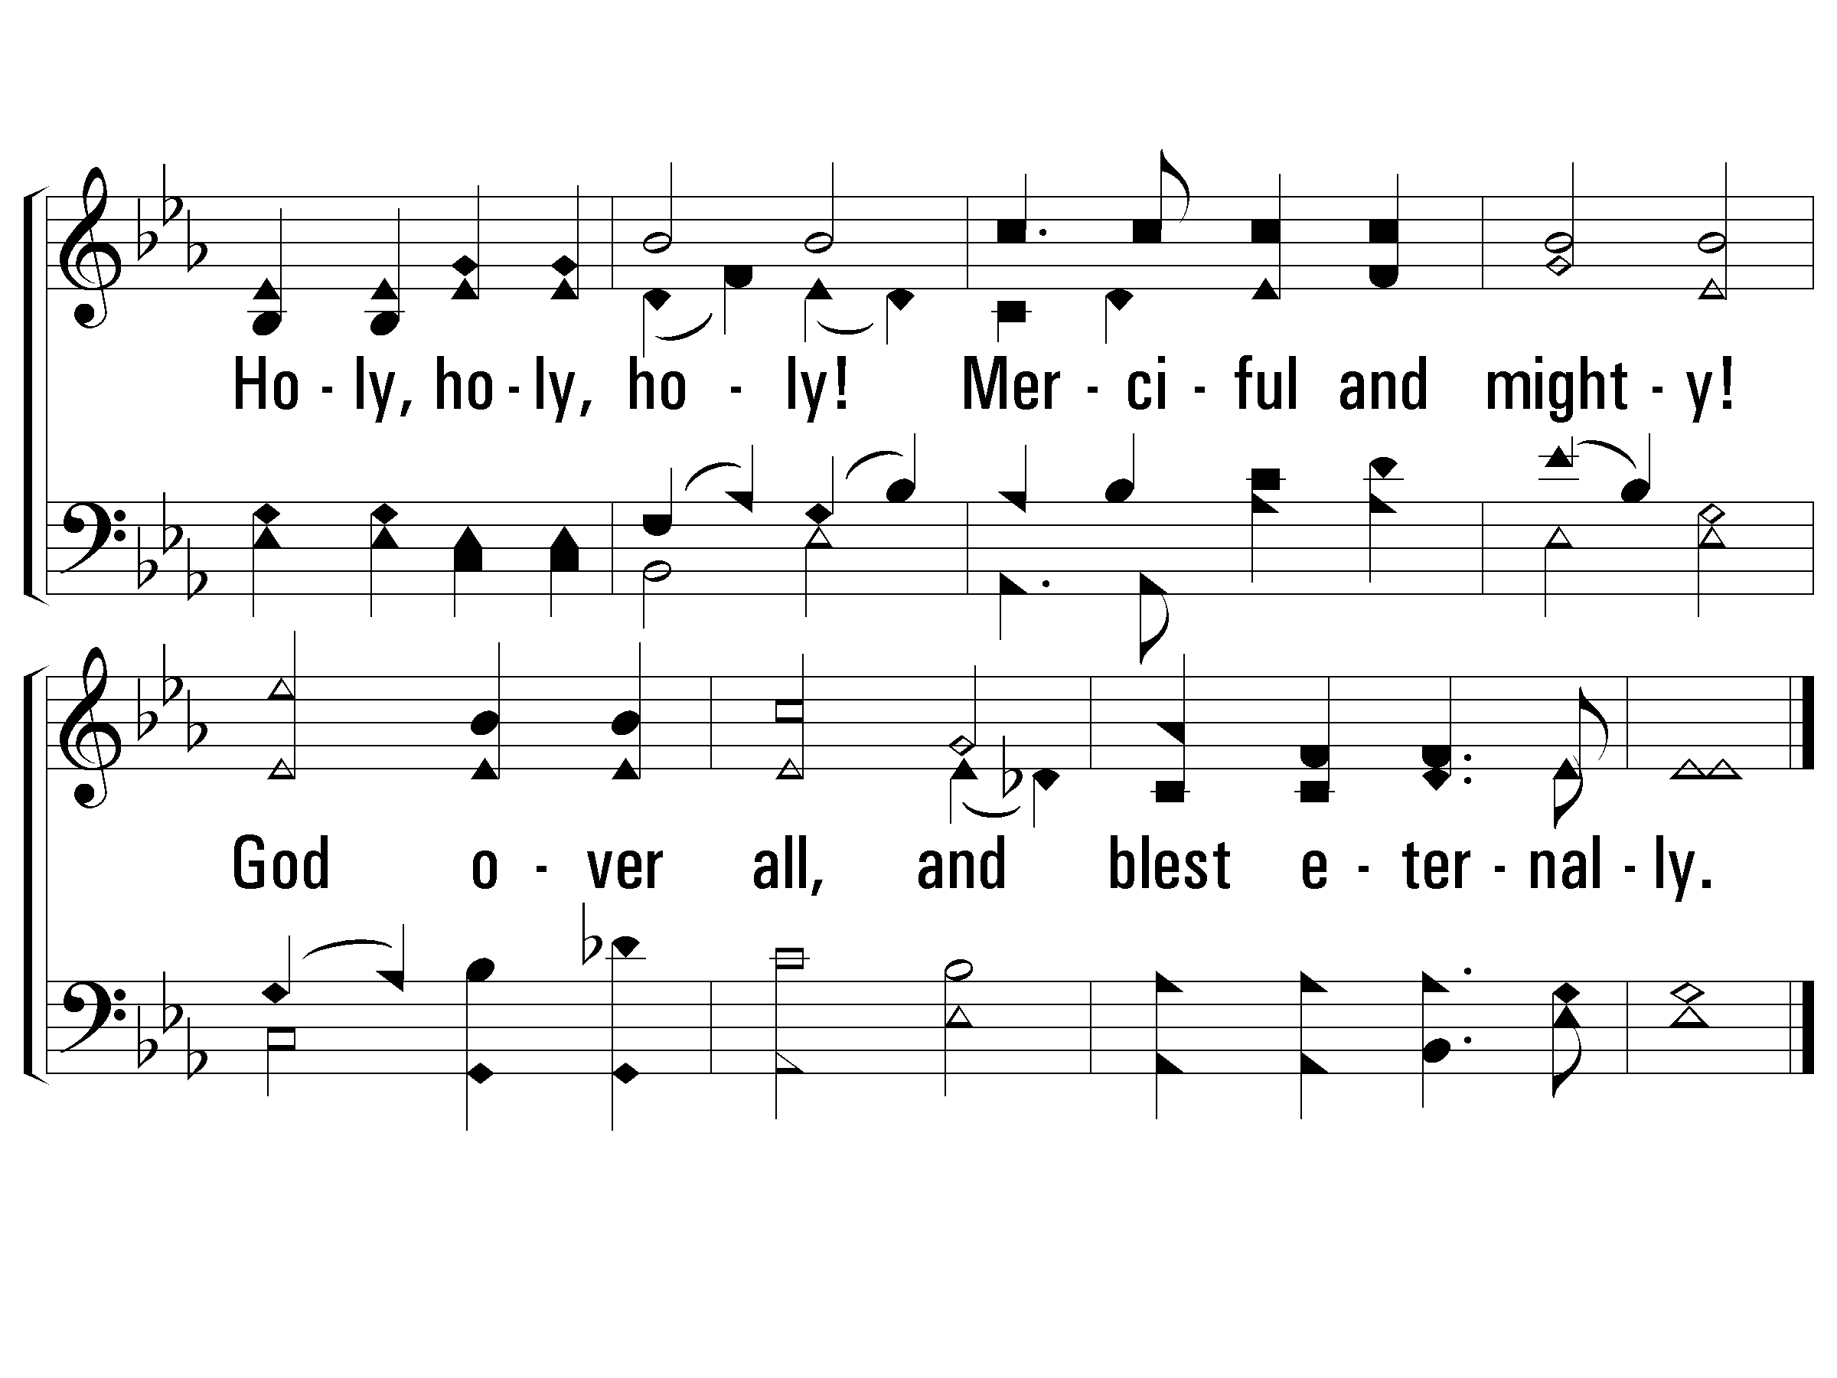
1 - Holy, Holy Holy!
238
© 2001 The Paperless Hymnal™

Slide 15
2 - Holy, Holy Holy!
238
2.
Holy, holy, holy! all the saints adore Thee,
Casting down their golden crowns around the crystal sea;
Cherubim and seraphim falling down before Thee,
Who wast, and art, and evermore shalt be.
Words by: Reginald Heber
Music by: John B. Dykes
© 2001 The Paperless Hymnal™

Slide 16
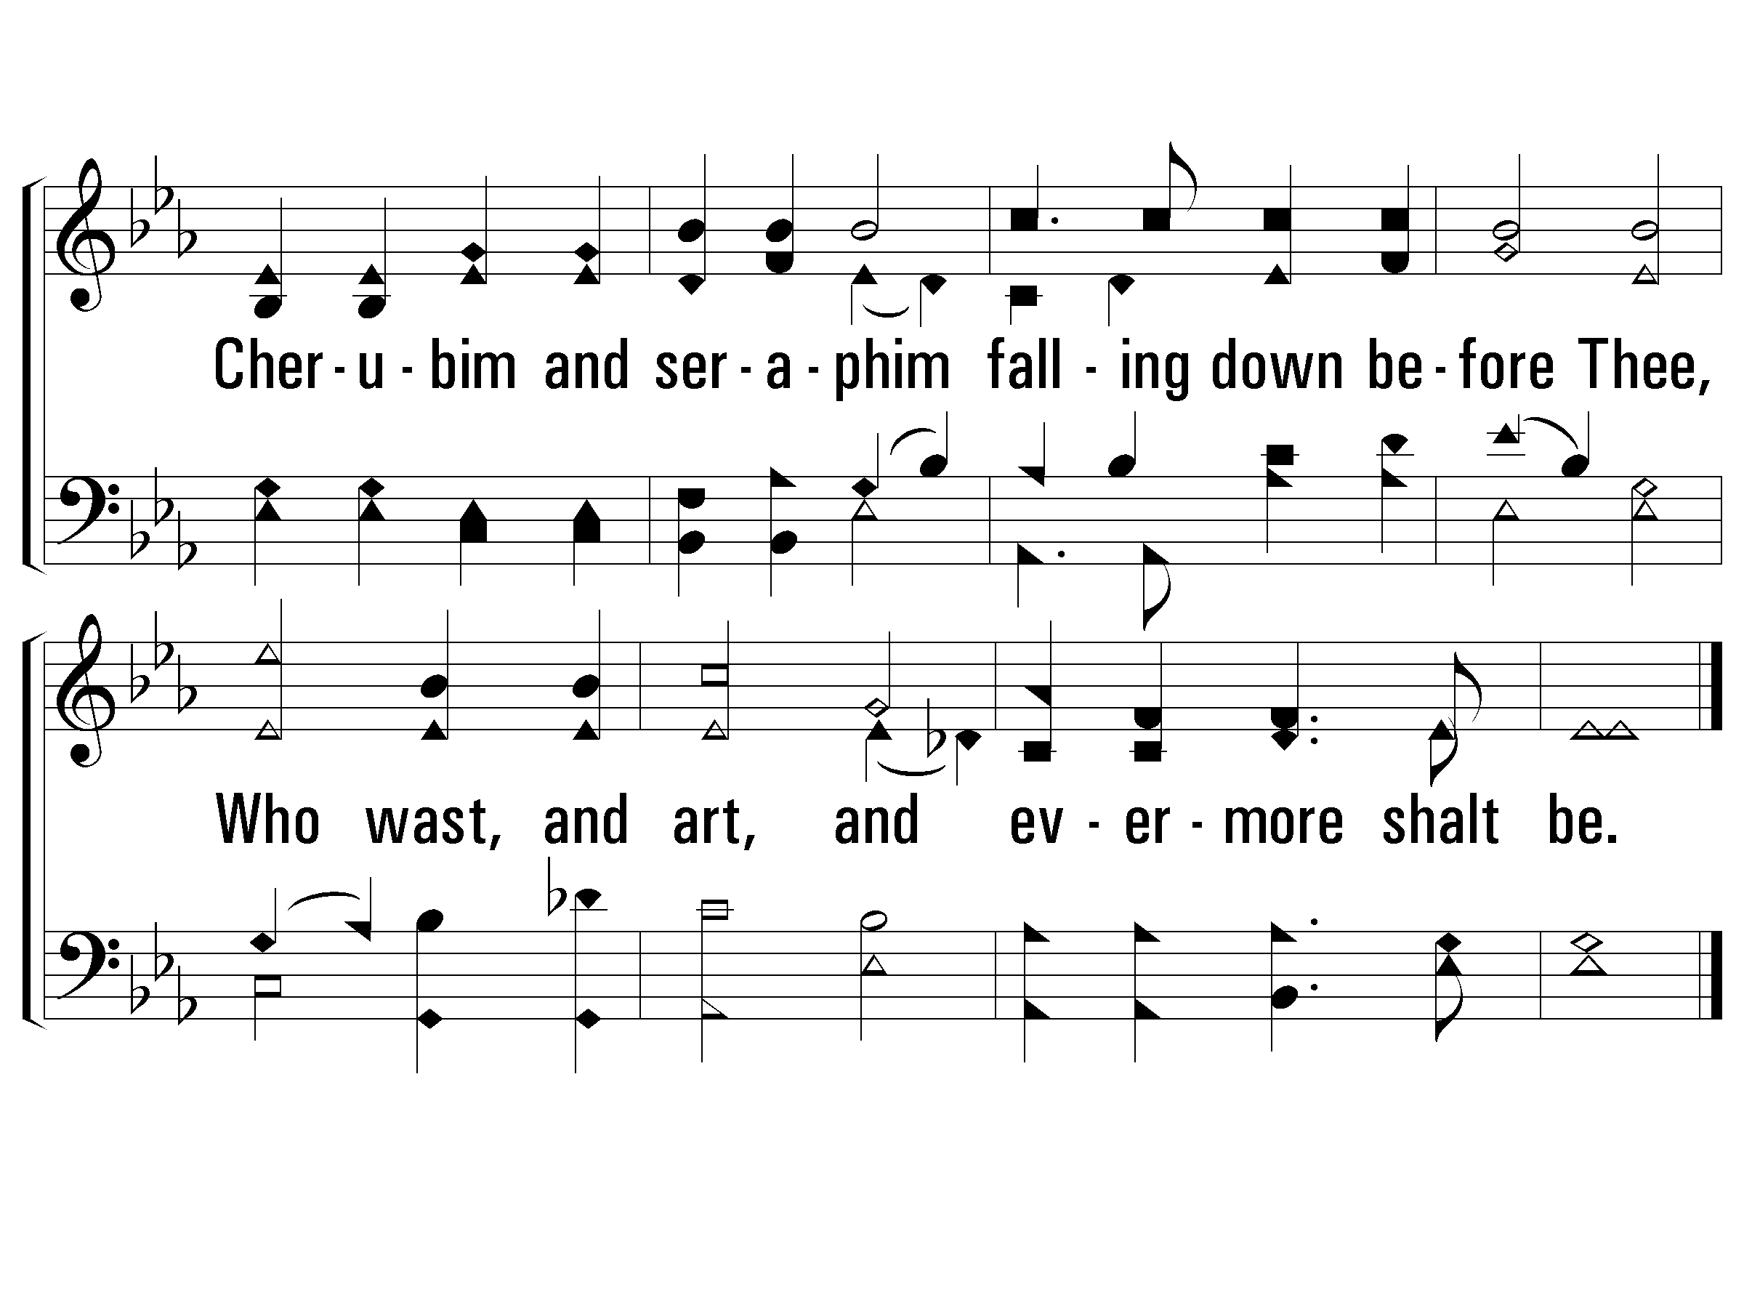
2 - Holy, Holy Holy!
238
© 2001 The Paperless Hymnal™

Slide 17
4 - Holy, Holy Holy!
238
4.
Holy, holy, holy! Lord God A-mighty!
All Thy works shall praise Thy name, in earth, and sky, and sea;
Holy, holy, holy! merciful and mighty!
God over all, and blest eternally.
Words by: Reginald Heber
Music by: John B. Dykes
© 2001 The Paperless Hymnal™

Slide 18
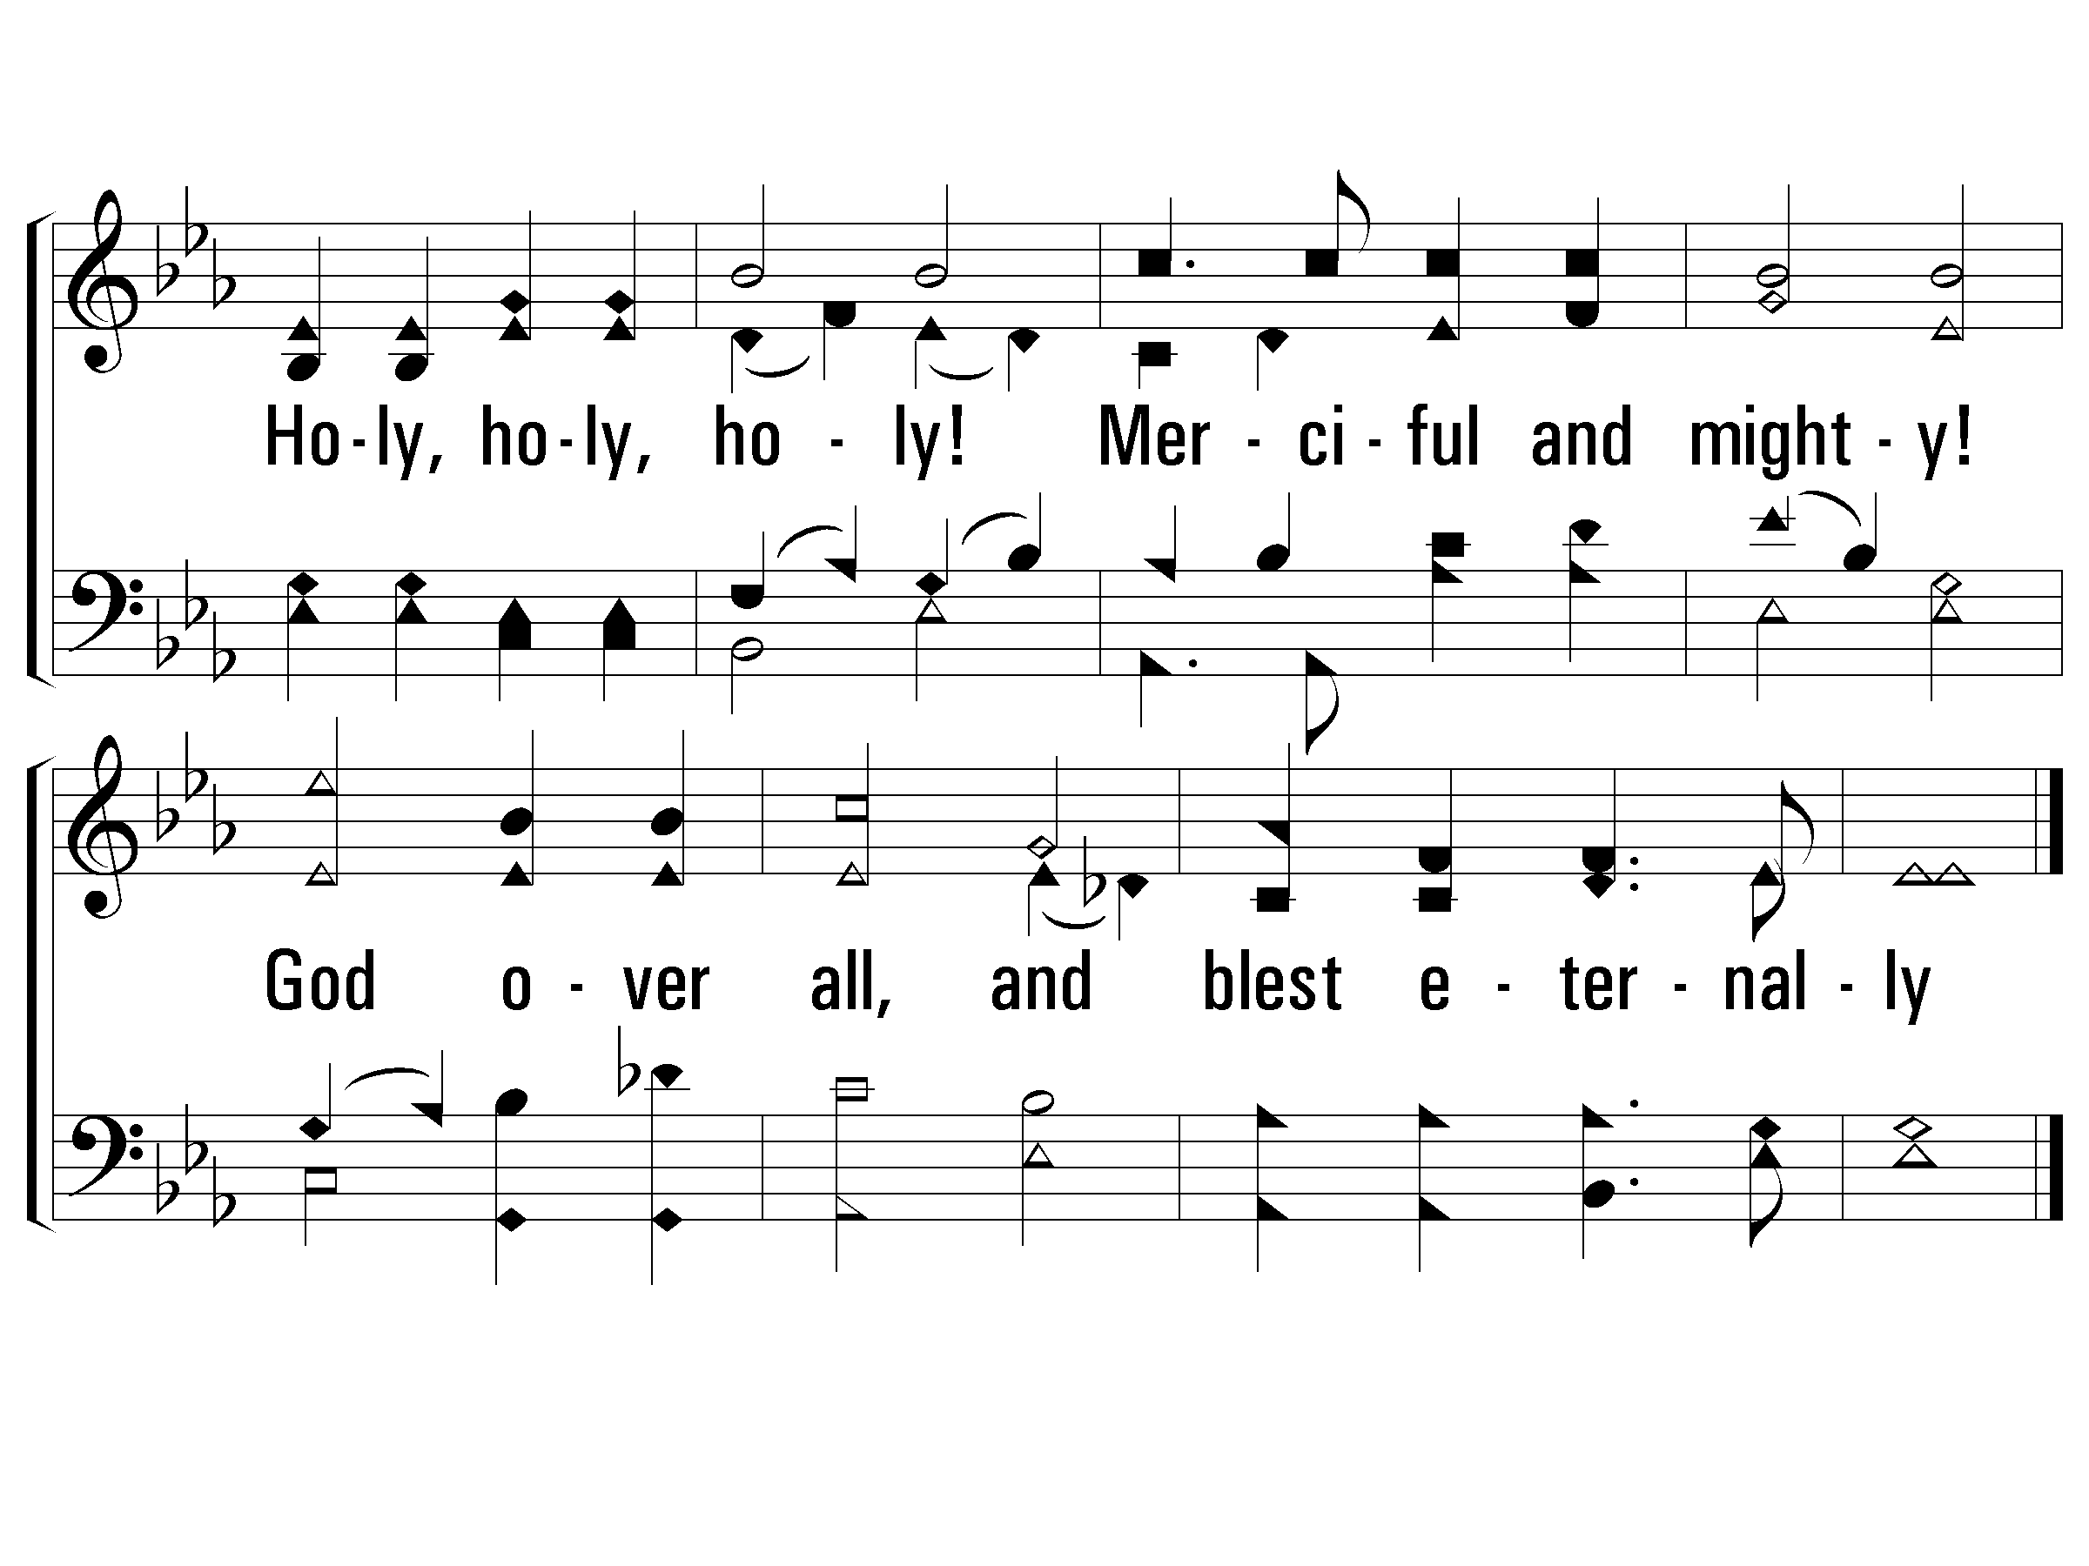
4 - Holy, Holy Holy!
238
© 2001 The Paperless Hymnal™

Slide 19
Revelation Chapter 4 & Chapter 5
Chapter 5: The Worthy Lamb
The Scroll with Seven Seals: A Sure & Complete Complete Message (vs. 1)
Search for Worthiness, Not Just Raw Strength (vs. 2-5)
The Worthy Qualities of Jesus (vs. 6-14)
Chapter 5: The Worthy Qualities of Jesus (vs. 6-14)
Vs 6: Complete Power (Horns) and Knowledge (Eyes)
Vs 9: You were slain
Vs 9: Purchased for God with Your blood men from every tribe…
Vs 10: Made them a kingdom and priests
Vs 12: Power, Riches, Wisdom, Might, Honor, Glory, Blessing
Vs 13: Every created thing praises the Lamb.
Vs 14: The 4 Living Creatures & Elders all Worship the Lamb

Slide 20
The Visions of Ezekiel & John
Ezekiel Sees Four Living Creatures
Ezekiel 1:5-12
Ezekiel Sees A Glorious Throne
Ezekiel 1:26-28
Notes:
The Key of David is a term found in Revelation and Isaiah. A key indicates control or authority; therefore, having the Key of David would give one control of David’s domain, i.e., Jerusalem, the City of David, and the kingdom of Israel.
In Isaiah ELIAKIM was given the key – the authority. It was taken away from the unworthy manager (SHEBNA).
Thus we are reminded that JESUS is the HEAD of the church. Our loyalty is not to the unworthy people who claim to lead the church. Our Loyalty is to the ONE TRUE KING, who holds the Key.
Consider the importance of this in relationship to vs. 9 – the synagogue of Satan… Those who would have rejected and Kicked out of the Synagogue the Jews who accepted the gospel.
Every Door That SATAN has slammed in our face – remember the DOOR that Jesus has opened to Salvation!!!

Slide 21
The Visions of Daniel & John
Daniel Sees A Great Throne
Daniel 7:9-10
Daniel Sees The Son of Man & His Kingdom
Daniel 7:13-14
Notes:
The Key of David is a term found in Revelation and Isaiah. A key indicates control or authority; therefore, having the Key of David would give one control of David’s domain, i.e., Jerusalem, the City of David, and the kingdom of Israel.
In Isaiah ELIAKIM was given the key – the authority. It was taken away from the unworthy manager (SHEBNA).
Thus we are reminded that JESUS is the HEAD of the church. Our loyalty is not to the unworthy people who claim to lead the church. Our Loyalty is to the ONE TRUE KING, who holds the Key.
Consider the importance of this in relationship to vs. 9 – the synagogue of Satan… Those who would have rejected and Kicked out of the Synagogue the Jews who accepted the gospel.
Every Door That SATAN has slammed in our face – remember the DOOR that Jesus has opened to Salvation!!!

Slide 22
Applications for Today
When I Face Challenges & Temptations, I Need To Stop & Remember The Most Holy God We Serve.
When I’m Tempted To Put Anything Above The Lord, I Need To Remember All That He Performed To Redeem Me.
When Following Jesus, I’m Following A Lion & A Lamb.
I want to imitate Him! Strong enough to win through sacrifice.
Everyone Needs To Hear The Good News of What Jesus Has Done!
“…for You were slain, and purchased for God with Your blood men from every tribe and tongue and people and nation. ¹⁰ “You have made them to be a kingdom and priests to our God; and they will reign upon the earth.”
Notes:
He Is Both Strong & Worthy.

Slide 23
Key Verses In The Book of Revelation
Rev. 1:1 “The Revelation of Jesus Christ…to show…soon take place.”
Rev. 1:5 “Jesus Christ…ruler of the kings of the earth…”
Rev. 1:20 “the seven lampstands are the seven churches…”
Rev. 2:4 (Eph.) “you have left your first love…”
Rev 2:10 (Smy.) “be faithful until death, and I will give you the crown of life.”
Rev 2:14 (Perg.) “I have a few things against you…the teaching of Balaam”
Rev 2:21 (Thy) “I gave her time to repent"
Rev 3:2 (Sar) “Wake up and strengthen the things that remain”
Notes:
Picture of Jesus in glory and in control over His churches.

Slide 24
Key Verses In The Book of Revelation
Rev 3:8 (Phil) “Behold I have put before you an open door”
Rev 3:19 (Laod) “I love, I reprove…therefore be zealous and repent.”
Rev. 4:2 “a throne was standing in heaven, and One sitting on the throne.”
Rev. 4:8 “Holy, holy, holy is the Lord God, the Almighty, who was and who is and who is to come.”
Rev. 5:9 “Worthy are You to take the book and to break its seals…”
Notes:
Picture of Jesus in glory and in control over His churches.

Slide 25
Revelation

Slide 26
Revelation Should Be Studied In Harmony With Other Clear Passages.
Passages That Discuss The Destruction of the World.
2 Peter 3:10-14
Passages That Discuss The Resurrection of All Mankind.
1 Corinthians 15:20-58
Passages That Discuss The Reign of Jesus.
1 Corinthians 15:25, 1 Timothy 6:13-16
Passages That Discuss The Return of Jesus.
1 Thessalonians 4:13 - 5:11
Notes:
How should we approach the rest of the book? On Sunday we wrapped up the 7 churches and now before we get into chapter 4 and 5 seems like the best time to discuss how we study this book as a a whole.
We’ve established that it is apocalyptic literature – with visions and symbolic language.
This language

