Slide 1
Revelation

Slide 2
Class Goals
To Better Understand The Language & Structure of Revelation.
To Understand The Purpose & Dramatic Style of Apocalyptic Literature.
To Identify Key Verses In Each Chapter As Stepping Stones of Understanding.
To Explain The Shortcomings of Premillennial Interpretations.
To Tackle A Challenging Book With The Support & Wisdom of Friends.
To More Clearly See The Events, Instructions, & Message of Revelation.
To See The Glory, Authority, Power, & Triumph of Jesus More Clearly.
To See The Limitations & Weaknesses of Earthly Kingdoms More Clearly.
To Fully Respond To The Insights Given In Revelation.
To Grow In Praise To God & Loyalty to His Kingdom.
To Increase Our Alertness & Preparation For The Judgment of God.
To Instill Courage & Hope In The Face of Persecutions.
To Stir Up Our Joy & Hope For Heaven.
Notes:
If we understand it – we can see it clearly. If we can see it clearly – we can respond to it.
To Emphasize Key Verses In Each Chapter That Provide Stepping Stones for Understanding the Full Book of Revelation.
To Examine & Understand The Use of Old Testament Language.

Slide 3
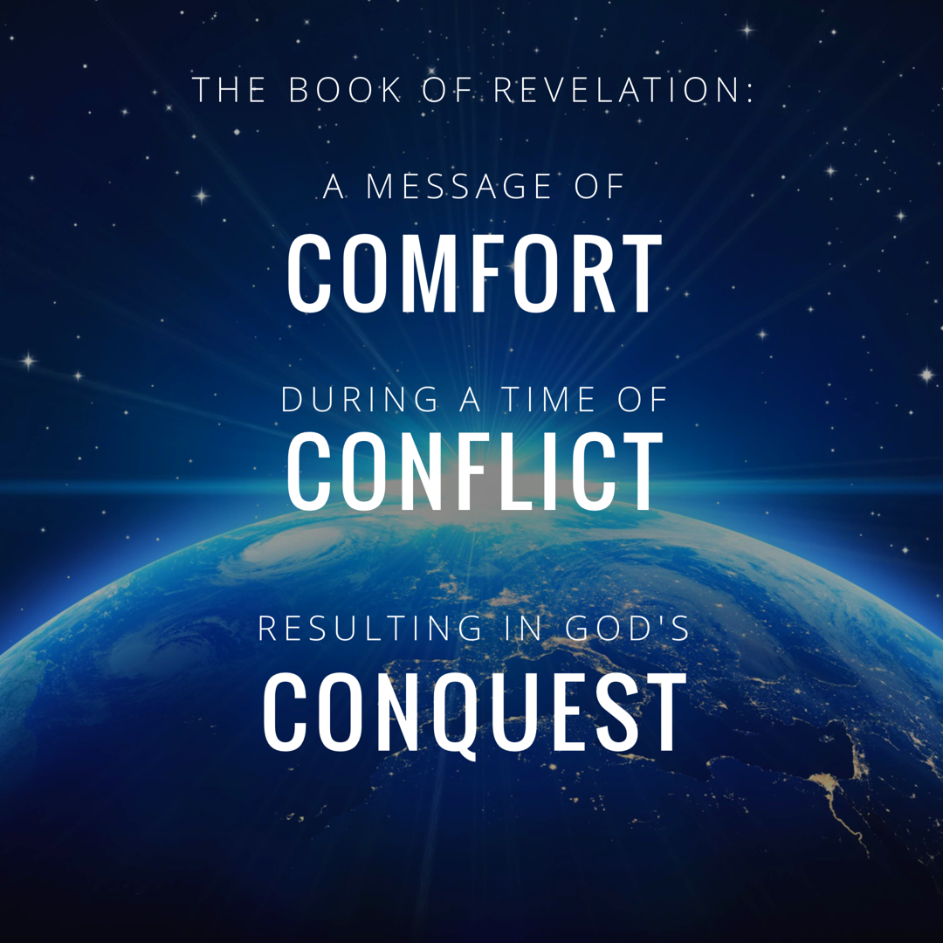

Slide 4
Revelation Chapter 1-3
Jesus Leads His Church
“The Revelation of Jesus Christ, which God gave Him to show to His bond-servants, the things which must soon take place; and He sent and communicated it by His angel to His bond-servant John,” (Rev 1:1)
“Do not fear what you are about to suffer. Behold, the devil is about to cast some of you into prison, so that you will be tested, and you will have tribulation for ten days. Be faithful until death, and I will give you the crown of life.” (Rev 2:10)
Notes:
A story, written in a time of crisis and distress, that is given by otherworldly beings explaining how God will reverse everything so the righteous will triumph.

Slide 5
Revelation Chapter 4
The Throne of Our Holy God
“Immediately I was in the Spirit; and behold, a throne was standing in heaven, and One sitting on the throne.” (Rev 4:2)
And the four living creatures, each one of them having six wings, are full of eyes around and within; and day and night they do not cease to say, “Holy, holy, holy is the Lord God, the Almighty, who was and who is and who is to come.” (Rev. 4:8)

Slide 6
Revelation Chapter 5
The Worthy Lamb
“And I saw a strong angel proclaiming with a loud voice, “Who is worthy to open the book and to break its seals?”(Rev 5:2)
“Worthy are You to take the book and to break its seals; for You were slain, and purchased for God with Your blood men from every tribe and tongue and people and nation.” (Rev. 5:9)
“saying with a loud voice, “Worthy is the Lamb that was slain to receive power and riches and wisdom and might and honor and glory and blessing.” (Rev. 5:12)

Slide 7
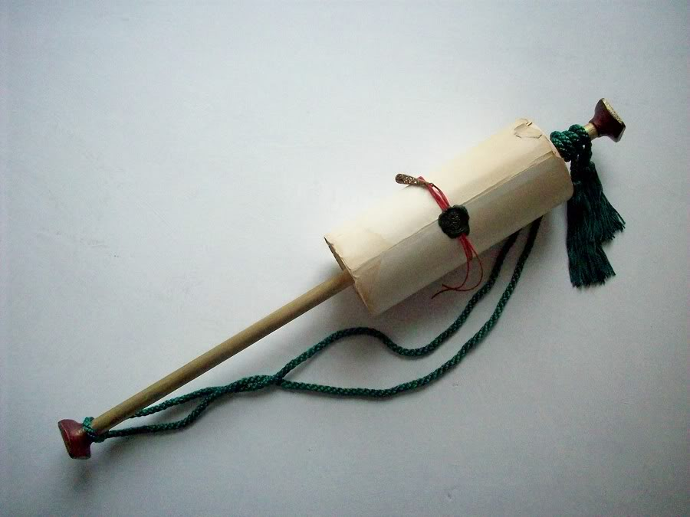
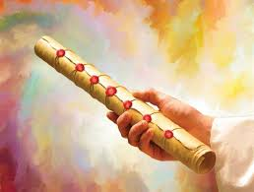
The Scroll with Seven Seals
Notes:
Jesus, the Lamb, is not described as worthy just to praise Him. He is described as worthy to open the seals of the scroll (or book).
This heavenly scene is the transition to the next section of the book – because as we’ve said all along – What happens in the spiritual realm is going to impact the physical realm.

Slide 8
Revelation Chapter 6
The Nation (Of Israel) Is Judged
“The sky was split apart like a scroll when it is rolled up, and every mountain and island were moved out of their places.” (Revelation 6:14)
And all the hosts of heaven will wear away, And the sky will be rolled up like a scroll All their hosts will also wither away As a leaf withers from the vine, Or as one withers from the fig tree.” (Isaiah 34:4)
Notes:
Cosmic Language. God describes everything being different. Hyperbole, focused on a national judgment.
Why describe it in such big terms? Because all of the other nations are to sit up and take notice.

Slide 9
Revelation Chapter 7
The People of God Are Identified & Protected
“saying “Do not harm the earth or the sea or the trees until we have sealed the bond-servants of our God on their foreheads.” (Revelation 7:3)
“The LORD said to him, “Go through the midst of the city, even through the midst of Jerusalem, and put a mark on the foreheads of the men who sigh and groan over all the abominations which are being committed in its midst.” (Ezekiel 9:4)

Slide 10
Revelation Chapter 8
A Portion of Israel Begins To Suffer.
“And the seven angels who had the seven trumpets prepared themselves to sound them.” (Revelation 8:6)
“The fourth angle sounded, and a third of the sun and a third of the moon and a third of the stars were struck, so that a third of them would be darkened and the day would not shine for a third of it, and the night in the same way. Then I looked, and I heard an eagle flying in midheaven, saying with a loud voice, “Woe, woe, woe…” (Revelation 8:12-13)
Notes:
If you want a phrase for the whole chapter I would say: Silence Followed By Suffering.
The judgement that was pronounced in Chapter 6 as each seal was opened – is now beginning to occur. And this judgment affects a third of the people.

Slide 11
Prophetic Judgement Language: Fire, Blood, Mountains, Wormwood, & Eagles
Bitter Wickedness -> Brings Bitter Punishment.
“The Lord said, “Because they have forsaken My law which I set before them and have not obeyed My voice…therefore thus says the LORD of hosts, the God of Israel, “behold, I will feed them, this people, with wormwood and give them poisoned water to drink.” (Jeremiah 9:13-16)
Source of Poison -> Will Suffer from Poison. (Jeremiah 23:15)

Slide 12
Prophetic Judgement Language: Fire, Blood, Mountains, Wormwood, & Eagles
Like An Eagle Swooping Down on Its Prey.
“The LORD will bring a nation against you from far away, from the end of the earth, swooping down like the eagle, a nation whose language you do not understand, a hard-faced nation who shall not respect the old or show mercy to the young.” (Deuteronomy 28:49-50)

Slide 13
Revelation Chapter 9
A Great Army Comes Against The Nation of Israel.
“The appearance of the locusts was like horses prepared for battle; and on their heads appeared to be crowns like gold, and their faces were like the faces of men.” (Revelation 9:7)
“and they did not repent of their murders nor of their sorceries nor of their immorality nor of their thefts. (Revelation 9:21)
“What the gnawing locust has left, the swarming locust has eaten; And what the creeping locust has left, the stripping locust has eaten.” “Their appearance is like the appearance of horses; And like war horses, so they run. With a noise as of chariots…” (Joel 1:4, 2:4-5a)
Notes:
In CH. 8 we had to look to Zechariah, Ezekiel, Daniel, and Deuteronomy. We learned that there would be all kinds of difficulties and suffering. But now we learn that God is going to go beyond the realm of nature. On top of the agricultural, economic, and health problems they were facing – now they will be facing an ARMY!
But in CH. 9 – it is Joel, Joel, and Joel!
In Joel 1:10 the destruction of the Locusts are described as affecting the plants (just like in Rev. 8).
In Joel 2:3 the destruction of the Locusts are described like a raging fire (just like in Rev. 8)
In Joel 2:4-5 the locusts themselves are described as a great army with horses and chariots (just like in Rev. 9)
In Joel 2:12 the Lord is looking for repentance – and now in Rev. 9 we see the Lord looking for repentance – but there is none.
A great army has truly come to carry out God’s judgment!
In Joel 3 – the nations that have afflicted Jerusalem are judged…and guess what…as the book of Revelation continues we will see that the Roman Empire will be judged too!

Slide 14
Revelation Chapter 10
The Delay Is Ending So John Must Prepare To Act.
“…there will be delay no longer, but in the days of the voice of the seventh angel, when he is about to sound, then the mystery of God is finished, as He preached to His servants the prophets.” (Revelation 10:6b-7)
“I took the little book out of the angel’s hand and ate it, and in my mouth it was sweet as honey; and when I had eaten it, my stomach was made bitter. And they said to me, “You must prophesy again concerning many peoples and nations and tongues and kings.” (Revelation 10:10-11)
Notes:
I hope you remember that after 6 seals were opened – there was a pause….it was clear that Judgment was decreed – but in ch 7 the people of God were identified and protected - only then was the 7th seal removed.
Now, again, 6 trumpets have sounded – and there is a pause to prepare John to prophesy – only then will the final trumpet sound.
The Delay Is Ending So John Must Prepare To Act.
The Roar of A Strong Angel Produces 7 Thunders: (10:1-4)
This scene is a great example of apocalyptic literature providing impressive details, but asking us to focus on something even more important.
Before The Seventh Trumpet: (Rev. 10:5-11, 11:15)
John Must Prepare Himself To Prophesy Before The 7th Trumpet.
“but in the days of the voice of the seventh angel, when he is about to sound, then the mystery of God is finished, as He preached to His servants the prophets.” (10:7)
Ezekiel 2:8– Ezekiel 3:4, Psalm 19:10

Slide 15
Revelation Chapter 11
The Faithful Worship & Witness As Judgment Arrives.
“Then there was given me a measuring rod like a staff; and someone said, “Get up and measure the temple of God and the altar, and those who worship in it.” (Revelation 11:1)
“And I will grant authority to my two witnesses, and they will prophecy for twelve hundred and sixty days, clothed in sackcloth.” (Revelation 11:3)
“When they have finished their testimony, the beast that comes up out of the abyss will make war with them, and overcome them and kill them.” (Revelation 11:7)
Notes:
If you want a phrase for the whole chapter I would say: Silence Followed By Suffering.
The judgement that was pronounced in Chapter 6 as each seal was opened – is now beginning to occur. And this judgment affects a third of the people.

Slide 16
Revelation Chapter 12
The Heavenly Victory Behind The Earthly Difficulty.
“And there was war in heaven, Michael and his angels waging war with the dragon. The dragon and his angels waged war, “ (Rev 12:7)
“And they overcame him because of the blood of the Lamb and because of the word of their testimony, and they did not love their life even when faced with death.” (Revelation 12:11)
“So the dragon was enraged with the woman, and went off to make war with the rest of her children, who keep the commandments of God and hold to the testimony of Jesus.” (Revelation 12:17)
Notes:
If you want a phrase for the whole chapter I would say: Silence Followed By Suffering.
The judgement that was pronounced in Chapter 6 as each seal was opened – is now beginning to occur. And this judgment affects a third of the people.

Slide 17
Revelation Chapter 11
The Faithful Worship & Witness As Judgment Arrives.
Measure The Temple
To Identify & Spiritually Protect The True People of God.
Taking Measurements: Zechariah 2:1-5, Revelation 21:15-17,
NT “Temple” Designation: 1 Corinthians 3:16, Ephesians 2:19-21
Tread Under Foot
Luke 21:24 “…and Jerusalem will be trampled underfoot…”
3.5 = A Broken 7.
A time, times, and half a time / 42 months / 1260 day
A limited period of time full of distress and persecution.
Years, Months, Days indicate duration.
Notes:
If you want a phrase for the whole chapter I would say: Silence Followed By Suffering.
The judgement that was pronounced in Chapter 6 as each seal was opened – is now beginning to occur. And this judgment affects a third of the people.

Slide 18
Revelation Chapter 11
The Faithful Worship & Witness As Judgment Arrives.
The Two Witnesses
Vs. 3: They Are Described By The Number Two; Sufficient To Establish The Truth.
Vs. 4: They Serve By The Power of the Spirit. (Zechariah 4:3, 11-14)
Vs. 5: Their Power Is In Their Words. (2 Kings 1:10)
Vs. 6: They Are Characterized By Moses & Elijah. (The Law & The Prophets)
Luke 24:27, 44-45
Vs. 7-12: They Will Be Killed & Disgraced, But Given Life & Victory By God.
The Great City: A City Full of Sinful Rejection
“the beast” (Daniel 7:7, Rev 13)
“Spiritually Called” Sodom & Egypt (Jer. 23:14, Ezekiel 23:19)
“Where Also Their Lord Was Crucified” (Jerusalem)
Notes:
Sackcloth: - for times of mourning and distress. Esther 4:1-3
Vs. 6 – They have a mastery of the Scriptures & being able to explain ALL the prophets foretold.
Odd to me that people look to make “2” literal when everything else is figurative, but ok.
So some see it as the Law & Prophets (taught by the apostles and other Christians)
So some see it as the Apostles & the Holy Spirit (John reference)
But, regardless of the exact identification: these are servants of God who are FAITHFULLY maintaining their testimony (see 12:11)
Daniel 9:24-27 (See Handout) Big thing: “about you and your people”
The Law & the Prophets declared this would take place – the apostles, prophets, and saints of the first century preached this message by the power of the Spirit.

Slide 19
Revelation Chapter 11
The Faithful Worship & Witness As Judgment Arrives.
The Seventh Trumpet, aka The Third Woe (vs. 15-19)
The Rule & Kingdom of Christ Are Confirmed!
The National Judgment on Israel Is Complete
“Your wrath came”
“lightning and sounds and peals of thunder and an earthquake and a great hailstorm.”
Lord, Prepare ME TO BE A SANCTUARY (vs. 19)
The Temple Measured & Preserved (vs. 1-2)
The Temple Seen In Heaven With God’s Faithfulness & Presence (vs 19)
Notes:
Oh, Lord prepare me, to be a Sanctuary, pure and holy, tried and true.
This victory is hard fought – but wonderful….and in ch 12 It. Gets. Better!
Think of this chapter – it begins and ends with God taking note of the SANCTUARY. Father, help us to always worship You, and be faithful in our testimony!

Slide 20
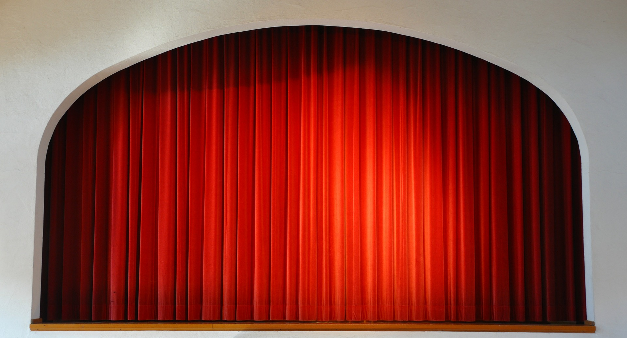

Slide 21
Revelation Chapter 12
The Heavenly Victory Behind The Earthly Difficulty.
“And there was war in heaven, Michael and his angels waging war with the dragon. The dragon and his angels waged war, “ (Rev 12:7)
“And they overcame him because of the blood of the Lamb and because of the word of their testimony, and they did not love their life even when faced with death.” (Revelation 12:11)
“So the dragon was enraged with the woman, and went off to make war with the rest of her children, who keep the commandments of God and hold to the testimony of Jesus.” (Revelation 12:17)
Notes:
If you want a phrase for the whole chapter I would say: Silence Followed By Suffering.
The judgement that was pronounced in Chapter 6 as each seal was opened – is now beginning to occur. And this judgment affects a third of the people.

Slide 22
Revelation Chapter 12
The Heavenly Victory Behind The Earthly Difficulty.
The People of God “A Woman” (Micah 4:9-10)
Easy To Mistake For Mary, But Notice Vs 17. “her children, who keep the commandments of God and hold to the testimony of Jesus.”
Wings of God’s Safety (The Remnant)
The Devil “The Great Red Dragon, Satan”
“cast out” Jesus’ Victory In The Cross & Resurrection (John 12:31-33)
“knowing that he has only a short time” “he persecuted the woman”
“so the dragon was enraged”
Jesus Christ “A Son, A Male Child”
Seen As Born of Spiritual Israel (Not Just Mary).
“Rule with Rod of Iron” (Psalm 2:7-9, Revelation 19:15)
Notes:
Woman: 12 stars – Israel. Crown (different from a diadem. - think temporary tiara vs. permanent king.). She has authority and honor.
Horns – symbol of power (think of a Ram battling for dominance)

Slide 23
Revelation Chapter 12
The Heavenly Victory Behind The Earthly Difficulty.
Applications For Today
Our Battle Is Spiritual & Our Victory Is Certain.
They That Wait Upon The Lord Shall Mount Up With Wings Like Eagles!
Deliverance from Slavery (Exodus 19:4)
Isaiah 40:31
“And they OVERCAME him because of the blood of the Lamb…” (vs. 11)
Notes:
If you want a phrase for the whole chapter I would say: Silence Followed By Suffering.
The judgement that was pronounced in Chapter 6 as each seal was opened – is now beginning to occur. And this judgment affects a third of the people.

Slide 24
1 – Faith is the Victory
134
1.
Encamped along the hills of light,
Ye Christian soldiers, rise,
And press the battle ere the night
Shall veil the glowing skies.
Against the foe in vales below
Let all our strength be hurled;
Faith is the victory, we know,
That overcomes the world.
Words by: John H. Yates
Music by: Ira D. Sankey
© 2001 The Paperless Hymnal™

Slide 25
1 – Faith is the Victory
134
© 2001 The Paperless Hymnal™

Slide 26
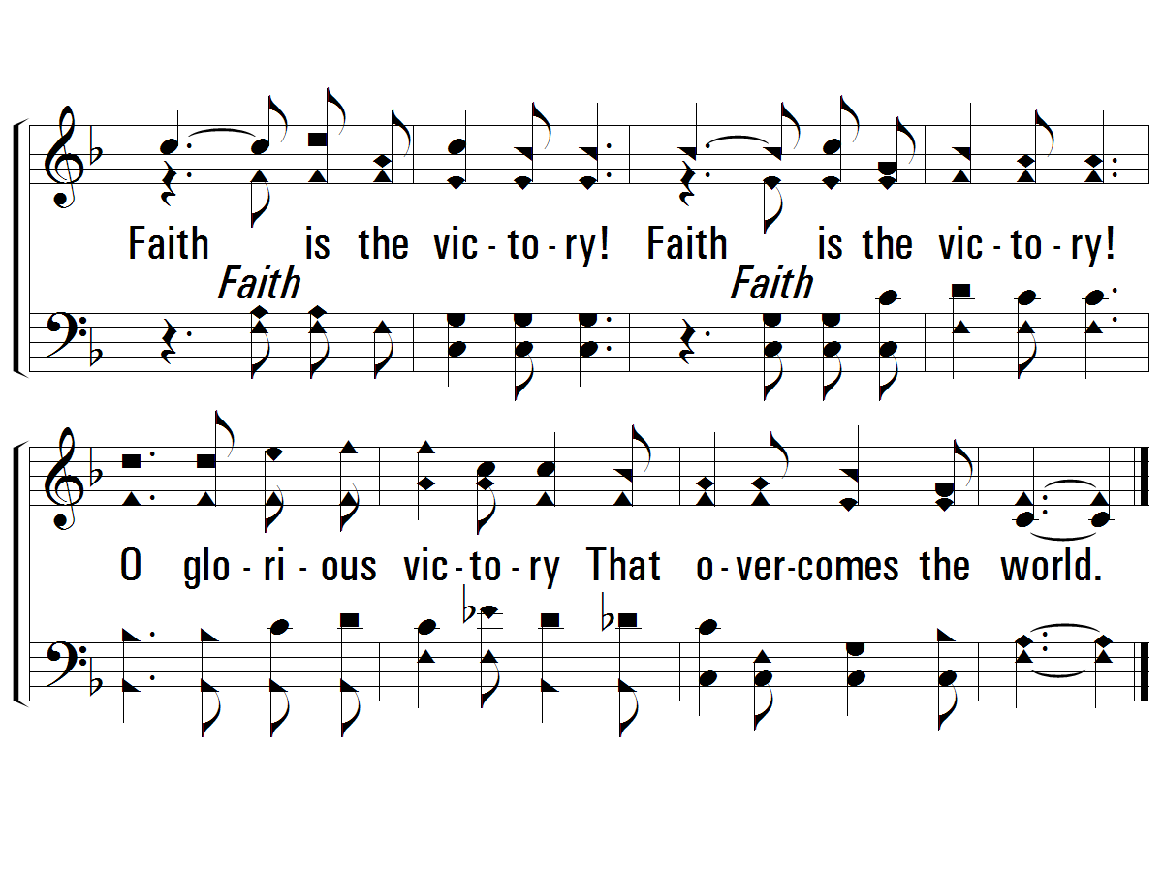
c – Faith is the Victory
134
Faith is the victory!
Faith is the victory!
O glorious victory
That overcomes the world.
© 2001 The Paperless Hymnal™

Slide 27
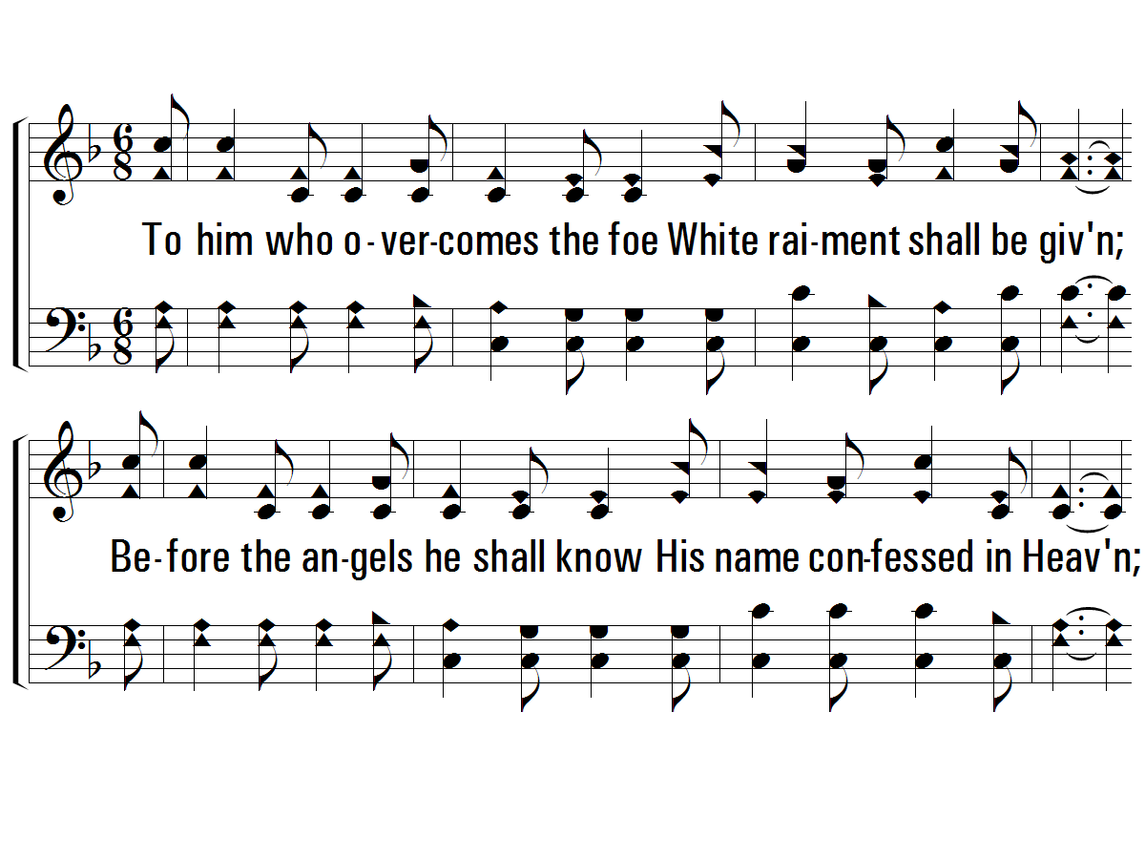
4 – Faith is the Victory
134
4.
To him who overcomes the foe
White raiment shall be given;
Be-fore the angels he shall know
His name confessed in Heaven;
Then onward from the hills of light,
Our hearts with love aflame;
We'll vanquish all the hosts of night,
In Jesus' conquering name.
Words by: John H. Yates
Music by: Ira D. Sankey
© 2001 The Paperless Hymnal™

Slide 28
4 – Faith is the Victory
134
© 2001 The Paperless Hymnal™

Slide 29
c – Faith is the Victory
134
Faith is the victory!
Faith is the victory!
O glorious victory
That overcomes the world.
© 2001 The Paperless Hymnal™

Slide 30
Revelation

Slide 31
God’s Judgment Upon The Jewish Officials & God’s Victory Over Roman Persecution
Jesus Rules His Church & Rewards Those Who Overcome.
Revelation 1-3
Judgment Begins On Earth Against Those Who Reject Christ (Likely The Jewish Officials.)
Revelation 4-7
Judgment Is Accomplished & Jesus Is Verified As The Ultimate King.
Revelation 8-11 (Emphasis on 11:15-17)
Satan Attacks The Church with Roman Political Pressure.
Revelation 12-13 (Emphasis on 13:4, 13:17)
Satan & His Allies Are Defeated.
Revelation 14-19 (Emphasis 17:16, 18:11, 19:2, 19:10)
Jesus Reigns Forever.
Revelation 20-22
Notes:
How should we approach the rest of the book? On Sunday we wrapped up the 7 churches and now before we get into chapter 4 and 5 seems like the best time to discuss how we study this book as a a whole.
We’ve established that it is apocalyptic literature – with visions and symbolic language.
** This book deals with the two biggest problems facing Christians. **. We know what these 2 problems are simply from reading the book of Acts. We see time and time again that Paul’s effort to spread the gospel is interrupted by Jews who violently oppose the gospel.
They had to face Jewish Officials who rallied the community against them, seeking imprisonment and execution.
And, They had to face Roman Officials who required them to worship the Emperor as a god to demonstrate national loyalty.
JUDGEMENT BEGINS ON EARTH….against who? Well in ch 2 and 3 we saw that it was a combo of false teachers and Jewish people in the synagogues what were rejecting Christ. So possibly against Jewish nation – in which some see the fall of Jerusalem.
But Christians didn’t just face opposition from Jews. Christians also faced opposition from Roman Emperors who demanded to be worshipped as a god.
Rome Itself is going to oppose Christians. This could be scary. It’s one thing to take on a local synoguge leader. It’s another thing completely to feel like you are up against the ENTIRE ROMAN EMPIRE.

Slide 32
Key Verses In The Book of Revelation
Rev. 1:1 “The Revelation of Jesus Christ…to show…soon take place.”
Rev. 1:5 “Jesus Christ…ruler of the kings of the earth…”
Rev. 1:20 “the seven lampstands are the seven churches…”
Rev. 2:4 (Eph.) “you have left your first love…”
Rev 2:10 (Smy.) “be faithful until death, and I will give you the crown of life.”
Rev 2:14 (Perg.) “I have a few things against you…the teaching of Balaam”
Rev 2:21 (Thy) “I gave her time to repent"
Rev 3:2 (Sar) “Wake up and strengthen the things that remain”
Notes:
Picture of Jesus in glory and in control over His churches.

Slide 33
Key Verses In The Book of Revelation
Rev 3:8 (Phil) “Behold I have put before you an open door”
Rev 3:19 (Laod) “I love, I reprove…therefore be zealous and repent.”
Rev 4:2 “a throne was standing in heaven, and One sitting on the throne.”
Rev 4:8 “Holy, holy, holy is the Lord God, the Almighty, who was and who is and who is to come.”
Rev 5:9 “Worthy are You to take the book and to break its seals…”
Rev 6:14 “The sky was split apart like a scroll…”
Rev 7:3 “Do not harm the earth…until we have sealed the bond-servants of our God on their foreheads.”
Notes:
Picture of Jesus in glory and in control over His churches.

Slide 34
Revelation Should Be Studied In Harmony With Other Clear Passages.
Passages That Discuss The Destruction of the World.
2 Peter 3:10-14
Passages That Discuss The Resurrection of All Mankind.
1 Corinthians 15:20-58
Passages That Discuss The Reign of Jesus.
1 Corinthians 15:25, 1 Timothy 6:13-16
Passages That Discuss The Return of Jesus.
1 Thessalonians 4:13 - 5:11
Notes:
How should we approach the rest of the book? On Sunday we wrapped up the 7 churches and now before we get into chapter 4 and 5 seems like the best time to discuss how we study this book as a a whole.
We’ve established that it is apocalyptic literature – with visions and symbolic language.
This language

