Slide 1
Revelation

Slide 2
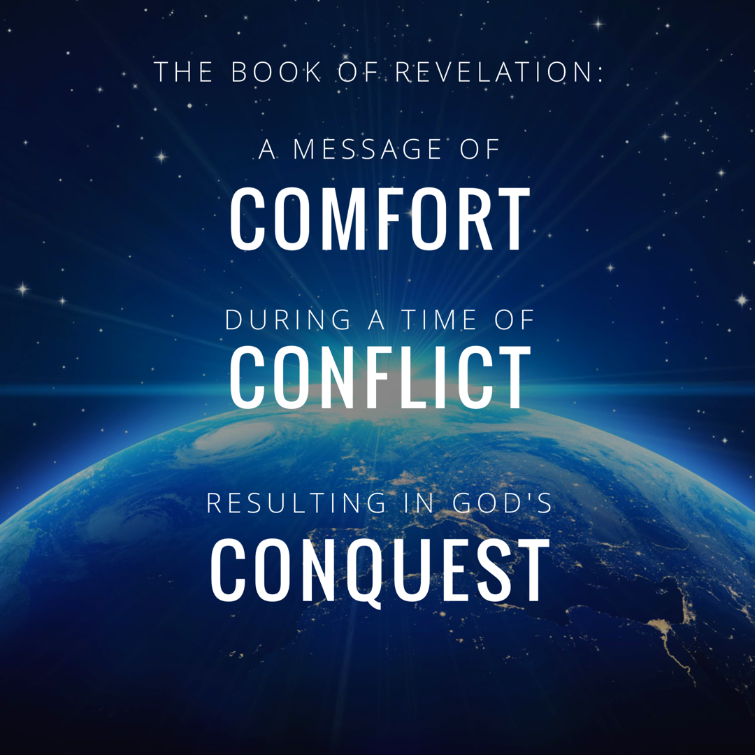
Notes:
In studying 12 we really rejoiced in GOD’s CONQUEST.
Rev. 12:11 “And they overcome him because of the blood of the Lamb and because of the word of their testimony, and they did not love their life even when faced with death.”

Slide 3
Revelation Chapter 1-3
Jesus Leads His Church
“The Revelation of Jesus Christ, which God gave Him to show to His bond-servants, the things which must soon take place; and He sent and communicated it by His angel to His bond-servant John,” (Rev 1:1)
“Do not fear what you are about to suffer. Behold, the devil is about to cast some of you into prison, so that you will be tested, and you will have tribulation for ten days. Be faithful until death, and I will give you the crown of life.” (Rev 2:10)
Notes:
A story, written in a time of crisis and distress, that is given by otherworldly beings explaining how God will reverse everything so the righteous will triumph.

Slide 4
Revelation Chapter 4-5
The Throne of Our Holy God
And the four living creatures, each one of them having six wings, are full of eyes around and within; and day and night they do not cease to say, “Holy, holy, holy is the Lord God, the Almighty, who was and who is and who is to come.” (Rev. 4:8)
The Worthy Lamb
“Worthy are You to take the book and to break its seals; for You were slain, and purchased for God with Your blood men from every tribe and tongue and people and nation.” (Rev. 5:9)

Slide 5
Revelation Chapter 6-8
The Nation (Of Israel) Is Judged
“The sky was split apart like a scroll when it is rolled up, and every mountain and island were moved out of their places.” (Revelation 6:14)
The People of God Are Identified & Protected
“saying “Do not harm the earth or the sea or the trees until we have sealed the bond-servants of our God on their foreheads.” (Revelation 7:3)
A Portion of Israel Begins To Suffer.
“And the seven angels who had the seven trumpets prepared themselves to sound them.” (Revelation 8:6)

Slide 6
Revelation Chapter 9-10
A Great Army Comes Against The Nation of Israel.
“The appearance of the locusts was like horses prepared for battle; and on their heads appeared to be crowns like gold, and their faces were like the faces of men.” (Revelation 9:7)
The Delay Is Ending So John Must Prepare To Act.
“…there will be delay no longer, but in the days of the voice of the seventh angel, when he is about to sound, then the mystery of God is finished, as He preached to His servants the prophets.” (Revelation 10:6b-7)

Slide 7
Revelation Chapter 11
The Faithful Worship & Witness As Judgment Arrives.
“Then there was given me a measuring rod like a staff; and someone said, “Get up and measure the temple of God and the altar, and those who worship in it.” (Revelation 11:1)
“And I will grant authority to my two witnesses, and they will prophecy for twelve hundred and sixty days, clothed in sackcloth.” (Revelation 11:3)
“When they have finished their testimony, the beast that comes up out of the abyss will make war with them, and overcome them and kill them.” (Revelation 11:7)
Notes:
If you want a phrase for the whole chapter I would say: Silence Followed By Suffering.
The judgement that was pronounced in Chapter 6 as each seal was opened – is now beginning to occur. And this judgment affects a third of the people.

Slide 8
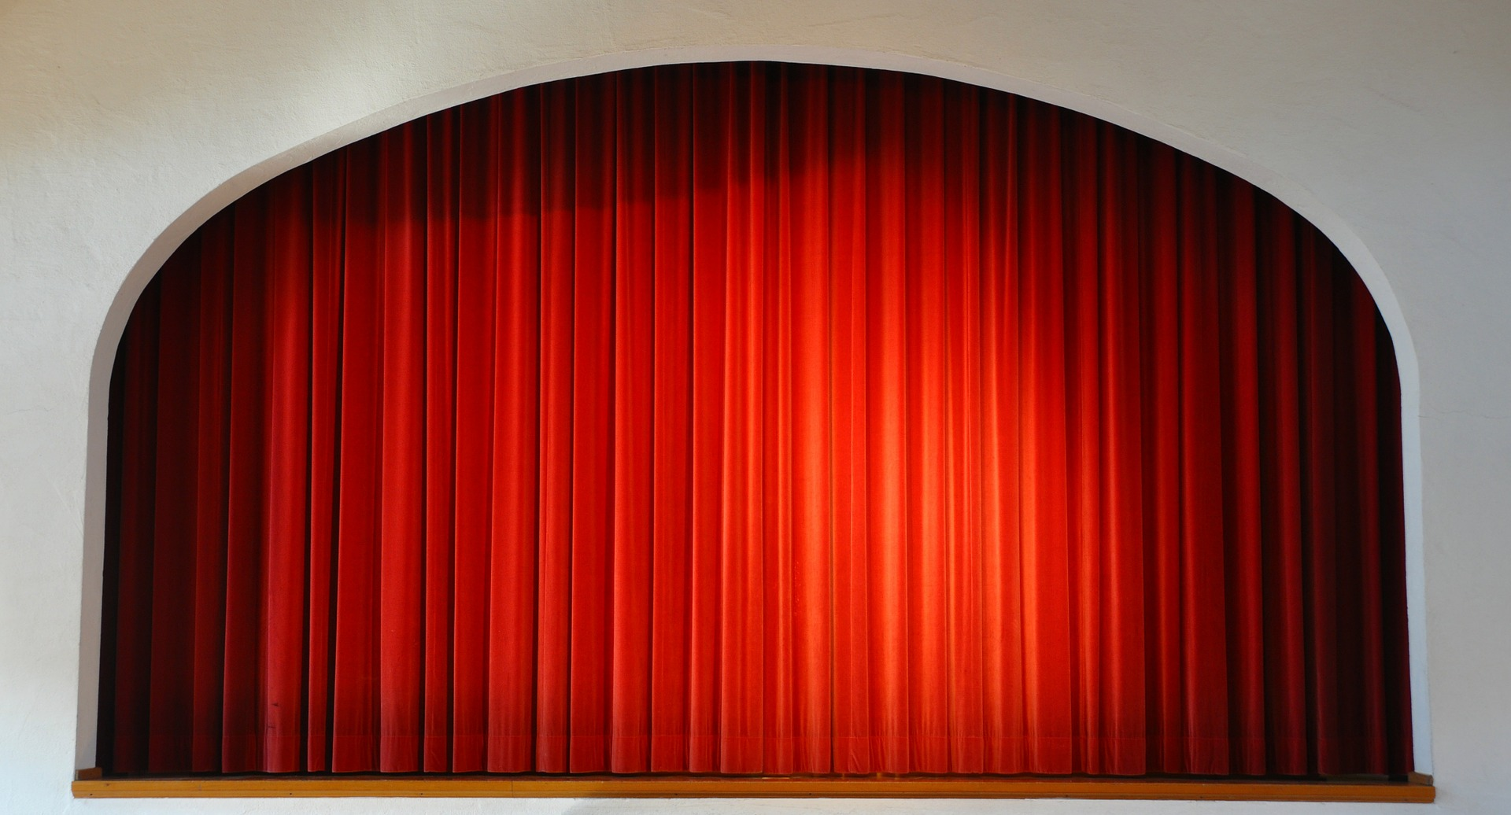

Slide 9
Revelation Chapter 12
The Heavenly Victory Behind The Earthly Difficulty.
“And there was war in heaven, Michael and his angels waging war with the dragon. The dragon and his angels waged war, “ (Rev 12:7)
“And they overcame him because of the blood of the Lamb and because of the word of their testimony, and they did not love their life even when faced with death.” (Revelation 12:11)
“So the dragon was enraged with the woman, and went off to make war with the rest of her children, who keep the commandments of God and hold to the testimony of Jesus.” (Revelation 12:17)
Notes:
If you want a phrase for the whole chapter I would say: Silence Followed By Suffering.
The judgement that was pronounced in Chapter 6 as each seal was opened – is now beginning to occur. And this judgment affects a third of the people.

Slide 10
“The Dragon Went Off To Make War…”

Slide 11
Revelation Chapter 13
Satan Stirs Up The Roman Empire Against The Saints.
“they worshipped the dragon because he gave his authority to the beast; and they worshipped the beast, saying, “Who is like the beast, and who is able to wage war with him?” (Rev 13:4)
“It was also given to him to make war with the saints and to overcome them, and authority over every tribe and people and tongue and nation was given to him.” (Rev 13:7)
“They I saw another beast coming up out of the earth; and he had two horns like a lamb and he spoke as a dragon.” (Rev 13:11)
Notes:
If you want a phrase for the whole chapter I would say: Silence Followed By Suffering.
The judgement that was pronounced in Chapter 6 as each seal was opened – is now beginning to occur. And this judgment affects a third of the people.

Slide 12
Revelation Chapter 13
Satan Stirs Up The Roman Empire Against The Saints.
The Beast of Daniel 7 and Revelation 13 Is The Same: Rome
Both Come From the Sea (Rev. 13:1 and Daniel 7:3)
Both Have 10 Horns (Rev. 13:1 and Daniel 7:7)
Both Speak Blasphemies (Rev. 13:1,5,6, and Daniel 7:8,25)
Both Have Limited Influence (Rev. 13:5 and Daniel 7:25)
Both Make War With The Saints (Rev. 13:7 and Daniel 7:21-22)
The Beast (Roman Empire) Recovers & Appears Unstoppable
The lack of leadership that would be fatal to many world powers did not destroy Rome.
“I believe this likely refers to the civil war that broke out within the Roman Empire for over one year after the death of Emperor Nero…Four emperors, Galba, Otho, Vitellius, and Vespasian, all seized the throne in less than one year. …It was a time of unrest and upheaval…”
Notes:
Sackcloth: - for times of mourning and distress. Esther 4:1-3
Vs. 6 – They have a mastery of the Scriptures & being able to explain ALL the prophets foretold.
Odd to me that people look to make “2” literal when everything else is figurative, but ok.
So some see it as the Law & Prophets (taught by the apostles and other Christians)
So some see it as the Apostles & the Holy Spirit (John reference)
But, regardless of the exact identification: these are servants of God who are FAITHFULLY maintaining their testimony (see 12:11)
Daniel 9:24-27 (See Handout) Big thing: “about you and your people”
The Law & the Prophets declared this would take place – the apostles, prophets, and saints of the first century preached this message by the power of the Spirit.

Slide 13
Revelation Chapter 13
Satan Stirs Up The Roman Empire Against The Saints.
The Blaspheme of The Beast
“and on his heads were blasphemous names…” 13:1
“a mouth speaking arrogant words and blasphemies…” 13:5
“he opened his mouth in blasphemies against God…” 13:6
“to blaspheme His name and His tabernacle, that is, those who dwell in heaven.” 13:6
The Repulsive Pride of Man Is On Display
Similar Descriptions in Daniel 11:36-37 and 2 Thessalonians 2:3-4
Lord, Help Us To See The Beauty of Humility!
Revelation 13:1-10 Show Us What Christians Are Up Against.
Satan Is Enraged & Attacking The People of God (12:17)
In Verse 8-10, John Calls Us To Take Note! The Rage of Satan will lead to the Imprisonment and Death of the Saints. Would We Spread The Gospel Anyway?
Notes:
Repulsive Pride: At a minimum – it is the same behavior in these pasages – and we see God’s disgust!

Slide 14
Revelation Chapter 13
Satan Stirs Up The Roman Empire Against The Saints.
“Then I Saw Another Beast…” (13:11)
Looks Like A Lamb, But Speaks Like A Dragon.
Religious Function: Compels People To Worship The Beast
Described As The “False Prophet” In Rev. 16:13
Tools: Weather Manipulation, Deceit, Idolatry (Rev. 13:13-14, Genesis 3:4, Job 1:16,19)
In Roman History We See The Religious Pressure Faced:
There were temples dedicated to the deity of Caesar in every city described in Rev 2-3.
There was a priesthood of the imperial cult promoting Emperor worship.
There was a “Commune of Asia” representing the major cities of the region demanding that people participate in Emperor worship.
The pressure would be political, social, and economic as well: vs. 16-18
Notes:
John Saw This Trouble Coming!

Slide 15
Revelation Chapter 13
Satan Stirs Up The Roman Empire Against The Saints.
“Then I Saw Another Beast…” (13:11, 16-18)
The Mark Is A Symbol of Ownership & Loyalty.
Our Faith Will Impact Our Finances. (Matthew 6:24)
The Number of the Beast: 666
John DOES NOT recommend Gemetria, the practice of assigning numbers to alphabetic characters.
John DOES EXPLAIN the key quality of the number: “the number is that of a man”
The 7th Day: The Sabbath, The Day God Rested. (Completeness, Perfection)
The 6th Day: The Day of Man’s Creation. (Human, Incomplete, Imperfection)
God Is Worthy of Worship: He Is Holy, Holy, Holy (Revelation 4:8)
Rome Is Not Worthy of Worship: It Is Human, Human, Human (Revelation 13:18)
Notes:
Repeated in Rev. 15:2
6 represented incompleteness, coming short of perfection.
Not just “Human” – but WEAK, WEAK, WEAK. DUST, DUST, DUST,
LESS, LESS, LESS,

Slide 16
Revelation Chapter 14
The Lamb Stirs Up His Angels Against Babylon.
“These are the ones who have not been defiled with women, for they have kept themselves chaste. These are the ones who follow the Lamb wherever He goes. These have been purchased from among men as first fruits to God and to the Lamb. (Rev 14:4)
“and he said with a loud voice, “Fear God, and give Him glory, because the hour of His judgment has come; worship Him who made the heavens and the earth and sea and springs of waters.”(7)
“So the angel swung his sickle to the earth and gathered the clusters from the vine fo the earth, and threw them into the great wine press of the wrath of God.” (Rev 14:19)
Notes:
14:7 is one of the most important lessons of the entire book!
No idolatry!!! Worship ONLY GOD!
A.) The False Lamb and the True Lamb.
B.) The Choice of Who We Will Worship Brings Punishment or Reward
C.) We Welcome or Fear the Reaping.

Slide 17
Revelation Chapter 14
The Lamb Stirs Up His Angels Against Babylon.
The True Lamb Is Shown In Contrast To The False Lamb of Ch. 13.
Qualities of the 144,000
His Name & His Father’s Name: Loyalty & Ownership
Praise & Purchase: A New Song
Purity: Faithfulness, Clothed In Good Works (2 Corinthians 11:2, Rev. 19:7-8)
Truthful: Opposite The Lies of The Dragon, Beast, & False Prophet
Blameless: No Charge Against Them Can Be Sustained
Does God See These Qualities In Me?
Notes:
He is standing on Mt. Zion! ( OT Reference)
14:7 is one of the most important lessons of the entire book!
No idolatry!!! Worship ONLY GOD!

Slide 18
Revelation Chapter 14
The Lamb Stirs Up His Angels Against Babylon.
The True Lamb Is Shown In Contrast To The False Lamb of Ch. 13.
Announcements By Three Angels: “And I Saw…”
One: The Eternal Gospel: Worship God!
Two: “Fallen, fallen is Babylon the great…”
Three: “he also will drink fo the wine of the wrath of God…”
Who Will We Worship? Contrasts of The Punishment & Rewards
“wrath of God…in full strength in the cup of His anger…the smoke of their torment goes up forever and ever.”
“Blessed are the dead who die in the Lord from now on…rest from their labors, for their deeds follow with them.”
Notes:
The Punishment and Reward are Contrasted.

Slide 19
Revelation Chapter 14
The Lamb Stirs Up His Angles Against Babylon.
The True Lamb Is Shown In Contrast To The False Lamb of Ch. 13.
The Lamb Is The King (Matthew 13:24-30, 36-43)
He Is Heavenly
He Is The Son of Man
He Is Truly Wealthy
He Is Royal
He Is Directing the Harvest
He Is Cheered On By The Angels (vs. 15)
Psalm 60:3, 75:8, Isa 51:17, 63:3-6, Jer. 25:15-16, 51:7
Notes:
Vs. 15- Do it! Do it! Let your great work be done!

Slide 20
Revelation

Slide 21
Revelation Should Be Studied In Harmony With Other Clear Passages.
Passages That Discuss The Destruction of the World.
2 Peter 3:10-14
Passages That Discuss The Resurrection of All Mankind.
1 Corinthians 15:20-58
Passages That Discuss The Reign of Jesus.
1 Corinthians 15:25, 1 Timothy 6:13-16
Passages That Discuss The Return of Jesus.
1 Thessalonians 4:13 - 5:11
Notes:
How should we approach the rest of the book? On Sunday we wrapped up the 7 churches and now before we get into chapter 4 and 5 seems like the best time to discuss how we study this book as a a whole.
We’ve established that it is apocalyptic literature – with visions and symbolic language.
This language

