Slide 1
Revelation

Slide 2
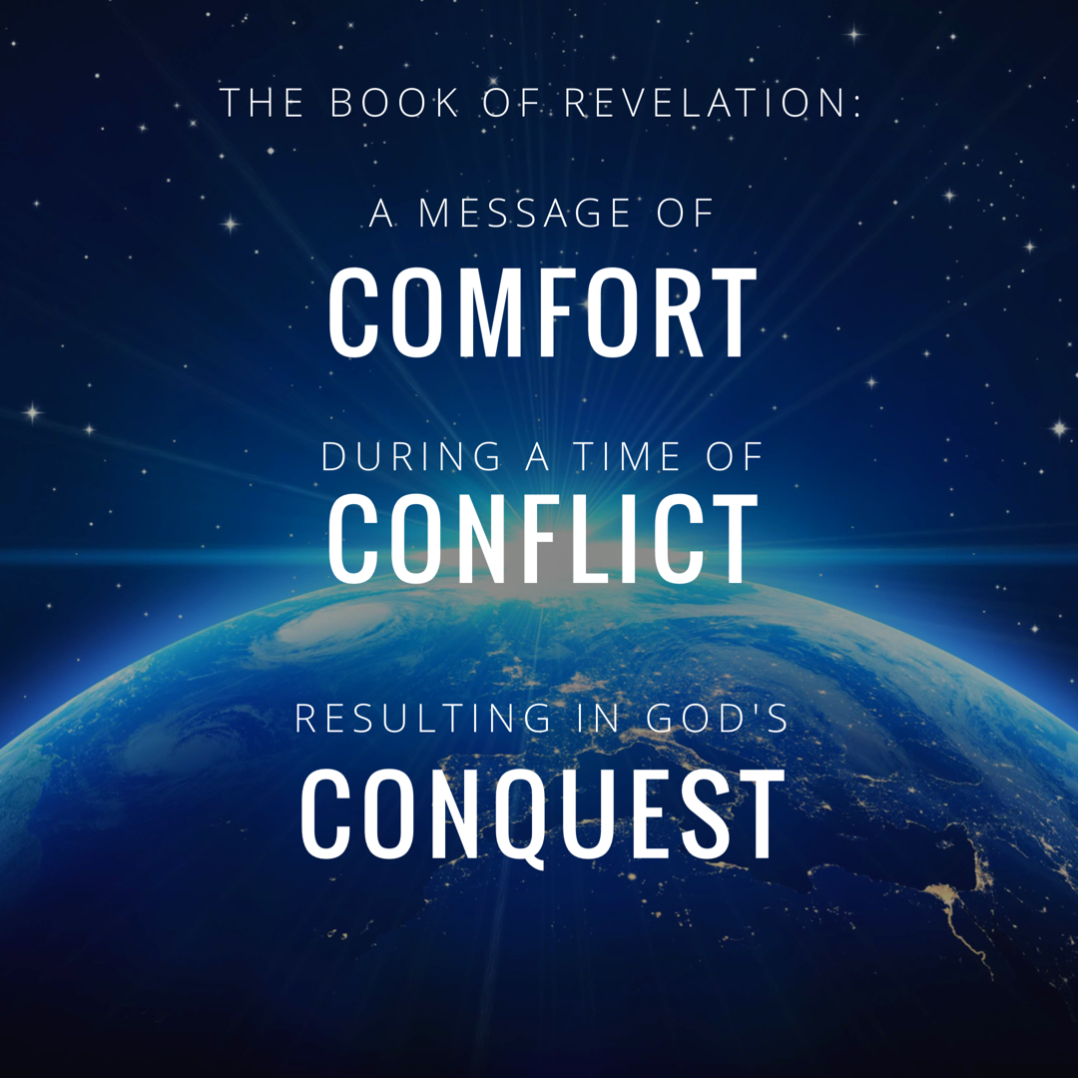
Notes:
In studying 12 we really rejoiced in GOD’s CONQUEST.
Rev. 12:11 “And they overcome him because of the blood of the Lamb and because of the word of their testimony, and they did not love their life even when faced with death.”

Slide 3
Revelation Chapter 1-3
Jesus Leads His Church
“The Revelation of Jesus Christ, which God gave Him to show to His bond-servants, the things which must soon take place; and He sent and communicated it by His angel to His bond-servant John,” (Rev 1:1)
“Do not fear what you are about to suffer. Behold, the devil is about to cast some of you into prison, so that you will be tested, and you will have tribulation for ten days. Be faithful until death, and I will give you the crown of life.” (Rev 2:10)
Notes:
A story, written in a time of crisis and distress, that is given by otherworldly beings explaining how God will reverse everything so the righteous will triumph.

Slide 4
Revelation Chapter 4-5
The Throne of Our Holy God
And the four living creatures, each one of them having six wings, are full of eyes around and within; and day and night they do not cease to say, “Holy, holy, holy is the Lord God, the Almighty, who was and who is and who is to come.” (Rev. 4:8)
The Worthy Lamb
“Worthy are You to take the book and to break its seals; for You were slain, and purchased for God with Your blood men from every tribe and tongue and people and nation.” (Rev. 5:9)

Slide 5
Revelation Chapter 6-8
The Nation (Of Israel) Is Judged
“The sky was split apart like a scroll when it is rolled up, and every mountain and island were moved out of their places.” (Revelation 6:14)
The People of God Are Identified & Protected
“saying “Do not harm the earth or the sea or the trees until we have sealed the bond-servants of our God on their foreheads.” (Revelation 7:3)
A Portion of Israel Begins To Suffer.
“And the seven angels who had the seven trumpets prepared themselves to sound them.” (Revelation 8:6)

Slide 6
Revelation Chapter 9-10
A Great Army Comes Against The Nation of Israel.
“The appearance of the locusts was like horses prepared for battle; and on their heads appeared to be crowns like gold, and their faces were like the faces of men.” (Revelation 9:7)
The Delay Is Ending So John Must Prepare To Act.
“…there will be delay no longer, but in the days of the voice of the seventh angel, when he is about to sound, then the mystery of God is finished, as He preached to His servants the prophets.” (Revelation 10:6b-7)

Slide 7
Revelation Chapter 11
The Faithful Worship & Witness As Judgment Arrives.
“Then there was given me a measuring rod like a staff; and someone said, “Get up and measure the temple of God and the altar, and those who worship in it.” (Revelation 11:1)
“And I will grant authority to my two witnesses, and they will prophecy for twelve hundred and sixty days, clothed in sackcloth.” (Revelation 11:3)
“When they have finished their testimony, the beast that comes up out of the abyss will make war with them, and overcome them and kill them.” (Revelation 11:7)
Notes:
If you want a phrase for the whole chapter I would say: Silence Followed By Suffering.
The judgement that was pronounced in Chapter 6 as each seal was opened – is now beginning to occur. And this judgment affects a third of the people.

Slide 8
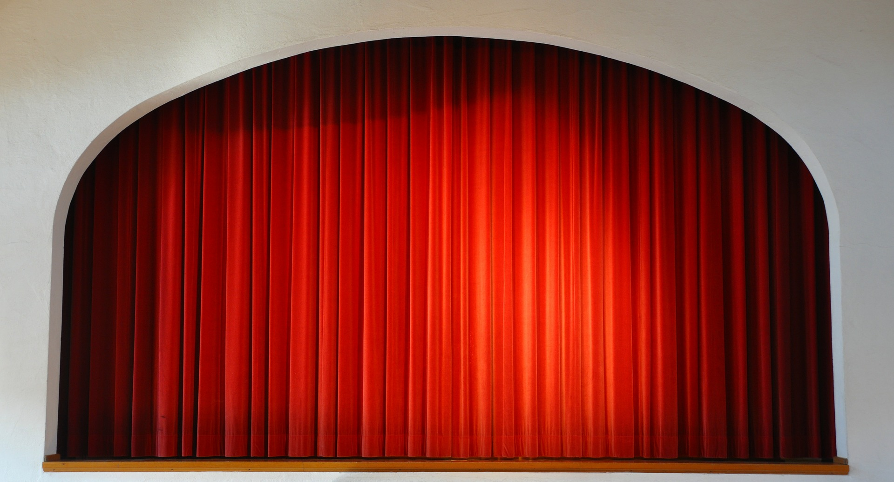

Slide 9
Revelation Chapter 12
The Heavenly Victory Behind The Earthly Difficulty.
“And there was war in heaven, Michael and his angels waging war with the dragon. The dragon and his angels waged war, “ (Rev 12:7)
“And they overcame him because of the blood of the Lamb and because of the word of their testimony, and they did not love their life even when faced with death.” (Revelation 12:11)
“So the dragon was enraged with the woman, and went off to make war with the rest of her children, who keep the commandments of God and hold to the testimony of Jesus.” (Revelation 12:17)
Notes:
If you want a phrase for the whole chapter I would say: Silence Followed By Suffering.
The judgement that was pronounced in Chapter 6 as each seal was opened – is now beginning to occur. And this judgment affects a third of the people.

Slide 10
Revelation Chapter 13-14
Satan Stirs Up The Roman Empire Against The Saints.
“they worshipped the dragon because he gave his authority to the beast; and they worshipped the beast, saying, “Who is like the beast, and who is able to wage war with him?” (Rev 13:4)
The Lamb Stirs Up His Angels Against Babylon.
“and he said with a loud voice, “Fear God, and give Him glory, because the hour of His judgment has come; worship Him who made the heavens and the earth and sea and springs of waters.”(7)
Notes:
If you want a phrase for the whole chapter I would say: Silence Followed By Suffering.
The judgement that was pronounced in Chapter 6 as each seal was opened – is now beginning to occur. And this judgment affects a third of the people.

Slide 11
Revelation Chapter 13
Satan Stirs Up The Roman Empire Against The Saints.
The Beast of Daniel 7 and Revelation 13 Is The Same: Rome
Both Come From the Sea (Rev. 13:1 and Daniel 7:3)
Both Have 10 Horns (Rev. 13:1 and Daniel 7:7)
Both Speak Blasphemies (Rev. 13:1,5,6, and Daniel 7:8,25)
Both Have Limited Influence (Rev. 13:5 and Daniel 7:25)
Both Make War With The Saints (Rev. 13:7 and Daniel 7:21-22)
The Blaspheme of The Beast
“and on his heads were blasphemous names…” 13:1
“a mouth speaking arrogant words and blasphemies…” 13:5
“he opened his mouth in blasphemies against God…” 13:6
“to blaspheme His name and His tabernacle, that is, those who dwell in heaven.” 13:6
Notes:
We concluded ch. 13 noting:
God is: HOLY, HOLY, HOLY
Beast is: Less, Less, Less

Slide 12
Revelation Chapter 14
The Lamb Stirs Up His Angels Against Babylon.
The True Lamb Is Shown In Contrast To The False Lamb of Ch. 13.
Announcements By Three Angels: “And I Saw…”
One: The Eternal Gospel: Worship God!
Two: “Fallen, fallen is Babylon the great…”
Three: “he also will drink fo the wine of the wrath of God…”
Notes:
The Punishment and Reward are Contrasted.

Slide 13
Overview of The Revelation
Introduction (Ch. 1)
The 7 Churches (Ch. 2-3)
Heavenly Scene: The Throne & The Lamb (Ch. 4-5)
The 7 Seals (Ch. 6-8)
Heavenly Scene: Silence in Heaven (Ch. 8)
The 7 Trumpets (Ch. 8-11)
Heavenly Scene: The Spiritual Conflict (Ch. 12-14)
The 7 Bowls (Ch. 15-18)
Heavenly Scene: The Spiritual Victory (Ch. 19)
Conclusion: The Rule of Christ (Ch. 20-22)

Slide 14
Revelation Chapter 15
God Is Exalted In All The World
“And they sang the song of Moses, the bond-servant of God, and the song of the Lamb, saying, “Great and marvelous are Your works, O Lord God, the Almighty; Righteous and true are Your ways, King of the nations! Who will not fear, O Lord, and glorify Your name? For You alone are holy; For all the nations will come and worship before You, For Your righteous acts have been revealed.” (Rev 15:3-4)
“Then one of the four living creatures gave to the seven angels seven golden bowls full of the wrath of God, who lives forever and ever.” (Rev. 15:7)
Notes:
Ch 13 – Satan stirred up the Beast
Ch 14 – Jesus stirred up the Angels
Ch 15 – Celebrating Jesus’ Superiority
God Is Exalted: The song of Moses is a song of deliverance and rescue. The saints who have given their lives aren’t asking: How could you let this happen. They are praising Him for His wonderful works. *Hymn: Come let us worship and bow down.

Slide 15
Revelation Chapter 15
God Is Exalted In All The World
John Sees God’s Judgment Will Be Complete & Praise Victorious
Completeness of 7 Bowls
We Must Tell The Good Deeds of God (Joshua 24:31, Psalm 25:8, Psalm 73:28, Psalm 150)
“After These Things I Looked…”
The Sanctuary Is Open
The Angels Are Especially Glorious
The Sanctuary Is Full of God’s Glory (vs. 8)
The Fall of the Roman Empire Is The Result of God’s Judgment
Christians See More Than Leadership Failure or Poor Economic Choices.
God Judges The Blaspheme and Sinfulness of the Nation.
Notes:
Ch 13 – Satan stirred up the Beast
Ch 14 – Jesus stirred up the Angels
Ch 15 – Celebrating Jesus’ Superiority
This chapter doesn’t just praise the nature of God or even just God as a Divine and perfect being. This chapter praises God for the actions He takes. This chapter evaluates and rightly assesses that the works of God – are wonderful. That His timing is different that we may prefer. That His actions are sometimes less or sometimes greater than we might judge….but are in actuallity – Totally perfect.
This is important given the context that “deeds” play in this book. In Rev. 2:19 – God knows our deeds. In Rev. 20:12 – we will be judged for our deeds.
Here God is shown to have perfect Judgment in His deeds.
God Is Exalted: The song of Moses is a song of deliverance and rescue. The saints who have given their lives aren’t asking: How could you let this happen. They are praising Him for His wonderful works. *Hymn: Come let us worship and bow down.

Slide 16
The Song of Moses Deuteronomy 32:1-43
“Rejoice, O nations, with His people; For He will avenge the blood of His servants, And will render vengeance on His adversaries, And will atone for His land and His people.” (Deuteronomy 32:43)

Slide 17
Revelation Chapter 16
God’s Conquest Over Rome Will Be Just & Decisive.
“And I heard the angel of the waters saying, “Righteous are You, who are and who were, O Holy One, because You judged these things; for they poured out the blood of saints and prophets, and You have given them blood to drink. They deserve it.” Rev. 16:5-6
“And I saw coming out of the mouth of the dragon an out of the mouth of the beast and out of the mouth of the false prophet, three unclean spirits like frogs; for they are spirits of demons, performing signs, which go out to the kings of the whole world, to gather them together for the war of the great day of God, the Almighty. (Rev. 16:13-14)
Notes:
16:13 – this is not the final day of judgment – but a judgment against the beast and it’s blaspheme.
** Key Word is MOUTH: When this battle does take place, it is JESUS and the sword of HIS MOUTH that brings Victory. Rev. 19:20-21

Slide 18
Revelation Chapter 16
God’s Conquest Over Rome Will Be Just & Decisive.
The Bowls of Wrath
1st “on the earth” 2nd “into the sea” 3rd “into the rivers”
4th “upon the sun” 5th “on the throne of the beast” 6th “the Euphrates”
There Are People Who Truly Hate God & Will Not Seek His Mercy.
“Men were scorched with fierce heat; and they blasphemed the name of God who has the power over these plagues, and they did not repent so as to give Him glory.” 9
Notes:
What is Literal?
The dragon – John specifically told us, the dragon is Satan.
The beast – Daniel helped us establish, this is the Roman Empire.
The false prophet – we’ve already seen this is those who compelled Emperor worship
The frogs – John tells us here directly this is evil teachings.
The battle – To say that this is a literal battle, with these literal soldiers, at this literal location is unjustified.
Bowls of Wrath: Here is what God’s judgment brings. Here are the results of choosing to break fellowship with God and be a friend of this world.
1 – pain and suffering
2 – hunger and economic impact: the sea.
3 – hunger and economic impact: the rivers

Slide 19
Waters Dried Up for The Coming War Revelation 16:12
“It is I who says to the depth of the sea, ‘Be dried up!’ And I will make your rivers dry. It is I who says of Cyrus, ’He is My shepherd! And will perform all My desire.’ And he declares of Jerusalem, ‘She will be built,’ And of the temple, ‘Your foundation will be laid.’ ” (Isaiah 44:27-28)
Notes:
Isaiah used the language of Drying Up the Waters to allow a great nation to be defeated.

Slide 20
Revelation Chapter 16
God’s Conquest Over Rome Will Be Just & Decisive.
The Battle of Armageddon
What Is Literal? The Dragon, The Beast, The False Prophet, The Frogs, The Battle?
The Three Frogs, Spirits of Demons (vs. 13, 1 Timothy 4:1-5)
Alert, Ready, Clothed, & Unashamed (vs. 15, 1 Thess 5:1-11)
The Battles At Megiddo (vs. 16)
Song of Deborah in Judges 5:19-20, Death of Josiah in 2 Kings 23:9
The Bowls of Wrath
7th “upon the air” – the full range of Satan’s attack
Notes:
What is Literal?
The dragon – John specifically told us, the dragon is Satan.
The beast – Daniel helped us establish, this is the Roman Empire.
The false prophet – we’ve already seen this is those who compelled Emperor worship
The frogs – John tells us here directly this is evil teachings.
The battle – To say that this is a literal battle, with these literal soldiers, at this literal location is unjustified.
Bowls of Wrath: Here is what God’s judgment brings. Here are the results of choosing to break fellowship with God and be a friend of this world.
1 – pain and suffering
2 – hunger and economic impact: the sea.
3 – hunger and economic impact: the rivers
The text only says they were gathered; it says nothing of the battle itself. The battle and its results are reserved for chapter 19.
Great mystery and obscurity surrounds the name Har-Magedon (Armageddon), which means ‘Mount of Megiddo.’ The Bible speaks geographically of ‘Megiddo and its three heights’ (Josh. 17:11), ‘Megiddo and its towns’ (Judg. 1:27), ‘the waters of Megiddo’ (Judg. 5:19), and ‘the valley of Megiddo’ (II Chron. 35:22; Zech. 12:11), but makes no mention of a Mount of Megiddo. Megiddo was a strategic point in the protection of Israel and Judah, since it guarded the northern entrance to Israel. It was in this area that several decisive battles had been fought, the most memorable being that of Deborah and Barak against Jabin and Sisera of the Canaanites; a decisive victory was given Israel by Jehovah (Judg. 4, 5). It was in this valley of Esdraelon (Jezreel), ‘west of the hill of Moreh,’ that Gideon’s three hundred men defeated and drove out the Midianites, another decisive battle determined by Jehovah (Judg. 7:1). Saul and Jonathan were slain at the eastern extremity of the plain (I Sam. 31 :1-6); and it was at Megiddo that Ahaziah, king of Judah, in league with Joram of Israel, died, having been slain at the command of Jehu (II Kings 9:27). King Josiah fought against Pharaoh Neco in the valley of Megiddo, where he was slain (II Kings 23:29f.; II Chron. 35:22). This proved to be a decisive battle of history in that Josiah slowed Neco in his effort to reach Haran and aid Assyria against Babylon. This delay of Neco allowed Babylon to defeat the Assyrian army, making Babylon the leading power of the east.
In view of these battles of historical significance we conclude that John used the word symbolically to describe a great decisive spiritual battle between the army of Satan and the forces of God, which would determine the fate of each. This battle was fought and won by the Lord in the complete defeat of the Roman Empire and paganism behind which Rome threw its total power (see 19:11-21). To look for a physical military battle between human armies to be fought in northern Palestine at some future date is completely without scriptural support and foreign to the spirit and purpose of Revelation” (Homer Hailey, Revelation: An Introduction and Commentary, pp. 336-337).

Slide 21
The Great Hailstones Revelation 16:21
“As they fled from before Israel, while they were at the descent of Beth-horon, the LORD threw large stones from heaven on them as far as Azekah, and they died; there were more who died from the hailstones than those whom the sons of Israel killed with the sword.” (Joshua 10:11)

Slide 22
Revelation Chapter 15
God Is Exalted In All The World
“And they sang the song of Moses, the bond-servant of God, and the song of the Lamb, saying, “Great and marvelous are Your works, O Lord God, the Almighty; Righteous and true are Your ways, King of the nations! Who will not fear, O Lord, and glorify Your name? For You alone are holy; For all the nations will come and worship before You, For Your righteous acts have been revealed.” (Rev 15:3-4)
“Then one of the four living creatures gave to the seven angels seven golden bowls full of the wrath of God, who lives forever and ever.” (Rev. 15:7)
Notes:
Ch 13 – Satan stirred up the Beast
Ch 14 – Jesus stirred up the Angels
Ch 15 – Celebrating Jesus’ Superiority
God Is Exalted: The song of Moses is a song of deliverance and rescue. The saints who have given their lives aren’t asking: How could you let this happen. They are praising Him for His wonderful works. *Hymn: Come let us worship and bow down.

Slide 23
Revelation Chapter 16
God’s Conquest Over Rome Will Be Just & Decisive.
“And I heard the angel of the waters saying, “Righteous are You, who are and who were, O Holy One, because You judged these things; for they poured out the blood of saints and prophets, and You have given them blood to drink. They deserve it.” Rev. 16:5-6
“And I saw coming out of the mouth of the dragon an out of the mouth of the beast and out of the mouth of the false prophet, three unclean spirits like frogs; for they are spirits of demons, performing signs, which go out to the kings of the whole world, to gather them together for the war of the great day of God, the Almighty. (Rev. 16:13-14)
Notes:
16:13 – this is not the final day of judgment – but a judgment against the beast and it’s blaspheme.
** Key Word is MOUTH: When this battle does take place, it is JESUS and the sword of HIS MOUTH that brings Victory. Rev. 19:20-21

Slide 24
Revelation

Slide 25
Revelation Should Be Studied In Harmony With Other Clear Passages.
Passages That Discuss The Destruction of the World.
2 Peter 3:10-14
Passages That Discuss The Resurrection of All Mankind.
1 Corinthians 15:20-58
Passages That Discuss The Reign of Jesus.
1 Corinthians 15:25, 1 Timothy 6:13-16
Passages That Discuss The Return of Jesus.
1 Thessalonians 4:13 - 5:11
Notes:
How should we approach the rest of the book? On Sunday we wrapped up the 7 churches and now before we get into chapter 4 and 5 seems like the best time to discuss how we study this book as a a whole.
We’ve established that it is apocalyptic literature – with visions and symbolic language.
This language

