Slide 1
MOSES

Slide 2
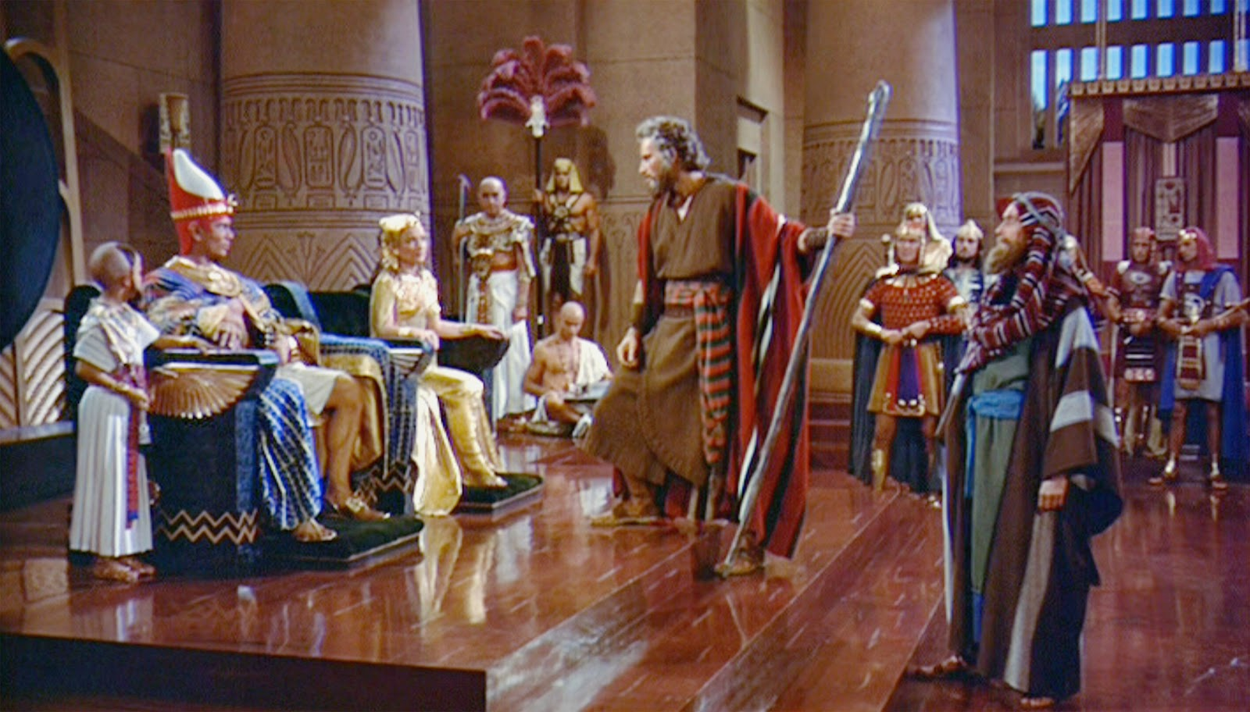
80 Year Old Hebrew Shepherd in Pharaoh’s Court Demanding Release of 2 Million Slaves

Slide 3
Most Remarkable Fact: He seems perfectly at home!
Why?
He is doing what God has commanded and he is aware that God is with him.
He spent his first 40 Years there.

Slide 5
Genesis 15:13-14
¹³ God said to Abram, “Know for certain that your descendants will be strangers in a land that is not theirs, where they will be enslaved and oppressed four hundred years. ¹⁴ But I will also judge the nation whom they will serve, and afterward they will come out with many possessions.

Slide 6
Four Lessons

Slide 7
1. God Always Keeps His Promises.

Slide 8
2. God is Fully Able to Accomplish His Purposes Without Miracles.

Slide 9
3. God Sometimes Uses the Sins of Evil People to Accomplish His Purposes.
Joseph’s brothers
Potiphar’s wife
Butler
Pharaoh
Cruel Taskmasters
“As for you, you meant evil against me, but God meant it for good, to bring it about that many people should be kept alive, as they are today.” (Genesis 50:20)

Slide 10
4. Good people often have to suffer.
Jacob
Joseph
Israelites
Amram & Jochebed
Moses
WHY?

Slide 11
Ecclesiastes 8:12-13
¹² Though a sinner does evil a hundred times and prolongs his life, yet I know that it will be well with those who fear God, because they fear before him.
THIS IS FAITH!

Slide 12
God has made “exceeding great and precious promises” to us
God will keep His Promises!
He may take more time than expected (2 Peter 3).
There may be no visible miracles.
It may appear at times that He has abandoned us.
Our part is to maintain faith and keep acting on it.

Slide 13
“He who did not spare His own Son, but delivered Him up for us all, how shall He not with Him also freely give us all things?” (Romans 8:32)

Slide 14
1 Corinthians 15:58
“Therefore, my beloved brethren, be steadfast, immovable, always abounding in the work of the Lord, knowing that your labor is not in vain in the Lord.”

Slide 15
God moves in a mysterious way His wonders to perform; He plants His footsteps in the sea And rides upon the storm.
Deep in unfathomable mines Of never failing skill He treasures up His bright designs And works His sov’reign will.
Ye fearful saints, fresh courage take; The clouds ye so much dread Are big with mercy and shall break In blessings on your head.
Judge not the Lord by feeble sense, But trust Him for His grace; Behind a frowning providence He hides a smiling face.
His purposes will ripen fast, Unfolding every hour; The bud may have a bitter taste, But sweet will be the flow’r.
Blind unbelief is sure to err And scan His work in vain; God is His own interpreter, And He will make it plain.

