Slide 1
Lesson 1: Introduction & Chapter 1

Slide 2
“The Acts of the Apostles”
Likely in its original form it had no title at all.
The traditional title of this book is, in some respects, a misnomer: it primarily deals with the "acts" of:
Peter (Chapters 1-12)
Paul (Chapters 13-28)
Or
“Some of the Acts of some of the Apostles
Perhaps it should be called "The Acts of the Holy Spirit” since the presence and work of the Holy Spirit is central to the book beginning on Pentecost ( >50x).

Slide 3
Acts - Introduction
Acts is often called Luke, Volume II – 1st chapter links Acts with last chapter of Luke.
The first volume (Luke) in Luke’s history tells us of how God saved us through Jesus Christ. The second volume (Acts) shows how God communicated salvation to the whole world through Jesus’ apostles and how the great commission was fulfilled.
Acts is both history and theology. In a generation or two Christianity turned the world upside down.
Luke and Acts contains more than 27% of the total words in the NT
Luke & Acts were addressed to a man named Theophilus - Lk 1:1-4; Ac 1:1-3. Responsible for socializing (copied & distributed)

Slide 4
Author
Luke never names himself as the author.
External and internal evidence confirm that Luke the physician (Col. 4:14), author of the Gospel of Luke, is also the author of Acts
The testimony of the early church “fathers” (a.d. 100-500) clearly affirms that Luke wrote Acts.
The author of Acts also traveled with Paul from Caesarea to Rome (Acts 27:1), and we know Luke was with Paul there (Col. 4:14 – Luke, the beloved physician, sends you his greetings).
Acts 16:10 (Troas)- After Paul had seen the vision, we got ready at once to leave for Macedonia, concluding that God had called us to preach the gospel to them.
numerous references to "we" (Acts 16:10-17; 20:5–21:18; 27:1–28:16)

Slide 5
Date/Place Written
≈62/63 AD - likely prior to the time Paul was released from his first Roman imprisonment.
Paul not yet killed
The temple is not mentioned as being destroyed (70 AD).
General agreement that it was written in Rome

Slide 6
Purpose/Value of Acts
FOR OBEYING THE GOSPEL OF CHRIST...
Luke records many examples of conversion in the book of Acts
For assurance of our own salvation, we can compare our own conversion experience with those in Acts; were we told the same gospel? Did we respond in the same way?
We read of the evangelistic methods and message of the early apostles and preachers
FOR UNDERSTANDING THE CHURCH OF CHRIST...
Acts contains the only record of the first thirty years of the early church
It describes establishment, growth, organization, worship and challenges of the church - e.g., Ac 2:42; 14:23
Comparing Luke’s record in Acts with the religious world today, we can see how far people have drifted from following Jesus as the Way
The book furnishes the background for at least ten of Paul's epistles. We find the historical setting for 1 & 2 Thessalonians, 1 & 2 Corinthians, Galatians, Romans, Colossians, Philemon, Ephesians & Philippians

Slide 7
Important Themes
The role of the Holy Spirit in the spread of the gospel
The acceptance of the Gentiles by God on equal terms
Pattern provided for church life
Worship
Evangelism
Organization
Edification
Benevolence
Miraculous Gifts: Who could impart these gifts and how they were imparted
The progress of the Kingdom of God in spite of all opposition

Slide 8
Theme
The progress of the Kingdom of God in spite of all opposition
Acts 1:3 - To these He also presented Himself alive after His suffering, by many convincing proofs, appearing to them over a period of forty days and speaking of the things concerning the kingdom of God
Acts 28:30-31 – And he stayed two full years in his own rented quarters and was welcoming all who came to him, ³¹ preaching the kingdom of God and teaching concerning the Lord Jesus Christ with all openness, unhindered
Acts 5:38-39 “So in the present case, I say to you, stay away from these men and let them alone, for if this plan or action is of men, it will be overthrown; ³⁹ but if it is of God, you will not be able to overthrow them; or else you may even be found fighting against God.”
The beginning and end of the letter emphasizes the kingdom. Throughout the book the kingdom of God is a central focus. Acts is a picture of God’s rule expanding and taking over the world.

Slide 9
Class Goals
To better understand the challenges, growth and practices of the New Testament church. Especially their worship, leadership, sharing, perseverance, and involvement in the Great Commission.
To equip one another to imitate the role models of the early church
First, to respond to the gospel with trust and loyalty towards God
Second, to tell others about Jesus in a loving and bold manner.
Third, to serve one another thoughtfully for edification.
Learn and imitate the teaching of the early Christian preachers, by evaluating the background and needs of the audience, and studying the content of the inspired preachers.

Slide 10
Acts Memorization
Chapter 1: Ascension / Matthias replaces Judas
Chapter 2: Peter Preaches the Gospel/ Beginning of the Church
Chapter 3: Lame man healed / Peter’s 2nd sermon
Chapter 4: Peter and John arrested & threatened
Chapter 5: Ananias & Sapphira / Apostles arrested & beaten
Chapter 6: Widows Neglected/Stephen Accused of Blasphemy
Chapter 7: Stephen’s Sermon and Martyrdom
Chapter 8: Church Scattered/ Samaria and Ethiopian
Chapter 9: Conversion of Saul/Peter heals Aeneas and raises Dorcas
Chapter 10: Conversion of First Gentile-Cornelius
Chapter 11: Gospel to Antioch
Chapter 12: James Martyred/Peter Escapes
Chapter 13: First Journey Begins
Chapter 14: Preaching in Asia Minor
Chapter 15: Conference in Jerusalem
Chapter 16: 2nd Journey/European converts - Lydia & Jailer

Slide 11
The Acts of the Apostles
Chapter 1
Some of the Acts of Some of the Apostles
The Acts of the Holy Spirit
The Progress of the Kingdom of God

Slide 12
The first account I composed, Theophilus, about all that Jesus began to do and teach, ² until the day when He was taken up to heaven, after He had by the Holy Spirit given orders to the apostles whom He had chosen. ³ To these He also presented Himself alive after His suffering, by many convincing proofs, appearing to them over a period of forty days and speaking of the things concerning the kingdom of God
Acts is the continuing story of Jesus through the Holy Spirit
Luke 4:43 - “I must preach the kingdom of God to the other cities also, for I was sent for this purpose.”
Jesus began the kingdom and his Apostles and his Church must continue. How will we respond?
Luke 1:1-4 - Inasmuch as many have undertaken to compile an account of the things accomplished among us, ² just as they were handed down to us by those who from the beginning were eyewitnesses and servants of the word, ³ it seemed fitting for me as well, having investigated everything carefully from the beginning, to write it out for you in consecutive order, most excellent Theophilus; ⁴ so that you may know the exact truth about the things you have been taught.
Matthew 28:18-20 - And Jesus came up and spoke to them, saying, “All authority has been given to Me in heaven and on earth. ¹⁹ Go therefore and make disciples of all the nations, baptizing them in the name of the Father and the Son and the Holy Spirit, ²⁰ teaching them to observe all that I commanded you; and lo, I am with you always, even to the end of the age.
“Most excellent Theophilus” (Luke 1:3), a title of respect usually given to a person of high political power in the Greco-Roman world.
“Theophilus” “Theo” - God and “philus” means “one who loves God” or “friend of God”.

Slide 13
“many convincing proofs”
How were they convincing?
1) The Apostles saw Jesus over 40 days at various times and places at which there could be no deception.
2) The apostles did not expect the resurrection (John 20:25; Luke 24:1-4, 19-24)
3) They were intimately familiar with Jesus after being with Him for three years.

Slide 14
Promise of the Holy Spirit
⁴ Gathering them together, He commanded them not to leave Jerusalem, but to wait for what the Father had promised, “Which,” He said, “you heard of from Me;
For the law will go forth from Zion And the word of the Lord from Jerusalem (Isaiah 2:3)
“I have many more things to say to you, but you cannot bear them now. ¹³ But when He, the Spirit of truth, comes, He will guide you into all the truth; for He will not speak on His own initiative, but whatever He hears, He will speak; and He will disclose to you what is to come. ¹⁴ He will glorify Me, for He will take of Mine and will disclose it to you. (John 16:12-14)

Slide 15
The Holy Spirit Promised
Gathering them together, He commanded them not to leave Jerusalem, but to wait for what the Father had promised, “Which,” He said, “you heard of from Me; ⁵ for John baptized with water, but you will be baptized with the Holy Spirit not many days from now.”
John answered and said to them all, “As for me, I baptize you with water; but One is coming who is mightier than I, and I am not fit to untie the thong of His sandals; He will baptize you with the Holy Spirit and fire. (Luke 3:16)

Slide 16
“restoring the kingdom to Israel”
⁶ So when they had come together, they were asking Him, saying, “Lord, is it at this time You are restoring the kingdom to Israel?
Their question may manifest a continued misunderstanding regarding the spiritual nature of the Lord’s kingdom.
Another possibility….

Slide 17
What had Jesus been teaching the disciples between the resurrection and ascension?
Luke 24:27 - … Then beginning with Moses and with all the prophets, He explained to them the things concerning Himself in all the Scriptures.;
Luke 24:45 - …Then He opened their minds to understand the Scriptures
Acts 1:3 - … appearing to them over a period of forty days and speaking of the things concerning the kingdom of God.

Slide 18
“restoring the kingdom to Israel”
⁶ So when they had come together, they were asking Him, saying, “Lord, is it at this time You are restoring the kingdom to Israel?
Their question may manifest a continued misunderstanding regarding the spiritual nature of the Lord’s kingdom.
Another possibility is that after the 40 days of instruction from Jesus about His kingdom their question was informed by OT prophecies regarding the restoration of the kingdom of Israel in the “last days” when the Messiah of the line of David would come.
When will all these OT prophecies culminate with the kingdom being in its perfected state where all has been restored and all enemies defeated and we have the eternal heavenly kingdom? (Cf I Cor 15:24)

Slide 19
ACTS 1:6-8
⁶ So when they had come together, they were asking Him, saying, “Lord, is it at this time You are restoring the kingdom to Israel?” ⁷ He said to them, “It is not for you to know times or epochs which the Father has fixed by His own authority; ⁸ but you will receive power when the Holy Spirit has come upon you; and you shall be My witnesses both in Jerusalem, and in all Judea and Samaria, and even to the remotest part of the earth.”
The establishment of any kingdom requires power. The power involved in the establishment of our Lord’s kingdom would not be military or political; it would be the power of the Holy Spirit, exercised through the apostles.

Slide 20
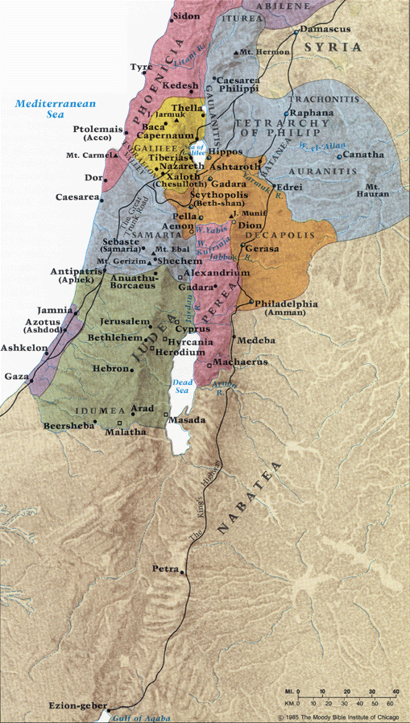
you shall be My witnesses both in Jerusalem, and in all Judea and Samaria… Acts 1:8

Slide 21
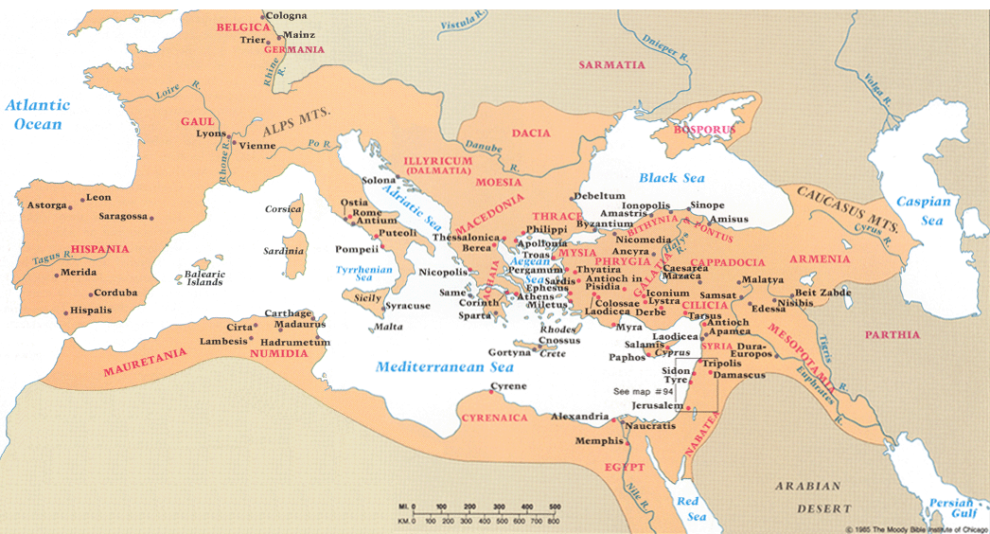
And to the remotest part of the earth …

Slide 22
Short Outline:
Jesus said to the apostles that they would be witnesses to Him in “Jerusalem, and in all Judea and Samaria, and to the remotest part of the earth.” (1:8)
(chapters 1-7) - The gospel is preached in Jerusalem
(chapters 8-12)- The gospel is preached in Judea and Samaria
(chapters 13-28) - The gospel is preached to the end of the earth
Acts Chapters 1 to 11, Peter and Jerusalem church are Prominent.
Acts Chapters 12 to 28, Paul and Antioch church are Prominent

Slide 23
And after He had said these things, He was lifted up while they were looking on, and a cloud received Him out of their sight. ¹⁰ And as they were gazing intently into the sky while He was going, behold, two men in white clothing stood beside them. ¹¹ They also said, “Men of Galilee, why do you stand looking into the sky? This Jesus, who has been taken up from you into heaven, will come in just the same way as you have watched Him go into heaven.”
Should have cleared any misconceptions about the nature of His kingdom
Visibly and in the air
Luke 24:50-51 - And He led them out as far as Bethany, and He lifted up His hands and blessed them. ⁵¹ While He was blessing them, He parted from them and was carried up into heaven.
Luke 24:52-53 - And they, after worshiping Him, returned to Jerusalem with great joy, ⁵³ and were continually in the temple praising God.

Slide 24
Daniel 7:13-14 – Coronation of the Son of Man from Heaven’s Perspective
“I kept looking in the night visions, And behold, with the clouds of heaven One like a Son of Man was coming, And He came up to the Ancient of Days And was presented before Him. ¹⁴ “And to Him was given dominion, Glory and a kingdom, That all the peoples, nations and men of every language Might serve Him. His dominion is an everlasting dominion Which will not pass away; And His kingdom is one Which will not be destroyed.
Hebrews 1:3 - And He is the radiance of His glory and the exact representation of His nature, and upholds all things by the word of His power. When He had made purification of sins, He sat down at the right hand of the Majesty on high
What were the apostles thinking as he left their sight? How will the kingdom advance now?

Slide 25
Waiting on the Spirit
¹² Then they returned to Jerusalem from the mount called Olivet, which is near Jerusalem, a Sabbath day’s journey away. ¹³ When they had entered the city, they went up to the upper room where they were staying; that is, Peter and John and James and Andrew, Philip and Thomas, Bartholomew and Matthew, James the son of Alphaeus, and Simon the Zealot, and Judas the son of James. ¹⁴ These all with one mind were continually devoting themselves to prayer, along with the women, and Mary the mother of Jesus, and with His brothers.
About 6-8 months before Jesus’ death, his brothers did not believe in Him (John 7:5)
In the Jewish mind, to travel further would be to violate the prohibition about working on the Sabbath
Why list all the apostles?
Luke 24:53 – praying was done in the temple at the hours of prayer.
In the book of Acts we see a reliance on prayer.
Mt of Olives
Jerusalem
Luke 23:49,55 – the women who accompanied Him from Galilee and saw His death and went to the tomb
≈ 3/5 mile

Slide 26
¹⁵ At this time Peter stood up in the midst of the brethren (a gathering of about one hundred and twenty persons was there together), and said, ¹⁶ “Brethren, the Scripture had to be fulfilled, which the Holy Spirit foretold by the mouth of David concerning Judas, who became a guide to those who arrested Jesus. ¹⁷ For he was counted among us and received his share in this ministry.” ¹⁸ (Now this man acquired a field with the price of his wickedness, and falling headlong, he burst open in the middle and all his intestines gushed out. ¹⁹ And it became known to all who were living in Jerusalem; so that in their own language that field was called Hakeldama, that is, Field of Blood.) ²⁰ “For it is written in the book of Psalms,
‘Let his homestead be made desolate, And let no one dwell in it’;
and,
‘Let another man take his office.
Vs 20 or Psalm 41:9? - Even my close friend in whom I trusted, Who ate my bread, Has lifted up his heel against me
One of the ten days between the ascension and Pentecost
Psalm 69:25 & 109:8
They knew and trusted God’s word and acted. We also must be guided by scripture if we will advance the kingdom

Slide 27
²¹ Therefore it is necessary that of the men who have accompanied us all the time that the Lord Jesus went in and out among us— ²² beginning with the baptism of John until the day that He was taken up from us—one of these must become a witness with us of His resurrection.” ²³ So they put forward two men, Joseph called Barsabbas (who was also called Justus), and Matthias. ²⁴ And they prayed and said, “You, Lord, who know the hearts of all men, show which one of these two You have chosen ²⁵ to occupy this ministry and apostleship from which Judas turned aside to go to his own place.” ²⁶ And they drew lots for them, and the lot fell to Matthias; and he was added to the eleven apostles.
One of the 70 disciples from Luke 10:1-2
Eyewitness testimony of the Lord’s resurrection was the very heart of apostolic preaching (Acts 4:33; 13:3-31).
The King reigning in heaven is directing the affairs of His church

Slide 28
How They Continued What Jesus Began (Kingdom)
Power of God & Holy Spirit – 1:2,5,8,16
Trusted & Obeyed Scripture – 1:3,16,20
Apostolic Witness – 1:8,13,17,20,21-22,23-26
Prayer – 1:14,24
Togetherness – 1:4,6,14,15,21,22,26
The King’s Church will advance the Kingdom in like manner

