Slide 1
Lesson 3: Acts 3-4:31

Slide 2
Prophecy of Resurrection & Coronation 25-36
Psalm 16:10
Peter’s Conclusion (32-36)
³² This Jesus God raised up again, to which we are all witnesses. ³³ Therefore having been exalted to the right hand of God, and having received from the Father the promise of the Holy Spirit, He has poured forth this which you both see and hear. ³⁴ For it was not David who ascended into heaven, but he himself says:
‘The Lord said to my Lord, “Sit at My right hand, ³⁵ Until I make Your enemies a footstool for Your feet.”’
³⁶ Therefore let all the house of Israel know for certain that God has made Him both Lord and Christ—this Jesus whom you crucified.”
Psalm 110:1
Possession of Authority/Deity
Anointed One - Messiah

Slide 3
Reaction of the Multitude
³⁷ Now when they heard this, they were cut to the heart, and said to Peter and the rest of the apostles, “Men and brethren, what shall we do?”

Slide 4
Peter’s Answer
³⁸ Then Peter said to them, “Repent, and let every one of you be baptized in the name of Jesus Christ for the remission of sins; and you shall receive the gift of the Holy Spirit. ³⁹ For the promise is to you and to your children, and to all who are afar off, as many as the Lord our God will call. ⁴⁰ And with many other words he testified and exhorted them, saying, “Be saved from this perverse generation.”
Repentance is the change of will produced by godly sorrow and resulting in a change of conduct.
Jew & Gentile
Baptizō – to immerse
On the basis of His authority
2 Thess. 2:14
This was “calling on the name of the Lord” (vs. 21)

Slide 5
Sermon Goals:
Establishment of Jesus as the Christ (Messiah), sitting on David’s throne at God’s right hand
Convict them of sin and the need for Salvation
Teach them the Gospel of Salvation which was through Christ Jesus

Slide 6
The Gift of the Holy Spirit
Grammatically it may mean either that the Holy Spirit is the gift or that the Holy Spirit is the giver of the gift.
2 Views
The Holy Spirit’s gift – The promised work of the Spirit of God in the world is to give life to those who give their lives to Christ. The gift he gives is – rejuvenation, salvation, Scripture,(Prayer, Worship, Character) & eternal life. The Spirit’s mission becomes our mission and we bear the fruit of the Spirit. (Gal. 5:22-23)

Slide 7
The Gift of the Holy Spirit
2) The gift is the Spirit Himself (how does the Spirit Dwell within us?)
Dwells in us by faith, through the Scripture –
Given to those who become children of God – (cf. Jn 7:37-39; Ac 5:32; Ga 4:6; Rom 8:9; 2 Tim 1:14) . The Holy Spirit dwells in God's children. Paul wrote, Or do you not know that your body is a temple of the Holy Spirit who is in you”. (1 Cor 6:19)
Scripture says that God the Father and Jesus resides in the Christian. (Eph. 3:17) They do not literally indwell us. It is scriptural and logical to conclude that the Holy Spirit dwells in us by faith.
Personal Indwelling –
the Holy Spirit comes personally to the Christian and begins to dwell in him, but that he does so without miraculous manifestations

Slide 8
How Can I know for Certain? (2:36)
Outpouring of the Holy Spirit
Demonstrative and Observable event
Sign of “Tongues” = understandable languages
Life & Ministry of Jesus the Nazarene
Fulfilled Messianic Prophecies
Joel 2 – Spirit Coming in “the Day of the Lord”
Psalm 16 – God Preserves the King
Psalm 132 – Surety of the Davidic Covenant
Psalm 110 – Reign of David’s “Lord”
Resurrection & Ascension of Jesus

Slide 9
What Should I do?
Commit to Christ Personally (37-41)
Repentance: Turning control of your life over to God
Baptism: Burying your old life to start a New one in Christ
“for the forgiveness of your sins; and you will receive the gift of the Holy Spirit” (2:38)

Slide 10
Lesson 2 Objectives
Explain what it means to call on the name of the Lord? (Joel 2:32; Acts 2:21,38; 22:16)
List the three arguments Peter makes to prove that Jesus is the Messiah.
Give the Old Testament reference for the three prophecies that Peter uses.
List four themes found in the sermon.
Responding in Faith to His Conditions for Salvation
Acts 2:38; 22:16 – Calling on the Lord was to Repent & be Baptized
Signs, Resurrection, Prophecy
Joel 2, Psalm 16, Psalm 110
Chart

Slide 11
Themes in Acts Sermons
Chapter 2
Miracles 22
Rejection by Jews 23,36
Resurrection 24, 32
Prophecies…
Suffering Messiah 27
Resurrection 24,31
Coronation 33,34
Reign in Heaven 36
Judgment 20,40
God’s Control 17-on
Human Guilt 23,36,40
Forgiveness 38,40
Repentance 38
Baptism 38
Exclusivity 40
Universality 39

Slide 12
Class Goals
To better understand the challenges, growth and practices of the New Testament church. Especially their worship, leadership, sharing, perseverance, and involvement in the Great Commission.
To equip one another to imitate the role models of the early church
First, to respond to the gospel with trust and loyalty towards God
Second, to tell others about Jesus in a loving and bold manner.
Third, to serve one another thoughtfully for edification.
Learn and imitate the teaching of the early Christian preachers, by evaluating the background and needs of the audience, and studying the content of the inspired preachers.

Slide 13
Beginning of the Church
⁴¹ Then those who gladly received his word were baptized; and that day about three thousand souls were added to them.

Slide 14
Activities of the Early Church
⁴¹ Then those who gladly received his word were baptized; and that day about three thousand souls were added to them. ⁴² And they continued steadfastly in the apostles’ doctrine and fellowship, in the breaking of bread, and in prayers. ⁴³ Then fear came upon every soul, and many wonders and signs were done through the apostles. ⁴⁴ Now all who believed were together, and had all things in common, ⁴⁵ and sold their possessions and goods, and divided them among all, as anyone had need.
⁴⁶ So continuing daily with one accord in the temple, and breaking bread from house to house, they ate their food with gladness and simplicity of heart, ⁴⁷ praising God and having favor with all the people. And the Lord added to the church daily those who were being saved.
Likely referring to Lord’s supper and not a common meal
Phobos - These miraculous deeds made people keenly aware of the presence and power of God
(didachē) = teaching
Matthew 28: 19-20 - Go therefore and make disciples of all the nations, baptizing them in the name of the Father and the Son and the Holy Spirit, ²⁰ teaching them to observe all that I commanded you
Koinōnia - close relationship, fellowship, or partnership of those sharing something in common. Sharing a common faith, a common hope, a common goal, and a common way of life.

Slide 15
Activities of the Early Church
⁴¹ Then those who gladly received his word were baptized; and that day about three thousand souls were added to them. ⁴² And they continued steadfastly in the apostles’ doctrine and fellowship, in the breaking of bread, and in prayers. ⁴³ Then fear came upon every soul, and many wonders and signs were done through the apostles. ⁴⁴ Now all who believed were together, and had all things in common, ⁴⁵ and sold their possessions and goods, and divided them among all, as anyone had need.
⁴⁶ So continuing daily with one accord in the temple, and breaking bread from house to house, they ate their food with gladness and simplicity of heart, ⁴⁷ praising God and having favor with all the people. And the Lord added to the church daily those who were being saved.
The courts of the temple served as a suitable place for the large number of Christians to gather
Not the Lord’s supper but rather eating of common meals
Matthew 16:18 - I also say to you that you are Peter, and upon this rock I will build My church
Is this example binding on Christians today?
ekklēsia - refers to a group of people, and the Lord’s church (group) is made up of the saved.
Are we devoted to the Apostle’s doctrine, to spiritual fellowship, Lord’s supper, prayer & brotherly love, daily service, unity & praising God
Notes:
Is this example of sharing binding? Yes, if the need arises. Talk about the money we provided to the saints in South Texas in 2017 after Hurricane Harvey hit

Slide 16
What Should I do?
Commit to Christ Personally (37-41)
Repentance: Turning control of your life over to God
Baptism: Burying your old life To starting a New one in Christ’s
“for the forgiveness of your sins; and you will receive the gift of the Holy Spirit” (2:38)
Commit to Christ Communally (42-47)
Devotion to Mutually Beneficial, Collective, Spiritual activity
Sacrifice of personal goods for the benefit of others
Cultivation of Family bonds in each others’ homes (included strangers)

Slide 17
How They Continued What Jesus Began (Acts 1:1) (Kingdom)
Power of God & Holy Spirit –
Trusted & Obeyed Scripture –
Apostolic Witness –
Prayer –
Togetherness –
Luke 4:43 - “I must preach the kingdom of God to the other cities also, for I was sent for this purpose.”
Jesus began the Kingdom and his Apostles continued and His Church must continue.
They were continually devoting themselves to the Apostle’s teaching and to fellowship, to the breaking of bread and prayer.
Acts 2:42
The King’s Church today will advance the Kingdom in like manner
Notes:
Acts is a book about the kingdom of God – Acts 1:3 talks about how Jesus began the kingdom and the last verse is the kingdom is being proclaimed and we have been talking about the continuation of that Kingdom. Jesus established it through his death resurrection and ascension and the aposltes continued it and the early church carried it forth and we must as well

Slide 18
Acts Memorization
Chapter 1:
Chapter 2:
Ascension & Reign of the King / Matthias replaces Judas
Peter preaches on Pentecost /Outpouring of the Holy Spirit/
Beginning of the Church

Slide 19
Lesson 3 Objectives
At the end of the study, the student will be able to:
List the two Old Testament references Peter uses to prove that Jesus is the Christ.
List four similarities and 2 differences between this sermon and the one on Pentecost.
List three ways Jesus is like Moses.
List four of the themes found in this sermon.

Slide 20
Class Goals
To better understand the challenges, growth and practices of the New Testament church. Especially their worship, leadership, sharing, perseverance, and involvement in the Great Commission.
To equip one another to imitate the role models of the early church
First, to respond to the gospel with trust and loyalty towards God
Second, to tell others about Jesus in a loving and bold manner.
Third, to serve one another thoughtfully for edification.
Learn and imitate the teaching of the early Christian preachers, by evaluating the background and needs of the audience, and studying the content of the inspired preachers.

Slide 21
Acts 3:1
Now Peter and John went up together into the temple at the hour of prayer, being the ninth hour.
Time Keeping
First Hour -- Sunrise (approx. 6 a.m.)
Third Hour -- 9 a.m. - Noon
Sixth Hour -- Noon - 3 p.m.
Ninth Hour -- 3 p.m. - Sunset (approx. 6 p.m.)
The traditions of the Jews had fixed the third, sixth and ninth hours as times for private prayer. Daniels practice of praying three times a day seems to imply that the practice was prevalent in his day.

Slide 22
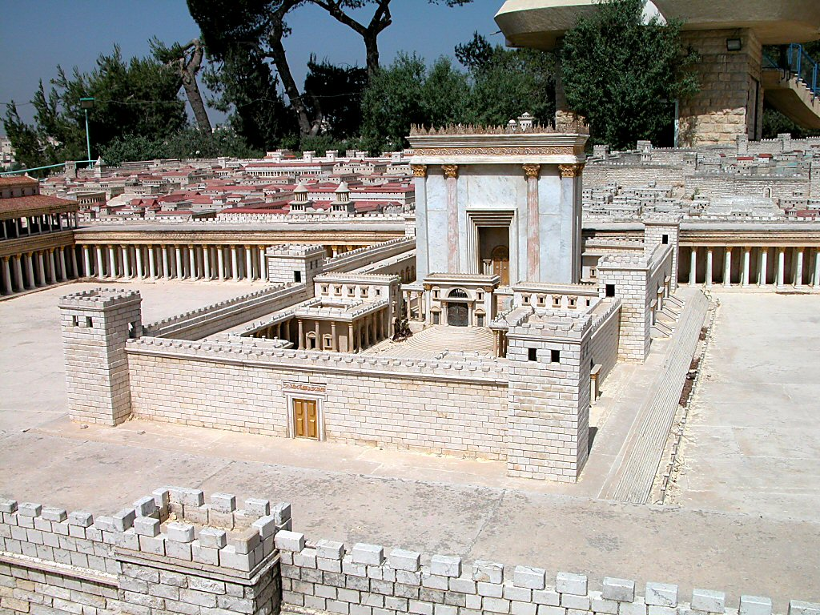
Temple with eastern gates
Acts 3:2 And a certain man lame from his mother’s womb was carried, whom they laid daily at the gate of the temple which is called Beautiful, to ask alms from those who entered the temple; ³who, seeing Peter and John about to go into the temple, asked for alms.
What circumstances makes this such an impactful miracle?
Beautiful Gate
Corinthian Brass
Temple with eastern gates

Slide 23
Healing the Lame Man & Reaction – Acts 3:4-11
But Peter said, "I do not possess silver and gold, but what I do have I give to you: In the name of Jesus Christ the Nazarene--walk!“ ⁷And seizing him by the right hand, he raised him up; and immediately his feet and his ankles were strengthened. ⁸With a leap he stood upright and began to walk; and he entered the temple with them, walking and leaping and praising God. And all the people saw him walking and praising God. ¹⁰Then they knew that it was he who sat begging alms at the Beautiful Gate of the temple; and they were filled with wonder and amazement at what had happened to him.
Over 40 years old – 4:22

Slide 24
Characteristics of this Miracle (Contrast to modern “miracles”)
It was not announced in advance.
The man was lame from birth (3:2).
He was over 40 years old (4:22).
He had to be carried (3:2).
He was well-known (3:10)
He had no faith to expect healing (3:3)
He was healed immediately (3:7).
Healing was so complete he walked and leaped (3:8).
He was pronounced in “perfect health” (3:16)
Even the enemies could not deny it (4:16).
What was the purpose of the miracle?

Slide 25
Acts 3:11 - Now as the lame man who was healed held on to Peter and John, all the people ran together to them in the porch which is called Solomon’s, greatly amazed.
Court of the Women
Gentiles Courtyard
Solomon’s Portico

Slide 26
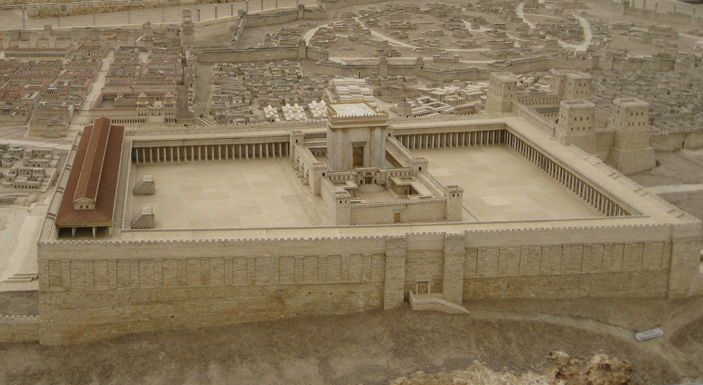
Solomon’s Portico
Eastern Wall
“Solomon’s Porch (Portico) was 800 (?) feet long with 162 Corinthian Columns. The porch was 90 feet wide.

Slide 27
Outline of Peter’s Sermon (Acts 3:11-26)
3:12-16 – Explanation of the Miracle
3:17-21 – Call to Repentance
3:22-24 – Moses’ Prophecy: A Prophet to Come
3:25-26 – Prophecy to Abraham: Seed Blessing
(Jesus fulfilled the OT prophecies)

Slide 28
3:12-16 – Explanation of the Miracle
But when Peter saw this, he replied to the people, "Men of Israel, why are you amazed at this, or why do you gaze at us, as if by our own power or piety we had made him walk?
“Men of Israel,
Acts 2:14 - Men of Judea and all you who live in Jerusalem, Acts 2:22 – “Men of Israel listen….
Jews (Leaders 3:13-15, 4:1, from all nations 2:5?)
Adhering to the Law of Moses ( devout men Acts 2:5)
Knowledge of OT scripture and of God
Knowledge of Jesus (teachings, miracles, death, report of resurrection/disappearance)
Converts and those who rejected message on Pentecost

Slide 29
3:12-16 – Explanation of the Miracle
¹³"The God of Abraham, Isaac and Jacob, the God of our fathers, has glorified His servant Jesus, the one whom you delivered and disowned in the presence of Pilate, when he had decided to release Him. ¹⁴"But you disowned the Holy and Righteous One and asked for a murderer to be granted to you, ¹⁵but put to death the Prince of life, the one whom God raised from the dead, a fact to which we are witnesses
It was the same God that the OT scriptures spoke about and that they worshiped.

Slide 30
Descriptions of Jesus- Acts 3:13-15,18
"The God of Abraham, Isaac and Jacob, the God of our fathers, has glorified His servant Jesus, the one whom you delivered and disowned in the presence of Pilate, when he had decided to release Him. ¹⁴"But you disowned the Holy and Righteous One and asked for a murderer to be granted to you, ¹⁵but put to death the Prince of life, the one whom God raised from the dead, a fact to which we are witnesses.
¹⁸"But the things which God announced beforehand by the mouth of all the prophets, that His Christ would suffer, He has thus fulfilled.
His Servant Jesus
Holy and Righteous
Prince of Life
His Christ
Notes:
Servant would make you think of Isasaih 40-53 – the servant passages

Slide 31
“CHRIST”
“Messiah” – Hebrew (mashiyach)
“Christ” – Greek (Christós)
“Anoint” – English
Would the Jews of Jesus' day understand the meaning of this word?

Slide 32
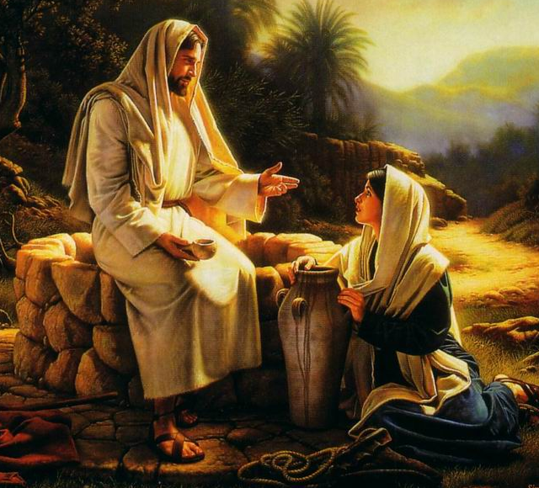
John 4:26
Jesus said to her, "I who speak to you am he."
John 4:25
The woman said to Him, "I know that Messiah is coming (He who is called Christ); when that One comes, He will declare all things to us."
The Prophets of Israel predicted that one day God, through His Spirit, would anoint a leader.
Isaiah 61:1; Daniel 9:24-26, Psalm 2:2

Slide 33
Guilt of Audience - Acts 3:13-15
Acts 2:23, 36
" this Man, delivered over by the predetermined plan and foreknowledge of God, you nailed to a cross by the hands of godless men and put Him to death. ³⁶"Therefore let all the house of Israel know for certain that God has made Him both Lord and Christ--this Jesus whom you crucified."
"The God of Abraham, Isaac and Jacob, the God of our fathers, has glorified His servant Jesus, the one whom you delivered and disowned in the presence of Pilate, when he had decided to release Him. ¹⁴"But you disowned the Holy and Righteous One and asked for a murderer to be granted to you, ¹⁵but put to death the Prince of life, the one whom God raised from the dead, a fact to which we are witnesses.
you delivered
you disowned
asked for a murderer
put to death
Acts 2:32 -"This Jesus God raised up again, to which we are all witnesses.

Slide 34
Guilt of Audience - Acts 3:13-15
the God of their fathers had glorified Jesus/ they had delivered him up to die
Pilate’s desire to let him go/ their refusal to let him be released,
One who was holy and just/ their demand that a murderer should be released to them
He was the author of life/ they killed him
But God raised Him from the dead!
They were in direct opposition with God
Reality of the Resurrection – good and evil can be distinguished

Slide 35
Acts 3:16
3:12-16 – Explanation of the Miracle
"And on the basis of faith in His name, it is the name of Jesus which has strengthened this man whom you see and know; and the faith which comes through Him has given him this perfect health in the presence of you all.
it is the name of Jesus
Whose faith had made the man strong?

Slide 36
Acts 3:17
3:17-21 – Call to Repentance
"And now, brethren, I know that you acted in ignorance, just as your rulers did also.
ignorance
Luke 23:34
Did their ignorance excuse them?

Slide 37
Acts 3:18
"But the things which God announced beforehand by the mouth of all the prophets, that His Christ would suffer, He has thus fulfilled.
He has thus fulfilled.
Isaiah 53
Psalm 22
Notes:
¹⁸"But the things which God announced beforehand by the mouth of all the prophets, that His Christ would suffer, He has thus fulfilled.
Here is summarized the third part of Peters message, that what happened to Jesus was just as we predicted in the prophets would happen to Messiah when He came. “The things” which God indicated in type and prophecy would happen to the Messiah has reference particularly to the sufferings and dealth of Messiah, the verty things just listed by Peter as done by the Jews to Jesus. But the Jews somehow missed these prediction and instead of a suffering Messiah they expected the Messiah to be a grand political, eartly ruler.
And it turned out just as the prophets said it would. Peter is removing all the obstacles that might be in the way of faith in his listeners minds. They had stumbled over Jesus’ life, sufferings and death thinking them to be un-Messiah-like. But there is no need to stumble longer. Now they too can see the OT prophecies like Jesus taught the apostles to see them. This fact just stated – that in the Jew’s mistreatment of Jesus, God was fulfilling what He had predicted throught the prophets – is not easily reconciled by human philosophy with the assertion of their guilt. Peter is saying “You people are guilty. God saw what you would do but you did not have to do it. You are guilty. Therefore you need to repent.

Slide 38
Acts 3:19-21
3:17-21 – Call to Repentance
"Therefore repent and return, so that your sins may be wiped away, in order that times of refreshing may come from the presence of the Lord; ²⁰and that He may send Jesus, the Christ appointed for you, ²¹whom heaven must receive until the period of restoration of all things about which God spoke by the mouth of His holy prophets from ancient time.
Therefore repent and return

Slide 39
“Repent and Return”
Verse | Commands | Promises
Acts 2:38 | Repent & baptized | Remission of sins and gift of the HS
Acts 3:19 | Repent & Turn (turn to God in obedience- calling on his name) | Sins wiped out and times of refreshing
Repent = Change of will caused by sorrow for sin and leading to a reformation of life. (II Cor. 7:8-10) Turning to the Lord would include baptism as a first act.
Audience had likely heard of baptism and had seen baptisms since Pentecost.
Not commanding something different than Acts 2:38 – baptism is key act in turning

Slide 40
Acts 3:19-21
3:17-21 – Call to Repentance
"Therefore repent and return, so that your sins may be wiped away, in order that times of refreshing may come from the presence of the Lord; ²⁰and that He may send Jesus, the Christ appointed for you, ²¹whom heaven must receive until the period of restoration of all things about which God spoke by the mouth of His holy prophets from ancient time.

Slide 41
The Promise of the Spirit
Isaiah 44:2-3
Do not fear, O Jacob My servant; And you Jeshurun whom I have chosen. ³ ‘For I will pour out water on the thirsty land And streams on the dry ground; I will pour out My Spirit on your offspring And My blessing on your descendants; ⁴ And they will spring up among the grass Like poplars by streams of water.
“Israel” will have their restoration and there would once again be spiritual life and blessing and rejuvenation when God would fulfill all His promises in those last days when His Spirit would be poured forth.

Slide 42
Acts 3:19-21
3:17-21 – Call to Repentance
Reference to the 2nd coming
"Therefore repent and return, so that your sins may be wiped away, in order that times of refreshing may come from the presence of the Lord; ²⁰and that He may send Jesus, the Christ appointed for you, ²¹whom heaven must receive until the period of restoration of all things about which God spoke by the mouth of His holy prophets from ancient time.
“the reference is to the refreshing of the soul effected by the joys of the Holy Spirit.”
- J. W. McGarvey

Slide 43
Timeline of the Kingdom
Acts 3
Heaven Receives Until…
Jesus
Glorified
Sins Blotted Out
Times of Refreshing
Jesus Sent
Restoration of all things
Jesus Delivered up
Repent & Turn
“Man will be restored to his complete fellowship with God that he had in Eden; to immortality such as he possessed before he was denied possession of the tree of life. This will happen when Jesus returns and death is abolished and those who are dead in Christ are raised to live with him. This will be the restoration of the original condition that existed in the time of Eden when sinless man walked daily with God”
(Sewell Hall – circa 1970 )
Notes:
Truth commentary - Similarly, Marshall says that it means “God’s perfect realization of the things which he had promised through the prophets” (94). This is the meaning that best fits this sentence, for it seems clear that Peter is speaking of the fulfillment of Old Testament prophecy. Inasmuch as Peter proceeded to show that the Old Testament prophecies are presently being fulfilled (v. 24), the idea of this verse is that Christ must remain in heaven until this process is completed
Reese commentary – In the beginning of creation, things were in their proper order. It was a paradise. Sin entered and threw the whole creation out of joint. We are living in the times of the restoration of all things. This restoration which is already in progress will culminate in the creation being delivered from the bondage of corruption into the glorious liberty of the sons og God. Peter says in vs 24 “they told of these days”. Peter says the days he was living in(and the days we are living in) were theses days. The first coming of Jesus marked the beginning of these times and His return will mark the end of the restoration of all things.
Sewell Hall – man will be restored to his complete fellowship with God that he had in Eden, to immortality such as he possessed before he was denied the possession of the tree of life. This will happen when Jesus returns and death is abolished and those who are dead in Christ are raised to live with him this will be the restoration of the orignianl condition that existed in Garden

Slide 44
Acts 3:22-24 – Moses’ Prophecy: A Prophet to Come
"Moses said, 'THE LORD GOD WILL RAISE UP FOR YOU A PROPHET LIKE ME FROM YOUR BRETHREN; TO HIM YOU SHALL GIVE HEED to everything He says to you. ²³'And it will be that every soul that does not heed that prophet shall be utterly destroyed from among the people.’
Therefore when the people saw the sign which He had performed, they said, “This is truly the Prophet who is to come into the world.” (John 6:14)
Deuteronomy 18:15-19
Since Jesus was raised, everyone must listen to this prophet
The Jews had exposed themselves to the severest punishment in rejecting and crucifying the Lord Jesus, and that they should therefor repent of this great sin and seek for mercy. Unless they do repent and return, God himself would visit punishment upon them
Notes:
WERE THEY TO ABANDON MOSES THE GREAT LAW GIVER AND INTERCESSOR FOR CHRIST?
Whatever might be proved concerning the resurrection or glorification of Jesus, a Jew would not be prepared to accept him as the promised Messiah unless the proof contained evidence that the facts were subjects of prophecy. To this end, and also for the purpose of warning his hearers against rejecting what they had heard, Peter next introduces a well know prophecy made by Moses.
²²"Moses said, 'THE LORD GOD WILL RAISE UP FOR YOU A PROPHET LIKE ME FROM YOUR BRETHREN; TO HIM YOU SHALL GIVE HEED to everything He says to you. ²³'And it will be that every soul that does not heed that prophet shall be utterly destroyed from among the people.‘ ²⁴"And likewise, all the prophets who have spoken, from Samuel and his successors onward, also announced these days.
The idea which Peter is expressing was that the Jews had exposed themselves to the severest punishment in rejecting and crucifying the Lord Jesus, and that they should therefor repent of this great sin and seek for mercy. Unless they do repent and return, God himself would visit punishment upon them.
²⁴"And likewise, all the prophets who have spoken, from Samuel and his successors onward,
Why pick Samuel? He was not the first prophet. In our OT Prophets class we start with Moses and then study Samuel. But actually Enoch was the first prophet. (Jude 14). Perhaps the reason Samuel is picked is because eh was the founder of the school of the prophets. Or perhaps there was no prophetic voice for almost 400 years. Samuel was the next, after Moses, to be names as a prophet. We could say there was no prophet between Moses and Samuel.
also announced these days.
The people listening to Peter preach could not reject his message without rejecting the Christ; and if they were to reject the Christ, they would be rejecting all their prophets, for those prophets had looked forward to the very age Peter and his listeners were living in.
If what Peter had just said of Jesus was true, then this prophecy obviosuly applied to him.
The quotation about to be repeated is recorded in Deuteronomy 18:15-19. This quote is brought up now, likely for the purpose of showing that the Prophets had spoken of the days of refreshing – the church age- the very things that were then taking place.
'THE LORD GOD WILL RAISE UP FOR YOU A PROPHET LIKE ME FROM YOUR BRETHREN;
The Jews acknowledged that this passage in Deutoronomy was a Messianic prophecy. They had asked John the Baptist, “Are you the prophet?” and John replied that he was not the Messiah. Here Peter indentifies “the prophet” with the Christ (Messiah). God was the one who would raise up Jesus.
Like Me – How are Moses and Christ alike? God sent both. Both were lawgivers. Both were saviors (Moses of a particular people; Christ of all people). Bothe delivered others from bondage (Egypt in Moses’ case; sin in Christ’s). Both were prophets (both revealed God’s will) Both were mediators (Moses for the people of Israel; Christ stands between all men and God). God rasied up both to do their particular job. Of all these suggested parallels, is not the salvation activity of each the great point of resemblance?
From your Brethren – The prophet (Messiah) was to be a Jew, one of the very countrymen to whom Peter was speaking.
TO HIM YOU SHALL GIVE HEED to everything He says to you.
Moses commanded you to listen to this Jesus whom I am preaching. Give heed = obey
²³'And it will be that every soul that does not heed that prophet shall be utterly destroyed from among the people.'
The idea which Peter is expressing was that the Jews had exposed themselves to the severest punishment in rejecting and crucifying the Lord Jesus, and that they should therefor repent of this great sin and seek for mercy. Unless they do repent and return, God himself would visit punishment upon them.
²⁴"And likewise, all the prophets who have spoken, from Samuel and his successors onward,
Why pick Samuel? He was not the first prophet. In our OT Prophets class we start with Moses and then study Samuel. But actually Enoch was the first prophet. (Jude 14). Perhaps the reason Samuel is picked is because eh was the founder of the school of the prophets. Or perhaps there was no prophetic voice for almost 400 years. Samuel was the next, after Moses, to be names as a prophet. We could say there was no prophet between Moses and Samuel.
also announced these days.
The people listening to Peter preach could not reject his message without rejecting the Christ; and if they were to reject the Christ, they would be rejecting all their prophets, for those prophets had looked forward to the very age Peter and his listeners were living in.
²⁵"It is you who are the sons of the prophets
They were the disciples, pupils, followers of the teachings of the prophets. Pter is saying to his listernes that they could inherit all the promises and blessings that were the subjects of thos prophecies of old if they would but repent and return.
and of the covenant which God made with your fathers, saying to Abraham,'AND IN YOUR SEED ALL THE FAMILIES OF THE EARTH SHALL BE BLESSED.'
From Galatians 3:15-29 Paul indicates that the reference in the word “seed” is to Christ. We have here an apostolic interpretation of the promise made to Abraham. It was fulfilled in the Messiah and men would be made spiritually prosperous if they would repent and turn away from their sins to service for Christ.
²⁶"For you first, God raised up His Servant and sent Him to bless you by turning every one of you from your wicked ways."
To you who are Jews, Christ came to his own people. “Servant” (as we have seen) is a term the people were familiar with from Isaiah 40-53. He was sent to make you spiritually happy by offering the forgivenss of sins. By His preaching, example, death, and glorification, Christ would make provision for men to turn from their iniquities.
^{John 6: 12} When they were filled, He *said to His disciples, “Gather up the leftover fragments so that nothing will be lost.” ¹³ So they gathered them up, and filled twelve baskets with fragments from the five barley loaves which were left over by those who had eaten. ¹⁴ Therefore when the people saw the sign which He had performed, they said, “This is truly the Prophet who is to come into the world.”

Slide 45
“A prophet like me”
God raised up both to do their particular job.
Both were lawgivers.
Both were rejected.
Both were saviors (Moses of a particular people; Christ of all people).
Both delivered others from bondage (Egypt in Moses’ case; sin in Christ’s).
Both were prophets (both revealed God’s will)
Both were mediators (Moses for the people of Israel; Christ stands between all men and God).
Notes:
Moses was distinguished from all the other prophets in that he was a delievere and a lawgiver. The others were employed in enforcing the law which Moses gave, but not in abiding to it, or setting any of it aside. Jesus however was like Moses in that he also came as a deliverer, proposing a far more glorious deliverance than that effected by Moses, and he aslo issued laws for a new government of men. This proved that he alone was the prophet spoken of by Moses and it showed the audience that in obeying Jesus they would be obeying Moses, while in rejecting him they would incur the curse which Moses pronounced.

Slide 46
Acts 3:22-24 – Moses’ Prophecy: A Prophet to Come
"Moses said, 'THE LORD GOD WILL RAISE UP FOR YOU A PROPHET LIKE ME FROM YOUR BRETHREN; TO HIM YOU SHALL GIVE HEED to everything He says to you. ²³'And it will be that every soul that does not heed that prophet shall be utterly destroyed from among the people.' ²⁴"And likewise, all the prophets who have spoken, from Samuel and his successors onward, also announced these days.
I Samuel 2:10
II Samuel 7:12-14
If they reject the Christ, they would be rejecting all their prophets who spoke of this time
Notes:
Verse 24 – Not content with bringing to bear the testimony of Moses, Peter adds to it the combined authority of all the prophets. This declaration is to be understood only of those prophets who predictions are recorded in the OT; for to these alone could Peter appeal before his hearers. The universal terms of the remark are used, as was common with Jewish speakers and writers, in only general sense; for it can not be affirmed absolutely that all of the prophets had spoken explicitly “of these days”; but this was true of the prophets in general, and Peter dates the beginning of the series from Samuel, not because Samuel himself spoke of these days, but because the constant succession began with him. IT is likely that Peter quoted many of these predictions but Luke as in the first sermon did not include all of the sermon
Why pick Samuel? He was not the first prophet. In our OT Prophets class we start with Moses and then study Samuel. But actually Enoch was the first prophet. (Jude 14). Perhaps the reason Samuel is picked is because eh was the founder of the school of the prophets. Or perhaps there was no prophetic voice for almost 400 years. Samuel was the next, after Moses, to be names as a prophet. We could say there was no prophet between Moses and Samuel.
also announced these days.
The people listening to Peter preach could not reject his message without rejecting the Christ; and if they were to reject the Christ, they would be rejecting all their prophets, for those prophets had looked forward to the very age Peter and his listeners were living in.
2 Samuel 7:12-14 (New American Standard Bible)
¹²"^{(A)}When your days are complete and you ^{(B)}lie down with your fathers, ^{(C)}I will raise up your descendant after you, who will come forth from you, and I will establish his kingdom.
¹³"^{(D)}He shall build a house for My name, and ^{(E)}I will establish the throne of his kingdom forever.
¹⁴"^{(F)}I will be a father to him and he will be a son to Me; ^{(G)}when he commits iniquity, I will correct him with the rod of men and the strokes of the sons of men,
I Samuel 2:10 ¹⁰"^{(Y)}Those who contend with the LORD will be shattered; ^{(Z)}Against them He will thunder in the heavens, ^{(AA)}The LORD will judge the ends of the earth; ^{(AB)}And He will give strength to His king, ^{(AC)}And will exalt the horn of His anointed."

Slide 47
3:25-26 – Prophecy to Abraham: Seed Blessing
The blessing offered in Christ was the blessing referenced in the promise to Abraham. They could inherit these promises & blessings.
²⁵"It is you who are the sons of the prophets and of the covenant which God made with your fathers, saying to Abraham, 'AND IN YOUR SEED ALL THE FAMILIES OF THE EARTH SHALL BE BLESSED.‘ ²⁶"For you first, God raised up His Servant and sent Him to bless you by turning every one of you from your wicked ways.“
Isaiah 40-53
Genesis 12:3, 18:18, 22:18
God is faithful & deserves our faithfulness
Gal 3:16
Now to Abraham and his Seed were the promises made. He does not say, "And to seeds," as of many, but as of one, "And to your Seed," who is Christ.

Slide 48
Lesson 3 Objectives
At the end of the study, the student will be able to:
List the two Old Testament references Peter uses to prove that Jesus is the Christ.
List three ways Jesus is like Moses.
List four similarities and 2 differences between this sermon and the one on Pentecost.
List four of the themes found in this sermon.
Deuteronomy 18:15-19 - Genesis 12:3, 18:18, 22:18
Chart

Slide 49
“A prophet like me”
God raised up both to do their particular job.
Both were lawgivers.
Both were rejected.
Both were saviors (Moses of a particular people; Christ of all people).
Both delivered others from bondage (Egypt in Moses’ case; sin in Christ’s).
Both were prophets (both revealed God’s will)
Both were mediators (Moses for the people of Israel; Christ stands between all men and God).
Notes:
Moses was distinguished from all the other prophets in that he was a delievere and a lawgiver. The others were employed in enforcing the law which Moses gave, but not in abiding to it, or setting any of it aside. Jesus however was like Moses in that he also came as a deliverer, proposing a far more glorious deliverance than that effected by Moses, and he aslo issued laws for a new government of men. This proved that he alone was the prophet spoken of by Moses and it showed the audience that in obeying Jesus they would be obeying Moses, while in rejecting him they would incur the curse which Moses pronounced.

Slide 50
Lesson 3 Objectives
List four similarities and 2 differences between this sermon and the one on Pentecost.
Began with Miracle
“Men of Israel”
Focus is on the resurrection
Guilt of audience
God is in control
Jesus fulfilled OT prophecy
“we are witnesses” vs 15
Repent and be baptized vs repent and return (3:19)
OT Prophecy: Acts 2 – Joel & Psalm Acts 3 – Deut & Genesis

Slide 51
Themes in Acts Sermons
Gospel Preaching involved:
Proclaiming the death, burial, resurrection and lordship of Jesus Christ
Calling on people to respond with repentance (with faith and baptism implied)
Offering the remission of sins and refreshing gift of the Spirit
Gospel Preaching included proclaiming:
The character of Jesus (Servant, Holy, Just, Prince of life, Christ, Prophet)
The return of Jesus (i.e., His second coming)
chapter 2 3
Miracles 22 16
Rejection by Jews 23,36 4:11
Resurrection 24 15
Prophecies… 24
Suffering Messiah 27 18
Resurrection 24,31 (24)
Coronation 33,34 4:11
Reign in Heaven 36 21
Judgment 20,40 21
God’s Control 17-on 15,18…
Human Guilt 36,40 26
Forgiveness 38,40 19
Repentance 38 19
Baptism 38
Exclusivity of Truth 40 4:12
Universality Gospel 39 25,26

Slide 52
Chapter 4

Slide 53
The Sadducees
They were always a party of the Jewish elite and identified themselves as part of the priestly aristocracy - the “truly righteous” ones.
They were not interested in proselytizing the common people. You had to be part of the “in” crowd to be a Sadducee.
They believed only the first five books of the Old Testament carried God’s authority (Mt. 22:23,31-32,34). They did not accept scribal tradition as authoritative.
They believed the soul dies with the physical body. They did not accept the concepts of immortality or eternal rewards and punishments. Thus, they also rejected any notion of spirit life (Acts 23:6-8).
They were largely in charge of the Jewish Sanhedrin, the council that advised the high priest concerning policy and served as a kind of liaison with the Roman authorities.

Slide 54
Acts 4:1-4 Peter & John Arrested
As they were speaking to the people, the priests and the captain of the temple guard and the Sadducees came up to them, ² being greatly disturbed because they were teaching the people and proclaiming in Jesus the resurrection from the dead. ³ And they laid hands on them and put them in jail until the next day, for it was already evening. ⁴ But many of those who had heard the message believed; and the number of the men came to be about five thousand.
First recorded opposition
2 Tim. 2:9 - for which I am suffering even to the point of being chained like a criminal. But God’s word is not chained.
The advancement of the Kingdom despite opposition
Notes:
The Sadducees were a politically powerful Jewish sect who denied that there is any resurrection of the dead and denied the existence of angels and spirits (Acts 23:8).
That they taught the people. The very fact that these unlearned and untrained Galileans were presuming to teach in the temple was disturbing to the Jewish leaders, who must have viewed this as a threat to their position of leadership.
And preached through Jesus the resurrection from the dead. By proclaiming that Jesus was raised, the apostles were affirming that it is possible for the dead to be raised. This was disturbing to the Sadducees, for they taught that the resurrection of the dead is impossible. Bruce makes the telling point that neither on this nor any other occasion did the Sadducees offer evidence to disprove the resurrection of Jesus. If they had been able to present such evidence, they surely would have done so, and Christianity would have collapsed (Book of Acts 96).
Luke’s probable meaning, therefore, is that there were five thousand men besides women and children who believed.

Slide 55
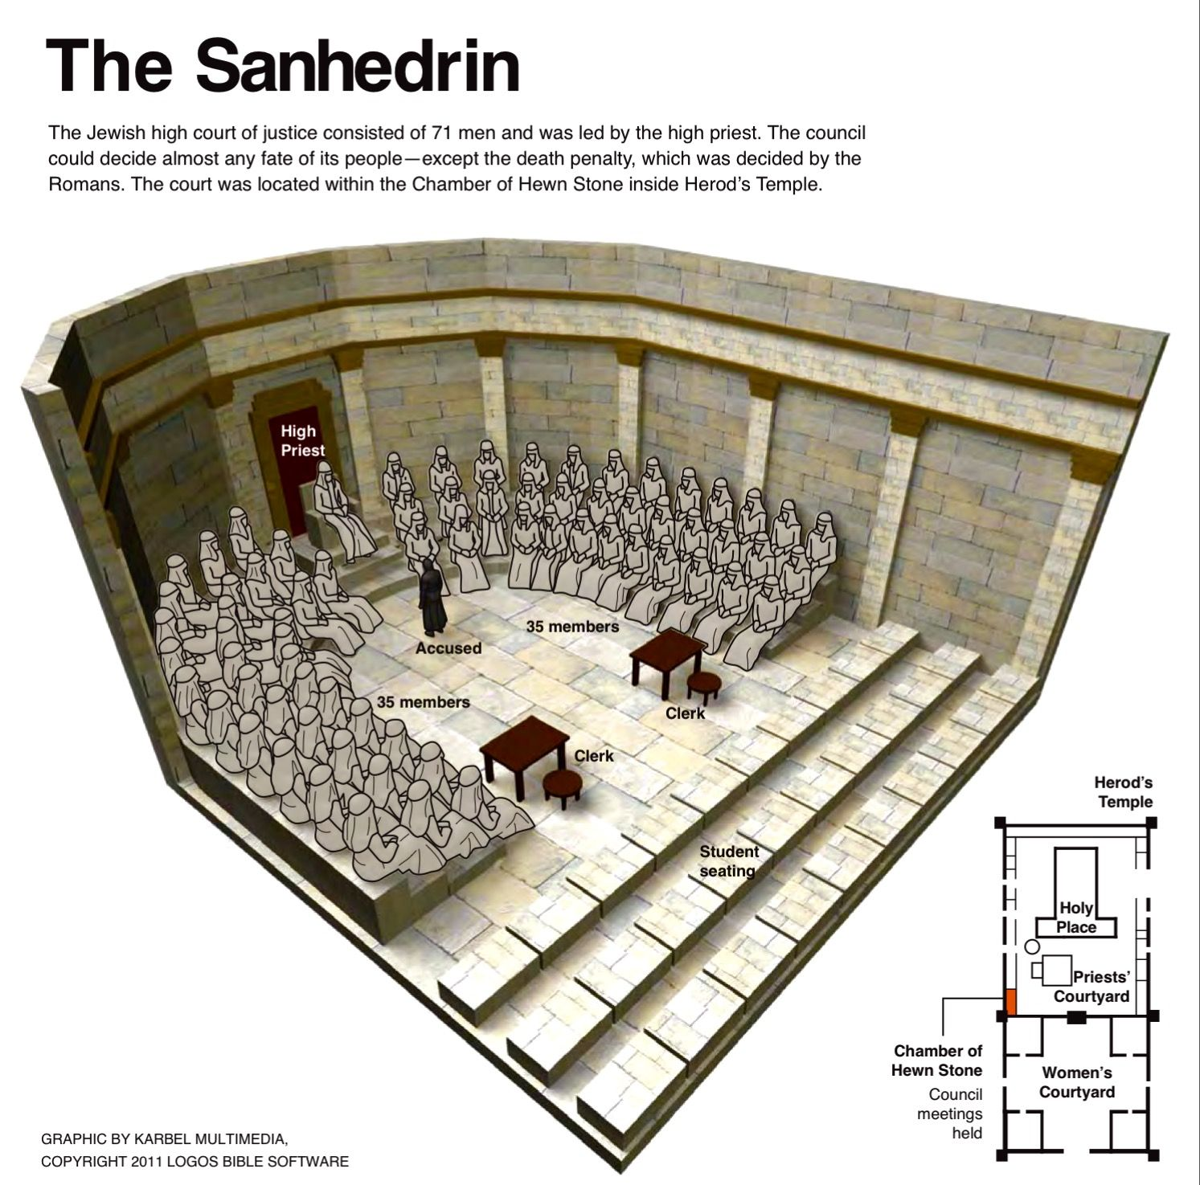
Sanhedrin
Council of 71 (Sadducees and Pharisees)
Presided over by the High Priest
Jewish High Court whose responsibility was to interpret civil and religious laws
It was made up more of Sadducees than Pharisees but the masses were more loyal to the Pharisees and thus made it hard on the Sadducees to do as they pleased.

Slide 56
Acts 4:5-7 Peter & John Before the Council
On the next day, their rulers and elders and scribes were gathered together in Jerusalem; ⁶ and Annas the high priest was there, and Caiaphas and John and Alexander, and all who were of high-priestly descent. ⁷ When they had placed them in the center, they began to inquire, “By what power, or in what name, have you done this?”
Healing the lame man
Annas is described as high priest even though the Roman governor had deposed him from that position in A.D. 15; however, the Jews continued to honor him with as high priest. Caiaphas was the son-in-law of Annas. He was presently recognized by the Roman authorities as high priest, occupying that office from A.D. 18 until A.D. 36
Notes:
Rulers is from archōn, a word that “denotes Roman and Jewish officials of all kinds” (Kittel 1:489). It is probably used in this verse to refer to the chief priests, who were the holders of higher priestly offices (Kittel 3:270-271). The elders were men of age and influence who were selected to sit on the court. The scribes were “professional students and teachers of scriptures” (Bruce, Acts of the Apostles 149).
Annas is described as high priest even though the Roman governor had deposed him from that position in A.D. 15; for even though the Romans no longer recognized him as high priest, the Jews continued to honor him with that title as well as considerable prestige and power. Caiaphas was the son-in-law of Annas. He was presently recognized by the Roman authorities as high priest, occupying that office from A.D. 18 until A.D. 36. We do not know the identities of John and Alexander. They must have been prominent figures among the Jews. Those of the high priest’s family were also present. All these were gathered to sit in judgment on Peter and John

Slide 57
Acts 4:5-7 Peter & John Before the Council
On the next day, their rulers and elders and scribes were gathered together in Jerusalem; ⁶ and Annas the high priest was there, and Caiaphas and John and Alexander, and all who were of high-priestly descent. ⁷ When they had placed them in the center, they began to inquire, “By what power, or in what name, have you done this?”
Healing the lame man
Annas is described as high priest even though the Roman governor had deposed him from that position in A.D. 15; however, the Jews continued to honor him with as high priest. Caiaphas was the son-in-law of Annas. He was presently recognized by the Roman authorities as high priest, occupying that office from A.D. 18 until A.D. 36
Notes:
Rulers is from archōn, a word that “denotes Roman and Jewish officials of all kinds” (Kittel 1:489). It is probably used in this verse to refer to the chief priests, who were the holders of higher priestly offices (Kittel 3:270-271). The elders were men of age and influence who were selected to sit on the court. The scribes were “professional students and teachers of scriptures” (Bruce, Acts of the Apostles 149).
Annas is described as high priest even though the Roman governor had deposed him from that position in A.D. 15; for even though the Romans no longer recognized him as high priest, the Jews continued to honor him with that title as well as considerable prestige and power. Caiaphas was the son-in-law of Annas. He was presently recognized by the Roman authorities as high priest, occupying that office from A.D. 18 until A.D. 36. We do not know the identities of John and Alexander. They must have been prominent figures among the Jews. Those of the high priest’s family were also present. All these were gathered to sit in judgment on Peter and John

Slide 58
Acts 4:8-12 – Peter’s Response (mini sermon)
⁸ Then Peter, filled with the Holy Spirit, said to them, “Rulers and elders of the people, ⁹ if we are on trial today for a benefit done to a sick man, as to how this man has been made well, ¹⁰ let it be known to all of you and to all the people of Israel, that by the name of Jesus Christ the Nazarene, whom you crucified, whom God raised from the dead—by this name this man stands here before you in good health. ¹¹ He is the stone which was rejected by you, the builders, but which became the chief corner stone. ¹² And there is salvation in no one else; for there is no other name under heaven that has been given among men by which we must be saved.”
But when they hand you over, do not worry about how or what you are to say; for it will be given you in that hour what you are to say. ²⁰ For it is not you who speak, but it is the Spirit of your Father who speaks in you. (Matthew 10:19-20)
Psalm 118:22 - The stone which the builders rejected Has become the chief corner stone.
John 14:6 - Jesus said to him, “I am the way, and the truth, and the life; no one comes to the Father but through Me.
Notes:
11 This is the stone which was set at nought of you builders, which is become the head of the corner. In rejecting Jesus, these Jewish leaders had made a colossal blunder. Quoting Psalm 118:22, Peter compared them to builders who reject a stone that later becomes the most important stone in the building — the cornerstone. Because of its importance, the cornerstone represents one who occupies the most exalted position. These religious leaders should have been prominently involved in the furtherance of God’s plan; yet they had rejected the one who occupied the supreme place in that plan! The truth of Peter’s charge is obvious from the fact that the one they had rejected and crucified had been raised from the dead and now lived; the living proof of this fact stood in their midst.

Slide 59
Acts 4:13-22
Now as they observed the confidence of Peter and John and understood that they were uneducated and untrained men, they were amazed, and began to recognize them as having been with Jesus. ¹⁴ And seeing the man who had been healed standing with them, they had nothing to say in reply. ¹⁵ But when they had ordered them to leave the Council, they began to confer with one another, ¹⁶ saying, “What shall we do with these men? For the fact that a noteworthy miracle has taken place through them is apparent to all who live in Jerusalem, and we cannot deny it. ¹⁷ But so that it will not spread any further among the people, let us warn them to speak no longer to any man in this name.” ¹⁸ And when they had summoned them, they commanded them not to speak or teach at all in the name of Jesus. ¹⁹ But Peter and John answered and said to them, “Whether it is right in the sight of God to give heed to you rather than to God, you be the judge; ²⁰ for we cannot stop speaking about what we have seen and heard.” ²¹ When they had threatened them further, they let them go (finding no basis on which to punish them) on account of the people, because they were all glorifying God for what had happened; ²² for the man was more than forty years old on whom this miracle of healing had been performed.
A pupil is not above his teacher; but everyone, after he has been fully trained, will be like his teacher. (Luke 6:40)
This made preaching illegal

Slide 60
According to Acts 4:23-31
What did Peter and John do when released?
What did the brethren do?
What characteristic of God did they feature in the prayer’s address?
What scripture did they quote as fulfilled?
What two things did they pray for?
What indicated that God heard them?

Slide 61
Acts 4:23-31
²³ When they had been released, they went to their own companions and reported all that the chief priests and the elders had said to them. ²⁴ And when they heard this, they lifted their voices to God with one accord and said, “O Lord, it is You who made the heaven and the earth and the sea, and all that is in them, ²⁵ who by the Holy Spirit, through the mouth of our father David Your servant, said,
‘Why did the Gentiles rage, And the peoples devise futile things? ²⁶ ‘The kings of the earth took their stand, And the rulers were gathered together Against the Lord and against His Christ.’
²⁷ For truly in this city there were gathered together against Your holy servant Jesus, whom You anointed, both Herod and Pontius Pilate, along with the Gentiles and the peoples of Israel, ²⁸ to do whatever Your hand and Your purpose predestined to occur. ²⁹ And now, Lord, take note of their threats, and grant that Your bond-servants may speak Your word with all confidence, ³⁰ while You extend Your hand to heal, and signs and wonders take place through the name of Your holy servant Jesus.” ³¹ And when they had prayed, the place where they had gathered together was shaken, and they were all filled with the Holy Spirit and began to speak the word of God with boldness.
Psalms 2

