Slide 1
Lesson 3
Asa & the Prophets

Slide 2
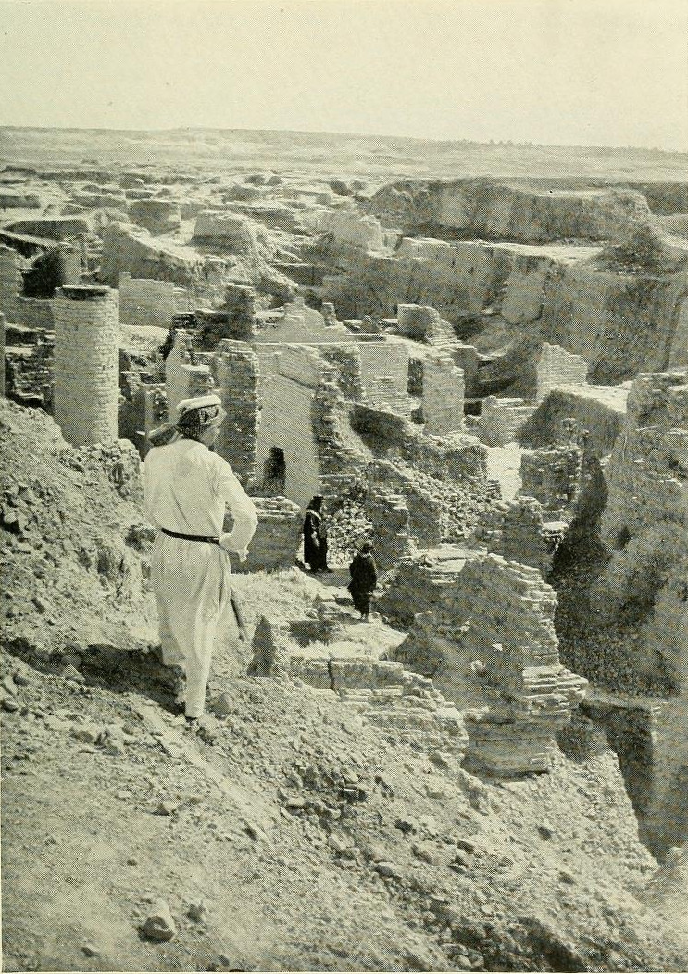
Return from Captivity
Can this be rebuilt?
Why did Jehovah let this happen?
What about a king?
What about the temple?
What do I do to keep this from happening again?

Slide 3
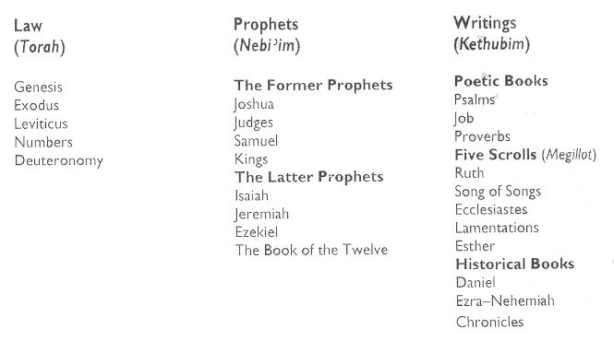
The Hebrew Canon
Gn 4:8
the blood of Abel
2 Chr 24:20-22
the blood of Zechariah

Slide 4
Least Popular Books of the Bible – 10 least read books on BibleGateway.com
Jonah
Joel
Jude
Zephaniah
Philemon
Haggai
3 John
2 John
Nahum
Obadiah
6 of 10 are Minor Prophets

Slide 5
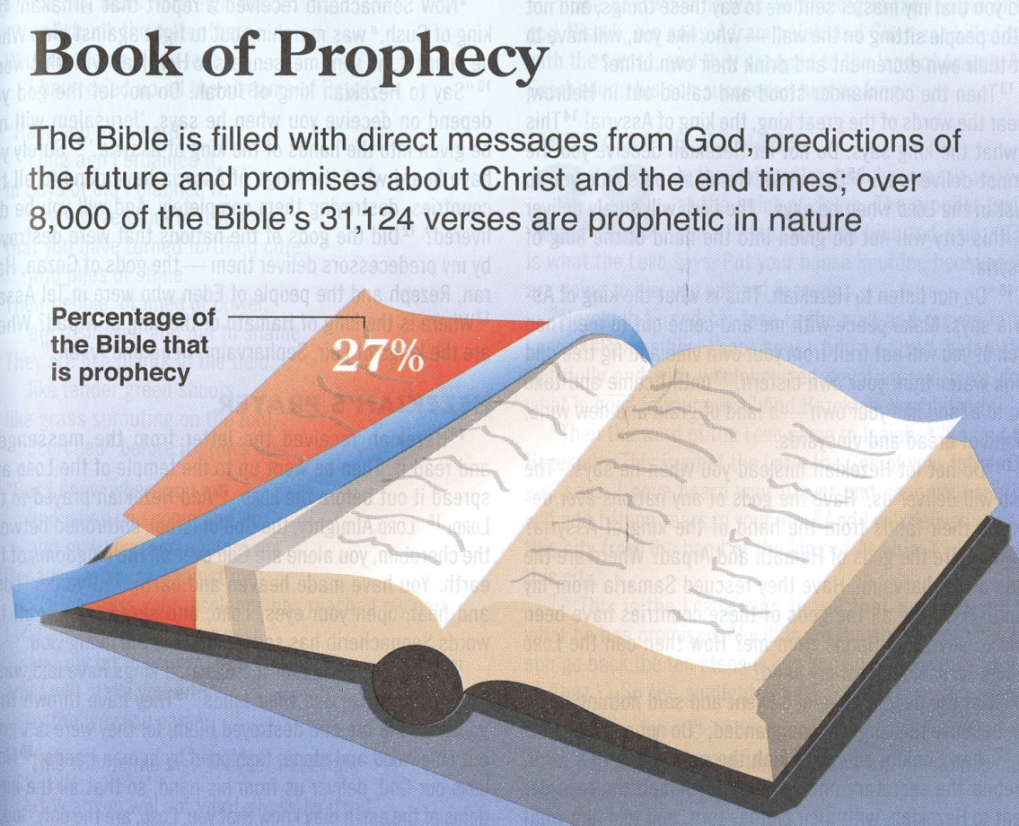

Slide 6
The Role of the Prophets
They are Spokesmen for God, serving as “forthtellers,” speaking what God put in their mouth.
They are Preachers of the Covenant, relating their message to God’s previous promises to the nation of Israel. These covenants were made with or through Abraham, Moses, and David
They are historians, or Interpreters of the Israelites’ History. With out their interpretation God’s people would not know why an event was occurring.

Slide 7
God’s Test for a Prophet
Deuteronomy 18:18-22(ESV)
¹⁸I will raise up for them a prophet like you from among their brothers.
And I will put my words in his mouth, and he shall speak to them
all that I command him.
¹⁹And whoever will not listen to my words that he shall speak in my name, I myself will require it of him.
²⁰But the prophet who presumes to speak a word in my name that I have not commanded him to speak, or who speaks in the name of other gods, that same prophet shall die.’
²¹And if you say in your heart, ‘How may we know the word that the Lord has not spoken?’—
²² when a prophet speaks in the name of the Lord, if the word does not come to pass or come true, that is a word that the Lord has not spoken; the prophet has spoken it presumptuously. You need not be afraid of him.

Slide 8
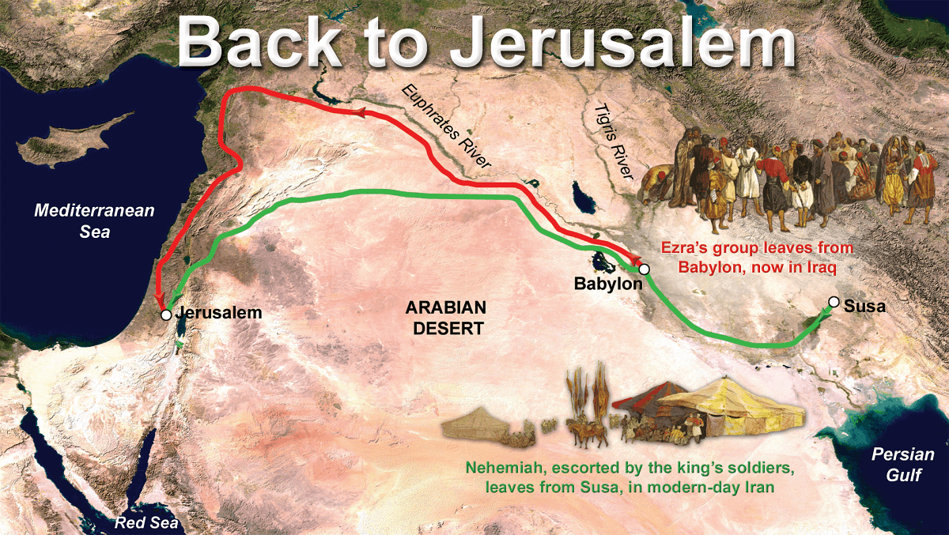
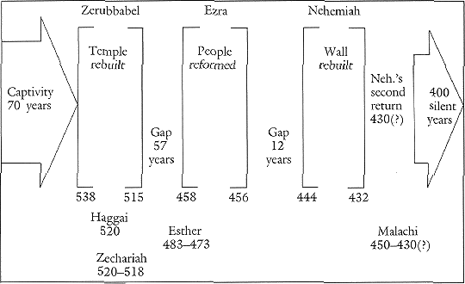

Slide 9
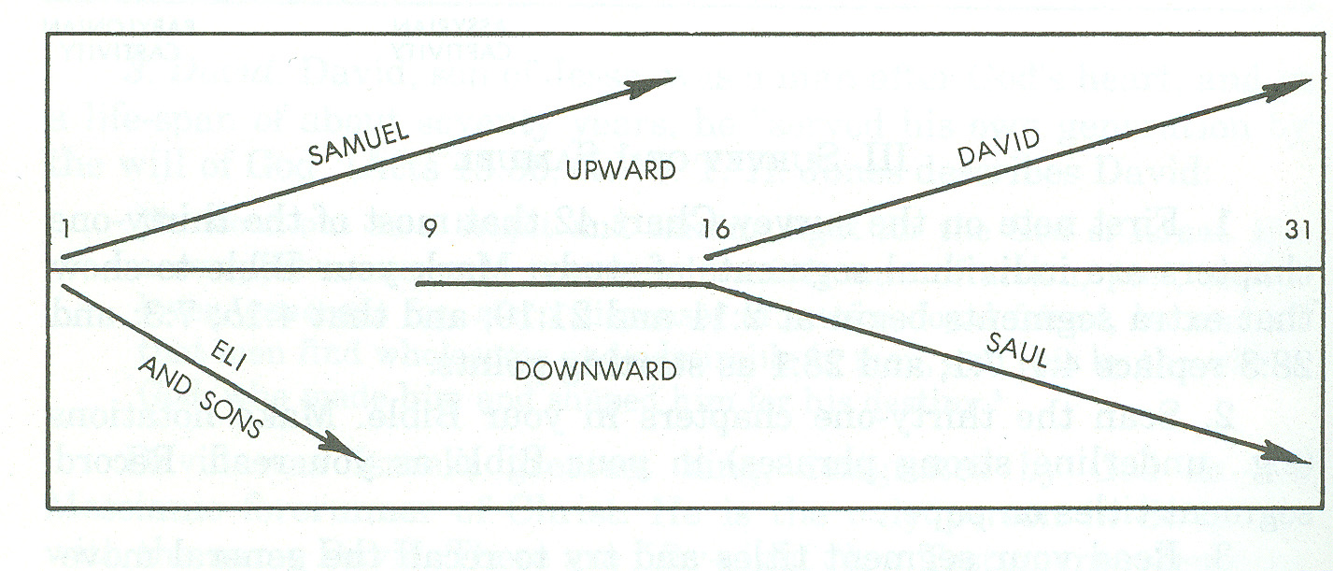
Flow of 1 Samuel

Slide 10
Flow of 2 Samuel
David’s Transgressions
11:1-27
Military
Triumphs
Troubles in David’s
House
12:1-13:36
8:1-10:19
Spiritual
Triumphs
Troubles in David’s
Kingdom
6:1-7:29
13:37-24:25
Political
Triumphs
1:1-5:25
7 years in Hebron
33 years in Jerusalem

Slide 11
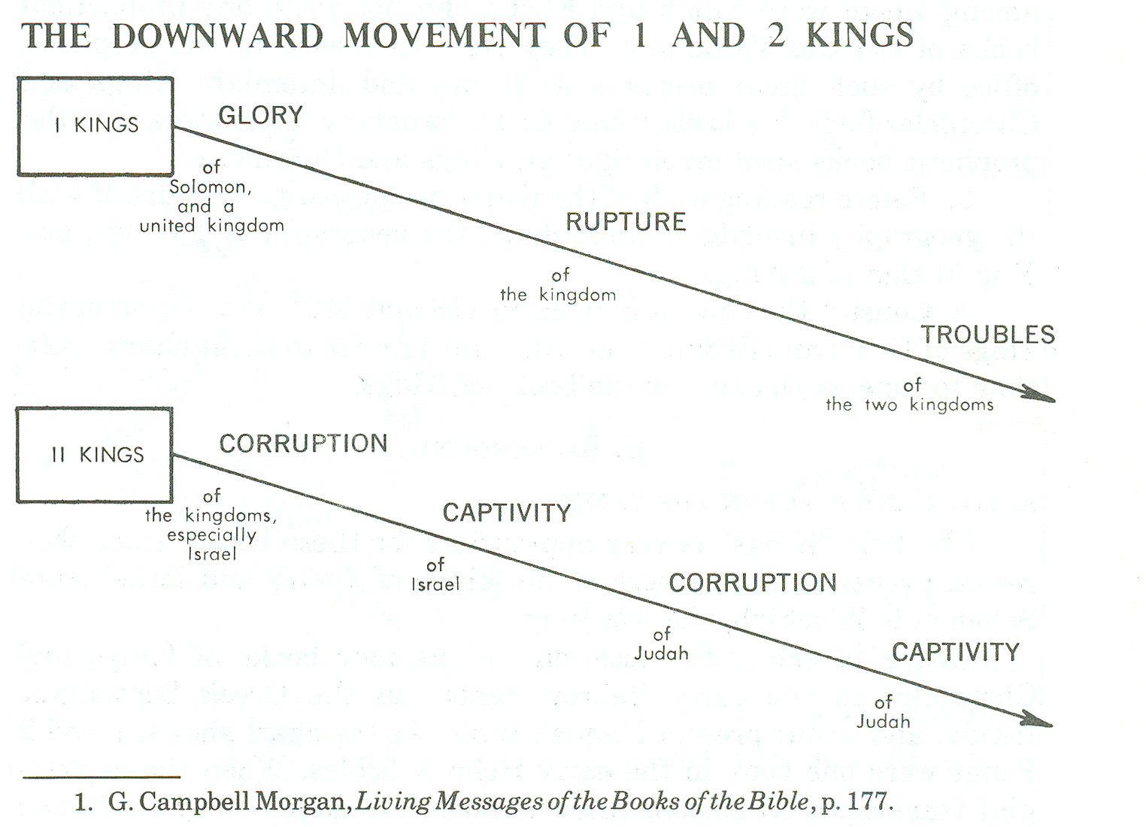
Flow of 1 & 2 Kings
1 KINGS 12

Slide 12
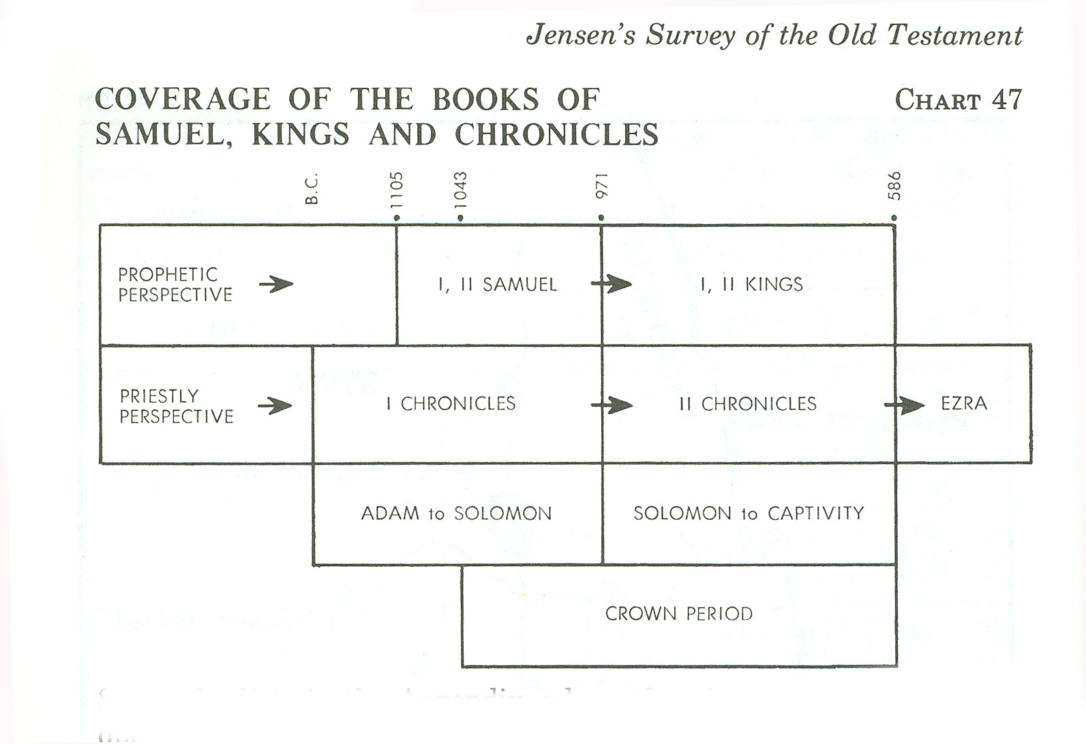
Samuel/Kings & Chronicles
Jeremiah
Ezra

Slide 13
Kings of United & Divided Kingdom
United
Kingdom
Divided Kingdom
Judah Alone
Early Kings – Israel
Dynasty 1&2
Omri
Dynasty 3
Jehu
Dynasty 4
Confusing
Dynasties
Hezekiah
Hezekiah
(728-686)
Manasseh
Amon
1
Jereboam
Nadab
3
Omri
Ahab
(874-853)
Ahaziah
Jehoram
4
Jehu
(841-814)
Jehoahaz
Jehoash
Jereboam II
(793-753)
Zechariah
Shallum
Menahem
Pekaiah
Pekah
Hosea
(732-722)
5
Saul
(1050-1010)
David
(1010-970)
Solomon
(970-930)
2
Baasha
Elah
Josiah &
Sons
Zimri ~ 885
Tibni
Josiah
(640-609)
Jehoahaz
Jehoiakim
Jehoiachin
Zedekiah
(597-586)
Early Kings – Judah
Dynasty 1&2
Omri
Dynasty 3
Jehu
Dynasty 4
Confusing
Dynasties
Rehoboam
Abijam
Asa
(930-870)
Jehosphat
(873-848)
Jehoram
Ahaziah
Athaliah
Joash
Amaziah
Azariah/Uzziah
(790-739)
Jotham
Ahaz
Hezekiah
Judah Return
Zerubbabel (538-515)
Ezra (458-456)
Nehemiah (444-432)

Slide 14
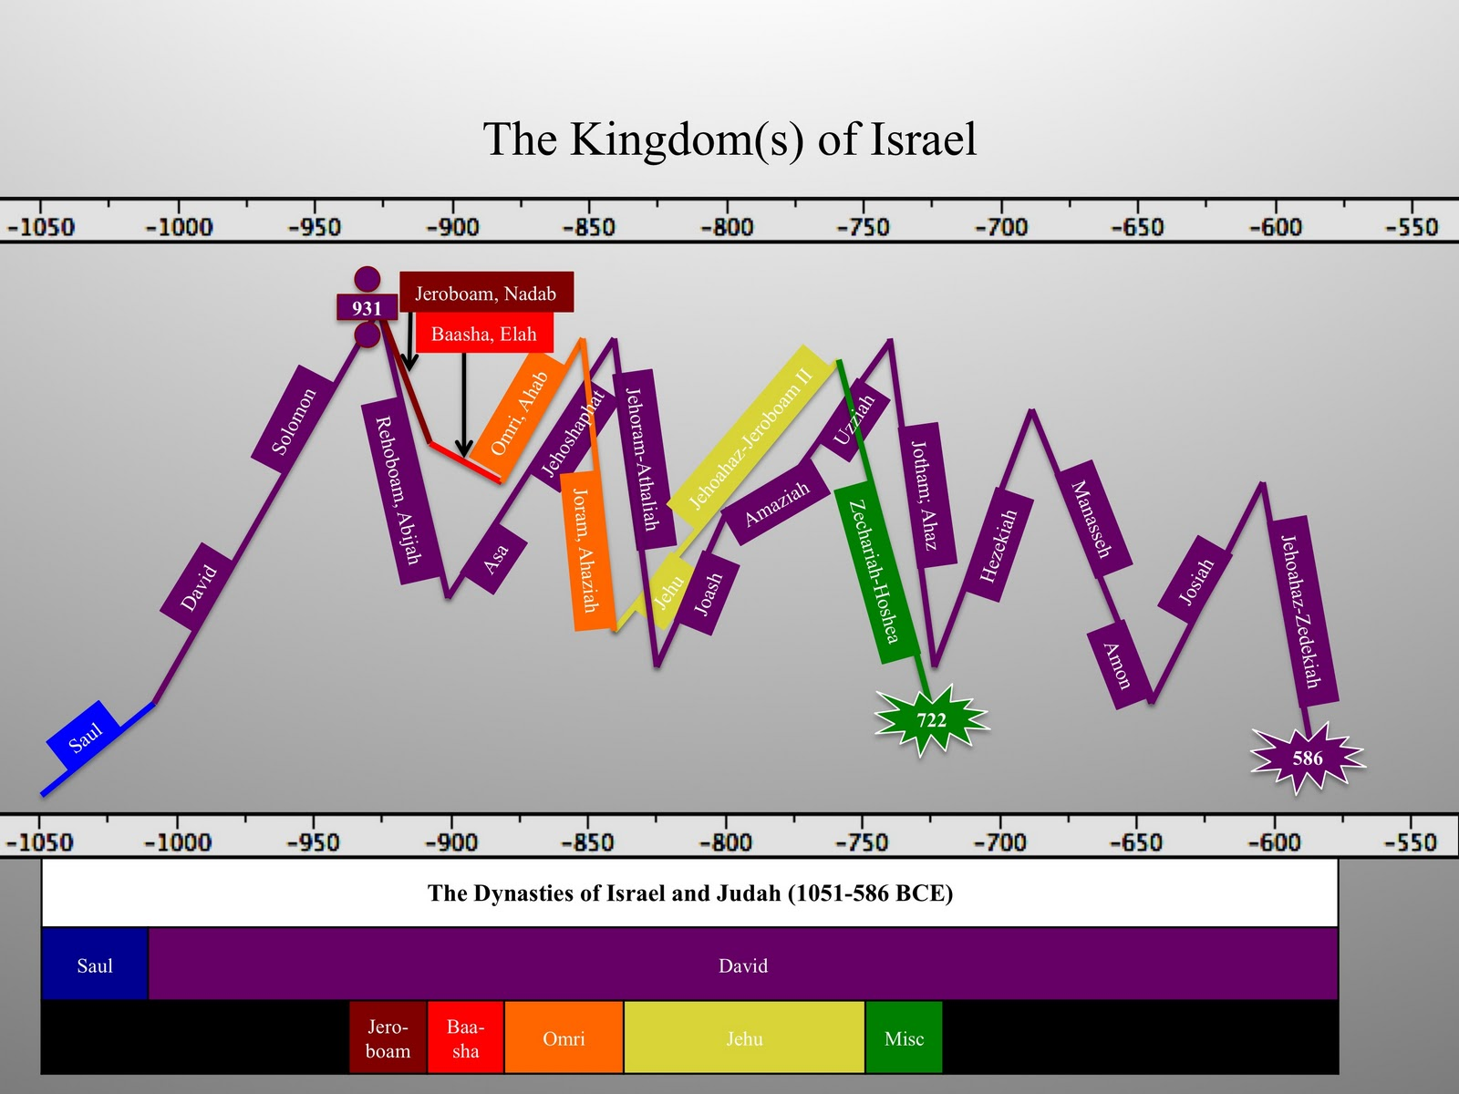
Lesson 2
Lesson 1
Lesson 3

Slide 15
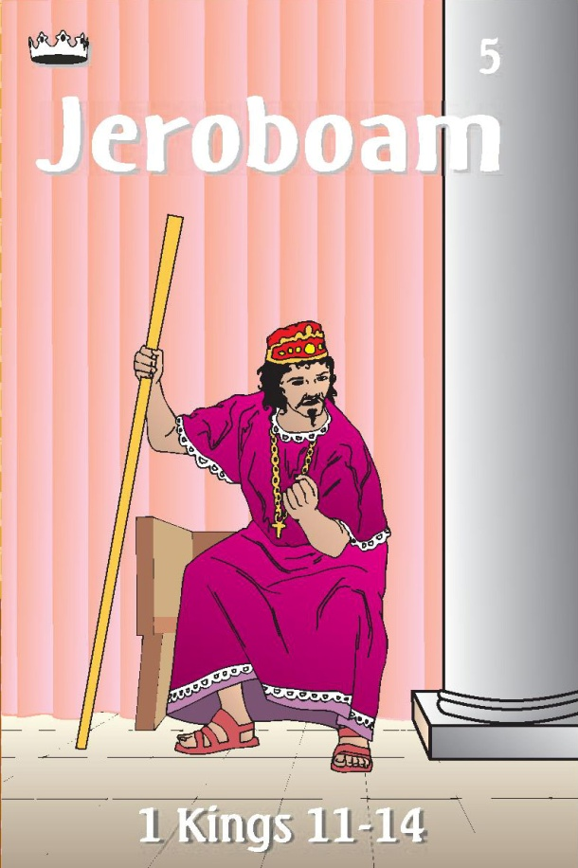
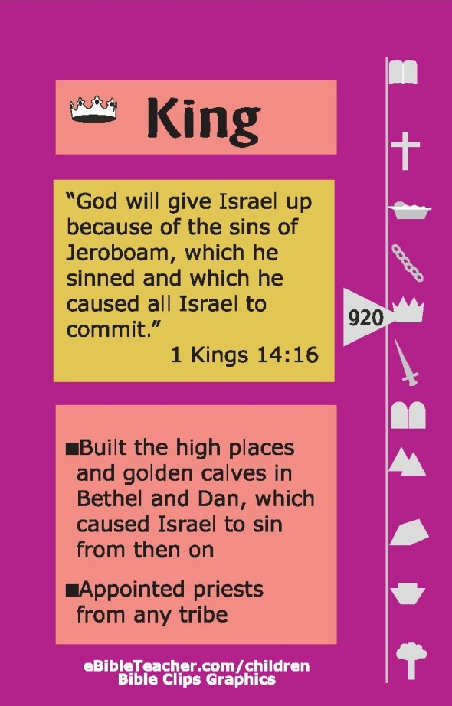

Jeroboam Card
Kings of Judah
Rehoboam
Abijam
Prophets
Ahijah

Slide 16
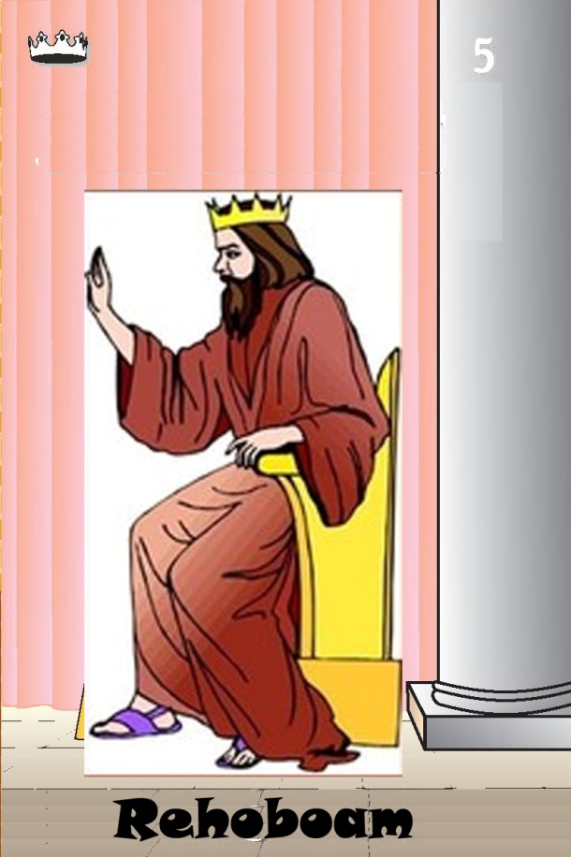

Rehoboam Card
Kings of Israel
Judah did evil in the sight of the Lord
their sins more than all that their fathers had done.
Jeroboam
931
-913
Prophets
Shemaiah
Lost kingdom – advice of young men
Served Lord 5 yrs – turned away
Shishak takes gold
Built Fortified Cities
1 Kings 12, 15/2 Chr 10-12

Slide 17


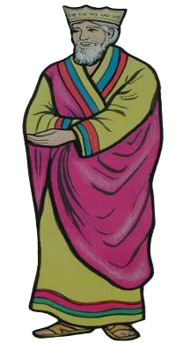

Asa Card
Kings of Israel
1-Nadab
2-Baasha
Elah
Zimri
Tibni
3-Omri
Heart was loyal to the Lord all his days
Removed all the idols that his fathers had made
Did not remove high places
911
-870
Made treaty with Syria
Took Ramah from Baasha
Imprisoned prophet
Diseased feet
Did not pray to God
Asa
Made covenant
EARLY KINGS

Slide 18
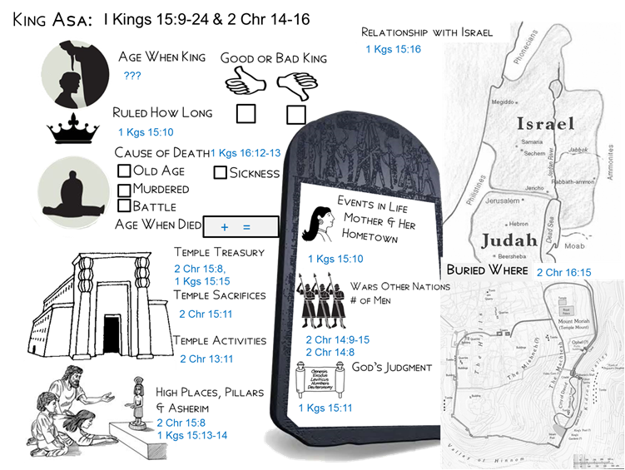

??
^{there was war all the} ^{days with Baasha}
41
diseased feet
??
he repaired the altar of the Lord
the sacred gifts of his father and his own sacred gifts, silver, and gold, and vessels
Maacah the daughter of Abishalom
buried him in the tomb that he had cut for himself in the city of David
sacrificed to the Lord on that day from the spoil that they had brought 700 oxen and 7,000 sheep.
Zerah the Ethiopian million men & 300 chariots
300,000 from Judah
280,000 from Benjamin
Made covenant with Lord
2 Chr 15:12-14
put away the detestable idols from all the land
removed Maacah his mother from being queen mother because she had made an abominable image for Asherah
But the high places were not taken away
And Asa did what was right in the eyes of the LORD, as David his father had done.

Slide 19
Kings of Judah Before Fall of Israel
Army

Slide 20
Kings of Judah Before Fall of Israel
Army

Slide 22
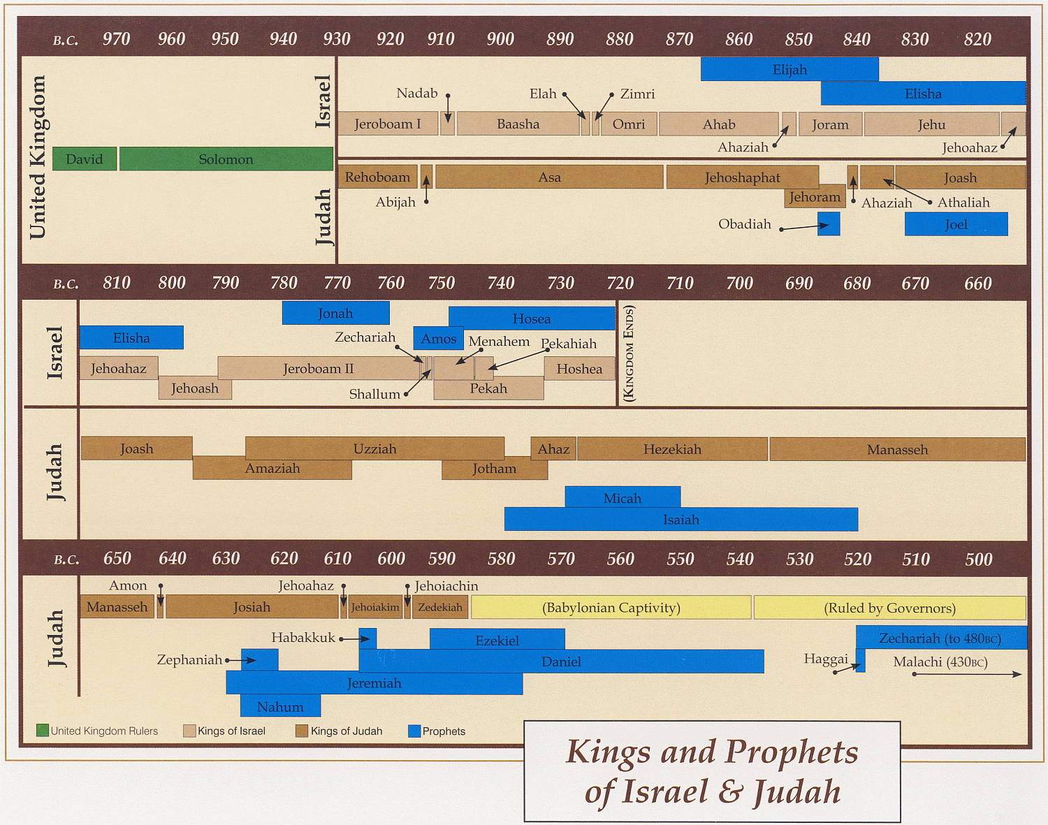
Ahijah
Jehu
Man of God
Micaiah
Man of God
Syria
Shemaiah
Azariah
Hanani
Assyria
Babylon/Persia

Slide 23
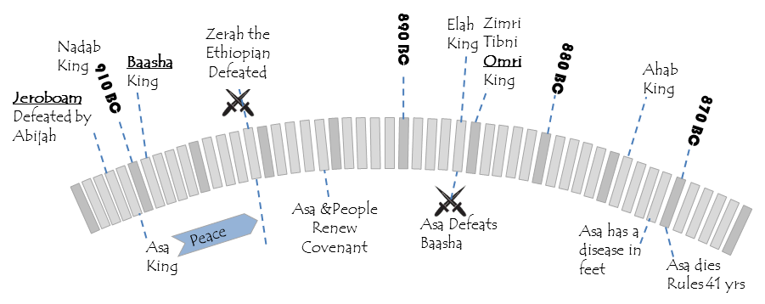
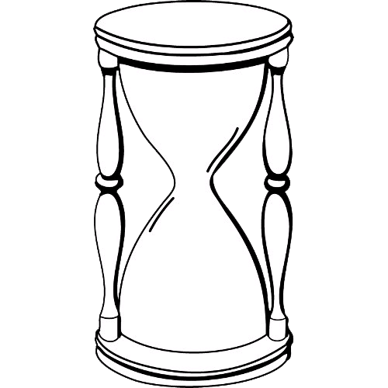
Asa’s First 10 Years 2 Chron 14:1-6
In his days the land had rest for ten years.
Asa did what was good and right in the eyes of the Lord his God.
He took away the foreign altars and the high places
Broke down the pillars and cut down the Asherim
Commanded Judah to seek the Lord, the God of their fathers, and to keep the law and the commandment.
He also took out of all the cities of Judah the high places and the incense altars. And the kingdom had rest under him.
He built fortified cities in Judah, for the land had rest.
He had no war in those years, for the Lord gave him peace.
10 Yrs of Peace

Slide 24
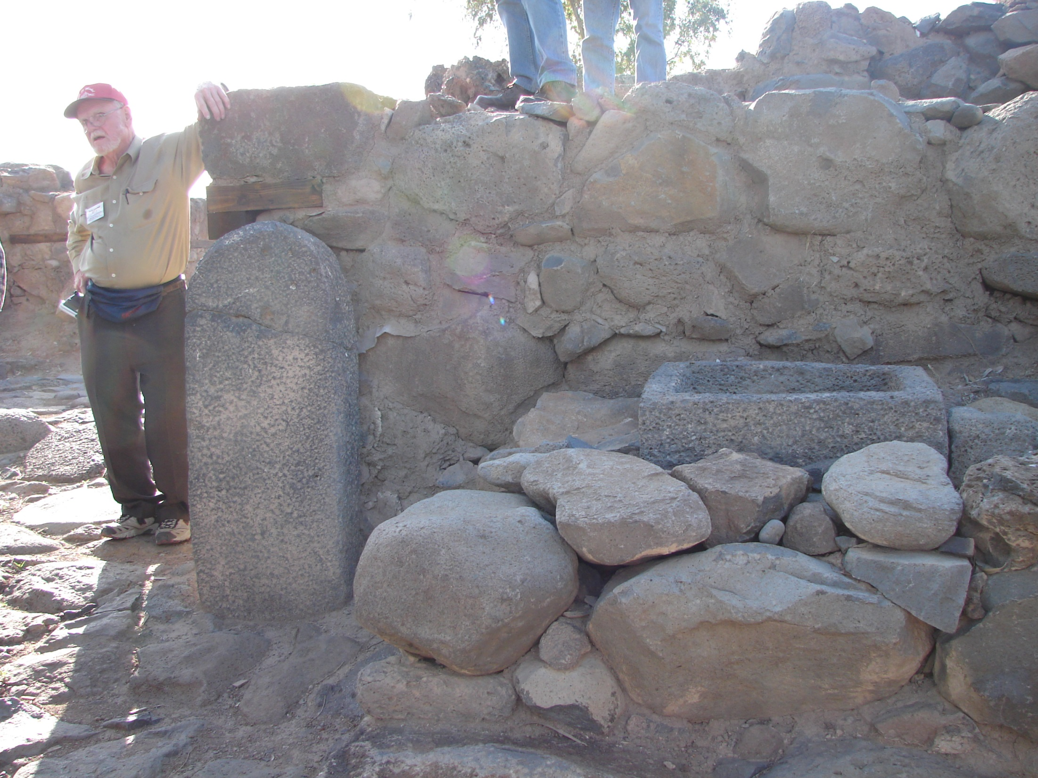
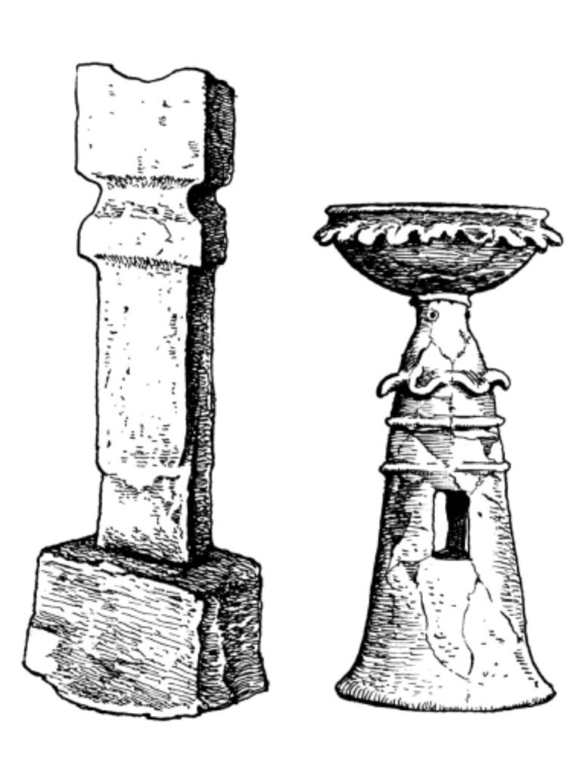
He also took out of all the cities of Judah the high places and the incense altars.

Slide 25
Asa’s Ethiopian Crisis – II Chr 14
⁹Zerah the Ethiopian came out against them with an army of a million men and 300 chariots, and came as far as Mareshah. ¹⁰And Asa went out to meet him, and they drew up their lines of battle in the Valley of Zephathah at Mareshah.
¹¹And Asa cried to the Lord his God, “O Lord, there is none like you to help, between the mighty and the weak. Help us, O Lord our God, for we rely on you, and in your name we have come against this multitude. O Lord, you are our God; let not man prevail against you.”
¹²So the Lord defeated the Ethiopians before Asa and before Judah, and the Ethiopians fled.

Slide 26
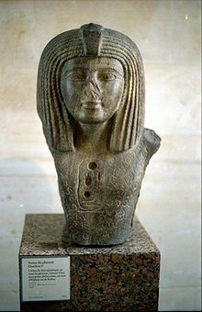
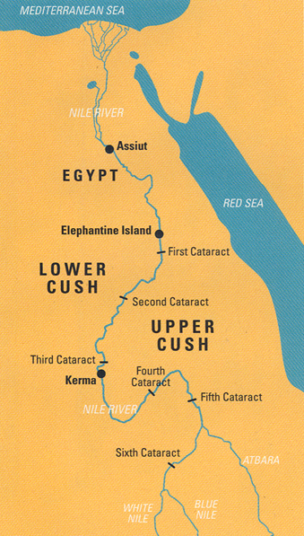
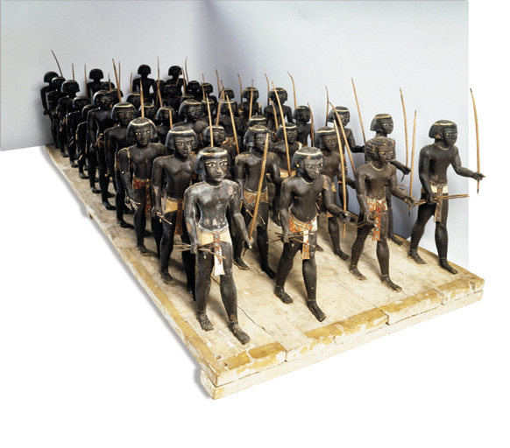
Zerah the Cushite?
General for Pharaoh?
BR 14:04, Aug 1998
Granite torso with the cartouche of
Osorkon I found at Byblos
The son of Shoshenq , Osorkon I was the second king of Egypt's 22nd Dynasty and ruled around 922 BC – 887 BC.
He succeeded his father Shoshenq I who probably died within a year of his successful 923 BC campaign against the kingdoms of Israel and Judah.
Osorkon I's reign is known for many temple building projects and was a long and prosperous period of Egypt's History.
Notes:
From the Land of the Bow
Black soldiers in the ancient Near East
By J. Daniel Hays
Photo by Jürgen Liepe
Marching as to war. Armed with bows and arrows, soldiers from Cush (also known as Nubia), or the Land of the Bow, are depicted in this wooden model from about 2040 B.C.E., found in a tomb in Assiut, Egypt. Famed throughout the Near East as skilled warriors, black soldiers were recruited by Egypt, Assyria, Greece, Rome and, according to the Bible, Israel (2 Samuel 18 and 2 Chronicles 14).
The Cushites’ international reputation as mercenaries, according to author J. Daniel Hays, clarifies the story behind one of the Bible’s more obscure characters, a Cushite named Ebedmelech, who played a pivotal role during the Babylonian siege of Jerusalem from 588 to 586 B.C.E.: When Jeremiah was condemned for preaching the futility of resisting Babylon, Ebedmelech interceded on his behalf and convinced Judah’s King Zedekiah to release the prophet. For this black foreigner to gain the king’s ear, Hays argues, he must have been a high-ranking military attaché hired by Zedekiah or dispatched by Egypt.
Cush occupied a strategic location south of Egypt, controlling the cataracts of the Nile: Because the cataracts are barriers to river transportation, whoever controlled them also controlled the important caravan routes that went around them. Cush’s capital, Kerma, lay between the third and fourth cataracts. A garrison of Jewish mercenary soldiers, brought to Egypt to help defend the southern border with Cush, was established on Elephantine Island in about 650 B.C.E. This provided some of the main points of contact between Hebrews and Cushites.
Another biblical reference, however, describes a Cushite soldier fighting against Israel: Second Chronicles 14:9–15 recounts a battle between Zerah the Cushite and Judah during the reign of Asa (913–873 B.C.E.). Zerah attacked with a vast army (literally “a thousand thousands”), including 300 chariots. Asa called to YHWH for assistance: “Help us, O Lord our God, for we rely on You, and in your name we have come against this great multitude” (2 Chronicles 14:10).¹¹ Zerah the Cushite was most likely a Cushite general from south of Egypt, either working directly for the pharaoh Osorkon I (924–889 B.C.E.) or invading under a treaty provision with him.

Slide 27
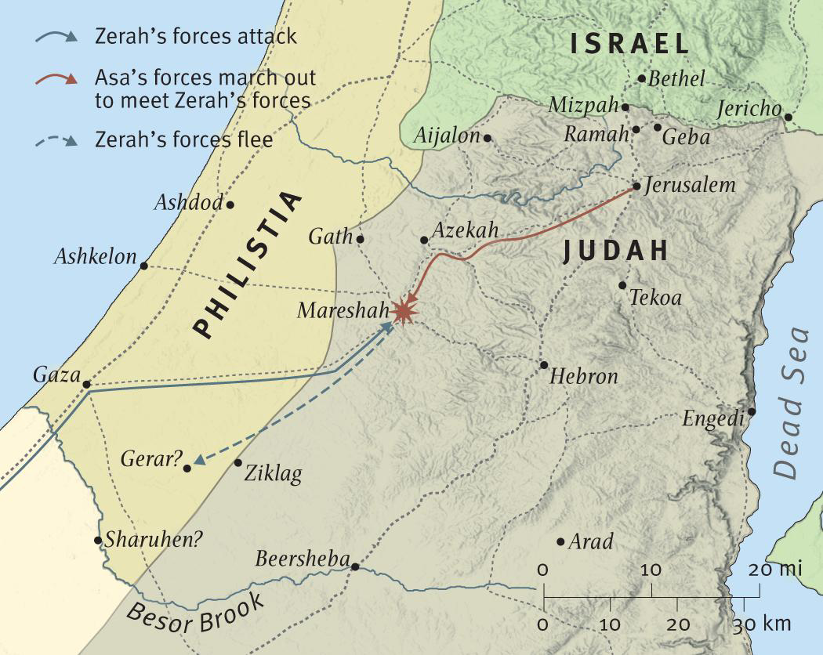
Egypt or
Arabs by Sea
¹⁰And Asa went out to meet him, and they drew up their lines of battle in the Valley of Zephathah at Mareshah.

Slide 28
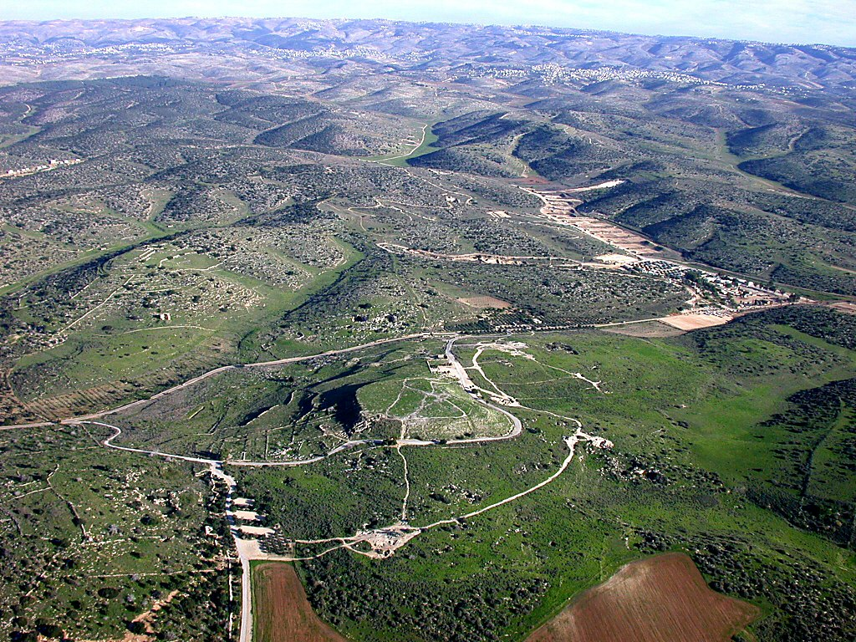
Maresha area aerial from west
Judean Hill Country
Tomb of Sidonian
Bell Caves
Tell Maresha
Columbarium
Maresha area aerial from west
BiblePlaces.com
Notes:
Names: Maresha, Marisa, Bet Guvrin, Eleutheropolis
Maresha was a city of Judah given to the clan of Caleb (Josh 15:44; 1 Chr 2:42; 4:21).
Maresha was fortified by Rehoboam (2 Chr 11:8-11).
Zerah the Cushite invaded Judah and made it as far as Maresha before meeting Asa and being turned back.
Maresha was the home of the prophet Eliezer, son of Dodavahu, who prophesied against Jehoshaphat (2 Chr 20:35-37).
Micah 1:15 (NIV) “I will bring a conqueror against you who live in Mareshah. He who is the glory of Israel will come to Adullam.”
Maresha was destroyed by Sennacherib in 701 B.C.
After 586 B.C., Maresha, along with all of southern Judah, came under the influence of Edom. The Edomites moved in and intermarried with the remaining people ― this gave rise to the Idumeans. Maresha was the capital city of the Idumeans.
A group of Sidonians settled at Maresha in the Hellenistic (or maybe the Persian) period.
Maresha is identified as Tel Sandahanna, which preserves the name of St. Anne. The tell is 357 meters (1,170 ft.) above sea level and six acres in size.

Slide 29
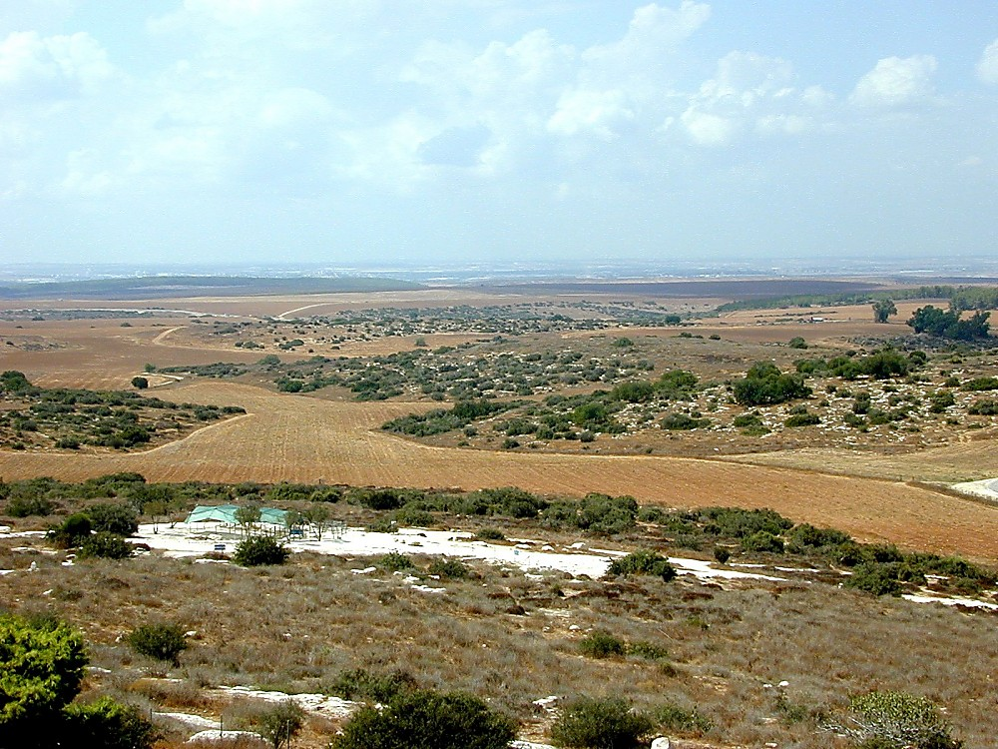
View west from Tell Maresha
View west from Tell Maresha
(Looking down Valley of Zephathah)
BiblePlaces.com
Notes:
Later History
This was an important city in the Islamic and Crusader periods.
In the Arab period (640-1099), Eleutheropolis became the capital of the south and a major producer of limestone.
The Crusaders came this far and built a fortress on their way to Ashkelon in 1136 A.D. They added more churches, and the order of the Hospitalers was brought in by King Fulk in 1134 A.D.
A small Arabic village, Bet Jibrin, stood here until it was captured by the Egyptian army in June 1948. It was retaken by the Israelis on October 27, 1948 in Operation Yoav. Kibbutz Beth Guvrin was founded in May 1949.

Slide 30
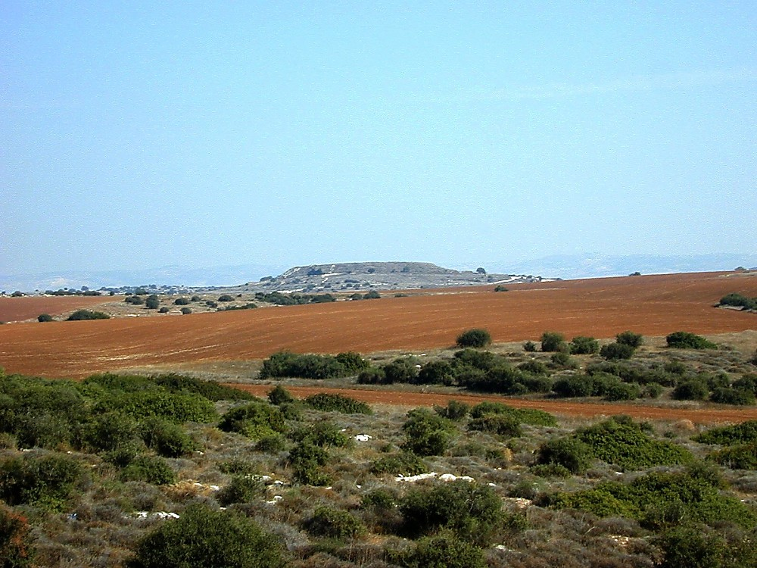
Maresha from south
Maresha from south
BiblePlaces.com
Notes:
Bet Guvrin
After the destruction by the Parthians in 40 B.C., the population center moved two miles north to a place known as Bet Guvrin. Bet Guvrin had been a suburb of Maresha; it became the major living center by the Roman Period.
Bet Guvrin means “House of Mighty Men.”
Bet Guvrin is first mentioned by Josephus as a city that Vespasian destroyed in 68 A.D.
Bet Guvrin was a Jewish city from 70 A.D. through the Byzantine period. Leading rabbis lived here in the 3rd and 4th centuries. The remains of a Jewish synagogue and cemetery have been found here.

Slide 31
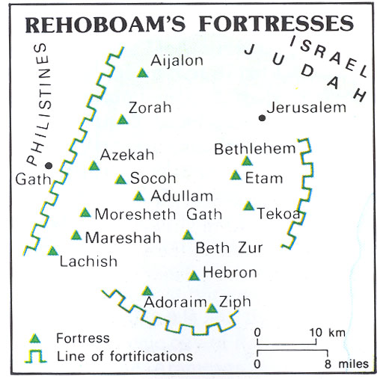
Rehoboam’s Fortresses
Egypt or
Arabs by Sea
Dead Sea
Ammon
Egypt or Arabs by
Mountian Ridgeline

Slide 32
Asa’s Reforms 2 Chron 15
Azariah the son of Oded,
“Hear me, Asa, and all Judah and Benjamin:
The Lord is with you while you are with him. If you seek him, he will be found by you, but if you forsake him, he will forsake you.
For a long time Israel was without the true God, and without a teaching priest and without law,
but when in their distress they turned to the Lord, the God of Israel, and sought him, he was found by them.
In those times there was no peace to him who went out or to him who came in, for great disturbances afflicted all the inhabitants of the lands.
They were broken in pieces. Nation was crushed by nation and city by city, for God troubled them with every sort of distress.
But you, take courage! Do not let your hands be weak, for your work shall be rewarded.”
1 million Ethiopians
10 Yrs of Peace

Slide 33
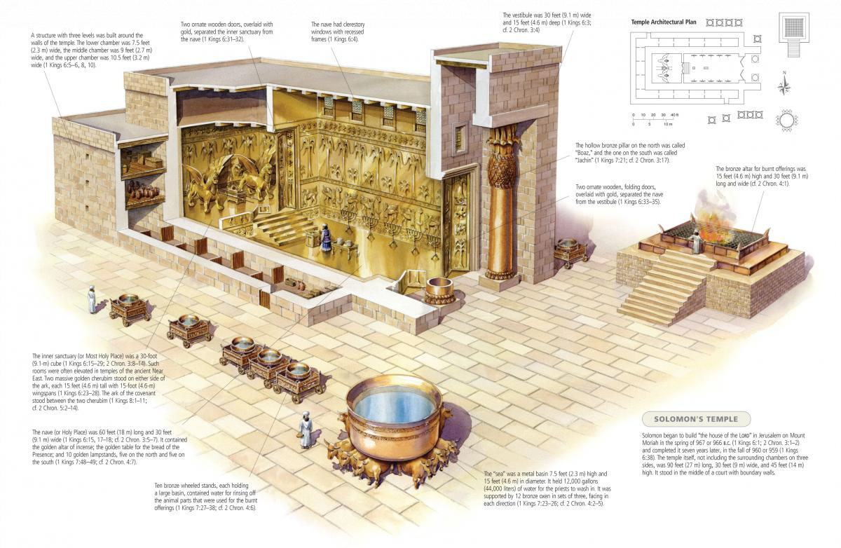
⁸As soon as Asa heard these words, the prophecy of Azariah the son of Oded,
he took courage and put away the detestable idols from all the land of Judah and Benjamin and from the cities that he had taken in the hill country of Ephraim, and he repaired the altar of the Lord that was in front of the vestibule of the house of the Lord.

Slide 34
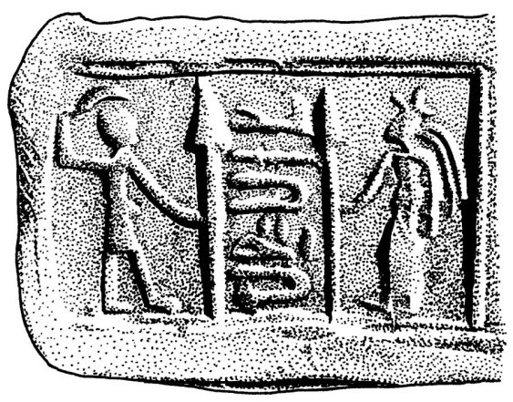
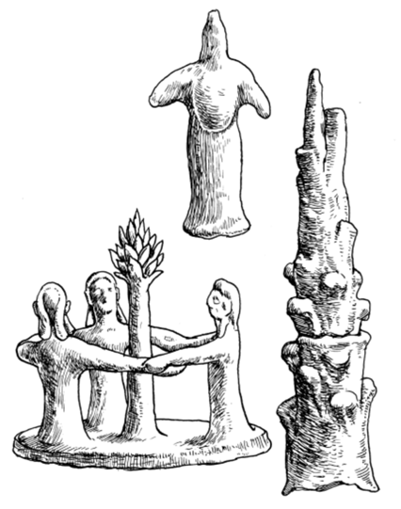
Asa’s Reforms II Chr 15
⁸As soon as Asa heard these words, the prophecy of Azariah the son of Oded,
he took courage and put away the detestable idols from all the land of Judah and Benjamin and from the cities that he had taken in the hill country of Ephraim, and he repaired the altar of the Lord that was in front of the vestibule of the house of the Lord.

Slide 35
2 Chronicles 15:11-15(ESV)
¹¹They sacrificed to the Lord on that day from the spoil that they had brought 700 oxen and 7,000 sheep.
¹²And they entered into a covenant to seek the Lord, the God of their fathers, with all their heart and with all their soul,
¹³but that whoever would not seek the Lord, the God of Israel, should be put to death, whether young or old, man or woman.
¹⁴They swore an oath to the Lord with a loud voice and with shouting and with trumpets and with horns.
¹⁵And all Judah rejoiced over the oath, for they had sworn with all their heart and had sought him with their whole desire, and he was found by them, and the Lord gave them rest all around.

Slide 36
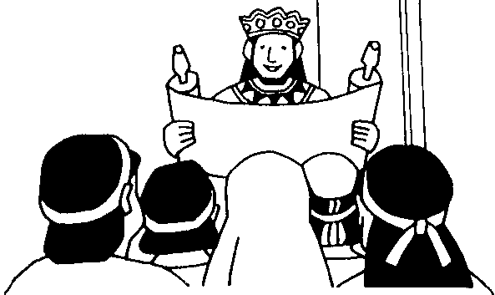

Covenant to Follow the Law
2 Chronicles 15:12-14(ESV)
¹²And they entered into a covenant to seek the Lord, the God of their fathers,
with all their heart and with all their soul,
¹³but that whoever would not seek the Lord, the God of Israel, should be put to death, whether young or old, man or woman.
¹⁴They swore an oath to the Lord with a loud voice and with shouting and with trumpets and with horns.
Asa
911-870
Joash
835-796
2 Kings 11:17(ESV)
¹⁷And Jehoiada made a covenant between the Lord and the king and people, that they should be the Lord’s people, and also between the king and the people.
2 Kings 23:3(ESV)
³And the king stood by the pillar and made a covenant before the Lord, to walk after the Lord and to keep his commandments and his testimonies and his statutes with all his heart and all his soul, to perform the words of this covenant that were written in this book. And all the people joined in the covenant.
Josiah
640-609

Slide 37
Asa and the people make a covenant to follow the Law which is recorded two other times
2 Kg 17:15-21 Joash/Jehoiada
- 2 Kg 23:1-3- Josiah

Slide 38
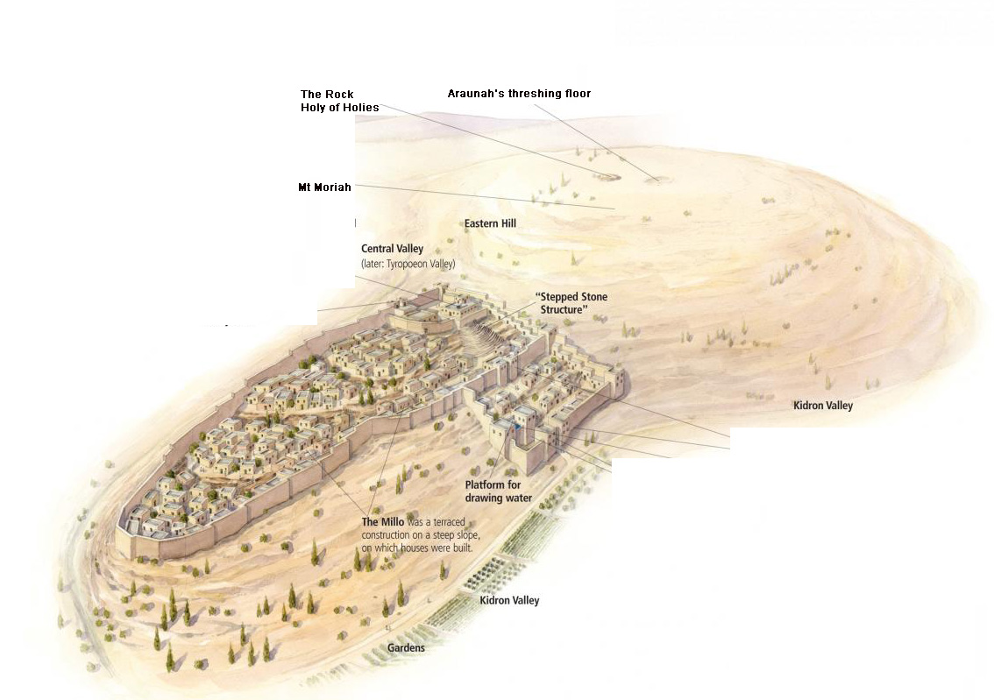
¹⁶Even Maacah, his mother, King Asa removed from being queen mother because she had made a detestable image for Asherah. Asa cut down her image, crushed it, and burned it at the brook Kidron.
¹⁷But the high places were not taken out of Israel. Nevertheless, the heart of Asa was wholly true all his days.

Slide 39
Asa’s Later Years - II Chr 16
¹In the thirty-sixth year of the reign of Asa, Baasha king of Israel went up against Judah and built Ramah, that he might permit no one to go out or come in to Asa king of Judah.
²Then Asa took silver and gold from the treasures of the house of the Lord and the king’s house and sent them to Ben-hadad king of Syria, who lived in Damascus, saying, ³“There is a covenant between me and you, as there was between my father and your father. Behold, I am sending to you silver and gold. Go, break your covenant with Baasha king of Israel, that he may withdraw from me.”
⁴And Ben-hadad listened to King Asa and sent the commanders of his armies against the cities of Israel, and they conquered Ijon, Dan, Abel-maim, and all the store cities of Naphtali.
14 Yrs
Baasha Attacks
15 Yrs of Reform
1 million Ethiopians
10 Yrs of Peace

Slide 40

Seeking Help
Asa ask Syria for Help 2
2 Chr 16:2
Ahaz ask Assyria to help 2 Chr 28:16

Slide 41
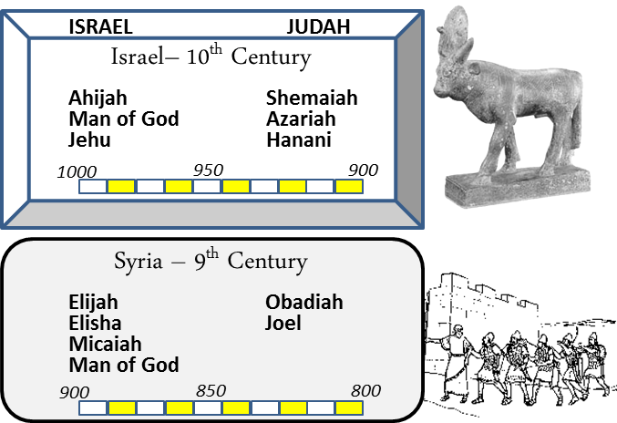
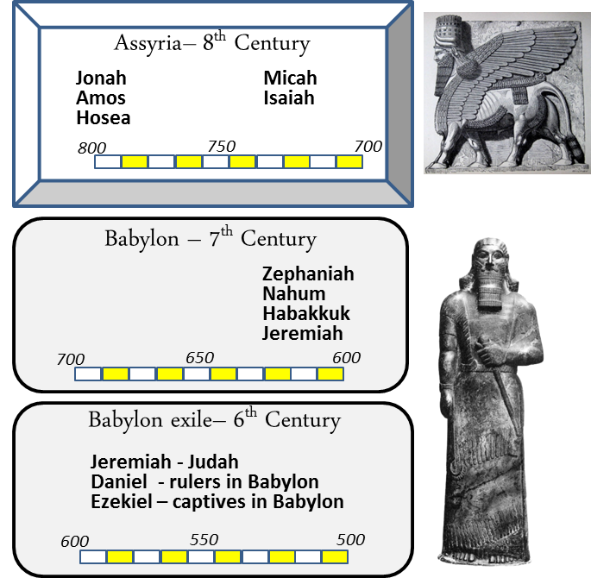
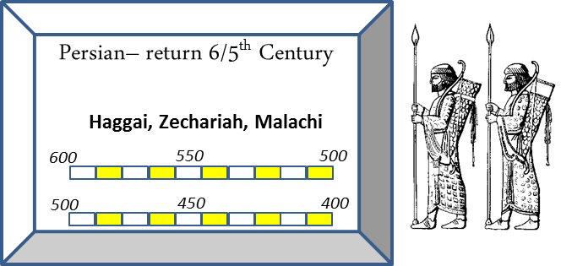
Time & Enemies

Slide 42
Asa’s Later Years - II Chr 16
⁵And when Baasha heard of it, he stopped building Ramah and let his work cease. ⁶Then King Asa took all Judah, and they carried away the stones of Ramah and its timber, with which Baasha had been building, and with them he built Geba and Mizpah.
14 Yrs
Baasha Attacks
15 Yrs of Reform
1 million Ethiopians
10 Yrs of Peace

Slide 43
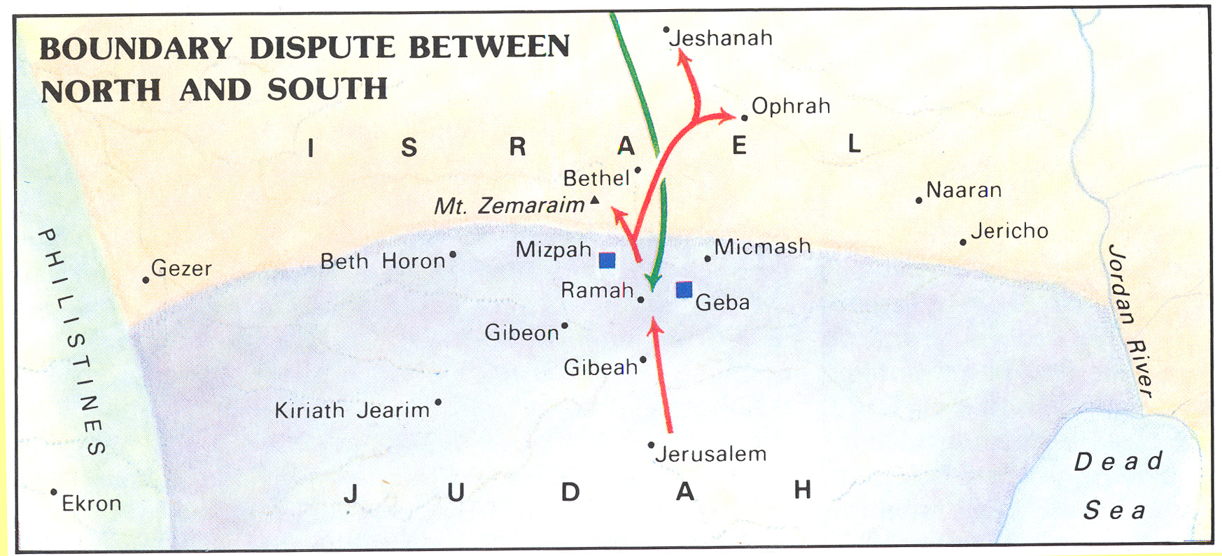
Problems with Baasha
Abijah’s Invasion
Baasha’s Invasion

Slide 44
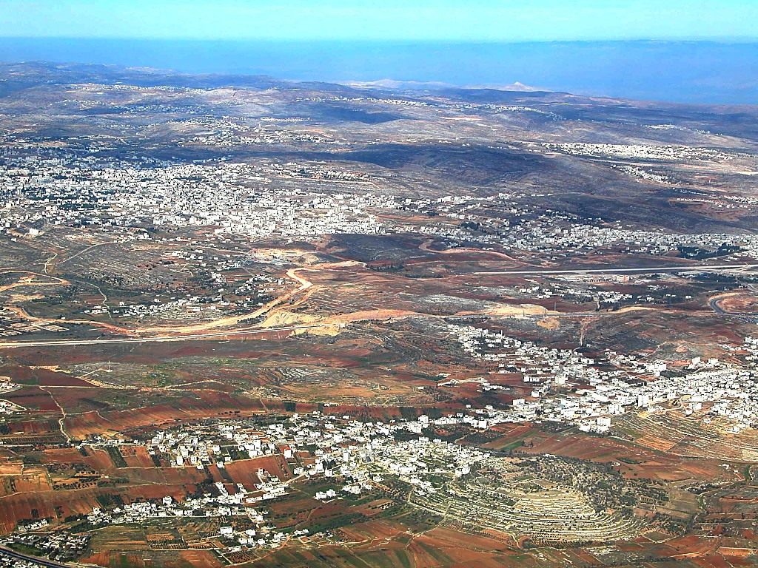
Ramallah/
El-Bireh(=Bethel?)
Alexandrium/Sartaba
Mizpah
Ramah
Gibeon
Central Benjamin Plateau aerial from southwest

Slide 45
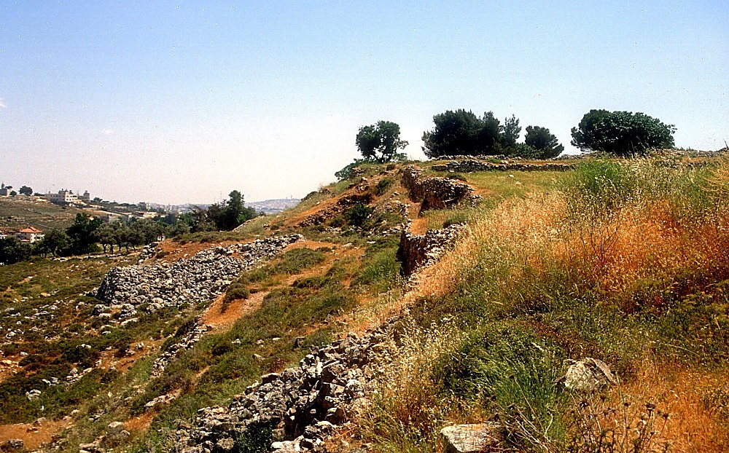
Mizpah ruins
Mizpah ruins
BiblePlaces.com
Notes:
Mizpah: Archaeology
A. Rabboisson (1897) was the first to identify Mizpah with Tell en-Nasbeh, a site 12 km (about 19.3 mi) north of Jerusalem. Tell en-Nasbeh matches Mizpah’s topographical requirements, and also has an Arabic version of the original Hebrew name (Arnold 1992d: 880).
W. F. Bade excavated the tell from 1926 to 1935. This expedition found no conclusive proof identifying Tell en-Nasbeh as Mizpah, but the evidence supports the identification.
Evidence was found at Tell en-Nasbeh of occupation the Iron, Persian, and Hellenistic ages, in accord with the biblical records. Also, large Iron Age walls, glacis, and towers were found that correspond to the type of fortress construction that would be expected by King Asa’s building of Mizpah recorded in 1 Kings 15:22.
One seal found at the site was inscribed to “Jaazaniah servant of the king.” This is possibly the Jaazaniah who was an official under Gedaliah in 2 Kings 25:23 (Arnold 1992d: 880).

Slide 46
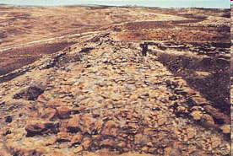
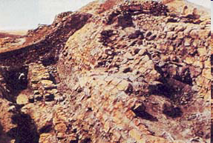
King Asa’s 15 ft Thick Wall
Asa’s defenses included (from right to left) the city wall, a sloping revetment, a retaining wall and a moat
Sloping
Revetment
Wall
When King Baasha (906 to 883 B.C.) of Israel invaded Judah, King Asa (908 to 867 B.C.) encouraged the ruler of Damascus to attack Baasha from the north. Baasha fled, leaving behind stones, timber and other supplies that Asa used to fortify Mizpah in 1 Kings 15:22.
Retaining
Wall
Moat
BAR 23:05 (Sep/Oct 1997).
Notes:
Courtesy Badè InstituteKing Asa’a wall. A 15-foot-thick wall protected Mizpah during the period of the Divided Monarchy, when the city lay on the border between Israel in the north and Judah in the south. (The figure in the photo is standing on top of the wall remains.) According to the Bible, when King Baasha (906 to 883 B.C.) of Israel invaded Judah, King Asa (908 to 867 B.C.) encouraged the ruler of Damascus to attack Baasha from the north. Baasha fled, leaving behind stones, timber and other supplies that Asa used to fortify Mizpah.Editor, H. S. (2004; 2004). BAR 23:05 (Sep/Oct 1997). Biblical Archaeology Society.
Courtesy Badè Institute Asa’s defenses included (from right to left) the city wall, a sloping revetment, a retaining wall and a moat.Editor, H. S. (2004; 2004). BAR 23:05 (Sep/Oct 1997). Biblical Archaeology Society.

Slide 47
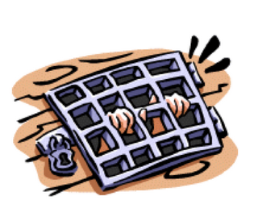
Asa Does Not Rely on God
2 Chronicles 16:7-10(NKJV)
⁷And at that time Hanani the seer came to Asa king of Judah, and said to him: “Because you have relied on the king of Syria, and have not relied on the Lord your God, therefore the army of the king of Syria has escaped from your hand.
⁸Were the Ethiopians and the Lubim not a huge army with very many chariots and horsemen? Yet, because you relied on the Lord, He delivered them into your hand.
⁹For the eyes of the Lord run to and fro throughout the whole earth, to show Himself strong on behalf of those whose heart is loyal to Him. In this you have done foolishly; therefore from now on you shall have wars.”
¹⁰Then Asa was angry with the seer, and put him in prison, for he was enraged at him because of this. And Asa oppressed some of the people at that time. .

Slide 48
II Chr 16 - Asa’s Stubborn End
¹²In the thirty-ninth year of his reign Asa was diseased in his feet, and his disease became severe.
Yet even in his disease he did not seek the Lord, but sought help from physicians.
¹³And Asa slept with his fathers, dying in the forty-first year of his reign.
Diseased Feet
3 yrs
14 Yrs
Baasha Attacks
15 Yrs of Reform
1 million Ethiopians
10 Yrs of Peace

Slide 49
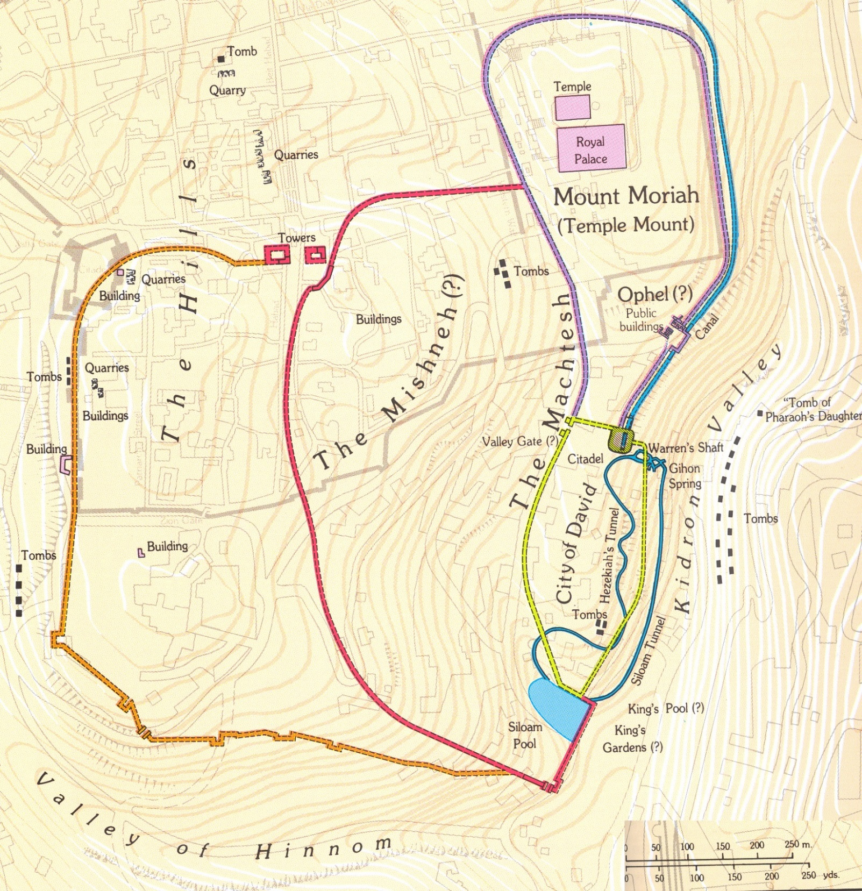

Slide 50
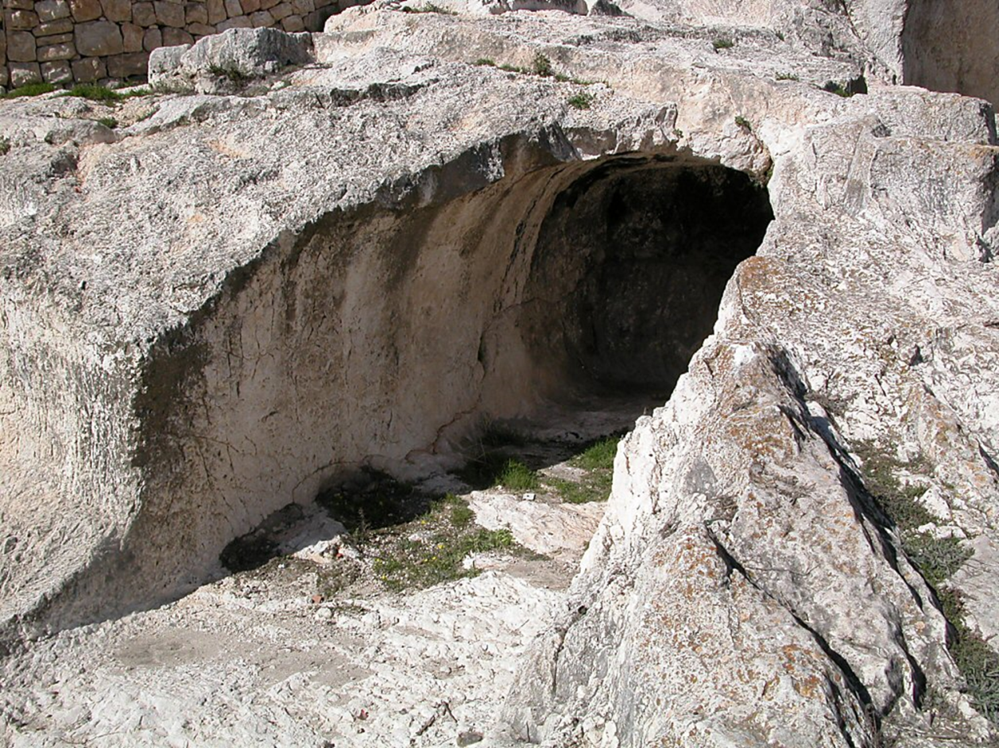
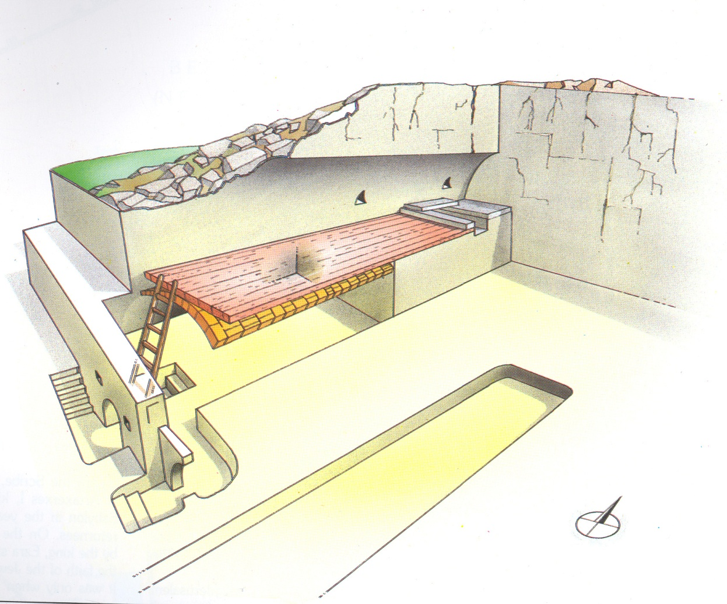
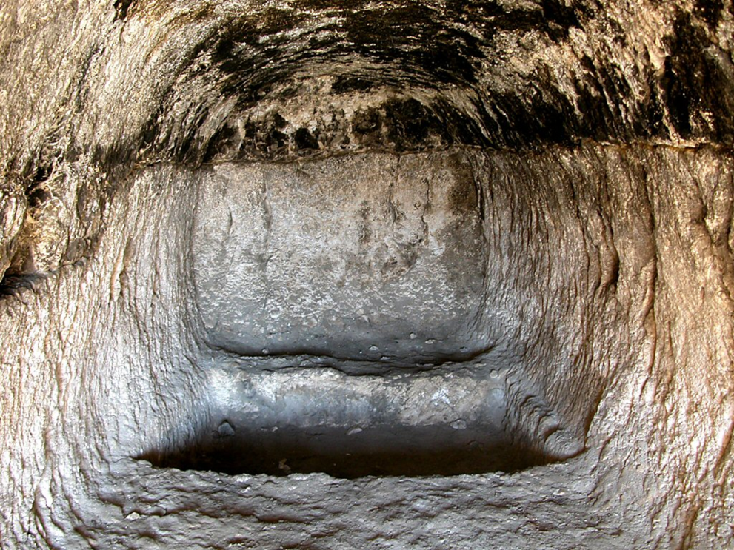
Fate of bones of Judah
¹⁴They buried him in the tomb that he had cut for himself in the city of David. They laid him on a bier that had been filled with various kinds of spices prepared by the perfumer’s art, and they made a very great fire in his honor.
Tombs of the Kings of Judah

Slide 51
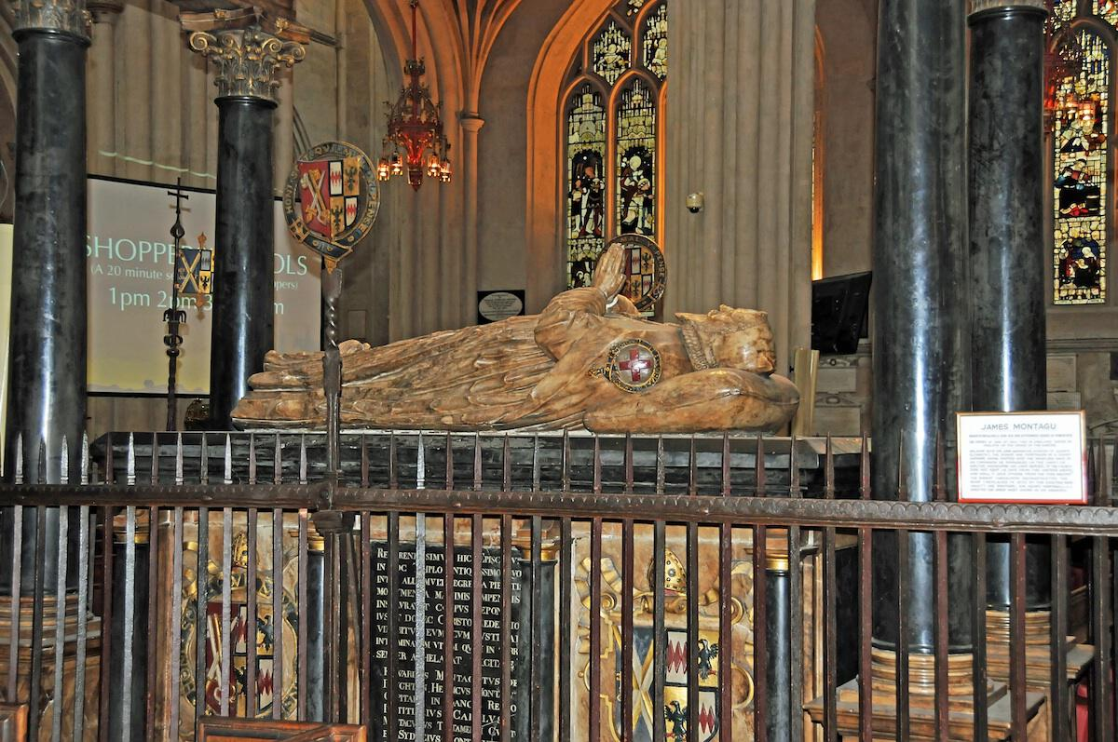
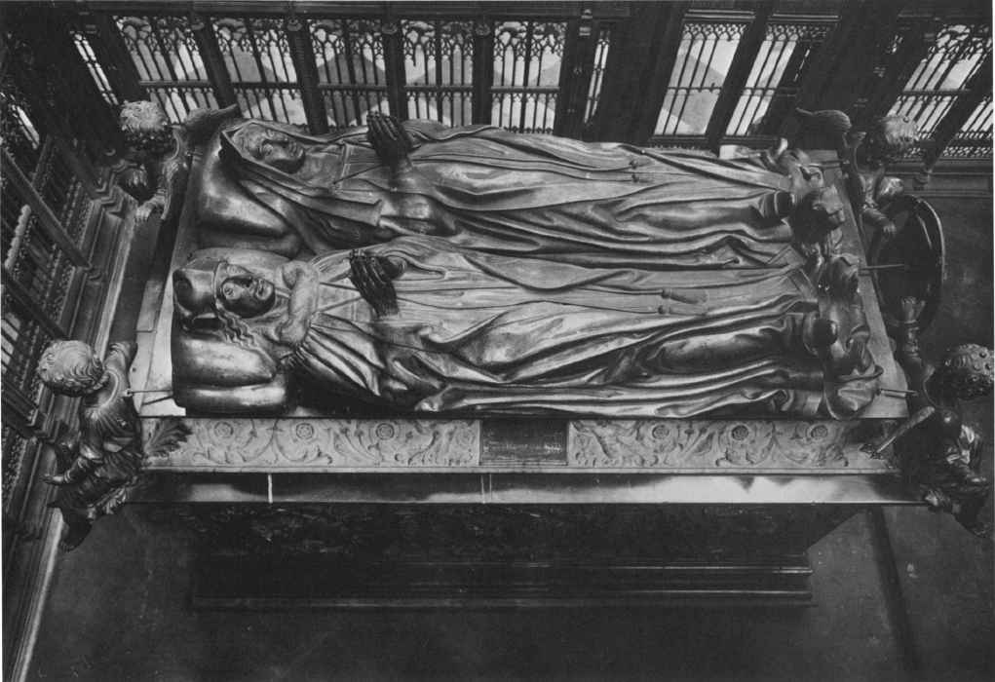
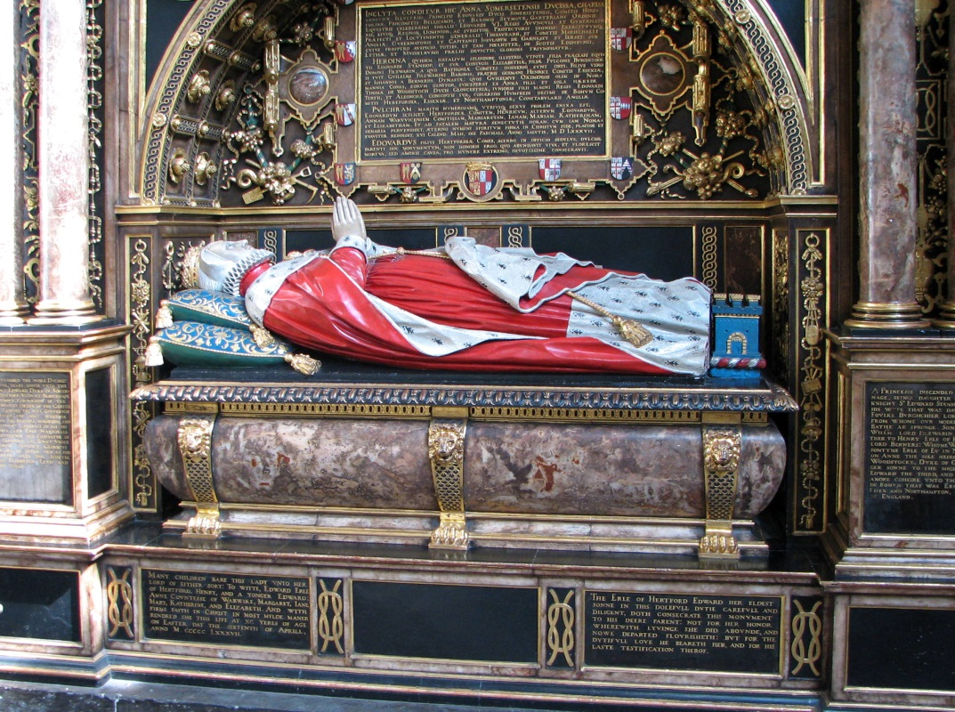
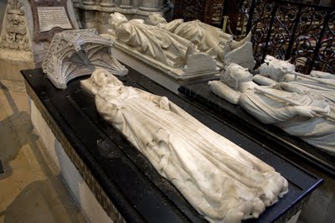
Westminster Abbey – Tomb of the Kings of England

Slide 52
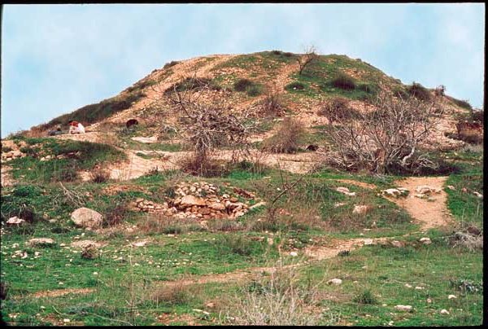


Mound Locations
¹⁴They buried him in the tomb that he had cut for himself in the city of David. They laid him on a bier that had been filled with various kinds of spices prepared by the perfumer’s art, and they made a very great fire in his honor.
Mound was found to have a platform with the burnt remains of a pyre..
BAR 29:03 (May/June 2003).
Notes:
Garo Nalbandian“The wild west.” All but one of Jerusalem’s enigmatic mounds were located in the three areas marked on the map below. Until recent decades these areas were far to the west of the city’s populated sections; today they are enclosed within Jerusalem’s newest neighborhoods.Editor, H. S. (2004; 2004). BAR 29:03 (May/June 2003). Biblical Archaeology Society.
Garo NalbandianA ring wall encircles mound 5. Excavated by Ruth Amiran half a century ago, the ring wall consists of 17 sections, each five meters long (about 16 feet, or 10 Biblical cubits). Amiran also found a platform with the burnt remains of a pyre. She believed (though not wholeheartedly) that Jerusalem’s mounds were tombs even though no burials were found within them.Editor, H. S. (2004; 2004). BAR 29:03 (May/June 2003). Biblical Archaeology Society.
Gordon Franz, Courtesy Gabriel BarkayExcavated by Ruth Amiran half a century ago, the ring wall consists of 17 sections, each five meters long (about 16 feet, or 10 Biblical cubits). Amiran also found a platform with the burnt remains of a pyre. She believed (though not wholeheartedly) that Jerusalem’s mounds were tombs even though no burials were found within them. Three decades later, when a neighborhood community center was slated for expansion, author Barkay excavated mound 4 (shown here), which adjoined the center.Editor, H. S. (2004; 2004). BAR 29:03 (May/June 2003). Biblical Archaeology Society.

Slide 53

Mounds of Mystery - Where the kings of Judah were Lamented
This mound and 19 others were once west of the city’s populated areas.
BAR 29:03 (May/June 2003).
Notes:
Garo NalbandianNestled today within modern neighborhoods in western Jerusalem, the mound above and 19 others were once west of the city’s populated areas. The mounds, called tumuli, were clearly manmade but their purpose has eluded excavators for over a century. The mound shown here was excavated by the great American scholar William F. Albright; the gash his team left on the mound gives it its humorous nickname: “Albright’s behind.” Archaeologist Gabriel Barkay, in the accompanying article, uses Biblical passages and comparisons with similar structures elsewhere in the Mediterranean world to identify these mysterious mounds at last.Editor, H. S. (2004; 2004). BAR 29:03 (May/June 2003). Biblical Archaeology Society.

