Slide 1
Revelation
Notes:
Ch. 19 ends with the destruction of the beast and the false prophet – but we are left to wonder? What about the dragon who was behind it all? What will be his end?
Ch 20 shows us that the answer to that question is CERTAIN but is not simultaneous with the fall of Rome. The defeat of Satan in fact will come after Christ has reigned for a long time – at an appointed time.

Slide 2
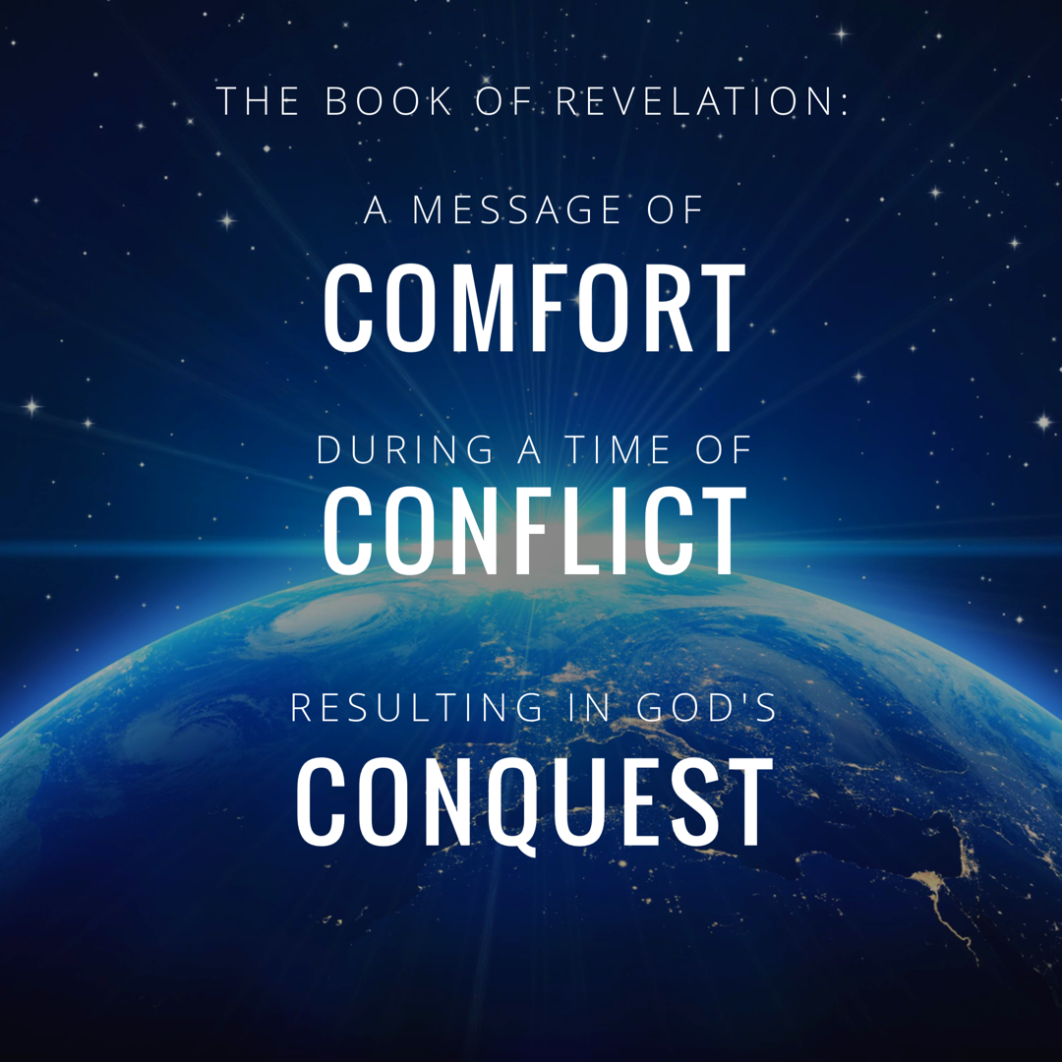
Notes:
In studying 12 we really rejoiced in GOD’s CONQUEST.
Rev. 12:11 “And they overcome him because of the blood of the Lamb and because of the word of their testimony, and they did not love their life even when faced with death.”

Slide 3
Revelation Chapter 1-3
Jesus Leads His Church
“The Revelation of Jesus Christ, which God gave Him to show to His bond-servants, the things which must soon take place; and He sent and communicated it by His angel to His bond-servant John,” (Rev 1:1)
“Do not fear what you are about to suffer. Behold, the devil is about to cast some of you into prison, so that you will be tested, and you will have tribulation for ten days. Be faithful until death, and I will give you the crown of life.” (Rev 2:10)
Notes:
A story, written in a time of crisis and distress, that is given by otherworldly beings explaining how God will reverse everything so the righteous will triumph.

Slide 4
Revelation Chapter 4-5
The Throne of Our Holy God
And the four living creatures, each one of them having six wings, are full of eyes around and within; and day and night they do not cease to say, “Holy, holy, holy is the Lord God, the Almighty, who was and who is and who is to come.” (Rev. 4:8)
The Worthy Lamb
“Worthy are You to take the book and to break its seals; for You were slain, and purchased for God with Your blood men from every tribe and tongue and people and nation.” (Rev. 5:9)

Slide 5
Revelation Chapter 6-8
The Nation (Of Israel) Is Judged
“The sky was split apart like a scroll when it is rolled up, and every mountain and island were moved out of their places.” (Revelation 6:14)
The People of God Are Identified & Protected
“saying “Do not harm the earth or the sea or the trees until we have sealed the bond-servants of our God on their foreheads.” (Revelation 7:3)
A Portion of Israel Begins To Suffer.
“And the seven angels who had the seven trumpets prepared themselves to sound them.” (Revelation 8:6)

Slide 6
Revelation Chapter 9-10
A Great Army Comes Against The Nation of Israel.
“The appearance of the locusts was like horses prepared for battle; and on their heads appeared to be crowns like gold, and their faces were like the faces of men.” (Revelation 9:7)
The Delay Is Ending So John Must Prepare To Act.
“…there will be delay no longer, but in the days of the voice of the seventh angel, when he is about to sound, then the mystery of God is finished, as He preached to His servants the prophets.” (Revelation 10:6b-7)

Slide 7
Revelation Chapter 11
The Faithful Worship & Witness As Judgment Arrives.
“Then there was given me a measuring rod like a staff; and someone said, “Get up and measure the temple of God and the altar, and those who worship in it.” (Revelation 11:1)
“And I will grant authority to my two witnesses, and they will prophecy for twelve hundred and sixty days, clothed in sackcloth.” (Revelation 11:3)
“When they have finished their testimony, the beast that comes up out of the abyss will make war with them, and overcome them and kill them.” (Revelation 11:7)
Notes:
If you want a phrase for the whole chapter I would say: Silence Followed By Suffering.
The judgement that was pronounced in Chapter 6 as each seal was opened – is now beginning to occur. And this judgment affects a third of the people.

Slide 8
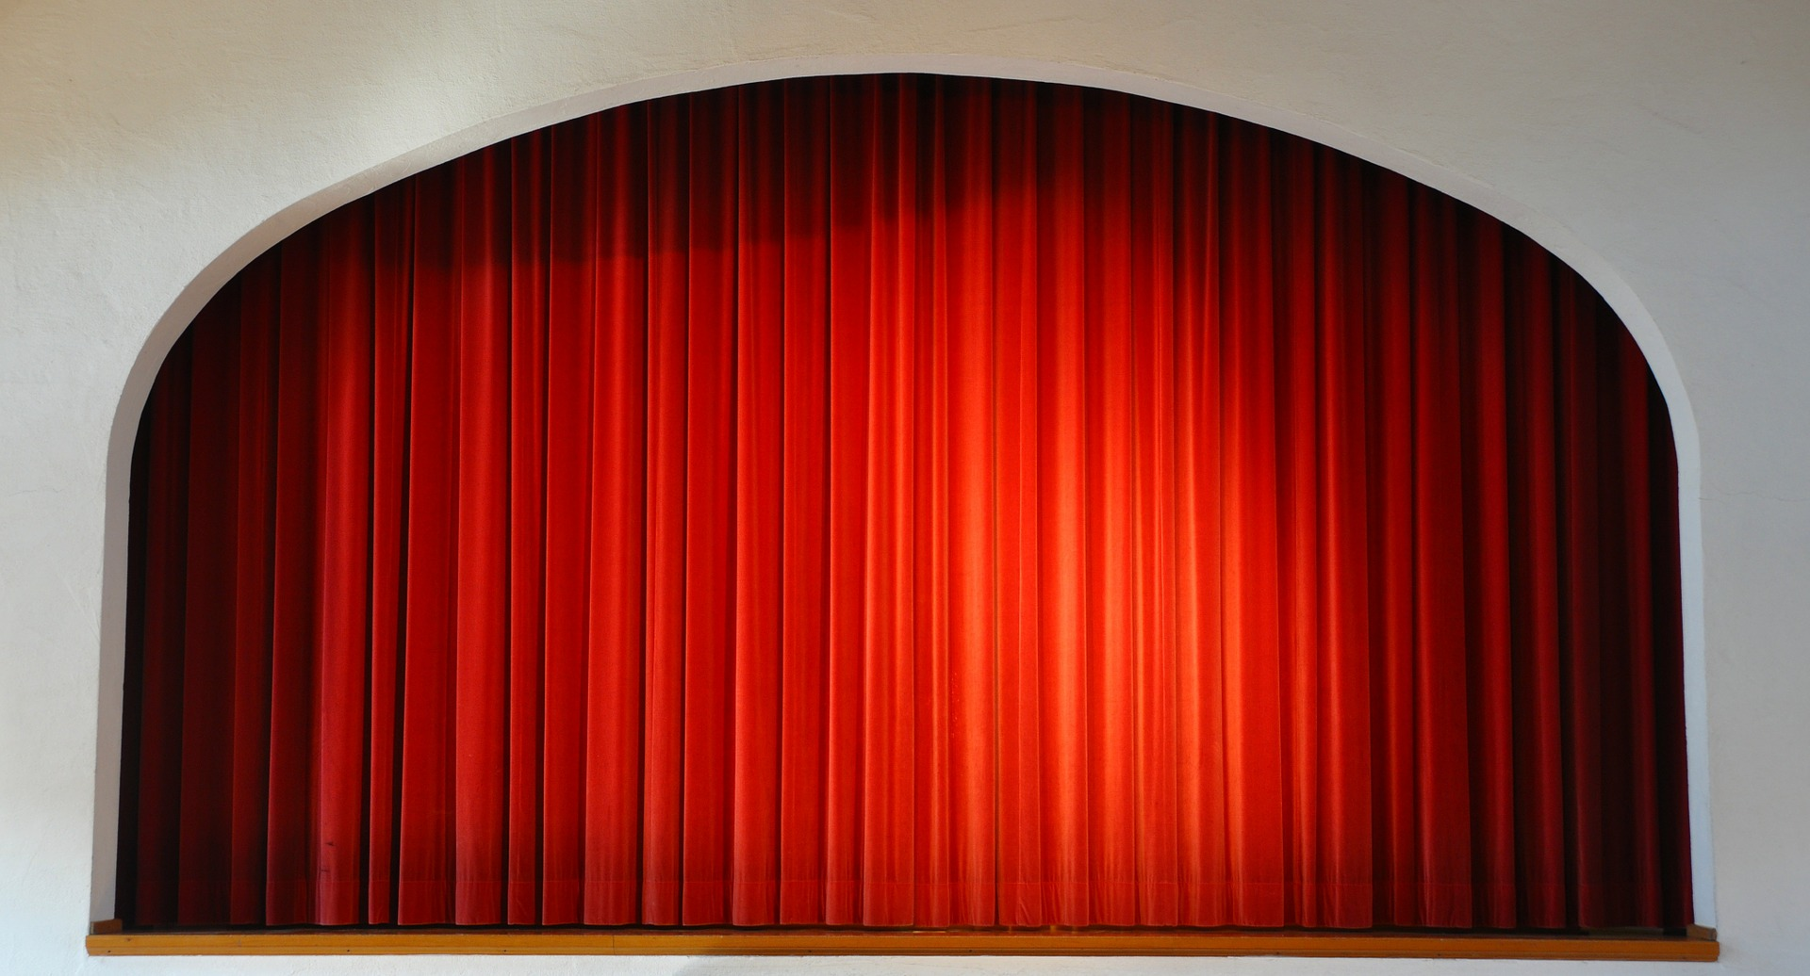

Slide 9
Revelation Chapter 12
The Heavenly Victory Behind The Earthly Difficulty.
“And there was war in heaven, Michael and his angels waging war with the dragon. The dragon and his angels waged war, “ (Rev 12:7)
“And they overcame him because of the blood of the Lamb and because of the word of their testimony, and they did not love their life even when faced with death.” (Revelation 12:11)
“So the dragon was enraged with the woman, and went off to make war with the rest of her children, who keep the commandments of God and hold to the testimony of Jesus.” (Revelation 12:17)
Notes:
If you want a phrase for the whole chapter I would say: Silence Followed By Suffering.
The judgement that was pronounced in Chapter 6 as each seal was opened – is now beginning to occur. And this judgment affects a third of the people.

Slide 10
Revelation Chapter 13-14
Satan Stirs Up The Roman Empire Against The Saints.
“they worshipped the dragon because he gave his authority to the beast; and they worshipped the beast, saying, “Who is like the beast, and who is able to wage war with him?” (Rev 13:4)
The Lamb Stirs Up His Angels Against Babylon.
“and he said with a loud voice, “Fear God, and give Him glory, because the hour of His judgment has come; worship Him who made the heavens and the earth and sea and springs of waters.”(7)
Notes:
If you want a phrase for the whole chapter I would say: Silence Followed By Suffering.
The judgement that was pronounced in Chapter 6 as each seal was opened – is now beginning to occur. And this judgment affects a third of the people.

Slide 11
Revelation Chapter 15
God Is Exalted In All The World.
“And they sang the song of Moses, the bond-servant of God, and the song of the Lamb, saying, “Great and marvelous are Your works, O Lord God, the Almighty; Righteous and true are Your ways, King of the nations! Who will not fear, O Lord, and glorify Your name? For You alone are holy; For all the nations will come and worship before You, For Your righteous acts have been revealed.” (Rev 15:3-4)
“Then one of the four living creatures gave to the seven angels seven golden bowls full of the wrath of God, who lives forever and ever.” (Rev. 15:7)
Notes:
Ch 13 – Satan stirred up the Beast
Ch 14 – Jesus stirred up the Angels
Ch 15 – Celebrating Jesus’ Superiority
God Is Exalted: The song of Moses is a song of deliverance and rescue. The saints who have given their lives aren’t asking: How could you let this happen. They are praising Him for His wonderful works. *Hymn: Come let us worship and bow down.

Slide 12
Revelation Chapter 16-18
God’s Conquest Over Rome Will Be Just & Decisive.
“And I heard the angel of the waters saying, “Righteous are You, who are and who were, O Holy One, because You judged these things; for they poured out the blood of saints and prophets, and You have given them blood to drink. They deserve it.” Rev. 16:5-6
God’s Conquest Over Rome Will Punish Her Harlotry
“…I will show you the judgment of the great harlot who sits on many waters, with whom the kings of the earth committed acts of immorality, and those who dwell on the earth were made drunk with the wine of her immorality.” (Rev. 17:1b-2)
God’s Conquest Over Rome Will Destroy Her Wealth
“And they threw dust on their heads and were crying out, weeping and mourning, saying “Woe, woe, the great city, in which all who had ships at sea became rich by her wealth, for in one hour she has been laid waste.” (18:19) “Rejoice over her, O heaven…” (18:20)
Notes:
16:13 – this is not the final day of judgment – but a judgment against the beast and it’s blaspheme.
** Key Word is MOUTH: When this battle does take place, it is JESUS and the sword of HIS MOUTH that brings Victory. Rev. 19:20-21

Slide 13
Revelation Chapter 19-20
Hallelujah! The Victory of The Lamb & His Bride.
“After these things…a great multitude in heaven saying, “Hallelujah! Salvation and glory and power belong to our God…for He has judged the great harlot.” (Rev. 19:1-2a) “And the beast was seized, and with him the false prophet who performed the signs in his presence, by which he deceived those who had received the mark of the beast and those who worshiped his image; these two were thrown alive into the lake of fire which burns with brimstone.” (20)
Jesus Defeats Both The Devil & Death Forever.
“And the devil who deceived them was thrown into the lake of fire and brimstone, where the beast and the false prophet are also; and they will be tormented day and night forever and ever.” Rev. 20:10.
“Then death and Hades were thrown into the lake of fire. This is the second death, the lake of fire.” Rev. 20:14
Notes:
This chapter picks up the pace significantly. IT crams in AMAZING and FANTASTIC images of Victory!
This one chapter has 6 key scenes
A.) John Sees the Hallelujah’s
B.) Then the Bride
C.) Then The Instruction To Worship God
D.) Then Lord Coming in Victory
E.) Then the Birds Gather
F.) Then The Lake of Fire.
The Conquest Brings The Destruction of the Beast & False Prophet

Slide 14
Revelation Chapter 21
The People of God Pictured In Eternal Glory.
“He who overcomes will inherit these things, and I will be his God and he will be My son.” (21:7)
“Then one of the seven angels who had the seven bowls full of the seven last plagues came and spoke with me, saying “Come here, I will show you the bride, the wife of the Lamb.” (21:9)
“And the city has no need of the sun or of the moon to shine on it, for the glory of God has illumined it, and its lamp is the Lamb. The nations will walk by its light, and the kings of the earth will bring their glory into it.” (21:23-24)
Notes:
Revelation 21:11
having the glory of God. Her brilliance was like a very costly stone, as a stone of crystal-clear jasper.
Revelation 21:23
And the city has no need of the sun or of the moon to shine on it, for the glory of God has illumined it, and its lamp is the Lamb.
Revelation 21:24
The nations will walk by its light, and the kings of the earth will bring their glory into it.
Revelation 21:26
and they will bring the glory and the honor of the nations into it;
The Glory of God and the glory of the Nations are both mentioned twice – the people of God, bride of the Lamb, are filled with both.
The magnificence and splendor of this chapter is without comparison. No other chapter in the Bible pictures a more victorious, more at rest, more glorified scene than this. The People of God Pictured in Eternal Glory.
There are “aspects of this” we can relate to here on earth. There are portions of this that we have a taste of today. But after extensive study the strongest conclusion I can reach is that this is the church in eternity.

Slide 15
Revelation Chapter 22
The People of God Pictured Enjoying Eternal Life.
“Then he showed me a river of the water of life, clear as crystal, coming from the throne of God and of the Lamb, in the middle of its street. On either side of the river was the tree of life, bearing twelve kinds of fruit, yielding its fruit every month; and the leaves of the tree were for the healing of the nations.” (22:1-2)
The Spirit and the bride say, “Come.” And let the one who hears say, “Come.” And let the one who is thirsty come; let the one who wishes take the water of life without cost.” (22:17)
Notes:
Revelation 21:11
having the glory of God. Her brilliance was like a very costly stone, as a stone of crystal-clear jasper.
Revelation 21:23
And the city has no need of the sun or of the moon to shine on it, for the glory of God has illumined it, and its lamp is the Lamb.
Revelation 21:24
The nations will walk by its light, and the kings of the earth will bring their glory into it.
Revelation 21:26
and they will bring the glory and the honor of the nations into it;
The Glory of God and the glory of the Nations are both mentioned twice – the people of God, bride of the Lamb, are filled with both.
The magnificence and splendor of this chapter is without comparison. No other chapter in the Bible pictures a more victorious, more at rest, more glorified scene than this. The People of God Pictured in Eternal Glory.
There are “aspects of this” we can relate to here on earth. There are portions of this that we have a taste of today. But after extensive study the strongest conclusion I can reach is that this is the church in eternity.

Slide 16
Revelation Chapter 21
The People of God Pictured In Eternal Glory.
Why Teach This Is “Eternal” Glory & Life?
The Continuation of The Timeline Described in Chapter 20. (1 Cor. 15:23-28)
“The first earth passed away…” (21:1, 2 Peter 3:10-14)
“He will dwell among them…” (21:3)
“the first things have passed away.” (21:4)
“It is done.” (21:6)
“will inherit these things” (21:7)
“the second death” (21:8, Matthew 25:46)
“having the glory of God” (21:11)
“the Lord God the Almighty and the Lamb are its temple” (21:22)
“only those whose names are written in the Lamb’s book of life.” (21:27)
Notes:
Revelation 21:11
having the glory of God. Her brilliance was like a very costly stone, as a stone of crystal-clear jasper.
Revelation 21:23
And the city has no need of the sun or of the moon to shine on it, for the glory of God has illumined it, and its lamp is the Lamb.
Revelation 21:24
The nations will walk by its light, and the kings of the earth will bring their glory into it.
Revelation 21:26
and they will bring the glory and the honor of the nations into it;
The Glory of God and the glory of the Nations are both mentioned twice – the people of God, bride of the Lamb, are filled with both.
The magnificence and splendor of this chapter is without comparison. No other chapter in the Bible pictures a more victorious, more at rest, more glorified scene than this. The People of God Pictured in Eternal Glory.
There are “aspects of this” we can relate to here on earth. There are portions of this that we have a taste of today. But after extensive study the strongest conclusion I can reach is that this is the church in eternity.

Slide 17
“New Heaven & A New Earth” Isaiah 65:17-19
¹⁷ “For behold, I create new heavens and a new earth; And the former things will not be remembered or come to mind. ¹⁸ “But be glad and rejoice forever in what I create; For behold, I create Jerusalem for rejoicing And her people for gladness. ¹⁹ “I will also rejoice in Jerusalem and be glad in My people; And there will no longer be heard in her The voice of weeping and the sound of crying.
Notes:
One of the strongest points for seeing it as the church in glory on earth would be related to Isaiah.
We all need to approach this chapter with some humility. We are preparing to see the GLORIFIED church. Is it the church GLORIFIED in eternity or on earth… some significant points in favor of each!
There does seem to be a common appeal in either interpretation to think about the good in store in our future.

Slide 18
“New Heaven & A New Earth” Isaiah 66:22-23
²² “For just as the new heavens and the new earth Which I make will endure before Me,” declares the Lord, “So your offspring and your name will endure. ²³ “And it shall be from new moon to new moon And from sabbath to sabbath, All mankind will come to bow down before Me,” says the Lord.
Notes:
It is a time for complete devotion and true worship.

Slide 19
“New Heaven & A New Earth” 2 Peter 3:10-14
“¹⁰ But the day of the Lord will come like a thief, in which the heavens will pass away with a roar and the elements will be destroyed with intense heat, and the earth and its works will be burned up.
¹¹ Since all these things are to be destroyed in this way, what sort of people ought you to be in holy conduct and godliness, ¹² looking for and hastening the coming of the day of God, because of which the heavens will be destroyed by burning, and the elements will melt with intense heat! ¹³ But according to His promise we are looking for new heavens and a new earth, in which righteousness dwells.
¹⁴ Therefore, beloved, since you look for these things, be diligent to be found by Him in peace, spotless and blameless,

Slide 20
Revelation Chapter 21
The People of God Pictured In Eternal Glory.
The New Heaven & Earth
“the first earth passed away, and there is no longer any sea.”
Isaiah 65:17-19, Isaiah 66:22-23
The People of God: Holy City, New Jerusalem, Bride Adorned
Complete Fellowship with God (vs. 3)
Complete Comfort from God (vs. 4)
Complete Renewal by God (vs. 5)
The Two Eternal Rewards
“the water of life without cost” (vs. 6)
“the lake that burns with fire and brimstone, which is the second death.” (8)
Notes:
Vs 3 – If you wanted to say more directly that God is with His people, how could you?

Slide 21
Revelation Chapter 21
The People of God Pictured In Eternal Glory.
The Wife of the Lamb
Glory Is The Defining Attribute: “having the glory of God” (vs. 11)
A Picture of Completeness: 12 Gates, 12 Angels, 12 Foun. Stones (vs. 11-14)
A Picture of Security: “measure the city” (vs. 15)
A Picture of Holiness: 12,000 stadia (vs. 16 ESV)
A Picture of Royal Wealth: “every kind of precious stone…pearls” (vs. 19,21)
A Picture of Nearness & Worship: “Lord God… and the Lamb are its temple”
A Picture of Greatness: “God has illumined it”
A Picture of Honor: “bring the glory and the honor of the nations into it”
A Picture of Purity: “nothing unclean..only those…in the Lamb’s book of life.”
Notes:
Vs 3 – If you wanted to say more directly that God is with His people, how could you?

Slide 22
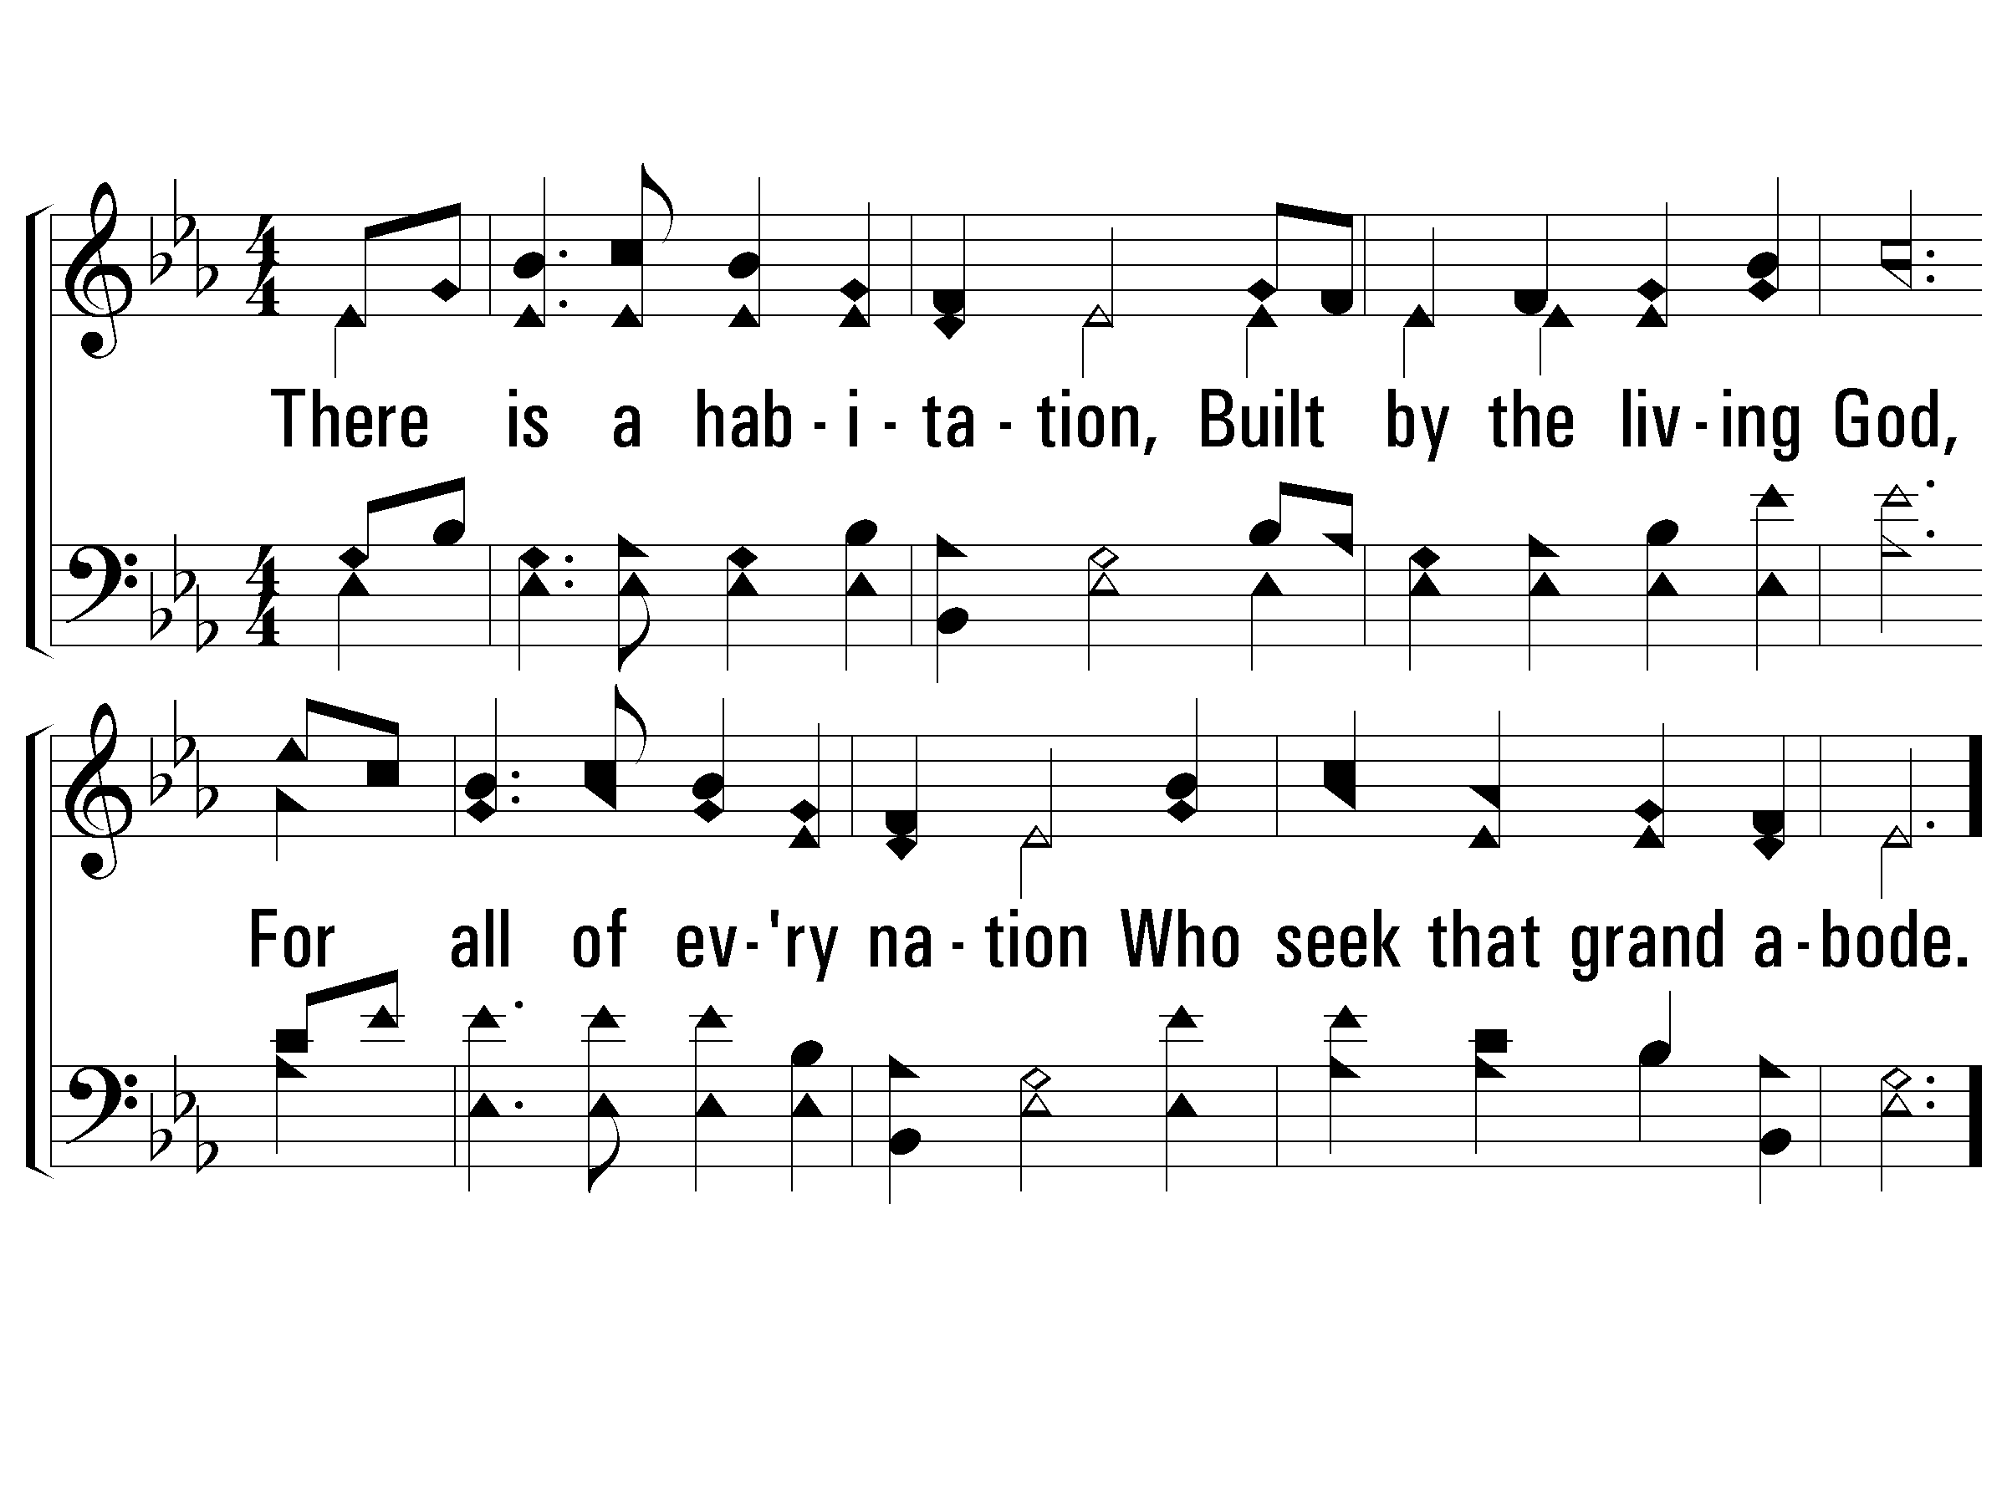
1 - There Is a Habitation
660
1.
There is a habitation,
Built by the living God,
For all of every nation
Who seek that grand abode.
Words by: Love H. Jameson
Music by: James H. Rosecrans
© 2001 The Paperless Hymnal™

Slide 23
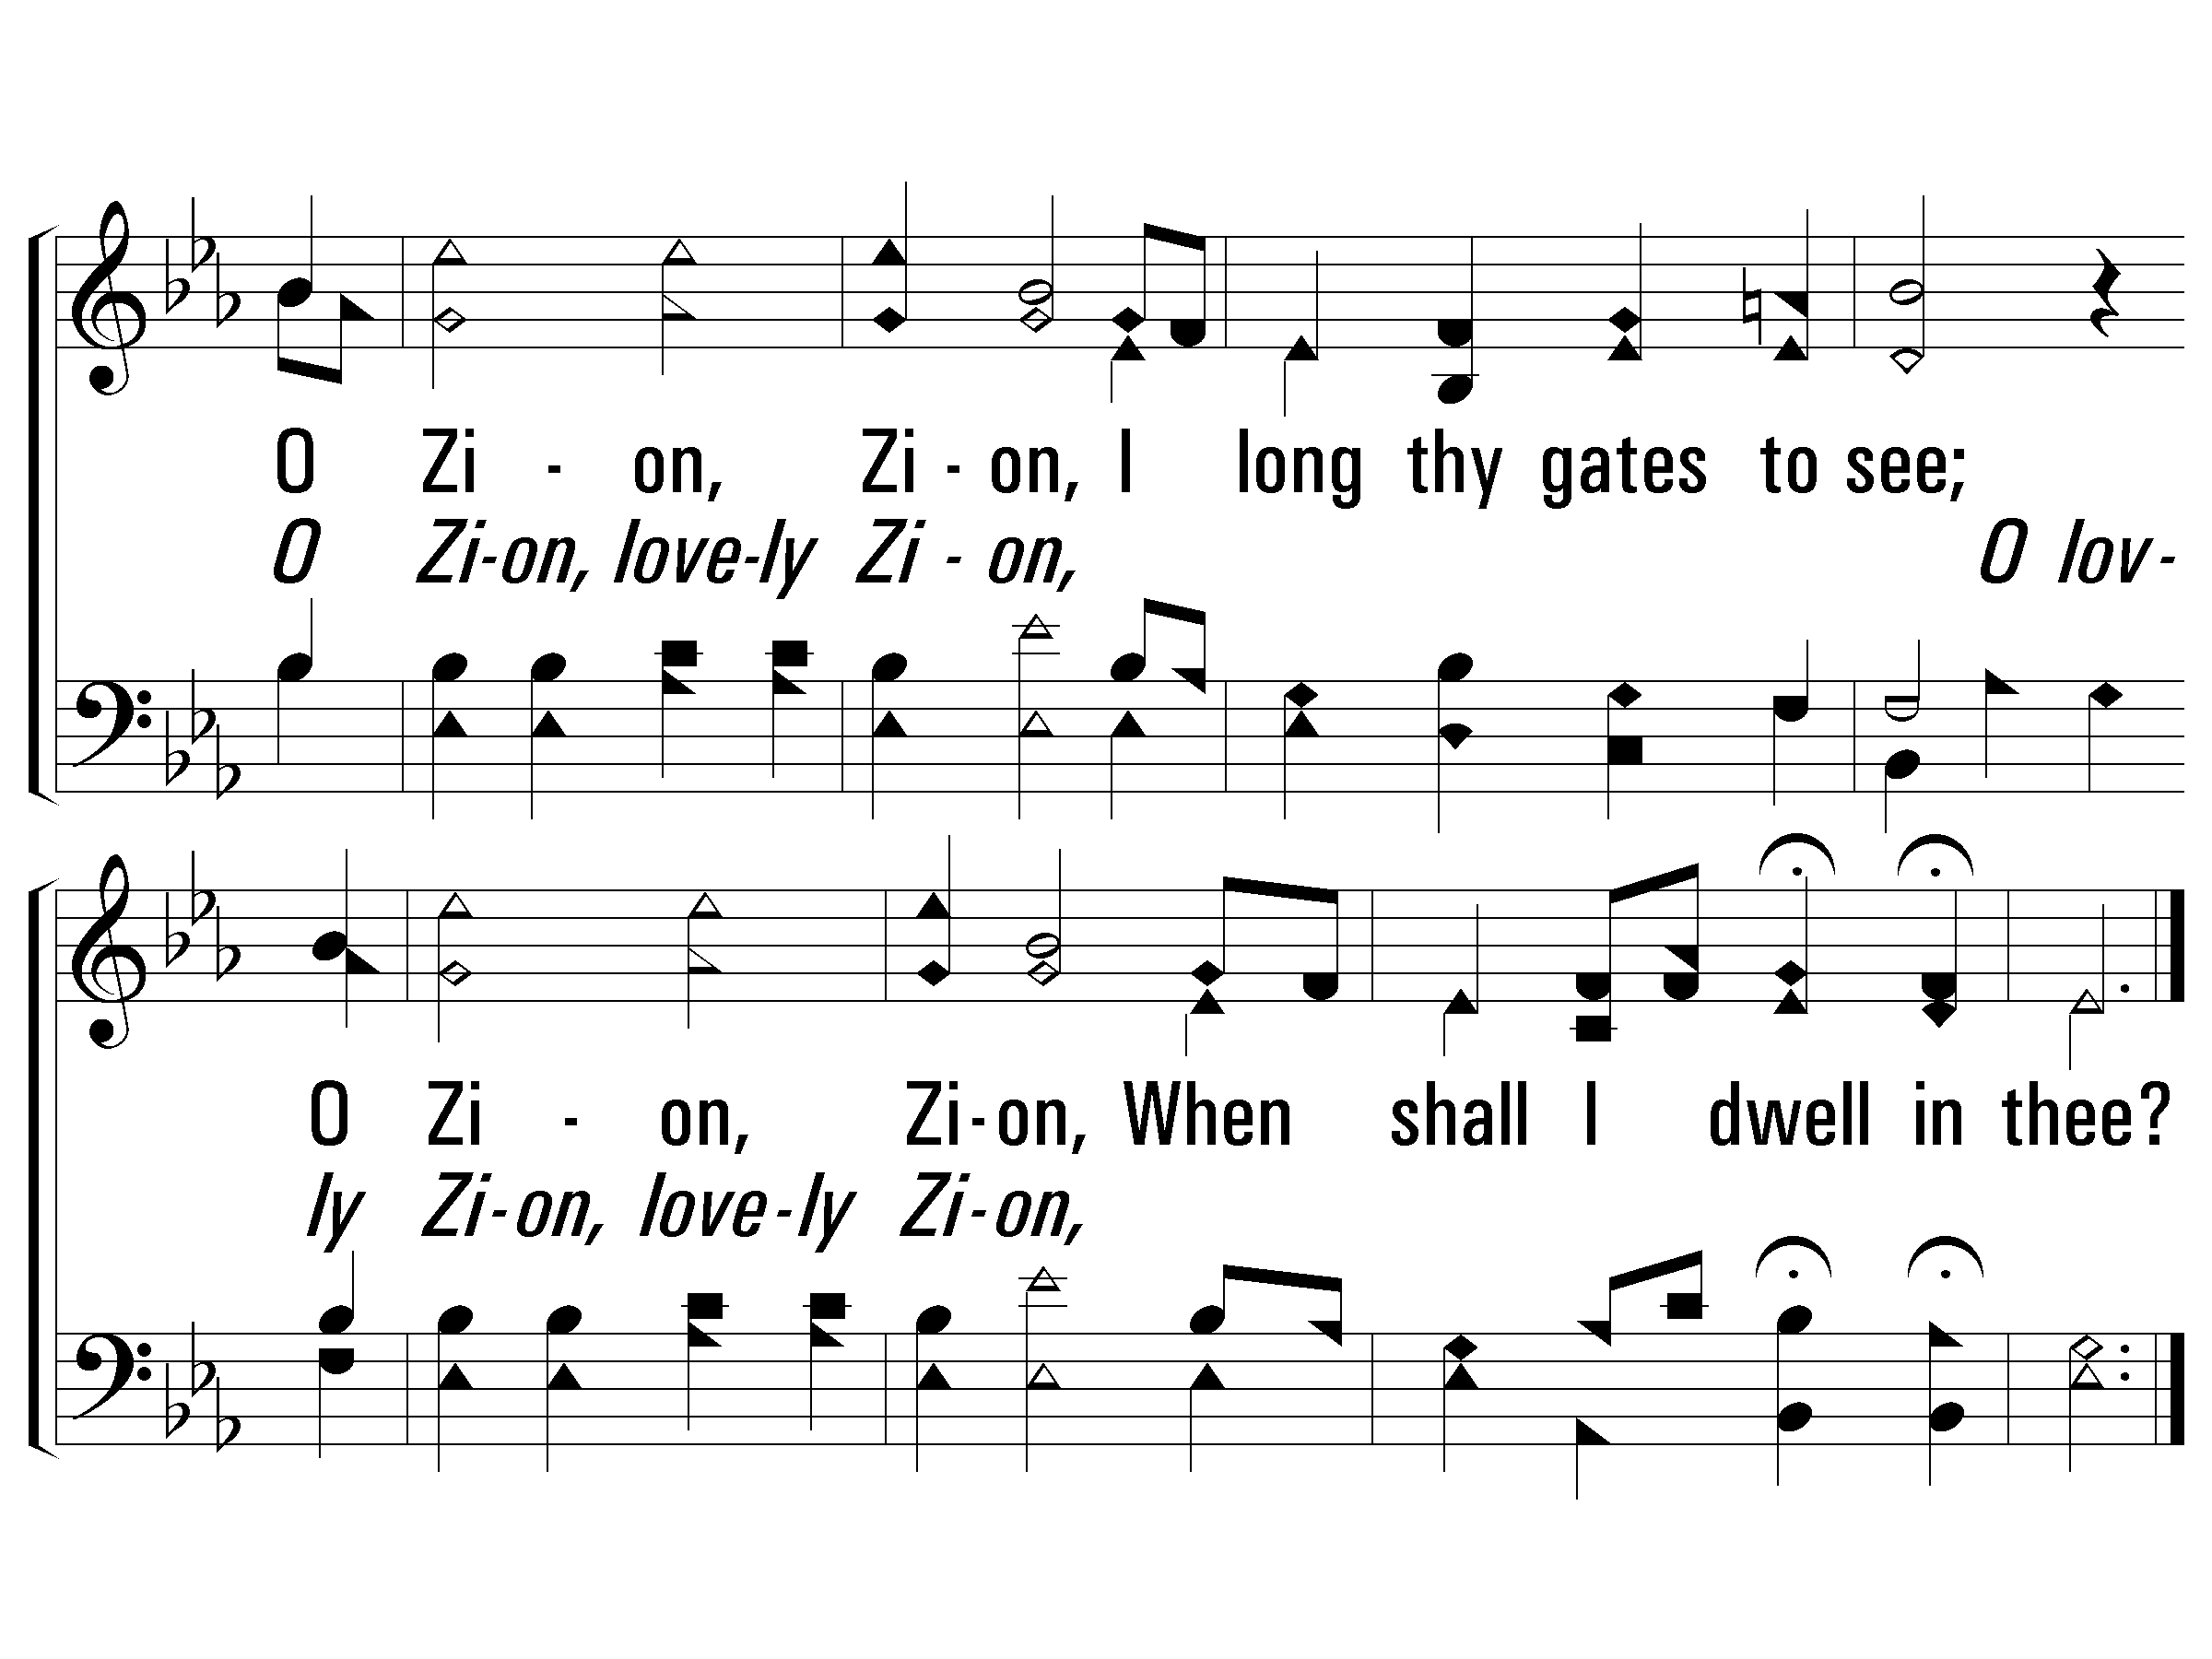
c - There Is a Habitation
660
O Zion, Zion,
I long thy gates to see;
O Zion, Zion,
When shall I dwell in thee?
© 2001 The Paperless Hymnal™

Slide 24
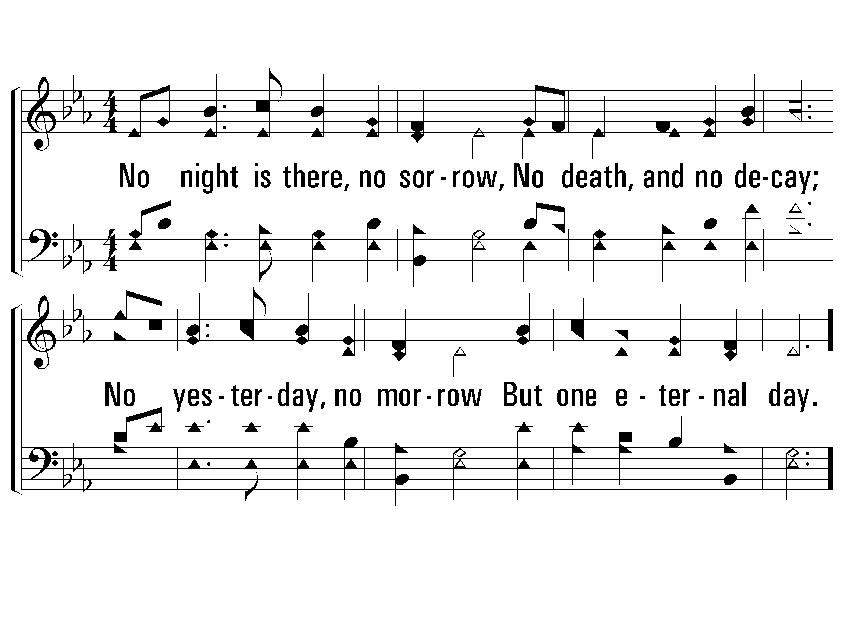
3 - There Is a Habitation
660
3.
No night is there, no sorrow,
No death, and no decay;
No yesterday, no morrow
But one eternal day.
Words by: Love H. Jameson
Music by: James H. Rosecrans
© 2001 The Paperless Hymnal™

Slide 25
c - There Is a Habitation
660
O Zion, Zion,
I long thy gates to see;
O Zion, Zion,
When shall I dwell in thee?
© 2001 The Paperless Hymnal™

Slide 26
Revelation Chapter 22
The People of God Pictured Enjoying Eternal Life.
“Then he showed me a river of the water of life, clear as crystal, coming from the throne of God and of the Lamb, in the middle of its street. On either side of the river was the tree of life, bearing twelve kinds of fruit, yielding its fruit every month; and the leaves of the tree were for the healing of the nations.” (22:1-2)
The Spirit and the bride say, “Come.” And let the one who hears say, “Come.” And let the one who is thirsty come; let the one who wishes take the water of life without cost.” (22:17)
Notes:
Revelation 21:11
having the glory of God. Her brilliance was like a very costly stone, as a stone of crystal-clear jasper.
Revelation 21:23
And the city has no need of the sun or of the moon to shine on it, for the glory of God has illumined it, and its lamp is the Lamb.
Revelation 21:24
The nations will walk by its light, and the kings of the earth will bring their glory into it.
Revelation 21:26
and they will bring the glory and the honor of the nations into it;
The Glory of God and the glory of the Nations are both mentioned twice – the people of God, bride of the Lamb, are filled with both.
The magnificence and splendor of this chapter is without comparison. No other chapter in the Bible pictures a more victorious, more at rest, more glorified scene than this. The People of God Pictured in Eternal Glory.
There are “aspects of this” we can relate to here on earth. There are portions of this that we have a taste of today. But after extensive study the strongest conclusion I can reach is that this is the church in eternity.

Slide 27
Revelation Chapter 22
The People of God Pictured Enjoying Eternal Life.
The Incredible Inheritance That Awaits Those Who Overcome!
Eternal Life: “the water of life” (Ezekiel 47:1-2)
Dwelling with God: “the throne of God and of the Lamb”
Every Need in Every Season: “tree of life, bearing twelve kinds of fruit”
Every Problem Healed: “healing of the nations” (Ezekiel 47:12)
Every Aspect of The Genesis Curse Relieved: “no longer any curse”
Every Leadership We Long For: “the throne”
Every Worthy Endeavor: “His bond-servants will serve Him”
Faith & Belonging Fulfilled: “see His face” and “name on foreheads”
No More Darkness of Any Kind: “no longer be any night”
Reign Forever and Ever.
Notes:
Sustaining Food – not literal food, but all our needs provided for. 12 fruits – every need met, in every season.

Slide 28
Revelation Chapter 22
The People of God Pictured Enjoying Eternal Life.
The Call To Action
Depend On These Promises. (vs. 6)
Heed The Words of This Prophecy. (vs. 7)
Worship God. (vs 8-9)
Watch For The Conquest of God. It Is At Hand. (vs. 10-11)
Recognize & Prepare For The Lord’s Judgment. (vs. 12-13)
Wash Your Robes In Christ! (vs. 14-15)
Respond To The Gospel & Engage In Good Deeds (Rev 19:8)
Churches, Listen To Your Lord. (vs. 16)
Call Others To “Come!” (vs. 17)
Do Not Add To or Take Away From This Book. (vs. 18-19)
Eagerly Hope For His Coming. (vs 20-21)
Notes:
Sustaining Food – not literal food, but all our needs provided for. 12 fruits – every need met, in every season.

Slide 29
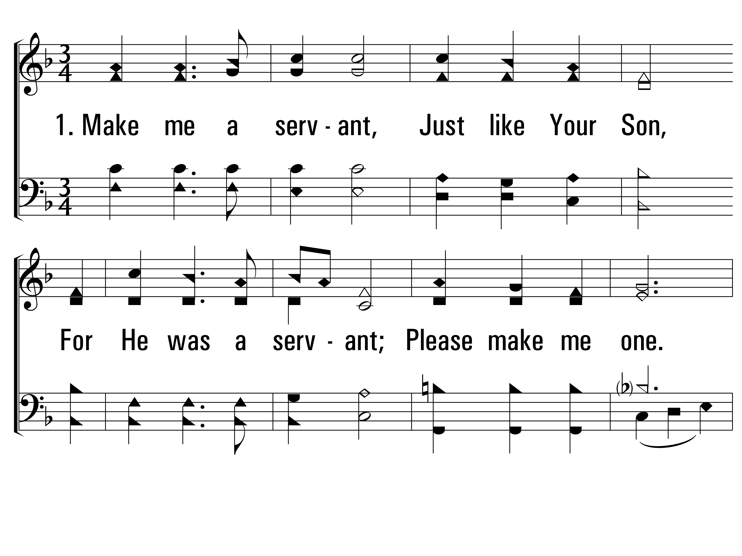
ServantSong_st1_a
Hymn: Jimmy Owens (1978); Carol Owens (1978); arr. Tim Jennings (2000); st. 2-3 M. W. Bassford (2000)
Tune: MAKE ME LIKE YOU • Jimmy Owens (1978); Carol Owens (1978); arr. Richard L. Morrison (2000)
© 1978 Communiqué Music, Inc.; st. 2-3 © 2000 Tim Jennings
Vs 1
© 2014 Sumphonia Productions, LLC

Slide 30
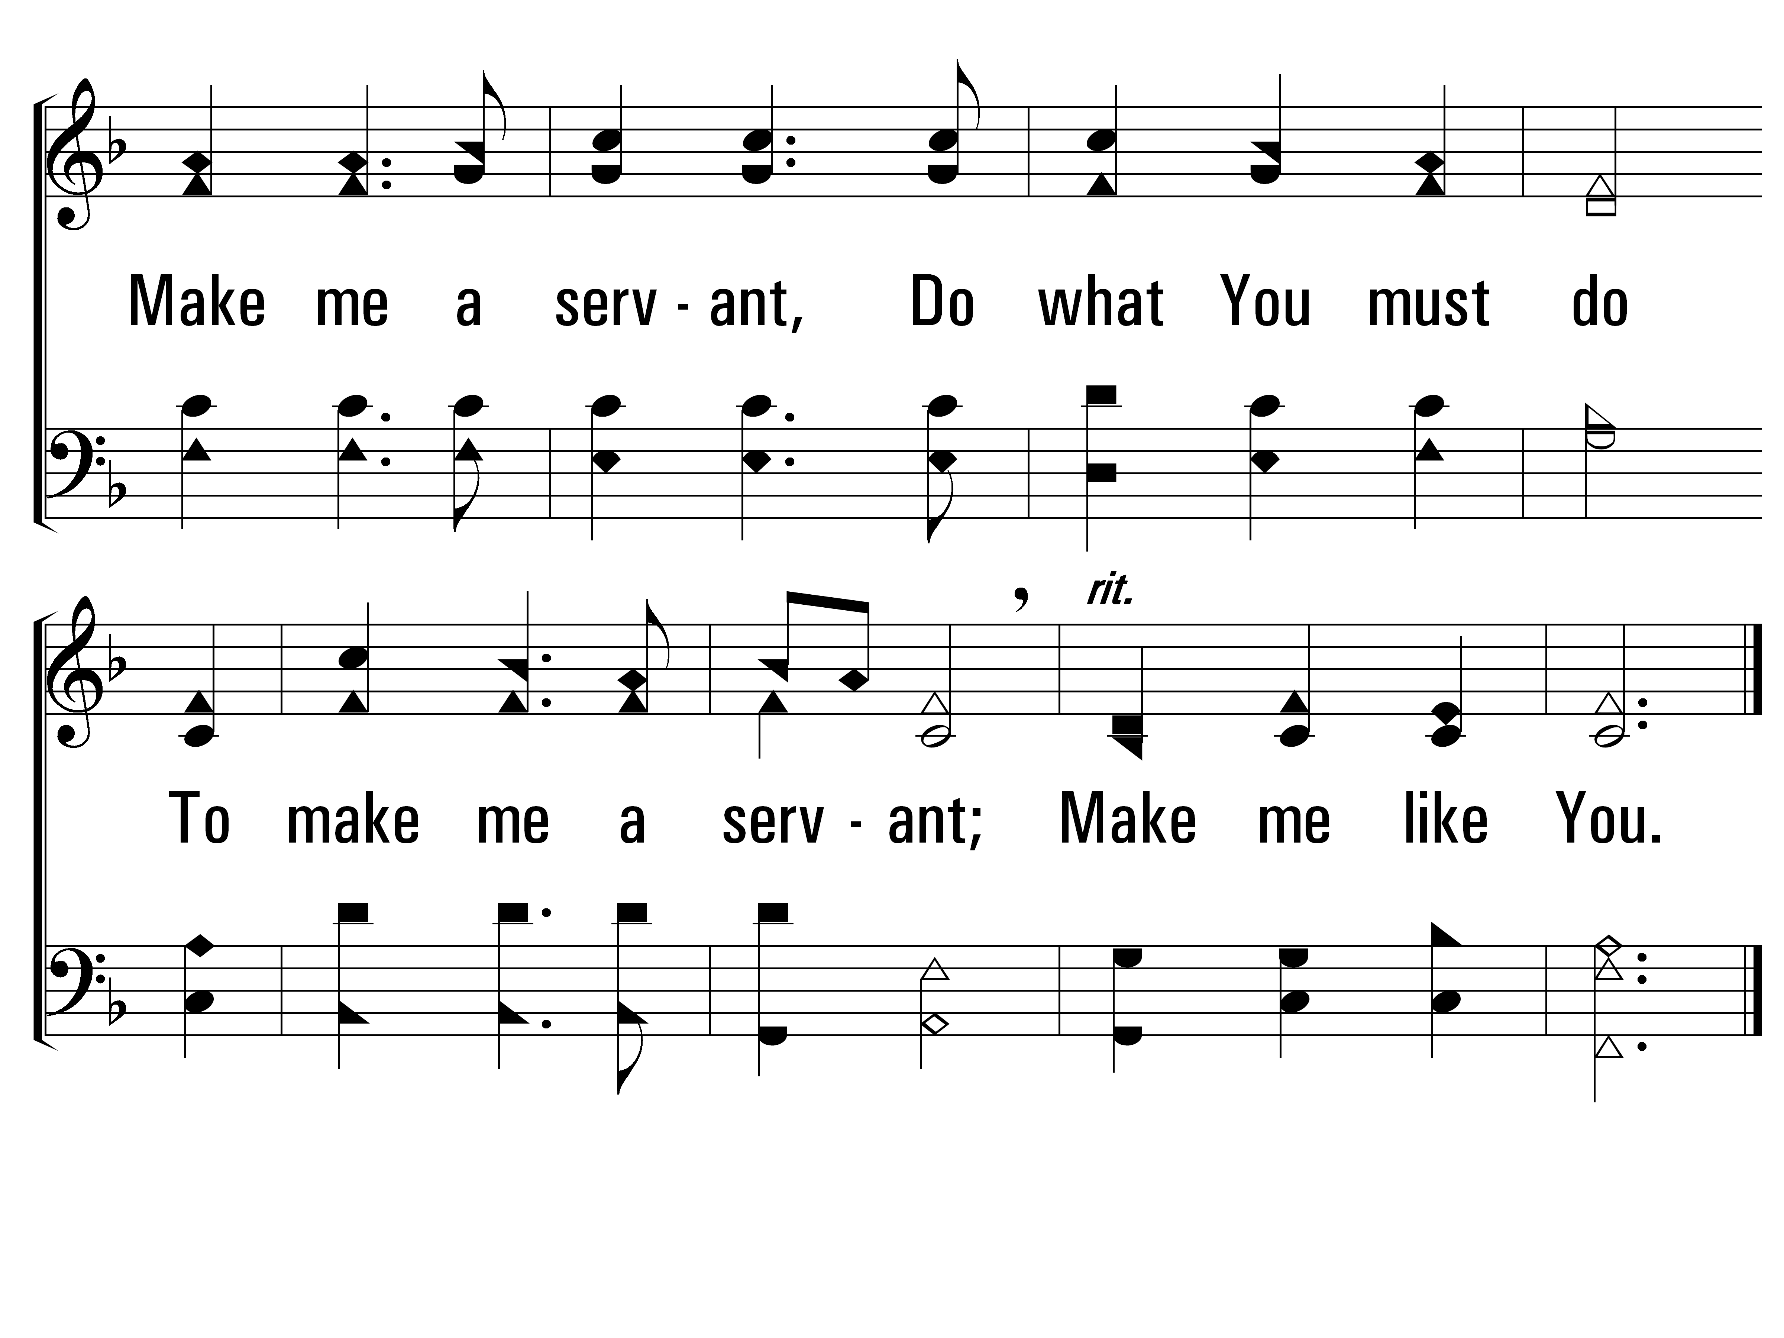
ServantSong_st1_b
Vs 1
© 2014 Sumphonia Productions, LLC

Slide 31
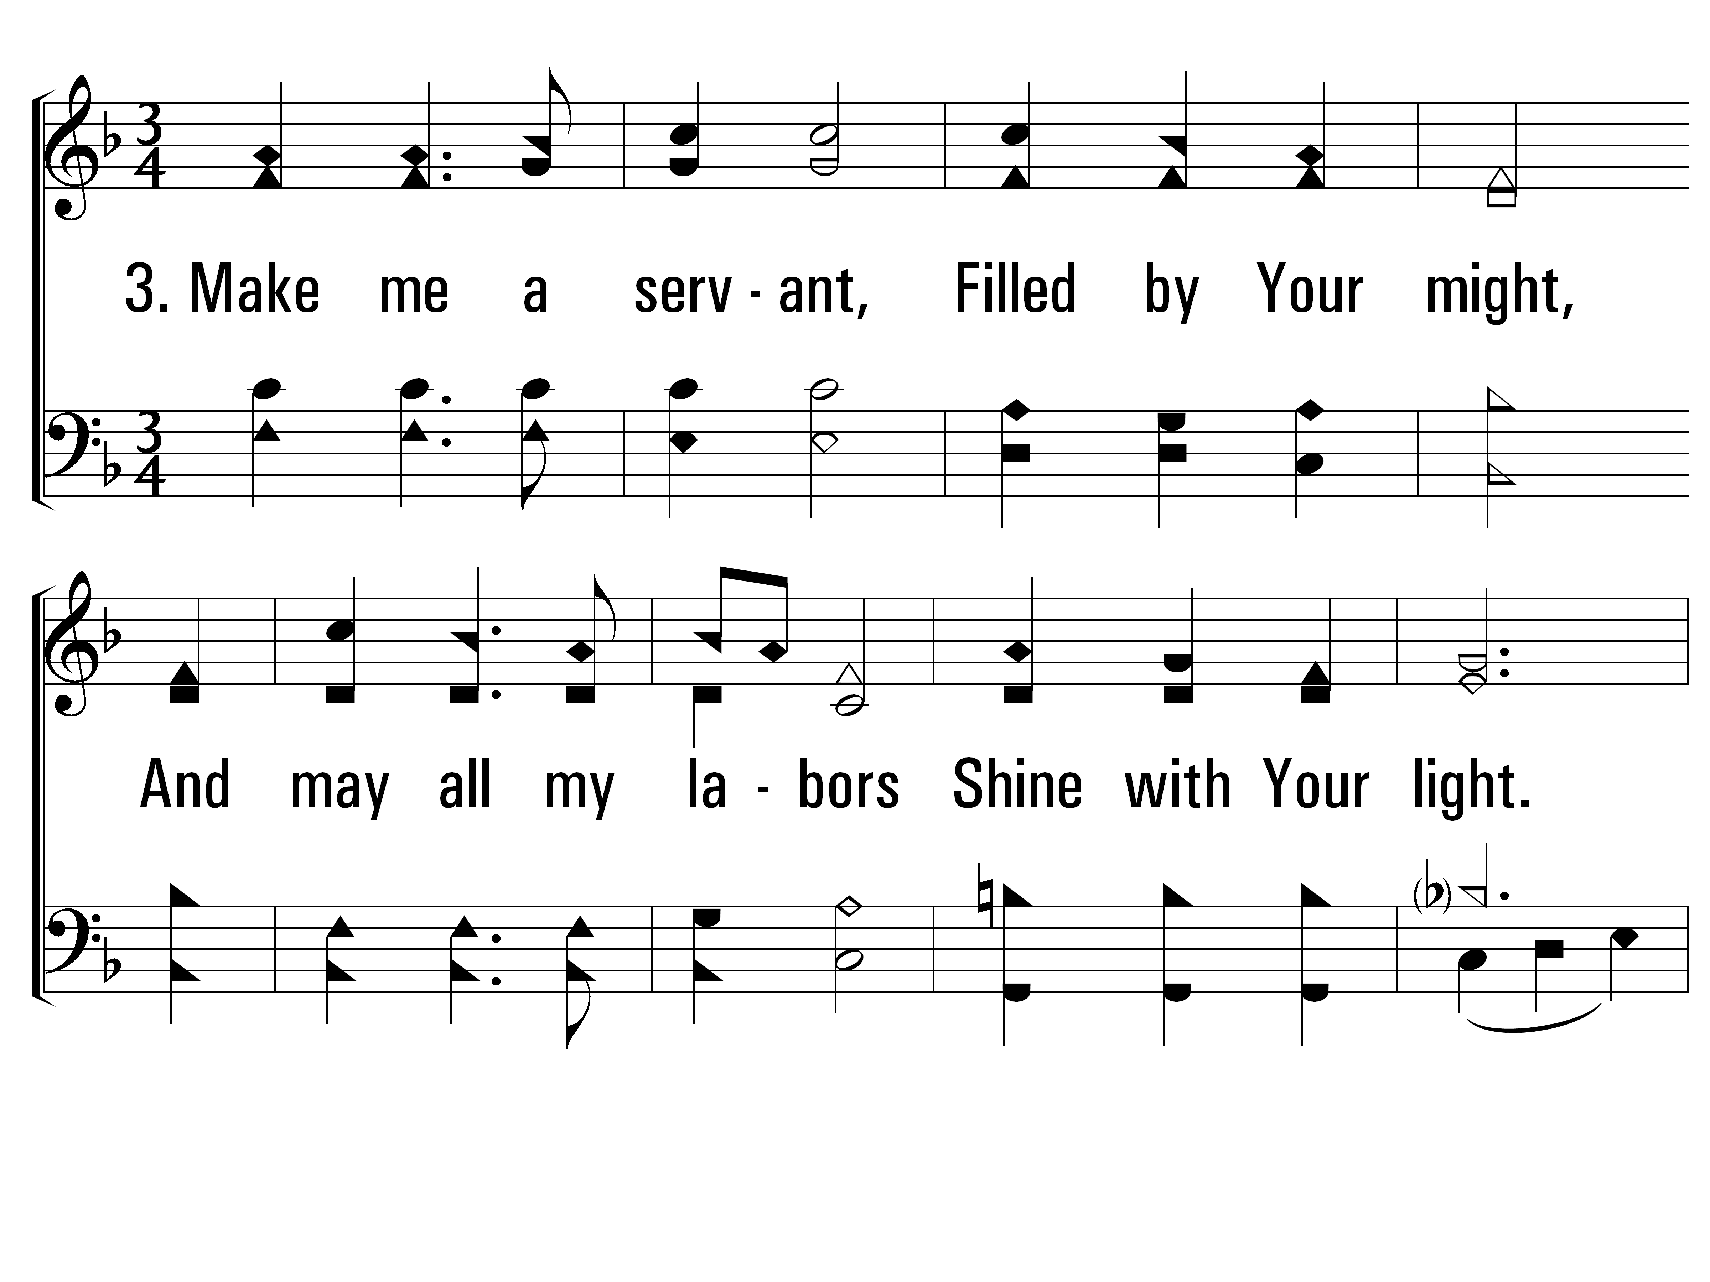
ServantSong_st3_a
Vs 3
© 2014 Sumphonia Productions, LLC

Slide 32
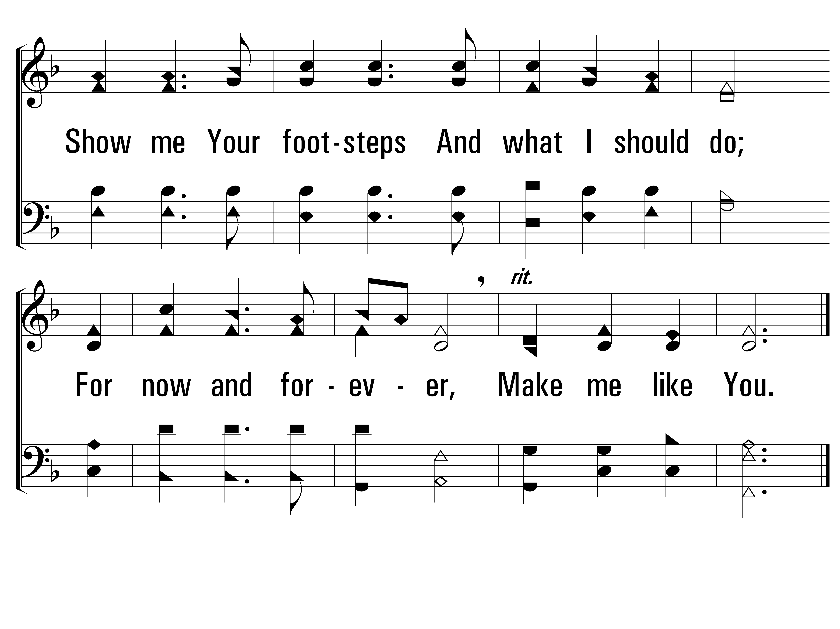
ServantSong_st3_b
Vs 3
© 2014 Sumphonia Productions, LLC
End

Slide 33
Revelation

