Slide 1
Revelation
Notes:
Thank everyone for their kind words and encouragement.
Remind the handouts are available.

Slide 2
Overview of The Revelation
Introduction (Ch. 1)
The 7 Churches (Ch. 2-3)
Heavenly Scene: The Throne & The Lamb (Ch. 4-5)
The 7 Seals (Ch. 6-8)
Heavenly Scene: Silence in Heaven (Ch. 8)
The 7 Trumpets (Ch. 8-11)
Heavenly Scene: The Spiritual Conflict (Ch. 12-14)
The 7 Bowls (Ch. 15-18)
Heavenly Scene: The Spiritual Victory (Ch. 19)
Conclusion: The Rule of Christ (Ch. 20-22)

Slide 3
Class Goals
To Better Understand The Language & Structure of Revelation.
To Understand The Purpose & Dramatic Style of Apocalyptic Literature.
To Identify Key Verses In Each Chapter As Stepping Stones of Understanding.
To Explain The Shortcomings of Premillennial Interpretations.
To Tackle A Challenging Book With The Support & Wisdom of Friends.
To More Clearly See The Events, Instructions, & Message of Revelation.
To See The Glory, Authority, Power, & Triumph of Jesus More Clearly.
To See The Limitations & Weaknesses of Earthly Kingdoms More Clearly.
To Fully Respond To The Insights Given In Revelation.
To Grow In Praise To God & Loyalty to His Kingdom.
To Increase Our Alertness & Preparation For The Judgment of God.
To Instill Courage & Hope In The Face of Persecutions.
To Stir Up Our Joy & Hope For Heaven.
Notes:
If we understand it – we can see it clearly. If we can see it clearly – we can respond to it.
To Emphasize Key Verses In Each Chapter That Provide Stepping Stones for Understanding the Full Book of Revelation.
To Examine & Understand The Use of Old Testament Language.

Slide 4
How Have The Key Verses & Key Ideas In The Book of Revelation Impacted You?
The Message To The Seven Churches? (Rev 2-3)
The Vision of God’s Holy Throne & The Worthy Lamb? (Rev 4-5)
The Message of National Judgment? (Rev 6-8)
The Faithful Worship & Witnessing During Difficulties? (Rev 9-11)
The Spiritual Battle With Satan & His Allies? (Rev 12-15)
The Complete Victory of God? (Rev 16-20)
The Picture of Eternal Glory & Eternal Life? (Rev 21-22)
The Saint’s Response “Come” (Rev 22)
Notes:
7 Churches: I’ve never seen the connection between Jesus urging endurance here – and the reward at the end so clear.
Throne: God’s extreme Holiness. What it means for Jesus to be WORTHY.
Nation: Amazed to see the Deut. Language show up. I knew the prophets, but not this.
Witness: - Great example of needing humility and thoughfulness.
Battle: The evil and wickedness of Satan is really vivid. So often we think of peer pressure from so called “friends.” Satan is is NO WAY a friend trying to nudge us into evil. Satan is a blood-thirsty, horrible – raging enemy who wants to destroy me.
Victory: Just, Harlotry, Wealth – The completeness of God’s victory is powerful.
PICTURE: Bride who overcomes.
Come: Makes me want to tell others about the Lamb!

Slide 5
Revelation 1:1-3
Apocalypse
“The Revelation of Jesus Christ, which God gave Him to show to His bond-servants, the things which must soon take place; and He sent and communicated it by His angel to His bond-servant John, ² who testified to the word of God and to the testimony of Jesus Christ, even to all that he saw. ³ Blessed is he who reads and those who hear the words of the prophecy, and heed the things which are written in it; for the time is near.”
Visual
Timing
Messenger
Source
Purpose
Action

Slide 6
Simplified Definition
A story, written in a time of crisis and distress, that is given by otherworldly beings explaining how God will reverse everything so the righteous will triumph.

Slide 7
Key Points of Apocalyptic Lit.
Revelatory Literature:
Claims It Is A Divine Message Coming From Heaven.
Narrative Framework: It Tells A Story.
Otherworldly Beings: Usually An Angel.
Temporal & Spatial:
“What is happening in the heavenly realm is reflected in the earthly events seen around us.”
Eschatological Salvation:
In The End, God Will Save.
Influence Audience: Trust & Endure
Notes:
Divine Message: Don’t throw our hands up and say – I’ll never understand this. The whole point is to understand it. And to know that understanding it as a whole is not lazy or inaccurate, but actually the first and primary point!
Page 24 – Temporal & Spatial
*** Reflected – not a one-for-one correlation. Simply pulling back the curtains and telling us – what you are experiecing on earth is connected to a larger drama unfolding between God and Satan.

Slide 8
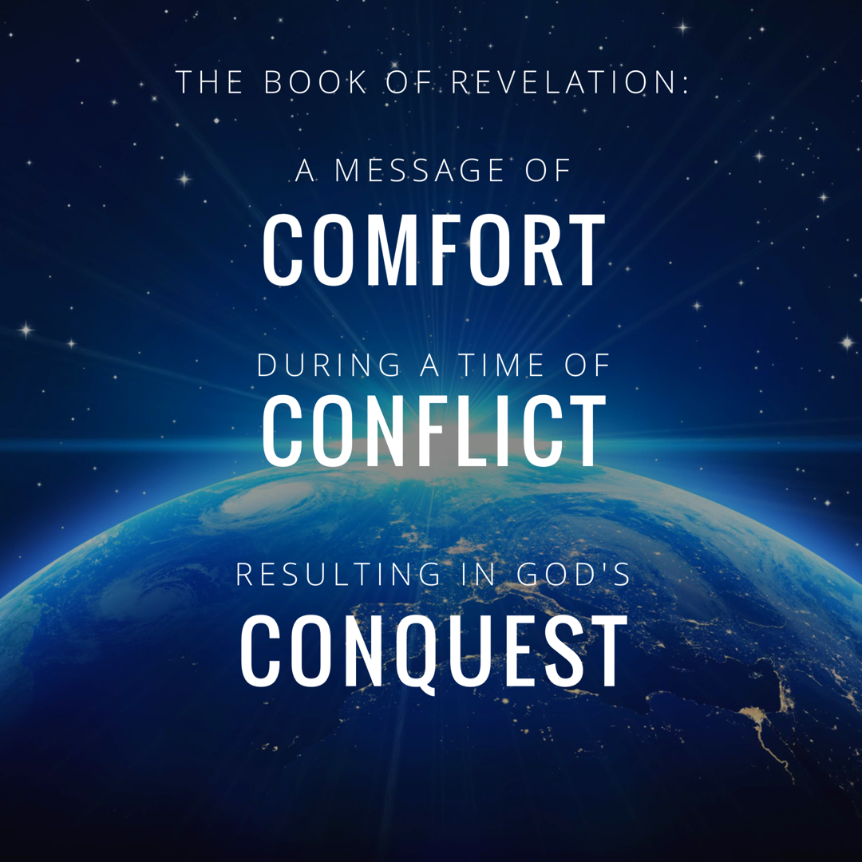
Notes:
In studying 12 we really rejoiced in GOD’s CONQUEST.
Rev. 12:11 “And they overcome him because of the blood of the Lamb and because of the word of their testimony, and they did not love their life even when faced with death.”

Slide 9
Revelation Chapter 1-3
Jesus Leads His Church
“The Revelation of Jesus Christ, which God gave Him to show to His bond-servants, the things which must soon take place; and He sent and communicated it by His angel to His bond-servant John,” (Rev 1:1)
“Do not fear what you are about to suffer. Behold, the devil is about to cast some of you into prison, so that you will be tested, and you will have tribulation for ten days. Be faithful until death, and I will give you the crown of life.” (Rev 2:10)
Notes:
A story, written in a time of crisis and distress, that is given by otherworldly beings explaining how God will reverse everything so the righteous will triumph.

Slide 10
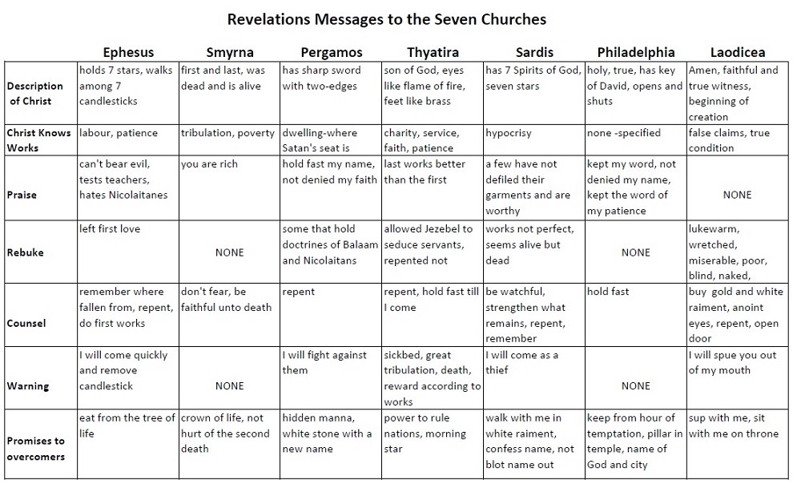

Slide 11
Revelation Chapter 4-5
The Throne of Our Holy God
And the four living creatures, each one of them having six wings, are full of eyes around and within; and day and night they do not cease to say, “Holy, holy, holy is the Lord God, the Almighty, who was and who is and who is to come.” (Rev. 4:8)
The Worthy Lamb
“Worthy are You to take the book and to break its seals; for You were slain, and purchased for God with Your blood men from every tribe and tongue and people and nation.” (Rev. 5:9)

Slide 12
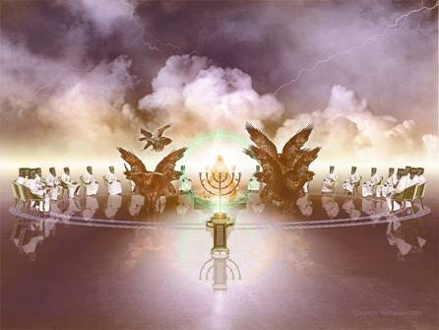
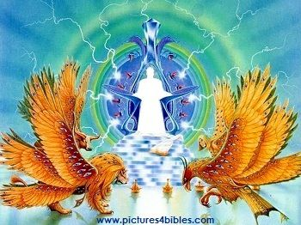
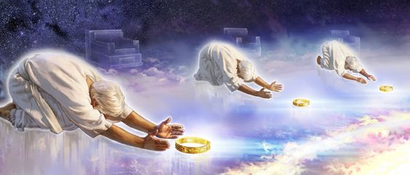
The Throne of our Holy God
Notes:
No one picture can fully capture this incredible scene.
As we read this – you’ll notice that John uses lots of images to describe the glory of the throne. But remember to think of this like a broadway play – We want to know WHERE IS THE SPOTLIGHT? The amazing backdrop is there to accentuate the main object of our focus – GOD.

Slide 13
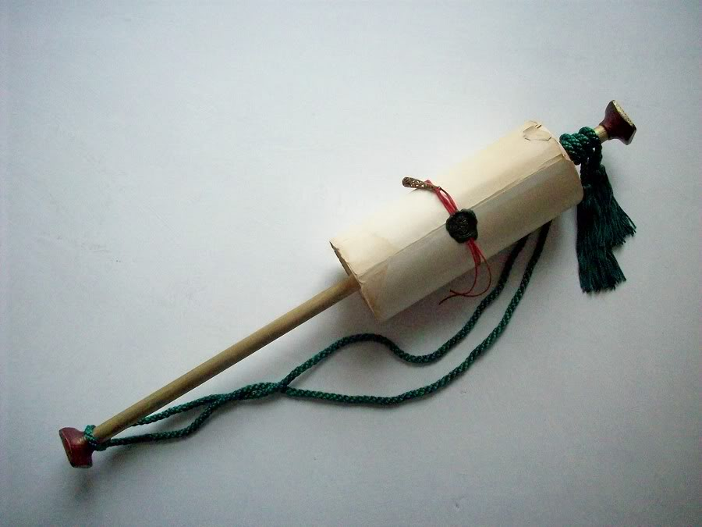
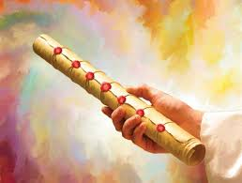
The Scroll with Seven Seals
Notes:
Jesus, the Lamb, is not described as worthy just to praise Him. He is described as worthy to open the seals of the scroll (or book).
This heavenly scene is the transition to the next section of the book – because as we’ve said all along – What happens in the spiritual realm is going to impact the physical realm.

Slide 14
Revelation Chapter 6-8
The Nation (Of Israel) Is Judged
“The sky was split apart like a scroll when it is rolled up, and every mountain and island were moved out of their places.” (Revelation 6:14)
The People of God Are Identified & Protected
“saying “Do not harm the earth or the sea or the trees until we have sealed the bond-servants of our God on their foreheads.” (Revelation 7:3)
A Portion of Israel Begins To Suffer.
“And the seven angels who had the seven trumpets prepared themselves to sound them.” (Revelation 8:6)

Slide 15
Prophetic Judgement Language: Fire, Blood, Mountains, Wormwood, & Eagles
Like An Eagle Swooping Down on Its Prey.
“The LORD will bring a nation against you from far away, from the end of the earth, swooping down like the eagle, a nation whose language you do not understand, a hard-faced nation who shall not respect the old or show mercy to the young.” (Deuteronomy 28:49-50)

Slide 16
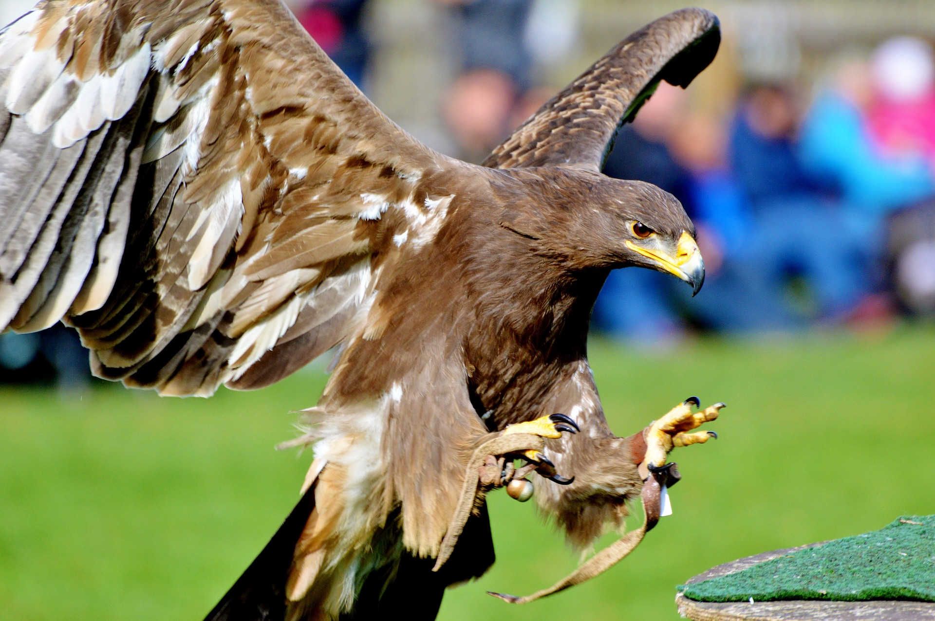
God Keeps His Promises

Slide 17
Revelation Chapter 9-10
A Great Army Comes Against The Nation of Israel.
“The appearance of the locusts was like horses prepared for battle; and on their heads appeared to be crowns like gold, and their faces were like the faces of men.” (Revelation 9:7)
The Delay Is Ending So John Must Prepare To Act.
“…there will be delay no longer, but in the days of the voice of the seventh angel, when he is about to sound, then the mystery of God is finished, as He preached to His servants the prophets.” (Revelation 10:6b-7)

Slide 18
Revelation Chapter 11
The Faithful Worship & Witness As Judgment Arrives.
“Then there was given me a measuring rod like a staff; and someone said, “Get up and measure the temple of God and the altar, and those who worship in it.” (Revelation 11:1)
“And I will grant authority to my two witnesses, and they will prophecy for twelve hundred and sixty days, clothed in sackcloth.” (Revelation 11:3)
“When they have finished their testimony, the beast that comes up out of the abyss will make war with them, and overcome them and kill them.” (Revelation 11:7)
Notes:
If you want a phrase for the whole chapter I would say: Silence Followed By Suffering.
The judgement that was pronounced in Chapter 6 as each seal was opened – is now beginning to occur. And this judgment affects a third of the people.

Slide 19
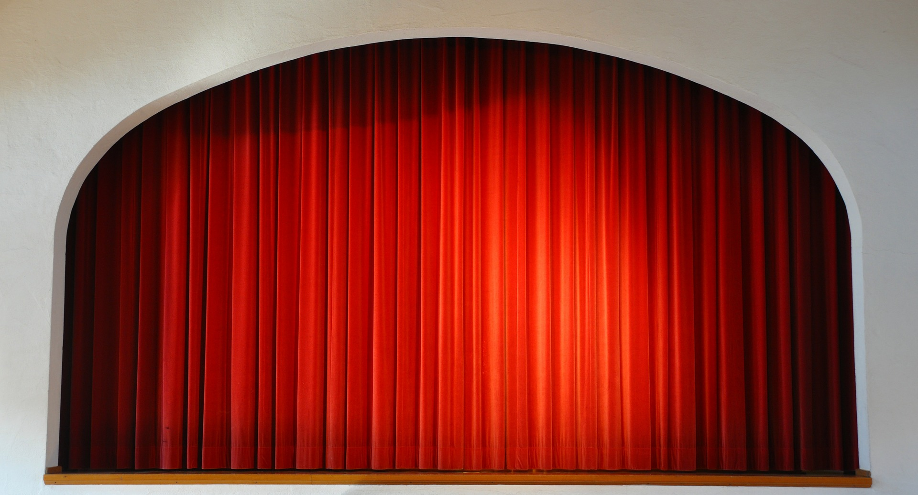

Slide 20
Revelation Chapter 12
The Heavenly Victory Behind The Earthly Difficulty.
“And there was war in heaven, Michael and his angels waging war with the dragon. The dragon and his angels waged war, “ (Rev 12:7)
“And they overcame him because of the blood of the Lamb and because of the word of their testimony, and they did not love their life even when faced with death.” (Revelation 12:11)
“So the dragon was enraged with the woman, and went off to make war with the rest of her children, who keep the commandments of God and hold to the testimony of Jesus.” (Revelation 12:17)
Notes:
If you want a phrase for the whole chapter I would say: Silence Followed By Suffering.
The judgement that was pronounced in Chapter 6 as each seal was opened – is now beginning to occur. And this judgment affects a third of the people.

Slide 21
Revelation Chapter 13-14
Satan Stirs Up The Roman Empire Against The Saints.
“they worshipped the dragon because he gave his authority to the beast; and they worshipped the beast, saying, “Who is like the beast, and who is able to wage war with him?” (Rev 13:4)
The Lamb Stirs Up His Angels Against Babylon.
“and he said with a loud voice, “Fear God, and give Him glory, because the hour of His judgment has come; worship Him who made the heavens and the earth and sea and springs of waters.”(7)
Notes:
If you want a phrase for the whole chapter I would say: Silence Followed By Suffering.
The judgement that was pronounced in Chapter 6 as each seal was opened – is now beginning to occur. And this judgment affects a third of the people.

Slide 22
Revelation Chapter 13
Satan Stirs Up The Roman Empire Against The Saints.
The Beast of Daniel 7 and Revelation 13 Is The Same: Rome
Both Come From the Sea (Rev. 13:1 and Daniel 7:3)
Both Have 10 Horns (Rev. 13:1 and Daniel 7:7)
Both Speak Blasphemies (Rev. 13:1,5,6, and Daniel 7:8,25)
Both Have Limited Influence (Rev. 13:5 and Daniel 7:25)
Both Make War With The Saints (Rev. 13:7 and Daniel 7:21-22)
The Blaspheme of The Beast
“and on his heads were blasphemous names…” 13:1
“a mouth speaking arrogant words and blasphemies…” 13:5
“he opened his mouth in blasphemies against God…” 13:6
“to blaspheme His name and His tabernacle, that is, those who dwell in heaven.” 13:6
Notes:
Sackcloth: - for times of mourning and distress. Esther 4:1-3
Vs. 6 – They have a mastery of the Scriptures & being able to explain ALL the prophets foretold.
Odd to me that people look to make “2” literal when everything else is figurative, but ok.
So some see it as the Law & Prophets (taught by the apostles and other Christians)
So some see it as the Apostles & the Holy Spirit (John reference)
But, regardless of the exact identification: these are servants of God who are FAITHFULLY maintaining their testimony (see 12:11)
Daniel 9:24-27 (See Handout) Big thing: “about you and your people”
The Law & the Prophets declared this would take place – the apostles, prophets, and saints of the first century preached this message by the power of the Spirit.

Slide 23
Revelation Chapter 15
God Is Exalted In All The World.
“And they sang the song of Moses, the bond-servant of God, and the song of the Lamb, saying, “Great and marvelous are Your works, O Lord God, the Almighty; Righteous and true are Your ways, King of the nations! Who will not fear, O Lord, and glorify Your name? For You alone are holy; For all the nations will come and worship before You, For Your righteous acts have been revealed.” (Rev 15:3-4)
“Then one of the four living creatures gave to the seven angels seven golden bowls full of the wrath of God, who lives forever and ever.” (Rev. 15:7)
Notes:
Ch 13 – Satan stirred up the Beast
Ch 14 – Jesus stirred up the Angels
Ch 15 – Celebrating Jesus’ Superiority
God Is Exalted: The song of Moses is a song of deliverance and rescue. The saints who have given their lives aren’t asking: How could you let this happen. They are praising Him for His wonderful works. *Hymn: Come let us worship and bow down.

Slide 24
Revelation Chapter 16-18
God’s Conquest Over Rome Will Be Just & Decisive.
“And I heard the angel of the waters saying, “Righteous are You, who are and who were, O Holy One, because You judged these things; for they poured out the blood of saints and prophets, and You have given them blood to drink. They deserve it.” Rev. 16:5-6
God’s Conquest Over Rome Will Punish Her Harlotry
“…I will show you the judgment of the great harlot who sits on many waters, with whom the kings of the earth committed acts of immorality, and those who dwell on the earth were made drunk with the wine of her immorality.” (Rev. 17:1b-2)
God’s Conquest Over Rome Will Destroy Her Wealth
“And they threw dust on their heads and were crying out, weeping and mourning, saying “Woe, woe, the great city, in which all who had ships at sea became rich by her wealth, for in one hour she has been laid waste.” (18:19) “Rejoice over her, O heaven…” (18:20)
Notes:
16:13 – this is not the final day of judgment – but a judgment against the beast and it’s blaspheme.
** Key Word is MOUTH: When this battle does take place, it is JESUS and the sword of HIS MOUTH that brings Victory. Rev. 19:20-21

Slide 25
Revelation Chapter 19-20
Hallelujah! The Victory of The Lamb & His Bride.
“After these things…a great multitude in heaven saying, “Hallelujah! Salvation and glory and power belong to our God…for He has judged the great harlot.” (Rev. 19:1-2a) “And the beast was seized, and with him the false prophet who performed the signs in his presence, by which he deceived those who had received the mark of the beast and those who worshiped his image; these two were thrown alive into the lake of fire which burns with brimstone.” (20)
Jesus Defeats Both The Devil & Death Forever.
“And the devil who deceived them was thrown into the lake of fire and brimstone, where the beast and the false prophet are also; and they will be tormented day and night forever and ever.” Rev. 20:10.
“Then death and Hades were thrown into the lake of fire. This is the second death, the lake of fire.” Rev. 20:14
Notes:
This chapter picks up the pace significantly. IT crams in AMAZING and FANTASTIC images of Victory!
This one chapter has 6 key scenes
A.) John Sees the Hallelujah’s
B.) Then the Bride
C.) Then The Instruction To Worship God
D.) Then Lord Coming in Victory
E.) Then the Birds Gather
F.) Then The Lake of Fire.
The Conquest Brings The Destruction of the Beast & False Prophet

Slide 26
Revelation Chapter 21
The People of God Pictured In Eternal Glory.
“He who overcomes will inherit these things, and I will be his God and he will be My son.” (21:7)
“Then one of the seven angels who had the seven bowls full of the seven last plagues came and spoke with me, saying “Come here, I will show you the bride, the wife of the Lamb.” (21:9)
“And the city has no need of the sun or of the moon to shine on it, for the glory of God has illumined it, and its lamp is the Lamb. The nations will walk by its light, and the kings of the earth will bring their glory into it.” (21:23-24)
Notes:
Revelation 21:11
having the glory of God. Her brilliance was like a very costly stone, as a stone of crystal-clear jasper.
Revelation 21:23
And the city has no need of the sun or of the moon to shine on it, for the glory of God has illumined it, and its lamp is the Lamb.
Revelation 21:24
The nations will walk by its light, and the kings of the earth will bring their glory into it.
Revelation 21:26
and they will bring the glory and the honor of the nations into it;
The Glory of God and the glory of the Nations are both mentioned twice – the people of God, bride of the Lamb, are filled with both.
The magnificence and splendor of this chapter is without comparison. No other chapter in the Bible pictures a more victorious, more at rest, more glorified scene than this. The People of God Pictured in Eternal Glory.
There are “aspects of this” we can relate to here on earth. There are portions of this that we have a taste of today. But after extensive study the strongest conclusion I can reach is that this is the church in eternity.

Slide 27
Revelation Chapter 21
The People of God Pictured In Eternal Glory.
Why Teach This Is “Eternal” Glory & Life?
The Continuation of The Timeline Described in Chapter 20.
“The first earth passed away…” (21:1, 2 Peter 3:10-14)
“He will dwell among them…” (21:3)
“the first things have passed away.” (21:4)
“It is done.” (21:6)
“will inherit these things” (21:7)
“the second death” (21:8, Matthew 25:46)
“having the glory of God” (21:11)
“the Lord God the Almighty and the Lamb are its temple” (21:22)
“only those whose names are written in the Lamb’s book of life.” (21:27)
Notes:
Revelation 21:11
having the glory of God. Her brilliance was like a very costly stone, as a stone of crystal-clear jasper.
Revelation 21:23
And the city has no need of the sun or of the moon to shine on it, for the glory of God has illumined it, and its lamp is the Lamb.
Revelation 21:24
The nations will walk by its light, and the kings of the earth will bring their glory into it.
Revelation 21:26
and they will bring the glory and the honor of the nations into it;
The Glory of God and the glory of the Nations are both mentioned twice – the people of God, bride of the Lamb, are filled with both.
The magnificence and splendor of this chapter is without comparison. No other chapter in the Bible pictures a more victorious, more at rest, more glorified scene than this. The People of God Pictured in Eternal Glory.
There are “aspects of this” we can relate to here on earth. There are portions of this that we have a taste of today. But after extensive study the strongest conclusion I can reach is that this is the church in eternity.

Slide 28
“New Heaven & A New Earth” Isaiah 66:22-23
²² “For just as the new heavens and the new earth Which I make will endure before Me,” declares the Lord, “So your offspring and your name will endure. ²³ “And it shall be from new moon to new moon And from sabbath to sabbath, All mankind will come to bow down before Me,” says the Lord.
Notes:
It is a time for complete devotion and true worship.

Slide 29
Revelation Chapter 22
The People of God Pictured Enjoying Eternal Life.
“Then he showed me a river of the water of life, clear as crystal, coming from the throne of God and of the Lamb, in the middle of its street. On either side of the river was the tree of life, bearing twelve kinds of fruit, yielding its fruit every month; and the leaves of the tree were for the healing of the nations.” (22:1-2)
The Spirit and the bride say, “Come.” And let the one who hears say, “Come.” And let the one who is thirsty come; let the one who wishes take the water of life without cost.” (22:17)
Notes:
Revelation 21:11
having the glory of God. Her brilliance was like a very costly stone, as a stone of crystal-clear jasper.
Revelation 21:23
And the city has no need of the sun or of the moon to shine on it, for the glory of God has illumined it, and its lamp is the Lamb.
Revelation 21:24
The nations will walk by its light, and the kings of the earth will bring their glory into it.
Revelation 21:26
and they will bring the glory and the honor of the nations into it;
The Glory of God and the glory of the Nations are both mentioned twice – the people of God, bride of the Lamb, are filled with both.
The magnificence and splendor of this chapter is without comparison. No other chapter in the Bible pictures a more victorious, more at rest, more glorified scene than this. The People of God Pictured in Eternal Glory.
There are “aspects of this” we can relate to here on earth. There are portions of this that we have a taste of today. But after extensive study the strongest conclusion I can reach is that this is the church in eternity.

Slide 30
Revelation Chapter 22
The People of God Pictured Enjoying Eternal Life.
The Incredible Inheritance That Awaits Those Who Overcome!
Eternal Life: “the water of life”
Dwelling with God: “the throne of God and of the Lamb”
Every Need in Every Season: “tree of life, bearing twelve kinds of fruit”
Every Problem Healed: “healing of the nations”
Every Aspect of The Genesis Curse Relieved: “no longer any curse”
Every Leadership We Long For: “the throne”
Every Worthy Endeavor: “His bond-servants will serve Him”
Faith & Belonging Fulfilled: “see His face” and “name on foreheads”
No More Darkness of Any Kind: “no longer be any night”
Reign Forever and Ever.
Notes:
Sustaining Food – not literal food, but all our needs provided for. 12 fruits – every need met, in every season.

Slide 31
Let Us Worship God Only
“the twenty-four elders will fall down before Him who sits on the throne, and will worship Him who lives forever and ever, and will cast their crowns before the throne, saying,” (Rev. 4:10)
“And every created thing which is in heaven and on the earth and under the earth and on the sea, and all things in them, I heard saying, “To Him who sits on the throne, and to the Lamb, be blessing and honor and glory and dominion forever and ever.” And the four living creatures kept saying, “Amen.” And the elders fell down and worshiped.” (Rev. 5:13-14)
“And all the angels were standing around the throne and around the elders and the four living creatures; and they fell on their faces before the throne and worshiped God,” (Rev. 7:11)

Slide 32
Let Us Worship God Only
“Then there was given me a measuring rod like a staff; and someone said, “Get up and measure the temple of God and the altar, and those who worship in it.” (Rev. 11:1)
“And the twenty-four elders, who sit on their thrones before God, fell on their faces and worshiped God,” (Rev. 11:16)
“and he said with a loud voice, “Fear God, and give Him glory, because the hour of His judgment has come; worship Him who made the heaven and the earth and sea and springs of waters.” (Rev. 14:7)
“Who will not fear, O Lord, and glorify Your name? For You alone are holy; For all the nations will come and worship before You, For Your righteous acts have been revealed.” (Rev. 15:4)

Slide 33
Let Us Worship God Only
“And the twenty-four elders and the four living creatures fell down and worshiped God who sits on the throne saying, “Amen. Hallelujah!” (Rev. 19:4)
Then I fell at his feet to worship him. But he *said to me, “Do not do that; I am a fellow servant of yours and your brethren who hold the testimony of Jesus; worship God. For the testimony of Jesus is the spirit of prophecy.” (Rev. 19:10)
“But he said to me, “Do not do that. I am a fellow servant of yours and of your brethren the prophets and of those who heed the words of this book. Worship God.” (Rev. 22:9)
Notes:
From Beginning To End…I loved seeing this theme develop.

Slide 34
How Have The Key Verses & Key Ideas In The Book of Revelation Impacted You?
The Message To The Seven Churches? (Rev 2-3)
The Vision of God’s Holy Throne & The Worthy Lamb? (Rev 4-5)
The Message of National Judgment? (Rev 6-8)
The Faithful Worship & Witnessing During Difficulties? (Rev 9-11)
The Spiritual Battle With Satan & His Allies? (Rev 12-15)
The Complete Victory of God? (Rev 16-20)
The Picture of Eternal Glory & Eternal Life? (Rev 21-22)
The Saint’s Response “Come” (Rev 22)
Notes:
7 Churches: I’ve never seen the connection between Jesus urging endurance here – and the reward at the end so clear.
Throne: God’s extreme Holiness. What it means for Jesus to be WORTHY.
Nation: Amazed to see the Deut. Language show up. I knew the prophets, but not this.
Witness: - Great example of needing humility and thoughfulness.
Battle: The evil and wickedness of Satan is really vivid. So often we think of peer pressure from so called “friends.” Satan is is NO WAY a friend trying to nudge us into evil. Satan is a blood-thirsty, horrible – raging enemy who wants to destroy me.
Victory: Just, Harlotry, Wealth – The completeness of God’s victory is powerful.
PICTURE: Bride who overcomes.
Come: Makes me want to tell others about the Lamb!

Slide 35
Why Identify Israel As The Likely Nation Being Judged In Revelation 6-8?
Daniel Prophesied About The Destruction of Jerusalem. Dan. 9:24-27
Jesus Prophesied About The Destruction of Jerusalem. Luke 21:20
John Is Told The Time Is At Hand For These Prophecies To Be Fulfilled.
The Jews Are Identified As A Source of Persecution for The Christians In Asia Minor. Rev. 2:9, Rev. 3:9
John Writes With The Language of National Judgment Used By Old Testament Prophets. (Isa. 34:4, Zech. 13:8-9, Ezek. 38:22, Jer. 23:15)
Jerusalem Is Identified As A City of Wickedness. Rev. 11:8
It Is Consistent With Previous Descriptions of Judgment Upon His People, Followed By Judgment Upon The Evil Nation He Used.
Jeremiah 50:1-3

Slide 36
The Lord Keeps His Promises To Those Who Overcome
Overcome → Tree of Life (Rev. 2:7, Rev. 22:2)
Overcome → Not Hurt By Second Death (Rev. 2:11, Rev. 20:6)
Overcome → New Name (Rev. 2:17, Rev. 14:1, 19:12)
Overcome → Rule With The Morning Star (Rev. 2:26, Rev. 22:5, 16)
Overcome → White Garments (Rev. 3:5, Rev. 6:10-11)
Overcome → Temple (Rev 3:12, Rev. 11:19, 21:22)
Overcome → Sit Down on Throne (Rev. 3:21, Rev. 20:4)

Slide 37
The Worthy Lamb Revelation 5:9,10,12,13
“Worthy are You to take the book and to break its seals; for You were slain, and purchased for God with Your blood men from every tribe and tongue and people and nation.” (5:9)
“You have made them to be a kingdom and priests to our God; and they will reign upon the earth.” (5:10)
“Worthy is the Lamb that was slain to receive power and riches and wisdom and might and honor and glory and blessing.” (5:12)
“To Him who sits on the throne, and to the Lamb, be blessing and honor and glory and dominion forever and ever.” (5:13)

Slide 38
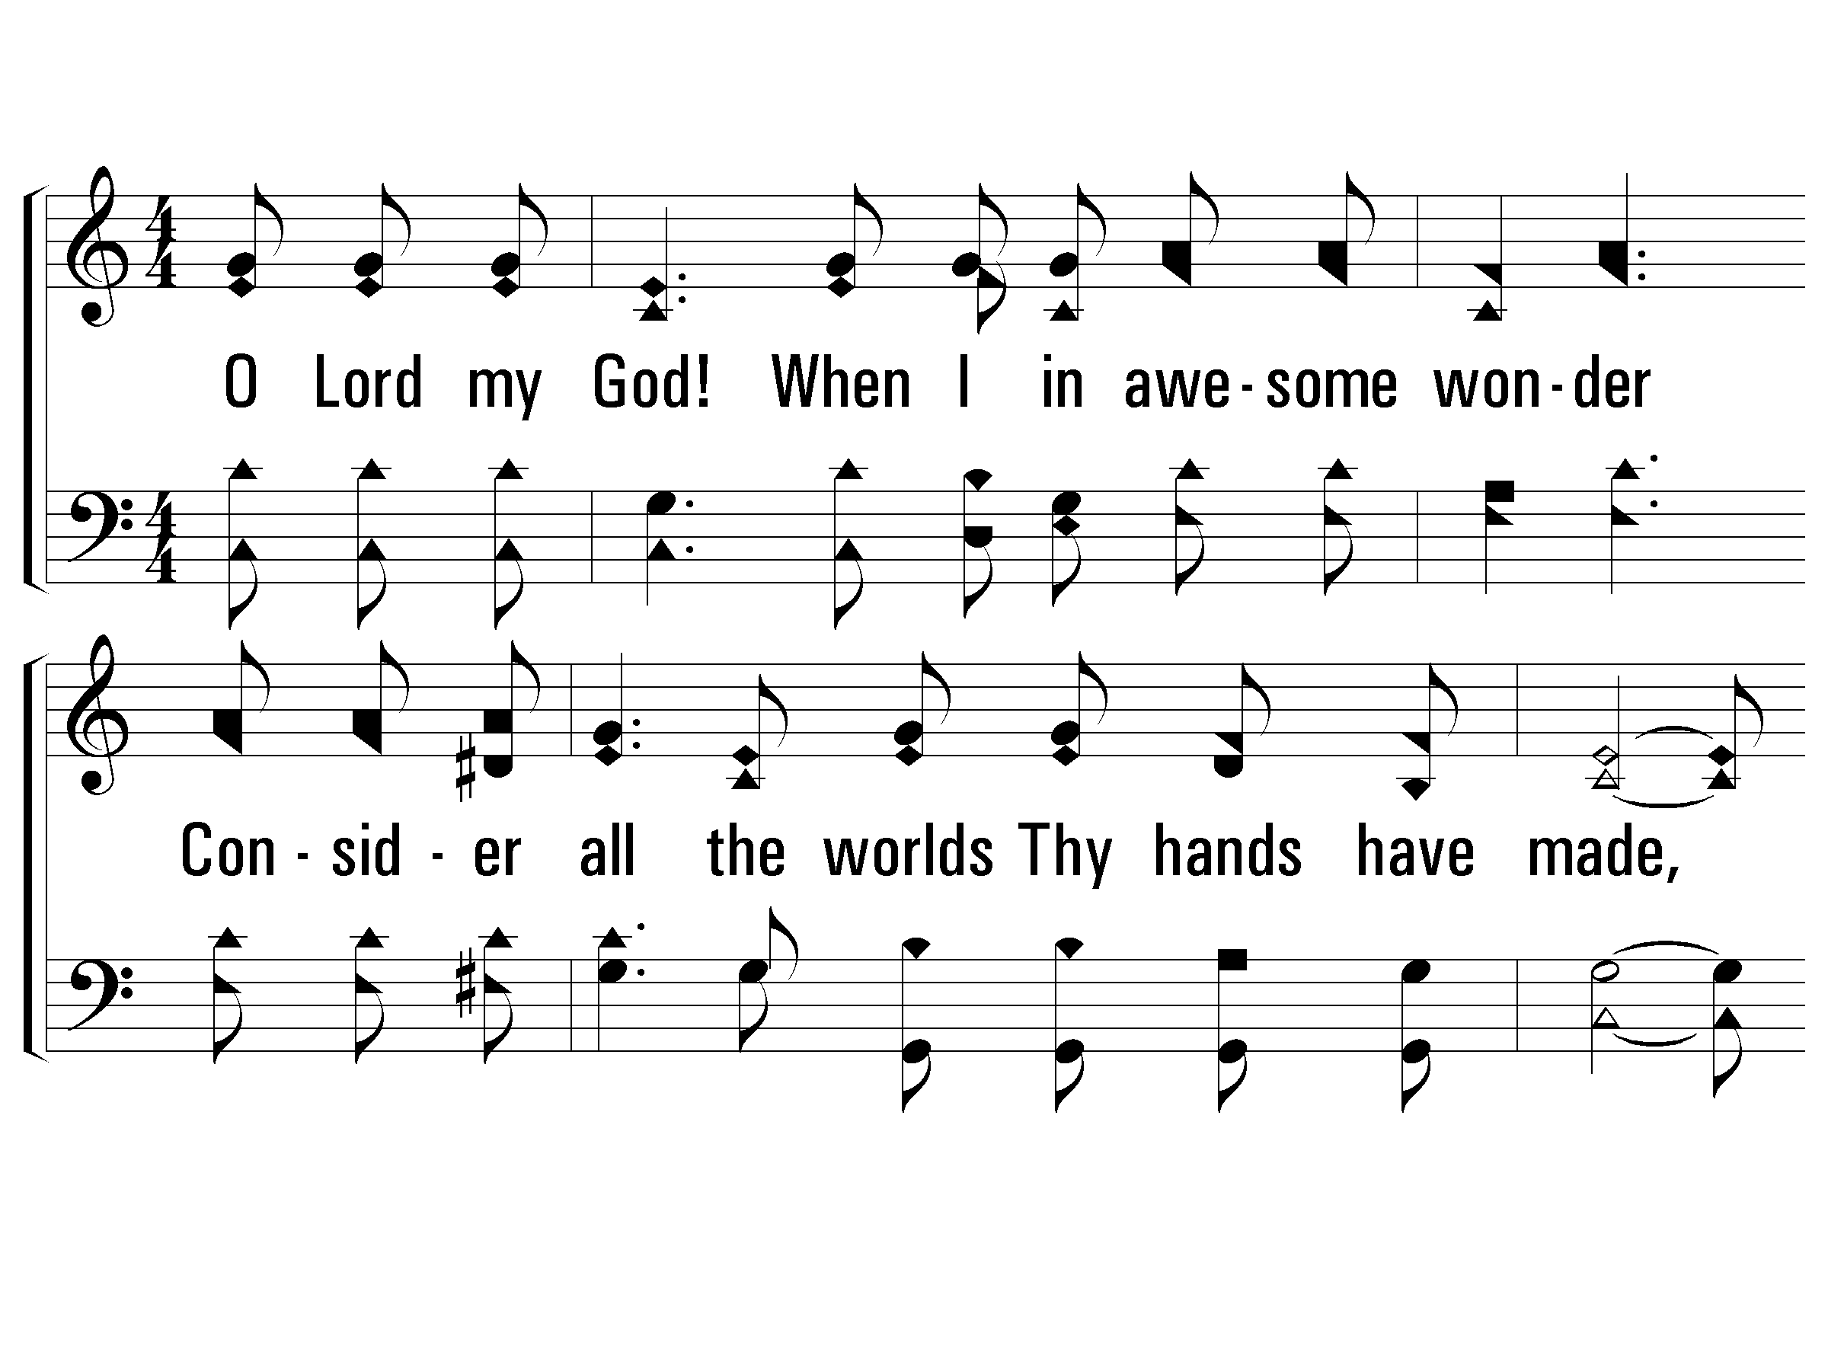
1 – How Great Thou Art
226
1.
O Lord my God! When I in awesome wonder
Consider all the worlds Thy hands have made,
I see the stars, I hear the rolling thunder,
Thy power throughout the universe displayed.
Words by: Carl Boberg / Tr.: Stuart K. Hine
Music by: Swedish Folk melody, Arrangement by: Stuart K. Hine
Copyright © 1953 by Stuart K. Hine. Assigned to Manna Music, Inc., 35255 Brooten Road, Pacific City, OR 97135.
All Rights Reserved. Used by Permission.
© 2001 The Paperless Hymnal™

Slide 39
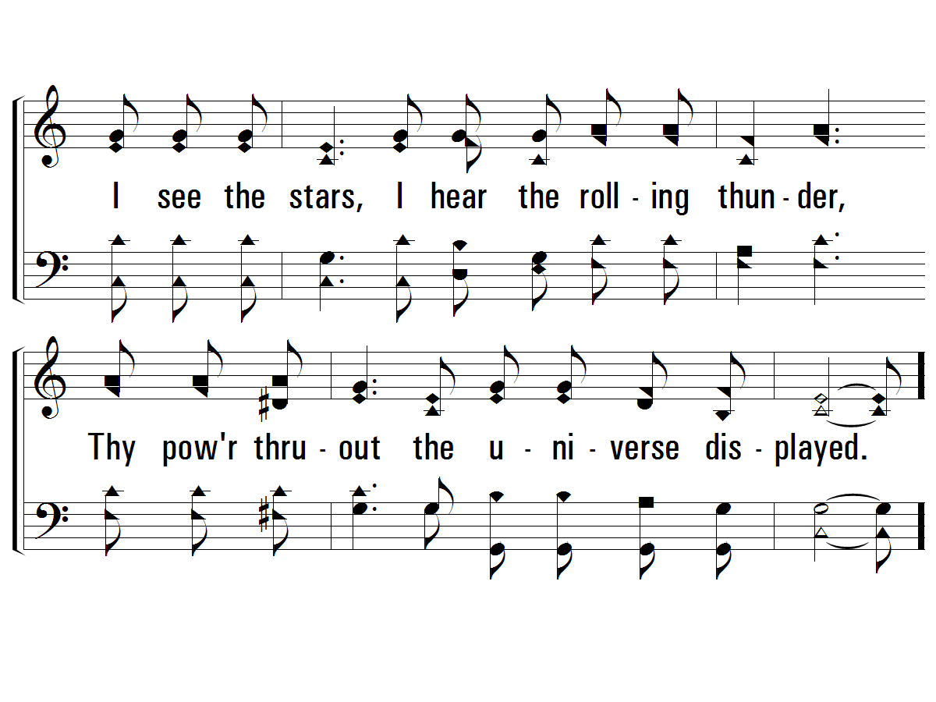
1 – How Great Thou Art
226
© 2001 The Paperless Hymnal™

Slide 40
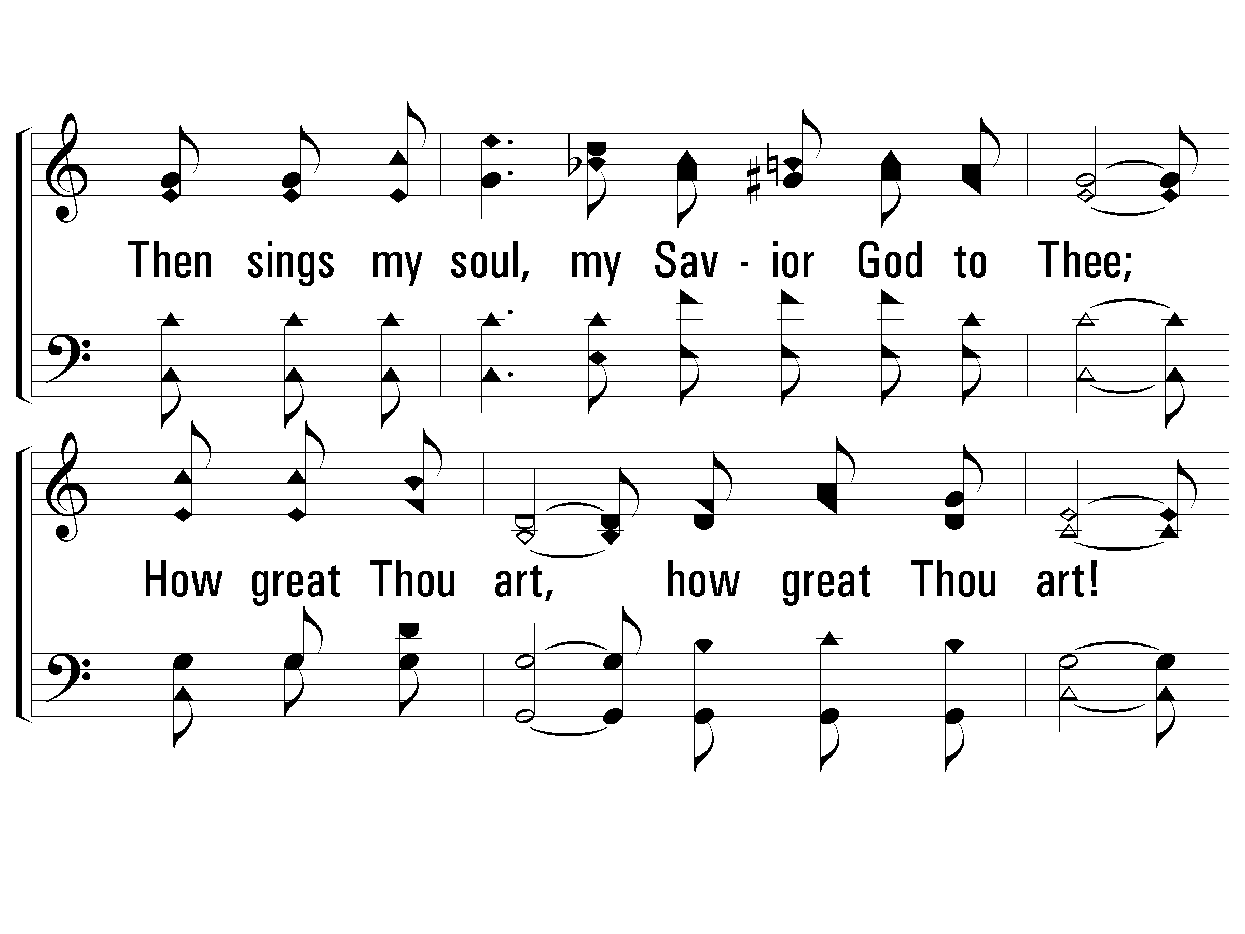
c – How Great Thou Art
226
Then sings my soul, my Savior God to Thee;
How great Thou art, how great Thou art!
Then sings my soul, my Savior God to Thee;
How great Thou art, how great Thou art!
© 2001 The Paperless Hymnal™

Slide 41
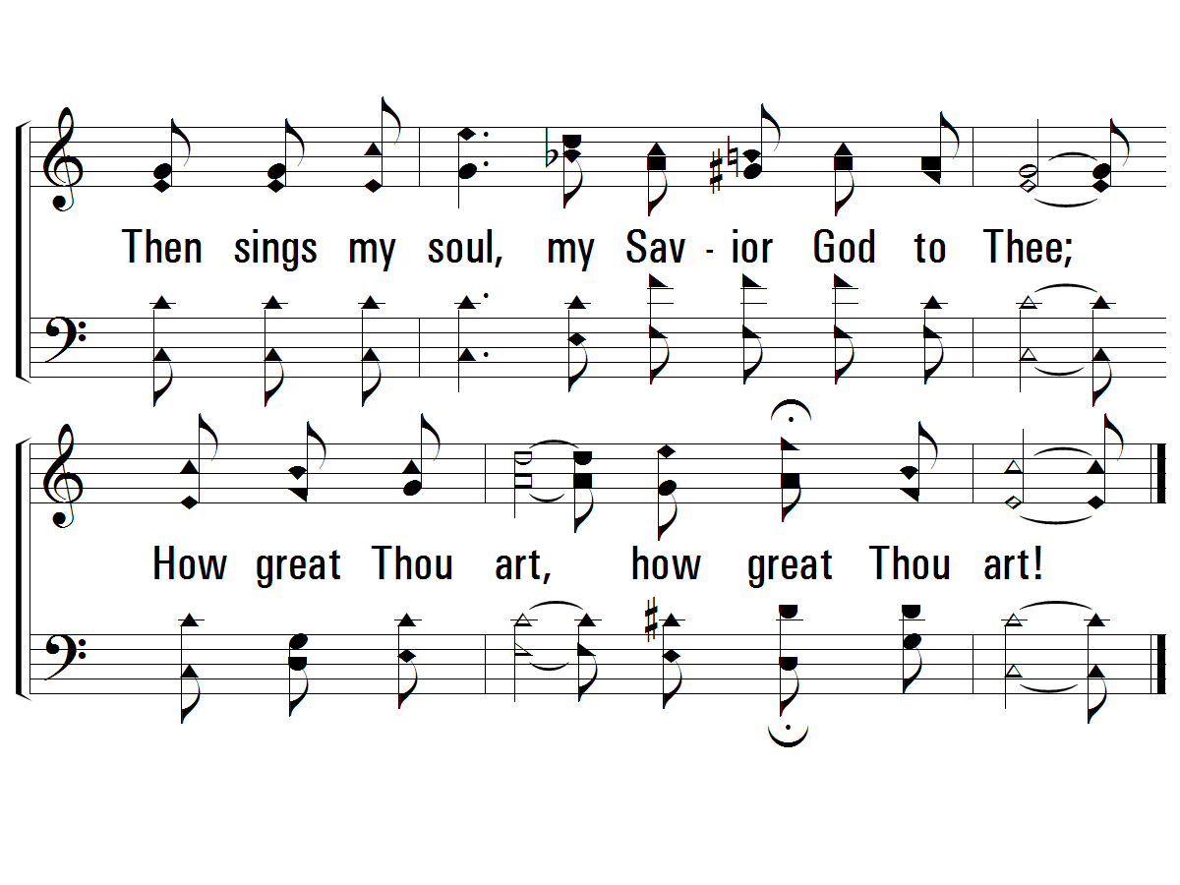
c – How Great Thou Art
226
© 2001 The Paperless Hymnal™

Slide 42
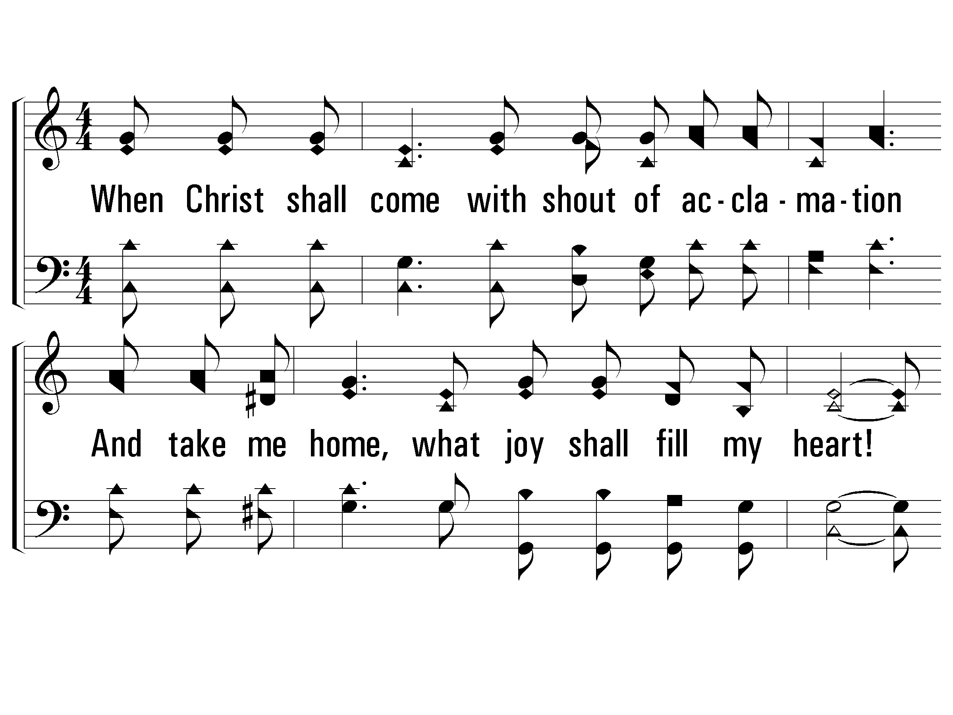
4 – How Great Thou Art
226
4.
When Christ shall come with shout of acclamation
And take me home, what joy shall fill my heart!
Then I shall bow in humble adoration
And there proclaim, my God, how great Thou art!
Words by: Carl Boberg / Tr.: Stuart K. Hine
Music by: Swedish Folk melody, Arrangement by: Stuart K. Hine
Copyright © 1953 by Stuart K. Hine. Assigned to Manna Music, Inc., 35255 Brooten Road, Pacific City, OR 97135.
All Rights Reserved. Used by Permission.
© 2001 The Paperless Hymnal™

Slide 43
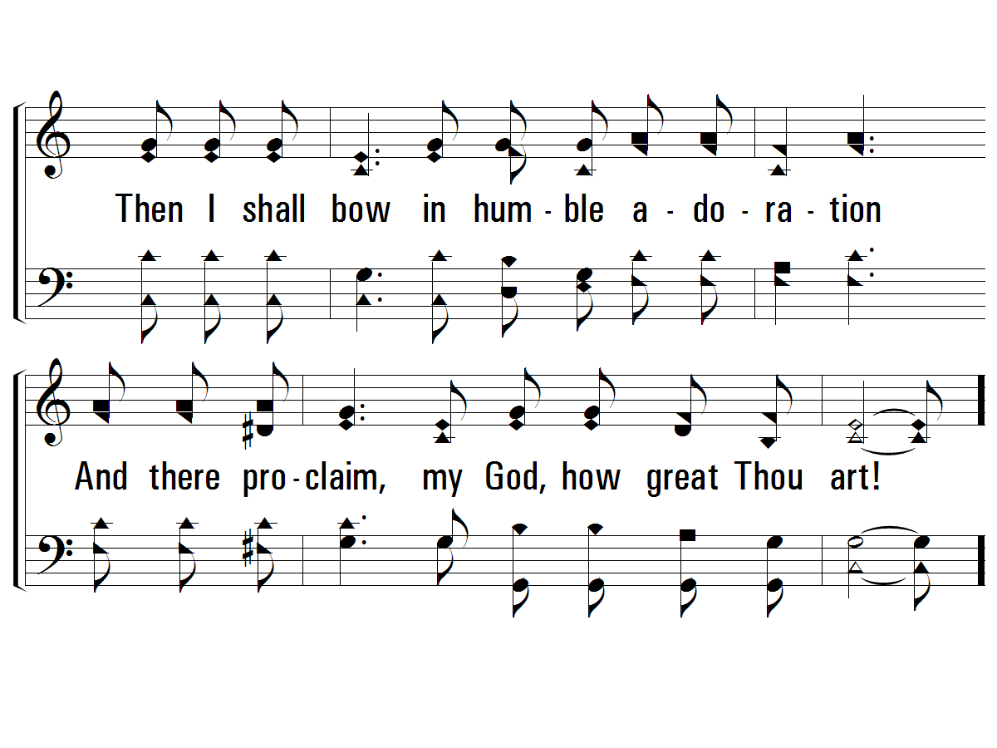
4 – How Great Thou Art
226
© 2001 The Paperless Hymnal™

Slide 44
c – How Great Thou Art
226
Then sings my soul, my Savior God to Thee;
How great Thou art, how great Thou art!
Then sings my soul, my Savior God to Thee;
How great Thou art, how great Thou art!
© 2001 The Paperless Hymnal™

Slide 45
c – How Great Thou Art
226
© 2001 The Paperless Hymnal™

Slide 46
Revelation

