Slide 1
The Psychological Evidence; Was Jesus Crazy When He Claimed to Be the Son of God?
Lesson 8

Slide 2
Class Outline
Lesson | Description
1 | Jesus of the Bible vs Reinvented Jesus of Modern Man
2 | Tools for Examination of the Evidence
3 | Does the Eyewitness Evidence of the Biographies of Jesus the Christ Stand Up to Scrutiny?
4 | Was the Documentary Evidence (Jesus’ Biographies) Reliably Preserved for Us?
5 | Is There Credible Non-Biblical Evidence for Jesus outside His Biographies?
6 | Does Archaeology/the Scientific Evidence Confirm or Contradict Biographies of Jesus?
7 | Was Jesus Really Convinced That He Was the Son of God and did Jesus the Christ fulfill the Attributes of God?
8 | The Psychological Evidence; Was Jesus Crazy When He Claimed to Be the Son of God?
9 | The Fingerprint Evidence – Prophecy Did Jesus—and Jesus Alone—Match the Identity of the Messiah?
10 | The Resurrection – was Jesus Raised from the Dead?
11 | What is the Evidence of that Jesus was seen Alive after His Death on the Cross?
12 | Tactics for Discussing the Case for Jesus the Christ
13 | What Does the Evidence Establish—And What Does It Mean Today?

Slide 3
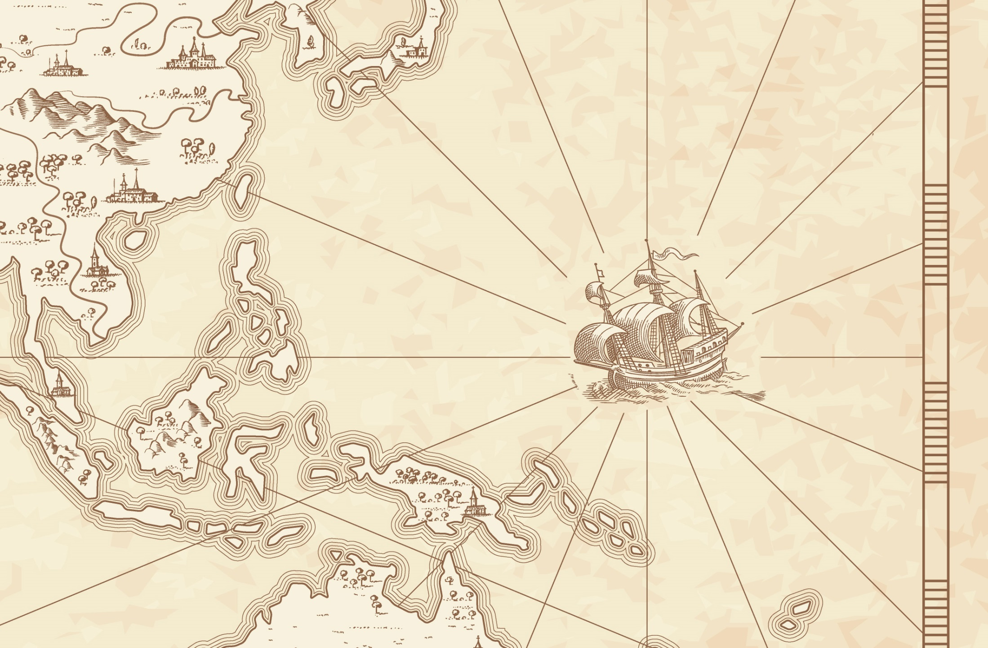
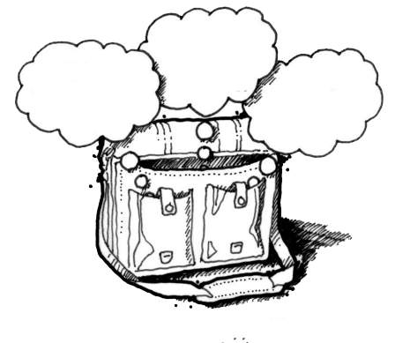
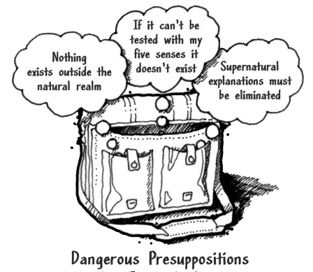
God
Supreme Being
We are created
Bible is
Accurate
Bible is Inspired
Bible is
Reliable
Super Naturalism it is possible that there is
a supreme being/someone beyond natural order
Intelligent Design – a programmer
nothing exists beyond the natural realm
Philosophical Naturalism The presuppositional belief
that only natural laws and forces occur
No God
No Supreme Being
We come from nothing
Using God
To fill in the Gaps

Slide 4



God
Supreme Being
We are created
Super Naturalism
Bible is
Accurate
Bible is Inspired
Bible is
Reliable
Resurrection
Prophecy/Messiah
Jesus Son of God
Was
Jesus
Crazy
Archaeology/the Scientific
Credible
Non-Biblical
Evidence
nothing exists beyond the natural realm
Reliably Preserved
Gospel Eyewitness Evidence
No God
No Supreme Being
We come from nothing

Slide 5



Bible Authority Established
Creation, Flood, Redemption Story, Moses, Moral Laws, Miracles, Nature of Man, Purpose of Man, Nature of God, Christ & Holy Spirit, Requirements for Worship, Personality of Jesus, Coming Judgment, Heaven, Hell, Angels, Demons, & Satan
Bible would be Accurate
Based on Bible Testimony Jesus is Son of God
Teachings of
Jesus are True
Accurate Account of Jesus’ Life
A Step of Faith not
A Leap of Faith
Bible can be Understood
Bible is Inspired
Bible is Accurate
Bible is Reliable
If Bible Revelation of Creator then
Divine Revelation Possible
& Accurate So Purpose is Known
Starting Point for
How We Got the Bible
class
Creation
has a purpose
Likely a Moral Law
Miracles &
Revelations
Universe had an Intelligent, Personal Origin
Possible that Universe had Supernatural Origin
It is Possible that there is Supernatural Force
Based on material from mmb, jr Establishing Bible Authority Class - 10/30/2002

Slide 6
Class Objectives
Demonstrate that the fulfillment of Messianic Prophecies shows an involvement of a supernatural being and that Jesus uniquely fulfills those prophecies.

Slide 7
Questions
Why do I always hear Christians appealing to fulfilled prophecy to prove the inspiration of the Bible?
List the Old Testament passages that Peter used in Acts 2
Do you believe Jesus was born of a virgin?
Aren’t there legitimate objections to the virgin birth which make it unbelievable to us today?
Confirms/gives context
The current class
Mt 2: 5-6 Born in Bethlehem – Micah 5:2
Mt 2:13-15 Flees to Egypt - Hosea 11:1
Mt 2:16-18 Death of male children in Bethlehem – Jeremiah 31:15
Mt 2:22-23 He shall be called a Nazarene ?
The current class
The current class
The current class
The current class
Notes:
Matthew 2:5-6 (NKJV) ⁵ So they said to him, "In Bethlehem of Judea, for thus it is written by the prophet:
⁶ 'But you, Bethlehem, in the land of Judah, Are not the least among the rulers of Judah; For out of you shall come a Ruler Who will shepherd My people Israel.' " Micah 5:2
Matthew 2:13-15 (NKJV) ¹³ Now when they had departed, behold, an angel of the Lord appeared to Joseph in a dream, saying, "Arise, take the young Child and His mother, flee to Egypt, and stay there until I bring you word; for Herod will seek the young Child to destroy Him."
¹⁴ When he arose, he took the young Child and His mother by night and departed for Egypt,
¹⁵ and was there until the death of Herod, that it might be fulfilled which was spoken by the Lord through the prophet, saying, "Out of Egypt I called My Son." (Hosea 11:1)
Matthew 2:16-18 (NKJV) ¹⁶ Then Herod, when he saw that he was deceived by the wise men, was exceedingly angry; and he sent forth and put to death all the male children who were in Bethlehem and in all its districts, from two years old and under, according to the time which he had determined from the wise men.
¹⁷ Then was fulfilled what was spoken by Jeremiah the prophet, saying:
¹⁸ "A voice was heard in Ramah, Lamentation, weeping, and great mourning, Rachel weeping for her children, Refusing to be comforted, Because they are no more." Jeremiah 31:15
Matthew 2:22-23 (NKJV) 22 But when he heard that Archelaus was reigning over Judea instead of his father Herod, he was afraid to go there. And being warned by God in a dream, he turned aside into the region of Galilee.
And he came and dwelt in a city called Nazareth, that it might be fulfilled which was spoken by the prophets, "He shall be called a Nazarene.“
Three major options exist for interpreting this verse. First, it may be that Matthew is associating the word Nazarene with the Hebrew word netser (“branch or sprout”). The “Branch” was a common term for the Messiah, such as in Isaiah 11:1: “A shoot will come up from the stump of Jesse; from his roots a Branch will bear fruit.” Hebrew was written with only consonants, and netser would have appeared as NZR—the same main consonants as Nazareth. In fact, in Aramaic, the common language of Jesus’ day, the word for “Nazareth” and the Hebrew word for “branch” sounded very much alike. Matthew’s point could be that Jesus was “sprouting up” from an obscure village in Galilee; Jesus was the Branch predicted by the prophets, and the name of the town He grew up in happens to sound just like the prophets’ word for “branch.”
A second option is that Matthew is citing a prophecy not found in the Old Testament but in another source. If so, Matthew referred to a prophecy known to his original audience yet unknown to us today. However, this is unlikely and an argument from silence.
A third option is that Matthew uses the word Nazarene in reference to a person who is “despised and rejected.” In the first century, Nazareth was a small town about 55 miles north of Jerusalem, and it had a negative reputation among the Jews. Galilee was generally looked down upon by Judeans, and Nazareth of Galilee was especially despised (see John 1:46). If this was Matthew’s emphasis, the prophecies Matthew had in mind could include these two passages concerning the Messiah:
“But I am a worm and not a man, scorned by everyone, despised by the people. All who see me mock me; they hurl insults, shaking their heads” (Psalm 22:6–7). It’s true that Nazarenes were “scorned by everyone,” and so one could see this messianic prophecy as an allusion to Jesus’ hometown of Nazareth.
“He was despised and rejected by mankind, a man of suffering, and familiar with pain. Like one from whom people hide their faces he was despised, and we held him in low esteem” (Isaiah 53:3). Again, in Jesus’ day, Nazarenes were “despised and rejected,” and so Isaiah’s prophecy could be viewed as an indirect reference to Jesus’ background as the supposed son of a carpenter from Nazareth.
If Psalm 22:6–7 and Isaiah 53:3 are the prophecies that Matthew had in mind, then the meaning of “He shall be called a Nazarene” is something akin to “He shall be despised and mocked by His own people.”

Slide 8
Matthew 16:13 (NKJV) When Jesus came into the region of Caesarea Philippi, He asked His disciples, saying, "Who do men say that I, the Son of Man, am?"
Matthew 16:14 (NKJV) So they said, "Some say John the Baptist, some Elijah, and others Jeremiah or one of the prophets."
Matthew 16:15 (NKJV) He said to them, "But who do you say that I am?"
Matthew 16:16 (NKJV) ¹⁶ Simon Peter answered and said,
"You are the Christ, the Son of the living God."

Slide 9
Who is Jesus
He is the Christ (Messiah), the Anointed One foreseen by the Old Testament prophets.
(Isaiah 9:6; Matthew 16:16; John 4:25–26; John 6:69)
He is the Savior of the world, the one who delivers from sin.
  (John 3:16–18; John 4:42; Acts 5:31; 1 John 4:14)
He is the Lamb of God, the one who sacrificed His life for sins.
  (Isaiah 53:7; John 1:29)
He is the Son of God, having a unique and intimate relationship with God the Father.
  (John 20:31)
He is the Creator of all things. (John 1:3; Colossians 1:16–17, Hebrews 1:2, 3)
He is equal to God. (John 5:23; Philippians 2:6)
He is eternal, existing with God from the very beginning. (John 1:1–2)
He is God in the flesh, revealing to us what God is like. (John 1:18, Hebrews 1:3)
He is the Lord of all. (Acts 10:36, Philippians 2:9–11)
He was born of a virgin. (Isaiah 7:14, Matthew 1:22–23; Luke 1:27–35)
He has the authority to forgive sins. (Mark 2:10)
He is worshiped. (John 9:38; Luke 24:52; Hebrews 1:6)
He is the living Savior, raised from the dead and sitting today at the right hand of God;
By His resurrection we have new life. (1 Peter 3:21–22; Romans 8:34)

Slide 10
Jesus of Modern Scholar
The followers of Jesus invented his deity after his death
Jesus was a Magician
Jesus is a non-apocalyptic, teasing teacher
Jesus was an apocalyptic prophet
Jesus was a Cynic
Jesus just man
Jesus never claimed to be God
Jesus was a revolutionary, a sage, an iconoclastic Jew

Slide 11
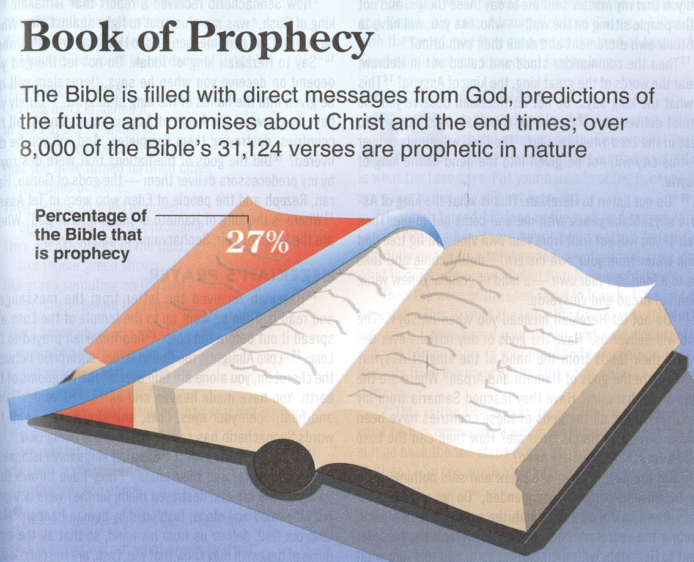

Slide 12
Common Prophetic Components
  The Lord Controls History is summed up in the phrase “thus says the Lord”
  Israel is an “Chosen Nation/People” thus with the blessings comes the need to keep God’s law
  The Rebellion of Israel as seen in their failure to obey God’s law
  Judgment to Come is warned
  Divine Compassion when judgment comes, God will not forget His people
  Call to Repentance
  Redemption and Restoration in not for those spoken to at least at a future time
  The Kingdom of God will be for all people

Slide 13
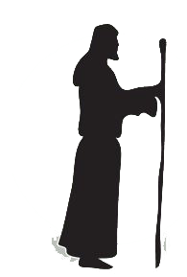
Time Range
Messianic Prophecy
Long Range
Medium Range
Prophet
Short Range
Or sign
Immediate
Or days
Within
Lifetime
Great span
Of time
Great time span
& offer hope of
a better day

Slide 14
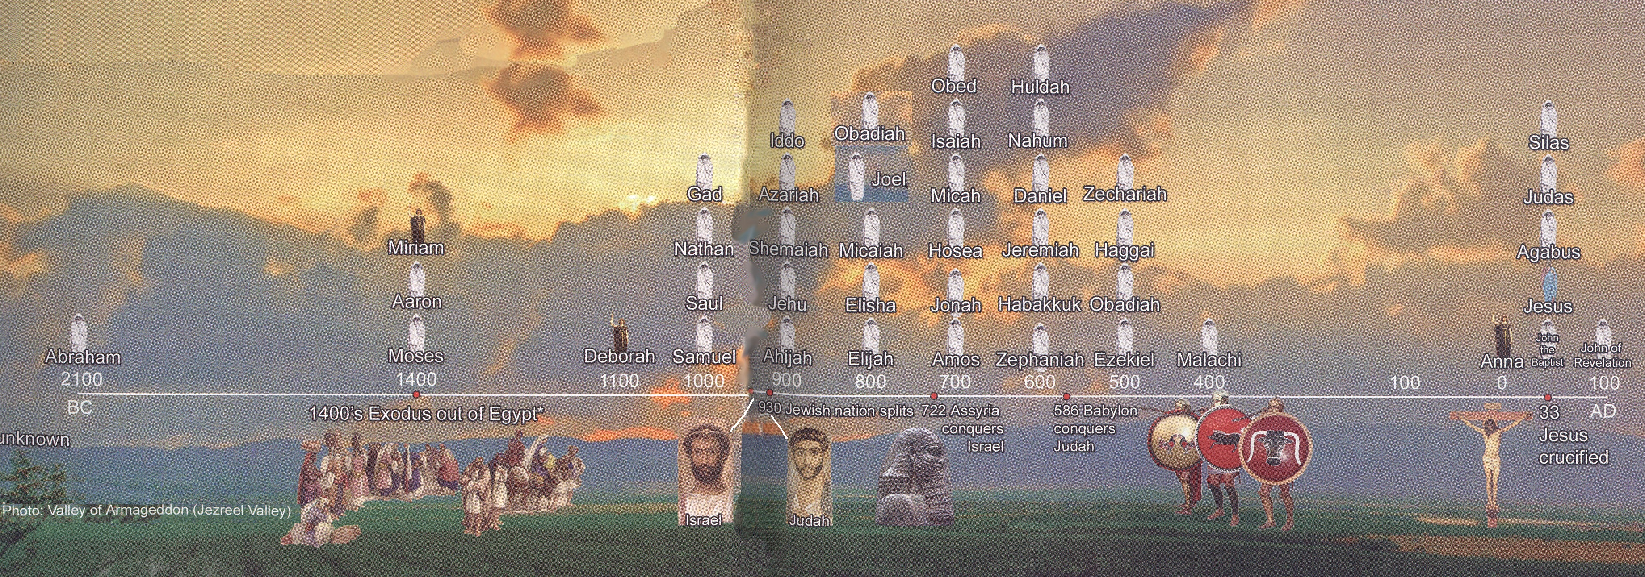
Prophets Time Line

Slide 15


Prophets Time Line
1000 years
700 years
David

Slide 16
Prophetic Waves
Assyrian Threat
Syrian Threat
Babylonian Threat
Romans
Moses
Exodus
Persian
Written
Israel Falls
Abraham
Judah Falls
Judges
Kingdom Divides
Captivity
& Return
United Kingdom
Oral
Greeks
2100
1400
1100
1000
900
800
700
600
500
400
100
0
~30
100
609
597
586
538
458
444
722
Christ
Exile
Return

Slide 17
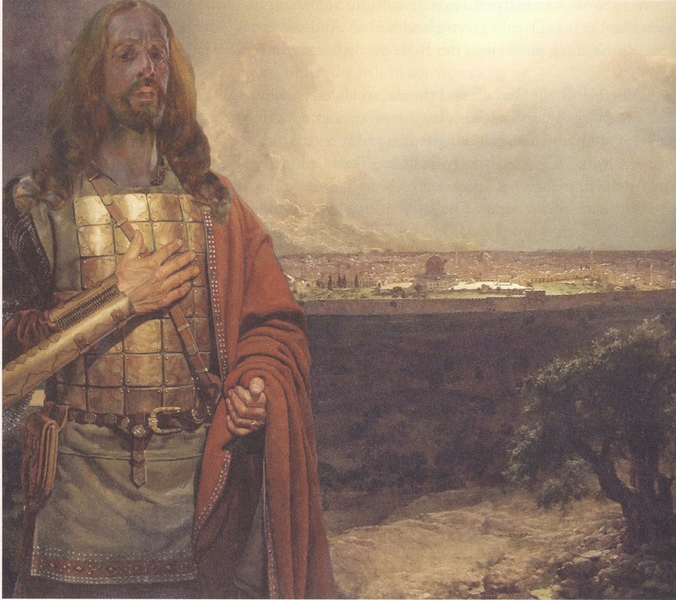
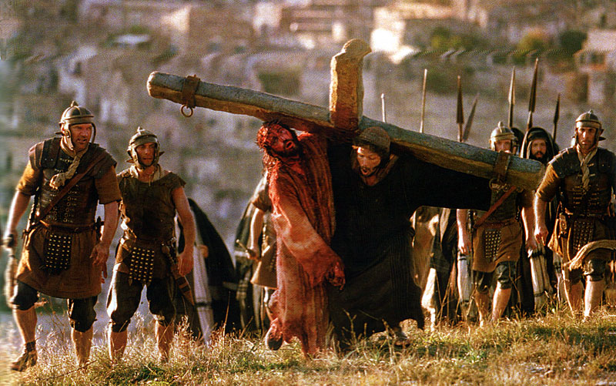
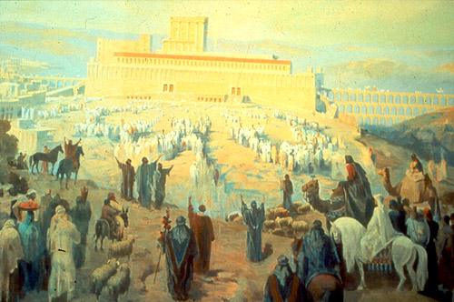
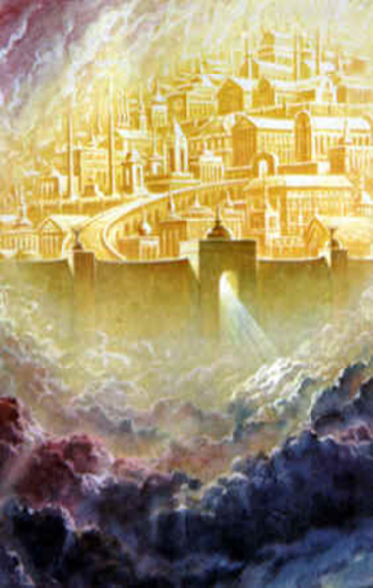
Messiah
A Warrior King or A Suffering Servant

Slide 18

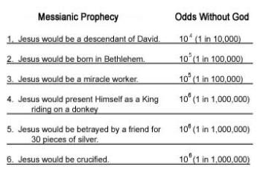

Messiah
Then
Today
God’s Eternal Purpose
Fulfilled
God Rules
God is Stronger than
  idols of other nations
Events due to God
Know God’s Power & Plan
Years
# | Prophecy | Scripture | Odds
1 | Born in Bethlehem | Micah 5:2 | 2.8 x 10⁵
2 | A Forerunner To Prepare the Way | Malachi 3:1 | 1 in 10³
3 | Enter Jerusalem as King on a Colt | Zechariah 9:9 | 1 in 10²
4 | Betrayed By Friend, Wounds In Hands | Zechariah 13:6 | 1 in 10³
5 | Betrayed for 30 Pieces of Silver | Zechariah 11:12 | 1 in 10³
6 | 30 Pieces Cast to Potter in Lord’s House | Zechariah 11:13 | 1 in 10⁵
7 | Oppressed and Afflicted, Yet Silent | Isaiah 53:7 | 1 in 10³
8 | Pierced Hands and Feet | Psalm 22:16 | 1 in 10⁴
700
400
500
700
1000
“We find that the chance that any man might have lived down to the present time and fulfilled all eight prophecies is 1 in 10¹⁷.”
-Peter W. Stoner
Quoted in Evidence That Demands A Verdict, p.167
God’s Eternal Purpose
Failed??
Prophecy applies to >2000 AD??
Still waiting for literal fulfillment??

Slide 19
“… Just the same chance that the prophets would have had in writing these eight prophecies and having them all come true in any one man, from their day to the present time, providing they wrote them in their own wisdom. Now these prophecies were either given by inspiration of God or the prophets just wrote them as they thought they should be. In such a case the prophets had just one chance in 10¹⁷ of having them come true in any man, but they all came true in Christ.”
-Peter W. Stoner
Quoted in Evidence That Demands A Verdict, p.167

Slide 20
“This means that the fulfillment of these eight prophecies alone proves that God inspired the writing of those prophecies to a definiteness which lacks only one change in 10¹⁷ of being absolute.”
-Peter W. Stoner

Slide 21
Virgin Birth
Matthew 1:18-25 (ESV)
¹⁸ Now the birth of Jesus Christ took place in this way. When his mother Mary had been betrothed to Joseph, before they came together she was found to be with child from the Holy Spirit.
¹⁹ And her husband Joseph, being a just man and unwilling to put her to shame, resolved to divorce her quietly.
²⁰ But as he considered these things, behold, an angel of the Lord appeared to him in a dream, saying,
“Joseph, son of David, do not fear to take Mary as your wife, for that which is conceived in her is from the Holy Spirit.
²¹ She will bear a son, and you shall call his name Jesus, for he will save his people from their sins.”
²² All this took place to fulfill what the Lord had spoken by the prophet:
²³ “Behold, the virgin shall conceive and bear a son, and they shall call his name Immanuel” (which means, God with us).
²⁴ When Joseph woke from sleep, he did as the angel of the Lord commanded him: he took his wife, ²⁵ but knew her not until she had given birth to a son. And he called his name Jesus.

Slide 22
Virgin Birth
Isaiah 7:14 (ESV) ¹⁴ Therefore the Lord himself will give you a sign. Behold, the virgin shall conceive and bear a son, and shall call his name Immanuel.
Isaiah 7:14 (NIV) ¹⁴ Therefore the Lord himself will give you a sign: The virgin will be with child and will give birth to a son, and will call him Immanuel.
Isaiah 7:14 (NKJV) ¹⁴ Therefore the Lord Himself will give you a sign: Behold, the virgin shall conceive and bear a Son, and shall call His name Immanuel.
Isaiah 7:14 (HCSB) ¹⁴ Therefore, the Lord Himself will give you a sign: The virgin will conceive, have a son, and name him Immanuel.
Isaiah 7:14 (TNIV) ¹⁴ Therefore the LORD himself will give you a sign: The virgin will conceive and give birth to a son, and will call him Immanuel.

Slide 23
Sermon by Peter
Acts 2:14-18 (NKJV) ¹⁴ But Peter, standing up with the eleven, raised his voice and said to them, "Men of Judea and all who dwell in Jerusalem, let this be known to you, and heed my words.
¹⁵ For these are not drunk, as you suppose, since it is only the third hour of the day.
¹⁶ But this is what was spoken by the prophet Joel:
¹⁷ 'And it shall come to pass in the last days, says God, That I will pour out of My Spirit on all flesh; Your sons and your daughters shall prophesy, Your young men shall see visions, Your old men shall dream dreams.
¹⁸ And on My menservants and on My maidservants I will pour out My Spirit in those days; And they shall prophesy….Joel 2:28-32

Slide 24
Sermon by Peter
Acts 2:22-28 (NKJV) ²² "Men of Israel, hear these words: Jesus of Nazareth, a Man attested by God to you by miracles, wonders, and signs which God did through Him in your midst, as you yourselves also know--
²³ Him, being delivered by the determined purpose and foreknowledge of God, you have taken by lawless hands, have crucified, and put to death;
²⁴ whom God raised up, having loosed the pains of death, because it was not possible that He should be held by it.
²⁵ For David says concerning Him: 'I foresaw the LORD always before my face, For He is at my right hand, that I may not be shaken.
²⁶ Therefore my heart rejoiced, and my tongue was glad;
Moreover my flesh also will rest in hope.
²⁷ For You will not leave my soul in Hades,
Nor will You allow Your Holy One to see corruption.
²⁸ You have made known to me the ways of life;
You will make me full of joy in Your presence.' Psalm 16:8-11

Slide 25
Sermon by Peter
Acts 2:29-39 (NKJV)
²⁹ "Men and brethren, let me speak freely to you of the patriarch David, that he is both dead and buried, and his tomb is with us to this day.
³⁰ Therefore, being a prophet, and knowing that God had sworn with an oath to him that of the fruit of his body, according to the flesh, He would raise up the Christ to sit on his throne,
³¹ he, foreseeing this, spoke concerning the resurrection of the Christ,
that His soul was not left in Hades, nor did His flesh see corruption.
³² This Jesus God has raised up, of which we are all witnesses.
³³ Therefore being exalted to the right hand of God, and having received from the Father the promise of the Holy Spirit, He poured out this which you now see and hear.
³⁴ For David did not ascend into the heavens, but he says himself:
'The LORD said to my Lord, "Sit at My right hand,
³⁵ Till I make Your enemies Your footstool." ' Psalm 110:1
³⁶ "Therefore let all the house of Israel know assuredly that God has made this Jesus, whom you crucified, both Lord and Christ."
³⁷ Now when they heard this, they were cut to the heart, and said to Peter and the rest of the apostles, "Men and brethren, what shall we do?"
³⁸ Then Peter said to them, "Repent, and let every one of you be baptized in the name of Jesus Christ for the remission of sins; and you shall receive the gift of the Holy Spirit.
³⁹ For the promise is to you and to your children, and to all who are afar off, as many as the Lord our God will call." Genesis 12:1-3

Slide 26
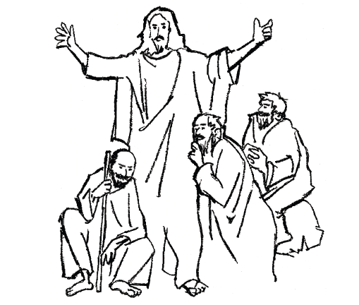
what Prophecy tells us about the Messiah
Is 7:14
___________________
virgin birth/Immanuel (God is with us)
Micah 5:2
___________________
But you, O Bethlehem
from you shall come forth for me
one who is to be ruler in Israel,
Is 53:3
___________________
He is despised and rejected by men
Is 53:6
___________________
the Lord has laid on him
the iniquity of us all
Is 53:12
___________________
And He was numbered with the transgressors
Zachariah 11:12
___________________
And they weighed out as my wages thirty pieces of silver.

Slide 27
what Prophecy tells us about the Messiah
1000 BC >>>>>>>> 30/33 AD
Ps 22:1
___________________
My God, my God,
why have you forsaken me?
Why are you so far from saving me,
from the words of my groaning?
Ps 16:10
___________________
For you will not abandon my soul to Sheol, or let your holy one see corruption
Ps 22:18
___________________
they divide my garments
among them,
and for my clothing
they cast lots
Ps 34:20
___________________
He keeps all his bones;
not one of them is broken
Ps 22:16
___________________
Ps 41:9
___________________
company of evildoers encircles me;
they have pierced my hands and feet
close friend in whom I trusted,
who ate my bread,
has lifted his heel against me

Slide 28

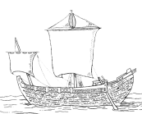








Paul’s Epistles
1 Thess ~50 AD
Gal ~53
1 Cor ~53-54
Phil ~55
Phmn~55
2 Cor ~55-56
Ro ~57
70 AD
Temple
Destroyed
27-30 AD
Ministry of Jesus
75 AD
100 AD
150 AD
200 AD
250 AD
25 AD
50 AD

Slide 29

Paul’s Epistles
1 Thess ~50 AD
Gal ~53
1 Cor ~53-54
Phil ~55
Phmn~55
2 Cor ~55-56
Ro ~57
70 AD
Temple
Destroyed
Polycarp
120 AD
Letter Quotes
16 NT Books
Clement
95 AD
Letter Quotes
10 NT Books
27-30 AD
Ministry of Jesus
75 AD
100 AD
150 AD
200 AD
250 AD
25 AD
50 AD
Tertullian (c. 150-c. 229) quotes from 23 of the 27 NT canon
AD 115,
Ignatius, bishop of Antioch,
Refers to “The Gospel” as
authoritative writing

Slide 30



100-200 AD
P104/ P. Oxy. 4404
Matthew 21
150-200 AD
P90 /P. Oxy. 3523
John 18-19
Paul’s Epistles
1 Thess ~50 AD
Gal ~53
1 Cor ~53-54
Phil ~55
Phmn~55
2 Cor ~55-56
Ro ~57
175-200 AD
Magdalen" papyrus
Matthew 3,5,26
70 AD
Temple
Destroyed
Polycarp
120 AD
Letter Quotes
16 NT Books
Clement
95 AD
Letter Quotes
10 NT Books
125-175 AD
J Ryland
John 18
27-30 AD
Ministry of Jesus
75 AD
100 AD
150 AD
200 AD
250 AD
25 AD
50 AD
Tertullian (c. 150-c. 229) quotes from 23 of the 27 NT canon
AD 105- 115
Ignatius, bishop of Antioch,
Refers to “The Gospel” as
authoritative writing

Slide 31
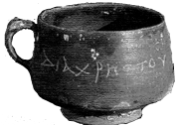
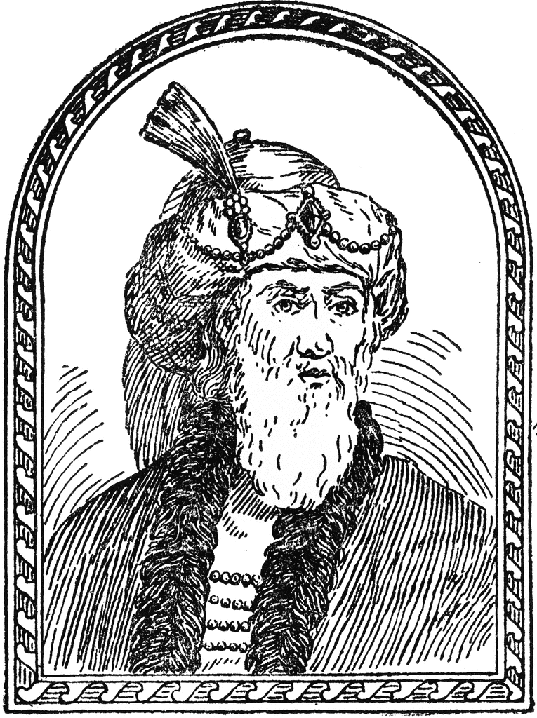

50 AD
Christ cup
Egypt
93 AD
Josephus
The Antiquities
100-200 AD
P104/ P. Oxy. 4404
Matthew 21
150-200 AD
P90 /P. Oxy. 3523
John 18-19
Paul’s Epistles
1 Thess ~50 AD
Gal ~53
1 Cor ~53-54
Phil ~55
Phmn~55
2 Cor ~55-56
Ro ~57
175-200 AD
Magdalen" papyrus
Matthew 3,5,26
70 AD
Temple
Destroyed
Polycarp
120 AD
Letter Quotes
16 NT Books
Clement
95 AD
Letter Quotes
10 NT Books
125-175 AD
J Ryland
John 18
27-30 AD
Ministry of Jesus
75 AD
100 AD
150 AD
200 AD
250 AD
25 AD
50 AD
28-29 AD
Death of
John The Baptist
Jesus ~30 AD
62 AD
Death of
James
Brother of Jesus
Tertullian (c. 150-c. 229) quotes from 23 of the 27 NT canon
AD 115,
Ignatius, bishop of Antioch,
Refers to “The Gospel” as
authoritative writing
Notes:
Suetonius Tranquillas (AD 69-160) wrote under the Roman emperor Hadrian, and he was a friend of Pliny the Younger. mentions early Christians and may refer to Jesus Christ in his work Lives of the Twelve Caesars, written in AD 121

Slide 32
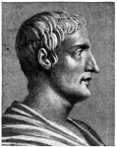
115 AD
Tacitus
Nero & Christians
50 AD
Christ cup
Egypt
93 AD
Josephus
The Antiquities
100-200 AD
P104/ P. Oxy. 4404
Matthew 21
150-200 AD
P90 /P. Oxy. 3523
John 18-19
Paul’s Epistles
1 Thess ~50 AD
Gal ~53
1 Cor ~53-54
Phil ~55
Phmn~55
2 Cor ~55-56
Ro ~57
175-200 AD
Magdalen" papyrus
Matthew 3,5,26
70 AD
Temple
Destroyed
Polycarp
120 AD
Letter Quotes
16 NT Books
Clement
95 AD
Letter Quotes
10 NT Books
125-175 AD
J Ryland
John 18
27-30 AD
Ministry of Jesus
75 AD
100 AD
150 AD
200 AD
250 AD
25 AD
50 AD
64 AD
28-29 AD
Death of
John The Baptist
Jesus ~30 AD
62 AD
Death of
James
Brother of Jesus
Tertullian (c. 150-c. 229) quotes from 23 of the 27 NT canon
AD 115,
Ignatius, bishop of Antioch,
Refers to “The Gospel” as
authoritative writing
Notes:
Suetonius Tranquillas (AD 69-160) wrote under the Roman emperor Hadrian, and he was a friend of Pliny the Younger. mentions early Christians and may refer to Jesus Christ in his work Lives of the Twelve Caesars, written in AD 121

Slide 33
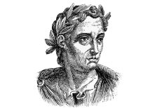

Mark 9:38-39 (NKJV) ³⁸ Now John answered Him, saying, "Teacher, we saw someone who does not follow us casting out demons in Your name, and we forbade him because he does not follow us."
³⁹ But Jesus said, "Do not forbid him, for no one who works a miracle in My name can soon afterward speak evil of Me.
111 AD
Pliny the Younger
Letter to Trajan
115 AD
Tacitus
Nero & Christians
121 AD
Suetonius
Claudius, Nero & Christians
50 AD
Christ cup
Egypt
93 AD
Josephus
The Antiquities
100-200 AD
P104/ P. Oxy. 4404
Matthew 21
150-200 AD
P90 /P. Oxy. 3523
John 18-19
Paul’s Epistles
1 Thess ~50 AD
Gal ~53
1 Cor ~53-54
Phil ~55
Phmn~55
2 Cor ~55-56
Ro ~57
175-200 AD
Magdalen" papyrus
Matthew 3,5,26
70 AD
Temple
Destroyed
Polycarp
120 AD
Letter Quotes
16 NT Books
Clement
95 AD
Letter Quotes
10 NT Books
125-175 AD
J Ryland
John 18
27-30 AD
Ministry of Jesus
75 AD
100 AD
150 AD
200 AD
250 AD
25 AD
50 AD
28-29 AD
Death of
John The Baptist
Jesus ~30 AD
~53 AD
Jews out Rome
62 AD
Death of
James
Brother of Jesus
Tertullian (c. 150-c. 229) quotes from 23 of the 27 NT canon
AD 115,
Ignatius, bishop of Antioch,
Refers to “The Gospel” as
authoritative writing
Notes:
Suetonius Tranquillas (AD 69-160) wrote under the Roman emperor Hadrian, and he was a friend of Pliny the Younger. mentions early Christians and may refer to Jesus Christ in his work Lives of the Twelve Caesars, written in AD 121

Slide 34
Written by Paul - Undisputed
Resurrection, Miracles, Deity
L07 First Epistle to the Thessalonians (51 AD) Danny H
L07 Epistle to the Galatians (47 (51-53)AD?) Joel Y
L11 First Epistle to the Corinthians (52-56 AD) Luke Rosetti
L11Second Epistle to the Corinthians (52-56 AD) Corey W
L08 Epistle to the Philippians (60-62 AD) Jana S, Chester T, Corey W, DeAnna B
L08 Epistle to Philemon (60-62 AD) Sara H
L13 Epistle to the Romans (52-57 AD) Marty B

Slide 35



~55 AD
Mark
~60 AD
Matthew
~62 AD
Luke
~90 AD
John
Paul’s Missionary
Journeys
1 st
45-46
AD
2 nd
48-51
AD
3 rd
52-57
AD
Paul’s Epistles
70 AD
Temple
Destroyed
27-30 AD
Gal ~53
Ro ~57
Ministry of Jesus
1 Thess ~50 AD
Phil ~55
Phmn~55
1 Cor ~53-54
2 Cor ~55-56
20AD
30AD
40 AD
50AD
60 AD
70 AD
80 AD
90 AD
100 AD
75-90AD
Matthew
90 AD
John
65-75 AD
Mark
80-95 AD
Luke

Slide 36
Galatians
Resurrection
Deity
Miracles
Galatians 2:2 (ESV) ² I went up because of a revelation and set before them (though privately before those who seemed influential) the gospel that I proclaim among the Gentiles, in order to make sure I was not running or had not run in vain.
Galatians 1:15-16 (ESV) ¹⁵ But when he who had set me apart before I was born, and who called me by his grace,
¹⁶ was pleased to reveal his Son to me, in order that I might preach him among the Gentiles, I did not immediately consult with anyone;
Galatians 1:1 (ESV) ¹ Paul, an apostle—not from men nor through man, but through Jesus Christ and God the Father, who raised him from the dead—
Galatians 1:3-4 (ESV) ³ Grace to you and peace from God our Father and the Lord Jesus Christ,
⁴ who gave himself for our sins to deliver us from the present evil age, according to the will of our God and Father,
Galatians 3:1 (ESV) ¹ O foolish Galatians! Who has bewitched you? It was before your eyes that Jesus Christ was publicly portrayed as crucified.
Galatians 2:7 (ESV) ⁷ On the contrary, when they saw that I had been entrusted with the gospel to the uncircumcised, just as Peter had been entrusted with the gospel to the circumcised
Galatians 2:20-21 (ESV) ²⁰ I have been crucified with Christ. It is no longer I who live, but Christ who lives in me. And the life I now live in the flesh I live by faith in the Son of God, who loved me and gave himself for me. ²¹ I do not nullify the grace of God, for if righteousness were through the law, then Christ died for no purpose.
Galatians 4:4-5 (ESV) ⁴ But when the fullness of time had come, God sent forth his Son, born of woman, born under the law, ⁵ to redeem those who were under the law, so that we might receive adoption as sons.
Notes:
Deity
Miracles
Resurrection

Slide 37
Galatians
Gospel
Galatians 2:2 (ESV) ² I went up because of a revelation and set before them (though privately before those who seemed influential) the gospel that I proclaim among the Gentiles, in order to make sure I was not running or had not run in vain.
Galatians 1:6-7 (ESV) ⁶ I am astonished that you are so quickly deserting him who called you in the grace of Christ and are turning to a different gospel—
⁷ not that there is another one, but there are some who trouble you and want to distort the gospel of Christ.
Galatians 1:11-12 (ESV) ¹¹ For I would have you know, brothers, that the gospel that was preached by me is not man’s gospel.
¹² For I did not receive it from any man, nor was I taught it, but I received it through a revelation of Jesus Christ.
Galatians 2:2 (ESV) ² I went up because of a revelation and… the gospel that I proclaim among the Gentiles, in order to make sure I was not running or had not run in vain.
Galatians 1:9 (ESV) ⁹ As we have said before, so now I say again: If anyone is preaching to you a gospel contrary to the one you received, let him be accursed.
Galatians 3:8 (ESV) ⁸ And the Scripture, foreseeing that God would justify the Gentiles by faith, preached the gospel beforehand to Abraham, saying, “In you shall all the nations be blessed.”
Galatians 2:7 (ESV) ⁷ …that I had been entrusted with the gospel to the uncircumcised, just as Peter had been entrusted with the gospel to the circumcised
Galatians 2:7 (ESV) ⁷ On the contrary, when they saw that I had been entrusted with the gospel to the uncircumcised, just as Peter had been entrusted with the gospel to the circumcised
What is the Gospel?
Galatians 3:13-14 (ESV) ¹³ Christ redeemed us from the curse of the law by becoming a curse for us—for it is written, “Cursed is everyone who is hanged on a tree”—
¹⁴ so that in Christ Jesus the blessing of Abraham might come to the Gentiles, so that we might receive the promised Spirit through faith.
Notes:
Deity
Miracles
Resurrection

Slide 38
Gospel Preached by Paul
1 Corinthians 15:1-8 (ESV)
¹ Now I would remind you, brothers, of the gospel I preached to you, which you received, in which you stand,
² and by which you are being saved, if you hold fast to the word I preached to you—unless you believed in vain.
³ For I delivered to you as of first importance what I also received:
that Christ died for our sins in accordance with the Scriptures,
⁴ that he was buried, that he was raised on the third day in accordance with the Scriptures,
⁵ and that he appeared to Cephas, then to the twelve.
⁶ Then he appeared to more than five hundred brothers at one time, most of whom are still alive, though some have fallen asleep.
⁷ Then he appeared to James, then to all the apostles.
⁸ Last of all, as to one untimely born, he appeared also to me.
Notes:
Deity
Miracles
Resurrection

Slide 39
I Thessalonians
1 Thessalonians 1:5 (ESV) because our gospel came to you not only in word, but also in power and in the Holy Spirit and with full conviction. You know what kind of men we proved to be among you for your sake.
1 Thessalonians 1:9-10 (ESV) ⁹ For they themselves report concerning us the kind of reception we had among you, and how you turned to God from idols to serve the living and true God, ¹⁰ and to wait for his Son from heaven, whom he raised from the dead, Jesus who delivers us from the wrath to come.
1 Thessalonians 2:4 (ESV) ⁴ but just as we have been approved by God to be entrusted with the gospel, so we speak, not to please man, but to please God who tests our hearts.
1 Thessalonians 2:6 (ESV) ⁶ Nor did we seek glory from people, whether from you or from others, though we could have made demands as apostles of Christ.
1 Thessalonians 2:8 (ESV) ⁸ So, being affectionately desirous of you, we were ready to share with you not only the gospel of God but also our own selves, because you had become very dear to us.

Slide 40
I Thessalonians
1 Thessalonians 2:14-16 (ESV) ¹⁴ For you, brothers, became imitators of the churches of God in Christ Jesus that are in Judea. For you suffered the same things from your own countrymen as they did from the Jews,
¹⁵ who killed both the Lord Jesus and the prophets, and drove us out, and displease God and oppose all mankind
¹⁶ by hindering us from speaking to the Gentiles that they might be saved—so as always to fill up the measure of their sins. But wrath has come upon them at last!
1 Thessalonians 3:2 (ESV) ² and we sent Timothy, our brother and God’s coworker in the gospel of Christ, to establish and exhort you in your faith,
1 Thessalonians 3:11-13 (ESV) ¹¹ Now may our God and Father himself, and our Lord Jesus, direct our way to you,
¹² and may the Lord make you increase and abound in love for one another and for all, as we do for you,
¹³ so that he may establish your hearts blameless in holiness before our God and Father, at the coming of our Lord Jesus with all his saints.
1 Thessalonians 4:1-3 (ESV)
² For you know what instructions we gave you through the Lord Jesus.
³ For this is the will of God, your sanctification: that you abstain from sexual immorality;
Notes:
Deity
Miracles
Resurrection

Slide 41
I Thessalonians
1 Thessalonians 4:14-16 (ESV) ¹⁴ For since we believe that Jesus died and rose again, even so, through Jesus, God will bring with him those who have fallen asleep.
¹⁵ For this we declare to you by a word from the Lord, that we who are alive, who are left until the coming of the Lord, will not precede those who have fallen asleep.
¹⁶ For the Lord himself will descend from heaven with a cry of command, with the voice of an archangel, and with the sound of the trumpet of God. And the dead in Christ will rise first.
1 Thessalonians 5:9-10 (ESV) ⁹ For God has not destined us for wrath, but to obtain salvation through our Lord Jesus Christ,
¹⁰ who died for us so that whether we are awake or asleep we might live with him.
1 Thessalonians 5:23 (ESV) ²³ Now may the God of peace himself sanctify you completely, and may your whole spirit and soul and body be kept blameless at the coming of our Lord Jesus Christ.
Notes:
Deity
Miracles
Resurrection

Slide 42
Philippians
Notes:
Deity
Miracles
Resurrection

Slide 43
Philippians
a "case study" of a crucial passage that comprises a particularly revealing "window" upon early Christian belief and piety, especially with reference to the place of Jesus in early Christian faith and practice.'
Philippians 2:5-11 (ESV) ⁵ Have this mind among yourselves, which is yours in Christ Jesus,
⁶ who, though he was in the form of God,
did not count equality with God a thing to be grasped,
⁷ but emptied himself,
by taking the form of a servant,
being born in the likeness of men.
⁸ And being found in human form,
he humbled himself by becoming obedient to the point of death,
even death on a cross.
⁹ Therefore God has highly exalted him
and bestowed on him the name that is above every name,
¹⁰ so that at the name of Jesus every knee should bow,
in heaven and on earth and under the earth,
¹¹ and every tongue confess that Jesus Christ is Lord, to the glory of God the Father.
Notes:
Deity
Miracles
Resurrection

Slide 44
Philemon
Notes:
Deity
Miracles
Resurrection

Slide 45
II Thessalonians
2 Thessalonians 1:1-2 (ESV) ¹ Paul, Silvanus, and Timothy, To the church of the Thessalonians in God our Father and the Lord Jesus Christ:
² Grace to you and peace from God our Father and the Lord Jesus Christ.
2 Thessalonians 1:7-8 (ESV) ⁷ and to grant relief to you who are afflicted as well as to us, when the Lord Jesus is revealed from heaven with his mighty angels ⁸ in flaming fire, inflicting vengeance on those who do not know God and on those who do not obey the gospel of our Lord Jesus.
2 Thessalonians 1:12 (ESV) ¹² so that the name of our Lord Jesus may be glorified in you, and you in him, according to the grace of our God and the Lord Jesus Christ.
2 Thessalonians 2:13-14 (ESV) ¹³ But we ought always to give thanks to God for you, brothers beloved by the Lord, because God chose you as the first fruits to be saved, through sanctification by the Spirit and belief in the truth. ¹⁴ To this he called you through our gospel, so that you may obtain the glory of our Lord Jesus Christ.
2 Thessalonians 2:16-17 (ESV) ¹⁶ Now may our Lord Jesus Christ himself, and God our Father, who loved us and gave us eternal comfort and good hope through grace,
¹⁷ comfort your hearts and establish them in every good work and word.
Notes:
Deity
Miracles
Resurrection

Slide 46
II Thessalonians
2 Thessalonians 3:5 (ESV) ⁵ May the Lord direct your hearts to the love of God and to the steadfastness of Christ.
2 Thessalonians 3:6 (ESV) ⁶ Now we command you, brothers, in the name of our Lord Jesus Christ, that you keep away from any brother who is walking in idleness and not in accord with the tradition that you received from us.
2 Thessalonians 3:12 (ESV) ¹² Now such persons we command and encourage in the Lord Jesus Christ to do their work quietly and to earn their own living.
2 Thessalonians 3:17-18 (ESV) ¹⁷ I, Paul, write this greeting with my own hand. This is the sign of genuineness in every letter of mine; it is the way I write.
¹⁸ The grace of our Lord Jesus Christ be with you all.
Notes:
Deity
Miracles
Resurrection

