Slide 1
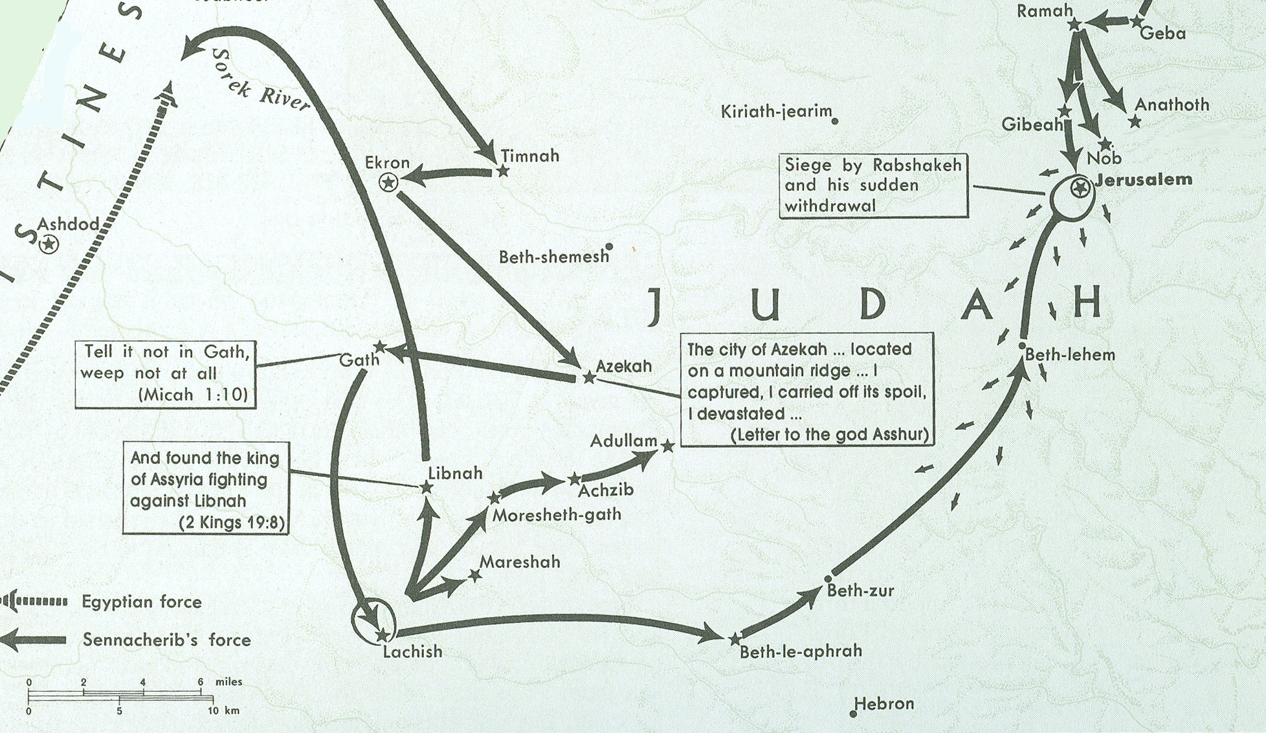
Sennacherib in Philistia & Judah 701 BC
Micah 5
¹ Now gather yourself in troops,
O daughter of troops;
He has laid siege against us;
They will strike the judge of Israel with a rod on the cheek.
² “But you, Bethlehem Ephrathah,
Though you are little among the thousands of Judah,
Yet out of you shall come forth to Me
The One to be Ruler in Israel,
Whose goings forth are from of old,
From everlasting.”
Beth-le-aphrah/ophrah

Slide 2
Who is speaking in verses 6:1 thru 5?
¹Hear now what the Lord says:
“Arise, plead your case before the mountains,
And let the hills hear your voice.
² Hear, O you mountains, the Lord’S complaint,
And you strong foundations of the earth;
For the Lord has a complaint against His people,
And He will contend with Israel.
³ “O My people, what have I done to you?
And how have I wearied you?
Testify against Me.
⁴ For I brought you up from the land of Egypt,
I redeemed you from the house of bondage;
And I sent before you Moses, Aaron, and Miriam.
⁵ O My people, remember now
What Balak king of Moab counseled,
And what Balaam the son of Beor answered him,
From Acacia Grove to Gilgal,
That you may know the righteousness of the Lord.”
God is Lord Of History
Election of Israel
Rebellion of Israel
Election of Israel
God is Lord Of History
Judgment of God

Slide 3
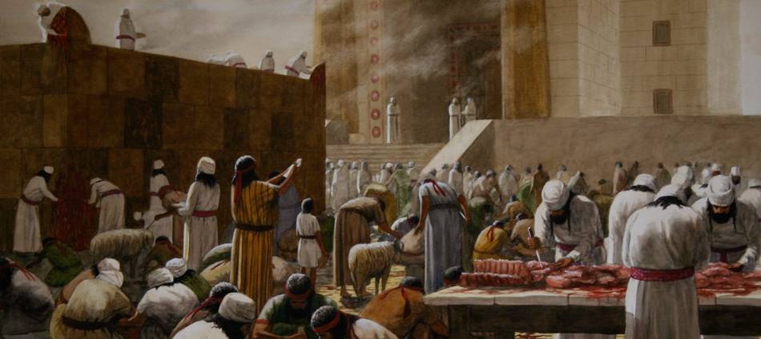
Who is His Audience 6:6 thru 7?
6 With what shall I come before the Lord,
And bow myself before the High God?
Shall I come before Him with burnt offerings,
With calves a year old?
7 Will the Lord be pleased with thousands of rams,
Ten thousand rivers of oil?
Shall I give my firstborn for my transgression,
The fruit of my body for the sin of my soul?
8 He has shown you, O man, what is good;
And what does the Lord require of you
But to do justly,
To love mercy,
And to walk humbly with your God?

Slide 4
What is their question to the Lord?
6 With what shall I come before the Lord,
And bow myself before the High God?
Shall I come before Him with burnt offerings,
With calves a year old?
7 Will the Lord be pleased with thousands of rams,
Ten thousand rivers of oil?
Shall I give my firstborn for my transgression,
The fruit of my body for the sin of my soul?
8 He has shown you, O man, what is good;
And what does the Lord require of you
But to do justly,
To love mercy,
And to walk humbly with your God?

Slide 5
What is their understanding of the Lord?
6 With what shall I come before the Lord,
And bow myself before the High God?
Shall I come before Him with burnt offerings,
With calves a year old?
7 Will the Lord be pleased with thousands of rams,
Ten thousand rivers of oil?
Shall I give my firstborn for my transgression,
The fruit of my body for the sin of my soul?
8 He has shown you, O man, what is good;
And what does the Lord require of you
But to do justly,
To love mercy,
And to walk humbly with your God?

Slide 6
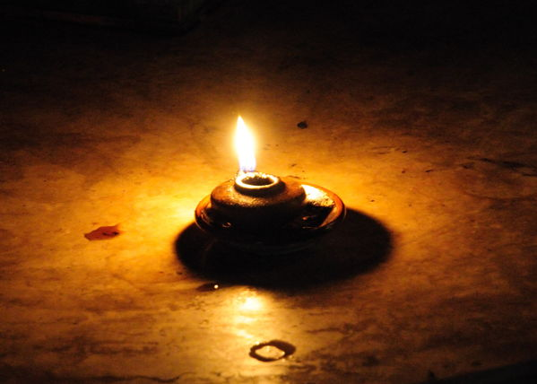
What is the attitude of the God-fearing individual as expressed in verses 7 to 8?
Micah 7
⁷ Therefore I will look to the Lord;
I will wait for the God of my salvation;
My God will hear me.
⁸ Do not rejoice over me, my enemy;
When I fall, I will arise;
When I sit in darkness,
The Lord will be a light to me.

Slide 7
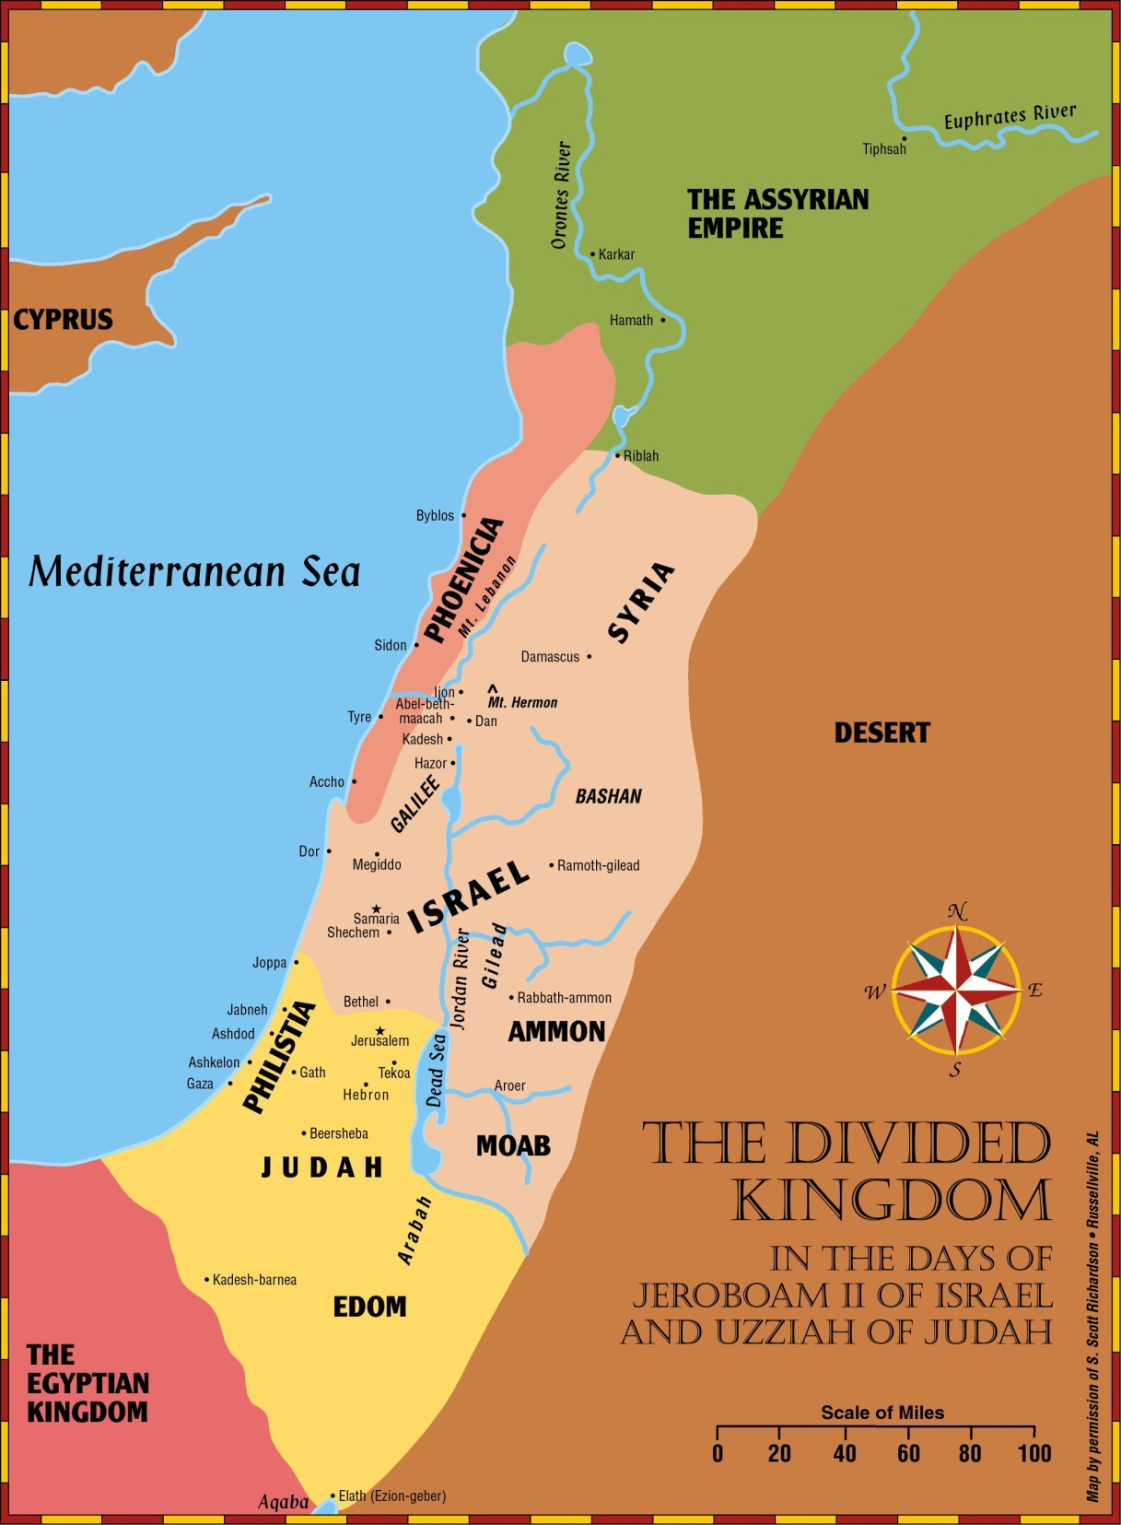
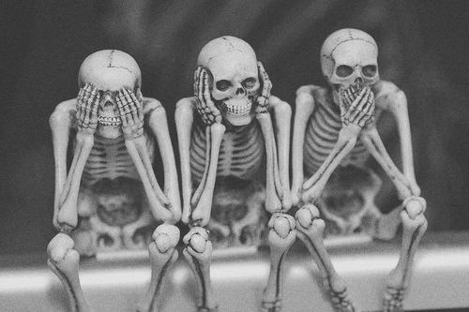
How will the other nations react to that as stated in verses 16 to 17?
Micah 7
¹⁶ The nations shall see and be ashamed of all their might;
They shall put their hand over their mouth;
Their ears shall be deaf.
¹⁷ They shall lick the dust like a serpent;
They shall crawl from their holes like snakes of the earth.
They shall be afraid of the Lord our God,
And shall fear because of You.

Slide 8
Lesson 8
Isaiah & Hezekiah

Slide 9
Kings of United & Divided Kingdom
United
Kingdom
Divided Kingdom
Judah Alone
Early Kings – Israel
Dynasty 1&2
Omri
Dynasty 3
Jehu
Dynasty 4
Confusing
Dynasties
Hezekiah
Hezekiah
(728-686)
Manasseh
Amon
1
Jereboam
Nadab
3
Omri
Ahab
(874-853)
Ahaziah
Jehoram
4
Jehu
(841-814)
Jehoahaz
Jehoash
Jereboam II
(793-753)
Zechariah
Shallum
Menahem
Pekaiah
Pekah
Hosea
(732-722)
5
Saul
(1050-1010)
David
(1010-970)
Solomon
(970-930)
2
Baasha
Elah
Josiah &
Sons
Zimri ~ 885
Tibni
Josiah
(640-609)
Jehoahaz
Jehoiakim
Jehoiachin
Zedekiah
(597-586)
Early Kings – Judah
Dynasty 1&2
Omri
Dynasty 3
Jehu
Dynasty 4
Confusing
Dynasties
Rehoboam
Abijam
Asa
(930-870)
Jehosphat
(873-848)
Jehoram
Ahaziah
Athaliah
Joash
Amaziah
Azariah/Uzziah
(790-739)
Jotham
Ahaz
Hezekiah
Judah Return
Zerubbabel (538-515)
Ezra (458-456)
Nehemiah (444-432)

Slide 11
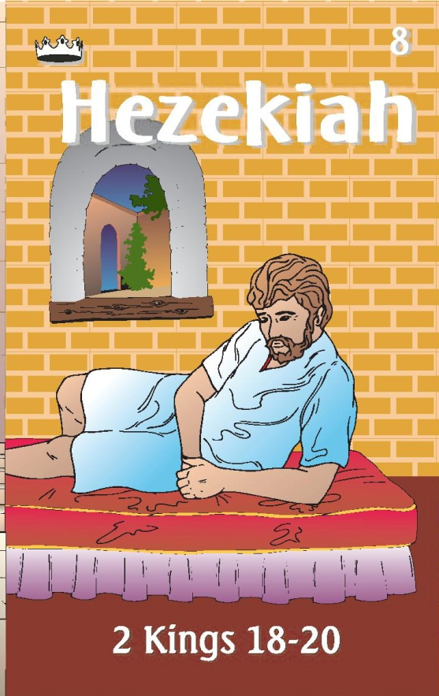
#13 Hezekiah Card
Kings of Israel
Hoshea
did not do what was right in the eyes of the Lord, as his father David had done, but he walked in ways of the kings of Israel. He made metal images for the Baals
728 -686
Prophets
Turned to idolatry and worship of Baal
burned his sons as an offering
Sent to Assyria for help against Israel & Syria
Shut up Lord’s house
Isaiah (J)
Micah (J)
CONFUSING DYNASTY
HEZEKIAH

Slide 12
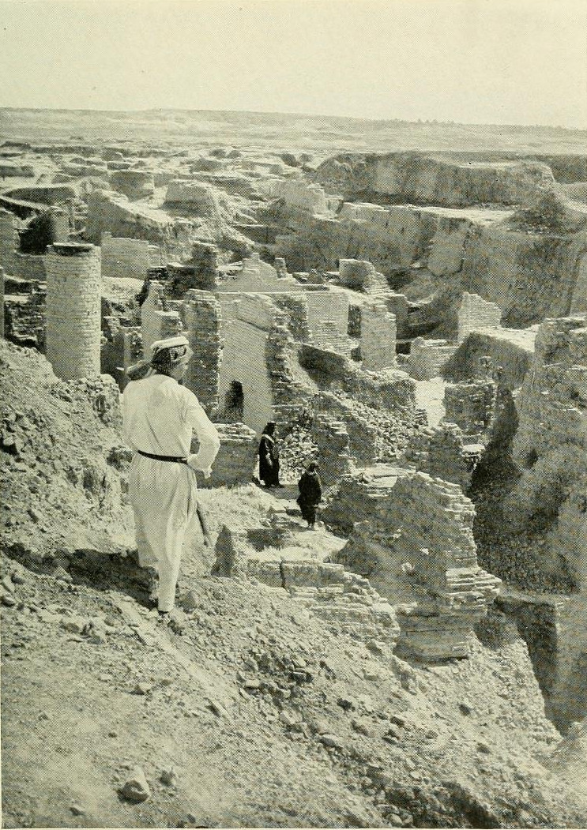
Return from Captivity
Can this be rebuilt?
Why did Jehovah let this happen?
What about a king?
What about the temple?
What do I do to keep this from happening again?

Slide 13
The Role of the Prophets
They are Spokesmen for God, serving as “forthtellers,” speaking what God put in their mouth.
They are Preachers of the Covenant, relating their message to God’s previous promises to the nation of Israel. These covenants were made with or through Abraham, Moses, and David
They are historians, or Interpreters of the Israelites’ History. With out their interpretation God’s people would not know why an event was occurring.

Slide 14
God’s Test for a Prophet
Deuteronomy 18:18-22(ESV) ¹⁸I will raise up for them a prophet like you from among their brothers.
And I will put my words in his mouth, and he shall speak to them
all that I command him.
¹⁹And whoever will not listen to my words that he shall speak in my name, I myself will require it of him.
²⁰But the prophet who presumes to speak a word in my name that I have not commanded him to speak, or who speaks in the name of other gods, that same prophet shall die.’
²¹And if you say in your heart, ‘How may we know the word that the Lord has not spoken?’—
²² when a prophet speaks in the name of the Lord, if the word does not come to pass or come true, that is a word that the Lord has not spoken; the prophet has spoken it presumptuously. You need not be afraid of him.

Slide 15
Ahijah
Jehu
Man of God
Micaiah
Man of God
Syria
Shemaiah
Azariah
Hanani
Assyria
Babylon/Persia

Slide 16
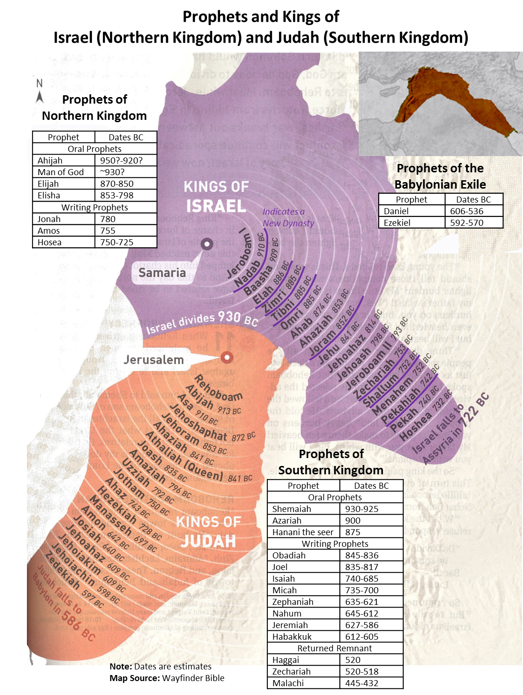

Slide 17
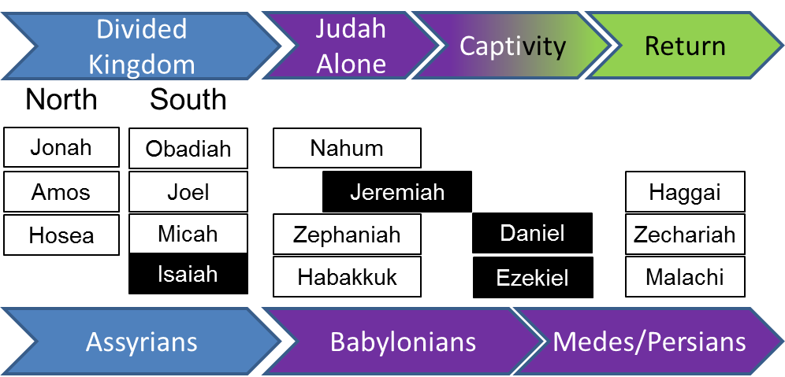

Slide 18
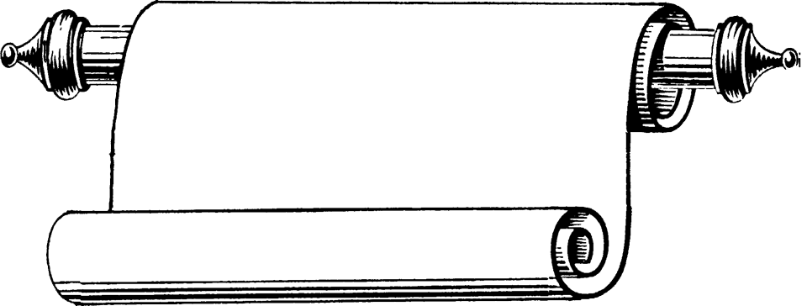
Edomites invaded Judah just as Judah was being ransacked - prophesies Edom's downfall
The
Judges
OBADIAH
845 Edom
JOEL
Judah see severe locust plague as a coming
Day of the LORD
830
Told to preach in Nineveh resulted in his being swallowed by a fish & city repenting
Kings & Prophets
JONAH
780 Nineveh
Israel, repent of injustice and idolatry or else go into exile
AMOS
Divided Kingdom
Israel & Judah
755
HOSEA
His life with adulterous wife like God & Israel
750-725
MICAH
Judah, repent of injustice and idolatry or else go into exile
735-700
ISAIAH
Isaiah 1-6 Reason for God’s Actions &
Isaiah’s Call
Isaiah 7-35 Immediate threat & Judgments
Isaiah 36-39 Historical account of siege
Isaiah 40-66 Cyrus, Future Threats & Hopes
740-690

Slide 19
Kings & Prophets
NAHUM
Divided Kingdom
Judah Alone
& Fall of Judah
The prophet predicts the fall of Nineveh
630-612 Nineveh
ZEPHANIAH
Prophet emphasizes the need for the people of Judah to turn away from idolatry
630-625
HABAKKUK
"Why do the wicked and cruel Babylonians go unpunished?" Prophet finds his answer in God's goodness and wisdom
612-606
Jer 1-20 Sermons & prophecies during Josiah
Jer 21-39 Prophecies of Specific Events
Jer 40-45 Sermons after fall of Israel
Jer 46-51 God’s Judgment on Foreign Nations
Jer 52 Fall of Jerusalem
JEREMIAH
627-586
LAMENTATIONS
Jeremiah cries from the depths of his heart over the destruction of Jerusalem
586

Slide 20
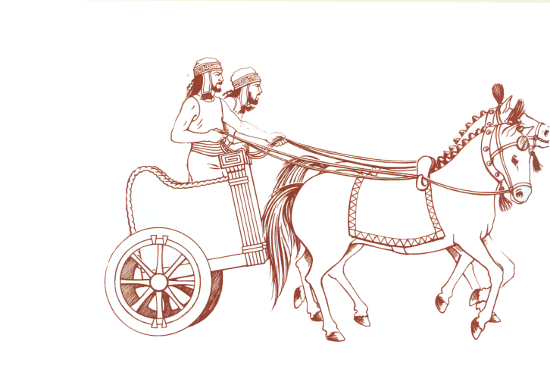
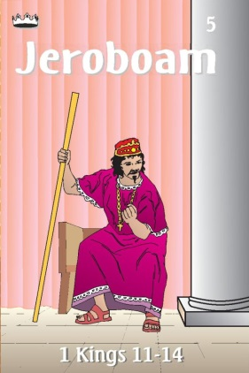
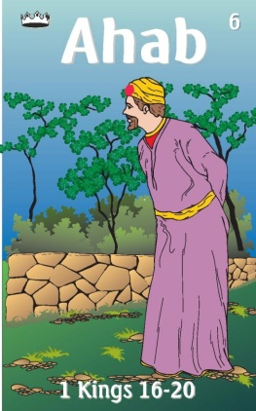
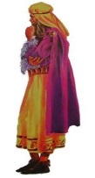
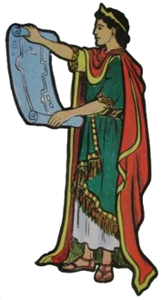
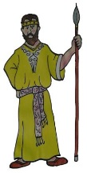
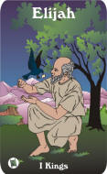
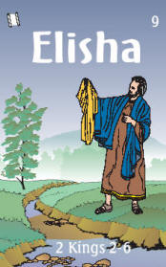
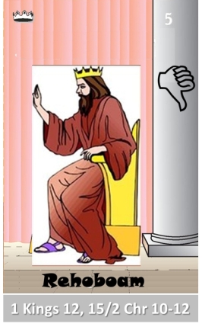
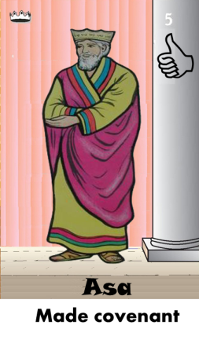
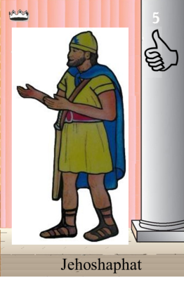
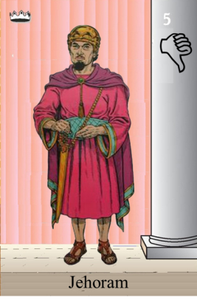
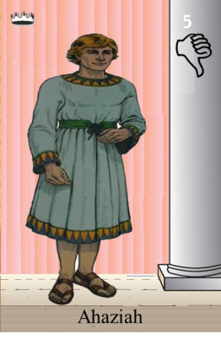
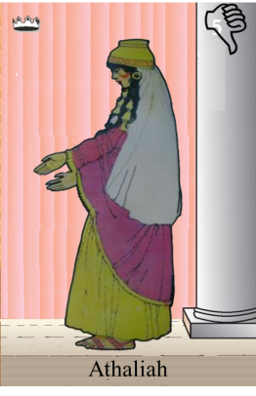
Ahaziah
Jehoram
Killed by Jehu
Baasha
Jehu
Ahijah
Man of God
Rocks for
Mizpah & Geba
Early Kings
Omri Kings
Jehu Kings
Brings in Syria
Obadiah - 830
Killed by Jehu
Shemaiah
Azariah
Hanani the Seer

Slide 21
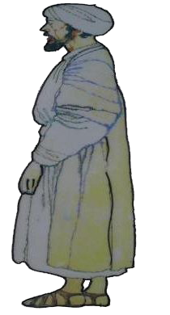
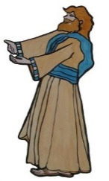
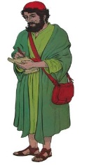
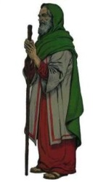
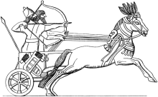
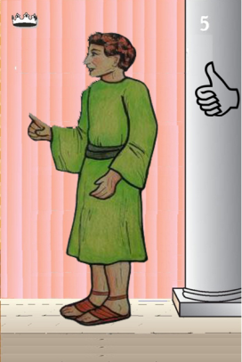
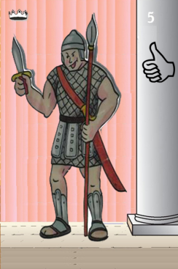
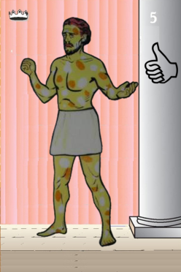
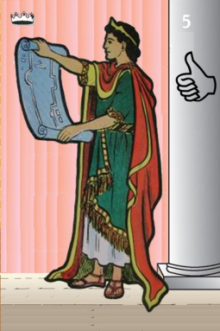
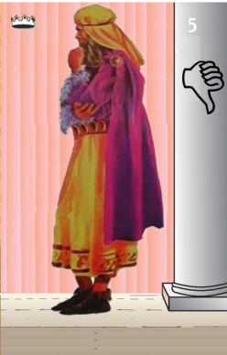
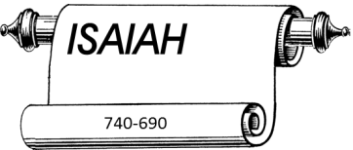
Jehu
841-814
Jehoahaz
Jehoash
Elisha &
the Arrows
Jeroboam II
Zechariah
Tiglath-pileser III
(745–727 b.c.)
793-753
Jehu Kings
Confusing
Brings in Assyria
Joash
Amaziah
Uzziah
Jotham
Ahaz
Jehoiada Made covenant

Slide 22
Confusing
Judah Alone
Tiglath-pileser III
(745–727 b.c.)
Shallum 752
Menahem 752-742
Pekahiah 742-740
Pekah(752) 740-732
Hoshea 732-722
Uzziah
Jotham
Ahaz

Slide 23
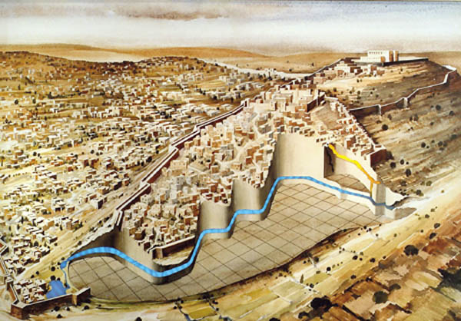
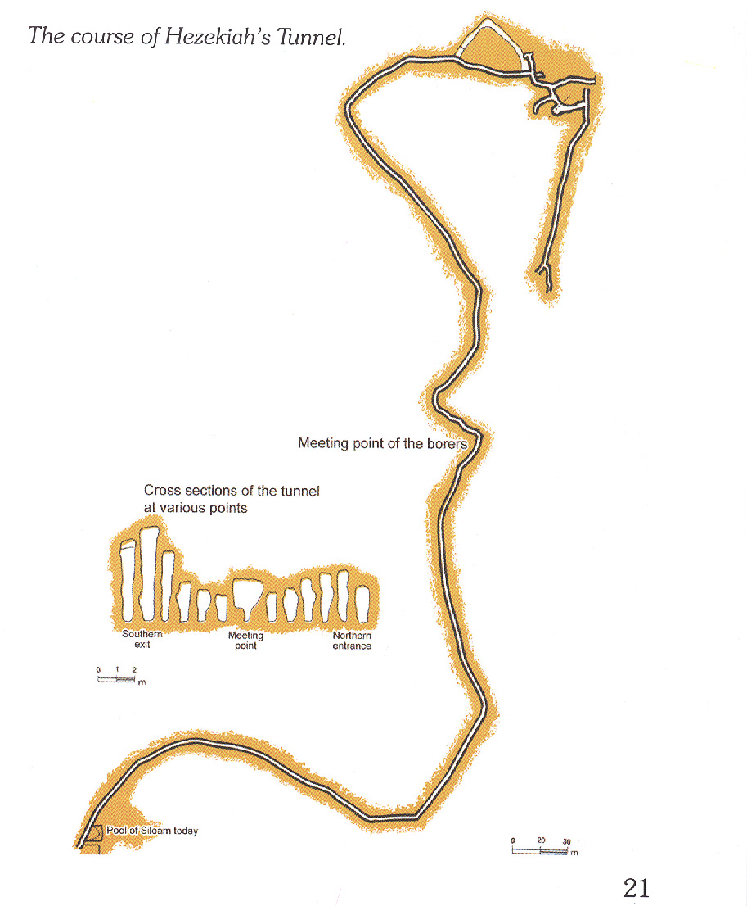
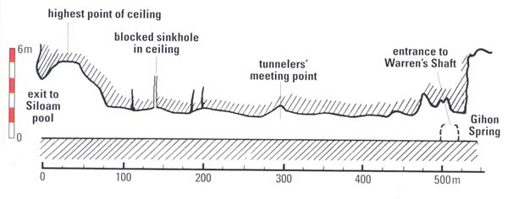
Side View of the Tunnel
Copyright 1995 Hebrew University of Jerusalem

Slide 24
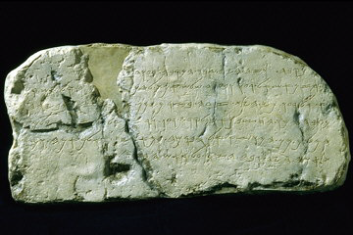
Siloam Inscription

Slide 25
Life of Hezekiah; Bible Conflict? 728 or 725 BC?
2 Kings 18:13(ESV) In the fourteenth year of King Hezekiah, Sennacherib king of Assyria came up against all the fortified cities of Judah and took them.
2 Kings 18:10(ESV) and at the end of three years he took it. In the sixth year of Hezekiah, which was the ninth year of Hoshea king of Israel, Samaria was taken.
Sargon attacks Philistines
728
722
720
714/12
711/709
701
686
Hezekiah
Dies
2 Kings 18:13(ESV) In the fourteenth year (life extended) of King Hezekiah, Sennacherib king of Assyria came up against all the fortified cities of Judah and took them.
Hezekiah submits
Ashdod
Philistines
fall
11 yrs old
4th yr- Samaria
Under Siege
Sennacherib
attacks
6th yr- Samaria
Taken by Shalmaneser
Sargon II
(722–705 b.c.)
Manasseh born
12 yrs old
3rd yr
Hoshea
Hezekiah Rules alone
715 BC
2 Kings 21:1-2 (ESV) ¹ Manasseh was twelve years old when he began to reign, and he reigned fifty-five years in Jerusalem. His mother’s name was Hephzibah. ² And he did what was evil in the sight of the LORD, according to the despicable practices of the nations whom the LORD drove out before the people of Israel.
2 Kings 18:1-2(ESV) ¹In the third year of Hoshea son of Elah, king of Israel, Hezekiah the son of Ahaz, king of Judah, began to reign. ²He was twenty-five years old when he began to reign, and he reigned twenty-nine years in Jerusalem. His mother’s name was Abi the daughter of Zechariah.

Slide 26
Outline of Book
Message of Isaiah: Israel/Judah in Crisis
Consequences of Rebellion, Reasons for God’s Actions, God’s Offer & Isaiah’s Call 1-6
Future Threat
from Babylon…
The immediate threat…
Syria, Israel 7-12
Jerusalem 28-30
Assyria 31-35
Cyrus and deliverance
from captivity 40-48
Real Problem for Crisis
Bondage to Sin &
not Bondage to Babylon 49-57
Judgment on
Nations 13-23
World 24-27
Historical
Account
Conditions of Future
Redemption & Glory
58-66
Sennacherib’s Invasion 36-37
Illness of Hezekiah
38-39
I Prophecies of Condemnation (1:1–35:10)
II Hezekiah’s Life (36:1–39:8)
III Prophecies of Comfort (40:1–66:24

Slide 27
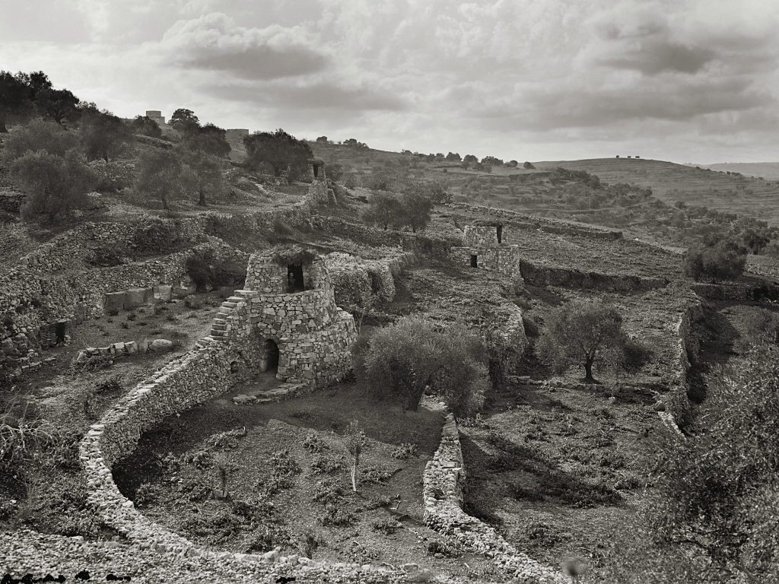
Vineyard with watchtowers
Isaiah 5:1-4(ESV) ¹ Let me sing for my beloved
my love song concerning his vineyard:
My beloved had a vineyard on a very fertile hill. ² He dug it and cleared it of stones,
and planted it with choice vines;
he built a watchtower in the midst of it,
and hewed out a wine vat in it;
and he looked for it to yield grapes,
but it yielded wild grapes. ³ And now, O inhabitants of Jerusalem
and men of Judah,
judge between me and my vineyard. ⁴ What more was there to do for my vineyard,
that I have not done in it?
When I looked for it to yield grapes,
why did it yield wild grapes?
Vineyard with watchtowers
Notes:
“There is scarcely any region in the world more admirably adapted for wine culture than Palestine, with the exception only of its maritime plains, and the Jordan valley. It is the true climate of the Vine. The rocky hill-sides, with their light gravelly soil and sunny exposures, the heat of summer, and the rapid drainage of the winter rains, all combine to render it peculiarly a land of vines. The hill country presents in combination all the features characteristic of the choicest wine districts of the Rhine, of France, and Spain; and not only Judah, but all the land from Lebanon to Beersheba, was once clad on every hill with terraced vineyards, which have left behind them the traces of their existence in the winepresses and vats hewn in the rocks” (Tristram 1868: 404).
Date of photograph: between 1920 and 1933
mat02970

Slide 28
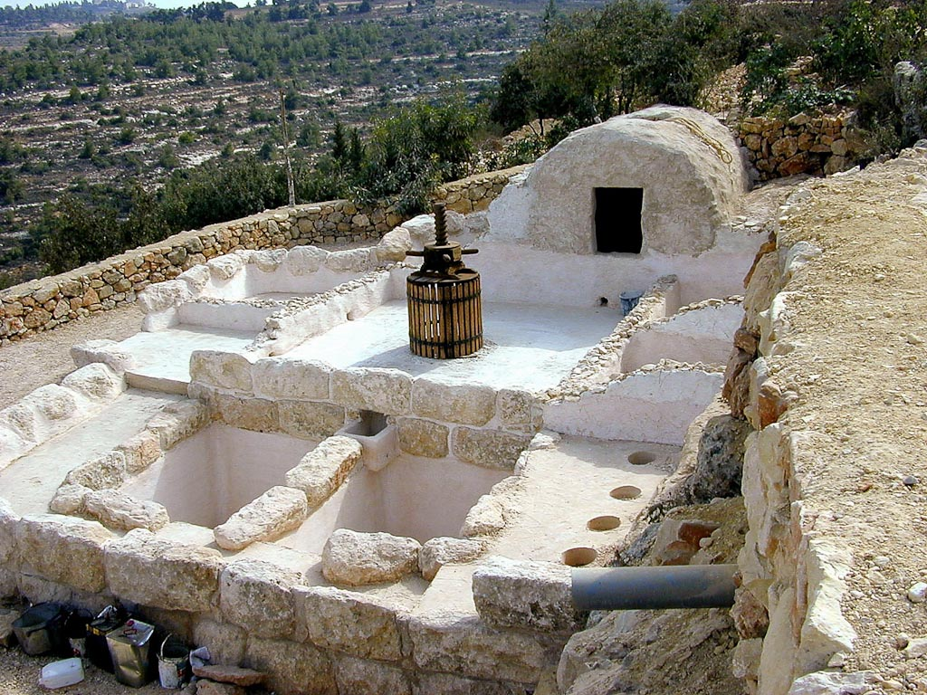
² He dug it and cleared it of stones,
and planted it with choice vines;
he built a watchtower in the midst of it,
and hewed out a wine vat in it;
Winepress at Yad HaShmonah
Notes:
tb101500100

Slide 29
and he looked for it to yield grapes,
but it yielded wild grapes.
Harvesting grapes in vineyard
Notes:
Jeremiah 31:29 (NET) ““When that time comes, people will no longer say, ‘The parents have eaten sour grapes, but the children’s teeth have grown numb.’”
tb092506849

Slide 30
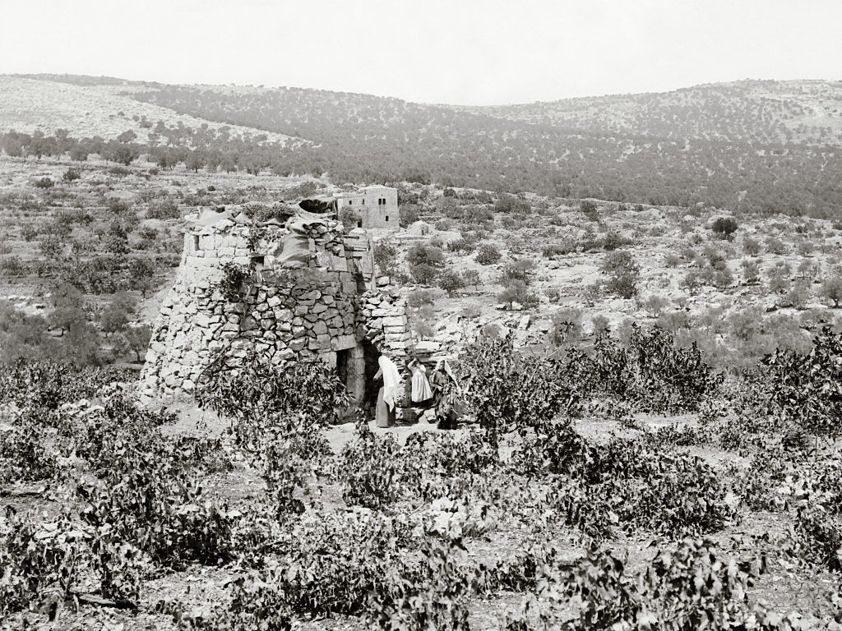
Watchtower in vineyard
Judgment
Isaiah 5:5-6(ESV) ⁵ And now I will tell you
what I will do to my vineyard.
I will remove its hedge,
and it shall be devoured;
I will break down its wall,
and it shall be trampled down. ⁶ I will make it a waste;
it shall not be pruned or hoed,
and briers and thorns shall grow up;
I will also command the clouds
that they rain no rain upon it.
Watchtower in vineyard
Notes:
“In Eshcol, as elsewhere where vineyards remain, we see them marked by their watch-towers and walls fenced, where no other crop is so protected, rising one above another on their terraces, the earliest and latest symbol of Judah” (Tristram 1868: 404).
Date of photograph: between 1898 and 1946
mat06021

Slide 31
Isaiah 5:7(ESV) ⁷ For the vineyard of the Lord of hosts
is the house of Israel, and the men of Judah
are his pleasant planting;
and he looked for justice,
but behold, bloodshed;
for righteousness,
but behold, an outcry!
Harvesting grapes in vineyard
Notes:
Jeremiah 31:29 (NET) ““When that time comes, people will no longer say, ‘The parents have eaten sour grapes, but the children’s teeth have grown numb.’”
tb092506849

Slide 32
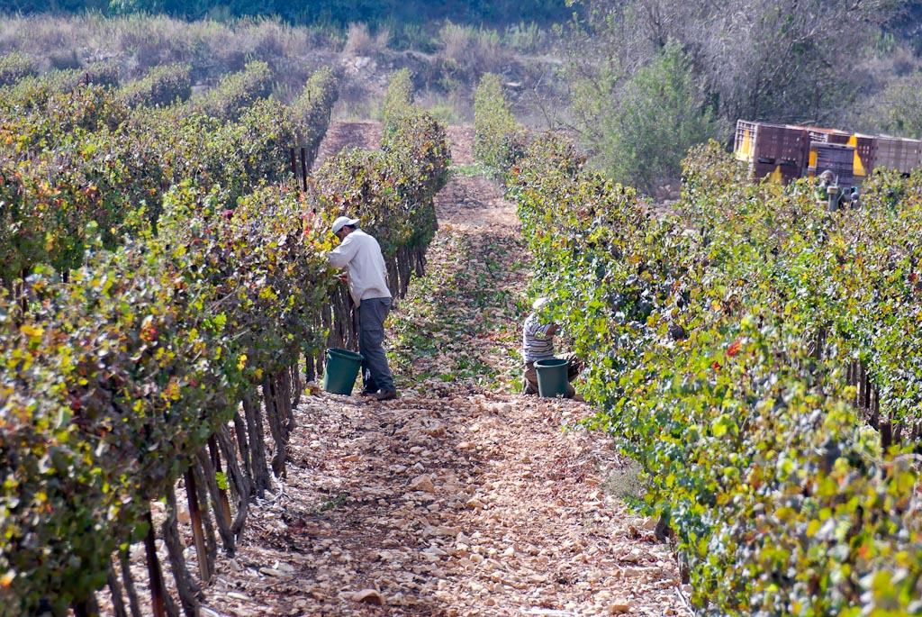
Isaiah 5:8(ESV) ⁸ Woe to those who join house to house,
who add field to field,
until there is no more room,
and you are made to dwell alone
in the midst of the land.
Harvesting grapes near Kiriath Jearim
Notes:
Leviticus 19:10 (NET) “You must not pick your vineyard bare, and you must not gather up the fallen grapes of your vineyard. You must leave them for the poor and the foreigner. I am the Lord your God.”
tb092506929

Slide 33
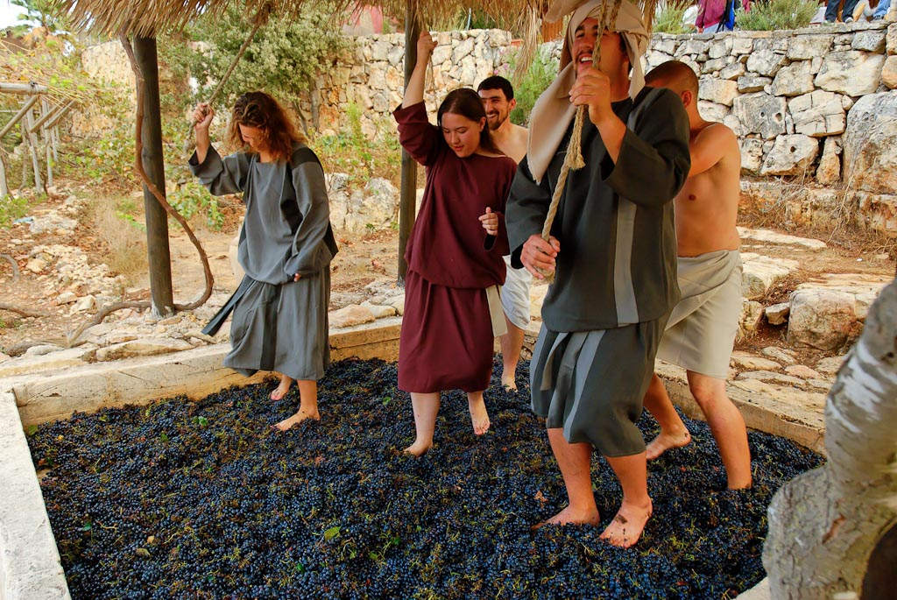
Isaiah 5:11-12(ESV) ¹¹ Woe to those who rise early in the morning,
that they may run after strong drink,
who tarry late into the evening as wine inflames them! ¹² They have lyre and harp, tambourine and flute and
wine at their feasts,
but they do not regard the deeds of the Lord,
or see the work of his hands.
Treading winepress
Notes:
Joel 3:13 (NET) “Rush forth with the sickle, for the harvest is ripe! Come, stomp the grapes, for the winepress is full! The vats overflow. Indeed, their evil is great!”
tb100806663

Slide 34
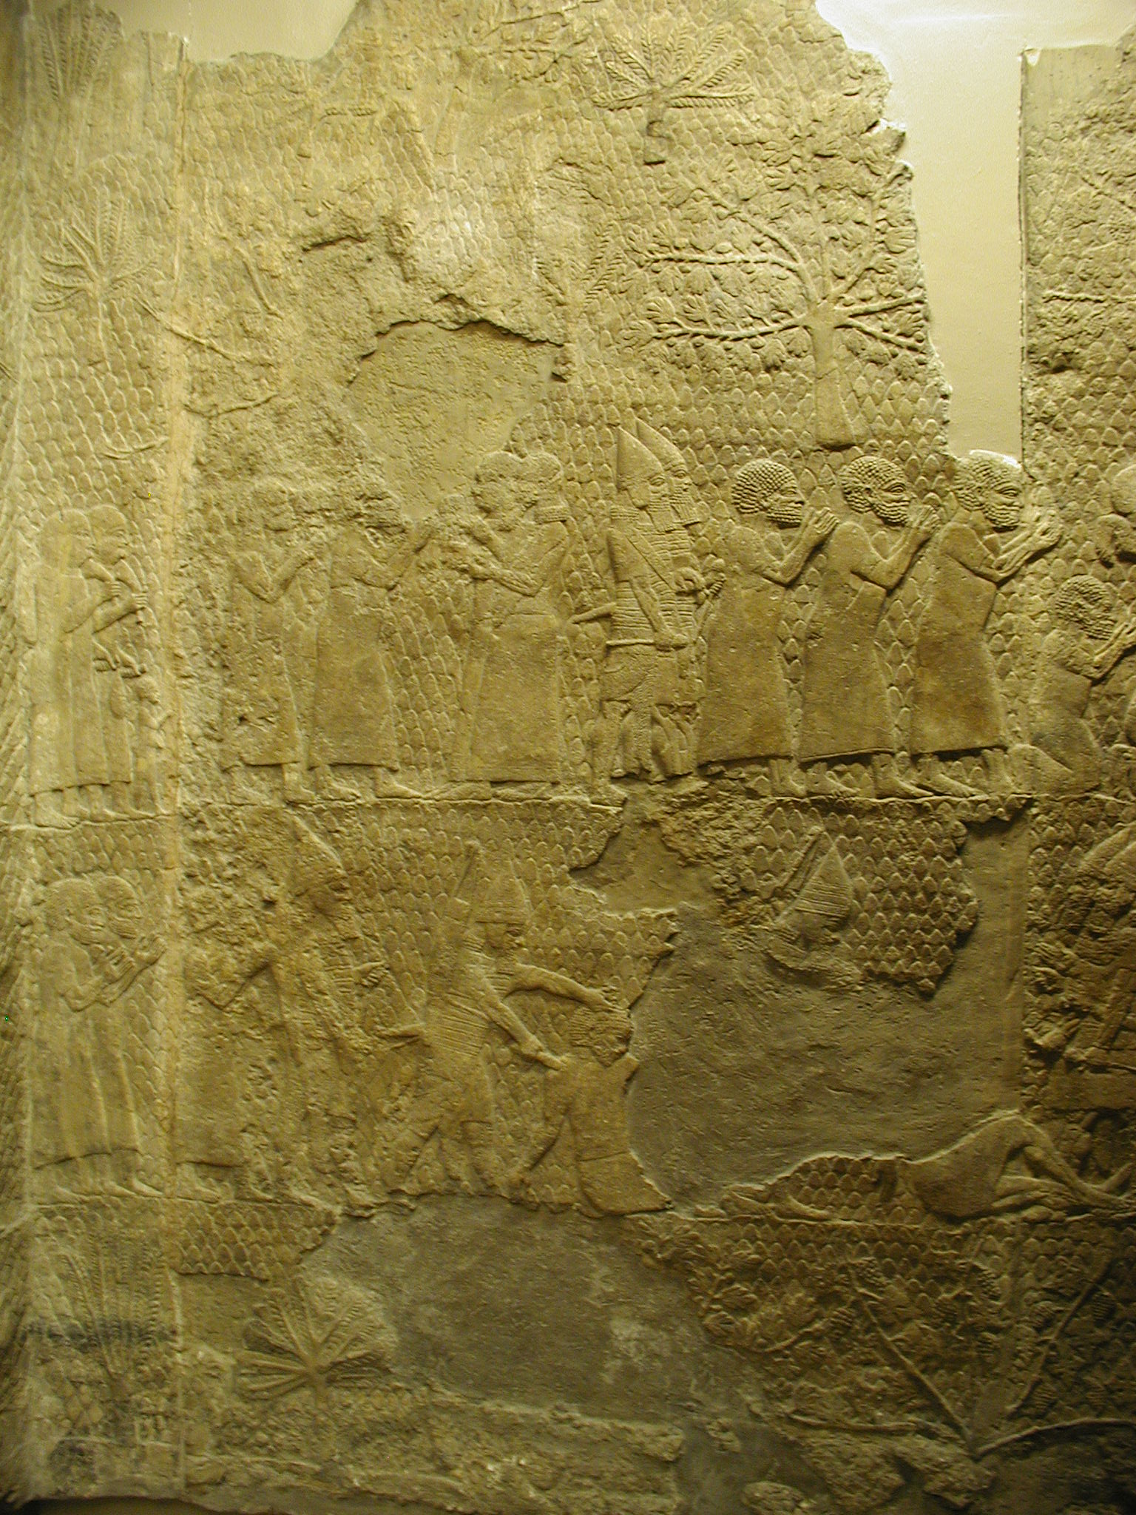
Captives from Lacish
Isaiah 5:13(ESV) ¹³ Therefore
my people go into exile
for lack of knowledge;
their honored men go hungry,
and their multitude
is parched with thirst.

Slide 35
Call of Isaiah
Isaiah 6:1-7(ESV) ¹In the year that King Uzziah died I saw the Lord sitting upon a throne, high and lifted up; and the train of his robe filled the temple. ²Above him stood the seraphim. Each had six wings: with two he covered his face, and with two he covered his feet, and with two he flew. ³And one called to another and said:
“Holy, holy, holy is the Lord of hosts;
the whole earth is full of his glory!”£ ⁴And the foundations of the thresholds shook at the voice of him who called, and the house was filled with smoke. ⁵And I said: “Woe is me! For I am lost; for I am a man of unclean lips, and I dwell in the midst of a people of unclean lips; for my eyes have seen the King, the Lord of hosts!” ⁶Then one of the seraphim flew to me, having in his hand a burning coal that he had taken with tongs from the altar. ⁷And he touched my mouth and said: “Behold, this has touched your lips; your guilt is taken away, and your sin atoned for.

Slide 36
Call of Isaiah
Isaiah 6:8-13(ESV) ⁸And I heard the voice of the Lord saying,
“Whom shall I send, and who will go for us?”
Then I said, “Here am I! Send me.” ⁹And he said, “Go, and say to this people:
“‘Keep on hearing, but do not understand;
keep on seeing, but do not perceive.’ ¹⁰ Make the heart of this people dull,
and their ears heavy,
and blind their eyes;
lest they see with their eyes,
and hear with their ears,
and understand with their hearts,
and turn and be healed.” ¹¹Then I said, “How long, O Lord?”
And he said: “Until cities lie waste without inhabitant,
and houses without people,
and the land is a desolate waste, ¹² and the Lord removes people far away,
and the forsaken places are many in the midst of the land. ¹³ And though a tenth remain in it,
it will be burned£ again,
like a terebinth or an oak, whose stump remains when it is felled.”
The holy seed is its stump.

Slide 37
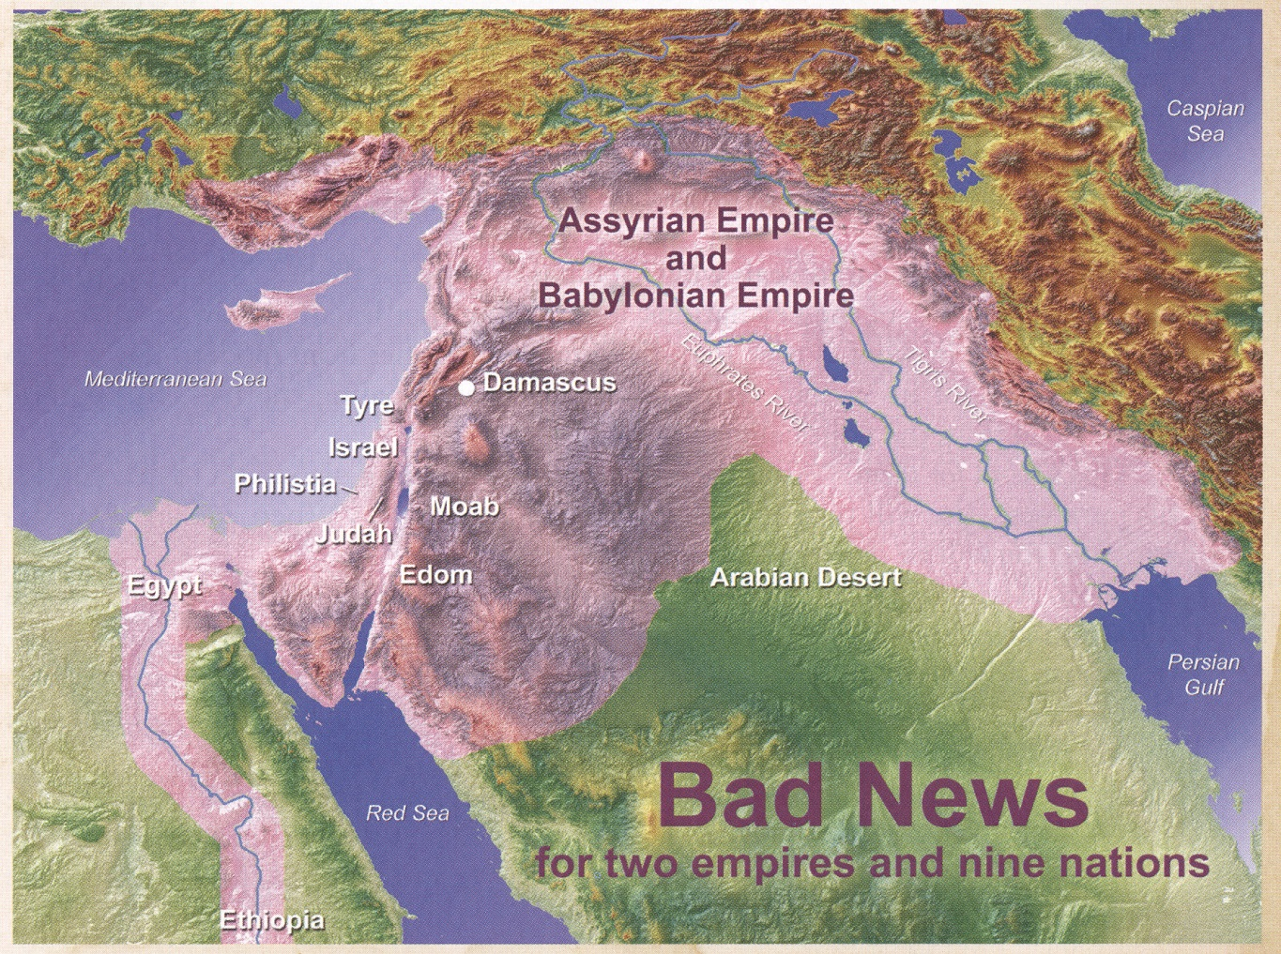
Isaiah 13-28
Assyria
Isa 14:23-27
Isa 23
Isa 17
Isa 14:28-32
Babylon
Isa 13,14:1-22,21
Isa 15-16
Isa 22,28
Isa 19,20
Isa 12, 21:11
Isa 21:13-17
Isa 18

Slide 38
Oracles against the Nations in the Prophets
 | Isaiah | Jeremiah | Ezekiel | Joel | Amos | Obadiah | Jonah | Nahum | Zephaniah | Zechariah*
Ammon |  | 49:1–6 | 25:1–7 |  | 1:13–15
Arabia | 21:13–17
Assyria (Nineveh) | 10:5–19; 14:24–27 |  |  |  |  |  | (Nineveh) | (Nineveh)
Babylon | 13:1–14:23; 21:1–10; 46:1–47:15 | 50:1–51:64 |  |  |  |  |  |  |  | 2:9–12?
Damascus | 17:1–6? | 49:23–27 |  |  | 1:3–5 |  |  |  |  | 9:1
Edom | 21:11–12 | 49:7–22 | 25:12–14 |  | 1:11–12 | 1–14?
Egypt | 18:1–20:6 | 46:2–26 | 29:1–32:32
Elam |  | 49:34–39
Ethiopia |  |  |  |  |  |  |  |  | 2:12–15
Gaza |  |  |  |  | 1:6–8 |  |  |  |  | 9:5
Kedar and Hazor |  | 49:28–33
Lebanon |  |  |  |  |  |  |  |  |  | 11:1–3?
Moab | 15:1–16:14 | 48:1–47 | 25:8–11 |  | 2:1–3 |  |  |  | 2:8–11
Philistia | 14:28–32 | 47:1–7 | 25:15–17 | 3:4–8 |  |  |  |  | 2:5–7 | 9:6
Tyre Sidon | 23:1–18 |  | 26:1–28:19; 28:20–23 | 3:4–8 | 1:9–10 |  |  |  |  | 9:2–3

Slide 39
Key Verses
Isaiah 1:18-20(ESV) ¹⁸ “Come now, let us reason together, says
the Lord:
though your sins are like scarlet,
they shall be as white as snow;
though they are red like crimson,
they shall become like wool.
¹⁹ If you are willing and obedient,
you shall eat the good of the land;
²⁰ but if you refuse and rebel,
you shall be eaten by the sword;
for the mouth of the Lord has spoken.”
Isaiah 9:6(ESV)
⁶ For to us a child is born,
to us a son is given;
and the government shall be
upon his shoulder,
and his name shall be called
Wonderful Counselor, Mighty God
Everlasting Father, Prince of Peace.

Slide 40
Isaiah's four "servant songs"
Passage contains the first of four about the Messiah,
1. who would bring justice and light to the Gentiles (Isaiah 42:1-9)
2. restore Israel and bring salvation to all people
(Isaiah 49:1-7)
3. be obedient in suffering (Isaiah 50:4-9)
4. be rejected by humankind but exalted by God
(Isaiah 52:13-53:12)

Slide 41
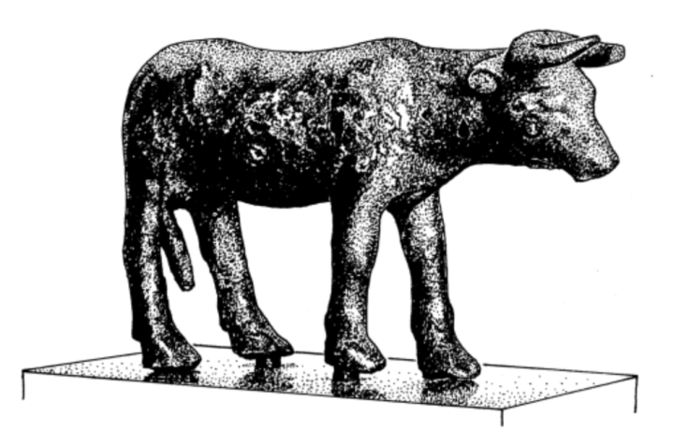
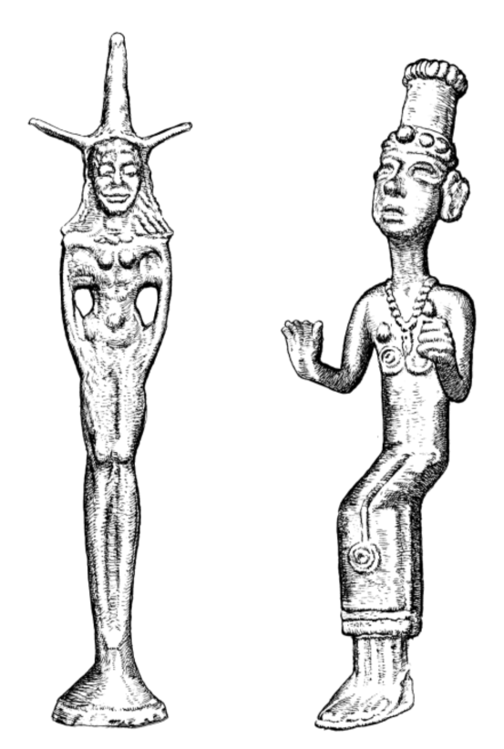
Folly of Idols
Isaiah 44:9-12(ESV)
9 All who fashion idols are nothing, and the things they delight in do not profit. Their witnesses neither see nor know, that they may be put to shame.
10 Who fashions a god or casts an idol that is profitable for nothing?
11 Behold, all his companions shall be put to shame, and the craftsmen are only human. Let them all assemble, let them stand forth. They shall be terrified; they shall be put to shame together.
12 The ironsmith takes a cutting tool and works it over the coals. He fashions it with hammers and works it with his strong arm. He becomes hungry, and his strength fails; he drinks no water and is faint.
Notes:
Isaiah 44:9-20 (ESV)
9 All who fashion idols are nothing, and the things they delight in do not profit. Their witnesses neither see nor know, that they may be put to shame.
10 Who fashions a god or casts an idol that is profitable for nothing?
11 Behold, all his companions shall be put to shame, and the craftsmen are only human. Let them all assemble, let them stand forth. They shall be terrified; they shall be put to shame together.
12 The ironsmith takes a cutting tool and works it over the coals. He fashions it with hammers and works it with his strong arm. He becomes hungry, and his strength fails; he drinks no water and is faint.
13 The carpenter stretches a line; he marks it out with a pencil. He shapes it with planes and marks it with a compass. He shapes it into the figure of a man, with the beauty of a man, to dwell in a house.
14 He cuts down cedars, or he chooses a cypress tree or an oak and lets it grow strong among the trees of the forest. He plants a cedar and the rain nourishes it.
15 Then it becomes fuel for a man. He takes a part of it and warms himself; he kindles a fire and bakes bread. Also he makes a god and worships it; he makes it an idol and falls down before it.
16 Half of it he burns in the fire. Over the half he eats meat; he roasts it and is satisfied. Also he warms himself and says, “Aha, I am warm, I have seen the fire!”
17 And the rest of it he makes into a god, his idol, and falls down to it and worships it. He prays to it and says, “Deliver me, for you are my god!”
18 They know not, nor do they discern, for he has shut their eyes, so that they cannot see, and their hearts, so that they cannot understand.
19 No one considers, nor is there knowledge or discernment to say, “Half of it I burned in the fire; I also baked bread on its coals; I roasted meat and have eaten. And shall I make the rest of it an abomination? Shall I fall down before a block of wood?”
20 He feeds on ashes; a deluded heart has led him astray, and he cannot deliver himself or say, “Is there not a lie in my right hand?”

Slide 42
Folly of Idols
Isaiah 44:13-20(ESV)
The carpenter stretches a line; he marks it out with a pencil. He shapes it with planes and marks it with a compass. He shapes it into the figure of a man, with the beauty of a man, to dwell in a house.
14 He cuts down cedars, or he chooses a cypress tree or an oak and lets it grow strong among the trees of the forest. He plants a cedar and the rain nourishes it.
15 Then it becomes fuel for a man. He takes a part of it and warms himself; he kindles a fire and bakes bread. Also he makes a god and worships it; he makes it an idol and falls down before it.
16 Half of it he burns in the fire. Over the half he eats meat; he roasts it and is satisfied. Also he warms himself and says, “Aha, I am warm, I have seen the fire!”
17 And the rest of it he makes into a god, his idol, and falls down to it and worships it. He prays to it and says, “Deliver me, for you are my god!”
They know not, nor do they discern, for he has shut their eyes, so that they cannot see, and their hearts, so that they cannot understand.
19 No one considers, nor is there knowledge or discernment to say, “Half of it I burned in the fire; I also baked bread on its coals; I roasted meat and have eaten. And shall I make the rest of it an abomination? Shall I fall down before a block of wood?”
20 He feeds on ashes; a deluded heart has led him astray, and he cannot deliver himself or say, “Is there not a lie in my right hand?”
Notes:
Isaiah 44:9-20 (ESV)
9 All who fashion idols are nothing, and the things they delight in do not profit. Their witnesses neither see nor know, that they may be put to shame.
10 Who fashions a god or casts an idol that is profitable for nothing?
11 Behold, all his companions shall be put to shame, and the craftsmen are only human. Let them all assemble, let them stand forth. They shall be terrified; they shall be put to shame together.
12 The ironsmith takes a cutting tool and works it over the coals. He fashions it with hammers and works it with his strong arm. He becomes hungry, and his strength fails; he drinks no water and is faint.
13 The carpenter stretches a line; he marks it out with a pencil. He shapes it with planes and marks it with a compass. He shapes it into the figure of a man, with the beauty of a man, to dwell in a house.
14 He cuts down cedars, or he chooses a cypress tree or an oak and lets it grow strong among the trees of the forest. He plants a cedar and the rain nourishes it.
15 Then it becomes fuel for a man. He takes a part of it and warms himself; he kindles a fire and bakes bread. Also he makes a god and worships it; he makes it an idol and falls down before it.
16 Half of it he burns in the fire. Over the half he eats meat; he roasts it and is satisfied. Also he warms himself and says, “Aha, I am warm, I have seen the fire!”
17 And the rest of it he makes into a god, his idol, and falls down to it and worships it. He prays to it and says, “Deliver me, for you are my god!”
18 They know not, nor do they discern, for he has shut their eyes, so that they cannot see, and their hearts, so that they cannot understand.
19 No one considers, nor is there knowledge or discernment to say, “Half of it I burned in the fire; I also baked bread on its coals; I roasted meat and have eaten. And shall I make the rest of it an abomination? Shall I fall down before a block of wood?”
20 He feeds on ashes; a deluded heart has led him astray, and he cannot deliver himself or say, “Is there not a lie in my right hand?”

Slide 43
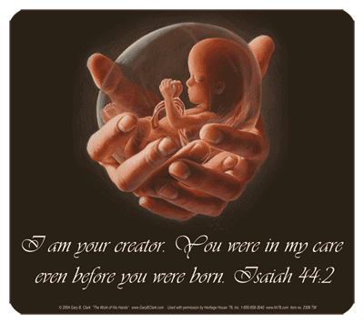
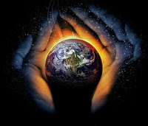
Lord, the Redeemer
Thus says the LORD, your Redeemer, who formed you from the womb: “I am the LORD, who made all things, who alone stretched out the heavens, who spread out the earth by myself, ²⁵ who frustrates the signs of liars and makes fools of diviners, who turns wise men back and makes their knowledge foolish, ²⁶ who confirms the word of his servant and fulfills the counsel of his messengers, who says of Jerusalem, ‘She shall be inhabited,’ and of the cities of Judah, ‘They shall be built, and I will raise up their ruins’; ²⁷ who says to the deep, ‘Be dry; I will dry up your rivers’; ²⁸ who says of Cyrus, ‘He is my shepherd, and he shall fulfill all my purpose’; saying of Jerusalem, ‘She shall be built,’ and of the temple, ‘Your foundation shall be laid.’”
God is in
control
Restore in the
Future
~700 BC
~530 BC
Notes:
Isaiah 44:9-20 (ESV)
9 All who fashion idols are nothing, and the things they delight in do not profit. Their witnesses neither see nor know, that they may be put to shame.
10 Who fashions a god or casts an idol that is profitable for nothing?
11 Behold, all his companions shall be put to shame, and the craftsmen are only human. Let them all assemble, let them stand forth. They shall be terrified; they shall be put to shame together.
12 The ironsmith takes a cutting tool and works it over the coals. He fashions it with hammers and works it with his strong arm. He becomes hungry, and his strength fails; he drinks no water and is faint.
13 The carpenter stretches a line; he marks it out with a pencil. He shapes it with planes and marks it with a compass. He shapes it into the figure of a man, with the beauty of a man, to dwell in a house.
14 He cuts down cedars, or he chooses a cypress tree or an oak and lets it grow strong among the trees of the forest. He plants a cedar and the rain nourishes it.
15 Then it becomes fuel for a man. He takes a part of it and warms himself; he kindles a fire and bakes bread. Also he makes a god and worships it; he makes it an idol and falls down before it.
16 Half of it he burns in the fire. Over the half he eats meat; he roasts it and is satisfied. Also he warms himself and says, “Aha, I am warm, I have seen the fire!”
17 And the rest of it he makes into a god, his idol, and falls down to it and worships it. He prays to it and says, “Deliver me, for you are my god!”
18 They know not, nor do they discern, for he has shut their eyes, so that they cannot see, and their hearts, so that they cannot understand.
19 No one considers, nor is there knowledge or discernment to say, “Half of it I burned in the fire; I also baked bread on its coals; I roasted meat and have eaten. And shall I make the rest of it an abomination? Shall I fall down before a block of wood?”
20 He feeds on ashes; a deluded heart has led him astray, and he cannot deliver himself or say, “Is there not a lie in my right hand?”

Slide 44
Isaiah's four "servant songs"
Passage contains the first of four about the Messiah,
1. who would bring justice and light to the Gentiles (Isaiah 42:1-9)
Isaiah 42:1-9 (ESV)
¹ Behold my servant, whom I uphold, my chosen, in whom my soul delights;
I have put my Spirit upon him; he will bring forth justice to the nations.
² He will not cry aloud or lift up his voice, or make it heard in the street;
³ a bruised reed he will not break, and a faintly burning wick he will not quench; he will faithfully bring forth justice.
⁴ He will not grow faint or be discouraged till he has established justice in the earth; and the coastlands wait for his law.
⁵ Thus says God, the LORD, who created the heavens and stretched them out, who spread out the earth and what comes from it, who gives breath to the people on it and spirit to those who walk in it:
⁶ “I am the LORD; I have called you in righteousness; I will take you by the hand and keep you; I will give you as a covenant for the people, a light for the nations,
⁷ to open the eyes that are blind, to bring out the prisoners from the dungeon, from the prison those who sit in darkness.
⁸ I am the LORD; that is my name; my glory I give to no other, nor my praise to carved idols.
⁹ Behold, the former things have come to pass, and new things I now declare; before they spring forth I tell you of them.”
God is in
control

Slide 45
Isaiah's four "servant songs"
Passage contains the second of four about the Messiah,
2. restore Israel and bring salvation to all people (Isaiah 49:1-7)
Isaiah 49:1-7 (ESV)
¹ Listen to me, O coastlands, and give attention, you peoples from afar. The LORD called me from the womb, from the body of my mother he named my name.
² He made my mouth like a sharp sword; in the shadow of his hand he hid me; he made me a polished arrow; in his quiver he hid me away.
³ And he said to me, “You are my servant, Israel, in whom I will be glorified.”
⁴ But I said, “I have labored in vain; I have spent my strength for nothing and vanity; yet surely my right is with the LORD, and my recompense with my God.”
⁵ And now the LORD says, he who formed me from the womb to be his servant, to bring Jacob back to him; and that Israel might be gathered to him— for I am honored in the eyes of the LORD, and my God has become my strength—
⁶ he says: “It is too light a thing that you should be my servant to raise up the tribes of Jacob and to bring back the preserved of Israel; I will make you as a light for the nations, that my salvation may reach to the end of the earth.”
⁷ Thus says the LORD, the Redeemer of Israel and his Holy One, to one deeply despised, abhorred by the nation, the servant of rulers: “Kings shall see and arise; princes, and they shall prostrate themselves; because of the LORD, who is faithful, the Holy One of Israel, who has chosen you.”
God is in
control
Chosen Nation/ People

Slide 46
Isaiah's four "servant songs"
Passage contains the third of four about the Messiah,
3. be obedient in suffering (Isaiah 50:4-9)
Isaiah 50:4-9 (ESV)
⁴ The Lord GOD has given me the tongue of those who are taught, that I may know how to sustain with a word him who is weary. Morning by morning he awakens; he awakens my ear to hear as those who are taught.
⁵ The Lord GOD has opened my ear, and I was not rebellious; I turned not backward.
⁶ I gave my back to those who strike, and my cheeks to those who pull out the beard; I hid not my face from disgrace and spitting.
⁷ But the Lord GOD helps me; therefore I have not been disgraced; therefore I have set my face like a flint, and I know that I shall not be put to shame.
⁸ He who vindicates me is near. Who will contend with me? Let us stand up together. Who is my adversary? Let him come near to me.
⁹ Behold, the Lord GOD helps me; who will declare me guilty? Behold, all of them will wear out like a garment; the moth will eat them up.

Slide 47
Isaiah's four "servant songs"
Passage contains the fourth of four about the Messiah,
be rejected by humankind but exalted by God (Isaiah 52:13-53:12)
Isaiah 52:13-15 (ESV)
¹³ Behold, my servant shall act wisely; he shall be high and lifted up, and shall be exalted.
¹⁴ As many were astonished at you— his appearance was so marred, beyond human semblance, and his form beyond that of the children of mankind—
¹⁵ so shall he sprinkle many nations; kings shall shut their mouths because of him; for that which has not been told them they see, and that which they have not heard they understand.
Isaiah 53:1-6 (ESV)
¹ Who has believed what he has heard from us? And to whom has the arm of the LORD been revealed?
² For he grew up before him like a young plant, and like a root out of dry ground; he had no form or majesty that we should look at him, and no beauty that we should desire him.
³ He was despised and rejected by men; a man of sorrows, and acquainted with grief; & as one from whom men hide their faces he was despised, and we esteemed him not.
⁴ Surely he has borne our griefs and carried our sorrows; yet we esteemed him stricken, smitten by God, and afflicted.
⁵ But he was pierced for our transgressions; he was crushed for our iniquities; upon him was the chastisement that brought us peace, and with his wounds we are healed.
⁶ All we like sheep have gone astray; we have turned—every one—to his own way; and the LORD has laid on him the iniquity of us all.

Slide 48
Isaiah's four "servant songs"
Passage contains the fourth of four about the Messiah continues,
be rejected by humankind but exalted by God (Isaiah 52:13-53:12)
Isaiah 53:7-12 (ESV)
⁷ He was oppressed, and he was afflicted, yet he opened not his mouth; like a lamb that is led to the slaughter, and like a sheep that before its shearers is silent, so he opened not his mouth.
⁸ By oppression and judgment he was taken away; and as for his generation, who considered that he was cut off out of the land of the living, stricken for the transgression of my people?
⁹ And they made his grave with the wicked and with a rich man in his death, although he had done no violence, and there was no deceit in his mouth.
¹⁰ Yet it was the will of the LORD to crush him; he has put him to grief; when his soul makes an offering for guilt, he shall see his offspring; he shall prolong his days; the will of the LORD shall prosper in his hand.
¹¹ Out of the anguish of his soul he shall see and be satisfied; by his knowledge shall the righteous one, my servant, make many to be accounted righteous, and he shall bear their iniquities.
¹² Therefore I will divide him a portion with the many, and he shall divide the spoil with the strong, because he poured out his soul to death and was numbered with the transgressors; yet he bore the sin of many, and makes intercession for the transgressors.

