Slide 1
2 Samuel
“you save the humble, But your eyes are on the haughty” (22:28)

Slide 2
Schedule
Date | Teacher | Text
10/28 | Dave | Intro: 1 Samuel Recap
10/31 | Dave | House of David v. House of Saul (1-4)
11/4 | Dave | The New King (5-6)
11/7 | Dave | The Promise (7)
11/11 | Dave | David’s Administration (8-10)
11/14 | Dave | David & Bathsheba (11-12)
11/18 | Dave | Amnon & Tamar (13-14)
Date | Teacher | Title
11/21 | No Class | TBD
11/25 | Dave | Abaslom’s Treason (15-17)
11/28 | Dave | Absalom’s Fall (18-20)
12/2 | Dave | Atonement & the Song of Praise (21-22)
12/5 | Dave | Last Words/Mighty Men/Census (23-24)
12/9 | TBD | David’s Death (1 Kings 1-2)
12/12 | TBD | Review

Slide 3
Relationships in 2 Samuel 1-4
Saul
Jesse
Abner
Rechab and Baanah
Jonathan
Ishbosheth
David
Zeruiah
(Sister, 1 Chr. 2:16)
Joab
Abishai
Mephibosheth
Asahel

Slide 4
Relationships in 2 Samuel 1-4
Saul
Jesse
Abner
Rechab and Baanah
Jonathan
Ishbosheth
David
Zeruiah
(Sister, 1 Chr. 2:16)
Joab
Abishai
Mephibosheth
Asahel

Slide 5
1 Samuel 26-31
Chapter | Summary
26 | David has 2nd chance to kill Saul but doesn’t. References to Abner, Abishai.
27 | David discouraged; he joinsAchish the Philistine, covertly attacks enemies.
28 | Achish calls David to fight Israel, then … (pause). Saul seeks a medium.
29 | (back to David) … he providentially is released from having to fight Israel!
30 | David returns to Ziklag to find destruction, faithfully leads a rescue mission.
31 | Saul and his sons die in the Philistine attack. Jabesh Gilead’s honor of Saul.

Slide 6
The Amelekite (1:1-16)
What did he claim to have seen and done?
Was his report true?
What was his motivation?
Summarize the Amelekite’s character.

Slide 7
David
Tore clothes, mourned, wept, fasted until evening when told of Saul and Israel’s defeat (1:11-12)
Executed the Amelekite (1:15-16)
Song of the Bow – David’s view of Israel, of Saul, and of Jonathan.

Slide 8
Relationships in 2 Samuel 1-4
Saul
Jesse
Abner
Rechab and Baanah
Jonathan
Ishbosheth
David
Zeruiah
(Sister, 1 Chr. 2:16)
Joab
Abishai
Mephibosheth
Asahel

Slide 9
Jonathan
1 Samuel 18:1-4 – Jonathan makes a covenant with David and gives his robe, armor, sword, belt, bow.
1 Samuel 19:1-6 – Jonathan protects David and holds his father Saul to account for his murderous intentions.
1 Samuel 20 – Jonathan makes a covenant with David, see v.12-17
1 Samuel 23:14-18 – Jonathan finds David and encourages him.
1 Samuel 31, 2 Samuel 1:22-23 – What do you make of the fact that Jonathan continued with Saul?
“You have been very pleasant to me; Your love to me was wonderful, surpassing the love of women.” (2 Sam. 1:26)

Slide 10
David
Tore clothes, mourned, wept, fasted until evening when told of Saul and Israel’s defeat (1:11-12)
Executed the Amelekite (1:15-16)
Song of the Bow – David’s view of Israel, of Saul, and of Jonathan.
Inquires of the LORD and becomes king … of Judah (2:1-4)
Blesses the men of Jabesh Gilead (2:5-7)

Slide 11
Relationships in 2 Samuel 1-4
Saul
Jesse
Abner
Rechab and Baanah
Jonathan
Ishbosheth
David
Zeruiah
(Sister, 1 Chr. 2:16)
Joab
Abishai
Mephibosheth
Asahel

Slide 12
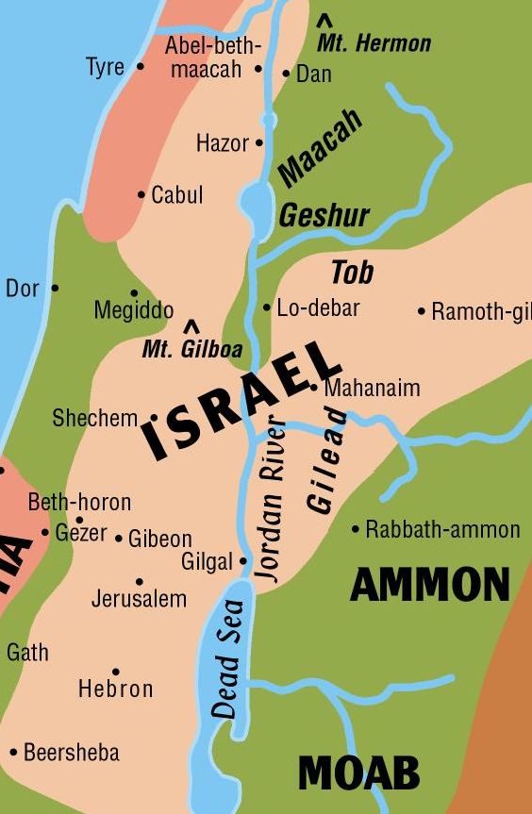
Abner
“Who is like you in Israel?” (1 Sam. 26:15)
Made Ishbosheth king over Israel (2:8-9)
Yet knew David was chosen by God (3:9,18)
Suggested a contest with Joab’s men (2:14)
Killed Asahel, but tried to stop him (2:18-23)
Accused of going to Saul’s concubine (3:7)
Left Ishbosheth to join David (genuine?)
Killed by Joab

Slide 13
David
Tore clothes, mourned, wept, fasted until evening when told of Saul and Israel’s defeat (1:11-12)
Executed the Amelekite (1:15-16)
Song of the Bow – David’s view of Israel, of Saul, and of Jonathan.
Inquires of the LORD and becomes king … of Judah (2:1-4)
Blesses the men of Jabesh Gilead (2:5-7)
Extended trust with Abner (on condition of Michal) (3:13)
Upon Abner’s death, cursed Joab’s house and mourned greatly (3:28-39)
What are your impressions of Joab?

Slide 14
Relationships in 2 Samuel 1-4
Saul
Jesse
Abner
Rechab and Baanah
Jonathan
Ishbosheth
David
Zeruiah
(Sister, 1 Chr. 2:16)
Joab
Abishai
Mephibosheth
Asahel

Slide 15
Ishbosheth
Did four things recorded after he became king:
Accused Abner (see 3:8)
Sent Michel to David (see 3:16)
Lost heart (see 4:1)
Laid on a bed at noon (4:5)
What are your impressions of Ishbosheth?
Rechab and Baanah – what did they do and why did they do it?

Slide 16
David
Tore clothes, mourned, wept, fasted until evening when told of Saul and Israel’s defeat (1:11-12)
Executed the Amelekite (1:15-16)
Song of the Bow – David’s view of Israel, of Saul, and of Jonathan.
Inquires of the LORD and becomes king … of Judah (2:1-4)
Blesses the men of Jabesh Gilead (2:5-7)
Extended trust with Abner (on condition of Michal) (3:13)
Upon Abner’s death, cursed Joab’s house and mourned greatly (3:28-39)
Executed Rechab and Baanah (4:10-12)

Slide 17
“As the LORD lives, who has redeemed my life from all adversity…”
2 samuel 4:9

Slide 18
Amelekite
Abner
Joab
Ishbosheth
Rechab and Baanah
David
Jonathan

