Slide 1
2 Samuel
“you save the humble, But your eyes are on the haughty” (22:28)

Slide 2
Schedule
Date | Teacher | Text
10/28 | Dave | Intro: 1 Samuel Recap
10/31 | Dave | House of David v. House of Saul (1-4)
11/4 | Dave | The New King (5-6)
11/7 | Dave | The Promise (7)
11/11 | Dave | David’s Administration (8-10)
11/14 | Dave | David & Bathsheba (11-12)
11/18 | Dave | Amnon & Tamar (13-14)
Date | Teacher | Title
11/21 | No Class | Lesson by Gary Kerr
11/25 | Dave | Abaslom’s Treason (15-17)
11/28 | Dave | Absalom’s Fall (18-20)
12/2 | Dave | Atonement & the Song of Praise (21-22)
12/5 | Dave | Last Words/Mighty Men/Census (23-24)
12/9 | Mason B. | David’s Death (1 Kings 1-2)
12/12 | Ryan P. | Review

Slide 3
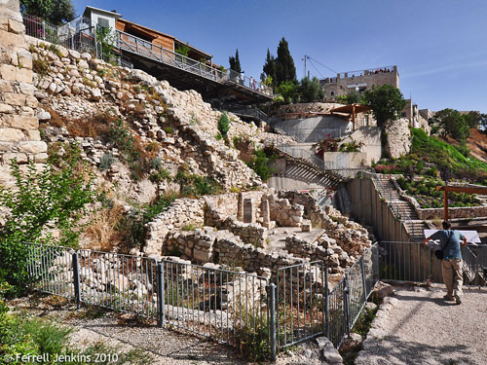
City of David

Slide 4
“But each one is tempted when he is drawn away by his own desires and enticed. Then, when desire has conceived, it gives birth to sin; and sin, when it is full-grown, brings forth death.”
James 1:14-15

Slide 5
1 Have mercy upon me, O God, According to Your lovingkindness;
According to the multitude of Your tender mercies, Blot out my transgressions.
2 Wash me thoroughly from my iniquity, And cleanse me from my sin.
3 For I acknowledge my transgressions, And my sin is always before me.
4 Against You, You only, have I sinned, And done this evil in Your sight—
That You may be found just when You speak, And blameless when You judge.
5 Behold, I was brought forth in iniquity, And in sin my mother conceived me.
6 Behold, You desire truth in the inward parts, And in the hidden part You will make me to know wisdom.
7 Purge me with hyssop, and I shall be clean; Wash me, and I shall be whiter than snow.
8 Make me hear joy and gladness, That the bones You have broken may rejoice.
9 Hide Your face from my sins, And blot out all my iniquities.
10 Create in me a clean heart, O God, And renew a steadfast spirit within me.
11 Do not cast me away from Your presence, And do not take Your Holy Spirit from me.
12 Restore to me the joy of Your salvation, And uphold me by Your generous Spirit.
13 Then I will teach transgressors Your ways, And sinners shall be converted to You.
14 Deliver me from the guilt of bloodshed, O God, The God of my salvation,
And my tongue shall sing aloud of Your righteousness.
15 O Lord, open my lips, And my mouth shall show forth Your praise.
16 For You do not desire sacrifice, or else I would give it; You do not delight in burnt offering.
17 The sacrifices of God are a broken spirit, A broken and a contrite heart—These, O God, You will not despise.
18 Do good in Your good pleasure to Zion; Build the walls of Jerusalem.
19 Then You shall be pleased with the sacrifices of righteousness, With burnt offering and whole burnt offering;
Then they shall offer bulls on Your altar.
Psalm 51

Slide 6
“The LORD has also put away your sin; you shall not die.” (v.13)
“I have sinned against the LORD.” (v.13)

Slide 7
12:15-31
afterward

Slide 8
Parallels David and Amnon
David
Amnon
Committed sexual immorality outside of marriage (11:4)
With a beautiful woman in the privacy of his own residence (11:2,4)
Law prescribed death (Lev. 20:10)
The woman experienced great grief (11:26)
Ultimately, the transgression resulted in the death of one of David’s sons (12:18)
Sin added to sin (11:6-17)
On the throne
Committed sexual immorality outside of marriage (13:14)
With a beautiful woman in the privacy of his own residence (13:1,7)
Law prescribed death (Lev. 20:17)
The woman experienced great grief (13:19)
Ultimately, the transgression resulted in the death of one of David’s sons (13:29)
Sin added to sin (13:15-18)
Presumed heir to the throne (3:2)
In part from R. Bergen,
1,2 Samuel, p. 379

Slide 9
Reactions 2 Samuel 13:1-22
What was Amnon’s reaction?
What was Tamar’s reaction?
What was Absalom’s reaction?
What was David’s reaction?
“When King David heard of all these things, he became very angry, but he would not punish his son Amnon, because he loved him, for he was his firstborn.” (13:21, NRSV)

Slide 10
13:23-39
Amnon’s Murder and Absalom’s flight

Slide 11
Parallels Between Joab’s Tale and Gen. 4:1-15
 | Cain & Abel | Joab’s Tale
Two brothers | Gen. 4:1 | v.6
alone together in a field | Gen. 4:8 | v.6
one killed the other | Gen. 4:8 | v.6
concerns expressed about murderer being killed by others | Gen. 4:14 | v.7
authority figure intervened to save murderer’s life | Gen. 4:15 | v.8
threat of retaliation for anyone contravening authority’s decision | Gen. 4:15 | v.10
R. Bergen,
1,2 Samuel, p. 390

Slide 12
What is the lesson of this chapter?
2 samuel 14

