Slide 1
Godly Religion
Embry Hills, December 30, 2018
Sam Freesmeyer

Slide 2
What is Godliness?

Slide 3
Godliness Defined
Greek: eusebia – literally, “worship well,” “be very devout”
Thayer: “Reverence. Respect; in the Bible everywhere piety towards God.”
Vine: “piety…characterized by a God-ward attitude; does that which is well-pleasing to Him”

Slide 4
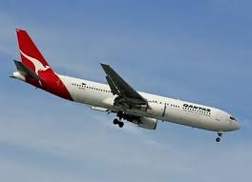
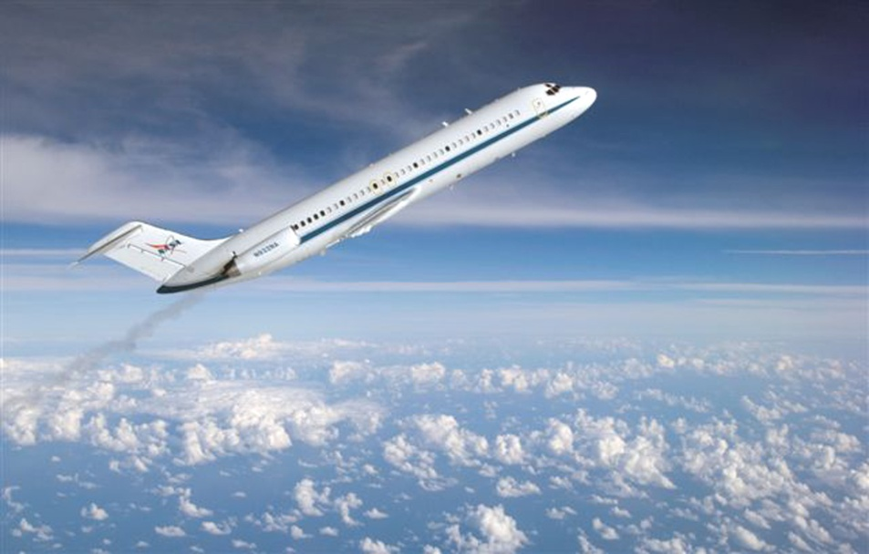
“Attitude”
5. the position of an aircraft or spacecraft determined by the relationship between its axes and a reference datum (as the horizon or a particular star) Merriam-Webster
A “Godward Attitude” means that our thoughts are always upward toward God.

Slide 5
What is Godliness?
Not “Just doing good”
Not “Being in the Right Church”
Not Exactly “Godlikeness”
An Attitude resulting in a way of life
Opposite of Ungodliness. “ …denying ungodliness and worldly lusts, we should live soberly, righteously, and godly” – Titus 2:12

Slide 6
8 Rules Toward Godliness
Trust the Ordinary Means of Grace – Trust the Word, Prayer, and Fellowship
1 Timothy 4:13-16–Practice these things, Immerse yourself in them, so others may see your progress
Guard Against Worldliness – a Way of Thinking and Living that Rejects God’s Rule
1 Timothy 6:6 – there is great gain in godliness with contentment (Materialism)
Think Holy Thoughts - Set your minds on things that are above (Col 3:2; Phil 4:8)
Gen 6:5 – thoughts of his heart was only evil continually
Watch for Temptation – Be Watchful, stay awake (Matt 24.42a). Be Alert 1 Pe 4.8
Ponder the Brevity of Life - “teach us to number our days,” (Psa 90:12). James 4.14
Redeem Your Time - making the best use of the time, …” (Eph 5:15-16).
Fellowship with Godly People – We need the Counsel, Prayers, Zeal, and Example of Godly, Seasoned Christians.
Titus 2:2-8 – Teach, Train, Show your Good Works, Integrity, Dignity, Sound Speech
Hebrews 10:24-25 – let us consider how to stir up one another to love and good works
1 Corinthians 15:33 – bad company corrupts good morals
Purpose To Be Godly - must approach godliness with tenacity
1 Timothy 6:11 – Pursue Godliness, Righteousness, Faith, Love, Steadfastness, Gentleness
Eccl 12:13 –The end of the matter (the purpose of life) Fear God and Keep His Commands – Our Duty
Notes:
WORLDLINESS - It is a way of thinking and living that rejects God’s rule. It is enthusiasm for the temporal and apathy for the eternal. It is living as if this world is all there is. To love the world is to value what unbelievers value, to foster ungodly desires and attitudes, to indulge in what is delightful to those who refuse to delight in God.
Those who love the world naturally succumb to worldliness. Worldliness is a failure to renew our minds by the Word of God so we can live in a manner pleasing to God. It is the failure to think and live in distinctly godly ways. It is the failure to become who God has called us to be through the gospel.
More commonly, though, Christians become worldly by neglect. We fail to be watchful, to maintain an offensive posture against the world’s attraction and intrusion. We neglect the means of grace, allowing ourselves to lose confidence in the ordinary means of Word, prayer, and fellowship. Having lost our confidence in them, we soon forsake them altogether.
THINK – Psalms 19.14
Temptation: - Every temptation is an opportunity to resist, to obey, and to grow in conformity to Christ Jesus.
LIFE:
Time: Sometimes we squander it by committing it to sinful passions and pursuits
Sometimes we squander it by dedicating too much of it to lesser, frivolous pursuits
by intentionally or unintentionally neglecting the matters of first importance
time gives opportunity to “put on then, as God’s chosen ones, holy and beloved, compassionate hearts, kindness, humility, meekness,” and every other virtue (Colossians 3:5, 12).

Slide 7
What is Godly Worship?

Slide 8
Godliness Looking up? Or Looking down?
GOD
God is Spirit… John 4:24
Self
Experiences
Possessions
Pleasure
Money
Position
Passions
Power
Things
Lust of the eyes
Lust of the flesh
Pride of Life
1 John 2:15-17

Slide 9
Godly Worship
Spiritual
John 4:23-24, God is Spirit, we worship in spirit and in truth
Gal 5:16-25, Walk in the Spirit, and you are not condemned by the law
Eph 1:3-14, God has blessed us with all spiritual blessings in Christ
I say then: Walk in the Spirit, and you shall not fulfill the lust of the flesh. For the flesh lusts against the Spirit, and the Spirit against the flesh; and these are contrary to one another, so that you do not do the things that you wish. But if you are led by the Spirit, you are not under the law. Now the works of the flesh are evident, which are: adultery, fornication, uncleanness, lewdness, idolatry, sorcery, hatred, contentions, jealousies, outbursts of wrath, selfish ambitions, dissensions, heresies, envy, murders, drunkenness, revelries, and the like; of which I tell you beforehand, just as I also told you in time past, that those who practice such things will not inherit the kingdom of God. But the fruit of the Spirit is love, joy, peace, longsuffering, kindness, goodness, faithfulness, gentleness, self-control. Against such there is no law. And those who are Christ's have crucified the flesh with its passions and desires. If we live in the Spirit, let us also walk in the Spirit.
(Gal 5:16-25)
Blessed be the God and Father of our Lord Jesus Christ, who has blessed us with every spiritual blessing in the heavenly places in Christ, just as He chose us in Him before the foundation of the world, that we should be holy and without blame before Him in love, having predestined us to adoption as sons by Jesus Christ to Himself, according to the good pleasure of His will, to the praise of the glory of His grace, by which He made us accepted in the Beloved. In Him we have redemption through His blood, the forgiveness of sins, according to the riches of His grace which He made to abound toward us in all wisdom and prudence, having made known to us the mystery of His will, according to His good pleasure which He purposed in Himself, that in the dispensation of the fullness of the times He might gather together in one all things in Christ, both which are in heaven and which are on earth—in Him. In Him also we have obtained an inheritance, being predestined according to the purpose of Him who works all things according to the counsel of His will, that we who first trusted in Christ should be to the praise of His glory. In Him you also trusted, after you heard the word of truth, the gospel of your salvation; in whom also, having believed, you were sealed with the Holy Spirit of promise, who is the guarantee of our inheritance until the redemption of the purchased possession, to the praise of His glory.
(Eph 1:3-14)
But the hour is coming, and now is, when the true worshipers will worship the Father in spirit and truth; for the Father is seeking such to worship Him. God is Spirit, and those who worship Him must worship in spirit and truth."
(Joh 4:23-24)

Slide 10
Godly Worship
Spiritual
John 4:23-24, God is Spirit, we worship in spirit and in truth
Gal 5:16-25, Walk in the Spirit, and you are not condemned by the law
Eph 1:3-14, God has blessed us with all spiritual blessings in Christ
Focused Godward, As God has Directed
2 Pet 1:2-4, He has given all things for life and godliness, through knowledge of Him
1 Thess 4:3-7, this is the will of God, your sanctification and holiness
1 John 2:15-17, do not love the world or things of it. It is temporary and passing away
Matt 6:19-24, lay up treasures in heaven, not on earth, You cannot serve 2 masters
"Do not lay up for yourselves treasures on earth, where moth and rust destroy and where thieves break in and steal; but lay up for yourselves treasures in heaven, where neither moth nor rust destroys and where thieves do not break in and steal. For where your treasure is, there your heart will be also. "The lamp of the body is the eye. If therefore your eye is good, your whole body will be full of light. But if your eye is bad, your whole body will be full of darkness. If therefore the light that is in you is darkness, how great is that darkness! "No one can serve two masters; for either he will hate the one and love the other, or else he will be loyal to the one and despise the other. You cannot serve God and mammon.
(Mat 6:19-24)
Grace and peace be multiplied to you in the knowledge of God and of Jesus our Lord, as His divine power has given to us all things that pertain to life and godliness, through the knowledge of Him who called us by glory and virtue, by which have been given to us exceedingly great and precious promises, that through these you may be partakers of the divine nature, having escaped the corruption that is in the world through lust.
(2Pe 1:2-4)
For this is the will of God, your sanctification: that you should abstain from sexual immorality; that each of you should know how to possess his own vessel in sanctification and honor, not in passion of lust, like the Gentiles who do not know God; that no one should take advantage of and defraud his brother in this matter, because the Lord is the avenger of all such, as we also forewarned you and testified. For God did not call us to uncleanness, but in holiness.
(1Th 4:3-7)
Do not love the world or the things in the world. If anyone loves the world, the love of the Father is not in him. For all that is in the world—the lust of the flesh, the lust of the eyes, and the pride of life—is not of the Father but is of the world. And the world is passing away, and the lust of it; but he who does the will of God abides forever.
(1Jn 2:15-17)

Slide 11
Godly Worship
"Teacher, which is the great commandment in the law?" Jesus said to him, 'YOU SHALL LOVE THE LORD YOUR GOD WITH ALL YOUR HEART, WITH ALL YOUR SOUL, AND WITH ALL YOUR MIND.' This is the first and great commandment. And the second is like it: 'YOU SHALL LOVE YOUR NEIGHBOR AS YOURSELF.' On these two commandments hang all the Law and the Prophets."
(Mat 22:36-40)
For the commandments, "YOU SHALL NOT COMMIT ADULTERY," "YOU SHALL NOT MURDER," "YOU SHALL NOT STEAL," "YOU SHALL NOT BEAR FALSE WITNESS," "YOU SHALL NOT COVET," and if there is any other commandment, are all summed up in this saying, namely, "YOU SHALL LOVE YOUR NEIGHBOR AS YOURSELF." Love does no harm to a neighbor; therefore love is the fulfillment of the law.
(Rom 13:9-10)
Spiritual
John 4:23-24, God is Spirit, we worship in spirit and in truth
Gal 5:16-25, Walk in the Spirit, and you are not condemned by the law
Eph 1:3-14, God has blessed us with all spiritual blessings in Christ
Focused Godward, As God has Directed
2 Pet 1:2-4, He has given all things for life and godliness, through knowledge of Him
1 Thess 4:3-7, this is the will of God, your sanctification and holiness
1 John 2:15-17, do not love the world or things of it. It is temporary and passing away
Matt 6:19-24, lay up treasures in heaven, not on earth, You cannot serve 2 masters
According to Godliness
Titus 2:11-12, deny ungodliness, live soberly and righteously
Jas 1:27, pure and undefiled religion acts for the benefit of the helpless
Matt 22:36-40, Rom 13:9-10, all of the law and commandments are fulfilled in Love
Rom 12:1-2 be transformed by the renewing of your mind
Pure and undefiled religion before God and the Father is this: to visit orphans and widows in their trouble, and to keep oneself unspotted from the world.
(Jas 1:27)
I beseech you therefore, brethren, by the mercies of God, that you present your bodies a living sacrifice, holy, acceptable to God, which is your reasonable service. And do not be conformed to this world, but be transformed by the renewing of your mind, that you may prove what is that good and acceptable and perfect will of God.
(Rom 12:1-2)
For the grace of God that brings salvation has appeared to all men, teaching us that, denying ungodliness and worldly lusts, we should live soberly, righteously, and godly in the present age,
(Tit 2:11-12)

Slide 12
Godliness Looking up? Or Looking down?
GOD
God is Spirit… John 4:24
Self
Experiences
Possessions
Pleasure
Money
Position
Passions
Power
Things
Lust of the eyes
Lust of the flesh
Pride of Life
1 John 2:15-17

Slide 13
Ungodly Worship
Vain Worship
Matt 15:3-9, following doctrines of men instead of God
Col 2:20-23, self-imposed man-made religion, false humility, neglect of the body
2 John 1:9, who does not abide in the doctrine of Christ does not have God
He answered and said to them, "Why do you also transgress the commandment of God because of your tradition? For God commanded, saying, 'HONOR YOUR FATHER AND YOUR MOTHER'; and, 'HE WHO CURSES FATHER OR MOTHER, LET HIM BE PUT TO DEATH.' But you say, 'Whoever says to his father or mother, "Whatever profit you might have received from me is a gift to God"— then he need not honor his father or mother.' Thus you have made the commandment of God of no effect by your tradition. Hypocrites! Well did Isaiah prophesy about you, saying: 'THESE PEOPLE DRAW NEAR TO ME WITH THEIR MOUTH, AND HONOR ME WITH THEIR LIPS, BUT THEIR HEART IS FAR FROM ME. AND IN VAIN THEY WORSHIP ME, TEACHING AS DOCTRINES THE COMMANDMENTS OF MEN.' "
(Mat 15:3-9)
Therefore, if you died with Christ from the basic principles of the world, why, as though living in the world, do you subject yourselves to regulations— "Do not touch, do not taste, do not handle," which all concern things which perish with the using—according to the commandments and doctrines of men? These things indeed have an appearance of wisdom in self-imposed religion, false humility, and neglect of the body, but are of no value against the indulgence of the flesh.
(Col 2:20-23)
Whoever transgresses and does not abide in the doctrine of Christ does not have God. He who abides in the doctrine of Christ has both the Father and the Son.
(2Jn 1:9)

Slide 14
Ungodly Worship
Vain Worship
Matt 15:3-9, following doctrines of men instead of God
Col 2:20-23, self-imposed man-made religion, false humility, neglect of the body
2 John 1:9, who does not abide in the doctrine of Christ does not have God
Powerless Worship
2 Tim 3:1-5, powerless worship is not directed toward God
James 4:1-4, powerless prayer, focused on own pleasures instead of God’s will
But know this, that in the last days perilous times will come: For men will be lovers of themselves, lovers of money, boasters, proud, blasphemers, disobedient to parents, unthankful, unholy, unloving, unforgiving, slanderers, without self-control, brutal, despisers of good, traitors, headstrong, haughty, lovers of pleasure rather than lovers of God, having a form of godliness but denying its power. And from such people turn away!
(2Ti 3:1-5)
Where do wars and fights come from among you? Do they not come from your desires for pleasure that war in your members? You lust and do not have. You murder and covet and cannot obtain. You fight and war. Yet you do not have because you do not ask. You ask and do not receive, because you ask amiss, that you may spend it on your pleasures. Adulterers and adulteresses! Do you not know that friendship with the world is enmity with God? Whoever therefore wants to be a friend of the world makes himself an enemy of God.
(Jas 4:1-4)

Slide 15
Ungodly Worship
Beloved, while I was very diligent to write to you concerning our common salvation, I found it necessary to write to you exhorting you to contend earnestly for the faith which was once for all delivered to the saints. For certain men have crept in unnoticed, who long ago were marked out for this condemnation, ungodly men, who turn the grace of our God into lewdness and deny the only Lord God and our Lord Jesus Christ.
(Jud 1:3-4)
But you, beloved, remember the words which were spoken before by the apostles of our Lord Jesus Christ: how they told you that there would be mockers in the last time who would walk according to their own ungodly lusts.
(Jud 1:17-18)
and especially those who walk according to the flesh in the lust of uncleanness and despise authority. They are presumptuous, self-willed. They are not afraid to speak evil of dignitaries, whereas angels, who are greater in power and might, do not bring a reviling accusation against them before the Lord. But these, like natural brute beasts made to be caught and destroyed, speak evil of the things they do not understand, and will utterly perish in their own corruption, and will receive the wages of unrighteousness, as those who count it pleasure to carouse in the daytime. They are spots and blemishes, carousing in their own deceptions while they feast with you, having eyes full of adultery and that cannot cease from sin, enticing unstable souls. They have a heart trained in covetous practices, and are accursed children.
(2Pe 2:10-14)
Vain Worship
Matt 15:3-9, following doctrines of men instead of God
Col 2:20-23, self-imposed man-made religion, false humility, neglect of the body
2 John 1:9, who does not abide in the doctrine of Christ does not have God
Powerless Worship
2 Tim 3:1-5, powerless worship is not directed toward God
James 4:1-4, powerless prayer, focused on own pleasures instead of God’s will
Deceitful Worship
Jude 3-4, 17-19, claim to follow Christ but cause division and strife
Col 2:8, philosophy and empty deceit, based on traditions of men
1 Tim 4:1-2, deceiving spirits, doctrines of demons, hypocritical lies
1 Tim 6:3-5, When not aligned with godliness, creates strife and other evils
2 Peter 2:10-14, Walk according to the flesh, speak evil of things they don’t comprehend,
If anyone teaches otherwise and does not consent to wholesome words, even the words of our Lord Jesus Christ, and to the doctrine which accords with godliness, he is proud, knowing nothing, but is obsessed with disputes and arguments over words, from which come envy, strife, reviling, evil suspicions, useless wranglings of men of corrupt minds and destitute of the truth, who suppose that godliness is a means of gain. From such withdraw yourself.
(1Ti 6:3-5)
Now the Spirit expressly says that in latter times some will depart from the faith, giving heed to deceiving spirits and doctrines of demons, speaking lies in hypocrisy, having their own conscience seared with a hot iron,
(1Ti 4:1-2)
Beware lest anyone cheat you through philosophy and empty deceit, according to the tradition of men, according to the basic principles of the world, and not according to Christ.
(Col 2:8)

Slide 16
Characteristics of Worship
What kind of… | Godly Worship | Ungodly Worship
Goals and Purpose?
Doctrine taught?
Discipline maintained?
Activities in Worship?
Qualities in a Preacher?
Activities would be demanded?
Primary focus: Inner or Outer Man?
Focused on Kingdom Earthly mission
Only God’s Word Doctrines of men
That we may share His holiness No one feels upset
Only as directed in scripture Additions or Omissions
Preach the whole truth Satisfy itching ears
That please God and cause That please people
growth of the Kingdom
Inner Outer

Slide 17
Godliness Looking up? Or Looking down?
GOD
God is Spirit… John 4:24
Self
Experiences
Possessions
Pleasure
Money
Position
Passions
Power
Things
Lust of the eyes
Lust of the flesh
Pride of Life
1 John 2:15-17

