Slide 1
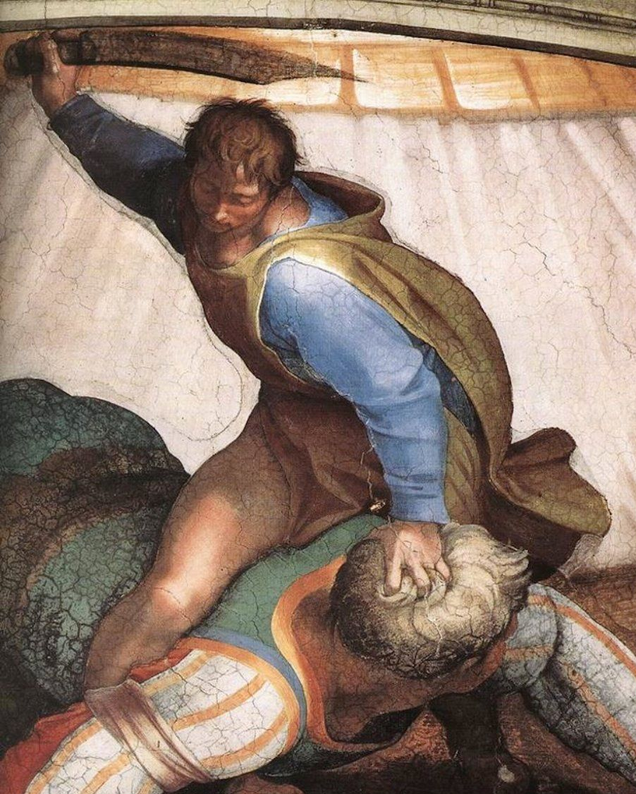
Lesson 8
Psalms, part 1
David and Goliath
Michelangelo Buonarroti, 1509

Slide 2
Class Schedule
LESSON | TITLE | DATE | TEACHER
1 | Introduction | Sunday Feb. 24 | Mason
2 | The Messiah in Moses’ Writings 1 | Wednesday Feb. 27 | Grady
3 | The Messiah in Moses’ Writings 1 | Sunday Mar. 3 | Grady
4 | The Messiah in the Minor Prophets 1 | Wednesday Mar. 6 | Grady
5 | The Messiah in the Minor Prophets 2 | Sunday Mar. 10 | Mason
6 | The Messiah in the Major Prophets 1 | Wednesday, Mar. 13 | Grady
7 | The Messiah in the Major Prophets 2 | Sunday, Mar. 17 | Mason
8 | The Messiah in the Psalms 1 | Wednesday, Mar. 20 | Mason
9 | The Messiah in the Psalms 2 | Sunday, Mar. 24 | Mason
 | NO CLASS – MEETING | Wednesday, Mar. 27 | --
10 | The Messiah in Isaiah 1 | Sunday, Mar. 31 | Mason
11 | The Messiah in Isaiah 2 | Wednesday, Apr. 3 | Grady
12 | The Messiah in Isaiah 3 | Sunday, Apr. 7 | Mason
13 | Review/How Jesus & the Apostles Applied Prophecy | Wednesday, Apr. 10 | Grady

Slide 3
Lesson 8 Objectives
List 3 useful criteria for determining if a psalm is Messianic.
Explain how Messianic prophecy expands in the Psalms.
Describe how the psalmic view of kingship changes from Book 1 to Book 5, and name the psalm that forms the centerpiece of this transition.

Slide 4
What would you say is the most important Messianic psalm?
Why?
Notes:
We’ll come back to your answers toward the end of next class, but I hope this question has also raised this thought in your mind: “How do I know if a psalm IS Messicanic? How can I tell?”

Slide 5
How would you determine if a psalm is Messianic?
What clues would you look for?
Notes:
What I want to do in the next two lessons is to explore the characteristics that suggest a psalm is Messianic, and then see how those psalms help us understand Christ’s life and mission better.

Slide 6
Periods of Messianic Prophecy
Genesis to Judges
Vague but forceful prophecies—no clear time or place references
Images introduced: victorious sufferer, king, lion, star, prophet
Overall picture: no cohesion, no clarity
Early kingdom and psalms
More specific promises—time not specified, but Israel clearly the place
Images expanded: victorious (vindicated) sufferer, king
Images introduced: priest, anointed, son of God, David
Overall picture: some clarity, little cohesion
Later kingdom and prophets
Very detailed images and descriptions—time and places specified for events
Images expanded: vindicated sufferer, king, anointed, son of God, David
Images introduced: lamb, servant, root and branch, son of man, shepherd
Overall picture: great clarity, moderate cohesion
Notes:
We saw in the Minor Prophets a detailed outline and description of the Messiah’s work. Those descriptions built on the details supplied by Jeremiah, Ezekiel, and Isaiah, and on the timeline established by Daniel (today’s class). The Major and Minor prophets all build on the Messianic descriptions in the Psalms, which begin to tie the isolated images of the Pentateuch into descriptions of people

Slide 7
The Place of Psalms in Messianic Revelation
The Psalms begin at a moment in Israel’s history when the national consciousness shifts to the Seed Promise
God has made Israel a great nation (in terms of numbers and prominence)
God has given Israel the land (at its largest extent under David and Solomon)
Israel expects that God will begin blessing the earth through them
The Psalms connect the dots of the early Messianic images, and introduce the 3-character description of the Messiah
King (Psalm 2)
Priest (Psalm 110)
Righteous Sufferer (Psalm 22)
Because the Psalms cover 500+ years of Israel’s history, they contain a record of changes in Israelite thought about the Messiah and His role, especially the kingship element
Notes:
Many references in psalms to “all the nations” or “subduing peoples under me,” seemingly with no precedent in revelation or history. One theory: the view of the Messiah literally ruling the nations grows out of a renewed focus on the Seed promise at this time.

Slide 8
Messianic Psalms
A psalm could be Messianic in two ways:
Directly predicting the actions, thoughts, or words of the Messiah, with no reference to the life or circumstances of its writer (i.e.- Daniel 7, etc.)
Anticipating the Messiah by recording the writer’s actions, thoughts, or words that are ultimately fulfilled in Christ’s corresponding actions, thoughts, or words
Criteria for determining a Messianic psalm
Does the psalm reference (a/the) son of Jehovah?
Does the psalm reference David or his descendants?
Is the psalm quoted by Jesus or the apostles as Messianic?
Messianic psalms appear in many genres, especially Kingship psalms
Psalms of the earthly king (Psalm 2, Psalm 45, Psalm 89, Psalm 110)
Psalms of the Heavenly King (Psalm 47, Psalms 93-100)
Notes:
To read the psalms as Messianic in the narrow sense (only predictive) requires us to ignore the clear historical detail so often associated with the psalms that contain Messianic content. Putting these psalms back in their historical context, and then examining the Messianic elements in that context, helps us to see the Messianic message more clearly, and offers additional insight into Christ’s life and work.
A large part of that context lies in the genre that contains many Messianic psalms: kingship psalms

Slide 9
Outline for Lessons 8 and 9
Describe Messianic Psalms
God as Israel’s True King (Psalms 99, 89, 74)
Genre: Psalms of the Heavenly King
Israel’s King as God’s Son (Psalms 2, 89)
Genre: Psalms of the Earthly King
Messianic feature: Reference to a (a/the) son of Jehovah
David the King (Psalms 18, 89)
Messianic feature: Reference to David or his descendants
Psalms Quoted as Messianic in the New Testament (Psalms 110, 118)
Messianic feature: Quoted by Jesus or the Apostles

Slide 10
God as Israel’s King
Israel rejected God as their king, 1 Samuel 8:7
Israel’s sin was not that they had a king, but that they asked for one
Therefore, a king “after God’s own heart” would recognize God’s sovereignty
One of the central themes of the Psalms is the re-enthronement of Yahweh as the king of Israel
In Psalm 2, God invests the king with power and authority
In Psalm 89, the power and authority of that king have vanished
In Psalm 146, Israel is urged not to trust in princes, but in God
Psalm 74 and 89 describe a crucial transition point in Israel’s understanding of God’s kingship
Notes:
“I was going to tell you that you didn’t have to do your chores today, but then you whined about your chores, so now giving you the very thing I wanted for you feels like a loss.”

Slide 11
Psalm 2
Probably a coronation psalm, with the priest and the king speaking
The king becomes God’s son when he is enthroned, v.7 (cf. Psalm 89:27)
God invests the king with His authority and power
To rule over the whole earth, v.8
To judge and administer righteousness, v.9
To receive homage, v.12a
To administer mercy, v.12b
In Acts 13, Paul applies “today I have begotten you” to Christ’s resurrection, which began His reign (Acts 2:32-33)
The apostles understood that all of Psalm 2 was about Christ’s assumption of rule, Acts 4:25-28
Notes:
All of Psalm 2 is Messianic. If we just focus on the verses quoted to prove Jesus’ Messiahship, we miss great insight into how God’s kingdom came into being: that the wicked always reject God, and God establishes His chosen ruler. (To demonstrate this, Psalm 2 makes just as much sense describing David’s ascension to the throne as Christ’s.)

Slide 12
Psalm 89 and 74
These psalms wrestle with the meaning of the destruction of the Temple and the Babylonian Captivity
Psalm 89 asks what God is doing, since all of His promises to David have failed and His chosen nation has been cast off
Recounts the Davidic covenant, vv.19-37
The psalmist’s conclusion: “How long will this misery go on? Does God even care that His king has been destroyed and His name is dishonored?”
Psalm 74 turns to God as the only source of comfort in a terrible situation
Looks back to God’s work in creation for reassurance of God’s power, vv.12-17
References the Abrahamic covenant, v.20
The psalmist’s conclusion: “God is still the king, even though I don’t see Him working to fix this situation.”
Notes:
The writer of psalm 89 shares a common view of the Davidic line and promise: that because of His promises to David, God is bound to fulfill the Seed promise through their physical rule. Psalm 74 takes a more comprehensive view of things, concluding that because of who He is, God must still be working to fulfill the promise to Abraham.
Psalm 89 describes the moment when Israel was forced to trust in God’s kingship, not the Davidic kingship. The book of Psalms narrates this transition. When Book 3 of Psalms ends (89), Israel is forced to realize that God is Israel’s true king.

Slide 13
Psalm 99
Part of the “Yahweh malak” psalms (47, 93-100)
Can be translated as “Jehovah is king” or “Jehovah has become king”
God rules as king in Israel
Enthroned, v.1, but “above the cherubim”
In Zion, v.2
Over all the nations, v.2
Receives praise, not just homage, vv.3, 5, 9
Establishes justice and mercy, vv.4, 8
All His ministers are highly-qualified and obedient, v.6-7
In order for Israel to have the blessings God intended and promised, God Himself has to be their king
Notes:
As long as Israel placed even the slightest confidence in the actual Davidic line reigning on a literal throne, they would not see God as their king. By cutting off the Davidic line (from the throne, if not from existence), God was helping Israel see Who was really the source of their hope. God was their king, and any king God appointed was, at best, a son of God. Christ resolves these two offices by coming in the flesh as the only-begotten Son of God. After He died, He rose to reign as the King who is God and the Son of God.
So since they narrate this important moment of realization about the nature of kingship, and make true kingship only something Christ can attain, I would argue that Psalm 89 and 74 and 99 are Messianic, even though they’re not quoted in the NT as such.

Slide 14
Lesson 8 Objectives
List 3 useful criteria for determining if a psalm is Messianic.
Does the psalm reference (a/the) son of Jehovah?
Does the psalm reference David or his descendants?
Is the psalm quoted by Jesus or the apostles as Messianic?
Explain how Messianic prophecy expands in the Psalms.
The Psalms connect the dots of the early Messianic images, and introduce the 3-character description of the Messiah
Describe how the psalmic view of kingship changes from Book 1 to Book 5, and name the psalm that forms the centerpiece of this transition.
Psalm 89 describes the moment when Israel was forced to trust in God’s kingship, not the Davidic kingship. The book of Psalms narrates this transition.

