Slide 1
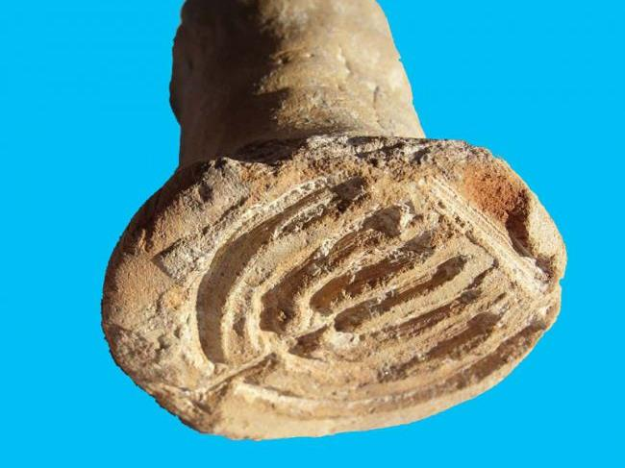
500’s AD (6th century) Jewish Bread Mold
The seven-branched menorah was engraved on what researchers say was likely a bread stamp used by Jewish bakers to identify their kosher breads by name some 1,500 years ago
In 2011, Excavators with the Israel Antiquities Authority unearthed a 1,500-year-old Jewish bread stamp from a small Byzantine settlement near the ancient port city of Akko. The sixth-century clay stamp, excavated from the small site

Slide 2
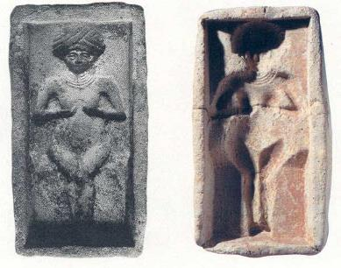
Cake to Queen of Heaven
Jeremiah 44: 19And the women said, “When we made offerings to the queen of heaven and poured out drink offerings to her, was it without our husbands’ approval that we made cakes for her bearing her image and poured out drink offerings to her?”
This lady might be [the goddess] Ishtar. Jeremiah condemns the holy cakes made for Ishtar, the Queen of Heaven [Jeremiah 7:16–20 and particularly Jeremiah 44:19]. In Mari you have the same thing 1,200 years earlier! BAR 29:01 (Jan/Feb 2003).
Notes:
Erich Lessing.
Let them eat (sacred) cake. Wearing an elaborate headdress and necklace, and cupping her breasts in her hands, a curvaceous female graces this clay cake mold found at Mari (its front and back are shown here). Malamat believes the woman on the mold may be the goddess Ishtar. He cites an early Israelite parallel in the Book of Jeremiah, where the prophet condemns the making of holy cakes for Ishtar (Jeremiah 7:16–20 and 44:19). As the passage indicates, worship of Ishtar was widespread and represents a religious phenomenon common to both Mari and ancient Israel.
Editor, H. S. (2004; 2004). BAR 29:01 (Jan/Feb 2003). Biblical Archaeology Society.
2

Slide 3
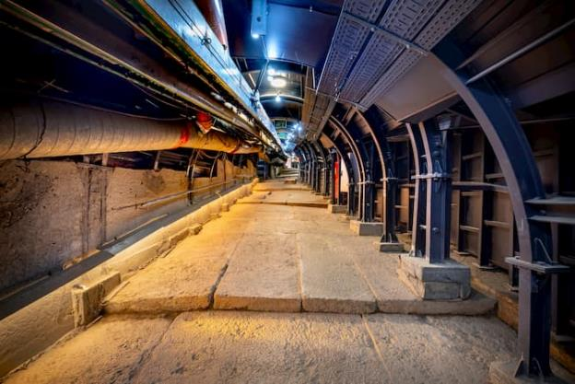
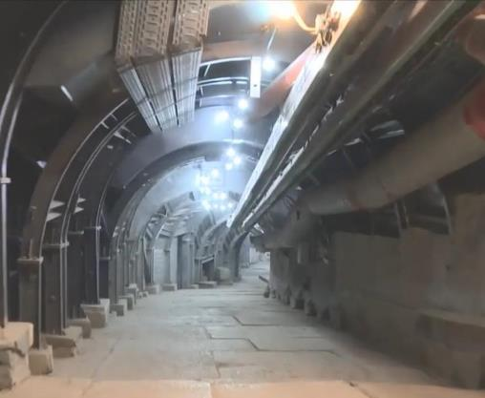
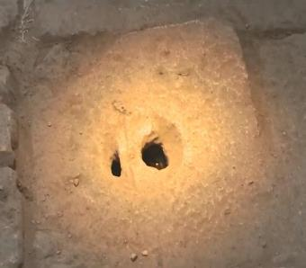
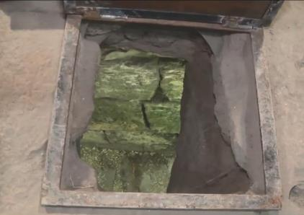
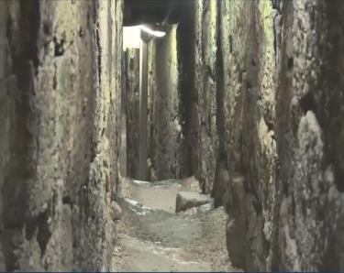

Slide 4
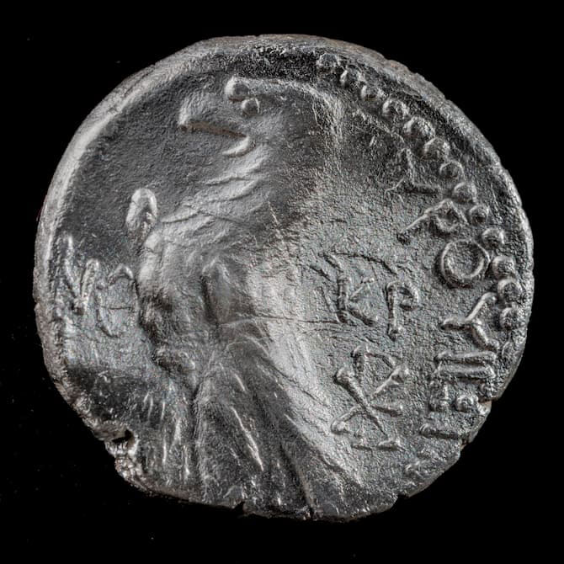
A number of silver coins were minted in the city of Tyre in AD 33 were found, which helped date the construction of the road.
Half Shekel silver coins used to pay the Temple tax found in the excavation of the street.

Slide 5
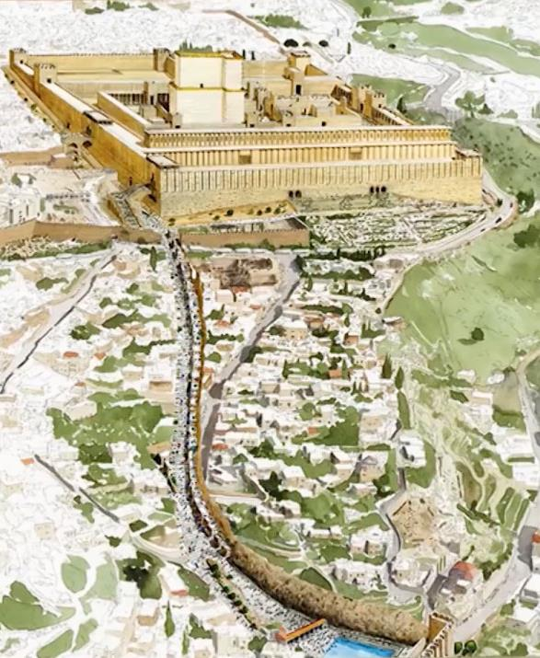
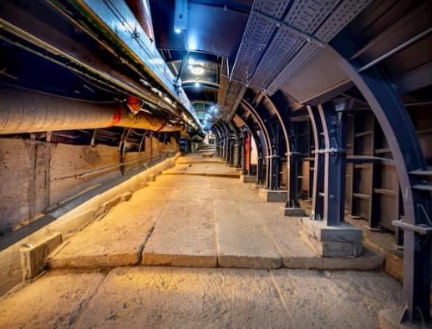
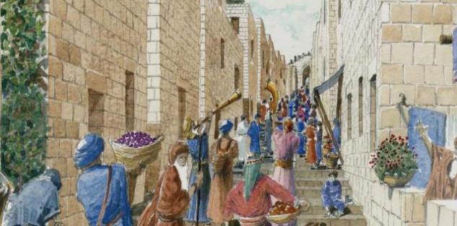

Slide 6
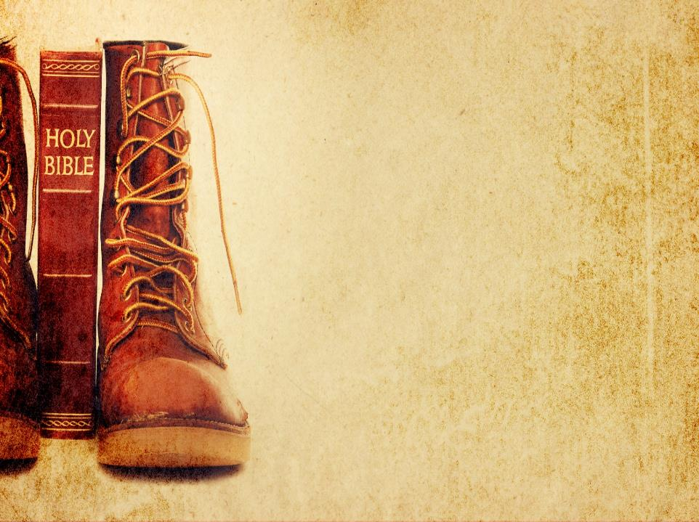
Journey thru the Bible with Archaeology
A Bible and Spade Evidence Class.
Lesson 11 Crucifixion and Burial

Slide 7
Objectives:
Improve our knowledge of Bible Locations, People and Timeline
Gain an understanding that the Bible deals with real events, real people, and real places.
Strengthen our faith by examining the physical remains/evidence that have been discovered in Middle East and Mediterranean related to Bible events.

Slide 8

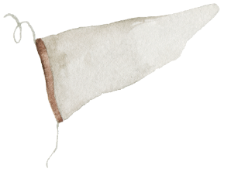
Journey thru the Bible with Archaeology
04-Shechem a City for All Times
03-Joshua and the Conquest
01-Introduction to Bible Archaeology
03-Joshua and the Conquest
02-Patriarchs
and Camels
05-David, Samson and the Philistines
17-Archaeology and the Bible Text
06-Solomon the Builder
07-Ahab and the Northern Kingdom
11-Crucifixion and Burial
16-Archaeology in Jerusalem
15-Museums and Key Bible Finds
14-Daniel and the Kingdoms
08-The Hezekiah Defense
09-Jeremiah and the Last Days of Judah
12-Cities of Paul and John
13-Finding People in the Bible Outside the Bible

Slide 9
Sin Separates Us from God
Bible is God’s Effort to Redeem Us
See it Unfold via Bible Periods
Creation & Fall
The Patriarchs
Exodus Conquest
The Judges
Kings & Prophets
Exile & Return
Life of Jesus
Early Church
United
Divided
Judah Alone
Between the Testaments

Slide 10
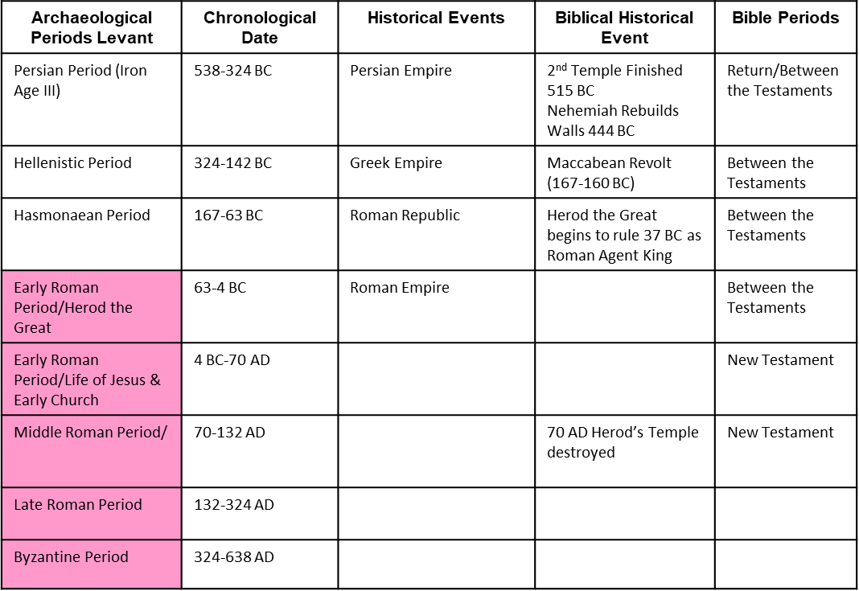
Putting Bible Time to Archaeological Time

Slide 11
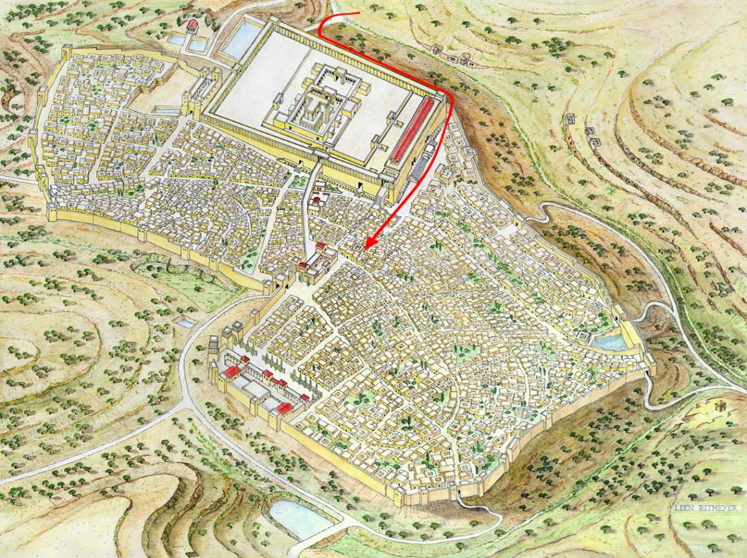
Gethsemane
From Gethsemane to the High Priest
Palace of
High Priest
Notes:
The Way to Golgotha - From Gethsemane to Annas the High Priest
After he was betrayed by Judas, Jesus was arrested in the Garden of Gethsemane. According to the Gospel of John 18.13, he was then brought first to the Palace of the High Priest, Annas, which we have tentatively identified with the Palatial Mansion (see Slide 52). As we have seen, Annas was High Priest from 6-15 AD only. However, his five sons subsequently held office and his son-in-law Caiphas, served from 18-37 A.D., so it is not difficult to imagine the power wielded by him. The other gospel writers didn’t record this meeting, but John, who was known to the High Priest, found it important enough to mention. It gives us a clue to the first leg of the last journey of Jesus. He must have re-crossed the Kedron Valley and entered the city through the Eastern Gate of the Muster. Passage across the Temple Mount through its eastern gate was forbidden, so he would have walked along the Eastern and Southern walls of the Temple Mount and then climbed up to the Palace of the High Priest.

Slide 12
Trial of Jesus – Before Annas
John 18:12-14 (ESV)
¹² So the band of soldiers and their captain and the officers of the Jews arrested Jesus and bound him.
¹³ First they led him to Annas, for he was the father-in-law of Caiaphas, who was high priest that year.
¹⁴ It was Caiaphas who had advised the Jews that it would be expedient that one man should die for the people.
Was high priest A.D. 7-14. In A.D. 25 Caiaphas, who had married the daughter of Annas (John 18:13), was raised to that office, and probably Annas was now made president of the Sanhedrim, or deputy or coadjutor of the high priest, and thus was also called high priest along with Caiaphas (Luke 3:2). By the Mosaic law the high-priesthood was held for life (Num 3:10); and although Annas had been deposed by the Roman procurator, the Jews may still have regarded him as legally the high priest.
Easton Illustrated Bible Dictionary

Slide 13
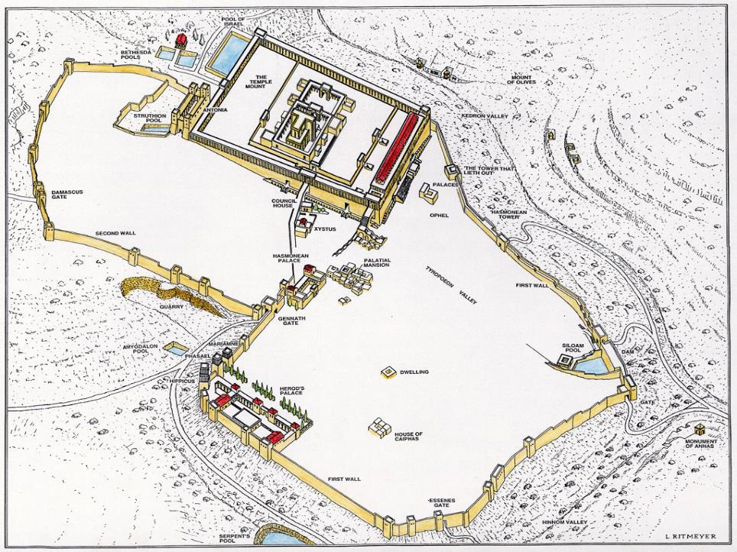
Notes:
Reconstruction drawing of the known elements
This drawing of Jerusalem in the time when Jesus walked its streets is a synthesis of the results of archaeological investigations, with the details that are inaccessible to the archaeologist’s spade culled from the written sources. The texts of Josephus inform us that from the eastern cloisters of the Temple Mount, the First Wall ran above the Kedron Valley, including in its fortifications the "tower which lieth out" of Nehemiah's time and another tower which can be clearly dated to the Hasmonean period. The wall of a large dam belonging to the Siloam reservoir was also part of the city wall, after which it ran along the southern slopes of the Western Hill, linking up with the Essenes Gate. It then curved round to meet up with the outer wall of Herod's Palace, incorporating the three great towers of Hippicus, Phasael and Mariamme. From there it veered in the direction of the western portico of the Temple Mount, passing the Hasmonean Palace, the Xystus (the former Gymnasium) and the Council Chamber.
The line of the Second Wall is less clear. Our main source, Josephus, records merely that it began at the Gennath Gate in the First Wall and ended at the Antonia Fortress, which stood at the north-west corner of the Temple Mount. Its construction is believed to date from the Hasmonean or early Herodian period. We shall justify our positioning of the wall in due course, when we proceed to examine the various features of the city point by point. It is indeed the walls that present the most unresolvable questions.
Other major features such as Herod's Palace and the Council Chamber are fairly well attested. No remains of the Hasmonean Palace have come to light, despite the fact that its location can be accurately surmised. The various pools and water reservoirs have been found just where they were expected to be. And, although the exact mode of the development of the Temple Mount is contested, there is unanimity among scholars that the Temple Mount of Herod stood on the eastern ridge, dominating the city just as it does today.

Slide 14
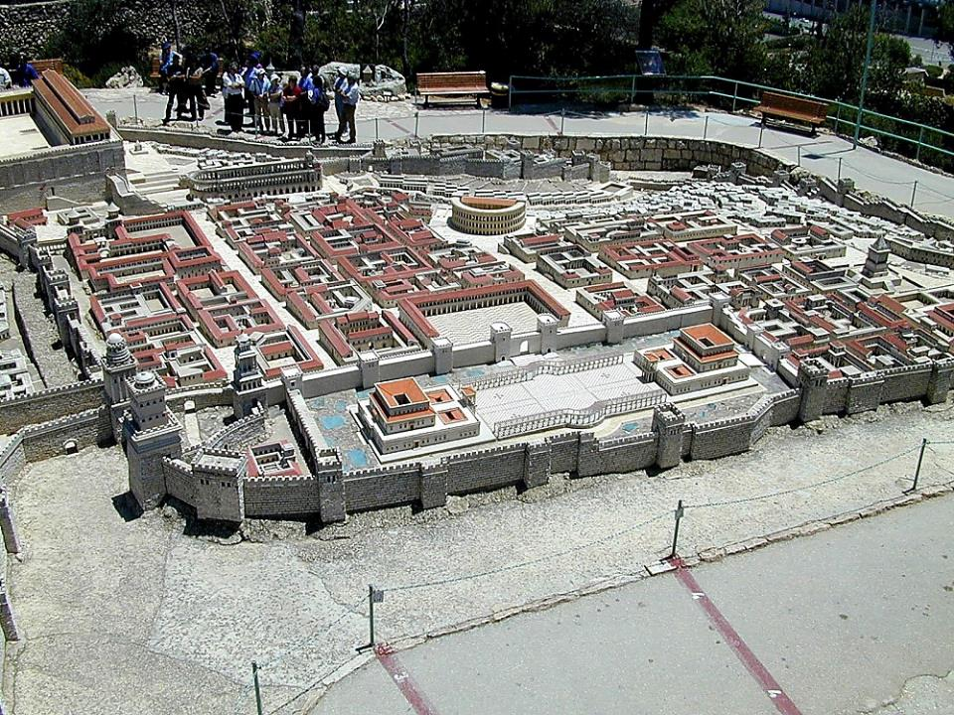
Upper City from west
Mark 15:
¹ Immediately, in the morning, the chief priests held a consultation with the elders and scribes and the whole council; and they bound Jesus, led Him away, and delivered Him to Pilate.
Houses of Chief High Priests
Annas
Caiaphas
Old Palace of Herod the Great
Upper City from west
Notes:
The Upper City
The Upper City was the location of a wealthy residential quarter in the 1st century A.D. It was located on the summit of the Western Hill.
When first constructed, Avi-Yonah was criticized for making the houses too large and luxurious. Since that time, excavations in the Jewish Quarter of the Old City have revealed that the model is too modest.
Many priests likely lived in the Upper City.

Slide 15
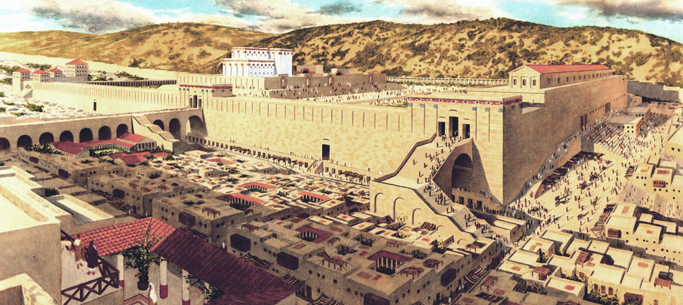
View from a Rich Man’s House

Slide 16
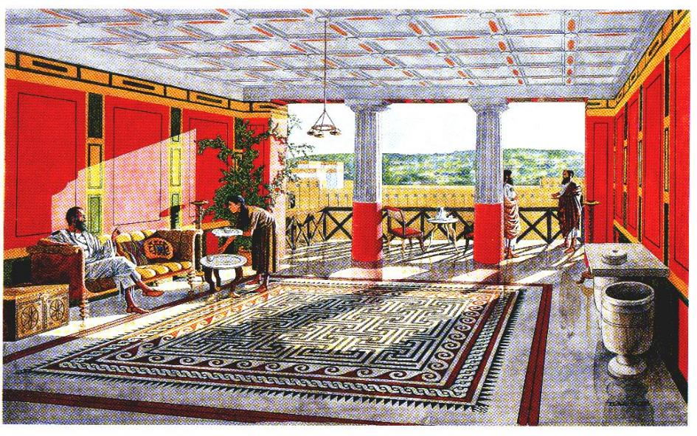
Rich Man’s House
Mark 10:21 ²¹And Jesus, looking at him, loved him, and said to him, “You lack one thing: go, sell all that you have and give to the poor, and you will have treasure in heaven; and come, follow me.”

Slide 17
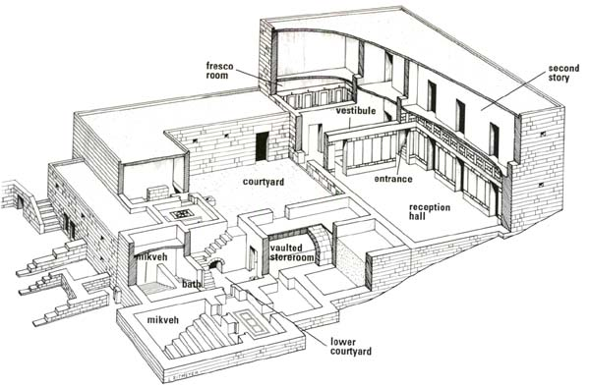
Rich Man’s House

Slide 18
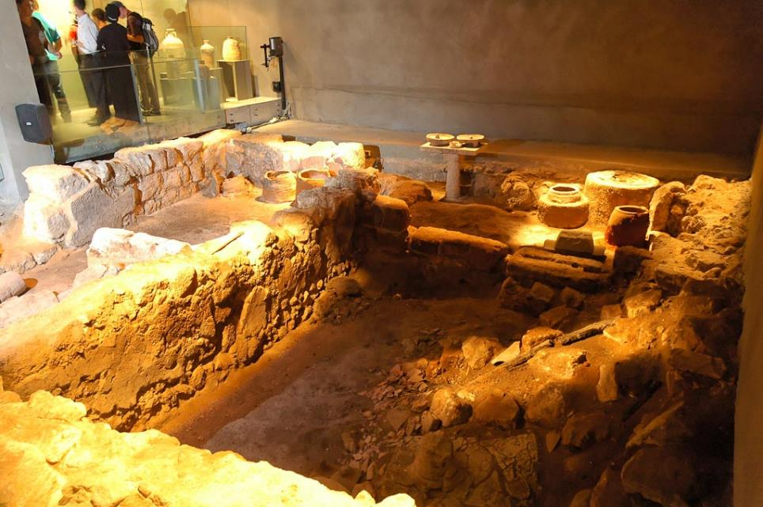
Burnt House
Notes:
One of the areas excavated by Nahman Avigad in the 1970s, this building is located on the eastern edge of the Upper City (Western Hill), near the top of the present staircase leading down to the Western Wall.
tb051906365

Slide 19
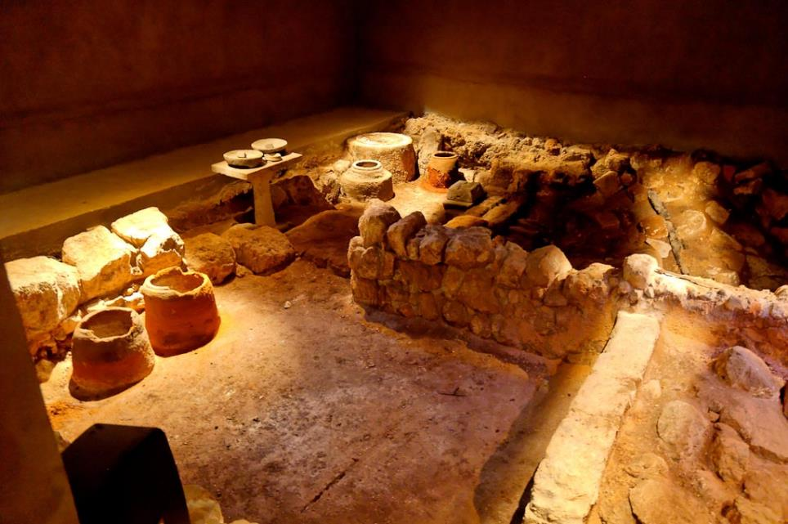
Burnt House
Notes:
This building, known today as the “Burnt House,” had four rooms and some sort of an additional kitchenette. This is only the basement level of the house, as the superstructure was destroyed in antiquity. The excavators determined that this area was used for industrial purposes, probably serving either the priesthood or the temple. They found barrels, different kinds of ovens, stone vessels, tables, and perfumes. Many stone vessels and coins and other daily use objects were also found.
tb051906385

Slide 20
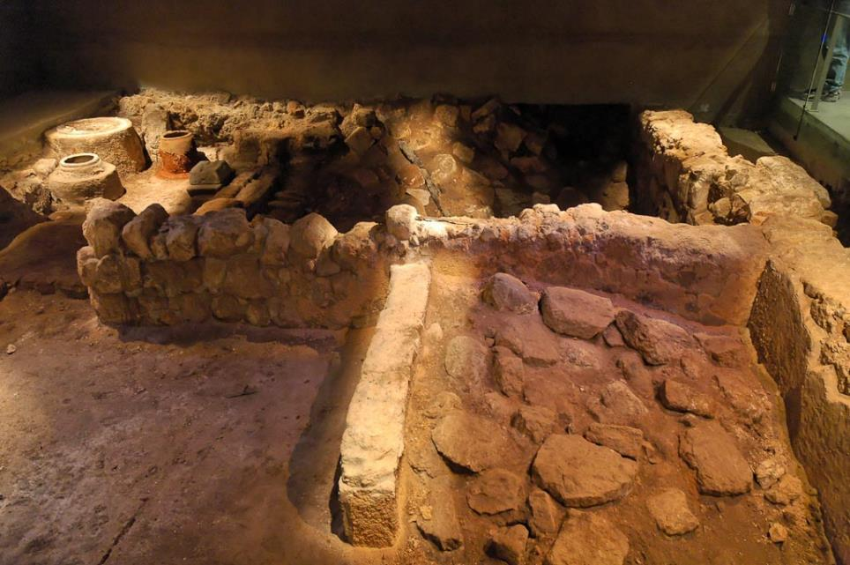
Burnt House
Notes:
The house gets its name from the extensive evidence of destruction by fire. While other buildings excavated by Avigad in the Jewish Quarter were also destroyed in AD 70, this one stood out with an unusual amount of evidence of conflagration. The burning was so intensive that the excavators would finish their days completely blackened with soot. The stones of the Burnt House turned multicolored from the intense heat of the fire. The ashy material came from the superstructure that was destroyed by fire in antiquity.
tb051906384

Slide 21
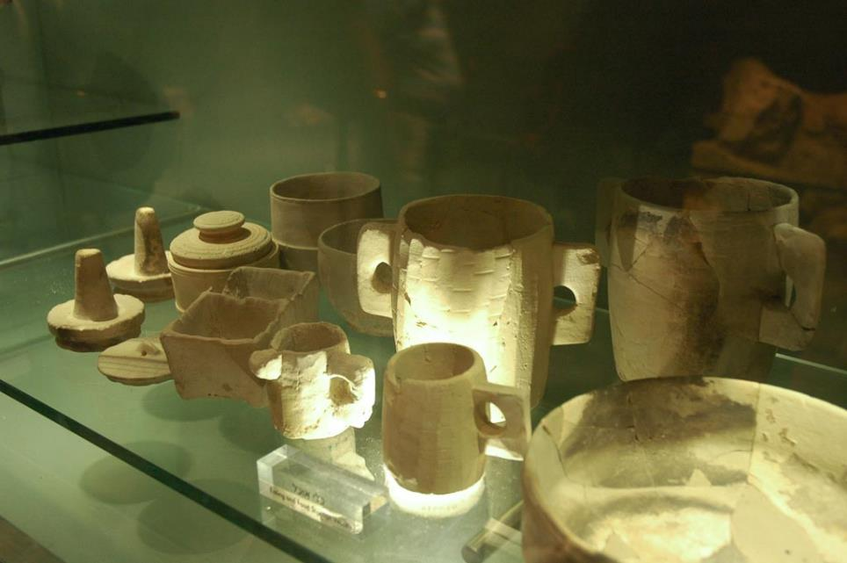
Burnt House stone vessels
Notes:
These stone vessels are typical of those used in Jerusalem in the 1st century AD.
tb051906396

Slide 22
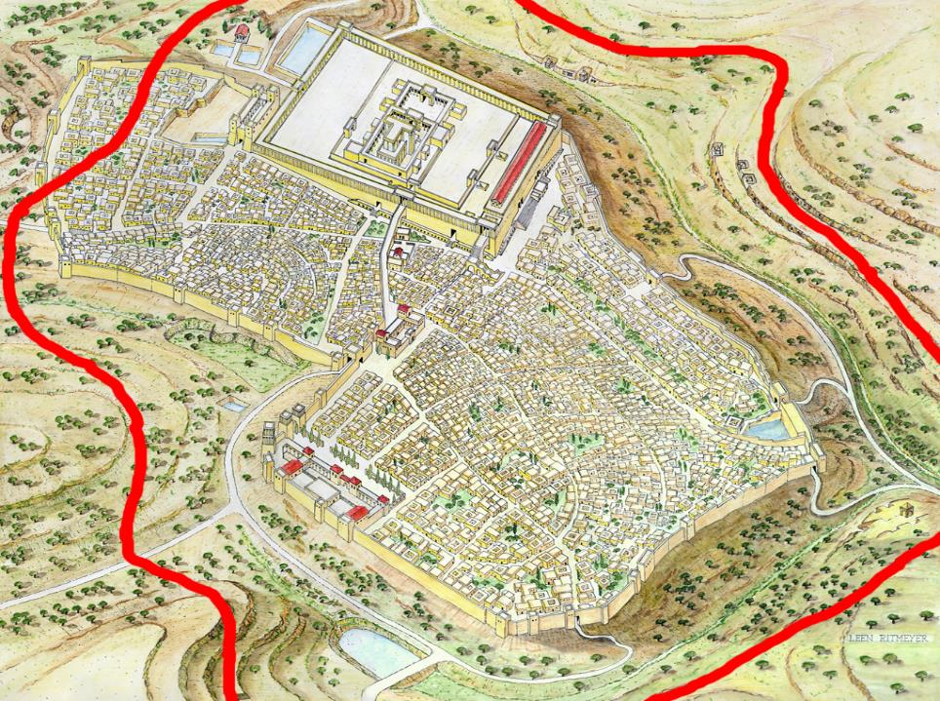
Monument
of Annas
Notes:
Roman Circumvallation Wall
Josephus, in his record of the siege of Jerusalem by Titus in 70 A.D. (War 5.504-7), describes the final ploy of the Roman leader, the building of a circumvallation or siege wall to block off all escape by the Jews. He gives the precise line of the 39 furlong earthworks, including in it the Tomb (Greek: monument) of Annas the High Priest, at a location which can only be the prominent southern rock scarp of the Hinnom Valley where the decorated tomb complex is located.

Slide 23
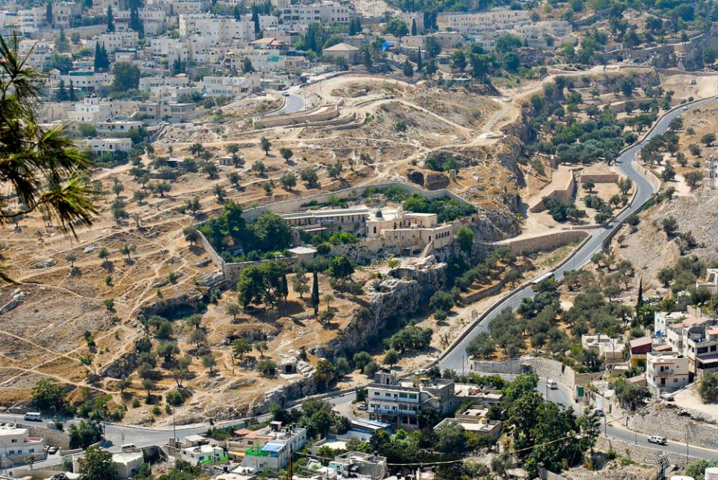
And he went away and hanged himself
Monastery of St. Onuphrius, traditional Akeldama (from the east)
27:5
Notes:
tb091306366

Slide 24
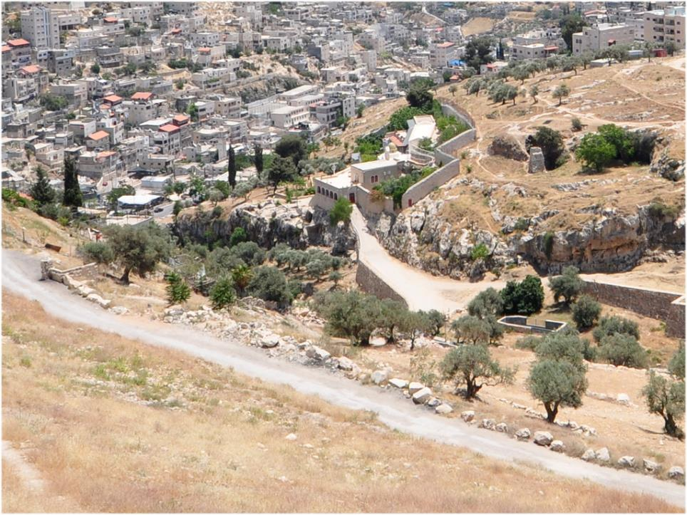
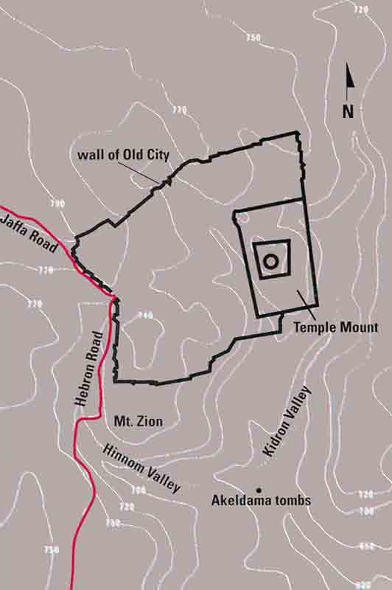
Notes:
View of the Hinnom Valley and the so-called Akeldama
Outside the southern city gate lay the Hinnom Valley. In New Testament times, the Aramaic form of the name Hinnom: “Gehenna” was used as a metaphor for hell or everlasting punishment. Dating from this time, it also gained a strong association with Akeldama, the Field of Blood or Potter’s Field bought by the Jewish chief priests with money the remorseful Judas had thrown into the Treasury. However, in the first century A.D., this area, far from being an impoverished cemetery, was rather an elegant tomb complex decorated in the finest Herodian style.

Slide 25
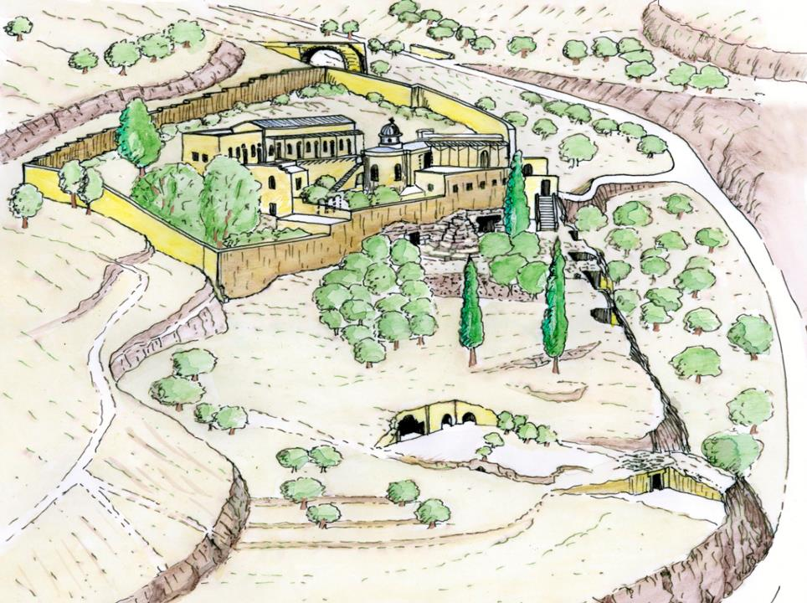
Crusader Charnel House
Hinnom Valley
Monastery of St. Onuphrius
Tomb of Annas
this tomb has been identified as belonging to Annas, the High Priest, father-in-law to Caiaphas, who presided at the trial of Jesus.
Notes:
First century tombs in the Hinnom Valley
Today, the Hinnom Valley is a dry ravine which separates present-day Mount Zion from the hill of Abu-Tor. In Arabic the valley is known as Wadi-er-Rababi - the valley of the lute - because of its shape. Now landscaped as part of the National Park which surrounds the city, it is the site of the Greek Orthodox Monastery of St. Onuphrius, shown in this drawing. The ruins of the underground vaulted charnel-house built by the Crusaders to house the bones of deceased knights and pilgrims can be seen near the monastery walls to the north.
There are two tombs decorated in the finest Herodian style inside the walled monastery compound. The most outstanding tomb in this lavishly decorated group of tombs however, is located outside the monastery walls, on the terrace just below the two slender cypresses visible in the drawing. For reasons explained in the following slides, this tomb has been identified as belonging to Annas, the High Priest, father-in-law to Caiaphas, who presided at the trial of Jesus.

Slide 26
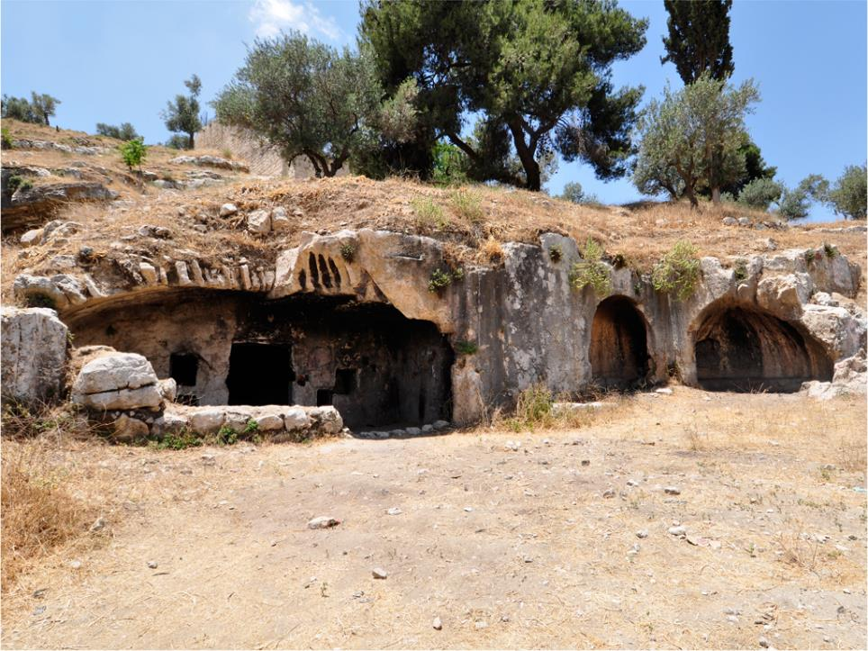
Nat Ritmeyer
Notes:
The Tomb of Annas
This tomb is now much destroyed, but enough has been preserved to make it clear that it once belonged to a very important personage.
Part of the original triple-gated entrance can still be seen, as can a portion of the scalloped shell decoration that lay over the central doorway. One of the two apses with benches is visible on the right of the slide. These could have served as a resting place for visitors or may have been designed as a post for tomb guards. Recently used as a shed, the tomb has now been fenced off in order to protect it.

Slide 27
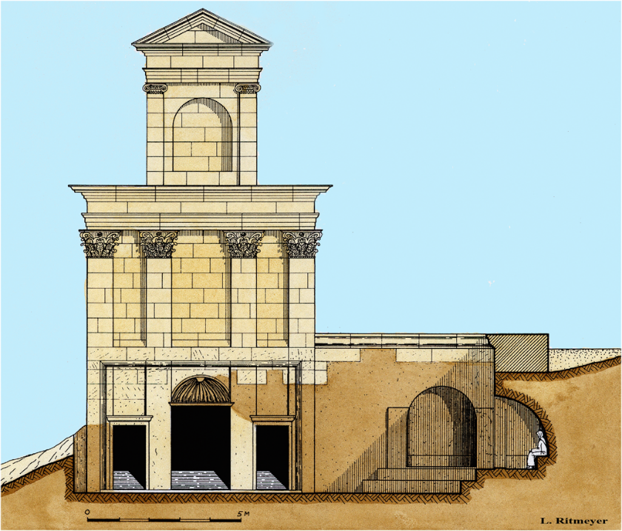
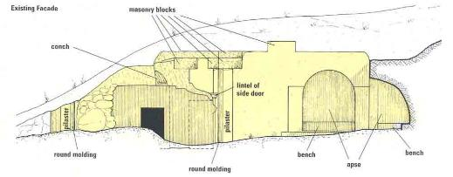
Notes:
Reconstruction drawing of the Tomb of Annas
The reconstruction drawing shows the triple-gated entrance to the tomb's anteroom. This is based on the remains of the partly preserved scalloped conch above the central doorway and those of four pilasters, the outer ones showing an additional rounded moulding which was part of a frame. The reconstruction of the Triple Gate of the southern wall of Herod's Temple Mount was modelled on the proportions of the triple gate of Annas' tomb.
On the right of the conch decoration, the top of the rock wall is carved in such a way as to receive masonry blocks. This would indicate that the facade of this tomb was continued upward in masonry, in contrast to other surrounding tombs. Having a superstructure would enable it to be seen from afar and make it worthy of mention by Josephus in his description of the siege wall. As the southern wall of the Temple Mount could be seen from the front of this tomb, we have modelled the superstructure in the style of the Royal Stoa which stood above the Triple Gate of the Temple Mount.

Slide 28
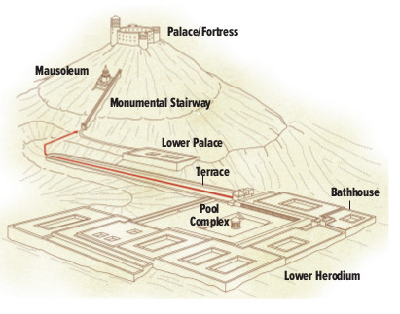
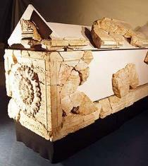
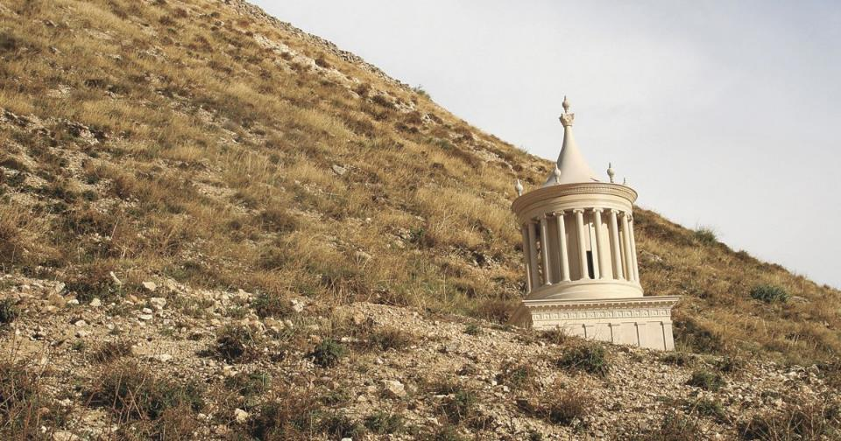
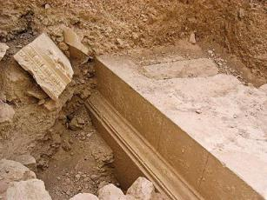
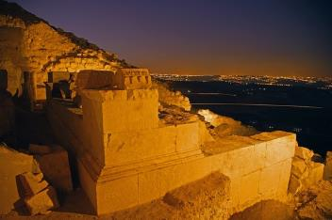
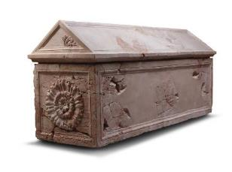

Slide 29
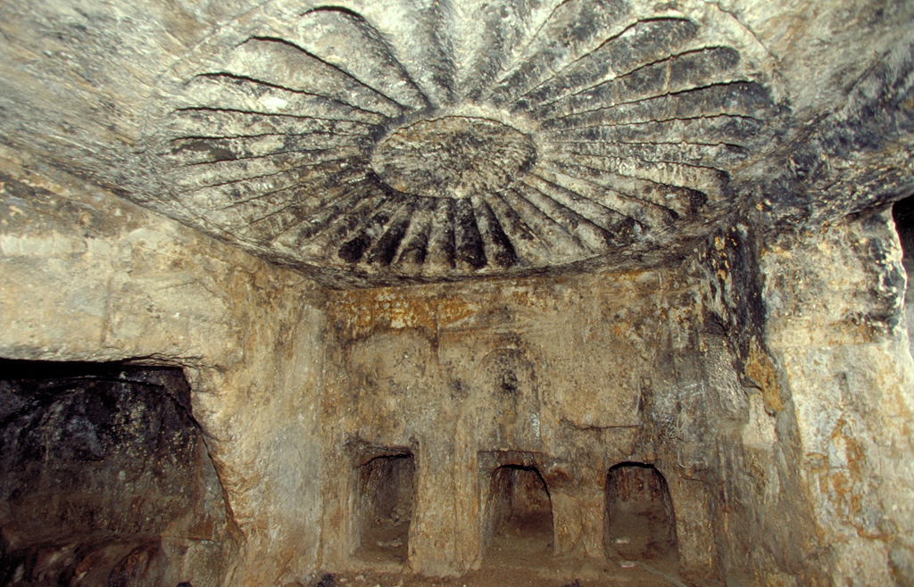
Alexander Schick
Notes:
Carved ceiling inside the Tomb of Annas
The carved domed ceiling in the chamber inside this tomb distinguishes it from every other Second Temple period tomb in Jerusalem. With one exception, no other tomb contains sculpted internal decoration. Thirty two petals surround a small whorl rosette, with stylised acanthus leaves at the four corners. There is an obvious resemblance between this decoration and the rosettes carved onto the domed ceiling in the passageway leading up from the Double Gate of the Temple Mount.
Each of the two side walls of this chamber had three loculi (kokhim) or burial niches. The central kokh of the western wall was once sealed off by the lower half of a false door of the Attic type i.e. one whose side mouldings widen out at the top to give the impression of a lintel. This doorway was not meant to provide passage, but was an elaborately decorated burial cavity for a highly honoured person, most probably that of the High Priest Annas himself. He held office from 6-15 A.D. and is mentioned a number of times in the New Testament. His five sons all officiated as High Priest for varying periods of time. However, it was his son-in-law Caiaphas, who served from 18-37 A.D. and presided at the trial of Jesus (Matt. 26.57), who is best known.

Slide 30
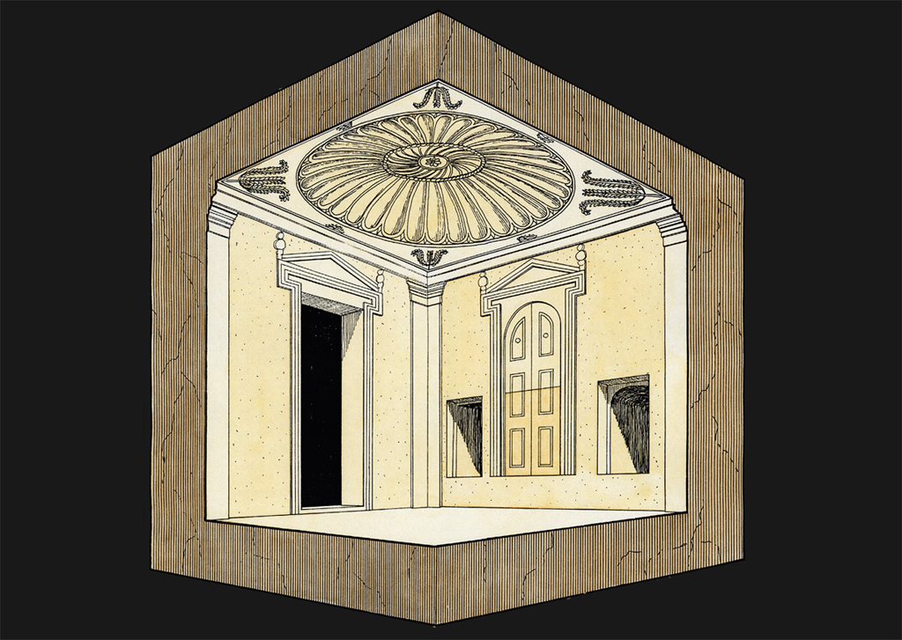
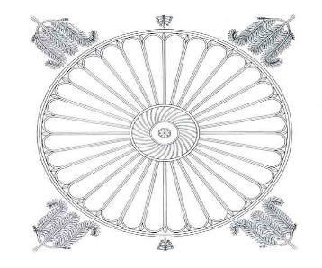
False Door
Blocking Stone
Notes:
A Reconstruction of the interior of the Tomb of Annas
In this reconstruction drawing of the interior of the tomb chamber, we can see further similarities to the style of decoration found in architectural elements from near the Temple Mount. For example, the form of the Attic doorways are seen to resemble fragments of Attic doorways found in the excavations that took place in that area. We must remember that the entrances of this complex of tombs faced north across the valley to the Temple Mount, which was decorated in fine Oriental-Hellenistic style. It appears that the priestly family of Annas wanted to transfer to their final resting place some of the magnificence they were accustomed to seeing on their regular visits to the centre of Jewish worship.

Slide 31
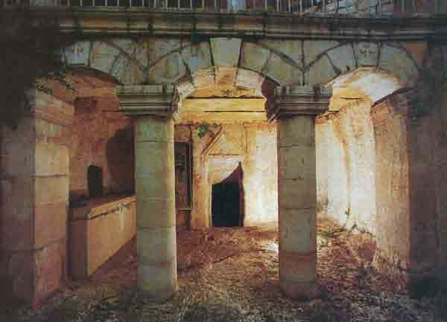
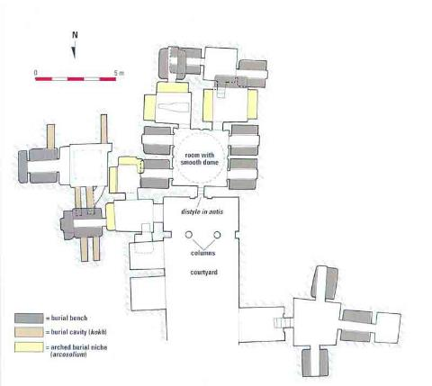
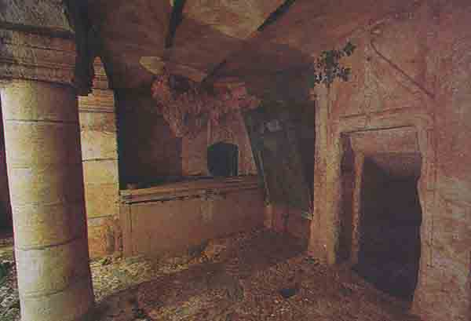
Biblical Archaeology Review 20:6, November/December 1994

Slide 32
Notes:
Reconstruction drawing of the known elements
This drawing of Jerusalem in the time when Jesus walked its streets is a synthesis of the results of archaeological investigations, with the details that are inaccessible to the archaeologist’s spade culled from the written sources. The texts of Josephus inform us that from the eastern cloisters of the Temple Mount, the First Wall ran above the Kedron Valley, including in its fortifications the "tower which lieth out" of Nehemiah's time and another tower which can be clearly dated to the Hasmonean period. The wall of a large dam belonging to the Siloam reservoir was also part of the city wall, after which it ran along the southern slopes of the Western Hill, linking up with the Essenes Gate. It then curved round to meet up with the outer wall of Herod's Palace, incorporating the three great towers of Hippicus, Phasael and Mariamme. From there it veered in the direction of the western portico of the Temple Mount, passing the Hasmonean Palace, the Xystus (the former Gymnasium) and the Council Chamber.
The line of the Second Wall is less clear. Our main source, Josephus, records merely that it began at the Gennath Gate in the First Wall and ended at the Antonia Fortress, which stood at the north-west corner of the Temple Mount. Its construction is believed to date from the Hasmonean or early Herodian period. We shall justify our positioning of the wall in due course, when we proceed to examine the various features of the city point by point. It is indeed the walls that present the most unresolvable questions.
Other major features such as Herod's Palace and the Council Chamber are fairly well attested. No remains of the Hasmonean Palace have come to light, despite the fact that its location can be accurately surmised. The various pools and water reservoirs have been found just where they were expected to be. And, although the exact mode of the development of the Temple Mount is contested, there is unanimity among scholars that the Temple Mount of Herod stood on the eastern ridge, dominating the city just as it does today.

Slide 33
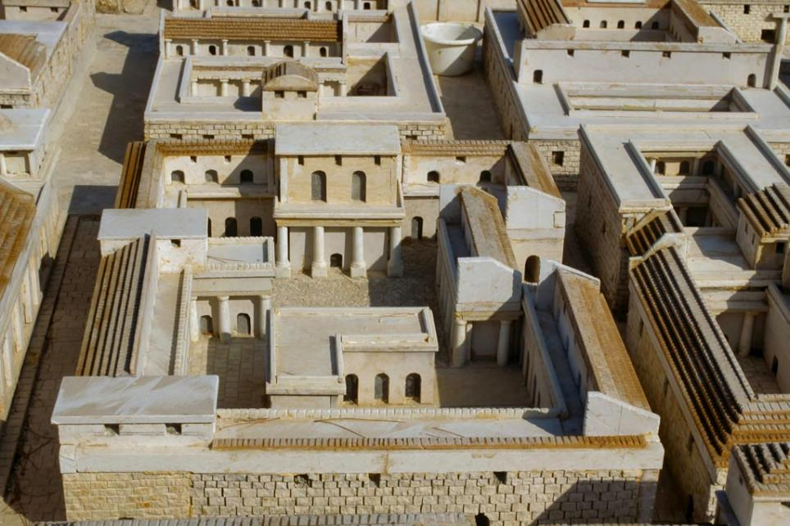
Jerusalem model typical house in Upper City
Notes:
tbs41289009

Slide 34
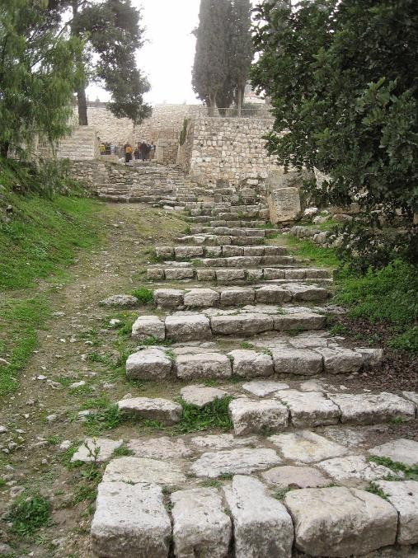
Matthew 26:57 (ESV)
⁵⁷ Then those who had seized Jesus led him to Caiaphas the high priest, where the scribes and the elders had gathered.
He then went with His disciples to Gethsemane. From there He was taken to the House of Caiaphas. Jesus may have taken these steps in both directions.
First century steps leading to the Upper City

Slide 35
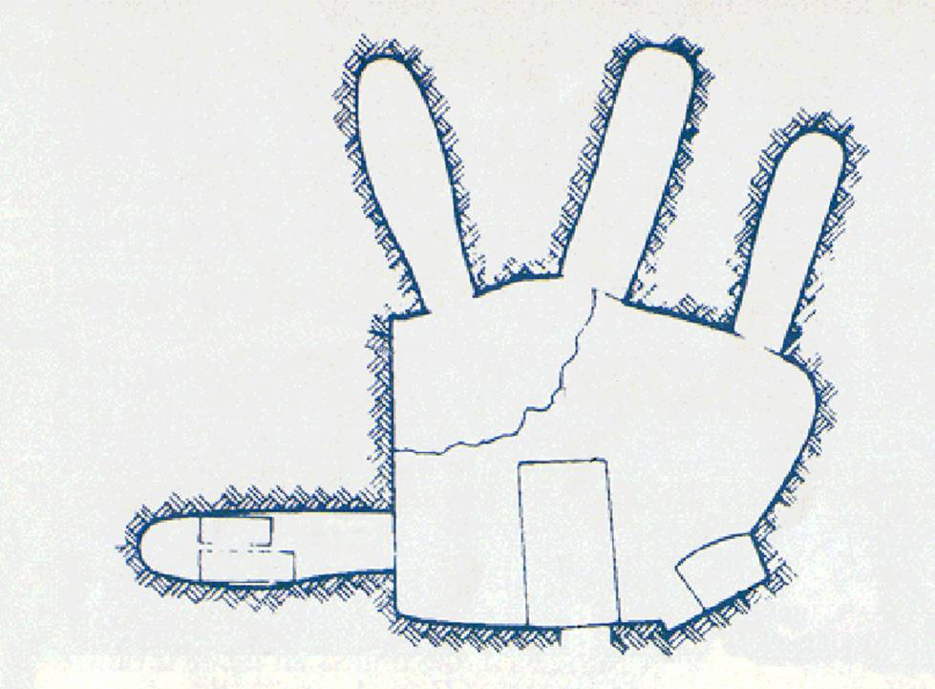
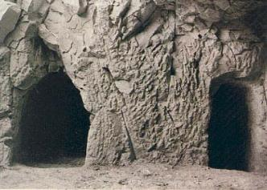
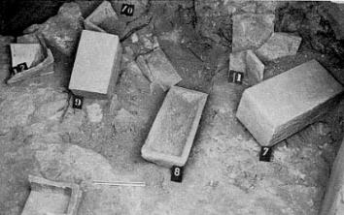
Housed
Two ossuaries
One of which was Caiaphas ossuary
Caiaphas’ tomb.
6 other ossuary find turn over
Robbed in ancient times
Notes:
Caiaphas’ tomb. A narrow entranceway leads into the chamber, a rectangular pit, dug below floor level, allowed workers or mourners to stand upright. Four 6-foot-deep by 1.5 foot-wide cavities were carved into the chamber’s limestone walls. Known as loculi (sing., loculus), the one at the far right housed two (of the six total) ossuaries, one of which was the elaborate Caiaphas ossuary. To the right of the entrance is a pit that served as a repository for bones that were not placed in ossuaries. BAS book, In The Temple of Solomon And The Tomb Of Caiaphas.

Slide 36
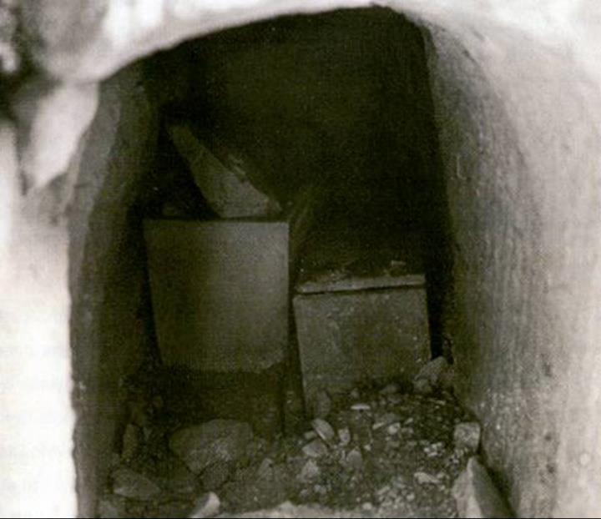
Discovered in 1990 south of Jerusalem by workers widening a road.

Slide 37


Notes:
Ossuaris 5 & 6 in the far right loculus as they were originally found. Caiaphas’ ossuary is the one on the left. BAS book, In The Temple of Solomon And The Tomb Of Caiaphas.

Slide 38

Notes:
While constructing a water park in Jerusalem’s Peace Forest, workman stumbled upon an ancient burial cave with numerous ossuaries. 2.5 feet long, 1 foot wide, and 1.25 feet high. “Yehoseph bar Qafa.” BAS book, In the Temple of Solomon aand the Tomb of Caiaphas.

Slide 39


Annas Tomb

Slide 40


Slide 41

Joseph Caiaphas

Slide 42

Notes:
Thousands of ossuaries from the late Second Temple Period have been discovered in and around Jerusalem. They average two feet in length,one foot in width, and a little over one foot in height. BAS book, In The Temple of Solomon and The Tomb Of Caiaphas.

Slide 43

Gethsemane
From Gethsemane to the High Priest
From the High Priest to Pilate
Palace of
High Priest
Pilate at
Praetorium
Notes:
The Way to Golgotha - From the Palace of the High Priest to Pilate
Having been found worthy of death, Jesus was beaten and spat upon in the Palace of the High Priest, where Peter also denied that he knew him. Then, as the Jews had no authority to execute anybody, they sent Jesus to Pilate, who was Roman Governor at the time. Herod the Great had built a sumptuous palace on the Western Hill of Jerusalem, where the Citadel now stands. We have seen in Slide 34, that this had been appropriated by the Romans, who generally claimed the royal palaces in the countries they conquered. Pilate usually stayed in Caesarea, the seat of Roman government for Judea but used this as his official residence (or praetorium) when he came to Jerusalem, especially during the Jewish festivals, such as Passover.
John points out that “By now it was early morning,” (John 18.28) when Jesus was pushed through dark narrow streets until he arrived at the Praetorium to stand before Pilate.

Slide 44

Jerusalem model Herod's Palace from southwest
Notes:
Herod’s Palace
The palace had two main wings, named after Agrippa and Caesar, two important friends of King Herod. Each wing had its own banquet halls, baths, and accommodations for hundreds of guests. The palace was surrounded by groves of trees, canals, and ponds, and studded with bronze fountains.
tb020101208

Slide 45

Matthew 27:1-2 (ESV)
¹ When morning came, all the chief priests and the elders of the people took counsel against Jesus to put him to death.
² And they bound him and led him away and delivered him over to Pilate the governor.
Notes:
Matthew 27:27 (ESV)
²⁷ Then the soldiers of the governor took Jesus into the governor’s headquarters, and they gathered the whole battalion before him.

Slide 46

This inscription clarifies the position Pilate held—correcting an error found in the writings of both Greek and Latin authors. The Roman historian Tacitus wrote at the beginning of the second century AD., “Christus, the founder of the name, had undergone the death penalty in the reign of Tiberius, by sentence of the procurator Pontius Pilatus” (Annals 15:44). However, the Caesarea inscription indicates that Pilate was a Roman prefect, not a procurator. In the Roman Empire—at least initially—a prefect was an official with military responsibilities, whereas a procurator had primarily financial ones. This is a minor historical detail, but it demonstrates how archaeology helps us to present Pilate’s role correctly. Further, in Egypt and the Roman East, there were no procurators before Claudius’s reign (41–54 C.E.).
This roughly translates as
“[Po]ntius Pilate, [pref]ect of Jud[e]a, [made and d]e[dicated] Tiberieum to the [divine August]us.”

Slide 47


a prefect was an official with military responsibilities, whereas a procurator had primarily financial ones.
there were no procurators before Claudius’s reign (41–54 AD)

Slide 48

Gethsemane
From Gethsemane to the High Priest
From the High Priest to Pilate
From Pilate to Herod Antipas
Herod Antipas at
Hasmonean Palace
Palace of
High Priest
Pilate at
Praetorium
Notes:
The Way to Golgotha - From Pilate to Herod Antipas
It became obvious to Pilate that the Jews had no case against Jesus and that he posed no challenge to the Romans. Luke 23.6 -16 gives us a detail that is not recorded in the other gospel records, that when the Roman governor heard then that Jesus was from Galilee, he sent him to Herod Antipas, who was tetrarch of Galilee and Perea and in Jerusalem for the Passover season. As we have seen, the Romans had confiscated the Palace of Herod the Great after his death and therefore his sons had to use the old Hasmonean Palace (Slide 42), which stood halfway between Herod’s Palace and the Temple Mount. According to Josephus, this palace stood on the Western Hill above the Xystus on a high elevation from which the Temple Courts could be viewed. Herod, the executor of John the Baptist, who had originally also tried to kill Jesus, who referred to him as “that fox” (Luke 13.31,32), hoped to see him perform some sign.

Slide 49

Luke 23:6-7 (ESV)
⁶ When Pilate heard this, he asked whether the man was a Galilean.
⁷ And when he learned that he belonged to Herod’s jurisdiction, he sent him over to Herod, who was himself in Jerusalem at that time.

Slide 50

The Herod Family
Tyre/Sidon and worms

Slide 51

Jerusalem model Hasmonean palace and First Wall from south
Notes:
tb123011061

Slide 52

Gethsemane
From Gethsemane to the High Priest
From the High Priest to Pilate
From Pilate to Herod Antipas
From Herod Antipas to Pilate
Herod Antipas at
Hasmonean Palace
Palace of
High Priest
Pilate at
Praetorium
Notes:
The Way to Golgotha - From Herod Antipas back to Pilate
The sign that Herod Antipas looked for was not forthcoming. Jesus stood silently before the tetrarch, ignoring the accusations of the priests and scribes. Although Herod Antipas treated him with cruel derision, he could not find him guilty of the charges laid against him. After dressing him in an elegant robe, which mocked his claims to kingship, Herod Antipas had him retrace his steps back to Pilate in the Praetorium. By this juncture, both the Roman and Jewish authorities had found him to be innocent of the charges laid against him.

Slide 53






Rome fielded
some 30 legions
6 Cohorts = 1 Legion
(4800-6000 men)
Legate
Command of
Legion
Tribune
2nd in Command of Legion
Matthew 27:27 (ESV)
²⁷ Then the soldiers of the governor took Jesus into the governor’s headquarters, and they gathered the whole battalion (1 Cohort) before him.
Centurion
Signifier
Matthew 27:27 (YLT)
²⁷ then the soldiers of the governor having taken Jesus to the Praetorium, did gather to him all the band;
Century (80-160 men)
1st Cohort had 5 double Centuries
10 Centuries = 1 Cohort
(800-1000 men)

Slide 54


Mark Anthony – Antonia Fortress

Slide 55

THIS STONE PAVEMENT under the Sisters of Zion Convent in Jerusalem was long believed to be the famous paved courtyard (Greek lithostrotos, Aramaic gabbatha) where Pontius Pilate condemned Jesus (cf. John 19:13). We now know that it was laid as a roadway after the time of Jesus—possibly during the reign of Emperor Hadrian, after the foundation of Aelia Capitolina in 135 C.E.

Slide 56

The etchings in the stone were made by Roman soldiers stationed in Jerusalem in the 2nd century. Though later than the time of Jesus, they remind the visitor of the soldiers who cast lots for Jesus’ garments (John 19:23-24).
Sisters of Zion Roman game on traditional Lithostratos
Notes:
The etchings in the stone were made by Roman soldiers stationed in Jerusalem in the 2nd century. Though later than the time of Jesus, they remind the visitor of the soldiers who cast lots for Jesus’ garments (John 19:23-24).
tb041603203

Slide 57

Jerusalem model crucifixion area of Holy Sepulcher
Notes:
The traditional area of Jesus’ crucifixion and burial is the Church of the Holy Sepulcher. Excavations have determined that this was an area of quarrying in the 1st century AD. Areas of quarrying were often used for tombs after the quarrying was completed. Some have identified the nearby gate as the “Gennath (Garden) Gate.”
tb020101201

Slide 58

Matthew 27:26 (ESV)
²⁶ Then he released for them Barabbas, and having scourged Jesus, delivered him to be crucified.

Slide 59

Fig 2.Scourging
Fig 2.Scourging. Short whip (flagrum) with lead balls and sheep bones tied into leather thongs. Center left, Naked victim tied to flogging post. Deep stripelike lacerations were usually associated with considerable blood IOS6 Center right, View from above, showing position of lictors. Right, Inferomedial direction of wounds.
Notes:
Short whip with lead balls and sheep bones tied into leather thongs.
Naked victim tied to flogging post.

Slide 60

Gethsemane
From Gethsemane to the High Priest
From the High Priest to Pilate
From Pilate to Herod Antipas
From Herod Antipas to Pilate
From Pilate to Golgotha
Golgotha?
Herod Antipas at
Hasmonean Palace
Palace of
High Priest
Golgotha?
Pilate at
Praetorium
Notes:
The Way to Golgotha - From Pilate to the Crucifixion
Standing again before Pilate, the chief priests and the elders accused Jesus of making himself a king. Despite the warnings of Pilate’s wife, who had “suffered a great deal today in a dream because of him” (Matthew 27.19), all efforts to release him came to nothing. Pilate was under such pressure that he had to give in and deliver Jesus up to be crucified. Bearing the crushing weight of his own cross, until relieved by Simon of Cyrene, Jesus was led away to a place called Golgotha (Place of a Skull).
The Bible describes this site as outside the city walls of the time, near a main road and located in a garden where a new tomb had recently been made (see Slide 70). There are two main proposals for the location of Golgotha: the Holy Sepulchre (indicated just outside the Gennath Gate, half way down the left side of the drawing) and the Garden Tomb (just outside the Damascus Gate of the time, on top left of drawing). Both sites are problematic, as the traditional Tomb of Christ in the Holy Sepulchre has been destroyed about 1000 years ago and the tomb in the garden of the Garden Tomb was not a newly hewn tomb. Though the last resting place of Christ remains tantalizingly elusive however, there is no uncertainty as to the history-defining miracle that took place within it. As the angel said to the three women: “He has risen! He is not here.”

Slide 61

Mark 15:
²⁰And when they had mocked Him, they took the purple off Him, put His own clothes on Him, and led Him out to crucify Him.

Slide 62


Only cross piece would have been carried by Jesus and then Simon of Cyrenian
Mark 15:
²¹ Then they compelled a certain man, Simon a Cyrenian, the father of Alexander and Rufus, as he was coming out of the country and passing by, to bear His cross.

Slide 63




1st line “of Alexander” in Greek;
2nd line, in Hebrew characters “Alexander QRNYT.”
if engraver made a slight error then qrnyh —
Hebrew for “Cyrenian.”
Alexander (son) of Simon,”
In Greek on side
Mark 15:
²¹ Then they compelled a certain man, Simon a Cyrenian, the father of Alexander and Rufus, as he was coming out of the country and passing by, to bear His cross.
BAR 29:04 (July/Aug 2003).
known to early Christians when Mark wrote Gospel
Notes:
Hebrew University Institute of ArchaeologyAlexandros Simon, “Alexander (son) of Simon,” reads the inscription crudely scratched into the front of a plain stone ossuary, or bone box, from the Kidron Valley in eastern Jerusalem (the first line, written in green ink, has badly faded). In 1941, Israeli archaeologists Eleazer Sukenik and Nahman Avigad found the ossuary with ten others in a first-century C.E. tomb. They published the find in a scholarly journal, but the ossuary group sat unnoticed in a storeroom for the next 60 years.However, as author Tom Powers observes, the selection of Greek and Hebrew names used on the ossuaries suggests a family connection with Cyrene, in North Africa. Could the Simon mentioned on this ossuarybe the Biblical Simon of Cyrene, who carried Jesus’ cross on the road to Calvary?Editor, H. S. (2004; 2004). BAR 29:04 (July/Aug 2003). Biblical Archaeology Society.
Treasures in the StoreroomFamily tomb of Simon of CyreneBy Tom PowersTom Powers Tom PowersTom Powers holds degrees from Florida Atlantic University and the Southern Baptist Theological Seminary and has been a full-time volunteer in Israel since 1999. He has served as a guide and teacher for the Biblical Resources center in Ein Karem-Jerusalem and for the Nazareth Village project; he has also participated in projects with the Jerusalem Archaeology Field Unit and in the excavations at Bethsaida and Kursi. He previously worked in church-related social ministries and with the non-profit home builder Habitat for Humanity. He can be reached at tapow@hotmail.com.Editor, H. S. (2004; 2004). BAR 29:04 (July/Aug 2003). Biblical Archaeology Society.
Ossuaries were widely used in Jerusalem in the first century C.E. When someone died, his or her body would be laid on a stone ledge inside a burial cave (after his crucifixion Jesus would likely have been placed on such a ledge in a cave tomb) or in a long niche in the cave wall. A year later, after the flesh had fallen away, family members would gather the bones into an ossuary; some ossuaries contained the bones of several family members. Ossuaries are typically made of stone and measure about 2 feet long—a little longer than a thigh bone, the longest bone in the body—and a foot-and-a-half wide and high. Some ossuaries are elaborately decorated (at least on their front faces), but most are plain or even rough. The names of the deceased are sometimes crudely scratched on the side or back.Why are the Simon family bone boxes so little known today? Sometimes important artifacts are destined to be buried twice: first by the debris of history and again, after having come to light, by a lack of public exposure and a fall back into obscurity. That was the fate of the Simon family ossuaries—until now.The modern-day history of the Simon family ossuaries begins in 1941, when Palestine was ruled under the British Mandate. Hebrew University professor Eleazer Sukenik and his assistant, Nahman Avigad, investigated an ancient tomb in the Kidron Valley, east of the ridge on which the Old City of Jerusalem rests and south of the Arab village of Silwan. Sukenik would later become famous for acquiring the first Dead Sea Scrolls for the State of Israel; he was also the father of famed archaeologist Yigael Yadin. Avigad would go on to have a major career in his own right as an archaeologist and epigrapher (a specialist in ancient inscriptions), a career capped by his excavation of the Jewish Quarter of the Old City of Jerusalem from 1969 to 1983.The Kidron Valley tomb was not, as is so often the case today, discovered during a construction or road project but was instead located by Sukenik and Avigad in a systematic archaeological survey. The tomb proved to be a single-chamber, rock-hewn burial cave; the entrance was blocked, though not tightly sealed, by a partly broken closing stone.Sukenik and Avigad documented their finds, carefully cleared the tomb of its contents, and catalogued and stored the artifacts. But, with the exception of some brief notices by Sukenik in scholarly journals,† complete information on the discovery was not made available for decades. By the time Avigad published an article on the tomb in 1962 (Sukenik had died in 1953), the finds lacked the immediacy of a recent discovery.† The tomb and its contents slipped into obscurity, garnering little notice for the past four decades.The tomb chamber consisted simply of a standing pit hewn into the floor; the digging of the pit formed a continuous shelf along the side and back walls. Interestingly, such an arrangement is often associated with the First Temple period (tenth–sixth centuries B.C.E.). During the late Second Temple period (first century B.C.E.–first century C.E.), more than half of the burial caves around Jerusalem featured finger-like niches cut several feet into the chamber wall; these niches are called kokhim in Hebrew and loculi in Latin. A second, less common, type of burial cave (about one tomb in eight) consisted of wide, shallow arched niches cut into the cave wall, creating a shelf ledge; these are called arcosolia in Latin.Despite this tomb’s design, the pottery found inside left no doubt about when it was last used. Sukenik and Avigad found 13 intact vessels, including a Herodian oil lamp (considered especially useful for dating). The pottery put the date of the cave’s last use in the first century C.E.Of greater interest were 11 ossuaries found together on the left side of the cave. Opposite them were scattered, decayed bones, evidence of one or more primary burials left lying to decay on the stone bench. It is easy to imagine the family that owned the tomb placing the body of a close relative in the burial cave just before they were killed themselves or forced into exile by the Romans in 70 C.E. without being allowed to return to the tomb to gather the bones in an ossuary. The published reports by Sukenik and Avigad do not mention what became of these bones (or of the bones that would have been in the ossuaries, which were undisturbed) after the archaeologists found them; presumably the bones were re-interred elsewhere, in accordance with Jewish law and custom.All 11 ossuaries were plain, undecorated chests, but nine of them—an unusually high proportion—bore an inscription (and some had more than one). Ossuary inscriptions were rarely carved by a skilled professional engraver; they were usually crudely rendered, probably by a relative. Their main function was to identify to family members the remains contained in the various chests. Inscriptions are therefore written in chalk or charcoal or simply scratched with a nail into the soft limestone surface. With one exception, the inscriptions on these Kidron Valley ossuaries are as crude as any.Sukenik and Avigad found 12 names in 15 inscriptions on the ossuaries and lids, all in Greek letters except for one in Hebrew and one bilingual inscription—in Greek and Hebrew. Four of the names are typically Jewish: Sara, Sabatis (the feminine form of Shabbatai), Jacob and Simon; the first three had not previously been found on ossuaries and were names used chiefly in the Diaspora. And of the eight Greek-style names, most were not known among Greco-Jewish inscriptions in Palestine, but some were especially common in Cyrenaica, in North Africa. The inscriptions thus suggested that the family entombed in the cave came from a Jewish Diaspora community, most likely from Cyrenaica.Cyrenaica lay in the eastern part of modern Libya. Cyrene, its chief city during the Roman period, sat on a plateau inland from the Mediterranean, 500 miles west of Alexandria and 700 miles east of Carthage, as the crow flies.† Bulletin of the American Schools of Oriental Religion 88 (1942), p. 38, and Qedem 1 (1942), p. 104 (Hebrew).† Nahman Avigad, “A Depository of Inscribed Ossuaries in the Kidron Valley,” Israel Exploration Journal 12 (1962), pp. 1–12.Editor, H. S. (2004; 2004). BAR 29:04 (July/Aug 2003). Biblical Archaeology Society.
Cyrene was founded as a Greek colony in about 630 B.C.E. It later came under the rule of Alexander the Great and then of his successor dynasty, the Ptolemies of Egypt. By the first century B.C.E., Cyrene was the capital of a Roman province. Excavations at the site in the early 20th century, mainly by Italian teams, uncovered extensive remains, including a temple to Apollo, the agora-forum, the theater and a vast burial ground.The Jewish community in Cyrene dates to about 300 B.C.E., when Jews came as settlers from Egypt. Jews from Cyrene, like their counterparts from other Diaspora communities, visited Jerusalem during the three great pilgrimage festivals (Passover, Pentecost and Tabernacles), and it is clear that some of them settled there as well. The Book of Acts, when describing the descent of the Holy Spirit during Pentecost, says, “There were devout Jews from every nation under heaven living in Jerusalem…Phrygia and Pamphylia, Egypt and other parts of Libya belonging to Cyrene, and other visitors from Rome, both Jews and proselytes” (Acts 2:5, 10). According to Acts 6:9, some Jews from Cyrene quarreled with Stephen, who was to become the first Christian martyr; this suggests that the Cyrenians either had their own synagogue in Jerusalem or formed an identifiable group within a larger synagogue. Cyrenians were also a part of the earliest Christian communities in Jerusalem (Acts 11:19–20) and Antioch (Acts 13:1).Two of the Kidron Valley ossuaries found by Sukenik and Avigad bear the name Simon. One reads “Sara (daughter) of Simon, of Ptolemais.” The city is not likely to have been Ptolemais-Acre (modern Akko, just north of Haifa); given the family’s apparent Diaspora origins, a better candidate would be the Ptolemais in Egypt or, better yet, the Ptolemais located west of Cyrene, in the region of Cyrenaica.The second Simon ossuary—the one that’s of main interest here—is inscribed in three places. The front bears a two-line inscription, possibly written in green chalk, that reads, “Alexander (son) of Simon.” Each name appears on its own line. The back of the ossuary contains a sloppily executed three-line inscription, the first line of which is clearly an error. It reads, “SimonAle.” Realizing his mistake, the engraver started over again, writing “Alexander” on the second line and “(son) of Simon” on the third.Editor, H. S. (2004; 2004). BAR 29:04 (July/Aug 2003). Biblical Archaeology Society.
Hebrew University Institute of ArchaeologyFalse start. On the back of the Simon ossuary, a flawed inscription attests that the engraver was an amateur. The first line reads “SimonAle,” clearly a mistake; the name “Simon” and the first three letters of “Alexander” have been run together and the names are in the wrong order. Realizing his error, the engraver started over on the second line, carving “Alexander” and then, on the third line, “(son) of Simon.” Significantly, the Gospel of Mark relates that Simon of Cyrene had a son named Alexander: “They compelled a passerby, who was coming in from the country, to carry [Jesus’] cross; it was Simon of Cyrene, the father of Alexander and Rufus” (Mark 15:21).Supporting the identification of this ossuary as that of Simon of Cyrene’s son is a third inscription, carved neatly into the lid of the box. The first line spells “of Alexander” in Greek; the second line, in smaller Hebrew characters, reads “Alexander QRNYT.” The meaning of qrnyt is unclear, but it is possible the engraver made a slight error, and meant instead to write qrnyh—Hebrew for “Cyrenian.”Editor, H. S. (2004; 2004). BAR 29:04 (July/Aug 2003). Biblical Archaeology Society.
Drawing of a flawed inscription on the back of the Simon ossuary. The first line reads “SimonAle,” clearly a mistake; the name “Simon” and the first three letters of “Alexander” have been run together and the names are in the wrong order. Realizing his error, the engraver started over on the second line, carving “Alexander” and then, on the third line, “(son) of Simon.”Editor, H. S. (2004; 2004). BAR 29:04 (July/Aug 2003). Biblical Archaeology Society.
This drawing of the inscription on the lid of the Simon ossuary supports the identification of this ossuary as that of Simon of Cyrene’s son. The first line spells “of Alexander” in Greek; the second line, in smaller Hebrew characters, reads “Alexander QRNYT.” The meaning of qrnyt is unclear, but it is possible the engraver made a slight error, and meant instead to write qrnyh—Hebrew for “Cyrenian.”Editor, H. S. (2004; 2004). BAR 29:04 (July/Aug 2003). Biblical Archaeology Society.

Slide 64



Modern Egyptian
Lumber Yard
What is Crucifixion?
Large timber is scarce in Middle East, cross would have been about 6 to 8 feet high and could have been lower stump or part of a tree
Notes:
Luke 23:33 (KJV) “And when they were come to the place, which is called Calvary, there they crucified him, and the malefactors, one on the right hand, and the other on the left.”

Slide 65

Three crosses
What is Crucifixion?
Pins or a small wooden block were placed halfway up to provide a seat for the body lest the nails tear open the wounds or the ropes force the arms from their sockets.
Notes:
Luke 23:33 (KJV) “And when they were come to the place, which is called Calvary, there they crucified him, and the malefactors, one on the right hand, and the other on the left.”

Slide 66



What is Crucifixion?
Mark 15:
²⁰ …led Him out to crucify Him.
How was a person crucified in Jesus’ day?
A tablet detailing the crime(s) was often placed around the criminal’s neck and then fastened to the cross.
  Mark 15:26
    And the inscription of His accusation was written above: THE KING OF THE JEWS.
Reconstruction of inscription over the Cross in Hebrew, Latin and Greek.
Holman Bible Dictionary

Slide 67

Fig 3.Cross and titulus
Fig 3.Cross and titulus. Left, victim carrying crossbar (patibulum) to site of upright post (stipes). center Low Tau cross (crux commissa), commonly used by Romans at time of Christ. upper right, Rendition of Jesus' titulus with name and crime Jesus of Nazareth, King of the Jews written in Hebrew, Latin, and Greek. Lower right Possible methods for attaching tittles to Tau cross (left) and Latin cross (right).
Notes:
Cross and titulus.

Slide 69


What is Crucifixion?
Mark 15:
²⁰ …led Him out to crucify Him.
How was a person crucified in Jesus’ day?
At the site the prisoner was often tied (the normal method) or nailed (if a quicker death was desired) to the crossbeam.
The nail would be driven through the wrist rather than the palm, since the smaller bones of the hand could not support the weight of the body.
Holman Bible Dictionary

Slide 70

What is Crucifixion?
Mark 15:
²⁰ …led Him out to crucify Him.
How was a person crucified in Jesus’ day?
At the site the prisoner was often tied (the normal method) or nailed (if a quicker death was desired) to the crossbeam.
The nail would be driven through the wrist rather than the palm, since the smaller bones of the hand could not support the weight of the body.
Holman Bible Dictionary

Slide 71

Fig 4.Nailing of wrists
Fig 4.Nailing of wrists. Left, Size of iron nail. Center, Location of nail in wrist, between carpals and radius. Right, Cross section of wrist, at level of plane indicated at left, showing path of nail, with probable transection of median nerve and impalement of flexor pollicis longus, but without injury to major arterial trunks and without fractures of bones.
Notes:
Location of nail in wrist, between carpals and radius but without injury to major arterial trunks and without fractures of bones.

Slide 72

Fig 5. - Nailing of feet
Fig 5.Nailing of feet. Left, Position of feet atop one another and against stipes. Upper right, Location of nail in second intermetatarsal space. Lower right, Cross section of foot, at plane indicated at left, showing path of nail.
Notes:
Position of feet atop one another and against stipes.
Nail in second intermetatarsal space

Slide 73



Crucifixion (9.00 am on Friday 3 April AD 30)
In 1968 an ossuary was discovered in Jerusalem containing the bones of a young child and a man in his mid 20s. The inscription indicates that both the adult and the child were named Yehohanan (John) and that the child was ‘son of the one hanged with knees apart’. The right heel bone of the man has an 11.5cm (4.5 in) nail driven through it and the end of the nail has buckled, making it impossible to remove when the bones of the victim were later gathered into the ossuary. The rest of the skeleton shows no obvious signs of nailing so perhaps the arms were tied to the cross.
There is almost no skeletal evidence of crucifixion in spite of the wealth of texts referring to crucifixion throughout history

Slide 74



Right calcaneum penetrated by a nail. Note the thinness of the cortical bone.
Right calcaneum, view from above, before reconstruction.
Right calcaneum, after reconstruction.

Slide 75

“Hill of the Skull”
Garden Tomb
Jerusalem model Garden Tomb area
Notes:
tb051703204

Slide 76

Golgotha Evidence
Notes:
http://bp3.blogger.com/_Stme1tcLPmE/SIi7f5c24yI/AAAAAAAAALo/CVbClRe9uFY/s1600-h/Golgotha_Xlrg.jpg
Let’s start with the internal evidence for Golgotha; what do we know about the location from the biblical evidence alone?
The Gospel record tells us that Golgotha, which means a place of a skull (Matt. 27:33; Mark 15:22; John 19:17; cf. Luke 23:33), was located outside but near the city walls of Jerusalem at that time (Heb. 13:12) and also near a main road (Mark 15:21, 29). Golgotha was located in a garden (John 19:41a), where a new tomb had been made (Matt. 27:60; Luke 23:53; John 19:41b).
Does the Church of the Holy Sepulcher site (over the traditional location, depicted in our drawing) fit with the biblical criteria?
The site of the Church of the Holy Sepulcher certainly answers to these requirements. Although the church is located inside the walls of the Old City today, this was not the case in the first century A.D. At that time, this site was situated north of the First Wall and west of the Second Wall.
Substantial remains of the First Wall have been found in the Citadel and in the Jewish Quarter of the Old City of Jerusalem. In these latter excavations, the remains of the Gennath (Garden) Gate and the beginning of what is believed to be the Second Wall have been found, just where Josephus described them as being (cf. War 5.146). Both of these walls and the Garden Gate are indicated on the Golgotha drawing.
The name “Garden Gate” indicates that a garden must have been located nearby. Excavations below the Church of the Holy Sepulcher and the Lutheran Church of the Redeemer have shown that this area used to be an ancient quarry, which was later abandoned. The excavators believe that the area was then filled with arable soil, presumably to turn the ugly quarry remains into a beautiful garden.

Slide 77

Golgotha Location
Notes:
http://bp3.blogger.com/_Stme1tcLPmE/SIi7f5c24yI/AAAAAAAAALo/CVbClRe9uFY/s1600-h/Golgotha_Xlrg.jpg
Let’s start with the internal evidence for Golgotha; what do we know about the location from the biblical evidence alone?
The Gospel record tells us that Golgotha, which means a place of a skull (Matt. 27:33; Mark 15:22; John 19:17; cf. Luke 23:33), was located outside but near the city walls of Jerusalem at that time (Heb. 13:12) and also near a main road (Mark 15:21, 29). Golgotha was located in a garden (John 19:41a), where a new tomb had been made (Matt. 27:60; Luke 23:53; John 19:41b).
Does the Church of the Holy Sepulcher site (over the traditional location, depicted in our drawing) fit with the biblical criteria?
The site of the Church of the Holy Sepulcher certainly answers to these requirements. Although the church is located inside the walls of the Old City today, this was not the case in the first century A.D. At that time, this site was situated north of the First Wall and west of the Second Wall.
Substantial remains of the First Wall have been found in the Citadel and in the Jewish Quarter of the Old City of Jerusalem. In these latter excavations, the remains of the Gennath (Garden) Gate and the beginning of what is believed to be the Second Wall have been found, just where Josephus described them as being (cf. War 5.146). Both of these walls and the Garden Gate are indicated on the Golgotha drawing.
The name “Garden Gate” indicates that a garden must have been located nearby. Excavations below the Church of the Holy Sepulcher and the Lutheran Church of the Redeemer have shown that this area used to be an ancient quarry, which was later abandoned. The excavators believe that the area was then filled with arable soil, presumably to turn the ugly quarry remains into a beautiful garden.

Slide 78

A stone out cropping similar in appearance to Golgotha
Mark 15:
²² And they brought Him to the place Golgotha, which is translated, Place of a Skull.

Slide 79





Slide 80

Signs of an ancient quarry found everywhere beneath the Church of the Holy Sepulchre and in its vicinity.
Shown is impressions of stone blocks that were removed by the quarriers
BAR 12:03 (May/June 1986
Mark 15:
²² And they brought Him to the place Golgotha, which is translated, Place of a Skull.
Gennath or
Garden Gate
Poor Quality stone left unquarried
Notes:
Yoram Weinberg Signs of an ancient quarry were found everywhere beneath the Church of the Holy Sepulchre and in its vicinity. Here we see the impressions of stone blocks that were removed by the quarriers. This particular quarry is under the Chapel of St. Vartan east of St. Helena’s Chapel. Pottery sherds found in the fill date the quarry to the seventh century B.C. and perhaps as much as a century earlier. The stone is a fine-quality type of limestone known as meleke. Editor, H. S. (2004; 2004). BAR 12:03 (May/June 1986). Biblical Archaeology Society.
http://bp3.blogger.com/_Stme1tcLPmE/SIi7f5c24yI/AAAAAAAAALo/CVbClRe9uFY/s1600-h/Golgotha_Xlrg.jpg
Let’s start with the internal evidence for Golgotha; what do we know about the location from the biblical evidence alone?
The Gospel record tells us that Golgotha, which means a place of a skull (Matt. 27:33; Mark 15:22; John 19:17; cf. Luke 23:33), was located outside but near the city walls of Jerusalem at that time (Heb. 13:12) and also near a main road (Mark 15:21, 29). Golgotha was located in a garden (John 19:41a), where a new tomb had been made (Matt. 27:60; Luke 23:53; John 19:41b).
Does the Church of the Holy Sepulcher site (over the traditional location, depicted in our drawing) fit with the biblical criteria?
The site of the Church of the Holy Sepulcher certainly answers to these requirements. Although the church is located inside the walls of the Old City today, this was not the case in the first century A.D. At that time, this site was situated north of the First Wall and west of the Second Wall.
Substantial remains of the First Wall have been found in the Citadel and in the Jewish Quarter of the Old City of Jerusalem. In these latter excavations, the remains of the Gennath (Garden) Gate and the beginning of what is believed to be the Second Wall have been found, just where Josephus described them as being (cf. War 5.146). Both of these walls and the Garden Gate are indicated on the Golgotha drawing.
The name “Garden Gate” indicates that a garden must have been located nearby. Excavations below the Church of the Holy Sepulcher and the Lutheran Church of the Redeemer have shown that this area used to be an ancient quarry, which was later abandoned. The excavators believe that the area was then filled with arable soil, presumably to turn the ugly quarry remains into a beautiful garden.

Slide 81

Mark 15:
³¹ Likewise the chief priests also, mocking among themselves with the scribes, said, “He saved others; Himself He cannot save.
³²Let the Christ, the King of Israel, descend now from the cross, that we may see and believe.”
Even those who were crucified with Him reviled Him
Place of crucifixion close to main road & just outside of city

Slide 82

Mark 15:
³⁶ Then someone ran and filled a sponge full of sour wine, put it on a reed, and offered it to Him to drink, saying, “Let Him alone; let us see if Elijah will come to take Him down.”

Slide 83

Mark 15:
³⁶ Then someone ran and filled a sponge full of sour wine, put it on a reed, and offered it to Him to drink, saying, “Let Him alone; let us see if Elijah will come to take Him down.”

Slide 84

Fig 6.respirations during crucifixion
Fig 6.respirations during crucifixion. Inhalation. With elbows extended and shoulders abducted, respiratory muscles of inhalation are passively stretched and thorax is expanded. Right, Exhalation. With elbows flexed and shoulders adducted and with weight of body on nailed feet, exhalation is accomplished as active, rather than passive, process. Breaking legs below knees would place burden of exhalation on shoulder and arm muscles alone and soon would result in exhaustion asphyxia.
Notes:
Inhalation. With elbows extended and shoulders abducted, respiratory muscles of inhalation are passively stretched and thorax is expanded. Right, Exhalation. With elbows flexed and shoulders adducted and with weight of body on nailed feet, exhalation is accomplished as active, rather than passive, process. Breaking legs below knees would place burden of exhalation on shoulder and arm muscles alone and soon would result in exhaustion asphyxia.

Slide 85

Mark 15:
³⁷ …. and breathed His last.
Adequate exhalation required lifting the body by pushing up on the feet and by flexing the elbows and adducting the shoulders However, this maneuver would place the entire weight of the body on the tarsals and would produce searing pain.

Slide 86
Mark 15:
³⁷ …. and breathed His last.
The actual cause of death by crucifixion was multiple and varied somewhat with each ease, but the two most prominent causes probably were shock due to blood lost and exhaustion asphyxia.

Slide 87

Arrest, Trial, and Crucifixion of Jesus
Mark 15:
⁴³Joseph of Arimathea, a prominent council member, who was himself waiting for the kingdom of God, coming and taking courage, went into Pilate and asked for the body of Jesus.
Notes:
87
Jesus' Arrest, Trial, and Crucifixion
The path from Jesus' arrest to his crucifixion (part of which is often called the Via Dolorosa, “Way of Sorrows”) is difficult to retrace with certainty. According to a possible harmony of the Gospel accounts, after the Passover meal Judas led a contingent of soldiers to Gethsemane to arrest Jesus (1). From there Jesus was led to Annas (location unknown), who sent him to his son-in-law Caiaphas, the high priest (2). The Jewish leaders then appealed to the Roman governor Pilate to have Jesus put to death (3). Luke records that Pilate sent Jesus to Herod Antipas (4), who questioned Jesus but returned him to Pilate without rendering any judgment (5). Pilate then sent Jesus to be crucified at Golgotha (6).
87

Slide 88

Mark 15:
⁴⁵So when he found out from the centurion, he granted the body to Joseph.

Slide 89

Garden Tomb
Notes:
The Garden Tomb
The tomb and surrounding area were purchased by the Garden Tomb Association in 1894 for £2000.
In 1955 the Garden Tomb Association sponsored a small excavation in the garden area, but the results of this excavation have not yet been published.
tb042200204

Slide 90

Garden Tomb
Notes:
tb050507244

Slide 91

Garden Tomb channel
Notes:
tb010910338

Slide 92

Garden Tomb rolling stone
Notes:
This rolling stone was found elsewhere and brought to the Garden Tomb premises for illustration purposes.
tb051703205

Slide 93

And he rolled a great stone to the door of the tomb, and departed
“Herod’s Family Tomb” with rolling stone
27:60
Notes:
This tomb is located in the western cemetery of Jerusalem, not far from the King David Hotel. Though identified last century with the family tomb of Herod because of its fine qualities, it almost certainly is not. It can be identified with the tomb of a wealthy person, and its rolling stone provides a good visual aid for those seeking to understand the nature of Jesus’s tomb.
tb061116866

Slide 94

Stone rolled away from tomb near Tell Hesban
28:2

Slide 95

Rolling stone from inside the tomb at Tell Hesban
28:2
Notes:
tb061304085

Slide 96



One end of the blocking stone fit snugly into the entrance while the other end, like the top of a cork, was somewhat larger on the outside
the blocking stone in front of the tomb was square, not round. So it could not, as many New Testament translations have it, be “rolled away”; it could only be pulled back or away.
Are it is the rolling stone we think of but only a rich person would have such a tomb
Inside view

Slide 97


Matthew 27 ( NKJV )
⁶⁵Pilate said to them, “You have a guard; go your way, make it as secure as you know how.”
⁶⁶So they went and made the tomb secure, sealing the stone and setting the guard.

Slide 98


Guards (Roman)
4-12? highly trained and disciplined guards (cf Acts 12:4)
Round the clock shifts
Consequences for failure - death
Note: May have been Jewish guards instead of Roman.

Slide 99

Mark 15:
^{46 ….}And he laid Him in a tomb which had been hewn out of the rock, and rolled a stone against the door of the tomb.

Slide 100




Slide 101

Mark 15:
^{46 ….}And he laid Him in a tomb which had been hewn out of the rock, and rolled a stone against the door of the tomb.
Notes:
After it was confirmed that Jesus was dead, the Bible tells us that his body was taken to a garden and laid in Joseph of Arimathea’s newly hewn tomb (Matt. 27:60; Luke 23:53; John 19:41). Why is that important information for archaeologists
The fact that the tomb was a new one is hugely significant for the way in which archaeologists would try to understand the tomb layout. Tombs of the New Testament period usually consisted of several rock-cut chambers, which had burial and arched niches cut into the side walls. The first chamber was an entrance porch, while the other chambers had burial niches cut into the side walls for the burying of the dead. But multiple chambers would contradict the description of the tomb of Jesus in the gospels, for the women involved with the burial could apparently see the body from outside the tomb (cf. Matt. 22:61 and Luke 23:55). And John, while being outside the tomb and stooping to look inside, saw the linen grave clothes lying (John 20:5).
Other reconstructions of Jesus’ tomb show burial niches carved into the wall. Why are these lacking in the ESV Study Bible illustration?
The second phase in the development of a family tomb was the cutting out of a proper burial chamber. Such chambers had loculi (burial niches) where the body was put in. These niches were narrow and about 6 feet deep, so that a complete body could be put inside and the opening sealed off by a large stone. Higher up the wall, arched niches (arcosolia) were carved for the placing of the ossuaries. Once the tomb had reached this stage of construction, it could no longer be called a “newly hewn tomb.” It would be wrong therefore to portray burial niches in the Tomb of Joseph of Arimathea. The drawing of Jesus' tomb in the ESV Study Bible accurately shows what a newly hewn tomb would have looked like.
The truth of this description can now be confirmed by archaeology. Over 1,000 tombs have been studied around Jerusalem, and we know now that the first stage in tomb construction is the cutting out of a single chamber with benches arranged along the three sides, leaving a pit in the middle, so that the workmen could stand upright while working. A tomb could be left like this for a while, until the other chambers were added.
Such a newly hewn tomb could be used for the first phase of burial, the so-called “primary burial,” where the body was laid out on a bench. A year or so later, when only bones were left, these were placed in “ossuaries” or bone boxes. This was called “secondary burial.”

Slide 102

Mark 15:
⁴⁶Then he bought fine linen, took Him down, and wrapped Him in the linen. And he laid Him in a tomb which had been hewn out of the rock, and rolled a stone against the door of the tomb.
Notes:
102

Slide 103




Slide 104


Slide 106

Burial Preparation
John 19:39 (ESV)
³⁹ Nicodemus also, who earlier had come to Jesus by night, came bringing a mixture of myrrh and aloes, about seventy-five pounds in weight.
About 75 lbs of myrrh & Aloes – John 19:39
Bound in linen - John 19:40
Head napkin detail (Jn 20:7)
Bound in a resin (myrrh)
No “escape”
Difficult to remove
John 20:6-7 (ESV)
⁶ Then Simon Peter came, following him, and went into the tomb. He saw the linen cloths lying there, ⁷ and the face cloth, which had been on Jesus’ head, not lying with the linen cloths but folded up in a place by itself.

Slide 107


Mark 16:
¹ Now when the Sabbath was past, Mary Magdalene, Mary the mother of James, and Salome bought spices, that they might come and anoint Him.

Slide 108
Rolling Stone Entrance
Mark 16:
³And they said among themselves, “Who will roll away the stone from the door of the tomb for us?”
Only a few tombs with rolling stones have been found (actually only 4 found around Jerusalem). These were very elaborate tombs, built by wealthy people, as it is more expensive to build this kind of closing mechanism
Weight of stone
about 1 to 1.4 tons
Notes:
108
Only a few of these rolling stones have been found. They usually have a diameter of 4.5 feet (1.4 m) and were about a foot (0.3 m) or so thick. Based on these measurements, the stone would have weighed a good few hundred kilos. Were rolling stones typical of tombs in the first century? Surprisingly, only very few tombs dating to the Second Temple period (c. 516 B.C.–A.D. 70) had rolling stones to close off the entrance. Actually, only four have been found in the Jerusalem area. The most well-known examples are the so-called Tomb of the Kings (more likely the Tomb of Queen Helena of Adiabene) and the Tomb of Herod’s Family. These were very elaborate tombs, built by wealthy people, as it is more expensive to build this kind of closing mechanism than just putting a blocking stone in front of the entrance. It confirms the fact that Joseph of Arimathea was a wealthy man (cf. Matt. 27:57).
View looking east at the entrance to the tomb. The rolling stone was 6 ft. [1.8 m.] in diameter and 1.3 ft [0.4 m.] thick. It was placed between two walls, each built of hewn stone. When discovered, it still rolled in its trough.
The tomb itself was in use during the Roman Period — up until A.D. 135.
In my estimation, it was the best example of a rolling stone tomb in the country of Israel. It seems to illustrate well passages from the Gospels which speak of Jesus' tomb as being closed by a rolling stone. See especially Matthew 27:57-66; 28:1-2; Mark 15:42–47; 16:1–8; Luke 24:1–2, 10–11; and John 20:1, 11–18.

Slide 109
Rolling Stone Entrance
Mark 16:
⁴ But when they looked up, they saw that the stone had been rolled away—for it was very large.
Only a few tombs with rolling stones have been found (actually only 4 found around Jerusalem). These were very elaborate tombs, built by wealthy people, as it is more expensive to build this kind of closing mechanism
Weight of stone
about 1 to 1.4 tons
Notes:
109
Only a few of these rolling stones have been found. They usually have a diameter of 4.5 feet (1.4 m) and were about a foot (0.3 m) or so thick. Based on these measurements, the stone would have weighed a good few hundred kilos. Were rolling stones typical of tombs in the first century? Surprisingly, only very few tombs dating to the Second Temple period (c. 516 B.C.–A.D. 70) had rolling stones to close off the entrance. Actually, only four have been found in the Jerusalem area. The most well-known examples are the so-called Tomb of the Kings (more likely the Tomb of Queen Helena of Adiabene) and the Tomb of Herod’s Family. These were very elaborate tombs, built by wealthy people, as it is more expensive to build this kind of closing mechanism than just putting a blocking stone in front of the entrance. It confirms the fact that Joseph of Arimathea was a wealthy man (cf. Matt. 27:57).
View looking east at the entrance to the tomb. The rolling stone was 6 ft. [1.8 m.] in diameter and 1.3 ft [0.4 m.] thick. It was placed between two walls, each built of hewn stone. When discovered, it still rolled in its trough.
The tomb itself was in use during the Roman Period — up until A.D. 135.
In my estimation, it was the best example of a rolling stone tomb in the country of Israel. It seems to illustrate well passages from the Gospels which speak of Jesus' tomb as being closed by a rolling stone. See especially Matthew 27:57-66; 28:1-2; Mark 15:42–47; 16:1–8; Luke 24:1–2, 10–11; and John 20:1, 11–18.

Slide 110

Mark 16:
⁵ And entering the tomb, they saw a young man clothed in a long white robe sitting on the right side; and they were alarmed.
Right Side of Tomb

Slide 111


Tombs of New Testament Times
young man clothed in a long white robe sitting on the right side
Mark 16:
5 And entering the tomb, they saw a young man clothed in a long white robe sitting on the right side; and they were alarmed.
2nd Room is arcosolium
Slot for rolling stone
Vestibule
With benches
X
Entering into the tomb
Photo by F. Jenkins
Notes:
The New Testament describes the tomb and burial of Jesus:
When it was evening, there came a rich man from Arimathea, named Joseph, who also was a disciple of Jesus. He went to Pilate and asked for the body of Jesus. Then Pilate ordered it to be given to him. And Joseph took the body and wrapped it in a clean linen shroud and laid it in his own new tomb, which he had cut in the rock. And he rolled a great stone to the entrance of the tomb and went away. Mary Magdalene and the other Mary were there, sitting opposite the tomb. (Matthew 27:57-61 ESV)
The Church of the Holy Sepulchre likely contains the empty tomb of Jesus. Since 1810 the tomb has been covered by a monument that hides the original appearance of the tomb. In fact, even in the 4th century Constantine changed the natural appearance of the area by cutting away some of the natural stone.
The tomb is similar to other tombs from the first century. This one is small, but that would be consistent with the fact that it was the personal tomb of Joseph of Arimathea. The museum of the Studium Biblicum Franciscanum in the Old City has a model of the tomb showing a side view. From right to left one enters the tomb when the rolling stone is moved away. The first room serves as a vestibule. The second room contains a bench or shelf cut into the rock. This was called the arcosolium. The wrapped body would be placed on this bench.
Model of the tomb in the Church of the Holy Sepulchre. Photo by F. Jenkins.

Slide 112

Tomb of Kings arcosolium
Notes:
Jesus’ body was laid in an arcosolium-type burial place, as is apparent from the reference to angels sitting at the place of his head and his feet. This seating arrangement would not have been possible with a loculus-type burial niche.
John 20:11-12 (KJV) “But Mary stood without at the sepulchre weeping: and as she wept, she stooped down, and looked into the sepulchre, And seeth two angels in white sitting, the one at the head, and the other at the feet, where the body of Jesus had lain.”
tb100202212

Slide 113






Jesus dies (9th hr – 3 PM)
Cross
Golgotha
Tomb
Tomb & Cross – Distance 140 ft
Tomb
Bethany

Slide 114


Jesus dies (9th hr – 3 PM)
Cross at
Golgotha
Tomb
Tomb & Cross
Joseph of Arimathea vs 45
Tomb
Bethany
Mark 15:42-47 (NKJV) ⁴² Now when evening had come, because it was the Preparation Day, that is, the day before the Sabbath,
⁴³ Joseph of Arimathea, a prominent council member, who was himself waiting for the kingdom of God, coming and taking courage, went in to Pilate and asked for the body of Jesus.
⁴⁴ Pilate marveled that He was already dead; and summoning the centurion, he asked him if He had been dead for some time.
⁴⁵ So when he found out from the centurion, he granted the body to Joseph.
⁴⁶ Then he bought fine linen, took Him down, and wrapped Him in the linen. And he laid Him in a tomb which had been hewn out of the rock, and rolled a stone against the door of the tomb.
⁴⁷ And Mary Magdalene and Mary the mother of Joses observed where He was laid.
Section 167. Jesus' Burial
Harmony of the Gospels
Steven L. Cox & Kendell H. Easley

Slide 115

John 20:
² Then she ran and came to Simon Peter, and to the other disciple, whom Jesus loved, and said to them,
“They have taken away the Lord out of the tomb, and we do not know where they have laid Him.”

Slide 116


Tombs of New Testament Times
Tombs of the New Testament period usually consisted of several rock-cut chambers, which had burial and arched niches cut into the side walls.

Slide 117


A New Tomb in
New Testament Times
Over 1,000 tombs have been studied around Jerusalem, and we know now that the first stage in tomb construction is the cutting out of a single chamber with benches arranged along the three sides, leaving a pit in the middle, so that the workmen could stand upright while working. A tomb could be left like this for a while, until the other chambers were added.
Bench
Bench
Bench
Bench

Slide 118

Tombs of New Testament Times
Tombs of the New Testament period usually consisted of several rock-cut chambers, which had burial and arched niches cut into the side walls.

Slide 119


Tombs of New Testament Times
The gospel record tells us that the body of Jesus could be seen as soon as someone looked inside the tomb. Newly hewn tombs usually had a bench running along three sides of the chamber. Looking inside a tomb, the first thing one would notice is the bench opposite the entrance.
John 20:3-5 ( NKJV )
And he, stooping down and looking in, saw the linen cloths lying there; yet he did not go in.

Slide 120
Tombs of New Testament Times
John 20:3-5 ( NKJV )
And he, stooping down and looking in, saw the linen cloths lying there; yet he did not go in.
The gospel record tells us that the body of Jesus could be seen as soon as someone looked inside the tomb. Newly hewn tombs usually had a bench running along three sides of the chamber. Looking inside a tomb, the first thing one would notice is the bench opposite the entrance.
2nd Room is arcosolium
Slot for rolling stone
vestibule
Photo by F. Jenkins
Notes:
The New Testament describes the tomb and burial of Jesus:
When it was evening, there came a rich man from Arimathea, named Joseph, who also was a disciple of Jesus. He went to Pilate and asked for the body of Jesus. Then Pilate ordered it to be given to him. And Joseph took the body and wrapped it in a clean linen shroud and laid it in his own new tomb, which he had cut in the rock. And he rolled a great stone to the entrance of the tomb and went away. Mary Magdalene and the other Mary were there, sitting opposite the tomb. (Matthew 27:57-61 ESV)
The Church of the Holy Sepulchre likely contains the empty tomb of Jesus. Since 1810 the tomb has been covered by a monument that hides the original appearance of the tomb. In fact, even in the 4th century Constantine changed the natural appearance of the area by cutting away some of the natural stone.
The tomb is similar to other tombs from the first century. This one is small, but that would be consistent with the fact that it was the personal tomb of Joseph of Arimathea. The museum of the Studium Biblicum Franciscanum in the Old City has a model of the tomb showing a side view. From right to left one enters the tomb when the rolling stone is moved away. The first room serves as a vestibule. The second room contains a bench or shelf cut into the rock. This was called the arcosolium. The wrapped body would be placed on this bench.
Model of the tomb in the Church of the Holy Sepulchre. Photo by F. Jenkins.

Slide 121


