Slide 1

Nahum, Zephaniah & Habakkuk
Lesson 2 – Overview of Nahum

Slide 2
God’s Test for a Prophet
Deuteronomy 18:18-22(ESV)
¹⁸I will raise up for them a prophet like you from among their brothers.
And I will put my words in his mouth, and he shall speak to them
all that I command him.
¹⁹And whoever will not listen to my words that he shall speak in my name, I myself will require it of him.
²⁰But the prophet who presumes to speak a word in my name that I have not commanded him to speak, or who speaks in the name of other gods, that same prophet shall die.’
²¹And if you say in your heart, ‘How may we know the word that the Lord has not spoken?’—
²² when a prophet speaks in the name of the Lord, if the word does not come to pass or come true, that is a word that the Lord has not spoken; the prophet has spoken it presumptuously. You need not be afraid of him.

Slide 3
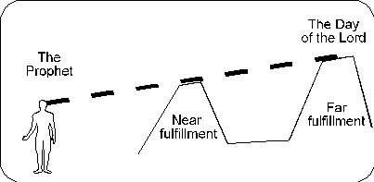
Prophecy – Near & Far
Within Few years of prophecy
Lifetime
Of prophet
Long
Range
Prophecies
Medium
Range
Prophecies
Messianic
Short
Term
Joel
Example
of
Locust
~830 BC
Syria
Assyria
Egypt
Edom
Babylon
“And it shall come
to pass afterward…

Slide 4
Prophecy – Near & Far
Within Few years of prophecy
Lifetime
Of prophet
Long
Range
Prophecies
Medium
Range
Prophecies
Messianic
Short
Term
Example
of
Locust
~830 BC
Syria
Assyria
Egypt
Edom
Babylon
“And it shall come
to pass afterward…

Slide 5
The purpose of the prophets was threefold:
To warn the nations of the coming judgment.
To explain why the judgment had come upon them.
To give assurance, at least to a remnant, of a hope that lay beyond the judgment.
Notes:
1. The purpose of the prophets was threefold:
a. To warn the nations of the coming judgment.
b. To explain why the judgment had come upon them.
To give assurance, at least to a remnant, of a hope that lay beyond the judgment.

Slide 6
The Role of the Prophets
They are Spokesmen for God, serving as “forthtellers,” speaking what God put in their mouth.
They are Preachers of the Covenant, relating their message to God’s previous promises to the nation of Israel. These covenants were made with or through Abraham, Moses, and David
They are historians, or Interpreters of the Israelites’ History. With out their interpretation God’s people would not know why an event was occurring.

Slide 7

Prophetic Waves
Assyrian Threat
Syrian Threat
Babylonian Threat
Romans
Moses
Exodus
Persian
Written
Israel Falls
Abraham
Judah Falls
Judges
Kingdom Divides
Captivity
& Return
United Kingdom
Oral
Daniel
roars
Greeks
2100
1400
1100
1000
900
800
700
600
500
400
100
0
~30
100
605
597
586
538
458
444
722
Christ
Exile
Return
Notes:
Prophet waves –
God tends to give the last gen before day of the Lord a chance to repent – ie lots of prophet activity
Between the Testament ok
400 years of silince not so much, Daniel roars In Between the Testament

Slide 8

Kings & Prophets
NAHUM
Divided Kingdom
Judah Alone
& Fall of Judah
The prophet predicts the fall of Nineveh
650-612 Nineveh
ZEPHANIAH
Prophet emphasizes the need for the people of Judah to turn away from idolatry.
630-625
HABAKKUK
"Why do the wicked and cruel Babylonians go unpunished?" Prophet finds his answer in God's goodness and wisdom
612-606
Jer 1-20 Sermons & prophecies during Josiah
Jer 21-39 Prophecies of Specific Events
Jer 40-45 Sermons after fall of Israel
Jer 46-51 God’s Judgment on Foreign Nations
Jer 52 Fall of Jerusalem
JEREMIAH
627-586
LAMENTATIONS
Jeremiah cries from the depths of his heart over the destruction of Jerusalem
586
Notes:
Nahum – Nineveh you will fall
Zephaniah – Day of the Lord – Judgement
Habakkuk – ask question about wicked – Babylon the answer – why wicked Babylon
Jeremiah – Sword Pestilence Famine

Slide 9
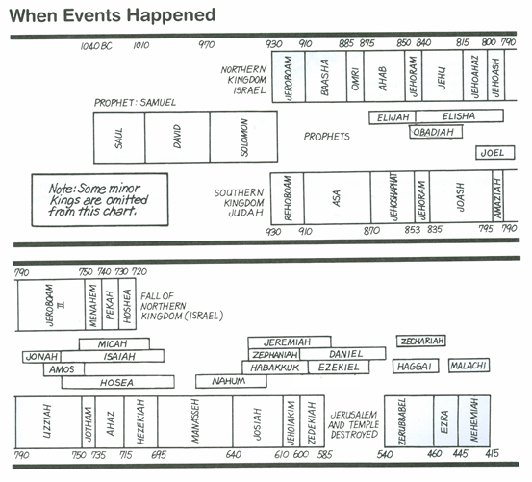
Kings & Prophets

Slide 10
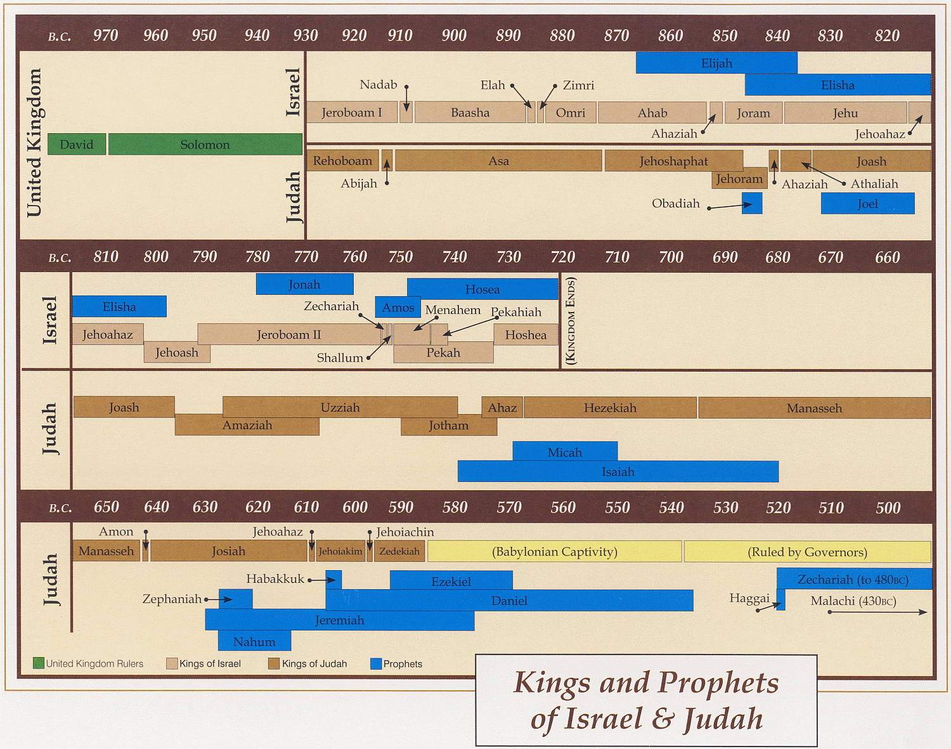
Ahijah
Jehu
Man of God
Micaiah
Man of God
Syria
Shemaiah
Azariah
Hanani
Assyria
Babylon/Persia

Slide 11
Kings of United & Divided Kingdom
United
Kingdom
Divided Kingdom
Judah Alone
Early Kings – Israel
Dynasty 1&2
Omri
Dynasty 3
Jehu
Dynasty 4
Confusing
Dynasties
Hezekiah
Hezekiah
(728-686)
Manasseh
Amon
1
Jereboam
Nadab
3
Omri
Ahab
(874-853)
Ahaziah
Jehoram
4
Jehu
(841-814)
Jehoahaz
Jehoash
Jereboam II
(793-753)
Zechariah
Shallum
Menahem
Pekaiah
Pekah
Hosea
(732-722)
5
Saul
(1050-1010)
David
(1010-970)
Solomon
(970-930)
2
Baasha
Elah
Josiah &
Sons
Zimri ~ 885
Tibni
Josiah
(640-609)
Jehoahaz
Jehoiakim
Jehoiachin
Zedekiah
(597-586)
Early Kings – Judah
Dynasty 1&2
Omri
Dynasty 3
Jehu
Dynasty 4
Confusing
Dynasties
Rehoboam
Abijam
Asa
(930-870)
Jehosphat
(873-848)
Jehoram
Ahaziah
Athaliah
Joash
Amaziah
Azariah/Uzziah
(790-739)
Jotham
Ahaz
Hezekiah
Judah Return
Zerubbabel (538-515)
Ezra (458-456)
Nehemiah (444-432)
Notes:
Omri – Ahab’s dad

Slide 12
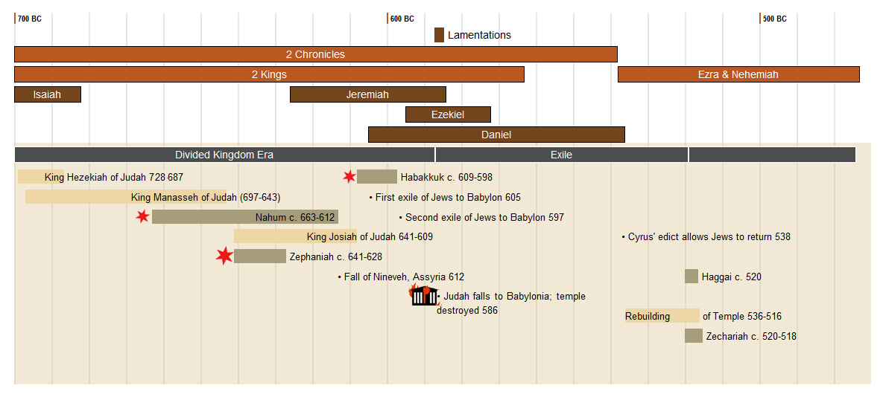

Slide 13
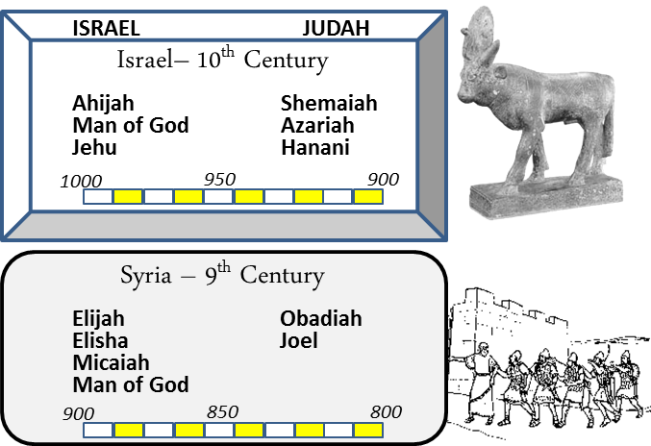
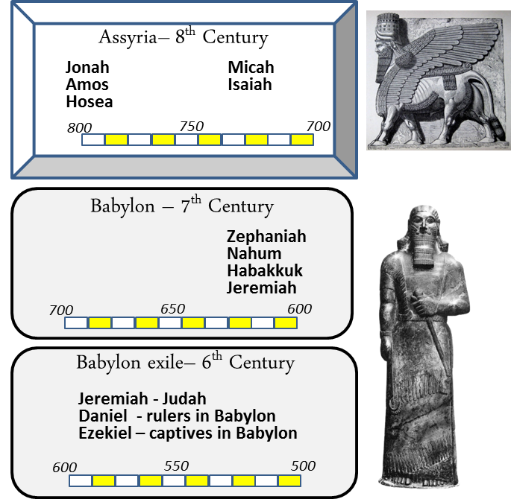
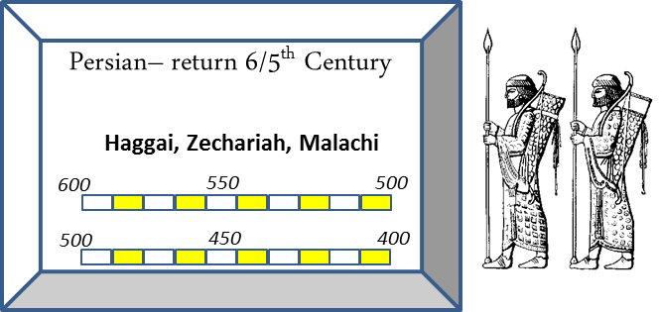
When

Slide 14
Oracles against the Nations in the Prophets
 | Isaiah | Jeremiah | Ezekiel | Joel | Amos | Obadiah | Jonah | Nahum | Zephaniah | Zechariah*
Ammon |  | 49:1–6 | 25:1–7 |  | 1:13–15
Arabia | 21:13–17
Assyria (Nineveh) | 10:5–19; 14:24–27 |  |  |  |  |  | (Nineveh) | (Nineveh)
Babylon | 13:1–14:23; 21:1–10; 46:1–47:15 | 50:1–51:64 |  |  |  |  |  |  |  | 2:9–12?
Damascus | 17:1–6? | 49:23–27 |  |  | 1:3–5 |  |  |  |  | 9:1
Edom | 21:11–12 | 49:7–22 | 25:12–14 |  | 1:11–12 | 1–14?
Egypt | 18:1–20:6 | 46:2–26 | 29:1–32:32
Elam |  | 49:34–39
Ethiopia |  |  |  |  |  |  |  |  | 2:12–15
Gaza |  |  |  |  | 1:6–8 |  |  |  |  | 9:5
Kedar and Hazor |  | 49:28–33
Lebanon |  |  |  |  |  |  |  |  |  | 11:1–3?
Moab | 15:1–16:14 | 48:1–47 | 25:8–11 |  | 2:1–3 |  |  |  | 2:8–11
Philistia | 14:28–32 | 47:1–7 | 25:15–17 | 3:4–8 |  |  |  |  | 2:5–7 | 9:6
Tyre Sidon | 23:1–18 |  | 26:1–28:19; 28:20–23 | 3:4–8 | 1:9–10 |  |  |  |  | 9:2–3
2:8–11

Slide 15
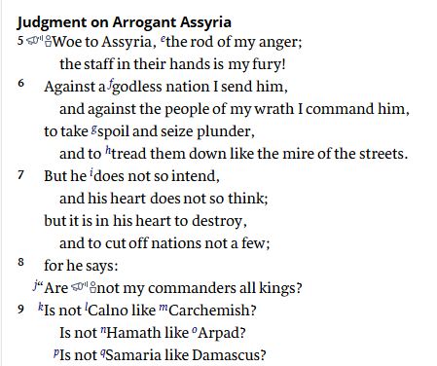
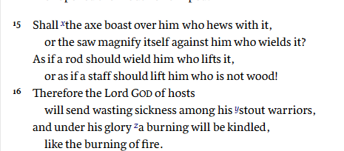

Isaiah – 740-680s
Isaiah 10
605 BC

Slide 16
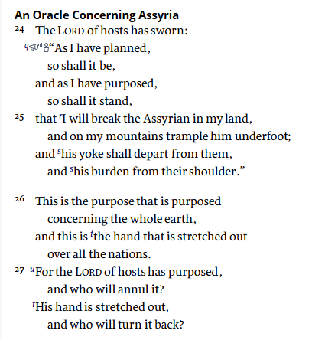
Isaiah – 740-680s
Isaiah 14

Slide 17

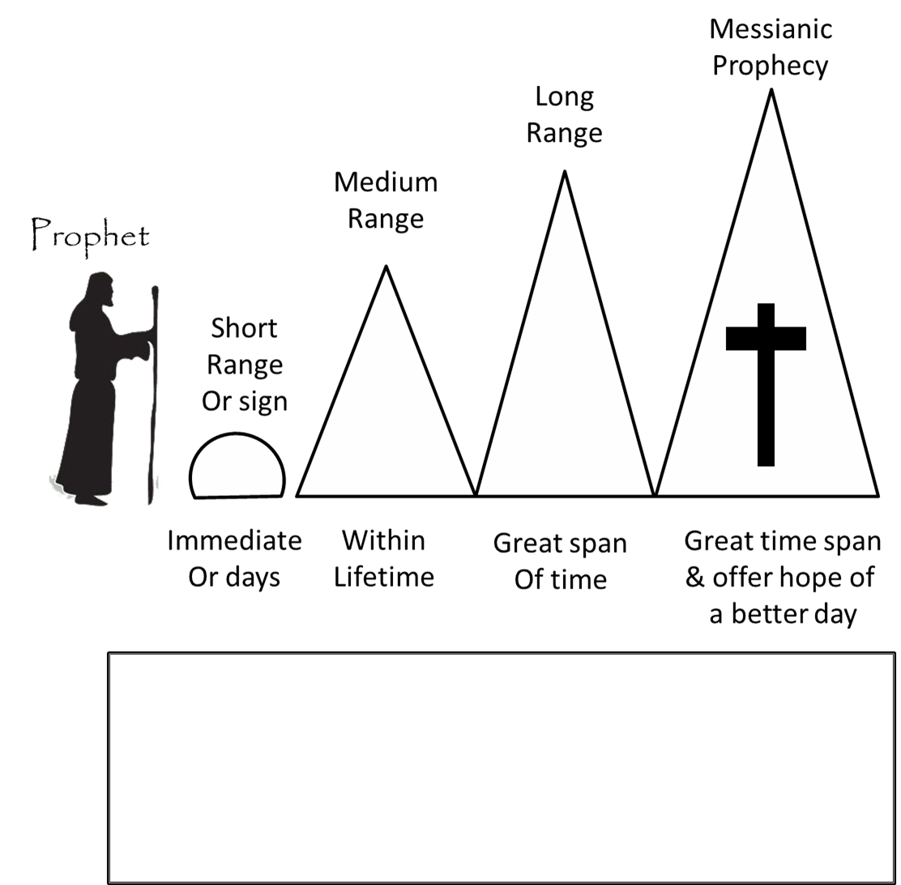
Nahum's Prophecies
What is the prophecy range?
650 BC
630 BC
612 BC

Slide 18
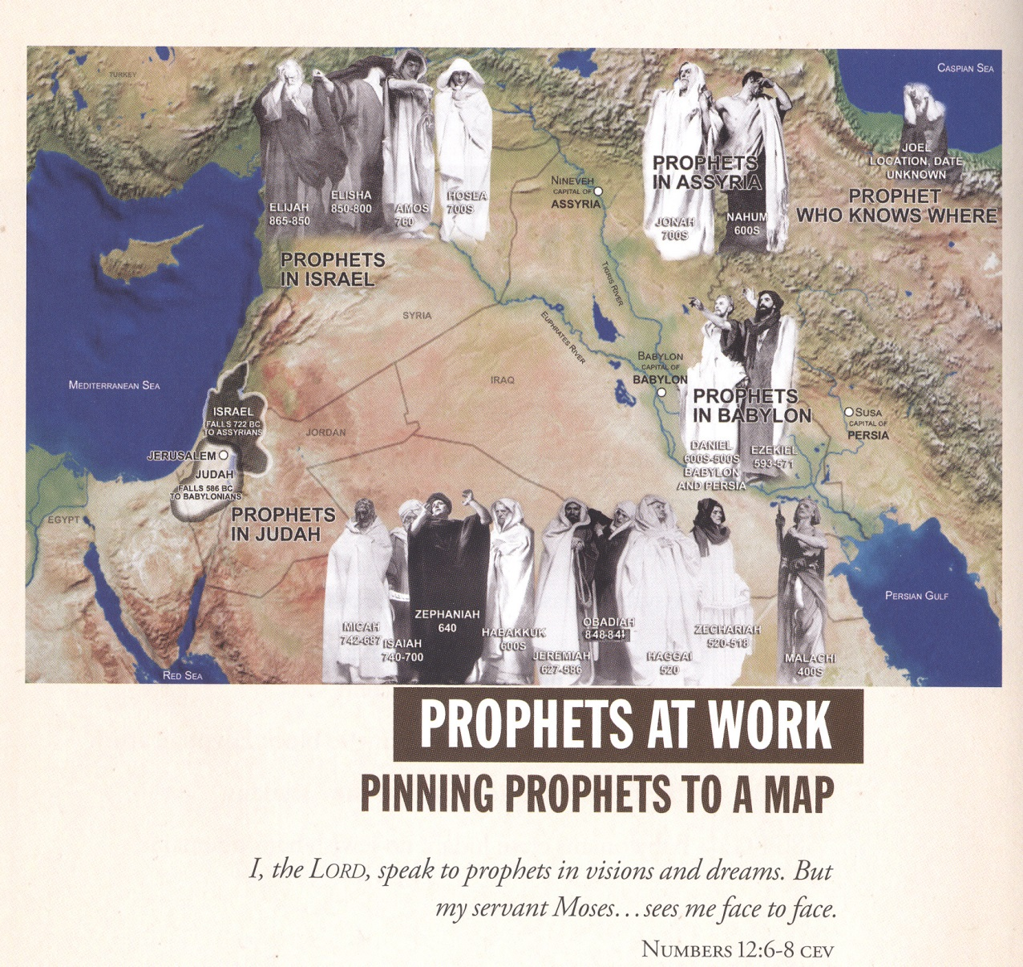

Slide 19
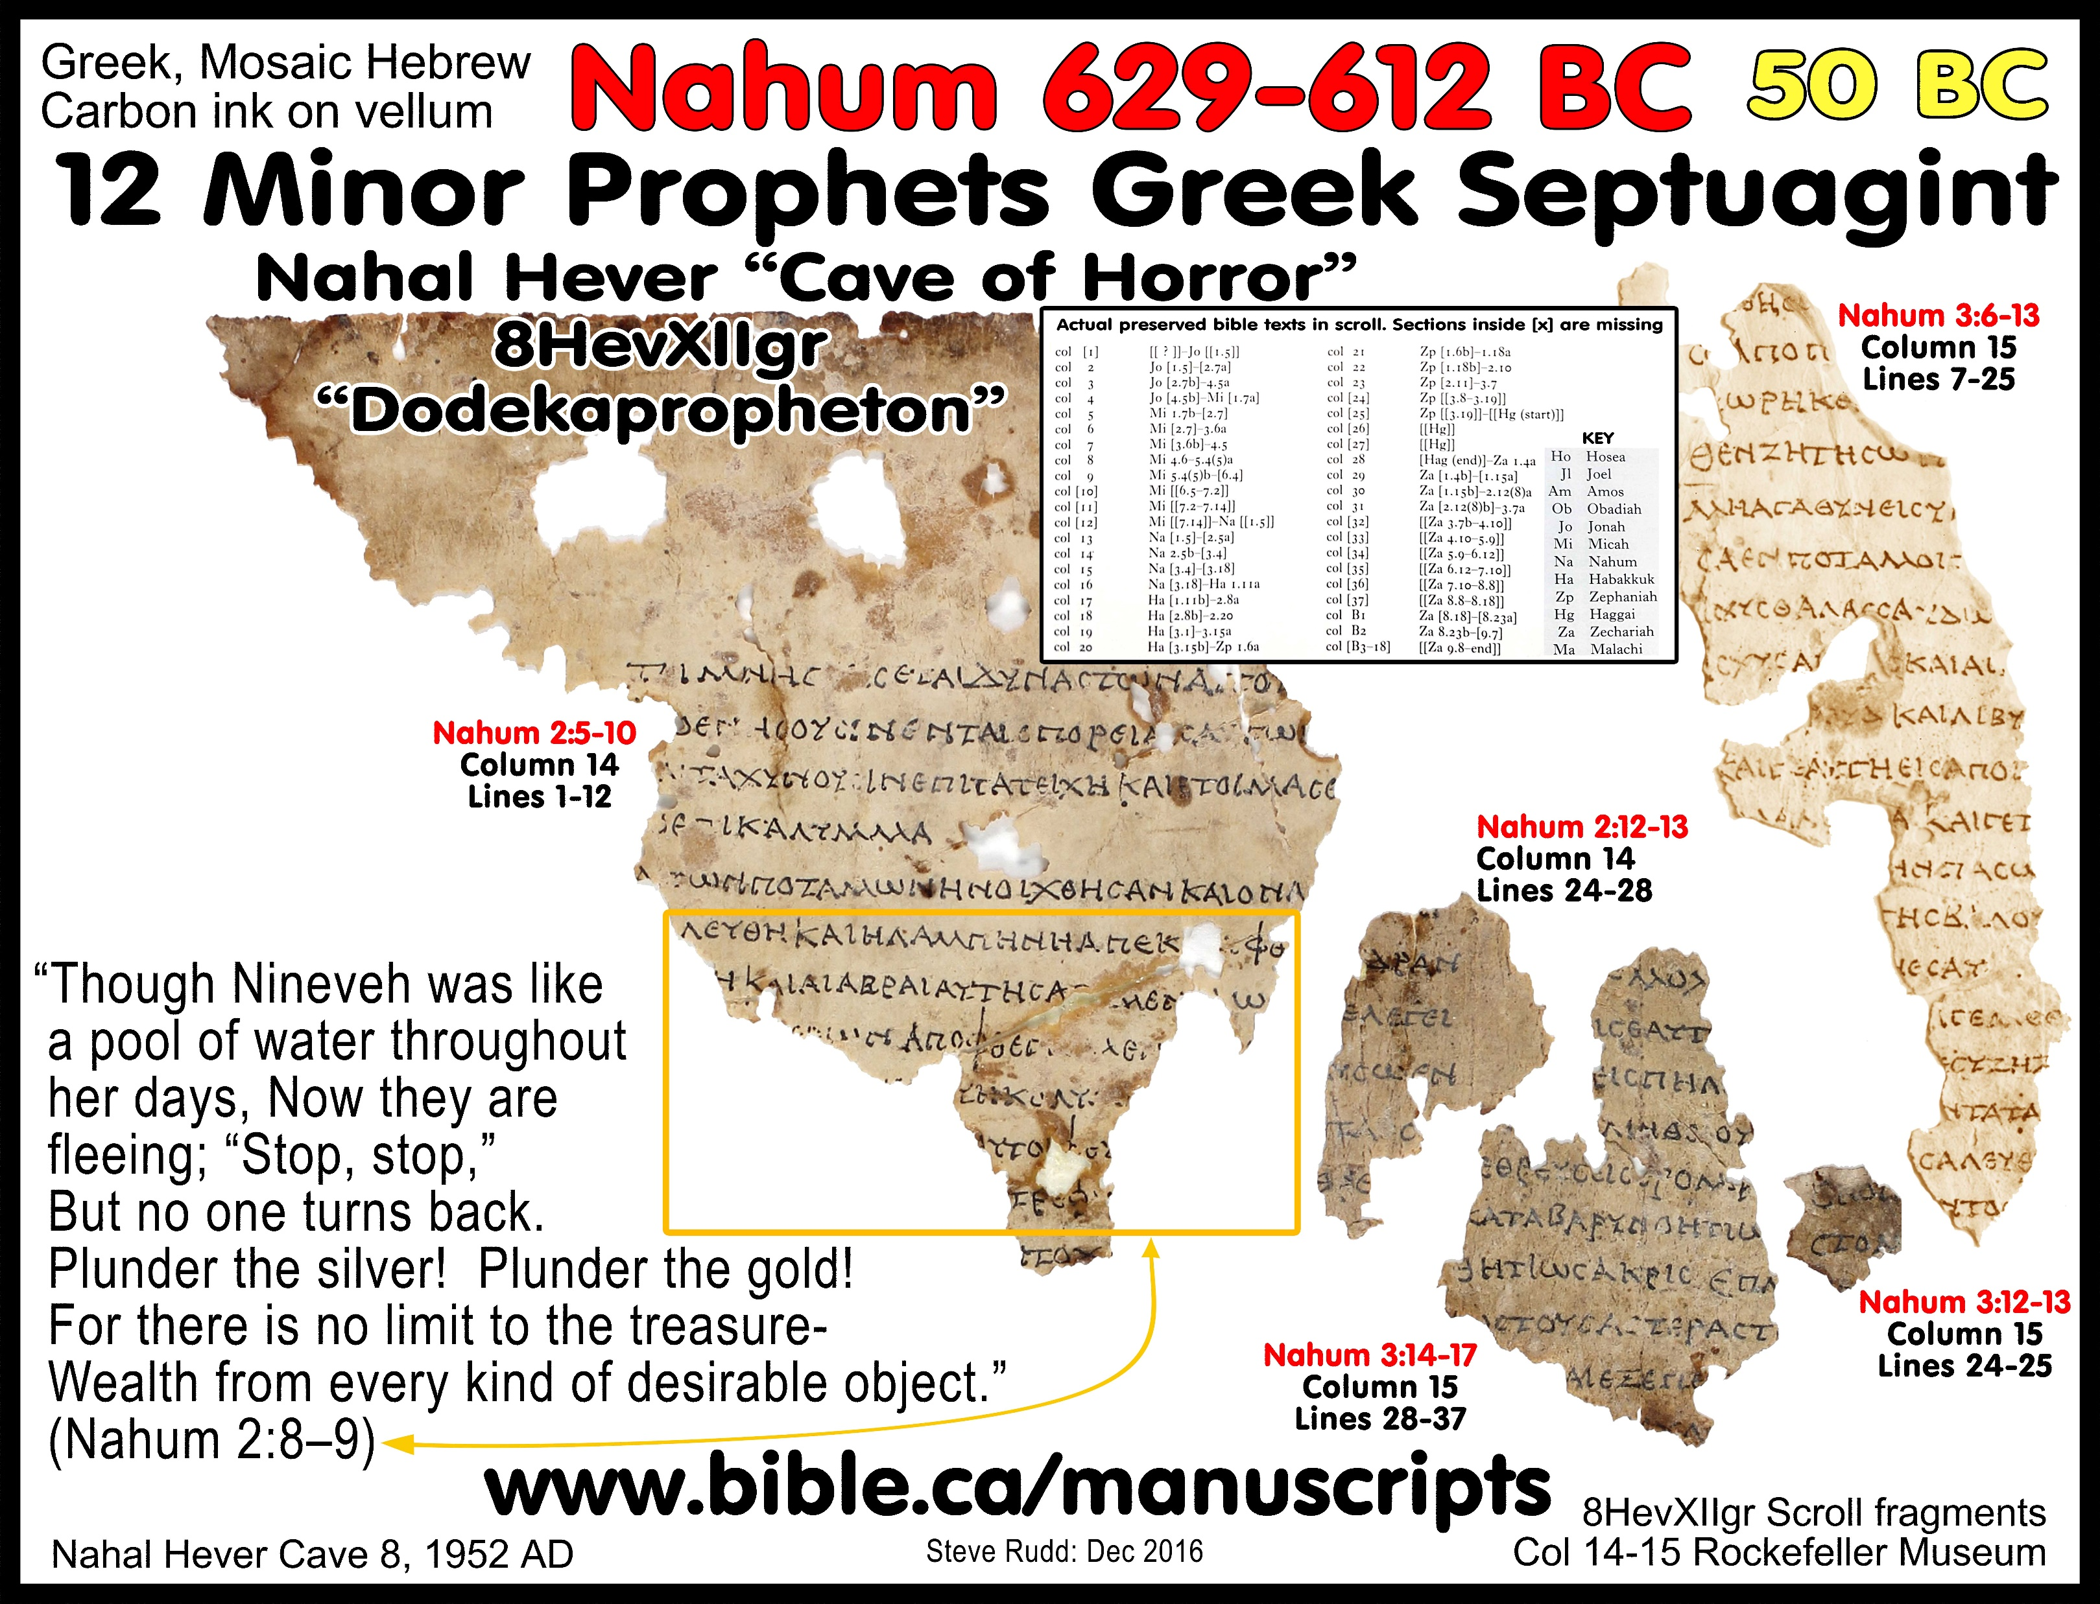

Slide 20
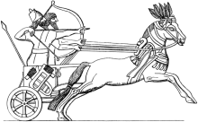




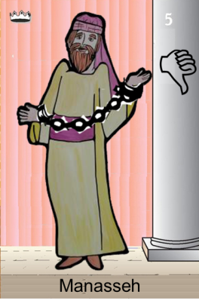
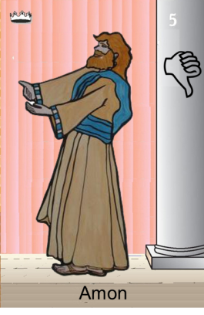
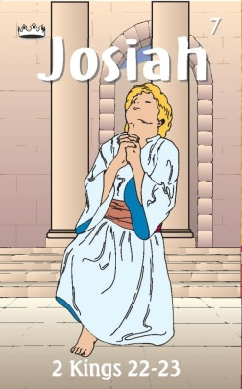
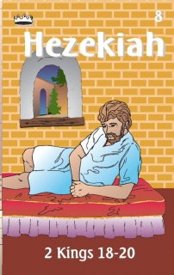

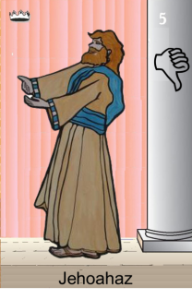



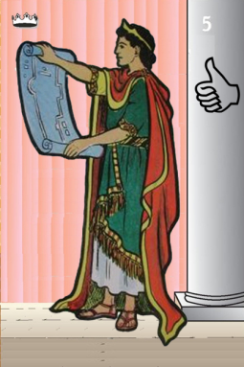


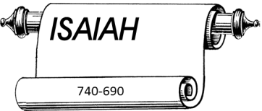

Confusing
Judah Alone
Revolt of 652 BC
Maybe occasion of Manasseh
Being taken captive
Tiglath-pileser III
(745–727 b.c.)
697-642
640-609
Shallum 752
Menahem 752-742
Pekahiah 742-740
Pekah(752) 740-732
Hoshea 732-722
Made covenant
609
609-597
Egypt
597-586
Babylon
Uzziah
Jotham
Ahaz
597
Babylon
Notes:
Manasseh worse king but repents – born in last 15 years of Hezekiah

Slide 21
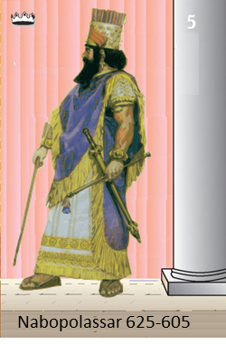

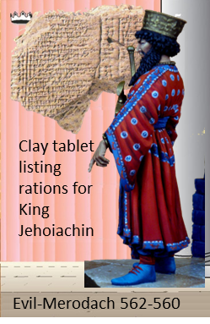
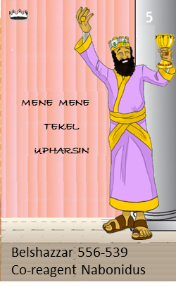
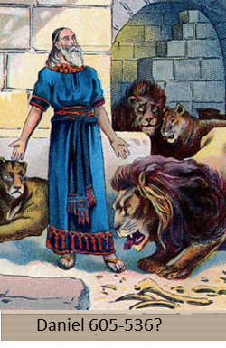
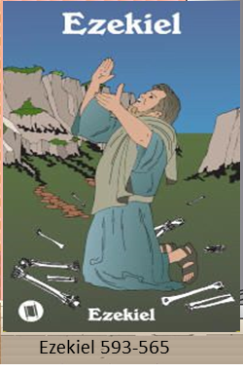

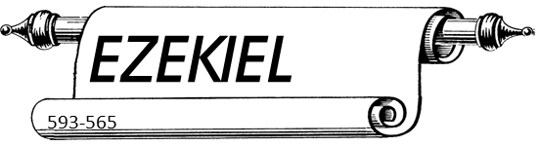
Judah Alone
605-538 BC
Return From Exile
640-609
Babylonian Captivity
538-425?
Daniel
605 BC
597 BC
586 BC

Slide 22
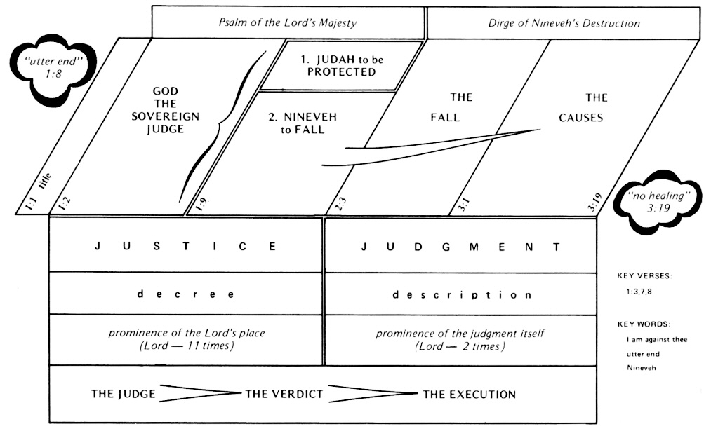
Nahum 1:2-3 (ESV)
God’s Wrath Against Nineveh
² The Lord is a jealous and avenging God;
the Lord is avenging and wrathful;
the Lord takes vengeance on his adversaries
and keeps wrath for his enemies.
³ The Lord is slow to anger and great in power,
and the Lord will by no means clear the guilty.
His way is in whirlwind and storm,
and the clouds are the dust of his feet.
Nahum 1:7–8 (ESV)
⁷ The Lord is good,
a stronghold in the day of trouble;
he knows those who take refuge in him.
⁸ But with an overflowing flood
he will make a complete end of the adversaries,
and will pursue his enemies into darkness.

Slide 23

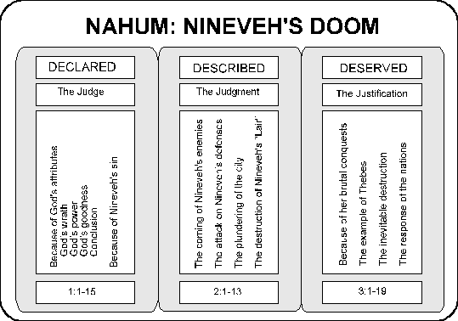

Slide 24
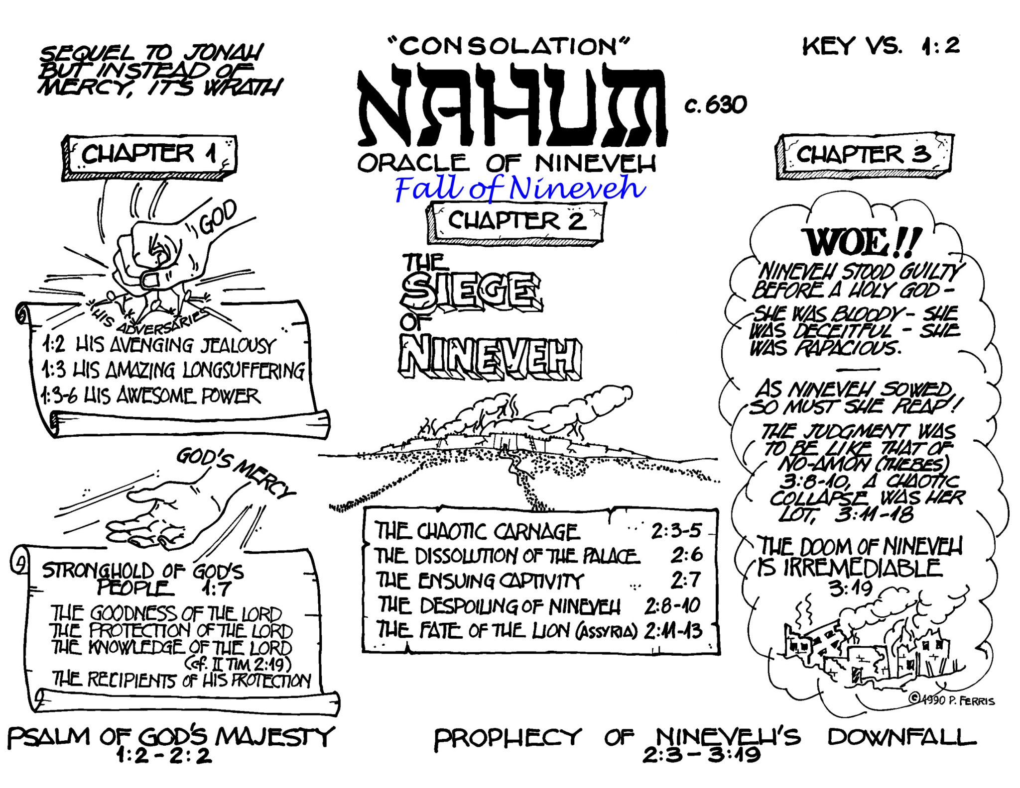
Nahum
The LORD is a jealous and avenging God;
the LORD is avenging and wrathful;
the LORD takes vengeance on his
adversaries and keeps wrath for his enemies.

Slide 25


Obadiah

Slide 26
Prophet’s Visual Aids
Nahum 1:6 (ESV)
⁶ Who can stand before his indignation?
Who can endure the heat of his anger?
His wrath is poured out like fire,
and the rocks are broken into pieces by him.
Vs 1:6
Vs 3:15-17
Nahum 3:15–17 (ESV)
¹⁵ There will the fire devour you;
the sword will cut you off.
It will devour you like the locust.
Multiply yourselves like the locust;
multiply like the grasshopper!
¹⁶ You increased your merchants
more than the stars of the heavens.
The locust spreads its wings and flies away.
¹⁷ Your princes are like grasshoppers,
your scribes like clouds of locusts
settling on the fences
in a day of cold—
when the sun rises, they fly away;
no one knows where they are.
Vs 2:4
Nahum 2:4 (ESV)
⁴ The chariots race madly through the streets;
they rush to and fro through the squares;
they gleam like torches;
they dart like lightning.
Vs 3:12
Nahum 3:12 (ESV)
¹² All your fortresses are like fig trees
with first-ripe figs—
if shaken they fall
into the mouth of the eater.

Slide 27
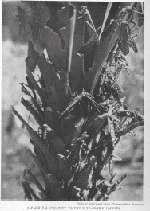
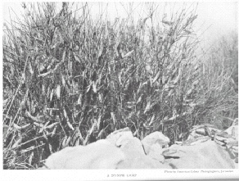
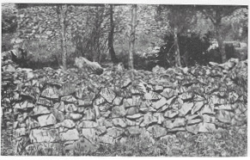
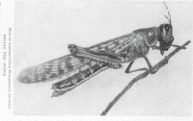
Flying Locust

Slide 28

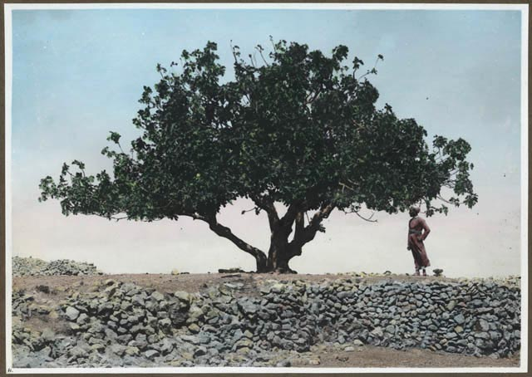
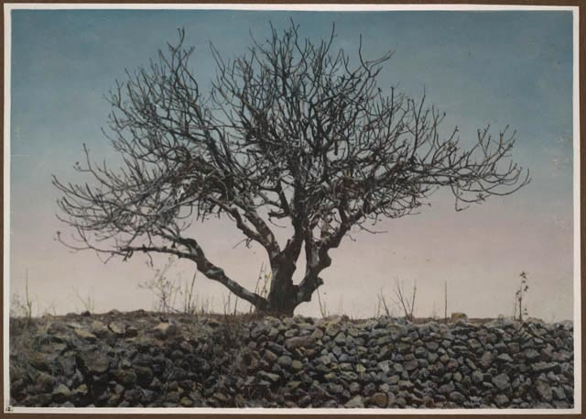
Attack on a Fig Tree
⁷ He has laid waste My vine,
And ruined My fig tree;
He has stripped it bare and thrown it away;
Its branches are made white.
A fig tree photographed just before and after the locusts attacked is graphic proof of the destruction wrought by the insect invasion.
Notes:
Locust Album
The Colony created the "locust album" that documented the course of the plague of 1915 at the request of Djemal Pasha. On these pages, a fig tree photographed just before and after the locusts attacked is graphic proof of the destruction wrought by the insect invasion. In his account of the devastation in The National Geographic, Colony member John Whiting wrote that the locusts were so voracious and numerous that they could swarm over an unguarded infant and devour its eyes within a few minutes.

Slide 29
Nahum's Prophecies
What is the prophecy range?
650 BC
630 BC
612 BC

Slide 30
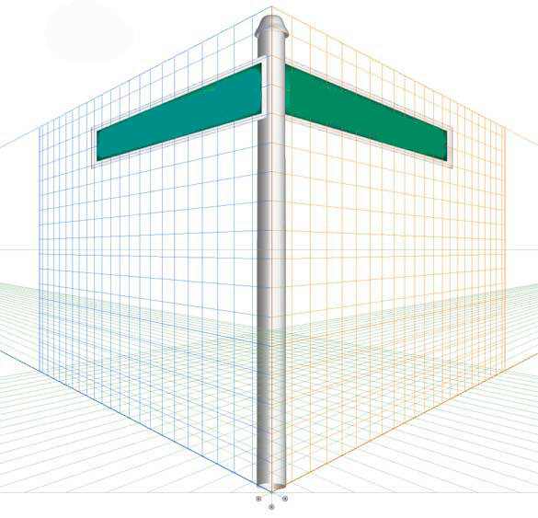

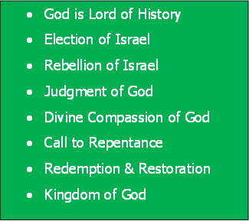
Bible Study Skills
Prophetic Paradigm
By Chapter

Slide 31
Bible Study Skills
 | Looking for -
A | Repeated Words and Phrases
B | Peculiar Words and Phrases
C | Comparisons and Contrasts

Slide 32
Bible Study Skills
D | Figurative Expressions
E | Anything Strange
F | Any prophetic statements

Slide 33
Prophetic Paradigms
Patterns Seen in the Prophets
 | Looking for - | Obadiah
A | God says /word of the Lord
B | Election of Israel Relationship of Nineveh to God
C | Rebellion of Israel Rebellion of Nineveh
D | Judgment of God

Slide 34
Prophetic Paradigms
Patterns Seen in the Prophets
E | Divine Compassion of God
F | Call to Repentance
G | Redemption & Restoration
H | Kingdom of God

Slide 35
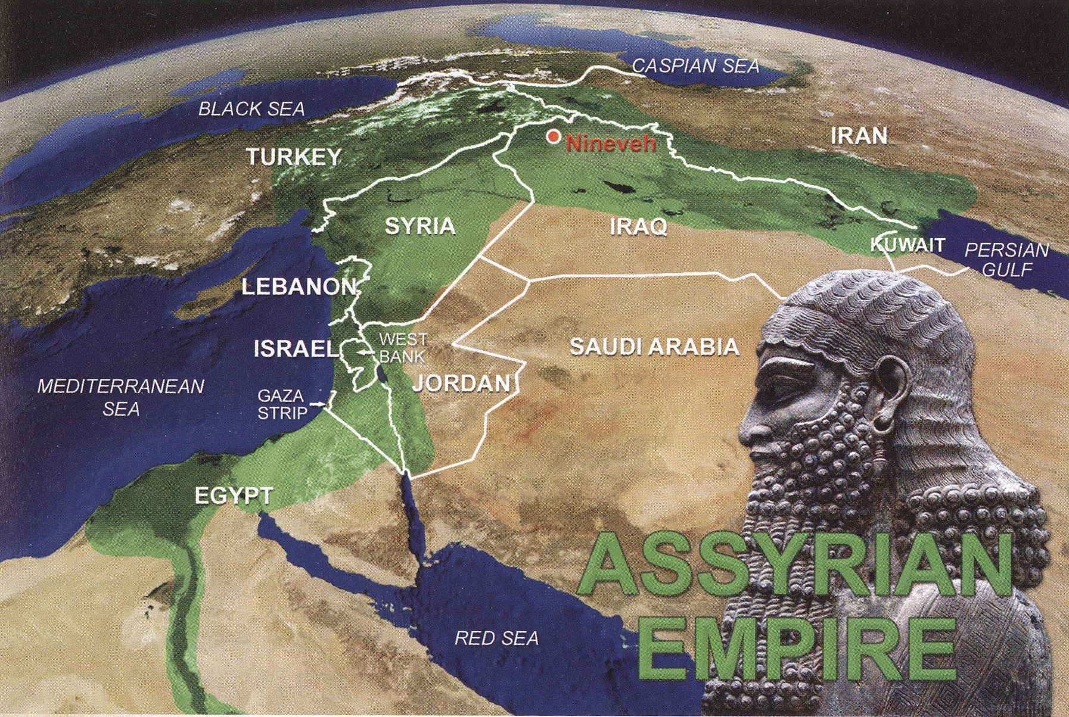

Slide 36
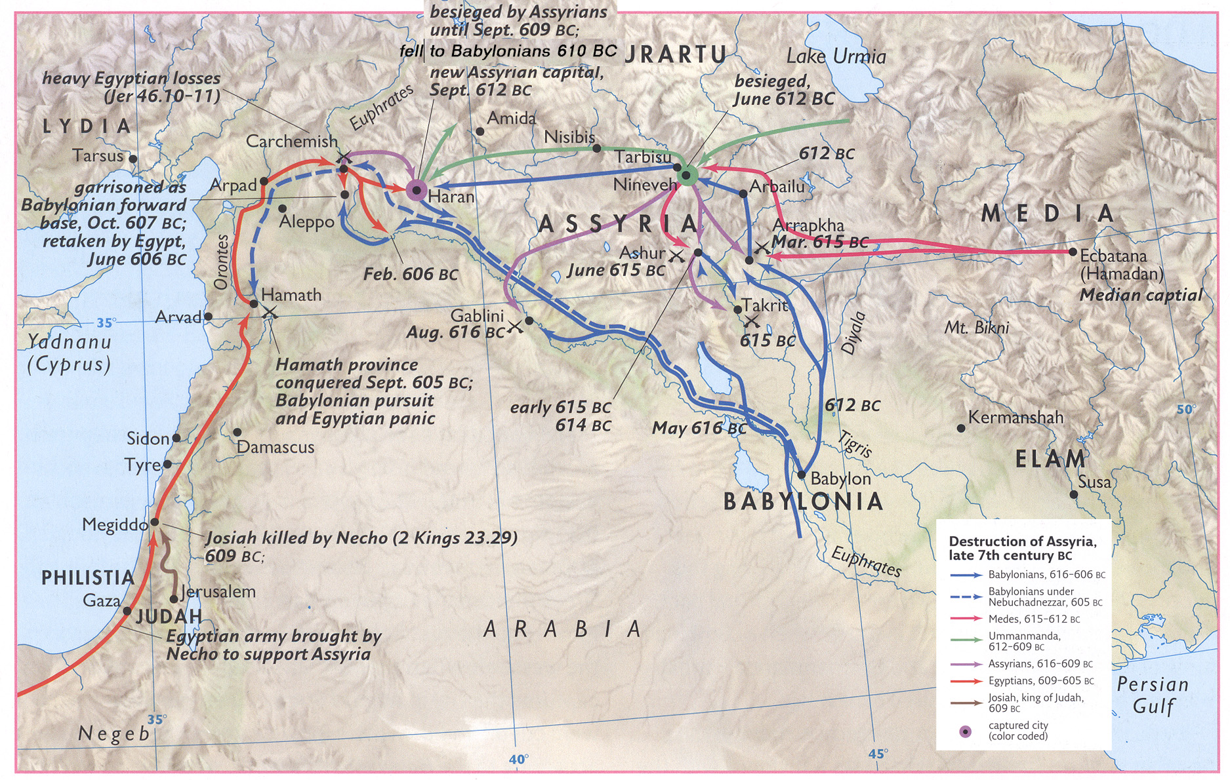
Decline of Assyria

Slide 37
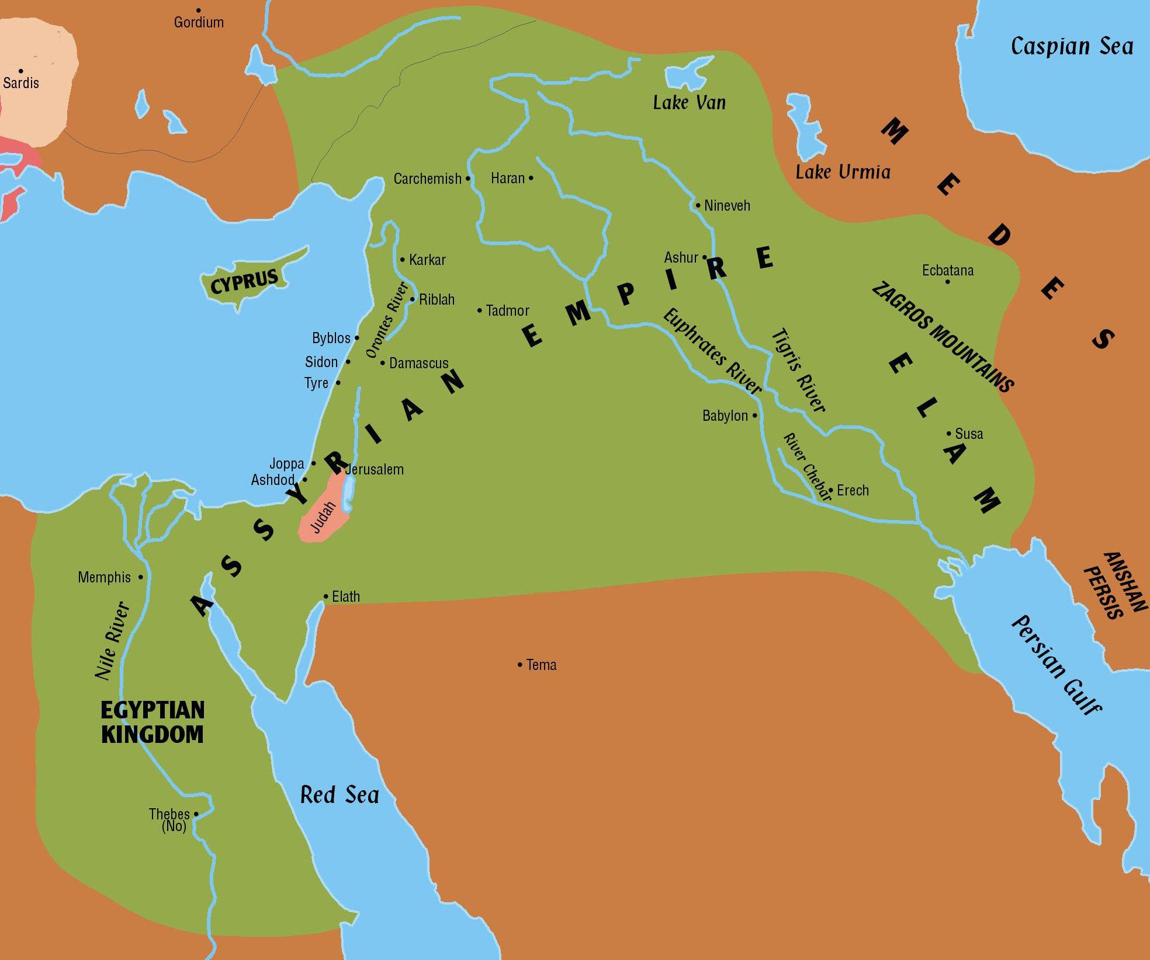

Judah in the Middle
Khorsabad .
Medes
697-642

Slide 38
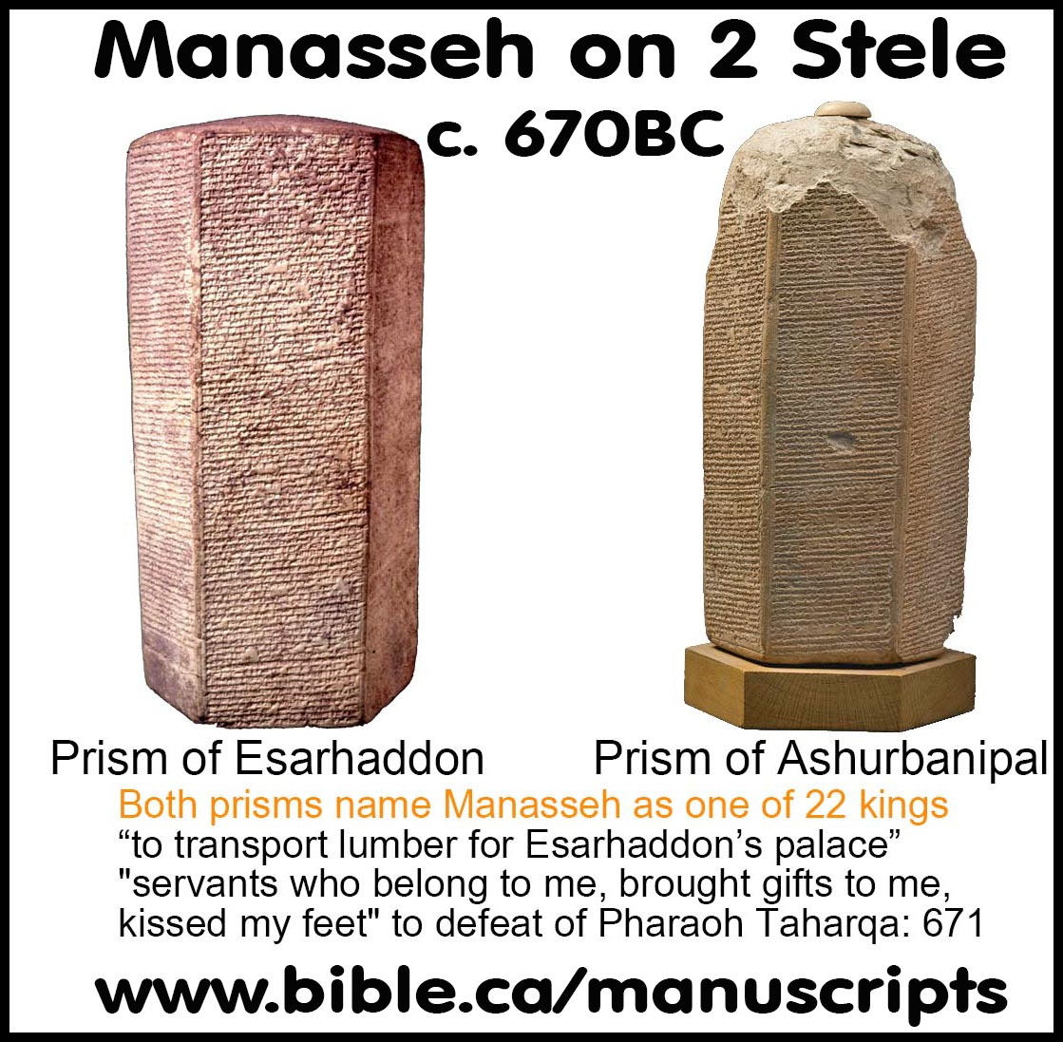

670 BC
Khorsabad .
697-642
Medes
Manasseh sends lumber to Assyria

Slide 39
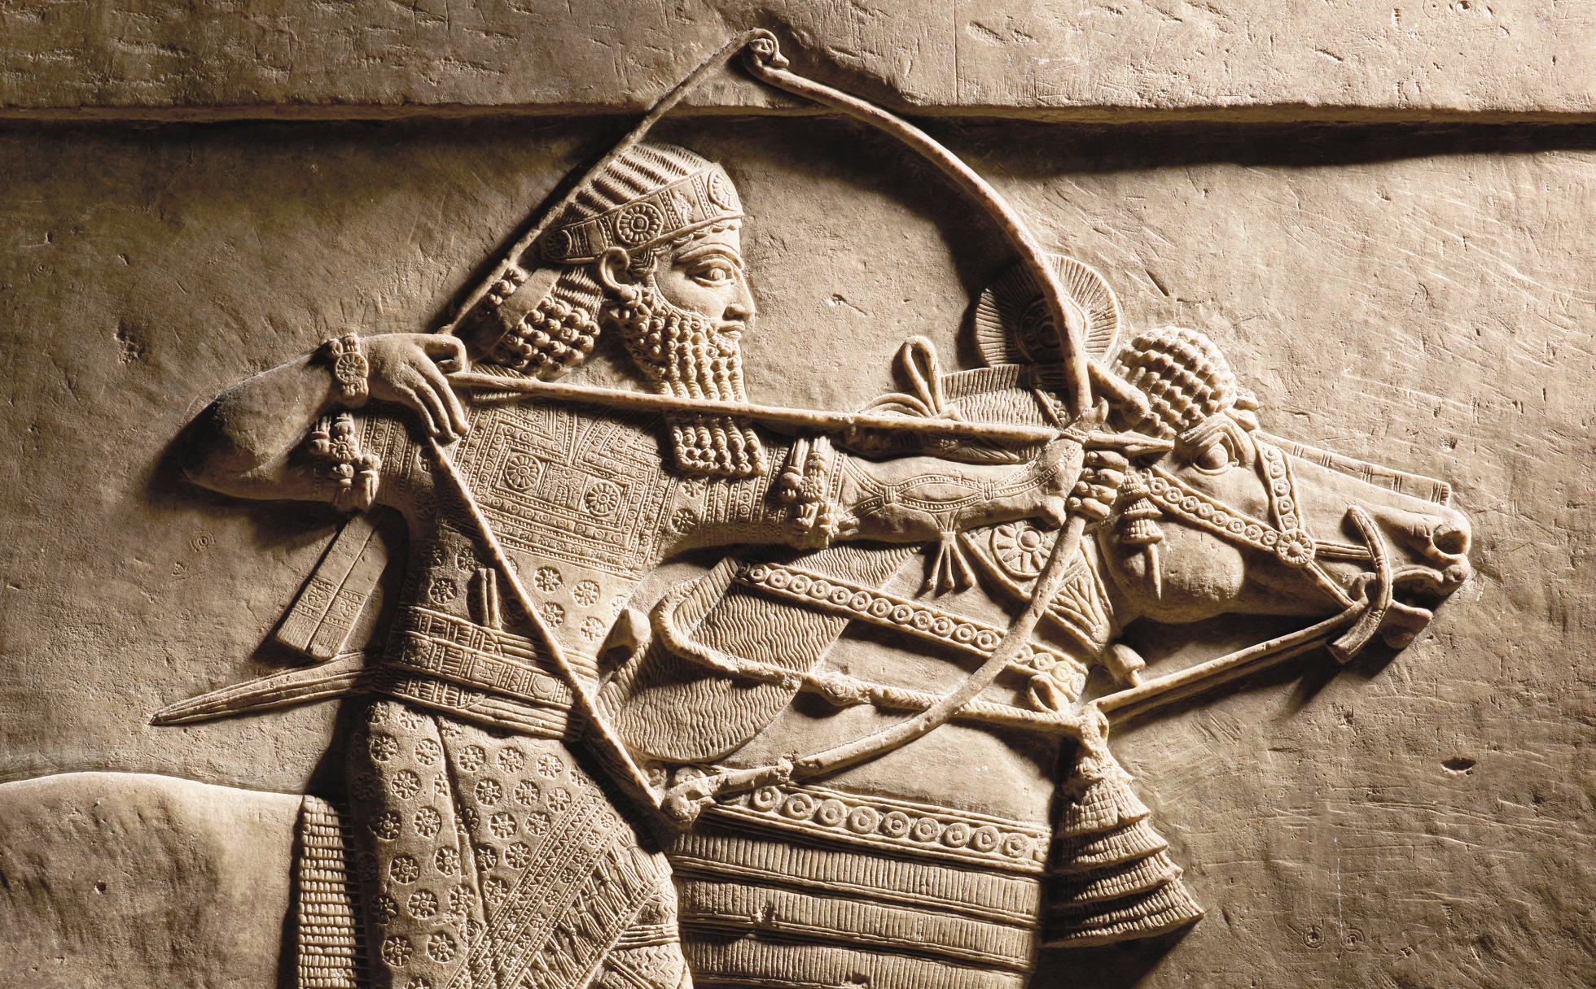
663 BC
Khorsabad .
697-642
Medes
Assurbanipal (668-627 BC)
burns Thebes (No)
– Nahum records

Slide 40
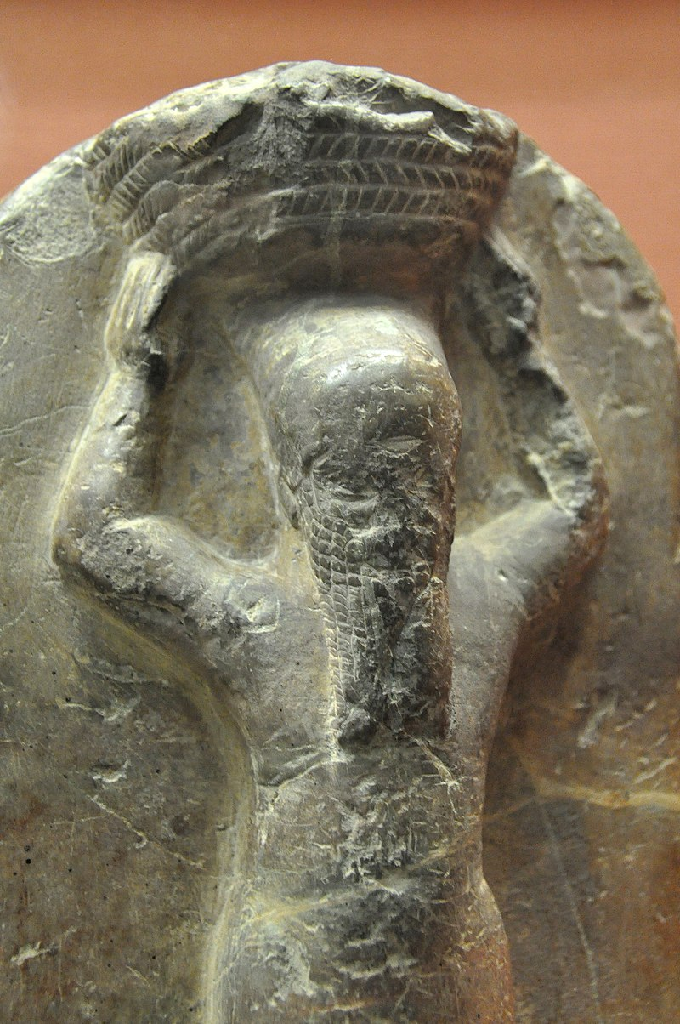
652 BC
Khorsabad .
697-642
Medes
652 BC: Babylonia rises in revolt under Shamash-shum-ukin against the Assyrians.
Maybe occasion of Manasseh’s
imprisonment

Slide 41

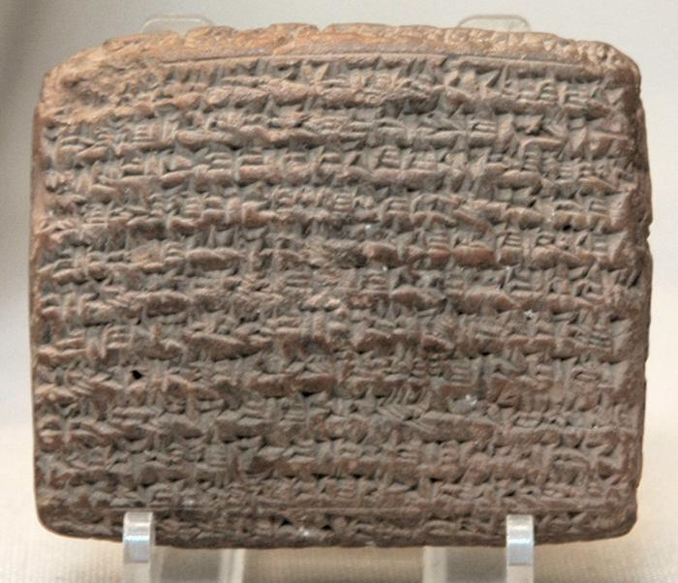
A year after Ashur-bani-pal died in 627 BC, Nabopolassar, who was probably a Chaldæan, was proclaimed king at Babylon
626 BC
Khorsabad .
Medes
Chronicle Concerning the Late Years of Nabopolassar

Slide 42
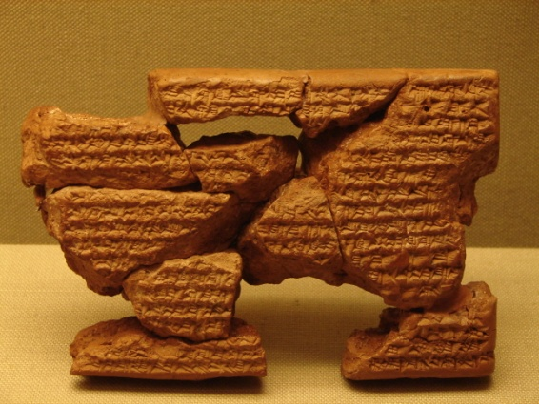
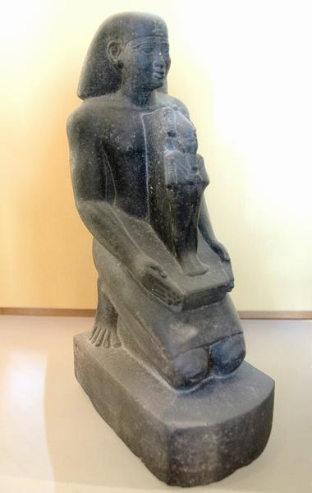

Sin-shar-ishkun of Assyria & Egypt deter expansion plans
616 BC
Khorsabad .
Psammetichus I
664 – 610 BC
Chronicle Concerning the Late Years of Nabopolassar
Notes:
Nabopolassar's sway at first was confined to Babylon and Borsippa, but he strengthened himself by forming an offensive and defensive alliance with the Median king, whose daughter he had married to his son Nebuchadrezzar

Slide 43
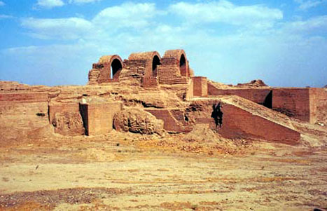
Medes capture & destroy
The city of Asshur
614BC
Khorsabad .
Formed an offensive and defensive alliance with the Median king, whose daughter he had married to his son Nebuchadrezzar
Sin-shar-ishkun of Assyria
Psammetichus I
664 – 610 BC
Chronicle Concerning the Late Years of Nabopolassar
Notes:
Nabopolassar's sway at first was confined to Babylon and Borsippa, but he strengthened himself by forming an offensive and defensive alliance with the Median king, whose daughter he had married to his son Nebuchadrezzar

Slide 44

Last Days of Assyria
612 BC
Tablet fragment copy of a letter written in 614-612 BC
from Sin-shara-ishkun (king of Assryia)
to Nabapolasser
(king of Babylon) requesting a truce
About 612 B.C. Nineveh fell, and Sin-shar-ishkun may have burned himself there in his palace
This tablet is a later copy of a letter from the last days of the Assyrian empire. In it, the last Assyrian king, Sin-sharra-ishkun, appears to reach out to the Babylonian king Nabopolassar, recognizing the latter’s rule and pleading to retain his own kingdom

Slide 45
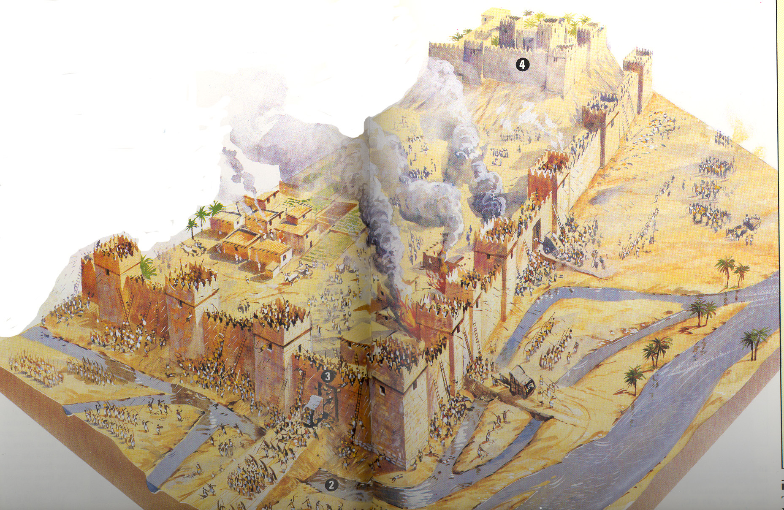
Nineveh Falls
612 BC

Slide 46
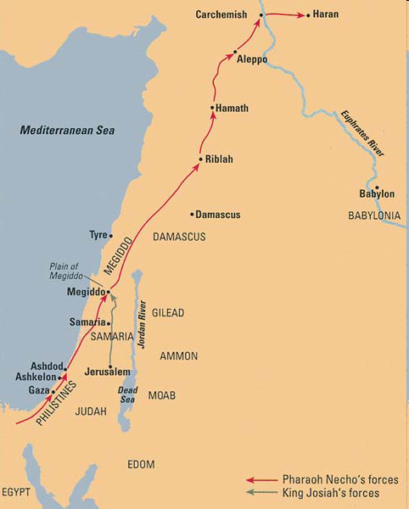
Josiah’s Battle
BAR 25:04 (July/Aug 1999).
Last Assyrian ruler Ahur-uballit retreats to Haran
ASSYRIANS
Political Purpose
By helping Babylon defeat Assyria he might gain some security for Judah
God’s Purpose
Promised that Josiah would not witness the judgment on Judah
609 BC
Notes:
What motivated Josiah? Possibly, the budding bipolar system influenced Josiah’s decision to try to halt Pharaoh Necho. Other factors were also doubtless at work. Necho was as yet inexperienced; the Egyptian army was far from its base; the Judahites had the advantage of a surprise attack; above all, a fact generally overlooked is that only half a year before, the Egyptians had sustained a setback in the Euphrates region at the hands of the up-and-coming Babylonians. At any rate, Josiah’s attack is a rare example of bold military initiative taken by a relatively small state against the biggest power of the day. Editor, H. S. (2004; 2004). BAR 25:04 (July/Aug 1999). Biblical Archaeology Society.
The Babylonian subjugation of Judah was not long in coming, although Judah seems to have held out for another two years after Egyptian defeat at the Battle of Carchemish. Judah surrendered only in the winter of 603 B.C.E. (or, according to several scholars, in 604 B.C.E.),† even though Nebuchadnezzar had already reached as far as Ashkelon and utterly destroyed it a year earlier (i.e., in 604 B.C.E.). Of this destruction, we now have archaeological proof from excavations at the site.* † Mordechai Cogan and Hayim Tadmor, II Kings, Anchor Bible 11, (Garden City, NY: Doubleday, 1988), p. 308.* See Lawrence E. Stager, “The Fury of Babylon: Askelon and the Archaeology of Destruction,” BAR 22:01.Editor, H. S. (2004; 2004). BAR 25:04 (July/Aug 1999). Biblical Archaeology Society.
Even though Judah had submitted to Babylonia in 603 B.C.E., it nevertheless lost no opportunity to throw off the yoke when it saw the chance. That chance came in the winter of 601/600 B.C.E. when Babylonia attacked Egypt proper, a major historical event revealed only relatively recently through publication of the Babylonian Chronicle.† This official historical record conceals neither the Babylonian shortcomings during this campaign, which led to heavy losses on both sides, nor the subsequent empty-handed Babylonian retreat. This Babylonian defeat apparently encouraged the Judahite leadership to rebel and defect to the Egyptian camp. † Babylonian Chronicle (of Nebuchadnezzar in His Fourth Year), in D.J. Wiseman, Chronicles of Chaldean Kings (London: British Museum, 1956), pp. 70–71, lines 5–7. On the campaign in his previous year (602 B.C.E.), see W. Tyborowski in Zeitschrift für Assyriologie 86 (1996), pp. 211–216.Editor, H. S. (2004; 2004). BAR 25:04 (July/Aug 1999). Biblical Archaeology Society.
For the next two years, the Babylonians were unable to retaliate against Judah as they concentrated on recouping their strength and re-equipping their chariot force.But in the winter of 598/7 B.C.E., the Babylonian monarch Nebuchadnezzar struck at Judah, in a show of strength that no doubt served as a warning to Egypt and her other allies as well. The first Babylonian siege of Jerusalem is well documented not only in the Bible (2 Kings 24:10ff.) but also in the Babylonian Chronicle, which even specifies the precise day of Jerusalem’s surrender—2 Adar, or March 16, 597 B.C.E.†Judah’s wise decision to surrender saved Jerusalem from physical destruction and saved Judah from the status of a conquered country within the Babylonian Empire. Nevertheless, its human resources were seriously depleted—10,000 of its inhabitants were exiled to Babylonia, including the elite of the nation, the “good figs” in Jeremiah’s prophecy (Jeremiah 24), and the higher military echelons (2 Kings 24:14–16).†Nebuchadnezzar’s policy of deportation and heavy tribute ultimately proved shortsighted. The very foundations of the Judahite kingdom were undermined. Social and economic chaos, as well as psychic and spiritual distress, prevailed, as can be discerned in the prophet’s words. This was the mise-en-scène for the appearance of irresponsible elements in Judahite leadership. Such has been the fate, time and again, of vanquished states burdened with such harsh conditions of surrender.Whether or not that explains the next development is questionable. In any event, in 594/3 B.C.E. the new puppet king and last monarch of Judah, Zedekiah (597–586 B.C.E.), hosted in Jerusalem a mini-summit of petty states—Edom, Moab and Ammon, in Transjordan, and the cities of the Phoenician coast (Jeremiah 27:3). Judah was apparently attempting to set up a league against Babylonia encompassing the area of modern Jordan, Israel and the coastal plain of Lebanon.As so often occurs in military history, this alliance of several small and rather weak states was of little avail against the big power. It posed no real threat to Nebuchadnezzar. Here again it would seem that Egypt subverted Judah against Babylonia, though we have no clear evidence. We do know, however, that in 592 B.C.E. Pharaoh Psammetich II (Necho’s successor) marched into Palestine and Phoenicia as a peaceful show of force, undoubtedly arousing anti-Babylonian sentiments.When Nebuchadnezzar finally reacted in the winter of 589/8 B.C.E., Judah found herself in a highly vulnerable position. Its northern region, the territory of Benjamin (as well as the vicinity of Bethlehem), most likely surrendered to the enemy and thus escaped destruction.† Both diplomatically and militarily, Judah was left in the lurch and had to face the might of Babylonia alone—“all her friends have dealt treacherously with her” (Lamentations 1:2). Moreover, the nation was internally divided between the hawks, determined on total war, and the doves, advocating appeasement and surrender. In these circumstances, Jerusalem’s resistance for as long as a year and a half was quite remarkable, more so if we adopt the more likely Tishri chronology, according to which the siege lasted for two and a half years.†The conquest of Jerusalem was a serious challenge for Nebuchadnezzar. Initially, his army was deployed to quell a rebellious city. In the end, it was obliged to change from siege warfare to open field battle (and back again), a difficult task indeed!† He employed his finest military commanders and the most advanced siegecraft of the day: dikes and ramps, upon which were stationed weapons such as battering rams. It was, however, that veteran of siege warfare, famine, that ultimately turned the tide.With the fall of Jerusalem in 586 B.C.E. and the total destruction of the palace and the holy Temple, the Davidic dynasty came to an end, and Judah was divested of its polity for generations to come.Her downfall provides a case study of the dilemma of a small or secondary state in a bipolar system. Unable to remain detached, the small or weak state must side with one or the other of the major actors. In time of conflict, the precarious status of neutrality for a small state, particularly when it is located in the center of the system, is practically impossible, as Machiavelli recognized long ago. Deciding which antagonist to side with is a crucial factor for the small state. Here Egypt was able to offer Judah only camp followers at most, a short-range advantage at best. In Judah’s hour of peril, Egypt proved powerless. Instead of turning to Babylonia, Judah toyed with false hopes created by the misleading image of Egypt, and hazardously gambled on her protection. Judah lost the gamble.† Wiseman, Chronicles of Chaldean Kings, pp. 72–73, lines 11–13.† Apparently there took place a two-stage deportation, a minor one during the Babylonian siege (Jeremiah 52:28) and a more prominent one a few months later, in Nebuchadnezzar’s eighth year (2 Kings 24:12). See Abraham Malamat, “The Last Years of the Kingdom of Judah,” in Malamat, ed., The Age of the Monarchies: Political History, World History of the Jewish People IV, 1 (Jerusalem: Masada Press, 1979), p. 211; for an analogous situation to the exile under Jehoiachin in the final siege under Zedekiah, see p. 219.† For the various arguments, textual as well as archaeological, see Malamat, “The Last Wars of the Kingdom of Judah,” Journal of Near Eastern Studies (1950), pp. 226–227; and Israel in Biblical Times (in Hebrew) (Jerusalem: Bialik Institute, 1983), pp. 285–287.† My reckoning of dates in this article is based on an autumnal calendar beginning on 1 Tishri; the spring calendar accepted by a majority of scholars was in general use in Babylonia but not, in my view, in Judah. My position is explained in “The Last Kings of Judah and the Fall of Jerusalem,” Israel Exploration Journal 18 (1968), pp. 137–156, and in “A Chronological Note,” in Israel in Biblical Times (in Hebrew), pp. 243–247. According to the chronological system that I use, Jerusalem survived until 586 B.C.E. rather than the generally accepted date of 587 B.C.E. Thus, according to my chronology, the siege of Jerusalem lasted two and a half years rather than one and a half years.† 12Cf. I. Eph‘al in History, Historiography and Interpretation, ed. H. Tadmor and Moshe Weinfeld (Jerusalem: Magnes Press, 1983), p. 97f.Editor, H. S. (2004; 2004). BAR 25:04 (July/Aug 1999). Biblical Archaeology Society.

Slide 47

Judah’s Road to Ruin – 609 BC
Necho II (also known as Nekau II) was a king of the Twenty-sixth dynasty of Egypt (610 - 595 BC), and the son of Psammetichus I. The Egyptologist Donald B. Redford observed that although he was "a man of action from the start and endowed with an imagination perhaps beyond that of his contemporaries, Necho had the misfortune to foster the impression of being a failure."
In the spring of 609 BC, Necho personally led a sizable force to help the Assyrians. Josiah of Judah sided with the Babylonians and attempted to block his advance at Megiddo, where a fierce battle was fought and Josiah was killed (2 Chr 35:20-24). Necho continued forward, joined forces with Ashur-uballit and together they crossed the Euphrates and laid siege to Harran. Although Necho became the first pharaoh to cross the Euphrates since Thutmose III, he failed to capture Harran, and retreated back to northern Syria. At this point Ashur-uballit vanishes from history, and the Assyrian Empire collapsed.
Notes:
Judah’s Road to Ruin609 B.C.E.• Pharaoh Necho II, leader of the mightiest power of the day, marches north to support the dying Assyrian Empire in its struggle against the rising star of Babylon. As the Egyptian forces pass through Megiddo, King Josiah of Judah attacks and is defeated. Josiah dies from a battle wound and is succeeded by his younger, anti-Egyptian son Jehoahaz. Necho swiftly deposes Jehoahaz and installs his elder, pro-Egyptian brother Jehoiakim as vassal king of Judah.• Egypt crosses the Euphrates in July and joins forces with the Assyrians. Egypt controls the region from the Euphrates to Egypt (2 Kings 24:7).• Judah’s brief stretch of independence, between periods of Assyrian and Egyptian domination, comes to an end.605 B.C.E.• Nebuchadnezzar of Babylon takes the reins of power and routs Pharaoh Necho at Carchemish, on the Euphrates. Syria and Palestine fall to the Babylonians.• Failing to recognize the enormity of this shift in power, Judah sympathizes with Egypt, thereby ensuring future conflict with Babylon.603 B.C.E.• Judah surrenders to Babylon as Nebuchadnezzar sweeps through Syria-Palestine. Despite his pro-Egyptian sympathies, Jehoiakim submits to Nebuchadnezzar (2 Kings 24:1).601/600 B.C.E.• Babylonia attacks, and is defeated by, Egypt in the eastern Delta. Nebuchadnezzar withdraws to Babylon for two years to rebuild his army. This allows Necho to campaign in southern Palestine. Jehoiakim, sensing shifts in the balance of power, switches his allegiance to Necho, who seeks to build a coalition against Babylon.598 B.C.E.• Jehoiakim dies (possibly as a result of foul play) and is succeeded by his 18-year-old son Jehoiachin. Late in the year, Nebuchadnezzar strikes at Judah.597 B.C.E.• Jerusalem surrenders to Babylon on March 16 (2 Adar). Appeased by Judah’s capitulation and Jehoiakim’s removal, Nebuchadnezzar orders that the city be spared. Nebuchadnezzar sends Jehoiachin and thousands of other Judahites into exile and installs Jehoiachin’s uncle Zedekiah as puppet king. The territory of Benjamin may also succumb to Nebuchadnezzar (although this might not occur until 589/588 B.C.E.).595 B.C.E.• Necho of Egypt dies and is succeeded by the ambitious pharaoh Psammetich II.594/593 B.C.E.• Zedekiah, emboldened by news of an uprising in Babylon, hosts a mini-summit of neighboring petty states—probably to plan a revolt against Babylon, whose defeat in 601/600 B.C.E. was still green in memory. This conspiracy comes to an end, however, when Nebuchadnezzar enters Palestine and is assured of Judah’s continuing loyalty.592 B.C.E.• Pharaoh Psammetich II marches into Palestine and Phoenicia with the aim of fomenting anti-Babylonian feeling in Judah, Philistia and Phoenicia.590/589 B.C.E.• Zedekiah, possibly inspired by the new pharaoh Hophra, rebels against Babylon.589/588 B.C.E.• Nebuchadnezzar, in a delayed reaction to Pharaoh Hophra’s aggressive initiative, attacks Judah and places Jerusalem under siege. The territory of Benjamin (and other territories) may also succumb to Nebuchadnezzar.586 B.C.E.• The Babylonian army breaches the walls of Jerusalem in July. Zedekiah is captured while trying to escape at night and is taken before Nebuchadnezzar at Riblah. He blinds Zedekiah and sends him into exile in Babylon. In August, the city and its Temple are razed, and more Jews are deported.• The Davidic dynasty comes to an end.Editor, H. S. (2004; 2004). BAR 25:04 (July/Aug 1999). Biblical Archaeology Society.

Slide 48


In 605 BC Neco’s forces defeated at Carchemish
608-605 BC
Series of battles between Egypt & Babylon along the Euphrates river
Cylinder mentions Nebuchadnezzar's building works

Slide 49

In 604 BC Nebucahnezzar attacks Ashkelon
604 BC
Cylinder mentions Nebuchadnezzar's building works
Jeremiah 47:5 ( NKJV )
Baldness has come upon Gaza,
Ashkelon is cut off
With the remnant of their valley.
How long will you cut yourself?
Notes:
Carl Andrews, Leon Levy Expedition“Nebuchadrezzar marched to the city of Ashkelon” and “turned the city into … heaps of ruins,” according to the cuneiform Babylonian Chronicle. The vitrified brick, crushed pottery and charcoal found throughout the city suggest the terror of the Babylonian destruction.
Two superpowers dominated the Near East in the late seventh century B.C.E.: in the East, the Neo-Babylonian Empire, which extended control over Syria after Assyria’s decline; in the West, Egypt, which dominated the southern Levant. In 605 B.C.E., Babylon pushed west; the newly crowned King Nebuchadrezzar II won a decisive battle against the Egyptians at Carchemish on the upper Euphrates. The next year he moved south, capturing and burning the Philistine seaport of Ashkelon.
The ferocity of the Babylonians is amply demonstrated by the archaeological evidence. Fires swept through the city’s winery (where the photo was taken), leaving remnants of charred wood; brick and pottery were melted into glass; ceramic jars were smashed and strewn helter skelter. So widely known was the destruction of Ashkelon that the prophet Jeremiah wrote that Babylon rose out of the north “to destroy all the Philistines … Ashkelon is silenced” (Jeremiah 47:4–5).Editor, H. S. (2004; 2004). BAR 22:01 (Jan/Feb 1996). Biblical Archaeology Society.

Slide 50
In 604 BC Nebucahnezzar attacks Ashkelon
604 BC
Cylinder mentions Nebuchadnezzar's building works
Jeremiah 47:5 ( NKJV )
Baldness has come upon Gaza,
Ashkelon is cut off
With the remnant of their valley.
How long will you cut yourself?
Notes:
Carl Andrews, Leon Levy Expedition“Nebuchadrezzar marched to the city of Ashkelon” and “turned the city into … heaps of ruins,” according to the cuneiform Babylonian Chronicle. The vitrified brick, crushed pottery and charcoal found throughout the city suggest the terror of the Babylonian destruction.
Two superpowers dominated the Near East in the late seventh century B.C.E.: in the East, the Neo-Babylonian Empire, which extended control over Syria after Assyria’s decline; in the West, Egypt, which dominated the southern Levant. In 605 B.C.E., Babylon pushed west; the newly crowned King Nebuchadrezzar II won a decisive battle against the Egyptians at Carchemish on the upper Euphrates. The next year he moved south, capturing and burning the Philistine seaport of Ashkelon.
The ferocity of the Babylonians is amply demonstrated by the archaeological evidence. Fires swept through the city’s winery (where the photo was taken), leaving remnants of charred wood; brick and pottery were melted into glass; ceramic jars were smashed and strewn helter skelter. So widely known was the destruction of Ashkelon that the prophet Jeremiah wrote that Babylon rose out of the north “to destroy all the Philistines … Ashkelon is silenced” (Jeremiah 47:4–5).Editor, H. S. (2004; 2004). BAR 22:01 (Jan/Feb 1996). Biblical Archaeology Society.

Slide 51
601 BC
Battle a draw – Nebuchadnezzar withdraws
Cylinder mentions Nebuchadnezzar's building works
Notes:
Carl Andrews, Leon Levy Expedition“Nebuchadrezzar marched to the city of Ashkelon” and “turned the city into … heaps of ruins,” according to the cuneiform Babylonian Chronicle. The vitrified brick, crushed pottery and charcoal found throughout the city suggest the terror of the Babylonian destruction.
Two superpowers dominated the Near East in the late seventh century B.C.E.: in the East, the Neo-Babylonian Empire, which extended control over Syria after Assyria’s decline; in the West, Egypt, which dominated the southern Levant. In 605 B.C.E., Babylon pushed west; the newly crowned King Nebuchadrezzar II won a decisive battle against the Egyptians at Carchemish on the upper Euphrates. The next year he moved south, capturing and burning the Philistine seaport of Ashkelon.
The ferocity of the Babylonians is amply demonstrated by the archaeological evidence. Fires swept through the city’s winery (where the photo was taken), leaving remnants of charred wood; brick and pottery were melted into glass; ceramic jars were smashed and strewn helter skelter. So widely known was the destruction of Ashkelon that the prophet Jeremiah wrote that Babylon rose out of the north “to destroy all the Philistines … Ashkelon is silenced” (Jeremiah 47:4–5).Editor, H. S. (2004; 2004). BAR 22:01 (Jan/Feb 1996). Biblical Archaeology Society.

