Slide 1
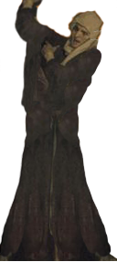
Nahum, Zephaniah & Habakkuk
Lesson 5 – Nahum 3: Woe to Nineveh

Slide 2
The purpose of the prophets was threefold:
To warn the nations of the coming judgment.
To explain why the judgment had come upon them.
To give assurance, at least to a remnant, of a hope that lay beyond the judgment.
Notes:
1. The purpose of the prophets was threefold:
a. To warn the nations of the coming judgment.
b. To explain why the judgment had come upon them.
To give assurance, at least to a remnant, of a hope that lay beyond the judgment.

Slide 3
The Role of the Prophets
They are Spokesmen for God, serving as “forthtellers,” speaking what God put in their mouth.
They are Preachers of the Covenant, relating their message to God’s previous promises to the nation of Israel. These covenants were made with or through Abraham, Moses, and David
They are historians, or Interpreters of the Israelites’ History. With out their interpretation God’s people would not know why an event was occurring.

Slide 4
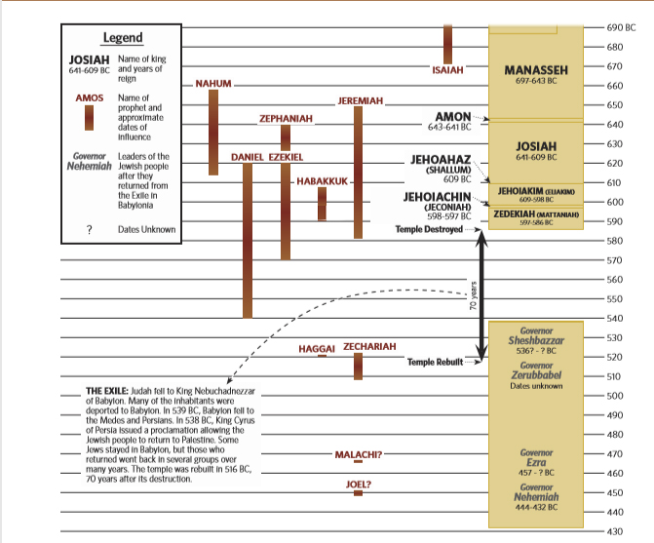

Slide 5
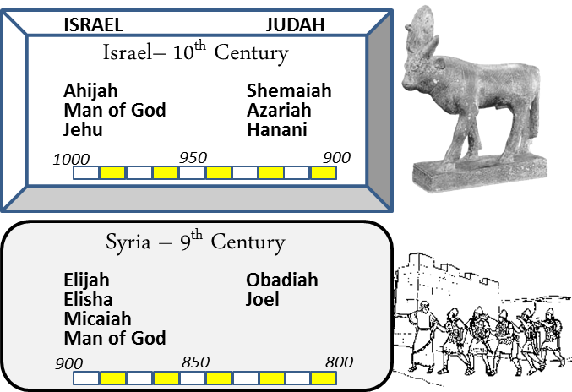
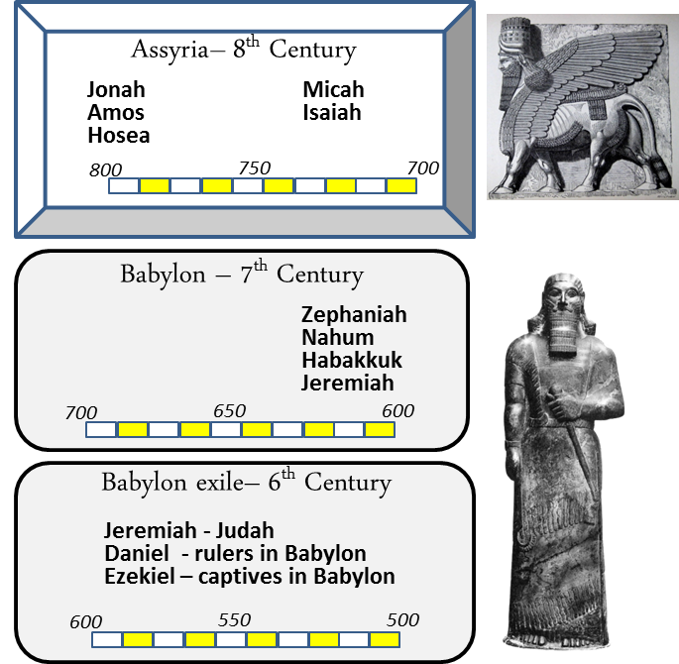
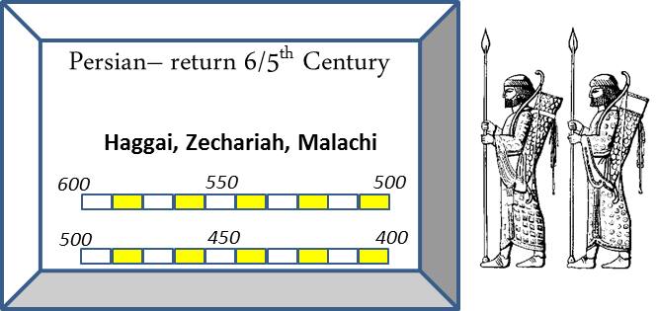
When

Slide 6
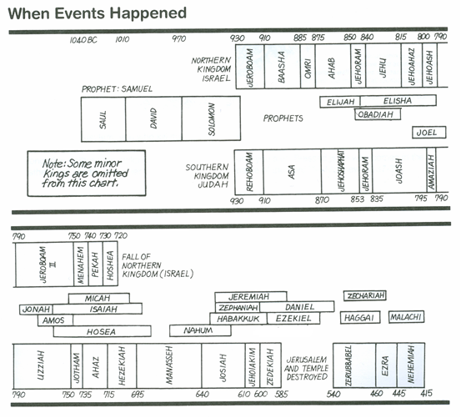
Kings & Prophets

Slide 7
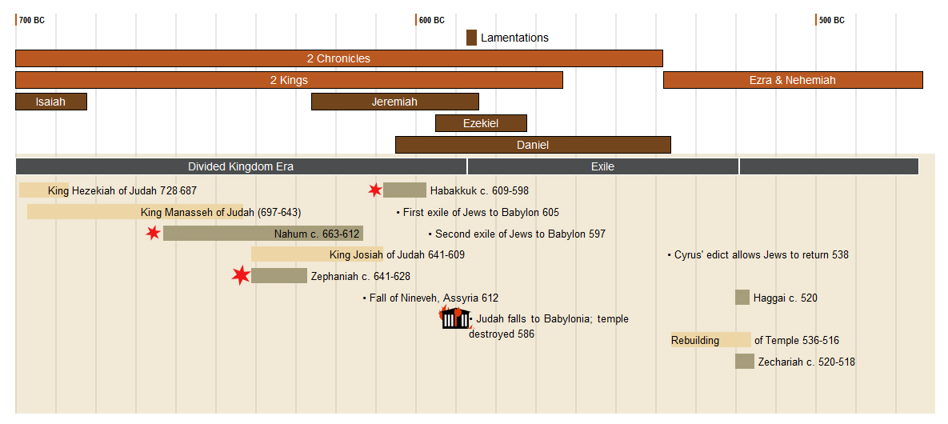

Slide 8
Assyria
Ashurnasirpal II 883-859
Shalmanser III 859-824
Tiglath-Pileser III (Pul) 745-727
Shalmaneser V 727-722
Esarhaddon
681-669
Sargon II
722-705
Sennacherib
705-681
Ashurbanipal
669-627
Tribute from Tyre & Sidon
Babylon rebels
626 BC
6 Campaigns Levant – Ahab at Qarqar 853 BC
Black Obelisk – Jehu giving tribute 841 BC
Killed brothers
Attacked Egypt 669 BC
Law Found 622 BC
Hoshea Rebels-Samaria
Northern Kingdom Falls 722 BC
(2 Kgs 17:1-6)
Ashur sacked
614
Conquered Samaria
713/712 BC revolt by Egypt Ashdod
Judah Edom & Moab
(2 kgs 17:24 Is 20)
Rebuilt Nineveh Subdued Babylon
Led attack on Judah 701 BC sacked Lachish
Trapped Hezekiah like Bird in a Cage
Killed by 2 of his sons 2 Kgs chap 18-19
Ahaz appeals to him to help with Israel/Syria 733 BC
Reduces Israel’s territory (2 Kgs 15:19,2916:7-10)
Conquered Thebes 663 BC
Brother ruler of Babylon Revolts 652 BC
Nineveh destroyed 612 BC
Haran Falls 610 BC
Neco of Egypt tries to help retake Haran 609 BC
Death of Josiah
Period of Weakness
823-745 BC
Battle of Carchemish – end of Assyria
605 BC
Nabopolassar 627-605 BC
Jeroboam II
793-753 BC
Hezekiah 727-697
Manasseh 697-642 BC
Josiah 640-609 BC
Nebuchadnezzar 605-562 BC
Lumber to Esarhaddon
& Ashurbanipal
Jonah 780 BC
Taken prisoner ~650 BC?
Zephaniah 641-628 BC
Habakkuk 609-598 BC
Nahum 663-612 BC

Slide 9
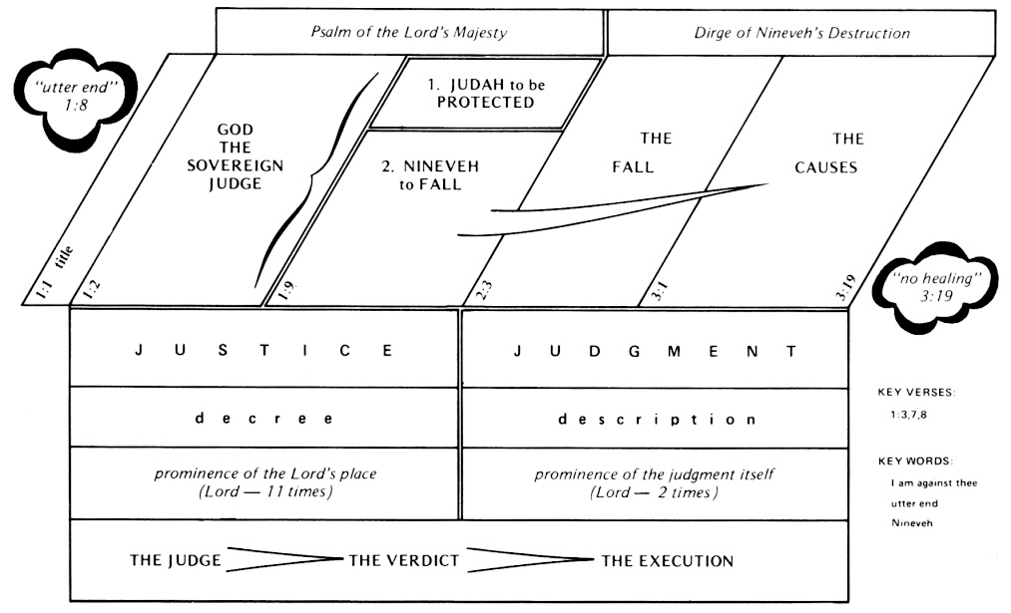
Nahum 1:2-3 (ESV)
God’s Wrath Against Nineveh
² The Lord is a jealous and avenging God;
the Lord is avenging and wrathful;
the Lord takes vengeance on his adversaries
and keeps wrath for his enemies.
³ The Lord is slow to anger and great in power,
and the Lord will by no means clear the guilty.
His way is in whirlwind and storm,
and the clouds are the dust of his feet.
Nahum 1:7–8 (ESV)
⁷ The Lord is good,
a stronghold in the day of trouble;
he knows those who take refuge in him.
⁸ But with an overflowing flood
he will make a complete end of the adversaries,
and will pursue his enemies into darkness.

Slide 10
The Lord’s Coming Judgment on Nineveh and Deliverance of Judah
Nineveh Judah
What do you conspire against the LORD?
1:9-12
He will make an utter end of it.
Affliction will not rise up a second time
while tangled like thorns,
while drunken like drunkards
They shall be devoured like stubble fully dried.
From you comes forth one
Who plots evil against the LORD,
A wicked counselor
Thus says the LORD:
"Though they are safe, and likewise many,
Yet in this manner they will be cut down
When he passes through.
^{12b} Though I have afflicted you,
I will afflict you no more;
¹³ For now I will break off his yoke from you,
And burst your bonds apart."

Slide 11
The Lord’s Coming Judgment on Nineveh and Deliverance of Judah
Nineveh Judah
¹⁴ The LORD has given a command concerning you:
"Your name shall be perpetuated no longer.
Out of the house of your gods I will cut off
the carved image and the molded image.
I will dig your grave,
For you are vile."
^{12b} Though I have afflicted you,
I will afflict you no more;
¹³ For now I will break off his yoke from you,
And burst your bonds apart."
¹⁵ Behold, on the mountains
The feet of him who brings good tidings,
Who proclaims peace!
O Judah, keep your appointed feasts,
Perform your vows.
For the wicked one shall no more pass through you;
He is utterly cut off.
For the wicked one shall no more pass through you;
He is utterly cut off.

Slide 12
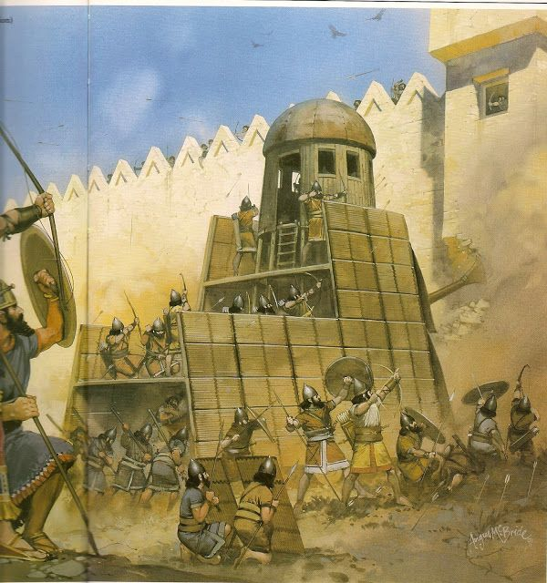
Nahum 2:1-13 The Lord’s Coming Judgment
Nahum 2:1 (NKJV)
The beginning of the attack on Nineveh
2 He who scatters has come up before your face.
Man the fort!
Watch the road!
Strengthen your flanks!
Fortify your power mightily.
Notes:
IV. Focus on Nineveh: The Lord’s Coming Judgment (2:1–13)
A. The beginning of the attack on Nineveh (2:1)
B. Reasons for judgment: the Assyrians’ plundering of Judah, though Judah’s restoration by God is planned (2:2)
C. Attacking soldiers and military action at Nineveh (2:3–5)
D. The fall and plundering of Nineveh (2:6–9)
E. A taunting song portraying Nineveh’s destruction because of the city’s lust for conquest (2:10–12)
F. The Lord speaks a word of judgment (2:13)
Crossway Bibles. (2008). (p. 1711). Wheaton, IL: Crossway Bibles.
Crossway Bibles. (2008). The ESV Study Bible (p. 1711). Wheaton, IL: Crossway Bibles.

Slide 13
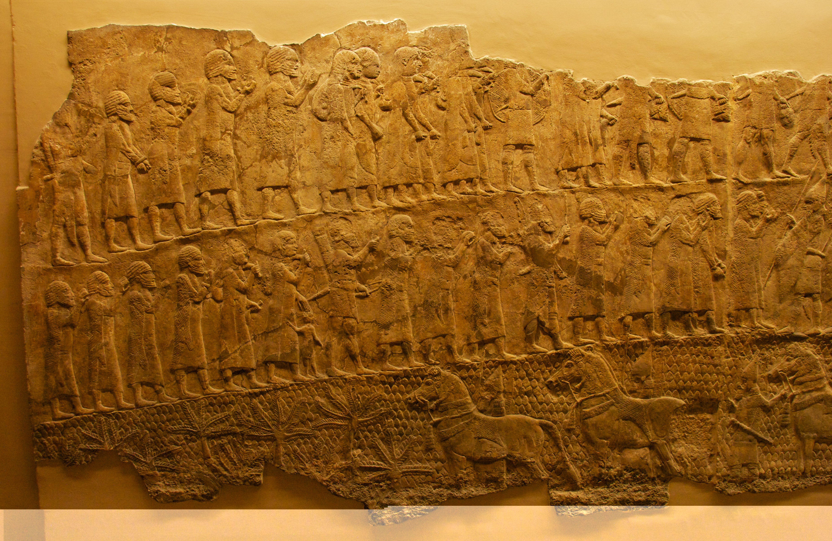
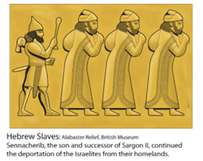
Nahum 2:1-13
Reasons for judgment
Nahum 2:2 (NKJV)
² For the Lord will restore the excellence of Jacob
Like the excellence of Israel,
For the emptiers have emptied them out
And ruined their vine branches.
Fall of Lachish
Notes:
IV. Focus on Nineveh: The Lord’s Coming Judgment (2:1–13)
A. The beginning of the attack on Nineveh (2:1)
B. Reasons for judgment: the Assyrians’ plundering of Judah, though Judah’s restoration by God is planned (2:2)
C. Attacking soldiers and military action at Nineveh (2:3–5)
D. The fall and plundering of Nineveh (2:6–9)
E. A taunting song portraying Nineveh’s destruction because of the city’s lust for conquest (2:10–12)
F. The Lord speaks a word of judgment (2:13)
Crossway Bibles. (2008). (p. 1711). Wheaton, IL: Crossway Bibles.
Crossway Bibles. (2008). The ESV Study Bible (p. 1711). Wheaton, IL: Crossway Bibles.

Slide 14
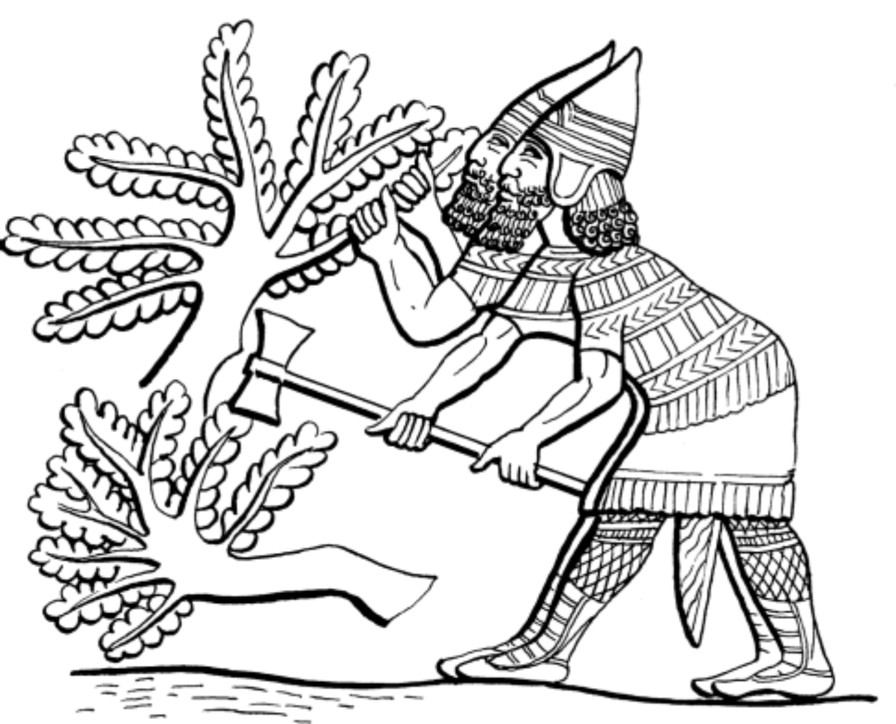
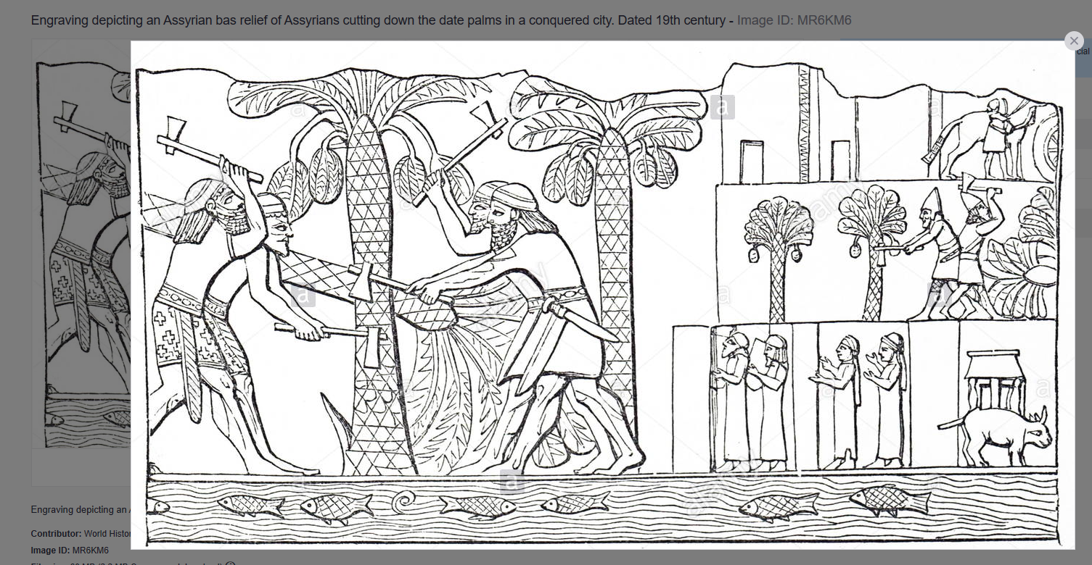
Nahum 2:1-13
Reasons for judgment
Nahum 2:2 (NKJV)
² For the Lord will restore the excellence of Jacob
Like the excellence of Israel,
For the emptiers have emptied them out
And ruined their vine branches.
Notes:
IV. Focus on Nineveh: The Lord’s Coming Judgment (2:1–13)
A. The beginning of the attack on Nineveh (2:1)
B. Reasons for judgment: the Assyrians’ plundering of Judah, though Judah’s restoration by God is planned (2:2)
C. Attacking soldiers and military action at Nineveh (2:3–5)
D. The fall and plundering of Nineveh (2:6–9)
E. A taunting song portraying Nineveh’s destruction because of the city’s lust for conquest (2:10–12)
F. The Lord speaks a word of judgment (2:13)
Crossway Bibles. (2008). (p. 1711). Wheaton, IL: Crossway Bibles.
Crossway Bibles. (2008). The ESV Study Bible (p. 1711). Wheaton, IL: Crossway Bibles.

Slide 15
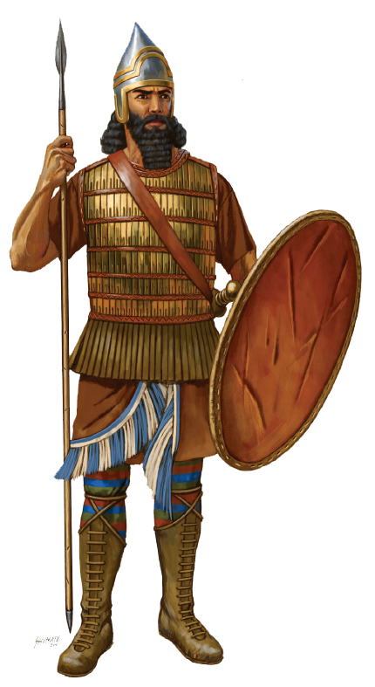
Visual Aids
Nahum 2:3(ESV) ³ The shield of his mighty men is red;
his soldiers are clothed in scarlet.
The chariots come with flashing metal
on the day he musters them;
the cypress spears are brandished.
Nahum 2:3 (NKJV)
³ The shields of his mighty men are made red,
The valiant men are in scarlet.
The chariots come with flaming torches
In the day of his preparation,
And the spears are brandished.
Nahum 2:3 (YLT) ³ The shield of his mighty ones is become red, Men of might are in scarlet, With fiery torches is the chariot in a day of his preparation,
And the firs have been caused to tremble.

Slide 16
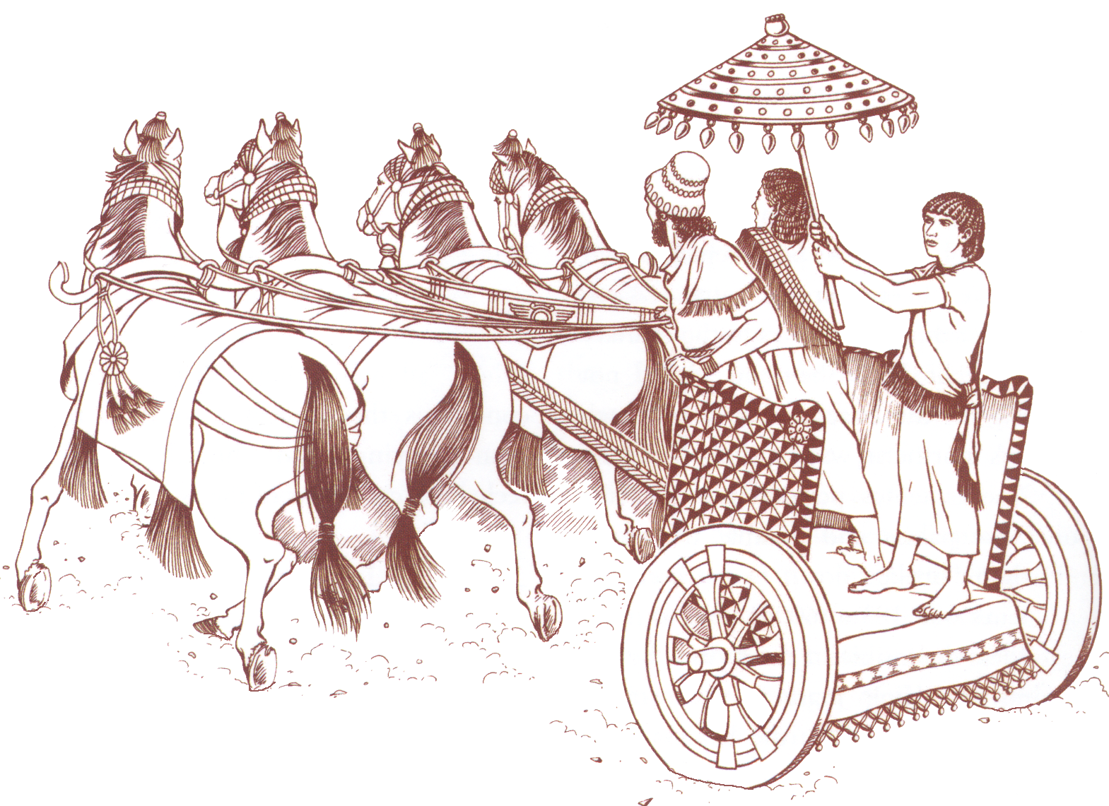
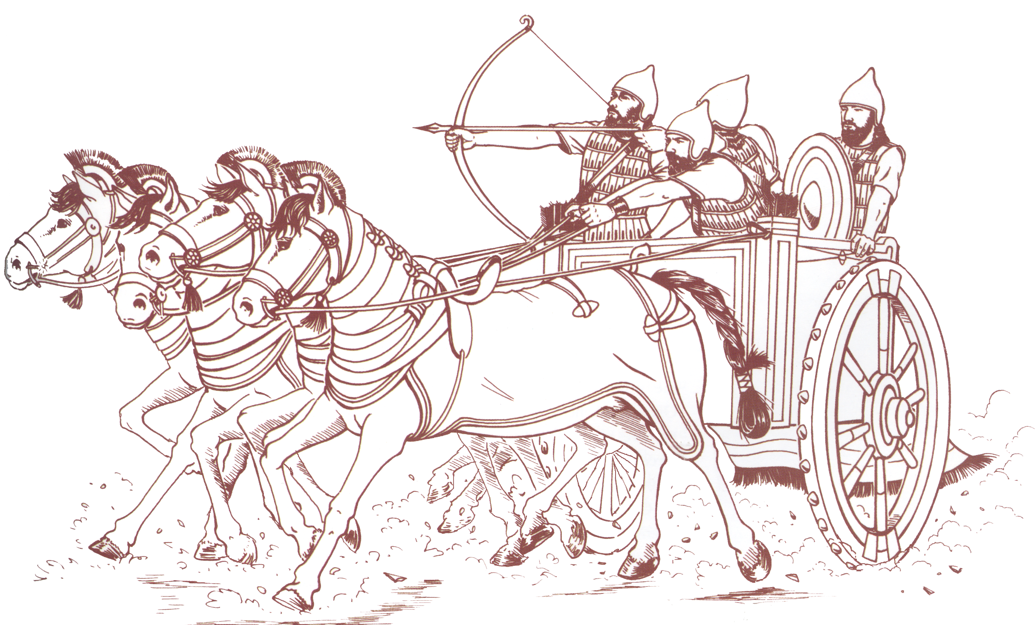
Nahum 2:4 (NKJV)
⁴ The chariots rage in the streets,
They jostle one another in the broad roads;
They seem like torches,
They run like lightning.
Nahum 2:3 (NKJV)
³ The shields of his mighty men are made red,
The valiant men are in scarlet.
The chariots come with flaming torches
In the day of his preparation,
And the spears are brandished.

Slide 17
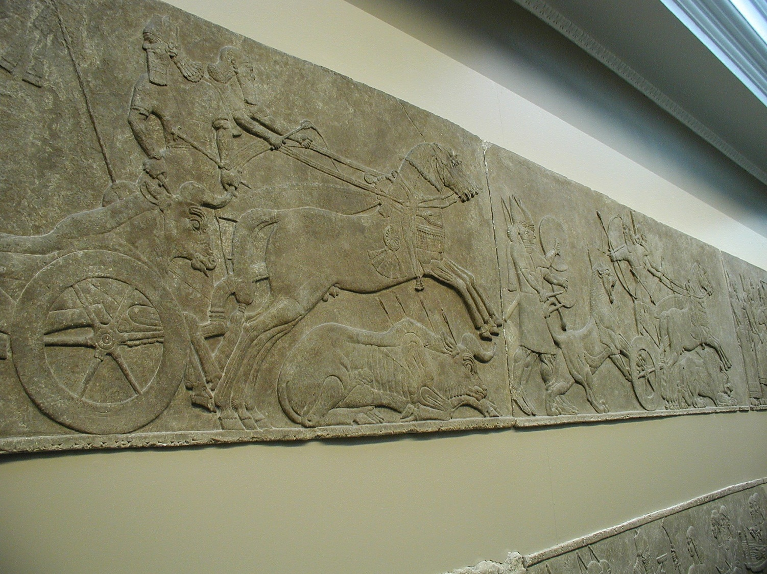
Nahum 2:4 (NKJV)
⁴ The chariots rage in the streets,
They jostle one another in the broad roads;
They seem like torches,
They run like lightning.

Slide 18
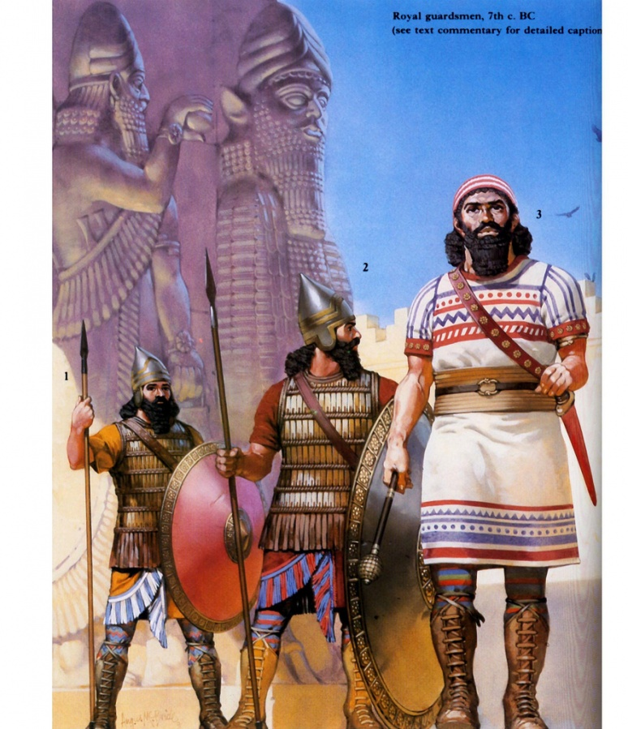
Nahum 2:5 (NKJV)
⁵ He remembers his nobles;
They stumble in their walk;
They make haste to her walls,
And the defense is prepared.

Slide 19
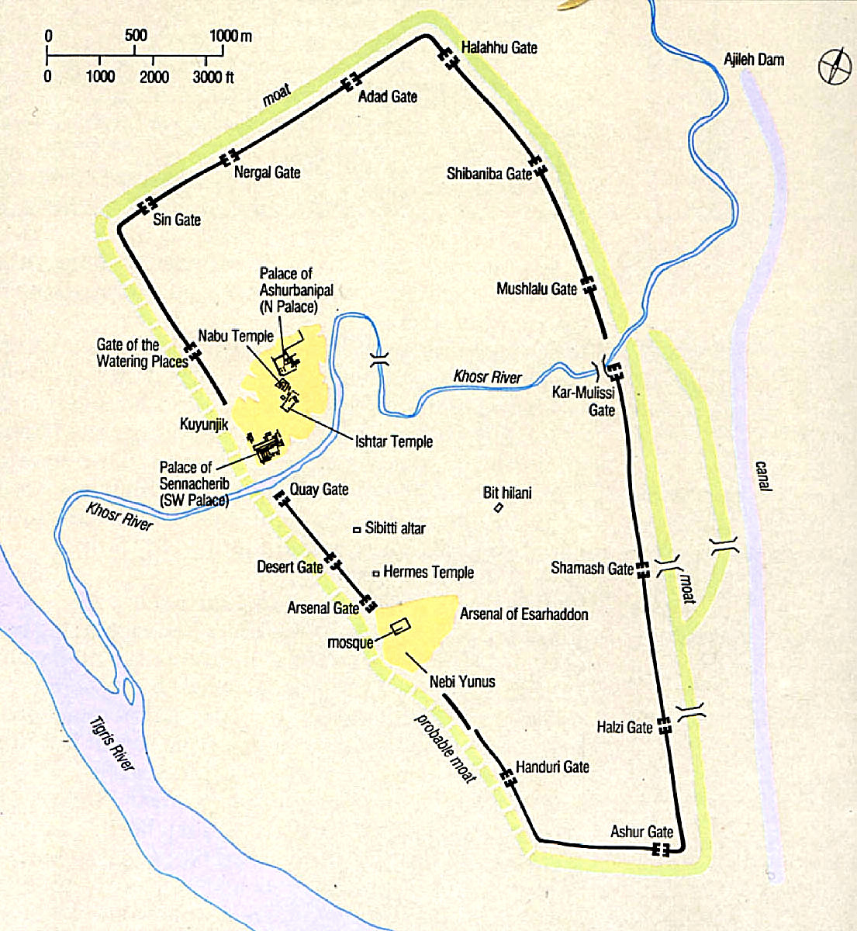
2:6 river gates. The Khoser River flowed through Nineveh; north of the city were dams, most likely with gates to regulate the flow of this river. The besieging coalition could easily have closed the gates (cutting off this water supply), waited until a considerable quantity of water collected, and then opened the gates. The resulting mass of water crashing against and through Nineveh would have done much damage to portions of the city’s wall, system of gates, and internal structures, thus greatly aiding the besiegers. Another river that probably flowed through Nineveh was the Tebiltu, which could have been used by the coalition in the same manner. The destruction caused by the waters no doubt was a factor contributing to the short length of the siege—only three months. The palace melts away because of the floodwaters.
Nahum 2:6 (NKJV)
⁶ The gates of the rivers are opened,
And the palace is dissolved.

Slide 20
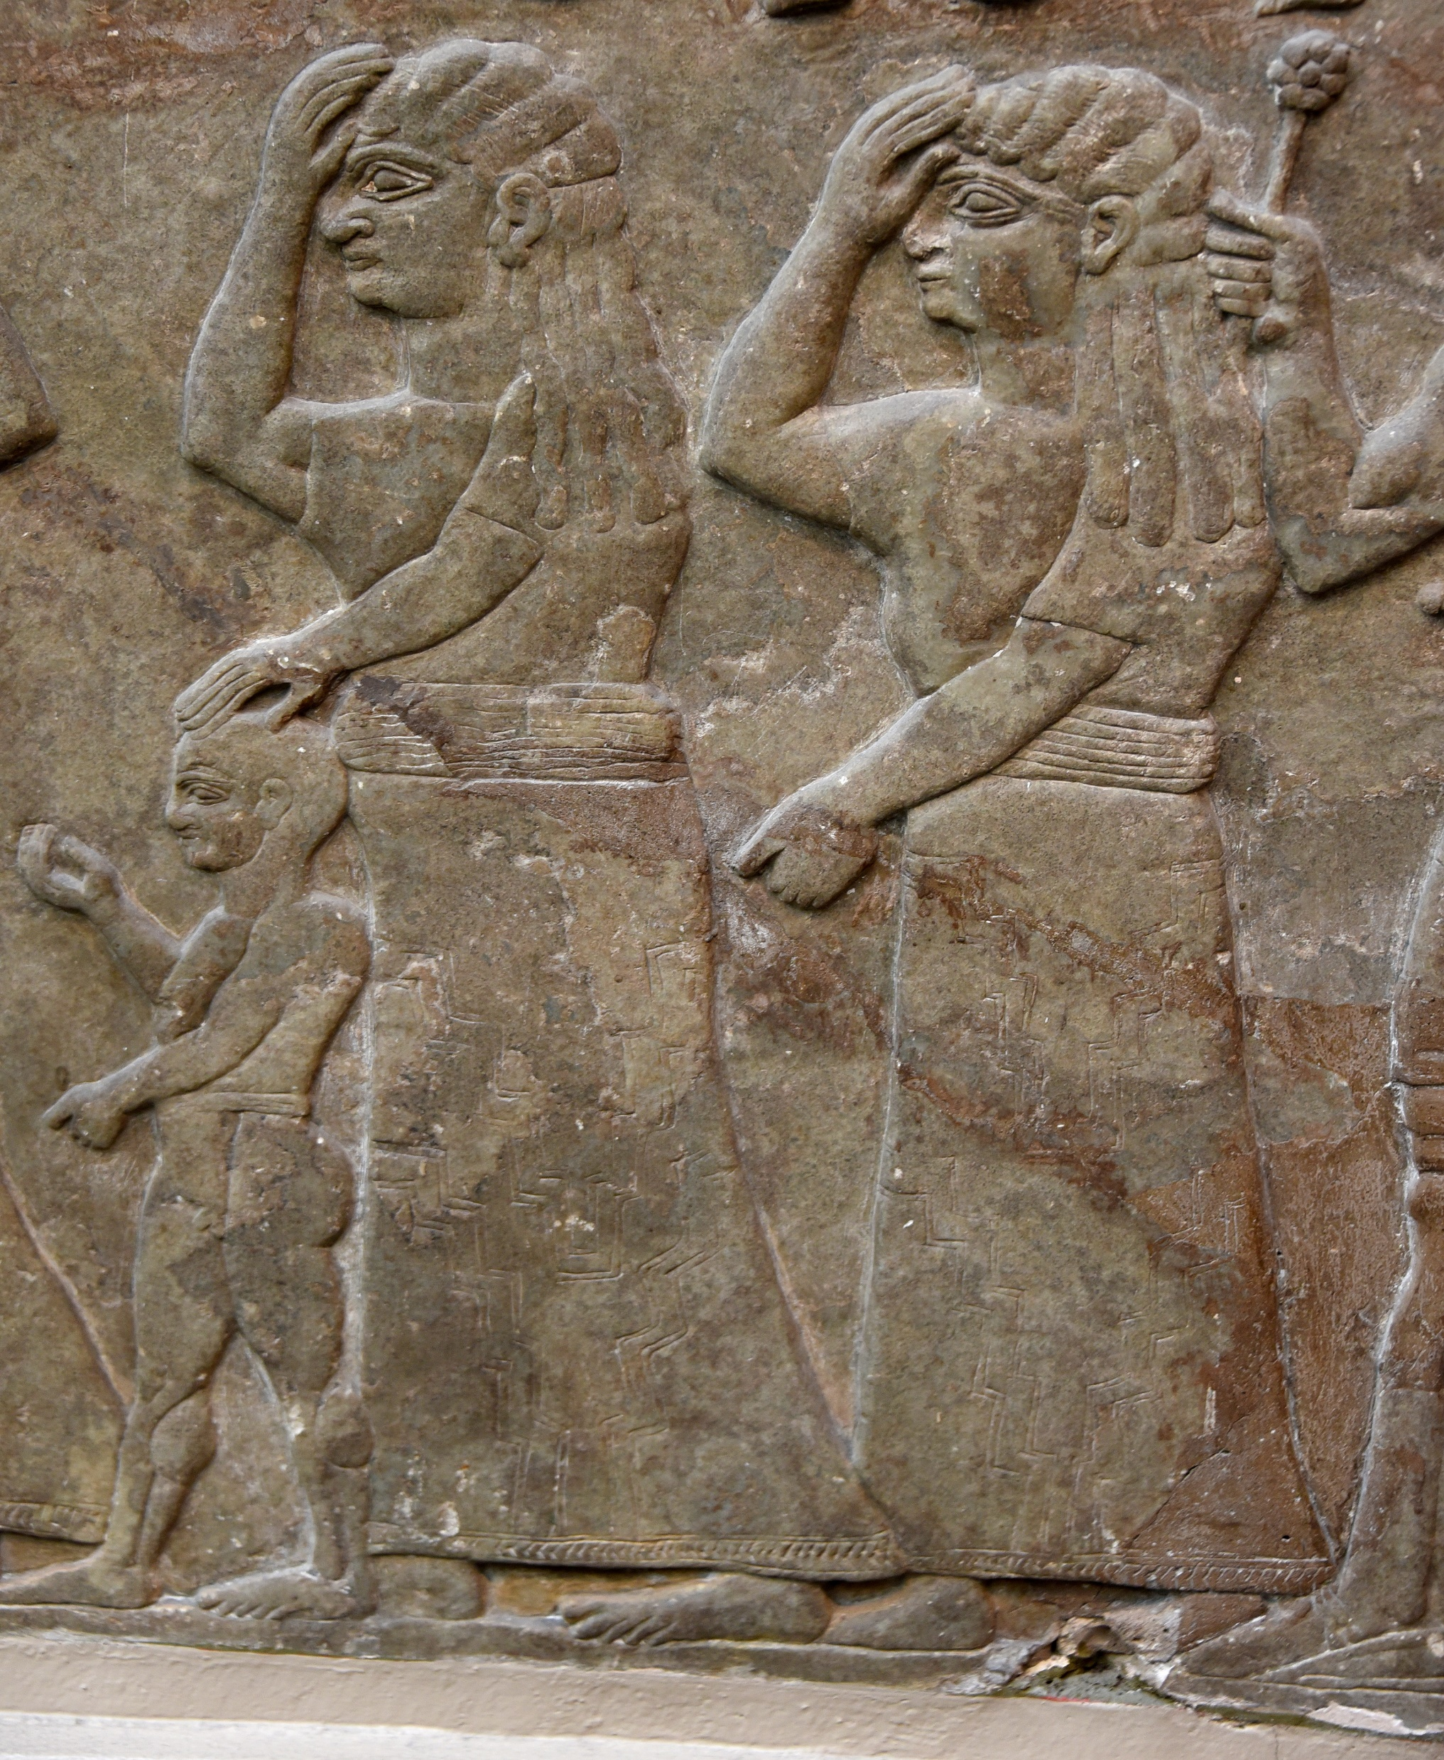
Nahum 2:7 (NKJV)
⁷ It is decreed:
She shall be led away captive,
She shall be brought up;
And her maidservants shall lead her as with the voice of doves,
Beating their breasts.
Alabaster bas-relief showing two woman and a child as prisoners of war after the Assyrian army captured their city. Neo-Assyrian Period, 865-860 BCE. Detail of Panel 5 (bottom), Room B, the North-Palace Palace, Nimrud, modern-day Iraq. (The British Museum, London)

Slide 21
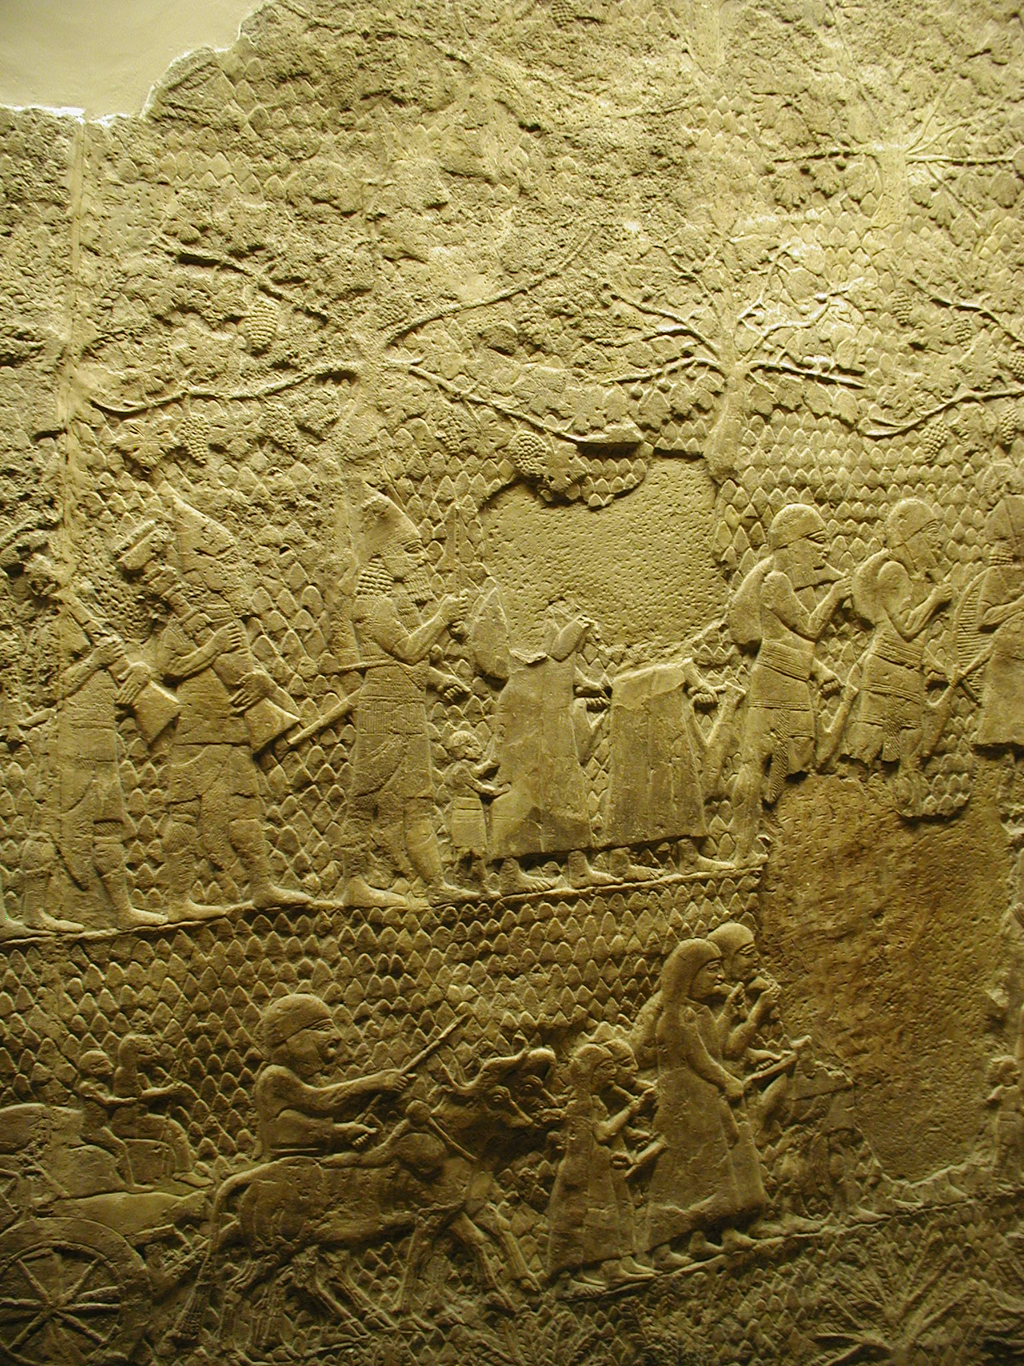
Nahum 2:9–10 (NKJV)
⁹ Take spoil of silver!
Take spoil of gold!
There is no end of treasure,
Or wealth of every desirable prize.
¹⁰ She is empty, desolate, and waste!
The heart melts, and the knees shake;
Much pain is in every side,
And all their faces are drained of color.

Slide 22
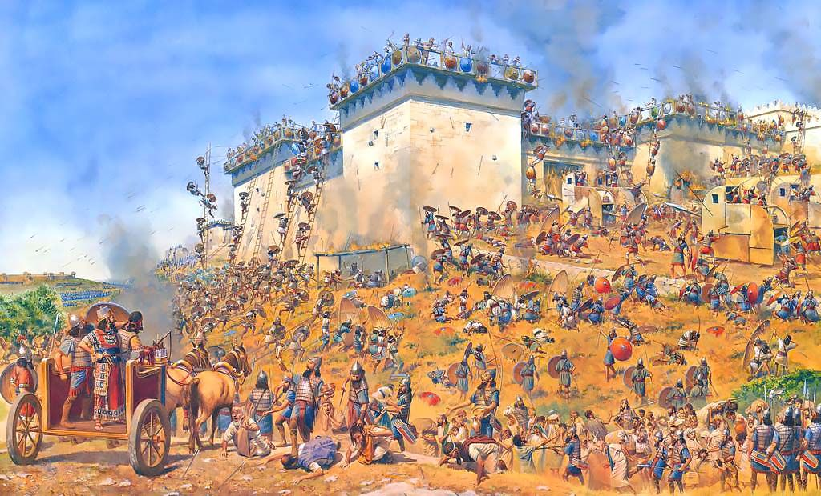
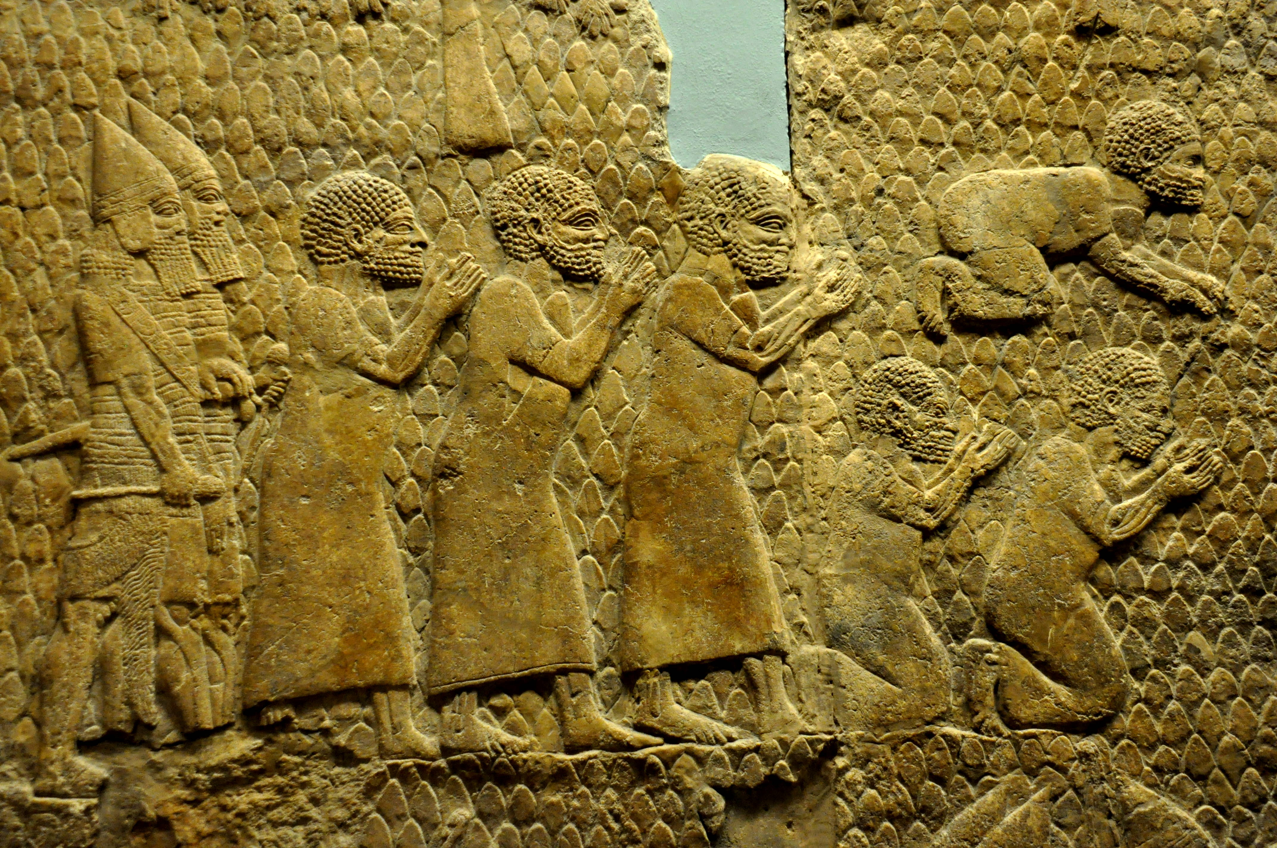
Nahum 2:10 (NKJV)
¹⁰ She is empty, desolate, and waste!
The heart melts, and the knees shake;
Much pain is in every side,
And all their faces are drained of color.

Slide 23
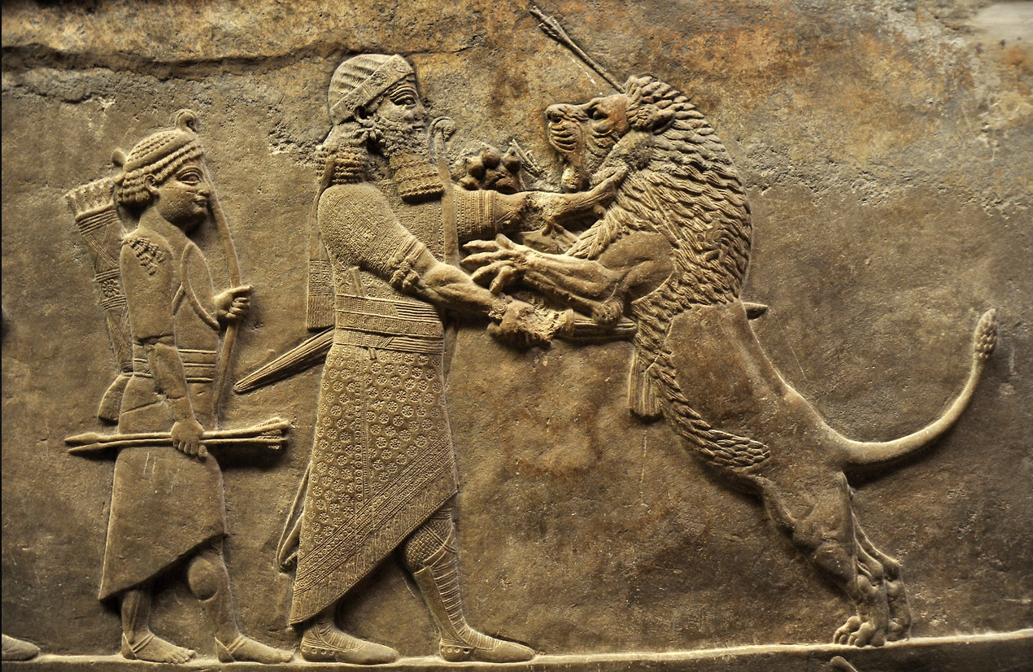
Nahum 2:11–12 (NKJV)
¹¹ Where is the dwelling of the lions,
And the feeding place of the young lions,
Where the lion walked, the lioness and lion’s cub,
And no one made them afraid?
¹² The lion tore in pieces enough for his cubs,
Killed for his lionesses,
Filled his caves with prey,
And his dens with flesh.
Assyrian relief sculpture from the North Palace at Nineveh, depicting King Ashurbanipal (r. 669-631 or 627 BCE) killing a lion. Artist unknown; 645-635 BCE. Now in the British Museum. Photo credit: Aiwok/Wikimedia Commons.

Slide 24
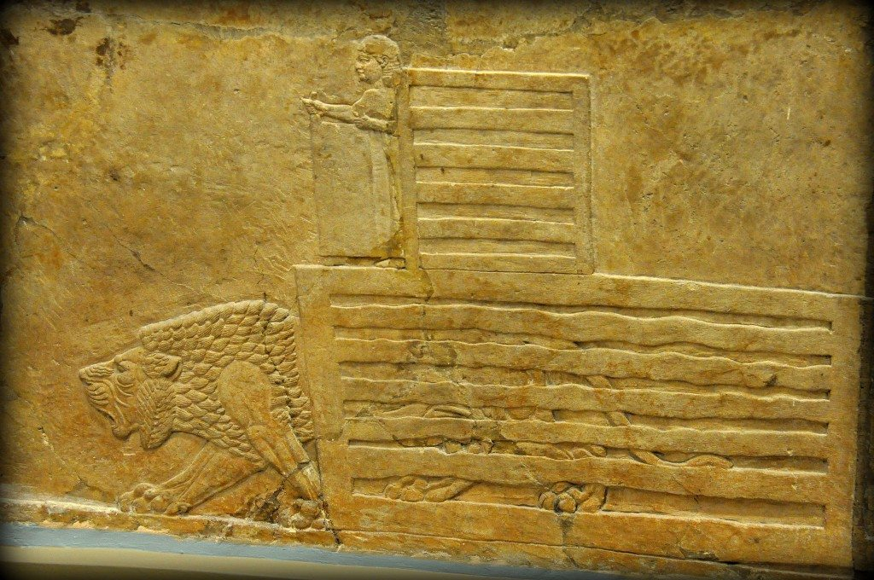
Nahum 2:11–12 (NKJV)
¹¹ Where is the dwelling of the lions,
And the feeding place of the young lions,
Where the lion walked, the lioness and lion’s cub,
And no one made them afraid?
¹² The lion tore in pieces enough for his cubs,
Killed for his lionesses,
Filled his caves with prey,
And his dens with flesh.
The action is about to begin; let’s rock! In this alabaster bas-relief, a child lifts up a trapdoor, releasing a lion from his cage. The child himself has a small cage for protection. From Room C of the North Palace, Nineveh (modern-day Kouyunjik, Mosul Governorate), Mesopotamia, Iraq. Circa 645-635 BCE. The British Museum, London. Photo © Osama S.M. Amin.

Slide 25
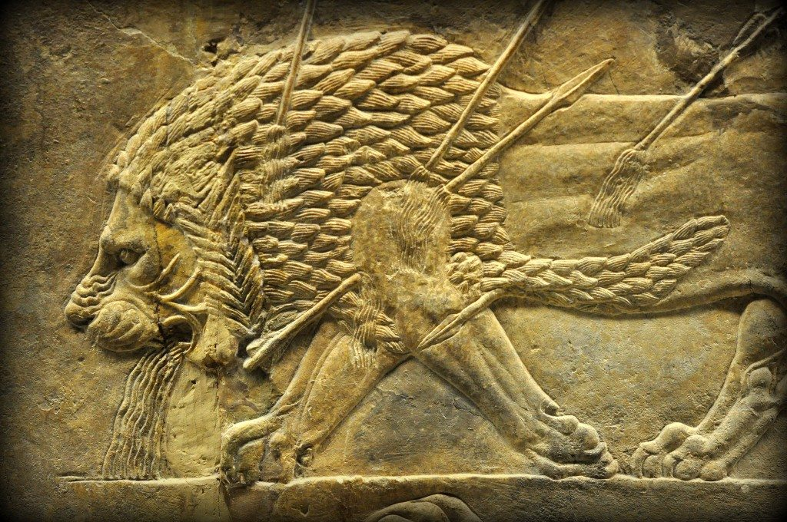
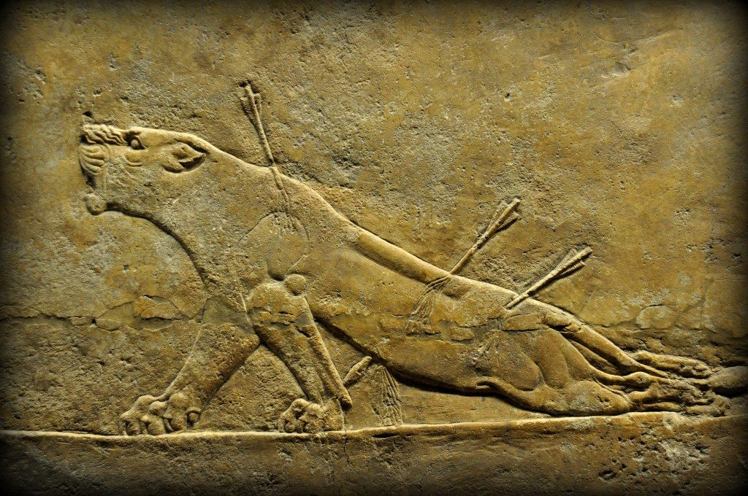
Nahum 2:11–12 (NKJV)
¹¹ Where is the dwelling of the lions,
And the feeding place of the young lions,
Where the lion walked, the lioness and lion’s cub,
And no one made them afraid?
¹² The lion tore in pieces enough for his cubs,
Killed for his lionesses,
Filled his caves with prey,
And his dens with flesh.
Alabaster bas-relief depicting a dying lion. He has been hit by four arrows; blood gushes from the entry and exit points of the arrows. One of the arrows has passed through the left shoulder; note the limping of the left foreleg. The lion also appears to vomit blood! His facial expression of agony and fear is very well reflected; note how he looks forward.
From Room C of the North Palace, Nineveh (modern-day Kouyunjik, Mosul Governorate), Mesopotamia, Iraq. Circa 645-635 BCE. The British Museum, London. Photo © Osama S.M. Amin.
Alabaster bas-relief depicting a dying lioness. The lioness has received three arrows; blood can be seen gushing from the ensuing wounds. One of the arrows hit her at the lower back; this may explain her hind legs’ weakness! She is roaring in agony, fighting death.

Slide 26
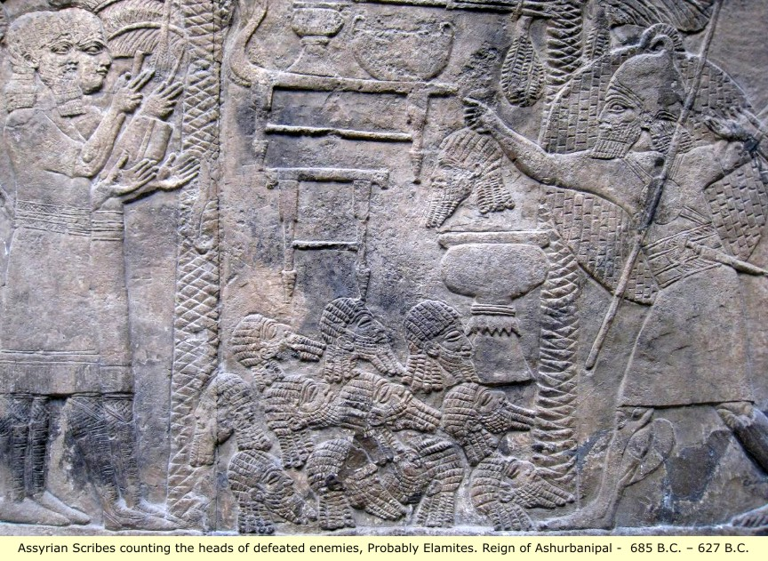
Visual Aids
Nahum 2:13(ESV) ¹³Behold, I am against you, declares the Lord of hosts, and I will burn your chariots in smoke, and the sword shall devour your young lions. I will cut off your prey from the earth, and the voice of your messengers shall no longer be heard.

Slide 27
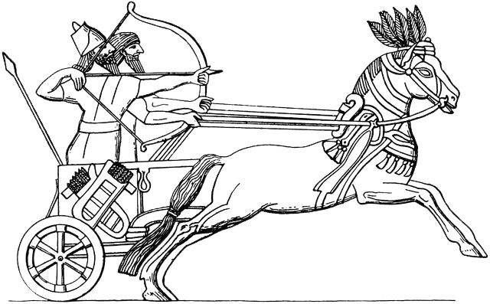
Nahum 3:1–2 (NKJV)
The Woe of Nineveh
3 Woe to the bloody city!
It is all full of lies and robbery.
Its victim never departs.
² The noise of a whip
And the noise of rattling wheels,
Of galloping horses,
Of clattering chariots!

Slide 28
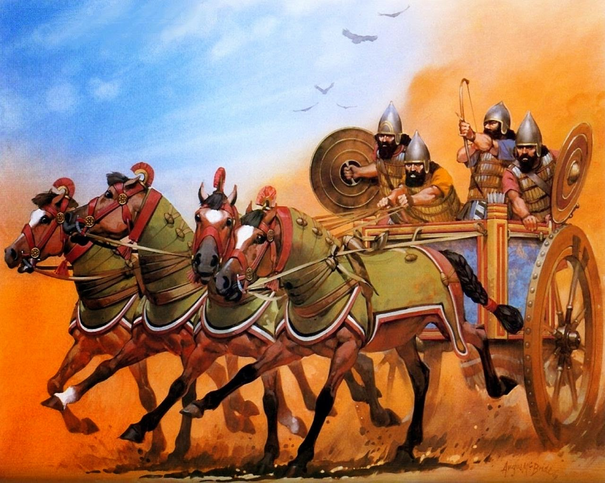
Nahum 3:1–2 (NKJV)
The Woe of Nineveh
3 Woe to the bloody city!
It is all full of lies and robbery.
Its victim never departs.
² The noise of a whip
And the noise of rattling wheels,
Of galloping horses,
Of clattering chariots!

Slide 29
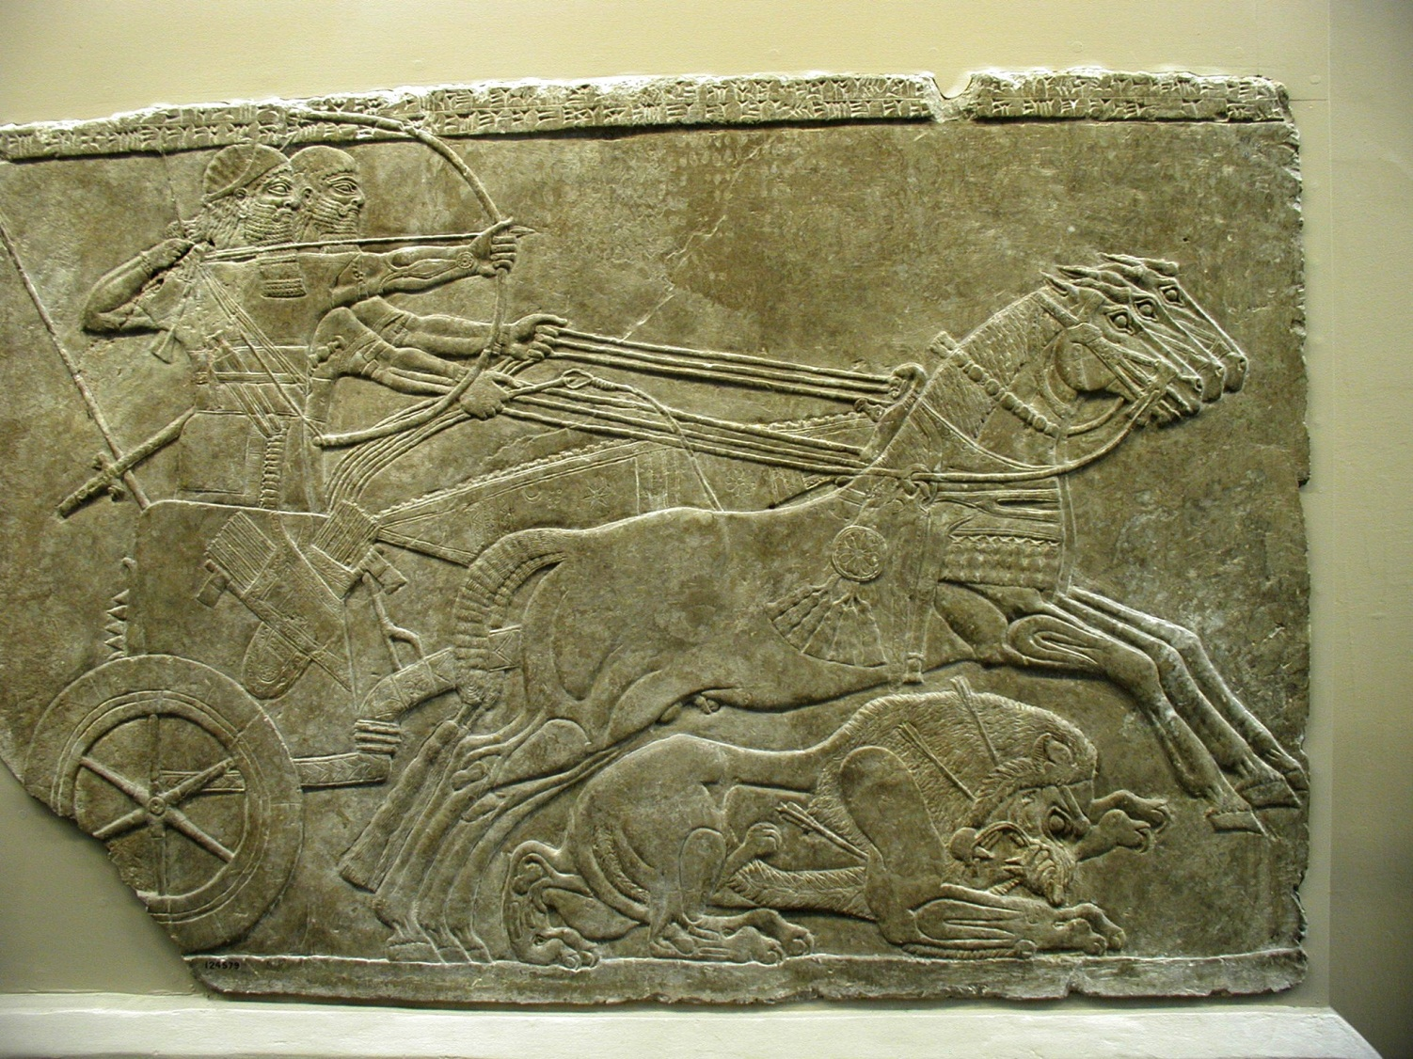
Nahum 3:1–2 (NKJV)
The Woe of Nineveh
3 Woe to the bloody city!
It is all full of lies and robbery.
Its victim never departs.
² The noise of a whip
And the noise of rattling wheels,
Of galloping horses,
Of clattering chariots!

Slide 30
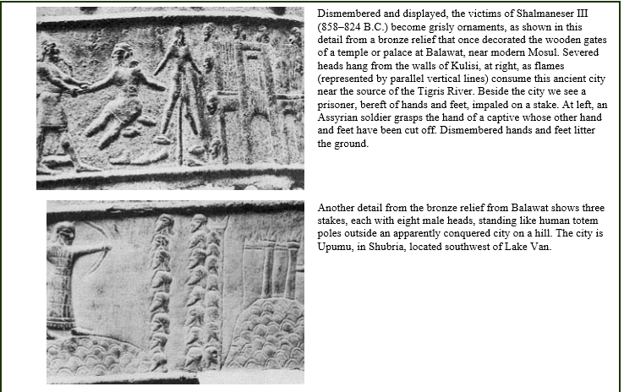
Nahum 3:3 (NKJV)
³ Horsemen charge with bright sword and glittering spear.
There is a multitude of slain,
A great number of bodies,
Countless corpses—
They stumble over the corpses—

Slide 31
Nahum 3:1 (NKJV)
¹Woe to the bloody city! It is all full of lies and robbery. Its victim never departs.
Nahum 3:5 (NKJV)
⁵“Behold,
I am against you,” says the Lord of hosts;
“I will lift your skirts over your face,
I will show the nations your nakedness, And the kingdoms your shame.
Nahum 3:6 (NKJV)
⁶ I will cast abominable filth upon you,
Make you vile,
And make you a spectacle.
Nahum 3:7 (NKJV)
⁷ It shall come to pass that all who look upon you
Will flee from you, and say,
‘Nineveh is laid waste!
Who will bemoan her?’
Where shall I seek comforters for you?”

Slide 32
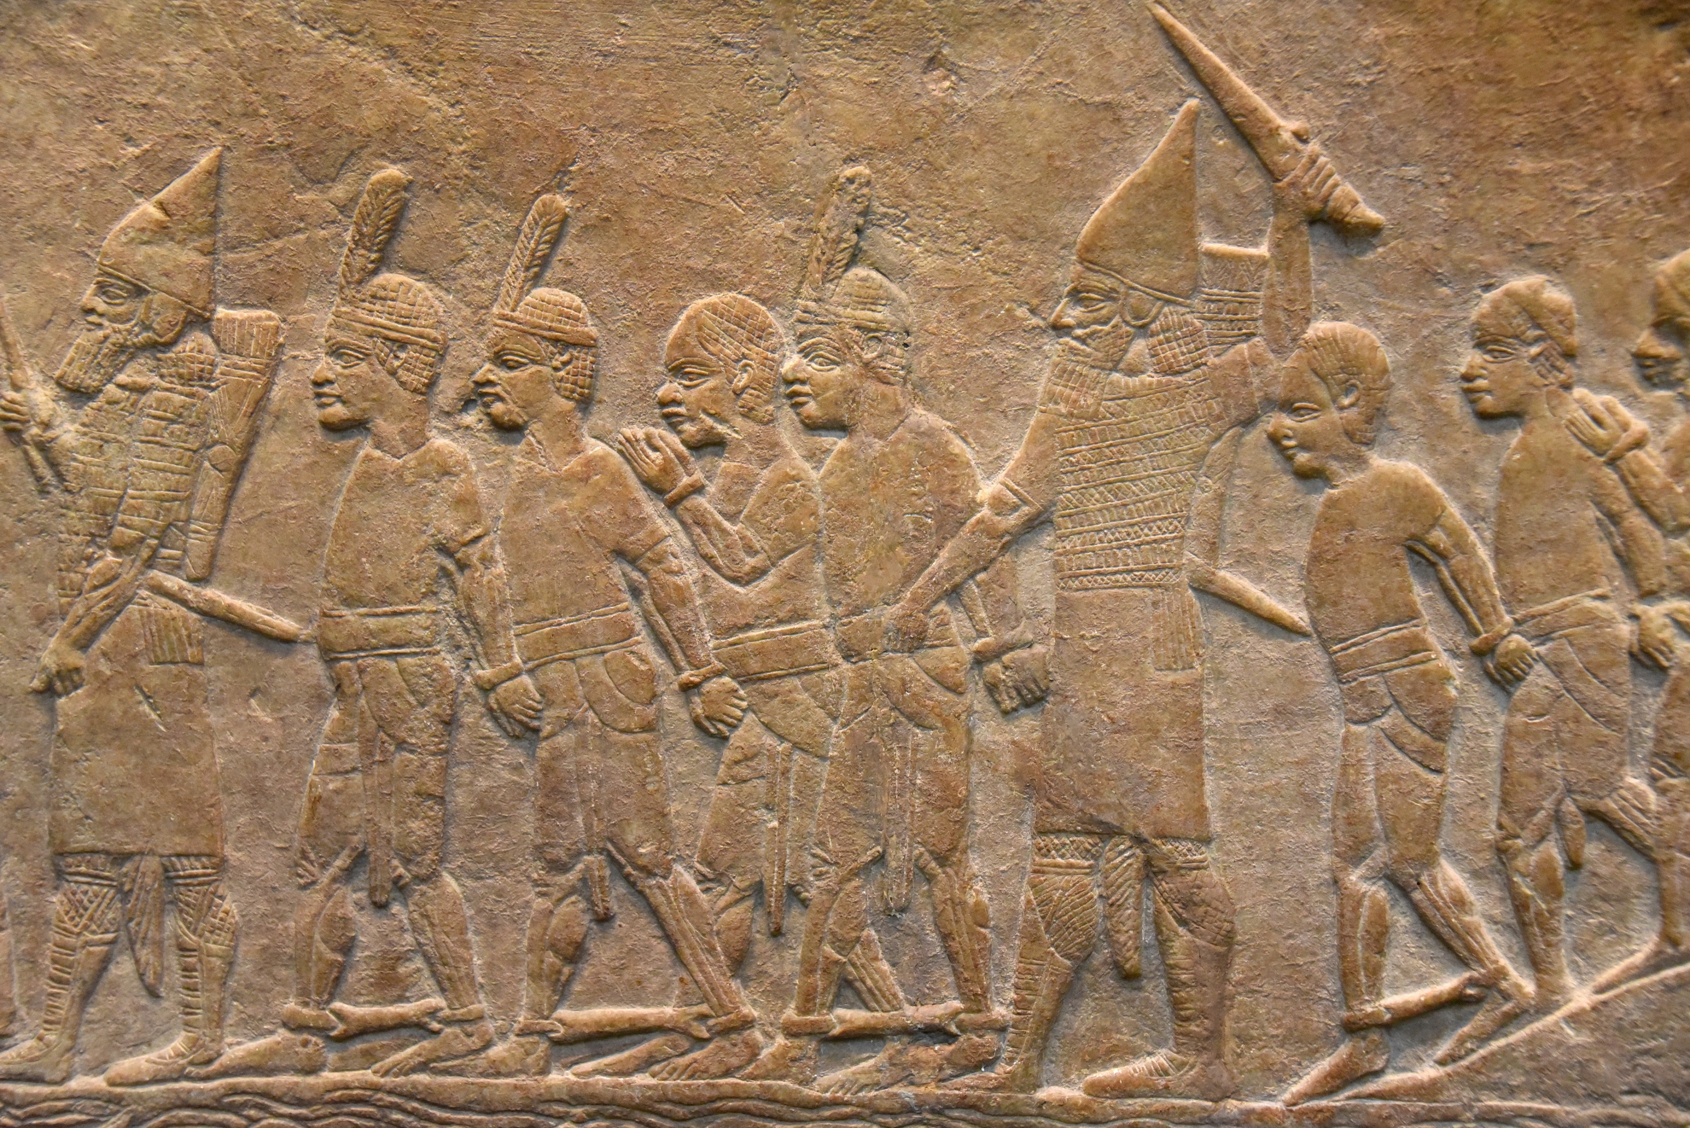
This is a detail of a large gypsum wall panel. The panel depicts the Assyrian attack on a fortress at the Egyptian city of Memphis in 667 BCE. Here the Nubian soldiers of King Taharqa (of the 25th Dynasty) are being led, as prisoners, by the Assyrian soldiers of Ashurbanipal II.
Nahum 3:8 (NKJV) 663 BC
⁸ Are you better than No Amon
That was situated by the River,
That had the waters around her,
Whose rampart was the sea,
Whose wall was the sea?

Slide 33
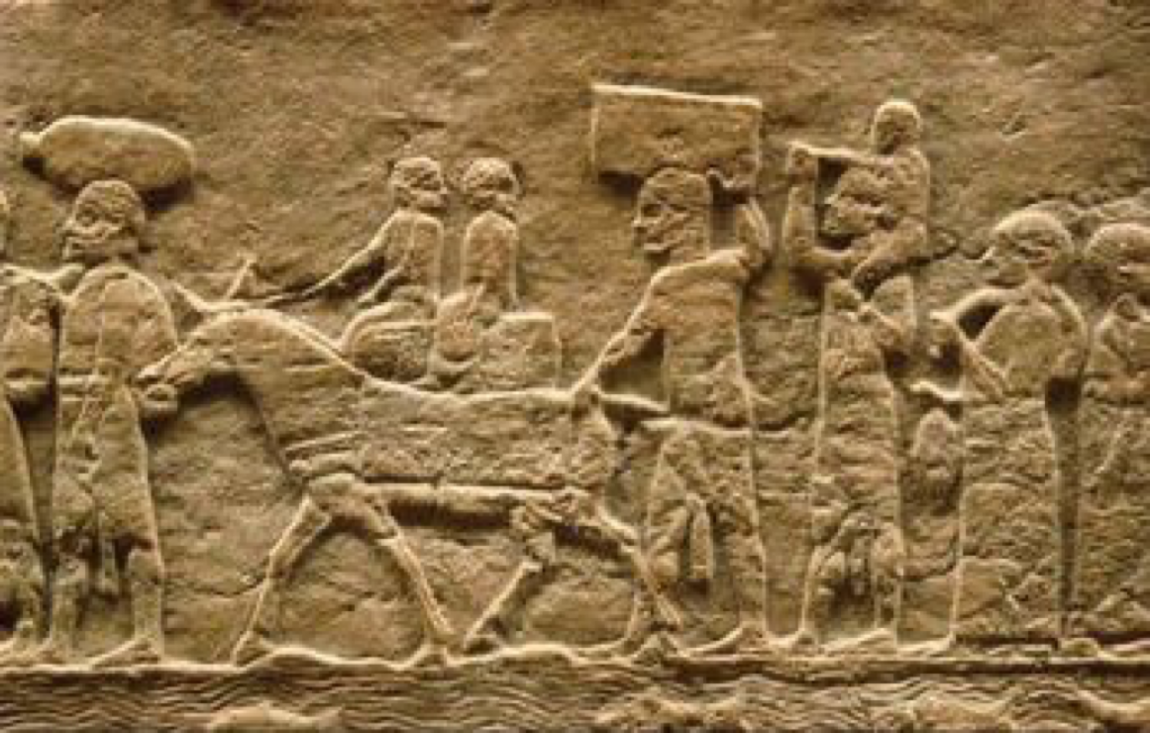
Nahum 3:10 (NKJV)
¹⁰ Yet she was carried away,
She went into captivity;
Her young children also were dashed to pieces
At the head of every street;
They cast lots for her honorable men,
And all her great men were bound in chains.
Children captives from Thebes

Slide 34
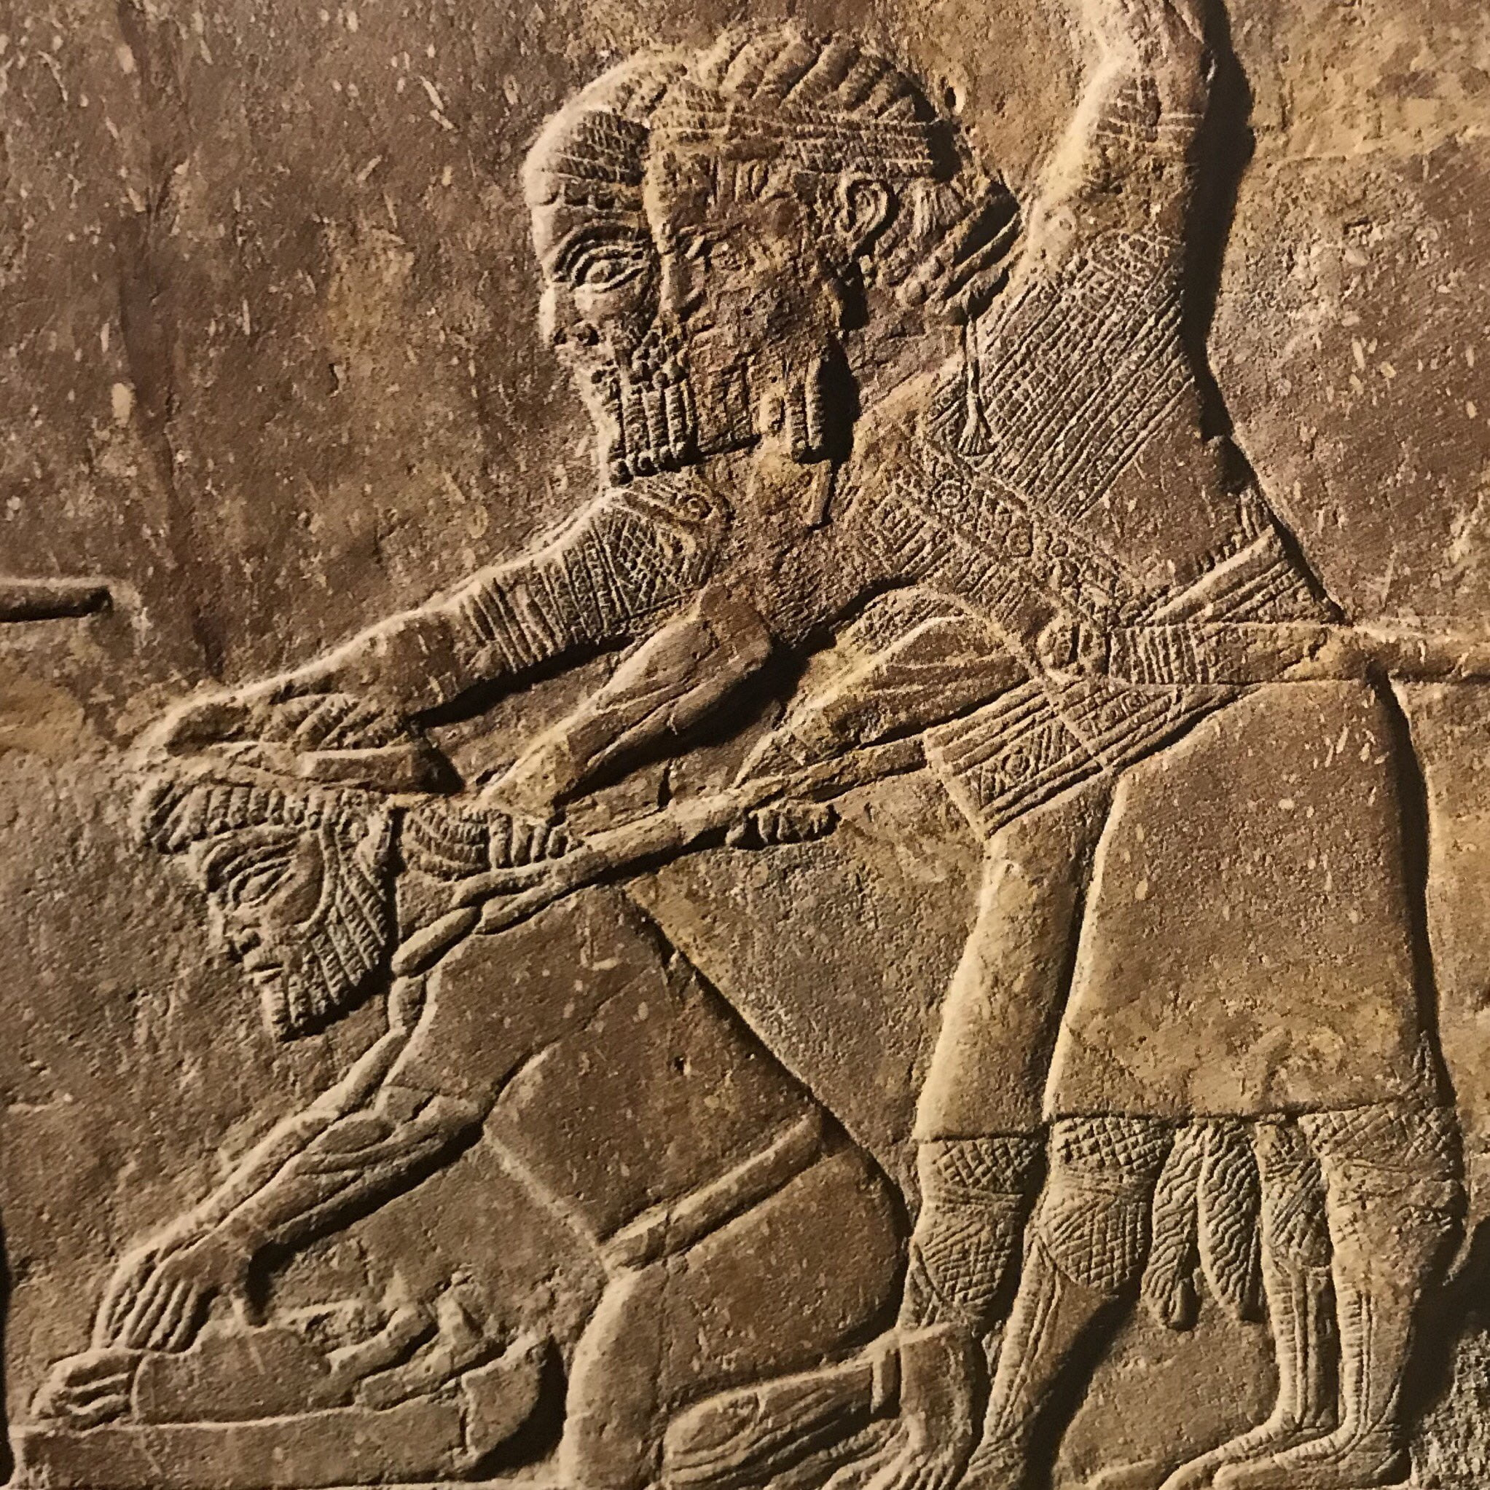
Nahum 3:10 (NKJV)
¹⁰ Yet she was carried away,
She went into captivity;
Her young children also were dashed to pieces
At the head of every street;
They cast lots for her honorable men,
And all her great men were bound in chains.
Two Assyrian soldiers forcing Babylonian captive to grind bones of his family, 7th - 6th c. BCE

Slide 35
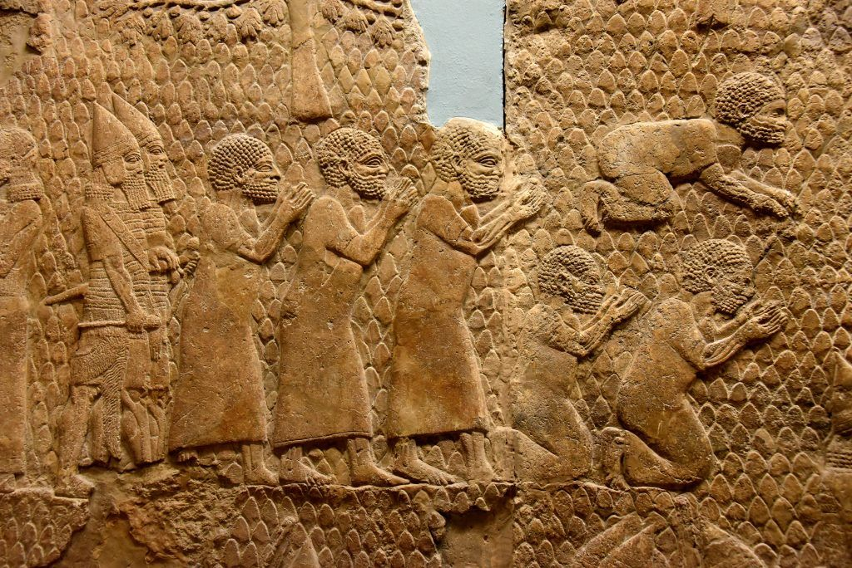
Nahum 3:10 (NKJV)
¹⁰ Yet she was carried away,
She went into captivity;
Her young children also were dashed to pieces
At the head of every street;
They cast lots for her honorable men,
And all her great men were bound in chains.
Lachish Captives

Slide 36
Nahum 3:12–13 (NKJV)
¹² All your strongholds are fig trees with ripened figs:
If they are shaken,
They fall into the mouth of the eater.
¹³ Surely, your people in your midst are women!
The gates of your land are wide open for your enemies;
Fire shall devour the bars of your gates.

Slide 37
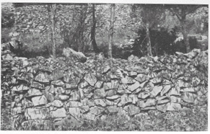
Nahum 3:14–17 (NKJV)
¹⁴ Draw your water for the siege!
Fortify your strongholds!
Go into the clay and tread the mortar!
Make strong the brick kiln!
¹⁵ There the fire will devour you,
The sword will cut you off;
It will eat you up like a locust.
Make yourself many—like the locust!
Make yourself many—like the swarming locusts!
¹⁶ You have multiplied your merchants more than the stars of heaven.
The locust plunders and flies away.
¹⁷ Your commanders are like swarming locusts,
And your generals like great grasshoppers,
Which camp in the hedges on a cold day;
When the sun rises they flee away,
And the place where they are is not known.

Slide 38
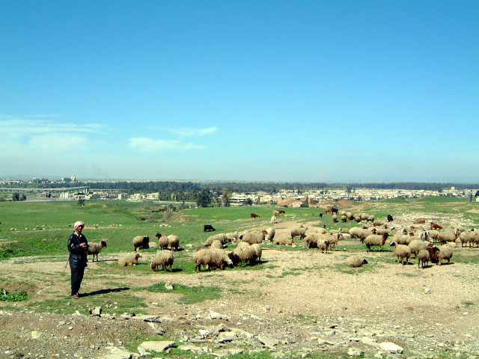
Nahum 3:18–19 (NKJV)
¹⁸ Your shepherds slumber, O king of Assyria;
Your nobles rest in the dust.
Your people are scattered on the mountains,
And no one gathers them.
¹⁹ Your injury has no healing,
Your wound is severe.
All who hear news of you
Will clap their hands over you,
For upon whom has not your wickedness passed continually?

Slide 39
Zephaniah began to prophesy around 630 BC while Nineveh, the capital of the mighty Assyrian Empire, was still the greatest city on earth with a population of possibly over a million people (Jonah 3:3, 4:11). He prophesied that God “will make Nineveh a desolation, and dry like a wilderness and flocks shall lie down in the midst of her” (Zephaniah 2:13-14). In 612 BC the Babylonians under Nebuchadnezzar's father, Nabopolassar, along with the Medes and the Scythians, destroyed Nineveh and the Assyrian empire along with it. Nineveh was never rebuilt and today the shepherds of nearby Mosul graze their sheep among the dunes of Nineveh.
Nineveh
Today

Slide 40
3rd year or month of siege, the Khosr River, which ran through the city flooded
Nineveh was so utterly devastated its location
was lost to memory until rediscovered in 1853
City was destroyed by the Babylonians, Medes & Scythians in 612 BC.
The king and his courtiers were surprised in the midst of their "carousings"
Broken wall from flood allowed the enemy to come in.
According to the ancient historian, Diodorus Siculus, the armies laid siege to the city for over two years or months.
The flood broke down the floodgates and part of the wall
fire played a great part in the destruction told by historians & ruins
The city was destroyed by the Medes, Babylonians and Scythians in 612 BC.
When gates the best defended and the hardest to capture taken no way of escape
City was destroyed so completely by the flood & enemies that when Alexander the Great fought the battle of Arbela nearby in 331 BC,
he did not know a city had been there.
Nineveh was never rebuilt,

Slide 41
Nahum Prophecy
3rd year or month of siege, the Khosr River, which ran through the city flooded
Nineveh was so utterly devastated its location
was lost to memory until rediscovered in 1853
In 401 BC, the Greek general Xenophon, who was a hero for Sparta in the Peloponnesian War, led 10,000 Greek mercenaries into Mesopotamia in an effort to topple the Persian king Artaxerxes II (404-359 BC) from the throne and replace him with his brother, Cyrus. After Cyrus was killed in battle, the Greeks were forced to march back home through hundreds of miles of enemy territory. The account was masterfully retold by Xenophon in The Anabasis, which is often translated into English as The Persian Expedition.

Slide 42
Nahum Prophecy
3rd year or month of siege, the Khosr River, which ran through the city flooded
Nineveh was so utterly devastated its location
was lost to memory until rediscovered in 1853
⁸ But with an overflowing flood
He will make an utter end of its place,
And darkness will pursue His enemies.
Nineveh destruction told in
Babylonian cuneiform annals,
the writings of Greek and Roman historians,
Nahum
Diodorus - The Library of History
but in the third year, after there had been heavy and continuous rains, it came to pass that the Euphrates, running very full, both inundated a portion of the city and broke down the walls for a distance of twenty stades (12,000 ft).

Slide 43
Nahum Prophecy
3rd year or month of siege, the Khosr River, which ran through the city flooded
Nineveh was so utterly devastated its location
was lost to memory until rediscovered in 1853
City was destroyed by the Babylonians, Medes & Scythians in 612 BC.

Slide 44
Nahum's Prophecies
What is the prophecy range?
650 BC
630 BC
612 BC
626-606 BC
612 BC??
Nineveh taken
In 401 BC, the Greek general Xenophon

Slide 45
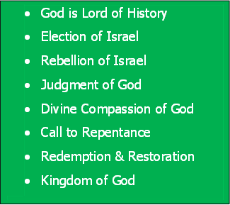
Bible Study Skills
Prophetic Paradigm
By Chapter

Slide 46
Bible Study Skills
 | Looking for -
A | Repeated Words and Phrases
B | Peculiar Words and Phrases
C | Comparisons and Contrasts

Slide 47
Bible Study Skills
D | Figurative Expressions
E | Anything Strange
F | Any prophetic statements

Slide 48
Prophetic Paradigms Patterns Seen in the Prophets
 | Looking for - | Obadiah
A | God says /word of the Lord
B | Election of Israel Relationship of Nineveh to God
C | Rebellion of Israel Rebellion of Nineveh
D | Judgment of God

