Slide 1
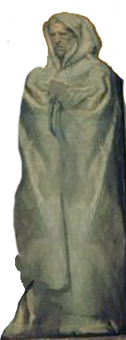
Nahum, Zephaniah & Habakkuk
Lesson 10 – Overview of Habakkuk

Slide 2
The purpose of the prophets was threefold:
To warn the nations of the coming judgment.
To explain why the judgment had come upon them.
To give assurance, at least to a remnant, of a hope that lay beyond the judgment.
Notes:
1. The purpose of the prophets was threefold:
a. To warn the nations of the coming judgment.
b. To explain why the judgment had come upon them.
To give assurance, at least to a remnant, of a hope that lay beyond the judgment.

Slide 3
The Role of the Prophets
They are Spokesmen for God, serving as “forthtellers,” speaking what God put in their mouth.
They are Preachers of the Covenant, relating their message to God’s previous promises to the nation of Israel. These covenants were made with or through Abraham, Moses, and David
They are historians, or Interpreters of the Israelites’ History. With out their interpretation God’s people would not know why an event was occurring.

Slide 4
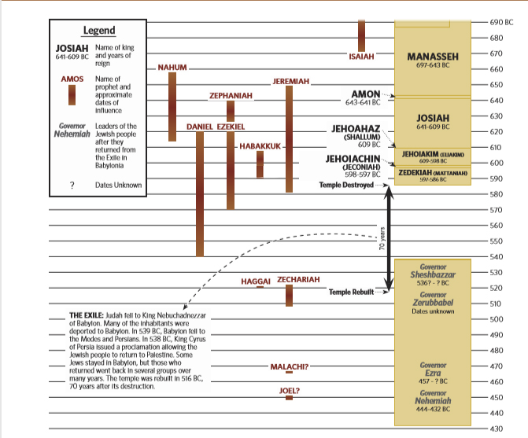

Slide 5
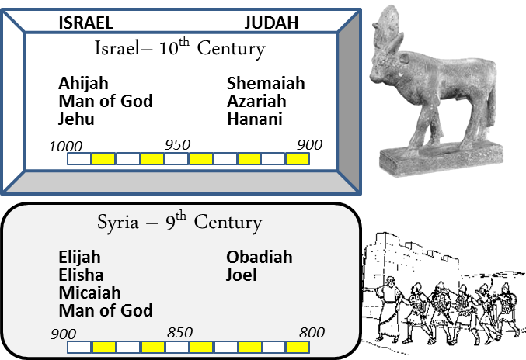
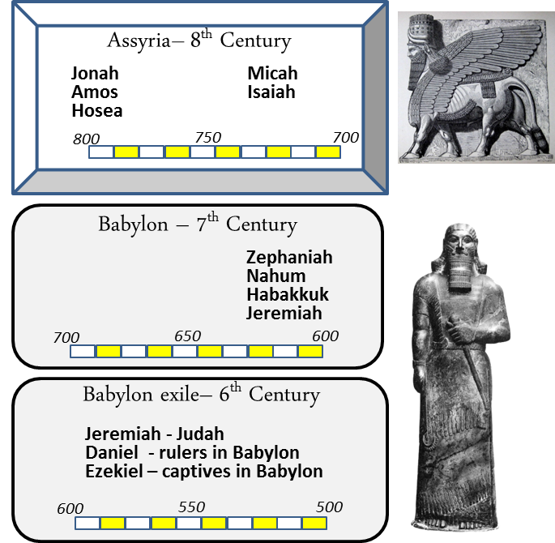
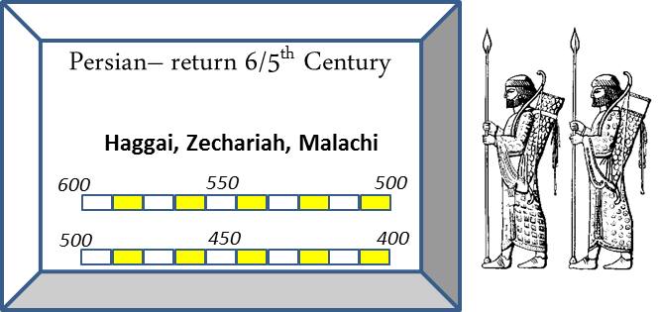
When

Slide 6
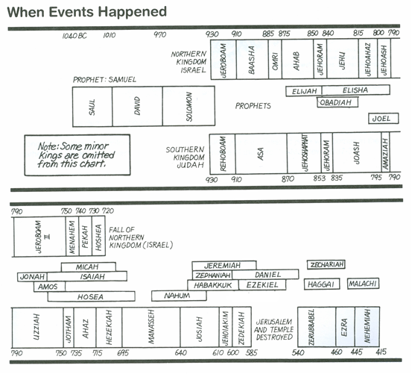
Kings & Prophets

Slide 7
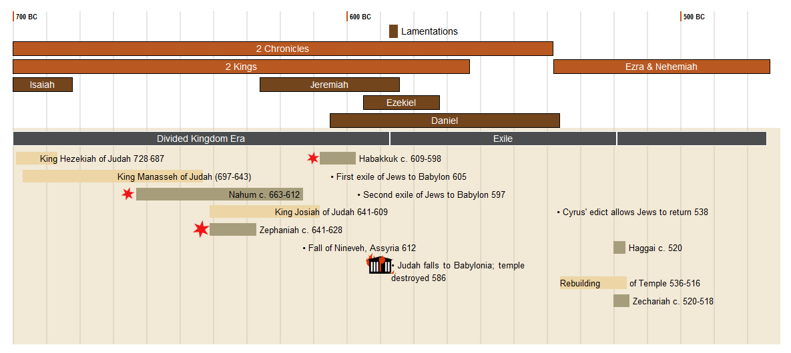

Slide 8
Assyria
Ashurnasirpal II 883-859
Shalmanser III 859-824
Tiglath-Pileser III (Pul) 745-727
Shalmaneser V 727-722
Esarhaddon
681-669
Sargon II
722-705
Sennacherib
705-681
Ashurbanipal
669-627
Tribute from Tyre & Sidon
Babylon rebels
626 BC
6 Campaigns Levant – Ahab at Qarqar 853 BC
Black Obelisk – Jehu giving tribute 841 BC
Killed brothers
Attacked Egypt 669 BC
Law Found 622 BC
Hoshea Rebels-Samaria
Northern Kingdom Falls 722 BC
(2 Kgs 17:1-6)
Ashur sacked
614
Conquered Samaria
713/712 BC revolt by Egypt Ashdod
Judah Edom & Moab
(2 kgs 17:24 Is 20)
Rebuilt Nineveh Subdued Babylon
Led attack on Judah 701 BC sacked Lachish
Trapped Hezekiah like Bird in a Cage
Killed by 2 of his sons 2 Kgs chap 18-19
Ahaz appeals to him to help with Israel/Syria 733 BC
Reduces Israel’s territory (2 Kgs 15:19,2916:7-10)
Conquered Thebes 663 BC
Brother ruler of Babylon Revolts 652 BC
Nineveh destroyed 612 BC
Haran Falls 610 BC
Neco of Egypt tries to help retake Haran 609 BC
Death of Josiah
Period of Weakness
823-745 BC
Battle of Carchemish – end of Assyria
605 BC
Nabopolassar 627-605 BC
Jeroboam II
793-753 BC
Hezekiah 727-697
Manasseh 697-642 BC
Josiah 640-609 BC
Nebuchadnezzar 605-562 BC
Lumber to Esarhaddon
& Ashurbanipal
Jonah 780 BC
Taken prisoner ~650 BC?
Zephaniah 641-628 BC
Habakkuk 612-605 BC
Nahum 663-612 BC

Slide 9
Josiah’s Family
640-609
Age 8
Zebudah
Hamutal
Hamutal
609-597
Age 25
609 (3 mon)
Age 23
597-586
Age 21
Nehushta
2Kgs 24:8 declares,
“Jehoiachin was 18 years old when he began to reign,”
2Chr 36:9 says “Jehoiachin was 8 years old when he began to reign
Copyist error or Start of Co-Regency vs Ruling alone
597
Age 8/18
Zerubbabel
Governor on Return
Shealtiel

Slide 10
Jehoiakim’s Palace of Injustice Jeremiah 22:13 - 17 (ESV)
¹³ “Woe to him who builds his house by unrighteousness, and his upper rooms by injustice,
who makes his neighbor serve him for nothing and does not give him his wages,
¹⁴ who says, ‘I will build myself a great house with spacious upper rooms,’ who cuts out windows for it, paneling it with cedar and painting it with vermilion.
¹⁵ Do you think you are a king because you compete in cedar?
Did not your father eat and drink and do justice & righteousness?
Then it was well with him. ¹⁶ He judged the cause of the poor and needy; then it was well. Is not this to know me? declares the Lord.
¹⁷ But you have eyes and heart only for your dishonest gain, for shedding innocent blood, and for practicing oppression and violence.”

Slide 11
Jehoiakim’s Uncertain Demise
2 Kings 24:6 (ESV) ⁶So Jehoiakim slept with his fathers, and Jehoiachin his son reigned in his place.
2 Chronicles 36:6 - 7 (ESV) ⁶Against him came up Nebuchadnezzar king of Babylon and bound him in chains to take him to Babylon. ⁷Nebuchadnezzar also carried part of the vessels of the house of the Lord to Babylon and put them in his palace in Babylon.
Jeremiah 22:18 - 19 (ESV) ¹⁸Therefore thus says the Lord concerning Jehoiakim the son of Josiah, king of Judah:
“They shall not lament for him, saying,
‘Ah, my brother!’ or ‘Ah, sister!’
They shall not lament for him, saying,
‘Ah, lord!’ or ‘Ah, his majesty!’
¹⁹ With the burial of a donkey he shall be buried,
dragged and dumped beyond the gates of Jerusalem.”

Slide 12
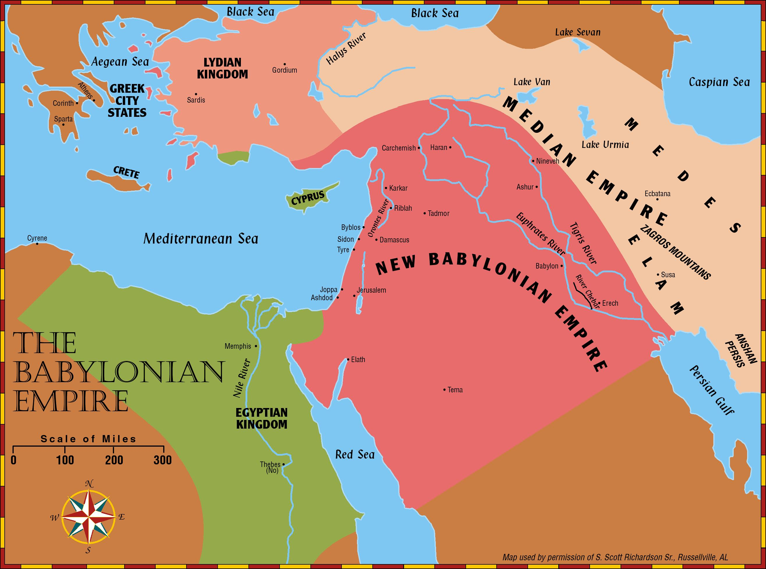
Days of Jehoiakim
Jeremiah 26:20-21(ESV) ²⁰There was another man who prophesied in the name of the Lord, Uriah the son of Shemaiah from Kiriath-jearim. He prophesied against this city and against this land in words like those of Jeremiah. ²¹And when King Jehoiakim, with all his warriors and all the officials, heard his words, the king sought to put him to death. But when Uriah heard of it, he was afraid and fled and escaped to Egypt.
Jeremiah 26:22-23(ESV) ²²Then King Jehoiakim sent to Egypt certain men, Elnathan the son of Achbor and others with him, ²³and they took Uriah from Egypt and brought him to King Jehoiakim, who struck him down with the sword and dumped his dead body into the burial place of the common people.

Slide 13
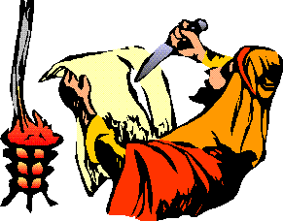
Response of Jehoakim Jeremiah 36
²¹So the king sent Jehudi to bring the scroll, and he took it from Elishama the scribe’s chamber. And Jehudi read it in the hearing of the king and in the hearing of all the princes who stood beside the king. ²²Now the king was sitting in the winter house in the ninth month, with a fire burning on the hearth before him. ²³And it happened, when Jehudi had read three or four columns, that the king cut it with the scribe’s knife and cast it into the fire that was on the hearth, until all the scroll was consumed in the fire that was on the hearth. ²⁴Yet they were not afraid, nor did they tear their garments, the king nor any of his servants who heard all these words

Slide 14
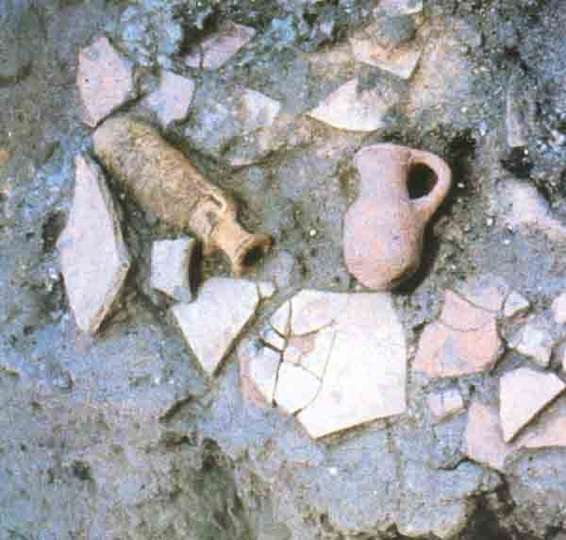
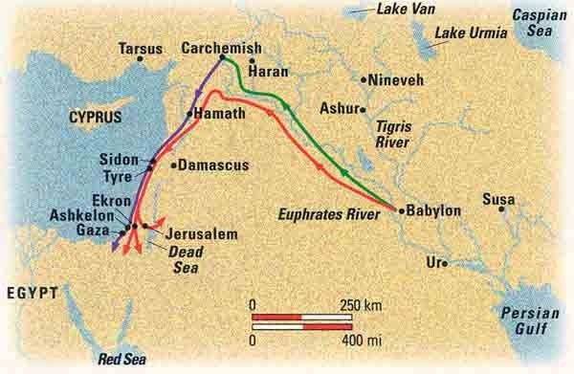
The Babylonian campaigns (609–586 B.C.E.) Green line: Nabopolassar’s campaigns (609–605 B.C.) Purple line: Nebuchadrezzar II’s campaigns (605–601 B.C.) Red line: Nebuchadrezzar II’s campaigns (599–586 B.C.)

Slide 15
Prophetic Waves
Assyrian Threat
Syrian Threat
Babylonian Threat
Romans
Moses
Exodus
Persian
Written
Israel Falls
Abraham
Judah Falls
Judges
Kingdom Divides
Captivity
& Return
United Kingdom
Oral
Daniel
roars
Greeks
2100
1400
1100
1000
900
800
700
600
500
400
100
0
~30
100
605
597
586
538
458
444
722
Christ
Exile
Return
Notes:
Prophet waves –
God tends to give the last gen before day of the Lord a chance to repent – ie lots of prophet activity
Between the Testament ok
400 years of silince not so much, Daniel roars In Between the Testament

Slide 16
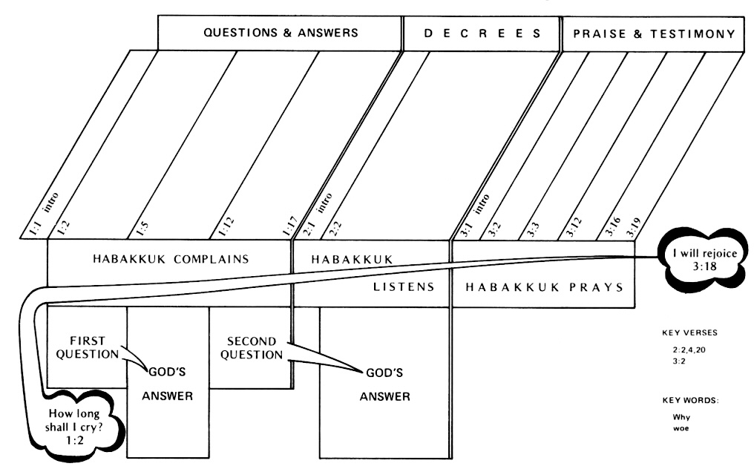
Habakkuk 2:2–4 (NKJV)
The Just Live by Faith
² Then the Lord answered me and said:
“Write the vision
And make it plain on tablets,
That he may run who reads it.
³ For the vision is yet for an appointed time;
But at the end it will speak, and it will not lie.
Though it tarries, wait for it;
Because it will surely come,
It will not tarry.
⁴ “Behold the proud,
His soul is not upright in him;
But the just shall live by his faith.
Habakkuk 2:20 (NKJV)
²⁰ “But the Lord is in His holy temple.
Let all the earth keep silence before Him.”
Habakkuk 3:2 (NKJV)
² O Lord, I have heard Your speech and was afraid;
O Lord, revive Your work in the midst of the years!
In the midst of the years make it known;
In wrath remember mercy.

Slide 17
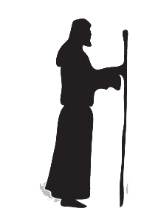
Who
Prophet
Outline - Habakkuk
Habakkuk
I. Introduction - An Oracle (1:1)
II. First Cycle (1:2–11)
A. Habakkuk’s lament (1:2–4)
B. God’s response (1:5–11)
III. Second Cycle (1:12–2:20)
A. Habakkuk’s lament (1:12–2:1)
B. God’s response (2:2–20)
C. Habakkuk’s Prayer (3:1–19)
Habakkuk probably lived to see the following events: the destruction of Nineveh by Babylon in 612 b.c.; the battle of Haran in 609 in which Josiah died as he tried to hinder the Egyptians from reaching the battle; the final defeat of the Assyrians at the Battle of Carchemish (605); and possibly the fulfillment of his own prophecy of the Babylonian invasions of Judah in 605, 597, and 586.

Slide 18
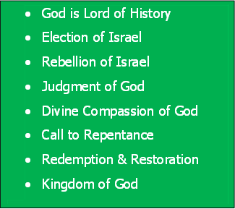
Bible Study Skills
Prophetic Paradigm
By Chapter

Slide 19
Habakkuk

Slide 20
Bible Study Skills
 | Looking for -
A | Repeated Words and Phrases
B | Peculiar Words and Phrases
C | Comparisons and Contrasts

Slide 21
Bible Study Skills
D | Figurative Expressions
E | Anything Strange
F | Any prophetic statements

Slide 22
Prophetic Paradigms Patterns Seen in the Prophets
 | Looking for - | Obadiah
A | God says /word of the Lord
B | Election of Israel Relationship of Nineveh to God
C | Rebellion of Israel Rebellion of Nineveh
D | Judgment of God

Slide 23
Nahum's Prophecies
What is the prophecy range?
612 BC
To 605 BC

