Slide 1
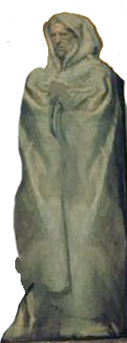
Nahum, Zephaniah & Habakkuk
Lesson 07 – Zephaniah Chap 1

Slide 2
